Slide 1
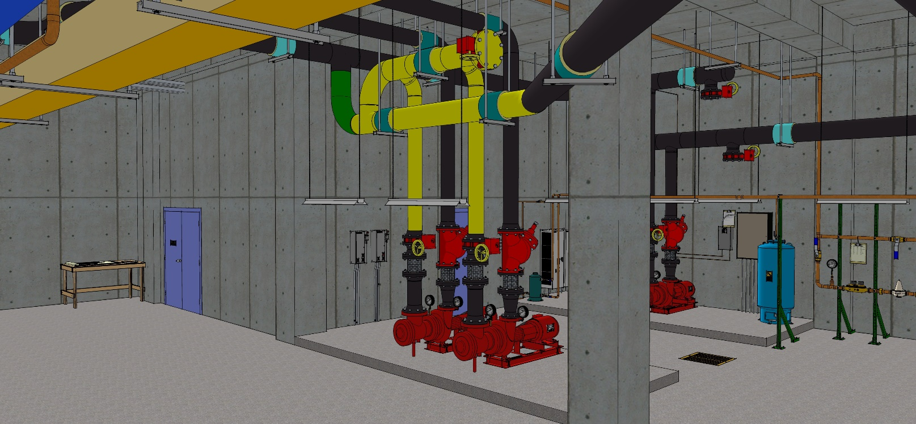
As Installed
TDV
1,100 gpm @ 90 ft.w.c., 40 hp (Typical)
TDV
SD
SD
Chiller 1 No VFD
550 tons (Typical)
EWT – 57°F
LWT – 45°F
Chiller 2 VFD & HG
Typical AHU
550 tons (Typical)
EWT – 45°F
LWT – 57°F
Typical AHU
TDV
1,100 gpm @ 40 ft.w.c., 15 hp (Typical)
TDV
SD
SD

