Slide 1
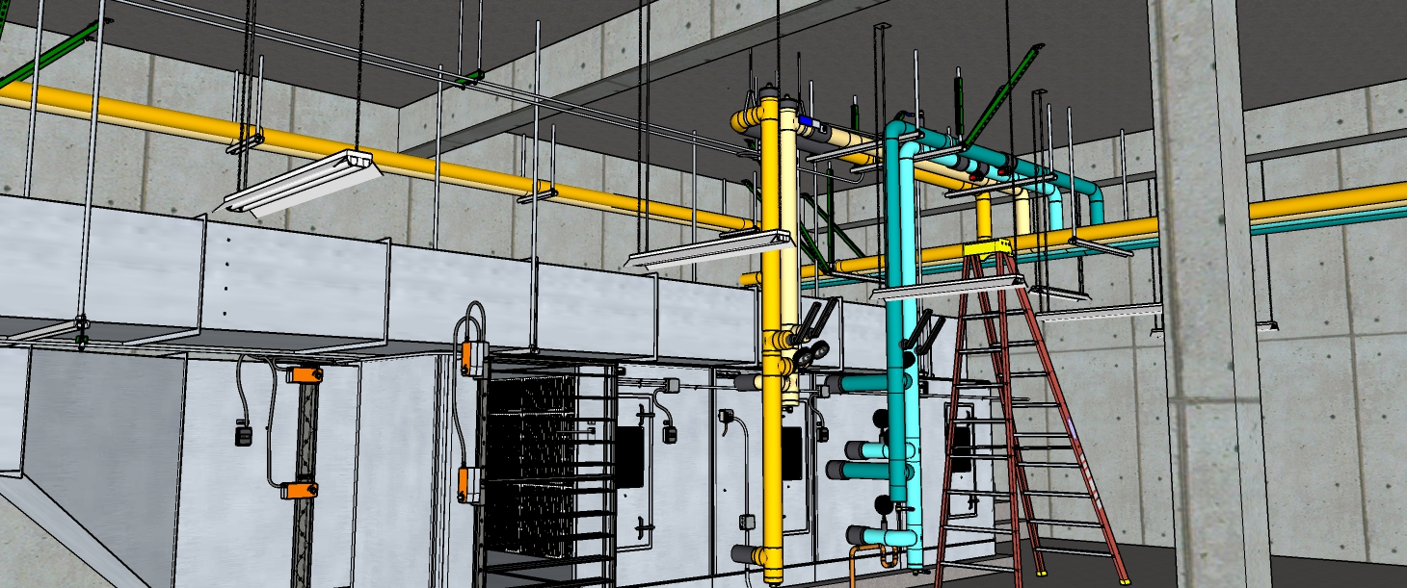
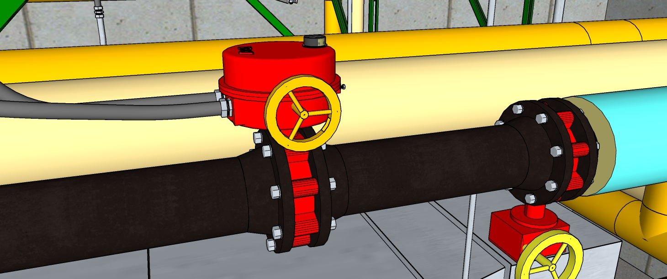
Take What We Started and Complete It
Starting Point
(Download it from the web site
Typical Load Connection

Slide 2

Morgan, Wright, Jungerman and Kelley
Architects, Master Planners
120 Gumby Place| Suite 1872 | San Diego, CA | 92101
619.608.1867
Hijend Hospitality International
San Diego Bay View Marquis Hotel and Marina
A. Goodenough Engineering, LLC
425 Golden St.
Suite 500
San Diego, CA 92101
619-014-1643
Main Man
Isaac Newton
Registered
State of Mass
F=ma
#1
Project 050420
Drawn By M. Nyun
Checked By M. Nature
Date 4-20-2005
Revisions
5-19-2004 - VE Study 1
8-9-2006 – As Built 2
Schedules
M-02
of 24

Slide 7
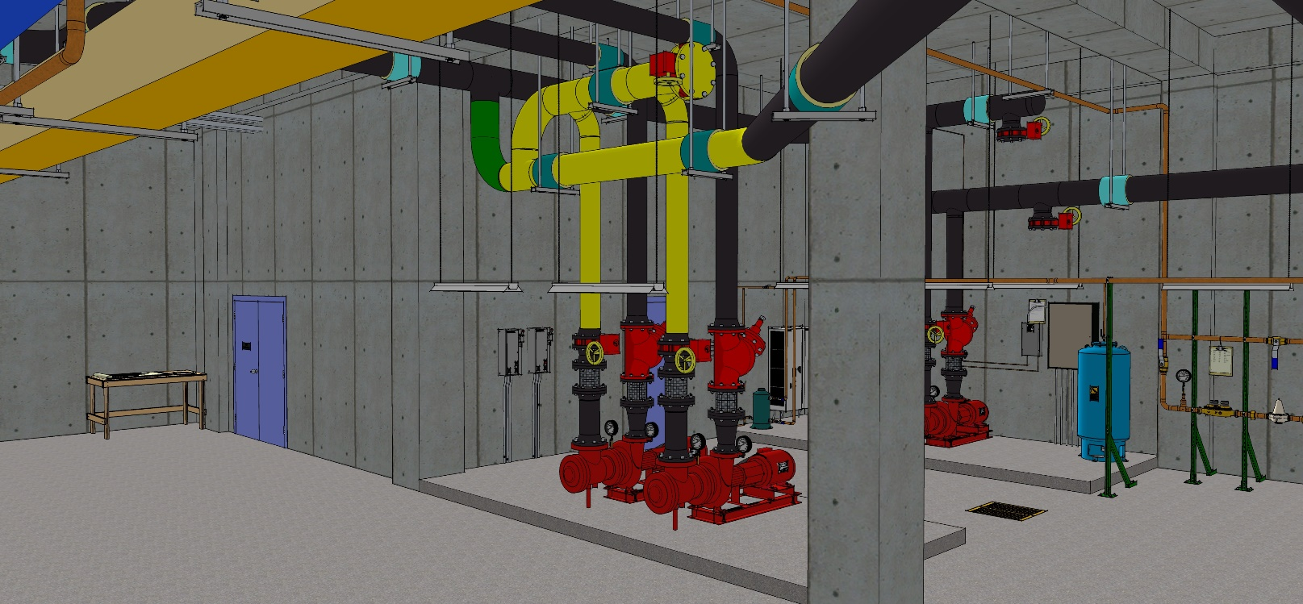
As Installed
TDV
1,100 gpm @ 90 ft.w.c., 40 hp (Typical)
TDV
SD
SD
Chiller 1 No VFD
550 tons (Typical)
EWT – 54°F
LWT – 42°F
Chiller 2 VFD & HG
Typical AHU
Typical AHU
Typical Loads, See Coil Schedule for Details
TDV
1,100 gpm @ 40 ft.w.c., 15 hp (Typical)
TDV
SD
SD

Slide 8
As Installed
TDV
1,100 gpm @ 90 ft.w.c., 40 hp (Typical)
TDV
SD
SD
Chiller 1 No VFD
550 tons (Typical)
EWT – 57°F
LWT – 45°F
Chiller 2 VFD & HG
Typical AHU
Typical AHU
Typical Loads, See Coil Schedule for Details
TDV
1,100 gpm @ 40 ft.w.c., 15 hp (Typical)
TDV
SD
SD

