Slide 1
Existing Building Commissioning Workshop: Series 16, Session 1
Scavenger Hunt
Presented By:
David Sellers
Senior Engineer, Facility Dynamics Engineering

Slide 2
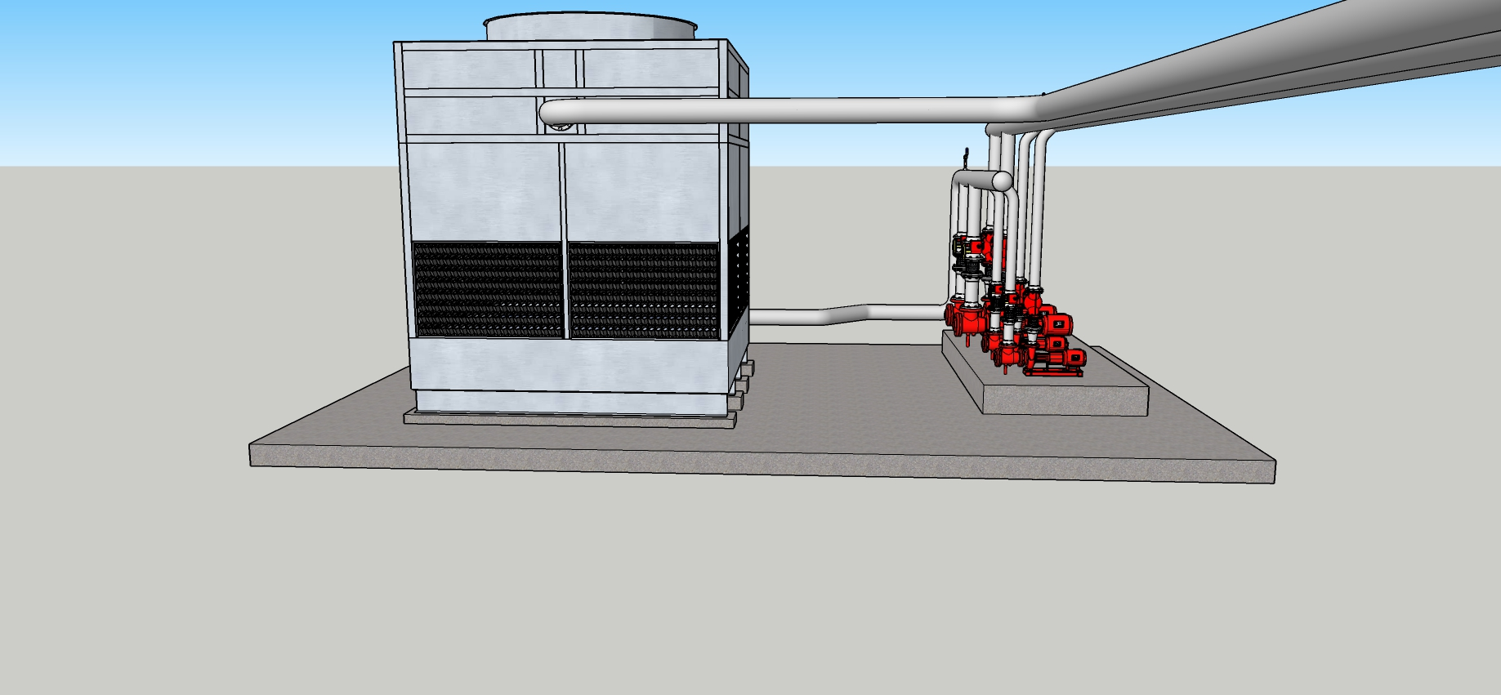
Scoping a Condenser Water System CW System v11 SUV8 NCV.skp

Slide 3
Explore the Model
What type of cooling tower is it? Choices are:
Forced draft
Hybrid
Cross flow
Dry cooler
Counter flow
Natural Draft
Induced draft
More than one descriptor may apply
What issues and opportunities do you see?

Slide 4
Vapor Compression Refrigeration Machines
An application of saturated system and phase change principles and concepts

Slide 5
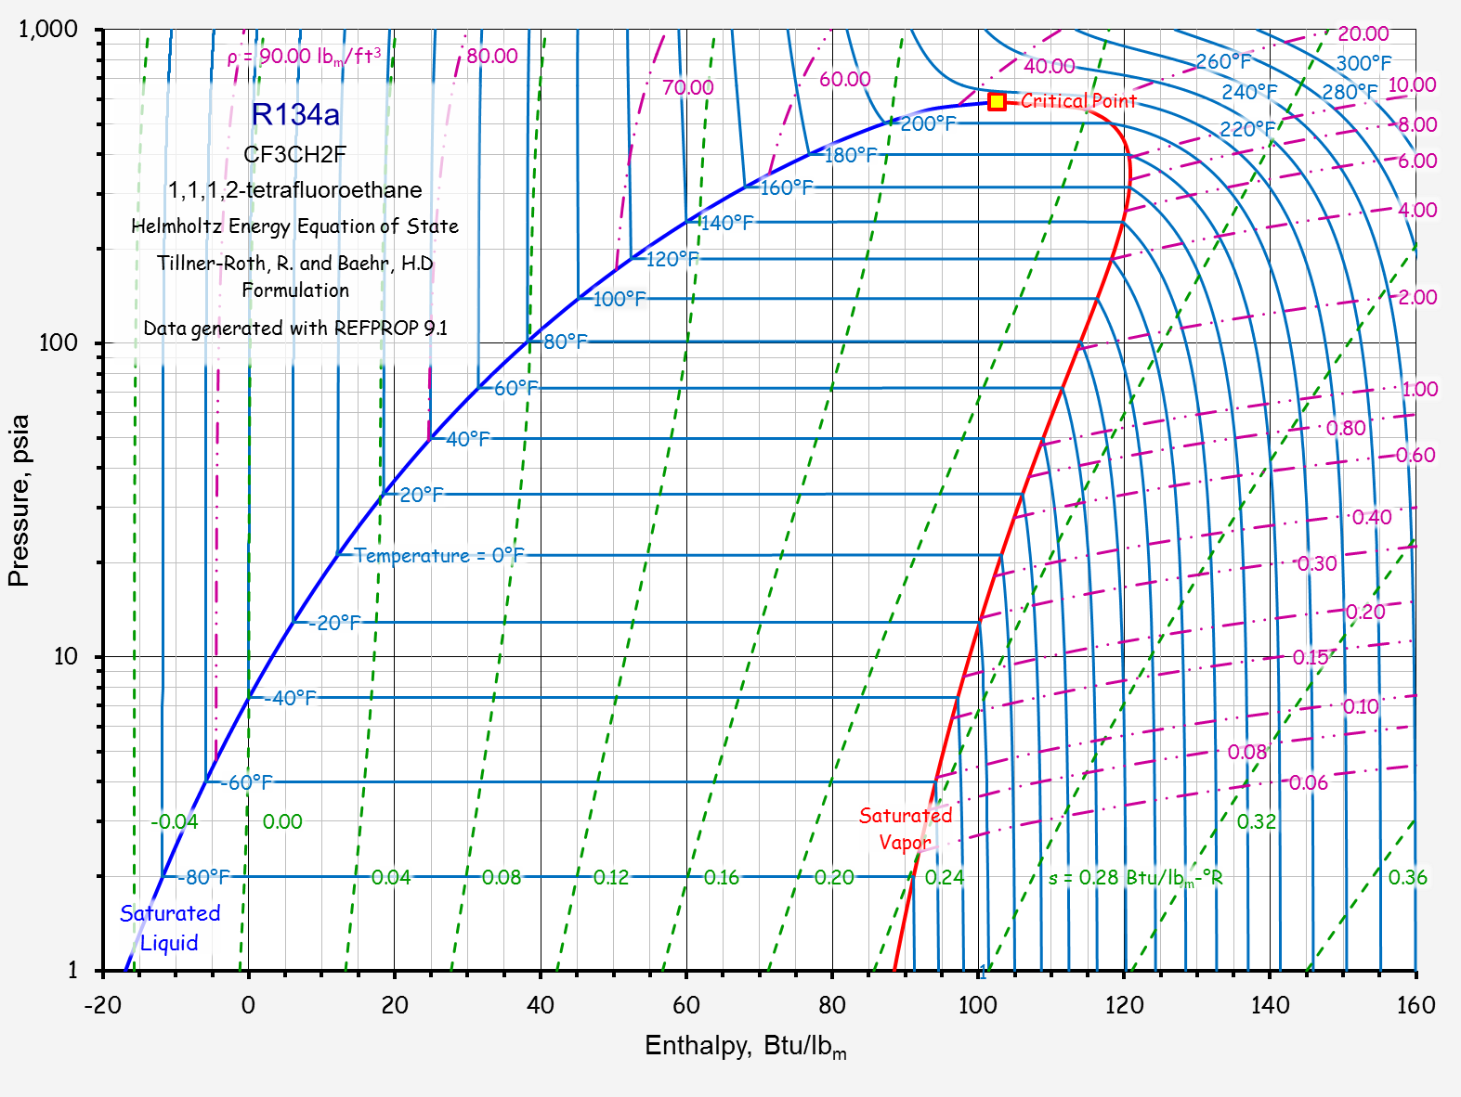

Slide 6
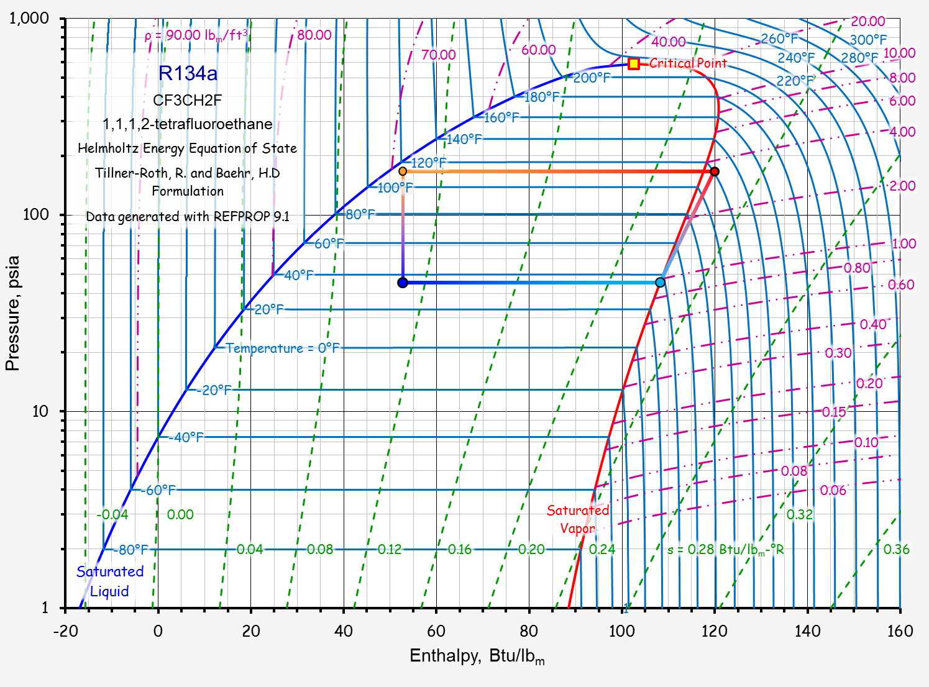
Condensation
Expansion
Compression
Evaporation

Slide 7
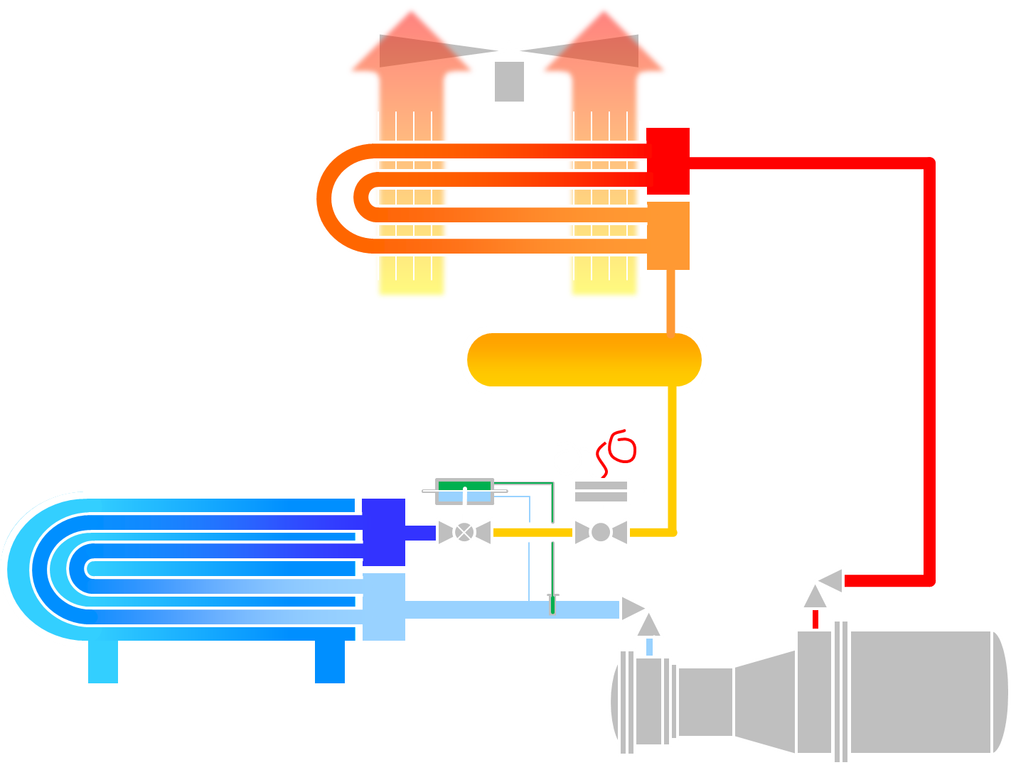
An Air Cooled Vapor Compression Cycle Chiller

Slide 8
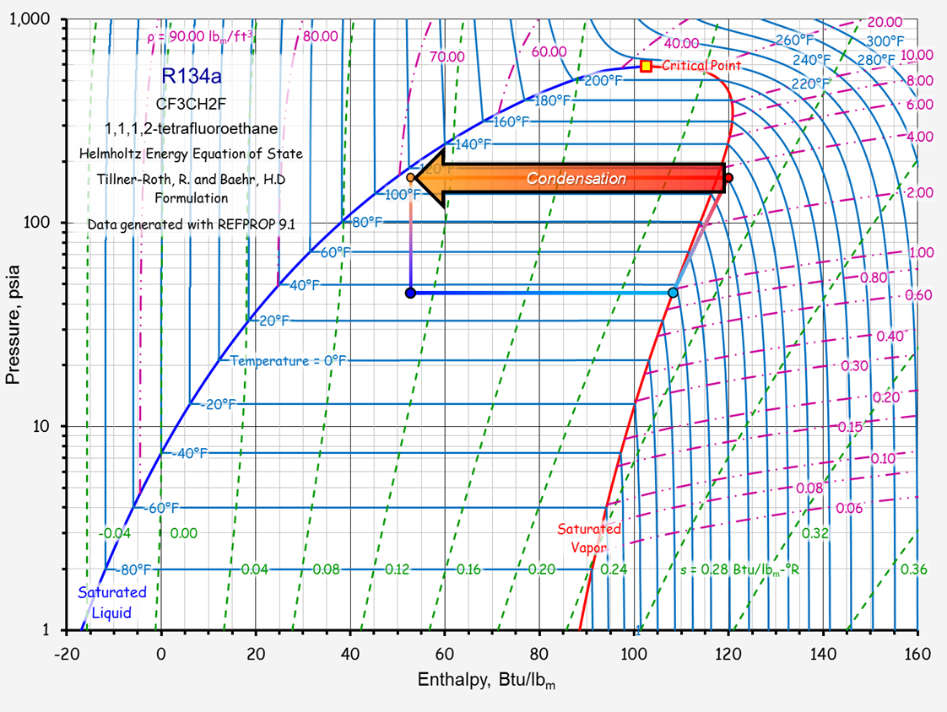
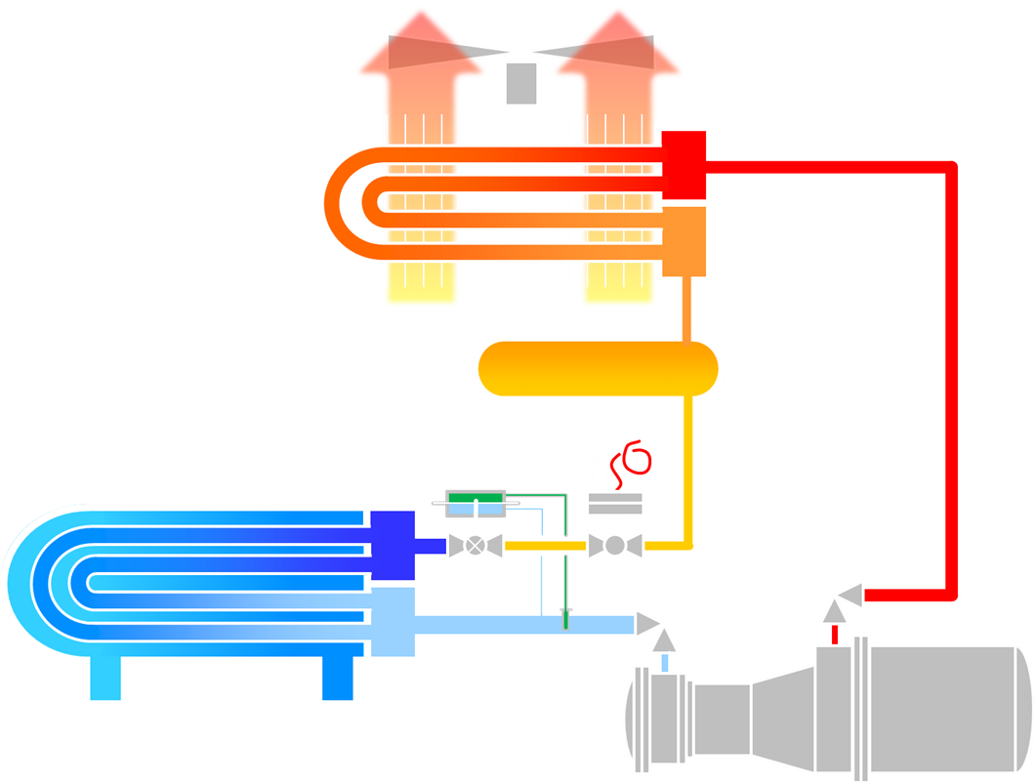
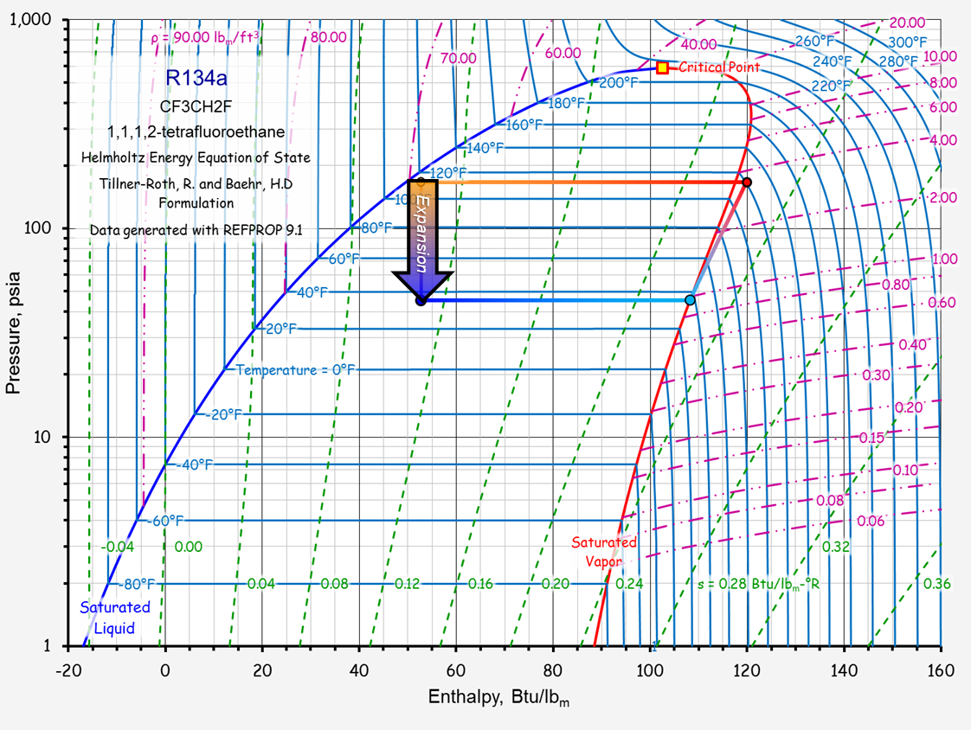
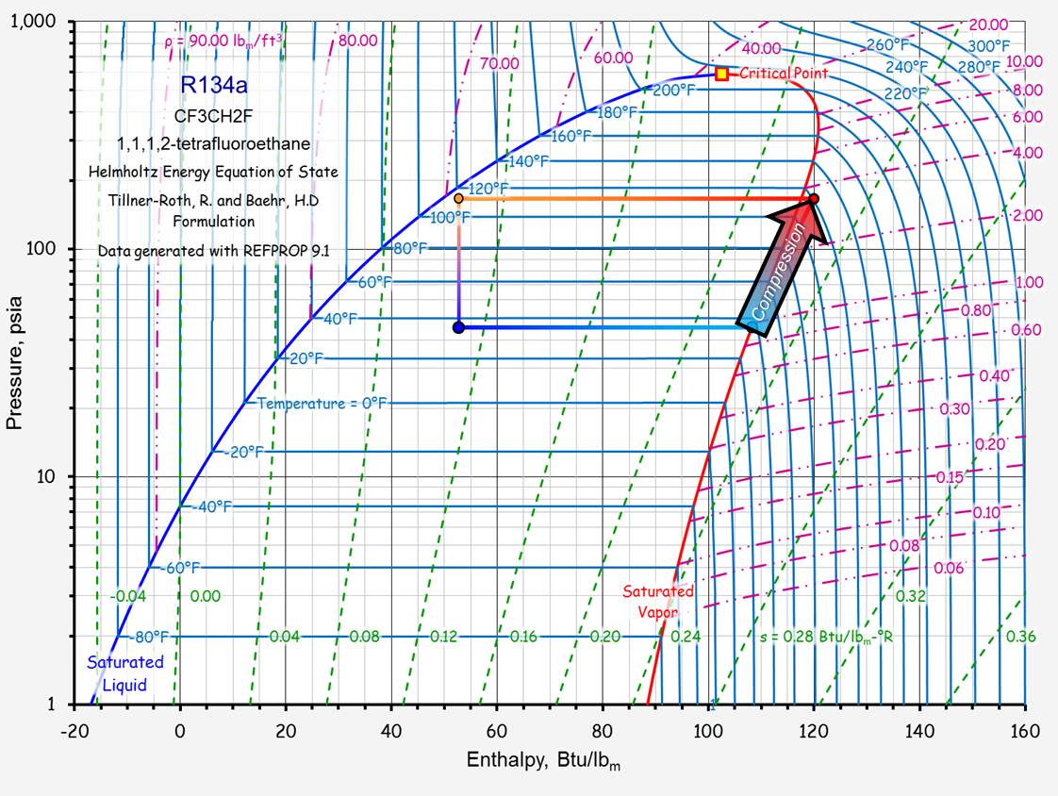
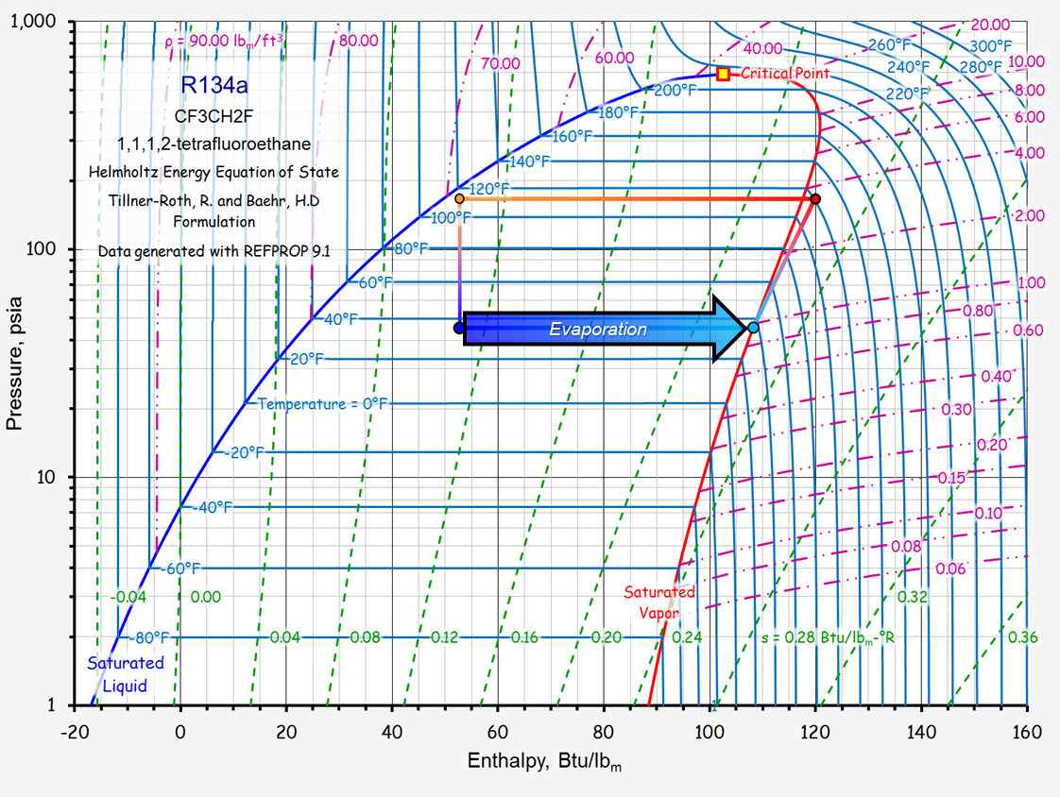
Condenser
Receiver
Liquid Line Solenoid Valve
Expansion Valve
Evaporator
Compressor

Slide 9
Condenser
Liquid Line Solenoid Valve
Expansion Valve
Receiver
Evaporator
Compressor

Slide 10
Condenser
Liquid Line Solenoid Valve
Expansion Valve
Receiver
Compressor
Evaporator

Slide 11
Liquid Line Solenoid Valve
Expansion Valve
Receiver
Condenser
Compressor
Evaporator

Slide 12
Liquid Line Solenoid Valve
Expansion Valve
Condenser
Receiver
Compressor
Evaporator

Slide 13
Condenser
Receiver
Expansion Valve
Liquid Line Solenoid Valve
Compressor
Evaporator

Slide 14
Condenser
Receiver
Liquid Line Solenoid Valve
Expansion Valve
Compressor
Evaporator

Slide 15
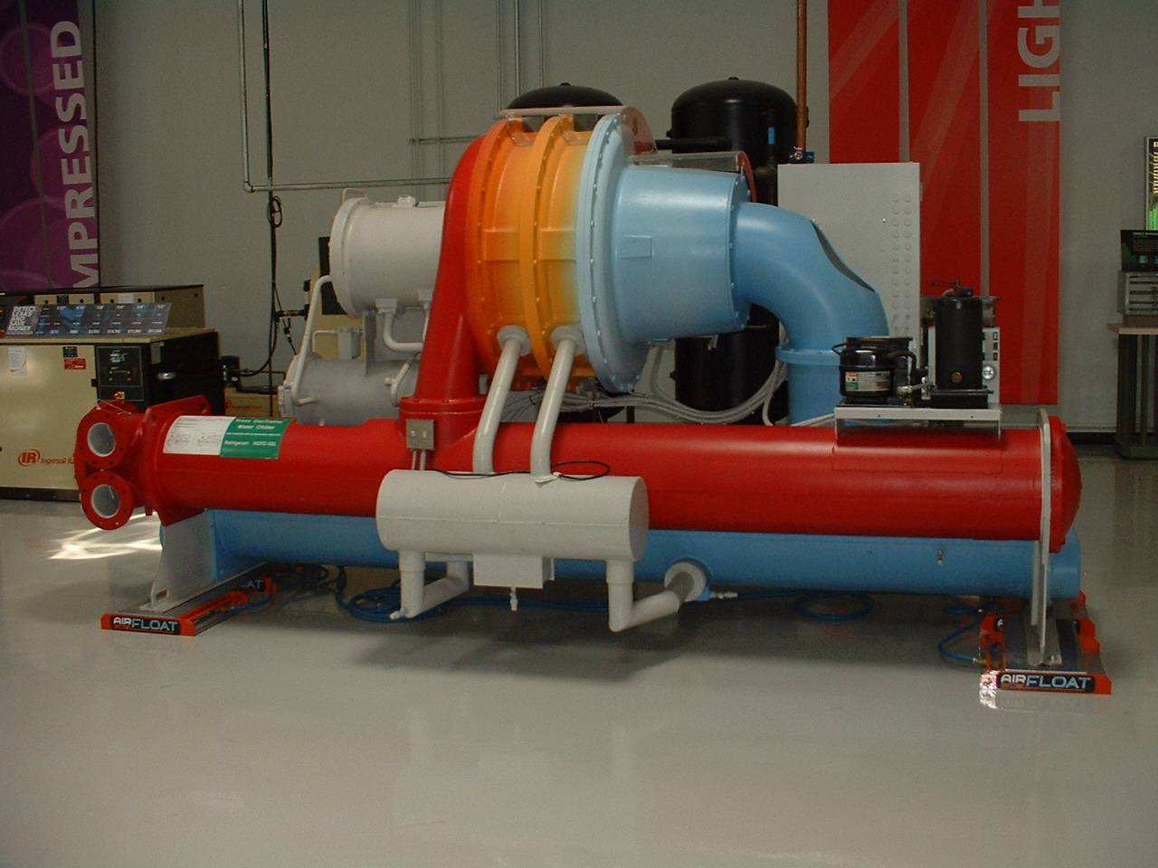
A Water Cooled Centrifugal Chiller

Slide 16
Same Cycle, Larger, Centrifugal vs. Screw Compressor, Water vs. Air Cooled

Slide 17
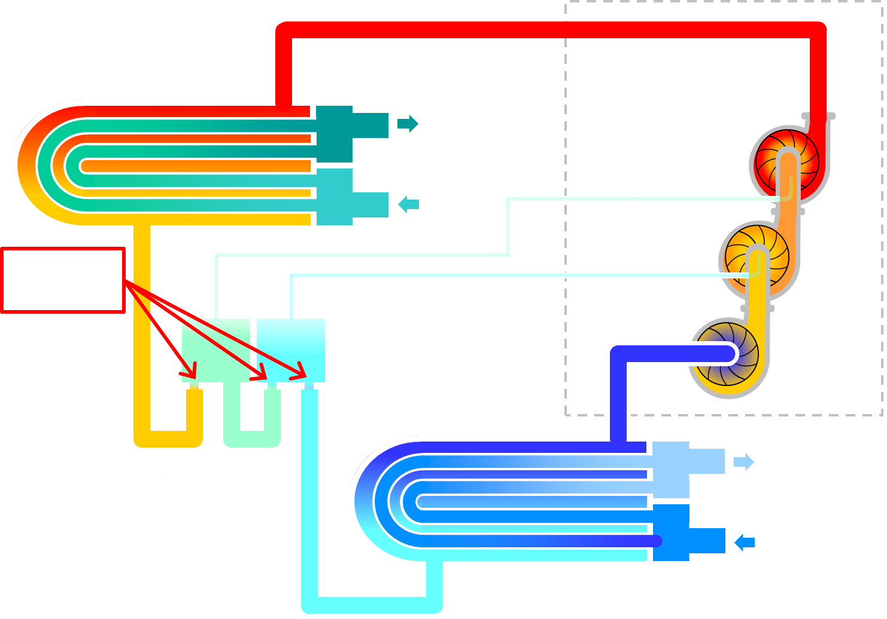
A Typical Water Cooled Vapor Compression Cycle Chiller

Slide 18
Try Your Hand At Identifying the Parts (Answers Follow)

Slide 19
A Water Cooled Centrifugal Chiller
1 ?
8 ?
2 ?
7 ?
9 ?
3 ?
4 ?
5 ?
6 ?

Slide 20
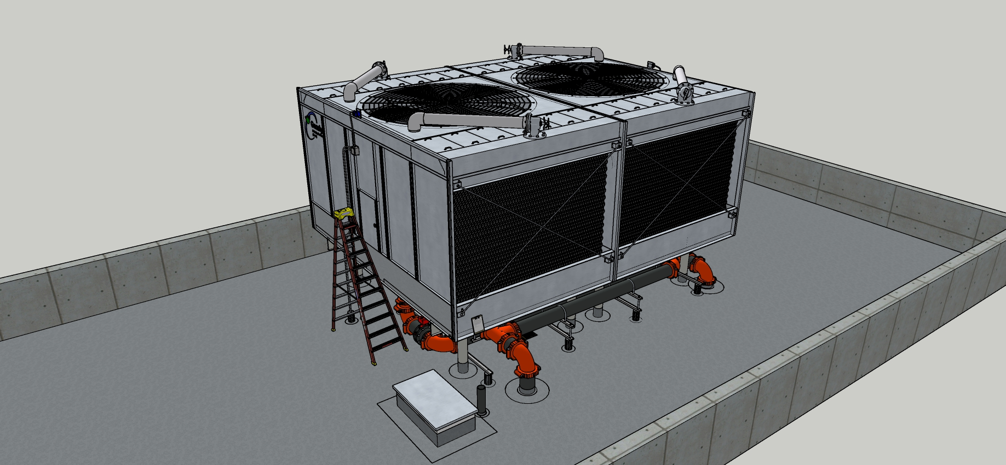
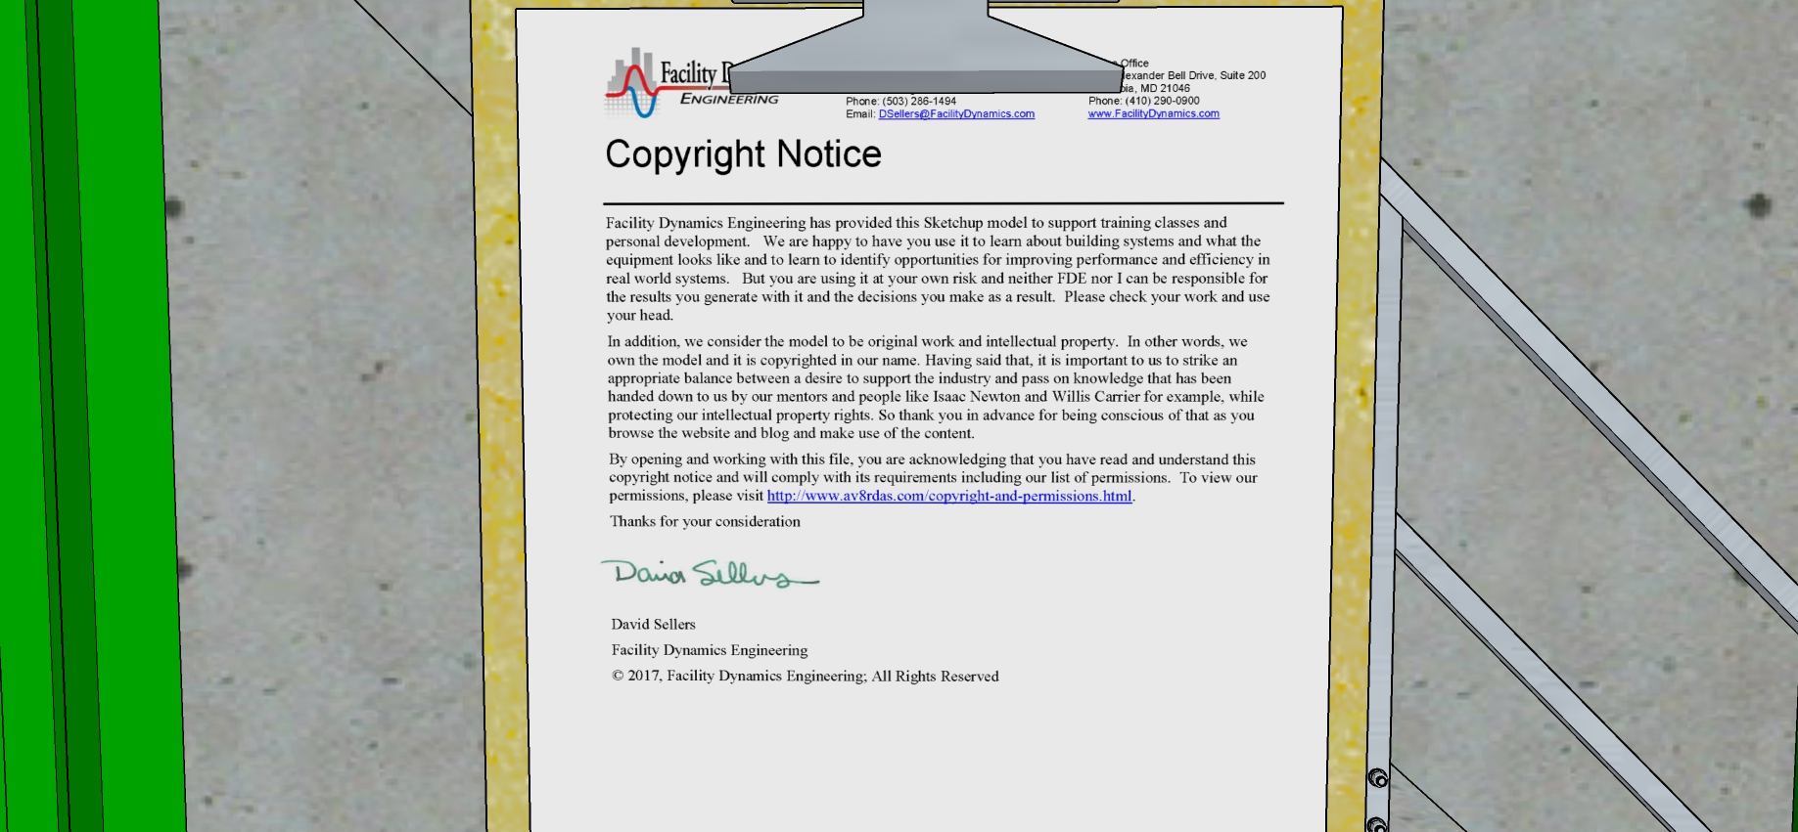
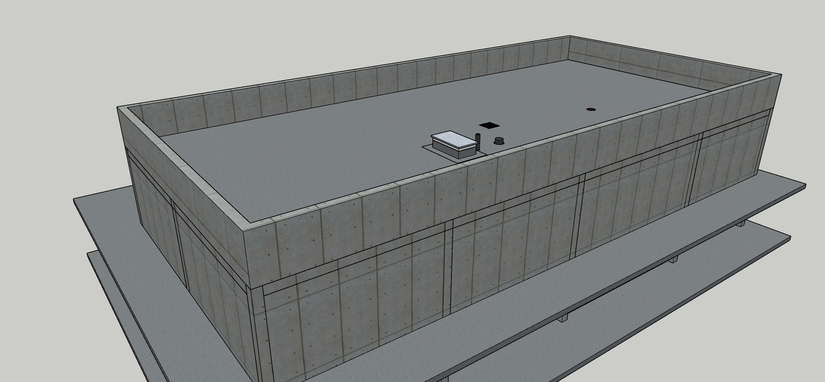
Scoping a Bigger Condenser Water System Mechanical Space v2 SUv8.skp and Cooling Towers v9 SUv8.skp

Slide 21
Explore the Model
What type of cooling tower is it? Choices are:
Forced draft
Hybrid
Cross flow
Dry cooler
Counter flow
Natural Draft
Induced draft
More than one descriptor may apply

Slide 22
A Few Things to Contemplate
What is the nominal chiller tonnage?
What is the blue box on the cooling tower and why is it required?
What type of drive system does the cooling tower have?
What type of cooling tower is this (forced draft, counter flow, etc.)?
Is there a reason the control system input wiring is segregated from the level control wiring?
Does the piping configuration for the cooling tower cells have the potential to impact their performance?
Is the system off or is the system running but the tower fans are off because they are cycling due to the system being at low load?
Is there a minimum speed you would not allow the tower fans to drop below?
Is it better to run one fan up and then the other or run both fans up together?

Slide 23
Pumps and Chillers
How many pumps and chillers are there in the system?
Will the pumps interact?
Is there an energy savings opportunity associated with pump interaction?
Is there an energy savings opportunity associated with the Griswold valve?

Slide 24
How Well is Water Being Distributed?
There is an important but subtle detail about how the settling well is fabricated; what is it?
What is the potential problem with different cold basin water levels?
What specific physical mechanisms are involved to uniformly distribute flow over the cooling tower fill?
What happens to tower performance if the fill is not uniformly wet?
Are there other issues associated with not getting the fill uniformly wet?
From a tower fan energy standpoint, what would be the best way to stage the tower fans?

Slide 25
Taking a Look at the Level Control System
How does the level control system work?
Does the system do more than control the water level?
Is there a problem with the control system currently?
What are the functions of the different terminal types in the control panel?
How much does the Warrick control relay cost?
Why did Ellis seal the electrode fitting conduit entry with caulk?
How would you figure out the maximum fuse rating you could safely install in the fuse holders?

Slide 26
What is the Purpose of the Control Valve Associated with the Condenser Water Piping?
Do you think the valve is properly sized?
Is there a difference between locating the valve where it is vs.:
Outside at the tower basin
Down by the chiller
Across the pipes but above the level of the cold basin and directly tied to the CW supply line

Slide 27
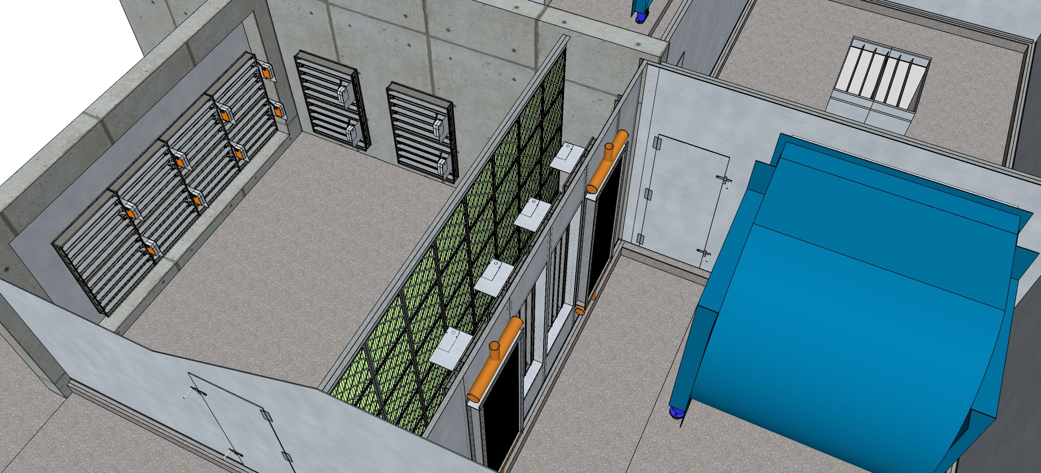
Scoping an Economizer Le Conte Annex AHU SUV8 v11 NCG.skp

Slide 28
Your Goal
Go get a copy of the economizer evaluation checklist from the Commissioning Resources website
Use the checklist to evaluate the economizer
Make a list of the issues and opportunities you identify
Be prepared to share your results with the class

