Slide 1
Pumps (and Piping)
Design, Performance and Commissioning Issues
Pipes, Valves, and Fittings
David Sellers
Senior Engineer
Facility Dynamics Engineering
April 4, 2017

Slide 2
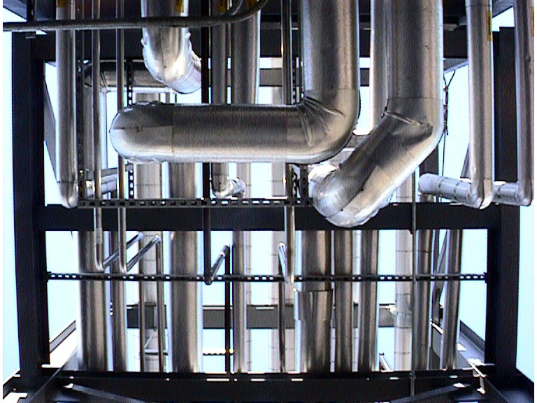
Pipes, Valves and Fittings;
The System Part of the Phrase “Pumping System”

Slide 3
Pipe Materials
Pipe Comes in a Variety of Materials
  HVAC
    Black Iron
    Cast Iron
    Copper
    Brass
    Plastic
    Composite/Fiberglass
  Process
    All the above
    Stainless
    Aluminum
Selection Depends On
  Service
  Exposure
  Cost

Slide 4
Pipe Sizes
Sizes are “Nominal”
  My or may not match the outside diameter
  May or may not match the inside diameter
  “Nominal” tends to vary with material
  Multiple wall thicknesses available for each size in most materials

Slide 5
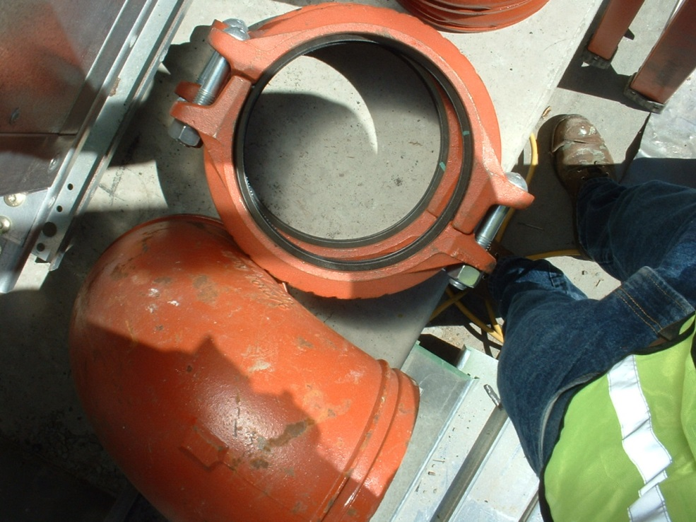
Pipe Joints
Most materials can be joined by a number of methods
  Threads
  Solder
  Braze
  Welding
  Flanges
  Grooved joints
    Different gaskets for different applications
    Color = Intended use
  Flare joints
  Compression joints

Slide 6
Pipe Joints
Most materials can be joined by a number of methods
  Threads
  Solder
  Braze
  Welding
  Flanges
  Grooved joints
    Different gaskets for different applications
    Color = Intended use
  Flare joints
  Compression joints
Selection determined by
  Material
  Service
  Exposure
  Cost/labor
    Example – Typical welded joint
      Cut to length
      Bevel
      Align and gap
      Tack
      Weld
        Multiple passes (c=πd)
        Chip out flux after each pass

Slide 7
Fitting Pressure Losses
Fitting pressure losses are also related to velocity
Commonly used tables have their roots in work that has it’s origins in the late 1800’s and early 1900’s
Recent ASHRAE research demonstrates
    Some variation from classic values
    Fittings in series interact to reduce the pressure drop compared to the sum of the losses
Losses may also be expressed as equivalent feet of pipe
A common rule of thumb is to estimate the fittings losses as adding another 50% to 100% to the actual length of pipe

Slide 8
An Interesting Thing about Elbows
One way to think of elbow resistance is to consider it as composed of:
Resistance due to interaction with the pipe wall
Resistance due to a change in direction

Slide 9
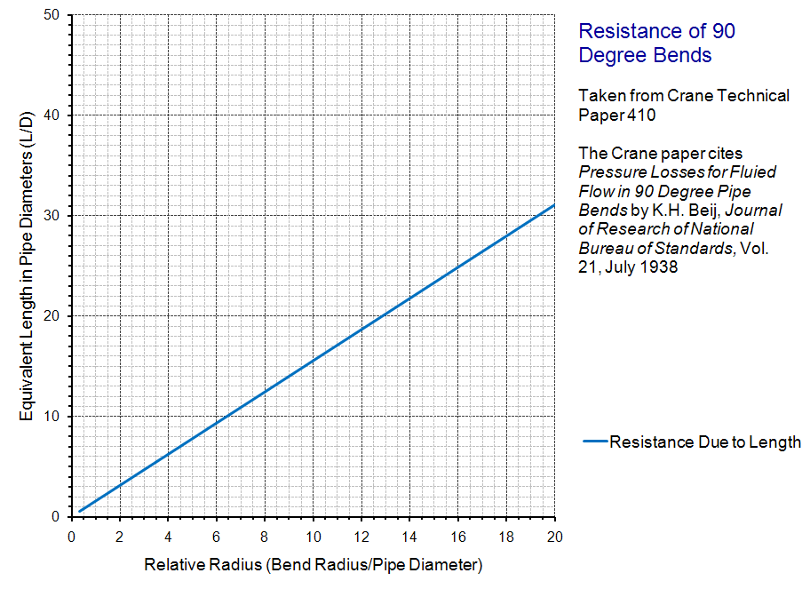
An Interesting Thing about Elbows

Slide 10
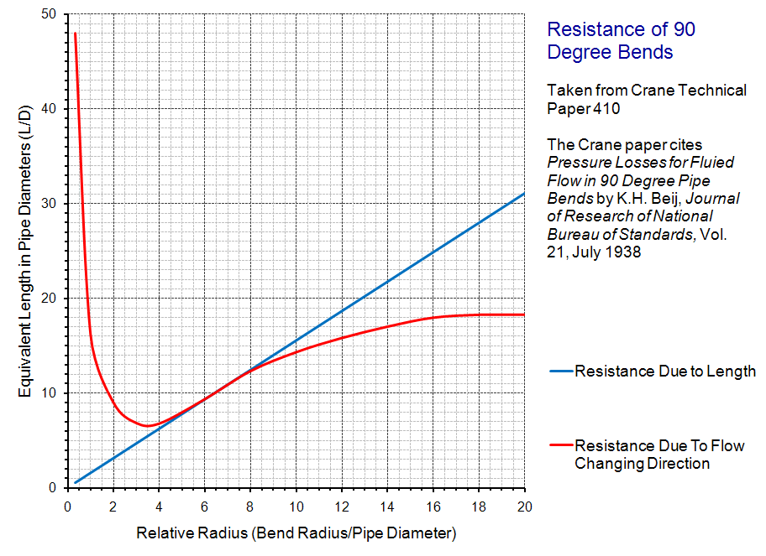
An Interesting Thing about Elbows

Slide 11
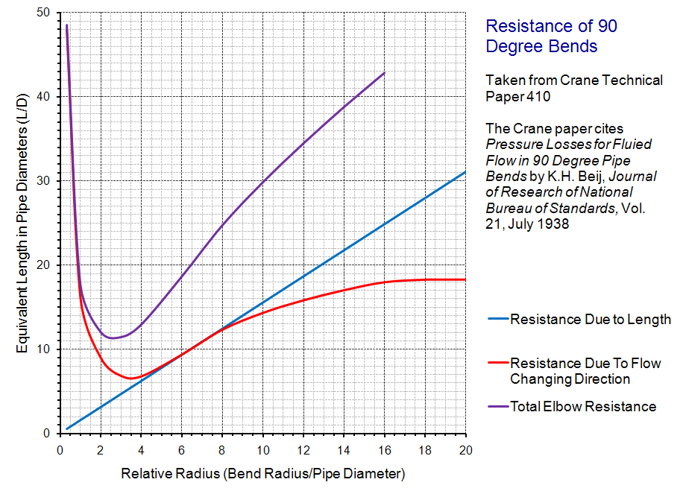
An Interesting Thing about Elbows
Short Radius Elbow
Pressure Drop Savings = Energy Savings
Long Radius Elbow

Slide 12
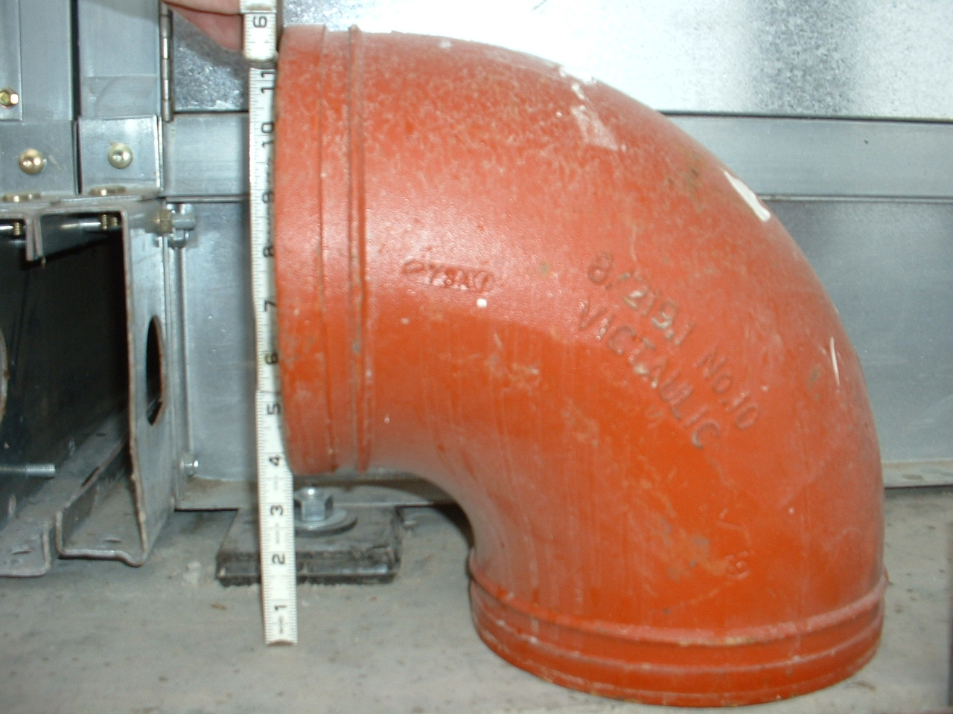
8” Short Radius Elbow
For a Long Radius Elbow the Centerline Radius would be 1.5 x 8” or 12”
The centerline radius is the same dimension as the pipe diameter
8”
8”

Slide 13
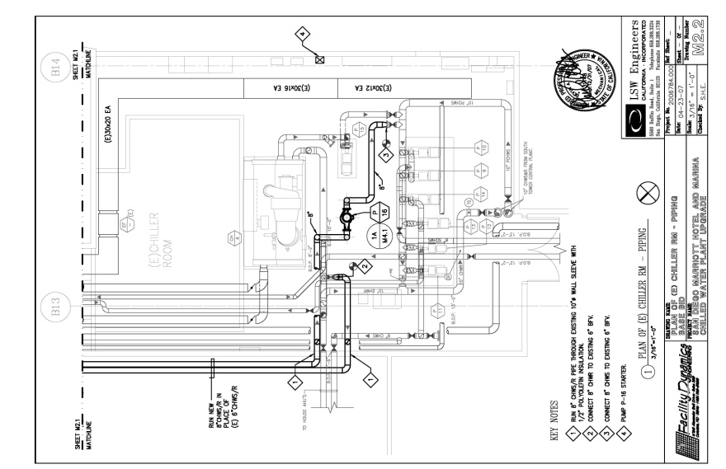
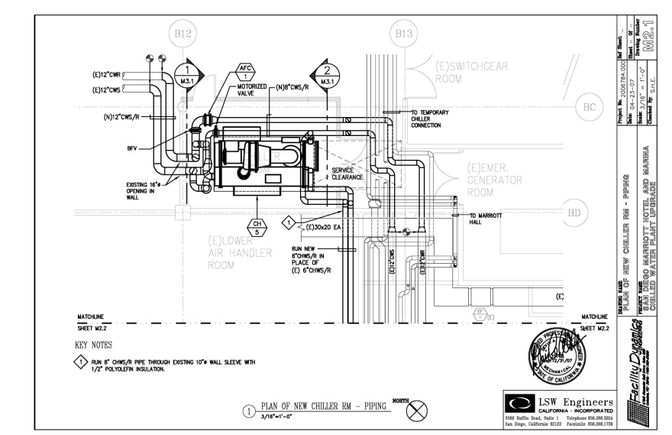
Short Radius vs. Long Radius Elbows
Small differences can add up to significant numbers
Number of elbows = 26
Difference in head for the circuit with long radius versus short radius elbows
  3+ ft.w.c.
  9+% difference in pump head (A.K.A. the safety factor)
  .8+ kW
  7,100 kWh annually
  $850 annually

Slide 14
Tees are Interesting Too
Different Flow Paths = Significantly Different Pressure Drops
  Bad thing if you are trying to minimize losses
    Branching points in distribution mains
    Areas where noise might be critical
  Good thing if you are trying to balance flow between branches
    Balancing flow to cooling tower cells
    Balancing flow to coil banks

Slide 15
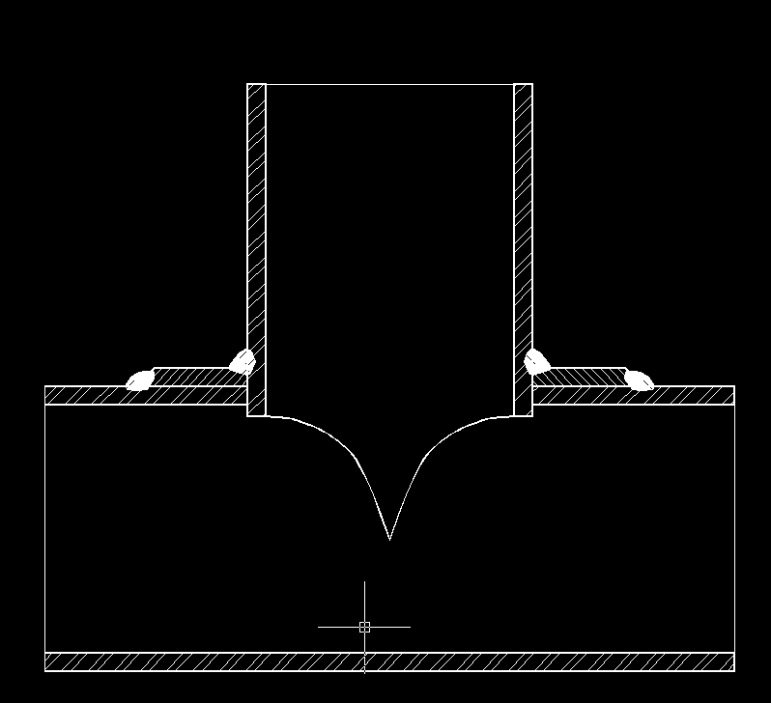
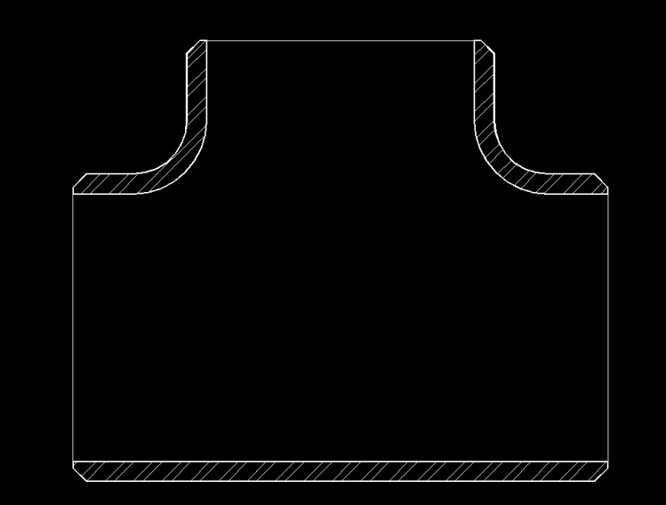
Construction Impacts Loss Too
Field Fabricated Tee
Factory Forged Tee
Square, rough exit to branch and run
Smooth exit to branch

Slide 16
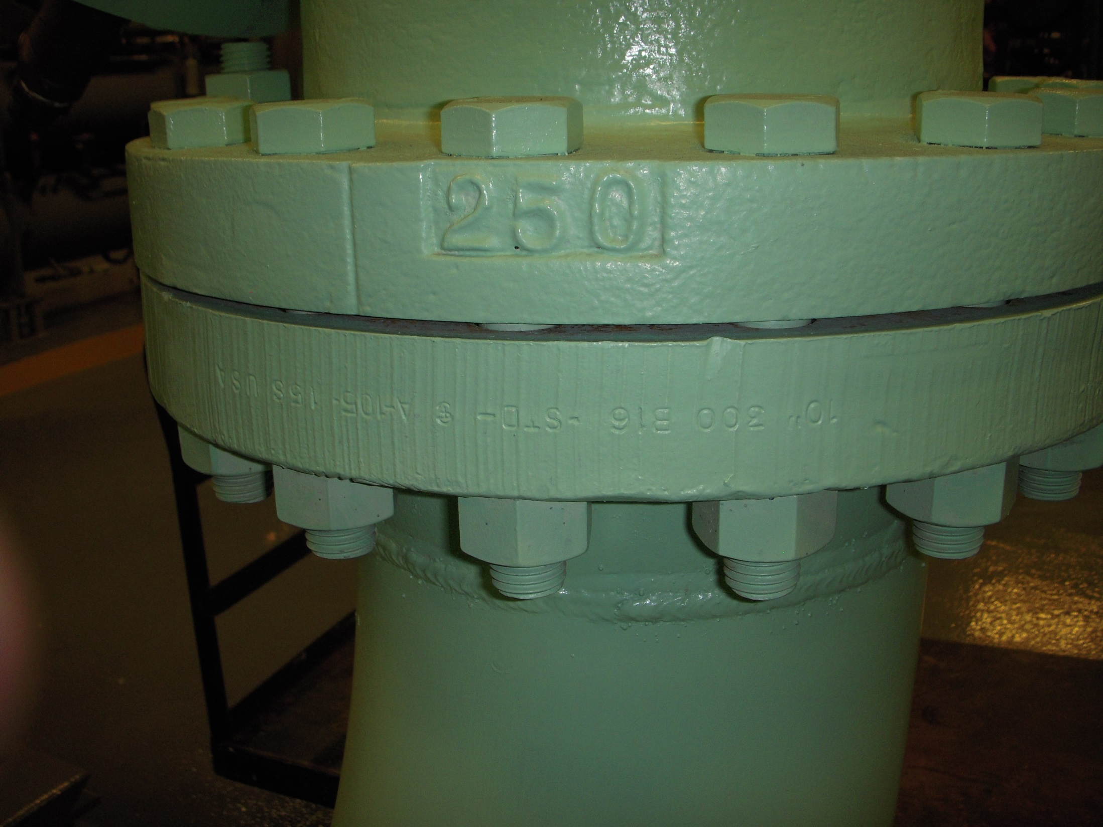
Fittings and Flanges have Pressure Ratings Pressure Class and Rated Pressure May Not be the Same

Slide 17
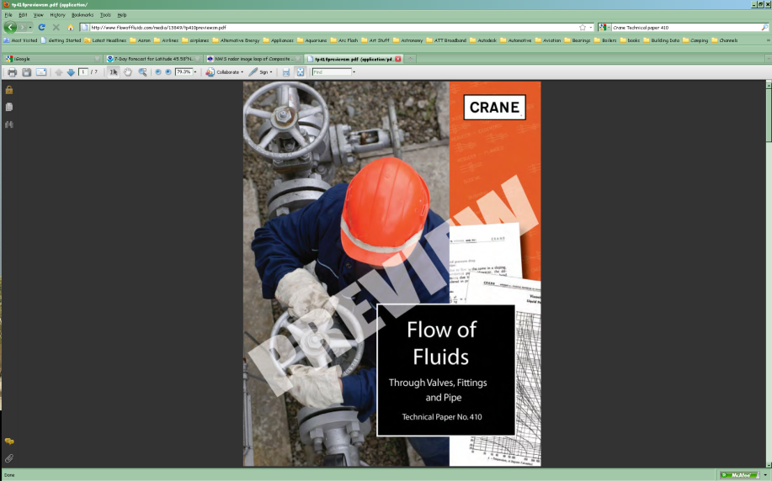

Crane Technical Paper 410
Available new for $60 at:
http://www.flowoffluids.com/publications/crane-tp-410.aspx
Available used from $49.99 and up at various used book stores
Notes:
http://www.flowoffluids.com/publications/crane-tp-410.aspx

Slide 18
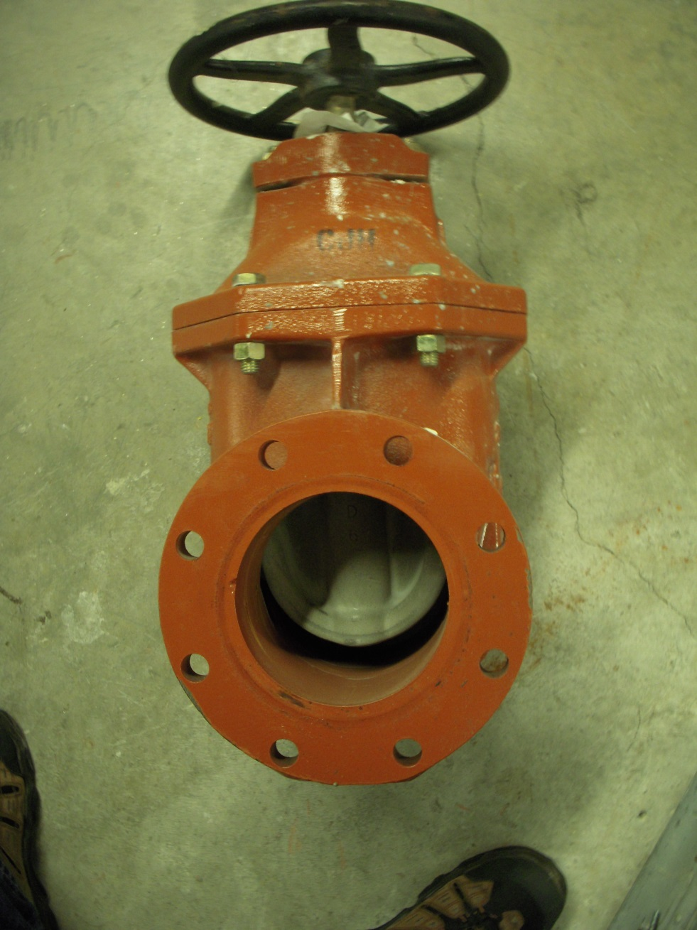
Service Valves
Intended to isolate things for service or repair
Open or Closed
Bubble Tight shut-off may be important
Gate Valve

Slide 19
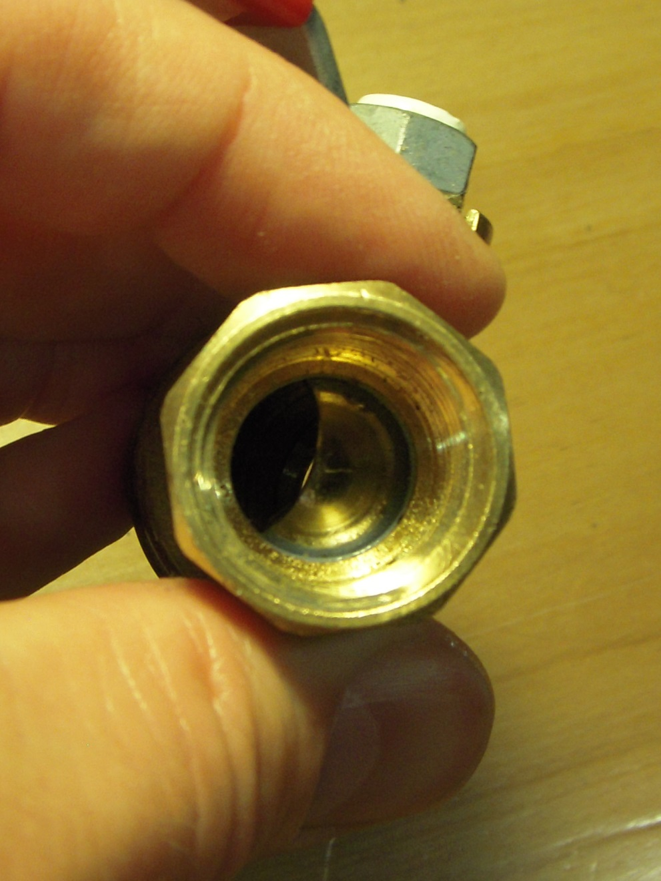
Service Valves
Intended to isolate things for service or repair
Open or Closed
Bubble Tight shut-off may be important
Ball Valve

Slide 20
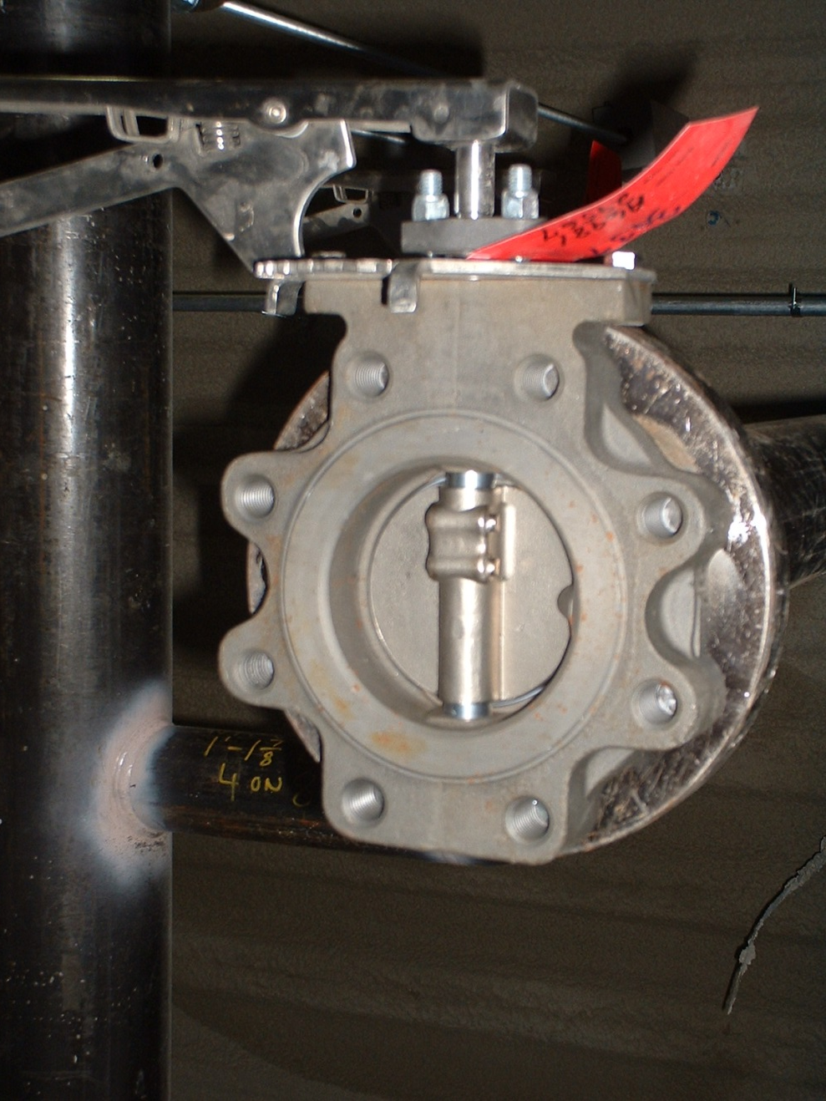
Service Valves
Intended to isolate things for service or repair
Open or Closed
Bubble Tight shut-off may be important
Lug Style Butterfly Valve

Slide 21
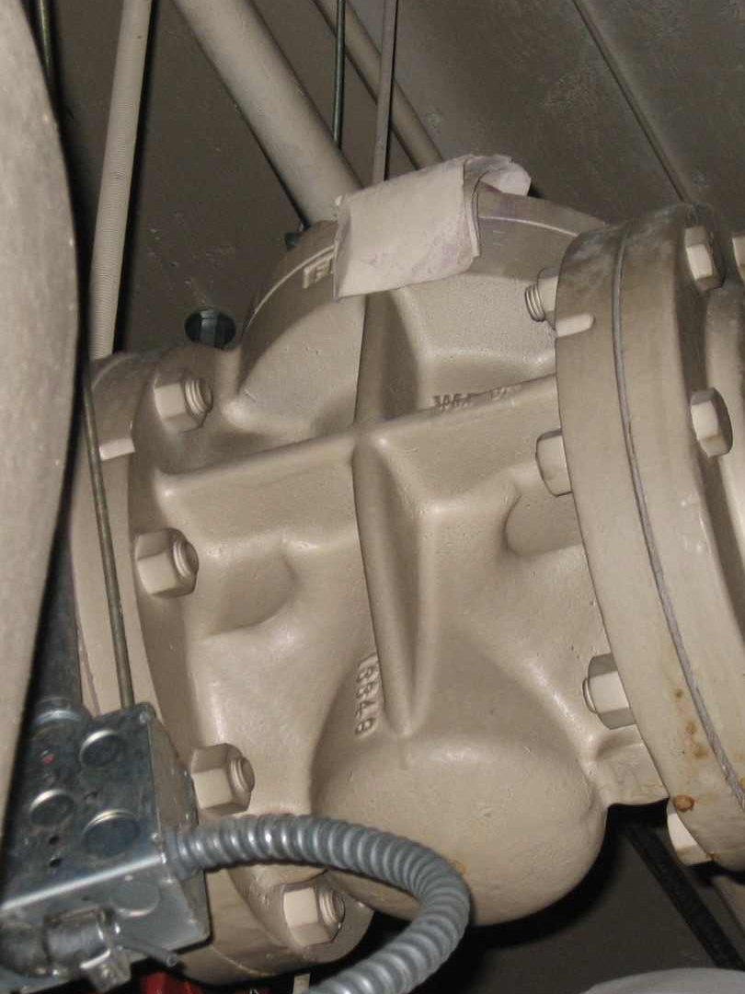
Service Valves
Intended to isolate things for service or repair
Open or Closed
Bubble Tight shut-off may be important
Plug Valve

Slide 22
Throttling Valves
Intended to be used to modulate flow
Can be “On-Off” but can also have intermediate positions
Most throttling valves can be used as service valves …
  Ball valve
  Butterfly valve
  Plug valve
… but not all service valves can be throttling valves
Gate valve
Plug Valve

Slide 23
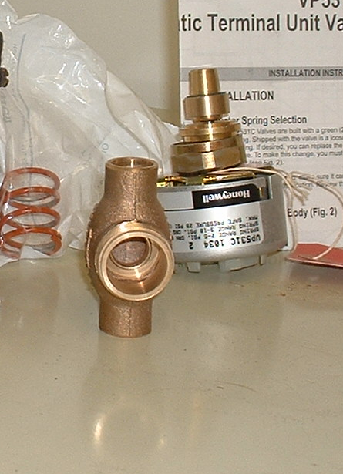
Throttling Valves
Control valves are automated throttling valves
Come in a variety of styles
  Globe
  Butterfly
  Ball
  Plug
Come in a variety of actuator types
  Pneumatic
    Piston
    Diaphragm
  Electric
    Gear motor
    Linear screw
Need to be properly sized for modulating control
  Rule of thumb – smaller than the line size
Globe Type Control Valve

Slide 24
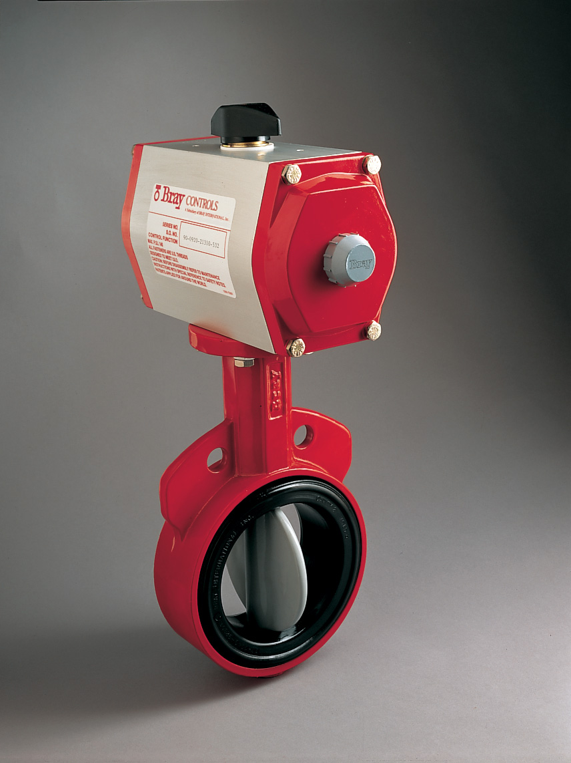
Throttling Valves
Control valves are automated throttling valves
Come in a variety of styles
  Globe
  Butterfly
  Ball
  Plug
Come in a variety of actuator types
  Pneumatic
    Piston
    Diaphragm
  Electric
    Gear motor
    Linear screw
Need to be properly sized for modulating control
  Rule of thumb – smaller than the line size
Wafer Style Butterfly Control Valve with Double Acting Pneumatic Actuator

Slide 25
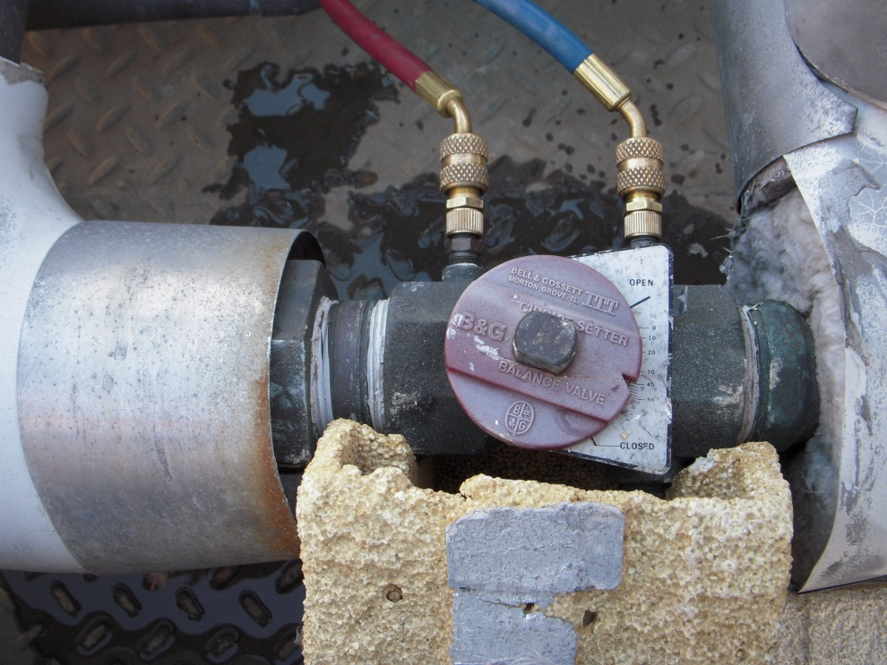
Throttling Valves
Balancing valves are manually adjusted characterized throttling valves
  Flow coefficient calibrated to valve position
  Pressure taps allow valve pressure drop to be measured
  Pressure drop and flow coefficient can be used to determine flow rate
Bell and Gossett “Circuit Setter” type balance valve

Slide 26
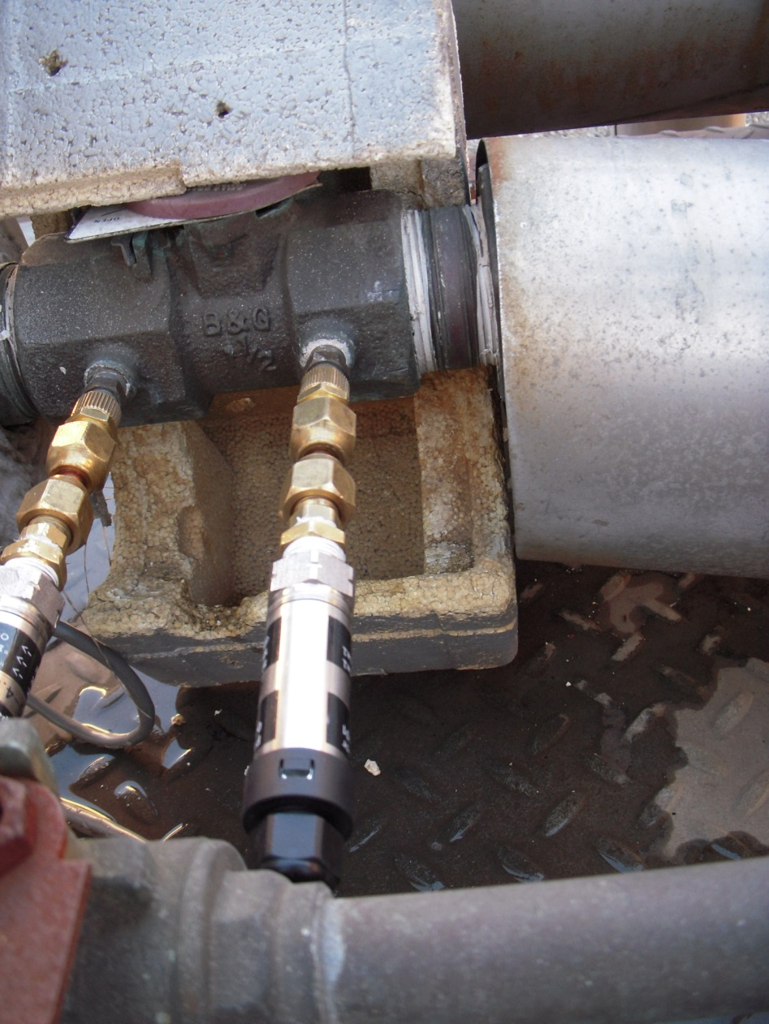
Throttling Valves
Balancing valves are manually adjusted characterized throttling valves
  Flow coefficient calibrated to valve position
  Pressure taps allow valve pressure drop to be measured
  Pressure drop and flow coefficient can be used to determine flow rate
Data logging across a “Circuit Setter” to develop a flow profile

Slide 27
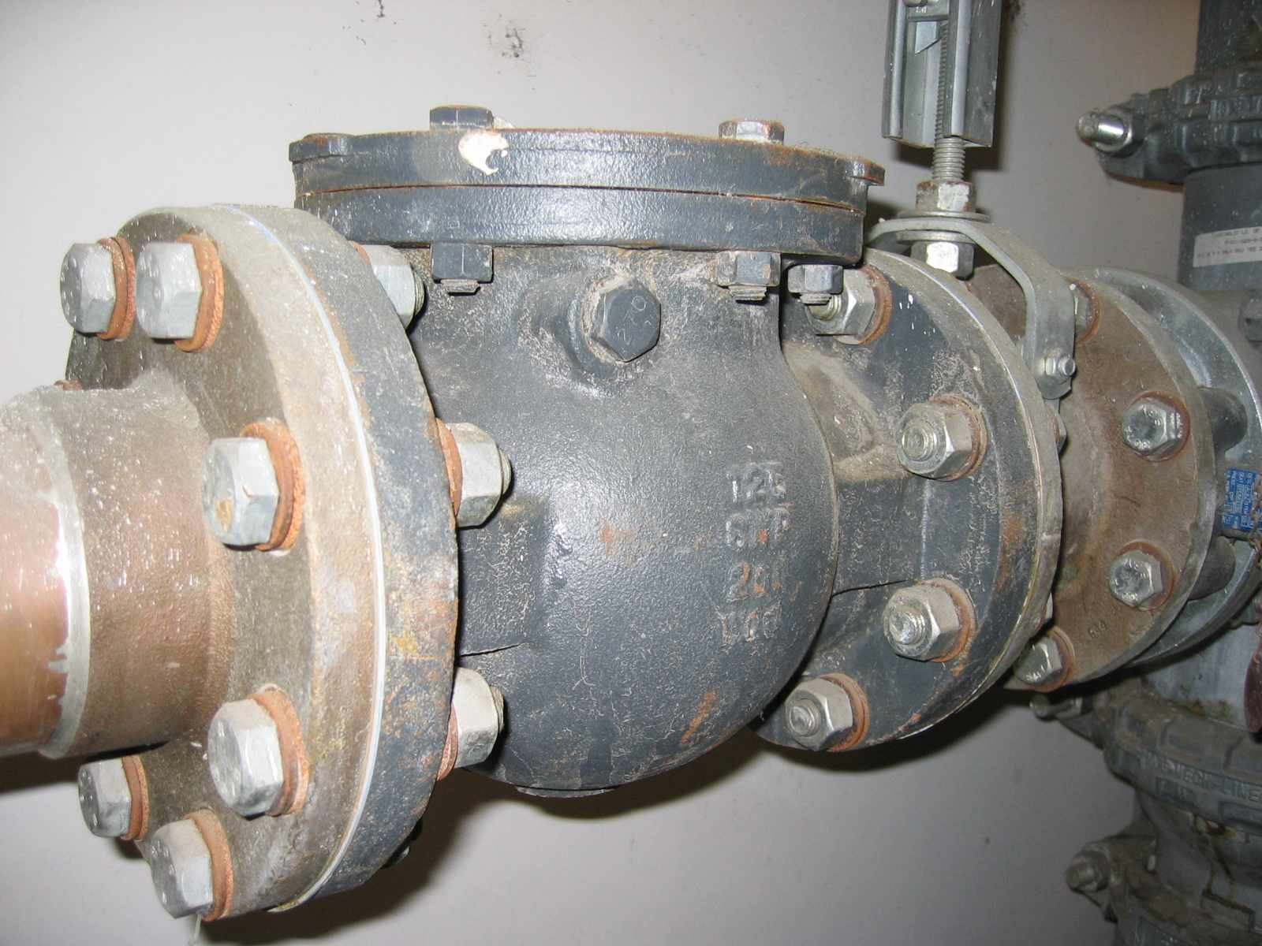
Check Valves
Intended to prevent reverse flow
Typically found on the discharge of pumps, especially parallel pumps
Swing Type Check Valve

Slide 28
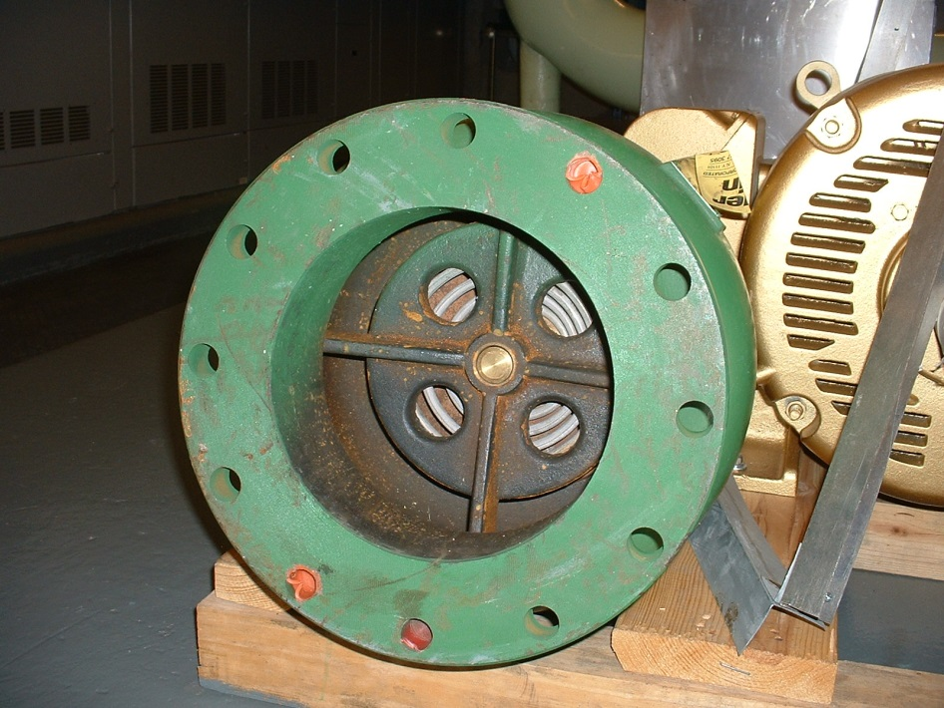
Check Valves
Intended to prevent reverse flow
Typically found on the discharge of pumps, especially parallel pumps
Wafer Type Check Valve – Outlet

Slide 29
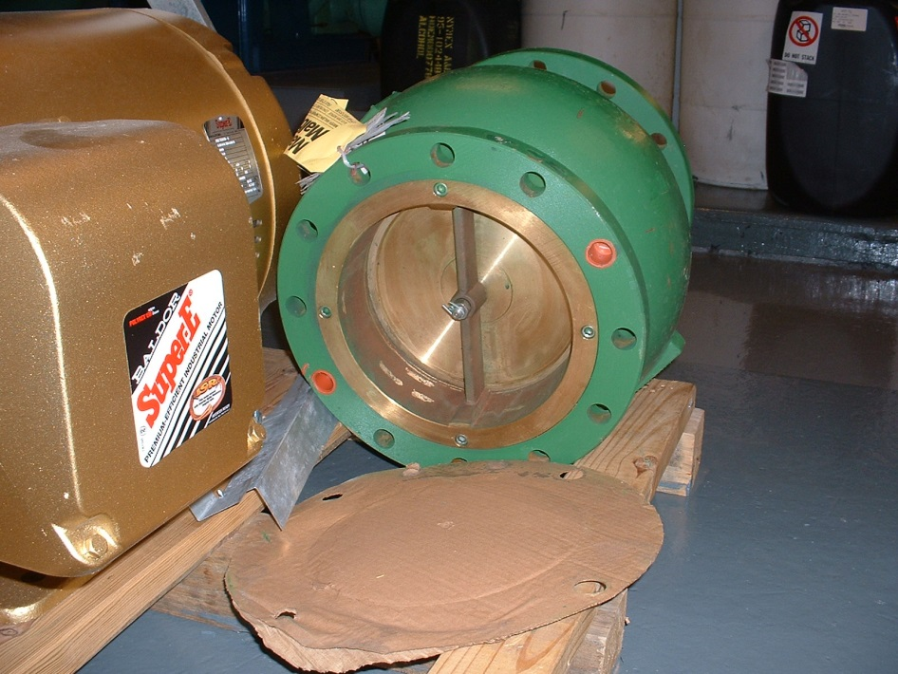
Check Valves
Intended to prevent reverse flow
Typically found on the discharge of pumps, especially parallel pumps
Wafer Type Check Valve – Inlet

Slide 30
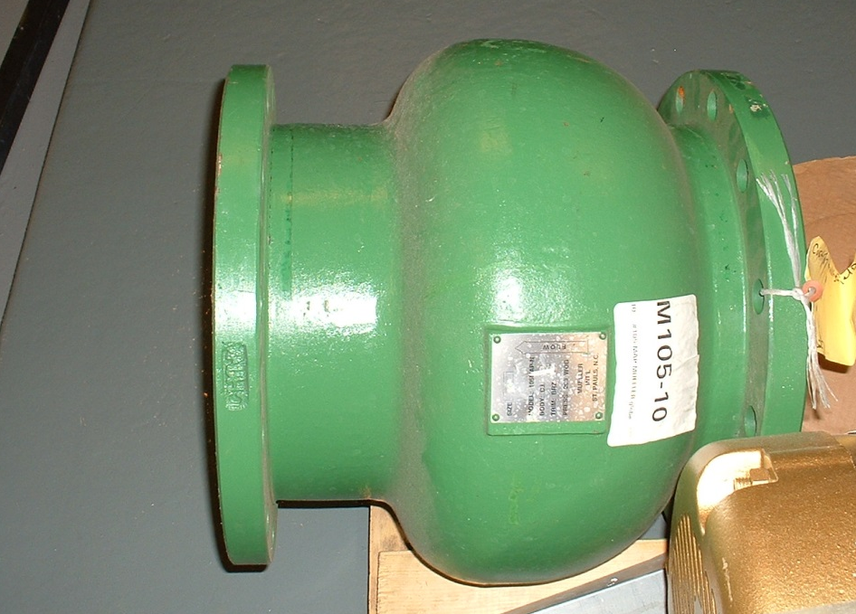
Check Valves
Intended to prevent reverse flow
Typically found on the discharge of pumps, especially parallel pumps
Directional; if you put it in backwards, it won’t do its job
Wafer Type Check Valve – Note Directional Arrow

Slide 31
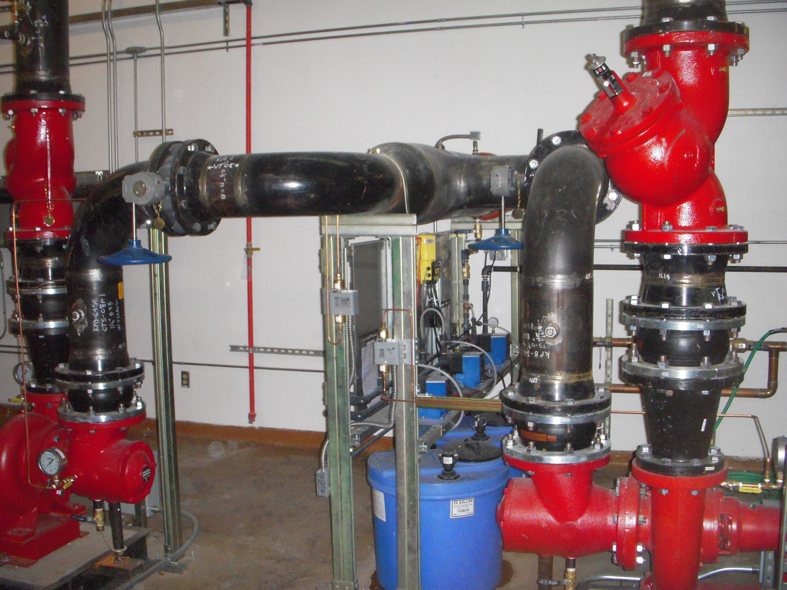
Valves with Multiple Functions
“Triple Duty” Valves
Throttling
Isolation
Check valve

Slide 32
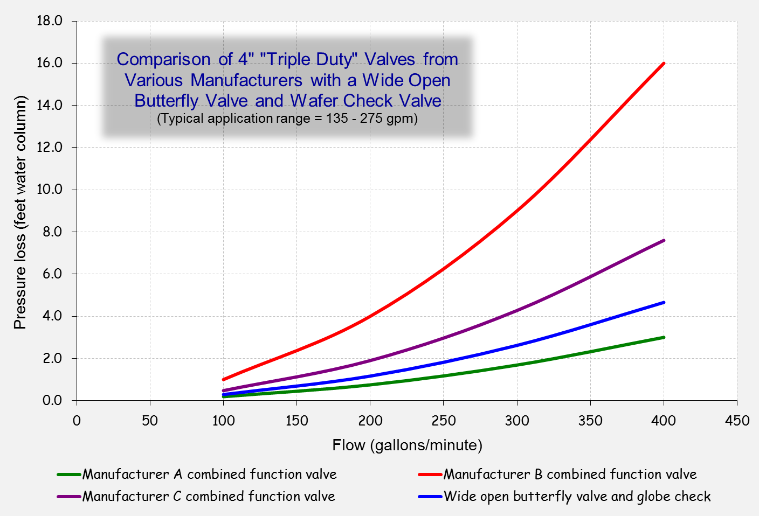
Different Manufacture's Have Different Performance Data

Slide 33
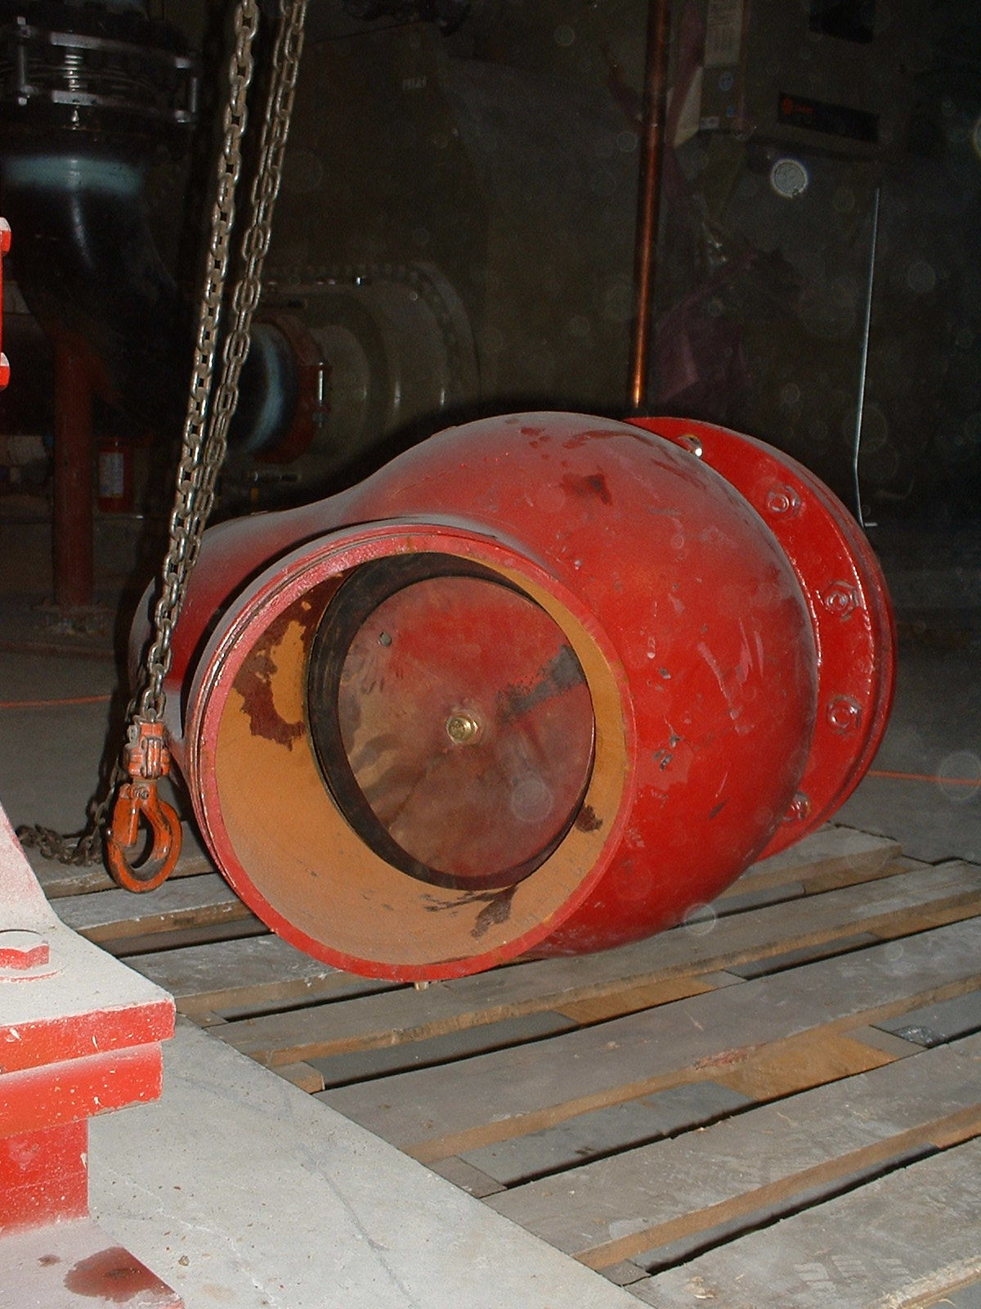
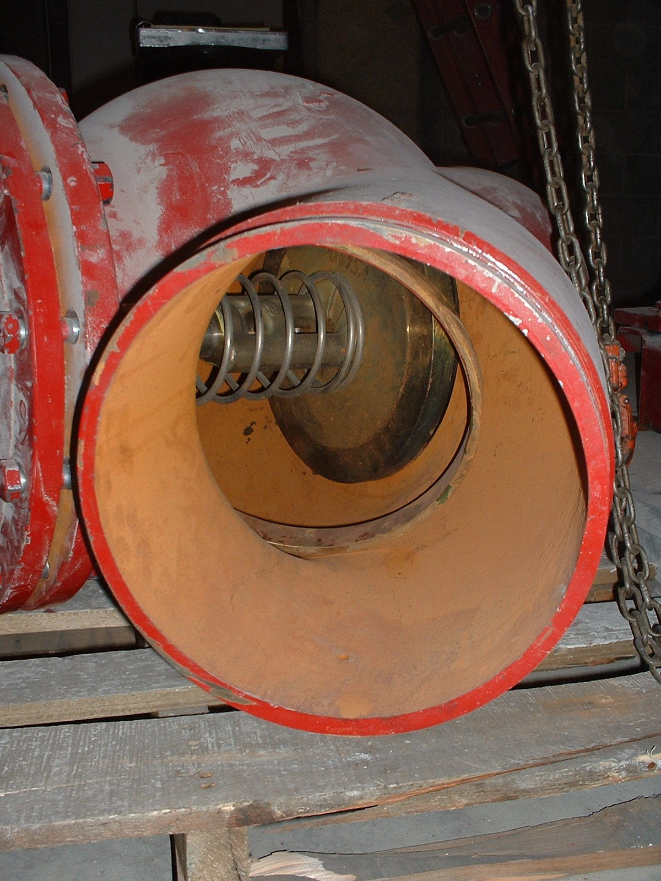
Different Manufacture's Have Different Features
The seat that is the check valve seat is also the isolation valve seat
Entering Side
Leaving Side

Slide 34
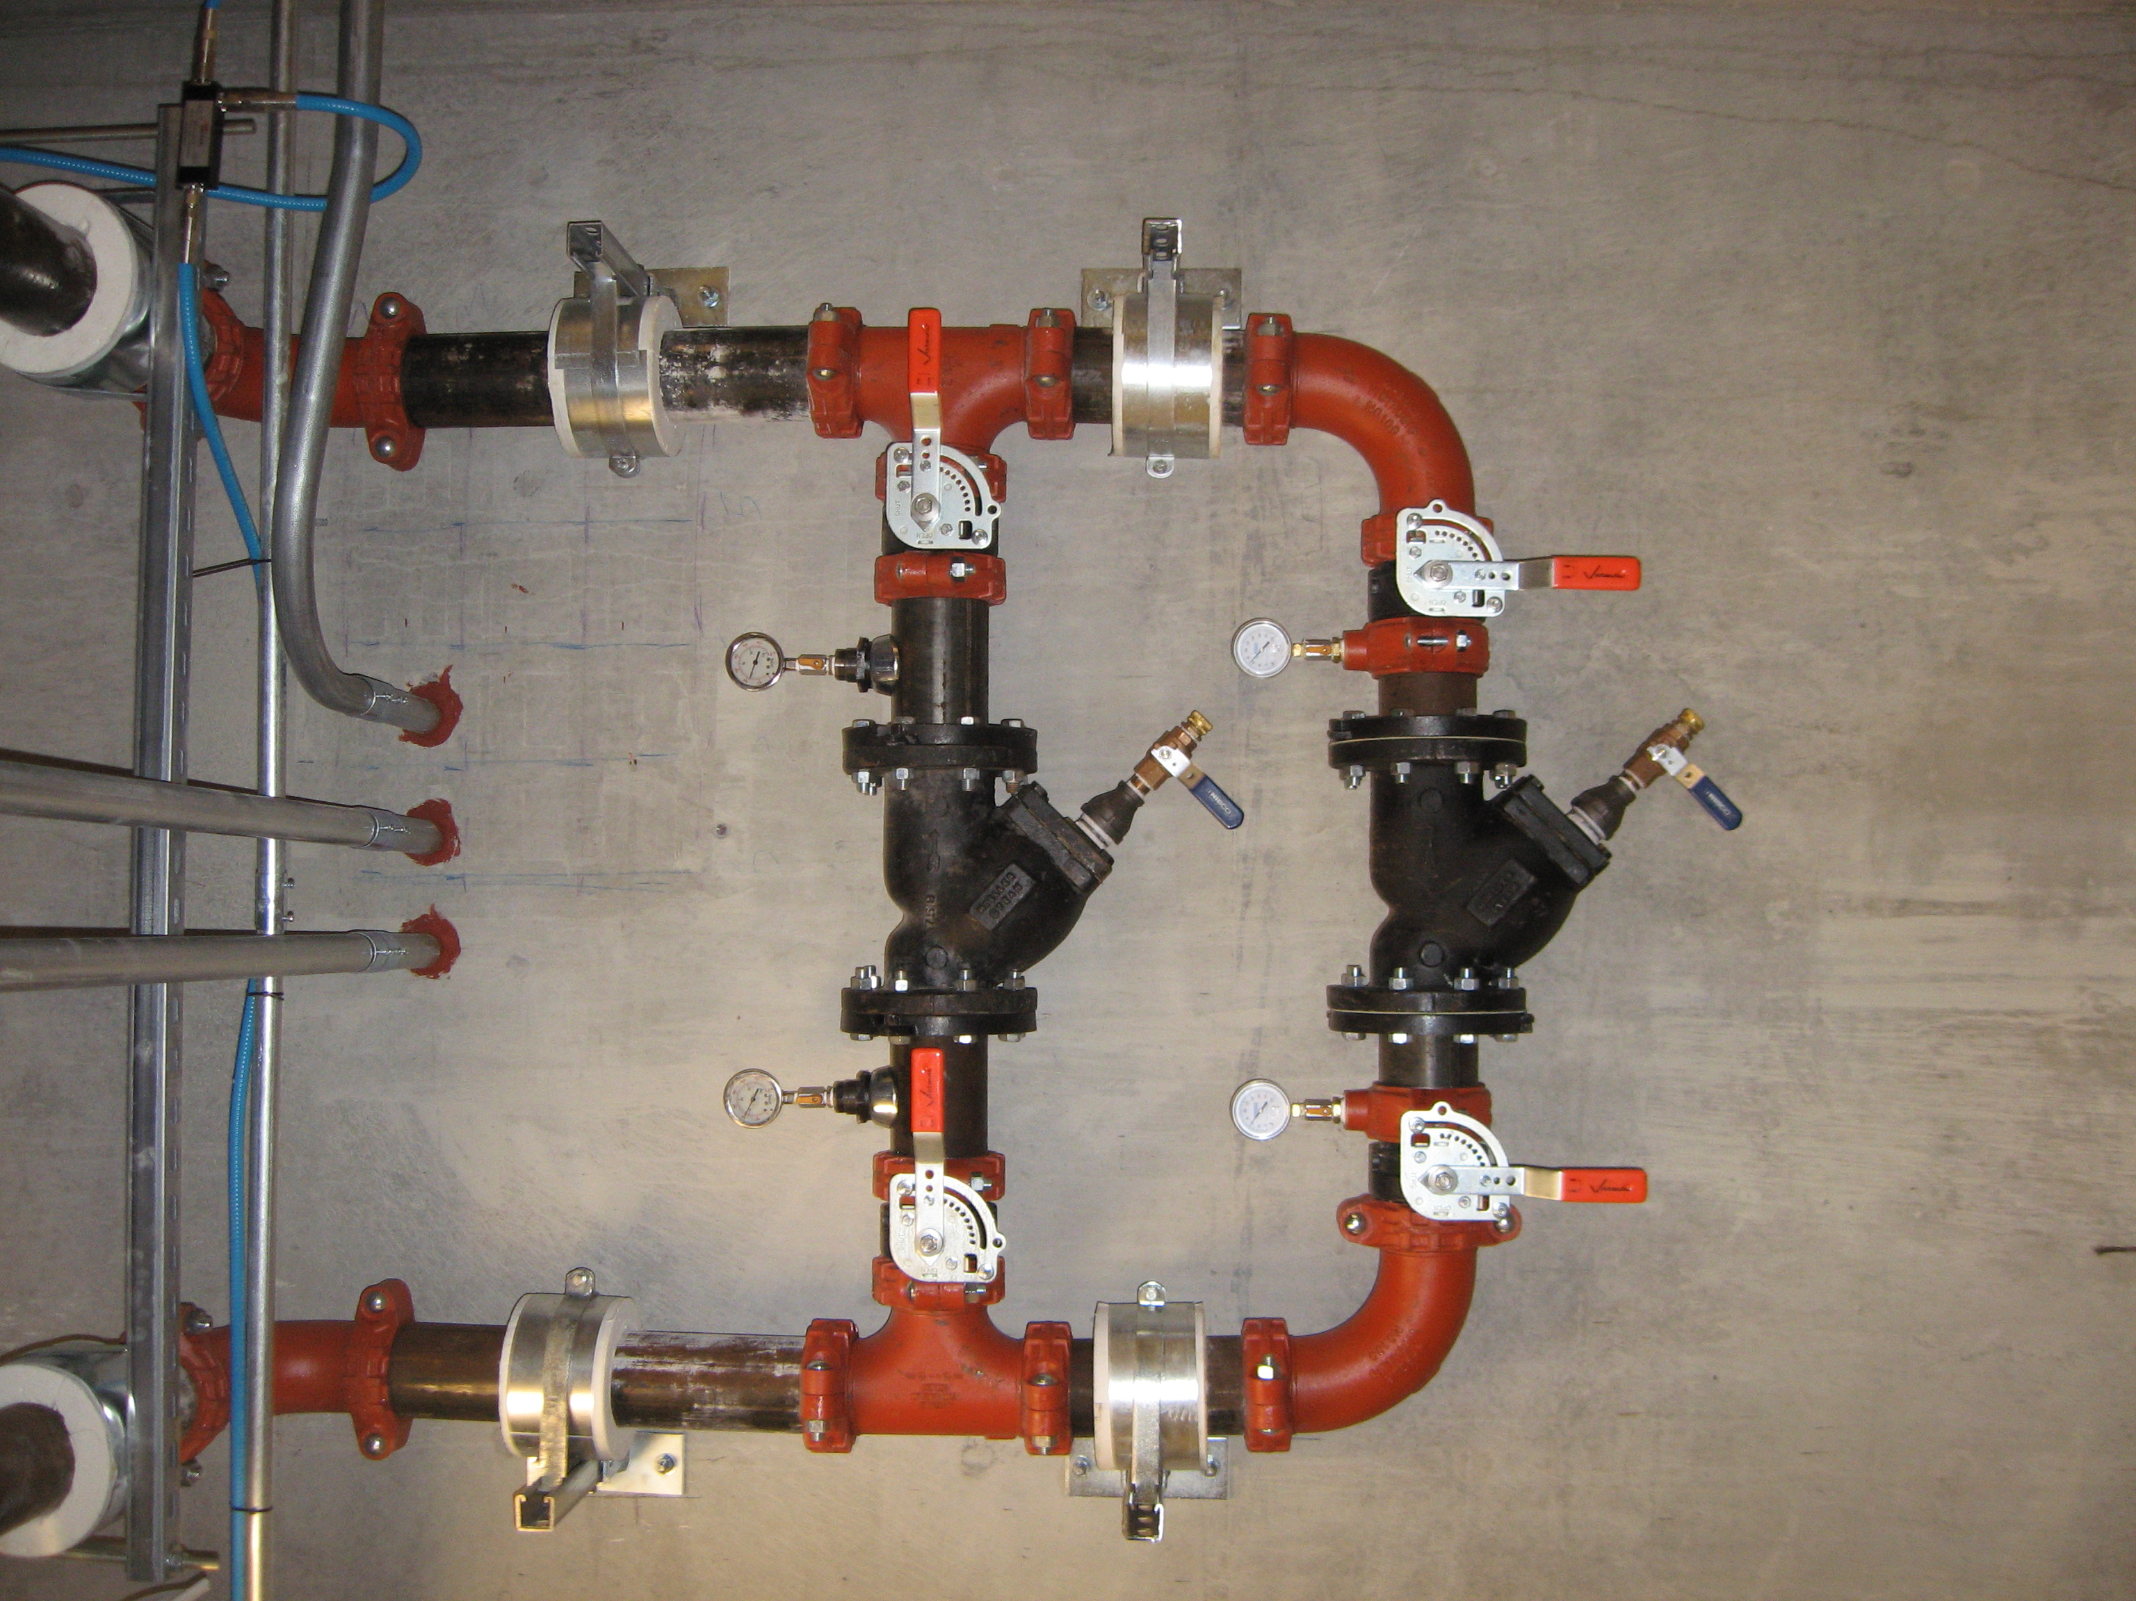
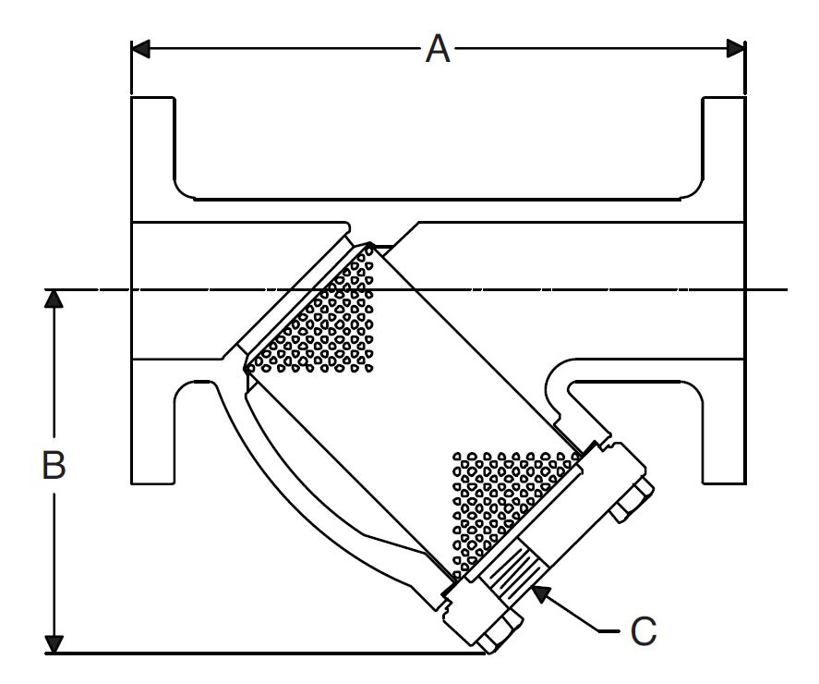
Strainers;
Details Matter
What happens if you put a reducer on the outlet or flip the cover plate so the outlet is on top vs. on the bottom?

Slide 35
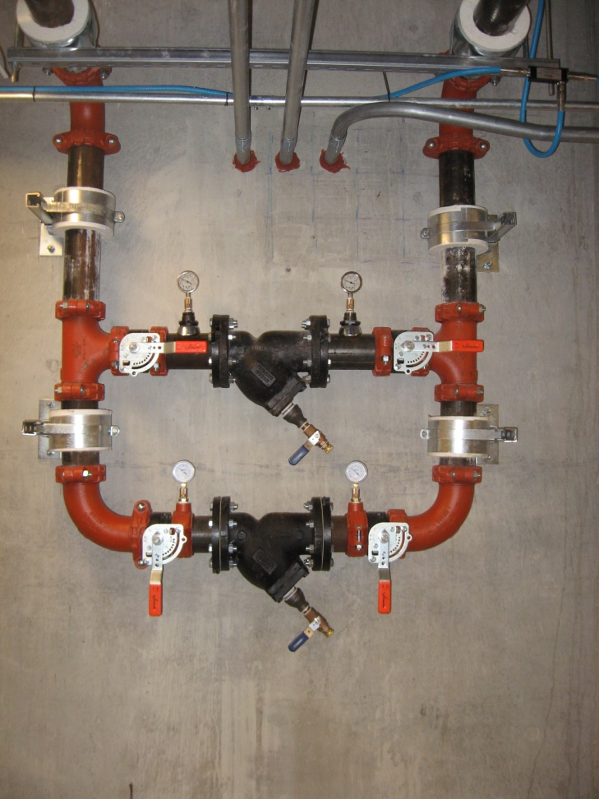
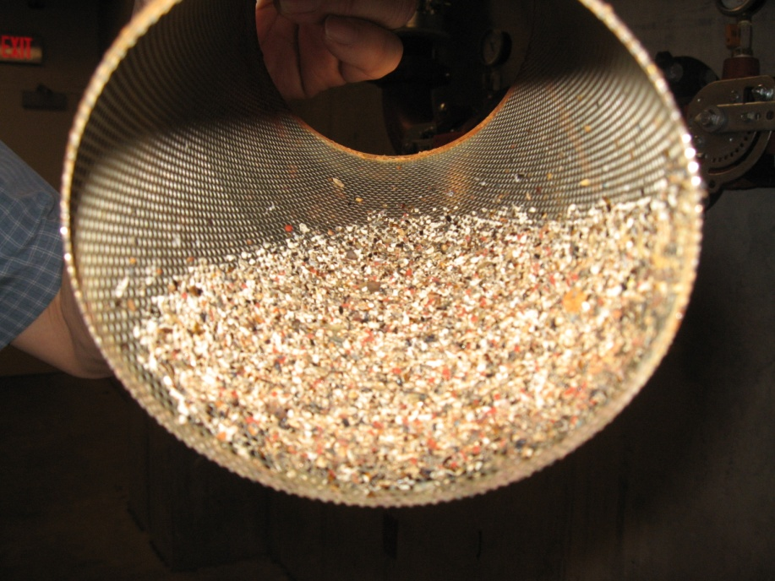
Redundant Strainers Allow Uninterrupted Service

Slide 36
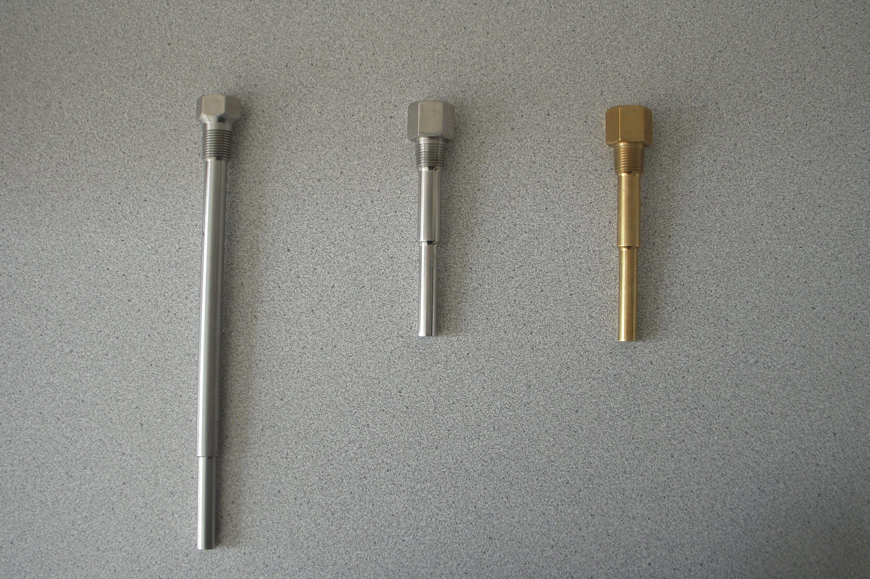

Slide 37
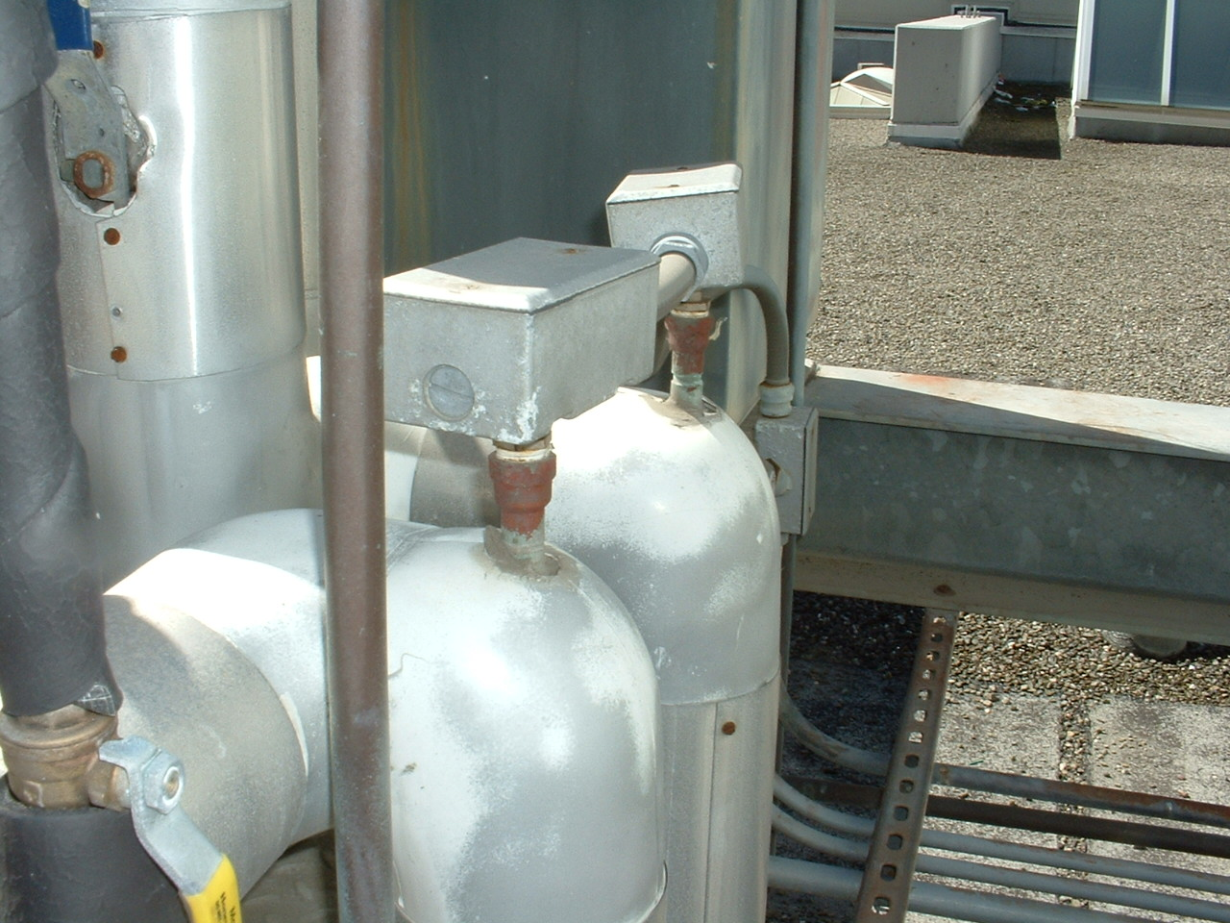
Temperature Sensors and Wells
Thermometer wells
Allow sensors to be removed and replaced with out draining the system
Introduce a thermal lag between the actual temperature change and the sensed temperature change

Slide 38
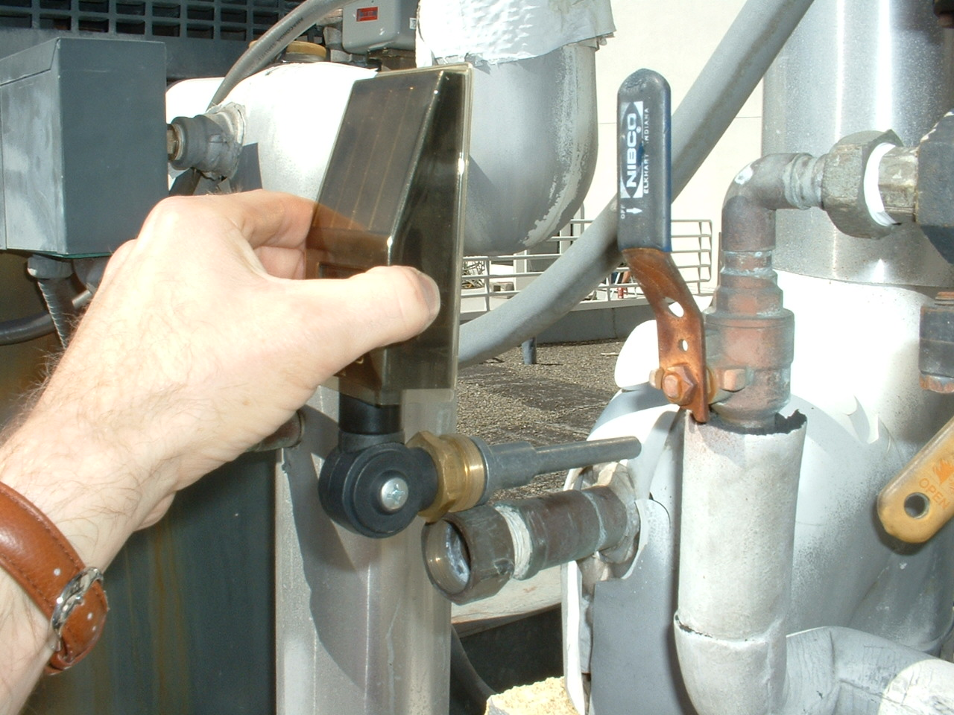
Insertion Length is Critical

Slide 39
Wells Introduce Lags

Slide 40
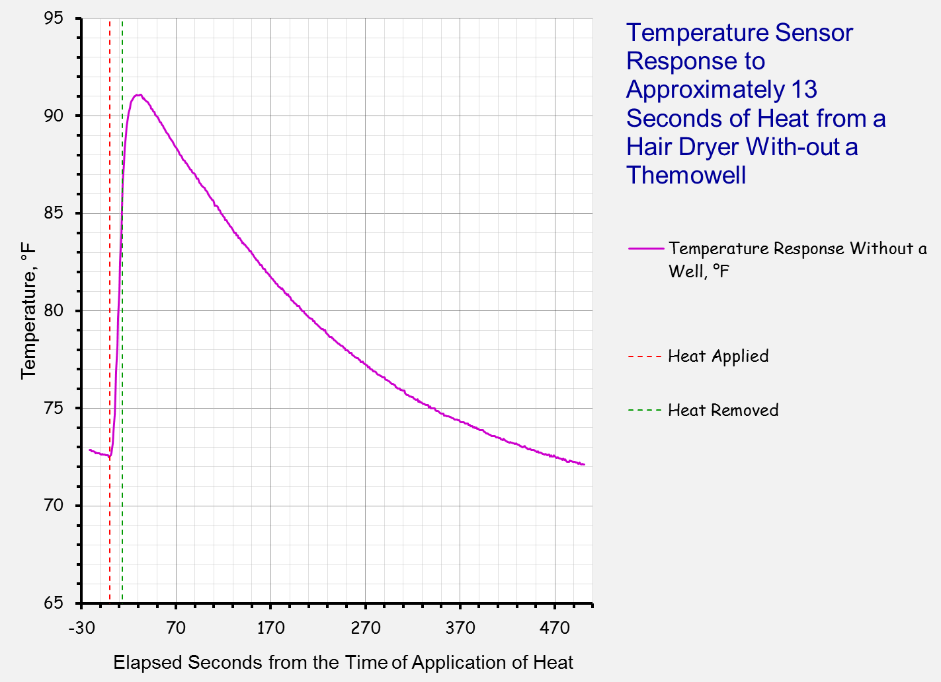

Slide 41
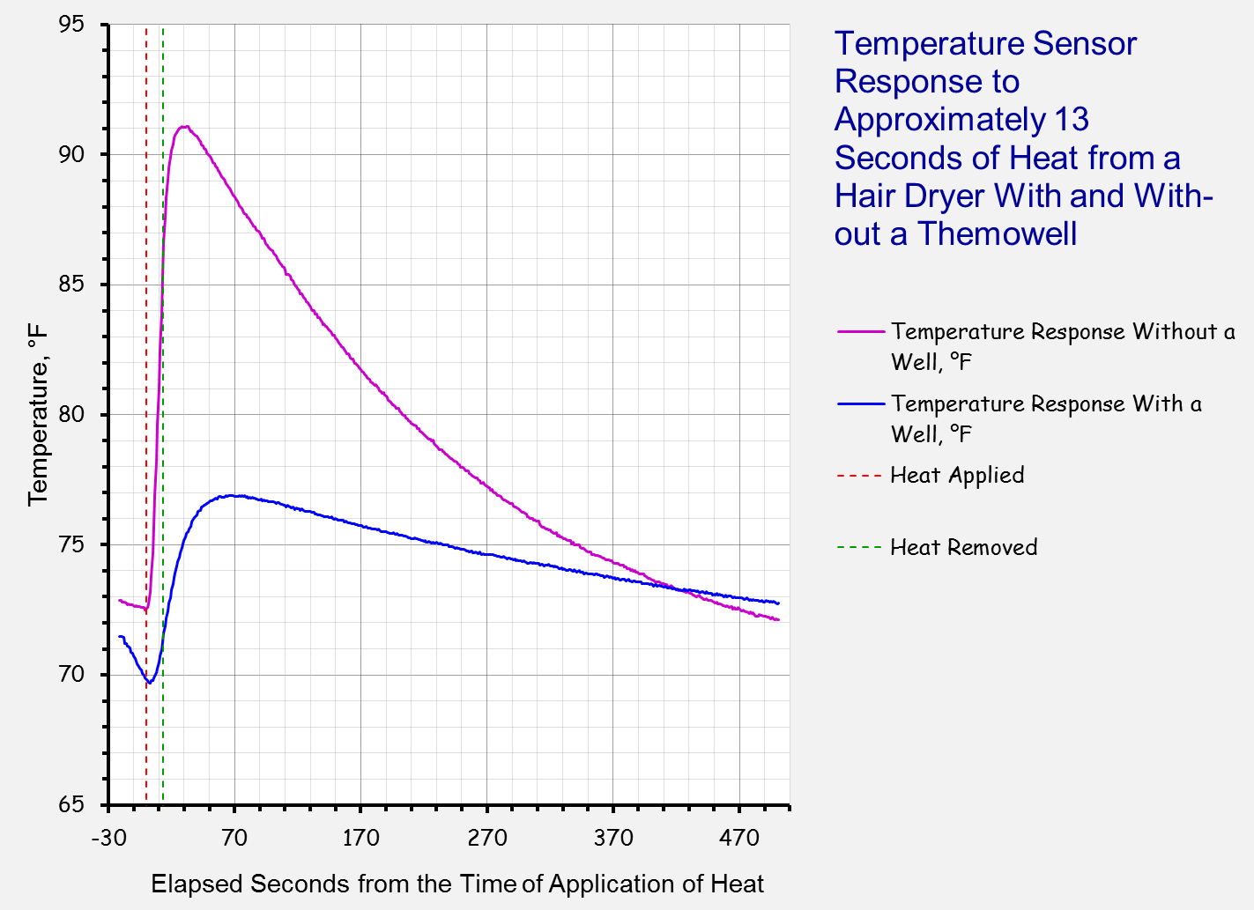

Slide 42
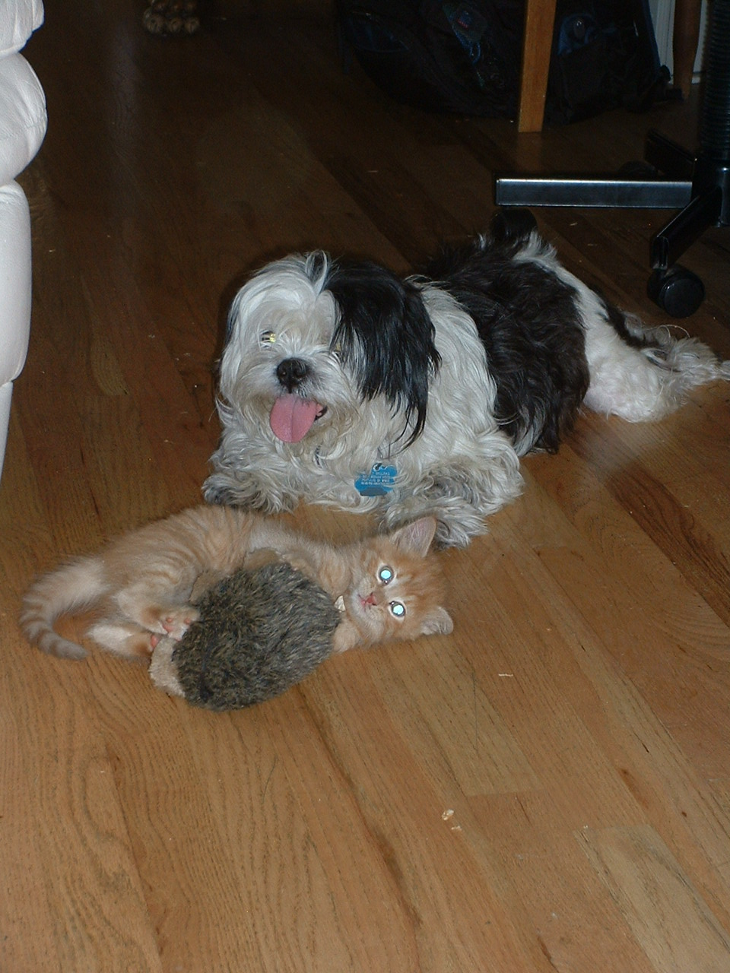
Thermal Lags
A Research Experiment by the FDE NW Research Lab
Dr. Riley Sellers; PhD CTK LBNL CTPSC *
Hobbes Sellers; Post Doc Applied Chaos Theory
See 4-20 ma Current Loop Experiments – Thermal Mass Effects for details
* Doctorate of Philosophy - Canine Treat Kinetics - Lower Buchanan National Labs, Canine Treat Preservation Systems Center

Slide 43
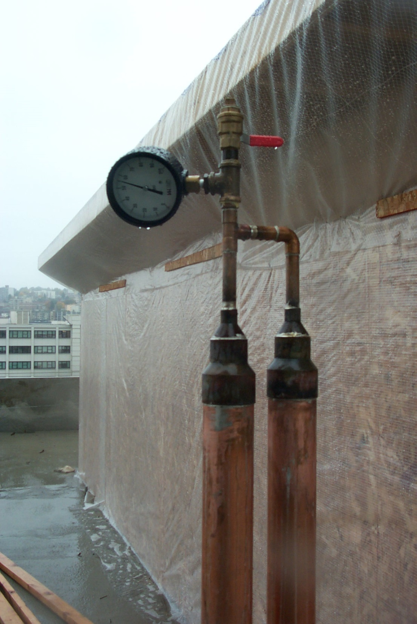
Pressure Testing
Typical Specifications
  Test medium (air or water)
  Test pressure
  Test duration
  Allowable variation
    Temperature compensation
  All may be driven by code requirements, especially life safety code requirements for fire protection systems

Slide 44
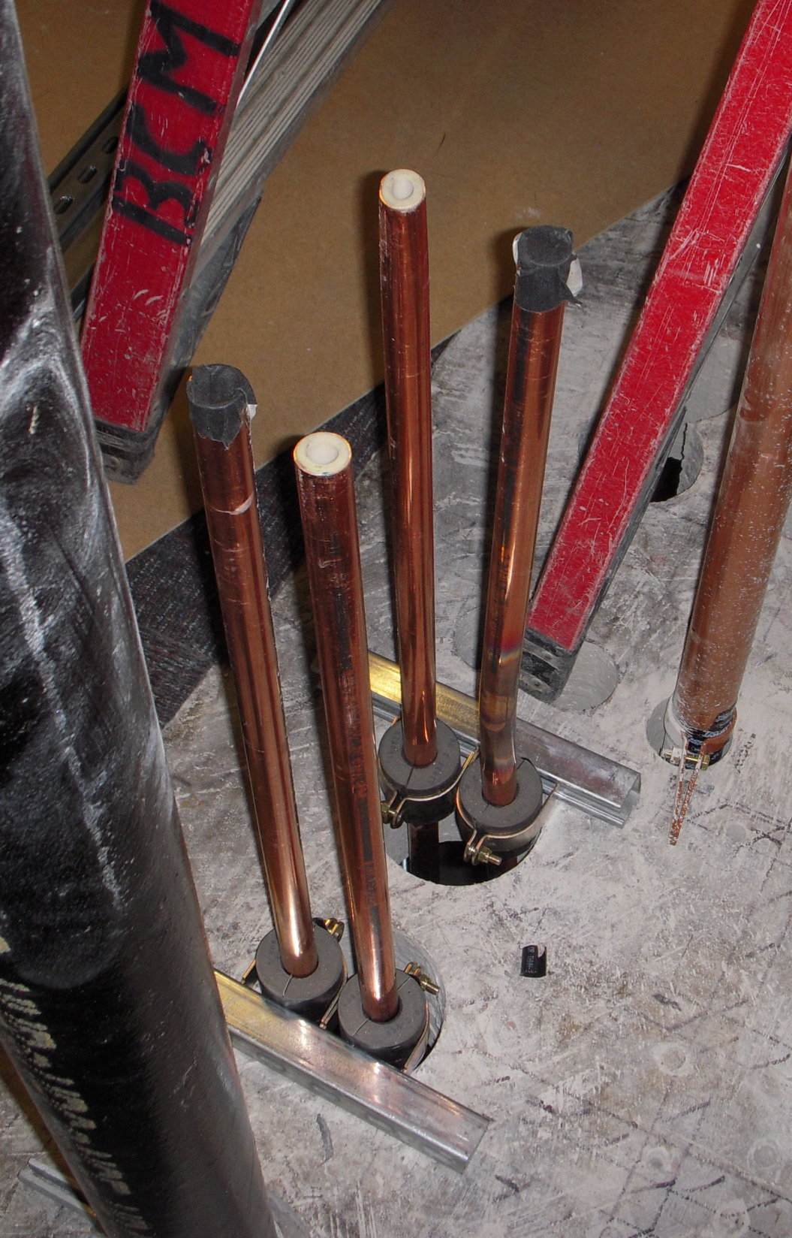
Cleaning
Step 1
    Don’t let it get dirty
May be more critical for some applications than others
    High purity vs. HVAC
    Refrigeration vs. Water
  Methodology
    Flushing
    Circulation of cleaning solution
      Velocities matter
      Solution matters
      Make-up quality matters

Slide 45
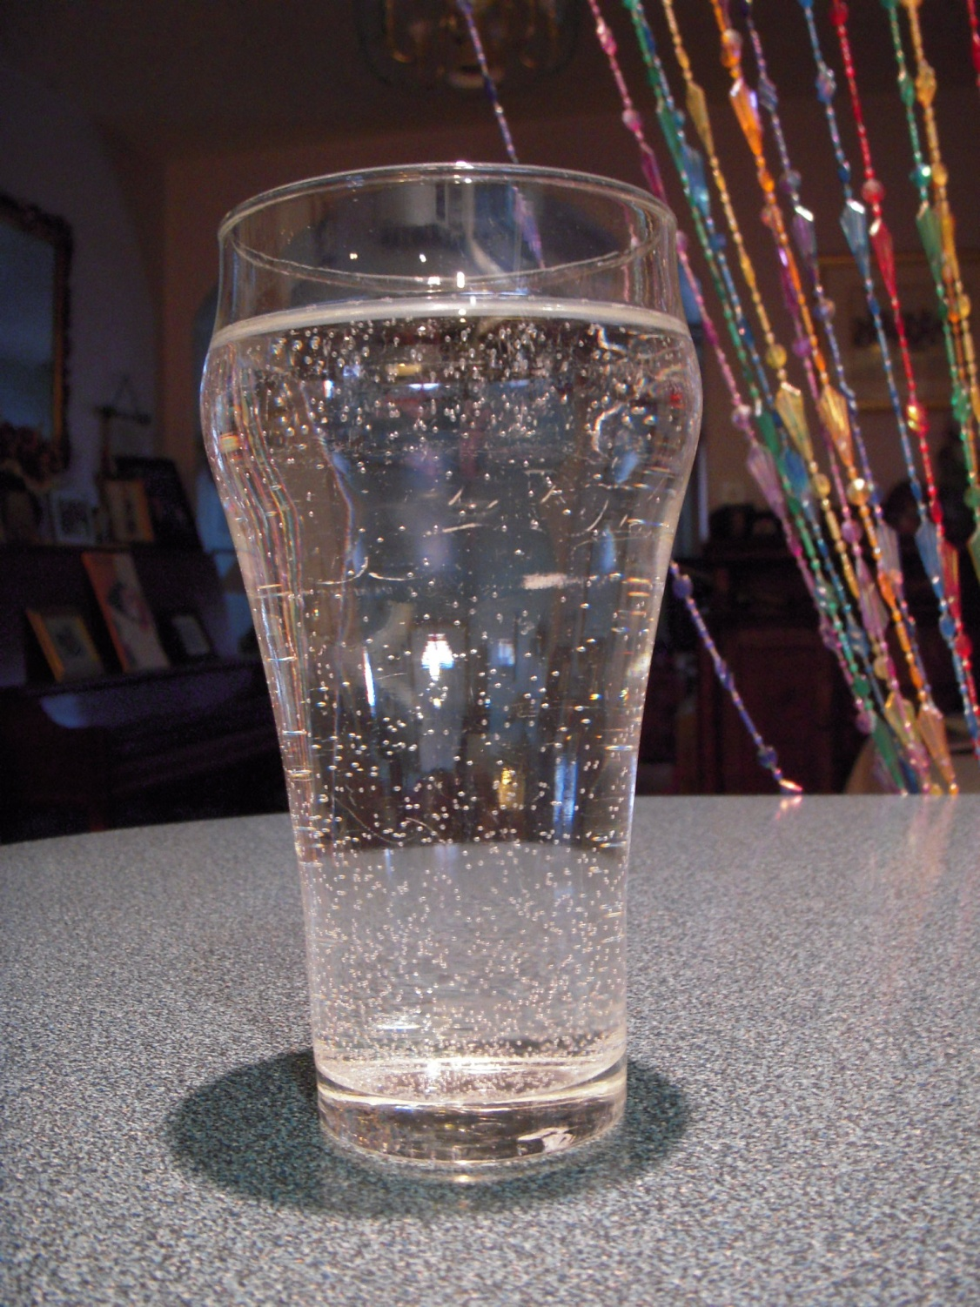
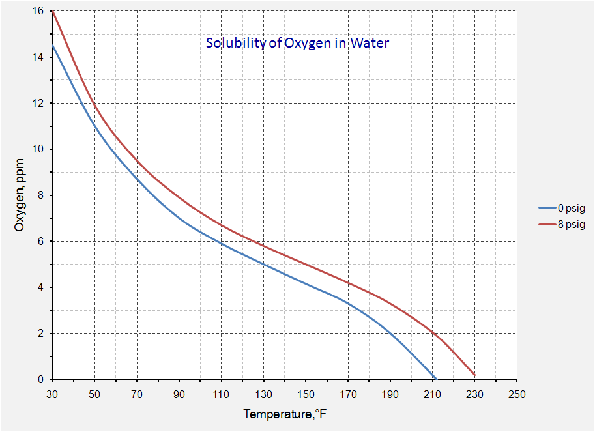
Why a Picture of a Glass of Water in a Pump (and Piping) Class

Slide 46
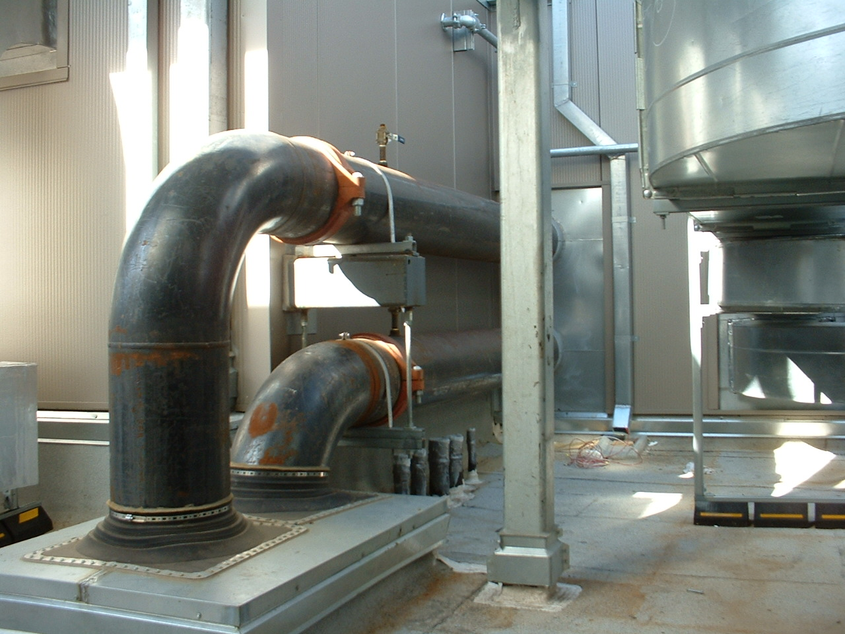
What Does the Glass of Water Have to do With This Pipe?

Slide 47
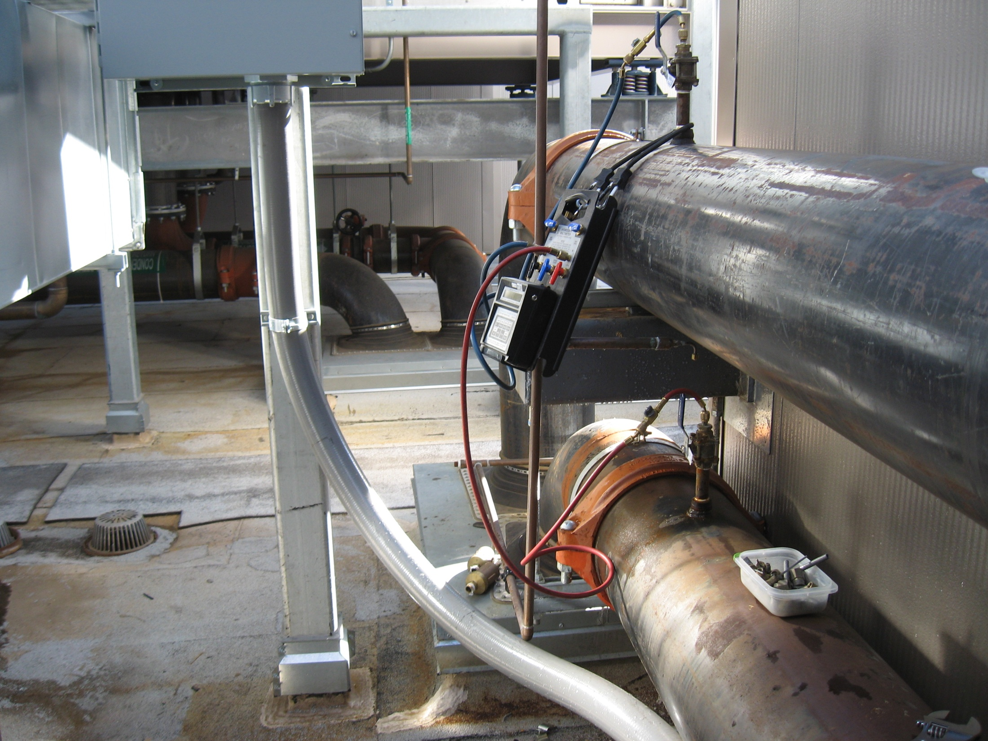
What Does the Glass of Water Have to do With This Pipe?

Slide 48
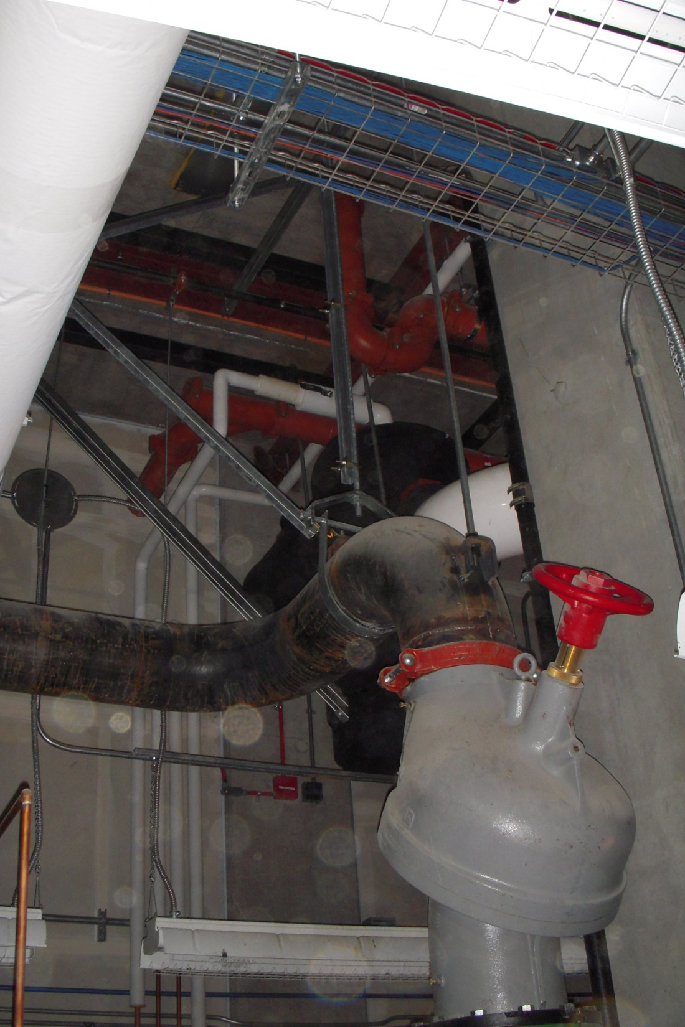
Hangers
Need to fully support the weight of the pipe and water
  No stress on equipment flanges
  Attachment points sufficient for the imposed loads
Need to constrain and guide movement
  Normal operation
  Seismic events
  Vibration isolation
Need to be coordinated with anchors, guides, and expansion loops
Need to be coordinated with insulation
Hanger rod supports piping weight and keeps it off of the pump flanges below

Slide 49
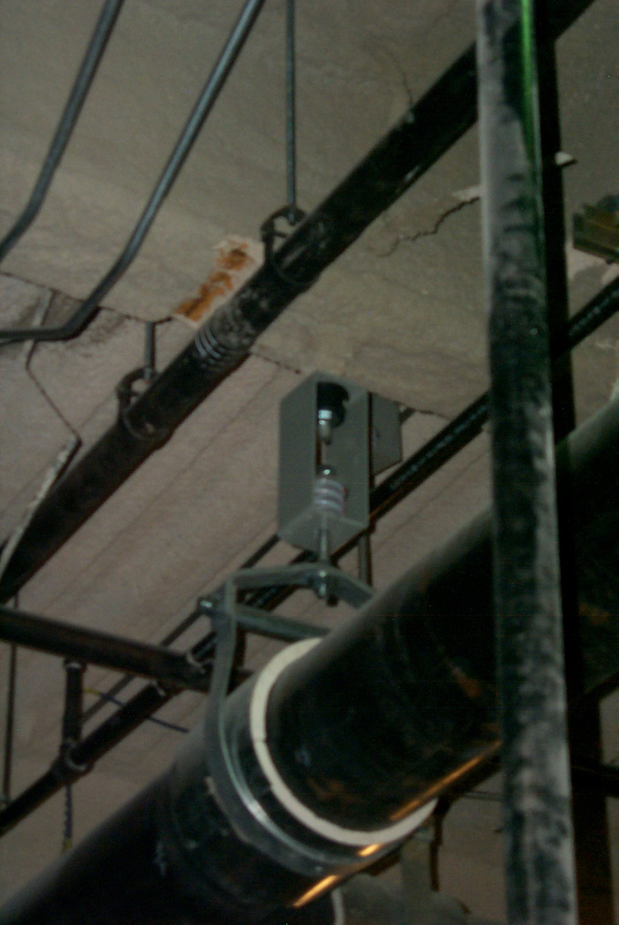
Hangers
Spring and neoprene isolators prevent vibration from reaching building structure
Need to fully support the weight of the pipe and water
  No stress on equipment flanges
  Attachment points sufficient for the imposed loads
Need to constrain and guide movement
  Vibration isolation
  Normal operation
  Seismic events
Need to be coordinated with anchors, guides, and expansion loops
Need to be coordinated with insulation

Slide 50
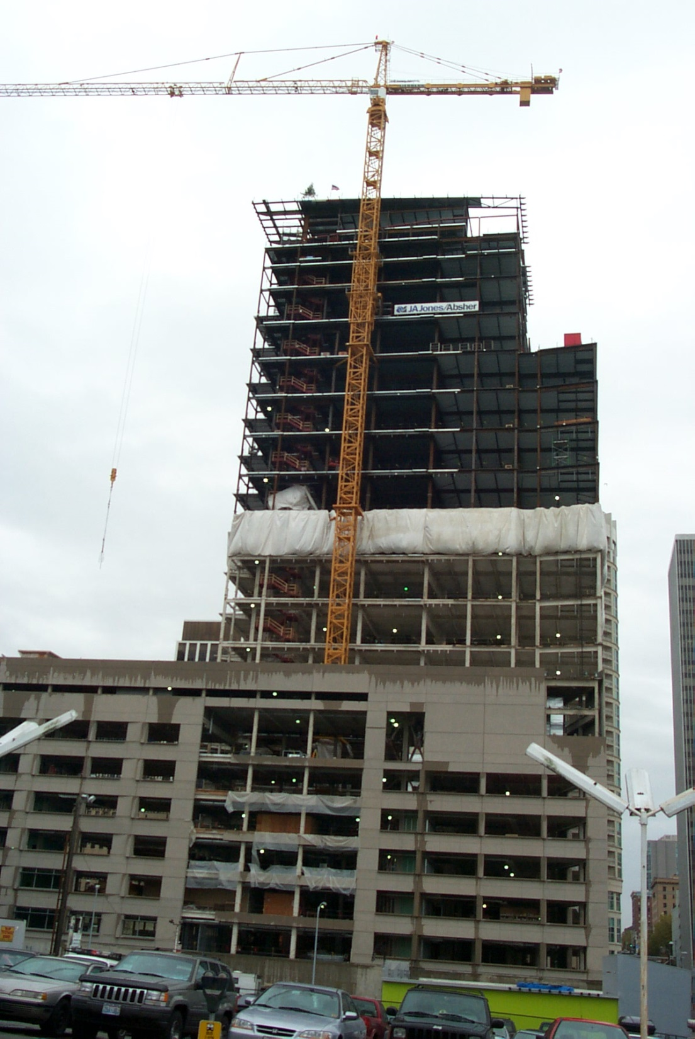
Hangers
Need to fully support the weight of the pipe and water
  No stress on equipment flanges
  Attachment points sufficient for the imposed loads
Need to constrain and guide movement
  Vibration isolation
  Normal operation
  Seismic events
Need to be coordinated with anchors, guides, and expansion loops
Need to be coordinated with insulation
The vertical pipe risers in this 450 foot tall high rise can expand 3-4 inches or more when subjected to the temperature change associated with standing empty on a cold day vs. being filled and coming up to operating temperature

Slide 51
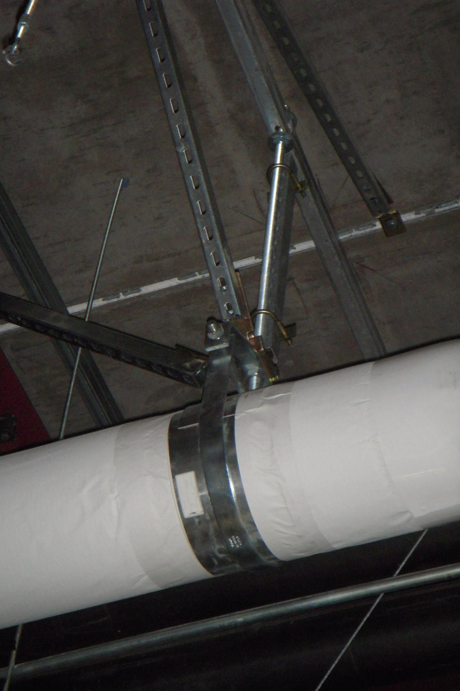
Hangers
Need to fully support the weight of the pipe and water
  No stress on equipment flanges
  Attachment points sufficient for the imposed loads
Need to constrain and guide movement
  Normal operation
  Vibration isolation
  Seismic events
Need to be coordinated with anchors, guides, and expansion loops
Need to be coordinated with insulation
Angle iron reinforces hanger rod and prevents lateral movement. Similar braces prevent longitudinal movement on long runs

Slide 52
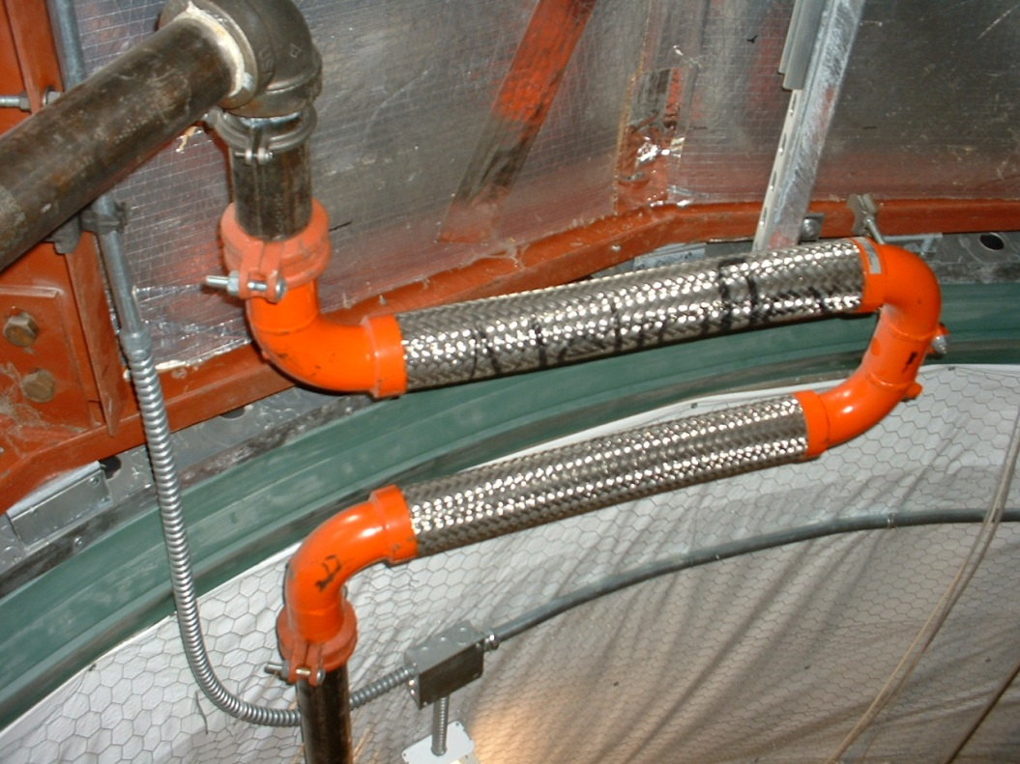
Hangers
Need to fully support the weight of the pipe and water
  No stress on equipment flanges
  Attachment points sufficient for the imposed loads
Need to constrain and guide movement
  Normal operation
  Seismic events
  Vibration isolation
Need to be coordinated with anchors, guides, and expansion loops
Need to be coordinated with insulation

Slide 53
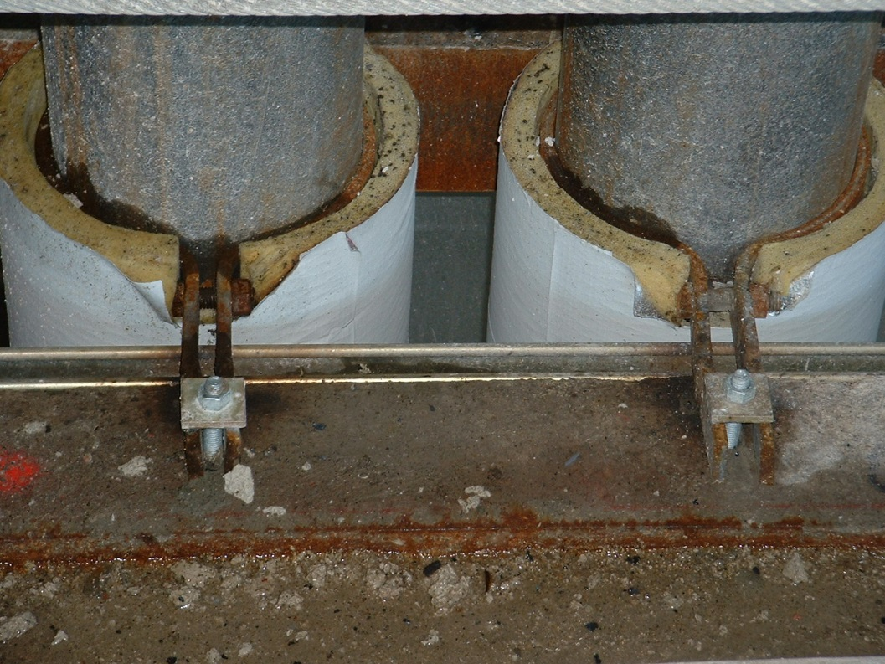
Hangers
Need to fully support the weight of the pipe and water
  No stress on equipment flanges
  Attachment points sufficient for the imposed loads
Need to constrain and guide movement
  Normal operation
  Seismic events
  Vibration isolation
Need to be coordinated with anchors, guides, and expansion loops
Need to be coordinated with insulation

Slide 54

Hangers
Need to fully support the weight of the pipe and water
  No stress on equipment flanges
  Attachment points sufficient for the imposed loads
Need to constrain and guide movement
  Normal operation
  Seismic events
  Vibration isolation
Need to be coordinated with anchors, guides, and expansion loops
Need to be coordinated with insulation

Slide 55

Pump Vibration Isolation
Similar Considerations to Hangers
  Isolate pump from structure
  Isolate pump from piping
  Eliminate loads on pump flanges
Springs prevent day to day vibration transmission. Seismic snubbers limit movement during a seismic event

Slide 56

Pump Vibration Isolation
Similar Considerations to Hangers
  Isolate pump from structure
  Isolate pump from piping
  Eliminate loads on pump flanges
Flex connectors and mechanical couplings prevent vibration transmission from pumps to the building structure

Slide 57

Gauge Manifolds
Less is Better
Three valves and one gauge allow:
Strainer pressure drop,
Suction pressure, and
Discharge pressure
to be read with one gauge, thereby eliminating gauge error and saving first cost

Slide 58

Gauge Manifolds
Less is Better

Slide 59
Small Differences can Make A Big Difference

Slide 60

Gauge Manifolds from Hell

Slide 61

A Great Resource for Understanding the Field Side of Piping

