Slide 1
2020 RCx Academy
Week 3
Pumping Systems
27 MAY 2020

Slide 2
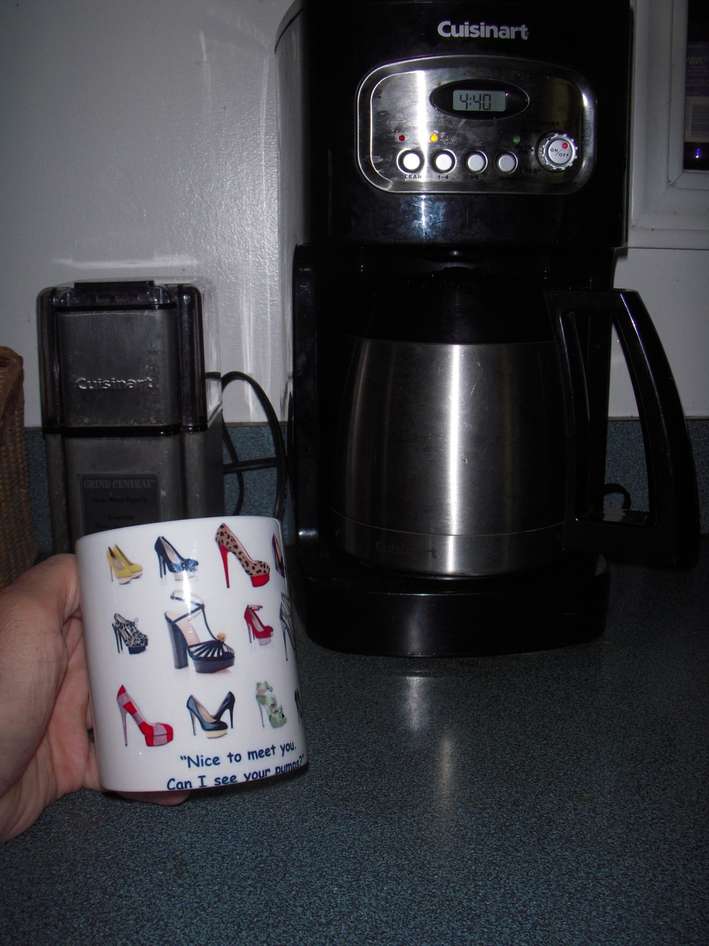

Slide 3
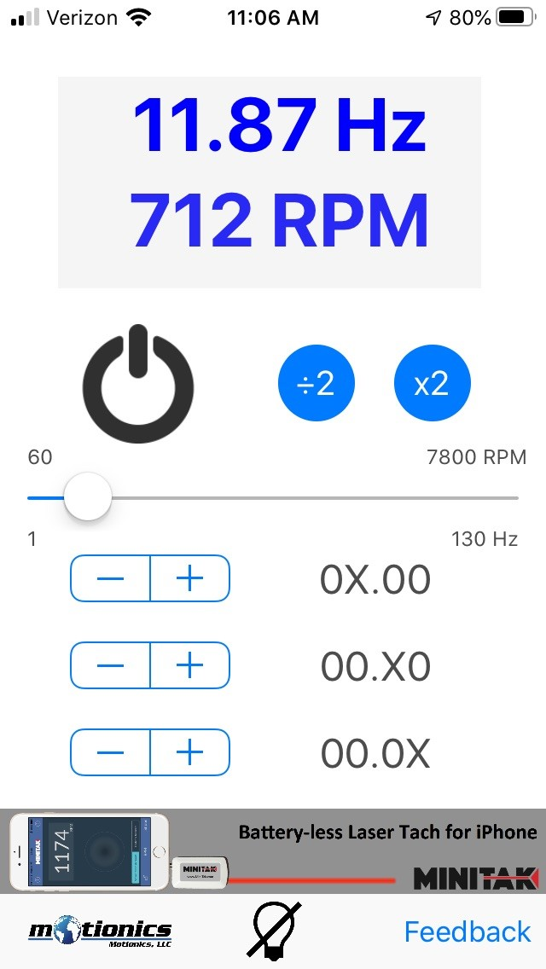
This is Cool
Free iPhone app from Motionics
https://apps.apple.com/us/app/strobe-light-tachometer/id978182913

Slide 4
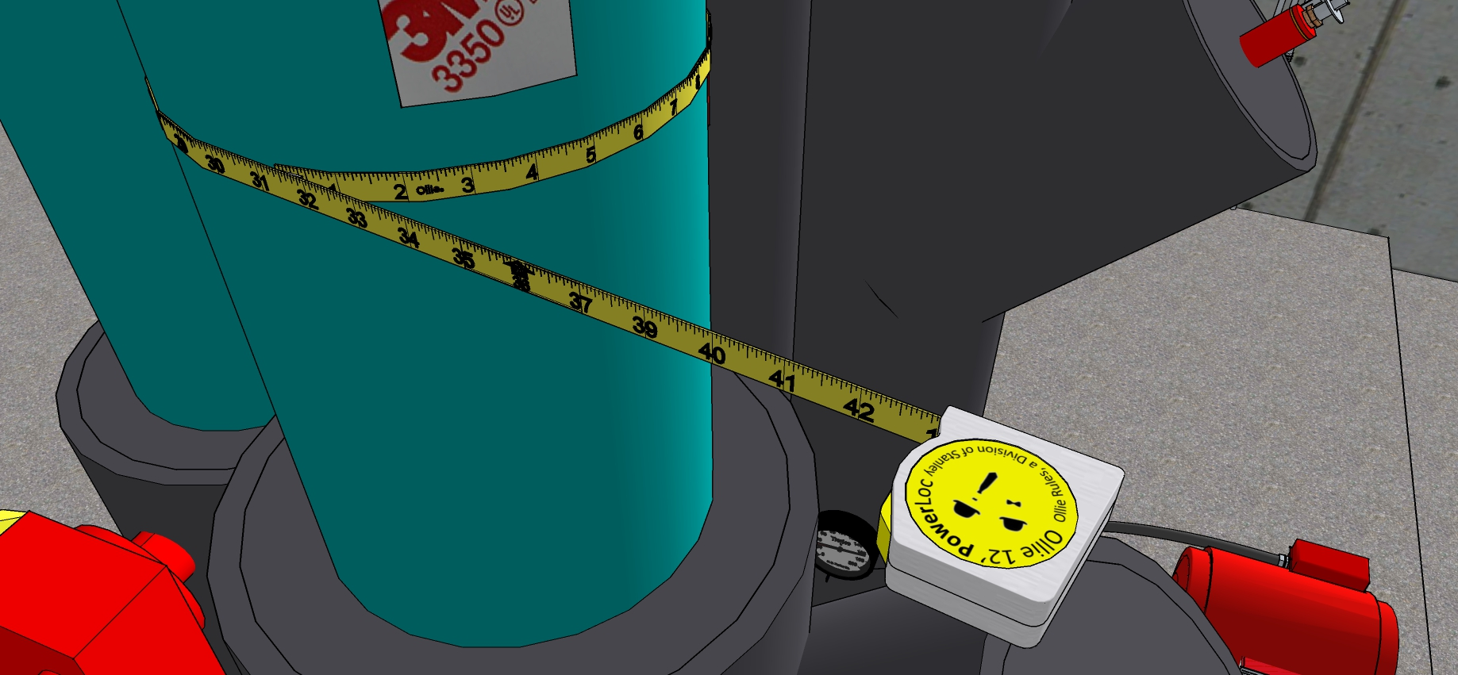
Pipe Diameter from Circumference

Slide 5
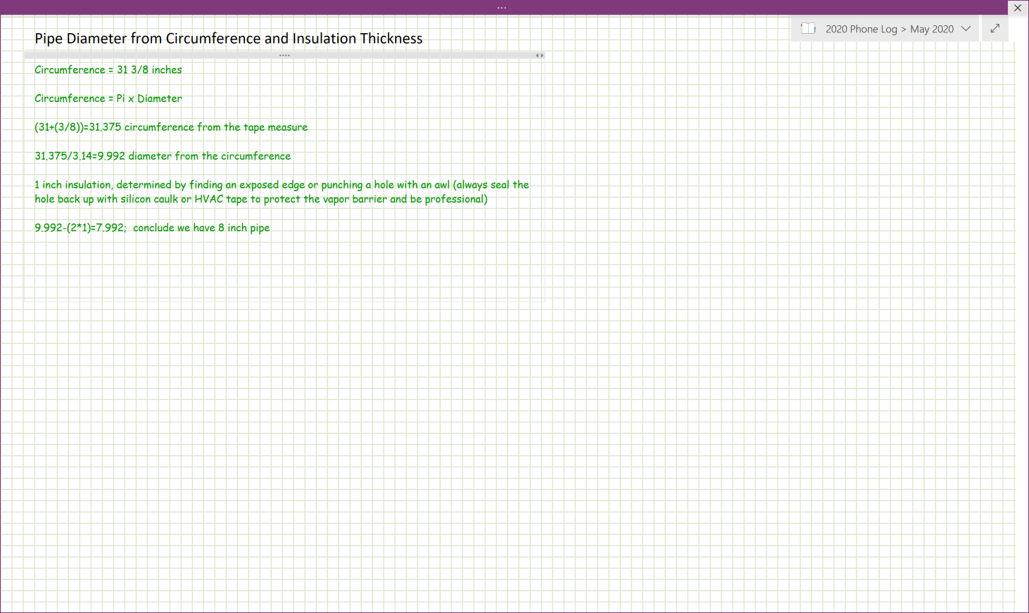
Pipe Diameter from Circumference

Slide 6
Pump Power Equation

Slide 7
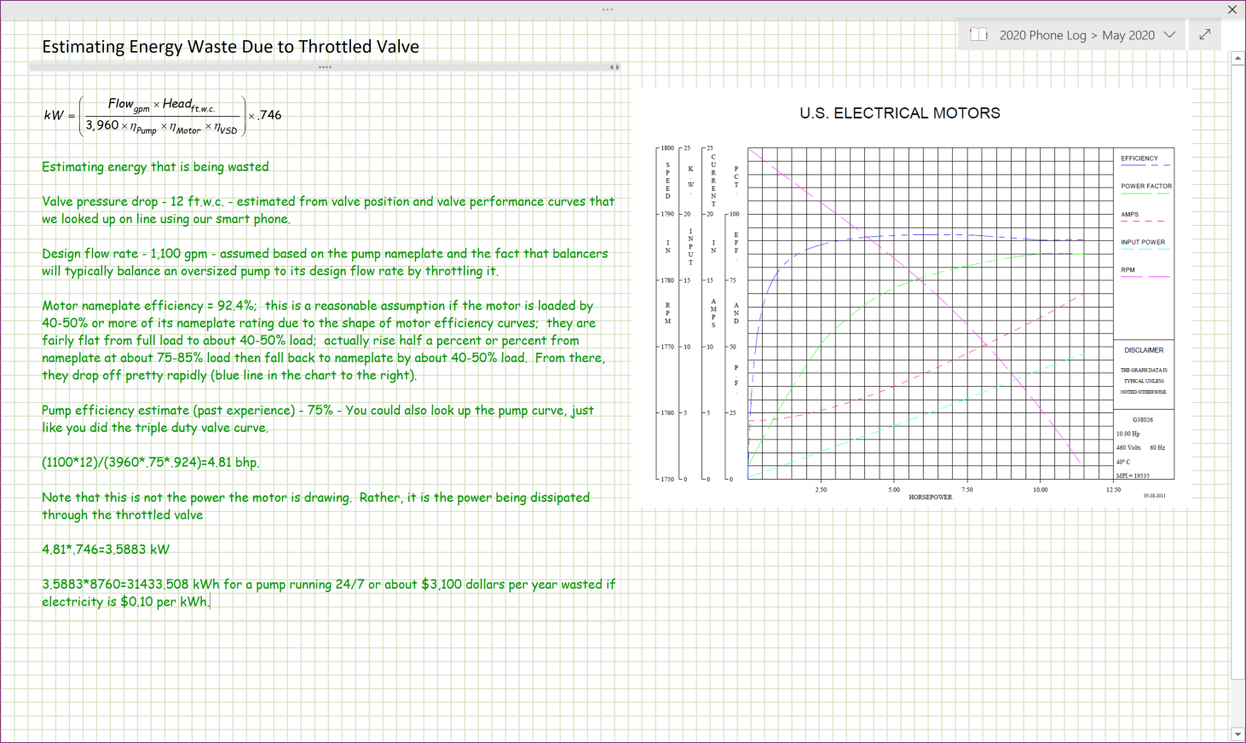

Slide 8
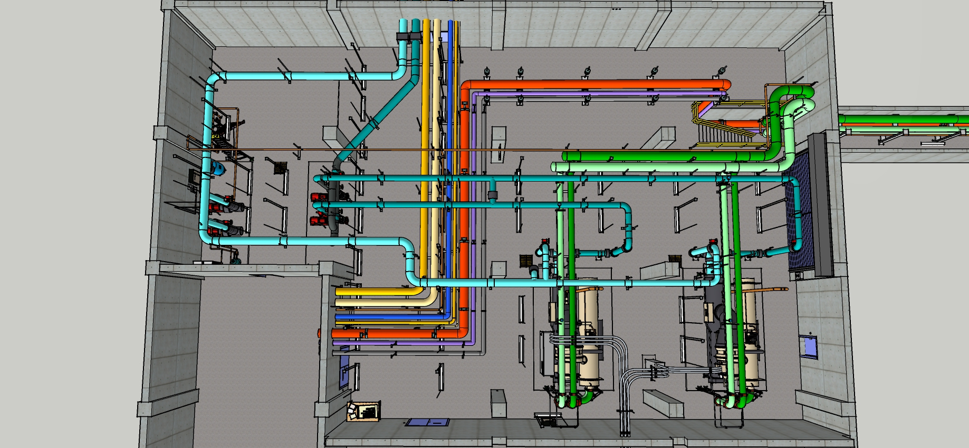
Some Dimensions
25’ Center Lines
20’ Center Lines

Slide 9
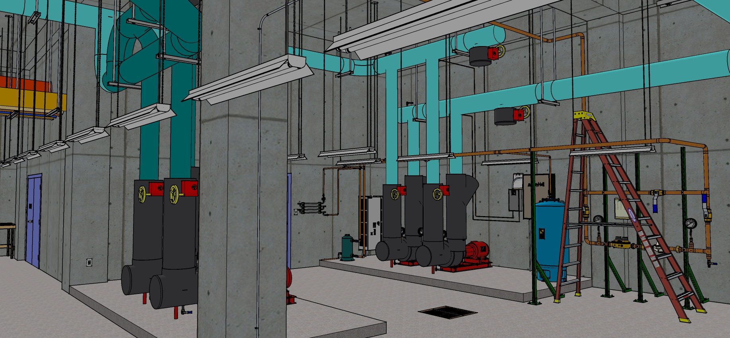
Some Dimensions
18’ Slab to bottom of slab above

Slide 10
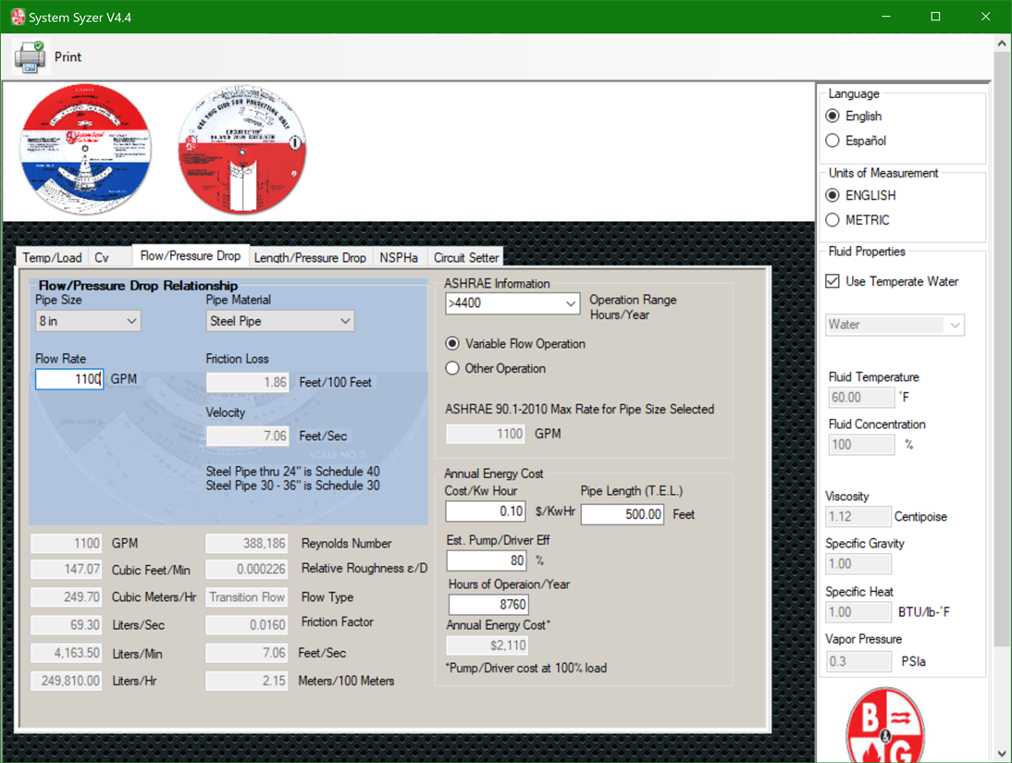
A Few Friction Factors
8 inch pipe at the design flow rate

Slide 11

A Few Friction Factors
8 inch pipe at the maximum recommended velocity (10 ft/sec)

Slide 12

A Few Friction Factors
8 inch pipe at the maximum recommended friction rate (4 ftwc/100 ft)

Slide 13
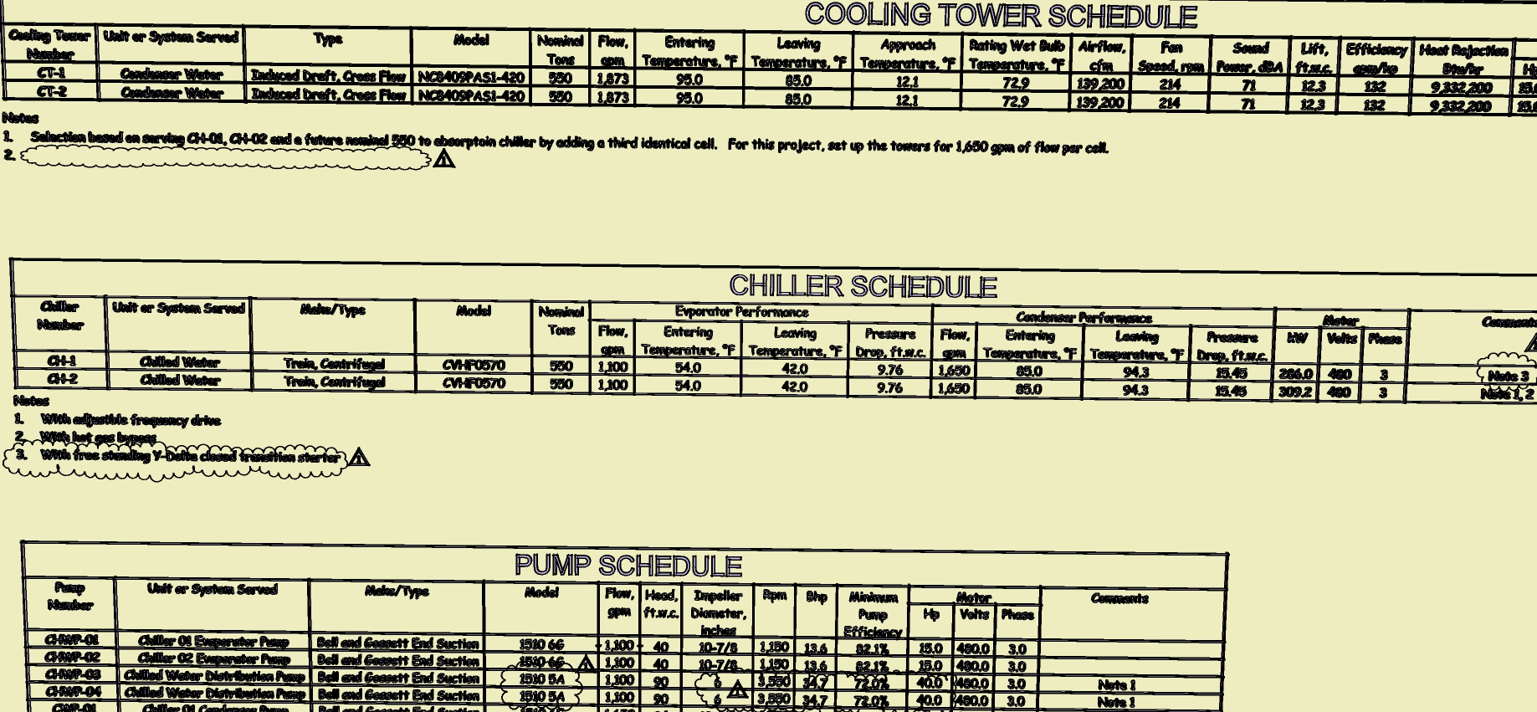
Some Chiller Data

Slide 14
Some Chiller Data

Slide 15
A Few Rules of Thumb
If you know the linear feet of pipe, if you multiply that by a factor of 1.5 to 2.0, you will end up with a number representing the equivalent feet of pipe for HVAC systems that includes things like the valves, fittings, etc.
Use engineering judgement
  Straight run with no fittings = multiplier of 1.0
  A run with a few fittings = multiplier of 1.5
  A run with a significant number of fittings = multiplier of 2.0
  A run with a crazy number of fittings = multiplier in excess of 2.0
  Remember, its an estimate, not an exactimate

Slide 16
Pump Head Estimate

Slide 17
System Curves from the Square Law (Slide 22)

Slide 18
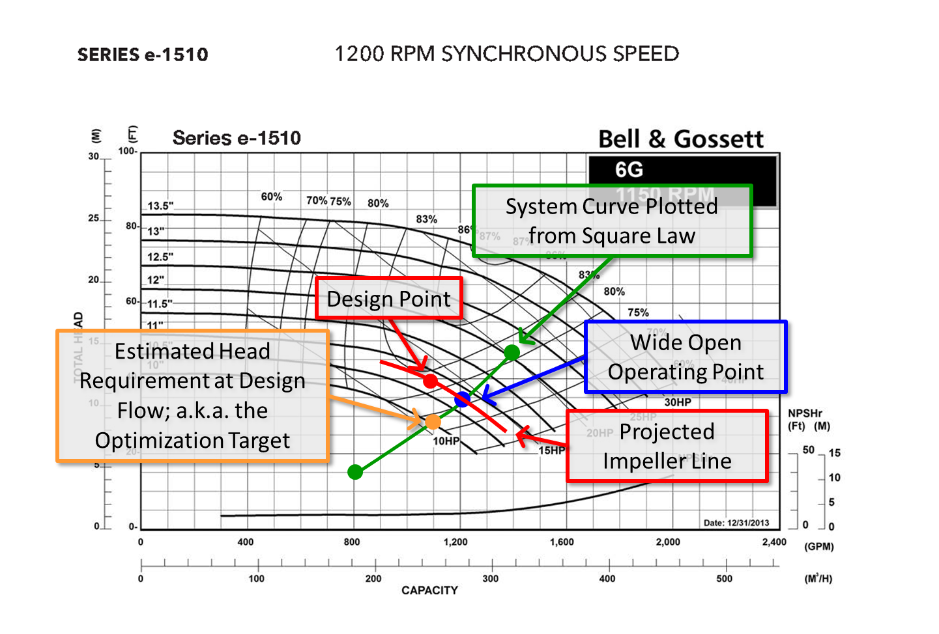
System Curves on Pump Curves

Slide 19
The Pump Curve

Slide 20
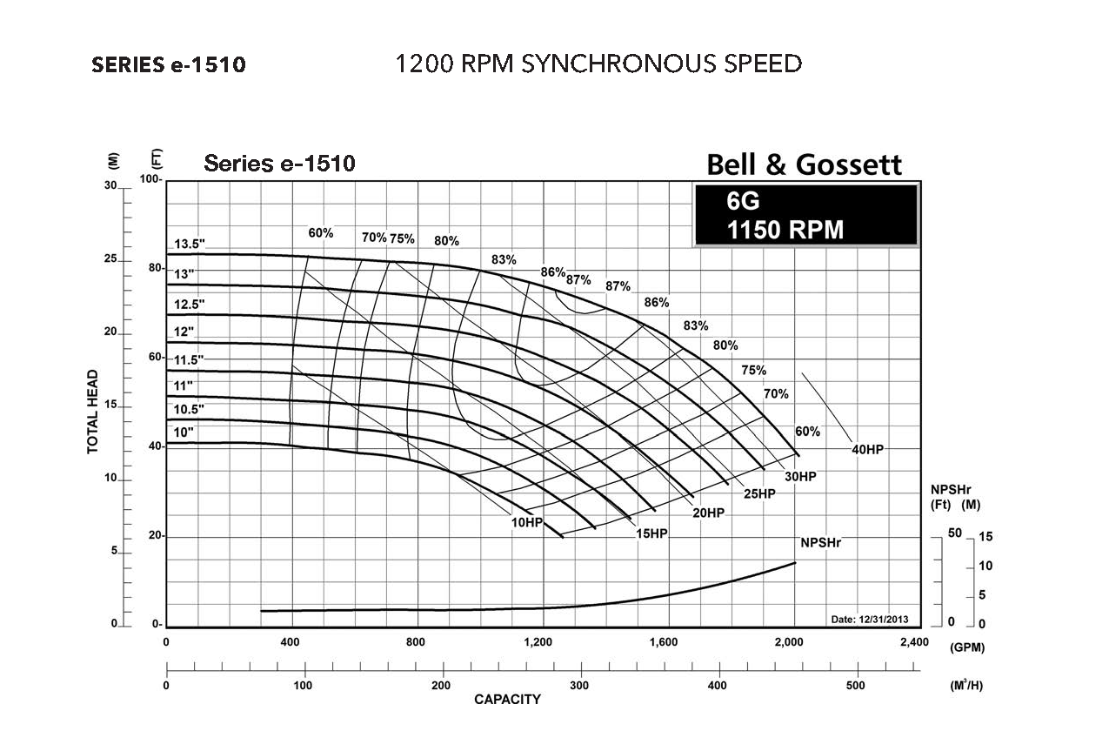

Slide 21
The System Curve

Slide 22
The System Curve

Slide 23
Pump Test Results

Slide 24
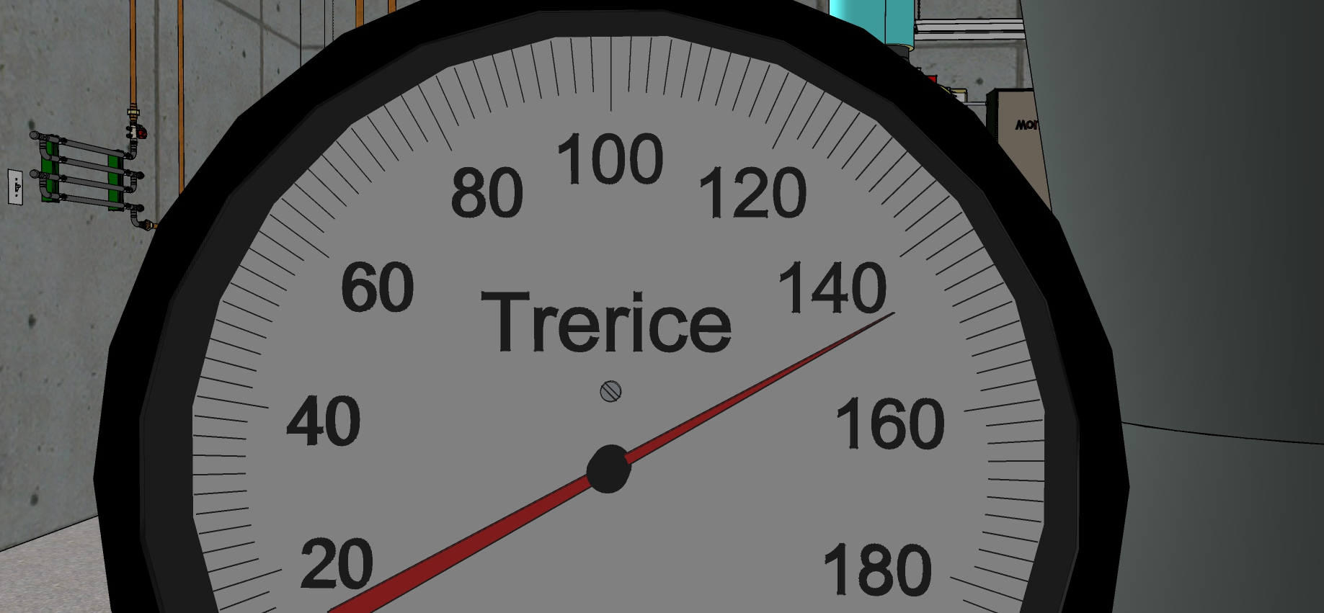
Pump Test Results
Suction Pressure

Slide 25
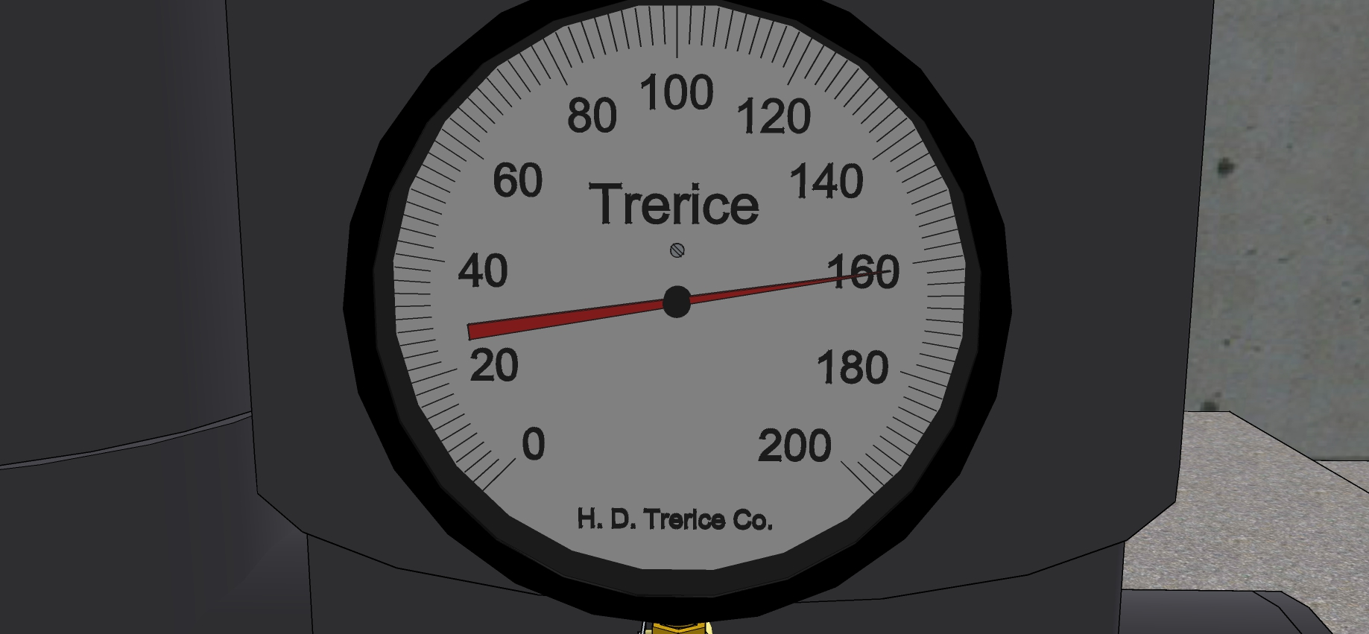
Pump Test Results
Discharge Pressure

Slide 26
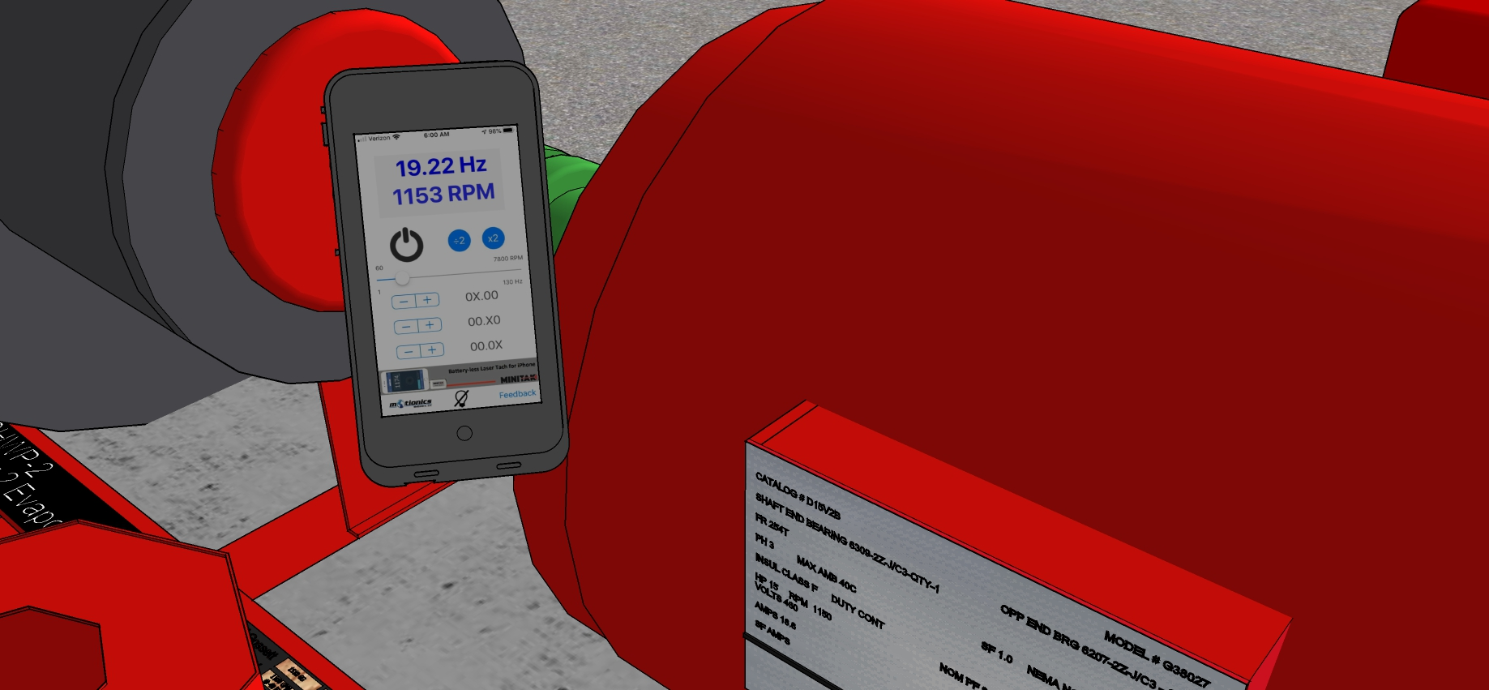
Pump Test Results
Speed

Slide 27
Motor Slip vs Load

