Slide 1
2020 RCx Academy Week 6 Office Hours Challenge
10 June 2020

Slide 2
Consider the Zone Level Scheduling Option for the Ball Room
Given the images that follow and what you have learned consider how you might go about implementing zone level scheduling for the Ball Room AHU
How could it be accomplished?
What modifications would need to be made to the system?
Where would energy be saved?
What control system modifications would be required?
How would the new operating conditions impact the economizer?

Slide 3
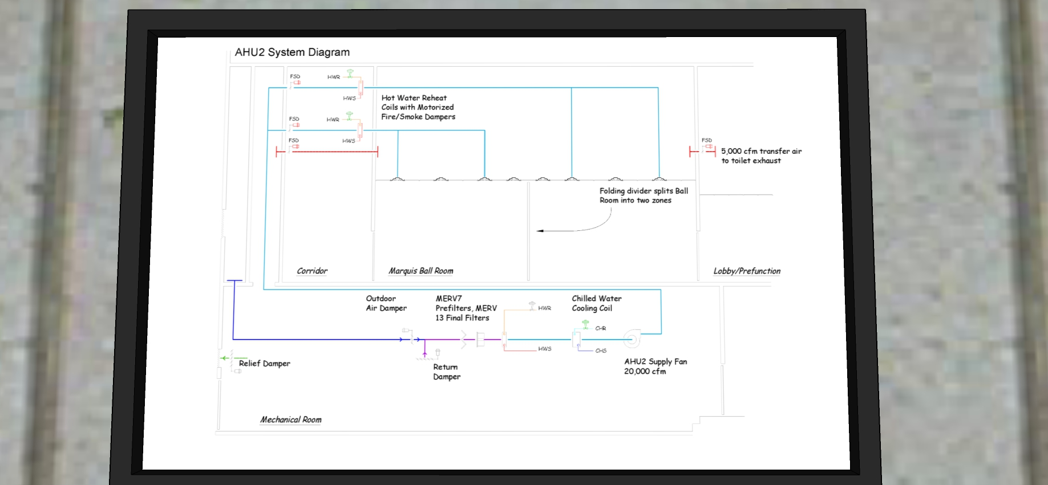
System Diagram

Slide 4
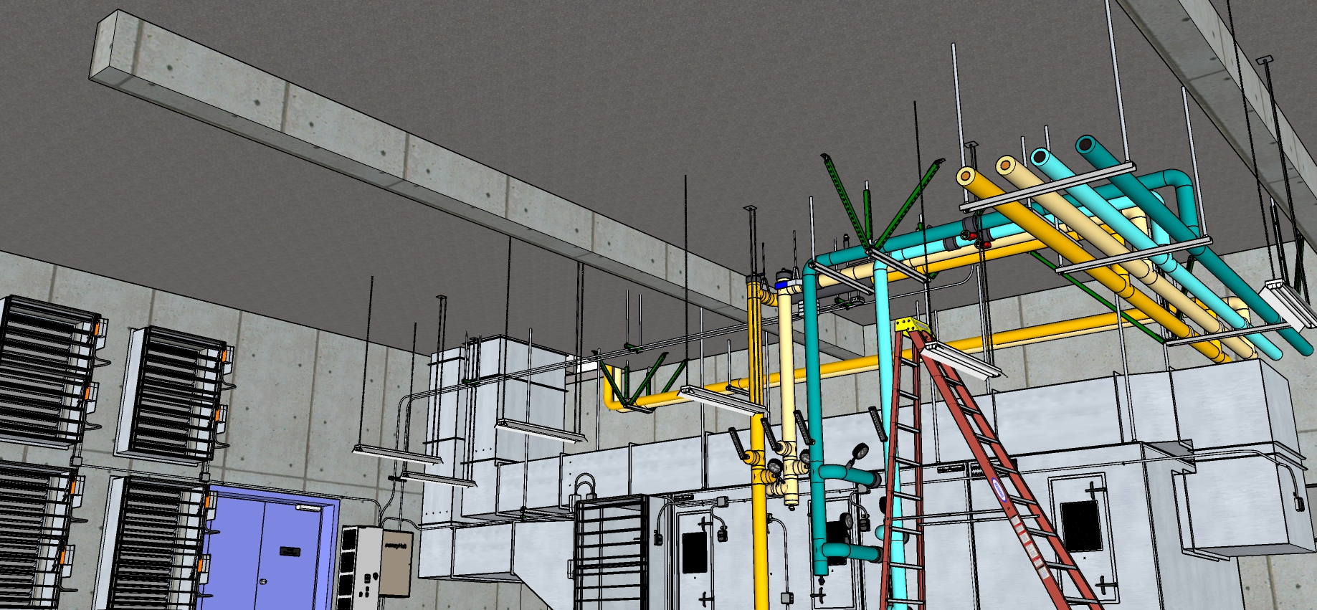
AHU Overview

Slide 5
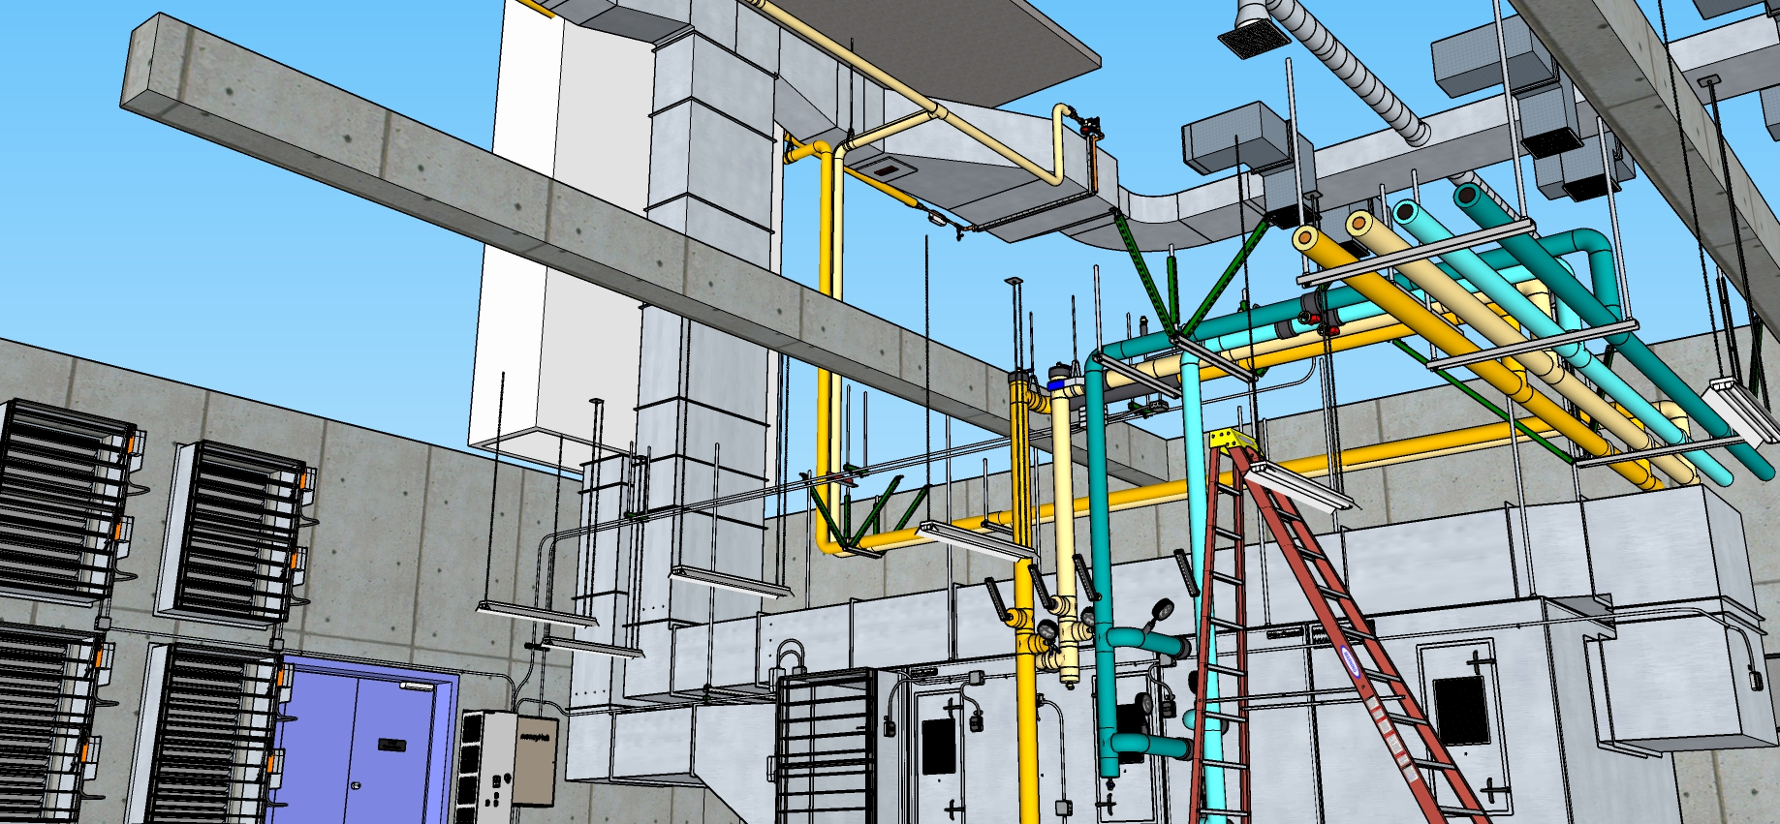
System Overview

Slide 6
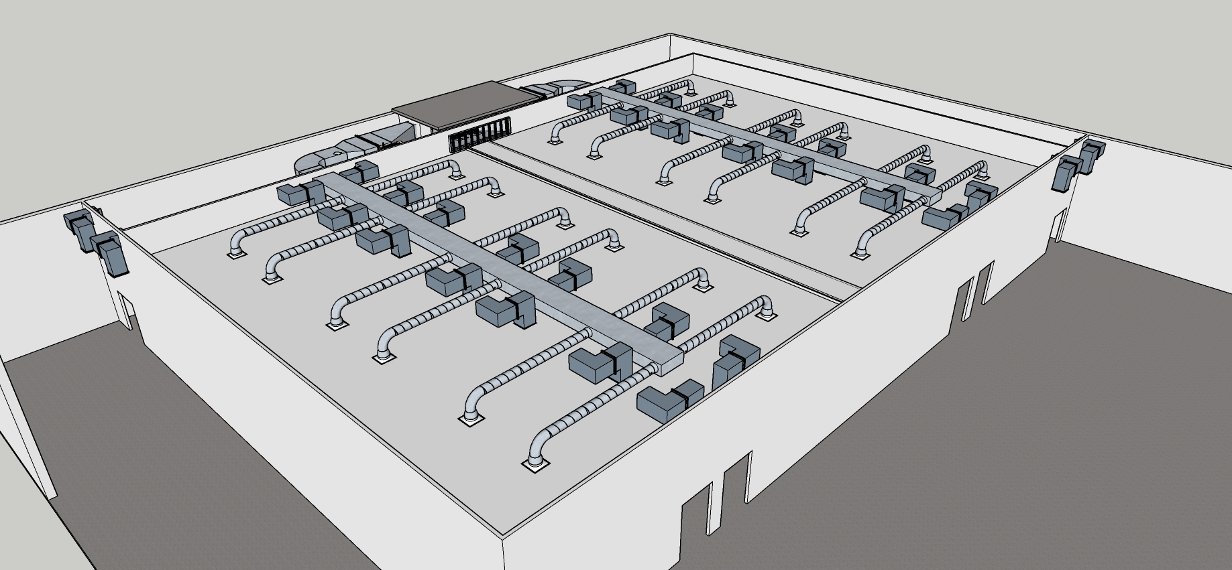
Ball Room Overview

Slide 7
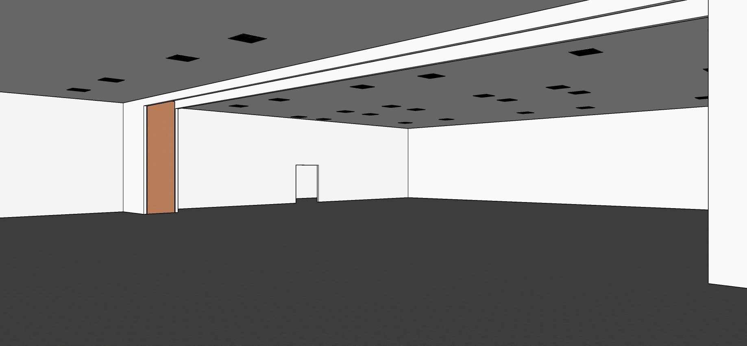
Inside the Ball Room

Slide 8
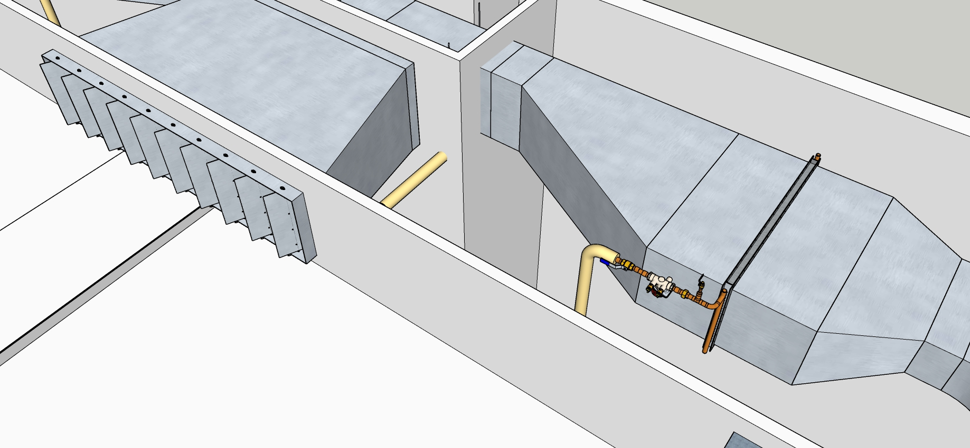
Typical Reheat Coil

Slide 9
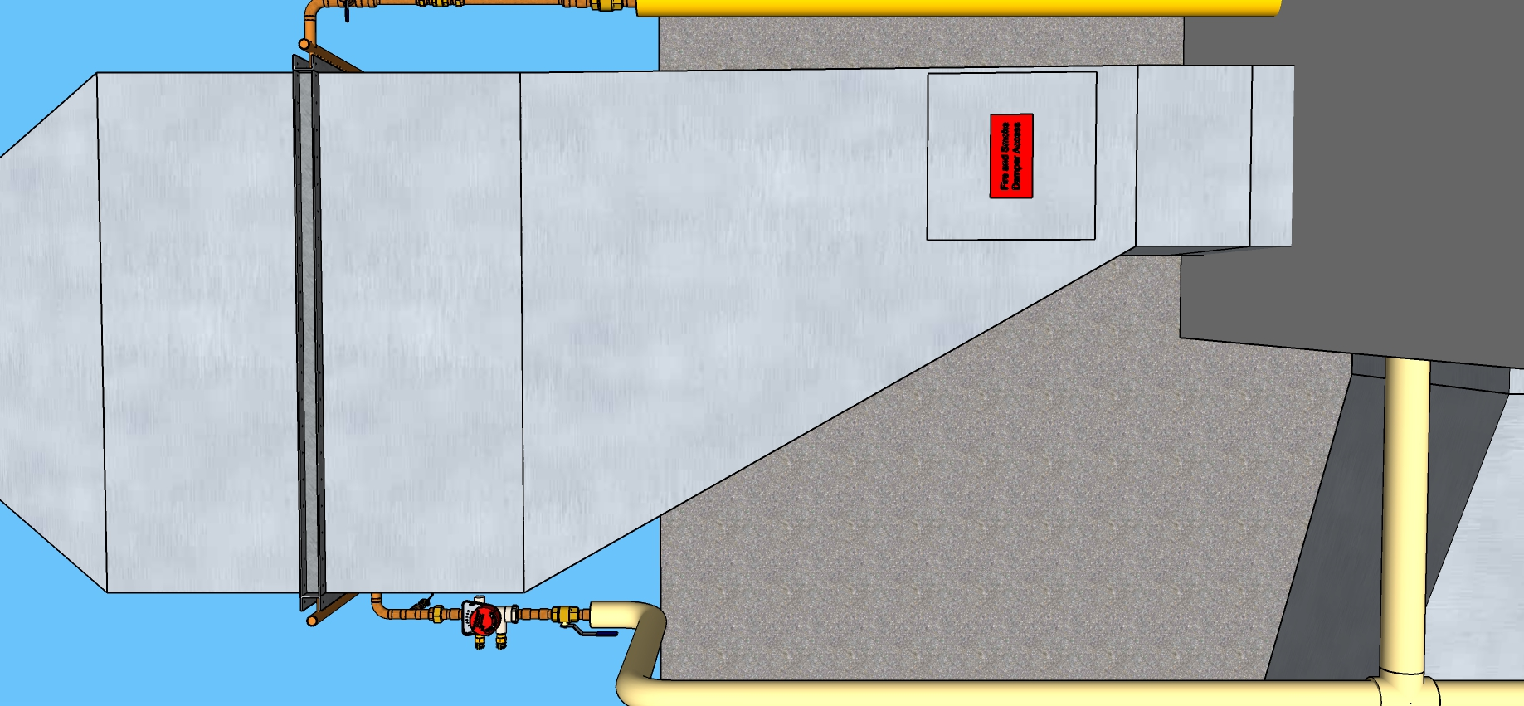
Typical Reheat Coil

Slide 10
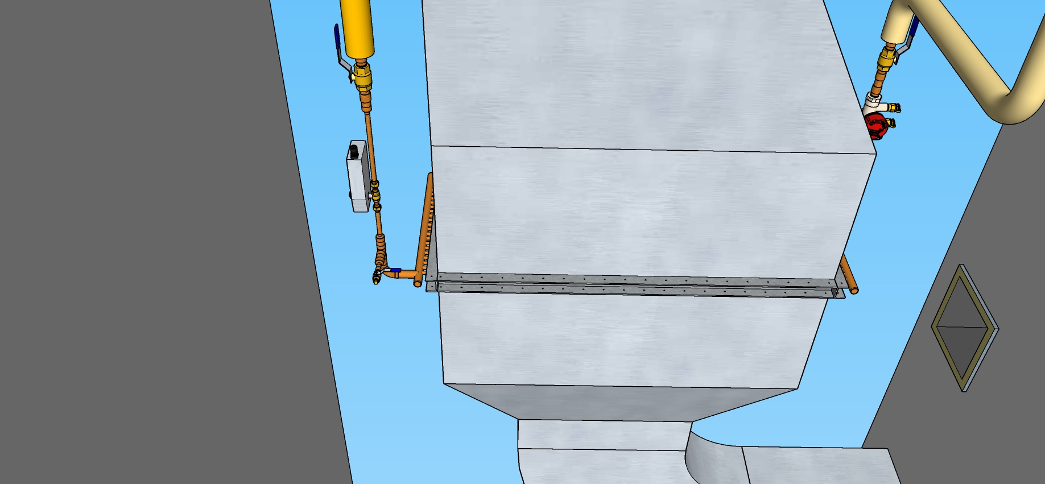
Typical Reheat Coil

Slide 11
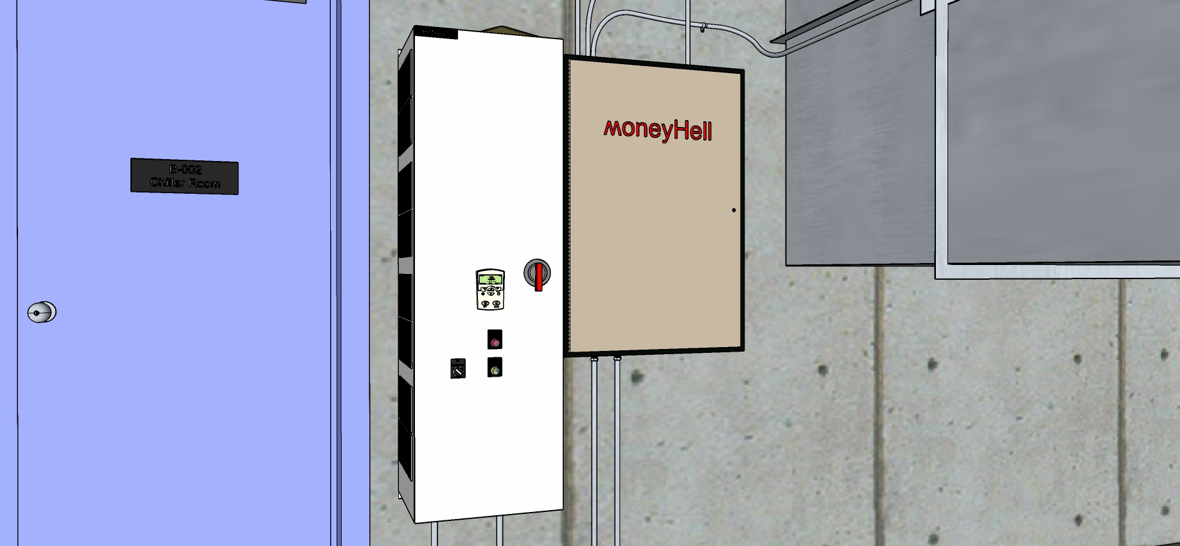
VSD

Slide 12
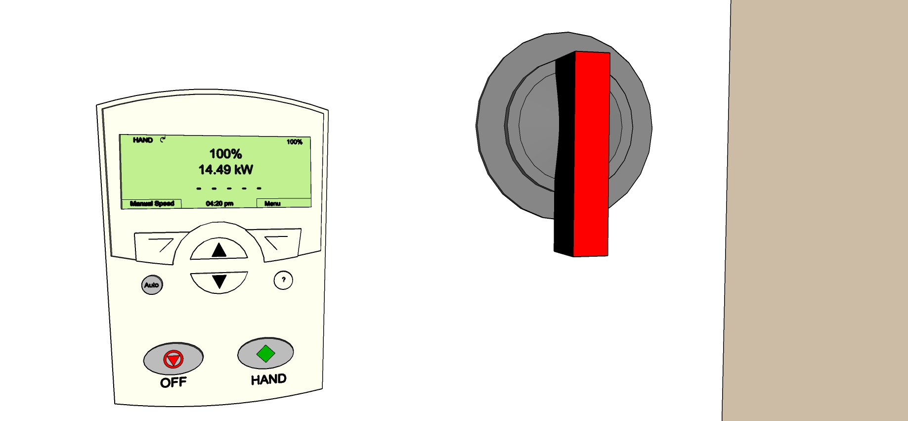
VSD

Slide 13
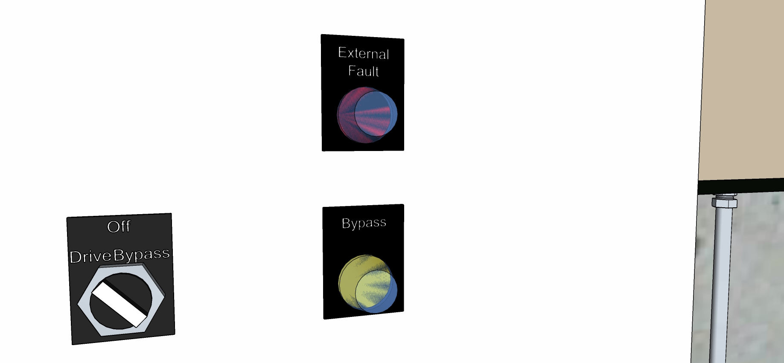
VSD

