Slide 1

Existing Building Commissioning Workshop: Series 17, April 13, 2022 Session
Introduction to Proportional + Integral + Derivative (PID) Control
Presented By:
David Sellers
Senior Engineer, Facility Dynamics Engineering

Slide 2
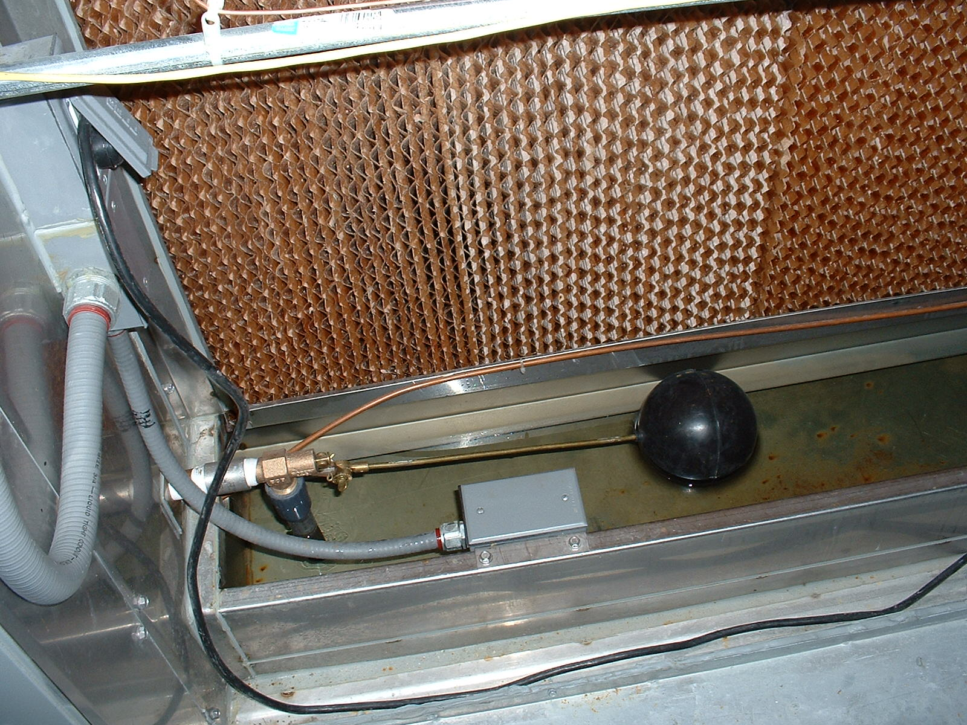
A Simple Analog Control System
Set Point and Throttling Range Adjustments
Sensor
Final Control Element
Feedback Mechanism

Slide 3
A Simple Control Requirement
The make up valve is the device to be controlled; a.k.a. the Controlled Variable or Final Control Element
Notes:
Development 2

Slide 4
A Simple Control Requirement
The tank water level is the Process Variable
The desired level becomes the Set Point
Set Point
Notes:
Development 2

Slide 5
A Simple Proportional Control System
The valve handle and linkage is the Actuation System
The lever arms and the pivot point are the controller
The float is the Sensor
Set Point
Notes:
Development 2

Slide 6
A Simple Proportional Control System
The linkage system makes the water level proportional to the amount the control valve is opened
Set Point
Notes:
Development 2

Slide 7
A Simple Proportional Control System
The ratio of the lever arms on each side of the fulcrum sets the proportional band and gain the of the control system
Set Point
Notes:
Development 2

Slide 8
A Simple Proportional Control System
The proportional band is the change in the process variable that causes the controlled variable to go through its full range
Set Point
Control Point
As long as the demand does not exceed the capacity of the delivery system (i.e. steady state can be achieved inside the proportional band) the system will be under control
Notes:
Development 2

Slide 9
A Simple Proportional Control System
By its nature, a proportional control system will always have a difference or “error” between the set point and the control point except at one specific condition
Set Point
Error
Control Point
Notes:
Development 2

Slide 10
A Simple Proportional Control System
We could reduce the error by increasing the gain of the controller (making it more sensitive to a level change in this case) …
Set Point
Control Point
Notes:
Development 2

Slide 11
A Simple Proportional Control System
… but at some point, feedback from the process would interact with the control loop in a way that would make it unstable
Set Point
Control Point
Notes:
Development 2

Slide 12
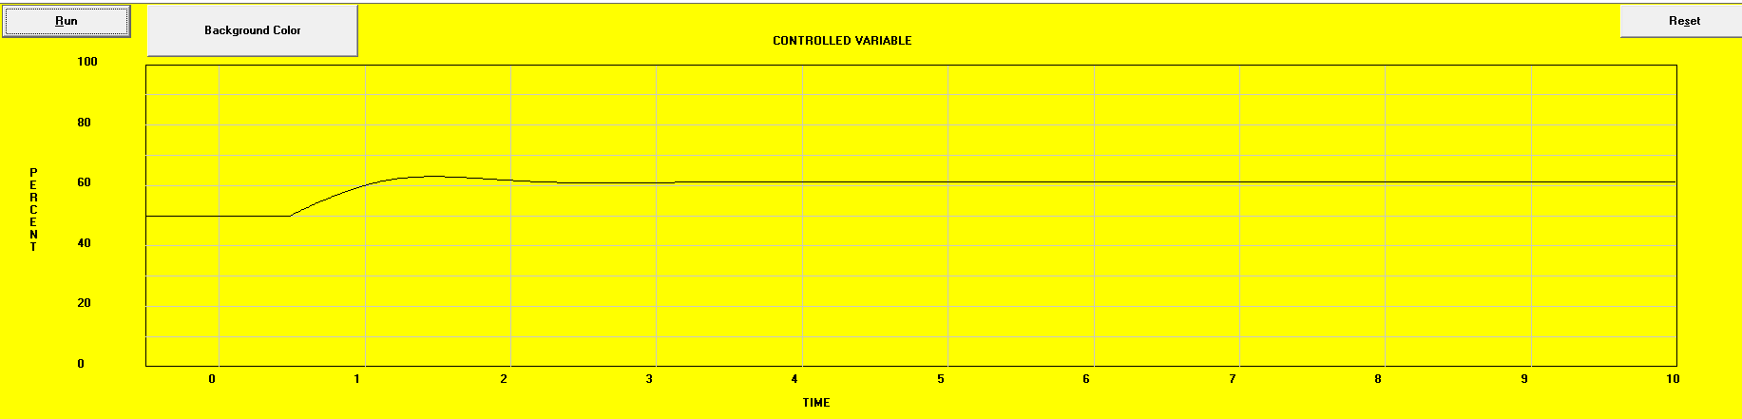
The Impact of Narrowing Throttling Range
Proportional band =400% and set point changed to 80% (black line)
Significant error between the control point and set point
Set point changed to 80%

Slide 13
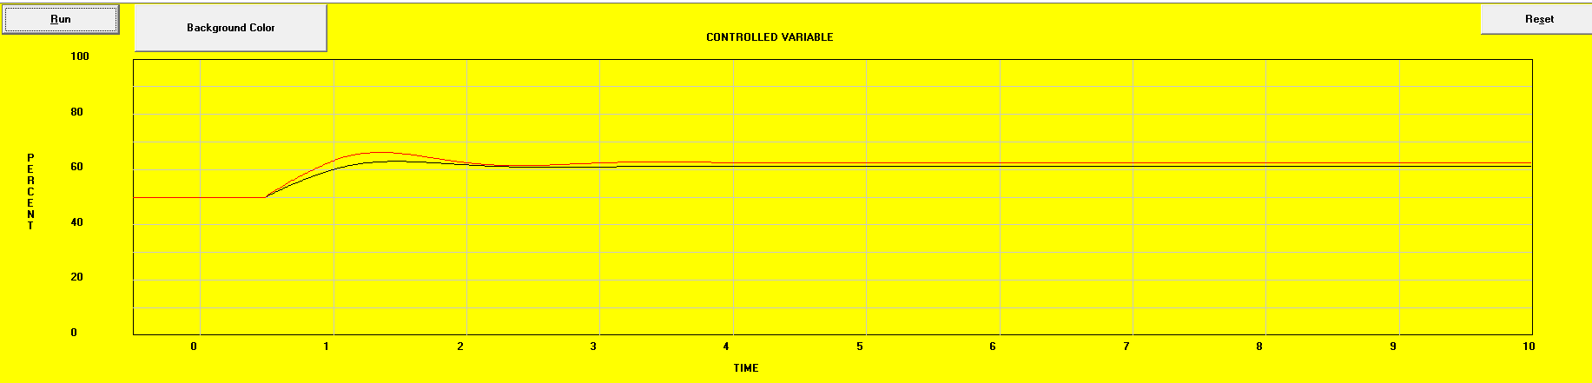
The Impact of Narrowing Throttling Range
Proportional band =400% (black line)
Proportional band =300% and set point changed to 80% (red line)
Error between the control point and set point is reduced
Set point changed to 80%

Slide 14
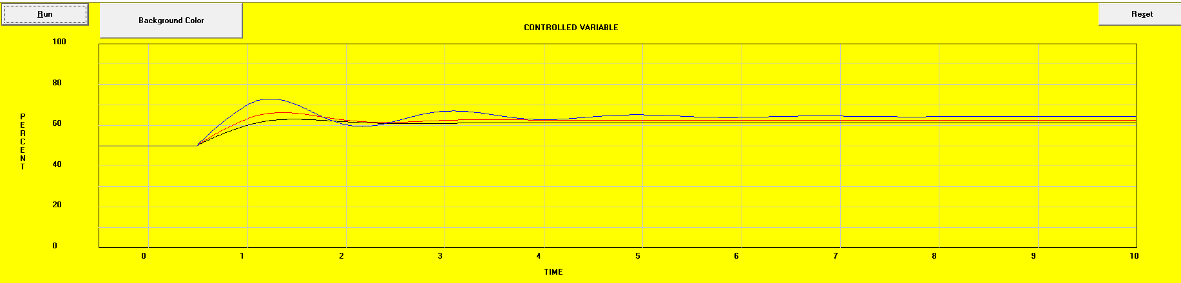
The Impact of Narrowing Throttling Range
Proportional band =400% (black line)
Proportional band =300% (red line)
Proportional band =200% and set point changed to 80% (blue line)
Signs of instability and hunting emerge
Error between the control point and set point is further reduced
Set point changed to 80%

Slide 15

The Impact of Narrowing Throttling Range
Proportional band =400% (black line)
Proportional band =300% (red line)
Proportional band =200% (blue line)
Proportional band =150% and set point changed to 80% (gray line)
The system begins to resonate at it’s natural frequency (hunting begins)
Set point changed to 80%

Slide 16

The Impact of Narrowing Throttling Range
Proportional band =400% (black line)
Proportional band =300% (red line)
Proportional band =200% (blue line)
Proportional band =150% (gray line)
Proportional band =100% and set point changed to 80% (second black line)
The system becomes dynamically unstable
Set point changed to 80%

Slide 17
Bottom Lines On Proportional Control
All proportional control processes will show a difference between set point and control point (a.k.a. error) under all operating conditions other than one very specific condition
The error can be reduced by narrowing down the throttling range
There is a limit to how much you can narrow the throttling range with out hunting
The limit is a function of the physics of the control system; things like lags, play in the linkage system, the nature of the process, etc.

Slide 18
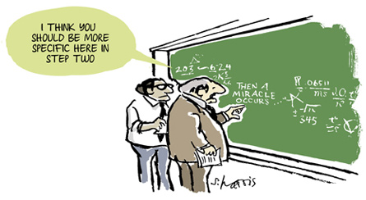
Then a Miracle Occurs
Image from http://www.sciencecartoonsplus.com/pages/gallery.php
Notes:
http://www.sciencecartoonsplus.com/pages/gallery.php

Slide 19
Proportional plus Integral plus Derivative Control (PID)
PID is the Miracle that can:
  Eliminate error
  Reduce the magnitude of a spike when a system is upset
  Reduce the settling time after an upset

Slide 20
A Simple Proportional Control System
Eliminating Proportional Error;
Becomes Less Simple
By its nature, a proportional control system will always have a difference or “error” between the set point and the control point except at one specific condition
Set Point
Error
Control Point
Notes:
Development 2

Slide 21
A Simple Proportional Control System
Eliminating Proportional Error;
Becomes Less Simple
If the system has capacity beyond the current operating requirement, and the error had persisted for a while, the operator could adjust the float to eliminate the error at the current load condition
Set Point
Control Point
Notes:
Development 2

Slide 22
A Simple Proportional Control System
Eliminating Proportional Error;
Becomes Less Simple
If the system has capacity beyond the current operating requirement, and the error had persisted for a while, the operator could adjust the float to eliminate the error at the current load condition
Set Point
Control Point
Notes:
Development 2

Slide 23
A Simple Proportional Control System
Eliminating Proportional Error;
Becomes Less Simple
By monitoring the error over time, the operator could adjust the float setting so that it always maintained the desired set point
Set Point =
Control Point
Notes:
Development 2

Slide 24
A Simple Proportional Control System
Eliminating Proportional Error;
Becomes Less Simple
This is what the Integral function in a Proportional plus Integral plus Derivative control loop does
Set Point =
Control Point
Notes:
Development 2

Slide 25
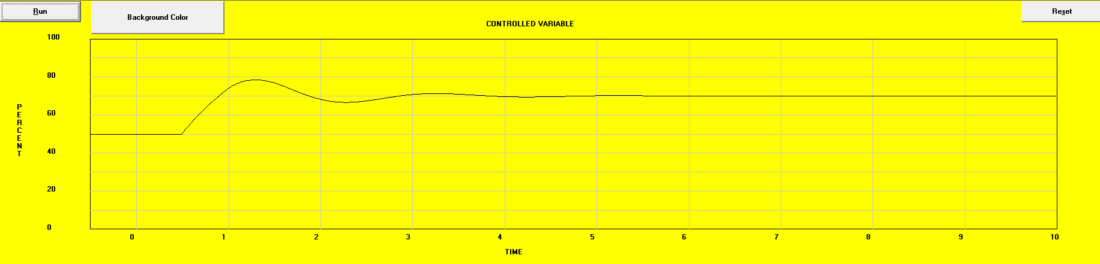
The Impact of Adding Integral Gain
Note error between the control point and set point
Proportional only response; 250% proportional band
Set point changed to 80%

Slide 26
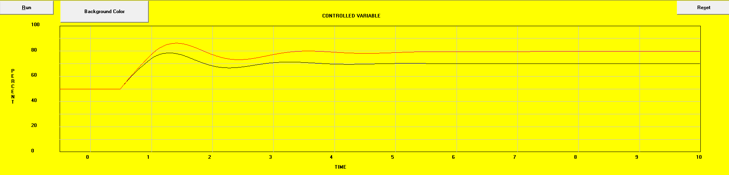
The Impact of Adding Integral Gain
Error eliminated!
Proportional only response; 250% proportional band
Proportional + Integral response; 250% proportional band, Integral time = 2 minutes
Set point changed to 80%

Slide 27
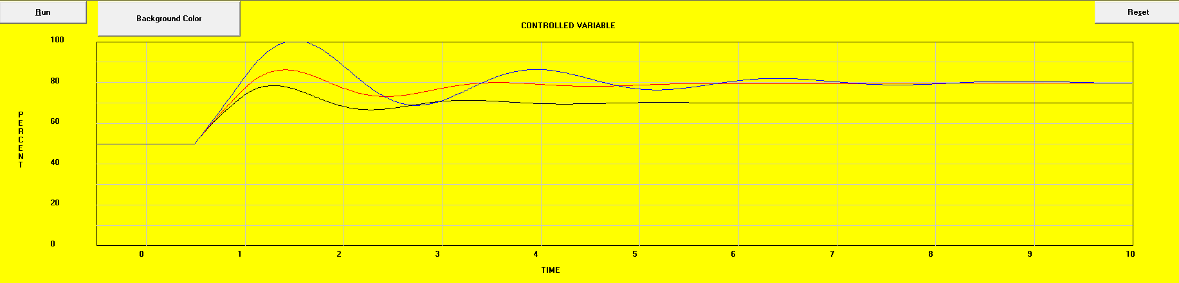
The Impact of Adding Integral Gain
Proportional + Integral response; 250% proportional band, Integral time = 0.75 minutes
Signs of instability and hunting emerge
Proportional only response; 250% proportional band
Proportional + Integral response; 250% proportional band, Integral time = 2 minutes
Set point changed to 80%

Slide 28
A Simple Proportional Control System
Eliminating Proportional Error;
Becomes Less Simple
Similarly, the operator could monitor the process and if he or she saw the error start to rapidly change relative to time, they could quickly push the float up or down to minimize the deviation from set point
Set Point =
Control Point
Notes:
Development 2

Slide 29
A Simple Proportional Control System
Eliminating Proportional Error;
Becomes Less Simple
Once the sudden change is over the operator could reset the float to match the current load condition and maintain the required set point
Set Point =
Control Point
Notes:
Development 2

Slide 30
A Simple Proportional Control System
Eliminating Proportional Error;
Becomes Less Simple
This is what the Derivative function in a Proportional plus Integral plus Derivative control loop does
Set Point =
Control Point
Notes:
Development 2

Slide 31
The Impact of Adding Derivative Gain
Proportional only response; 250% proportional band
Proportional + Integral response; 250% proportional band, Integral time = 2 minutes
Set point changed to 80%

Slide 32
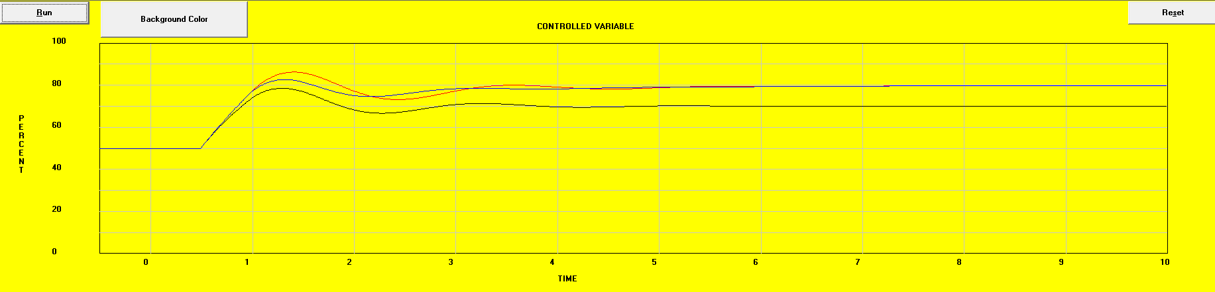
The Impact of Adding Derivative Gain
Proportional + Integral + Derivative response; 250% proportional band, Integral time = 0.75 minutes, Derivative time = 0.1 minutes
Properly applied, derivative reduces the spike at upset and shortens the settling time
Set point changed to 80%

Slide 33
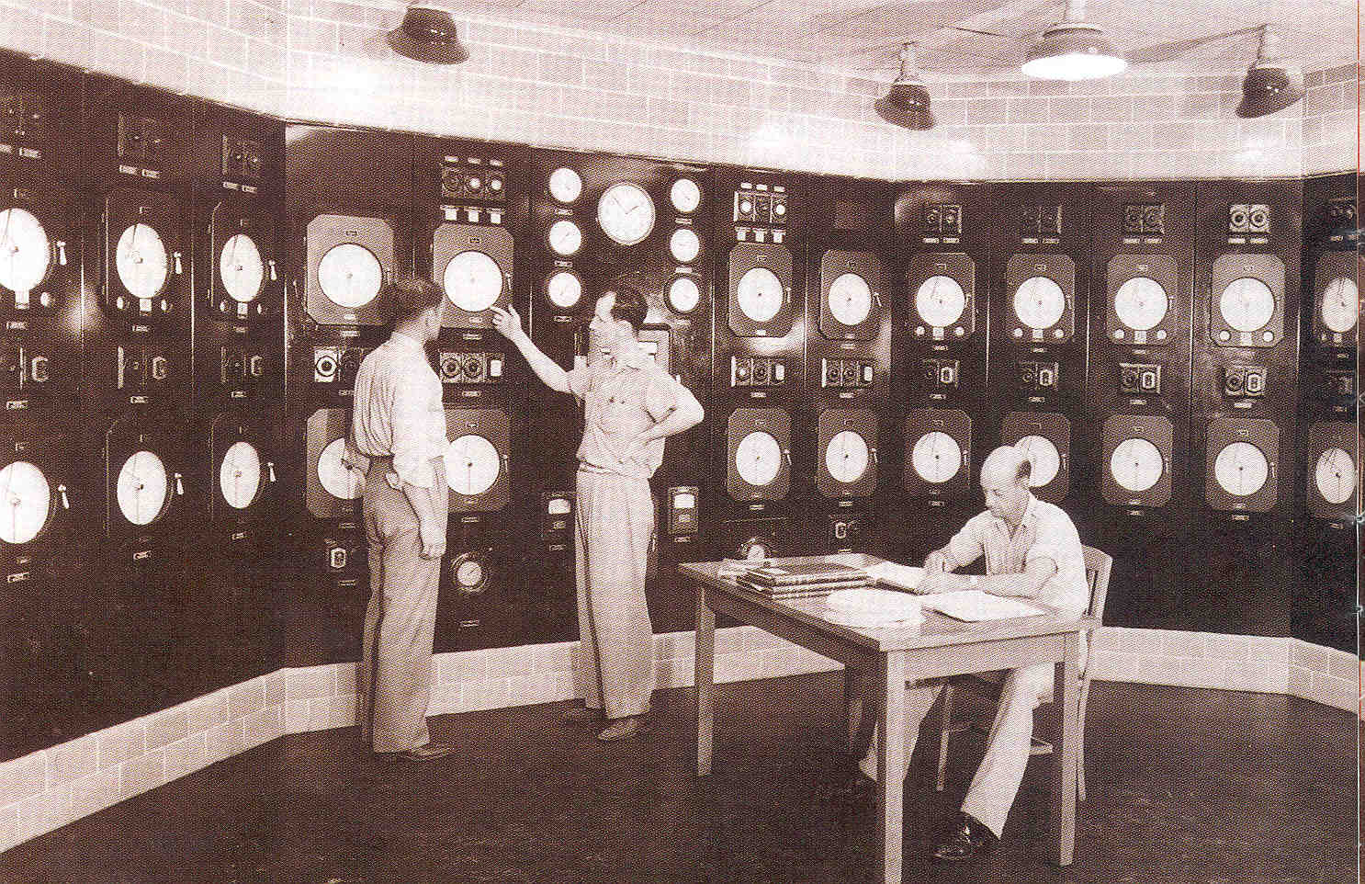
PID; Its Been Around for a While
Image courtesy Control Engineering Magazine
Notes:
Started to show up in the HVAC industry in the late 1970’s
Technology actually developed in the late 1930’s.
Ziegler-Nichols tuning techniques developed in the 1940’s.

Slide 34
PID Good News and Bad News
Good News
Eliminate offset
  Save energy
  Improve precision
Minimize process swings at start-up
Bad News
Not well understood by the HVAC industry
  More difficult to tune and adjust
  More difficult to maintain
Algorithm used varies with the manufacturer
  Tuning solution specifics are not portable
  Auto-tuning is not a panacea
Difficult to apply correctly
Often misapplied

Slide 35
PID; The Math Perspective

Slide 36
Integral Gain;
Minutes per Repeat or Repeats per Minute
P only response
Increasing Output Signal
Proportional only response to the upset
Process upset occurs
1
2
3
Increasing Time
Minutes
Notes:
H F
7.84 8.00
6.00 7.00
3.06 5.00
1.10 3.00
0.49 2.00
0.12 1.00
0.00 0.00

Slide 37
Integral Gain;
Minutes per Repeat or Repeats per Minute
P only response
PI response
Integral response to the upset
Increasing Output Signal
Process upset occurs
1
2
3
Increasing Time
Minutes
Notes:
H F
7.84 8.00
6.00 7.00
3.06 5.00
1.10 3.00
0.49 2.00
0.12 1.00
0.00 0.00

Slide 38
Integral Gain;
Minutes per Repeat or Repeats per Minute
P only response
PI response
Increasing Output Signal
Integral gain of 1 repeat per minute will increases the output by an amount equal to the P only response after one minute
Process upset occurs
1
2
3
Increasing Time
Minutes
Notes:
H F
7.84 8.00
6.00 7.00
3.06 5.00
1.10 3.00
0.49 2.00
0.12 1.00
0.00 0.00

Slide 39
Potential Problems when Adding Integral Action
Loop instability unless a commensurate reduction in proportional gain is made
Tuning and maintenance become more complex, time consuming and difficult
“Wind-up” can occur
  During HVAC system overload conditions.
  During HVAC shut down if not handled appropriately

Slide 40
Derivative Gain is in Minutes
P only response
Increasing Output Signal
Proportional only response to the upset
Process upset occurs
1
2
3
Increasing Time
Minutes
Notes:
H F
7.84 8.00
6.00 7.00
3.06 5.00
1.10 3.00
0.49 2.00
0.12 1.00
0.00 0.00

Slide 41
Derivative Gain is in Minutes
P only response
PD response
Derivative response to the upset
Increasing Output Signal
Process upset occurs
1
2
3
Increasing Time
Minutes
Notes:
H F
7.84 8.00
6.00 7.00
3.06 5.00
1.10 3.00
0.49 2.00
0.12 1.00
0.00 0.00

Slide 42
Derivative Gain is in Minutes
P only response
PI response
Increasing Output Signal
A derivative gain of 1 minute will immediately increases the output by an amount equal to the Integral response after one minute
Process upset occurs
1
2
3
Increasing Time
Minutes
Notes:
H F
7.84 8.00
6.00 7.00
3.06 5.00
1.10 3.00
0.49 2.00
0.12 1.00
0.00 0.00

Slide 43
Derivative Action Is Difficult to Apply
Provides no benefit if there is not enough
Too much can cause many more problems than it is worth
Typically not necessary for HVAC applications
Use it with CAUTION!

Slide 44
PID Controller Tuning
Roots of the process are in Optimum Settings for Automatic Controllers
    John G. Ziegler
    Nathan B. Nichols
    1940
    Ziegler-Nichols Method
Image courtesy Control Engineering Magazine

Slide 45
The Quarter Decay Ratio;
Signature of a Well Tuned PID Loop
Set Point
Process Variable
Increasing Process Variable
Process upset occurs
1
2
3
Increasing Time
Minutes
Notes:
H F
7.84 8.00
6.00 7.00
3.06 5.00
1.10 3.00
0.49 2.00
0.12 1.00
0.00 0.00

Slide 46
The Quarter Decay Ratio;
Signature of a Well Tuned PID Loop
Set Point
This …
Process Variable
… is about 4 times as big as this
Increasing Process Variable
Process upset occurs
1
2
3
Increasing Time
Minutes
Notes:
H F
7.84 8.00
6.00 7.00
3.06 5.00
1.10 3.00
0.49 2.00
0.12 1.00
0.00 0.00

Slide 47
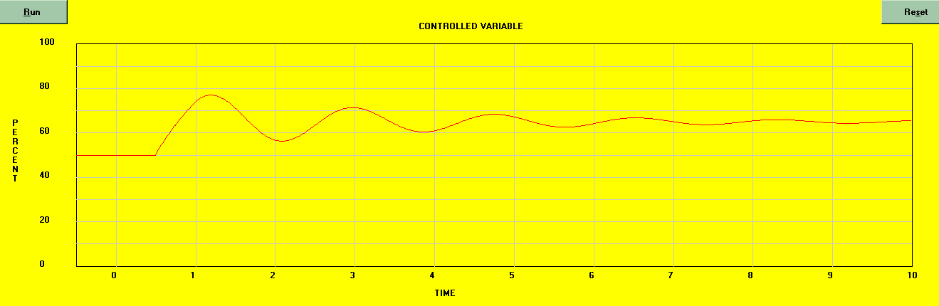
Closed Loop Tuning Method
Natural Period
With the system under automatic control, determine the Natural Period
  Proportional gain = ¼ to ½ of the ultimate gain producing the Natural Period
  Integral time in minutes per repeat = 1.2 times the Natural Period
  Derivative time in minutes = 1/8 of the Natural Period

Slide 48
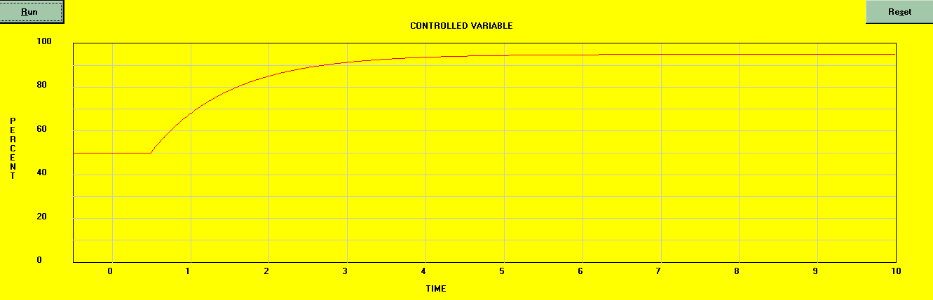
Open Loop Tuning Method
Some processes are self regulating and will level off. Others won’t.
Slope of the response curve after a stable rate of change is established (Rate of change; R)
Apparent dead time (Lag; L)
Point in time when the step change was initiated
Also useful for troubleshooting
With the system under manual control, insert a step change and observe the response curve. Set the controller as follows:
  Proportional gain = 1/(RL) to 1/(2 RL)
  Integral time in minutes per repeat = 5 times the apparent dead time
  Derivative time in minutes = ½ the apparent dead time.

Slide 49
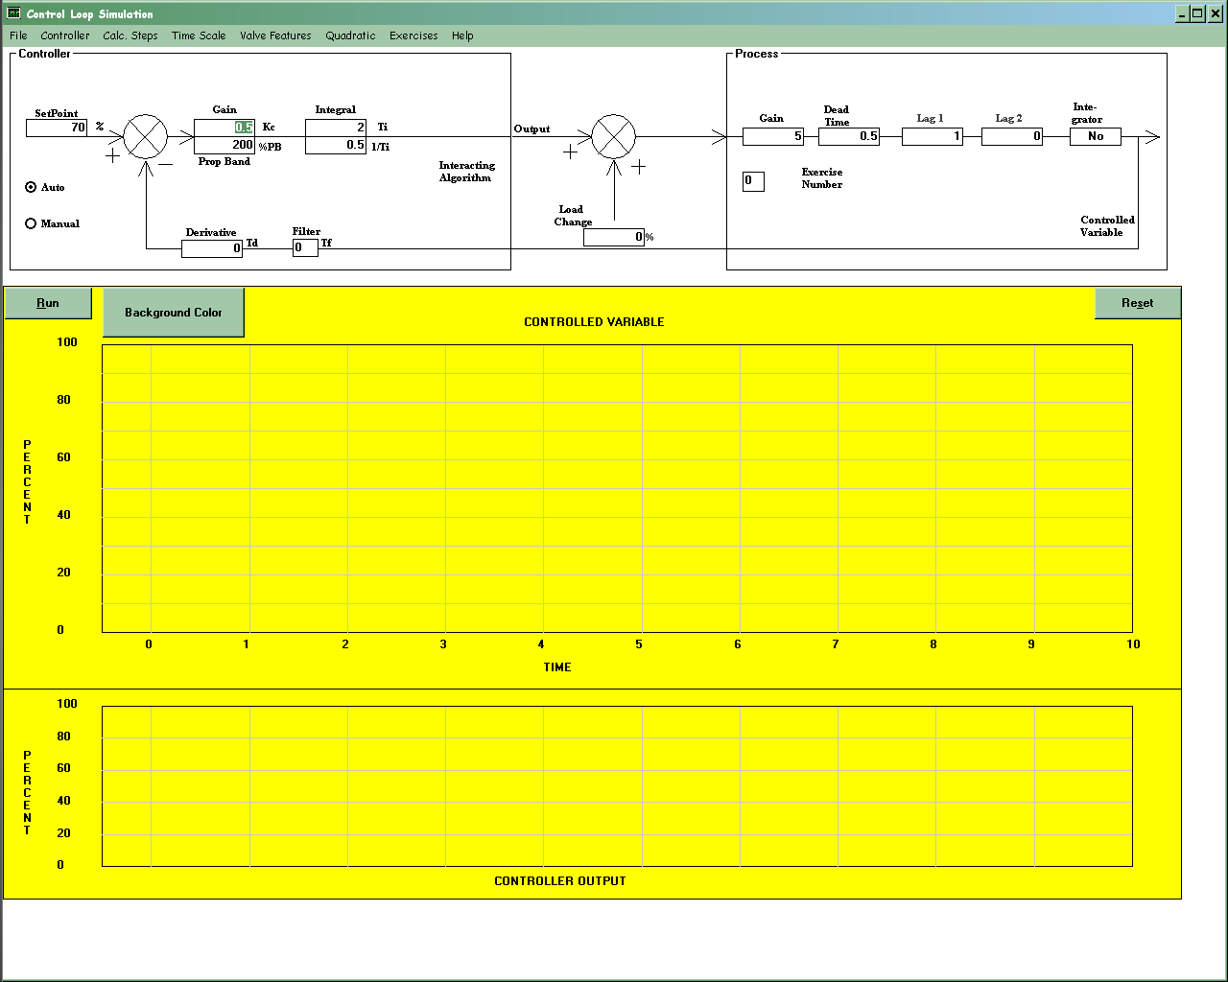
Learning by Doing (But With Out Blowing Something Up)

Slide 50
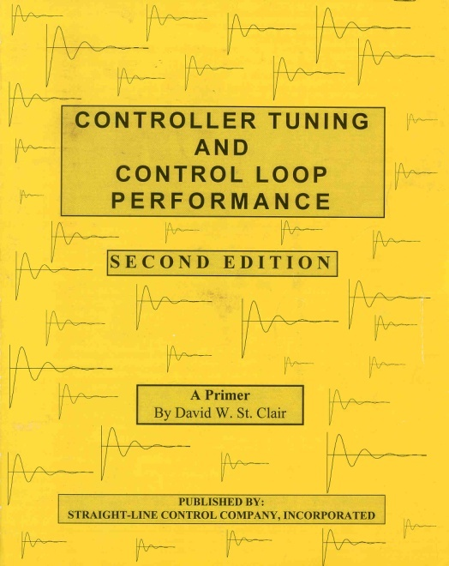
Tuning Resources
Controller Tuning and Control Loop Performance by David W. St. Clair
  Judy St. Clair
  Straight Line Control, LLC
  6326 4th Avenue South
  Richfield, MN 55423
  USA
  Phone:612-869-6814
  Fax: 612-869-2761
  jastclair@pro-ns.net
  http://www.straightlinecontrol.com
Notes:
To order a copy of "Reference Guide to PID Tuning" visit www.controleng.com/info and request number 367 from the August 1998 North American issue of Control Engineering.
Judy St. Clair
Straight Line Control, LLC
6326 4th Avenue South
Richfield, MN 55423
USA
Phone:612-869-6814
Fax: 612-869-2761
jastclair@pro-ns.net
http://www.straightlinecontrol.com

Slide 51
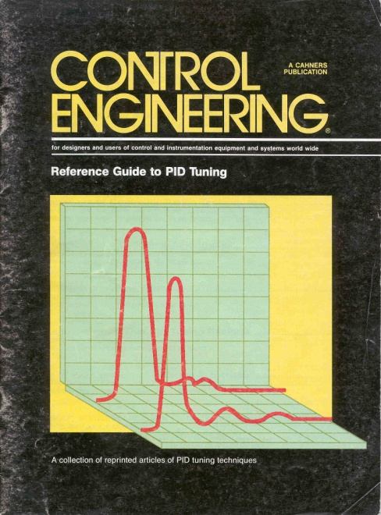
Tuning Resources
Reference Guide to PID Tuning
  Available from the publishers of Control Engineering
  See A Field Perspective on Engineering Blog Post for Links
Notes:
To order a copy of "Reference Guide to PID Tuning" visit www.controleng.com/info and request number 367 from the August 1998 North American issue of Control Engineering.
Judy St. Clair
Straight Line Control, LLC
6326 4th Avenue South
Richfield, MN 55423
USA
Phone:612-869-6814
Fax: 612-869-2761
jastclair@pro-ns.net
http://www.straightlinecontrol.com

Slide 52
Tuning Resources
See An Overview of Proportional plus Integral plus Derivative Control and Suggestions for Its Successful Application and Implementation from the proceedings of the 2001 International Conference on Enhanced Building Operations

Slide 53
The Quarter Decay Ratio;
Signature of a Well Tuned PID Loop
This spike needs to be small enough to not break something
Set Point
Process Variable
Increasing Process Variable
This settling time needs to be reasonable in the context of the load served by the process
Process upset occurs
1
2
3
Increasing Time
Minutes
Notes:
H F
7.84 8.00
6.00 7.00
3.06 5.00
1.10 3.00
0.49 2.00
0.12 1.00
0.00 0.00

Slide 54
It All Depends on the Lags
David W. St. Clair

Slide 55
Lags and the Response to a Set Point Change
The valve plug needs to move
The controller has to react to the change
The actuator linkage has to move through any “play” that exists
Steam needs to flow into the heat exchanger
A volume of air needs to move through the line and fill the actuator
The mass of the sensor and well needs to change temperature
The warmer water needs to move to the sensor location
The thermal mass of the heat exchanger and water needs to change temperature
Notes:
The warmer water needs to move to the sensor location

Slide 56
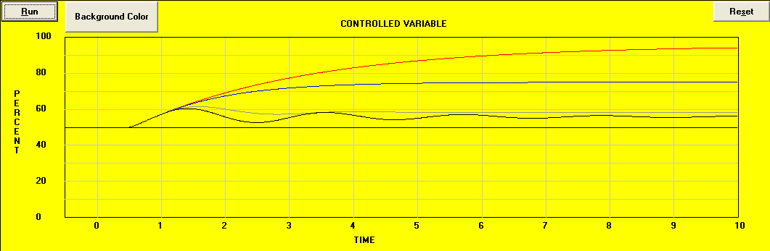
Some Observations
Red to Black is the control system response with increasing gains applied to the controller until the natural period is identified

Slide 57
Some Observations
Natural period P_{N}
Apparent dead time (Lag; L)

Slide 58
Some Observations
1
2
3
4
The Natural Period is about 4 times the Apparent Dead Time

Slide 59
Some Observations
The deviation from set point upon an upset with tightly tuned control loop (gray line) is about the same as a totally un-tuned loop (red line) at a point in time equal to about half the natural period

Slide 60
Some Observations
A tightly tuned control loop (gray line) will take about twice the natural period to re-stabilize after an upset

Slide 61
Lags;
The Bottom Line
… if this is less than twice the apparent dead time …
If this breaks something, or …
… then you won’t be able to solve the problem with loop tuning until you get rid of some lags
Increasing Process Variable
… if this is too long, and …
Process upset occurs
1
2
3
Set Point
Increasing Time
Minutes
Process Variable
Notes:
H F
7.84 8.00
6.00 7.00
3.06 5.00
1.10 3.00
0.49 2.00
0.12 1.00
0.00 0.00

Slide 62
Getting Rid of Lags;
Sometimes It’s Easier than Others
Easier
Harder
Add positioning relays to valve and damper actuators
Install faster actuators (particularly applicable to electric actuators)
Reduce the thermal lag associated with wells by not using them
Use tighter linkages to minimize hysteresis
Use ramps instead of acceleration and deceleration times in VFDs
Reducing transportation times
Reducing the thermal lags associated with the size of the machinery (mass of coils, fans, duct, pipe, etc.)

Slide 63
A Bit More About Ramps
Acceleration and Deceleration times
Ramps
Apply all of the time, any time there is a change in the process
  An acceleration setting of, for example, 1hz/second will always apply regardless of if the difference between set point and control point was because of a start-up or step change in set point vs. minor variations in the control point relative to set point
  This introduces a permanent lag into the control process with the associated implications for tuning the process
Only apply when the set point is outside some window relative to the control point
  Ramps will only apply if the difference between the set point and control point is large (outside of some predefined window)
  If the set point and control point are inside the window, then the lag associated with the ramp drops out of the picture
  As a result, the response to a minor variation in set point is much faster than the response to a step change (start up or set point change

Slide 64
It All Depends on the Lags
David W. St. Clair
An Air Handling System Example

Slide 65
Control Process Reaction Time
Pneumatic tubing lags
T
Fz
T
Mass of the Equipment Modifies the Real Temperature
Sensor Reaction Time
Air Must Move to the Sensor
Air Has to Mix
VFD
H
T
Actuator Motion
Linkage Motion
Dampers Move
VFD
T
H

Slide 66
It All Depends on the Lags
David W. St. Clair
An more detailed air handing system example:
https://tinyurl.com/LagsAndTheBigBangTheory

