Slide 1
Existing Building Commissioning Workshop: Series 16, Session 4
Exploring a Chiller
Presented By:
David Sellers
Senior Engineer, Facility Dynamics Engineering

Slide 2
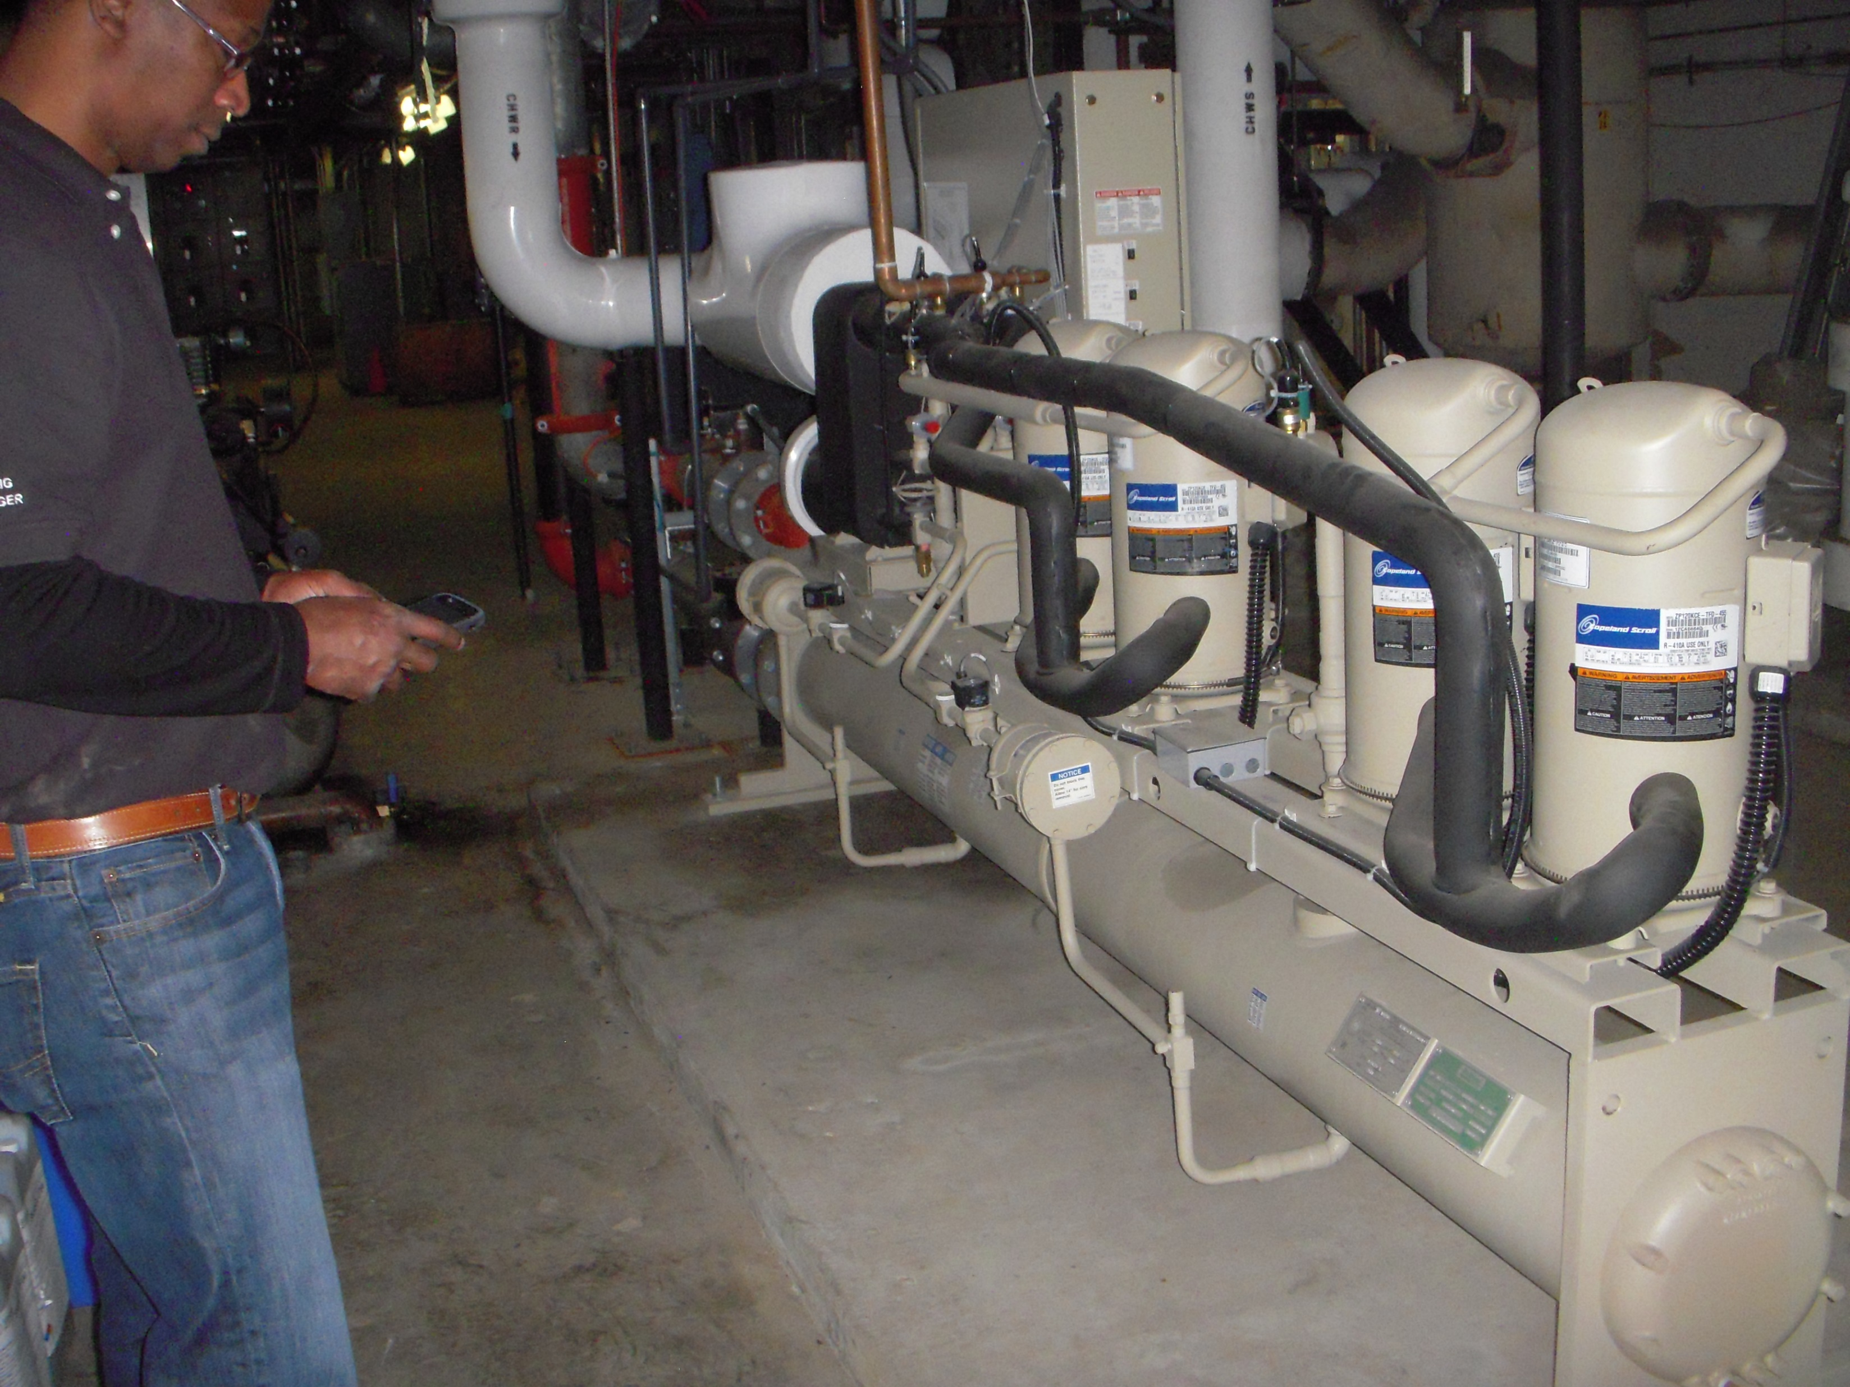
Label

Slide 3
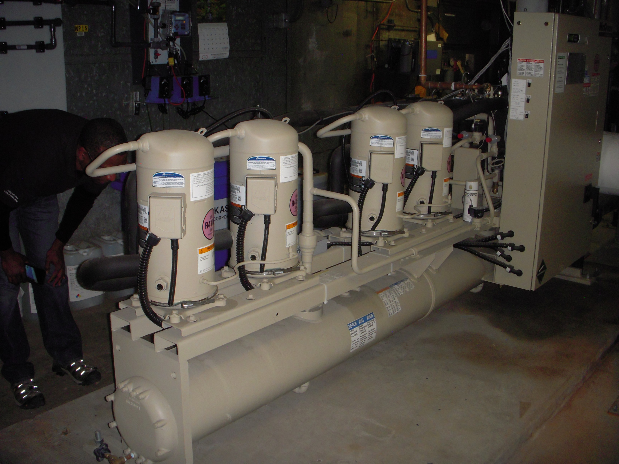

Slide 4
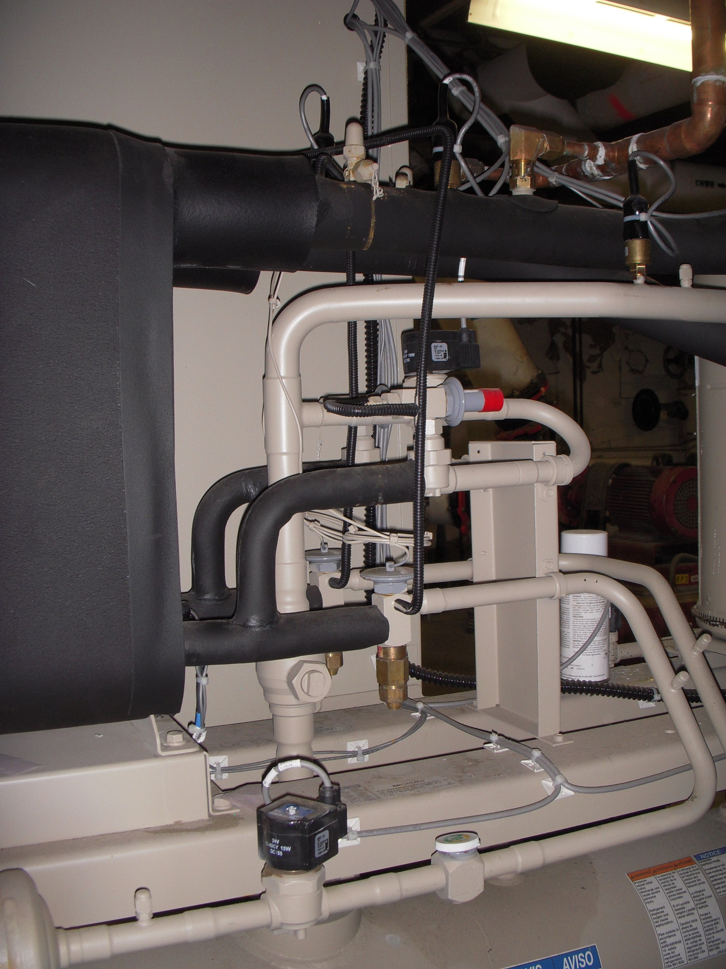

Slide 5
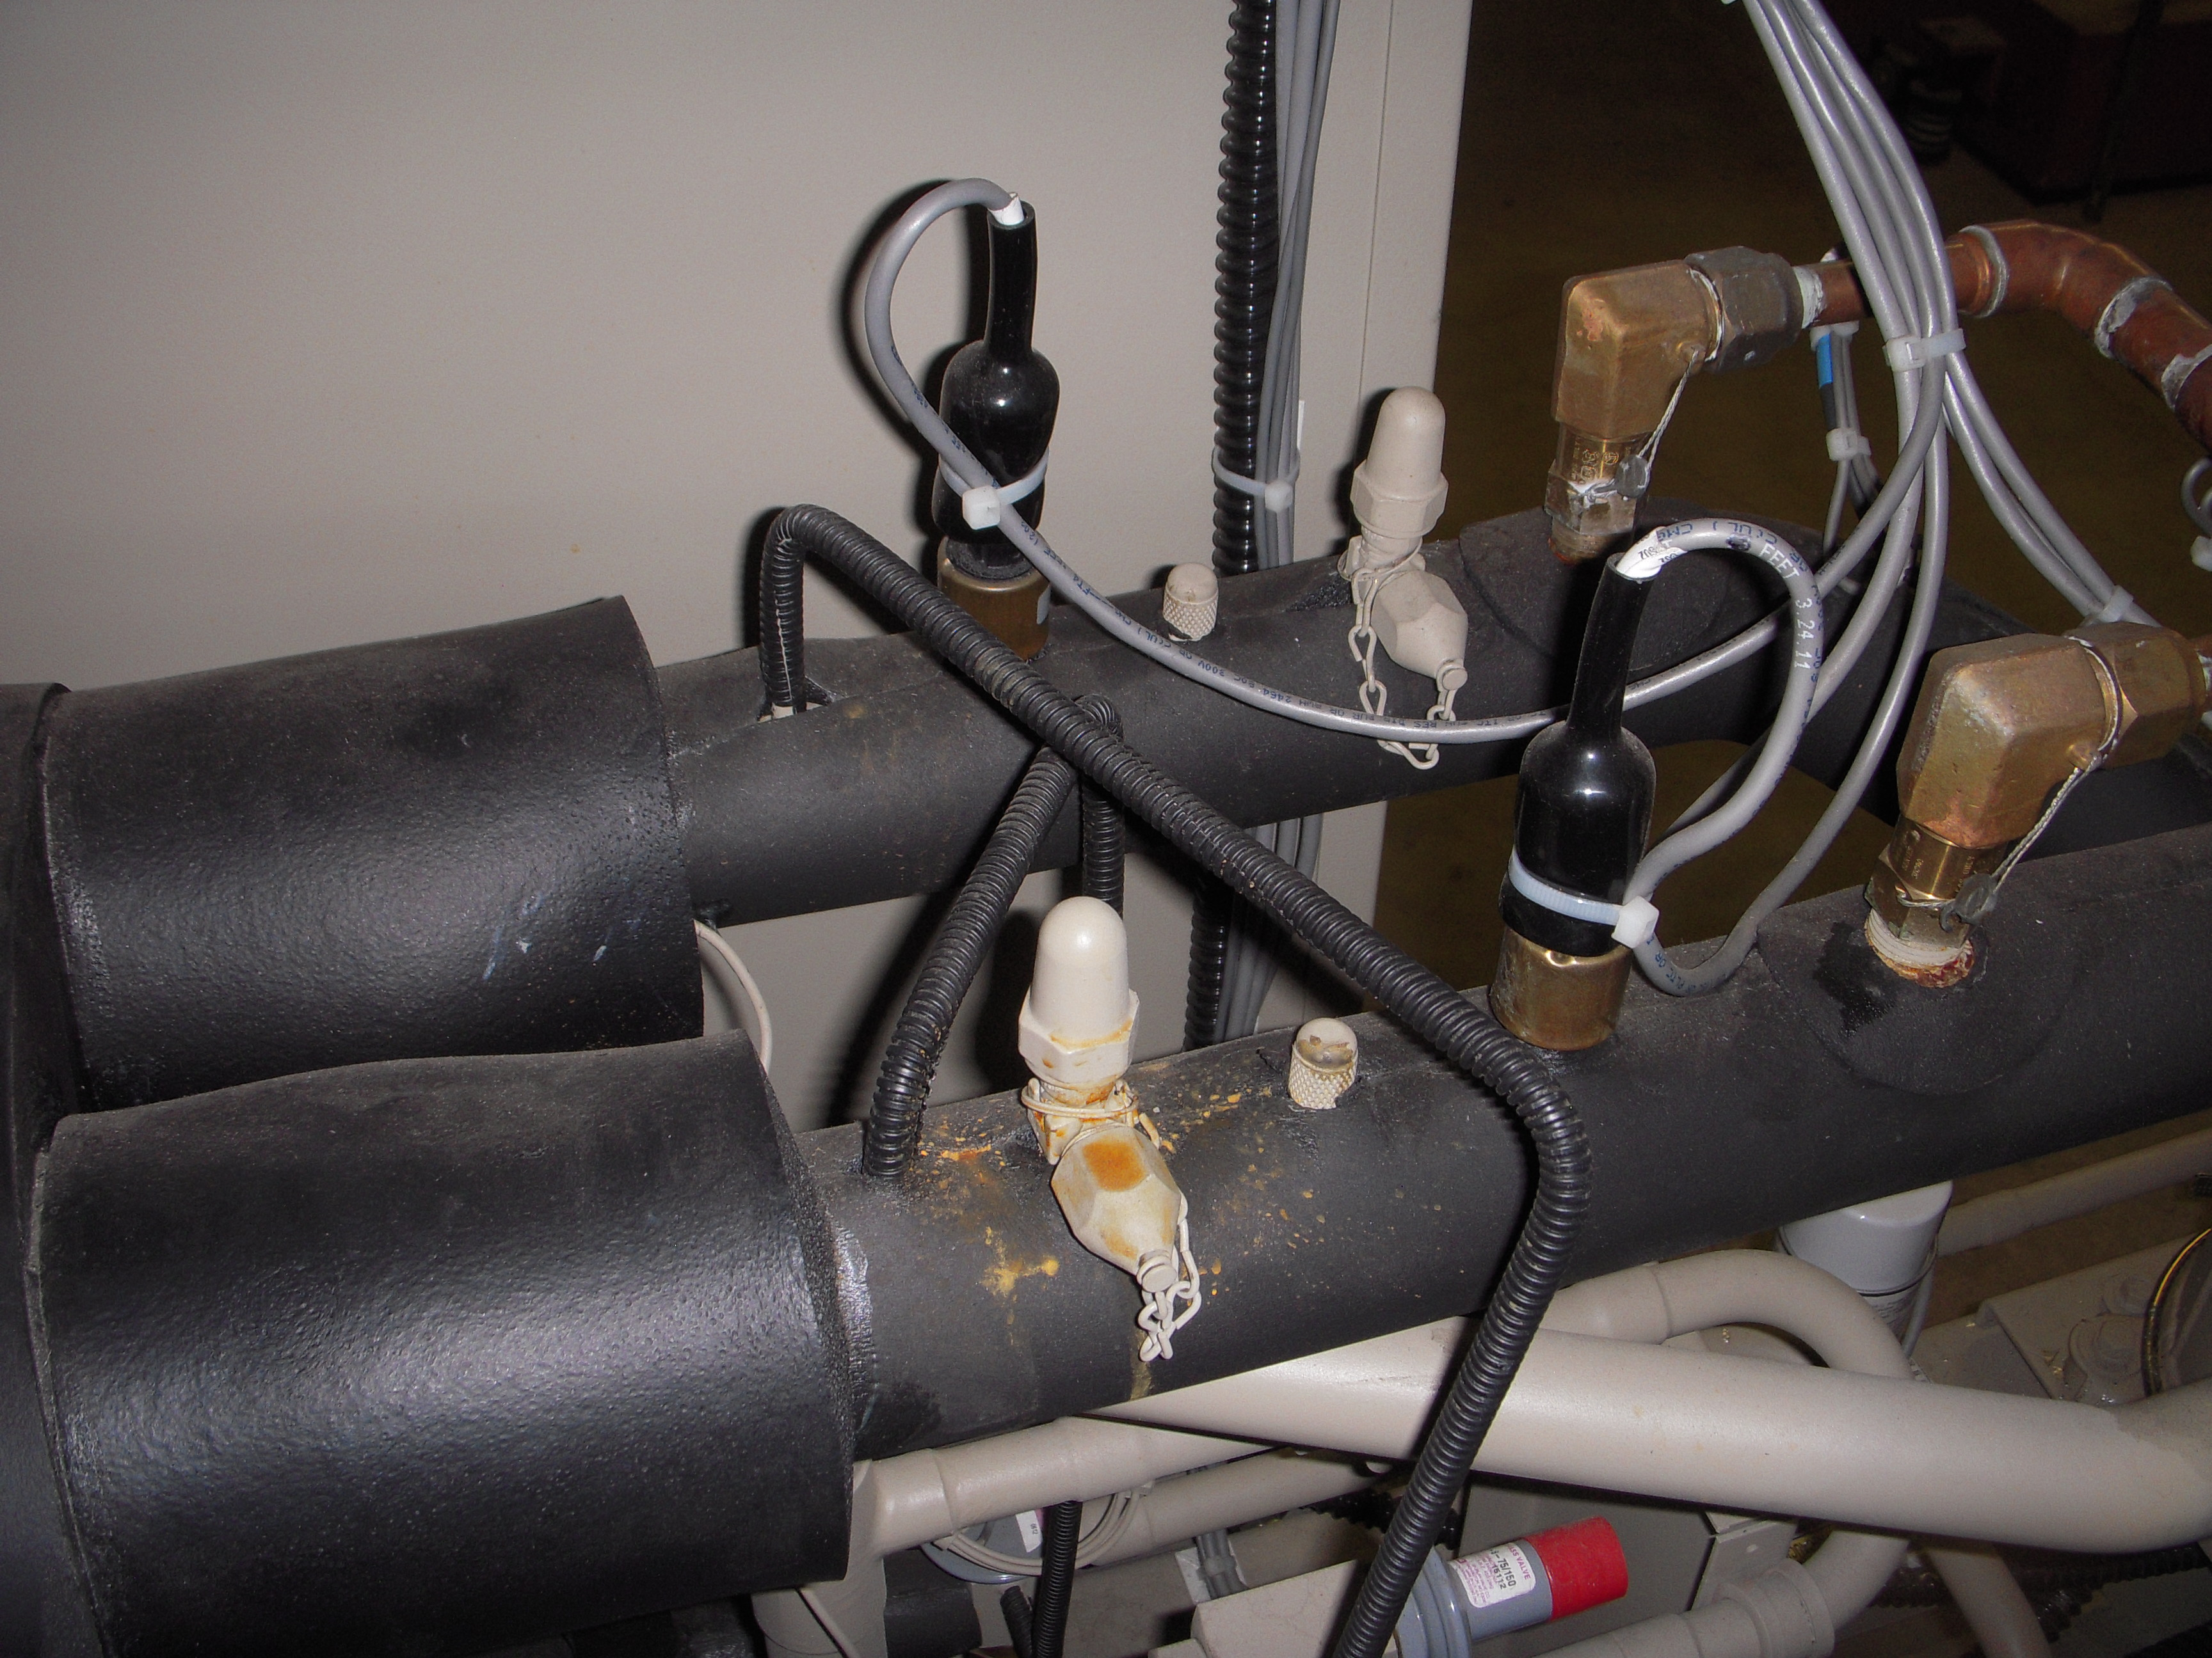

Slide 6
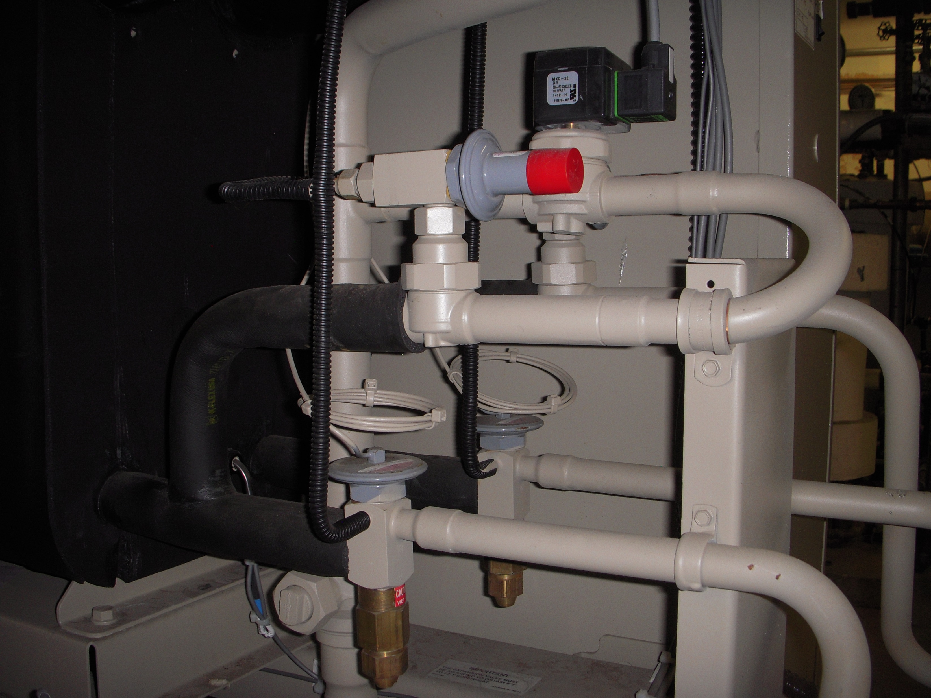

Slide 7
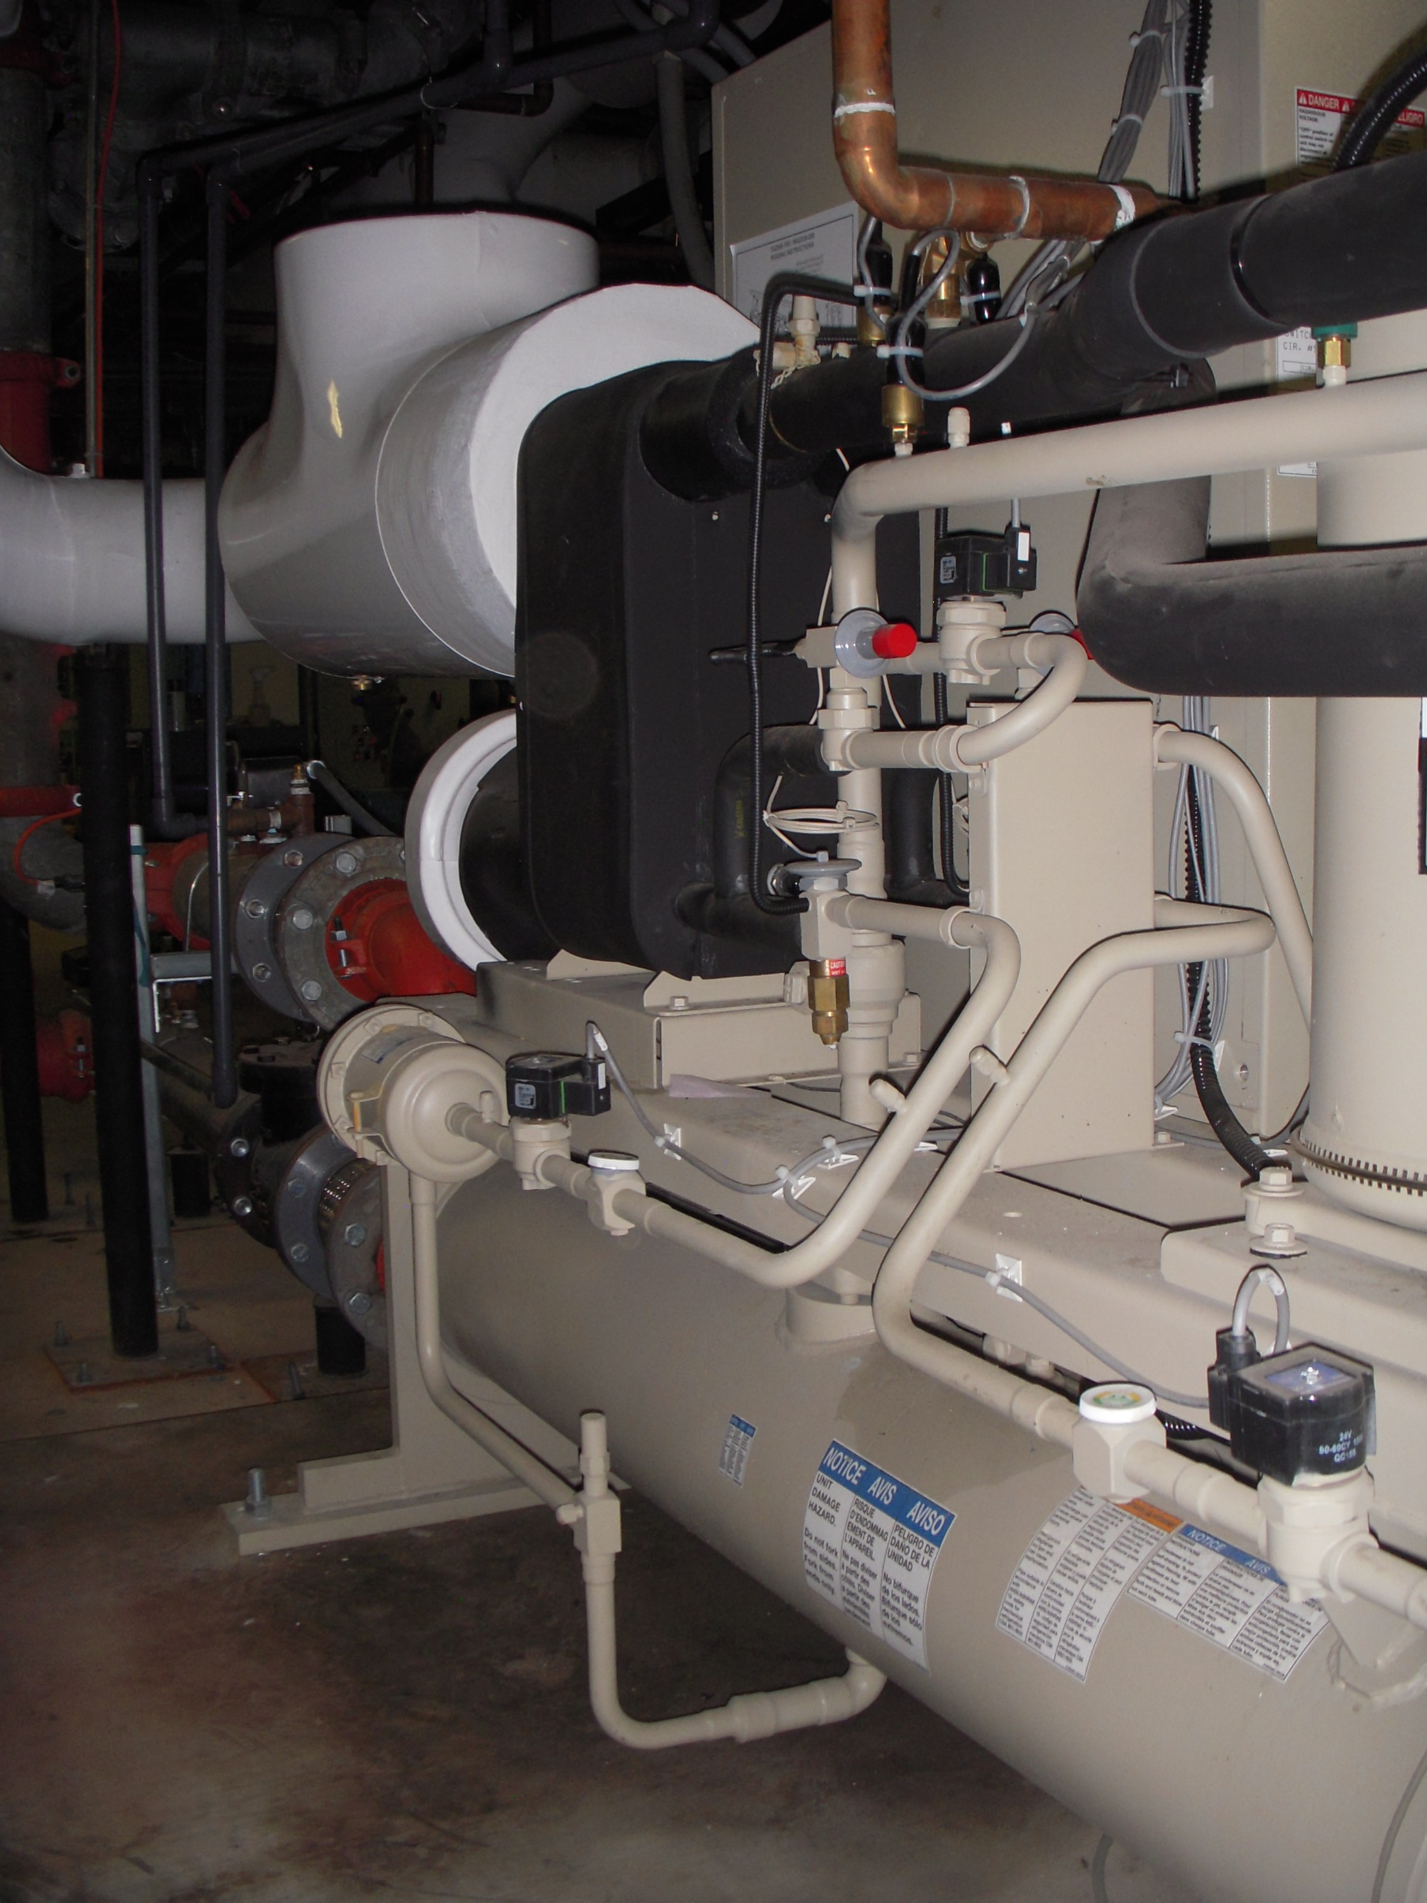

Slide 8
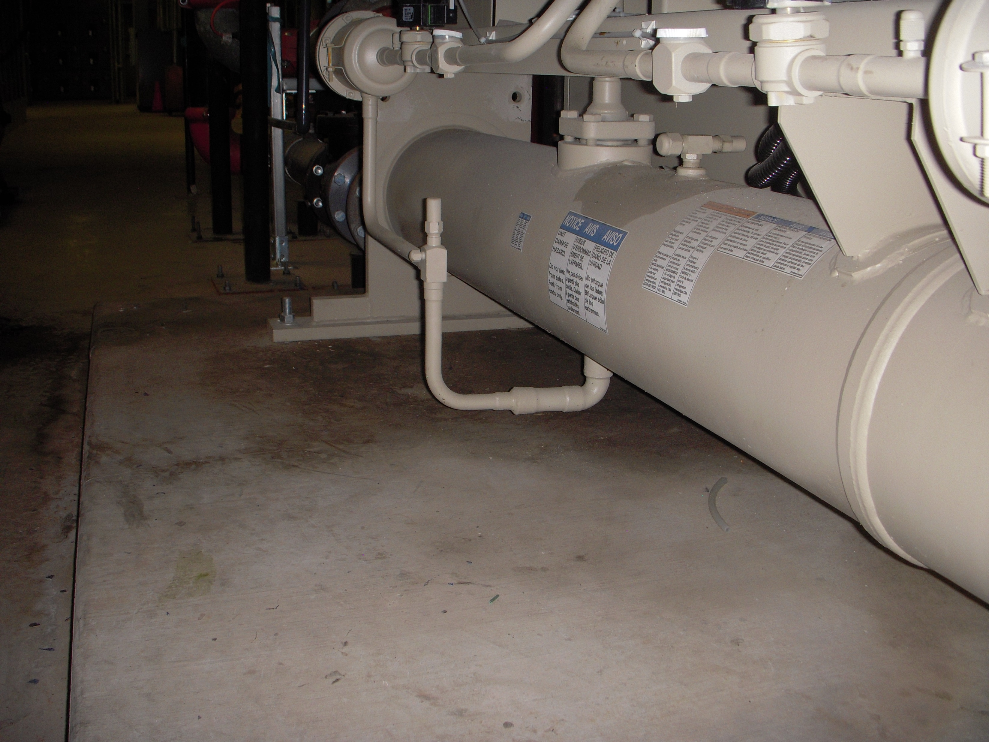

Slide 9
