Slide 1
A Field Perspective on Pneumatic Control and Actuation Systems
Introduction
Presented By:
David Sellers
Senior Engineer, Facility Dynamics Engineering

Slide 2
Connecting to David Sellers Poll Everywhere Account
We may be using Poll Everywhere during the class to foster interaction. Please take a few minutes ahead of the class or during the introduction to get yourself set up to use Poll Everywhere with my account.

Slide 3
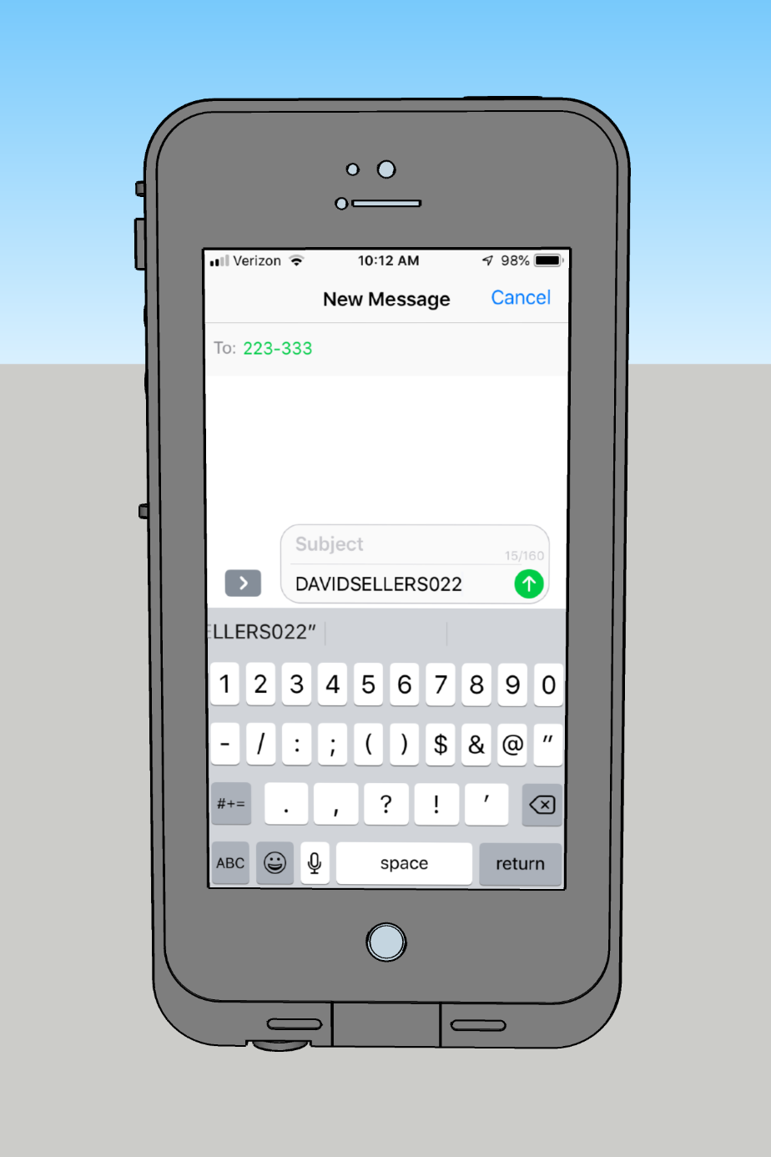
Get Connected with My Poll Everywhere
Via text messaging
Step 1
Text DAVIDSELLERS022 to 22333 (the hyphen gets inserted automatically on some phones)

Slide 4
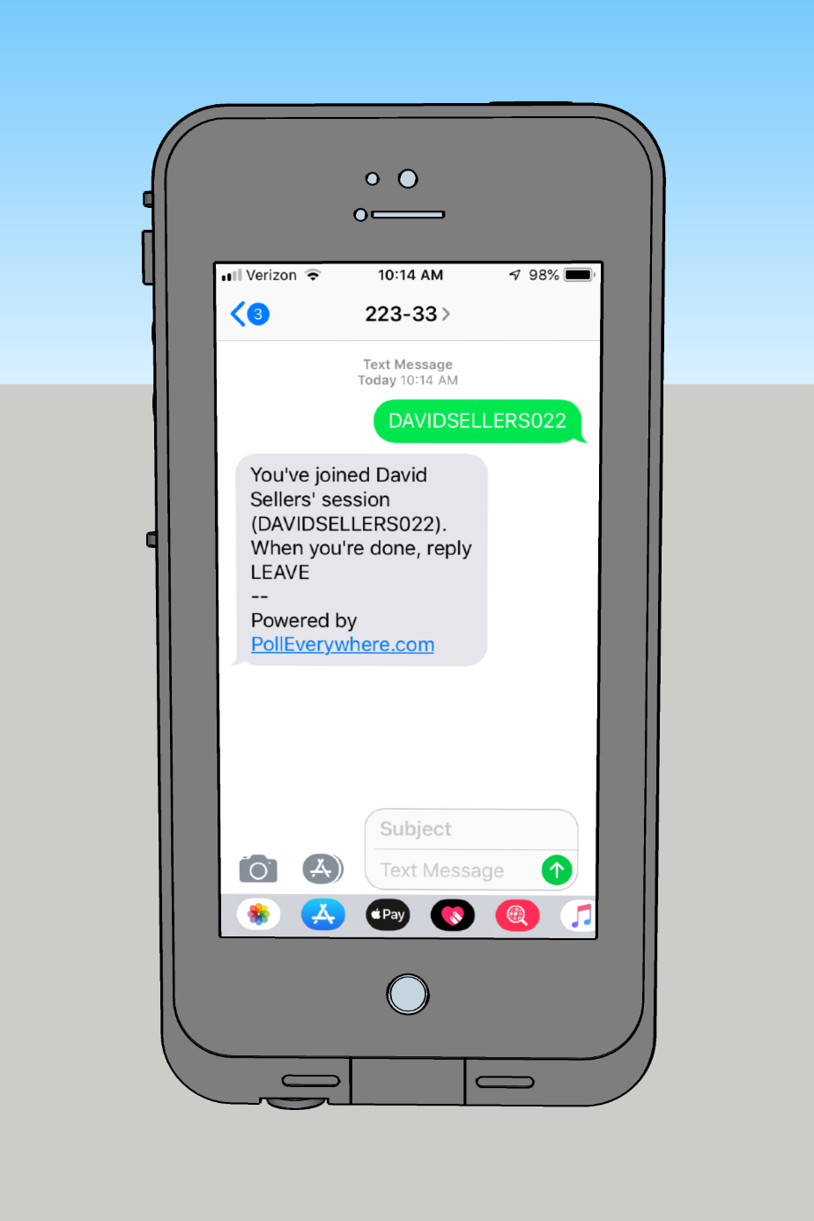
Get Connected with My Poll Everywhere
Via text messaging
Step 2
Receive confirmation that you have joined the session

Slide 5
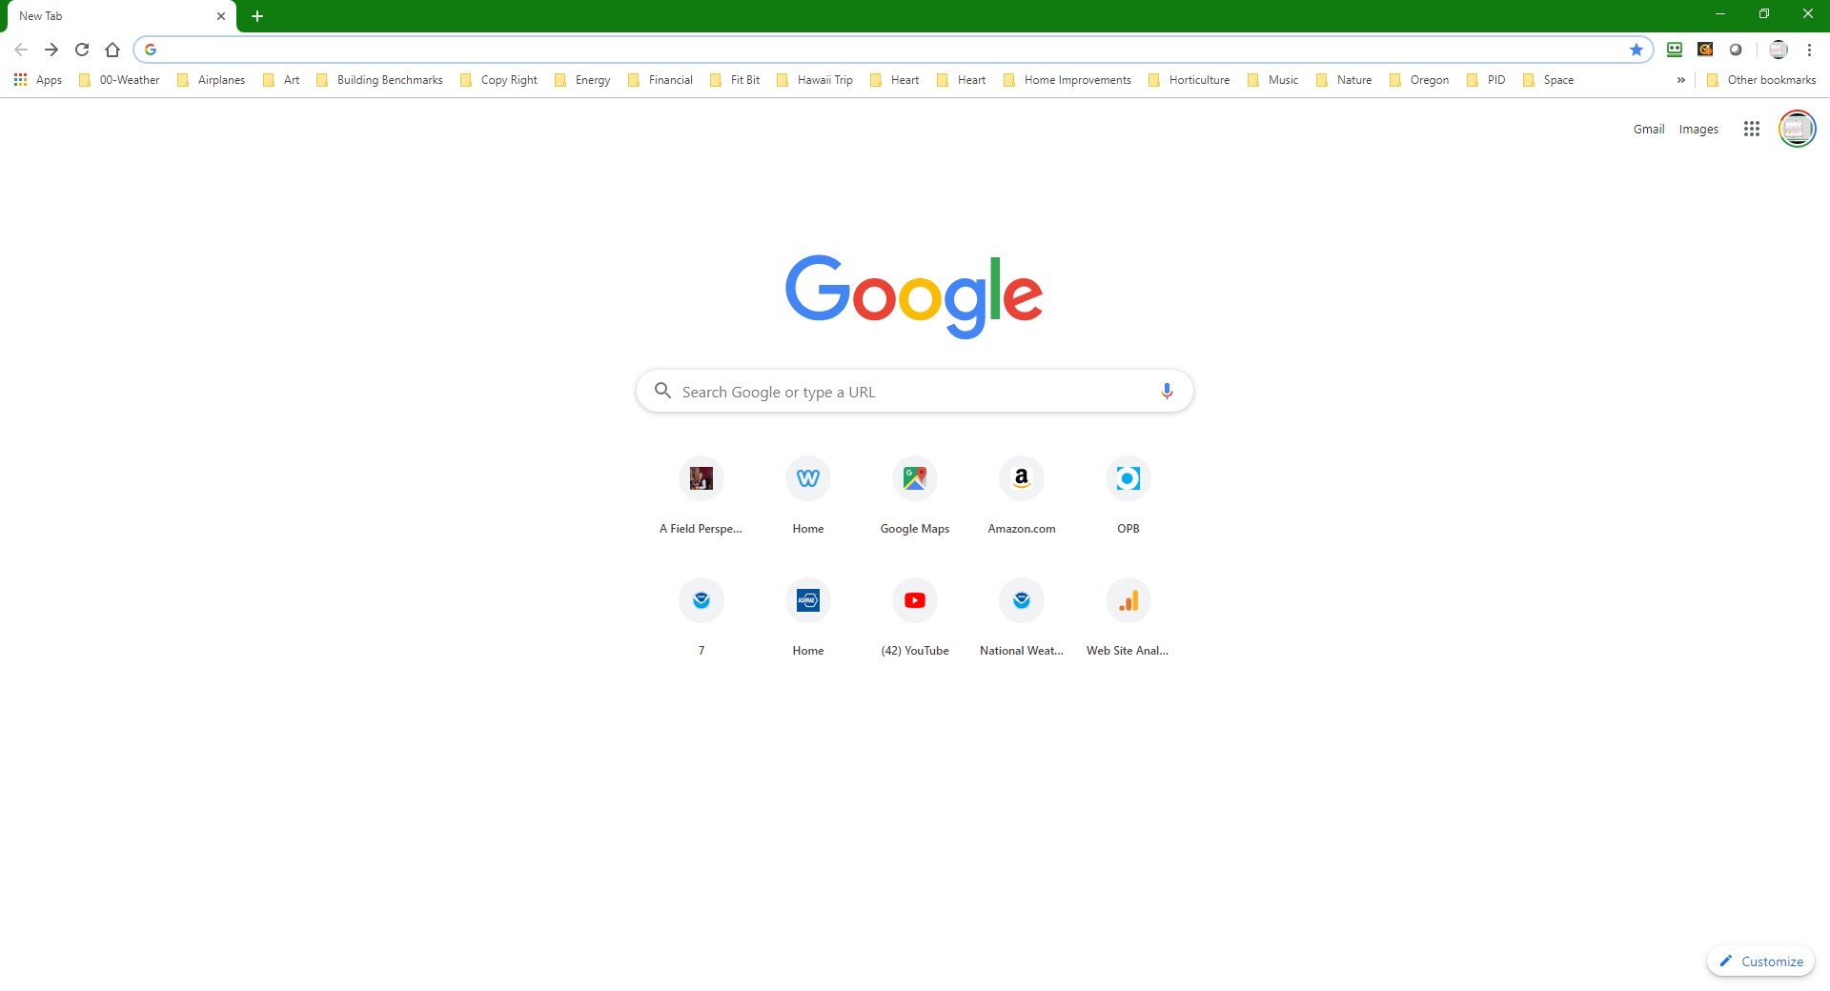
Get Connected with My Poll Everywhere
Via web browser
Step 1
Go to pollev.com/davidsellers022

Slide 6
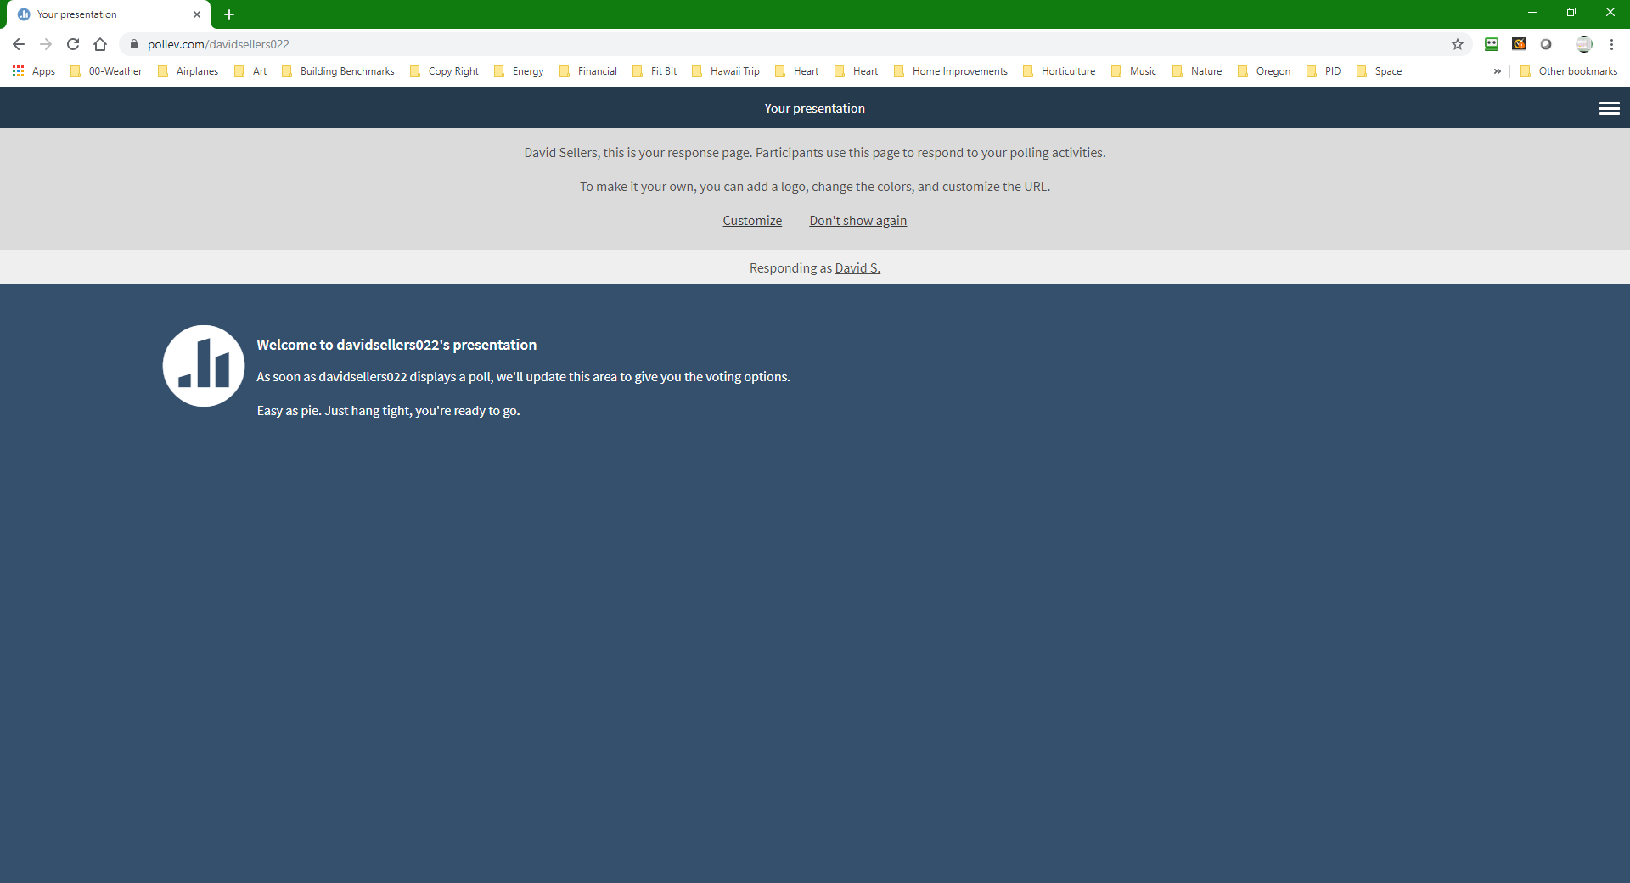
Get Connected with My Poll Everywhere
Via web browser
Step 1
Go to pollev.com/davidsellers022

Slide 7
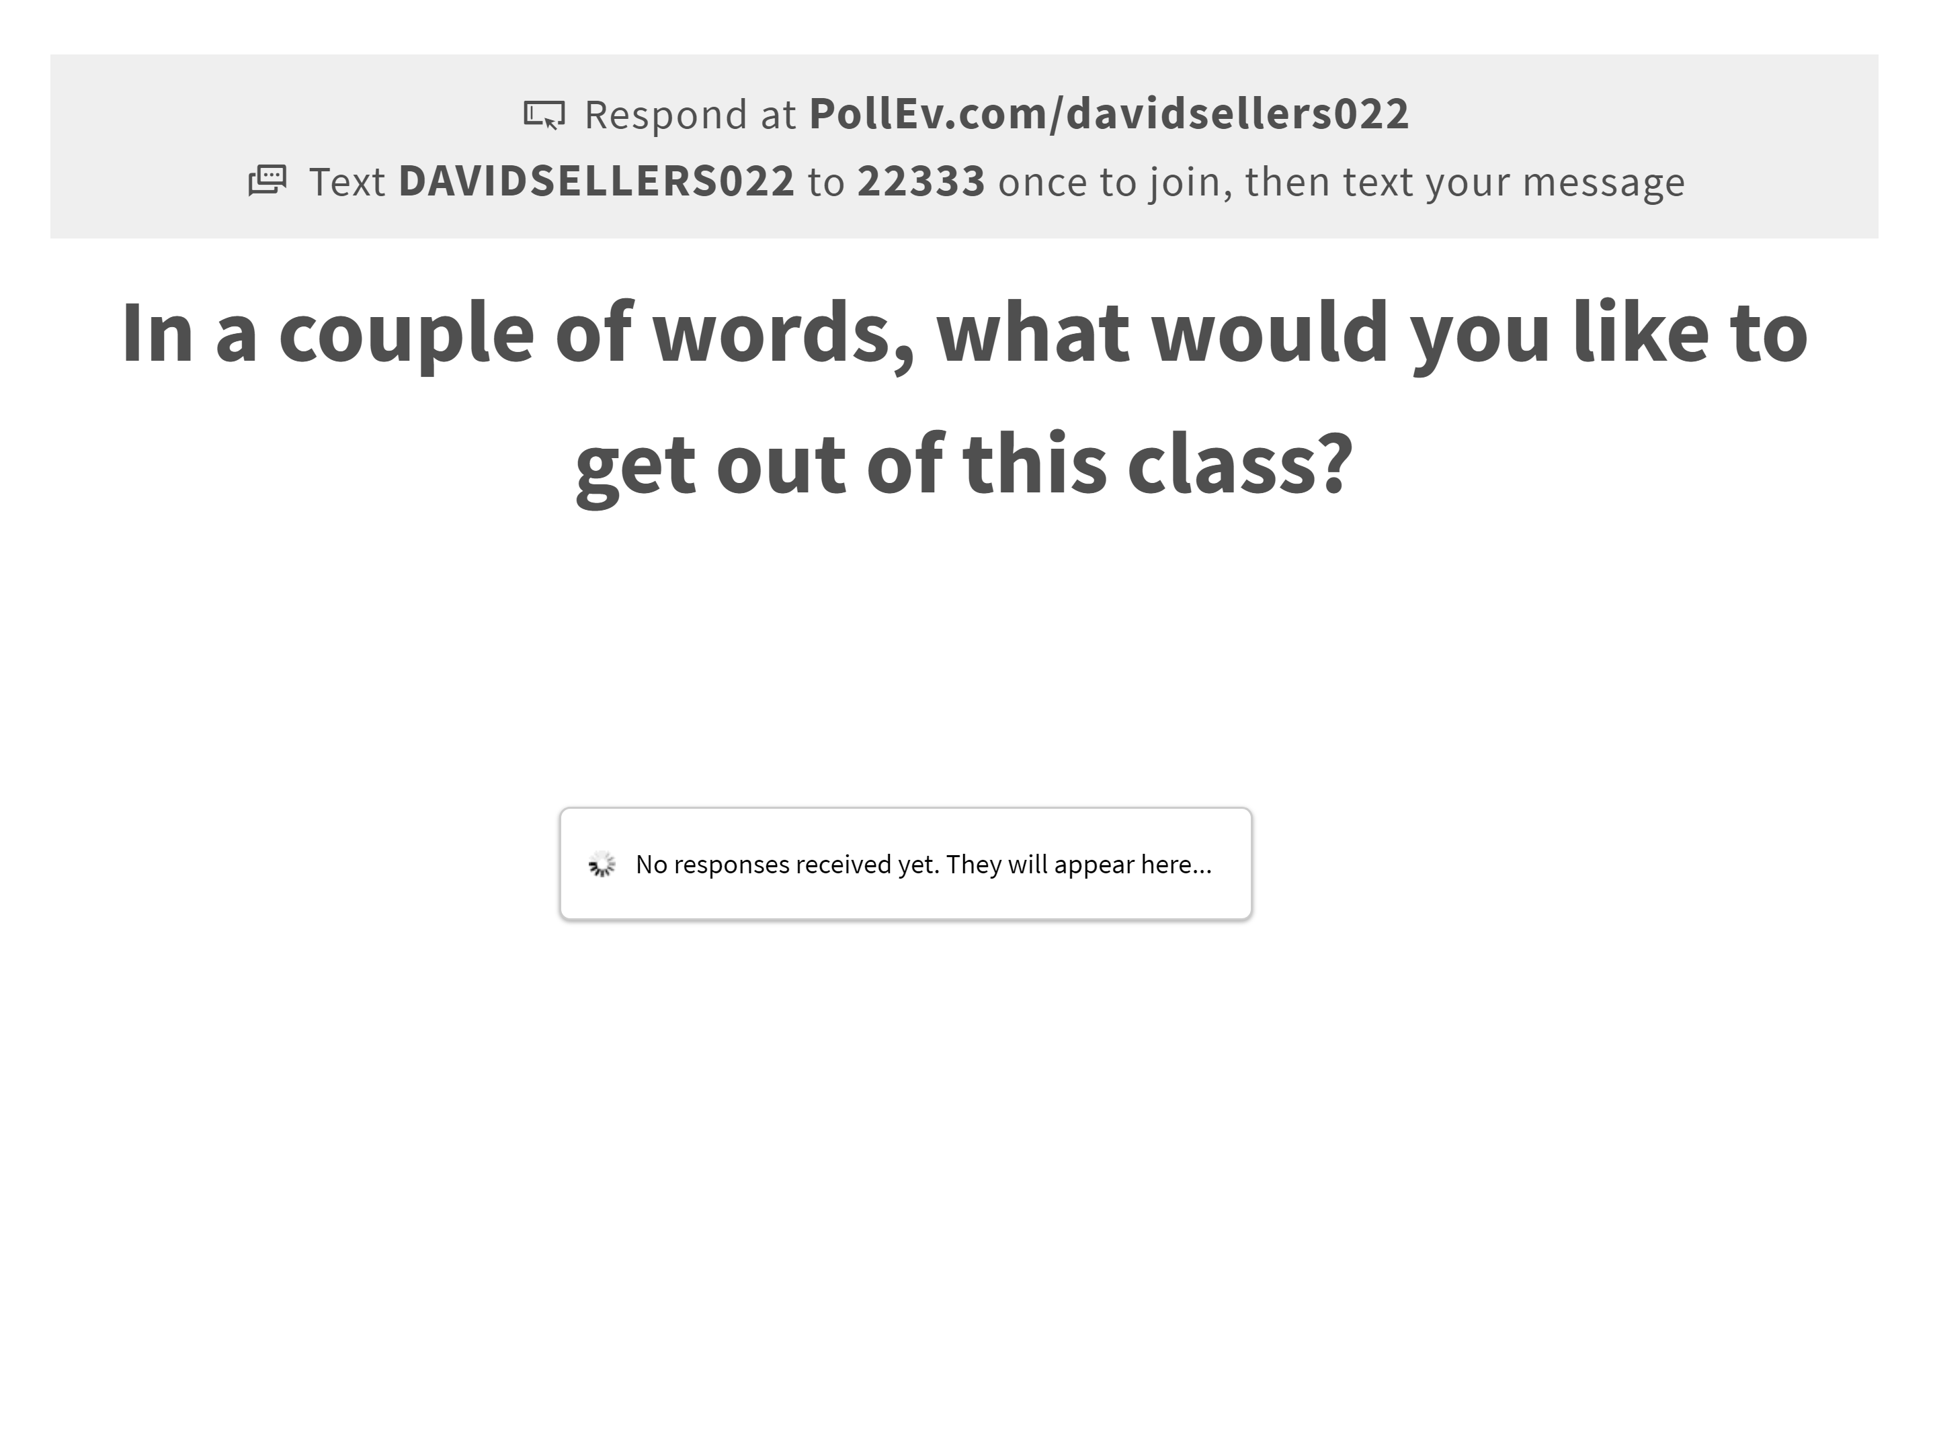
Get Connected with My Poll Everywhere
Via web browser or text messaging
Step 3
Wait for a poll question to come up

