Slide 1
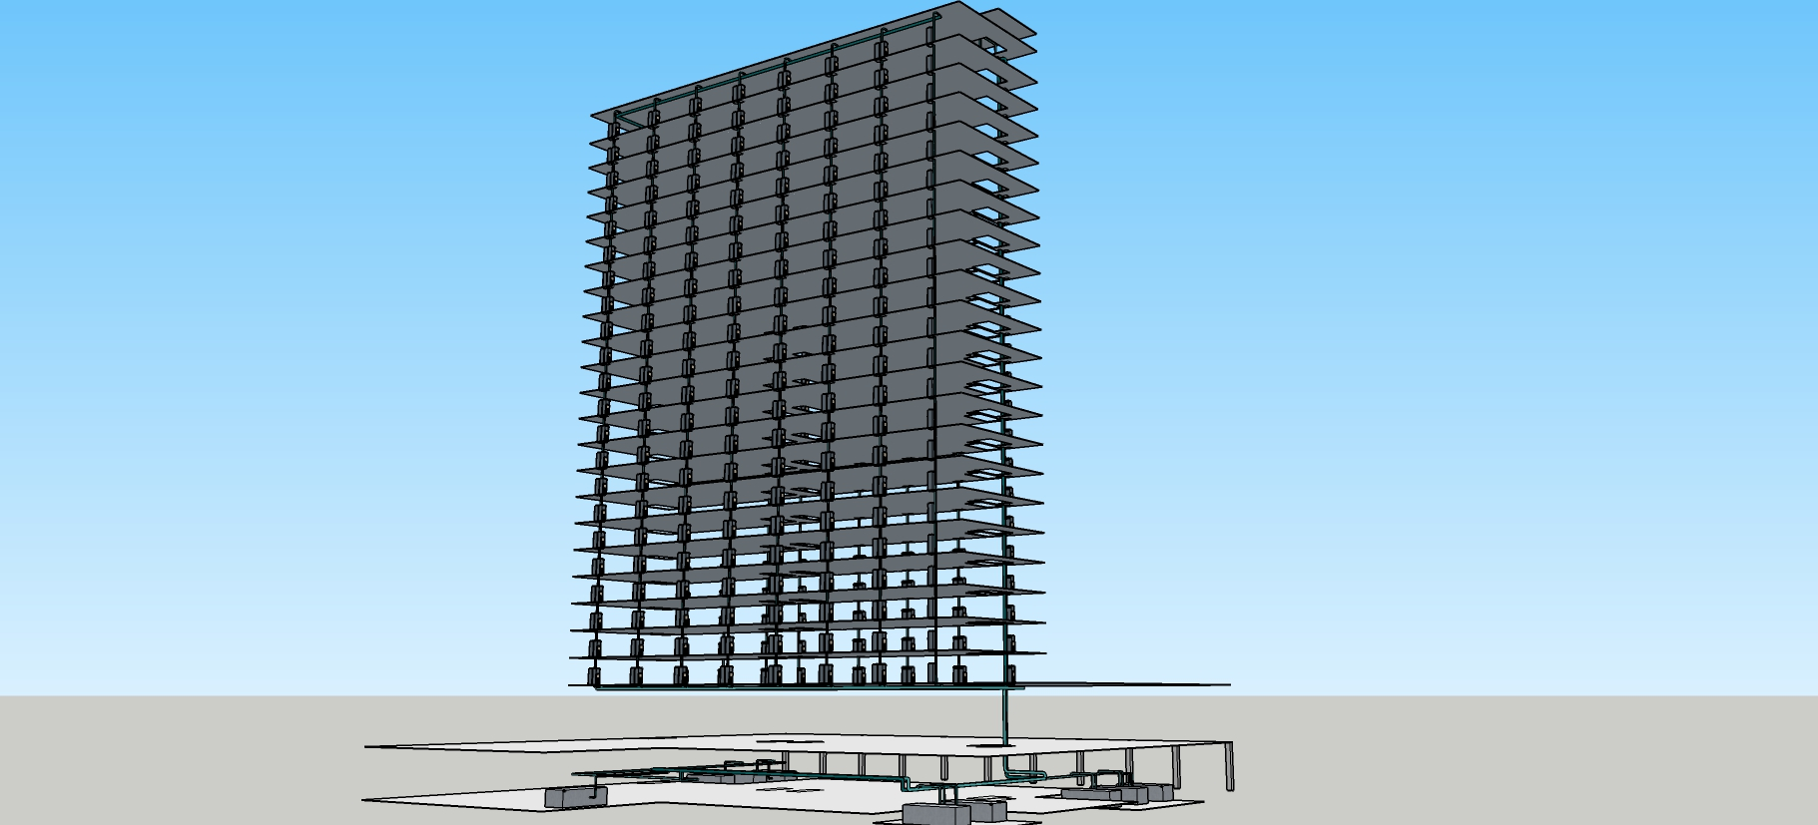
The Hijend Hotel Chilled Water System

Slide 2
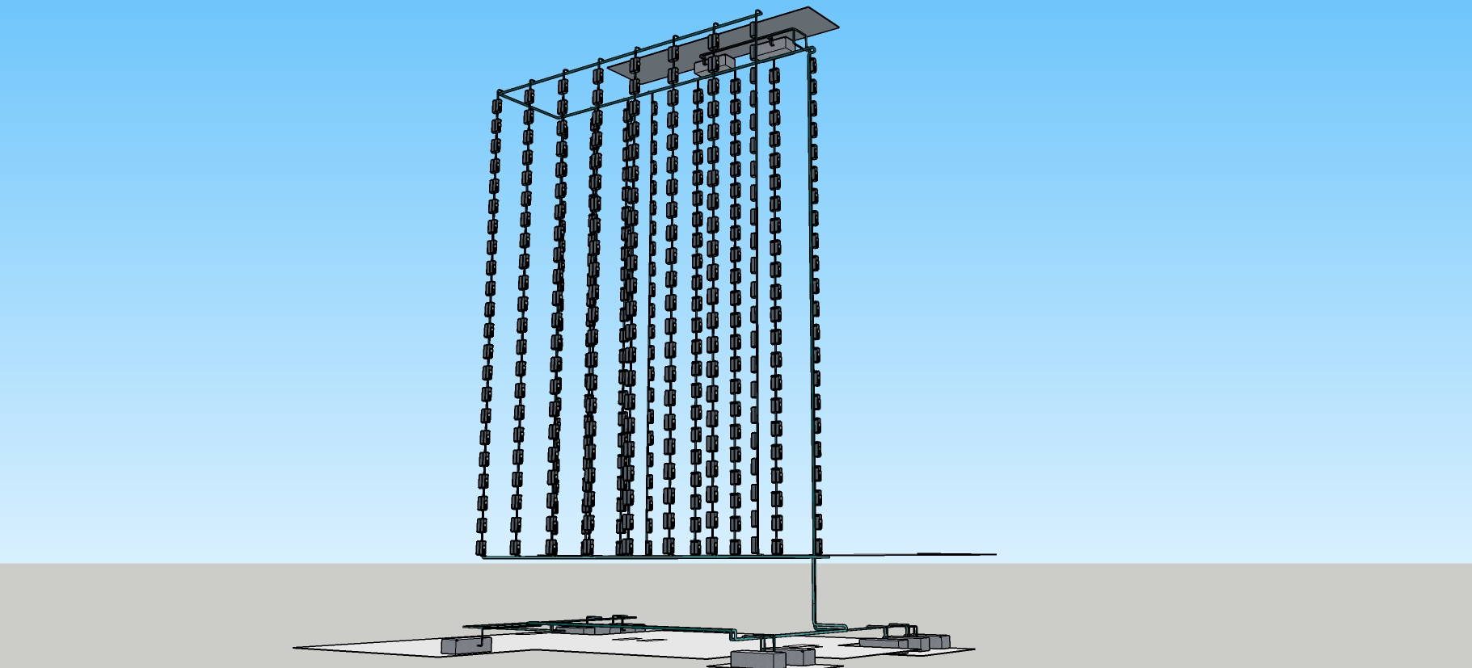
The Hijend Hotel Chilled Water System

Slide 3
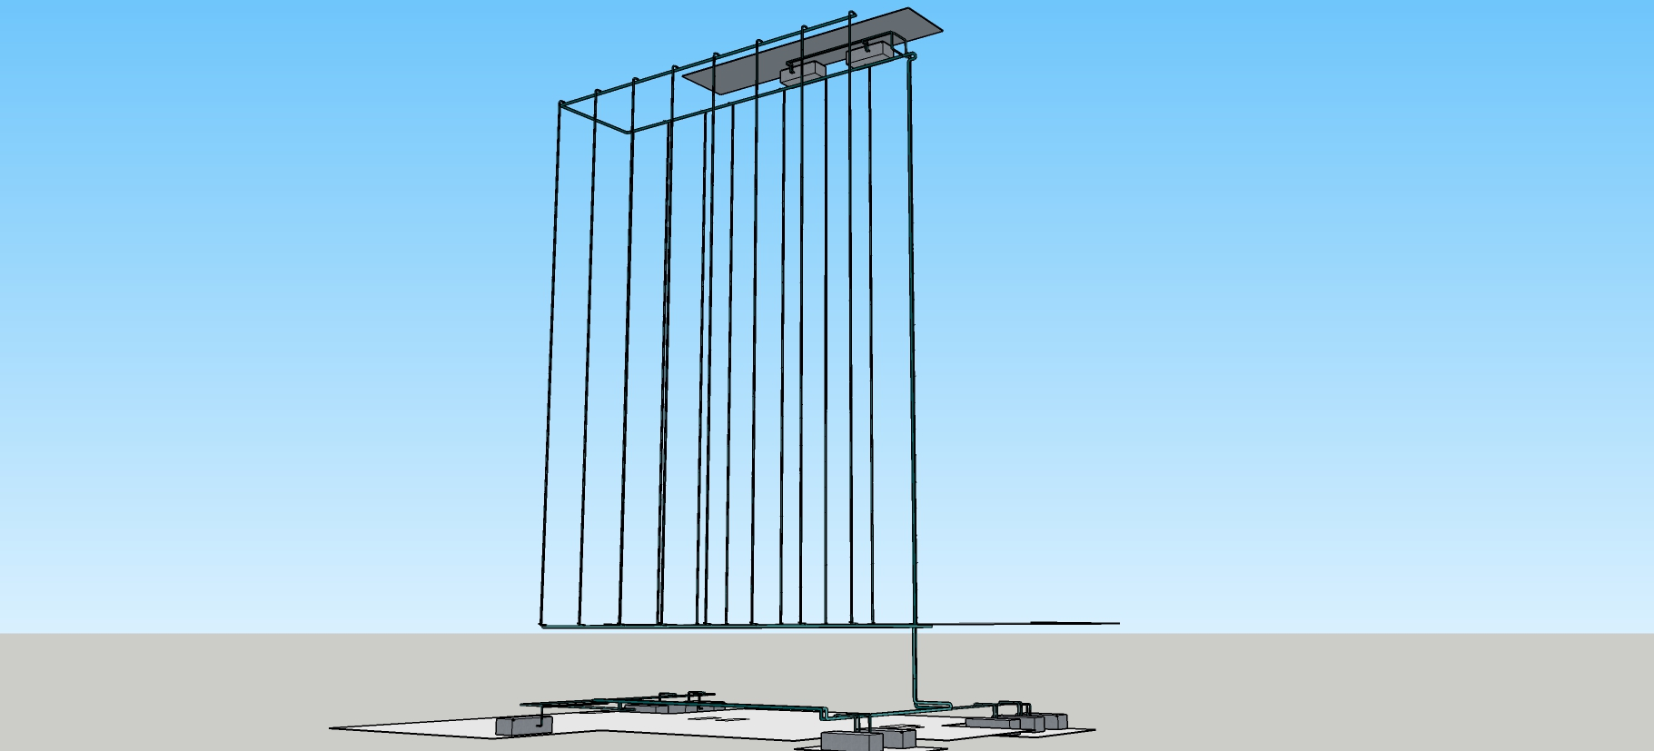
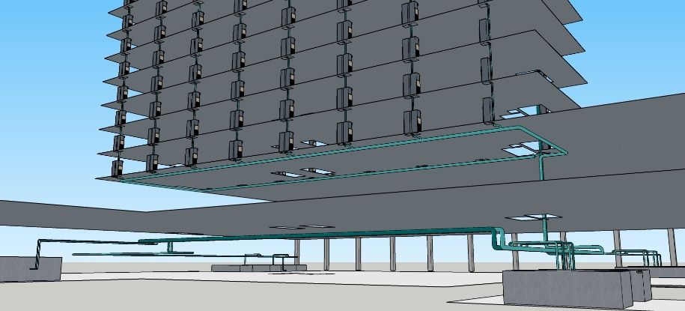
The Hijend Hotel Chilled Water System

Slide 4


The Hijend Hotel Chilled Water System

Slide 5
Simplified System Diagram
A
Pm
Pm
See Sheet 1
See Sheet 2
See Sheets 3 - 6
B
MATCH LINE
See Below
Ch1
Ch2 (VFD & HG)
VF1
AHU8
AHU9
AHU10
AHU1
AHU7
South FC Riser 1A
South FC Riser 8A
Pm
Pm
C
D
A
See Sheets 7 - 10
See Sheet 11
B
MATCH LINE
See Above
North FC Riser 8D
North FC Riser 1D
AHU5
AHU6
AHU2
AHU3
AHU4
C
D

Slide 6
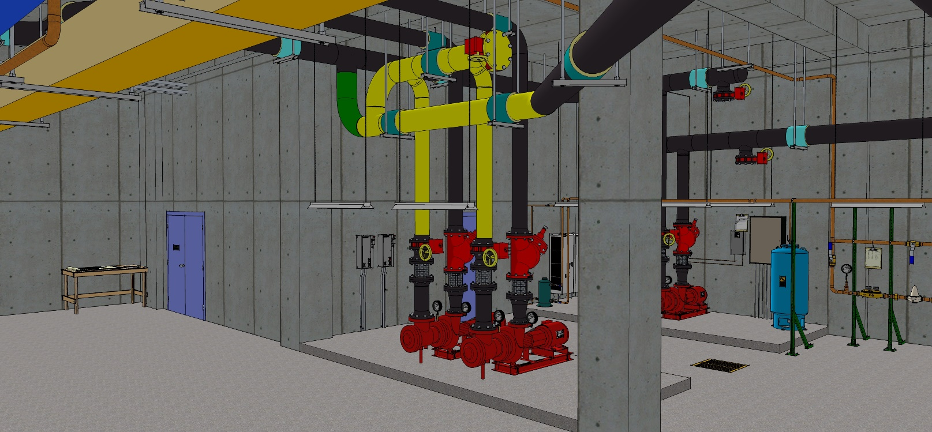
As Installed
Hijend Hotel CHW System Diagram
Sheet 1
A
TDV
TDV
1,100 gpm @ 90 ft.w.c., 40 hp (Typical)
SD
SD
Match Line – See Sheet 2
1,100 gpm from 54.0°F to 42.0°F, 9.8 ft.w.c. Δp, 286 kW
Chiller 1 No VFD
1,100 gpm from 54.0°F to 42.0°F, 9.8 ft.w.c. Δp, 309 kW
Chiller 2 VFD & HG
42.5 gpm from 42.0°F to 54°F, 9.8 ft.w.c. Δ p, 22.1 tons
VF-1 Elec. Rm.
TDV
TDV
1,100 gpm @ 40 ft.w.c., 15 hp (Typical)
SD
SD
B

Slide 7

Hijend Hotel CHW System Diagram
Sheet 2
A
C
Match Line – See Sheet 1
Match Line – See Sheet 3
43.9 gpm from 42.0°F to 54°F, 7.8 ft.w.c. Δ p, 21.9 tons; bypass balanced for 5 gpm in full bypass.
AHU8 Cafe
73.7 gpm from 42.0°F to 54°F, 9.3 ft.w.c. Δ p, 36.9 tons
AHU9 Rest/Lng
157.2 gpm from 42.0°F to 54°F, 9.6 ft.w.c. Δ p, 78.6 tons
AHU10 Kitchen
141 gpm from 42.0°F to 54°F, 8.6 ft.w.c. Δ p, 42.2 tons
AHU1 Admin/Lby
57.9 gpm from 42.0°F to 54°F, 3.1 ft.w.c. Δ p, 29 tons
AHU7 Laundry
B
D

Slide 8
Hijend Hotel CHW System Diagram
Sheet 3
C
E
F
Fan Coil Riser 1.5 A, North Face
62 gpm at 42°EWT, LWT varies, 19.1 tons
See coil schedule and fan coil riser schedule for details; three way valve bypass balanced for design flow in full bypass.
Fan Coil Riser 2.5 A, North Face
125.4 gpm at 42°EWT, LWT varies, 34.9 tons
See coil schedule and fan coil riser schedule for details; three way valve bypass balanced for design flow in full bypass.
Match Line – See Sheet 2
1st Floor (Typical through Floor 23)
24th Floor
1st Floor (Typical through Floor 24)
25th Floor
Match Line – See Sheet 4
West FCU
West FCU
West FCU
East FCU
West FCU
East FCU
G
D
H

Slide 9
Hijend Hotel CHW System Diagram
Sheet 4
E
I
F
J
Fan Coil Riser 3.5 A, North Face
124.5 gpm at 42°EWT, LWT varies, 34.2 tons
See coil schedule and fan coil riser schedule for details; three way valve bypass balanced for design flow in full bypass.
Fan Coil Riser 4.5 A, North Face
124.5 gpm at 42°EWT, LWT varies, 34.2 tons
See coil schedule and fan coil riser schedule for details; three way valve bypass balanced for design flow in full bypass.
Match Line – See Sheet 3
1st Floor (Typical through Floor 24)
25th Floor
1st Floor (Typical through Floor 24)
25th Floor
Match Line – See Sheet 5
West FCU
East FCU
West FCU
East FCU
West FCU
East FCU
West FCU
East FCU
G
K
H
L

Slide 10
Hijend Hotel CHW System Diagram
Sheet 5
I
M
J
N
Fan Coil Riser 5.5 A, North Face
124.5 gpm at 42°EWT, LWT varies, 34.2 tons
See coil schedule and fan coil riser schedule for details; ; three way valve bypass balanced for design flow in full bypass.
Fan Coil Riser 6.5 A, North Face
124.5 gpm at 42°EWT, LWT varies, 34.2 tons
See coil schedule and fan coil riser schedule for details; three way valve bypass balanced for design flow in full bypass.
Match Line – See Sheet 4
1st Floor (Typical through Floor 24)
25th Floor
1st Floor (Typical through Floor 24)
25th Floor
Match Line – See Sheet 6
West FCU
East FCU
West FCU
East FCU
West FCU
East FCU
West FCU
East FCU
K
O
L
P

Slide 11
Hijend Hotel CHW System Diagram
Sheet 6
M
Q
N
R
Fan Coil Riser 7.5 A, North Face
125.4 gpm at 42°EWT, LWT varies, 34.9 tons
See coil schedule and fan coil riser schedule for details; three way valve bypass balanced for design flow in full bypass.
Fan Coil Riser 8.5 A, North Face
121.5 gpm at 42°EWT, LWT varies, 35.5 tons
See coil schedule and fan coil riser schedule for details; three way valve bypass balanced for design flow in full bypass.
Match Line – See Sheet 5
1st Floor (Typical through Floor 24)
25th Floor
1st Floor (Typical through Floor 23)
24th Floor
Match Line – See Sheet 7
West FCU
East FCU
West FCU
West FCU
East FCU
West FCU
East FCU
O
S
P
T

Slide 12
Hijend Hotel CHW System Diagram
Sheet 7
Q
U
R
V
Fan Coil Riser 8.5 D, South Face
90.6 gpm at 42°EWT, LWT varies, 30.6 tons
See coil schedule and fan coil riser schedule for details; three way valve bypass balanced for design flow in full bypass.
Fan Coil Riser 7.5 D, South Face
187.6 gpm at 42°EWT, LWT varies, 63.4 tons
See coil schedule and fan coil riser schedule for details; three way valve bypass balanced for design flow in full bypass.
Match Line – See Sheet 6
1st Floor (Typical through Floor 23)
24th Floor
1st Floor (Typical through Floor 24)
25th Floor
Match Line – See Sheet 8
West FCU
East FCU
West FCU
West FCU
East FCU
West FCU
East FCU
S
W
T
X

Slide 13
Hijend Hotel CHW System Diagram
Sheet 8
U
Y
V
Z
Fan Coil Riser 6.5 D, South Face
189.5 gpm at 42°EWT, LWT varies, 64.0 tons
See coil schedule and fan coil riser schedule for details; three way valve bypass balanced for design flow in full bypass.
Fan Coil Riser 5.5 D, South Face
94.7 gpm at 42°EWT, LWT varies, 32 tons
See coil schedule and fan coil riser schedule for details; three way valve bypass balanced for design flow in full bypass.
Match Line – See Sheet 7
1st Floor (Typical through Floor 24)
25th Floor
1st Floor (Typical through Floor 24)
25th Floor
Match Line – See Sheet 9
West FCU
East FCU
West FCU
East FCU
East FCU
East FCU
W
A
X
B

Slide 14
Hijend Hotel CHW System Diagram
Sheet 9
U
Y
V
Z
Fan Coil Riser 4.5 D, South Face
189.5 gpm at 42°EWT, LWT varies, 64.0 tons
See coil schedule and fan coil riser schedule for details; three way valve bypass balanced for design flow in full bypass.
Fan Coil Riser 3.5 D, South Face
185.4 gpm at 42°EWT, LWT varies, 62.6 tons
See coil schedule and fan coil riser schedule for details; three way valve bypass balanced for design flow in full bypass.
Match Line – See Sheet 8
1st Floor (Typical through Floor 24)
25th Floor
1st Floor (Typical through Floor 24)
25th Floor
Match Line – See Sheet 10
West FCU
East FCU
West FCU
East FCU
West FCU
East FCU
East FCU
W
A
X
B

Slide 15
Hijend Hotel CHW System Diagram
Sheet 10
U
Y
V
Fan Coil Riser 2.5 D, South Face
181.2 gpm at 42°EWT, LWT varies, 61.2 tons
See coil schedule and fan coil riser schedule for details; three way valve bypass balanced for design flow in full bypass.
Fan Coil Riser 1.5 D, South Face
467.4 gpm at 42°EWT, LWT varies, 218.3 tons
See coil schedule and fan coil riser schedule for details; three way valve bypass balanced for design flow in full bypass.
Match Line – See Sheet 9
1st Floor (Typical through Floor 23)
24th Floor
1st Floor
25th Floor
AHU5 Corr. MAU
Roof Level
Match Line – See Sheet 11
186.3 gpm from 42.0°F to 54°F, 6.9 ft.w.c. Δ p, 91.2 tons (Typical of each MAU)
AHU6 Corr.MAU
West FCU
East FCU
West FCU
East FCU
West FCU (Typical through 24th floor)
West FCU
W
X
Z

Slide 16
Hijend Hotel CHW System Diagram
Sheet 11
Y
Match Line – See Sheet 10
148.7 gpm from 42.0°F to 54°F, 11 ft.w.c. Δ p, 74.4 tons
AHU2 Ball Room
88.7 gpm from 42.0°F to 54°F, 9.2 ft.w.c. Δ p, 44.3 tons
AHU3 Jr. Ball Room
120.1 gpm from 42.0°F to 54°F, 9.1 ft.w.c. Δ p, 60.1 tons; bypass balanced for 5 gpm in full bypass.
AHU4 Mtg. Rooms
Z

Slide 17
Fan Coil Unit Riser Schedule

Slide 18
Cooling Coil Schedule

Slide 19
System Volume Projection

