Slide 1
Existing Building Commissioning Workshop: Series 17, November 5, 2021
Applied System Diagrams
Presented By:
David Sellers
Senior Engineer, Facility Dynamics Engineering

Slide 2
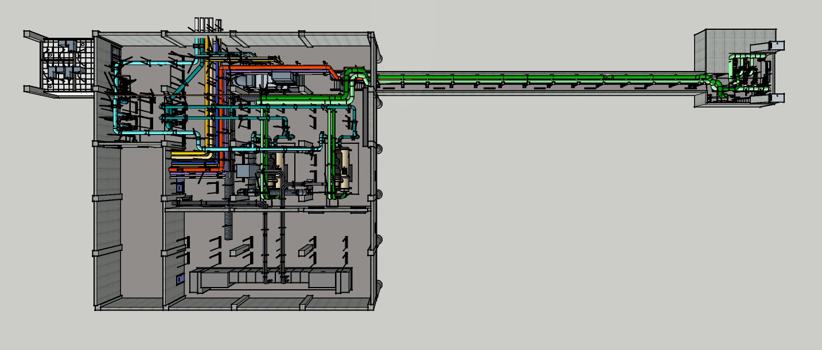
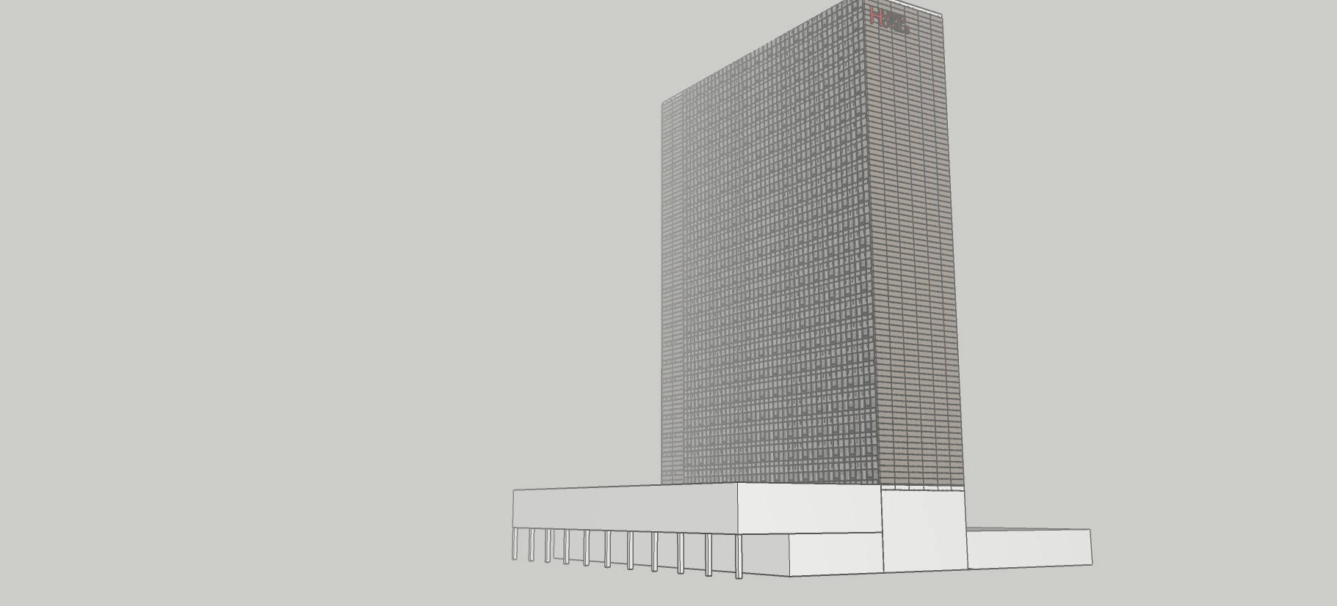
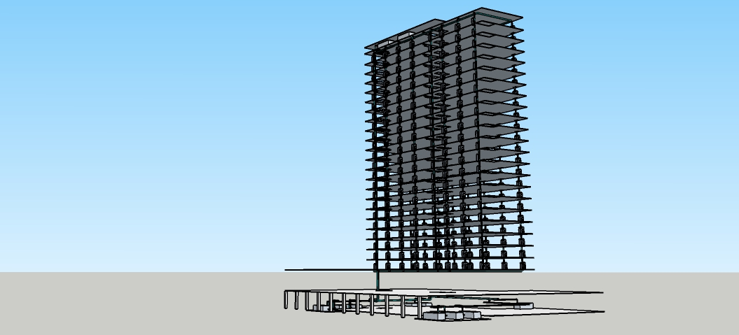
Field Verifying a Chilled Water System Diagram

Slide 3
Field Verifying a Chilled Water System Diagram

Slide 4
Field Verifying a Chilled Water System

Slide 5
The Simplified System Diagram
A
Pm
Pm
See Sheet 1
See Sheet 2
See Sheets 3 - 6
B
MATCH LINE
See Below
Ch1
Ch2
VF1
AHU8
AHU9
AHU10
AHU1
AHU7
South FC Riser 1A
South FC Riser 8A
Pm
Pm
C
D
A
See Sheets 7 - 10
See Sheet 11
B
MATCH LINE
See Above
North FC Riser 8D
North FC Riser 1D
AHU5
AHU6
AHU2
AHU3
AHU4
C
D

Slide 6
The Detailed Diagram
Hijend Hotel CHW System Diagram
Sheet 1
A
Developed from the mechanical drawings and submittals
Needs to be field verified
TDV
TDV
1,100 gpm @ 90 ft.w.c., 40 hp (Typical)
SD
SD
Match Line – See Sheet 2
1,100 gpm from 54.0°F to 42.0°F, 9.8 ft.w.c. Δp, 286 kW
Chiller 1
1,100 gpm from 54.0°F to 42.0°F, 9.8 ft.w.c. Δp, 309 kW
Chiller 2
42.5 gpm from 42.0°F to 54°F, 9.8 ft.w.c. Δ p, 22.1 tons
VF-1 Elec. Rm.
TDV
TDV
1,100 gpm @ 40 ft.w.c., 15 hp (Typical)
SD
SD
B

Slide 7
Hijend Hotel CHW System Diagram
Sheet 2
A
C
Match Line – See Sheet 1
Match Line – See Sheet 3
43.9 gpm from 42.0°F to 54°F, 7.8 ft.w.c. Δ p, 21.9 tons; bypass balanced for 5 gpm in full bypass.
AHU8 Cafe
73.7 gpm from 42.0°F to 54°F, 9.3 ft.w.c. Δ p, 36.9 tons
AHU9 Rest/Lng
157.2 gpm from 42.0°F to 54°F, 9.6 ft.w.c. Δ p, 78.6 tons
AHU10 Kitchen
141 gpm from 42.0°F to 54°F, 8.6 ft.w.c. Δ p, 42.2 tons
AHU1 Admin/Lby
57.9 gpm from 42.0°F to 54°F, 3.1 ft.w.c. Δ p, 29 tons
AHU7 Laundry
B
D

Slide 8
Hijend Hotel CHW System Diagram
Sheet 3
C
E
F
Fan Coil Riser 1.5 A, North Face
62 gpm at 42°EWT, LWT varies, 19.1 tons
See coil schedule and fan coil riser schedule for details; three way valve bypass balanced for design flow in full bypass.
Fan Coil Riser 2.5 A, North Face
125.4 gpm at 42°EWT, LWT varies, 34.9 tons
See coil schedule and fan coil riser schedule for details; three way valve bypass balanced for design flow in full bypass.
Match Line – See Sheet 2
1st Floor (Typical through Floor 23)
24th Floor
1st Floor (Typical through Floor 24)
25th Floor
Match Line – See Sheet 4
West FCU
West FCU
West FCU
East FCU
West FCU
East FCU
G
D
H

Slide 9
Hijend Hotel CHW System Diagram
Sheet 4
E
I
F
J
Fan Coil Riser 3.5 A, North Face
124.5 gpm at 42°EWT, LWT varies, 34.2 tons
See coil schedule and fan coil riser schedule for details; three way valve bypass balanced for design flow in full bypass.
Fan Coil Riser 4.5 A, North Face
124.5 gpm at 42°EWT, LWT varies, 34.2 tons
See coil schedule and fan coil riser schedule for details; three way valve bypass balanced for design flow in full bypass.
Match Line – See Sheet 3
1st Floor (Typical through Floor 24)
25th Floor
1st Floor (Typical through Floor 24)
25th Floor
Match Line – See Sheet 5
West FCU
East FCU
West FCU
East FCU
West FCU
East FCU
West FCU
East FCU
G
K
H
L

Slide 10
Hijend Hotel CHW System Diagram
Sheet 5
I
M
J
N
Fan Coil Riser 5.5 A, North Face
124.5 gpm at 42°EWT, LWT varies, 34.2 tons
See coil schedule and fan coil riser schedule for details; ; three way valve bypass balanced for design flow in full bypass.
Fan Coil Riser 6.5 A, North Face
124.5 gpm at 42°EWT, LWT varies, 34.2 tons
See coil schedule and fan coil riser schedule for details; three way valve bypass balanced for design flow in full bypass.
Match Line – See Sheet 4
1st Floor (Typical through Floor 24)
25th Floor
1st Floor (Typical through Floor 24)
25th Floor
Match Line – See Sheet 6
West FCU
East FCU
West FCU
East FCU
West FCU
East FCU
West FCU
East FCU
K
O
L
P

Slide 11
Hijend Hotel CHW System Diagram
Sheet 6
M
Q
N
R
Fan Coil Riser 7.5 A, North Face
125.4 gpm at 42°EWT, LWT varies, 34.9 tons
See coil schedule and fan coil riser schedule for details; three way valve bypass balanced for design flow in full bypass.
Fan Coil Riser 8.5 A, North Face
121.5 gpm at 42°EWT, LWT varies, 35.5 tons
See coil schedule and fan coil riser schedule for details; three way valve bypass balanced for design flow in full bypass.
Match Line – See Sheet 5
1st Floor (Typical through Floor 24)
25th Floor
1st Floor (Typical through Floor 23)
24th Floor
Match Line – See Sheet 7
West FCU
East FCU
West FCU
West FCU
East FCU
West FCU
East FCU
O
S
P
T

Slide 12
Hijend Hotel CHW System Diagram
Sheet 7
Q
U
R
V
Fan Coil Riser 8.5 D, South Face
90.6 gpm at 42°EWT, LWT varies, 30.6 tons
See coil schedule and fan coil riser schedule for details; three way valve bypass balanced for design flow in full bypass.
Fan Coil Riser 7.5 D, South Face
187.6 gpm at 42°EWT, LWT varies, 63.4 tons
See coil schedule and fan coil riser schedule for details; three way valve bypass balanced for design flow in full bypass.
Match Line – See Sheet 6
1st Floor (Typical through Floor 23)
24th Floor
1st Floor (Typical through Floor 24)
25th Floor
Match Line – See Sheet 8
West FCU
East FCU
West FCU
West FCU
East FCU
West FCU
East FCU
S
W
T
X

Slide 13
Hijend Hotel CHW System Diagram
Sheet 8
U
Y
V
Z
Fan Coil Riser 6.5 D, South Face
189.5 gpm at 42°EWT, LWT varies, 64.0 tons
See coil schedule and fan coil riser schedule for details; three way valve bypass balanced for design flow in full bypass.
Fan Coil Riser 5.5 D, South Face
94.7 gpm at 42°EWT, LWT varies, 32 tons
See coil schedule and fan coil riser schedule for details; three way valve bypass balanced for design flow in full bypass.
Match Line – See Sheet 7
1st Floor (Typical through Floor 24)
25th Floor
1st Floor (Typical through Floor 24)
25th Floor
Match Line – See Sheet 9
West FCU
East FCU
West FCU
East FCU
East FCU
East FCU
W
A
X
B

Slide 14
Hijend Hotel CHW System Diagram
Sheet 9
U
Y
V
Z
Fan Coil Riser 4.5 D, South Face
189.5 gpm at 42°EWT, LWT varies, 64.0 tons
See coil schedule and fan coil riser schedule for details; three way valve bypass balanced for design flow in full bypass.
Fan Coil Riser 3.5 D, South Face
185.4 gpm at 42°EWT, LWT varies, 62.6 tons
See coil schedule and fan coil riser schedule for details; three way valve bypass balanced for design flow in full bypass.
Match Line – See Sheet 8
1st Floor (Typical through Floor 24)
25th Floor
1st Floor (Typical through Floor 24)
25th Floor
Match Line – See Sheet 10
West FCU
East FCU
West FCU
East FCU
West FCU
East FCU
East FCU
W
A
X
B

Slide 15
Hijend Hotel CHW System Diagram
Sheet 10
U
Y
V
Fan Coil Riser 2.5 D, South Face
181.2 gpm at 42°EWT, LWT varies, 61.2 tons
See coil schedule and fan coil riser schedule for details; three way valve bypass balanced for design flow in full bypass.
Fan Coil Riser 1.5 D, South Face
467.4 gpm at 42°EWT, LWT varies, 218.3 tons
See coil schedule and fan coil riser schedule for details; three way valve bypass balanced for design flow in full bypass.
Match Line – See Sheet 9
1st Floor (Typical through Floor 23)
24th Floor
1st Floor
25th Floor
AHU5 Corr. MAU
Roof Level
Match Line – See Sheet 11
186.3 gpm from 42.0°F to 54°F, 6.9 ft.w.c. Δ p, 91.2 tons (Typical of each MAU)
AHU6 Corr.MAU
West FCU
East FCU
West FCU
East FCU
West FCU (Typical through 24th floor)
West FCU
W
X
Z

Slide 16
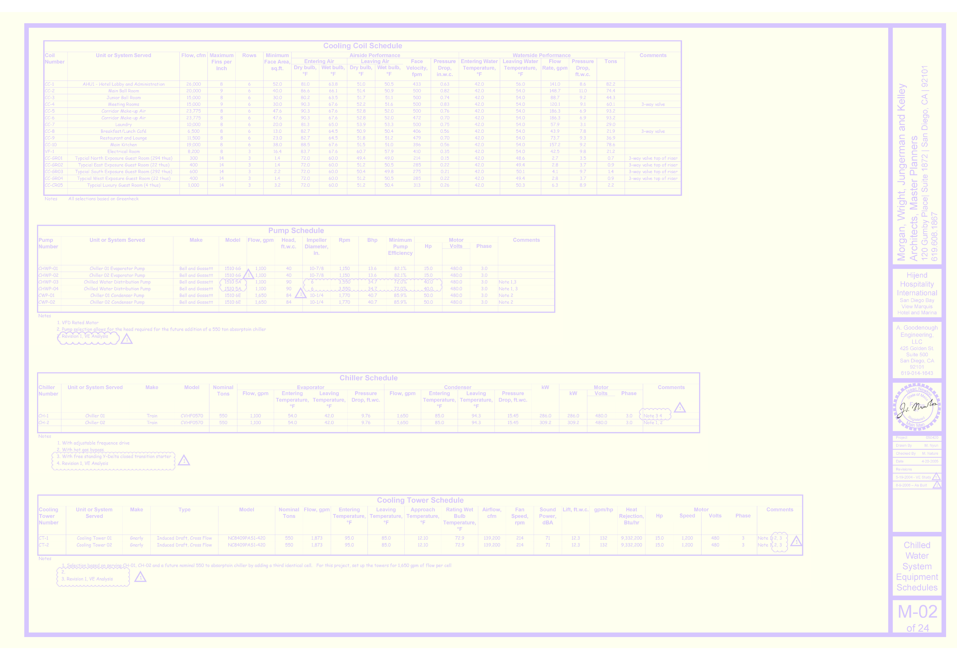
Cooling Coil Schedule

Slide 17
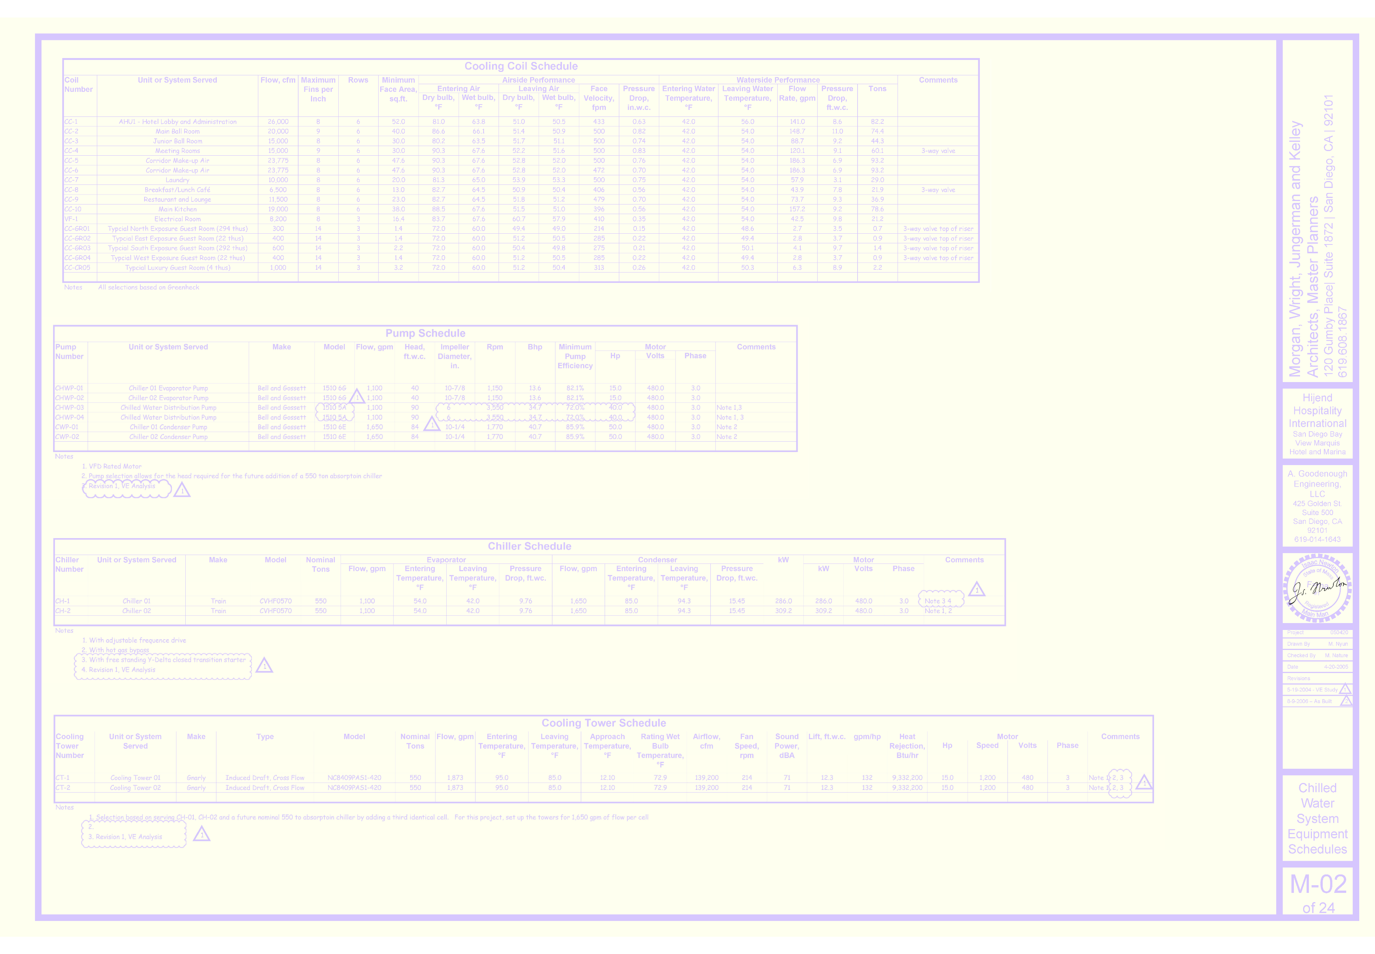
Cooling Coil Schedule

Slide 18
Break Out 1
Using the model of the plant or the video at this link or both …
https://tinyurl.com/Plantv442021-10-28
… answer the following questions
Are the chillers identical?
What is the basis for your conclusion?
How do the chiller run times and starts compare?
What does that tell you if anything?

Slide 19
Discussion

Slide 20
Break Out 2
Using the model of the plant or the video at this link or both …
https://tinyurl.com/Plantv442021-10-28
… field verify the portion of the CHW system diagram contained in the plant
Does the field verified diagram match the diagram developed from the mechanical drawings?

Slide 21
Discussion

Slide 22
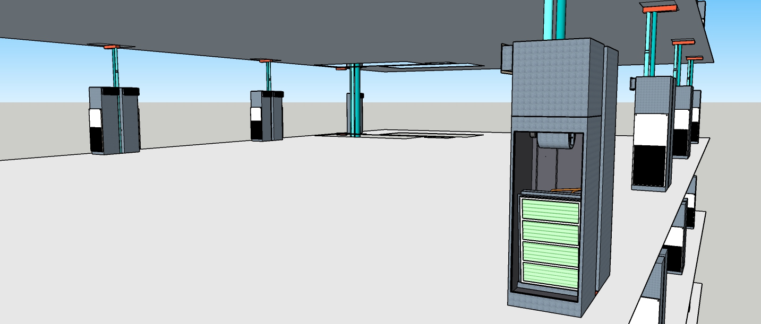
Break Out 3
Using the model of the chilled water system, field verify the details of the fan coil unit piping
Does the actual fan coil piping match the system diagram developed from the mechanical drawings?
If there are differences, what are they?
If there are differences, could they impact the way the central plant operates and if so, how?
(Pay particular attention to scenes 5, 6, and 7)

Slide 23
Discussion

Slide 24
Break Out 4
Using the two system diagrams that follow (Design Intent vs. As Installed), assess the entering water temperatures to the chillers with:
1,800 gpm flowing in the distribution loop
42°F supply to the distribution loop
54°F water returning from the distribution loop
Questions:
Does the difference between the design intent and as installed piping configuration make a difference?
Do features of the chillers play into this?

Slide 25
Design Intent System Diagram
Hijend Hotel CHW System Diagram
Sheet 1
A
TDV
TDV
1,100 gpm @ 90 ft.w.c., 40 hp (Typical)
SD
SD
Match Line – See Sheet 2
1,100 gpm from 54.0°F to 42.0°F, 9.8 ft.w.c. Δp, 286 kW
Chiller 1
1,100 gpm from 54.0°F to 42.0°F, 9.8 ft.w.c. Δp, 309 kW
Chiller 2
42.5 gpm from 42.0°F to 54°F, 9.8 ft.w.c. Δ p, 22.1 tons
VF-1 Elec. Rm.
TDV
TDV
1,100 gpm @ 40 ft.w.c., 15 hp (Typical)
SD
SD
B

Slide 26
As Installed System Diagram
As Installed
Hijend Hotel CHW System Diagram
Sheet 1
A
TDV
TDV
1,100 gpm @ 90 ft.w.c., 40 hp (Typical)
SD
SD
Match Line – See Sheet 2
1,100 gpm from 54.0°F to 42.0°F, 9.8 ft.w.c. Δp, 286 kW
Chiller 1
1,100 gpm from 54.0°F to 42.0°F, 9.8 ft.w.c. Δp, 309 kW
Chiller 2
42.5 gpm from 42.0°F to 54°F, 9.8 ft.w.c. Δ p, 22.1 tons
VF-1 Elec. Rm.
TDV
TDV
1,100 gpm @ 40 ft.w.c., 15 hp (Typical)
SD
SD
B

Slide 27
Discussion

Slide 28
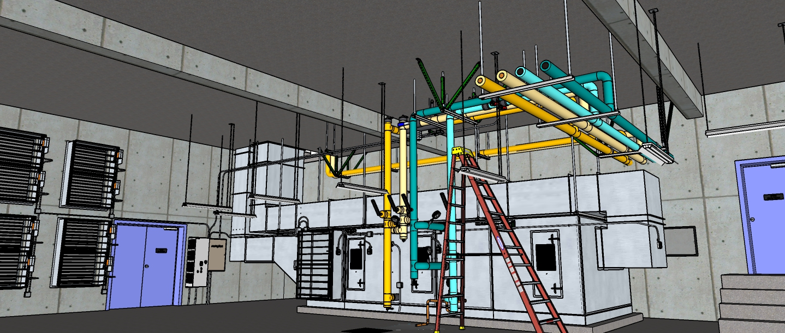
Scoping an AHU and Developing a Monitoring Plan

Slide 29
Break Out 5
Using the system diagram that follows along with the model of the Ball Room AHU or the video at this link or both …
https://tinyurl.com/BallRoomAHU2020
… identify potential resource conservation or performance improvement opportunities associated with the system
Note that for approximately 50% of the operating hours, only one side of the Ball Room is in use

Slide 31
Discussion

Slide 32
Break Out 6
Based on your scoping observations, what would your monitoring plan for this system look like?
The monitoring plan does not have to be the “full meal deal” version in David’s template but should include:
Points required
Sampling rate
Data source (data logger, control system or other resources)

Slide 33
Discussion

