Slide 1
2020 RCx Academy
Week 4
Air-Side Systems
3 June 2020

Slide 2
A Few References That Will Come Up
Information about COVID 19 and HVAC systems
https://av8rdas.wordpress.com/2020/05/30/taylor-engineerings-covid-19-white-paper/
Information about system effect
https://av8rdas.wordpress.com/2014/10/02/system-effectdealing-with-the-point-where-the-fan-meets-the-duct/
Information about filtration opportunities
https://www.av8rdas.com/ncbc.html#2015
Mixed air calculations spreadsheet
https://www.av8rdas.com/mixed-air-calculations.html
Economizer evaluation checklist
https://www.av8rdas.com/economizer-evaluation-checklist.html

Slide 3
A Few References That Will Come Up
Economizer Stratification Video
https://www.av8rdas.com/economizer-stratification.html
Economizer Stratification Blog Post
https://av8rdas.wordpress.com/2013/01/17/retrocommissioning-findings-economizer-mixed-air-plenum-stratificationoverview/
Pacific Energy Center Economizers; Design, Performance and Commissioning Issues Class Materials
https://www.av8rdas.com/pacific-energy-center-design-performance-and-commissioning-issues-classes.html#Economizers
Pacific Energy Center Fans, Ducts and AHUs; Design, Performance and Commissioning Issues Class Materials
https://www.av8rdas.com/pacific-energy-center-design-performance-and-commissioning-issues-classes.html#Fans

Slide 4
Taking a Closer Look at the Ball Room AHU
Some Floor Plans to Help You Stay Oriented

Slide 5
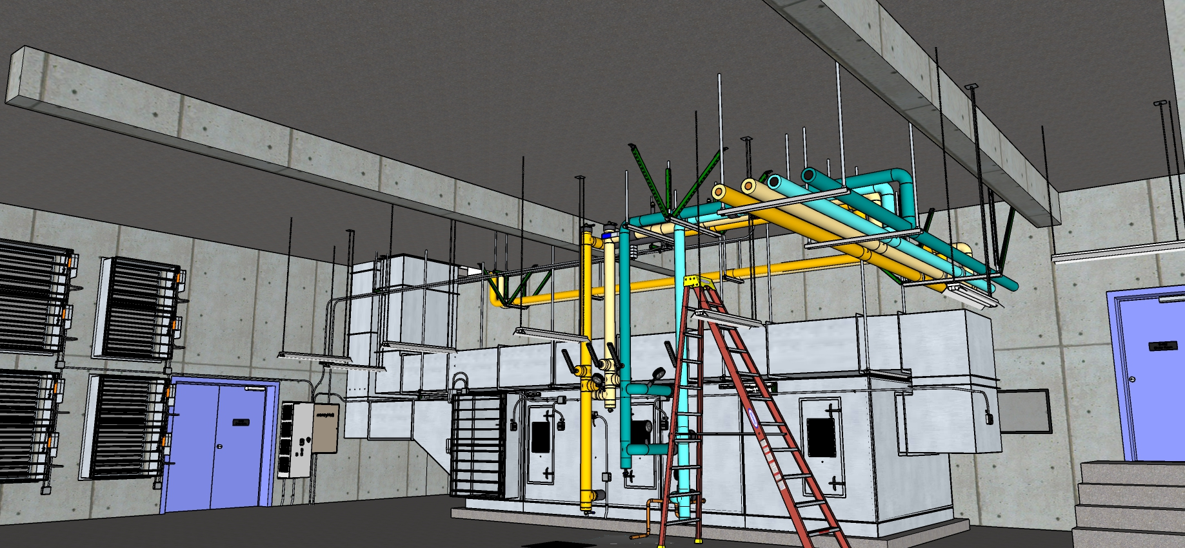
AHU Overview

Slide 6
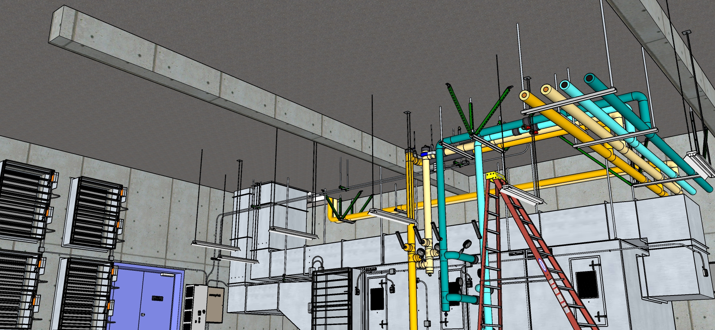
AHU System Overview

Slide 7
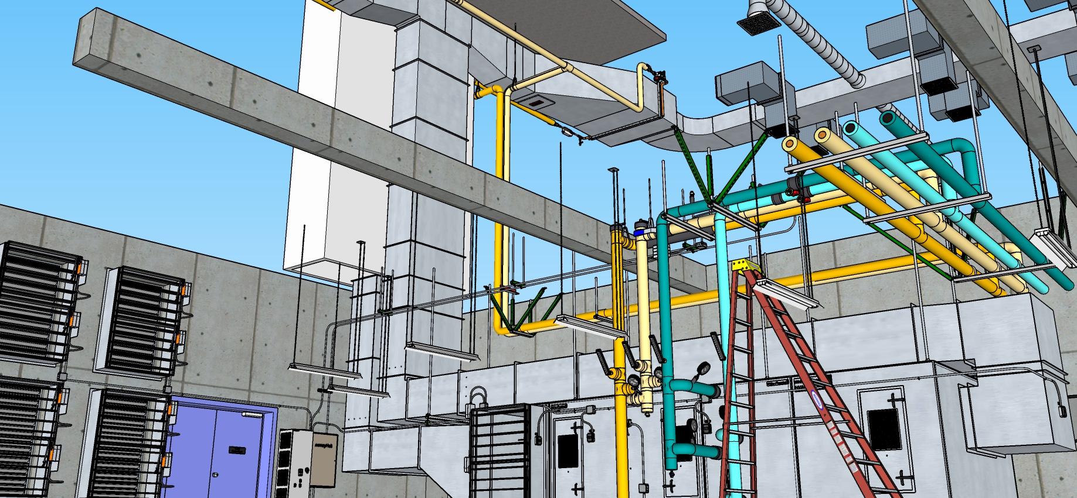
AHU System Overview

Slide 8
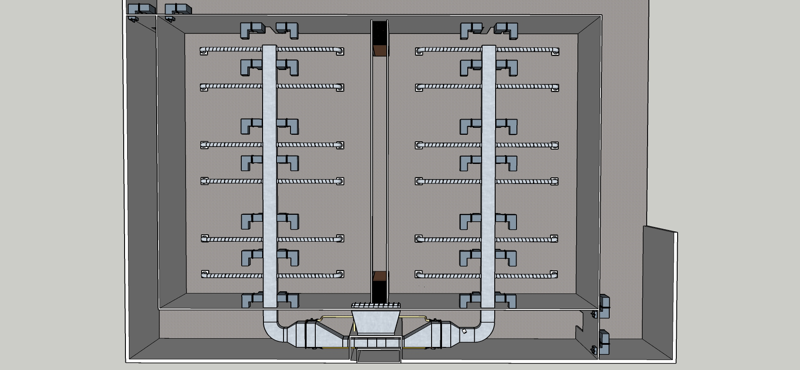
Ball Room Overview

Slide 9
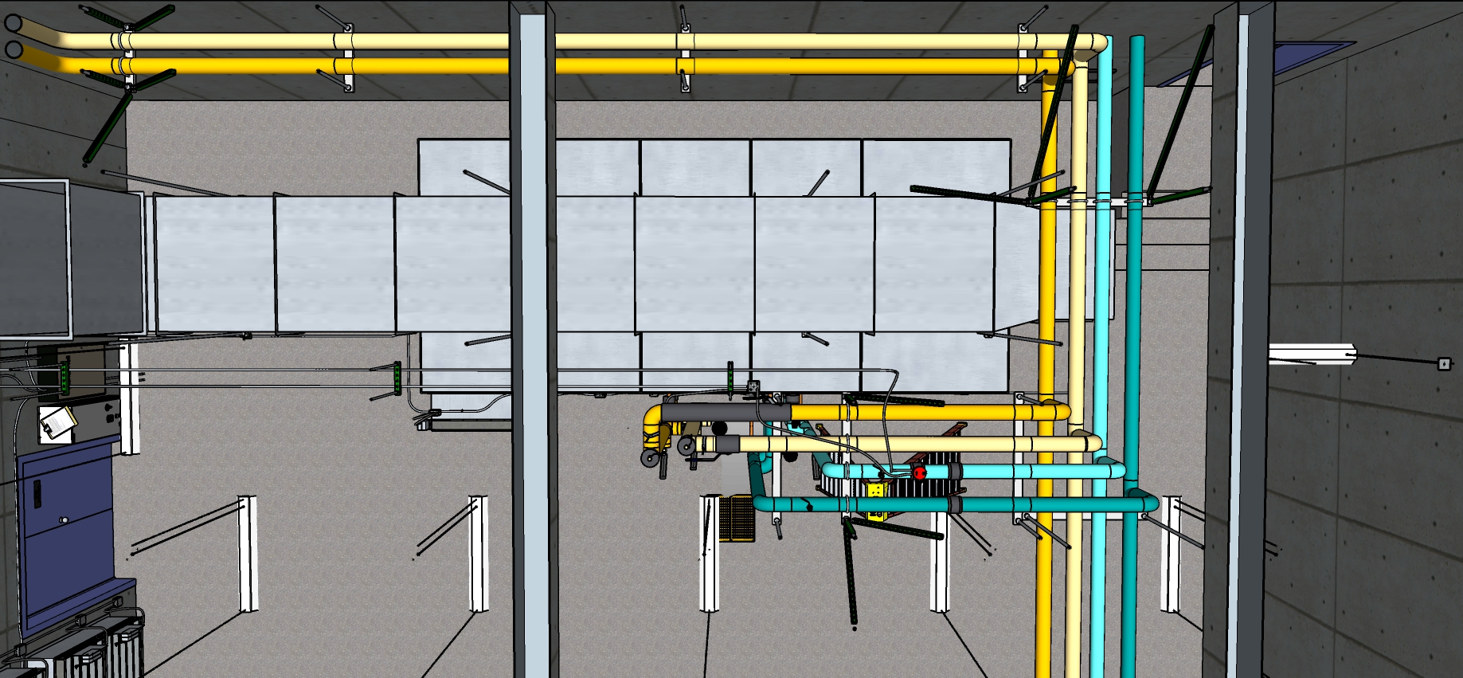
Mechanical Room Plan View

Slide 10
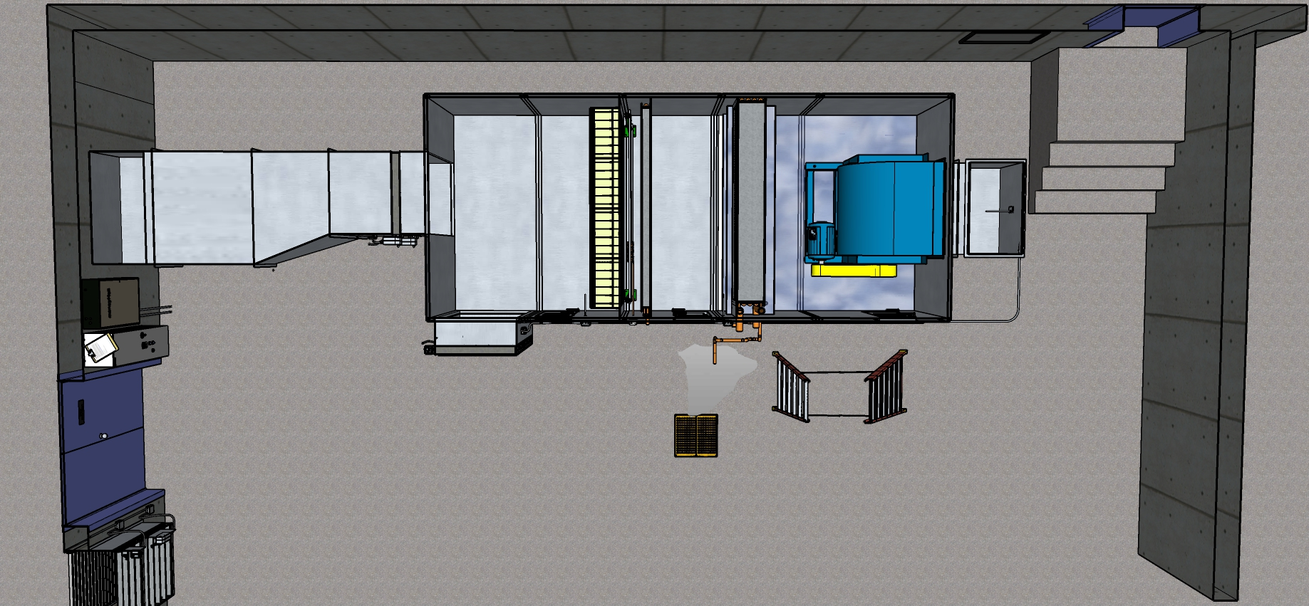
Mechanical Room Plan View – AHU Interior Exposed

Slide 11



A Bit About Dampers
Featuring
Parallel and Opposed Blade Action

Slide 12
Damper Parts
Parallel Blade Damper
Seals
Blades
Axles or Shafts
Frame

Slide 13
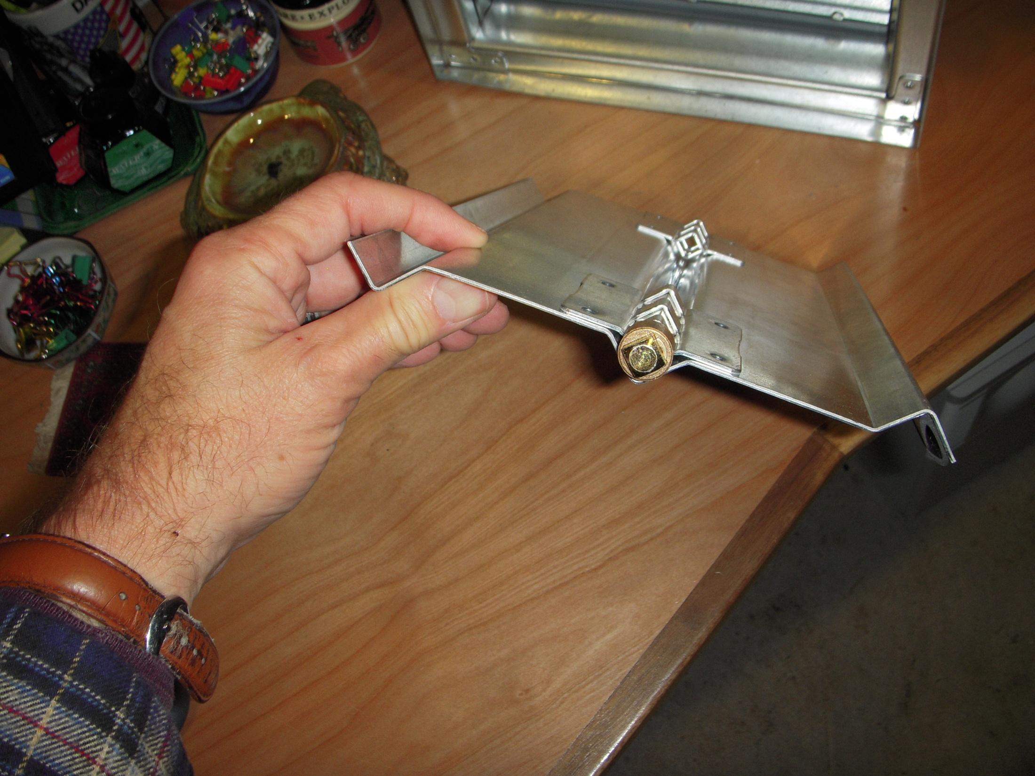
A Conventional, Flat Plate Blade Cross-Section

Slide 14
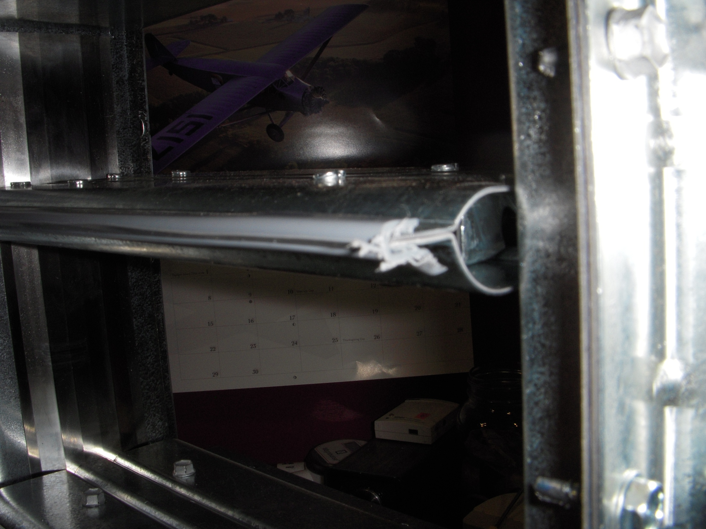
Greenheck’s Airfoil Blade Cross-Section

Slide 15
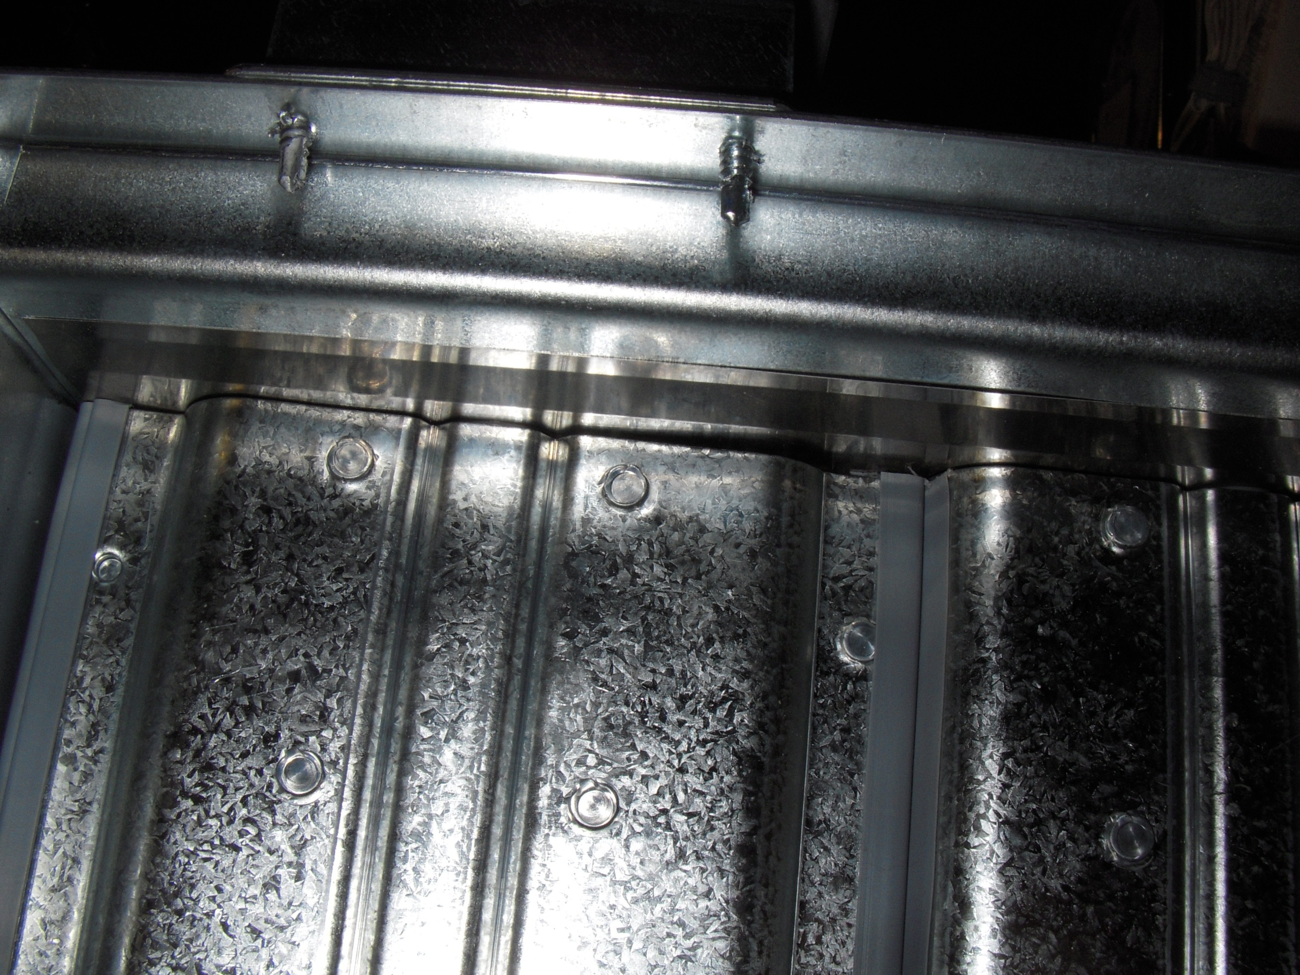
Seal Details
Jamb Seal
Blade seals

Slide 16
Parallel vs. Opposed Blade Dampers
Parallel Blade Damper
Opposed Blade Damper

Slide 17
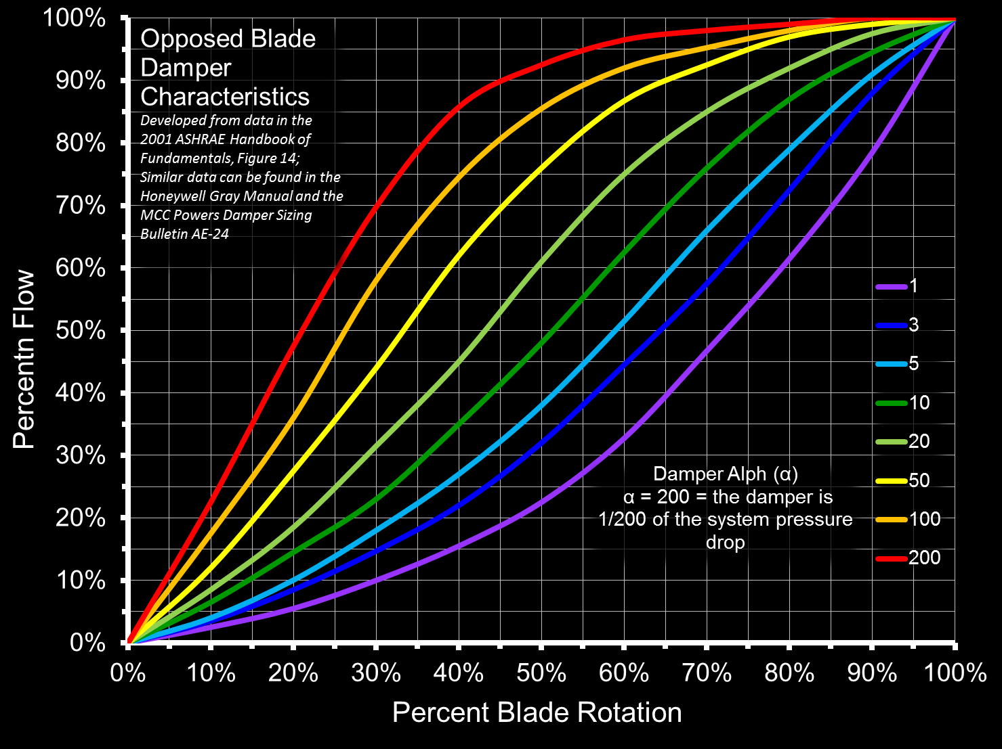
Dampers Need to be Sized for Modulating Control
Characteristics vary with damper design
Rules of thumb
  Pressure significant relative to the system
  Target face velocity of 1,500 to 2,500 fpm will usually work
  Air flow velocity conversions count in the over-all pressure loss

Slide 18
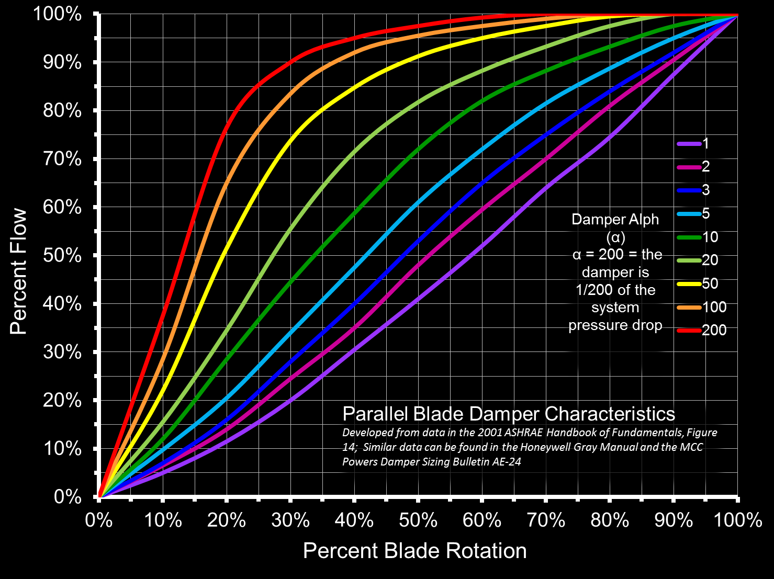
Opposed Blade Characteristics are Different from Parallel Blade Characteristics

Slide 19
Face Velocities of 1,500 – 2,500 fpm Will Generally Get You in the Range of a Linear Flow vs. Bade Rotation Curve

Slide 20

Thanks For Watching!
The End

Slide 21
Taking a Closer Look at an Economizer
Some Floor Plans to Help You Stay Oriented

Slide 22
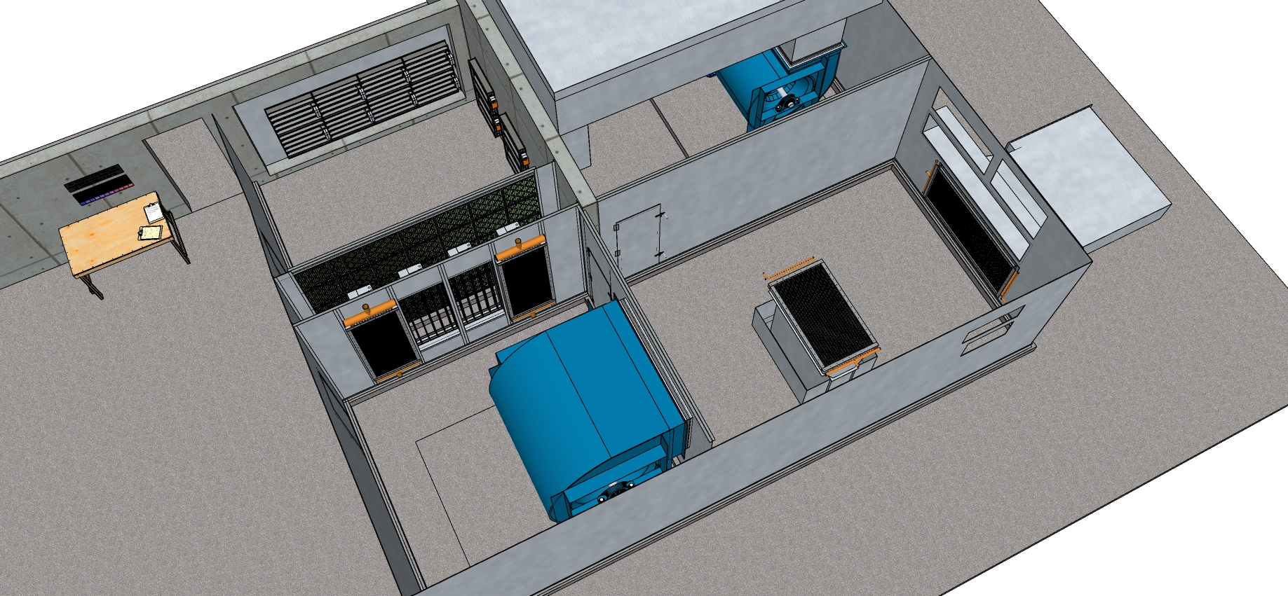
Overview

Slide 23
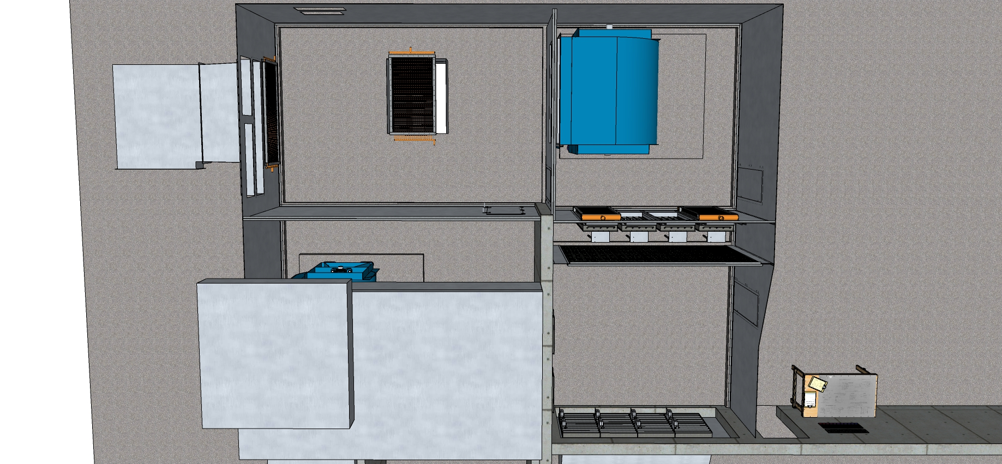
Plan View

Slide 24
A Break and an Exercise
Given:
The economizer evaluation checklist
The images that follow
The maximum face velocity rule of thumb;
  Face velocities through filters and coils are generally held between 350 and 500 feet per minute to minimize the potential for blowing water off a condensing cooling coil and to manage fan energy
The damper face velocity rule of thumb:
  Damper face velocities probably need to be in the 1,500 to 2,500 fpm range at design flow to provide a semi-linear control characteristic
Evaluate the economizer in the Le Conte AHU
How well do you think it mixes?
How linear to you think the flow vs. pressure drop relationship is as the dampers stroke?
Is the sensor located in a good position to control the dampers?
Etc.

Slide 25
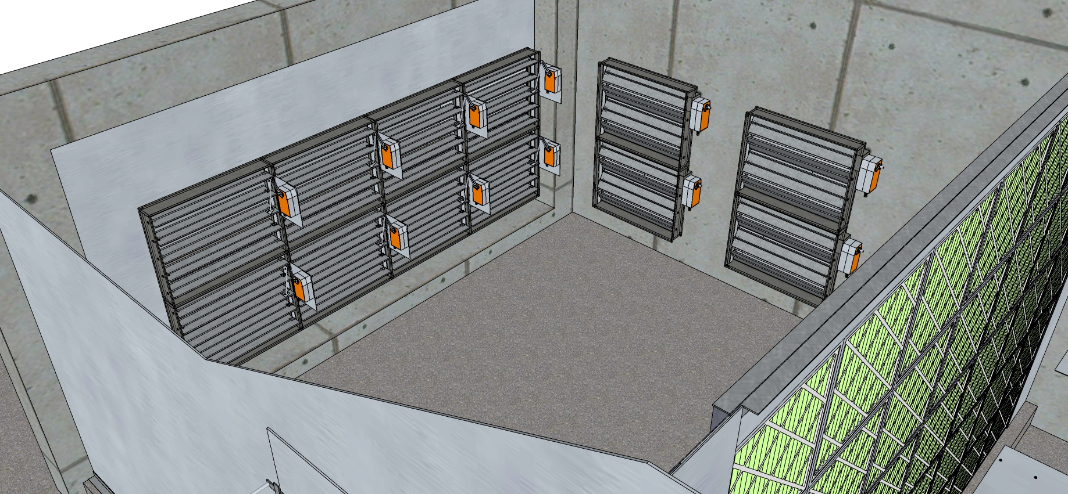
Mixed Air Plenum Overview

Slide 26
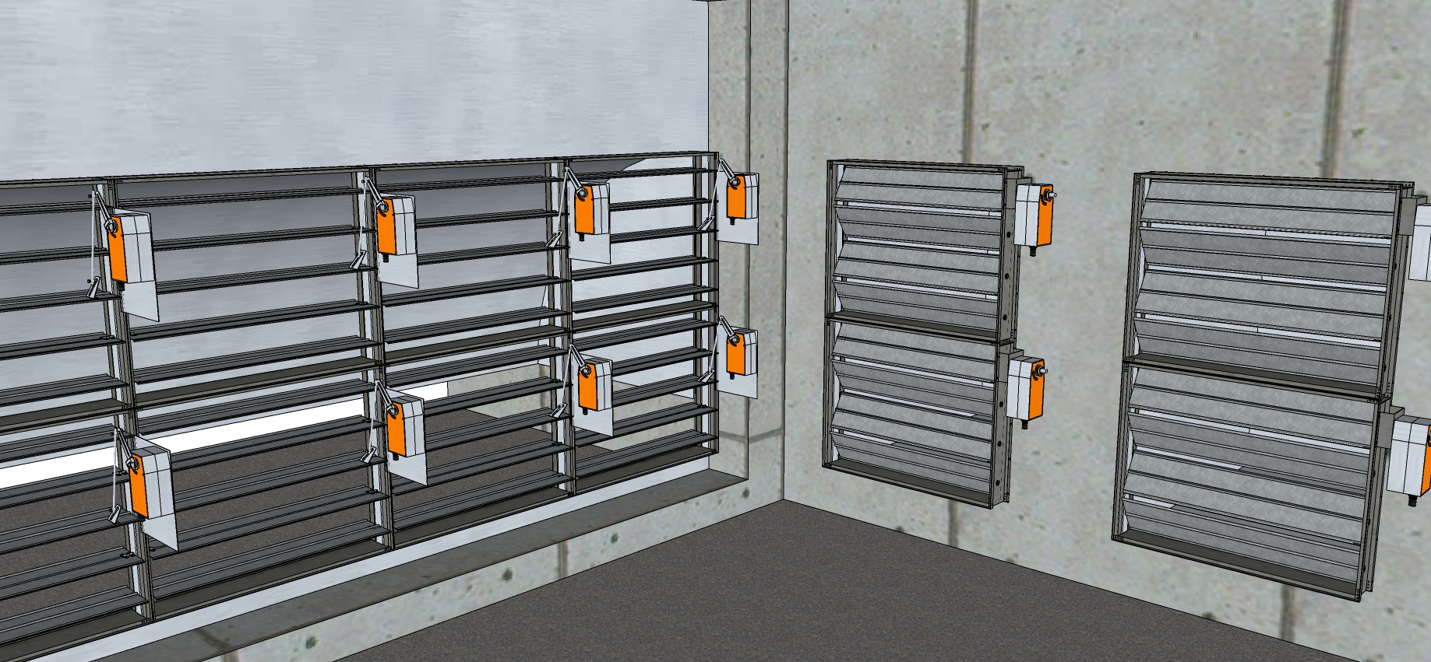
Outdoor Air and Return Air Dampers

Slide 27
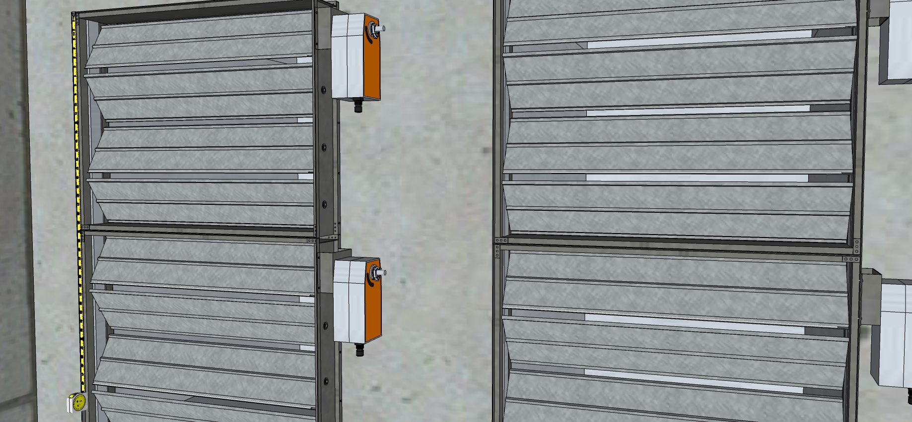
A Close-up of the Return Dampers

Slide 28
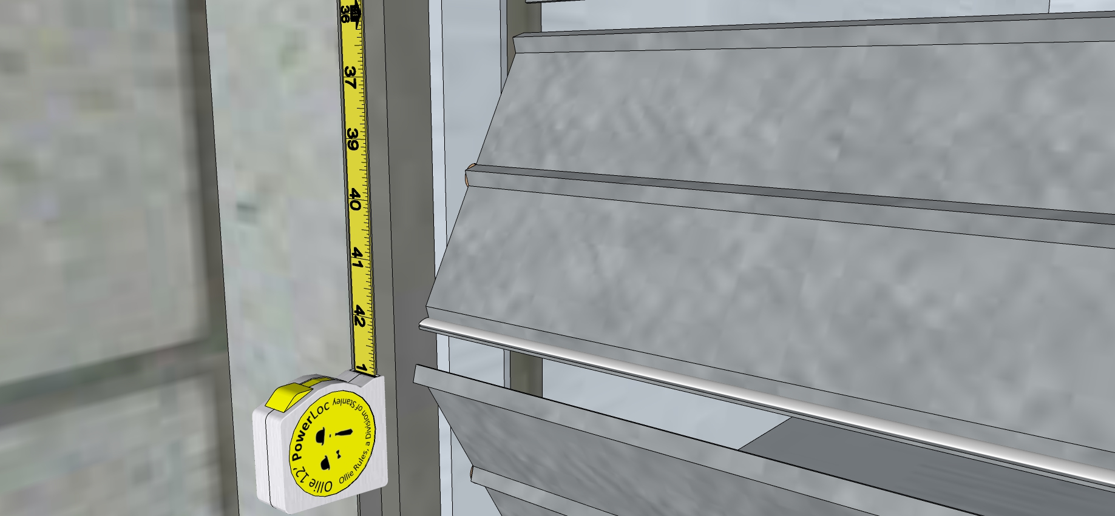
A Even Closer-upper of the Return Dampers

Slide 29
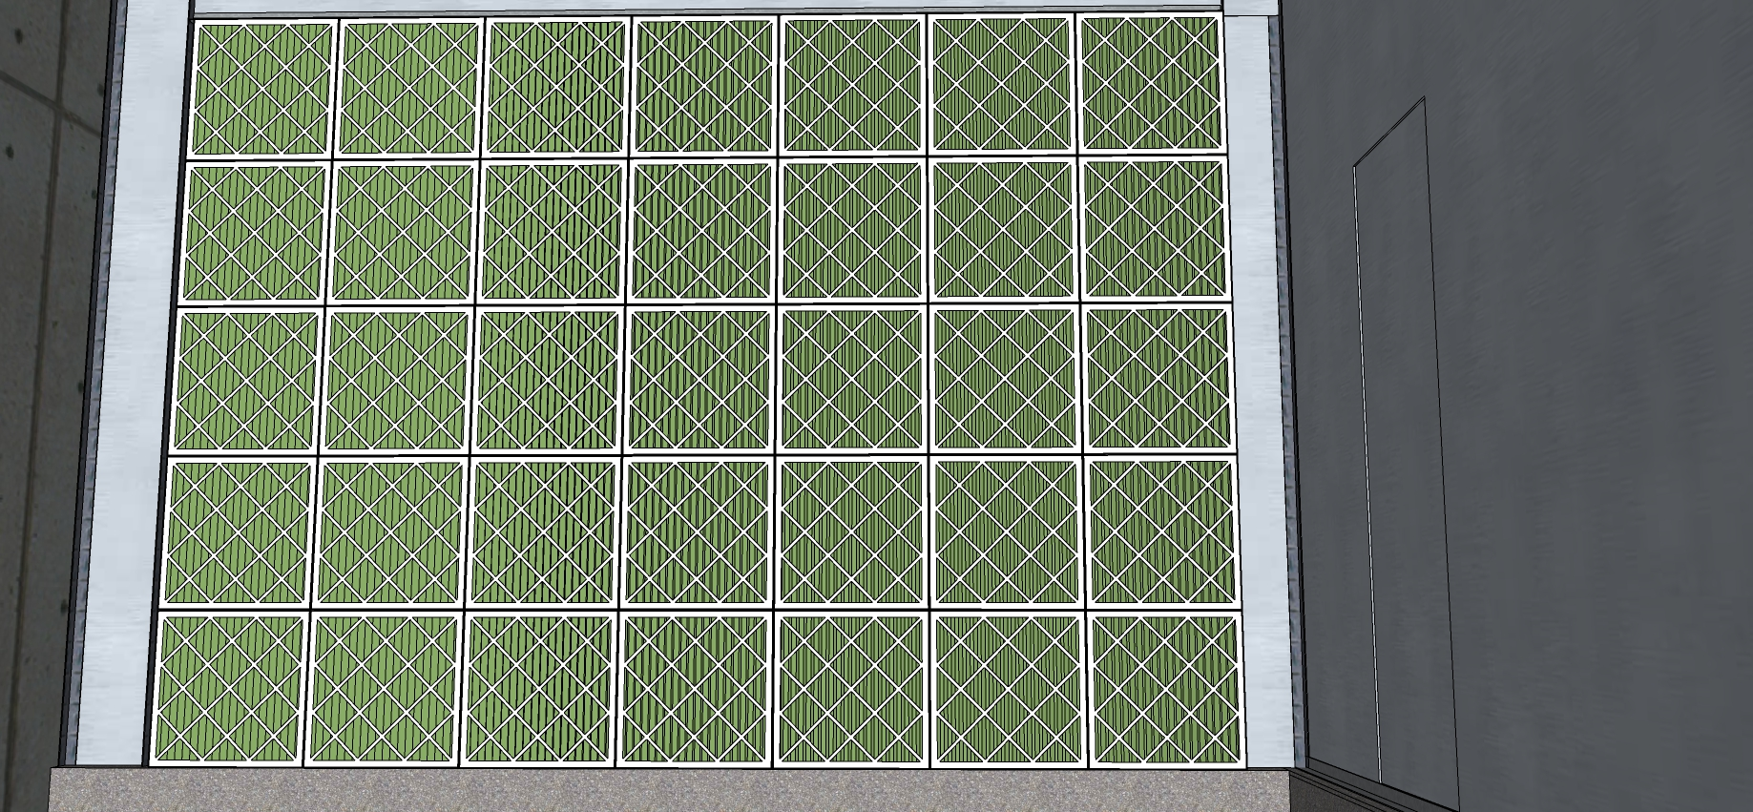
The Filter Bank

Slide 30
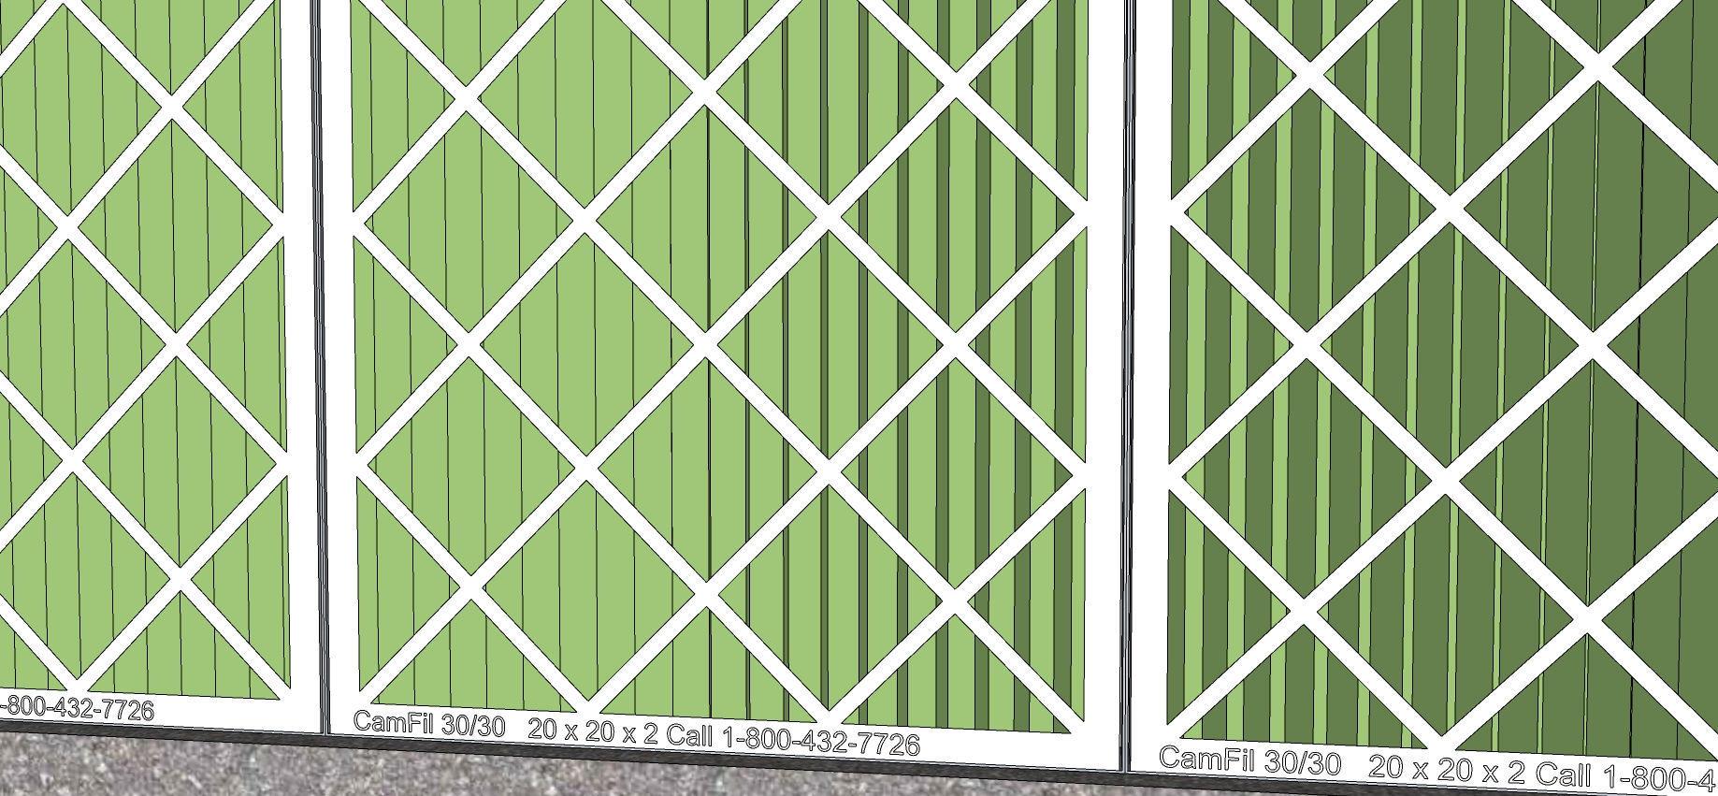
A Close-up of the Filters

Slide 31
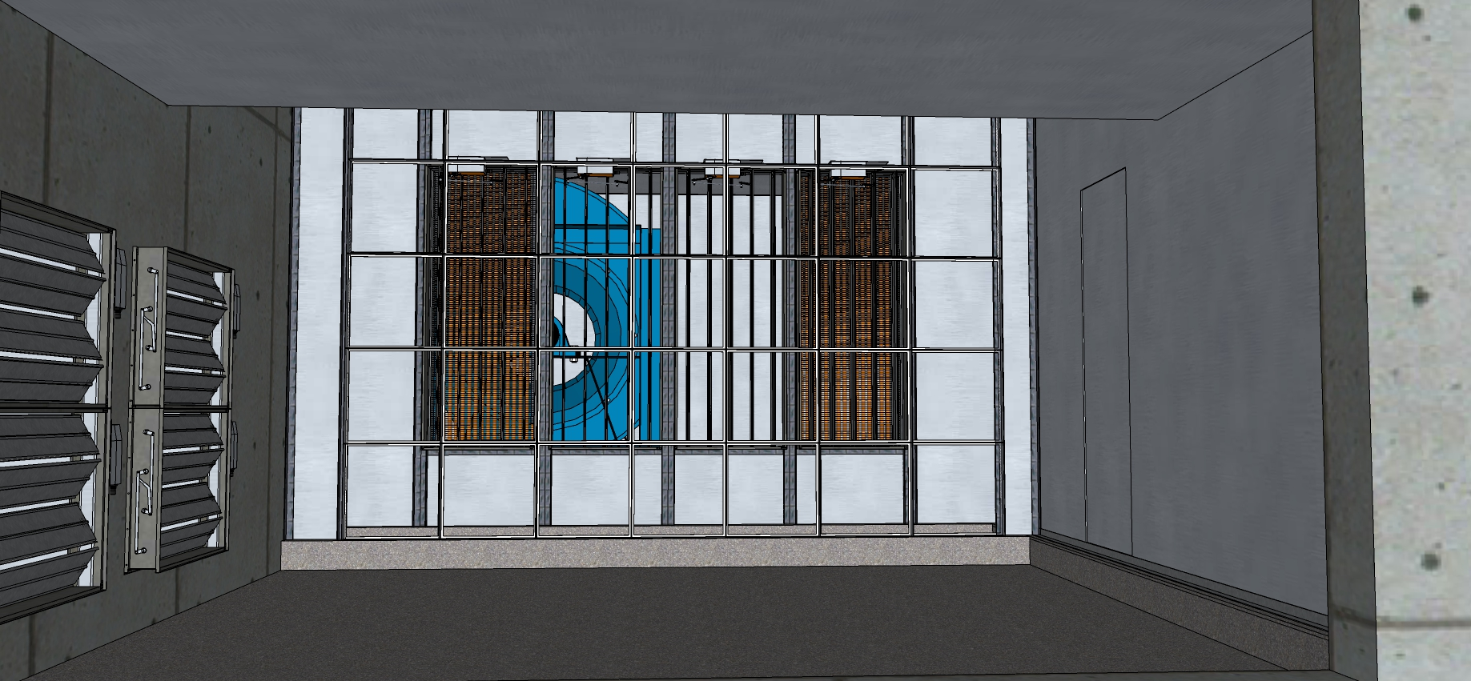
Looking Through the Filter Bank with No Filters

Slide 32
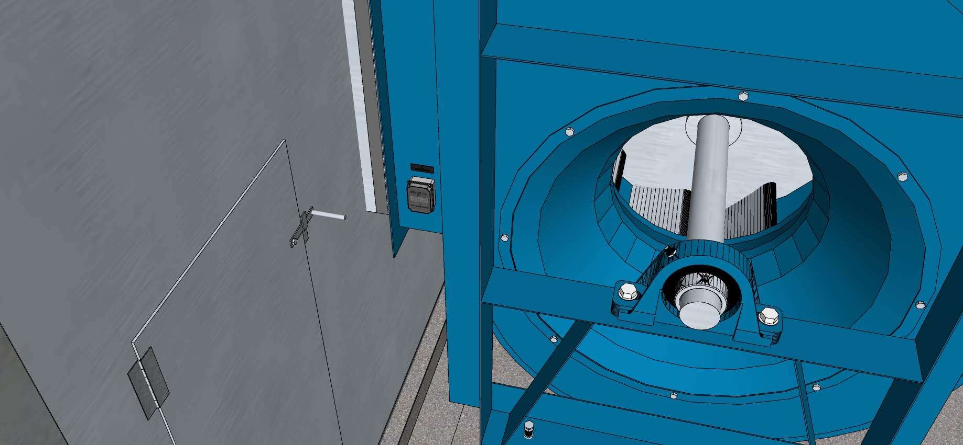
The Fan Discharge

Slide 33
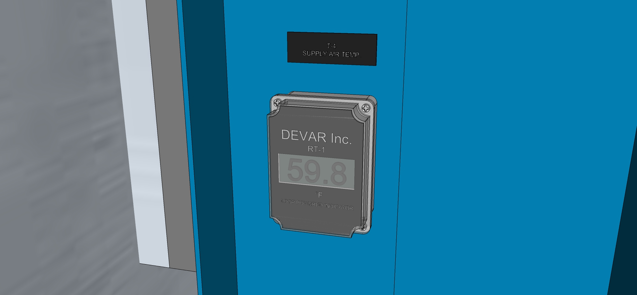

Slide 34
A Temperature Sensor

Slide 35
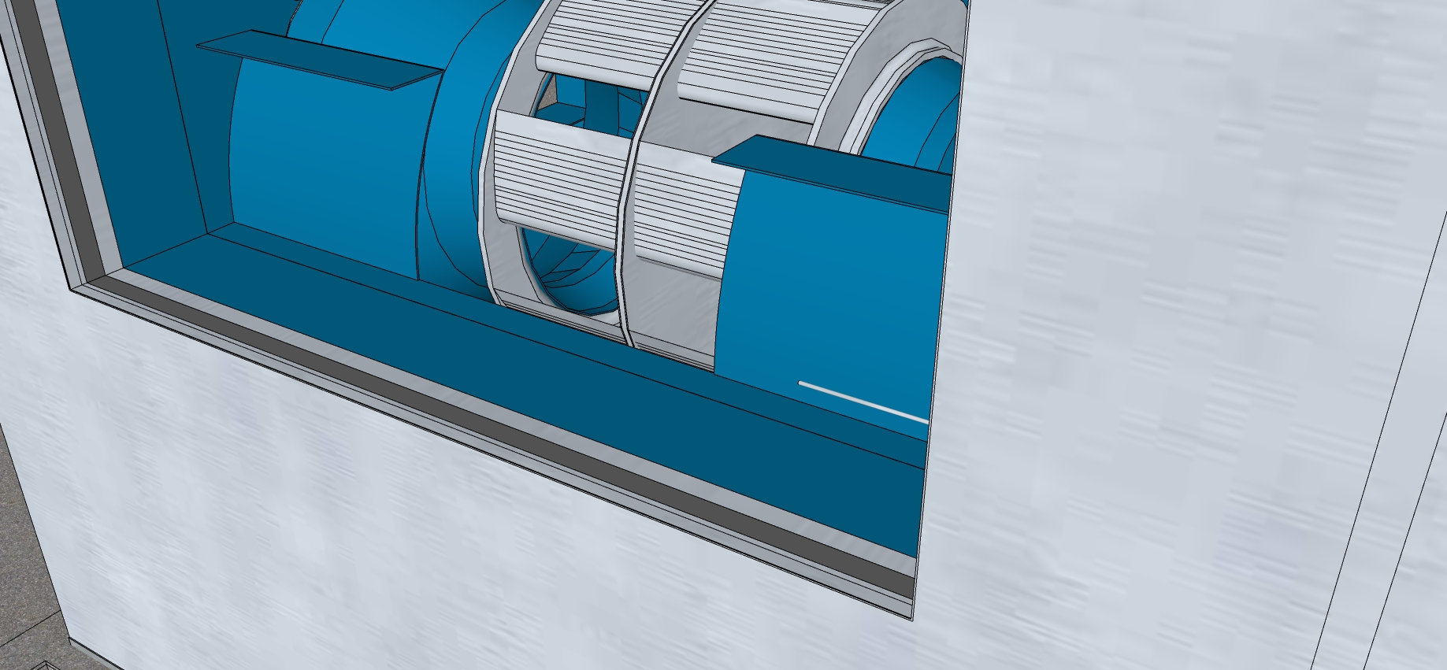
The Temperature Sensor from a Different Angle

Slide 36
Indicators of Potential Economizer Issues
Damper sizes are very different (outdoor air vs. return air); thus, they will have different characteristics
  The resistance to flow of the outdoor air damper on 100% outdoor air will likely be less than the resistance to flow or the return air damper on 100% return air
  Assuming the system does not have a large minimum outdoor air percentage and that it has a constant speed fan, as you drive to 100% OA, the fan will run out its curve and move more air than necessary (or on 100% RA, it will move less air than necessary)
No apparent independent minimum outdoor air regulation method
Damper sizing check indicates the outdoor air damper is oversized (next slide)
Single point sensor after the fan will still see stratified air due to the configuration of the fan wheel and the orientation of the fan relative to the stratification
Blade seals are mostly missing

Slide 37
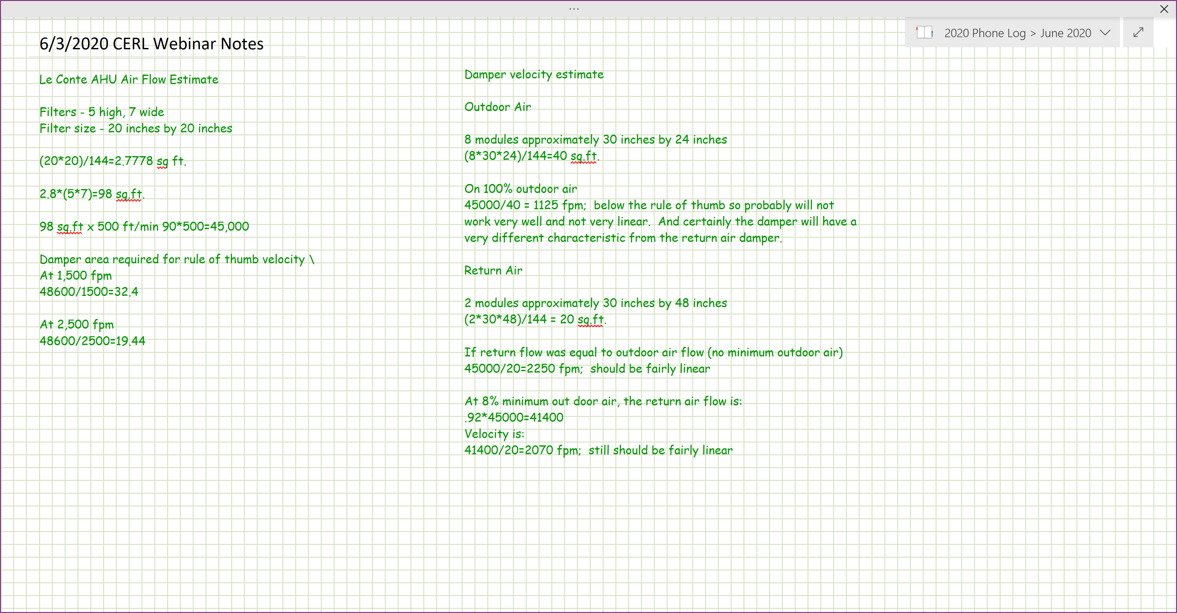
Damper Sizing Check

Slide 38
The Office Hours Challenge
Given:
The images that follow
The maximum face velocity rule of thumb;
  Face velocities through filters and coils are generally held between 350 and 500 feet per minute to minimize the potential for blowing water off a condensing cooling coil and to manage fan energy
The formulas that follow
Estimate
The load on the motor
The system static pressure

Slide 39
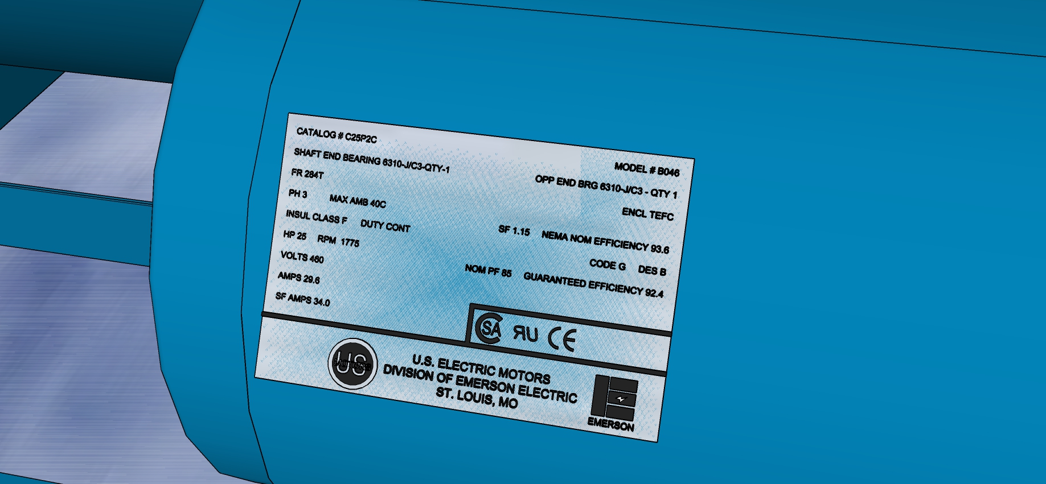
The Motor Nameplate

Slide 40
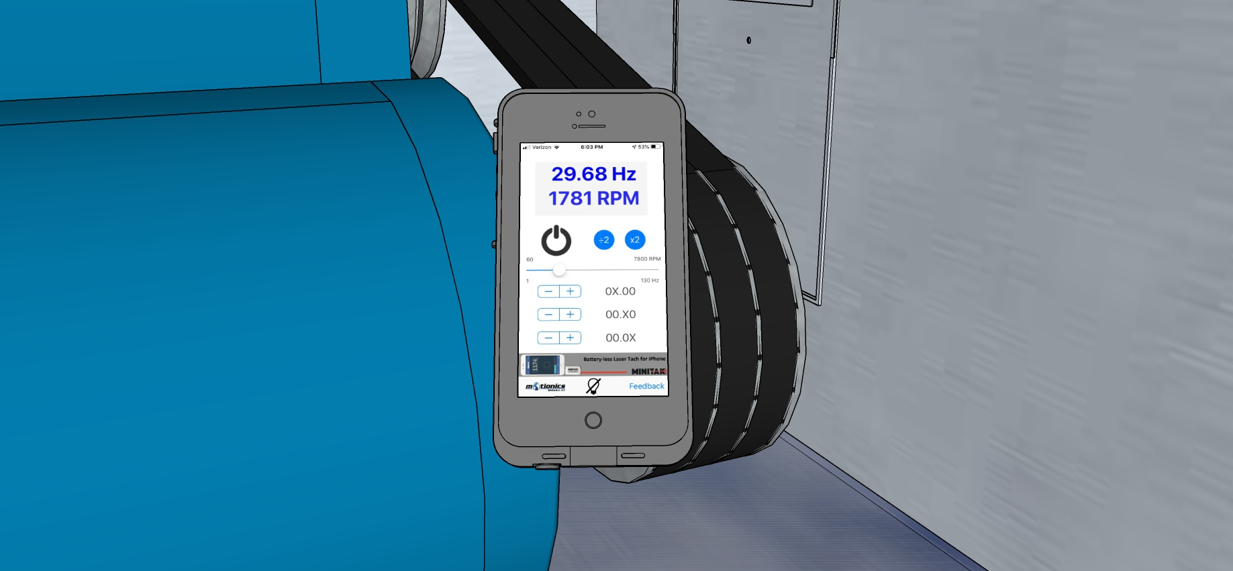
The Motor Speed

Slide 41
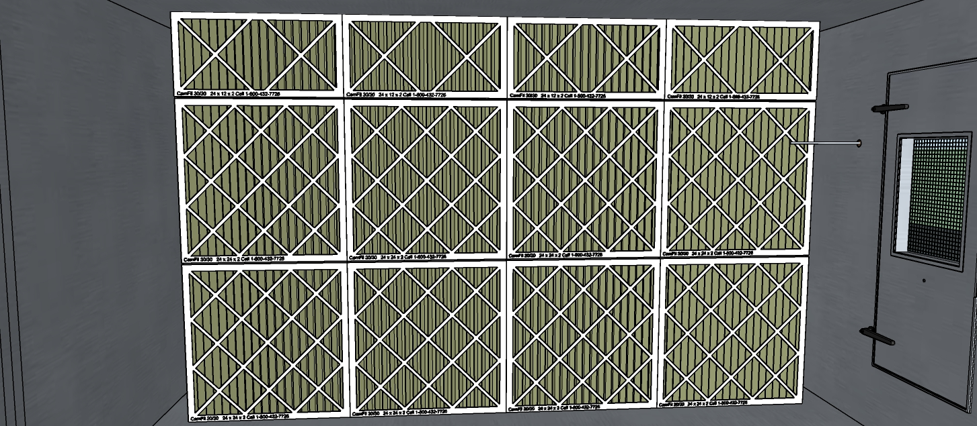
Filter Bank

Slide 42
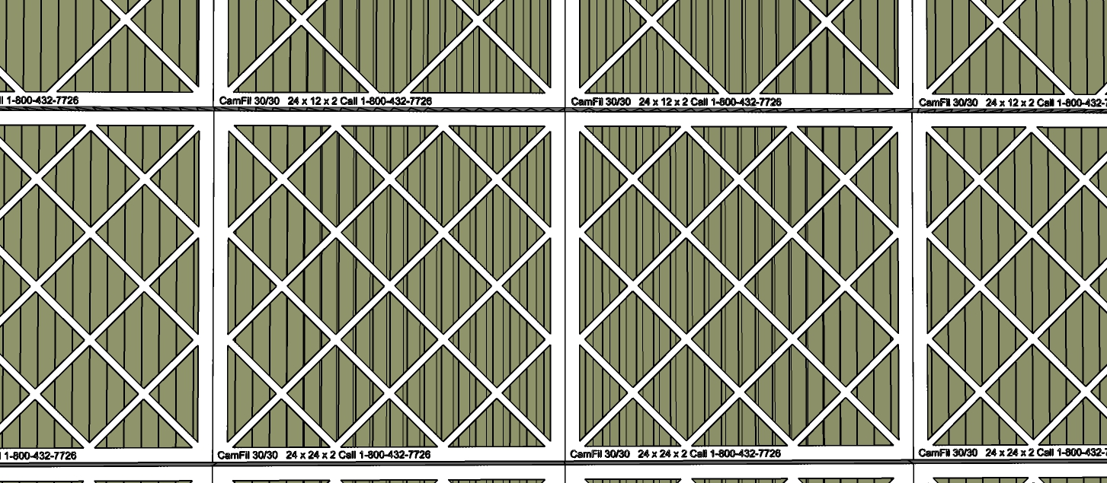
Filter Detail

Slide 43
The Relationship Between Slip and Motor Load

Slide 44
The Relationship Between Slip and Motor Load

