Slide 1
Affinity Laws
David Sellers; Facility Dynamics Engineering
Senior Engineer

Slide 2
Parallel Pumps
Increasing Head
Increasing Flow
If both pumps are operating at the same speed and one fails, the operating point shifts down the system curve to the point where the single pump curve crosses it; typically more than 50% of the original flow but at less head
Notes:
H F
7.84 8.00
6.00 7.00
3.06 5.00
1.10 3.00
0.49 2.00
0.12 1.00
0.00 0.00

Slide 3
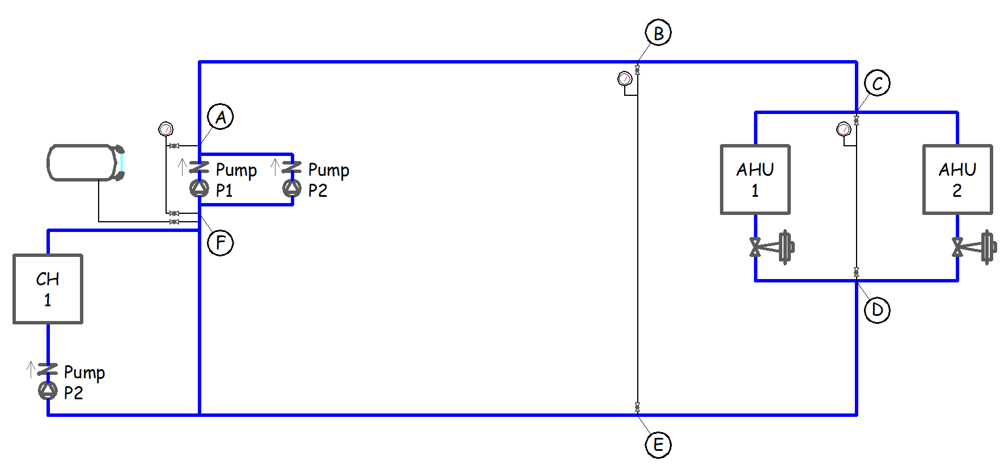
Assume the pumps are 100% redundant
    What should the logic be, specifically, to operate the pumps on a lead/lag basis?

Slide 4
Assume the pumps are 100% redundant
    Is there any problem with running one pump and starting the other pump if a failure is detected?

Slide 5
Assume the pumps are 100% redundant
    Will running two pumps at reduced speed save energy relative to running one pump at full speed?

Slide 6
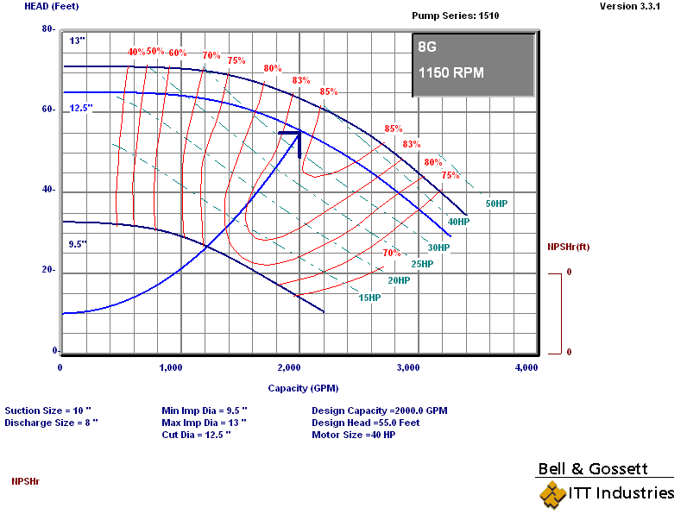
One Pump Operating Point
Single Pump Operating Point
2,000 gpm
55 ft.w.c.
12.5 inch impeller
1,150 rpm
84% efficiency
33.1 bhp

Slide 7
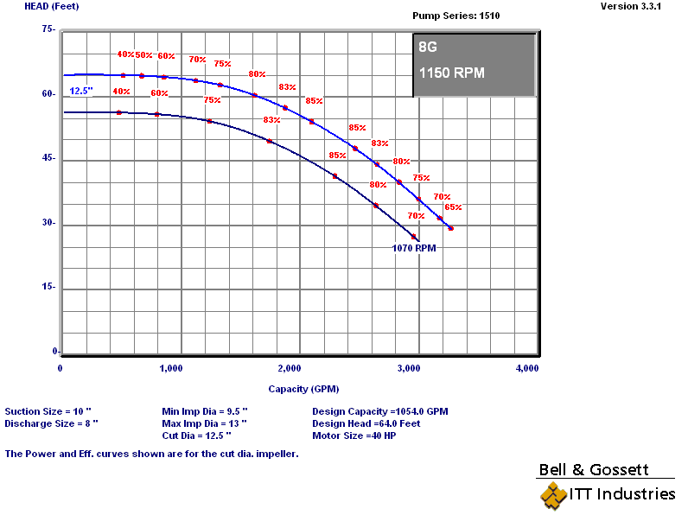
Two Pumps Doing What One Could Do
Each Pump Moves Half the Flow at the Design Head
Single Pump Operating Point
1,000 gpm
55 ft.w.c.
12.5 inch impeller
1,070 rpm
70% efficiency
19.8 bhp

Slide 8
Two Pumps Doing What One Could Do
Each Pump Moves Half the Flow at the Design Head
Both Pumps Operating Together
2,000 gpm
55 ft.w.c.
12.5 inch impeller
1,070 rpm
70% efficiency
39.6 bhp

Slide 9
Two Pumps Doing What One Could Do
Each Pump Moves Half the Flow at the Design Head
Both Pumps Operating Together
2,000 gpm
55 ft.w.c.
12.5 inch impeller
1,070 rpm
70% efficiency
39.6 bhp (vs. 33.1)

Slide 10
The Motor Efficiency Changed
19.8 bhp
33.1 bhp

Slide 11
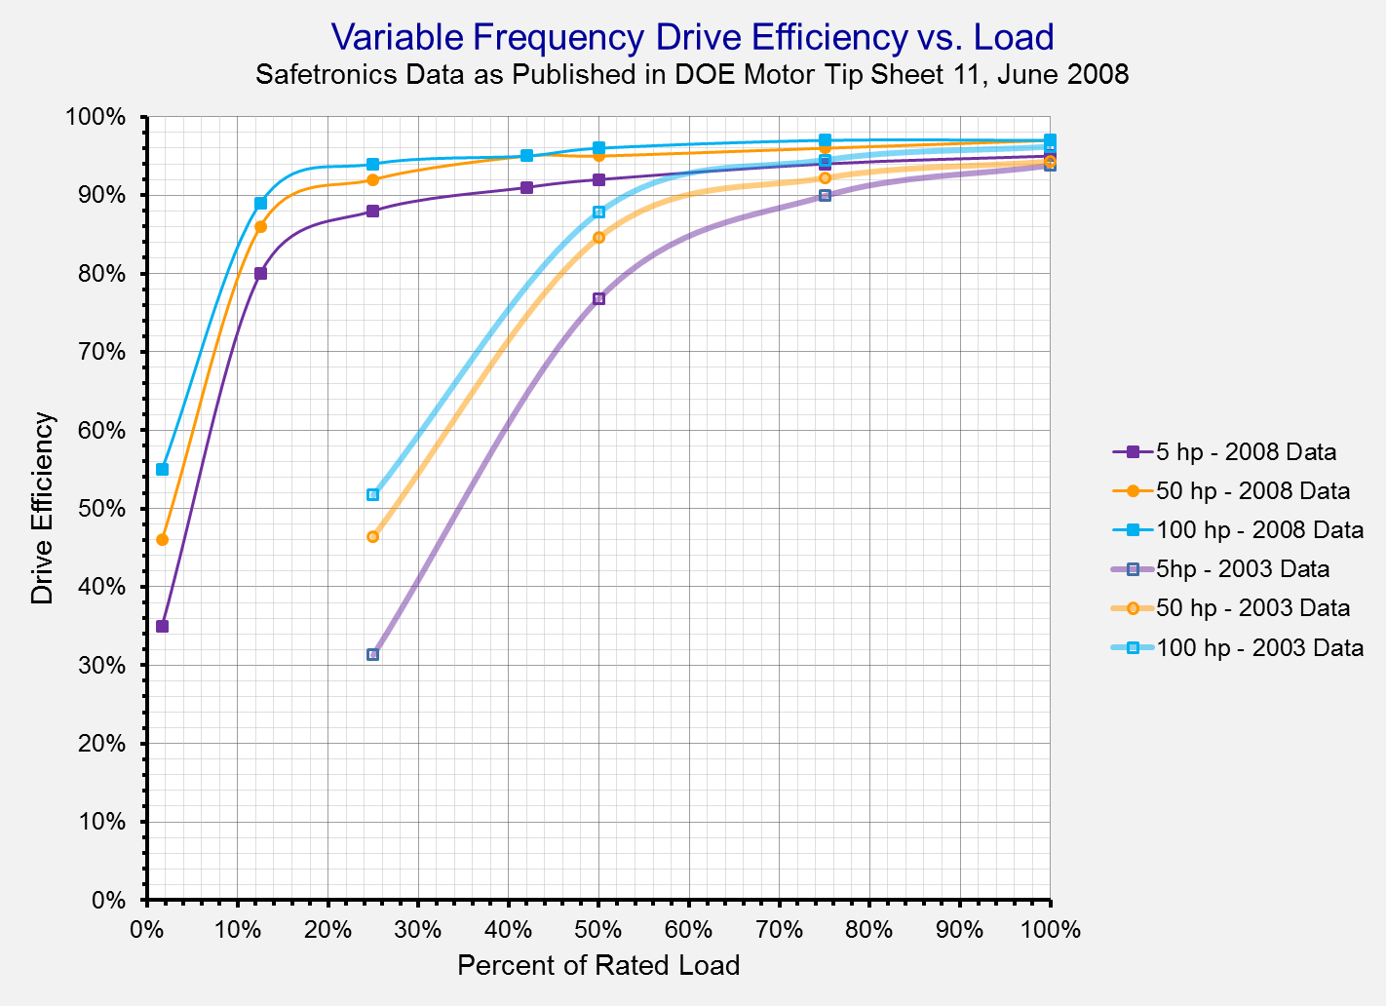
The Drive Efficiency Changed

Slide 12
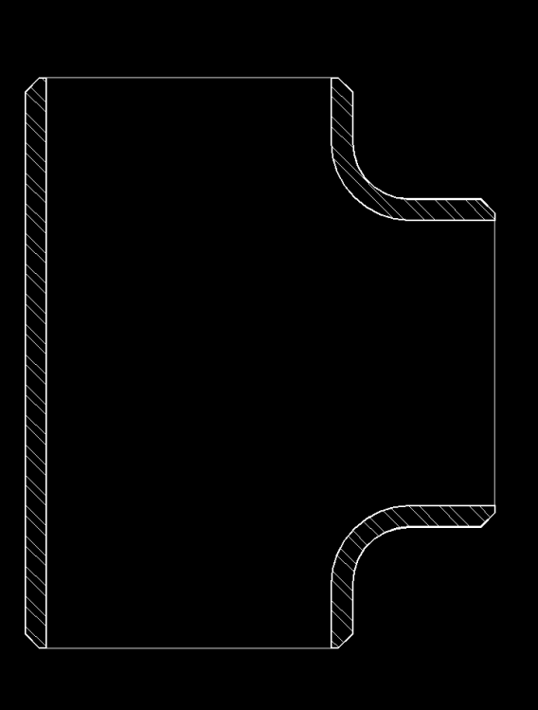
The Fluid Mechanics Changed
One Pump

Slide 13
The Fluid Mechanics Changed
One Pump

Slide 14
The Bottom Line
You’re Still Doing the Same Amount of Work
But probably not as efficiently

Slide 15
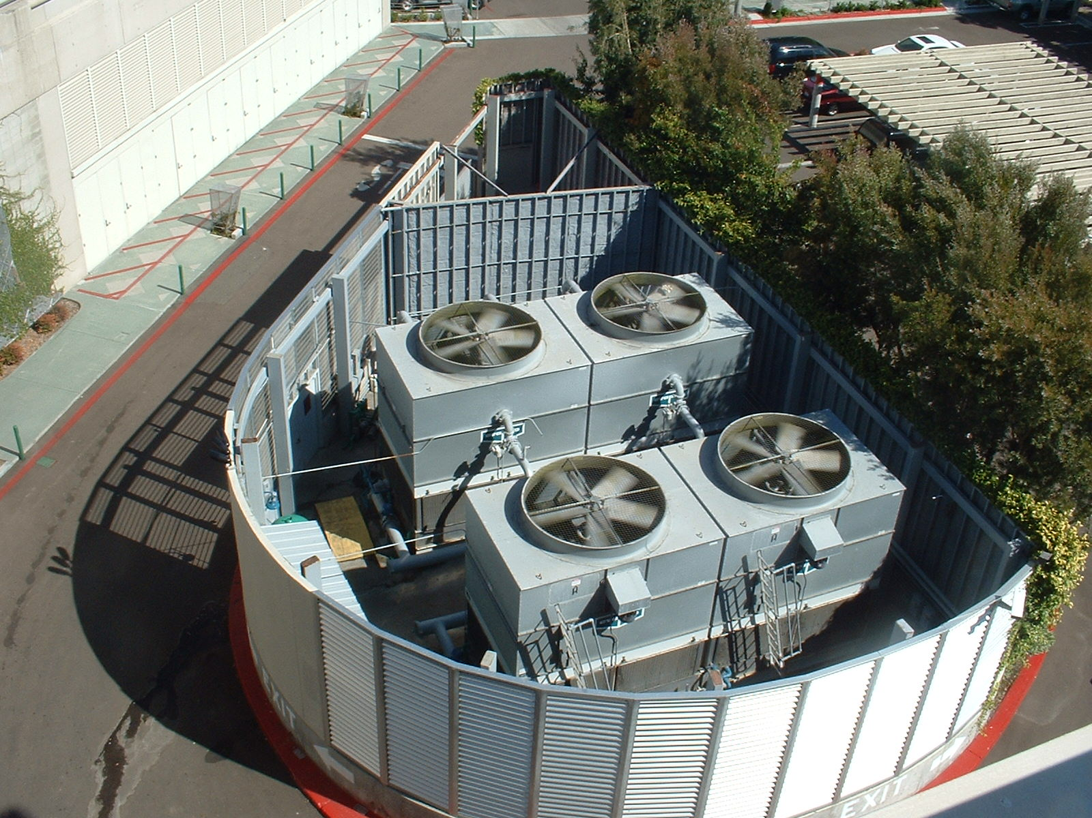
What About Running Two Tower Fans at Half Speed vs. One at Full Speed?

Slide 16

Same Question for These Towers?

Slide 17
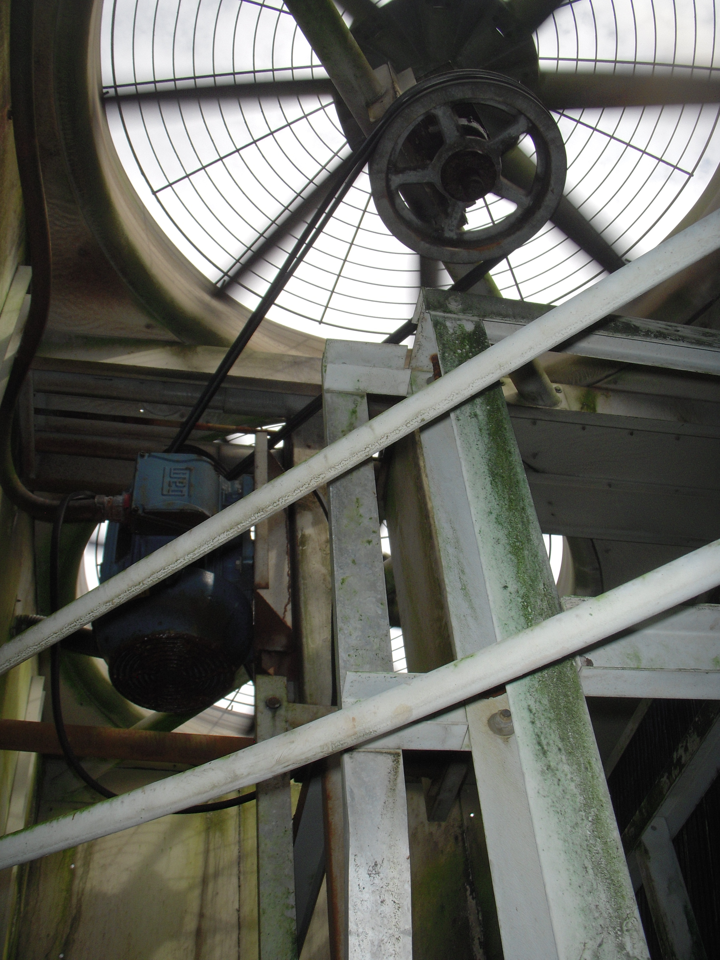
Same Question for These Towers?

Slide 18
Resources
The slides that follow this look at the topic a different way
https://www.av8rdas.com/affinity-laws.html#Wrong
https://www.av8rdas.com/ashrae---engineers-notebook.html#NPlus1

Slide 19
The Affinity Laws and Pump Energy
When They Can and Can’t Be Used to Predict Energy Savings and Why

Slide 20
Applying the Affinity Laws To Predict Performance
Approximate relationships
  In most practical applications, the pump impeller is trimmed
  Other dimensions do not change in proportion to the impeller changes
    Leakage losses impacted
    Hydraulic losses impacted
Notes:
900 50.40
750 35.00
500 15.56
250 1.73
0 0.00

Slide 21
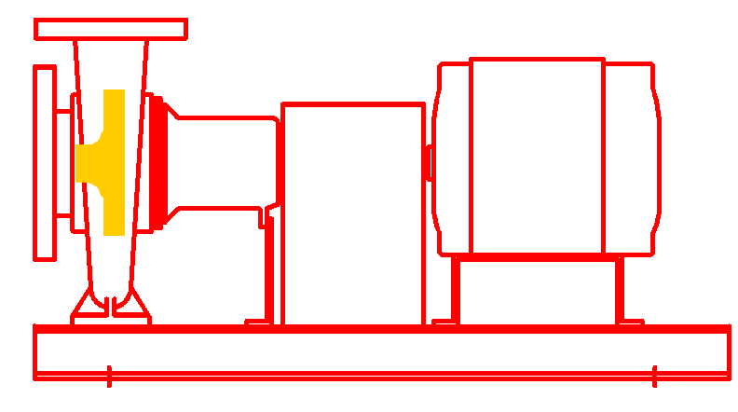

Applying the Affinity Laws To Predict Performance
The affinity laws assume geometric similarity
Proportional relationship between impeller and casing dimensions
Pump drawing courtesy of Bell and Gossett
Notes:
900 50.40
750 35.00
500 15.56
250 1.73
0 0.00

Slide 22
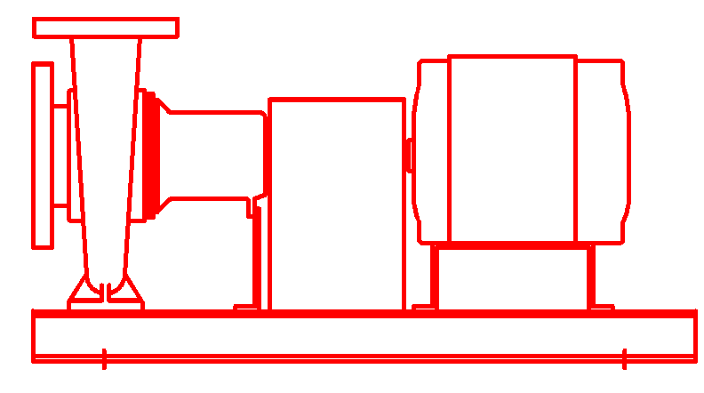
Applying the Affinity Laws To Predict Performance
Changing the impeller outside diameter with out changing the eye diameter and casing size is different
Affinity Law Predictions
Pump drawing courtesy of Bell and Gossett
Notes:
900 50.40
750 35.00
500 15.56
250 1.73
0 0.00

Slide 23
Applying the Affinity Laws To Predict Performance
Changing the impeller outside diameter with out changing the eye diameter and casing size is different
Actual performance based on testing
Pump drawing courtesy of Bell and Gossett
Notes:
900 50.40
750 35.00
500 15.56
250 1.73
0 0.00

Slide 24
Applying the Affinity Laws To Predict Performance
Changing the impeller outside diameter with out changing the eye diameter and casing size is different
The effect is most pronounced with smaller pumps and large trims
Pump drawing courtesy of Bell and Gossett
Notes:
900 50.40
750 35.00
500 15.56
250 1.73
0 0.00

Slide 25
Parallel Pumps and Affinity Laws
The pump affinity laws say that horse power varies as the cube of the flow rate.
HP_{New} = HP_{Old} x (Flow_{New}/Flow_{Old})³
Will two pumps in parallel use 1/8th (1/2 x 1/2 x 1/2) of the power required by running only one of the pumps to produce the same flow rate and head?

Slide 26
System 1:
Two Independent Fully Redundant Circuits

Slide 27
System 2:
Shared Circuit, Redundant Pumps

Slide 28
System 1: Head Loss Calculation
One Pump Provides All Flow
One circuit has loss as calculated
One circuit is inactive

Slide 29
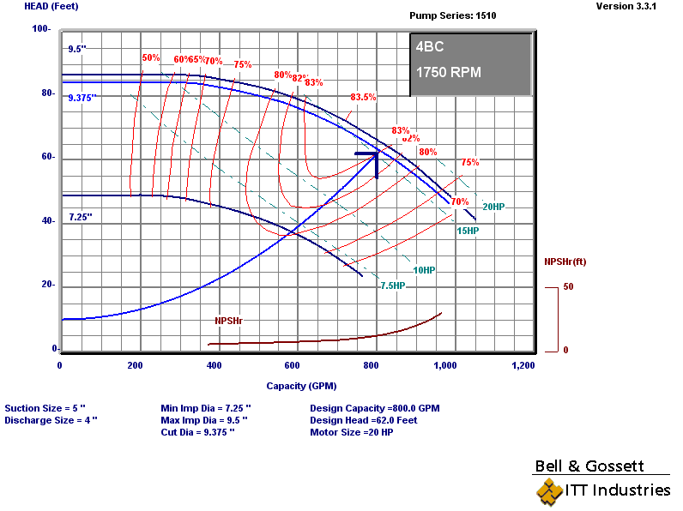
System 1:
One Pump Provides All Flow
Two redundant piping circuits
  Significant first cost penalty
  Most immune to failure of any component

Slide 30
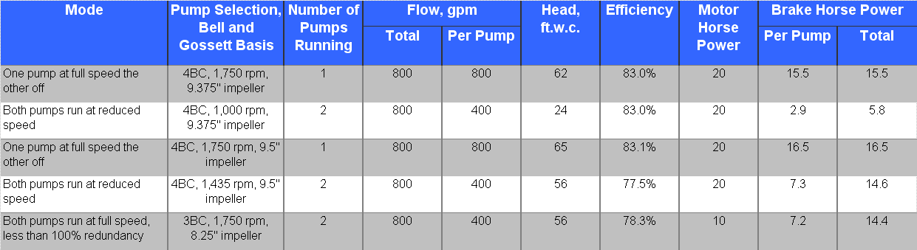
Summary

Slide 31
System 1: Head Loss Calculation
Each Pump Provides 50% of Flow
Both circuits have losses as calculated
Both circuits are active
Losses follow square law
Lift (elevation change) does not vary with flow rate
Was 8 ft.w.c. at 800 gpm

Slide 32
System 1:
Each Pump Provides 50% of Flow
Two redundant piping circuits
  Significant first cost penalty
  Most immune to failure of any component
  Approaches the “cube rule” but not quite due to the constant head associated with lift

Slide 33
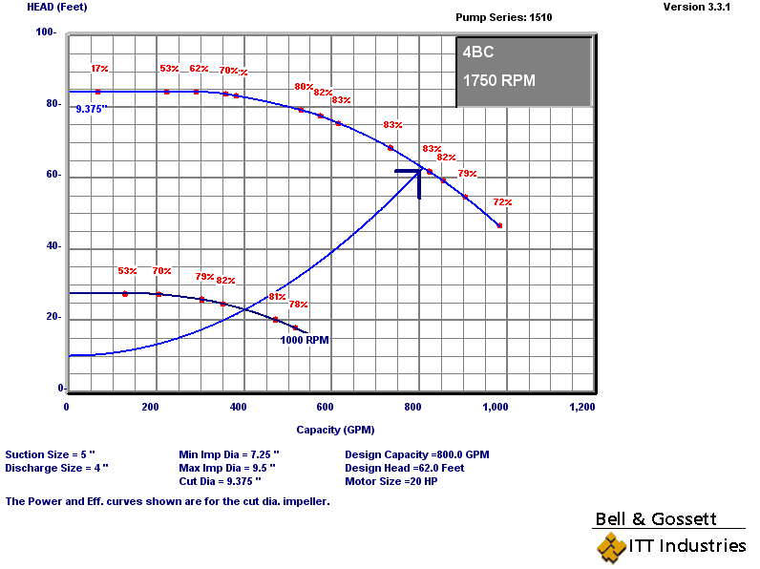
Option 1:
Operating Mode B – Two pumps run at reduced speed
Two redundant piping circuits
  Significant first cost penalty
  Most immune to failure of any component
  Approaches the “cube rule” but not quite due to the constant head associated with lift

Slide 34
Summary
Cube rule predicts 1.9 bhp per pump or 3.8 bhp total

Slide 35
System 2:
Shared Circuit, Redundant Pumps

Slide 36
System 2 versus System 1
Shared Circuit versus Independent Circuit
Shaded piping is the piping that sees 400 gpm with two pumps running at 400 gpm and thus sees a reduction in head that is proportional to the square of the reduction in flow
Notes:
5.47 8.47

Slide 37
System 2: Head Loss Calculation
One Pump Provides All Flow
Losses increase slightly compared to System 1 due to tees and extra elbows

Slide 38
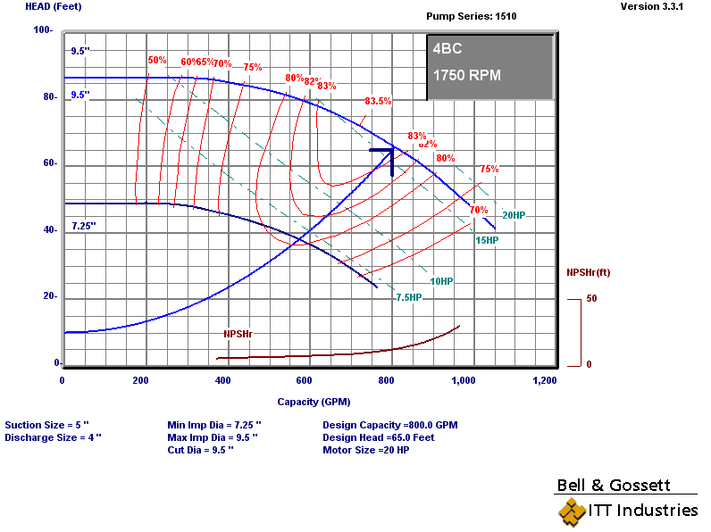
Option 2:
Operating Mode A – One pump runs at full speed
One common circuit
  Minimizes first cost penalty
  Immune to failure of a pump
  Not immune to a piping failure

Slide 39
Summary

Slide 40
System 2: Head Loss Calculation
Each Pump Provides 50% of Flow
Only a small portion of the system sees a reduction in flow
Losses in common pipe do not change

Slide 41
Option 2:
Operating Mode B – Two pumps run at 50% speed
One common circuit
  Minimizes first cost penalty
  Immune to failure of a pump
  Not immune to a piping failure
  Some, but not all of the piping circuit sees a 50% reduction in flow

Slide 42
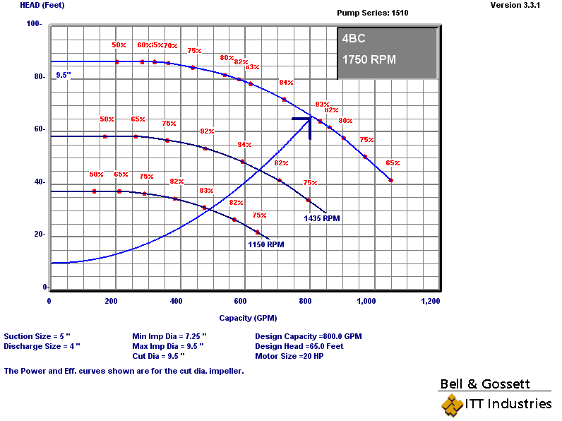
Option 2:
Operating Mode B – Two pumps run at reduced speed
One common circuit
  Minimizes first cost penalty
  Immune to failure of a pump
  Not immune to a piping failure
  Some, but not all of the piping circuit sees a 50% reduction in flow

Slide 43
Option 2:
Operating Mode B – Two pumps run at reduced speed
One common circuit
  Minimizes first cost penalty
  Immune to failure of a pump
  Not immune to a piping failure
  Some, but not all of the piping circuit sees a 50% reduction in flow

Slide 44
Summary

Slide 45
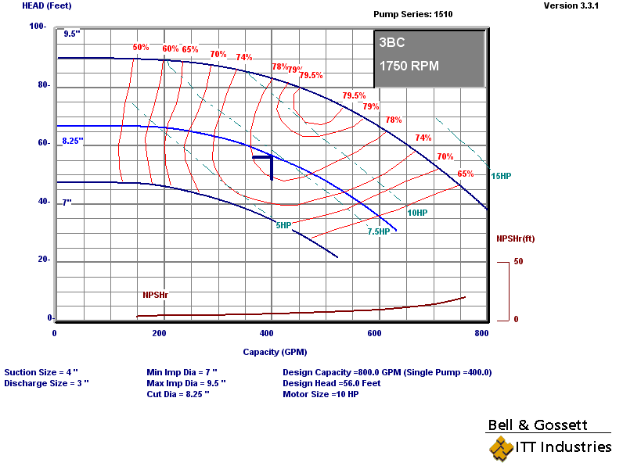
System 2:
Shared Circuit, Non-redundant pumps
One common circuit
  Lowest first cost penalty
    Smaller pump
    Smaller motor
    Smaller electrical service
  Not immune to pump or piping failure
  Better than 50% redundant
Each pump sized for 50% of the required flow at the required head

Slide 46
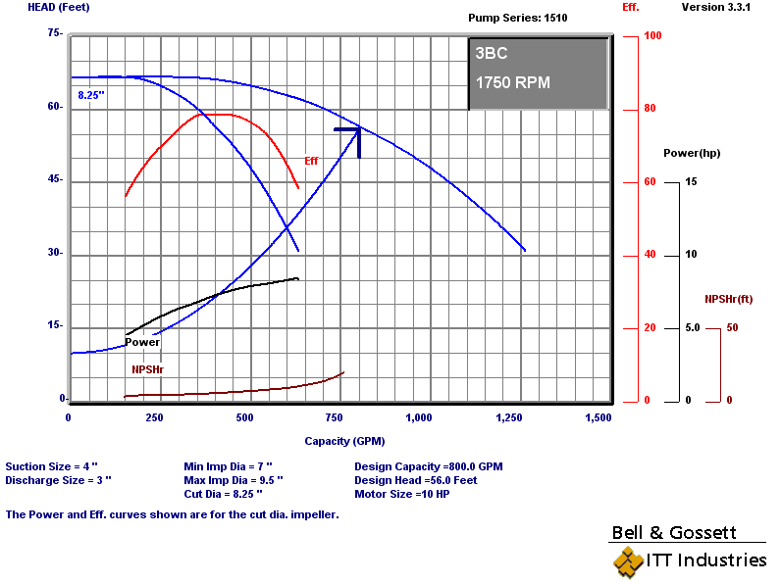
System 2 :
Shared Circuit, Non-redundant pumps
One common circuit
  Lowest first cost penalty
    Smaller pump
    Smaller motor
    Smaller electrical service
  Not immune to pump or piping failure
  Better than 50% redundant

Slide 47
Summary

Slide 48
The Bottom Lines
The cube rule can not be applied directly to parallel pumps running at 50% speed if the pumps share a common piping circuit
Even if the pumps have independent circuits, any lift due to an elevation change in an open system (and pump energy associated with it) will not follow the cube rule

Slide 49
The Bottom Lines
Parallel pumps sharing a common piping circuit will approach the performance predicted by the cube rule if the amount of shared piping is small relative to the amount of piping associated with each pump
Parallel pumps sharing a common piping circuit will approach the performance predicted by the cube rule if the pressure loss in the common circuit is insignificant relative to the losses in the piping serving each pump

