Slide 1
The Affinity Laws and Pump Energy
When They Can and Can’t Be Used to Predict Energy Savings and Why

Slide 2
Applying the Affinity Laws To Predict Performance
Approximate relationships
  In most practical applications, the pump impeller is trimmed
  Other dimensions do not change in proportion to the impeller changes
    Leakage losses impacted
    Hydraulic losses impacted
Notes:
900 50.40
750 35.00
500 15.56
250 1.73
0 0.00

Slide 3
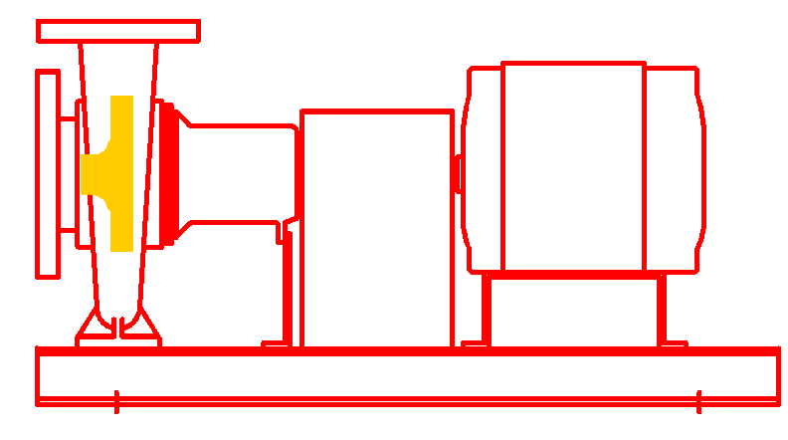

Applying the Affinity Laws To Predict Performance
The affinity laws assume geometric similarity
Proportional relationship between impeller and casing dimensions
Pump drawing courtesy of Bell and Gossett
Notes:
900 50.40
750 35.00
500 15.56
250 1.73
0 0.00

Slide 4
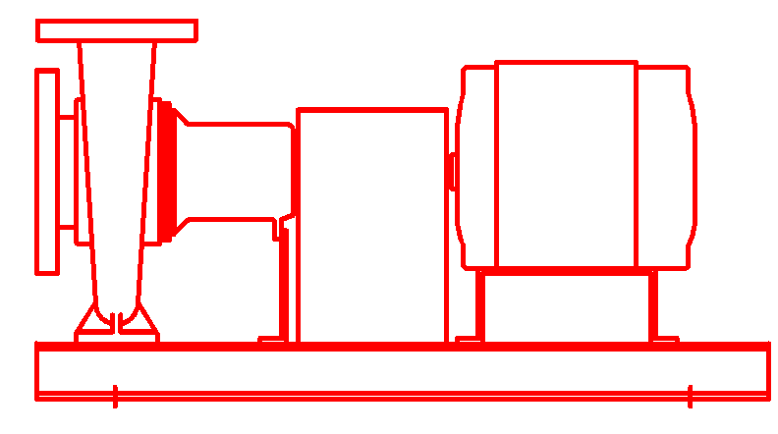
Applying the Affinity Laws To Predict Performance
Changing the impeller outside diameter with out changing the eye diameter and casing size is different
Affinity Law Predictions
Pump drawing courtesy of Bell and Gossett
Notes:
900 50.40
750 35.00
500 15.56
250 1.73
0 0.00

Slide 5
Applying the Affinity Laws To Predict Performance
Changing the impeller outside diameter with out changing the eye diameter and casing size is different
Actual performance based on testing
Pump drawing courtesy of Bell and Gossett
Notes:
900 50.40
750 35.00
500 15.56
250 1.73
0 0.00

Slide 6
Applying the Affinity Laws To Predict Performance
Changing the impeller outside diameter with out changing the eye diameter and casing size is different
The effect is most pronounced with smaller pumps and large trims
Pump drawing courtesy of Bell and Gossett
Notes:
900 50.40
750 35.00
500 15.56
250 1.73
0 0.00

Slide 7
Parallel Pumps and Affinity Laws
The pump affinity laws say that horse power varies as the cube of the flow rate.
HP_{New} = HP_{Old} x (Flow_{New}/Flow_{Old})³
Will two pumps in parallel use 1/8th (1/2 x 1/2 x 1/2) of the power required by running only one of the pumps to produce the same flow rate and head?

Slide 8
System 1:
Two Independent Fully Redundant Circuits

Slide 9
System 2:
Shared Circuit, Redundant Pumps

Slide 10
System 1: Head Loss Calculation
One Pump Provides All Flow
One circuit has loss as calculated
One circuit is inactive

Slide 11
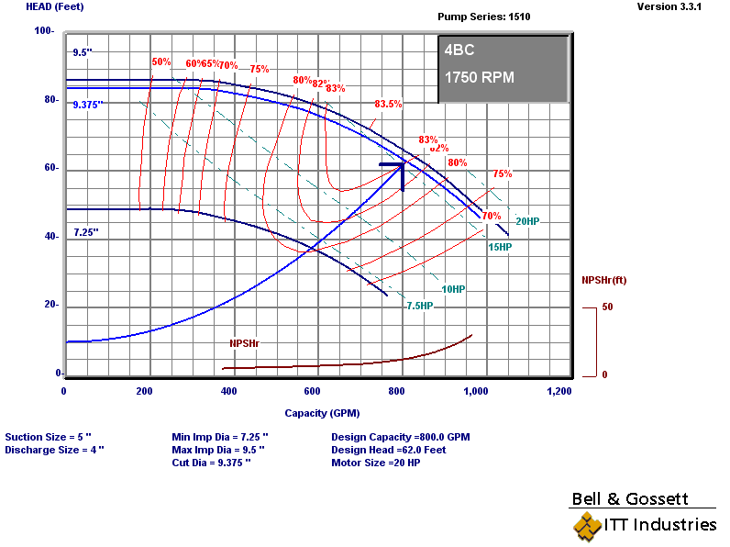
System 1:
One Pump Provides All Flow
Two redundant piping circuits
  Significant first cost penalty
  Most immune to failure of any component

Slide 12
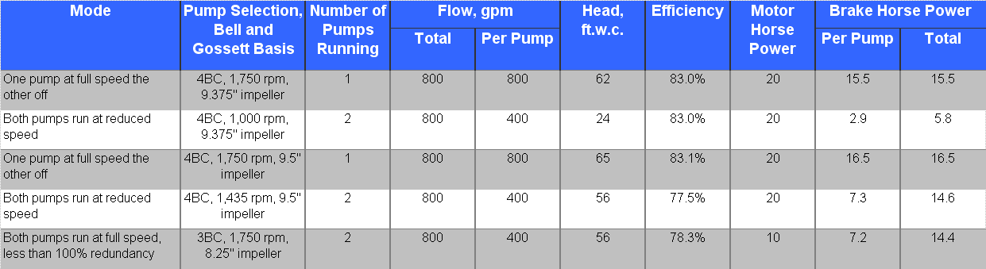
Summary

Slide 13
System 1: Head Loss Calculation
Each Pump Provides 50% of Flow
Both circuits have losses as calculated
Both circuits are active
Losses follow square law
Lift (elevation change) does not vary with flow rate
Was 8 ft.w.c. at 800 gpm

Slide 14
System 1:
Each Pump Provides 50% of Flow
Two redundant piping circuits
  Significant first cost penalty
  Most immune to failure of any component
  Approaches the “cube rule” but not quite due to the constant head associated with lift

Slide 15
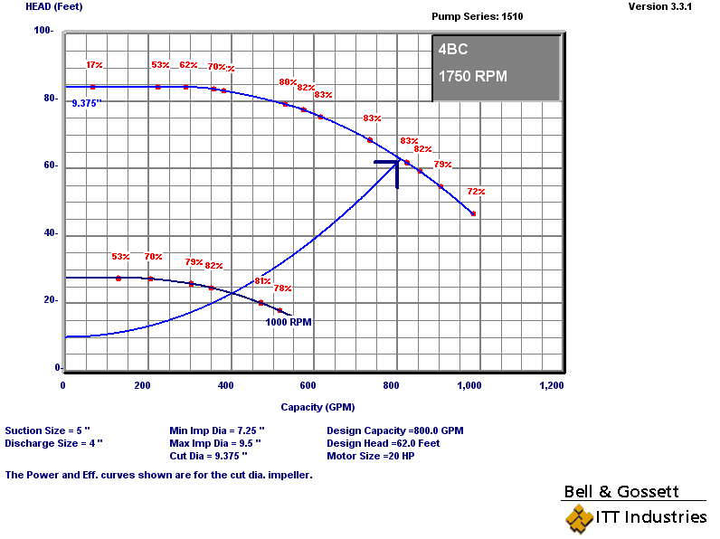
Option 1:
Operating Mode B – Two pumps run at reduced speed
Two redundant piping circuits
  Significant first cost penalty
  Most immune to failure of any component
  Approaches the “cube rule” but not quite due to the constant head associated with lift

Slide 16
Summary
Cube rule predicts 1.9 bhp per pump or 3.8 bhp total

Slide 17
System 2:
Shared Circuit, Redundant Pumps

Slide 18
System 2 versus System 1
Shared Circuit versus Independent Circuit
Shaded piping is the piping that sees 400 gpm with two pumps running at 400 gpm and thus sees a reduction in head that is proportional to the square of the reduction in flow
Notes:
5.47 8.47

Slide 19
System 2: Head Loss Calculation
One Pump Provides All Flow
Losses increase slightly compared to System 1 due to tees and extra elbows

Slide 20
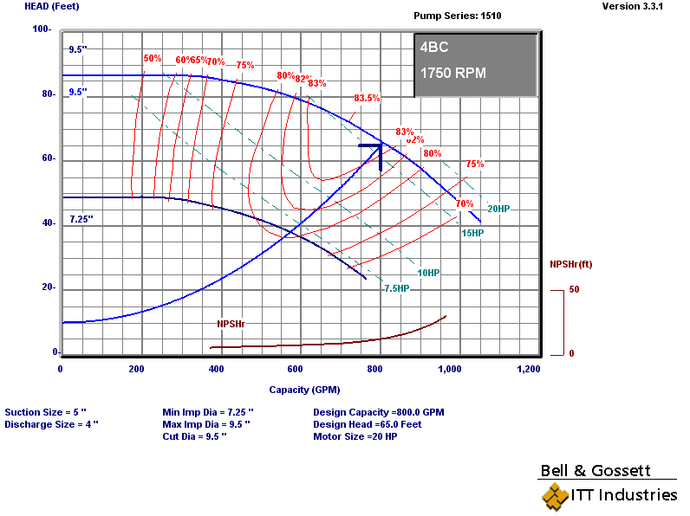
Option 2:
Operating Mode A – One pump runs at full speed
One common circuit
  Minimizes first cost penalty
  Immune to failure of a pump
  Not immune to a piping failure

Slide 21
Summary

Slide 22
System 2: Head Loss Calculation
Each Pump Provides 50% of Flow
Only a small portion of the system sees a reduction in flow
Losses in common pipe do not change

Slide 23
Option 2:
Operating Mode B – Two pumps run at 50% speed
One common circuit
  Minimizes first cost penalty
  Immune to failure of a pump
  Not immune to a piping failure
  Some, but not all of the piping circuit sees a 50% reduction in flow

Slide 24
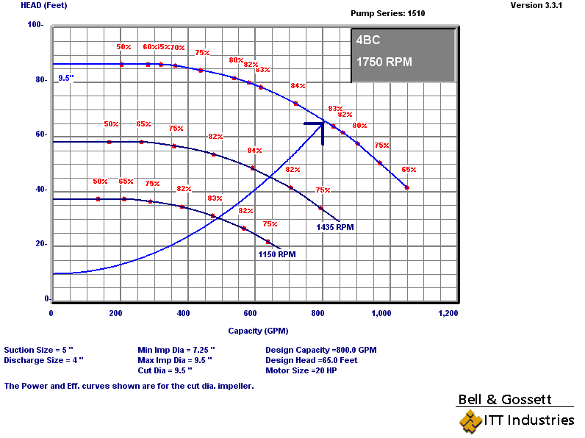
Option 2:
Operating Mode B – Two pumps run at reduced speed
One common circuit
  Minimizes first cost penalty
  Immune to failure of a pump
  Not immune to a piping failure
  Some, but not all of the piping circuit sees a 50% reduction in flow

Slide 25
Option 2:
Operating Mode B – Two pumps run at reduced speed
One common circuit
  Minimizes first cost penalty
  Immune to failure of a pump
  Not immune to a piping failure
  Some, but not all of the piping circuit sees a 50% reduction in flow

Slide 26
Summary

Slide 27
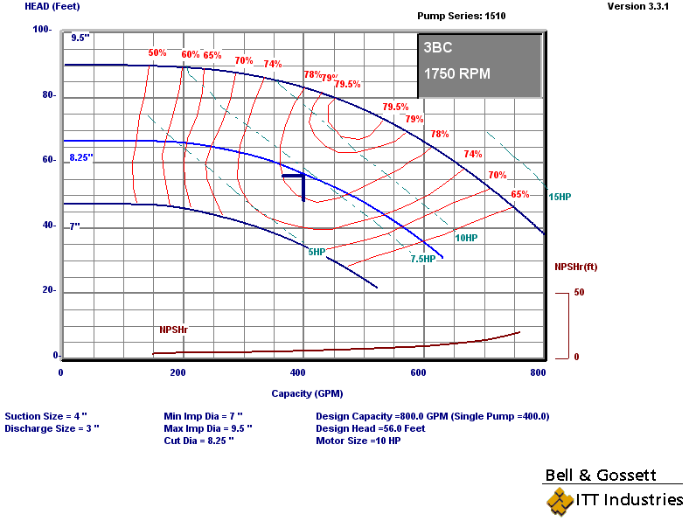
System 2:
Shared Circuit, Non-redundant pumps
One common circuit
  Lowest first cost penalty
    Smaller pump
    Smaller motor
    Smaller electrical service
  Not immune to pump or piping failure
  Better than 50% redundant
Each pump sized for 50% of the required flow at the required head

Slide 28
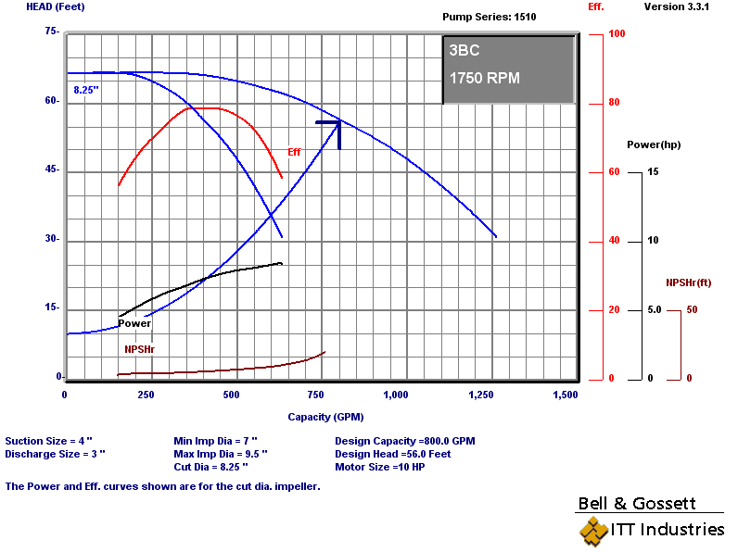
System 2 :
Shared Circuit, Non-redundant pumps
One common circuit
  Lowest first cost penalty
    Smaller pump
    Smaller motor
    Smaller electrical service
  Not immune to pump or piping failure
  Better than 50% redundant

Slide 29
Summary

Slide 30
The Bottom Lines
The cube rule can not be applied directly to parallel pumps running at 50% speed if the pumps share a common piping circuit
Even if the pumps have independent circuits, any lift due to an elevation change in an open system (and pump energy associated with it) will not follow the cube rule

Slide 31
The Bottom Lines
Parallel pumps sharing a common piping circuit will approach the performance predicted by the cube rule if the amount of shared piping is small relative to the amount of piping associated with each pump
Parallel pumps sharing a common piping circuit will approach the performance predicted by the cube rule if the pressure loss in the common circuit is insignificant relative to the losses in the piping serving each pump

