Slide 1
Existing Building Commissioning Workshop: Series 16, Session 4
Owning Control System Logic
Presented By:
David Sellers
Senior Engineer, Facility Dynamics Engineering

Slide 2
Three-way Switch Logic

Slide 3
Three-way Switch Logic
+120 vac
N

Slide 4
Three-way Switch Logic
+120 vac
N

Slide 5
Three-way Switch Logic
+120 vac
N

Slide 6
Does Anyone Want to Share?

Slide 7
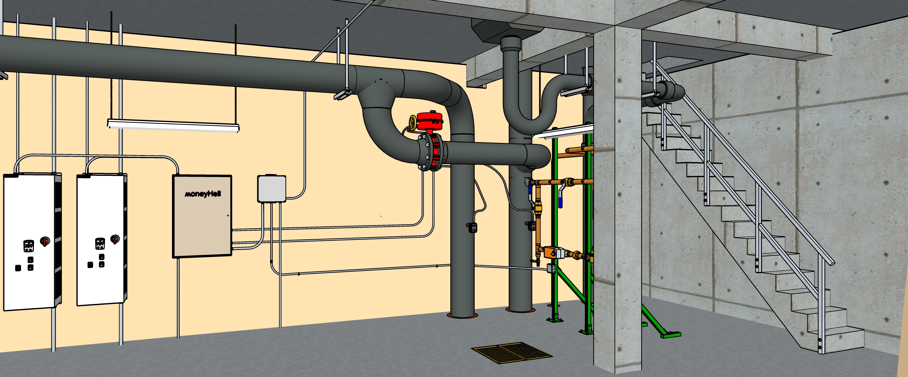
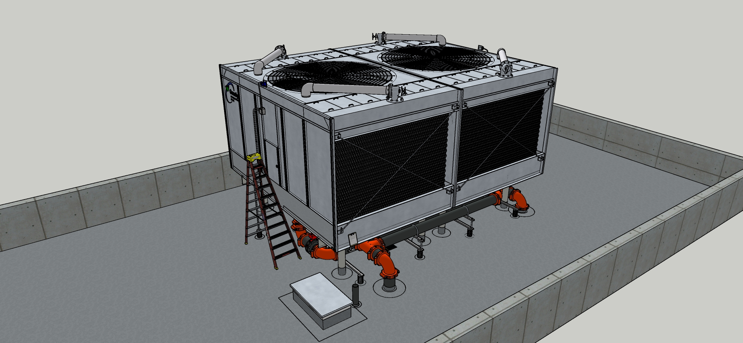
Learning Control Logic from Physical Logic

Slide 8
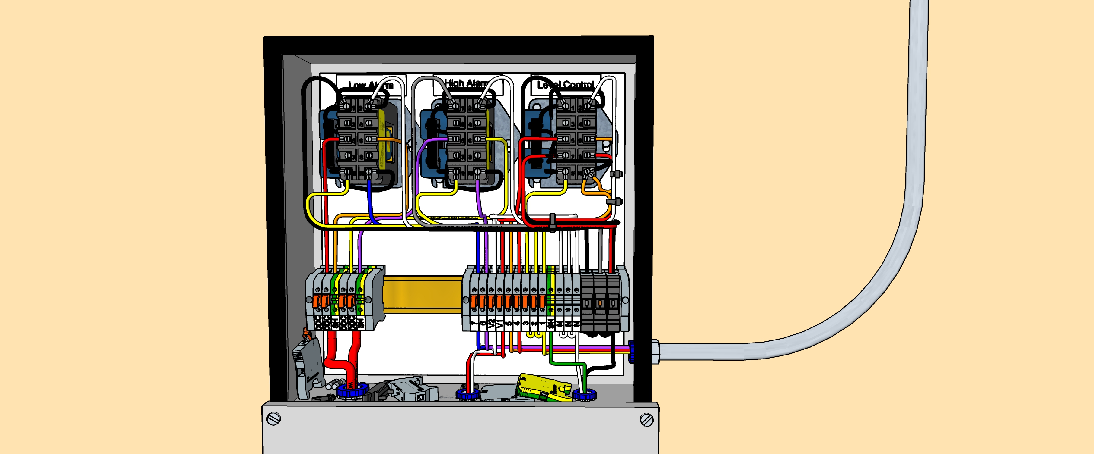
Physical Logic is Related to the System Physics

Slide 9
A Few Things to Discover
What is the nominal chiller tonnage?
Is the design intent for the condenser water system constant volume or variable volume?
Will the design intent be realized based on your field observations?
Is the system off or is the system running but the tower fans are off because they are cycling due to the system being at low load?
What type of cooling tower is this (forced draft, counter flow, etc.)?
What type of drive system does the cooling tower have?
What is the blue box on the cooling tower and why is it required?
Does the piping configuration for the cooling tower cells have the potential to impact their performance?
What is used to control the cooling tower water level?

Slide 11
A Few General Cooling Tower Questions
Is there a minimum speed you would not allow the tower fans to drop below?
Is it better to run one fan up and then the other or run both fans up together?
Is there a reason the control system input wiring is segregated from the level control wiring?

Slide 12
How Well is Water Being Distributed
There is an important but subtle detail about how the settling well is fabricated; what is it?
What is the potential problem with different cold basin water levels?
What specific physical mechanisms are involved to uniformly distribute flow over the cooling tower fill?
What happens to tower performance if the fill is not uniformly wet?
Are there other issues associated with not getting the fill uniformly wet?
How does water distribution play into optimizing the tower fan energy?

Slide 13
Your Assignment
Trace out the cooling tower level control system wiring
Answer the questions on the following slide

Slide 14
How Does the Level Control System Work?
What are the functions of the different terminal types in the control panel?
How much does the Warrick control relay cost?
Why did Ellis seal the electrode fitting conduit entry with caulk?
How would you figure out the maximum fuse rating you could safely install in the fuse holders?
How would you figure out the minimum water level in the tower (the level that would open the make-up valve)?
What sets the level at which you would close the make-up valve?
What sets the maximum water level in the tower (the level that would cause water to run out the overflow)?

