Slide 1
An Air Cooled Vapor Compression Cycle Chiller

Slide 2
Adding Hot Gas Bypass
Hot Gas Solenoid
Hot Gas Regulator

Slide 3
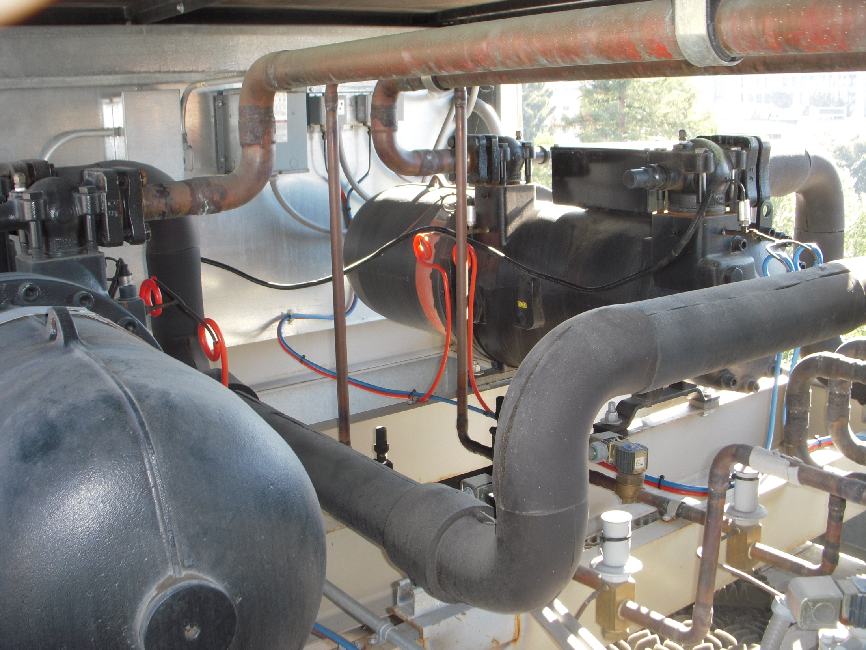
Hot Gas Bypass Lines
Hot Gas Solenoid Valve
Service Valve
Hot Gas Regulator

Slide 4
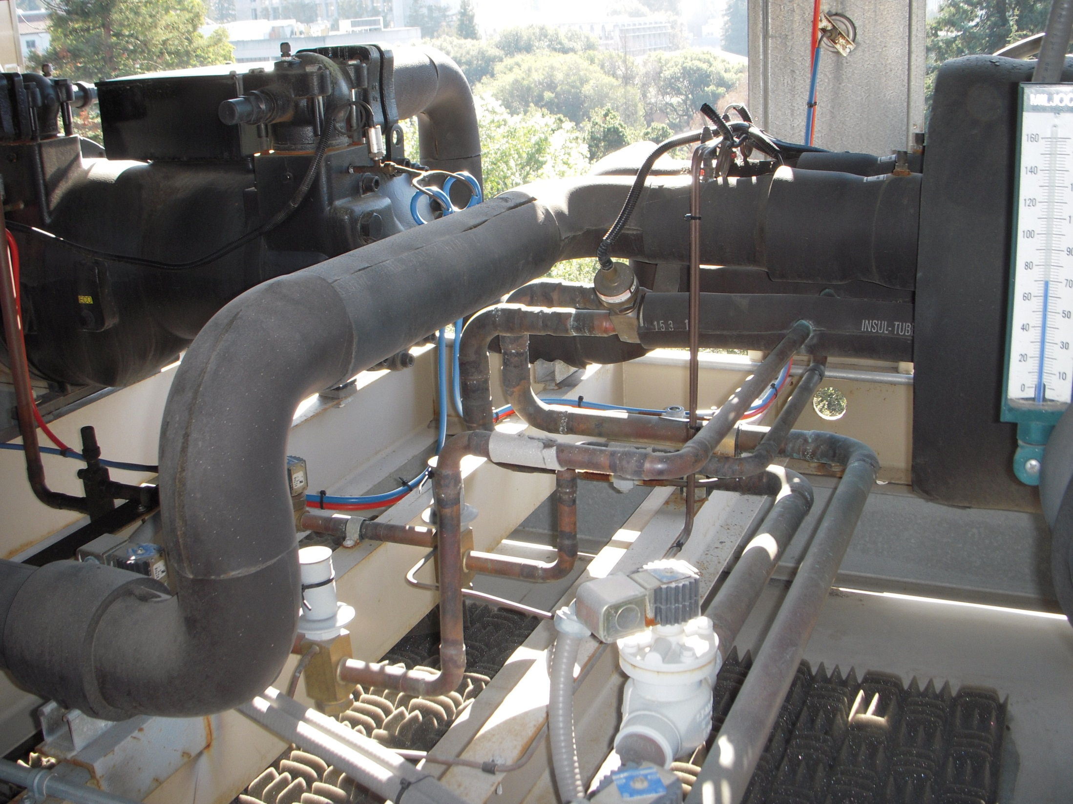
Hot Gas Connections to the Evaporator

Slide 5
Adding Hot Gas Bypass
Condenser
3 Stage Centrifugal Compressor
CW Supply and Return
Metering Orifices
Hot Gas Bypass Valve
Evaporator
Economizer
CHW Supply and Return

Slide 6
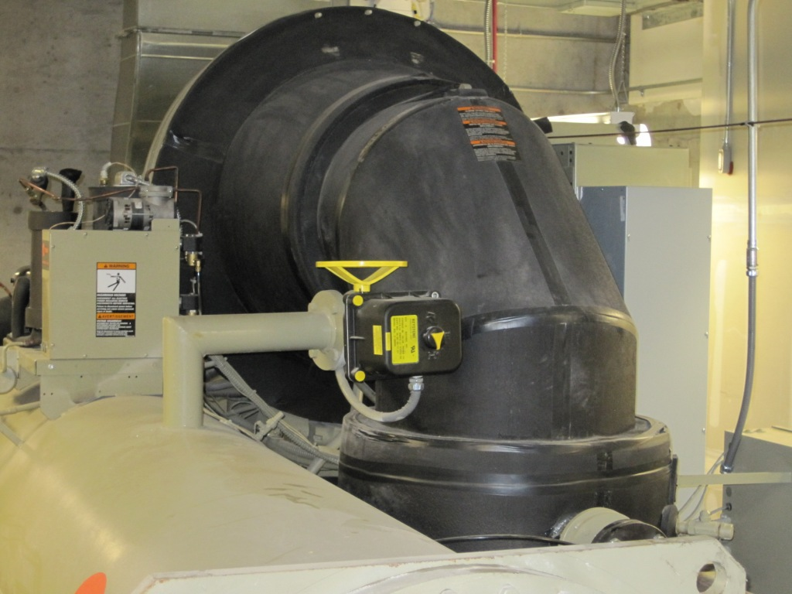

Slide 7
?
?
?
?

