Slide 1
Existing Building Commissioning Workshop: Series 17, Session 3
Monitoring Plans
Presented By:
David Sellers
Senior Engineer, Facility Dynamics Engineering

Slide 2
Self Study; Where You Should Be
Skills Guidebook
Checklist

Slide 3
Self Study; Where You Should Be Headed
Skills Guidebook
Checklist

Slide 4
Self Study; Where You Should Be Headed
Skills Guidebook
Checklist

Slide 5
Functional Testing Resources
Resources linked from the technical guide
Resources on the Commissioning Resources Website
https://www.av8rdas.com/functional-testing-guide.html
Review the Functional Testing Basics chapter
Resources on the blog
https://av8rdas.wordpress.com/?s=functional+testing

Slide 6
Functional Testing Resources
Resources linked from the technical guide
Resources on the Commissioning Resources Website
https://www.av8rdas.com/functional-testing-guide.html
Review the Functional Testing Basics chapter
Resources on the blog
https://av8rdas.wordpress.com/?s=functional+testing

Slide 7
Functional Testing Resources
Resources linked from the technical guide
Resources on the Commissioning Resources Website
https://www.av8rdas.com/functional-testing-guide.html
Review the Functional Testing Basics chapter
Resources on the blog
https://av8rdas.wordpress.com/?s=functional+testing

Slide 8
Functional Testing Resources
Resources linked from the technical guide
Resources on the Commissioning Resources Website
https://www.av8rdas.com/functional-testing-guide.html
Review the Functional Testing Basics chapter
Resources on the blog
https://av8rdas.wordpress.com/?s=functional+testing

Slide 9
Continue to Review the Logic Diagram Resources
To prepare for the next class, visit the Logic Diagram Tool page of the Commissioning Resources website
https://www.av8rdas.com/logic-diagram-tool.html
Download the Logic Diagram Tool file
Download the Logic Diagram Symbols file
Review the Logic Diagram Symbols file as time permits and be prepared to ask questions
Download and explore the other resources as time and interest permits

Slide 10
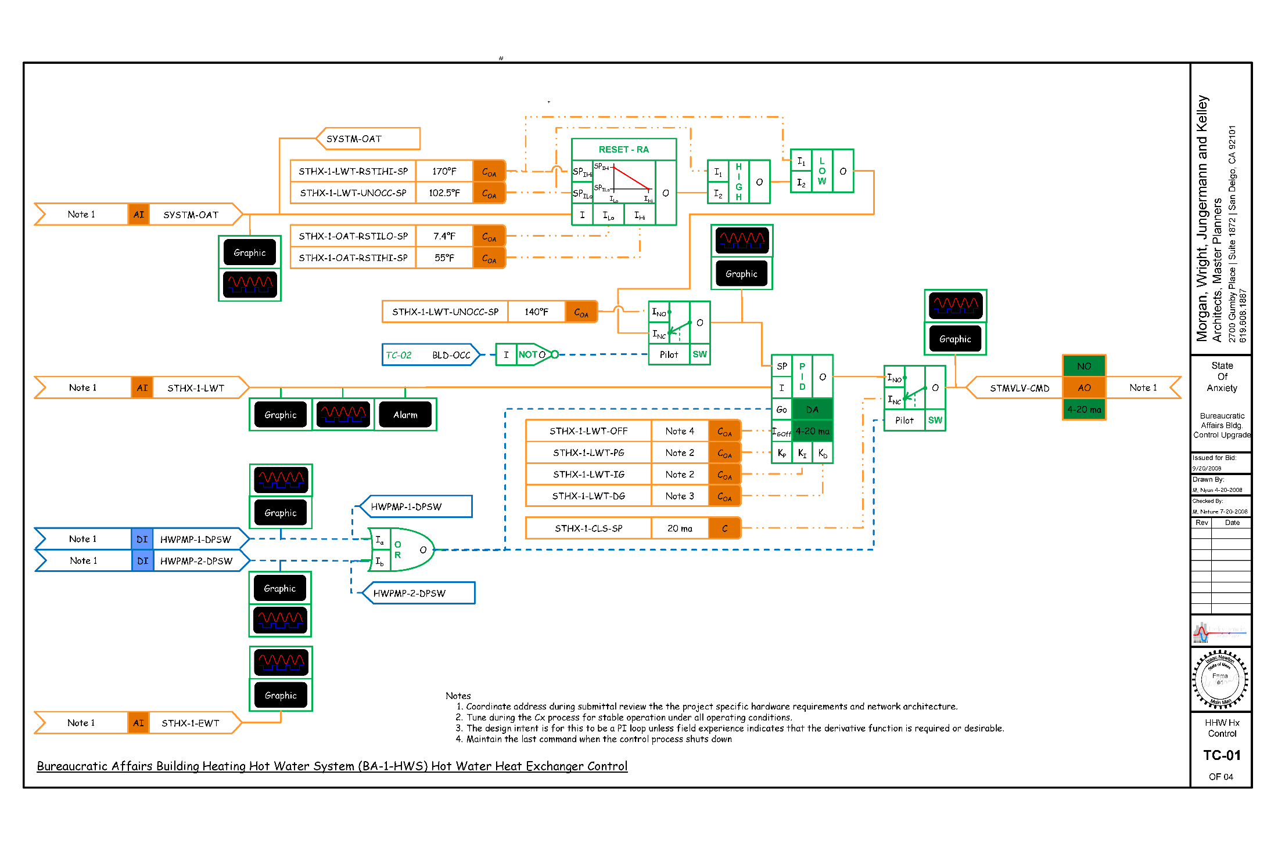
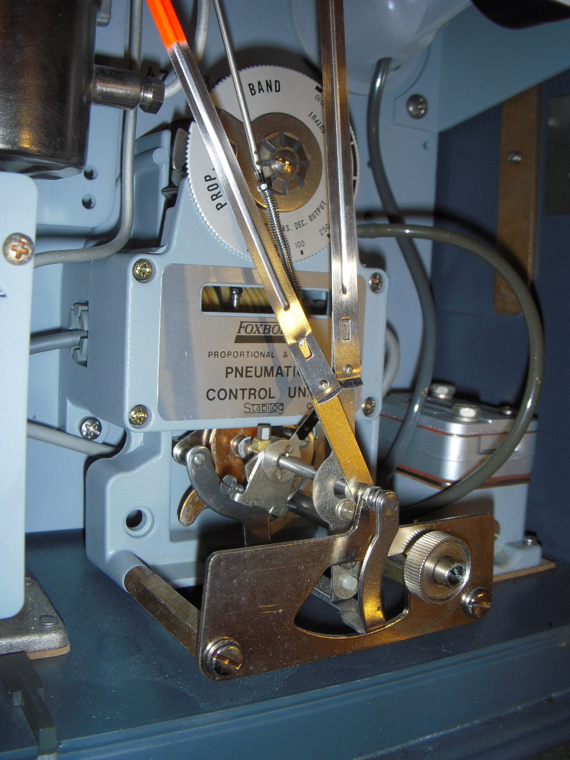
Why Study Logic and Control Systems?
The vast majority of commissioning opportunities involve resolving issues with control systems or making changes to them

Slide 11
Why Study Logic Diagrams?
(Go to https://tinyurl.com/PVequalsmRT for more pictures and videos from the balloon flight)
The vast majority of commissioning opportunities involve resolving issues with control systems or making changes to them

Slide 12
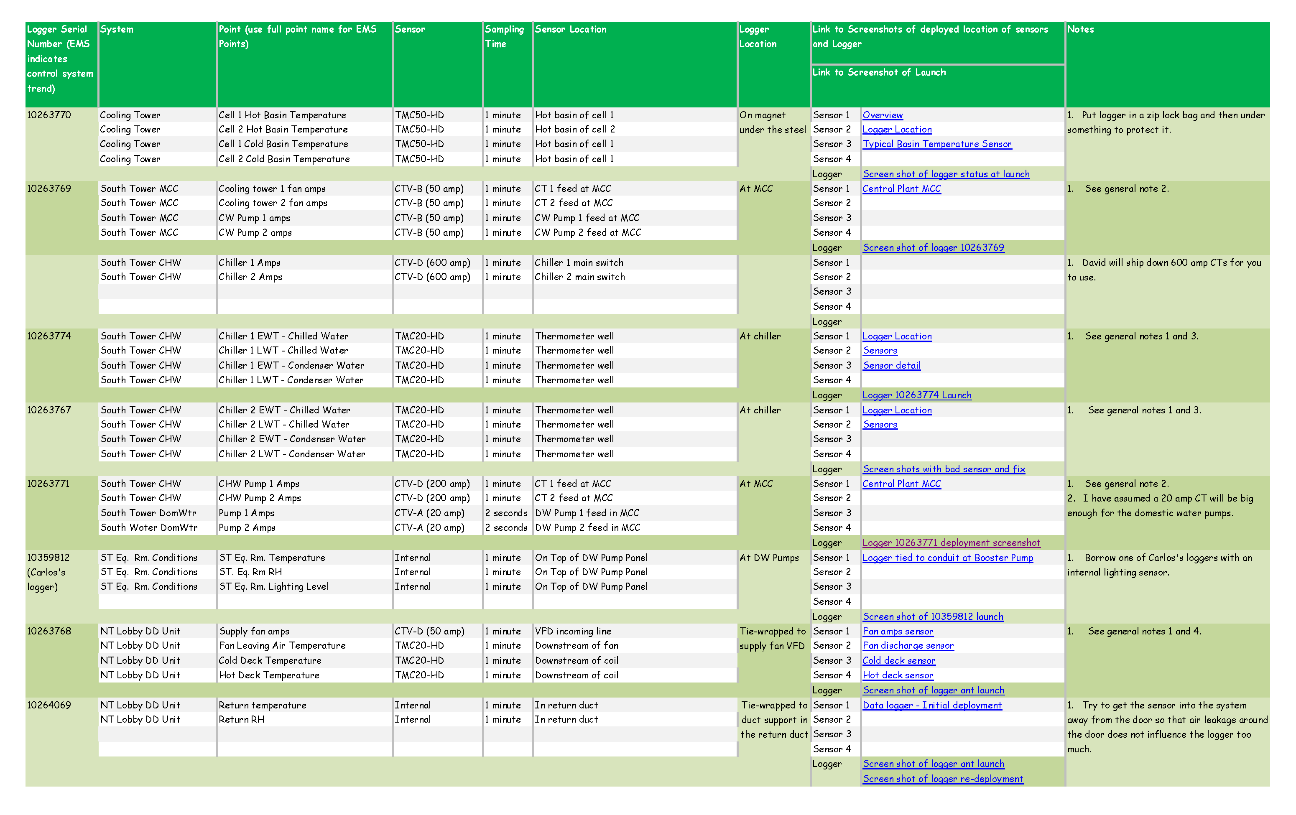
Why Study Logic Diagrams?
(Go to https://tinyurl.com/PVequalsmRT for more pictures and videos from the balloon flight)
Logic diagrams allow us to clearly communicate how we want our control systems to manage our building systems

Slide 13
Why Now?
(Go to https://tinyurl.com/PVequalsmRT for more pictures and videos from the balloon flight)
You are about to start logging data on your projects

Slide 14
Why Now?
(Go to https://tinyurl.com/PVequalsmRT for more pictures and videos from the balloon flight)
Control systems can be data loggers
Data loggers and control systems both use inputs
Data loggers can supplement control systems if points are missing

Slide 15
Monitoring Plans Document Logging Requirements
(Go to https://tinyurl.com/PVequalsmRT for more pictures and videos from the balloon flight)

Slide 16
Monitoring Plans Document Logging Requirements
(Go to https://tinyurl.com/PVequalsmRT for more pictures and videos from the balloon flight)
Visit www.av8rdas.com for a monitoring plan tool

Slide 17
Coming to a Cx Resources Website Near You
Will provide more depth for those who are interested
Our goal today is to get you going on your monitoring plans
Demonstrate how using the Hijend Hotel CW system
Let you try your hand using the Hijend Hotel CHW system
Expand the concepts using the Hijend Hotel Ball Room AHU

Slide 18
Monitoring Plan Targets
Firm up (or not) opportunities identified during scoping
Provide data
Support more detailed investigations
Diagnostics and trouble shooting
Calculations
Looking for common opportunities
Are schedules actually working?
Are VAV systems VAVing?
Are optimization strategies working?
Support expansion of the findings list
Support cost benefit assessments
Support verification

Slide 19
A Few Resources
Monitoring Plan Template (blank and a filled-out example)
https://www.av8rdas.com/monitoring-plan-spreadsheet.html
Monitoring Plan Blog Posts
https://av8rdas.wordpress.com/2008/10/14/developing-a-monitoring-plan-the-first-step-in-data-logger-deployment/
https://av8rdas.wordpress.com/2008/10/15/my-data-logging-monitoring-plan-one-more-thing/
Data Logging Resources
https://www.av8rdas.com/data-logging-resources.html
https://av8rdas.wordpress.com/category/data-logging/page/3/

