Slide 1
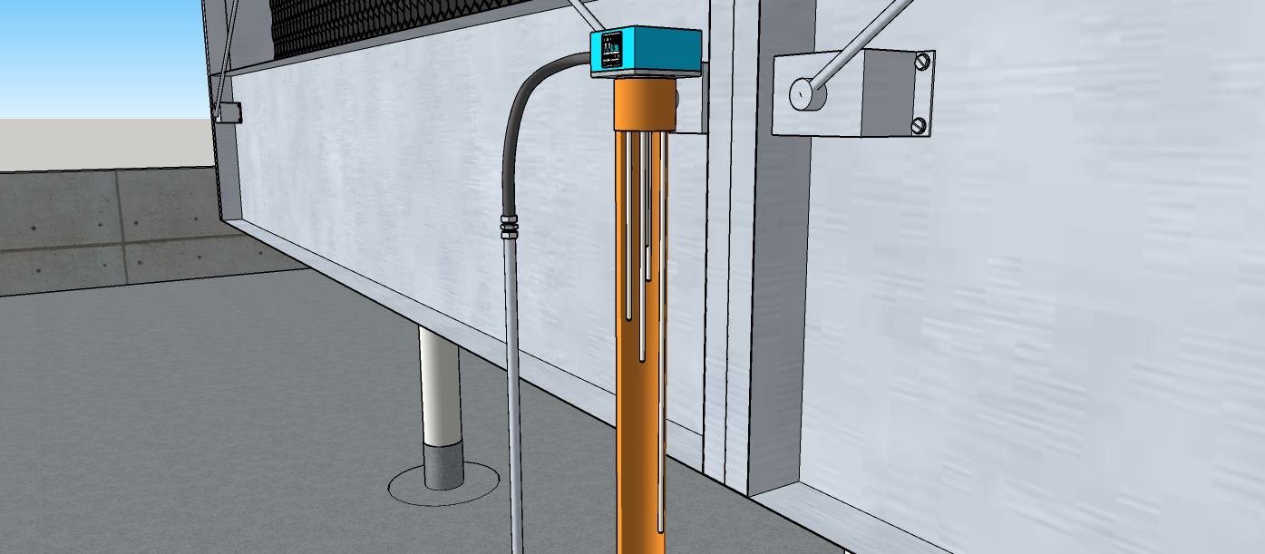
Purple Electrode
Red Electrode
Orange Electrode
Blue Electrode
Yellow Electrode

Slide 2
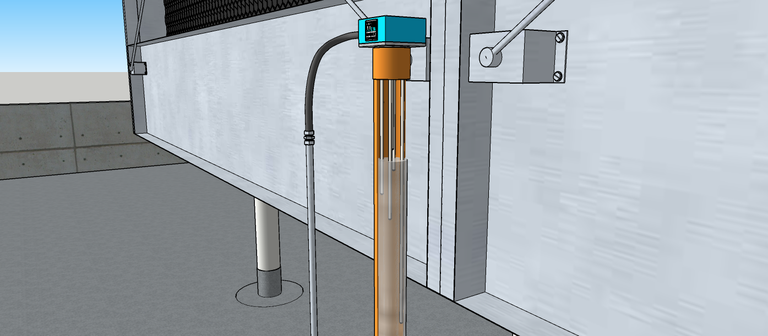

Slide 3
??
2A
TO LINE
??
1
2
3
4
Wires
5
6
Coil or Load
7
8
Electrode
?
9
10
ELECTRODE
CIRCUIT
Warrick Relay
Cooling Tower Basin

Slide 4
Sheet 1

