Slide 1
Vapor Compression Refrigeration
Leveraging Phase Changes in Saturated Systems to Provide Cooling
David Sellers
Senior Engineer, Facility Dynamics Engineering

Slide 2

Phase Changes and Saturated Systems

Slide 3

Phase Changes and Saturated Systems

Slide 4

Phase Changes and Saturated Systems

Slide 5

Phase Changes and Saturated Systems

Slide 6
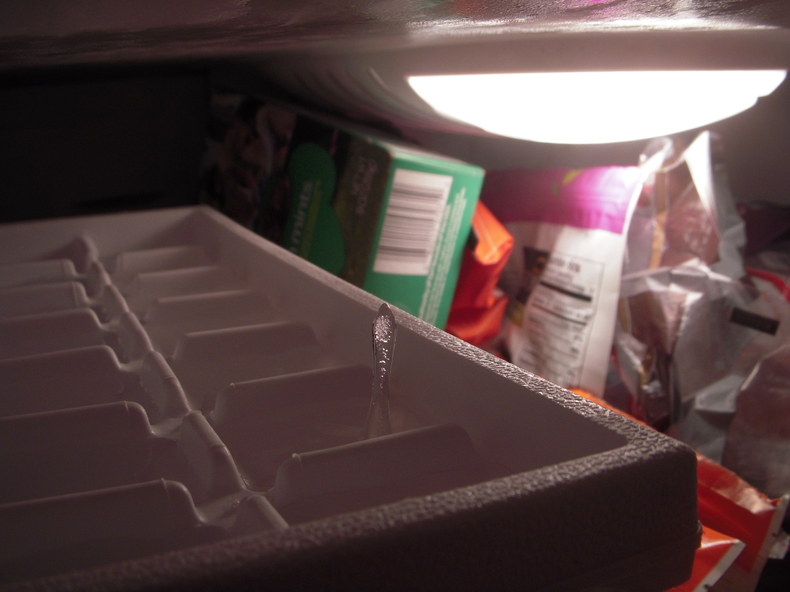
Phase Changes and Saturated Systems

Slide 7
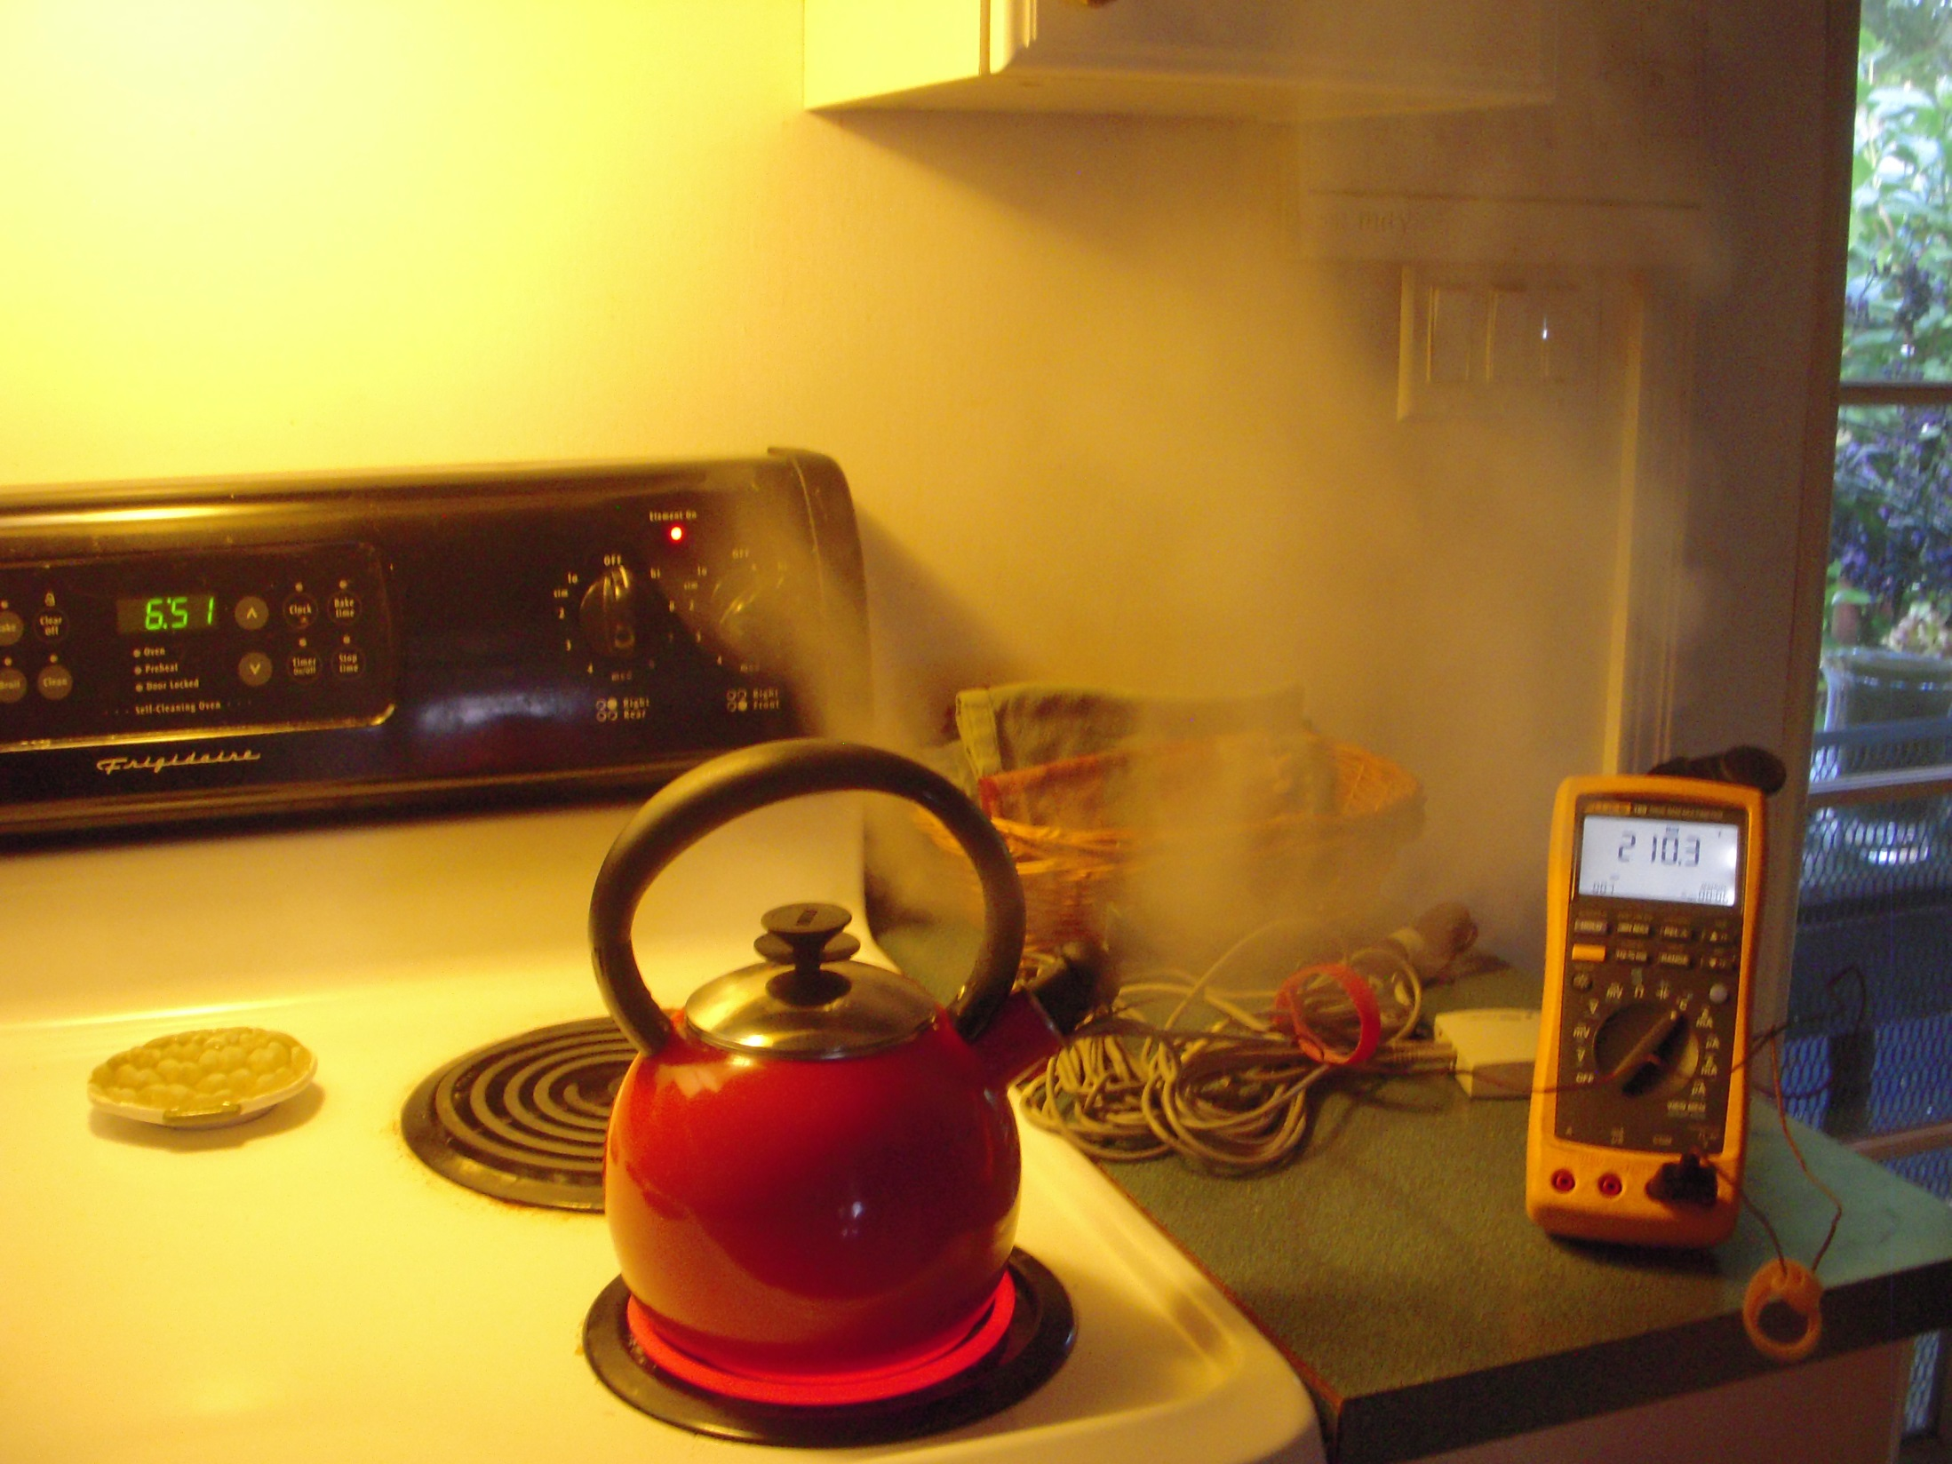
Phase Changes and Saturated Systems

Slide 8
Phase Changes and Saturated Systems
At saturation:
  The substance exists in both a liquid and vapor state
  At a constant pressure, the temperature of the substance will not change until:
    It is fully converted to a liquid (removing energy), or
    It is fully converted to a vapor (adding energy)
Notes:
Water
Temp Pressure Density Enthalpy Entropy
Liquid Vapor Liquid Vapor Liquid Vapor
°F psia lbm/cu ft lbm/cu ft Btu/lbm Btu/lbm Btu/lbm °R Btu/lbm °R
211.80 14.650 59.833 0.037201 180.12 1151.0 0.31212 1.7580

Slide 9
Phase Changes and Saturated Systems
Phase changes absorb a lot of energy
  Melting ice – 144 Btu/lb
  Heating water – 1Btu/lb-°F
  Converting water to steam – 971 Btu/lb
  Superheating steam – 0.5 Btu/lb
(all parameters are at atmospheric pressure)
Notes:
Water
Temp Pressure Density Enthalpy Entropy
Liquid Vapor Liquid Vapor Liquid Vapor
°F psia lbm/cu ft lbm/cu ft Btu/lbm Btu/lbm Btu/lbm °R Btu/lbm °R
211.80 14.650 59.833 0.037201 180.12 1151.0 0.31212 1.7580

Slide 10
Phase Changes and Saturated Systems
Phase changes absorb a lot of energy
  Melting ice – 144 Btu/lb
  Heating liquid R134 – .325 Btu/lb-°F
  Converting liquid R134 to vapor – 83.025 Btu/lb
  Superheating R134 vapor – .136 Btu/lb
(all parameters are at 40, psig, 45°F)
Notes:
Water
Temp Pressure Density Enthalpy Entropy
Liquid Vapor Liquid Vapor Liquid Vapor
°F psia lbm/cu ft lbm/cu ft Btu/lbm Btu/lbm Btu/lbm °R Btu/lbm °R
211.80 14.650 59.833 0.037201 180.12 1151.0 0.31212 1.7580

Slide 11
Ideal Refrigerant Properties
1928
Low condensing pressure
Evaporating pressure near atmospheric pressure
Condensing pressure not much higher than evaporating pressure
Low latent heat of vaporization for small machines to ensure controllability
Low vapor specific volume
Compatible with lubricating oil
Non-corrosive
Stable/does not decompose with age
Does not form non-condensable gasses upon contact with moisture
Does not form explosive compounds upon contact with lubricant
Non-explosive and non-inflammable
Low cost and easy to obtain
Non-poisonous and no discomfort if it leaks into air
Leaks easy to detect with simple methods
Compatible with gaskets and packing materials
Now
Nontoxic
Nonflammable
Zero ozone depletion potential (ODP)
Zero global warming potential (GWP)
Short atmospheric lifetime
High latent heat of vaporization
Low power consumption
Low vapor specific volume
Compressor discharge temperature below 260°F
Evaporating pressure above atmospheric pressure
Condensing pressure below the critical pressure

Slide 12
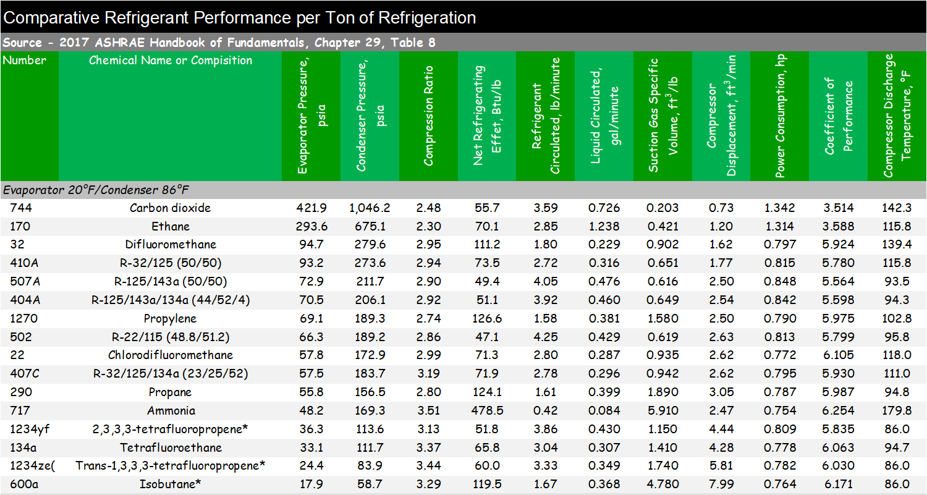
Refrigerant Properties Comparison for Typical HVAC Application Conditions

Slide 13
Refrigerant Properties Comparison for Typical Refrigeration Application Conditions

Slide 14
Refrigerant Properties Comparison for Typical Freezer Application Conditions

Slide 15
Refrigerant Environmental Properties

Slide 16
Refrigerant Environmental Properties

Slide 17
Refrigerant Environmental Properties

Slide 18
Refrigerant Environmental Properties

Slide 19
Refrigerant Environmental Properties

Slide 20
Refrigerant Environmental Properties

Slide 21
Refrigerant Environmental Properties

Slide 22
Refrigerant Environmental Properties

Slide 23
Refrigerant Environmental Properties

Slide 24
A Few Words about Refrigerant Blends

Slide 25
Azeotrope
A mixture made up of two or more refrigerants with similar boiling points that act as a single fluid. The components of azeotropic mixtures will not separate under normal operating conditions and can be charged as a vapor or liquid
Definitions from the National Refrigerants web site; http://www.refrigerants.com/frame.htm
Notes:
http://www.refrigerants.com/frame.htm

Slide 26
Near Azeotrope
A mixture made up of two or more refrigerants with different boiling points that, when in a totally liquid or vapor state, act as one component. However, when changing from vapor to liquid or liquid to vapor, the individual refrigerants evaporate or condense at different temperatures. Near-azeotropic mixtures have a temperature glide of less than 10° F and should be charged in the liquid state to assure proper mixture (non-azeotropic) composition
Definitions from the National Refrigerants web site; http://www.refrigerants.com/frame.htm
Notes:
http://www.refrigerants.com/frame.htm

Slide 27
Zeotrope
A mixture made up of two or more refrigerants with different boiling points. Zeotropic mixtures are similar to near-azeotropic mixtures with the exception of having a temperature glide greater than 10° F. Zeotropic mixtures should be charged in the liquid state
Definitions from the National Refrigerants web site; http://www.refrigerants.com/frame.htm
Notes:
http://www.refrigerants.com/frame.htm

Slide 28
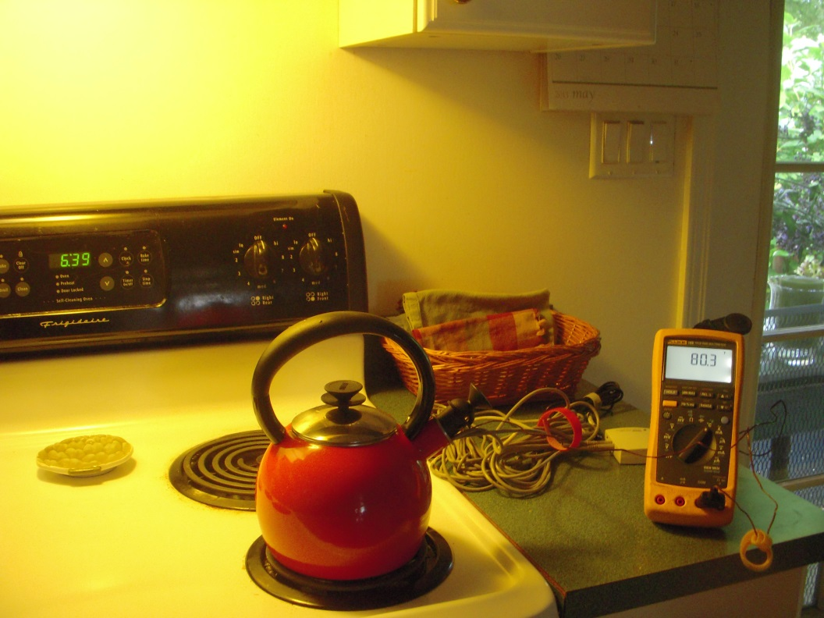
Phase Changes and Saturated Systems
An Experiment
Heat water in a low pressure boiler
Monitor:
  Water temperature
  Vapor temperature over the water surface
  Power
Plot the results

Slide 29
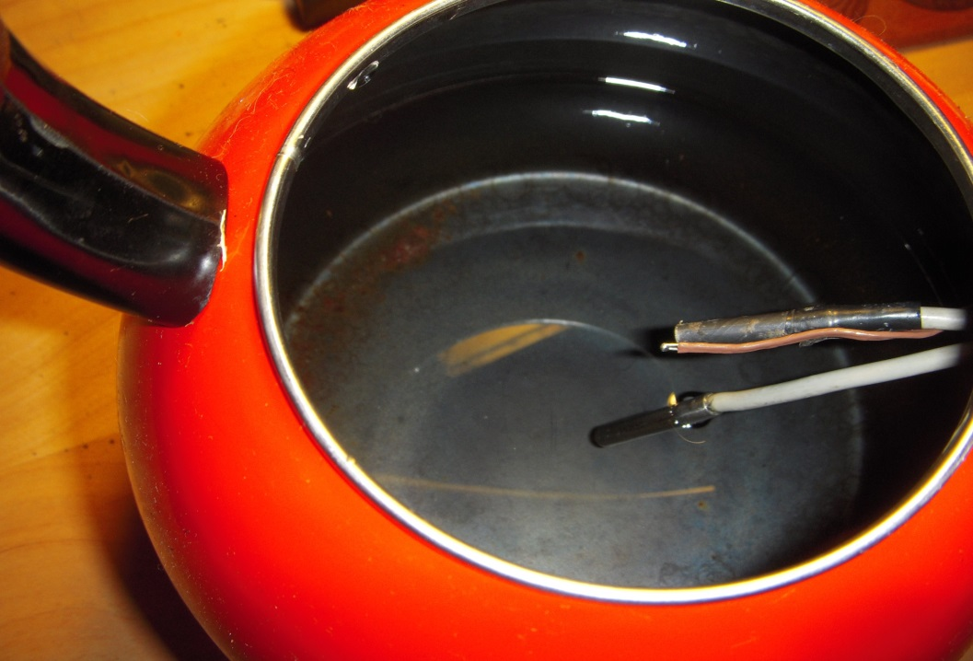
Phase Changes and Saturated Systems
An Experiment
Monitoring temperature
Vapor sensor
Thermocouple
Liquid sensor

Slide 30
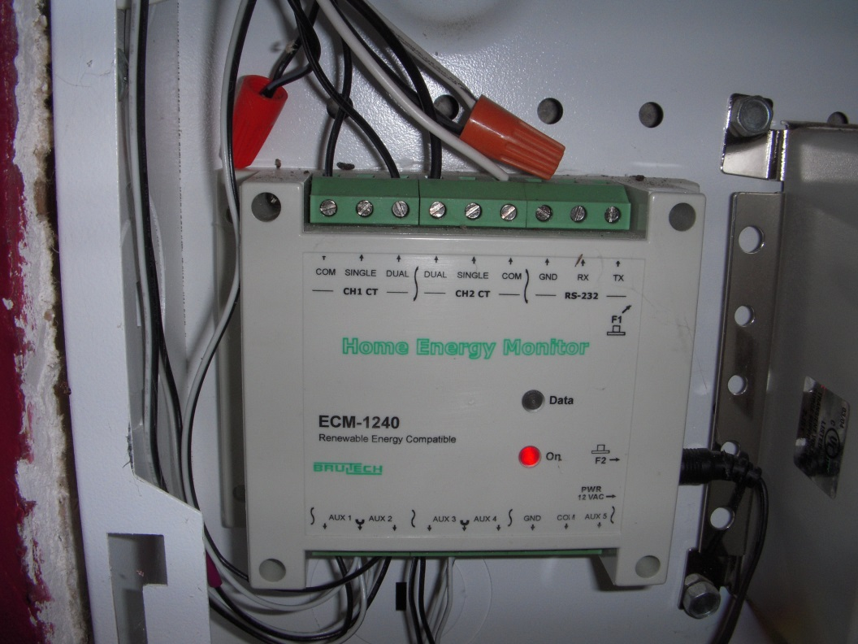
Phase Changes and Saturated Systems
An Experiment
Monitoring power

Slide 31
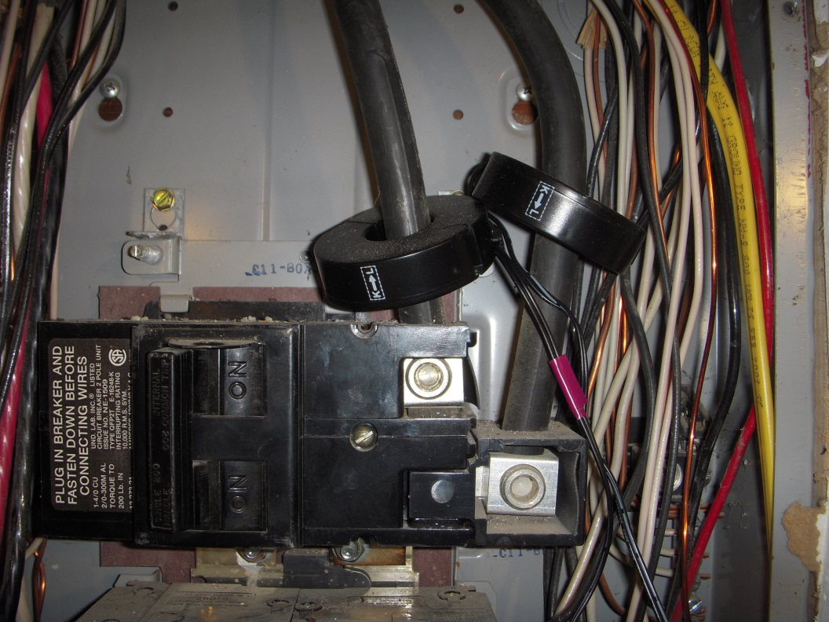
Phase Changes and Saturated Systems
An Experiment
Monitoring power

Slide 32
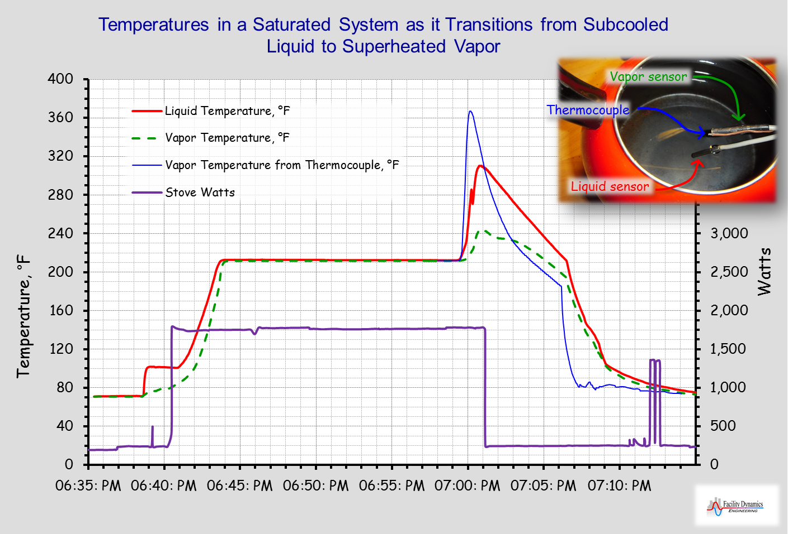

Slide 33
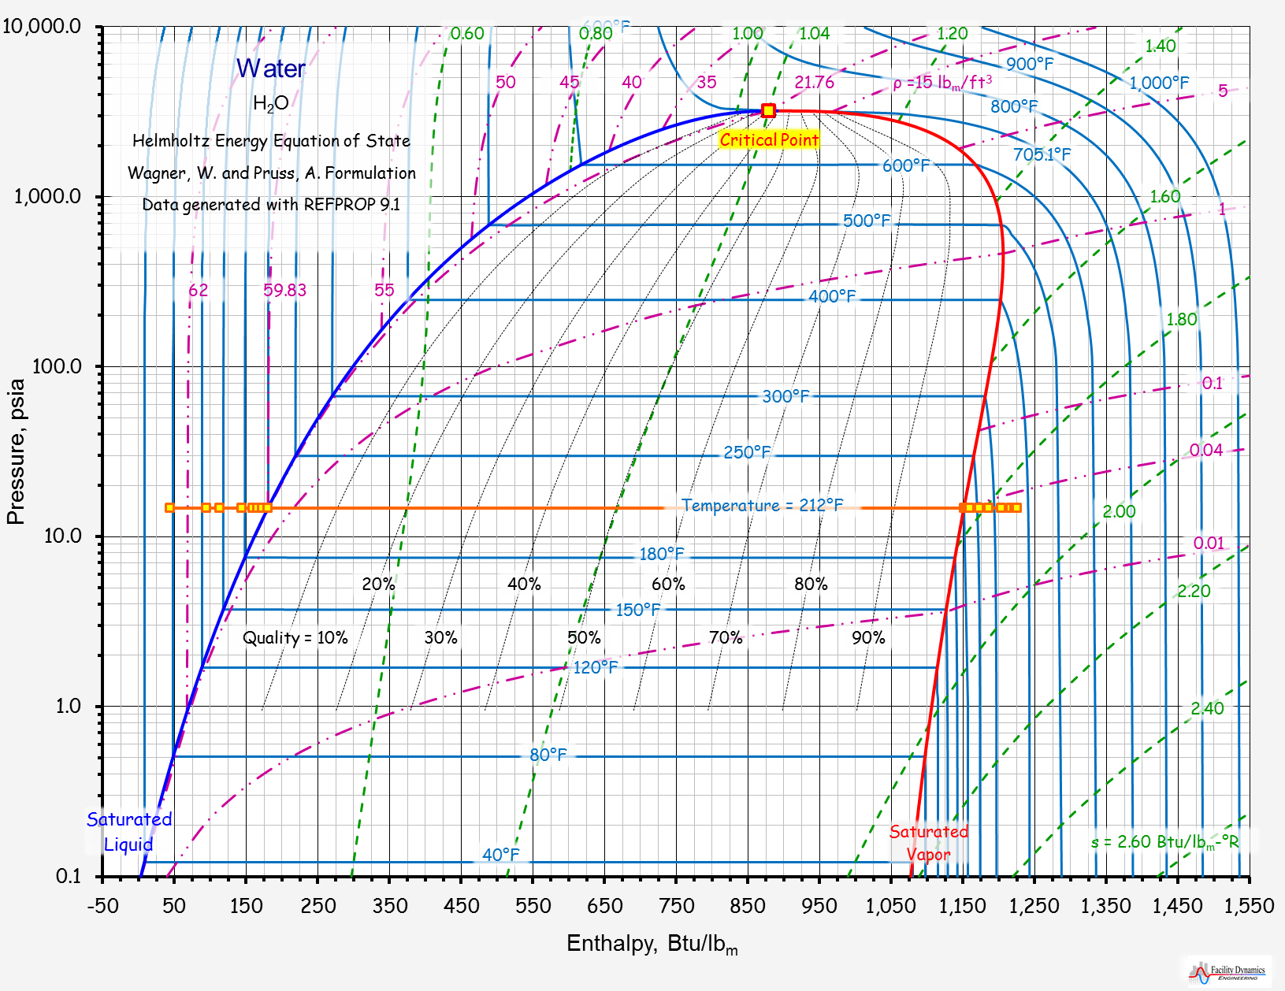

Slide 34
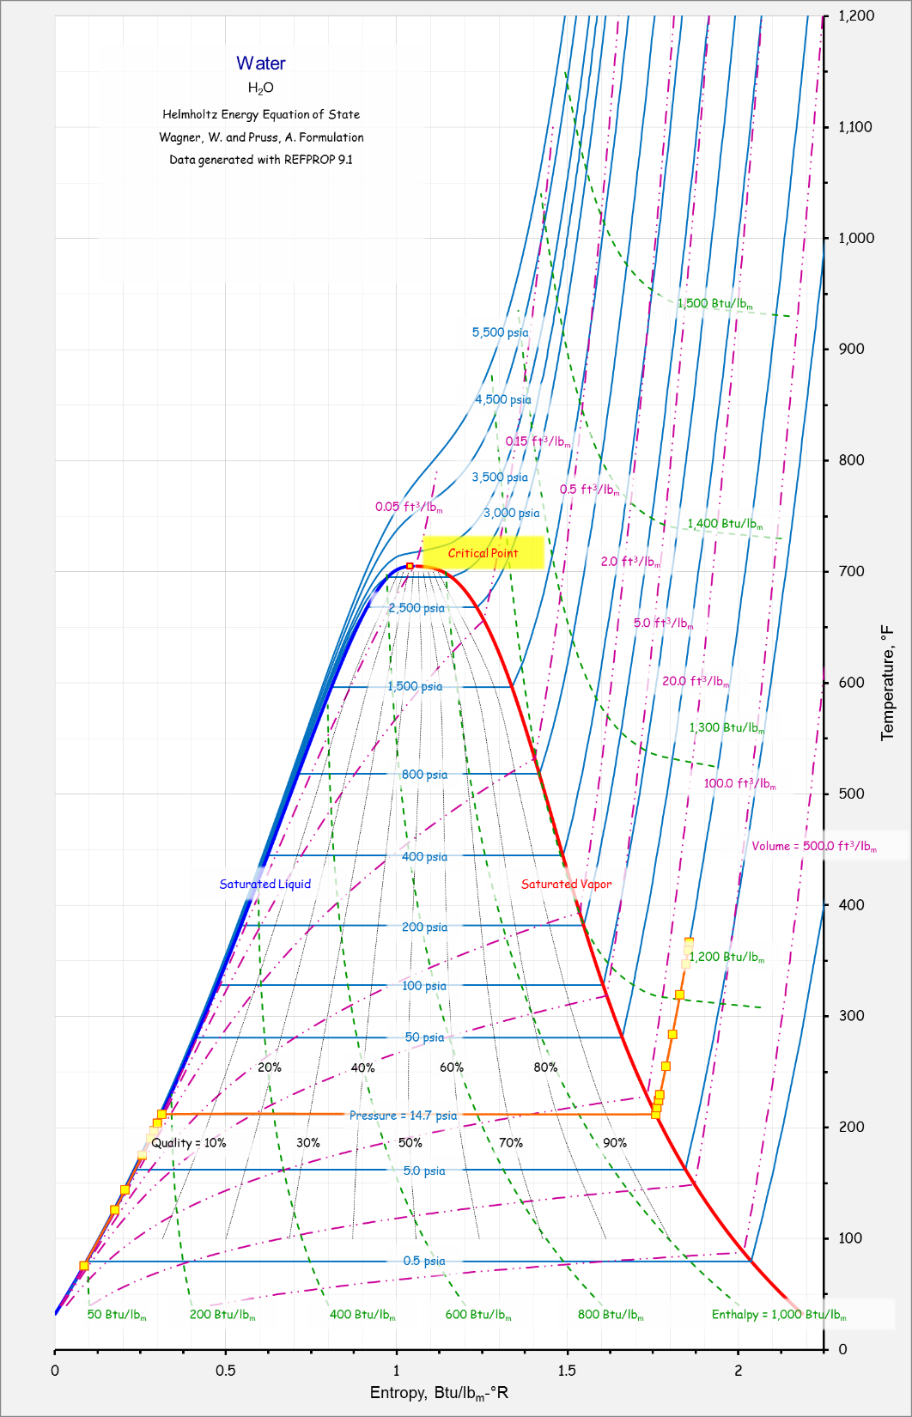

Slide 35
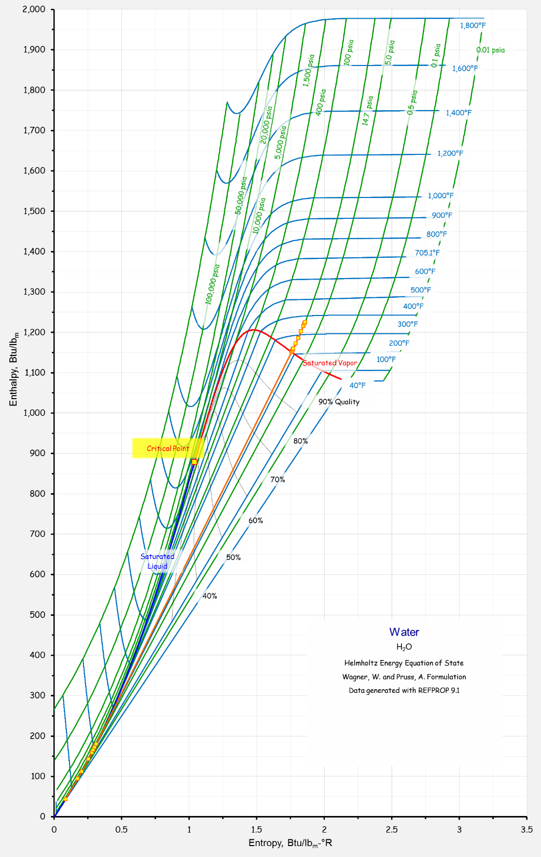

Slide 36
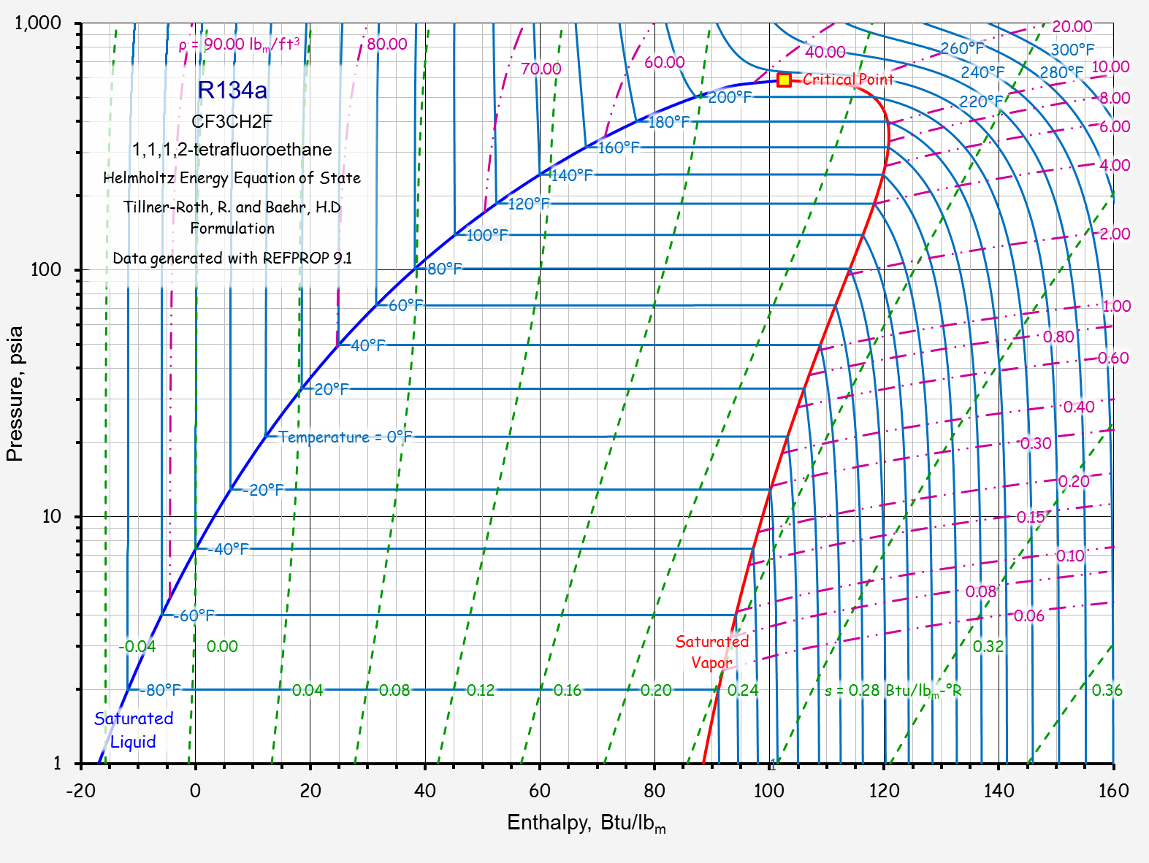

Slide 37
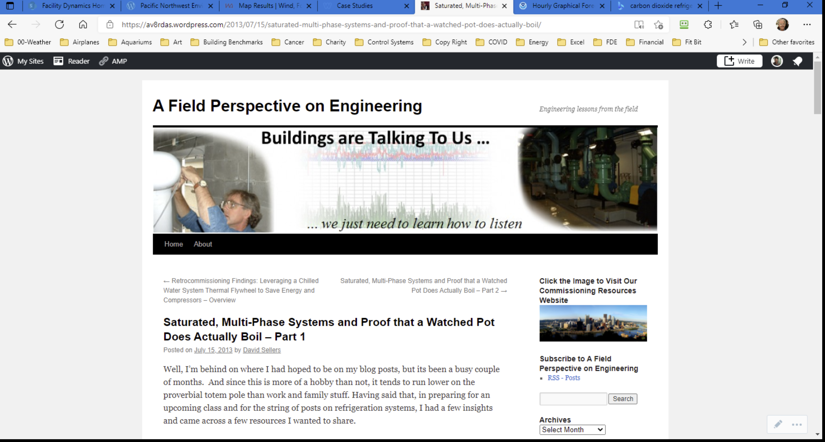
For More Information
https://av8rdas.wordpress.com/2013/07/15/saturated-multi-phase-systems-and-proof-that-a-watched-pot-does-actually-boil/

Slide 38
Vapor Compression Refrigeration Machines
An application of saturated system and phase change principles and concepts

Slide 39
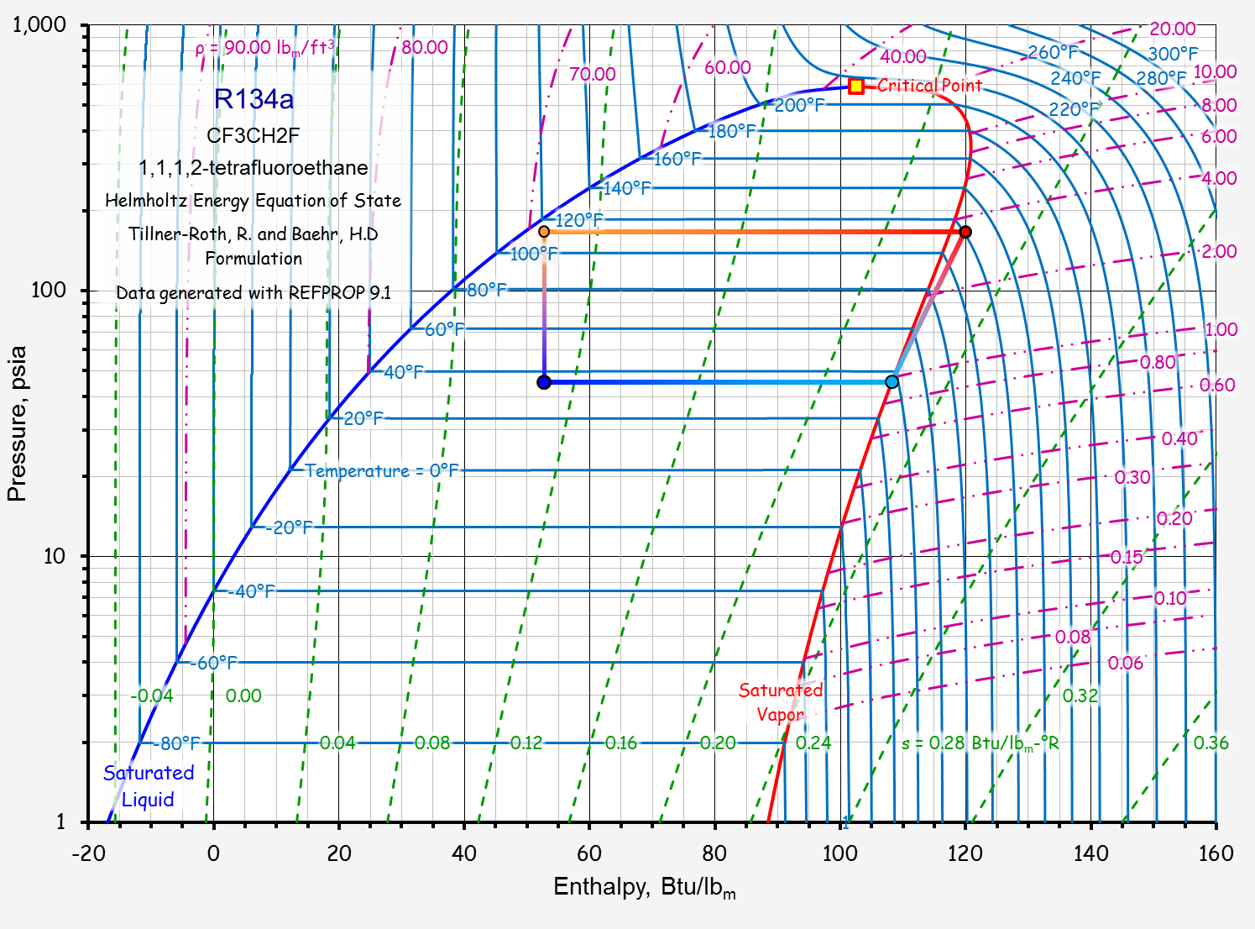
Condensation
Expansion
Compression
Evaporation

Slide 40
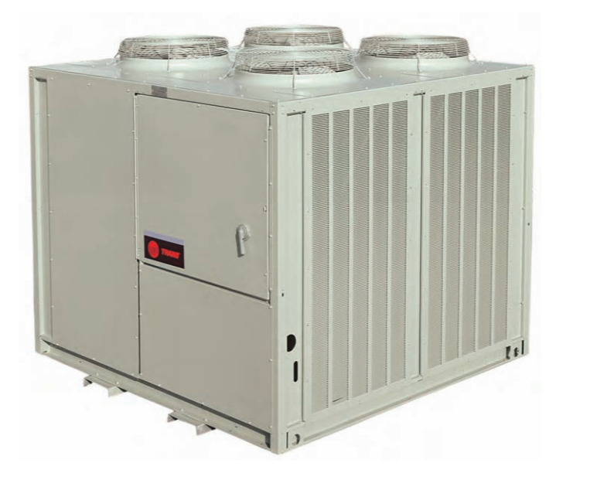
Refrigeration Compressor Performance
Basis for Example
Trane RAU air cooled condensing unit
  Contains compressors, and condenser coil
  Connects to a remote coil or evaporator
40 tons, 2 circuits,
Four 10 ton compressors
R410a
https://www.trane.com/commercial/north-america/us/en.html

Slide 41
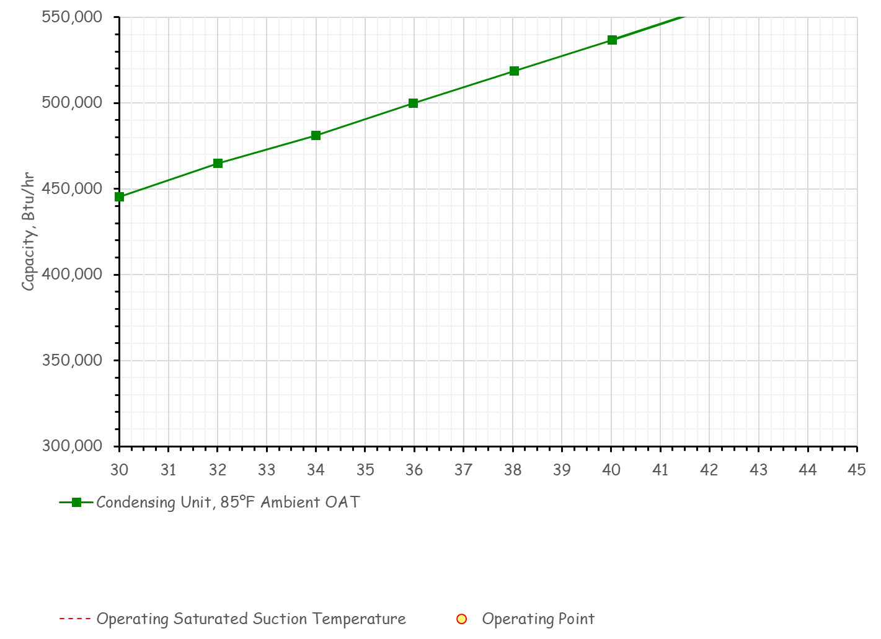

Slide 42
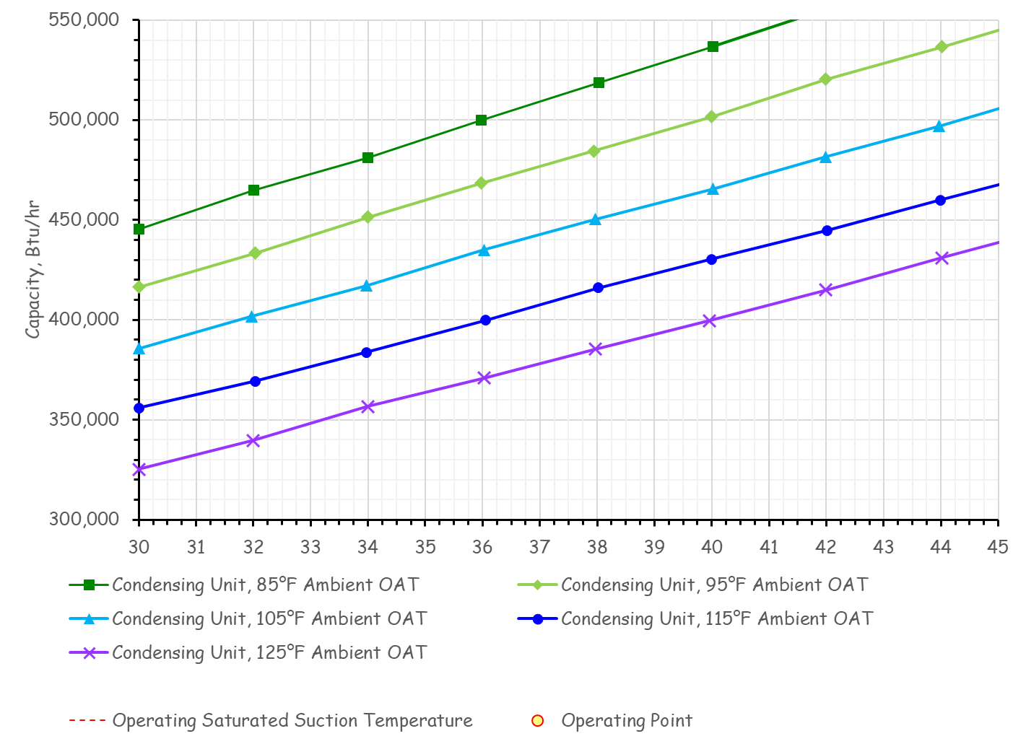

Slide 43
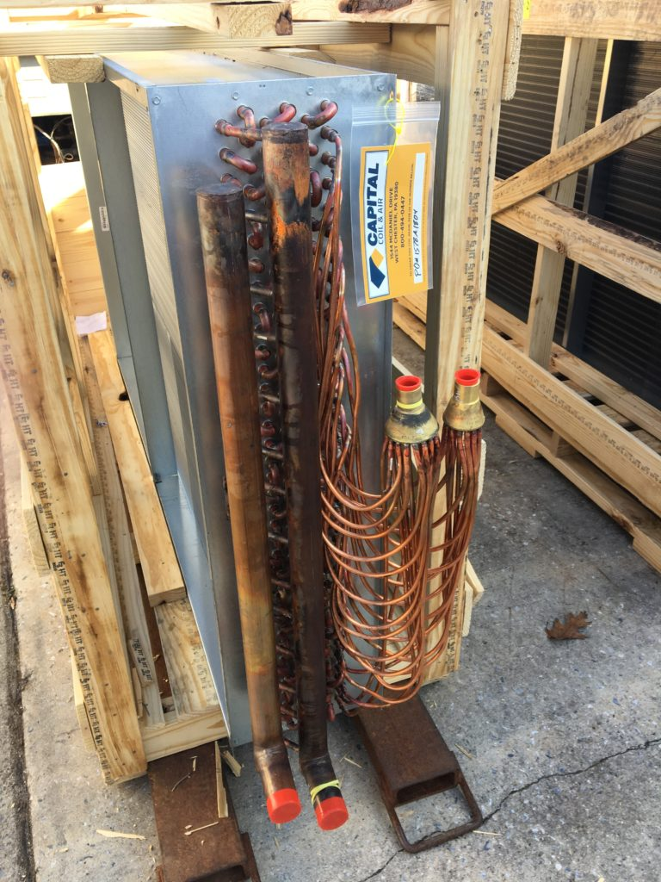
Evaporator Performance
Basis for Example
Greenheck Direct Expansion (Dx) Coil
  8,750 cfm
  500 fpm face velocity
  4 row
  10 fins per Inch
  Intertwined
Courtesy https://www.capitalcoil.com/

Slide 44
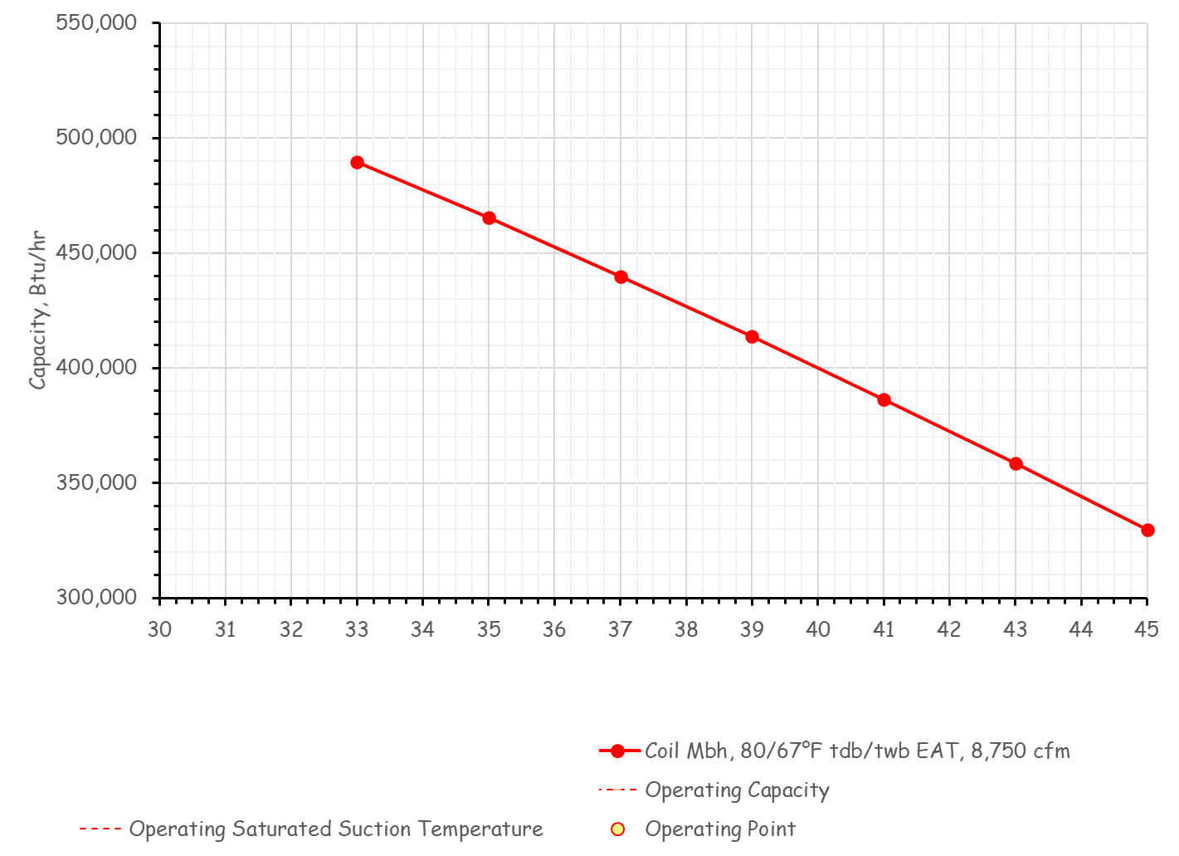

Slide 45
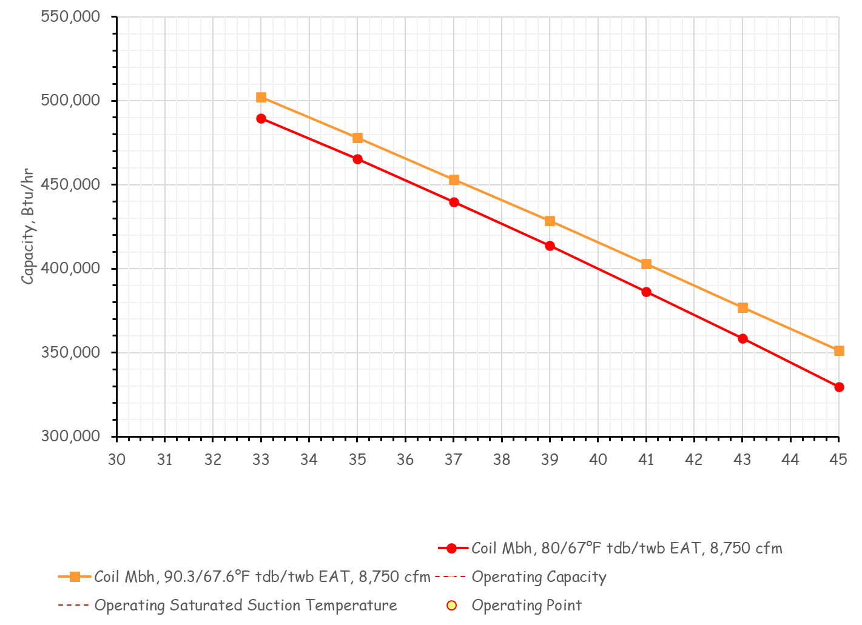
Compressor and Evaporator Interactions

Slide 46
Compressor and Evaporator Interactions

Slide 47
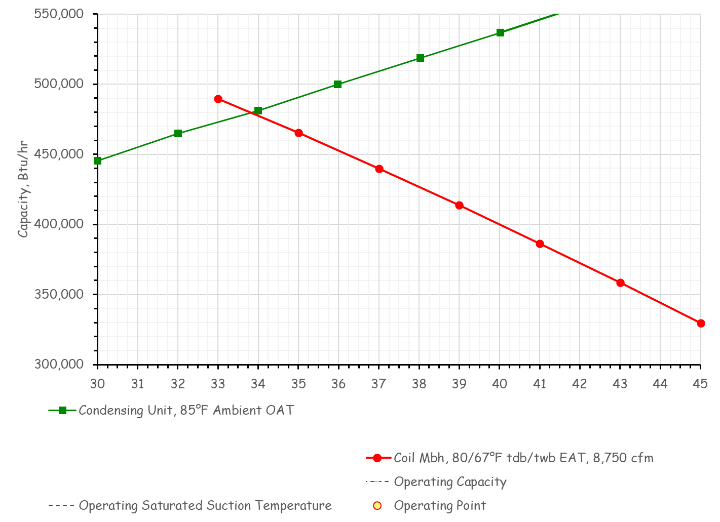
Compressor and Evaporator Interactions

Slide 48
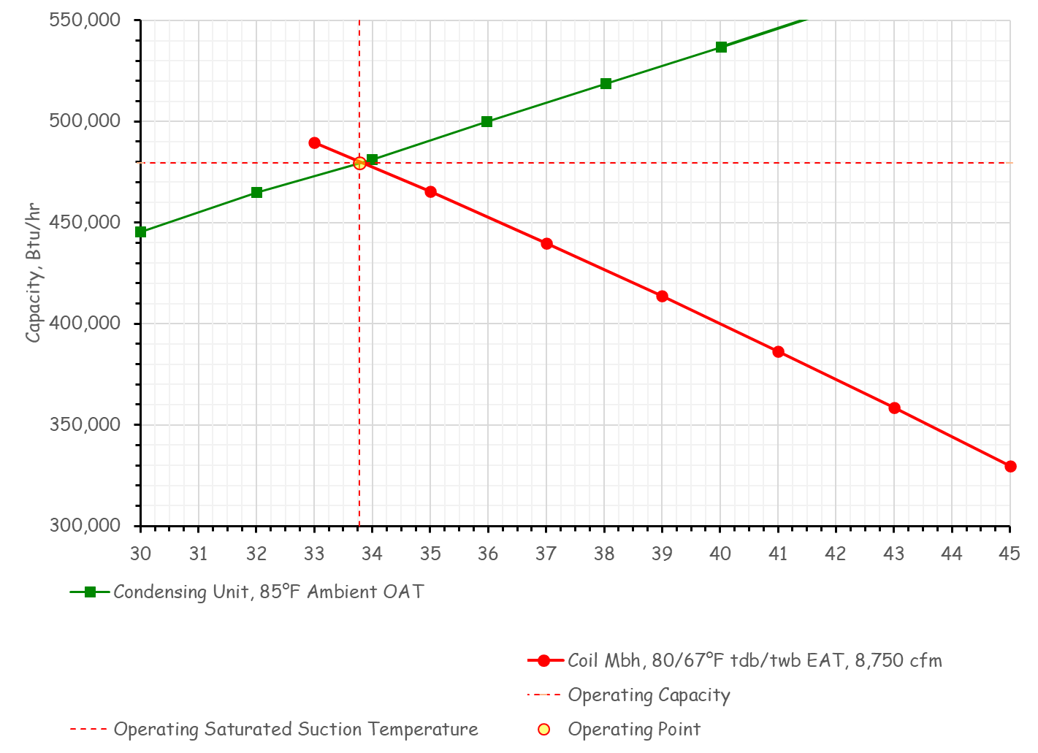
Compressor and Evaporator Interactions

Slide 49
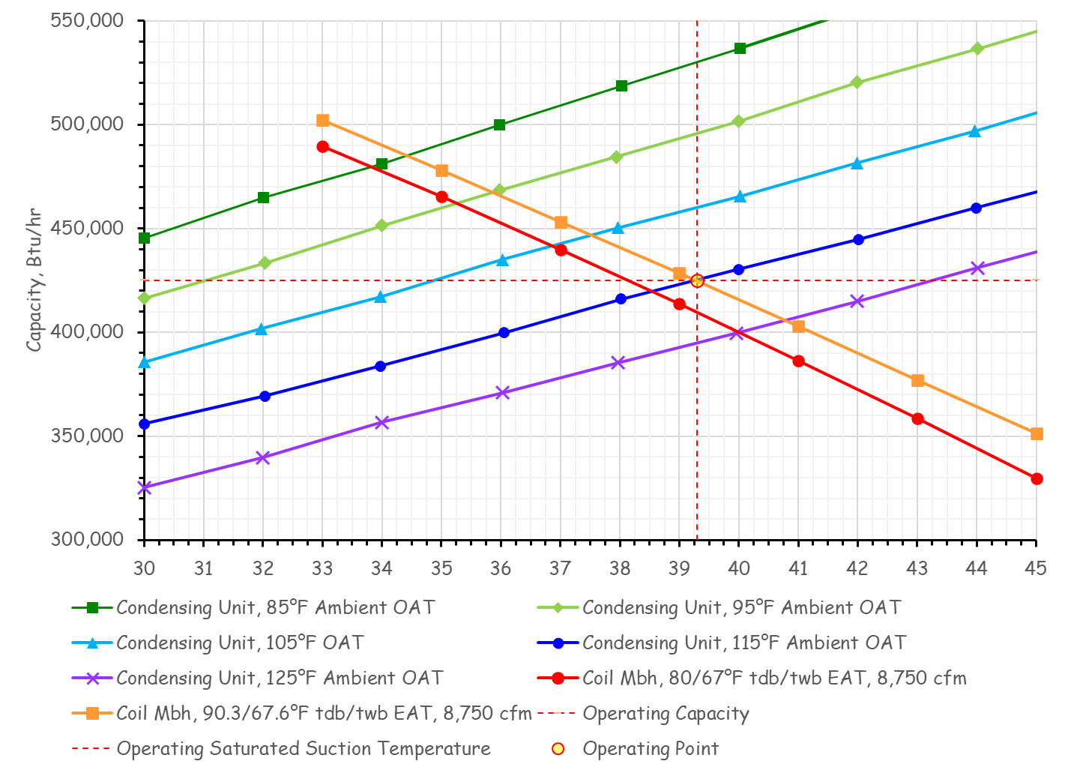
Compressor and Evaporator Interactions

Slide 50
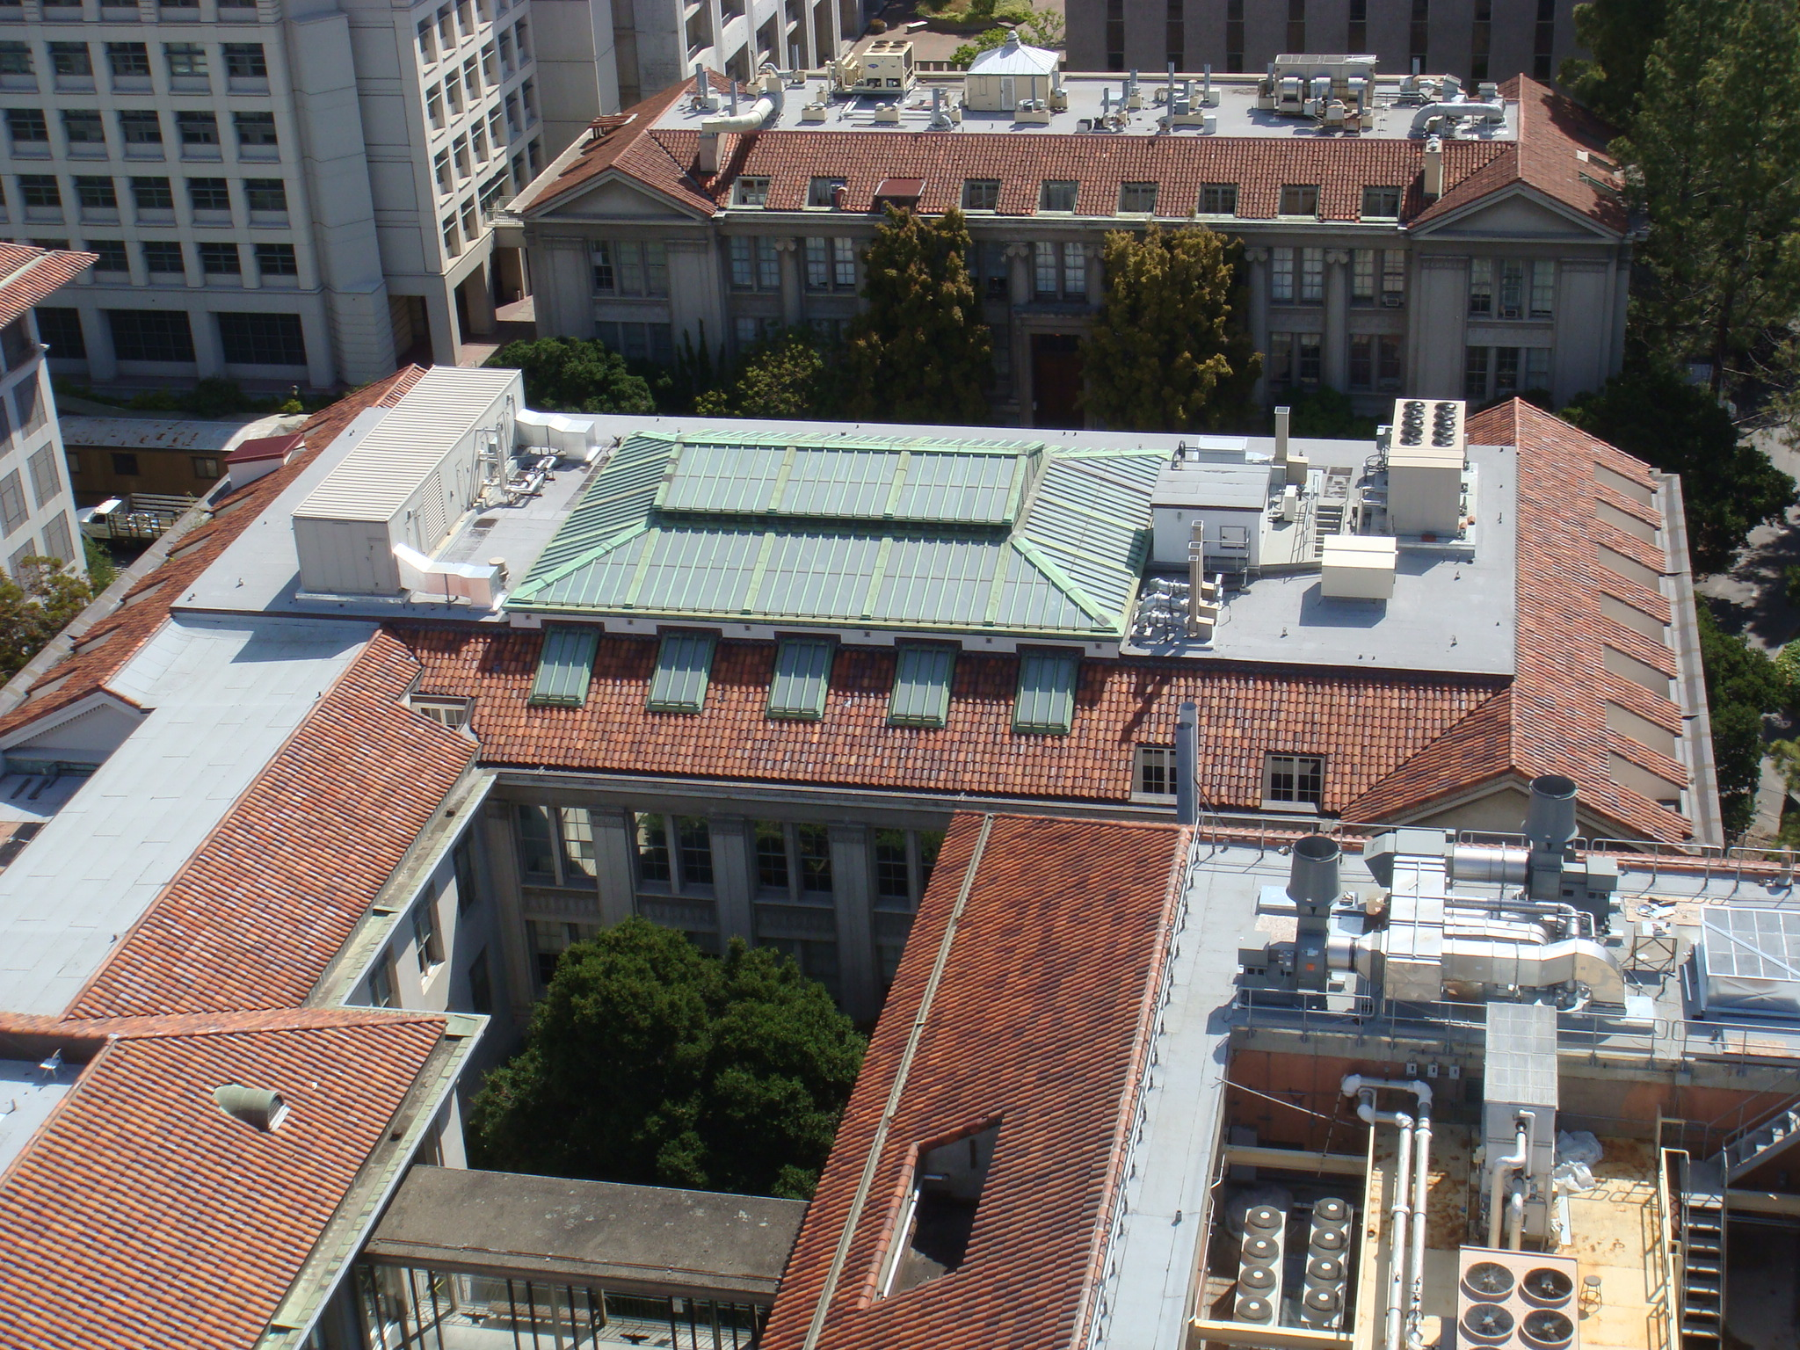
An Air Cooled Vapor Compression Cycle Chiller

Slide 51
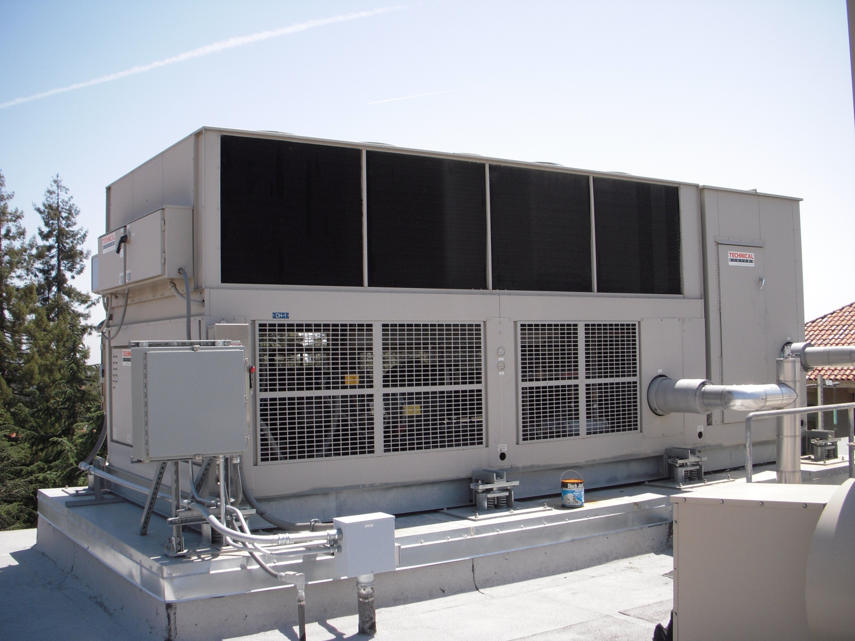

Slide 52
An Air Cooled Vapor Compression Cycle Chiller

Slide 53
Hot Gas Line
Liquid Line Solenoid Valve
Liquid Line
Suction Line
Evaporator

Slide 54
Which Pipe is Which
Suction Line
Liquid Line
Hot gas line
Largest, coldest and insulated
Smallest, warm, usually not insulated
Size between suction and liquid line size, hot, typically not insulated

Slide 55
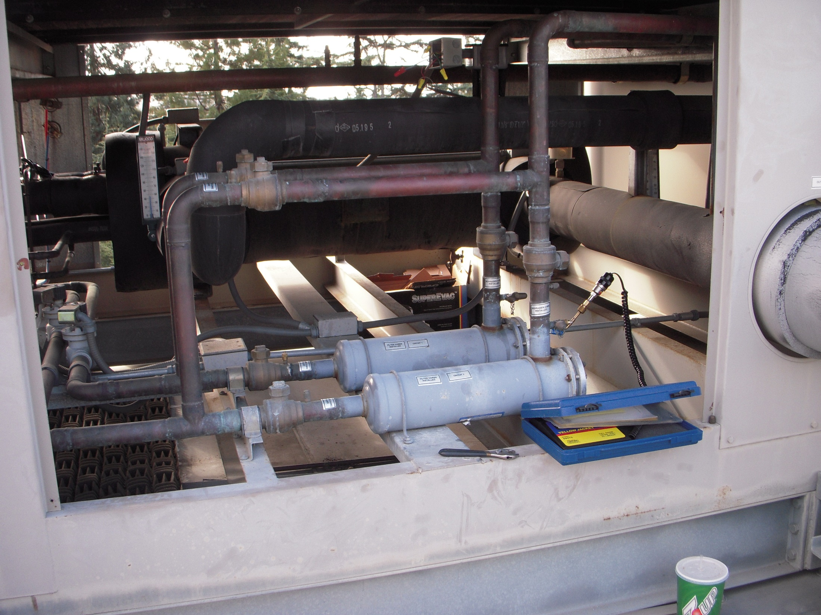
Service Bypass to Allow Filter Dryer to be Serviced (Not shown on diagram
Evaporator
Filter Dryer (Not shown on diagram)
Service Valves (Not shown on diagram

Slide 56
Liquid Lines
Chilled Water Pipes
Suction Line
Liquid Line Solenoid Valve

Slide 57
Hot Gas Line
Liquid Line
Suction Line
Evaporator
Compressor

Slide 58
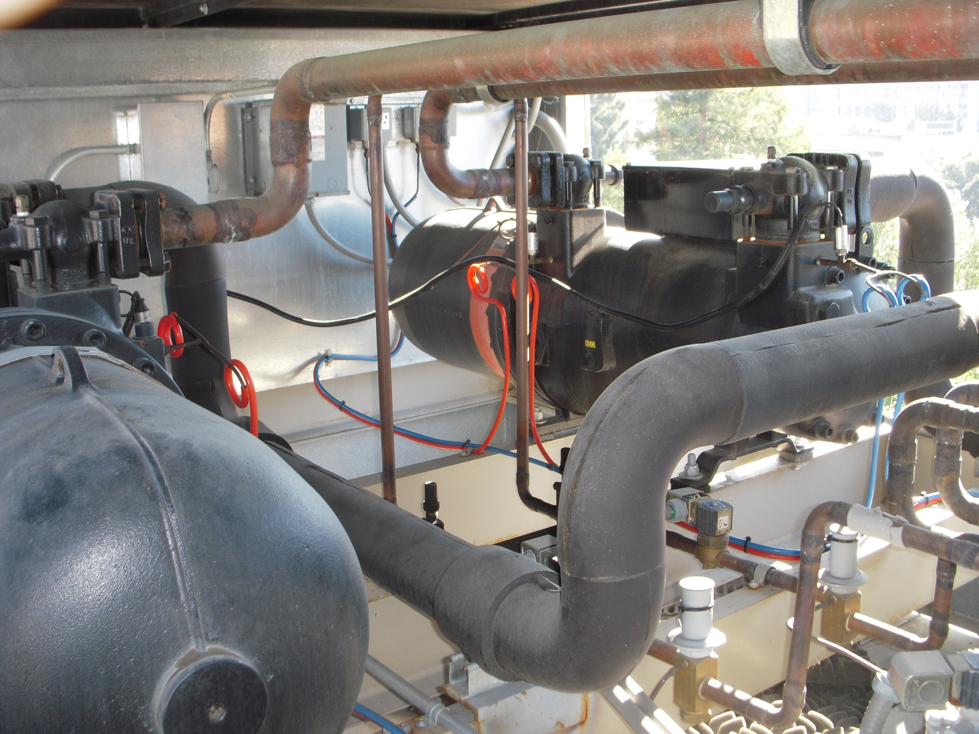
Hot Gas Lines
Compressor
Compressor
Suction Line

Slide 59
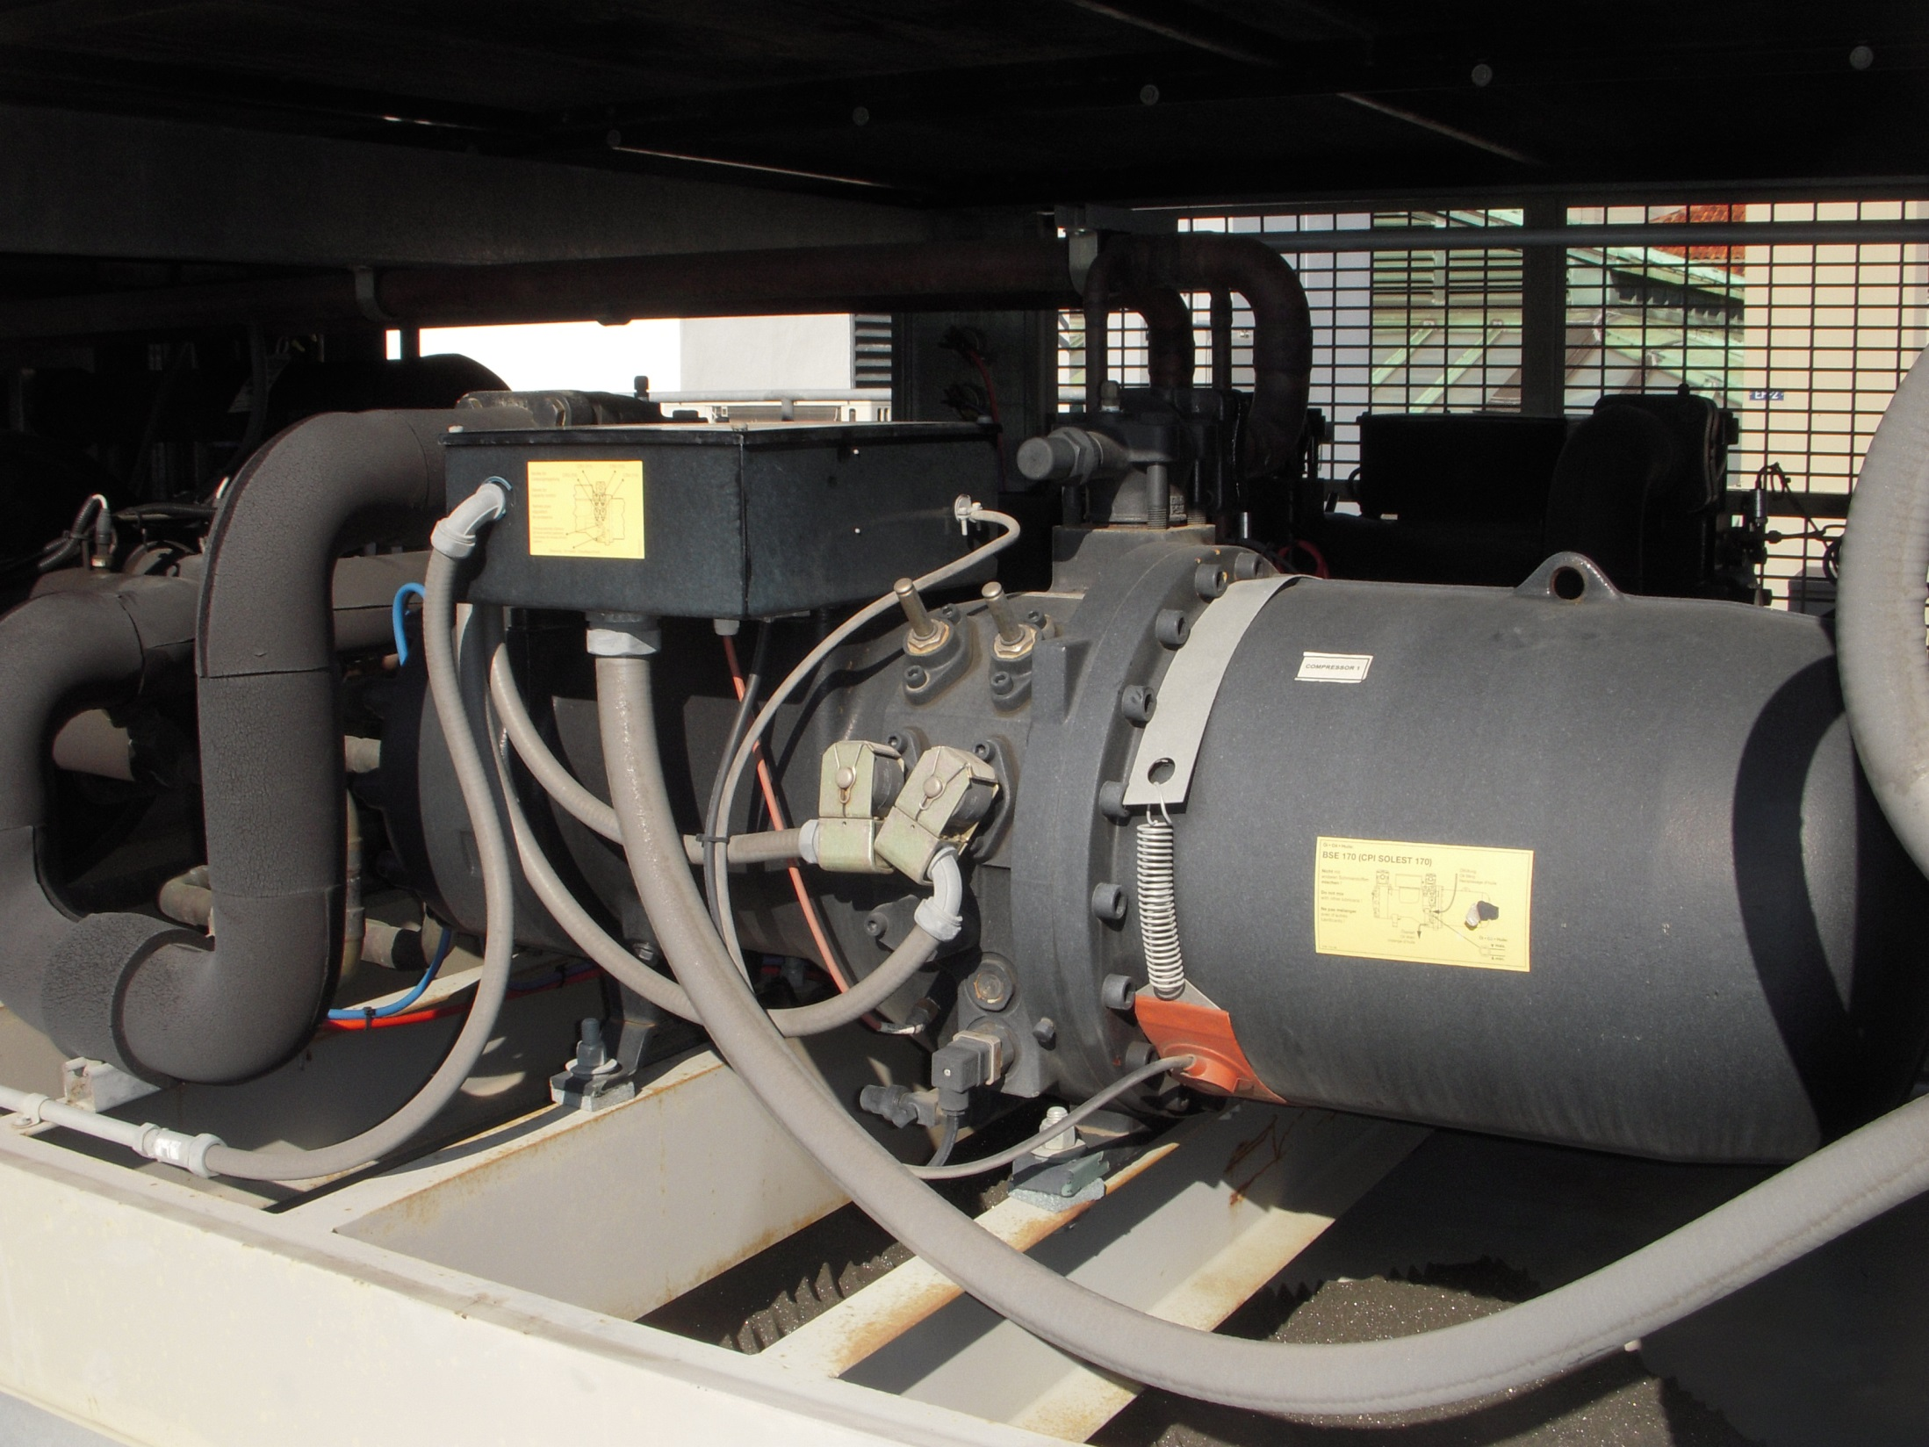
Compressor
Suction Line

Slide 60
Unloaders

Slide 61
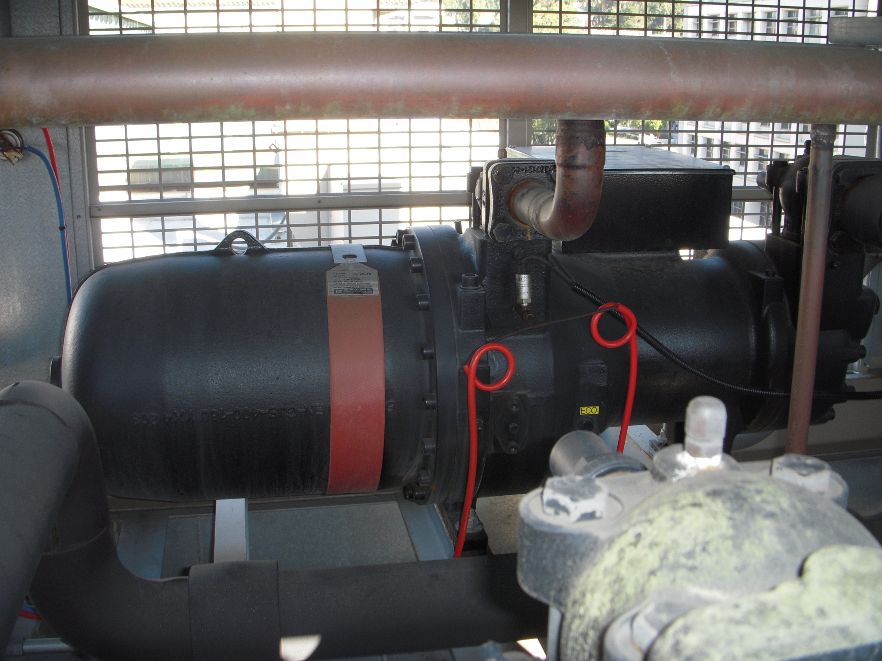
Crank Case Heater

Slide 62
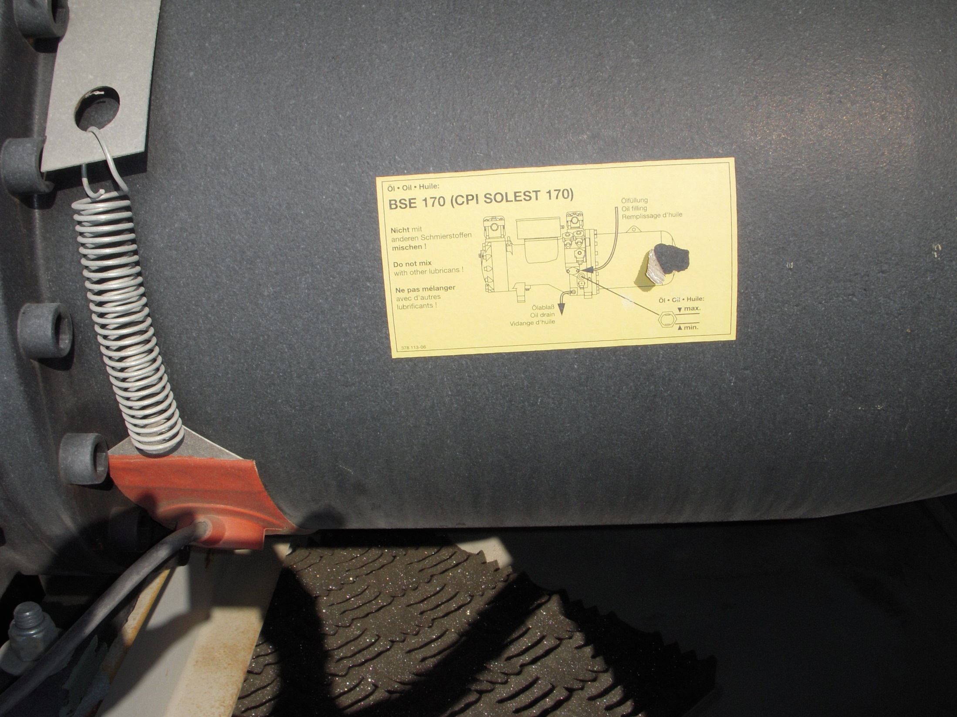
Crank Case Heater

Slide 63
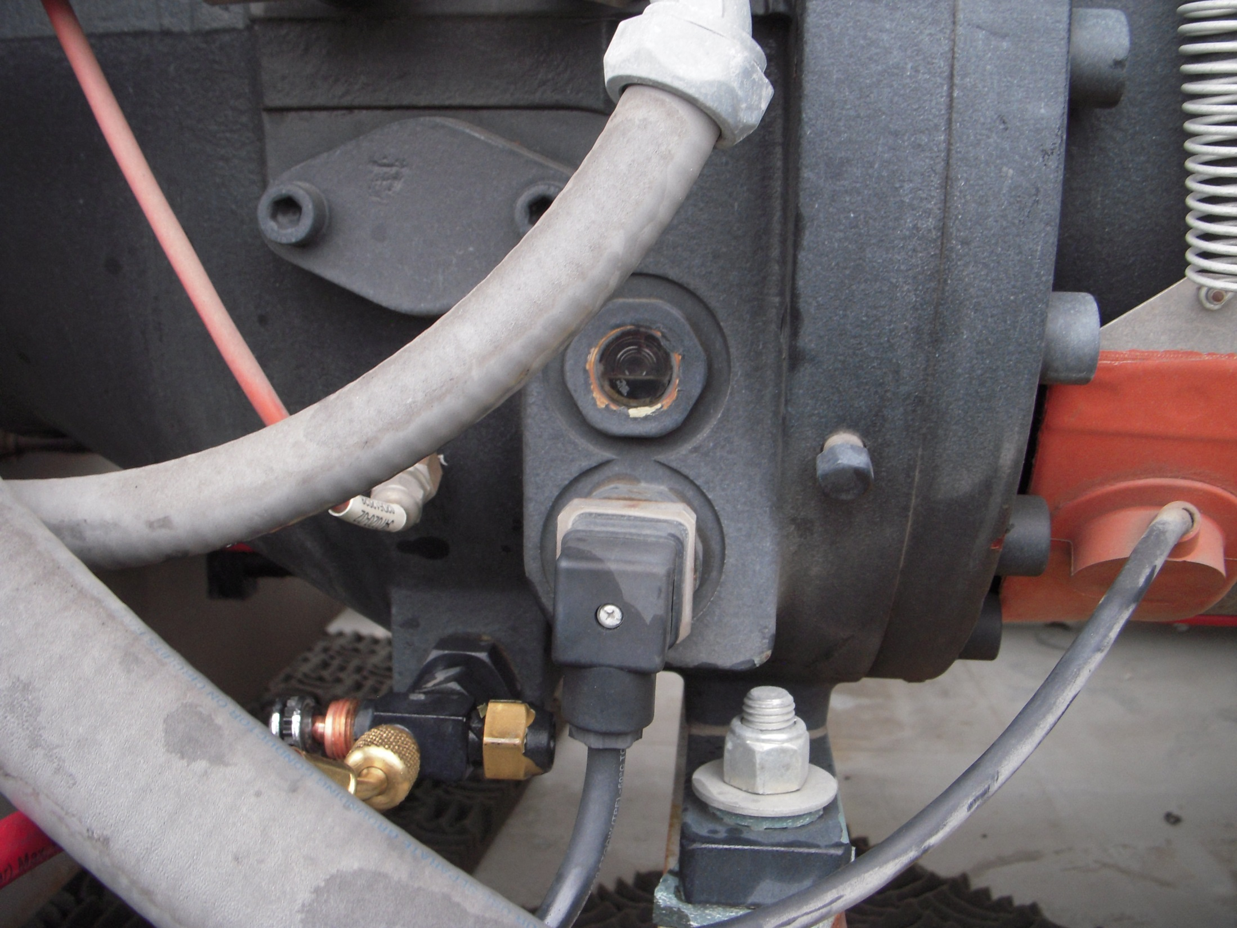
Oil Sight Glass

Slide 64
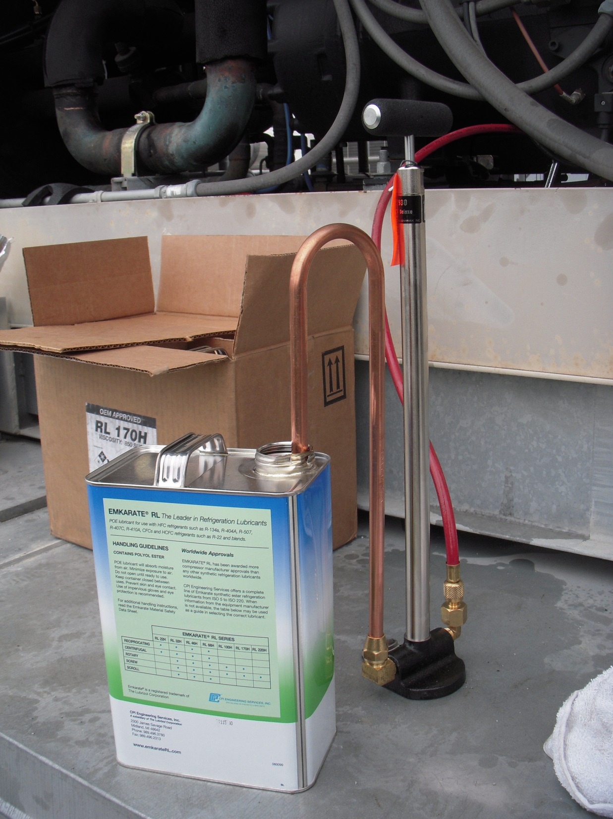
Hand Pump for Adding Oil

Slide 65
Refrigerant Oil
R22 systems use mineral oil as a lubricant
R410A systems use either ether oil or alkylbenzene
    Using the wrong oil can cause sludge and other problems leading to failure
    Tools use on R22 systems can be “contaminated” with mineral oil and should not be used on R410A systems
    Contamination can lead to sludge and other problems
    R410 oil is an order of magnitude more hygroscopic than R22 oil

Slide 66
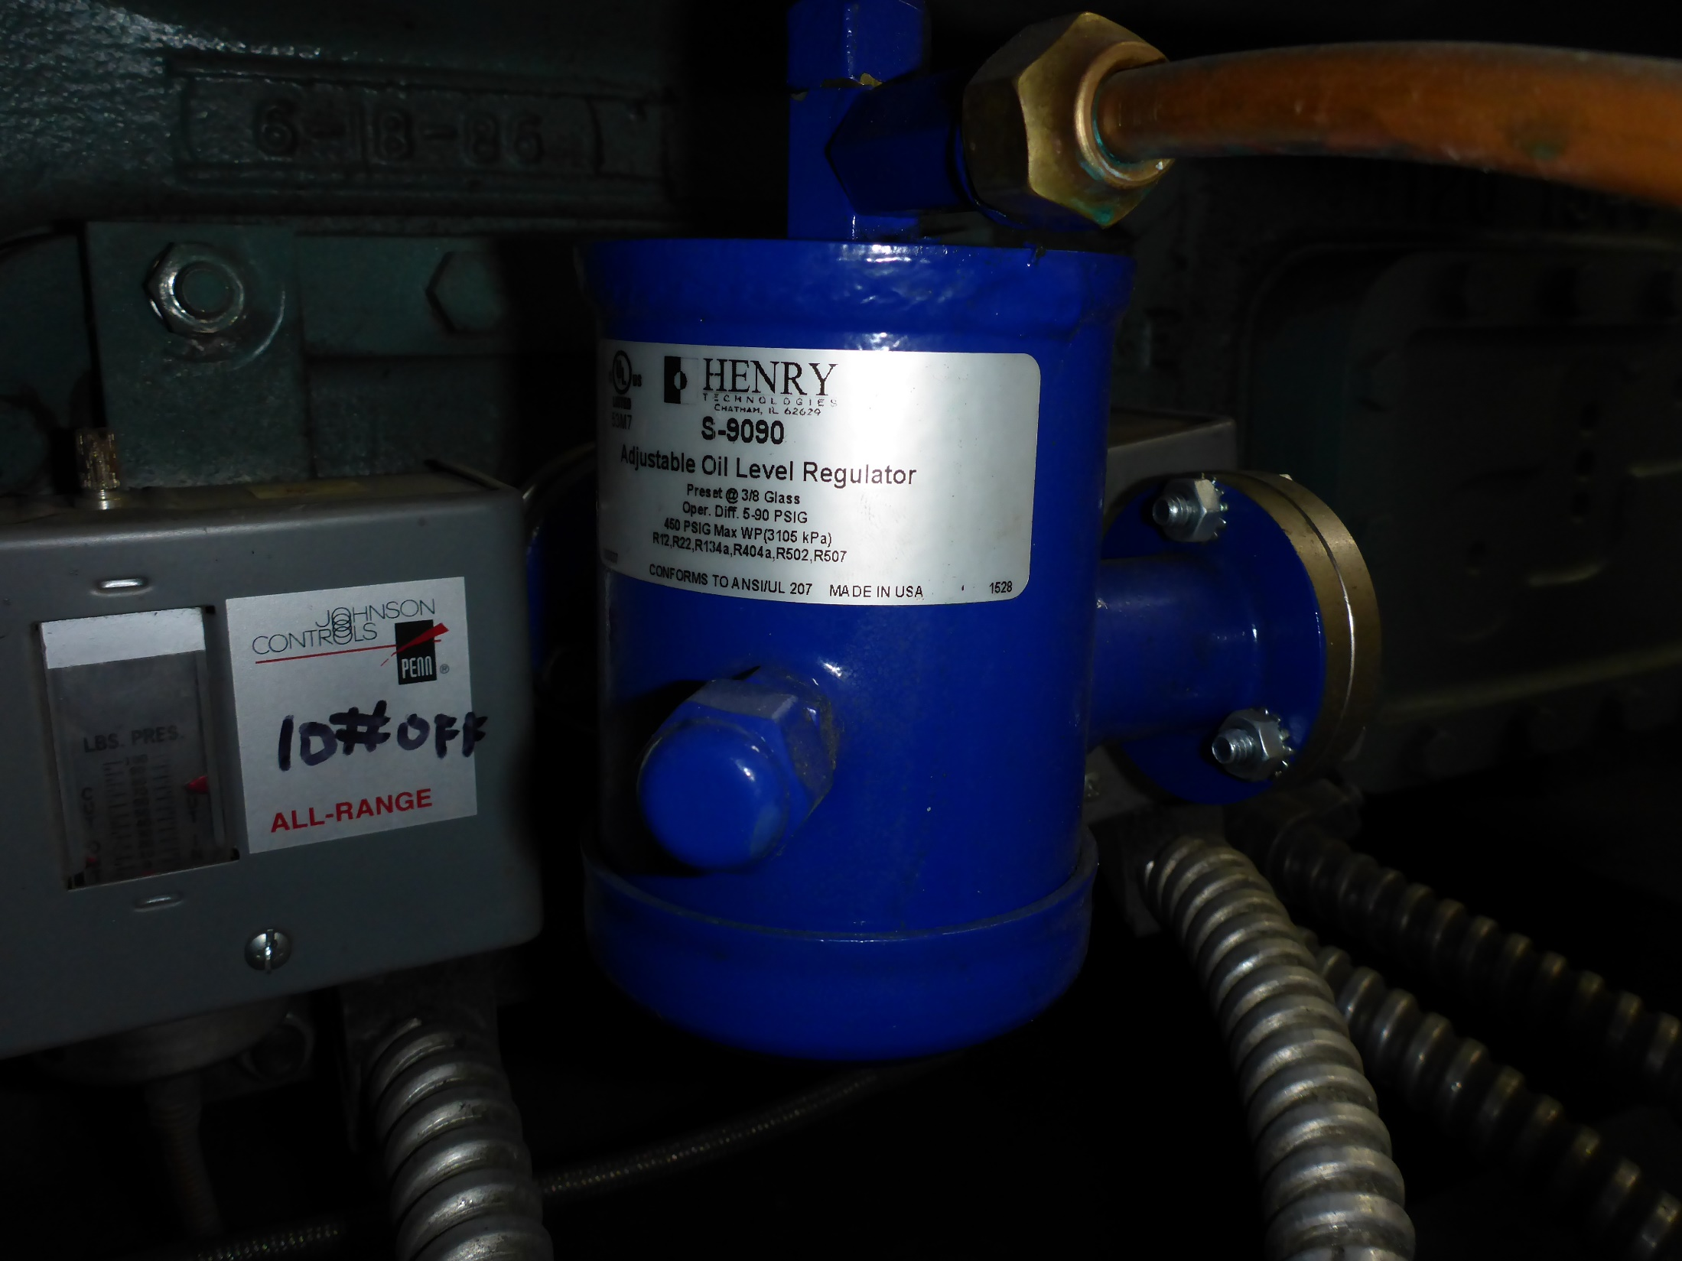
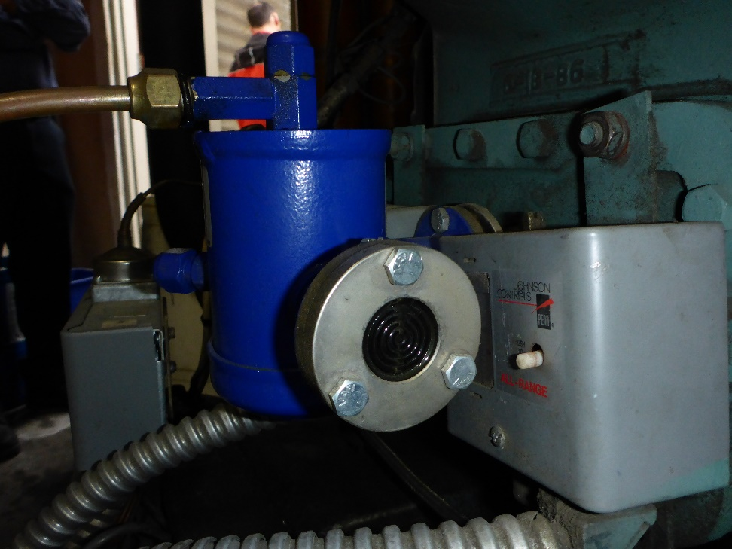
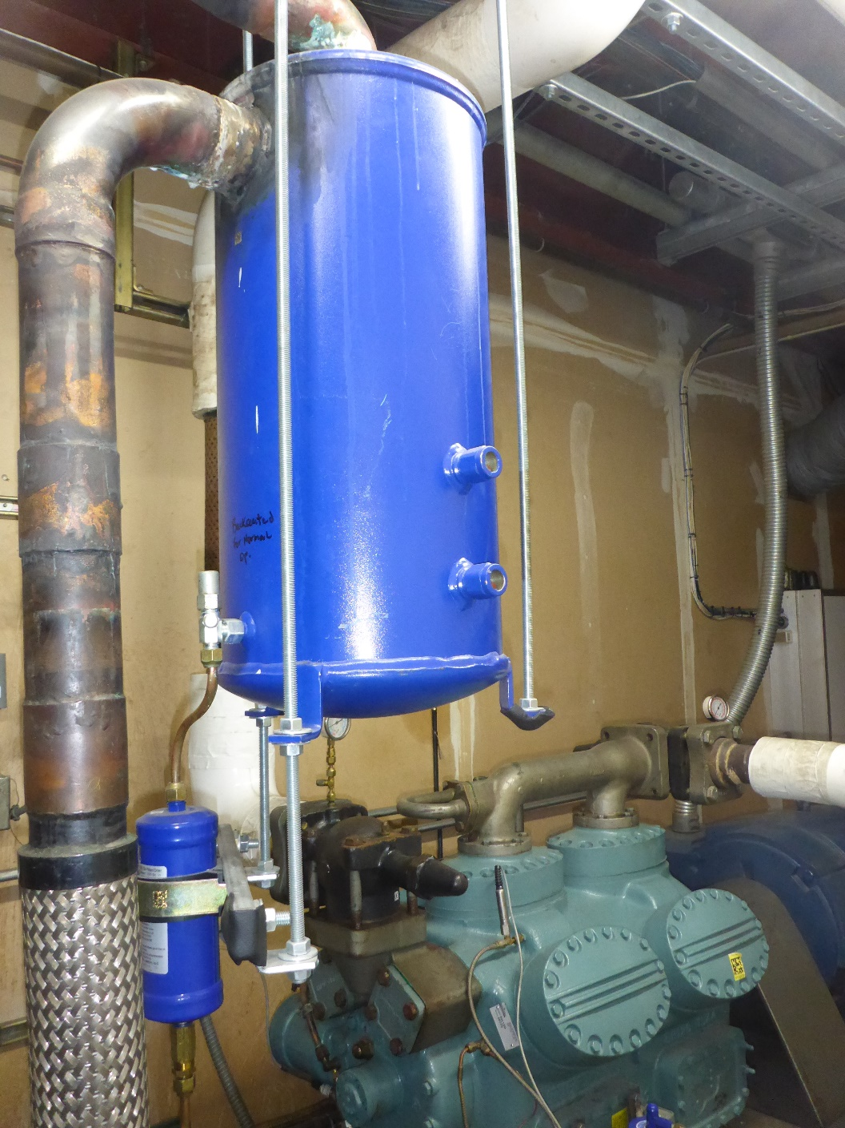
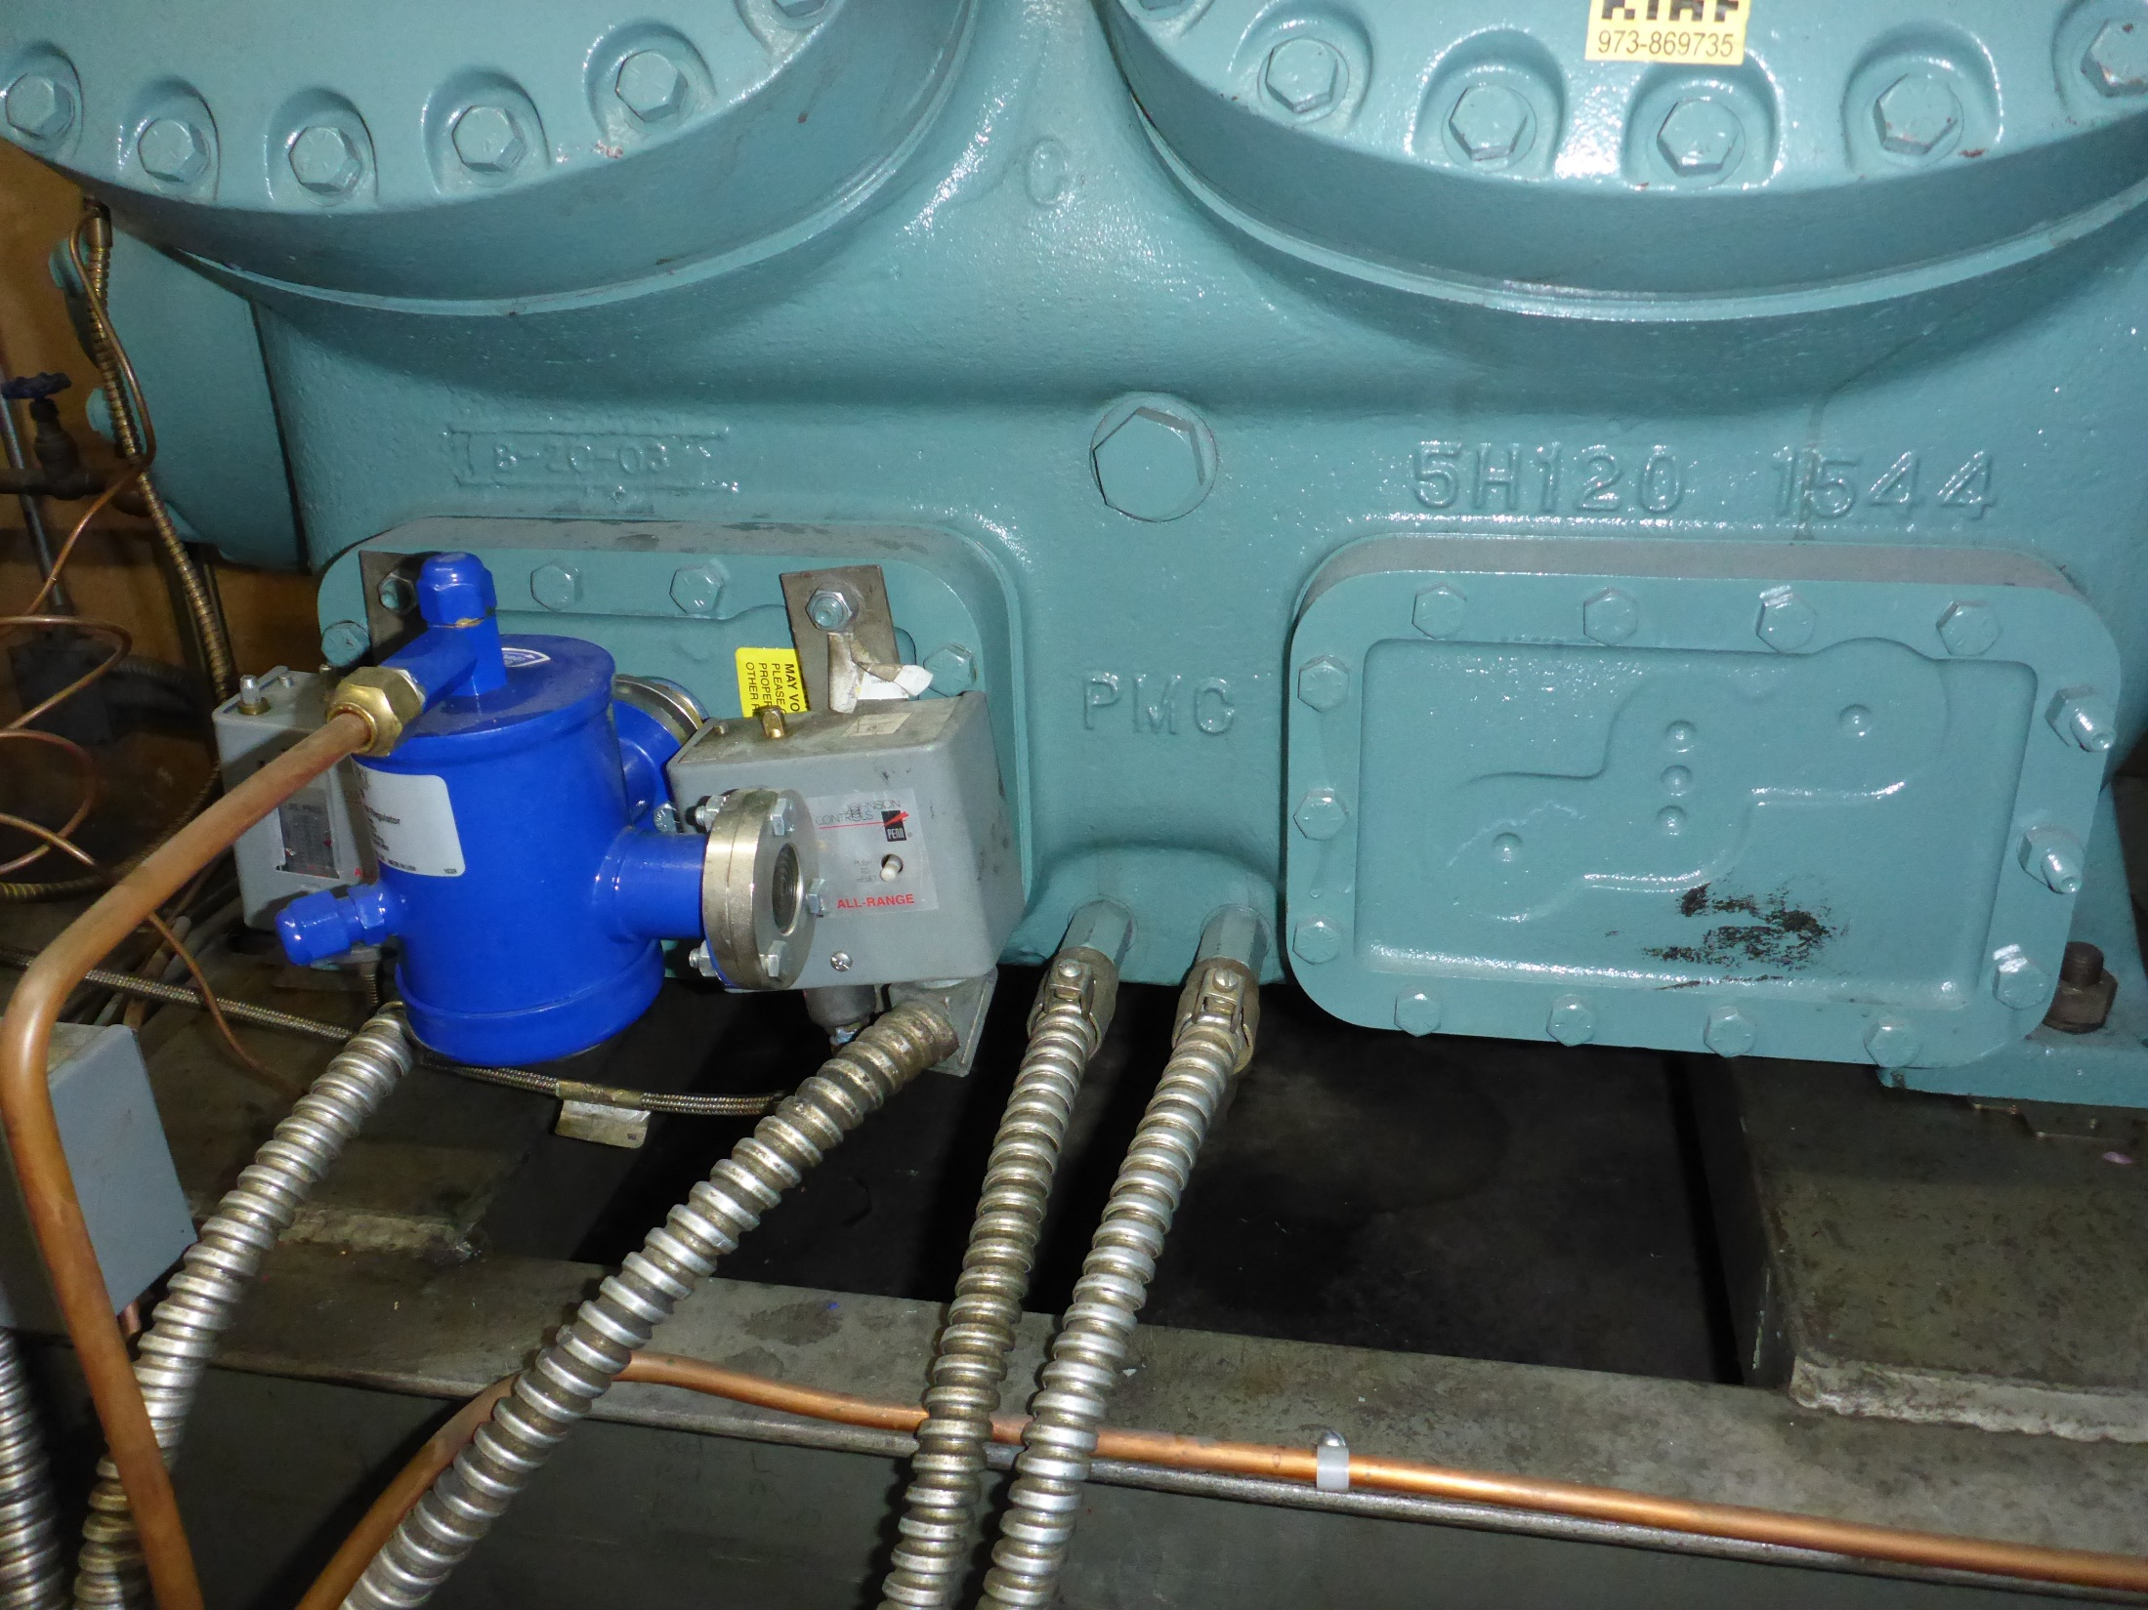
Oil Management is Crucial
Oil Seperators
  Piped into the discharge line
  Keep it from leaving the compressor

Slide 67



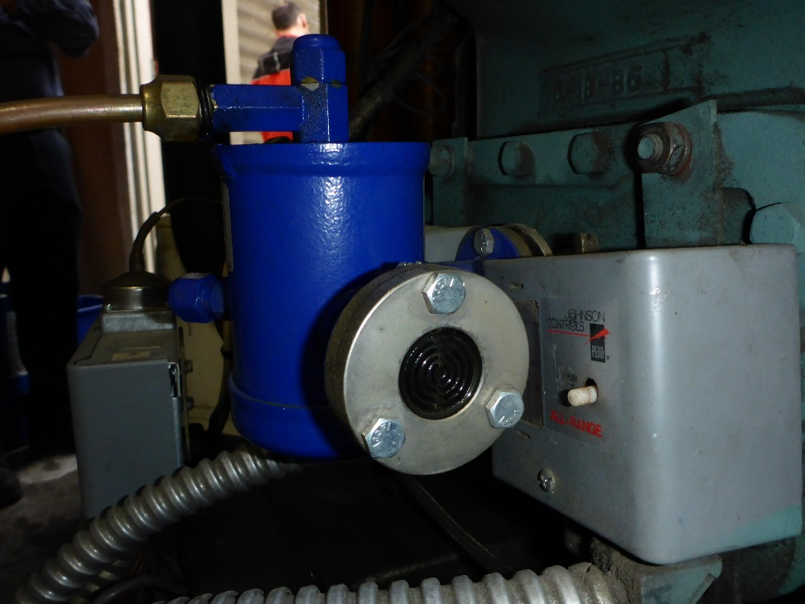
Oil Management is Crucial
Oil Seperators
  Piped into the discharge line
  Keep it from leaving the compressor

Slide 68

Oil Management is Crucial
Oil Seperators
  Piped into the discharge line
  Keep it from leaving the compressor

Slide 69
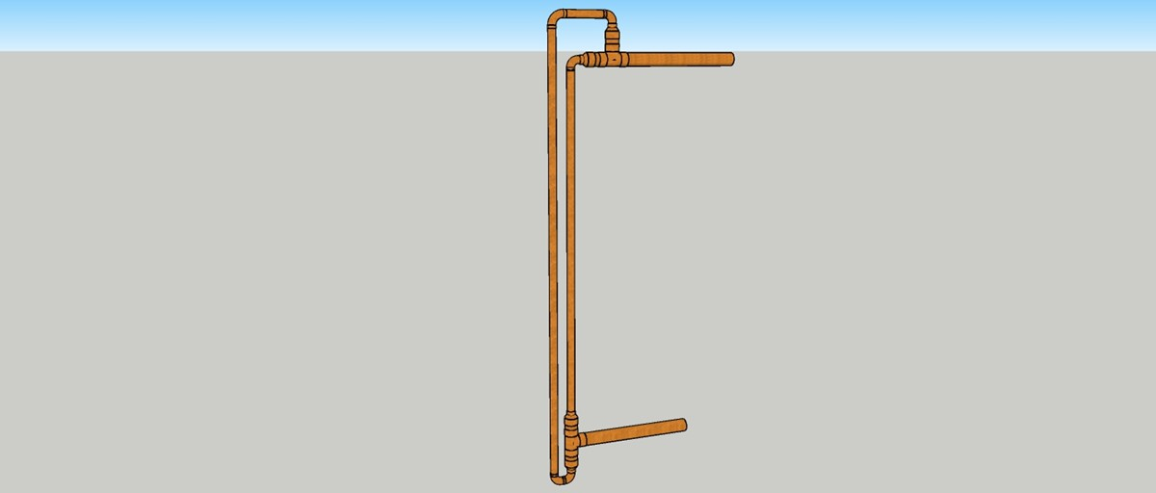
Oil Management is Crucial
Oil Seperators
  Piped into the discharge line
  Keep it from leaving the compressor

Slide 70
Oil Management is Crucial
Design the Piping to Bring it Back
Pitch towards the compressor
Maintain velocities that will carry the oil back
Use double suction risers to change elevation

Slide 71
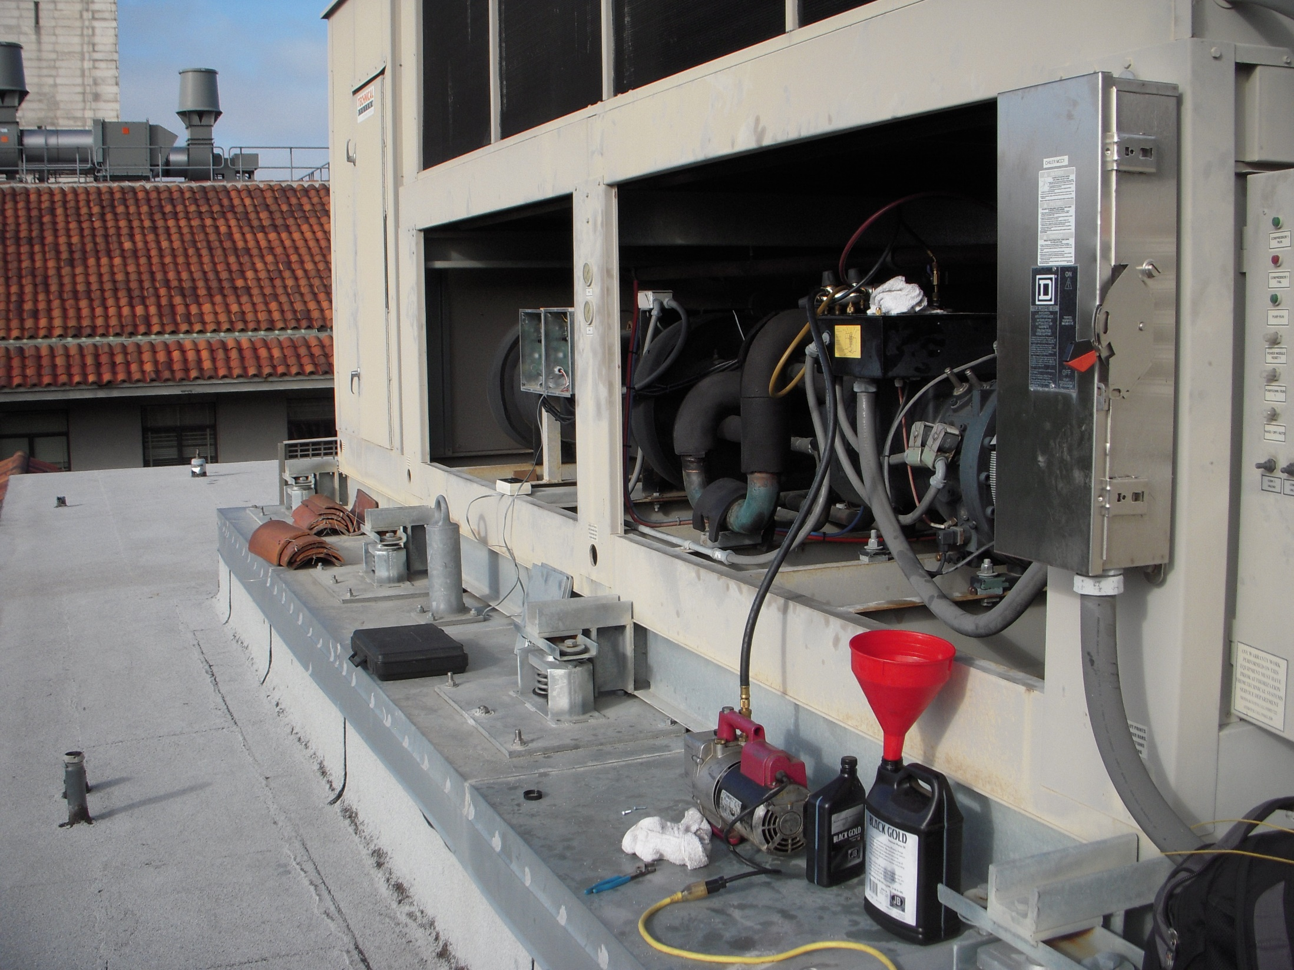
Vacuum Pump Evacuating the System in Preparation for Charging
Vacuum Pump

Slide 72
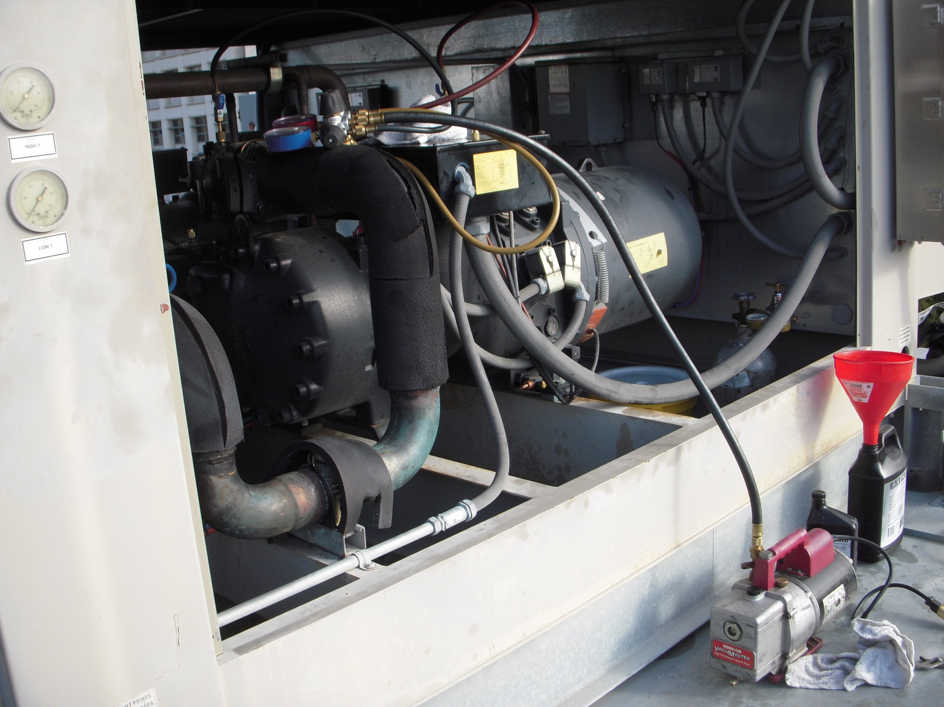

Slide 73
Installation Practices
Refrigerant piping installation practice critical to short and long term system integrity
  General requirements no different from those employed with any built up refrigeration system
  Details associated with R410 systems may vary from standard practice in the field at this point in time

Slide 74
Installation Practices
Refrigerant piping installation practice critical to short and long term system integrity
  General requirements no different from those employed with any built up refrigeration system
  Details associated with R410 systems may vary from standard practice in the field at this point in time

Slide 75
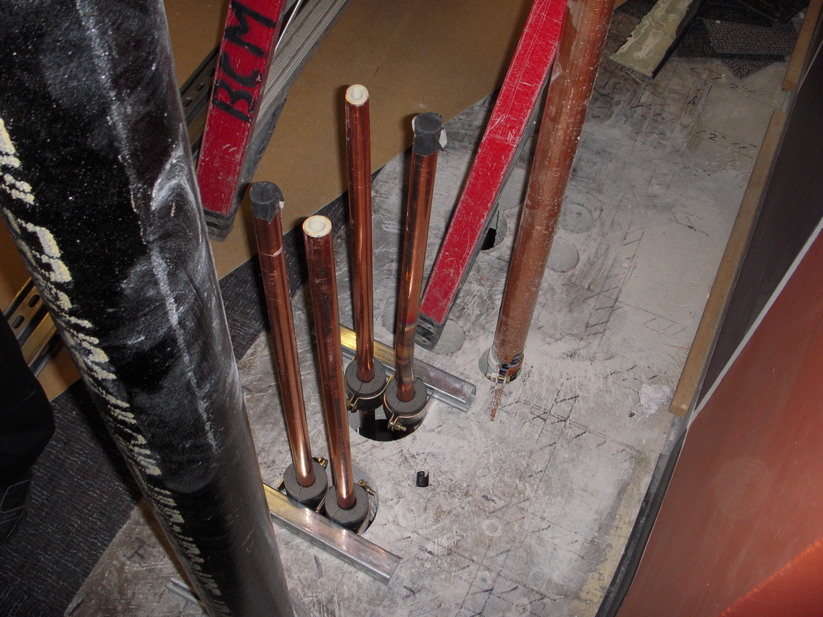
Cleanliness Is Essential
Cleaned and Capped
Used to be Cleaned and Capped
Cleaned to an ASTM established limit for residue
Purged with dry nitrogen
Sealed with rubber plugs with positive nitrogen pressure inside the tuber

Slide 76
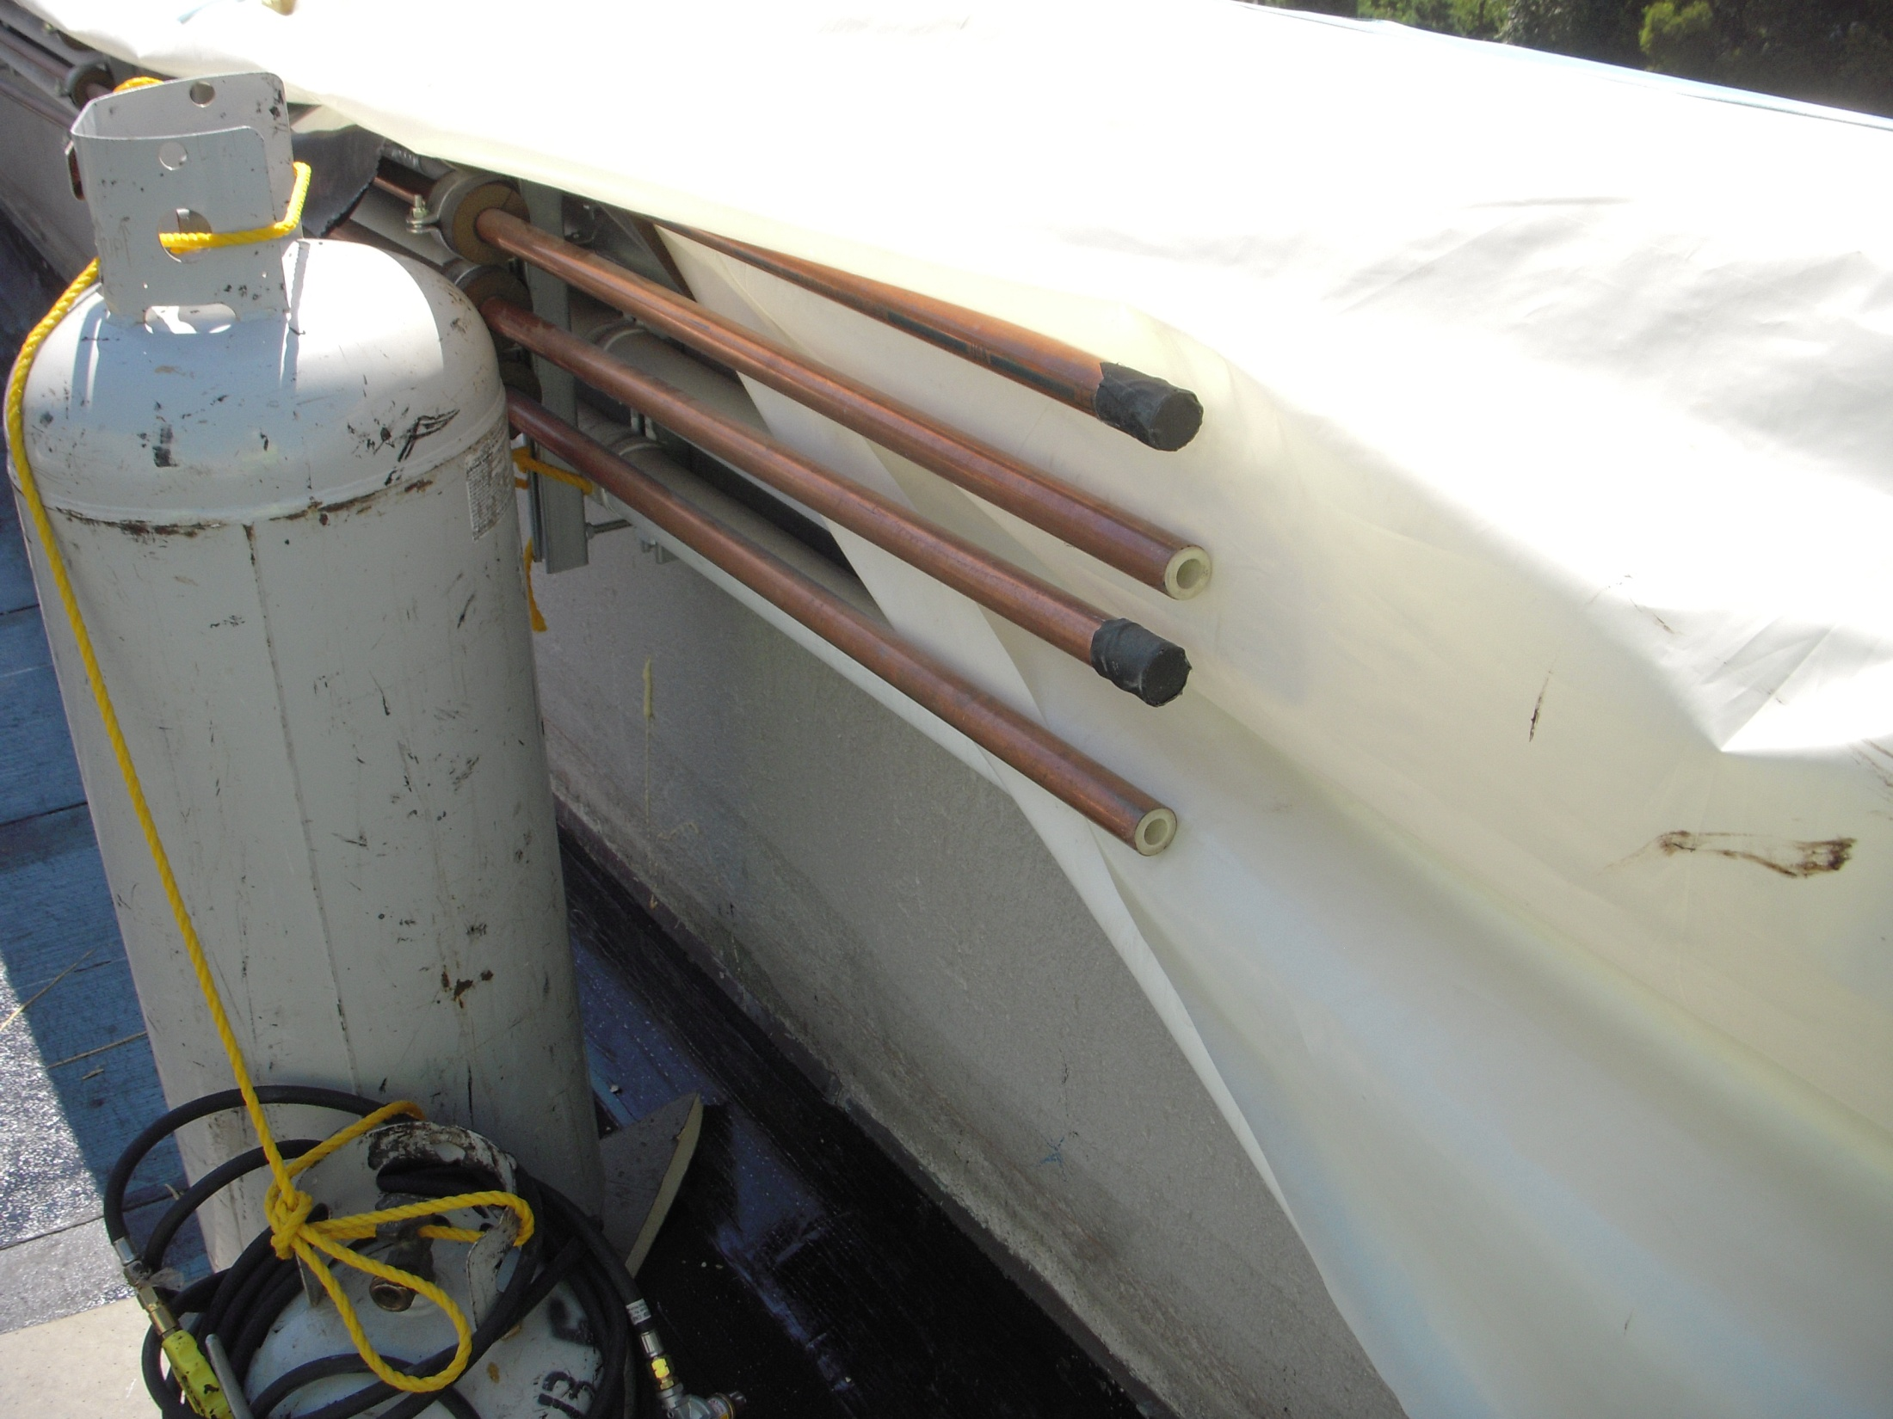
Cleanliness Is Essential
Cleaned and Capped
Used to be Cleaned and Capped
  Moisture and refrigerant don’t work well together
  Corrosion
  Ice
  Refrigerant oil problems
  Motor problems

Slide 77
Cleanliness Is Essential
Cleaned and Capped
Used to be Cleaned and Capped
  Dirt and precision machinery don’t work well together
  Moving parts in compressors
  Small orifices in metering and control valves and lubrication system
  Chemical reactions with oil and refrigerant

Slide 78
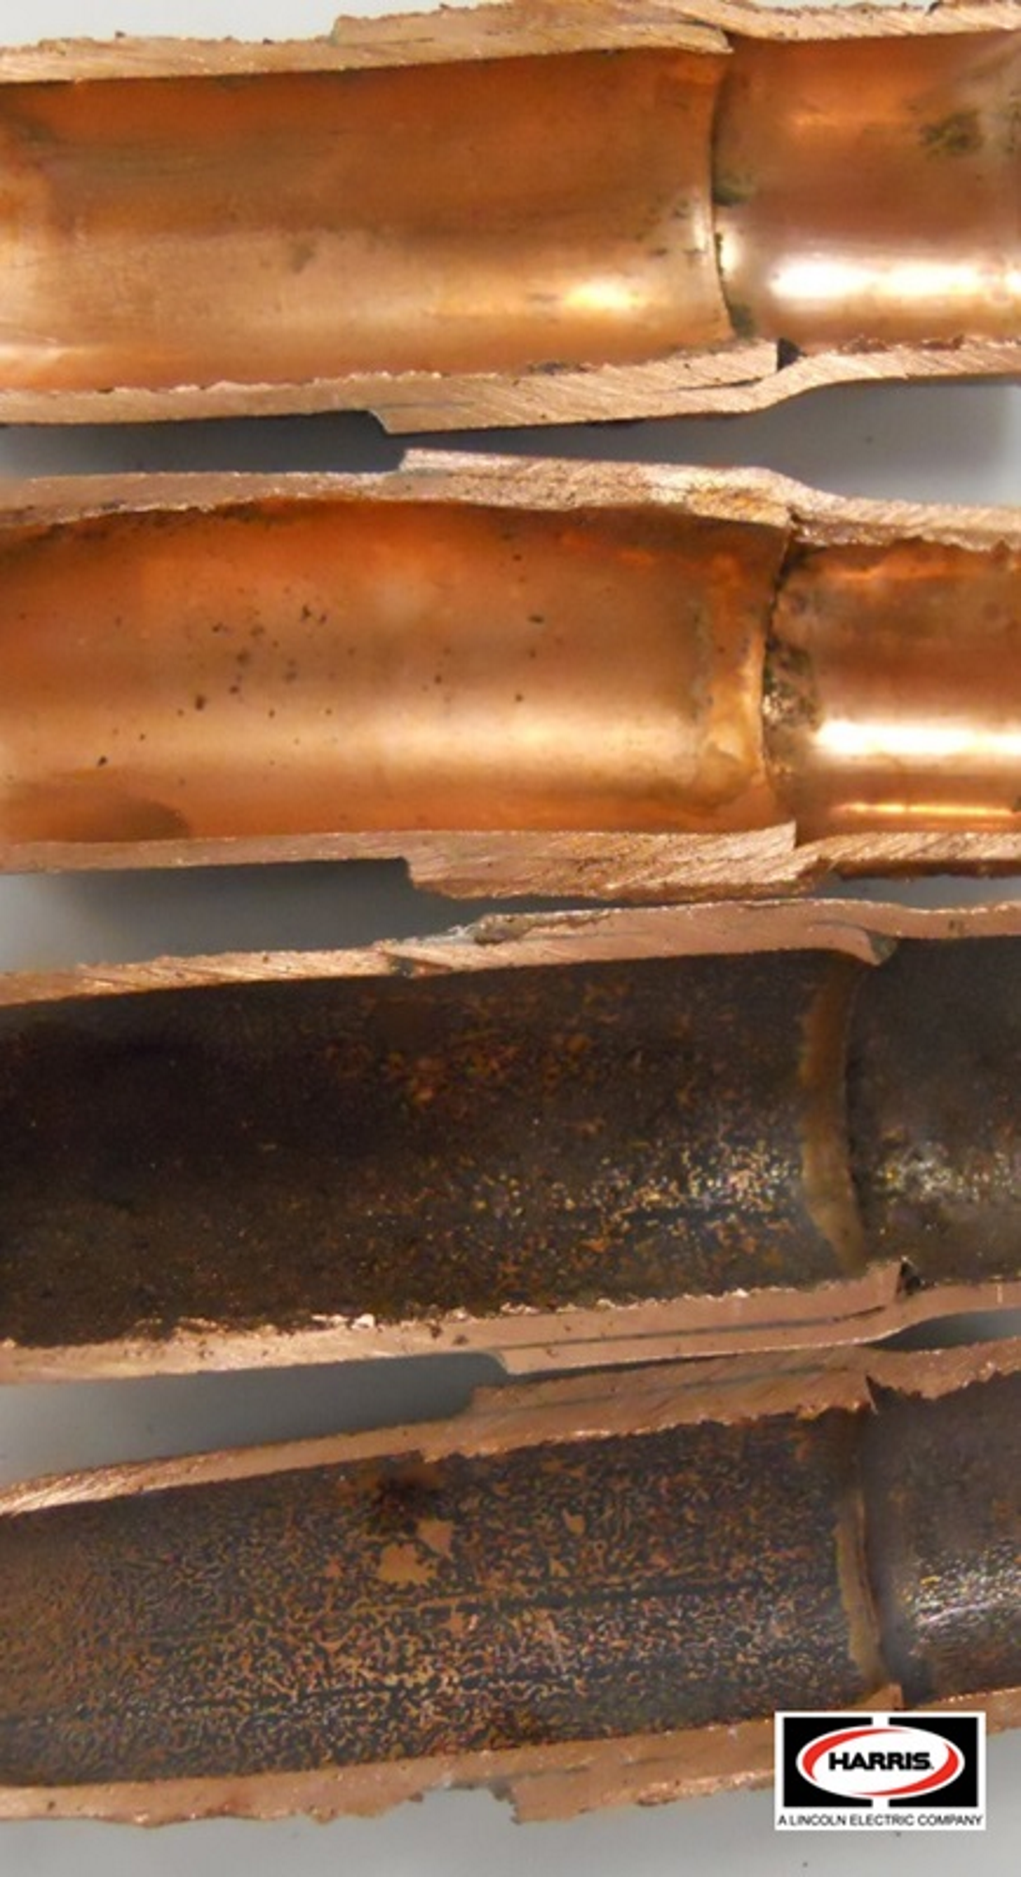
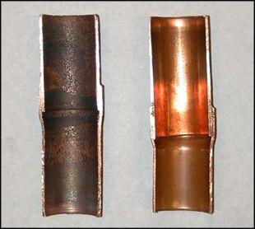
Nitrogen Purge is Essential While Brazing
Courtesy http://www.reflok.pl
Courtesy http://www.hvactrainingsolutions.net
Notes:
http://www.reflok.pl

Slide 79
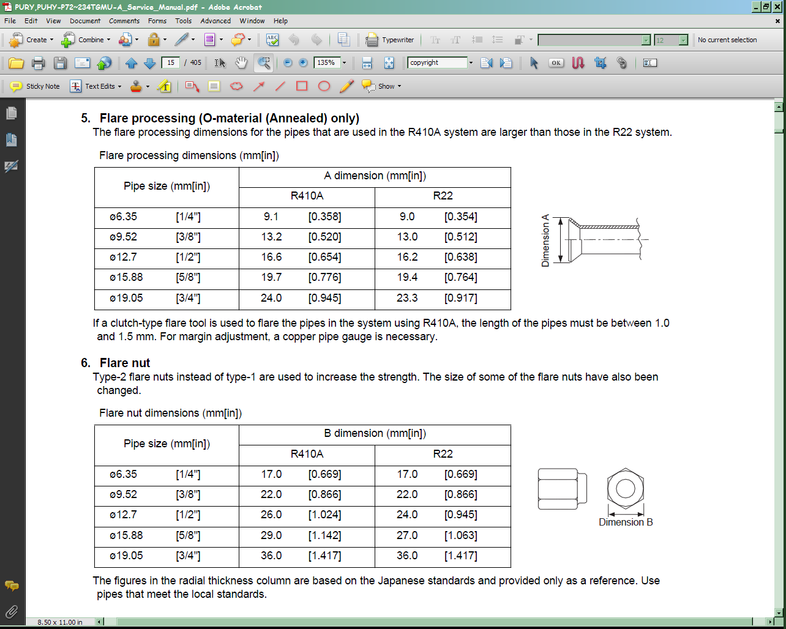
Field Joints
Field joints can be made using a frustum of right circular cone
Image courtesy Mitsubishi PRUY Service Instruction; Used with Permission

Slide 80
Field Joints
Field joints can be made using a 45°SAE Flare joint
Image courtesy Mitsubishi PRUY Service Instruction; Used with Permission
Operating Pressures
Refrigerant Low Side High Side
R22 55-70 psig 180 - 260 psig
R410 95 - 135 psig 305 - 410 psig

Slide 81
Field Joints
Field joints are made using a 45°SAE Flare joint
Operating Pressures
Refrigerant Low Side High Side
R22 55-70 psig 180 - 260 psig
R410 95 - 135 psig 305 - 410 psig
Image courtesy Mitsubishi PRUY Service Instruction; Used with Permission

Slide 82
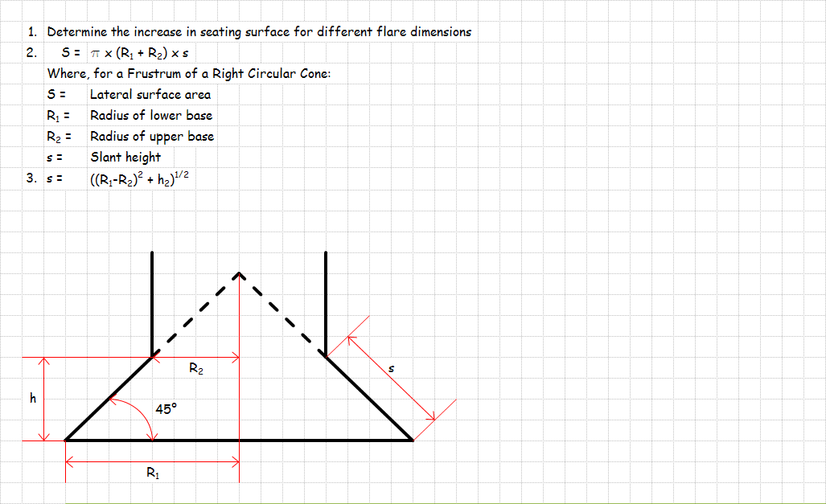
Field Joints

Slide 83
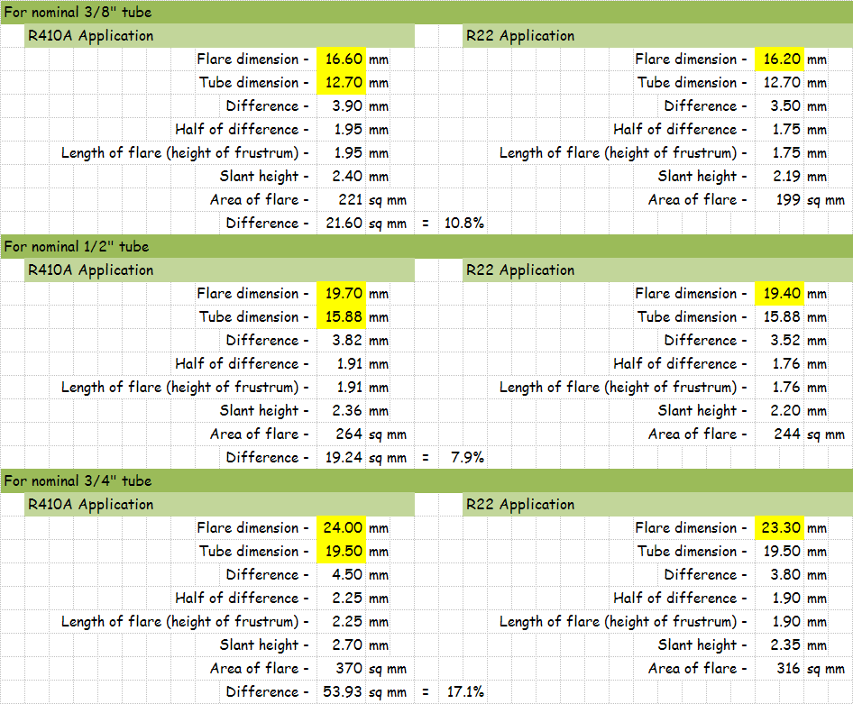
Field Joints

Slide 84
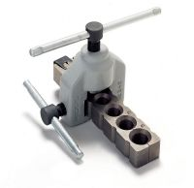
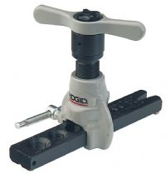
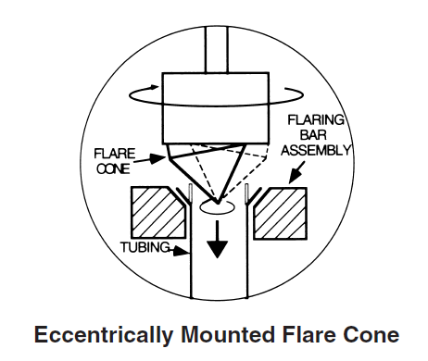
Flaring Tools; They’re Not All Created Equal
Conventional flaring tools “press” the flare onto the end of the tube
Recommended flaring tool rolls the flare onto the end of the tube
Either way:
  Metal to metal sealing mechanism
  Lubricate flare before tightening
Images courtesy www.ridgid.com/; Used with Permission
Notes:
http://www.ridgid.com/Tools/458R-Ratchet-Flaring-Tool/index.htm
www.snapon.com

Slide 85

Tightening the Connection
Lubricate with a refrigerant compatible oil
Use two wrenches
Use specified torque values

Slide 86

Torque Wrenches, Flare Nut Wrench and Crow’s Foot

Slide 87

Tightening the Connection
Easier accomplished on the bench than in the air
Factory line sets minimize field flares

Slide 88

Vibration and Stress Relief
Branch controller support per vendor requirements
Flare
Flare
Rigid support nominally with-in 20” per vendpr requirements

Slide 89
Vibration and Stress Relief
Relative motion still possible with out sway bracing

Slide 90
Condenser
Receiver
Compressor

Slide 91
Condenser

Slide 92

Failed Condenser Fan

Slide 93


Slide 94


Slide 95


Slide 96
Condenser
Receiver
Liquid Line Solenoid Valve
Expansion Valve
Evaporator
Compressor

Slide 97

Expansion Valve
Suction Line
Liquid Line Solenoid Valve
Liquid Lines

Slide 98

Electronic Expansion Valve Controllers

Slide 99

A Refrigerant Sight Glass

Slide 100


Slide 101

Typical Control Switches

Slide 102
Adding Hot Gas Bypass
Hot Gas Solenoid
Hot Gas Regulator

Slide 103

Hot Gas Bypass Lines
Hot Gas Solenoid Valve
Service Valve
Hot Gas Regulator

Slide 104
Hot Gas Connections to the Evaporator

Slide 105
Let’s Review

Slide 106
Name the Parts in the Diagram on the Next Slide

Slide 107
A
B
G
C
D
F
E

Slide 108
Name the Parts in the Diagram on the Next Slide
Air Cooled Condenser
Reciever
Liquid Line Solenoid Valve
Expansion Valve
Evaporator
Compressor
Hot Gas Solenoid Valve (Right) and Hot Gas Regulator (Left)

Slide 109

A Water Cooled Centrifugal Chiller

Slide 110
Same Cycle, Larger, Centrifugal vs. Screw Compressor, Water vs. Air Cooled

Slide 111
A Typical Water Cooled Vapor Compression Cycle Chiller
Condenser
3 Stage Centrifugal Compressor
CW Supply and Return
Metering Orifices
Evaporator
Economizer
CHW Supply and Return

Slide 112
Try Your Hand At Identifying the Parts (Answers Follow)

Slide 113
A Water Cooled Centrifugal Chiller
2 ?
3 ?
1 ?
5 ?
6 ?
4 ?
7 ?
8 ?
9 ?

Slide 114
A Water Cooled Centrifugal Chiller
Three Stage Centrifugal Compressor
Controls
Motor
Suction Elbow
Purge Pump
Lubrication System
Condenser
Economizer
Evaporator

Slide 115

Inside the Condenser
Temperature Sensor
Tubes
Baffle Plate
Tube Sheet
Water Box; Marine Head Type

Slide 116

Inside the Evaporator
Oil Sump and Pump
Eliminators

Slide 117

Inside the 3 Stage Compressor

Slide 118

Diffuser (One per Stage)
Inlet Vane Linkage System
Refrigerant Flow Through a Typical Compressor Stage
Impeller (One per Stage)

Slide 119

Inlet Vanes and Suction Elbow

Slide 120
Adding Hot Gas Bypass
Condenser
3 Stage Centrifugal Compressor
CW Supply and Return
Metering Orifices
Hot Gas Bypass Valve
Evaporator
Economizer
CHW Supply and Return

Slide 121

Compressor
Suction elbow
Hot gas valve and piping
Traditional condenser

Slide 122

Logging a Centrifugal Chiller’s Inlet Vanes and Hot Gas Bypass

Slide 123


Slide 124


Slide 125


Slide 127

Free Cooling Cycles
Are they really free?

Slide 128


Just Because It’s Free Doesn’t Mean You Should Use It

Slide 129
Plate and Frame Heat Exchangers

Slide 130


Slide 131


Slide 132


Slide 133


Slide 134



Slide 135




Plate and Frame vs. Shell and Tube

Slide 136




Plate and Frame vs. Shell and Tube

Slide 137
Plate and Frame vs. Shell and Tube

Slide 138
Plate and Frame vs. Shell and Tube

Slide 139
An Innovative Approach to Free Cooling

Slide 140

The Control System Graphic
UC Santa Cruz
Pre-Wet Economizer System
2016-01-29
Drawn By : DS

Slide 141
Physical Sciences Building Loads
Science Library Building Loads
Natural Science Building Loads
Thimann Building Loads
Sinsheimer Labs Building Loads
Chiller 3
Chiller 4
Chiller 6
The Untangled System Diagram
UC Santa Cruz
Pre-Wet Economizer System
2016-01-29
Drawn By : DS

Slide 142
Physical Sciences Building Loads
Science Library Building Loads
Natural Science Building Loads
Thimann Building Loads
Sinsheimer Labs Building Loads
Chiller 3
Chiller 4
Chiller 6
These loads are 100% outdoor air loads trying to deliver air in the low to mid 50’s°F
These loads are economizer equipped loads trying to deliver air in the upper 50’s to low 60’s°F
The Original Plant Configuration
UC Santa Cruz
Pre-Wet Economizer System
2016-01-29
Drawn By : DS

Slide 143
Physical Sciences Building Loads
Science Library Building Loads
Natural Science Building Loads
Thimann Building Loads
Sinsheimer Labs Building Loads
Chiller 3
Chiller 4
Chiller 6
These loads are 100% outdoor air loads trying to deliver air in the 50-60°F range
These loads are economizer equipped loads trying to deliver air in the upper 50’s to low 60’s°F
The Original Plant Configuration
UC Santa Cruz
Pre-Wet Economizer System
2016-01-29
Drawn By : DS

Slide 144

There Are A Lot of Hours When 100% Outdoor Air Systems Delivering 50-60°F Air will Need Preheat

Slide 145
Physical Sciences Building Loads
Science Library Building Loads
Natural Science Building Loads
Thimann Building Loads
Sinsheimer Labs Building Loads
Chiller 3
Chiller 4
Chiller 6
If you pumped water that was warmer than the outdoor air through the chilled water coils in these units, you would cool the water and warm the air
The Original Plant Configuration
UC Santa Cruz
Pre-Wet Economizer System
2016-01-29
Drawn By : DS

Slide 146
Physical Sciences Building Loads
Science Library Building Loads
Natural Science Building Loads
Thimann Building Loads
Sinsheimer Labs Building Loads
If you shut down the economizers, these loads would require cooling
If you pumped water that was colder than the mix of return air and minimum outdoor air through the chilled water coils in these units, you would provide the cooling and warm the water
Chiller 3
Chiller 4
Chiller 6
The Original Plant Configuration
UC Santa Cruz
Pre-Wet Economizer System
2016-01-29
Drawn By : DS

Slide 147
Physical Sciences Building Loads
Science Library Building Loads
Natural Science Building Loads
Thimann Building Loads
Sinsheimer Labs Building Loads
Chiller 3
Chiller 4
Chiller 6
A strategically located valve and piping connection will allow water returning from the loads requiring preheat (a source of cool water) to be circulated to the loads requiring cooling (a source of warm water) and then back to the loads requiring preheat
The Modification to Make the Wet Economizer
UC Santa Cruz
Wet Economizer System
2016-01-29
Drawn By : DS

Slide 148
≈ 62°F
Physical Sciences Building Loads
Science Library Building Loads
Natural Science Building Loads
Thimann Building Loads
Sinsheimer Labs Building Loads
Outdoor Air ≈ 53°F
≈ 62°F
≈ 61°F
≈ 55°F
≈ 58°F
Chiller 3
Chiller 4
Chiller 6
A strategically located valve and piping connection will allow water returning from the loads requiring preheat (a source of cool water) to be circulated to the loads requiring cooling (a source of warm water) and then back to the loads requiring preheat
The Wet Economizer in Operation
UC Santa Cruz
Wet Economizer System
2016-01-29
Drawn By : DS

Slide 149
Chiller Based Free Cooling Cycle

Slide 150
Adding “Free Cooling”
Condenser
3 Stage Centrifugal Compressor
CW Supply and Return
2 Position Valve (Typical of 2; Open for Free Cooling)
Hot Gas Bypass Valve
Evaporator
Economizer
CHW Supply and Return

Slide 151


“Free Cooling” Operation
Condenser
Compressor locked out
2 Position Valve Opens
CW Supply and Return
2 Position Valve Opens
Evaporator
Economizer
CHW Supply and Return

Slide 152
“Free Cooling” Operation
Condenser
Compressor locked out
2 Position Valve Opens
CW Supply and Return
2 Position Valve Opens
Evaporator
Economizer
CHW Supply and Return

Slide 153

“Free Cooling” Operation
Condenser
Compressor locked out
2 Position Valve Opens
CW Supply and Return
2 Position Valve Opens
Evaporator
Economizer
CHW Supply and Return

Slide 154


“Free Cooling” Operation
Condenser
Compressor locked out
2 Position Valve Opens
CW Supply and Return
2 Position Valve Opens
Evaporator
Economizer
CHW Supply and Return

Slide 155
A Heat Recovery Centrifugal Chiller
The chiller in the following slide has a second condenser tube bundle that is piped to the heating hot water system. This allows the hot gas off of the compressor to be used to generate hot water for reheat loads prior to having its heat rejected to the cooling tower via the traditional condenser.

Slide 156


Slide 157


Slide 158


Compressor
Hot gas valve and piping
Suction elbow
Heat recovery condenser
Traditional condenser
Evaporator

