Slide 1

Existing Building Commissioning Workshop: Series 16, Session 5
Testing the PEC Chilled Glycol System
Presented By:
David Sellers
Senior Engineer, Facility Dynamics Engineering

Slide 2
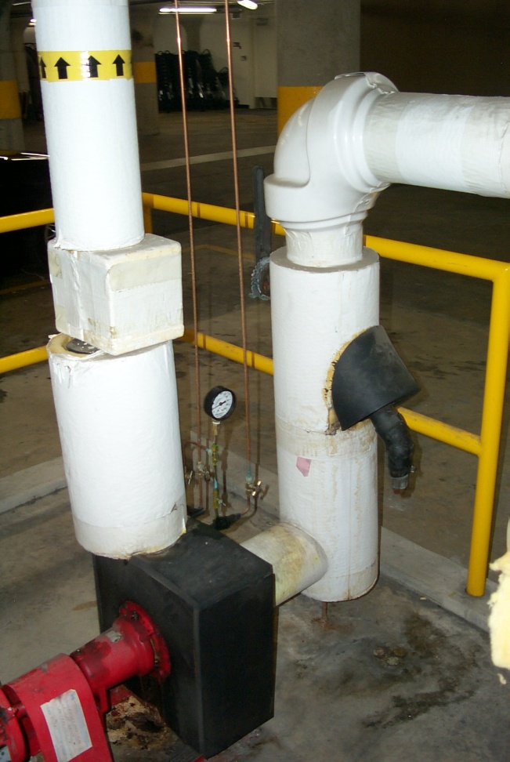
Design Intent vs. Our Intent
What the designer anticipated
  106 gpm at 110 ft.w.c
  Both pumps run
  53 gpm at 110 ft.w.c from each pump
What we anticipate
  106 gpm at 42 – 69 ft.w.c.
  See the article on right sizing pumps at the link below for the details of how we made this field estimate
What our functional testing told us
  To be seen!
https://www.av8rdas.com/magazine-articles.html#RightSize

Slide 3
Why Did We Need to Test the PEC Chilled Glycol System?
What the designer anticipated
  106 gpm at 110 ft.w.c
  Both pumps run
  53 gpm at 110 ft.w.c from each pump
What we anticipate
  106 gpm at 42 – 69 ft.w.c.
  See the article on right sizing pumps at the link below for the details of how we made this field estimate
What our functional testing told us
  To be seen!
https://www.av8rdas.com/magazine-articles.html#RightSize

Slide 4
Why Did We Need to Test the PEC Chilled Glycol System?
Trending shows evidence of flow variation and instability in a constant flow system

Slide 5
Flow Instability Appears to Trigger Temperature Control Instability

Slide 6
What Could Cause Flow Variation in a Constant Volume System?
Bypass with no balance valve
Three-way valve
Bypass with no balance valve
Three-way valve

Slide 7
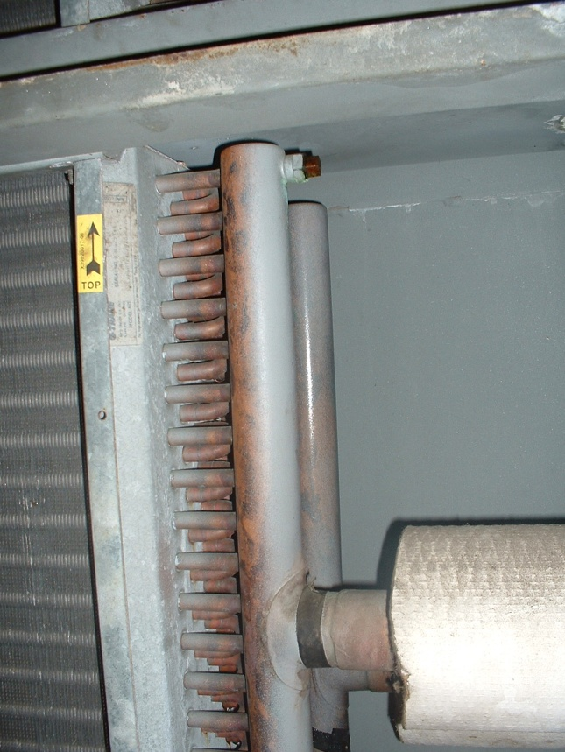
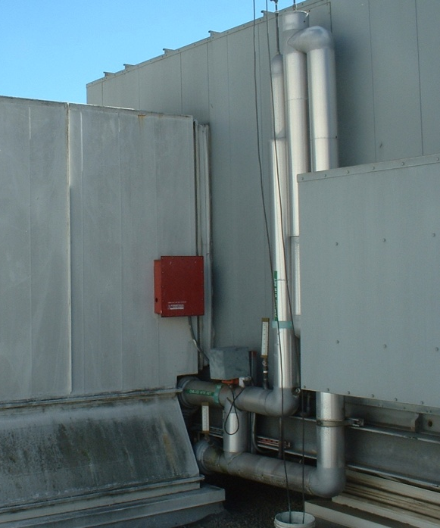
What Could Cause Flow Variation in a Constant Volume System?
Header
A
Supply piping
B
A
Tubes; 1 per row
B

Slide 8

What Could Cause Flow Variation in a Constant Volume System?
Multi-pass serpentine path through the coil fins

Slide 9
What Could Cause Flow Variation in a Constant Volume System?
A
No cooling and Ice Making
B
A
B

Slide 10
What Could Cause Flow Variation in a Constant Volume System?
A
Full Cooling
B
A
B

Slide 11
What Could Cause Flow Variation in a Constant Volume System?
A
Modulating
B
A
B

Slide 12
Assessing System Performance
Functional testing can help us assess these issues
…have pump, will test flow!
  Wide open test and shut off test establish pump performance point and impeller size
  Wide open test in different system configurations assesses the impact of configuration changes on flow

Slide 13
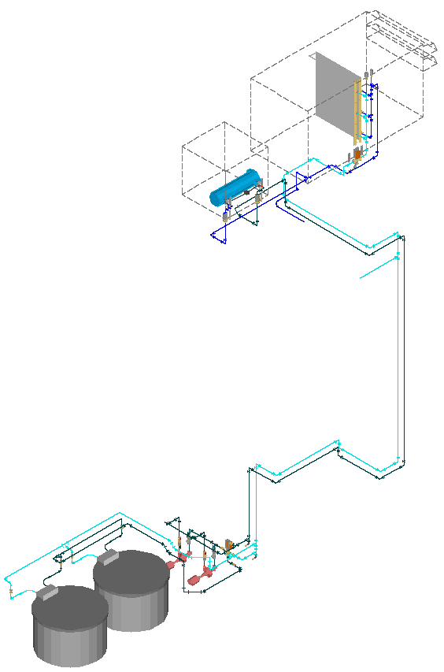
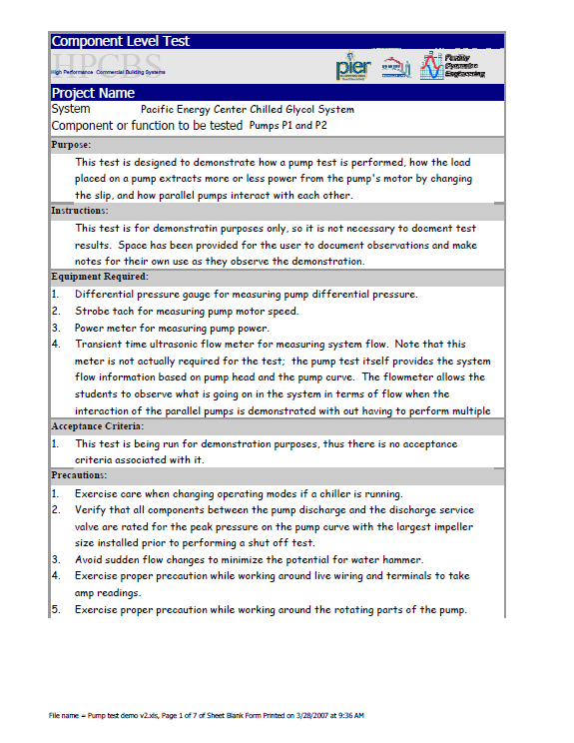
Our Test Procedure

Slide 14
What Operating Modes Should We Test?

Slide 15
What Operating Modes Should We Test?
Closed

Slide 16
What Operating Modes Should We Test?
50% Closed
Closed

Slide 17
What Operating Modes Should We Test?
Closed

Slide 18
What Operating Modes Should We Test?
Closed
50% Closed

Slide 19
What Operating Modes Should We Test?
Closed

Slide 20
What Operating Modes Should We Test?
50% Open
Closed

Slide 21
What Operating Modes Should We Test?
Closed

Slide 22
What Operating Modes Should We Test?

Slide 23
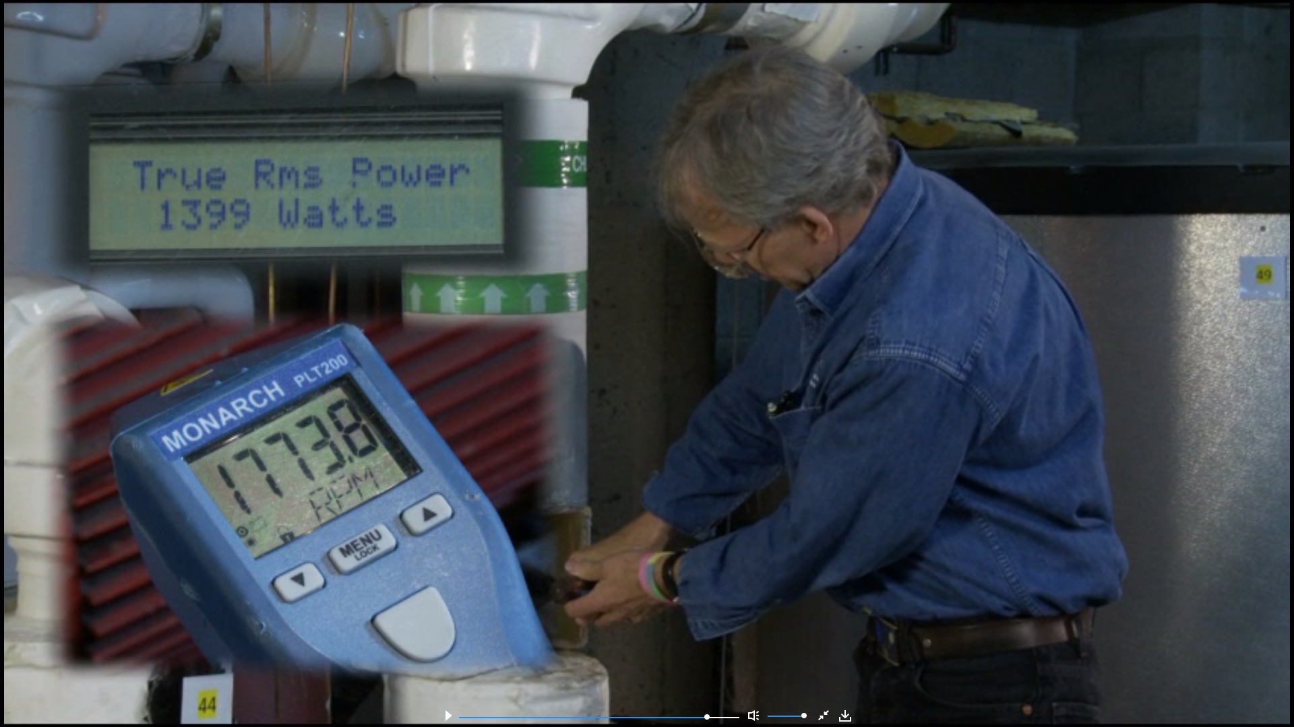
Performing the Test https://www.av8rdas.com/testing-a-pump.html

Slide 24
Plotting Our Pump Test Results
Test data
  Shut off test
    0 gpm
    106.4 ft. w.c.
  One pump, wide open
    ? gpm
    93.9 ft. w.c.

Slide 25
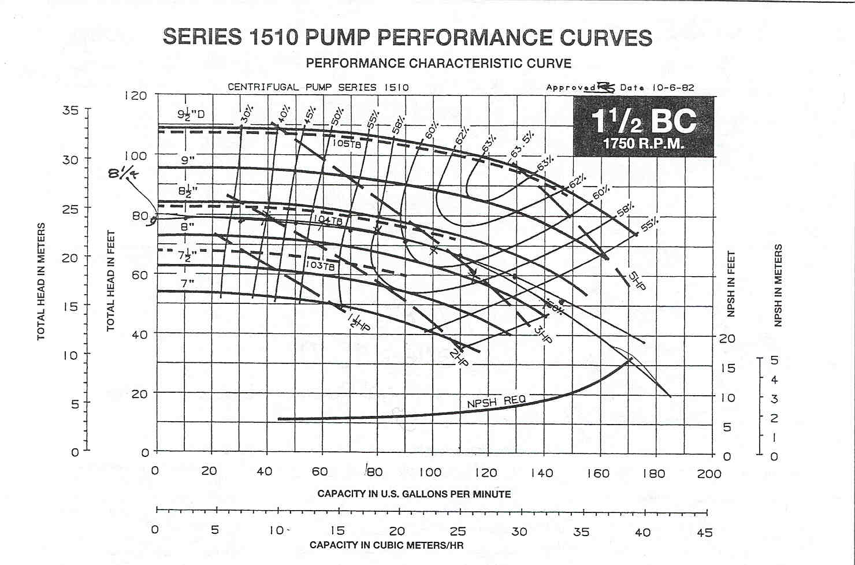
Our test point is one point on the system curve

Slide 26
Sketching an impeller curve through the intersection of our system curve and the design point shows we could get what we need with a 7-5/8” or so impeller
Projecting the required flow up to our system curve tells us the actual head required by the system at that flow rate

Slide 27
The pump affinity laws tell us we could also get what we need by a speed change:
Speed _{New} = Speed _{Old} x (Flow_{Ne}w/Flow_{Old})
Speed _{New} = 1,344 rpm

Slide 28
We could also get what we need by throttling to design with the existing impeller, which would generate a new system curve through that operating point
Notes:
Head - ft.w.c. Flow Rate - gpm
0.00 0
0.92 10
8.25 30
22.92 50
91.67 100
103.00 106

Slide 29

Our Options
Throttling ssss sss
Reduce speed with a motor change
Reduce speed with a VFD SSSSSSSsssss SSSSSSS
Trim the impeller
Quick, saves energy right away, but not as much as other options
Not possible ssssssss
Preserves pump efficiency, adds drive losses, adds complexity, adds cost
Reduces pump efficiency, very persistent, lower cost, less complex

Slide 30
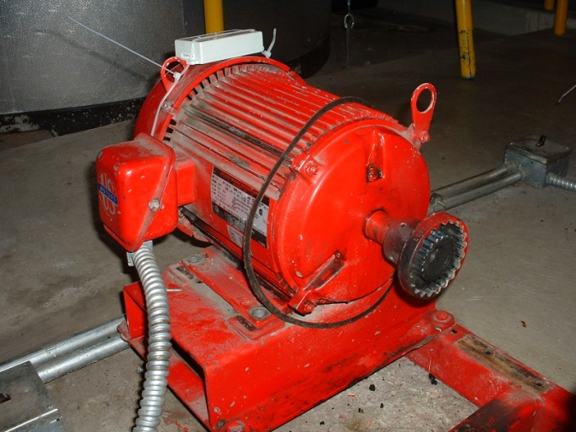
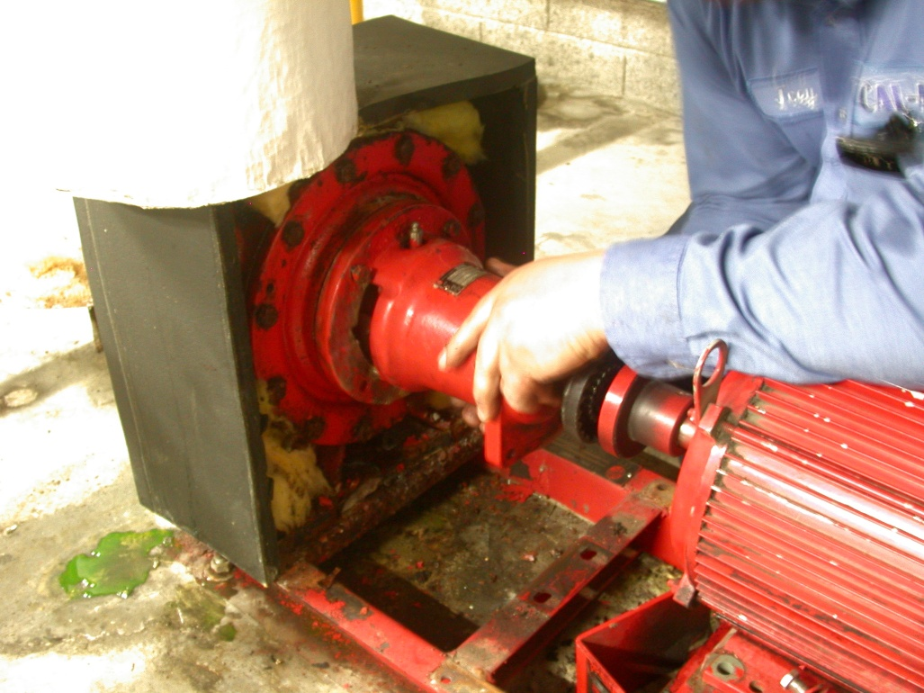
The Modification Process
Taking the pump apart
Motor shaft coupling hub
Rear access

Slide 31
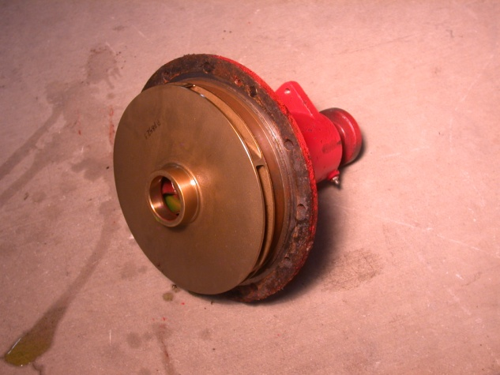
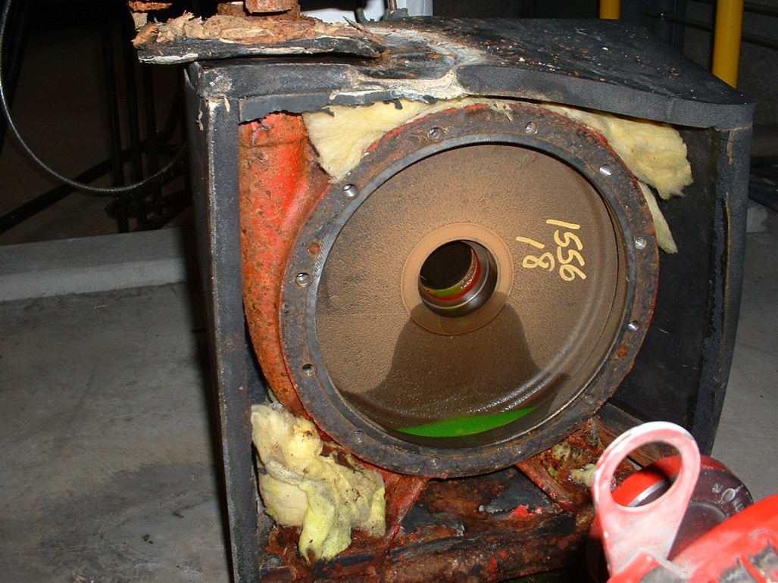
The Modification Process
The untrimmed impeller and empty casing

Slide 32
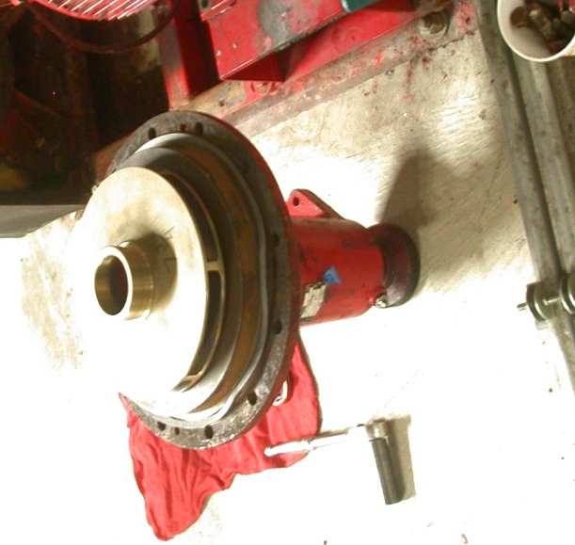
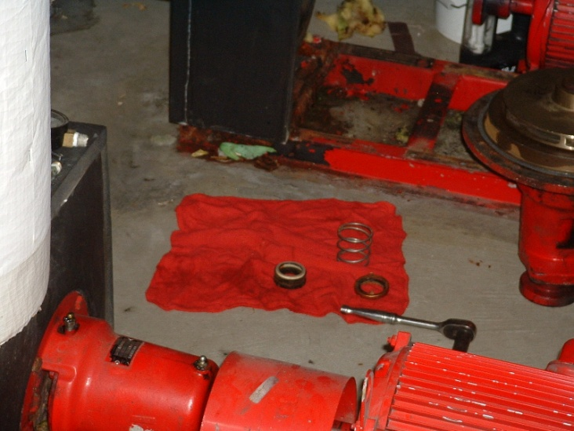
The Modification Process
The trimmed impeller ready for re-installation along with a new seal
Before trimming
The mechanical seal
After trimming

Slide 33

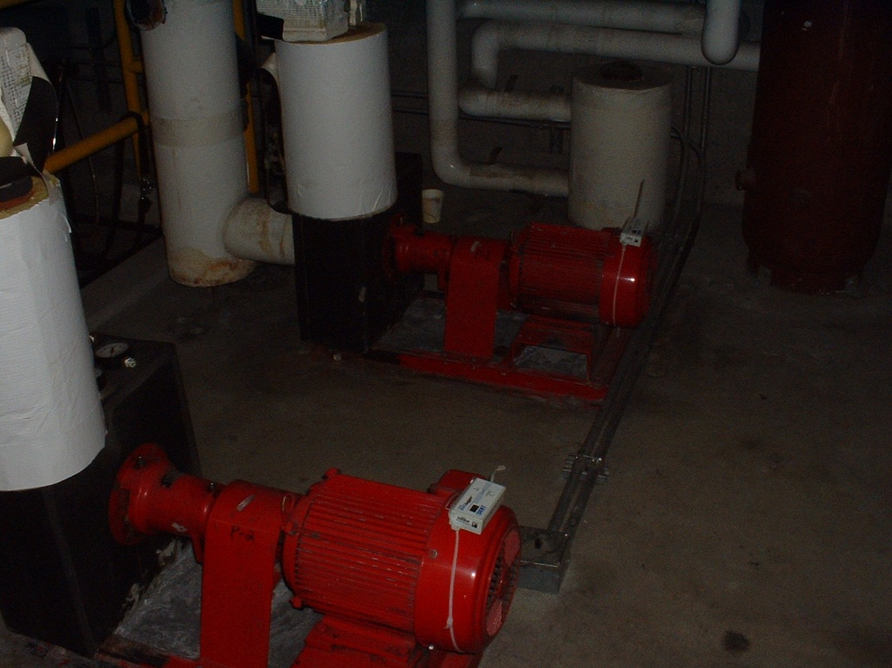
The Modification Process
The re-assembled pump with the base grouted and motor aligned

Slide 34
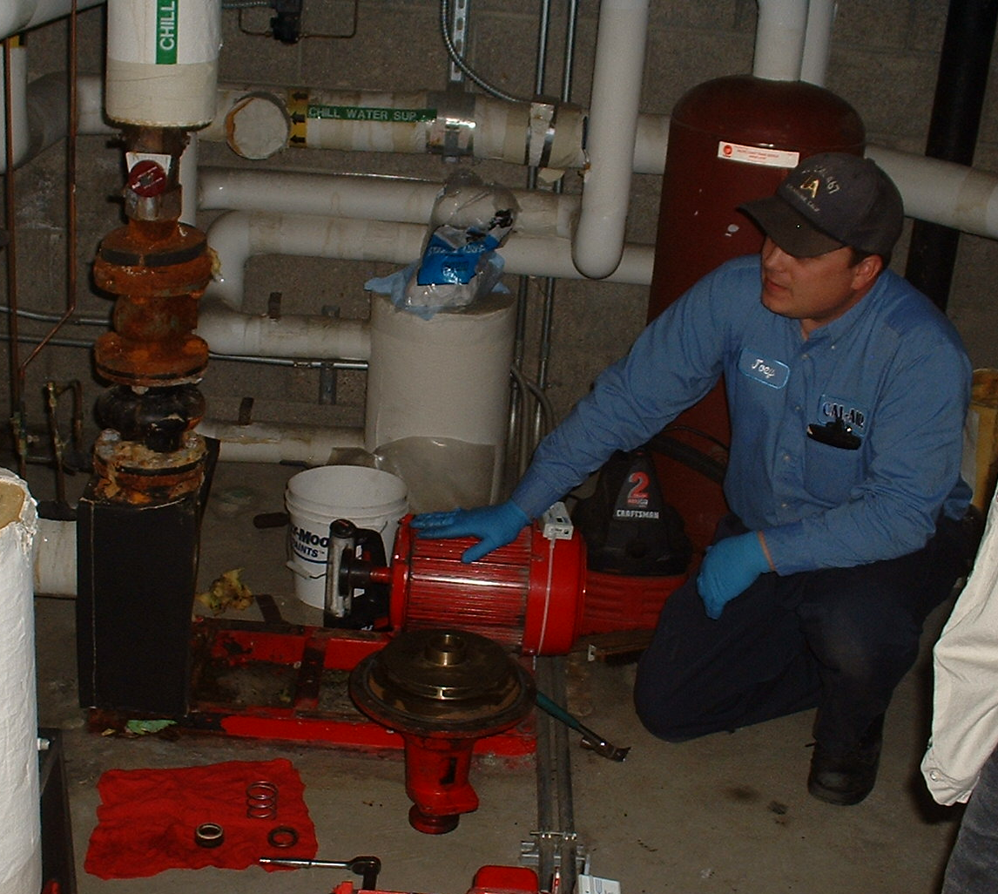
Plotting Our Pump Test Results
Data from the modified pump
  Shut off test
    0 gpm
    70.2 ft. w.c.
    1 kW
  One pump, wide open
    ? gpm
    58.7 ft. w.c.
    2.1 kW

Slide 35
The head produced matches a 7-3/4” impeller curve
Shut off test forces a known flow condition of 0 gpm

Slide 36
“Eye-ball” the new impeller curve through the shut-off head test point

Slide 37
With the pump running wide open, we read about 59 ft.w.c. of head
Our target = 106 gpm
Projecting our measured head over to the impeller curve we have, and then projecting down from that point indicates about 105 – 110 gpm of flow and 2.6 – 2.7 bhp. At .746 kW/hp this equates to 1.9 – 2.0 kW vs. the 2.1kW we read.

Slide 38
Another Interesting Result

Slide 39
Another Interesting Result
If P1 is started, the operating point shifts to the point where the system curve intersects the combined pump operating curve. The head at this point is above the shut-off head for P2, so it produces no flow, even though it is operating
With a smaller impeller, P2 can contribute nothing to the system flow until the head required drops below about 70 ft.w.c.
The system curve was unchanged by the impeller trim
With P2 running alone, we get the performance targeted by the modification

Slide 40
Component Interactions

Slide 41

Thanks For Attending!
The End

