Slide 1
Central Plants
Tab 18-1
Pump Interactions and the Affinity Laws

Slide 2
Parallel Pumps
Increasing Head
Increasing Flow
If both pumps are operating at the same speed and one fails, the operating point shifts down the system curve to the point where the single pump curve crosses it; typically more than 50% of the original flow but at less head
Notes:
H F
7.84 8.00
6.00 7.00
3.06 5.00
1.10 3.00
0.49 2.00
0.12 1.00
0.00 0.00

Slide 3
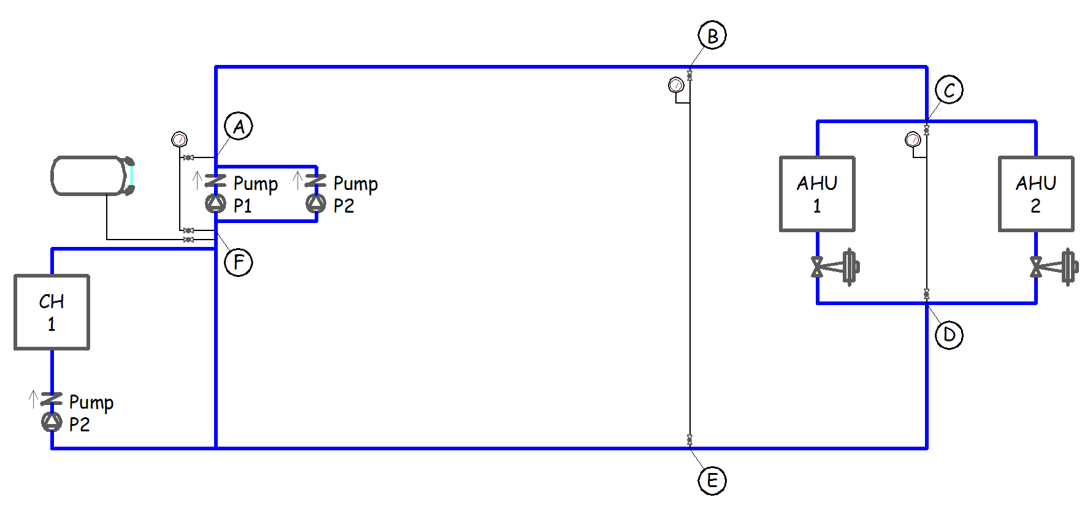
Assume the pumps are 100% redundant
    What should the logic be, specifically, to operate the pumps on a lead/lag basis?

Slide 4
Assume the pumps are 100% redundant
    Is there any problem with running one pump and starting the other pump if a failure is detected?

Slide 5
Assume the pumps are 100% redundant
    Will running two pumps at reduced speed save energy relative to running one pump at full speed?

Slide 6
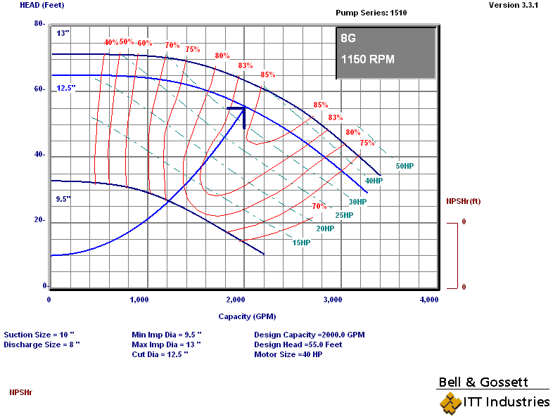
One Pump Operating Point
Single Pump Operating Point
2,000 gpm
55 ft.w.c.
12.5 inch impeller
1,150 rpm
84% efficiency
33.1 bhp

Slide 7
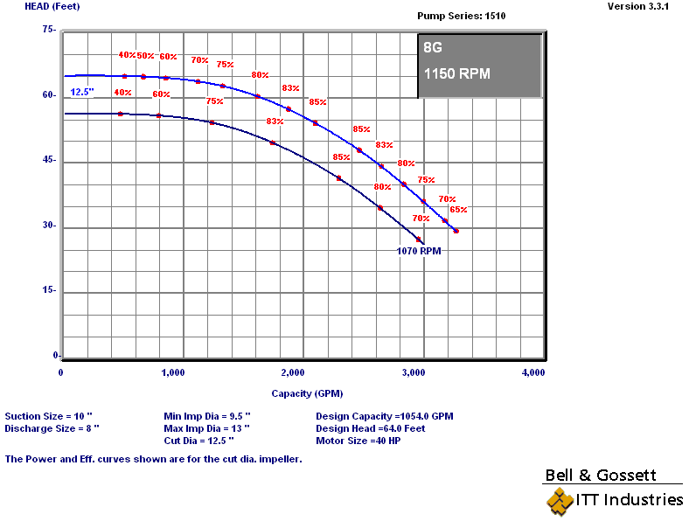
Two Pumps Doing What One Could Do
Each Pump Moves Half the Flow at the Design Head
Single Pump Operating Point
1,000 gpm
55 ft.w.c.
12.5 inch impeller
1,070 rpm
70% efficiency
19.8 bhp

Slide 8
Two Pumps Doing What One Could Do
Each Pump Moves Half the Flow at the Design Head
Both Pumps Operating Together
2,000 gpm
55 ft.w.c.
12.5 inch impeller
1,070 rpm
70% efficiency
39.6 bhp

Slide 9
Two Pumps Doing What One Could Do
Each Pump Moves Half the Flow at the Design Head
Both Pumps Operating Together
2,000 gpm
55 ft.w.c.
12.5 inch impeller
1,070 rpm
70% efficiency
39.6 bhp (vs. 33.1)

Slide 10
The Motor Efficiency Changed
19.8 bhp
33.1 bhp

Slide 11
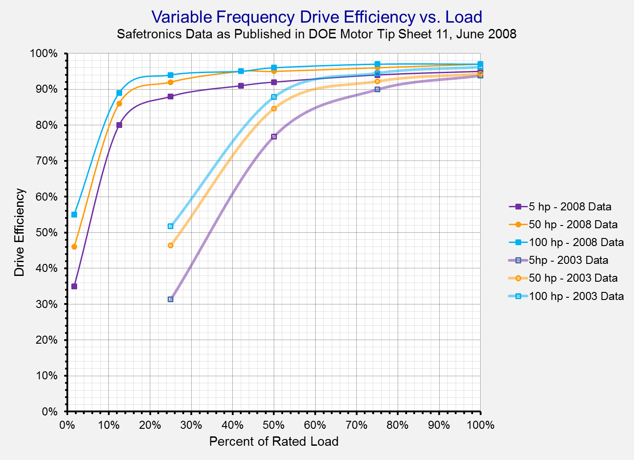
The Drive Efficiency Changed

Slide 12
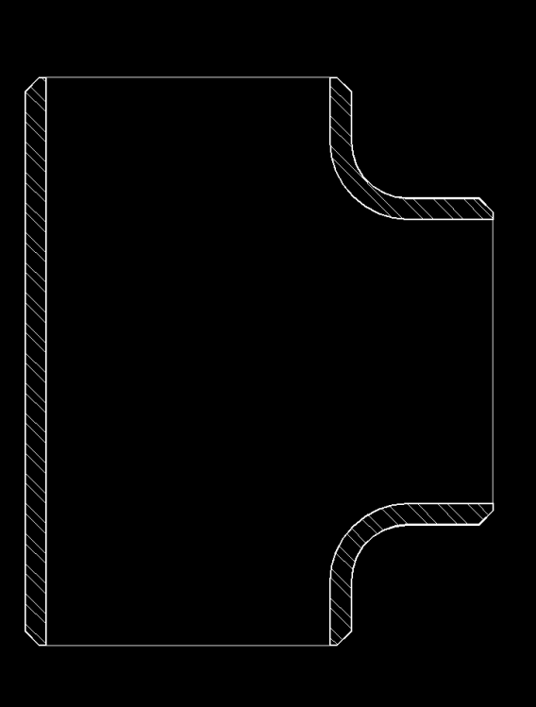
The Fluid Mechanics Changed
One Pump

Slide 13
The Fluid Mechanics Changed
One Pump

Slide 14
The Bottom Line
You’re Still Doing the Same Amount of Work
But probably not as efficiently

Slide 15
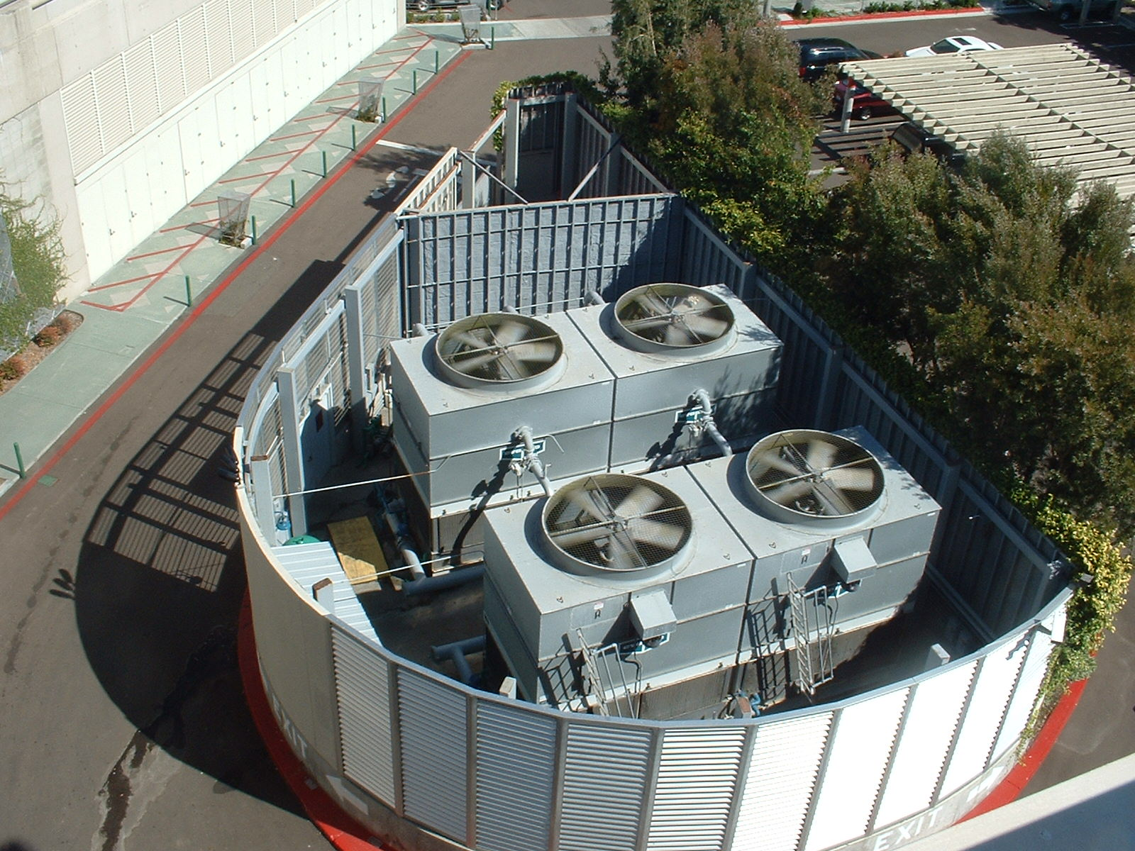
What About Running Two Tower Fans at Half Speed vs. One at Full Speed?

Slide 16

Same Question for These Towers?

Slide 17
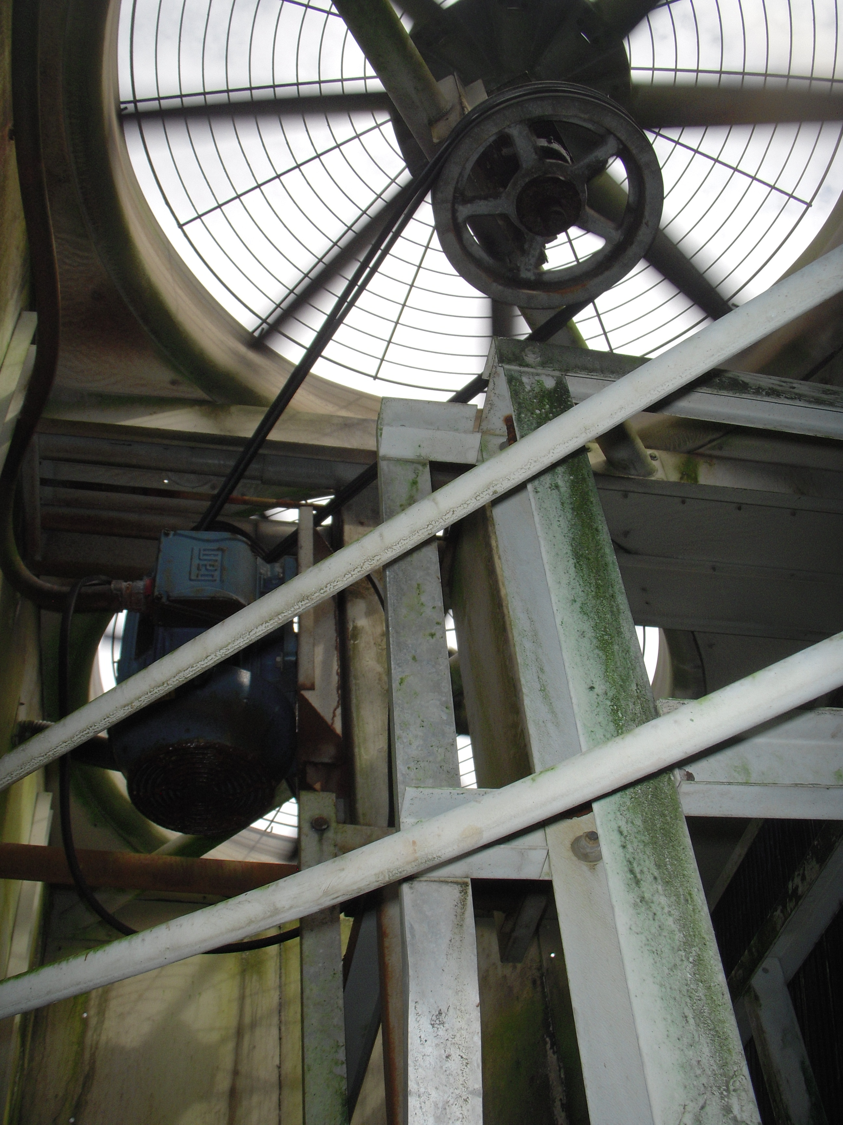
Same Question for These Towers?

Slide 18
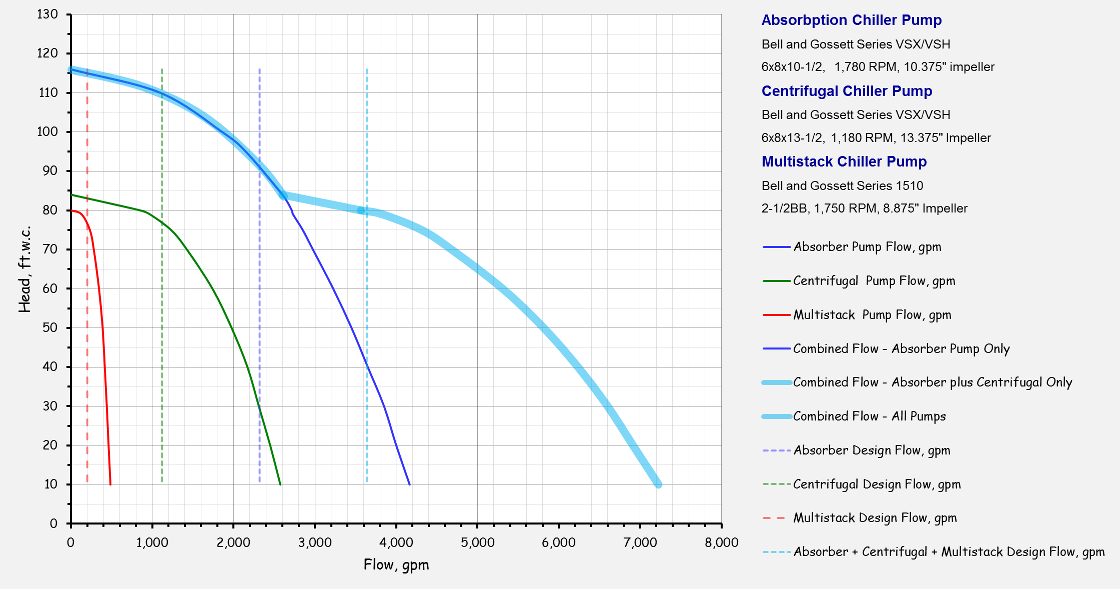
Different Size Parallel Pumps
System Dynamics can be Complex as Pumps Interact
The combined curve for different pumps in parallel can have an odd shape

Slide 19
Different Size Parallel Pumps
System Dynamics can be Complex as Pumps Interact
Odd shapes can lead to odd events
The absorber and centrifugal pumps can “dead head” the modular chiller pump in some operating modes

Slide 20
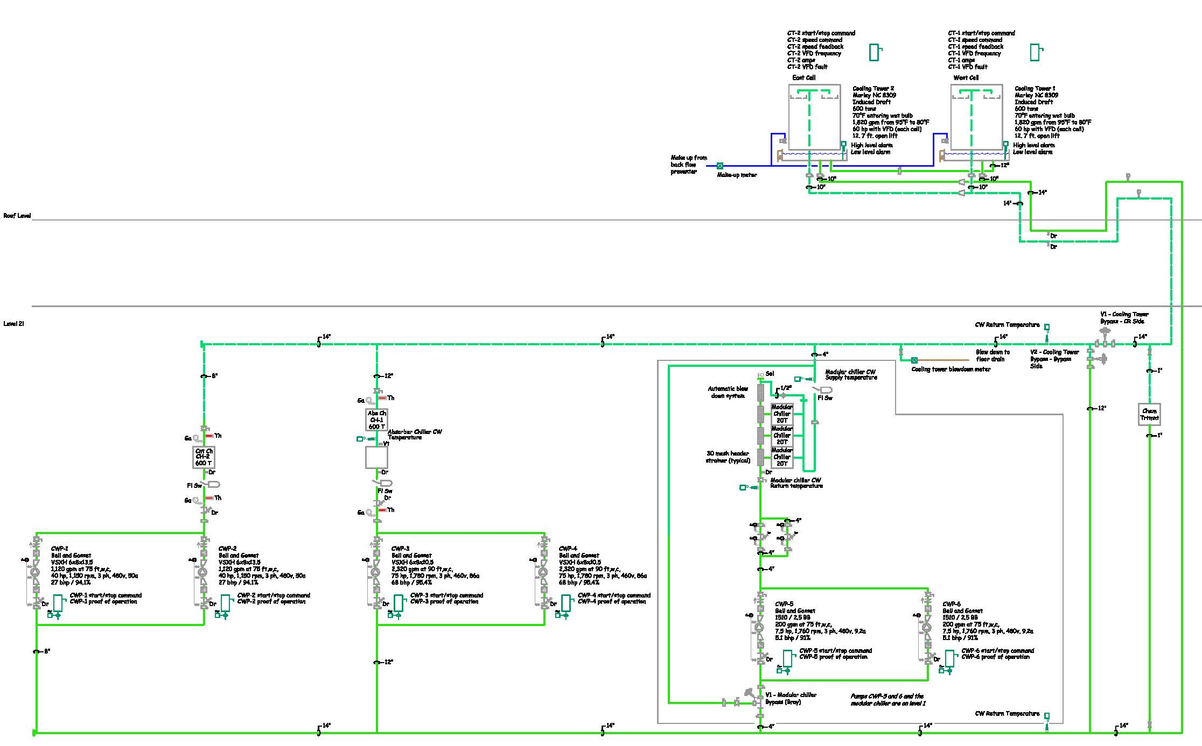
Multi Pump Constant Volume CW System
600 ton Absorption Chiller (Heat Sink for Cogen Plant)

Slide 21
Multi Pump Constant Volume CW System
600 ton Centrifugal Chiller (Runs when no Heat Sink Needed

Slide 22
Multi Pump Constant Volume CW System
60 Ton Modular Chiller Runs Year Round

Slide 23
Multi Pump Constant Volume CW System
60 Ton Modular Chiller Runs Year Round
Mission critical load

Slide 24
Multi Pump Constant Volume CW System
All Pumps in Parallel Through Their Loads
Mission critical load

Slide 25
Multi Pump Constant Volume CW System
Operating Mode for 4,380 hours per year
Mission critical load

Slide 26
Multi Pump Constant Volume CW System
Transitional Operating Mode

