Slide 1

Existing Building Commissioning Workshop:
Series 16, Session 4
A Field Introduction to Steam and Condensate Pumps
Presented By:
David Sellers
Senior Engineer, Facility Dynamics Engineering

Slide 2
Logging Hot Gas Bypass

Slide 3
Adding Hot Gas Bypass
Condenser
3 Stage Centrifugal Compressor
CW Supply and Return
Metering Orifices
Hot Gas Bypass Valve
Evaporator
Economizer
CHW Supply and Return

Slide 4
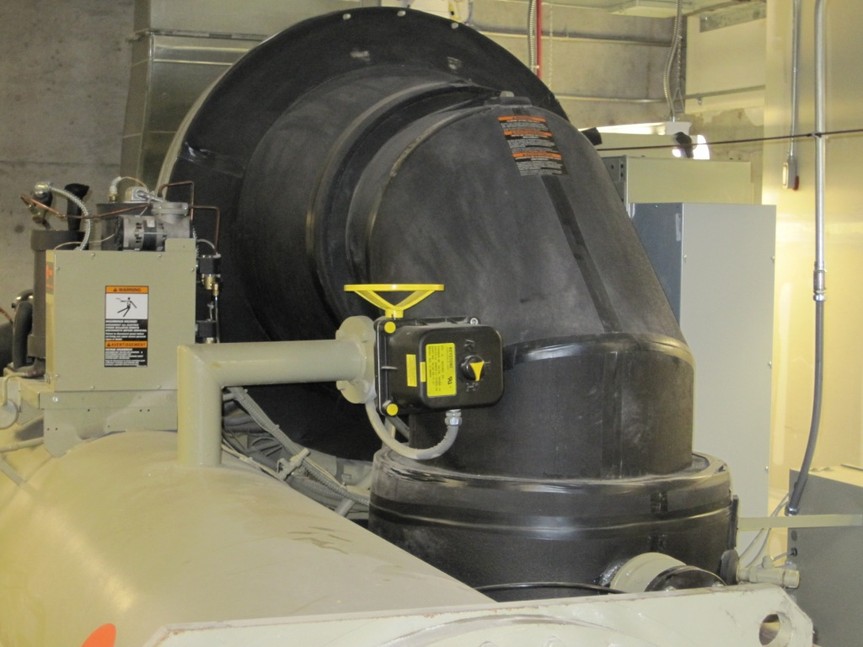
Compressor
Suction elbow
Hot gas valve and piping
Traditional condenser

Slide 5
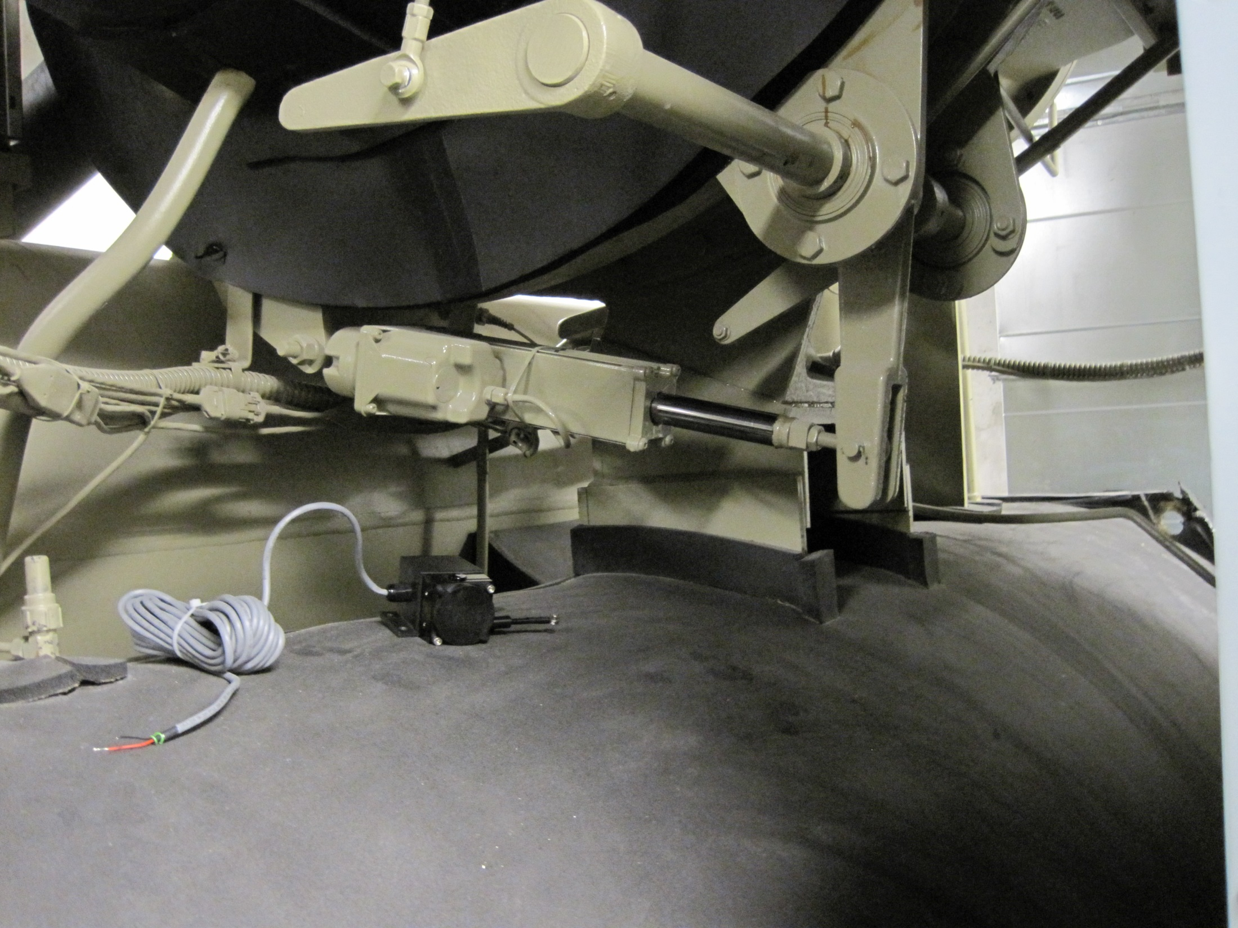
Logging a Centrifugal Chiller’s Inlet Vanes and Hot Gas Bypass

Slide 6
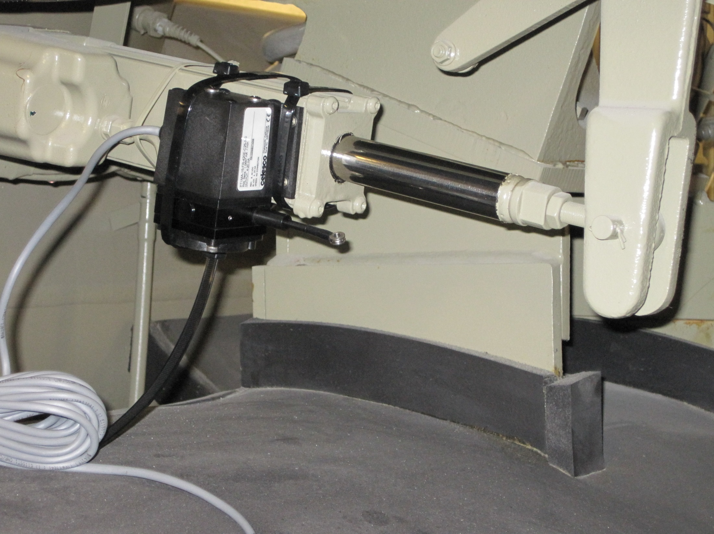

Slide 7
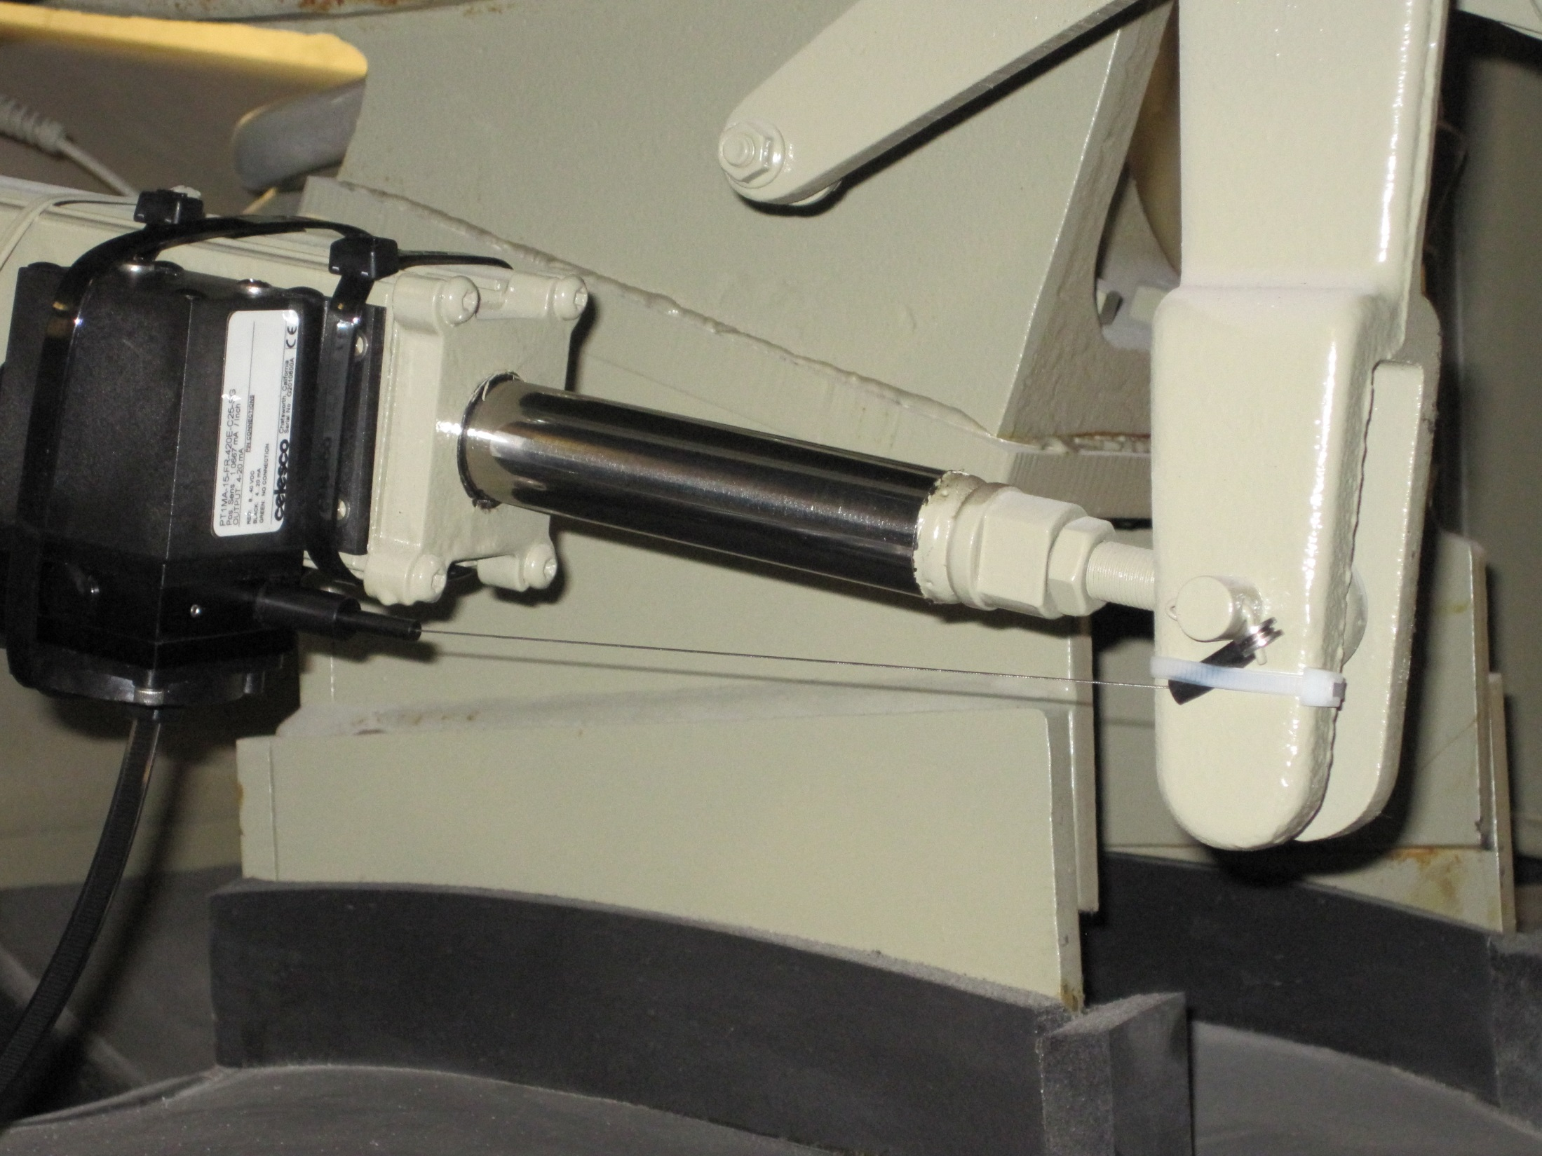

Slide 8
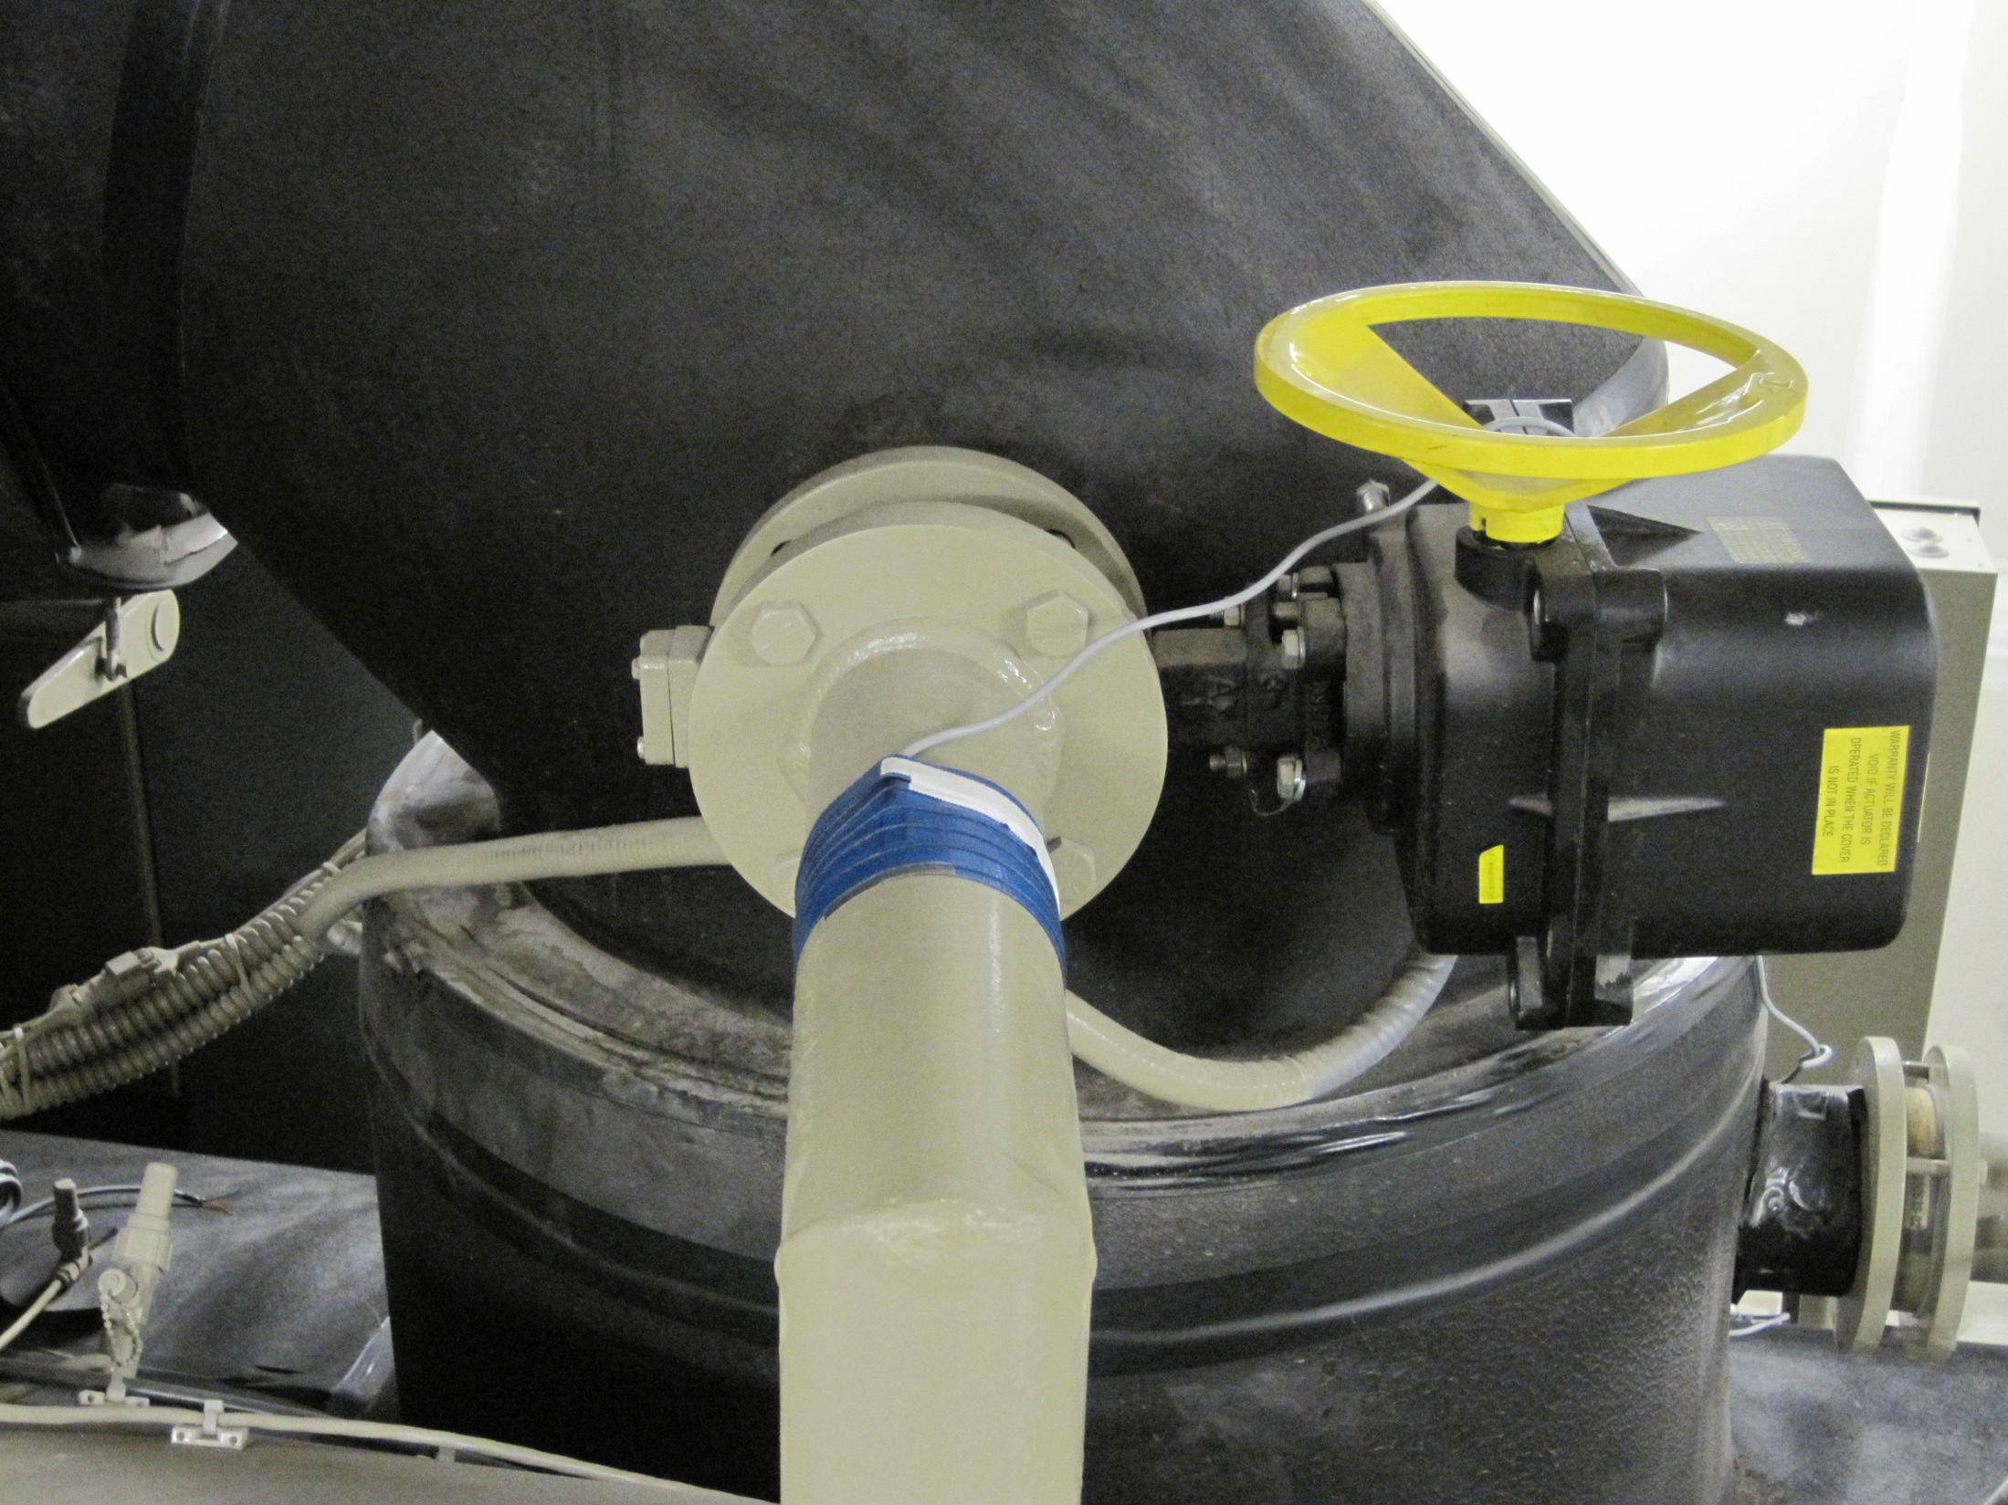

Slide 10
Steam and Condensate Resources
https://av8rdas.wordpress.com/2017/07/10/a-steam-heating-resources/
https://av8rdas.wordpress.com/2020/10/17/what-is-the-energy-content-of-a-pound-of-condensed-steam-part-1/
https://www.av8rdas.com/thermodynamic-diagrams-spreadsheet.html
https://www.av8rdas.com/magazine-articles.html#SteamValves

Slide 11
Gordon’s Question
How do you convert pounds of steam to Btus?
My Answer
It depends ….

Slide 12
It Depends on the Units of Measure
Invoice – 301.3 Mlbs of steam
So, M probably means mega, like megabyte, so the invoice is for 301,300,000 pounds of stream
But:
In the Roman Numeral System, M = 1,000, so the invoice could be for 301,300 pounds of steam

Slide 13
Gordon’s Next Question (to the Utility)
Can you clarify what the “M” stands for in the invoice ?
The Answer
It stands for “K”, the SI prefix for 1,000
(which is “M” in the Roman Numeral System)

Slide 14
Incidentally:
For a boiler burning gas to make steam, the bill could be:
MCF, for 1,000 (Roman M) cubic (volume, not the roman numeral for 100) feet, where a cubic foot is nominally 1,000 Btus, so about 1,000,000 Btu
Or it could be
Therms, which is exactly 100,000 Btu
Or it could be
Dth, the metric prefix Deka for 10, which is exactly 1,000,000 Btu
And the boiler itself could be rated in MMBtu, which are Roman “M”s so a thousand thousand Btus, i.e. a million Btus or a SI MBtus

Slide 15
Confused Yet?

Slide 16
Gordon’s Next Question
How do you convert pounds of steam to Btus?

Slide 17
How Does Steam Deliver Energy

Slide 19
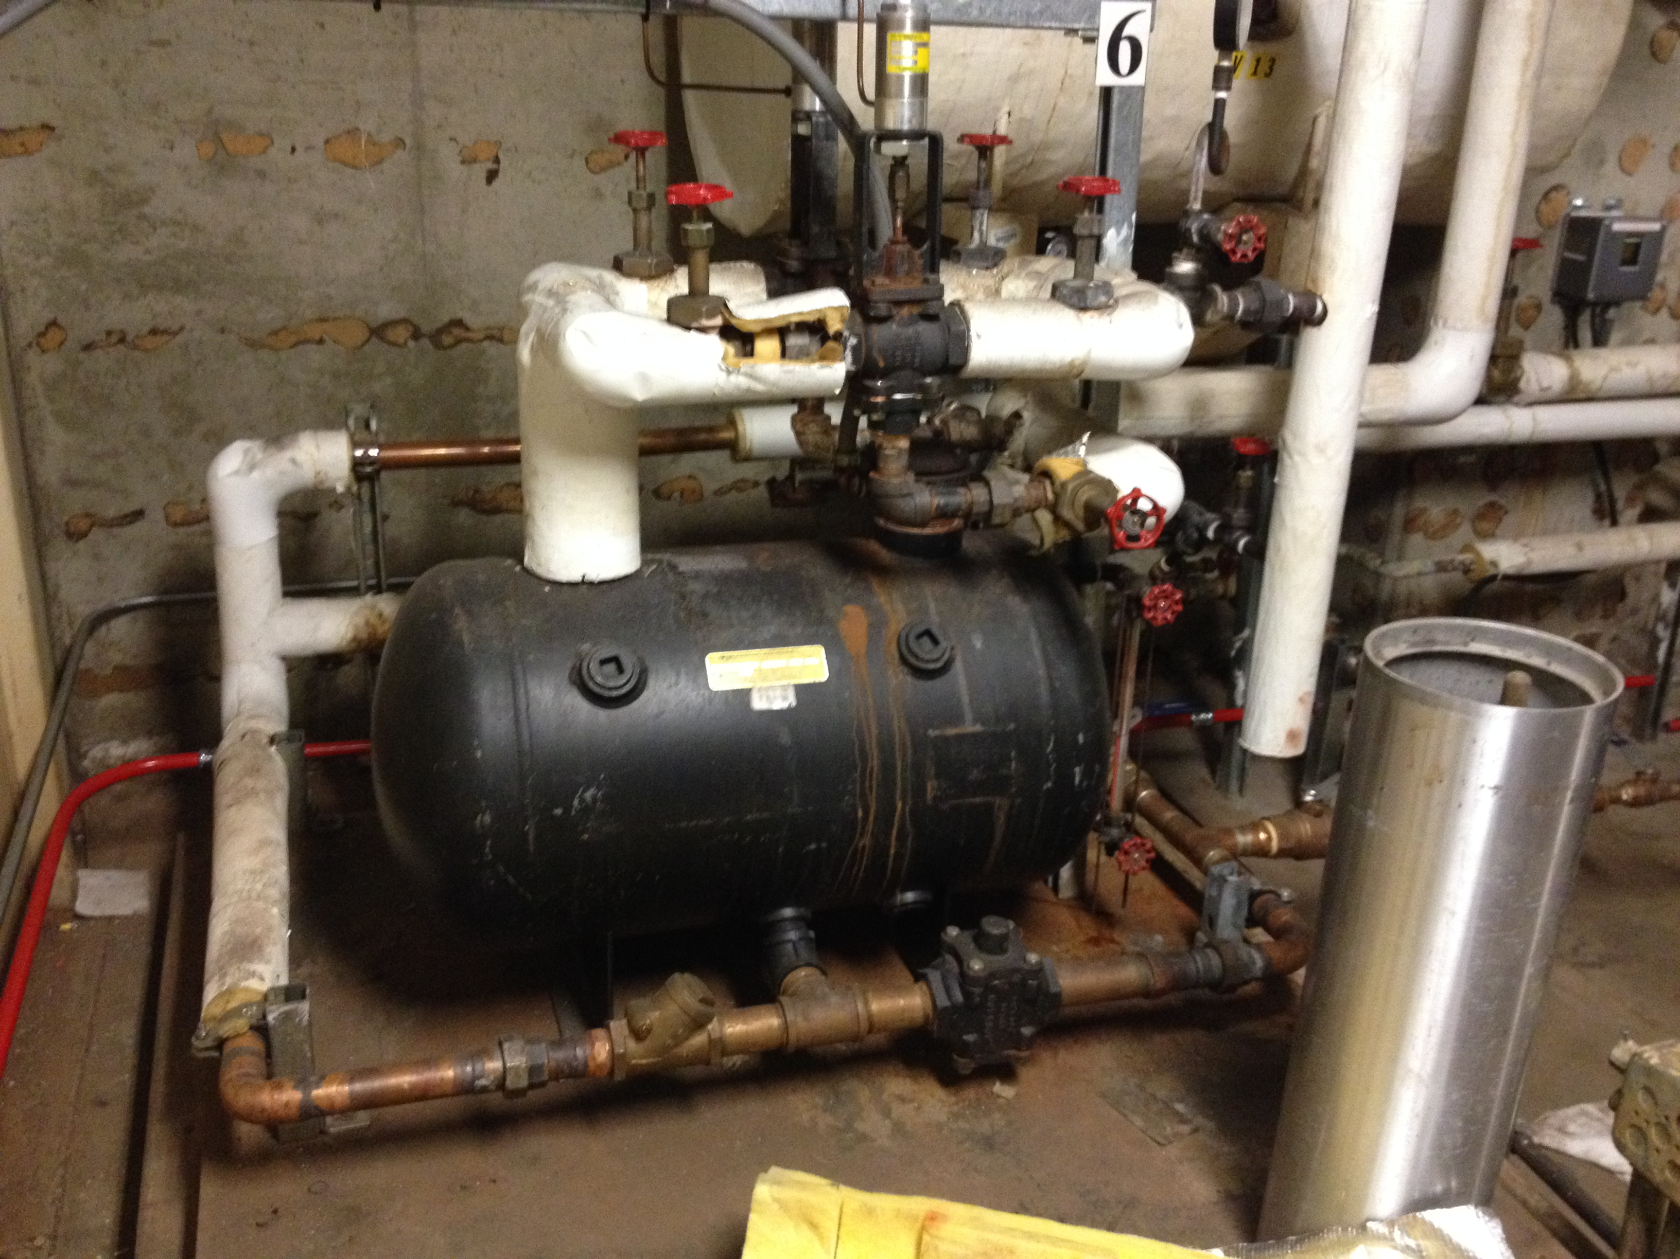

Slide 20
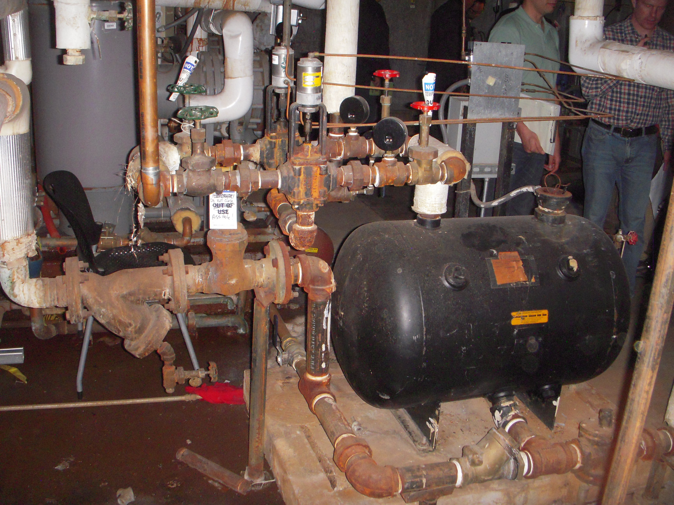

Slide 21
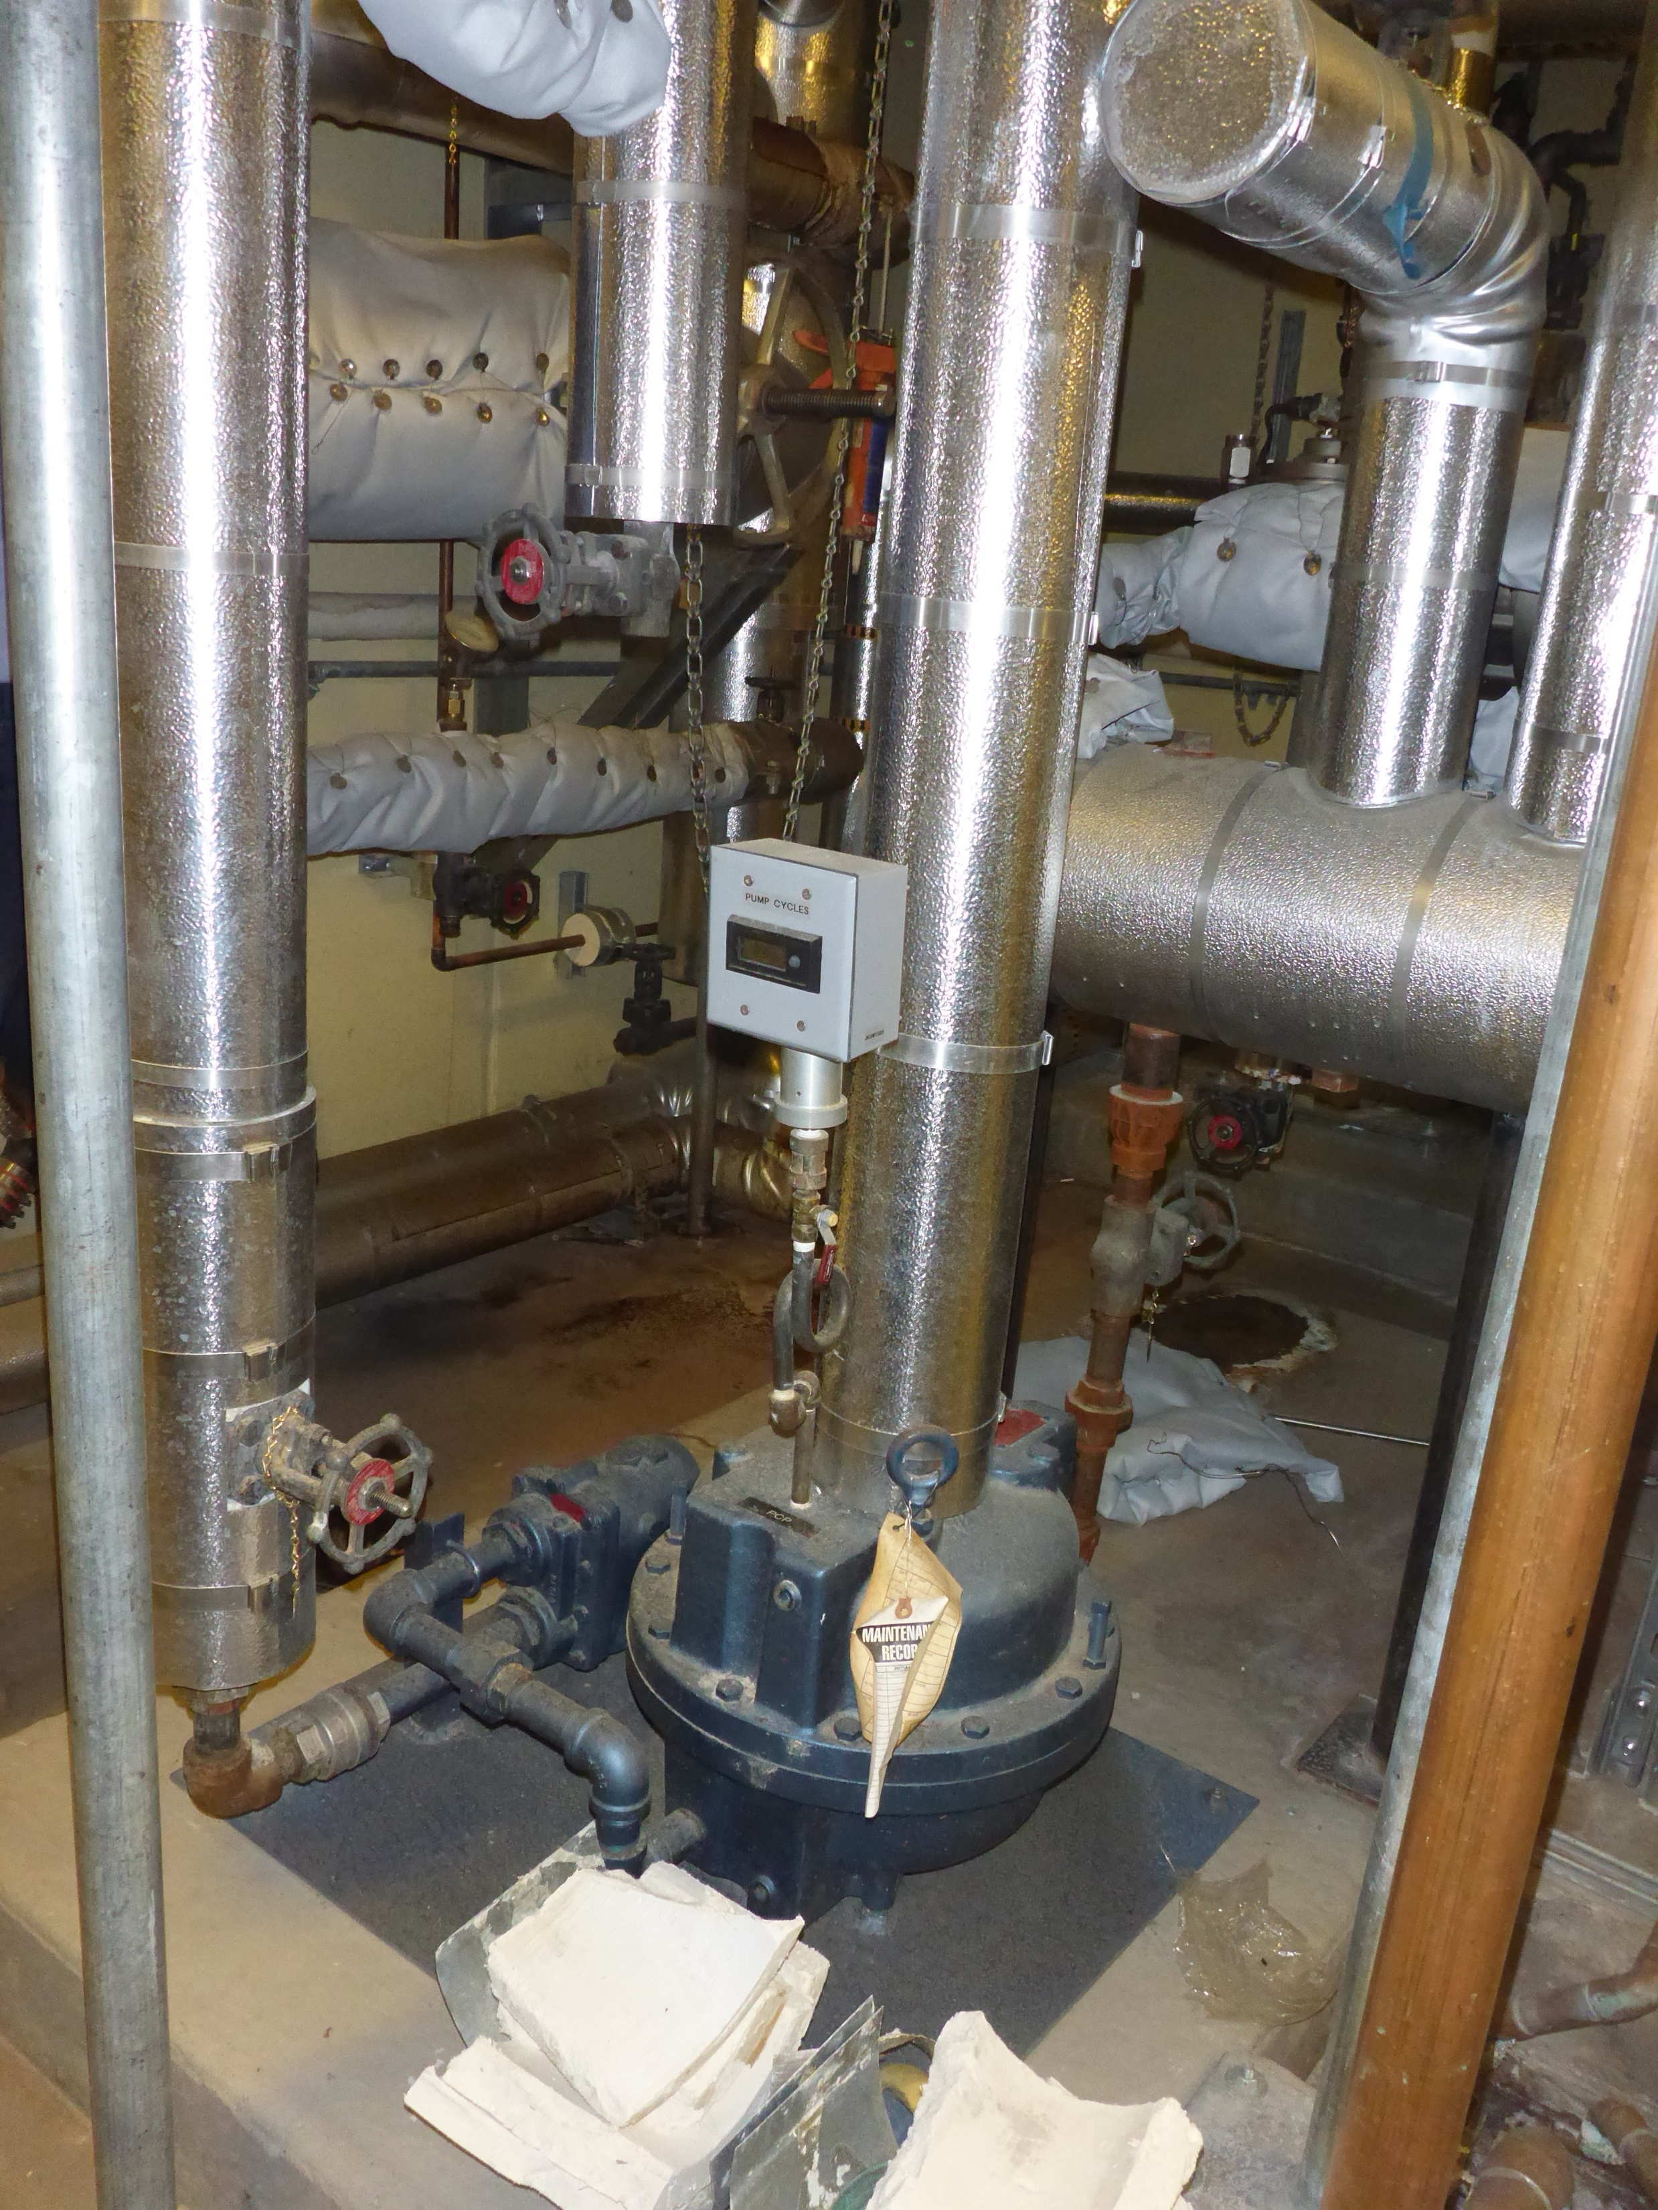

Slide 22
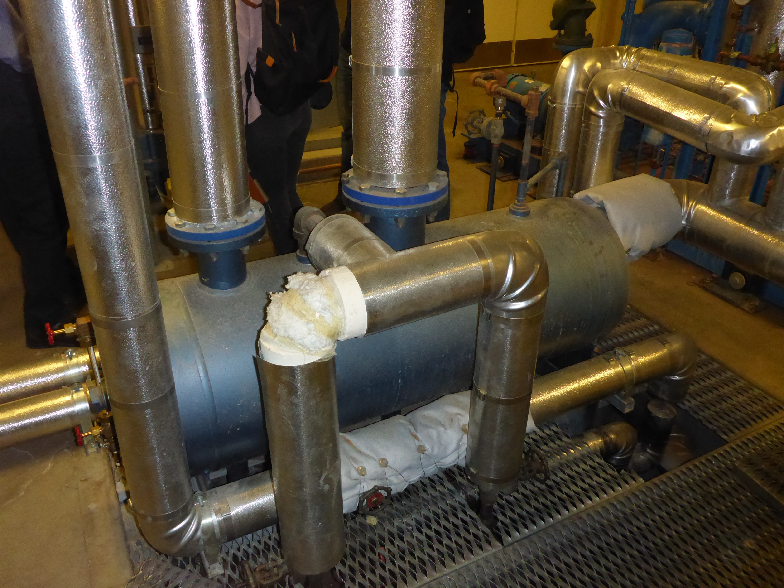

Slide 23
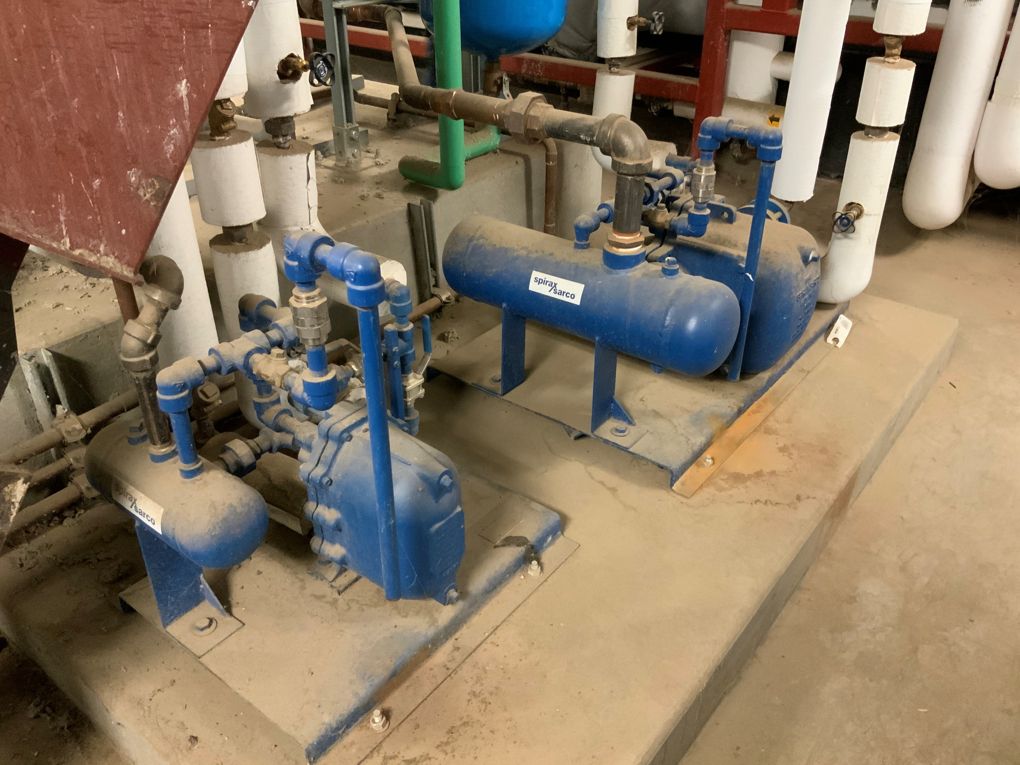

Slide 24
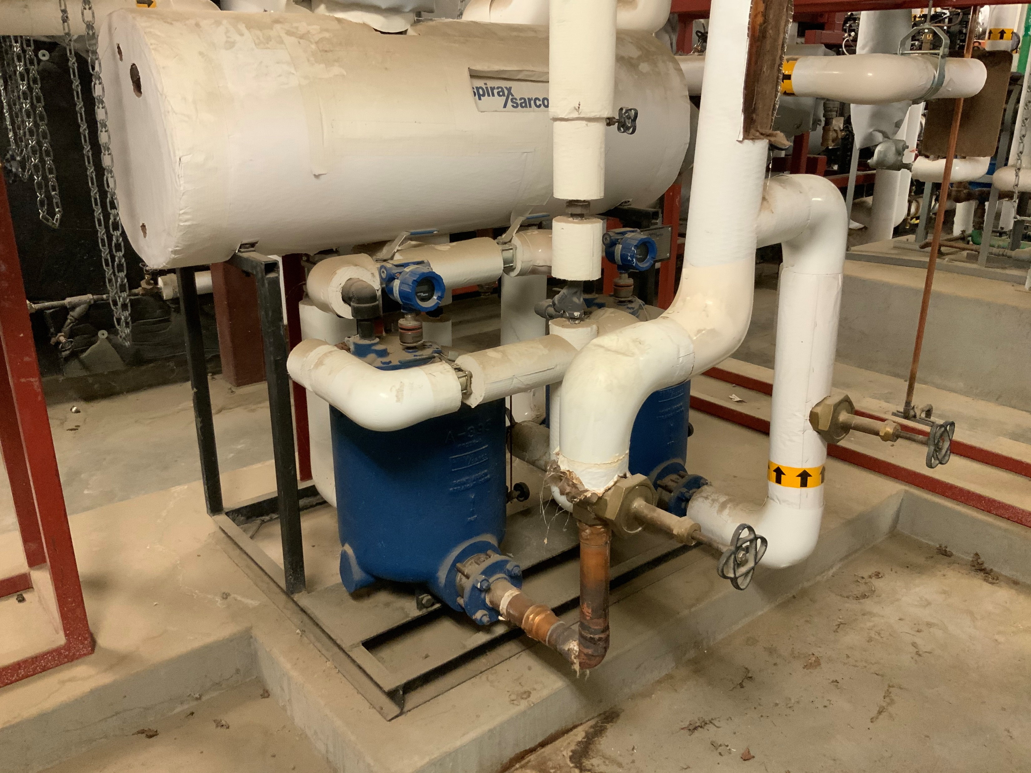

Slide 25
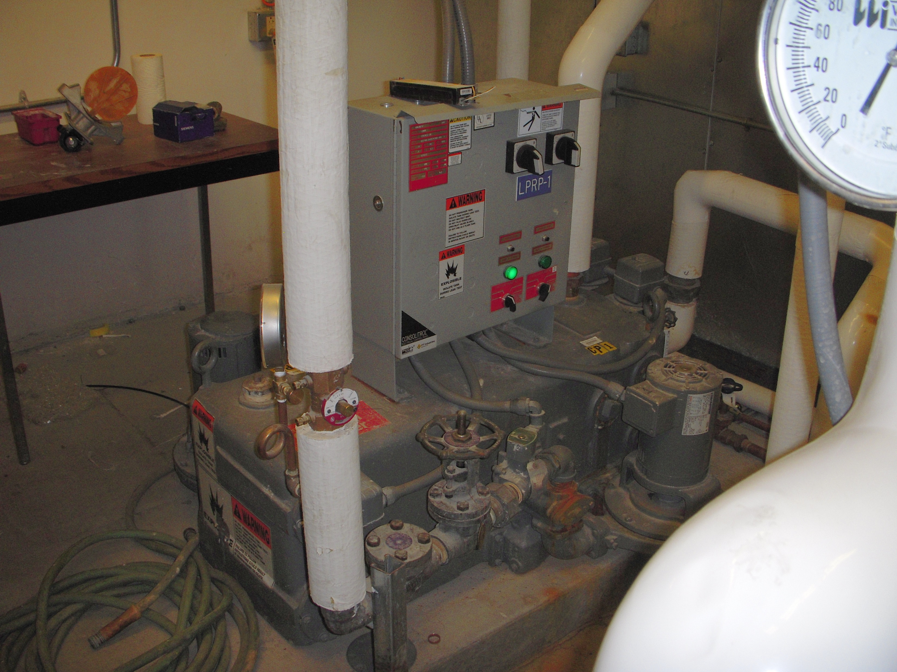
Our Condensate Pump
Field Notes:
Condensate receiver dimensions
  38” high
  38” wide
Level change per cycle – 3-5/8”
Typical cycle time – 13 seconds
The Technique:
https://av8rdas.wordpress.com/2009/12/23/assessing-steam-consumption-with-an-alarm-clock/

