Slide 1
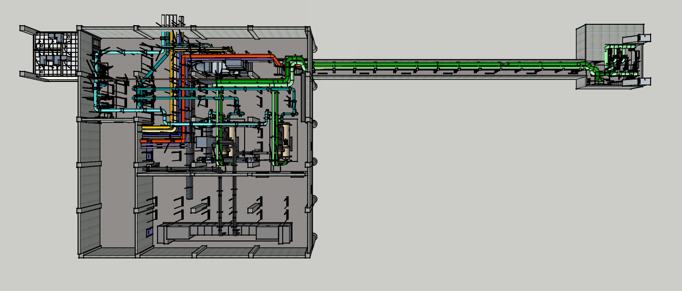
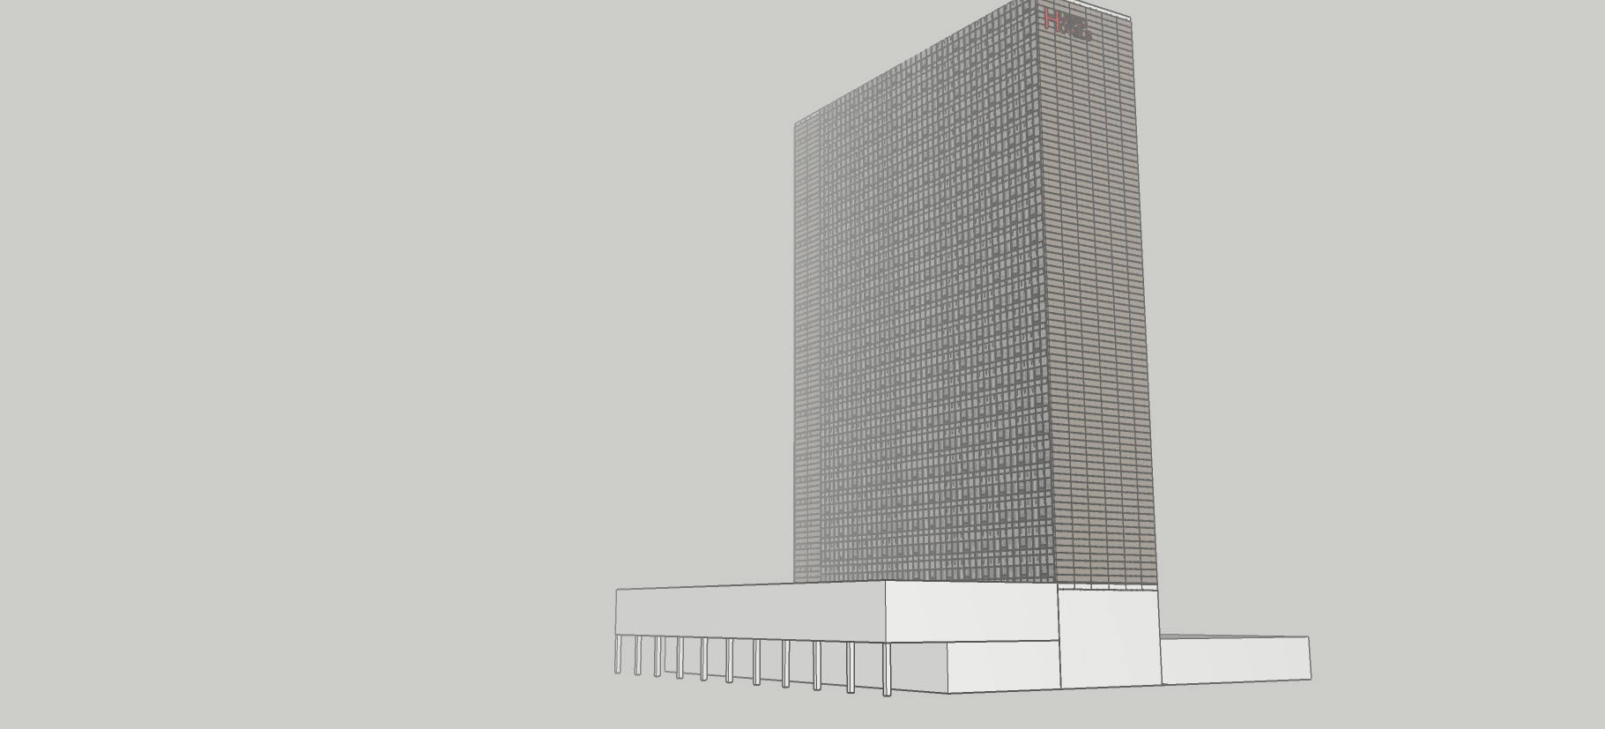
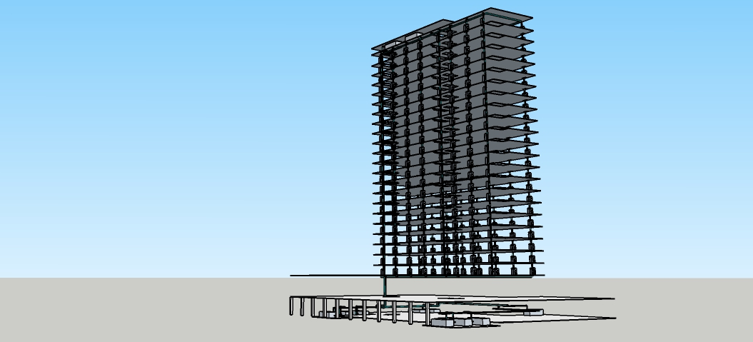
Developing a System Diagram in the Field

Slide 2
Developing a System Diagram in the Field
The slides that follows contain the distribution loop portion of the Hijend Hotel chilled water system in the central plant. The video series at this link/QR code illustrates how the diagram was developed.
https://tinyurl.com/HijendCPCHWDIstLpDgm
Take the distribution loop diagram and add the evaporator pump loops to it to complete the system diagram for the central plant chilled water system at the Hijend Hotel.
There are images from the central plant model in the slides after the distribution loop portion of the diagram that you can use. But you will find a video fly-through and links to the actual model that you can also use to support your effort at this link/QR code.
https://tinyurl.com/HijendEvapLoopFlyThru

Slide 3
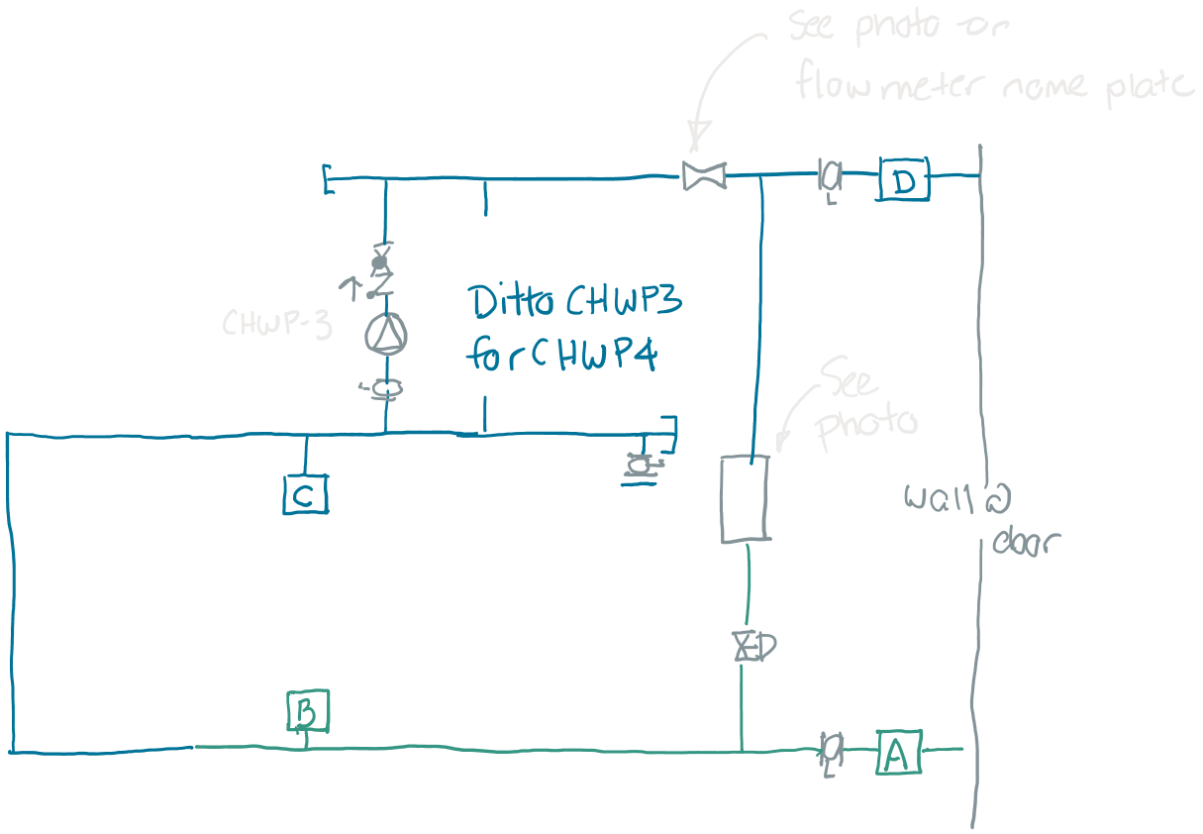
The Starting Point
The distribution loop as traced out in the field

Slide 4
The Starting Point
Hijend Hotel CHW System Diagram
Sheet 1
D
The distribution loop as traced out in the field and then cleaned up and detail added
TDV
TDV
1,100 gpm @ 90 ft.w.c., 40 hp (Typical)
SD
SD
C
Evaporator pumps connect here
42.5 gpm from 42.0°F to 54°F, 9.8 ft.w.c. Δ p, 22.1 tons
VF-1 Elec. Rm.
Evaporator pumps connect here
B
A

Slide 5
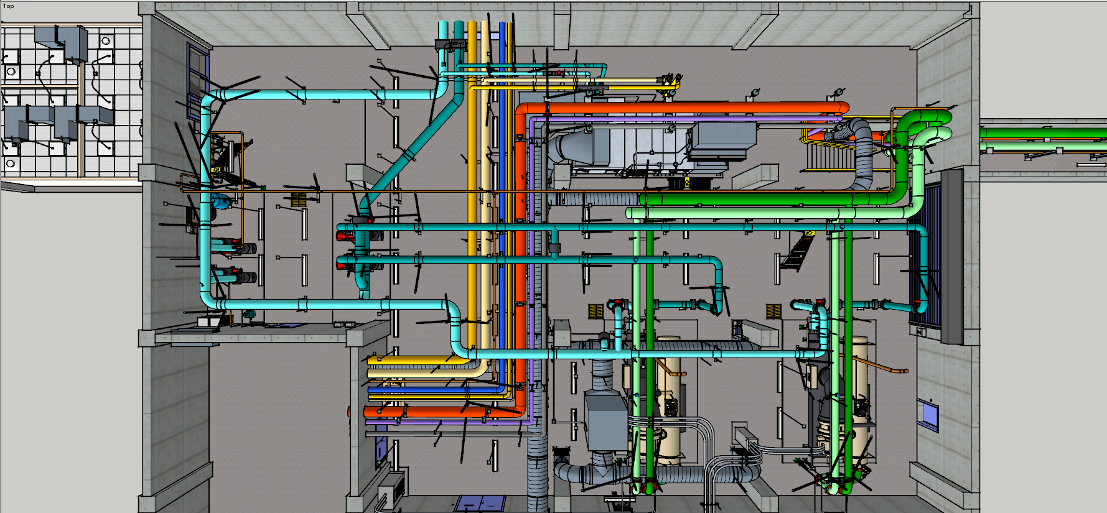

Slide 6
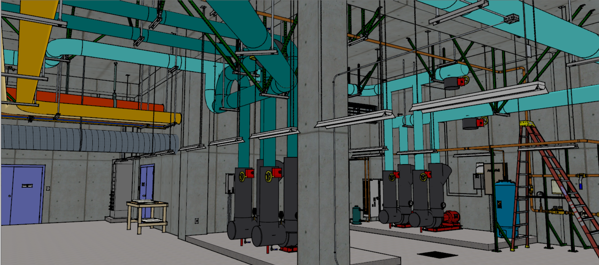

Slide 7
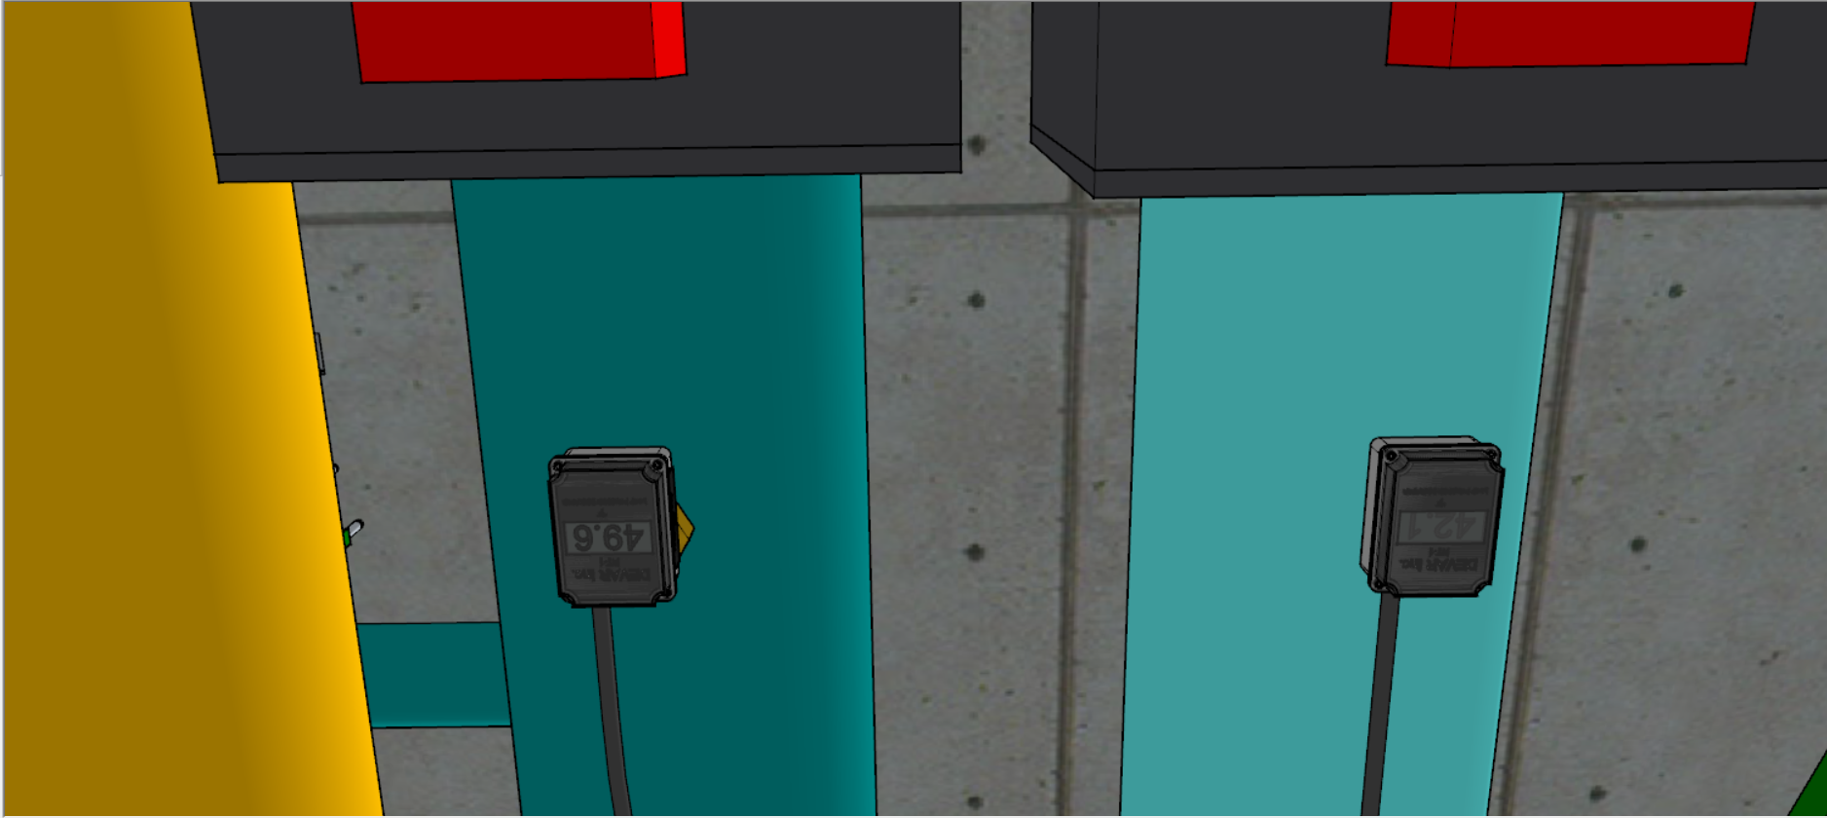

Slide 8
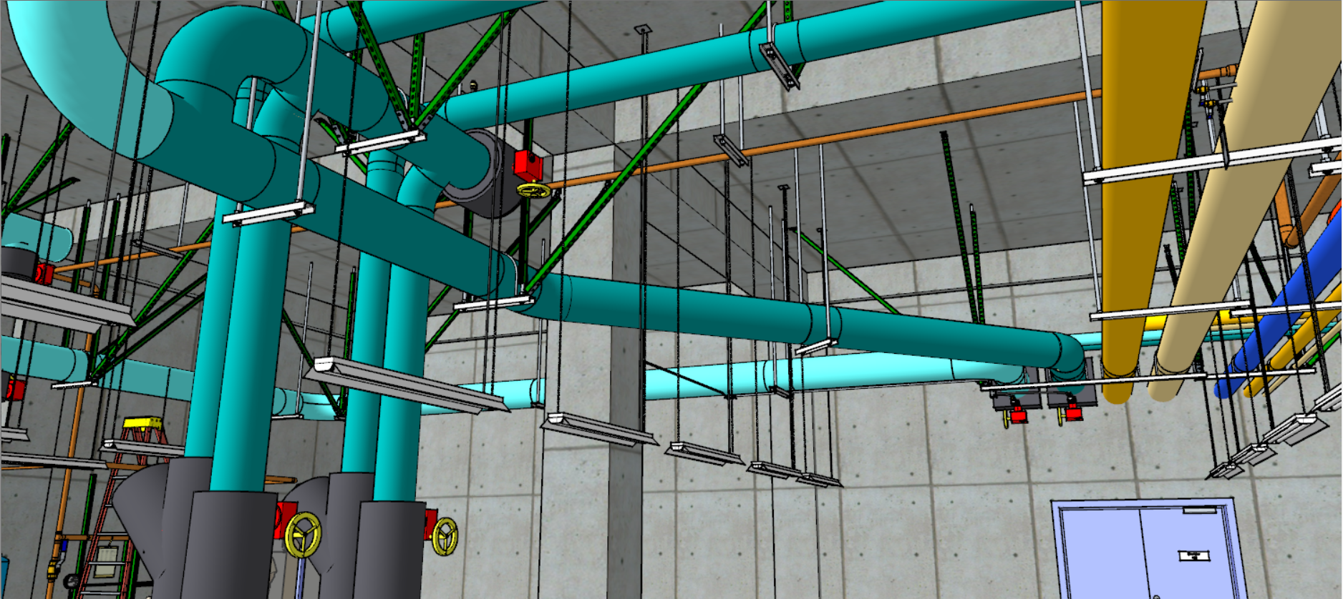

Slide 9
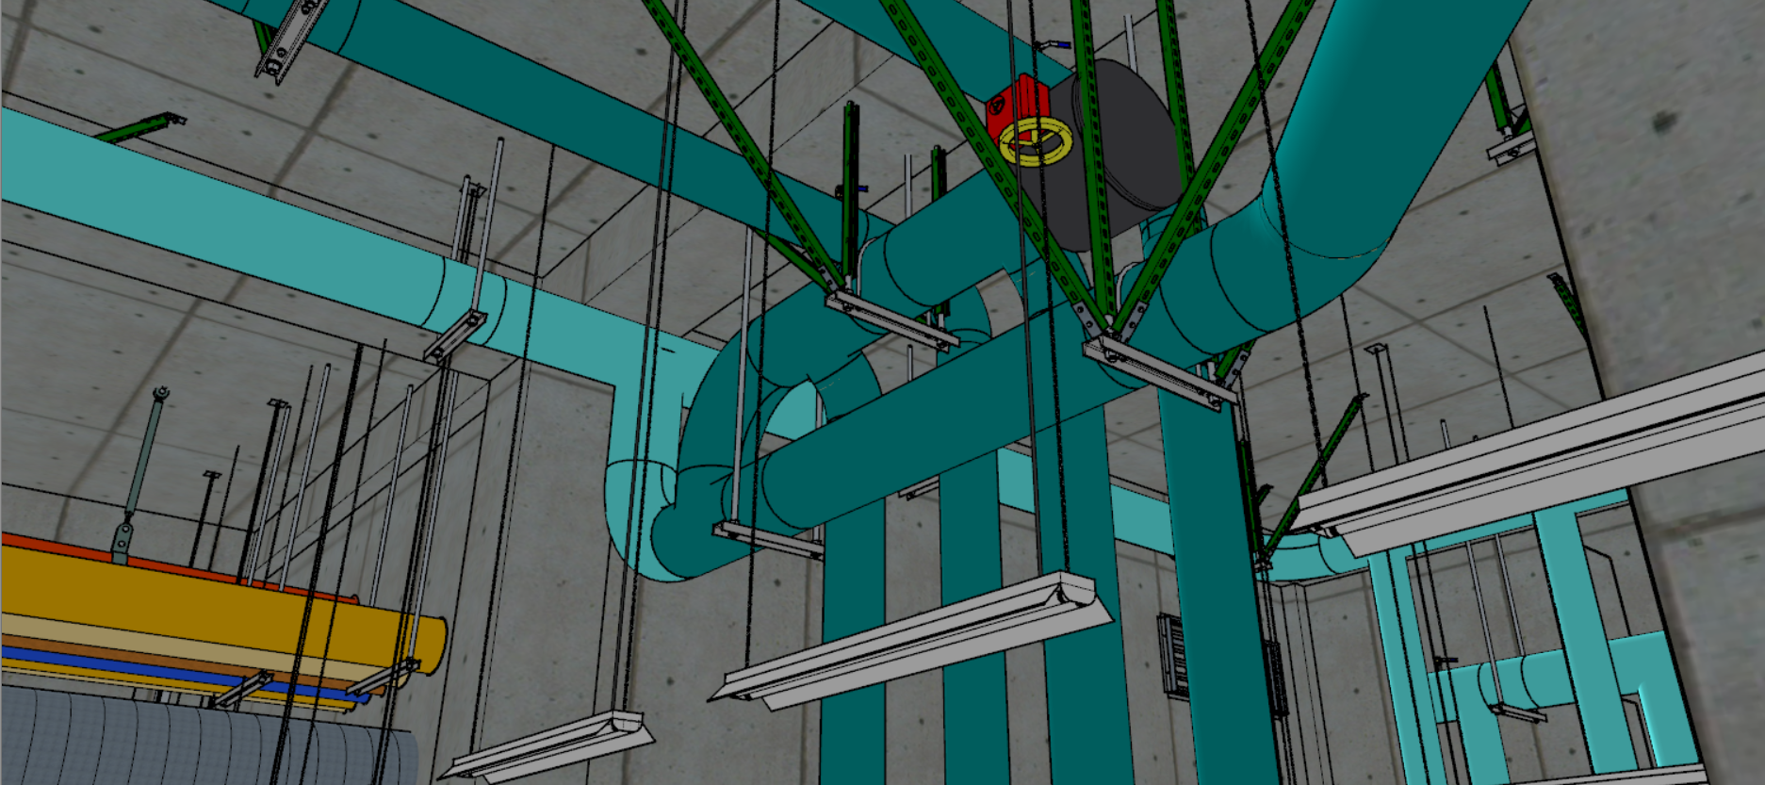

Slide 10
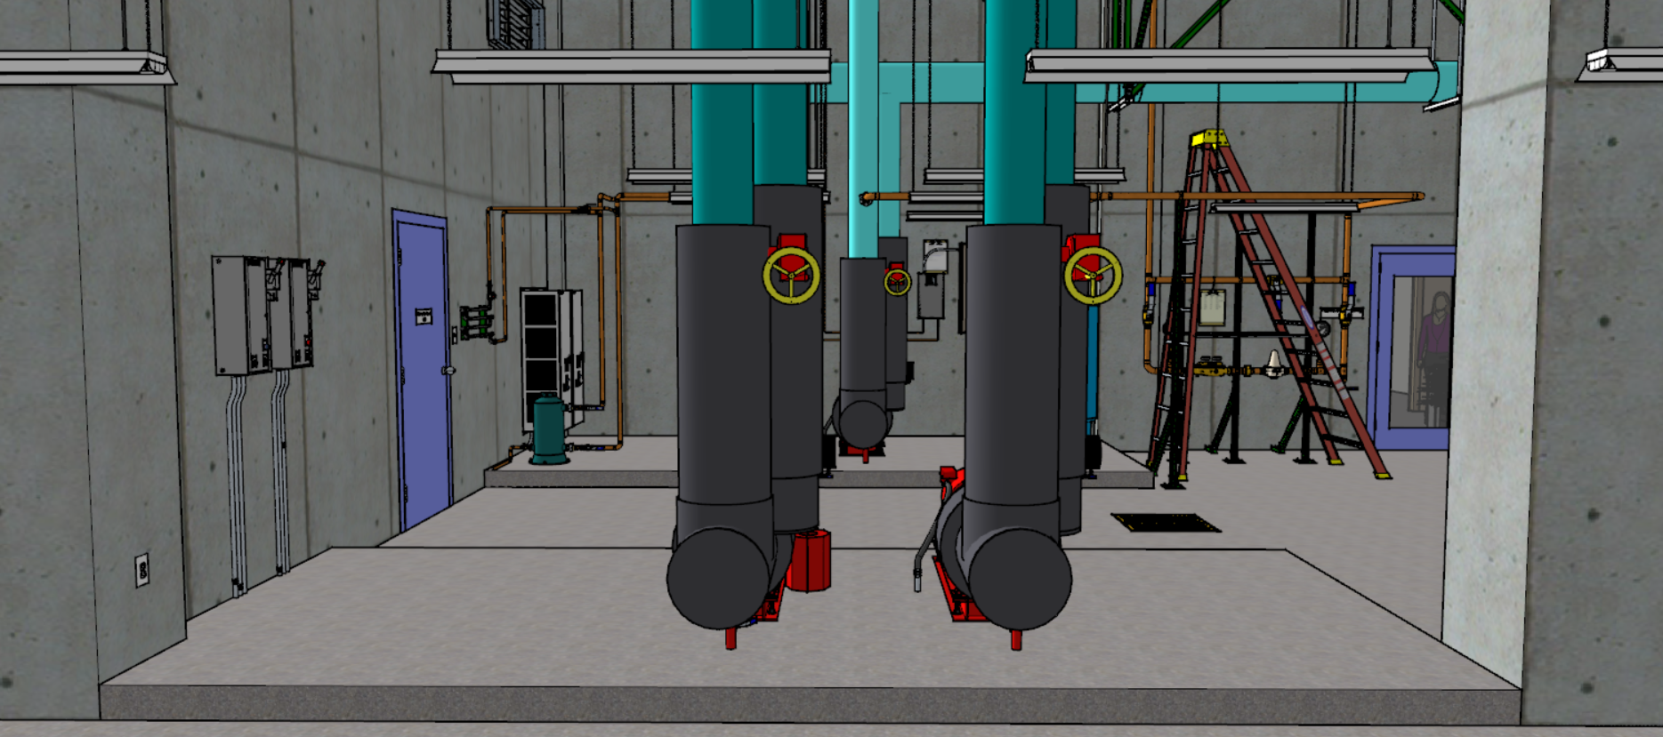

Slide 11
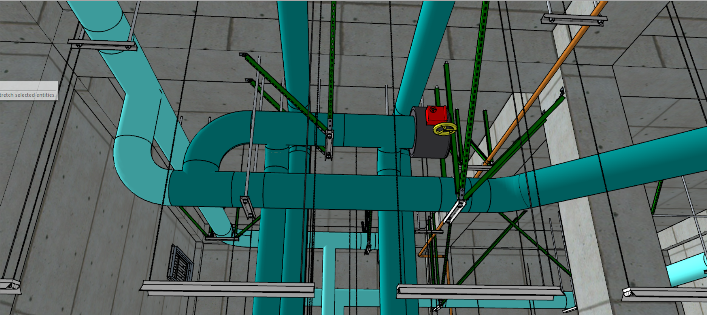

Slide 12
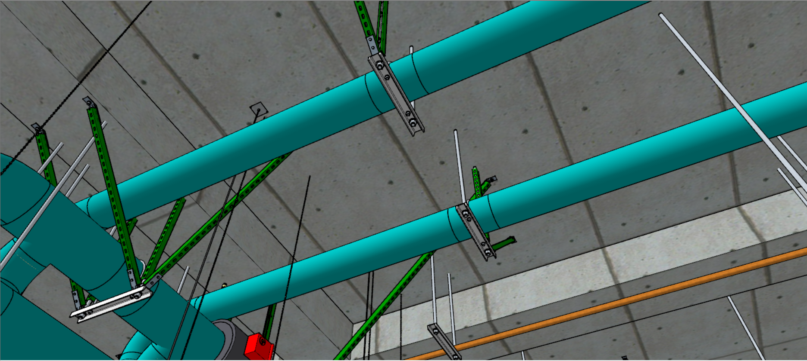

Slide 13
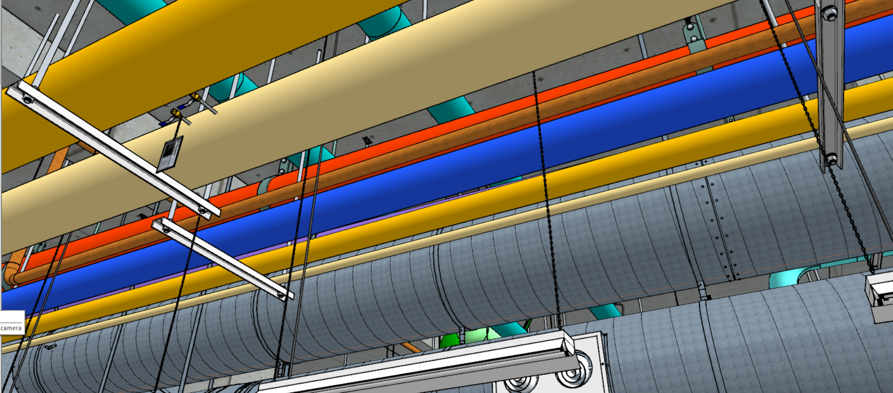

Slide 14
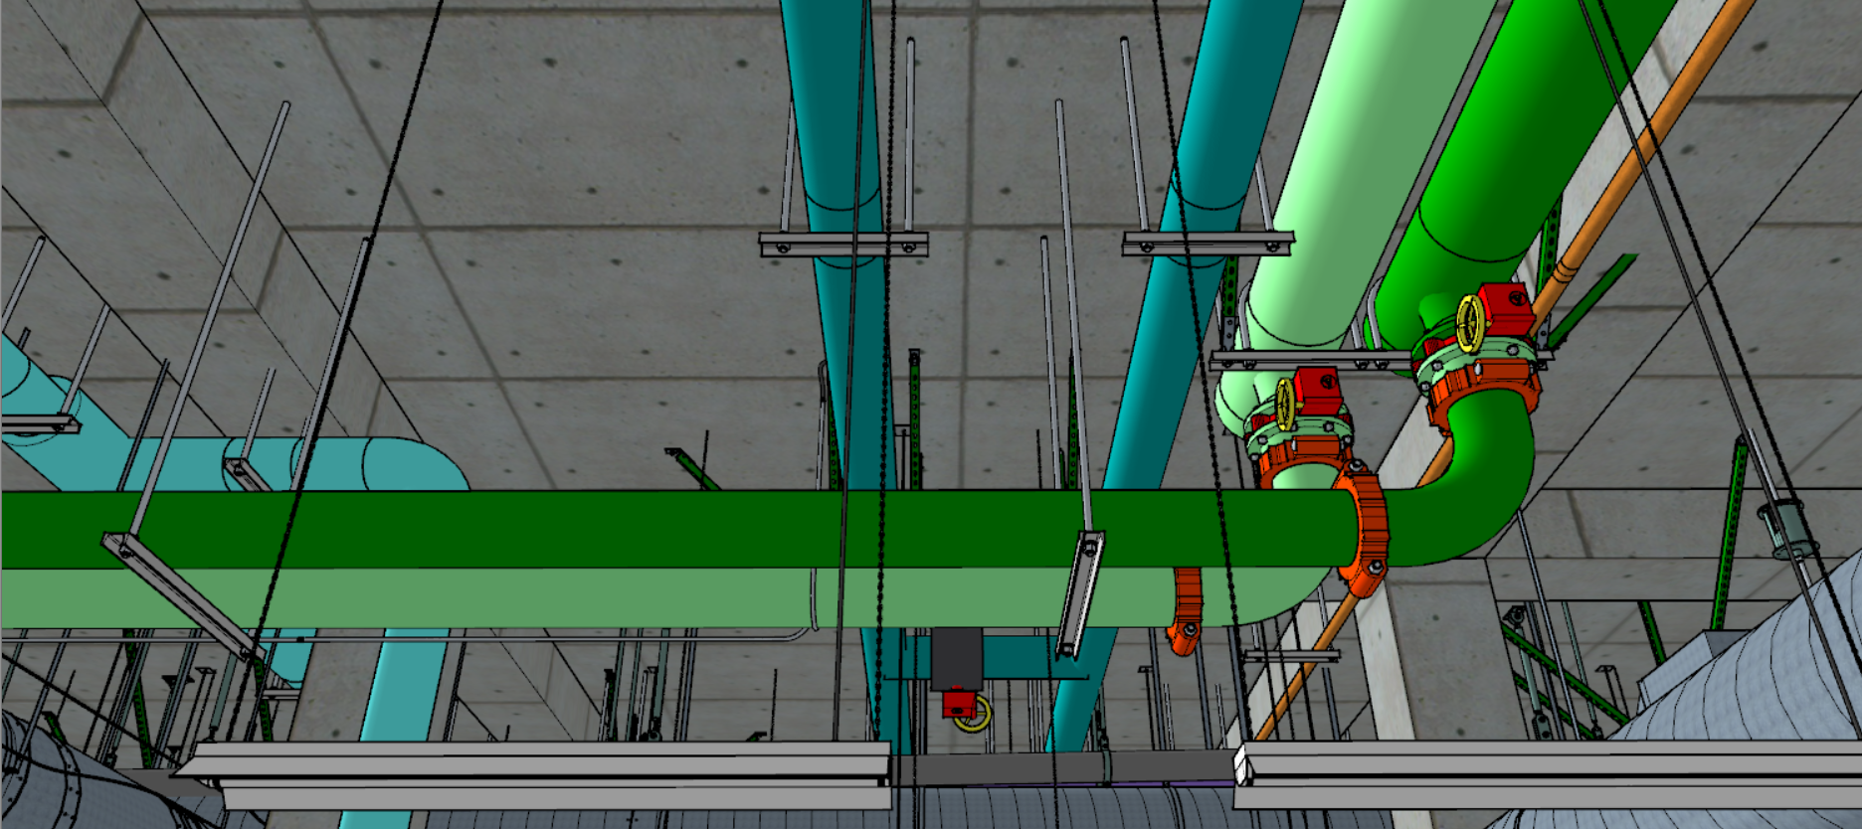

Slide 15
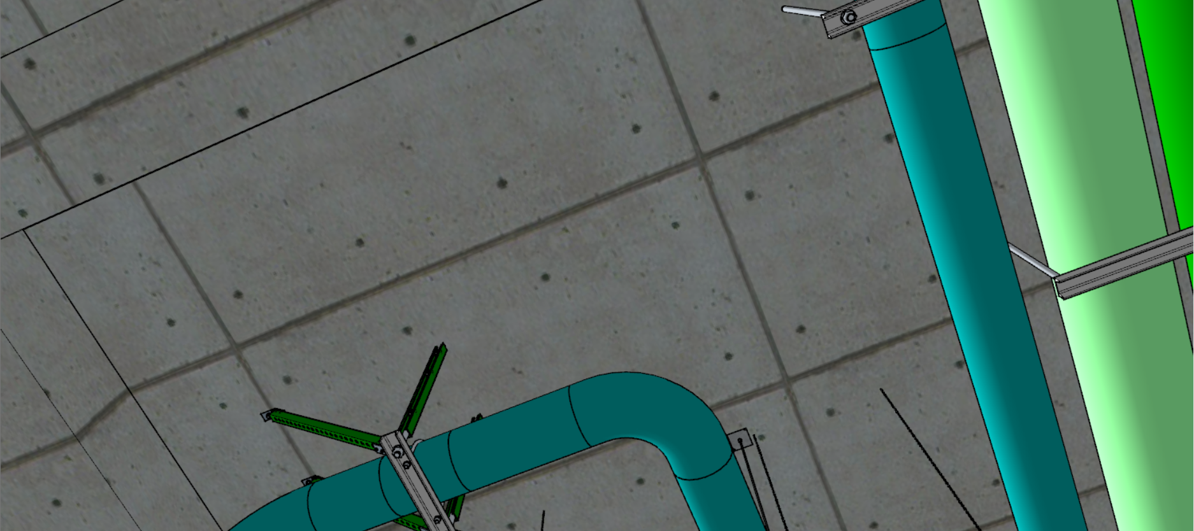

Slide 16
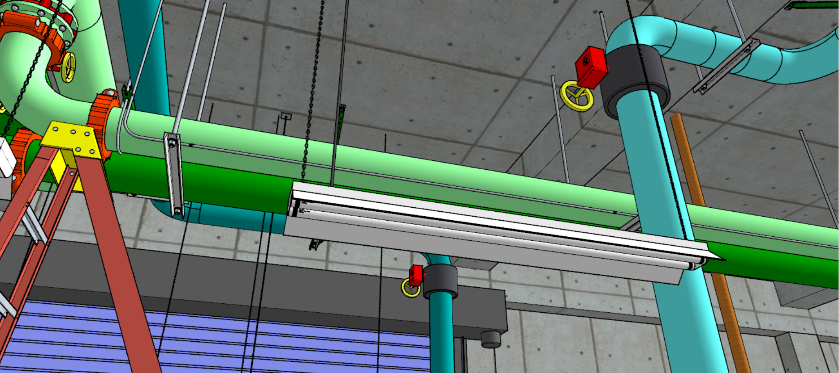

Slide 17
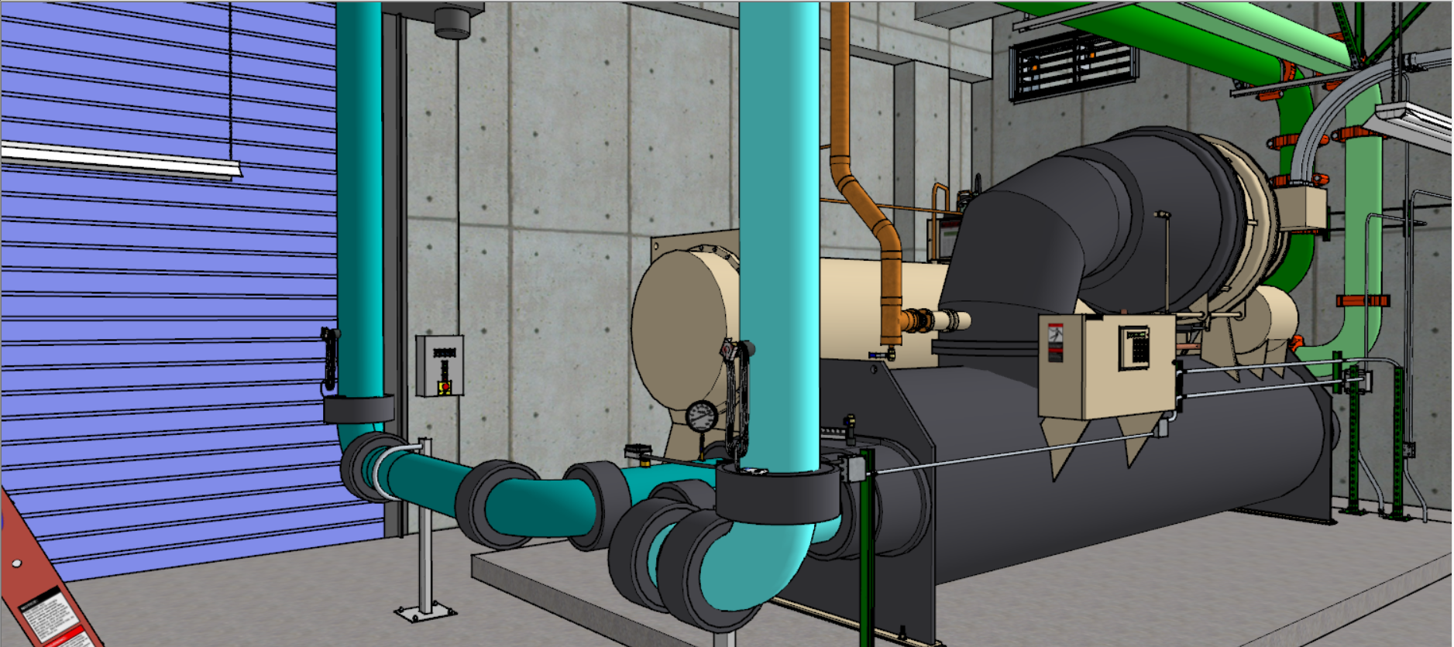

Slide 18
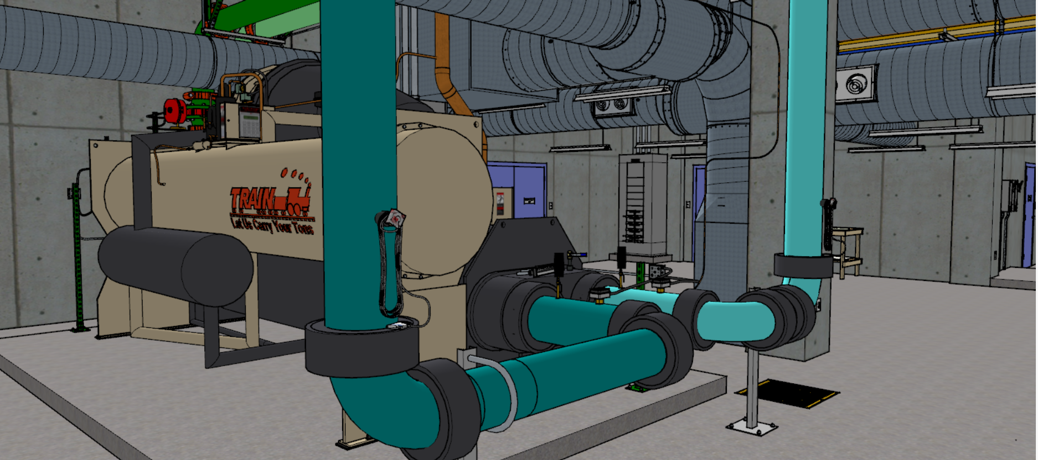

Slide 19
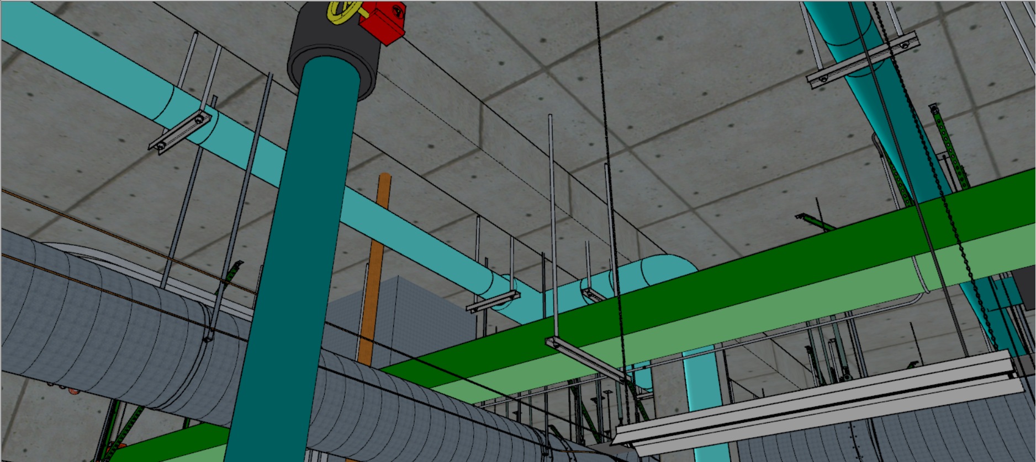

Slide 20
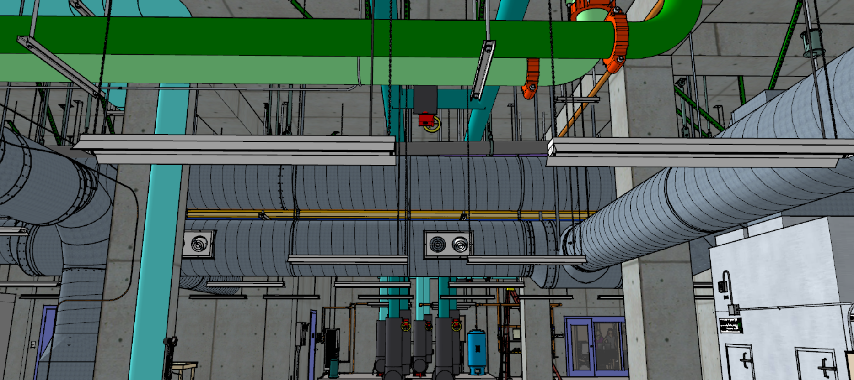

Slide 21
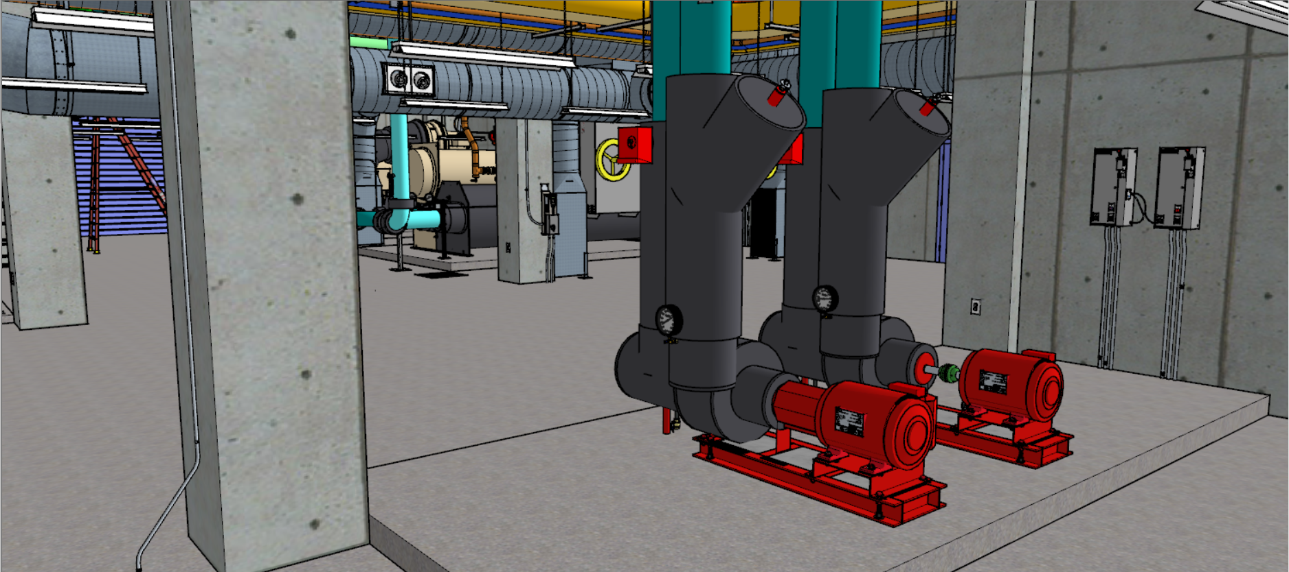

Slide 22
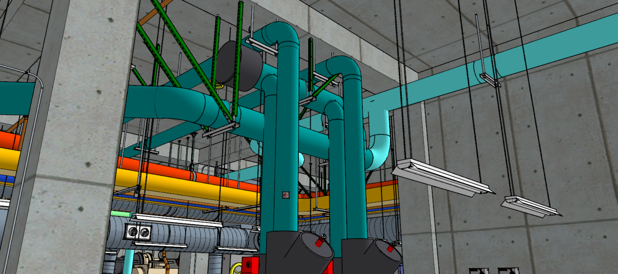

Slide 23
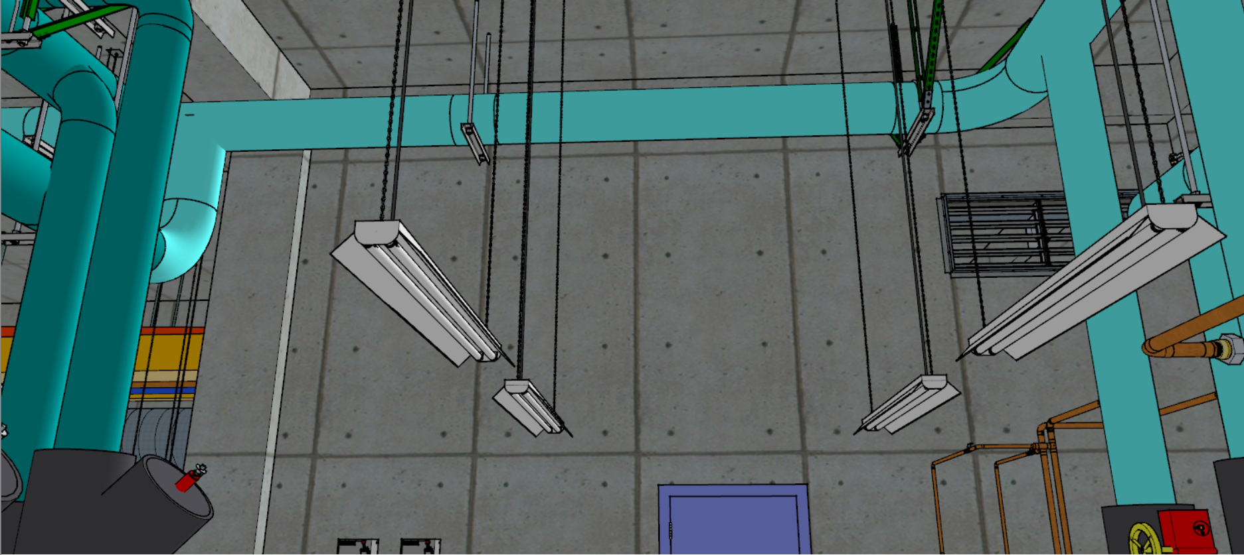

Slide 24
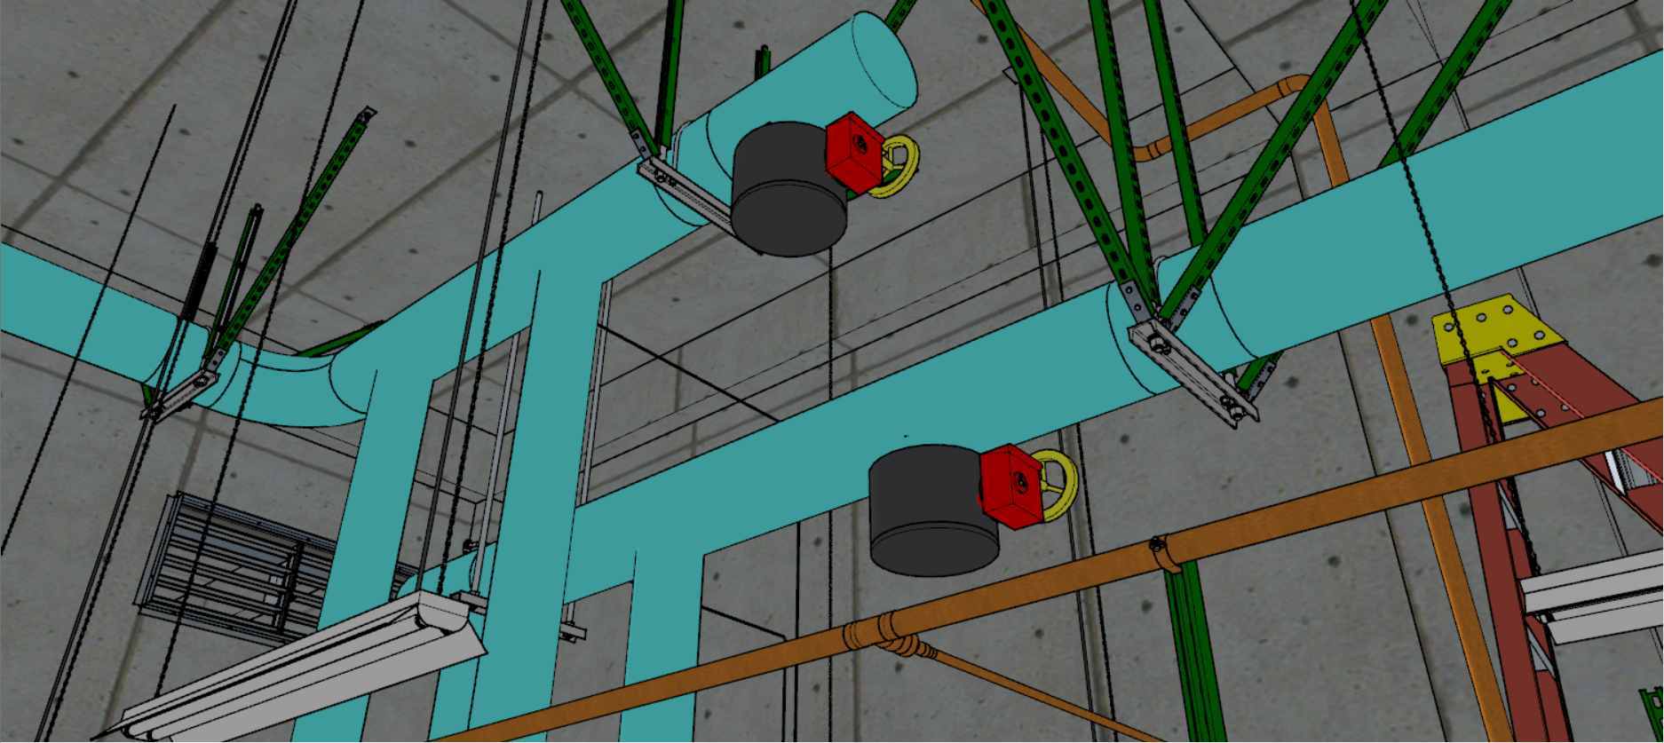

Slide 25
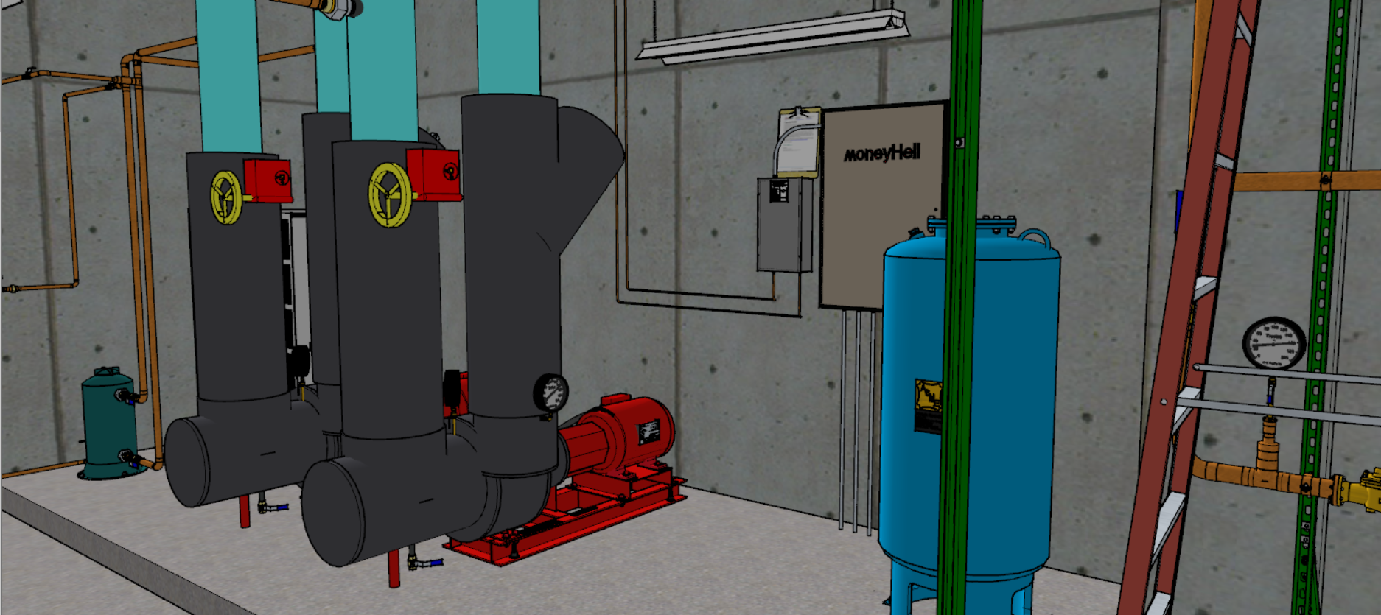

Slide 26
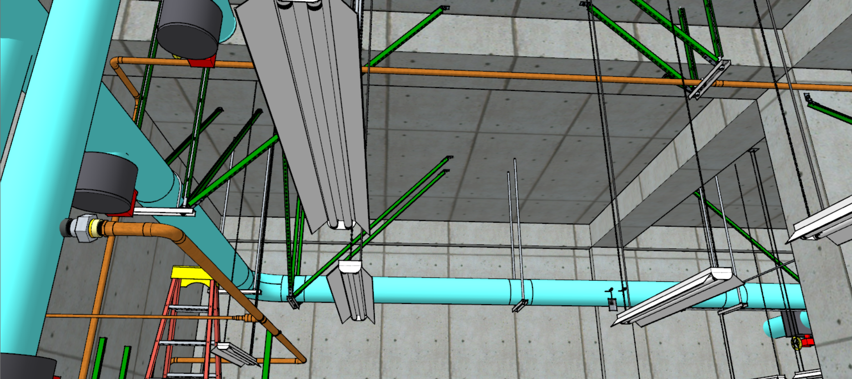

Slide 27
