Slide 1

Existing Building Commissioning Workshop: Series 16, Session 1
Scoping and the Findings List
Presented By:
David Sellers
Senior Engineer, Facility Dynamics Engineering

Slide 2
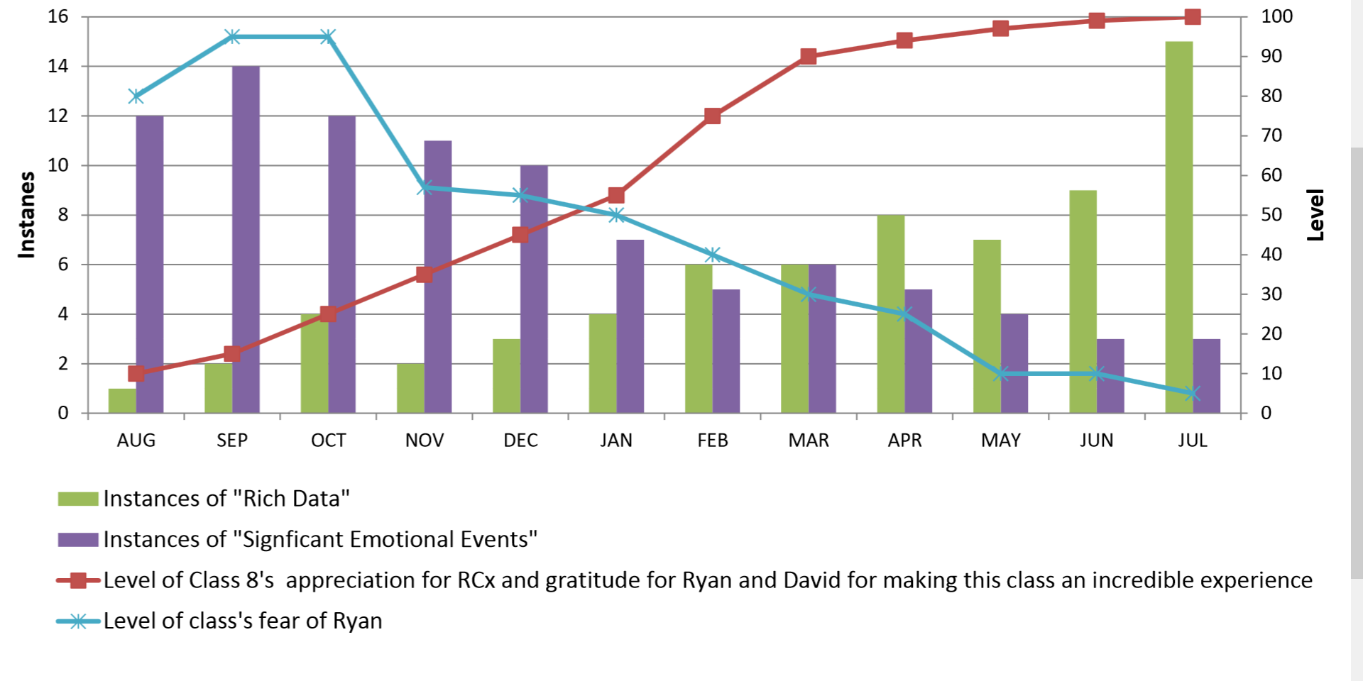
An Overview Of What to Expect Moving Forward

Slide 3
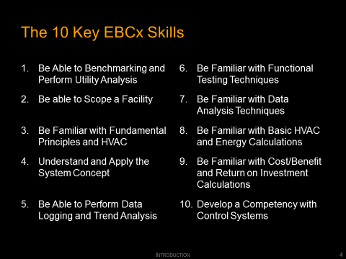
Your Progress To Date
Taken the RCx 101 Class
Begun to Become Familiar with the 10 Key Retrocommissioning Skills
Found or are Finding a Building
Obtaining Utility Data
Benchmarking Your Building

Slide 4
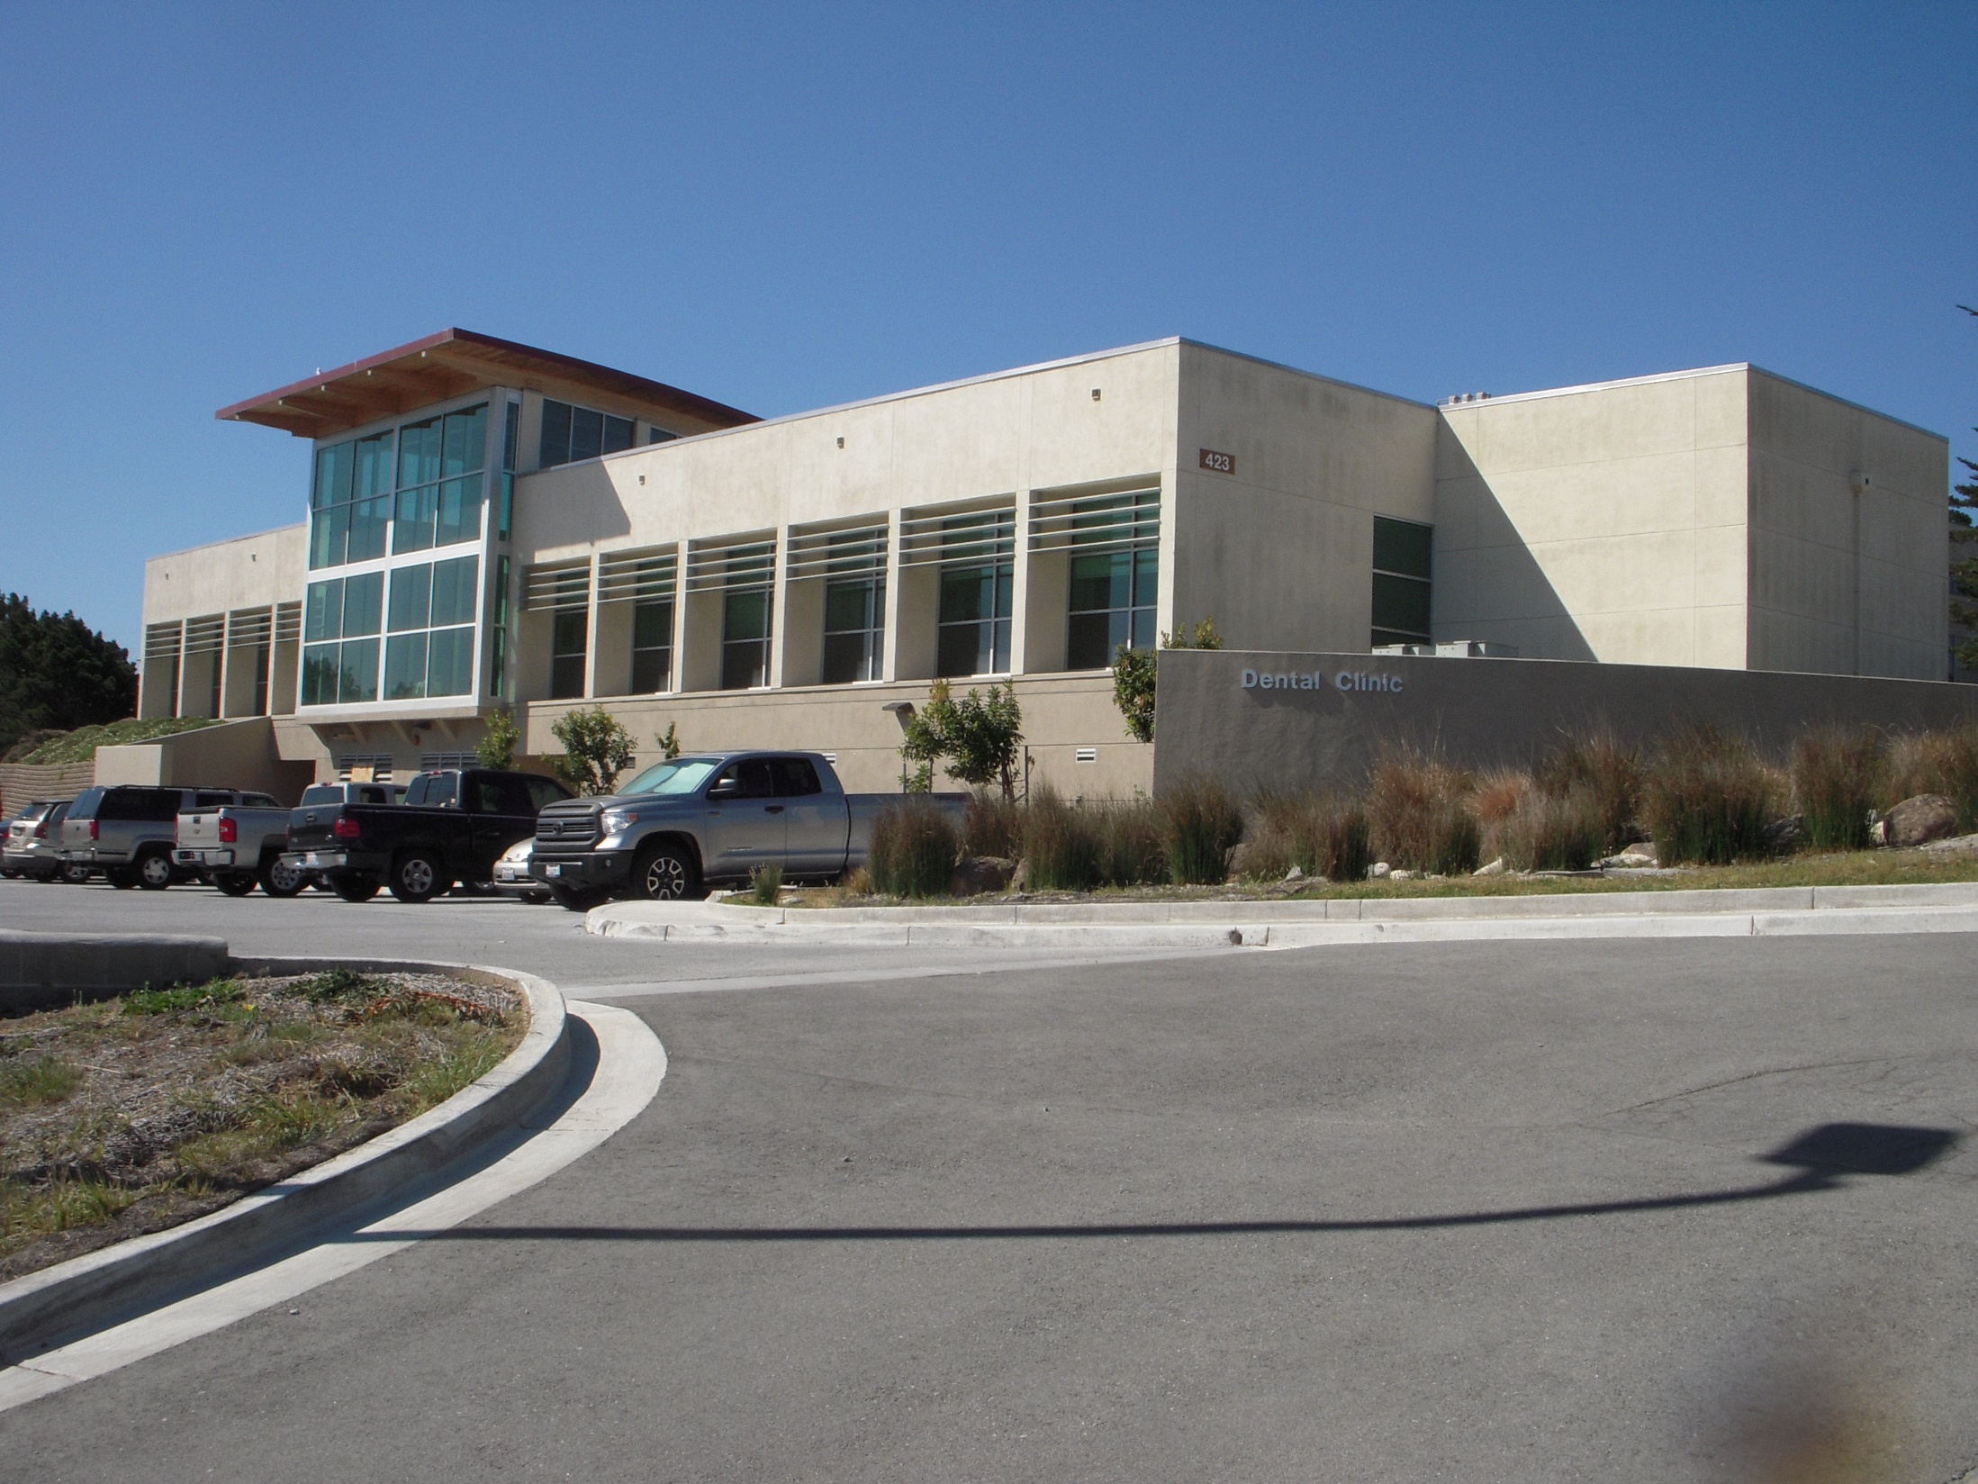
Benchmarking; An Example

Slide 5
Benchmarking; An Example
    Benchmarking compares the performance of your facility to that of similar facilities of a similar size, age, occupancy, and function that are located in a similar climate.

Slide 6
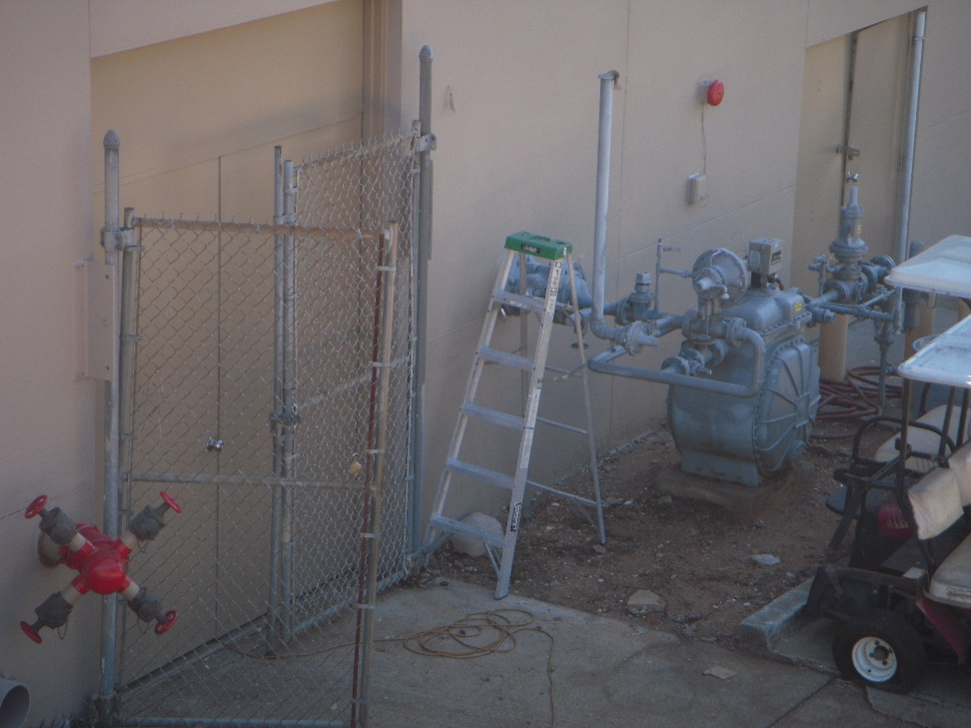
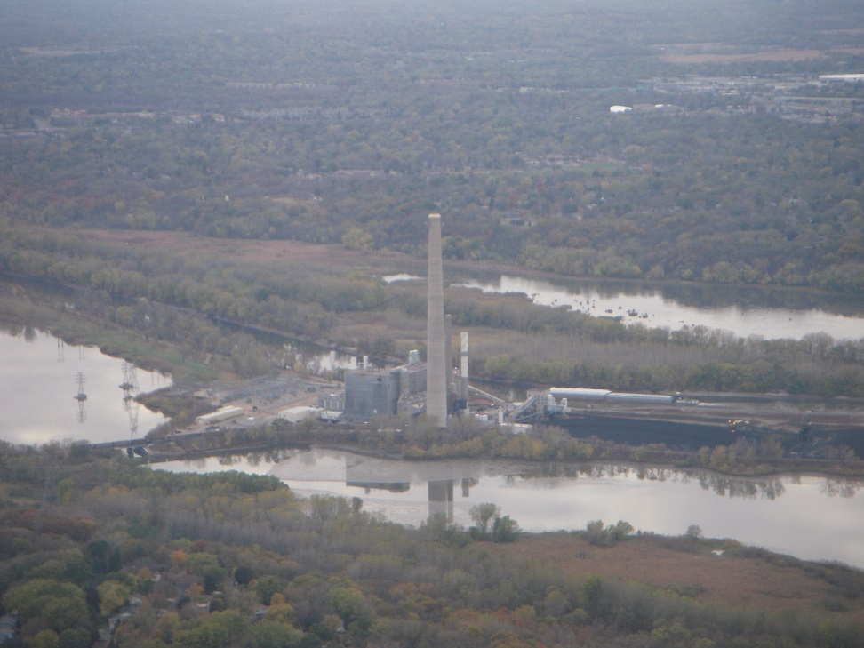
Site vs. Source Energy
Site Energy
Source Energy

Slide 7
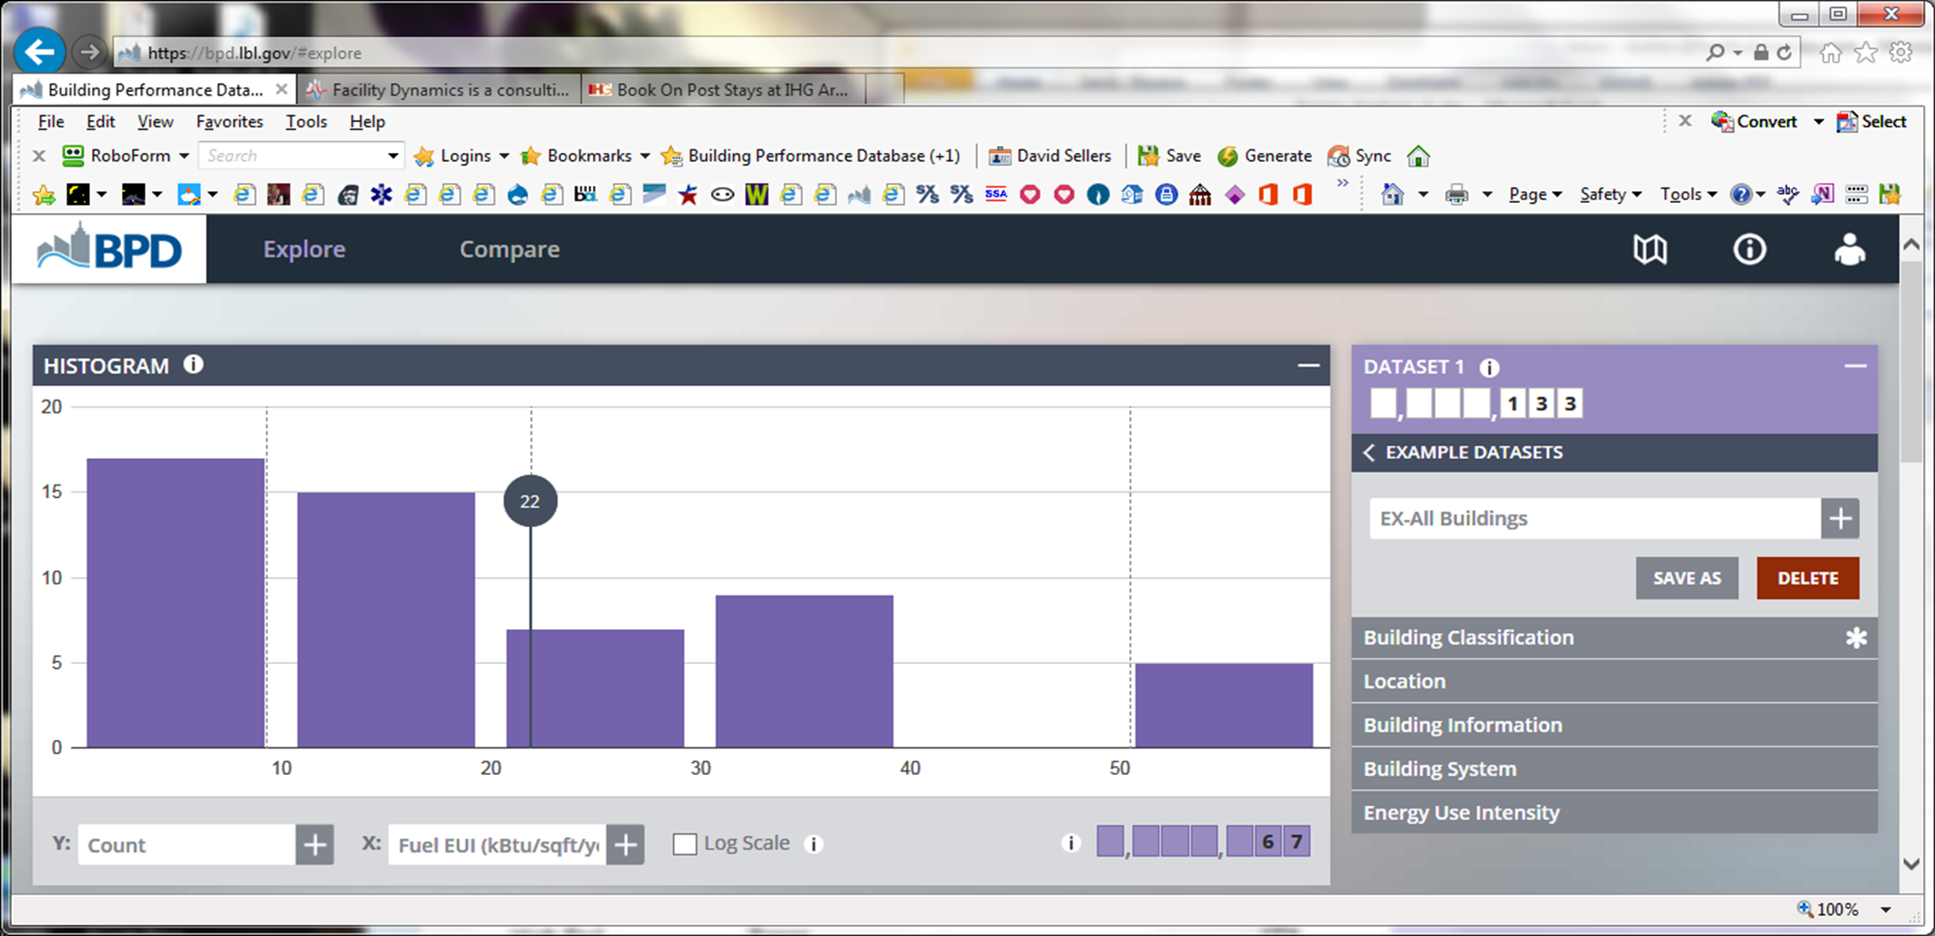
Benchmarking Against CBECS via DOE Buildings Performance Database
https://bpd.lbl.gov/
Notes:
https://bpd.lbl.gov/

Slide 8
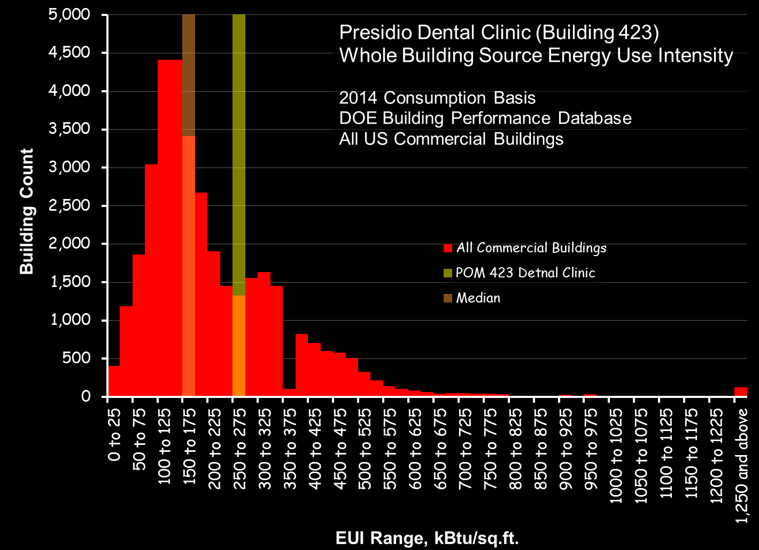

Slide 9
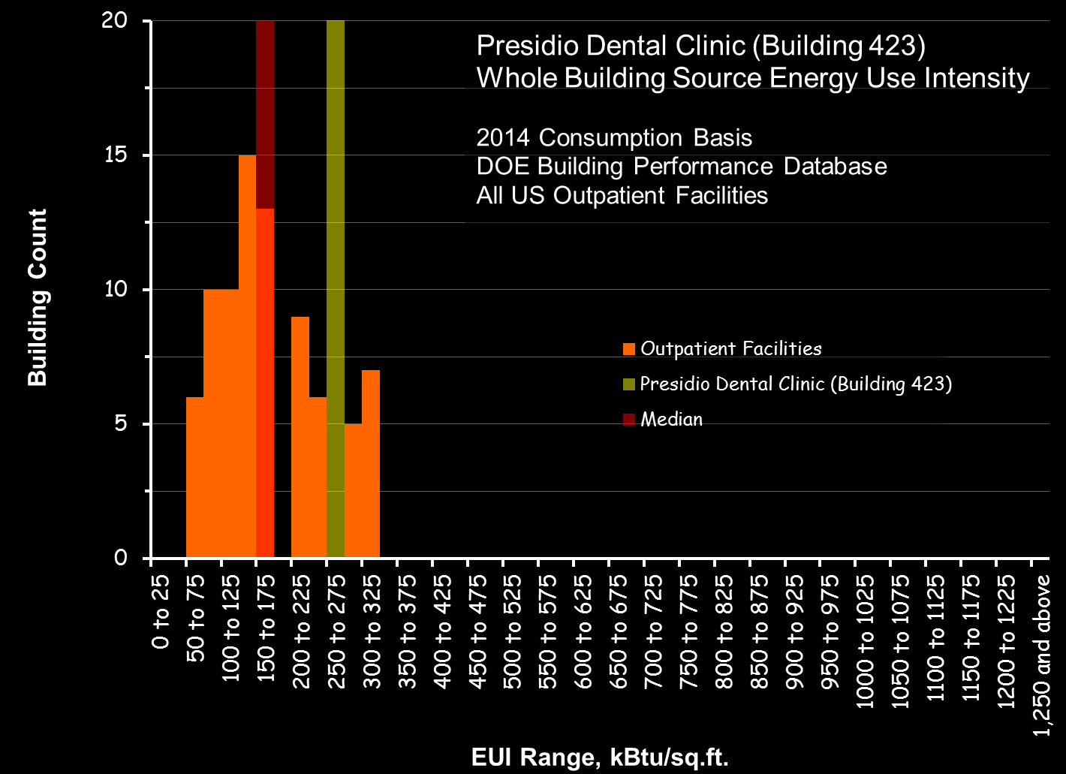

Slide 10
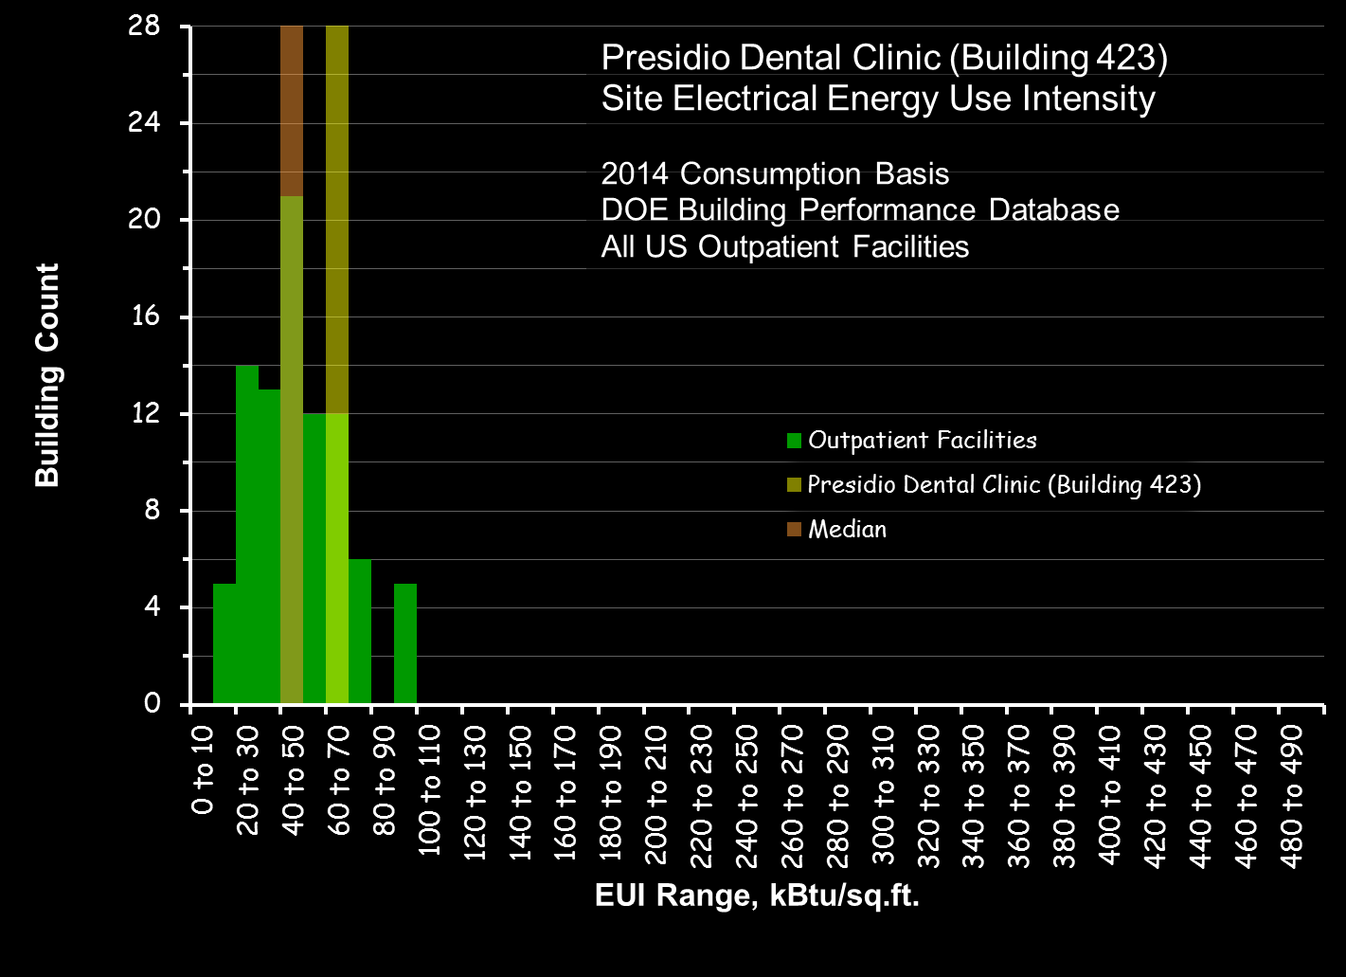

Slide 11
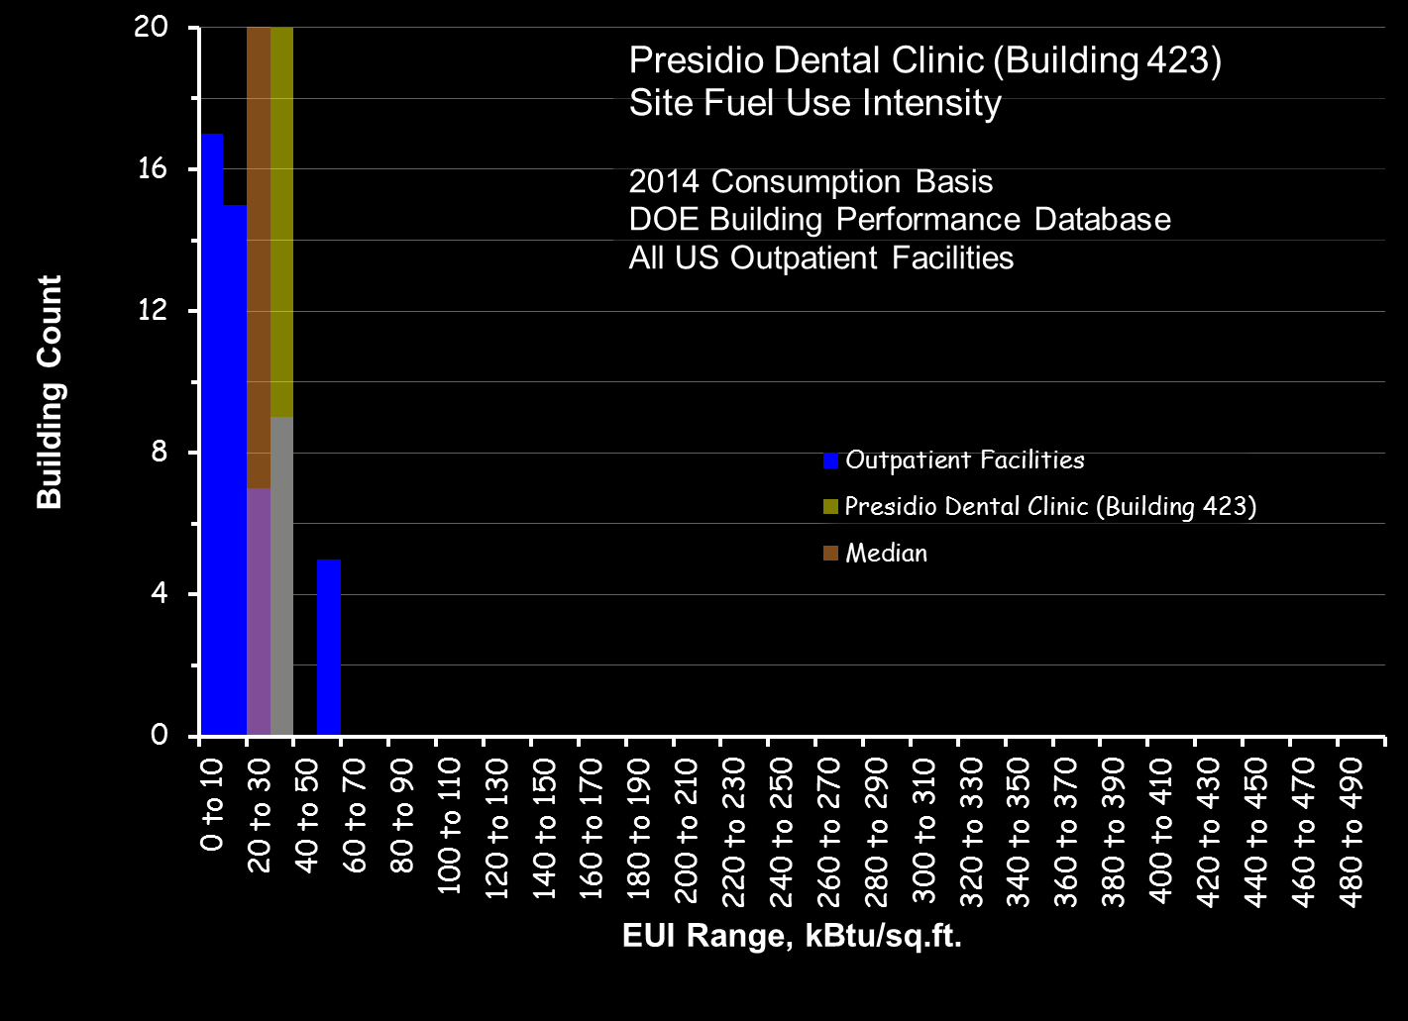

Slide 12
Next Month’s Assignment
Derive the Virial Equation of State

Slide 13
Next Month’s Assignment
Derive the Virial Equation of State for Air
Apply it to the ISA PID Algorithm for an AHU as a Method to Assess Your Project’s Savings Potential

Slide 14
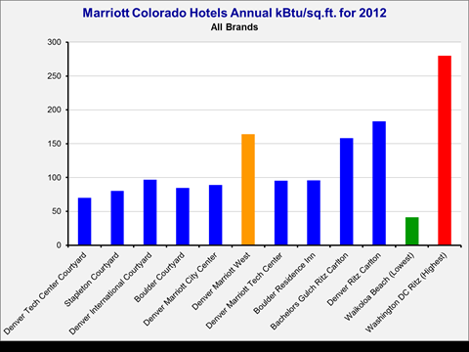
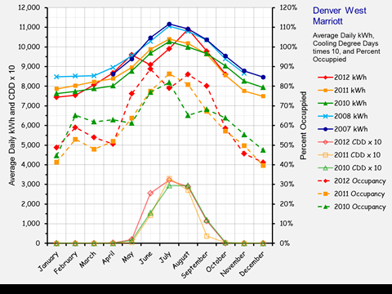
Next Month’s Assignment
Derive the Virial Equation of State
Take Your Utility Data to the Next Level
  Look at average daily consumption patterns
  Compare the patterns to common drivers
    Occupancy
    Climate
    Production

Slide 15
What is Utility Consumption Analysis?
Utility consumption analysis looks for trends in utility consumption patterns that are indicators of opportunities to save resources. These patterns are also indicators of the persistence of benefits provided by past projects.

Slide 16
Average Daily Energy Consumption Analysis
Compare average monthly patterns to potential drivers
    Heating and cooling degree days (http://www.weatherdatadepot.com/)
    Occupancy patterns
    Production
Critical considerations
    Data needs to be averaged over the days in the billing period
    Data needs to be normalized to the month not the billing period
Utility Consumption Analysis Tool (UCAT) will do the work for you (www.CACx.org)

Slide 17
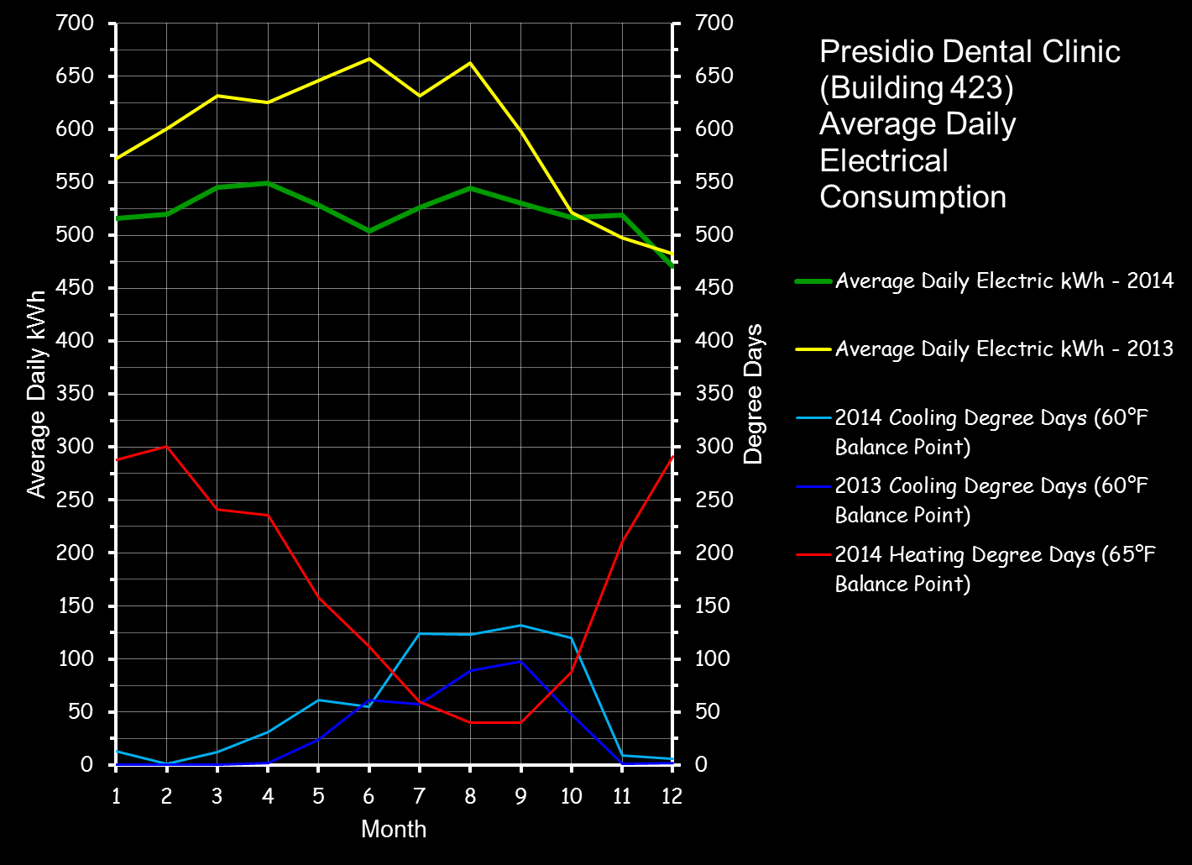

Slide 18
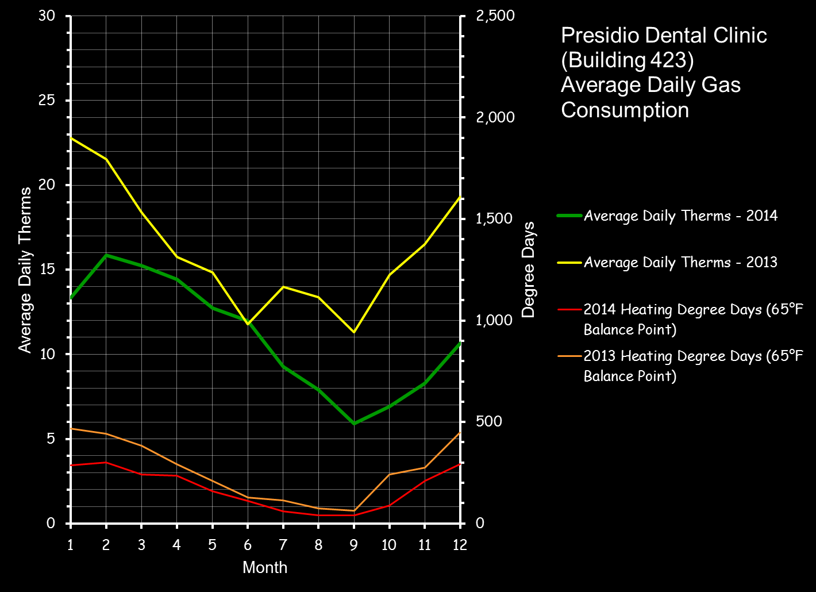

Slide 19
Leveraging the Utility Data
Use the utility data to “frame” your project
  Reverse engineer the savings potential from utility consumption, industry metrics and past experience
  Reverse engineer the over-all project budget from what is justified by the savings potential and the Owner’s financial metrics
  Reverse engineer budget line item amounts from past experience if needed
  Quantify risk by assessing the obvious

Slide 20
Reverse Engineering the Savings Potential
Resources
Utility Consumption Analysis Tool (UCAT)
  Allows very quick assessments of utility consumption patterns based on billing data and use
LBNL Commissioning Cost and Benefit Reports
  Provides savings metrics for EBCx and other Cx processes
    General case median for EBCx is 16% reduction
      Upper limit – 31%
      Lower limit – 9%
    Includes metrics by building type too
Free download from www.CACx.org
  Select “Resources” then “Tools and Templates” then “Existing Building Cx”
Free download from http://cx.lbl.gov/
  Select Cost-Benefit Assessments
  2004 Assessment is the foundation
  2009 Assessment updates the 2004 report
  MBCx report focuses on the UC/CSU/IOU program

Slide 21
Dental Clinic Annual Consumption

Slide 22
Dental Clinic Project Budget Range

Slide 23
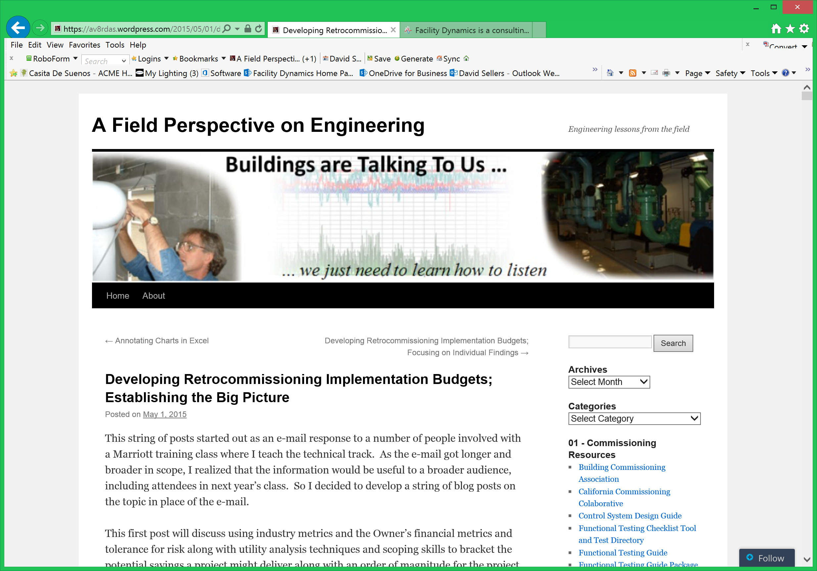

Slide 24
Next Month’s Assignment
Derive the Virial
Take Your Utility Data to the Next Level
  How many of you have already done this?
  What do you think you should be looking for in your buildings and why?

Slide 25
Next Month’s Assignment
Derive the Virial
Take Your Utility Data to the Next Level
  Maybe you should look for shapes in the clouds

Slide 26


Looking for Shapes in the Clouds
An Eagle over Cambridge, UK.
© Christie Nel

Slide 27

Looking for Shapes in the Clouds
This cloud's all Heart, spotted over Comologno, Switzerland.
© Regula Irmann

Slide 28
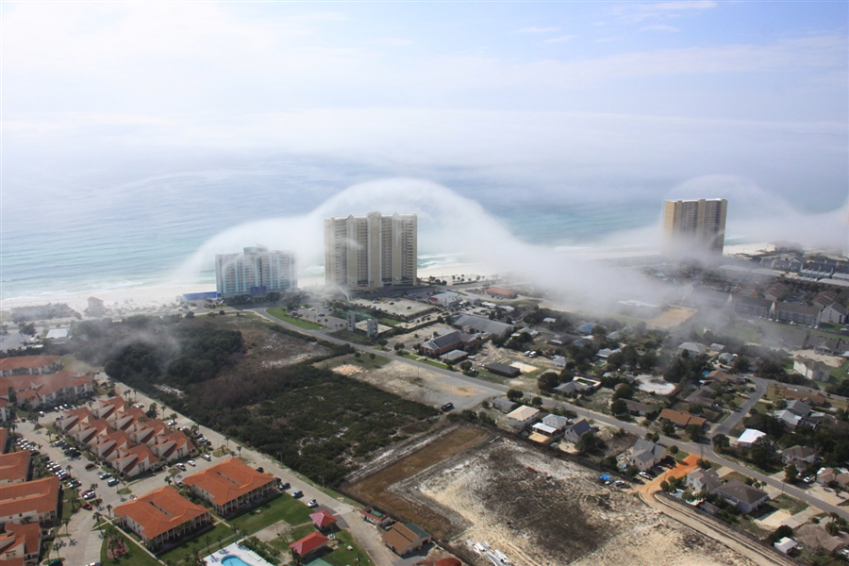
Looking for Shapes in the Clouds
A Cloud Revealing Something About Buildings.
© JR Hott

Slide 29
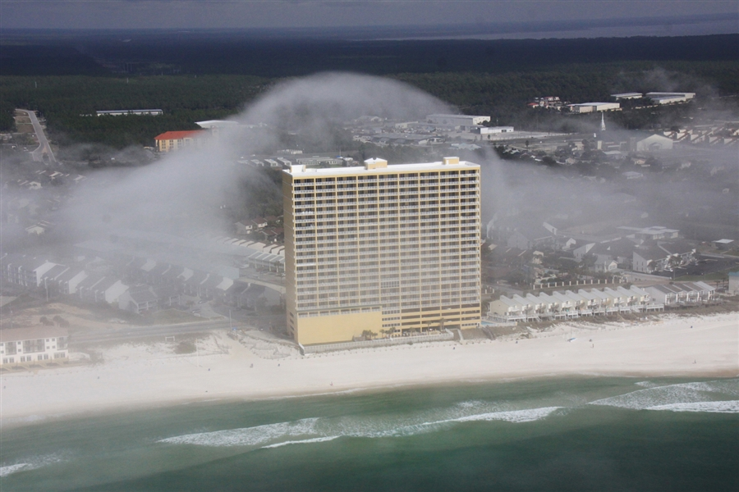
Looking for Shapes in the Clouds
A Cloud Revealing Something About Buildings.
© JR Hott

Slide 30
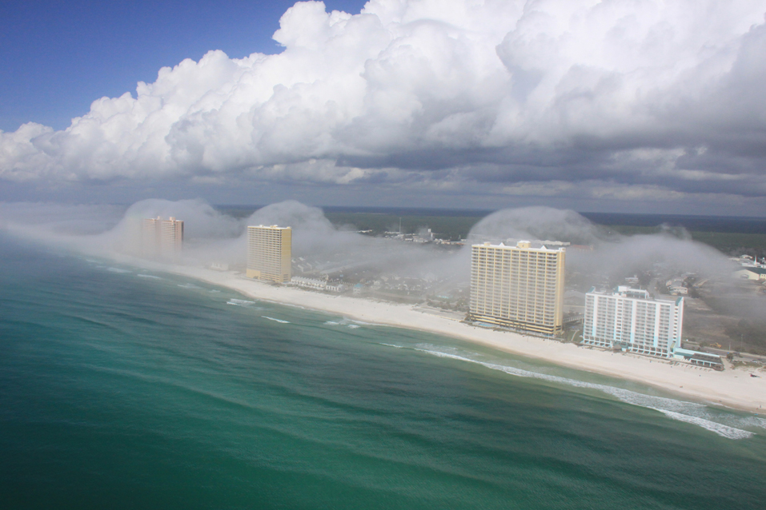
Looking for Shapes in the Clouds
A Cloud Revealing Something About Buildings.
© JR Hott

Slide 31
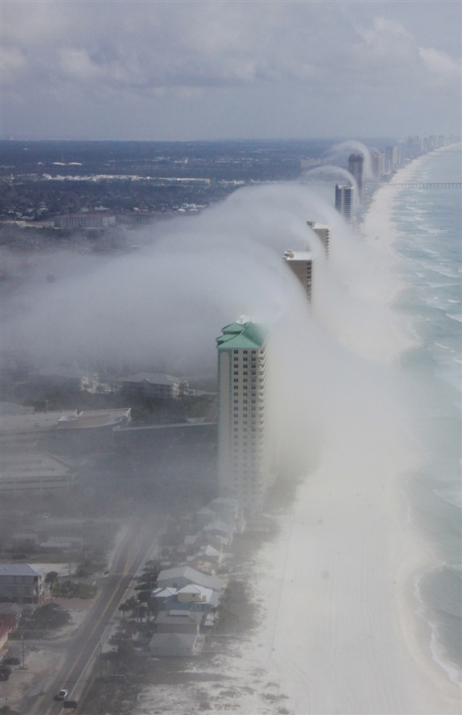
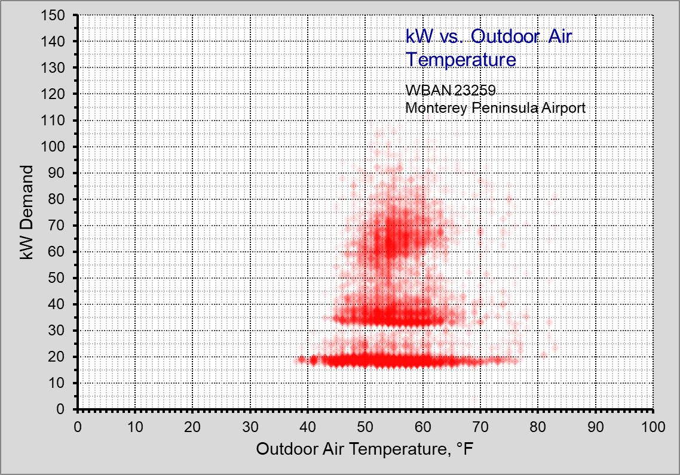
Looking for Shapes in the Clouds
A Cloud Revealing Something About Buildings.
© JR Hott

Slide 32
Looking for Shapes in the Clouds
A Cloud Revealing Something About Buildings.
© JR Hott

Slide 33
Looking for Shapes in the Clouds
About equal to 1 chiller circuit running
A Cloud Revealing Something About Buildings.
© JR Hott

Slide 34
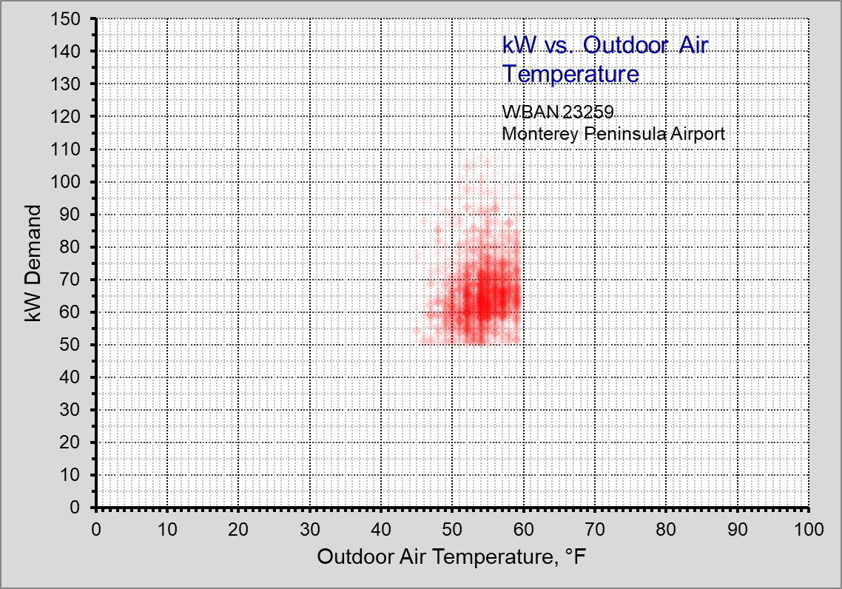

Slide 36
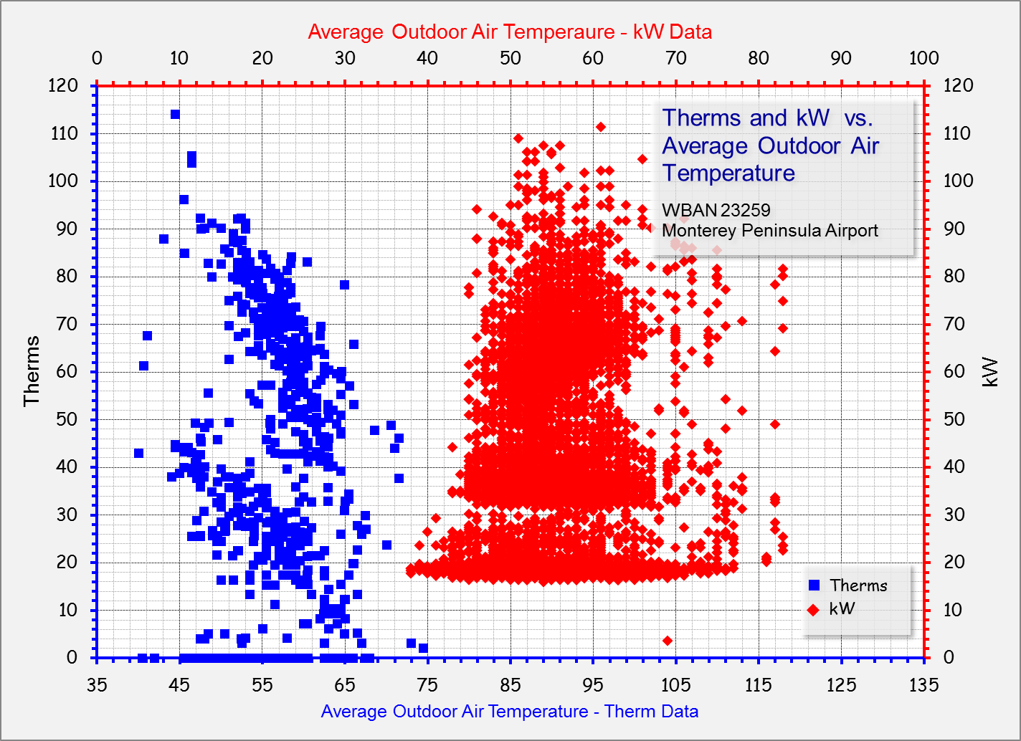
Looking for Shapes in the Clouds

Slide 37
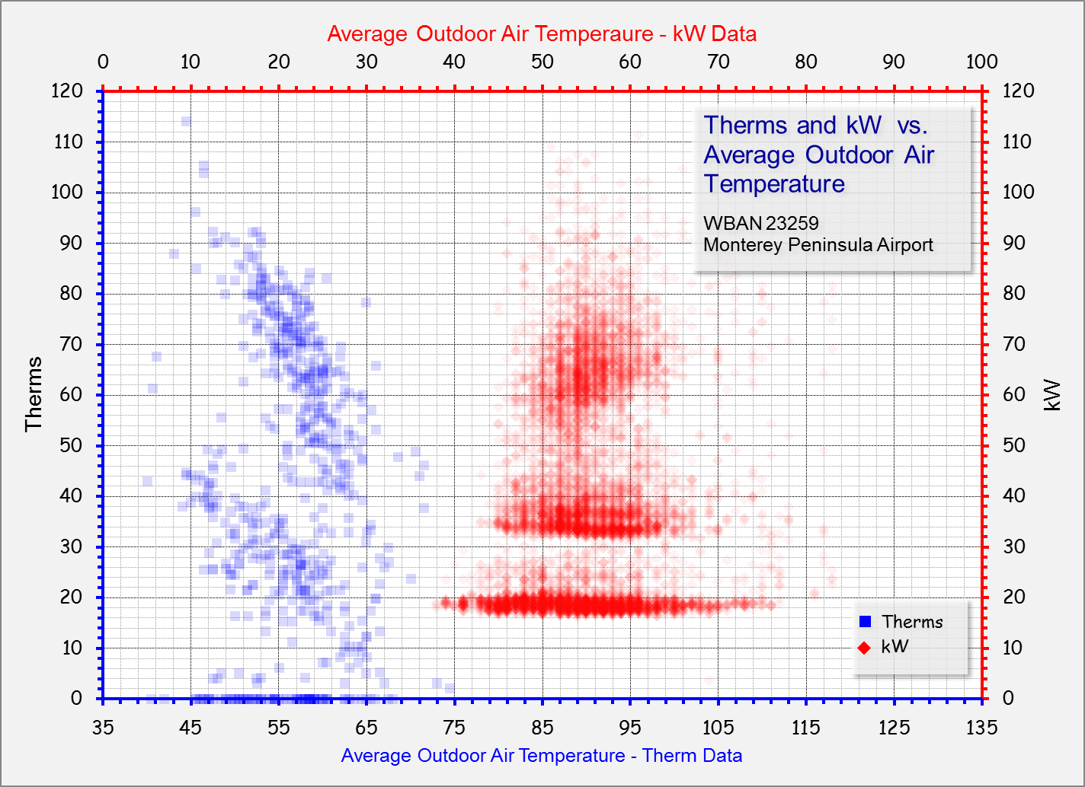

Slide 38
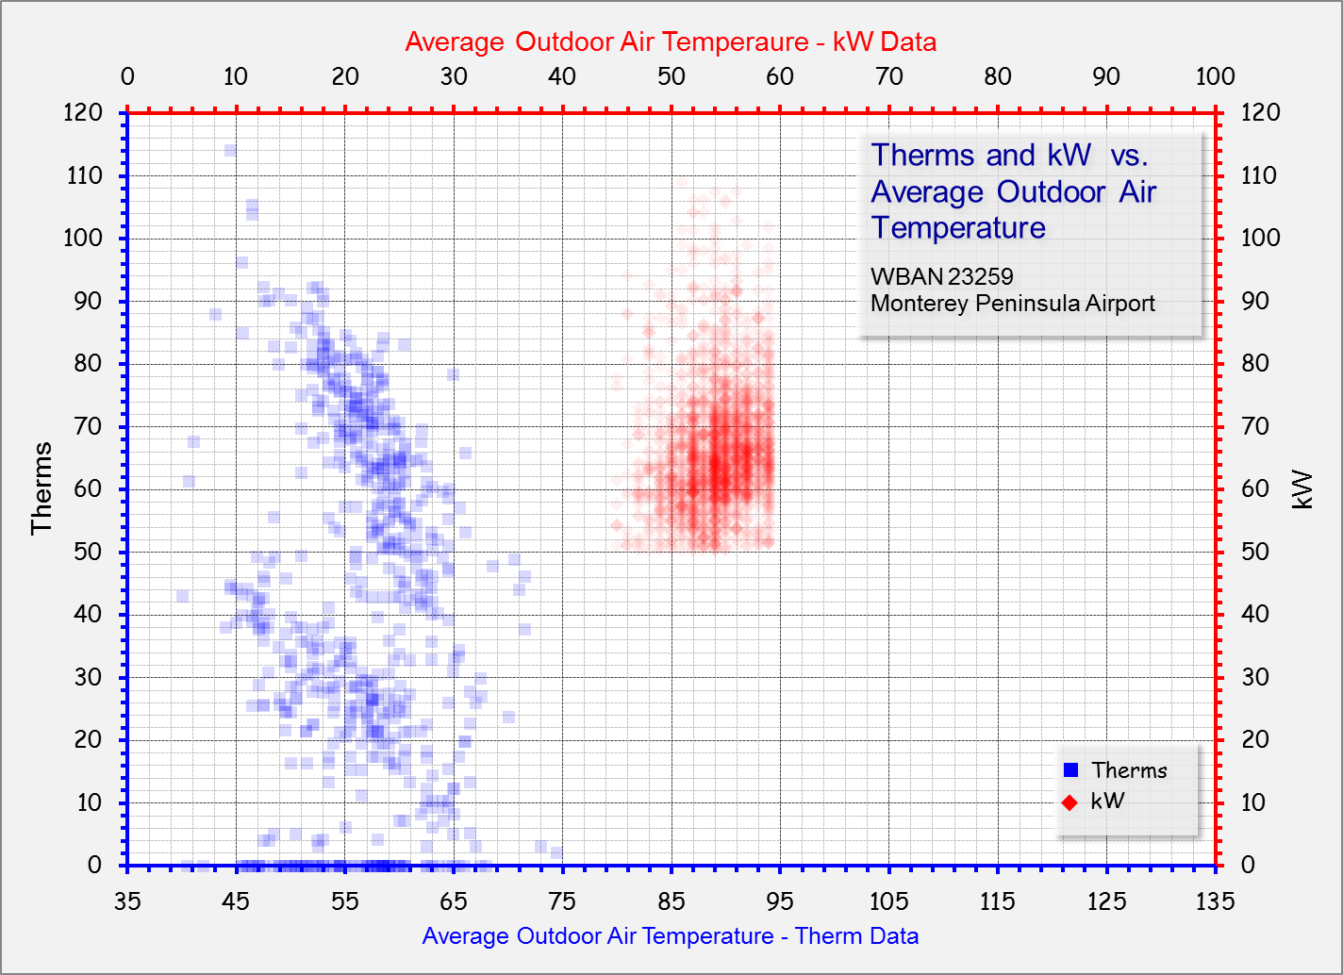
https://av8rdas.wordpress.com/2015/09/08/using-scatter-plots-to-assess-building-performancepart-4/

Slide 39
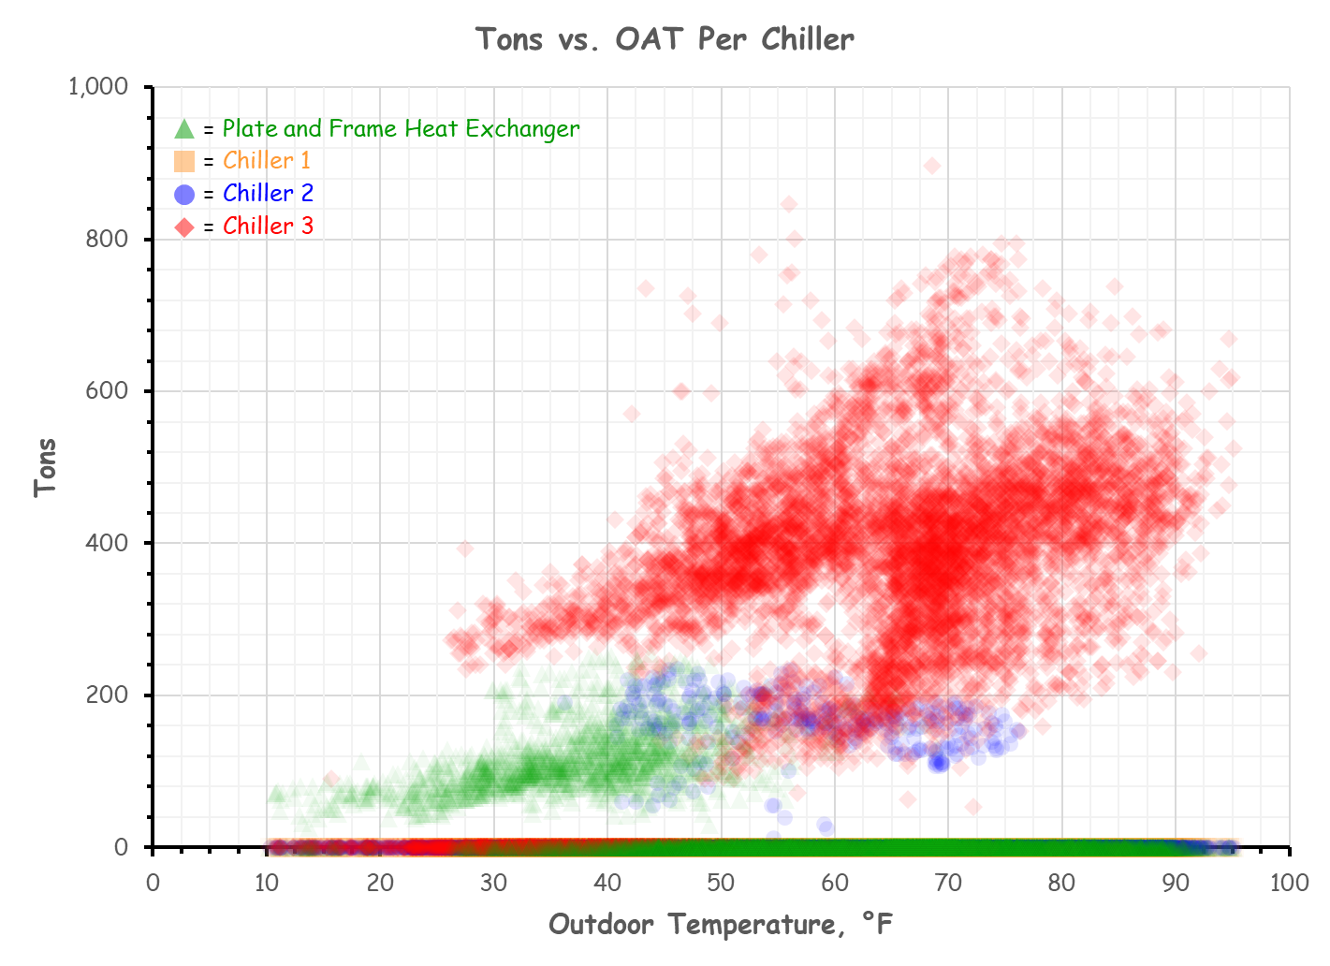

Dialoging with the Atlanta Airport Marriott

Slide 40
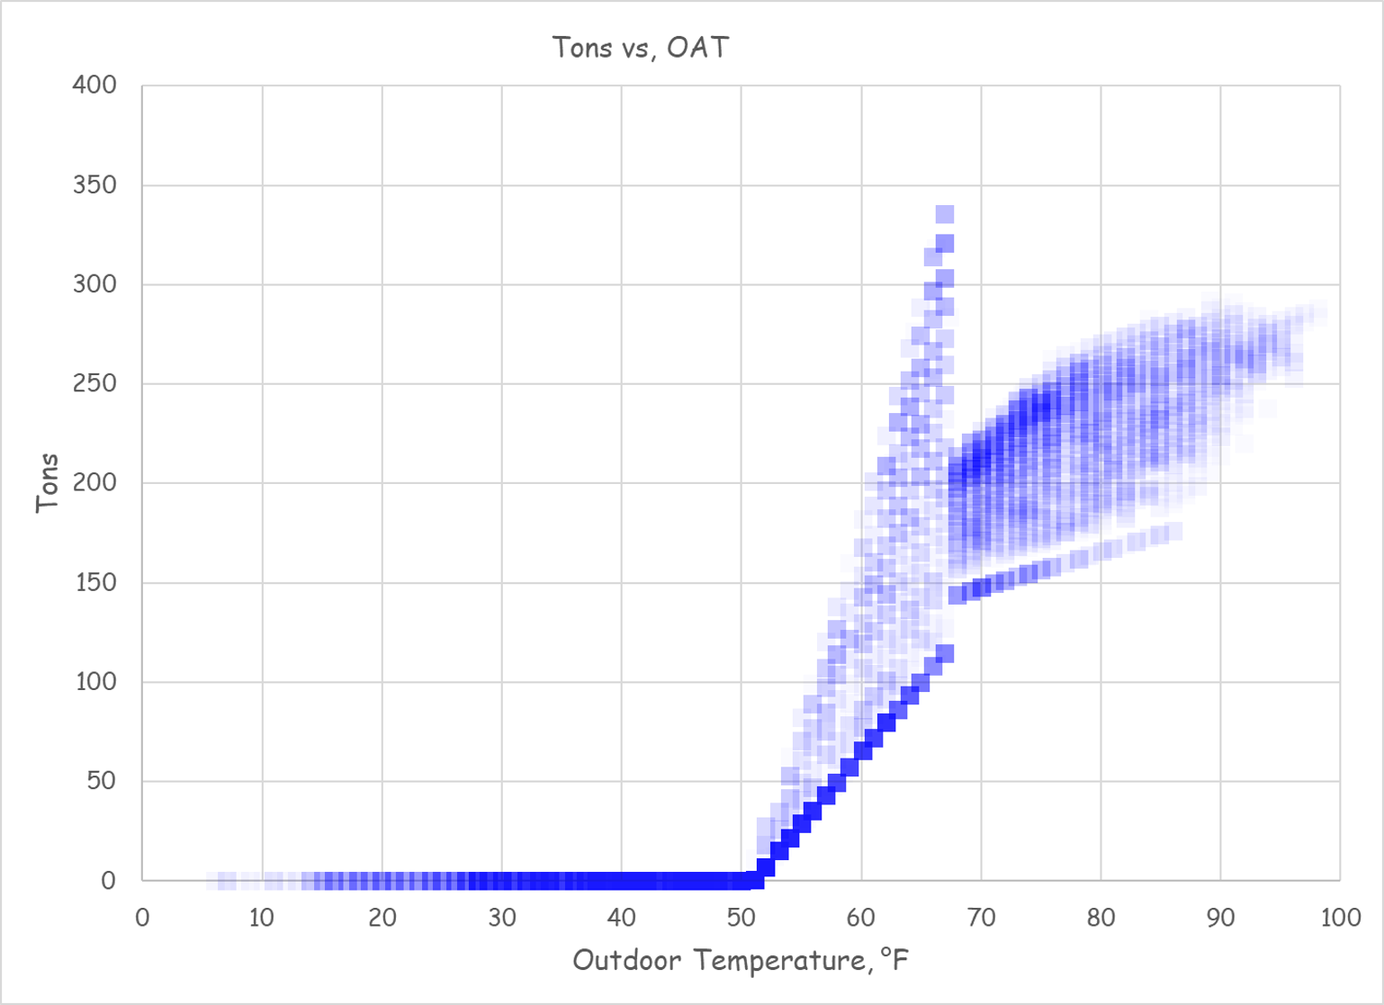
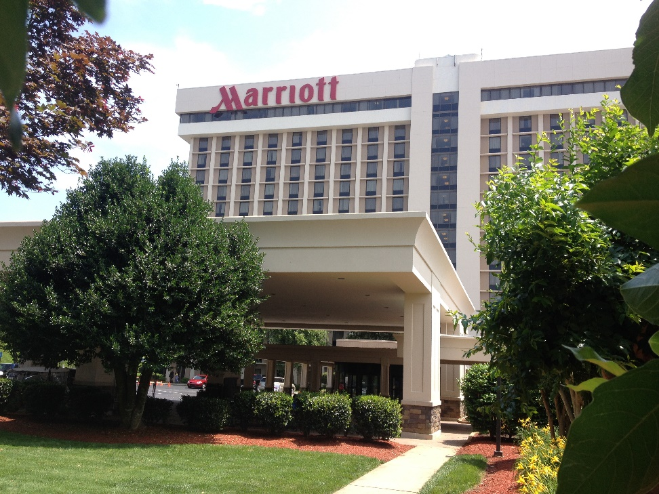
We’ll Be Dialoging with the Atlanta Airport Marriott
I’ve already started the discussion and am learning some pretty interesting things

Slide 41
We’ll Be Dialoging with the Atlanta Airport Marriott
I’ve already started the discussion and am learning some pretty interesting things

Slide 42
We’ll Be Dialoging with the Atlanta Airport Marriott
$50,000 – $70,000 per year
I’ve already started the discussion and am learning some pretty interesting things

Slide 43

Bottom line
Com·mis·sion
kəˈmiSHən/Submit
Verb; Gerund or present participle: Commissioning
1. A process during which buildings are mentoring us about design

Slide 44
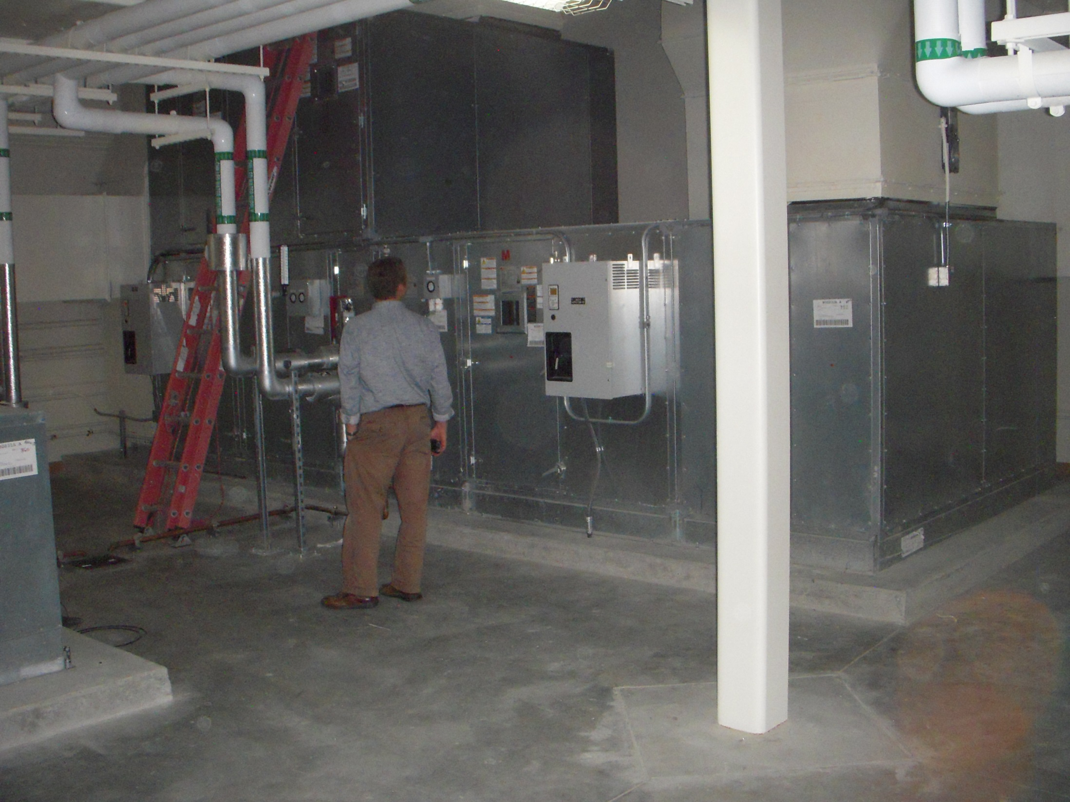
Next Month’s Assignment
Get Out In Your Building and Start Looking Around

Slide 45
Next Month’s Assignment
Derive the Virial
Begin to Develop a Findings List
What is a findings list?
    Its what the retrocommissioning community typically calls the list of opportunities that are observed and targeted for resolution via the retrocommissioning process
As an airplane mechanic, I called this a “squawk list”
As a design engineer, I called this a “punch list”
As a new construction commissioning provider, I call this an “issues log”
As an organized person, I all this a “to do” list
  Bottom line – It will lead you to the target(s) you
  choose for your class assignment

Slide 46
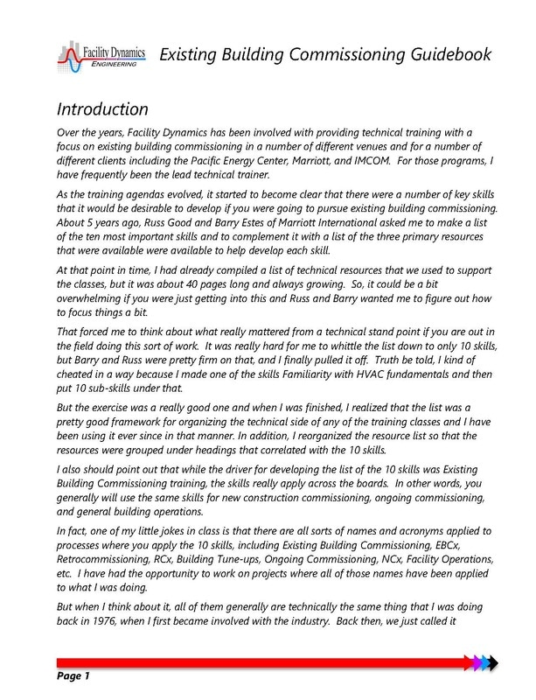
Resources for Identifying Targets
The Existing Building Commissioning Technical Guide

Slide 47
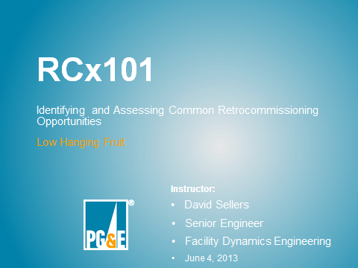
Resources for Identifying Targets
RCx 101 Materials

Slide 48
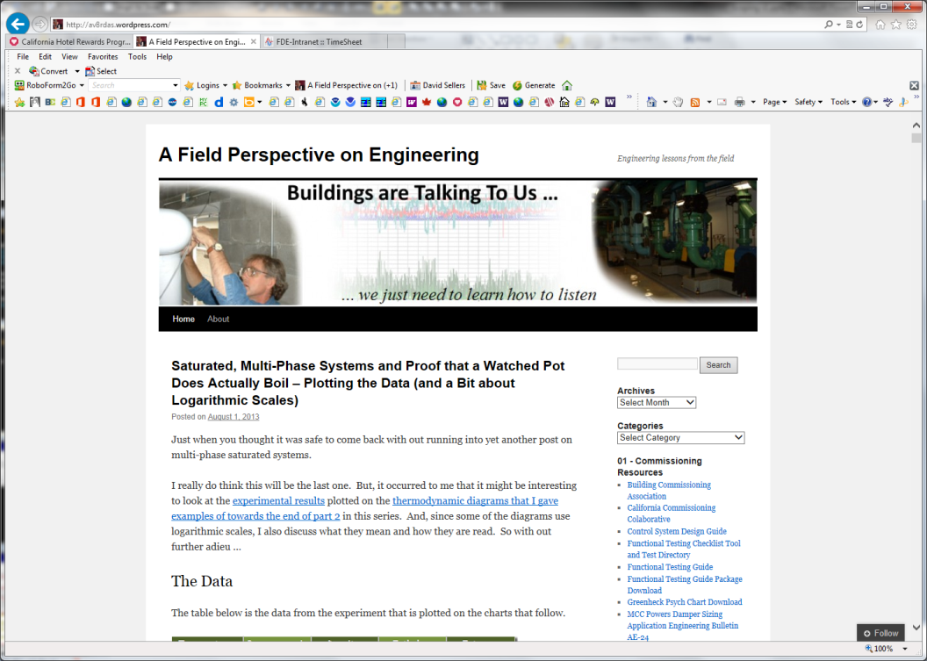
Resources for Identifying Targets
RCx 101 Materials
A Field Perspective on Engineering
  Retrocommissioning findings category
  Commissioning resources
  Class materials
www.Av8rdas.Wordpress.com

Slide 49
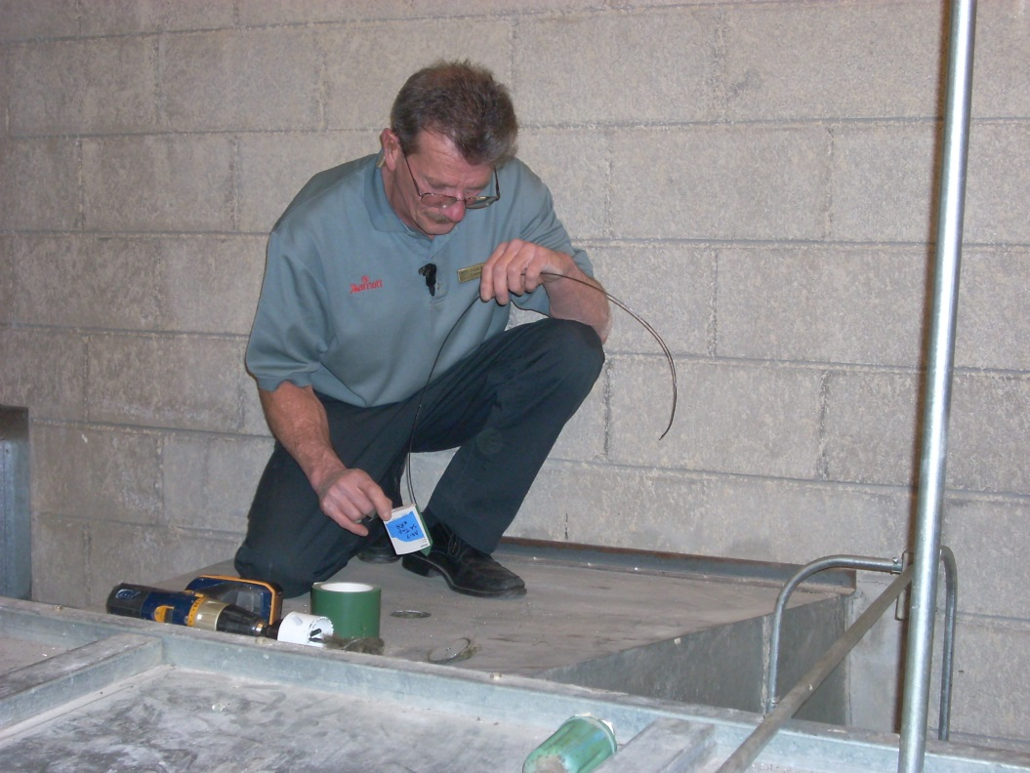
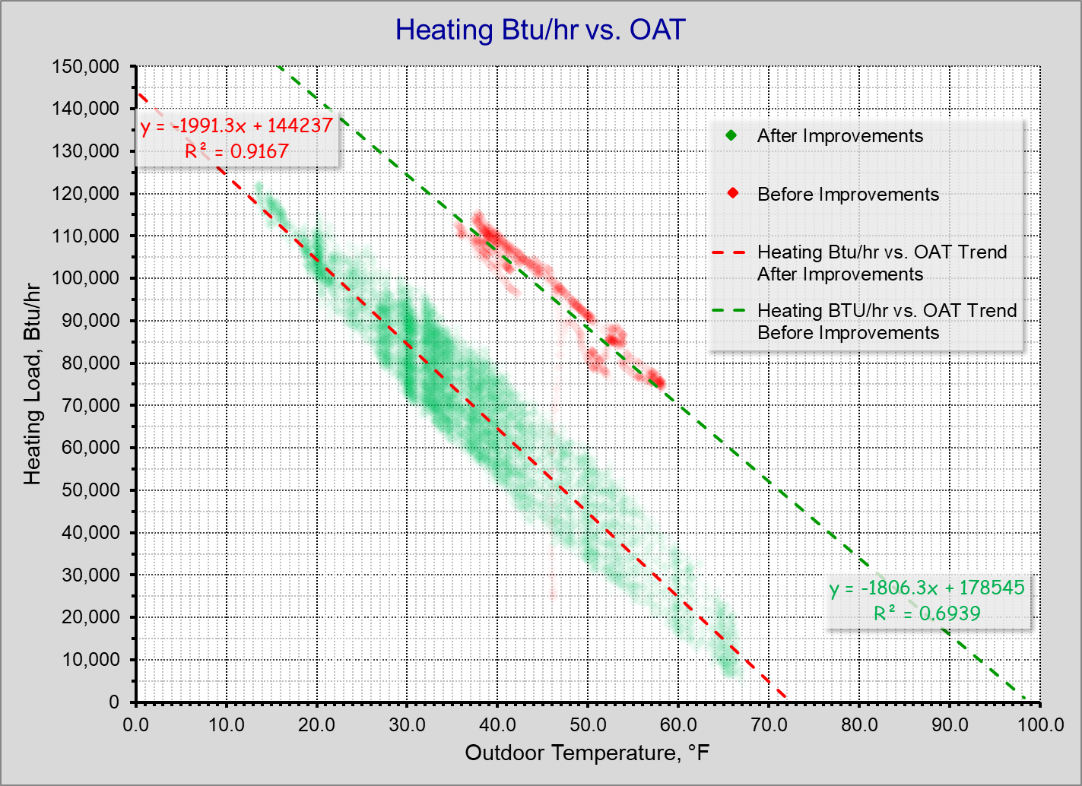
Resources for Identifying Targets
RCx 101 Materials
A Field Perspective on Engineering
  Retrocommissioning findings category
  Commissioning resources
  Class materials
Facility owners and operators
  Know the facility
  Give credit where its due

Slide 50
Resources for Identifying Targets
RCx 101 Materials
A Field Perspective on Engineering
  Retrocommissioning findings category
  Commissioning resources
  Class materials
Facility owners and operators
  Know the facility
  Give credit where its due

Slide 51
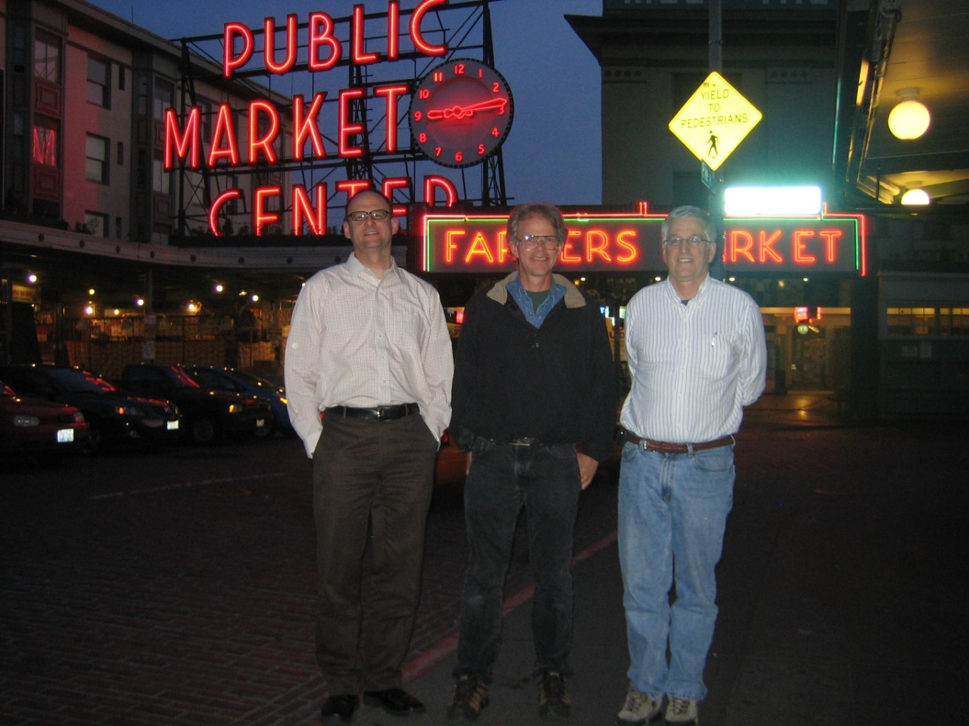
Resources for Identifying Targets
RCx 101 Materials
A Field Perspective on Engineering
  Retrocommissioning findings category
  Commissioning resources
  Class materials
Facility owners and operators
  Know the facility
  Give credit where its due
Ryan, David, and other Mentors
  Caveat – You have to own it

Slide 52
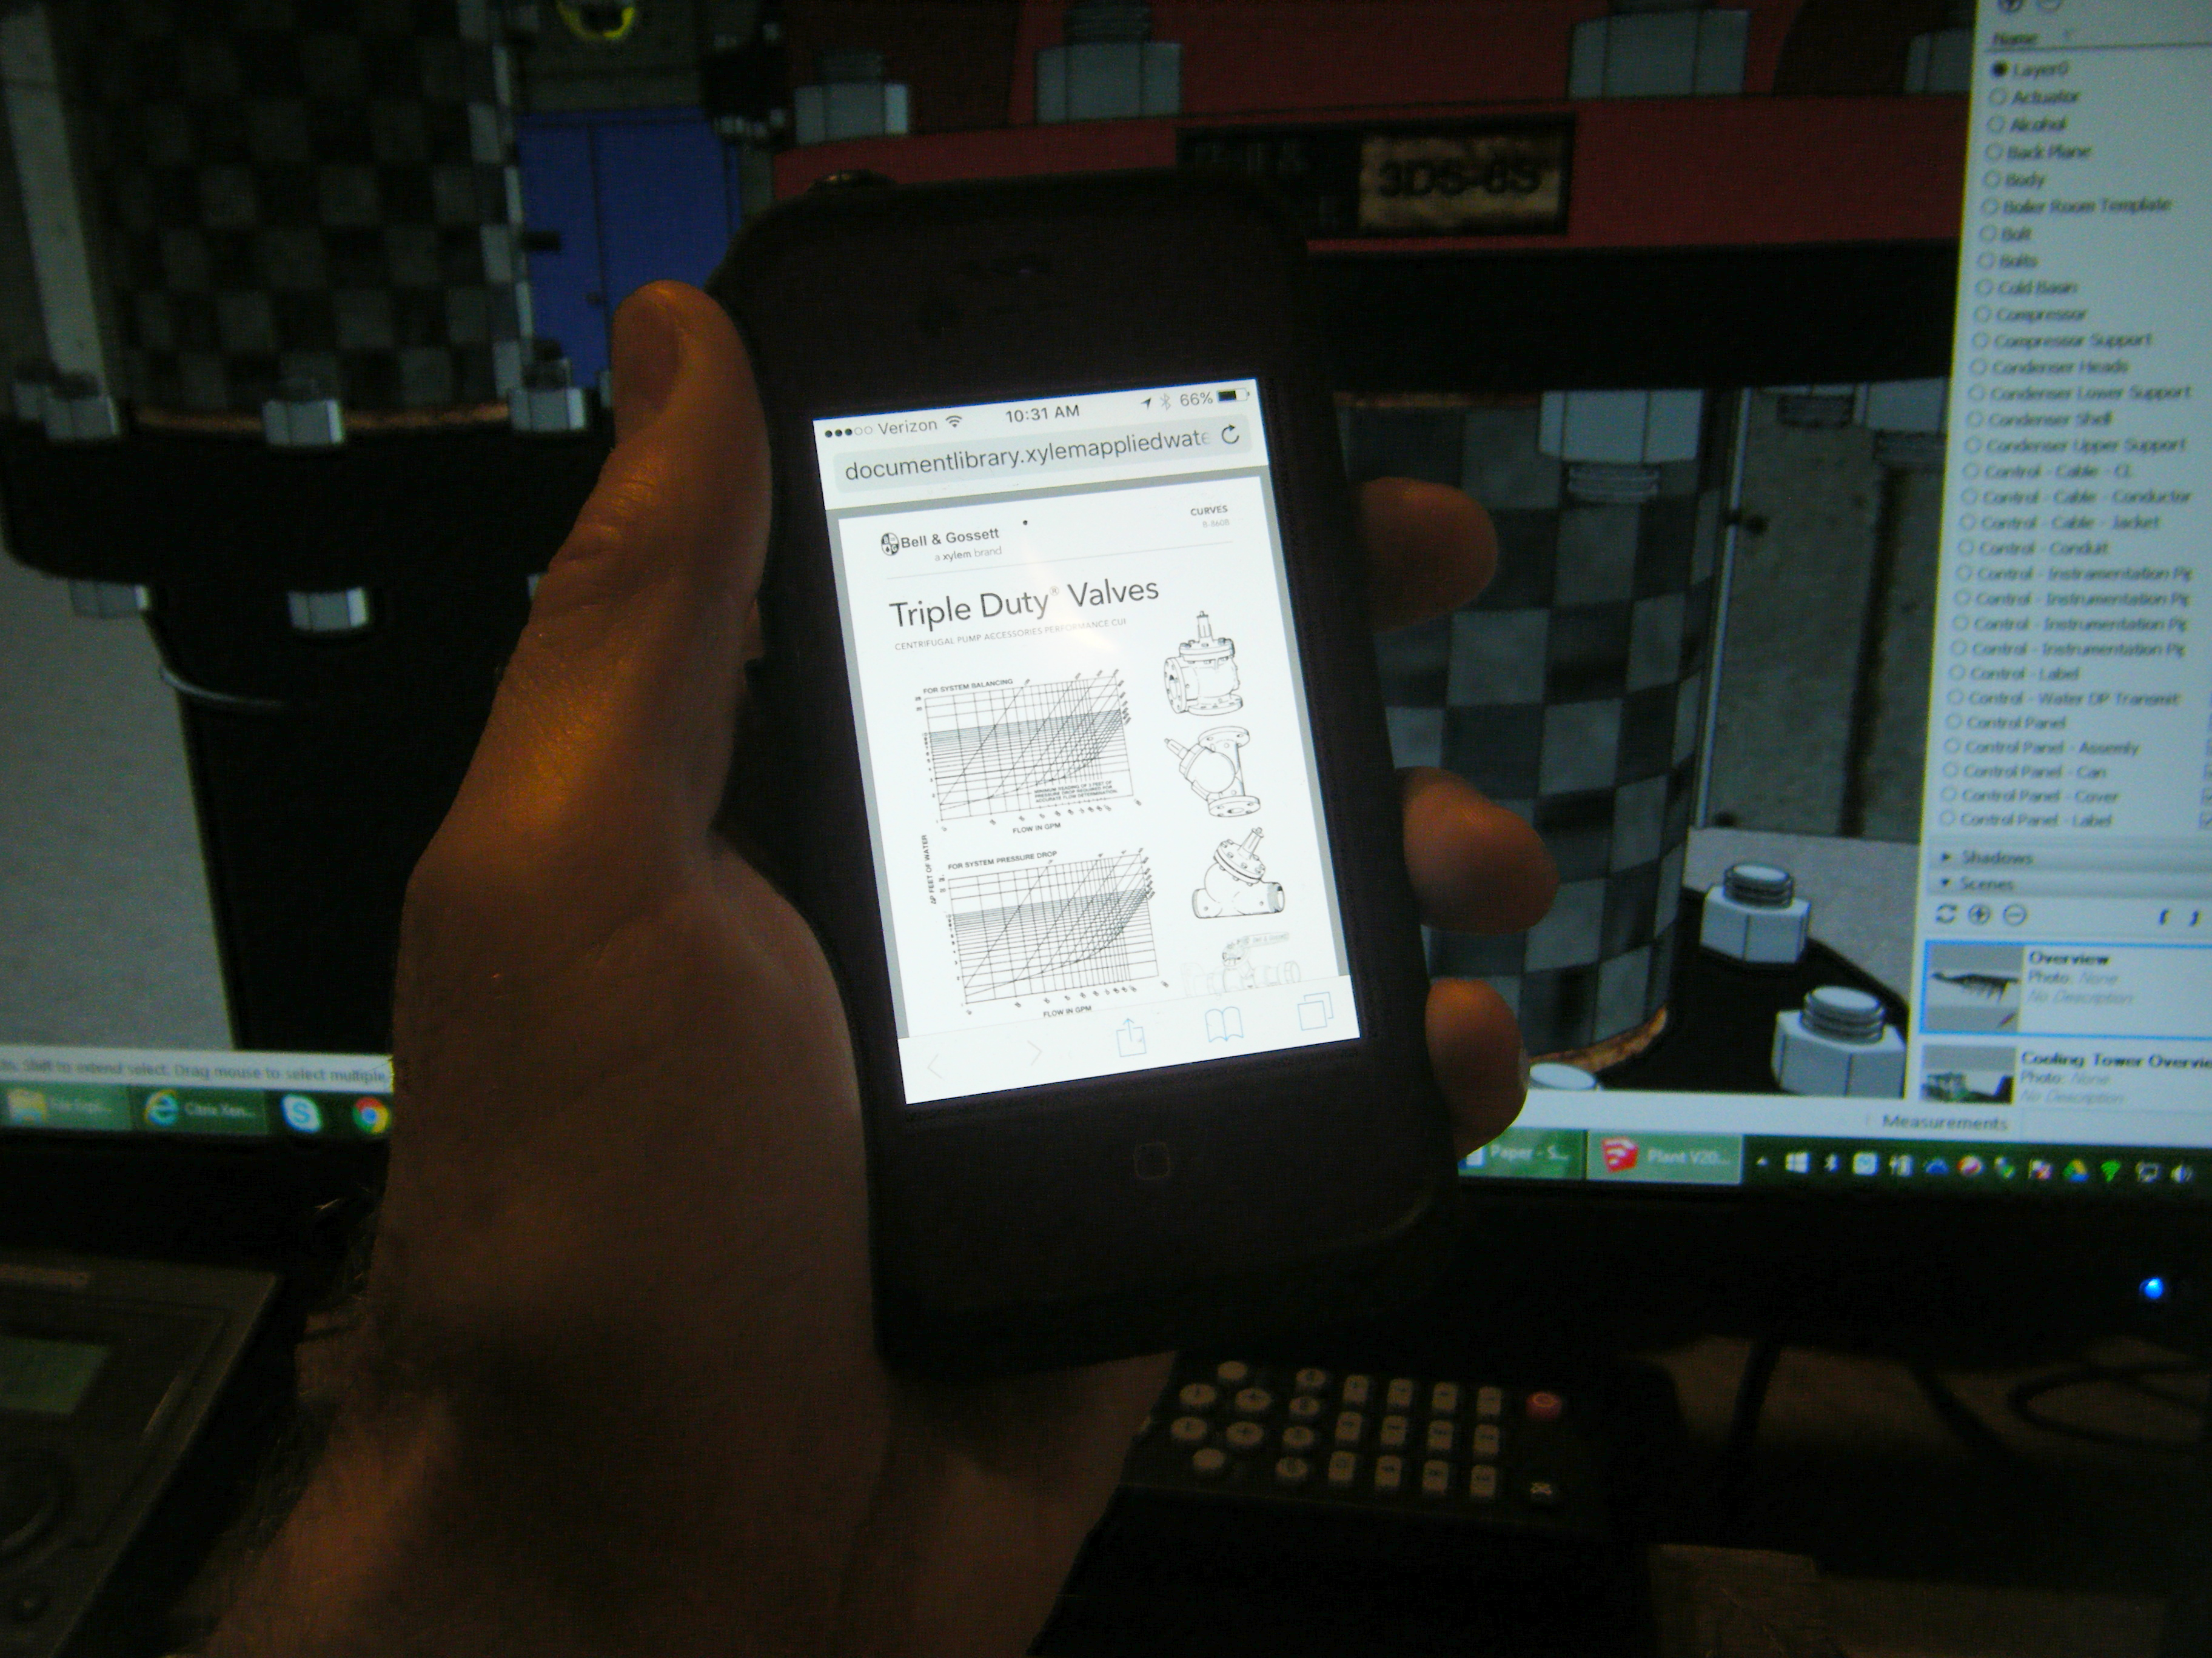
Resources for Identifying Targets
RCx 101 Materials
A Field Perspective on Engineering
  Retrocommissioning findings category
  Commissioning resources
  Class materials
Facility owners and operators
  Know the facility
  Give credit where its due
Ryan, David, and other Mentors
  Caveat – You have to own it
Your Smart Phone

Slide 53
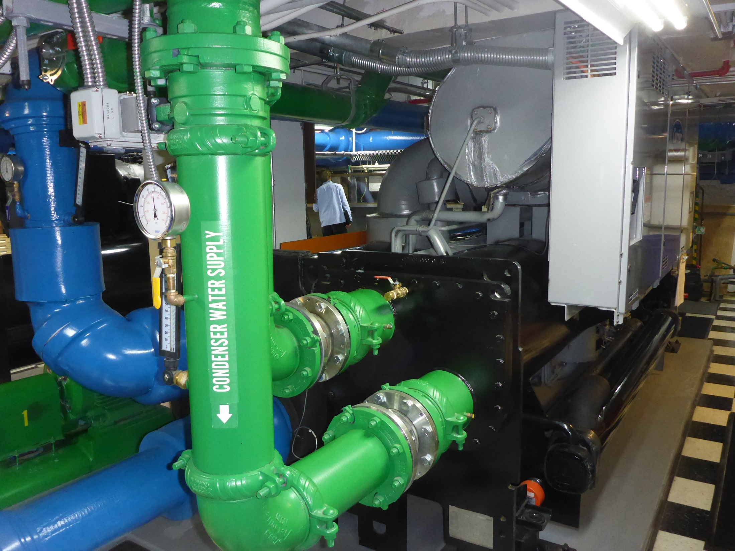

Slide 54

Resources for Identifying Targets
RCx 101 Materials
A Field Perspective on Engineering
  Retrocommissioning findings category
  Commissioning resources
  Class materials
Facility owners and operators
  Know the facility
  Give credit where its due
Ryan, David, and other Mentors
  Caveat – You have to own it
Your Smart Phone
… and the person in the reverse view camera in your Smart Phone

Slide 55
Person in the Smart Phone Characteristics
Curious
  Comfortable with machinery
  Comfortable with details
Strong work ethic
  Task vs. hours oriented
  View not knowing something as an opportunity
Willing to get dirty
  Want to be out in the field
  Want to be “hands on”
Think logically
Familiar with fundamental physics
Believe in fundamental physics

Slide 56
Logical Thinking and Fundamental Physics
Your everyday experiences expose you to fundamental physical principles
In the course of your day, you make logical decisions based on your knowledge of fundamental principles
Notes:
Drop something – what do you expect will happen
Pour water into a full glass – what do you expect will happen

Slide 57
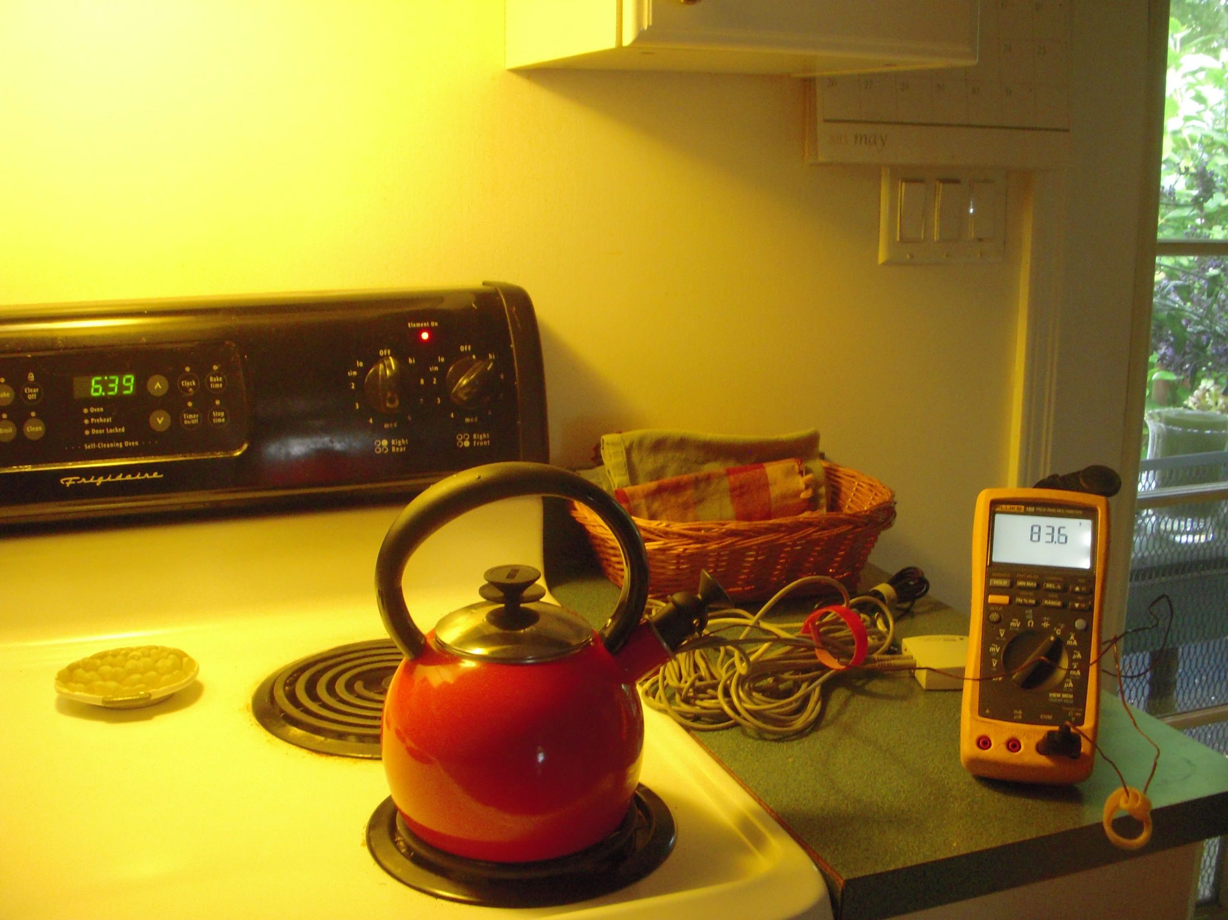
More Fundamental Physics
Visit www.Av8rdas.Wordpress.com for details
Notes:
Drop something – what do you expect will happen
Pour water into a full glass – what do you expect will happen

Slide 58
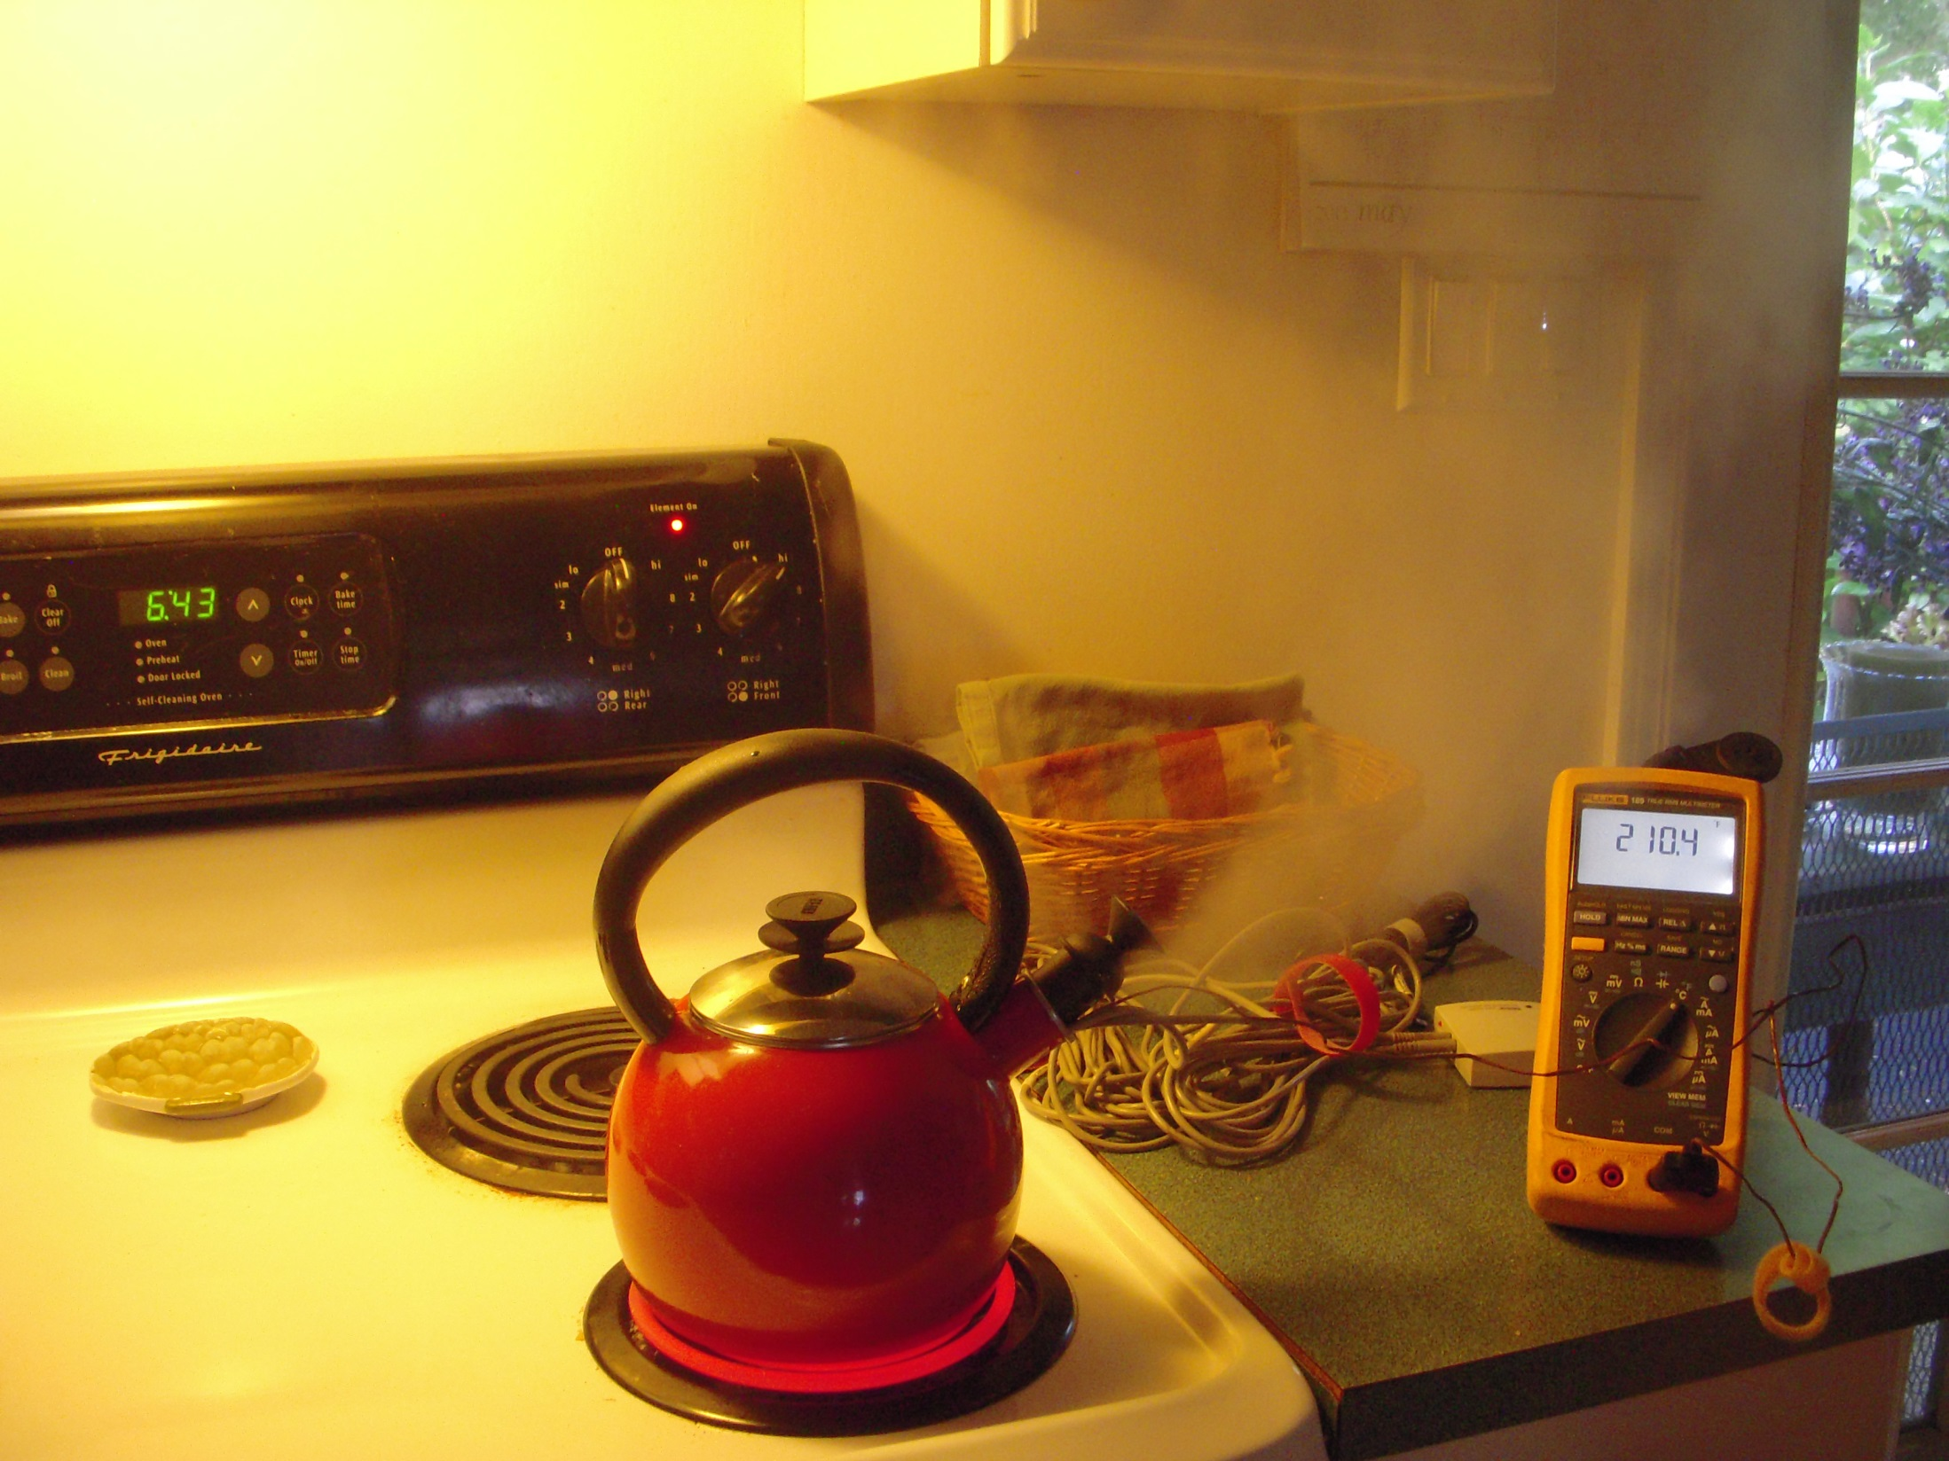
Notes:
How does a tea pot work
What happens when you heat the water
What does the volume do

Slide 59
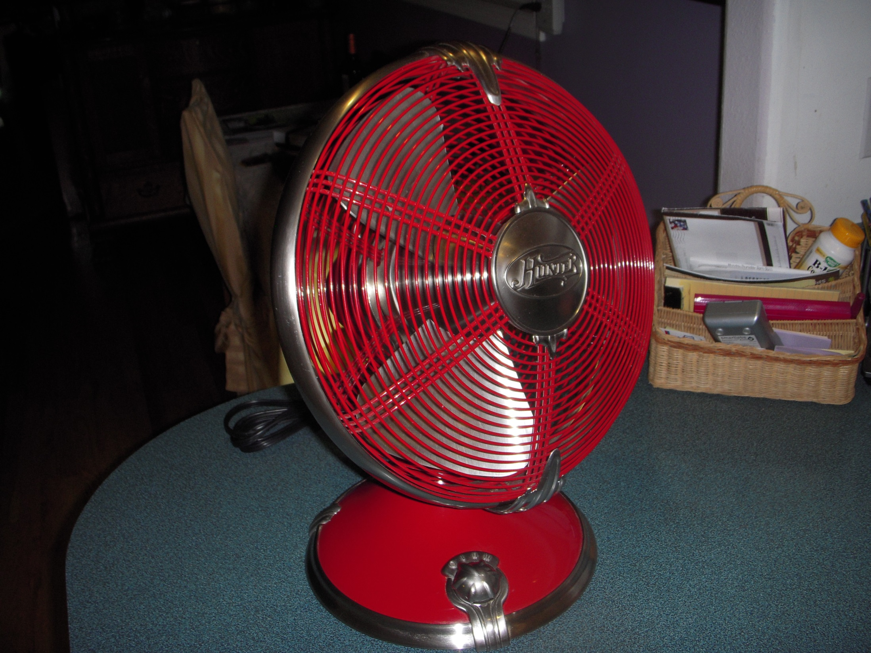
Logic Even Works for Identifying Things

Slide 60
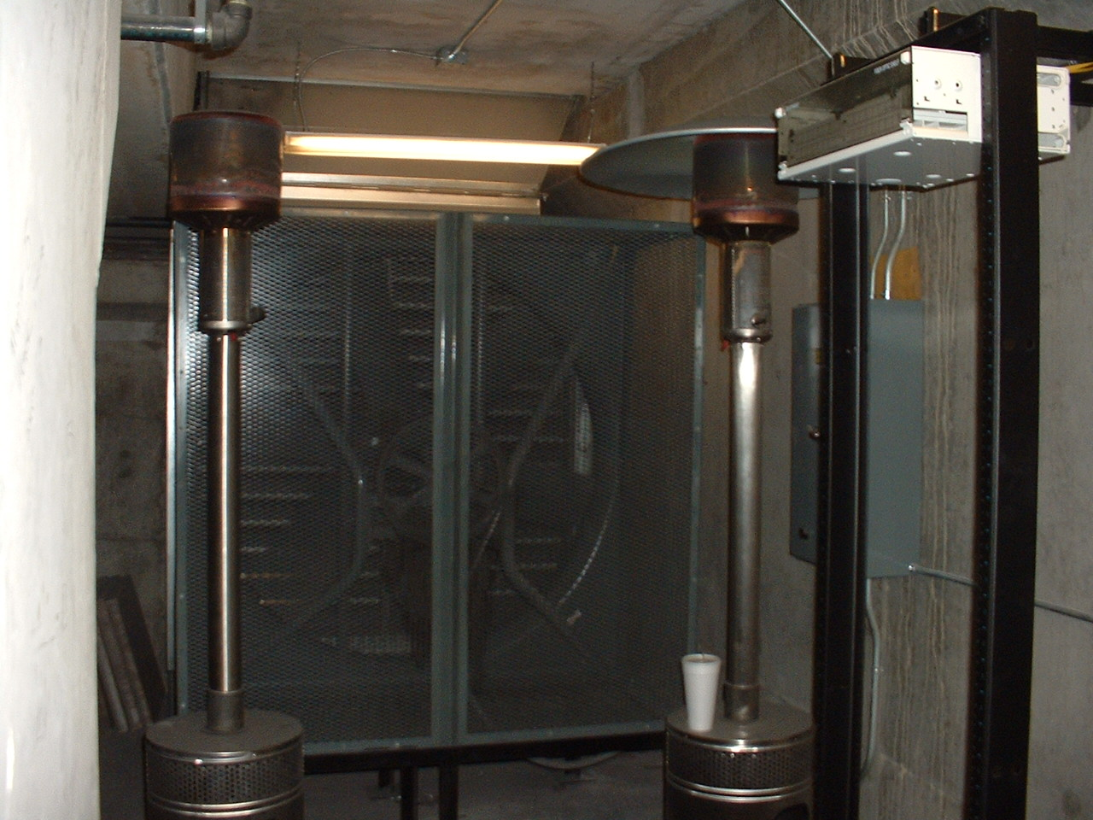

Slide 61
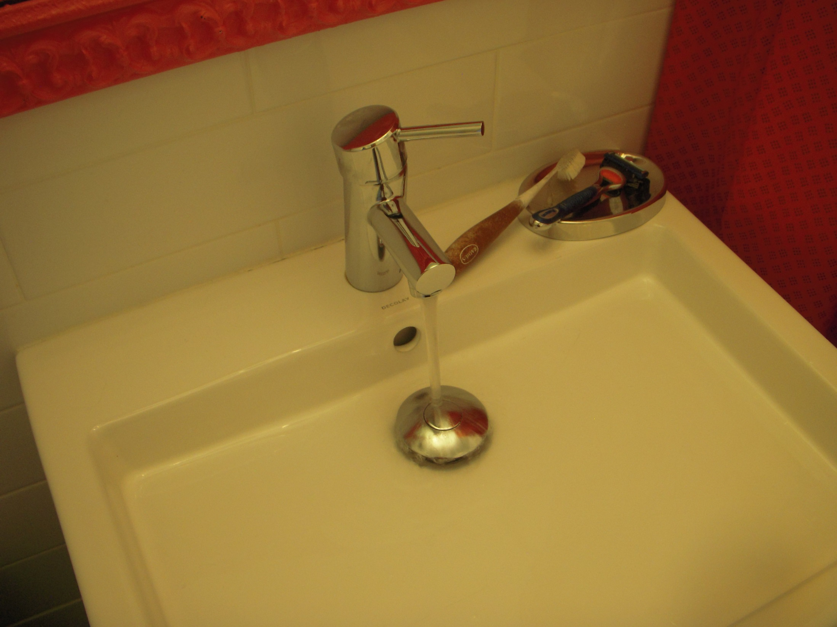
Twisty thingy in a pipe that turns water on and off

Slide 62
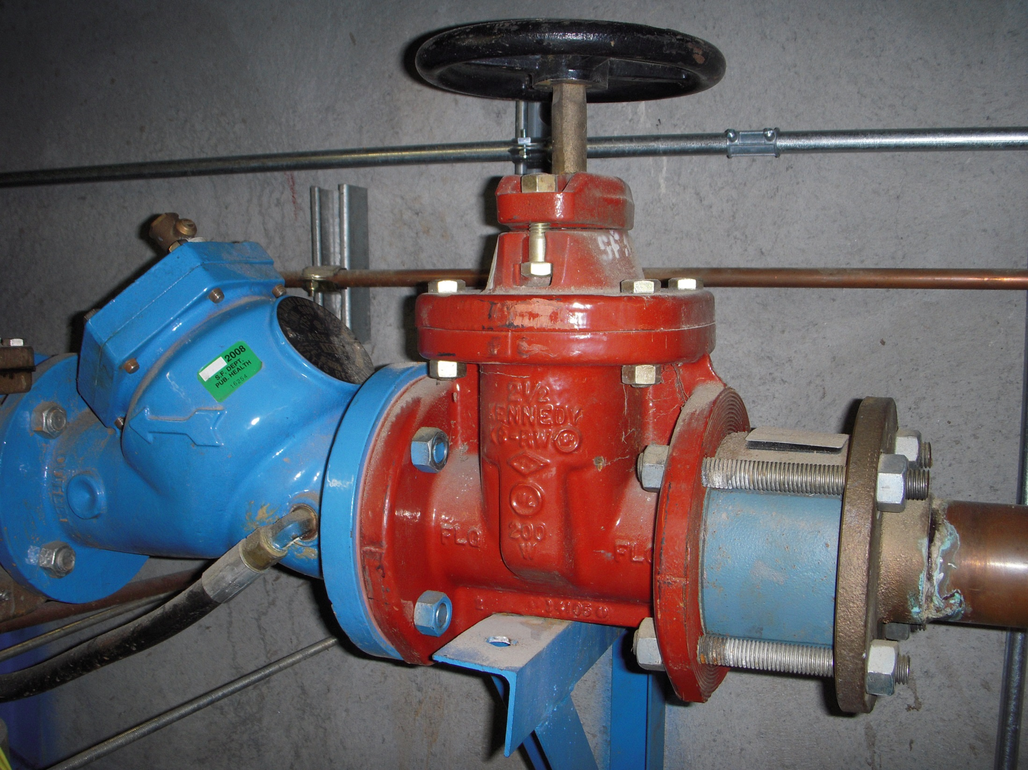
Twisty thingy in a pipe that turns water on and off

Slide 63
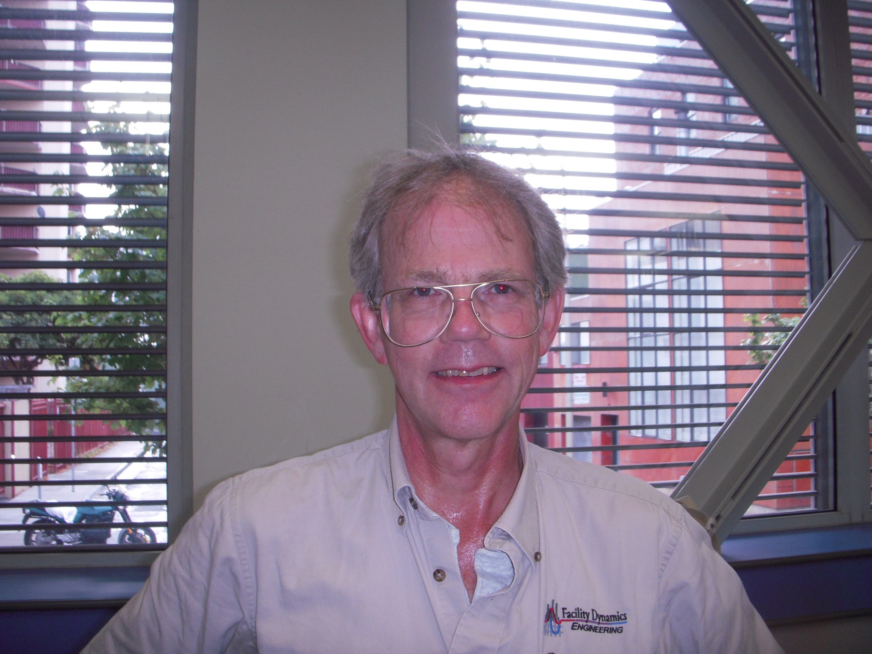
Sweat

Slide 64
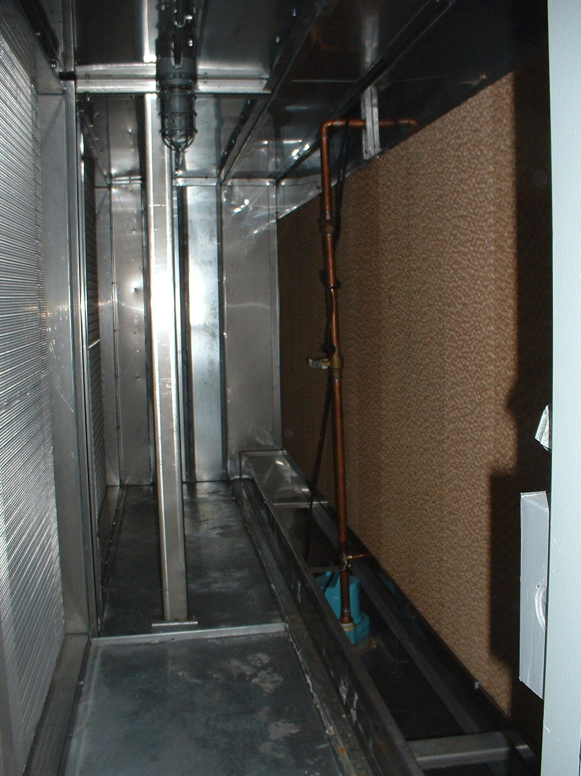
… a different thing that is wet
Thing that has air moving through …

Slide 65
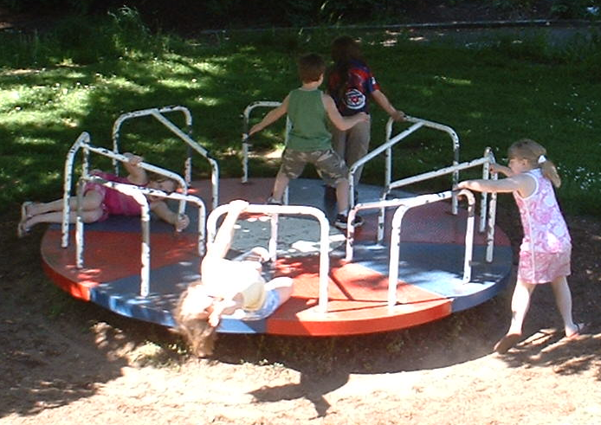
Round thing on playground with vanes that flings kids when you spin it

Slide 66
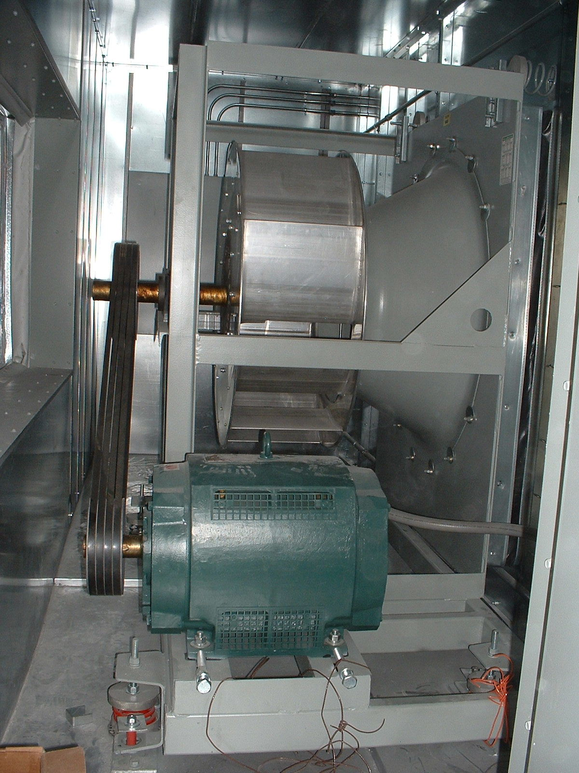
Round thing with vanes, inside a box with ducts attached to it, that flings air when you spin it

Slide 67
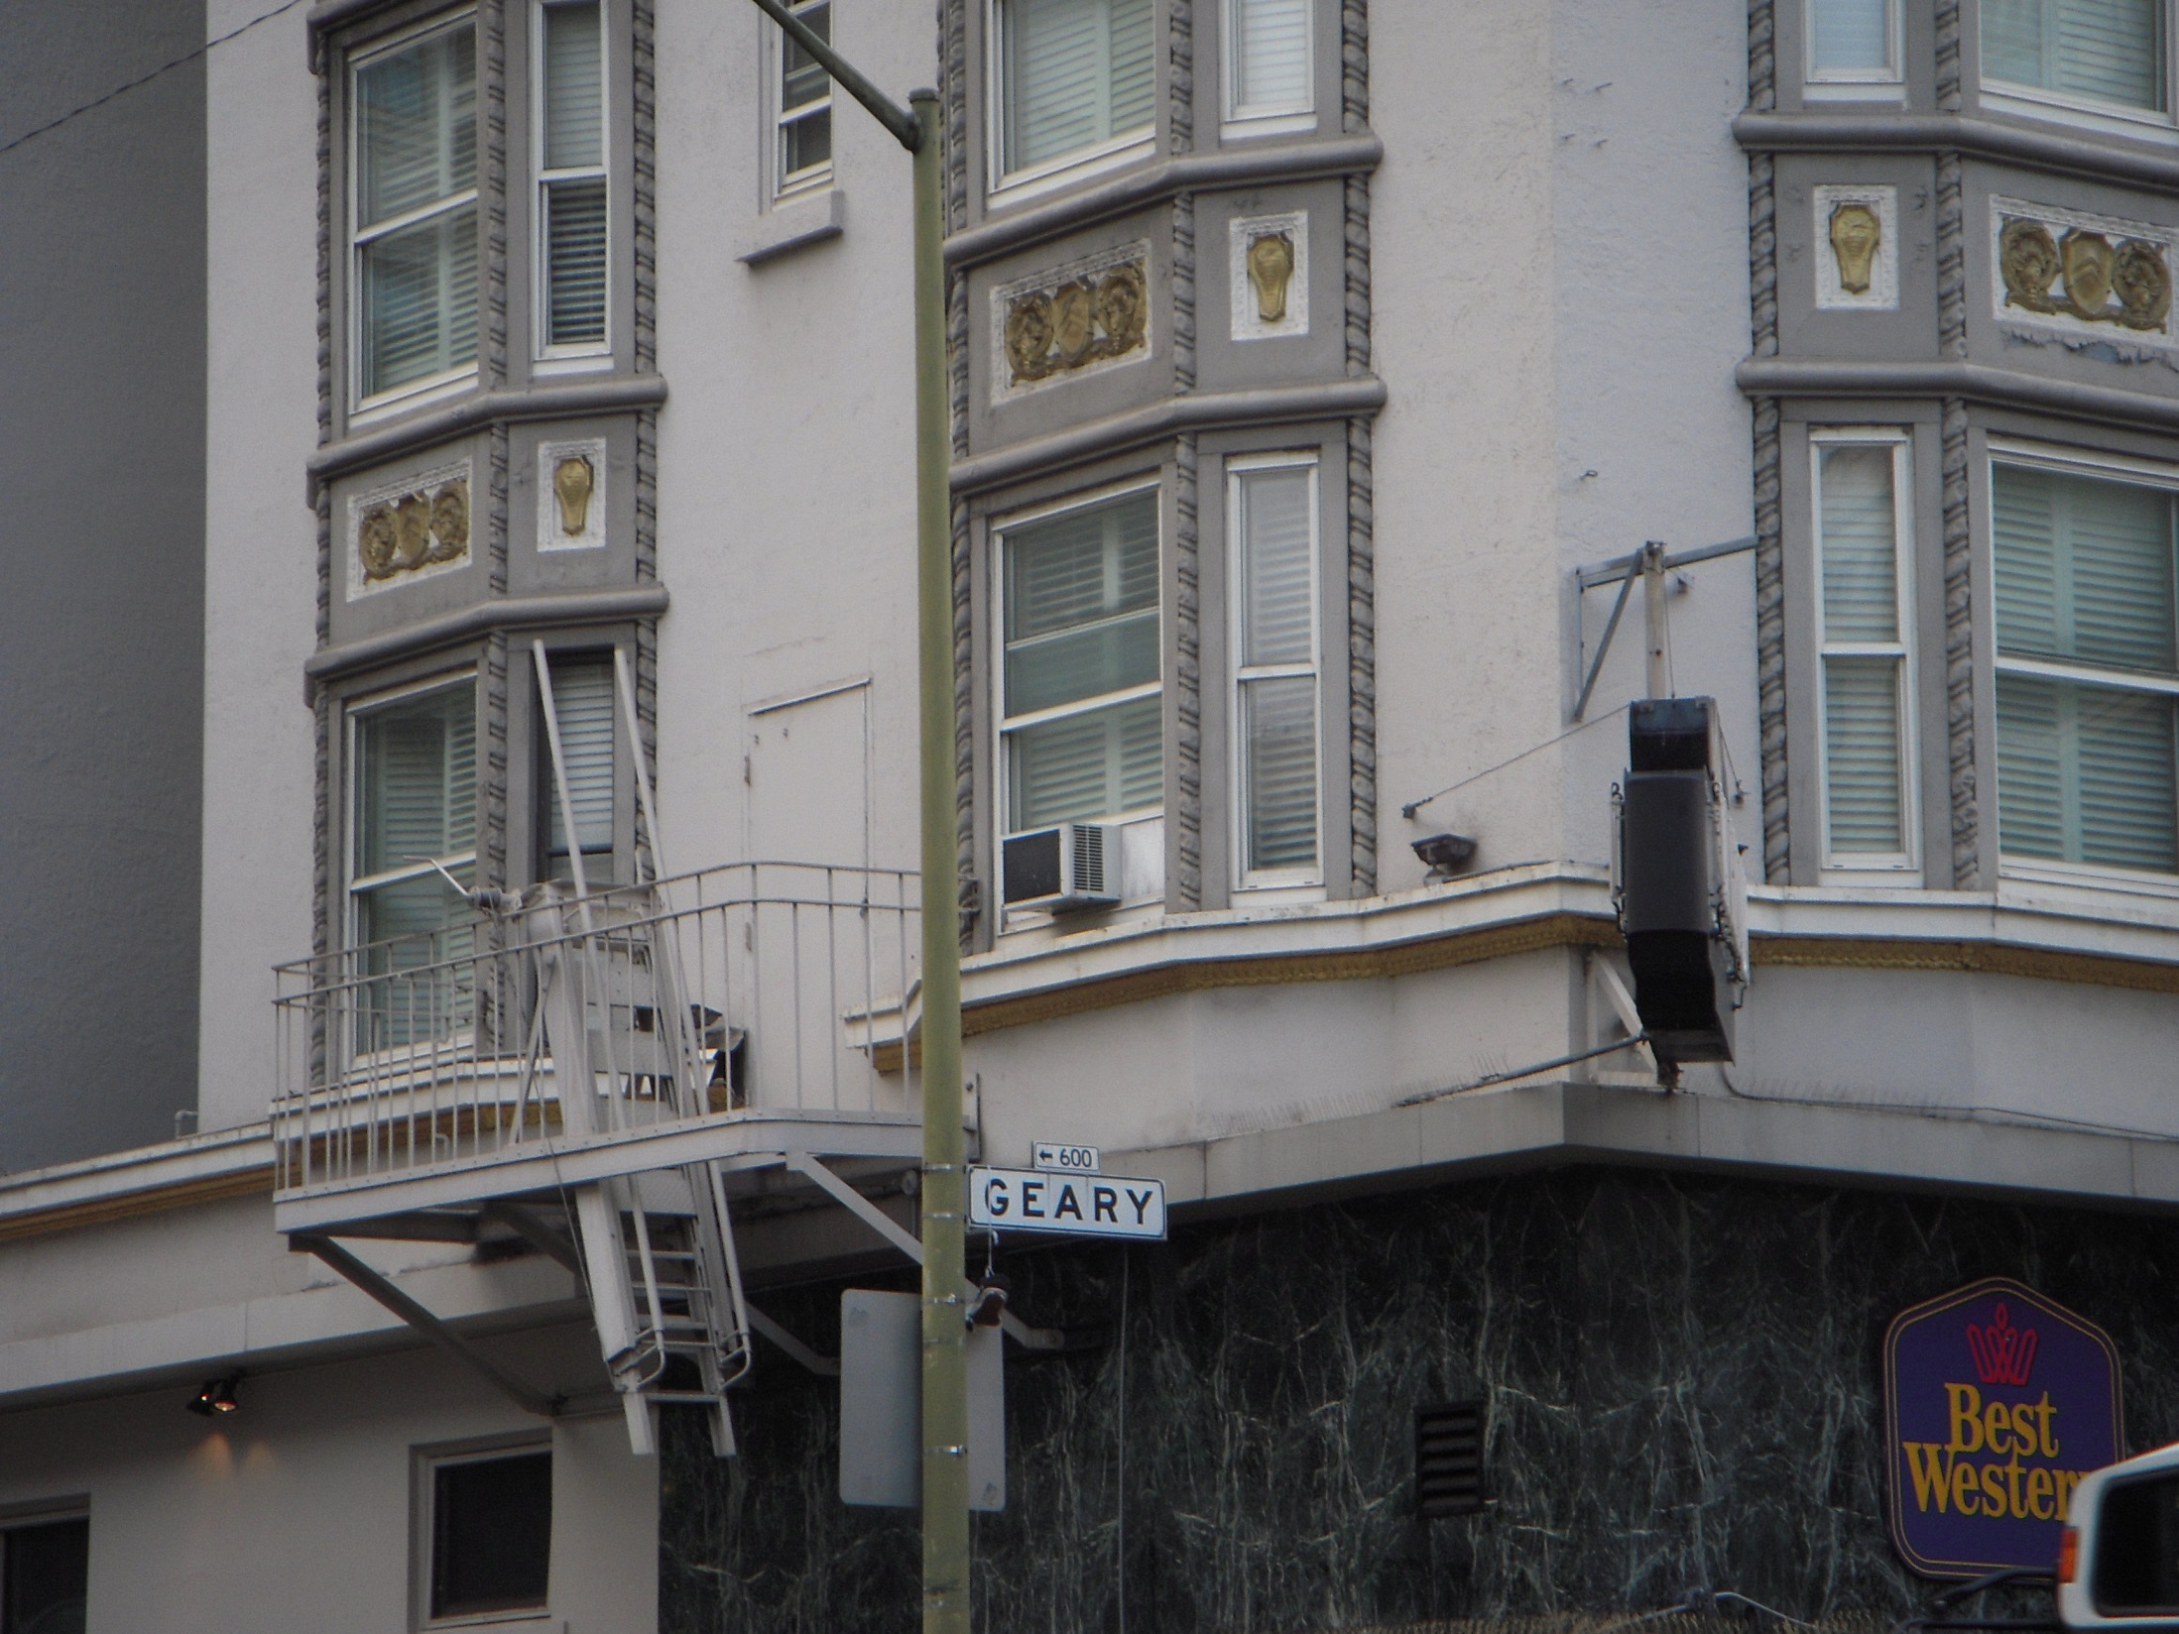
Box that makes a whirring sort of noise with some louvers on the outside that have hot air coming out and other louvers on the inside that have cold air coming out

Slide 68
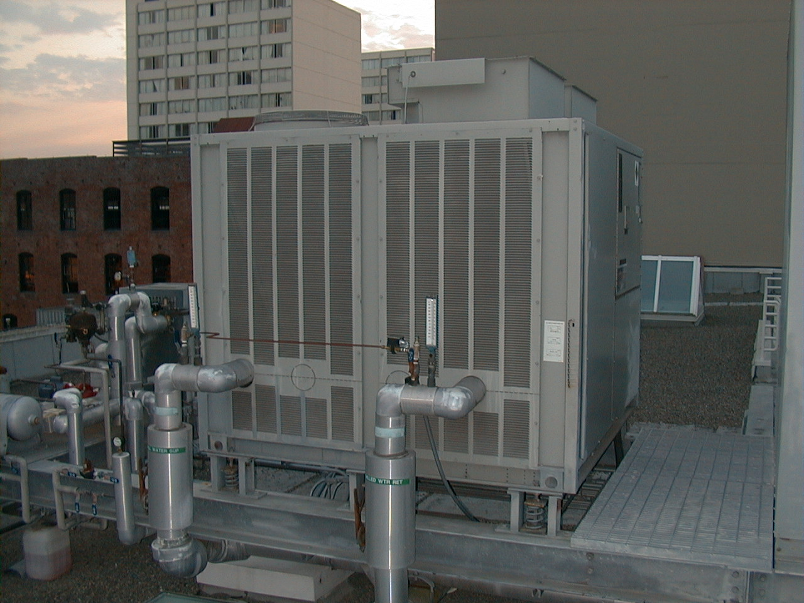
Box that makes a whirring sort of noise with some louvers on it that have hot air coming out and pipes coming out of it that are cold and go into the building

Slide 69
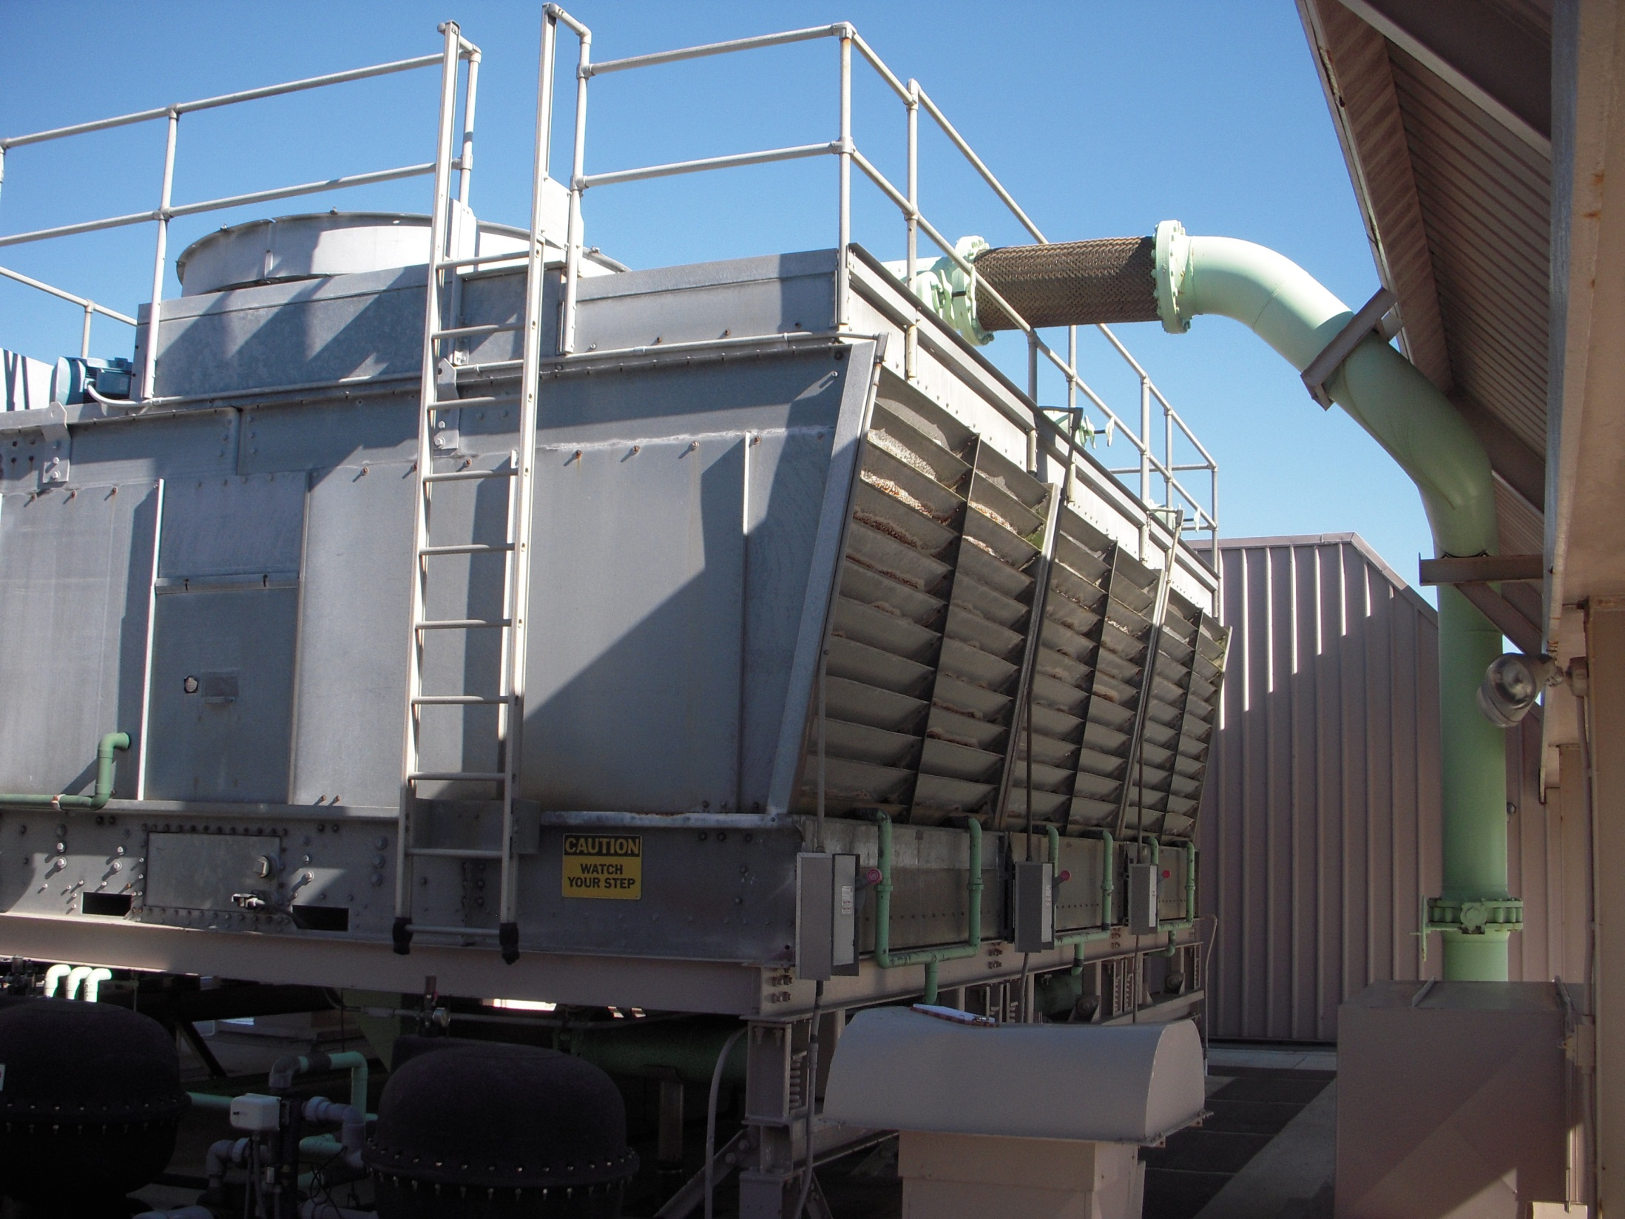
Sometimes You Have To “Connect the Dots”
Hot, Humid Air
Pleasant Day (Cool Dry Air)
Fan
Gravity
Warm Pipe
Splashing Sound
Cold tub of water

Slide 70
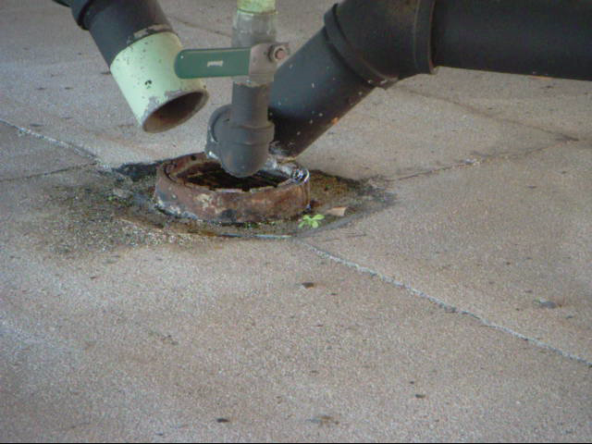
Sometimes You Have Be Flexible and Bring a Flashlight

Slide 71

Sometimes There Can be a Bit of Confusion Regarding Terminology
A Duck …

Slide 72

Sometimes There Can be a Bit of Confusion
… is Not the Same as a Duct

Slide 73

https://www.ashrae.org/technical-resources/free-resources/ashrae-terminology

Slide 74
https://www.ashrae.org/technical-resources/free-resources/ashrae-terminology

Slide 75

Being Able to Read Helps

Slide 76

Being Able to Read Helps
So Does Having Internet Access

Slide 77


Slide 78
Findings List Characteristics
It will grow as your familiarity with the facility grows

Slide 79
Findings List Characteristics
It will grow as your familiarity with the facility grows
Initially, the findings are just theories

Slide 80
Findings List Characteristics
It will grow as your familiarity with the facility grows
Initially, the findings are just theories
Some of them are just logical observations

Slide 81

This machine makes heat …
… and this machine needs to be kept below 85°F

Slide 82

Currently, this machine keeps it below 85°F …

Slide 83

… buy on the other side of this wall, it’s Denver…

Slide 84

… buy on the other side of this wall, it’s Denver…
… and on the other side of this wall is a machine that is pumping 100% outdoor air into the building

Slide 85
Findings List Characteristics
It will grow as your familiarity with the facility grows
Initially, the findings are just theories
Some of them are just logical observations

Slide 86
Sometimes the Math Leads You To Something
Pump Energy Equation
Sensible Load Equation

Slide 87
Findings List Characteristics
It will grow as your familiarity with the facility grows
Initially, the findings are just theories
Some of them are just logical observations

Slide 88
Findings List Characteristics
It will grow as your familiarity with the facility grows
Initially, the findings are just theories
Some of them are just logical observations
Some will come from discussions with the operators

Slide 89
Findings List Characteristics
It will grow as your familiarity with the facility grows
Initially, the findings are just theories
Some of them are just logical observations
Some will come from discussions with the operators
Some will just be common sense

Slide 90
Findings List Characteristics
It will grow as your familiarity with the facility grows
Initially, the findings are just theories
Some of them are just logical observations
Some will come from discussions with the operators
Some will just be common sense
Some will come from applying common sense outside the box

