Slide 1
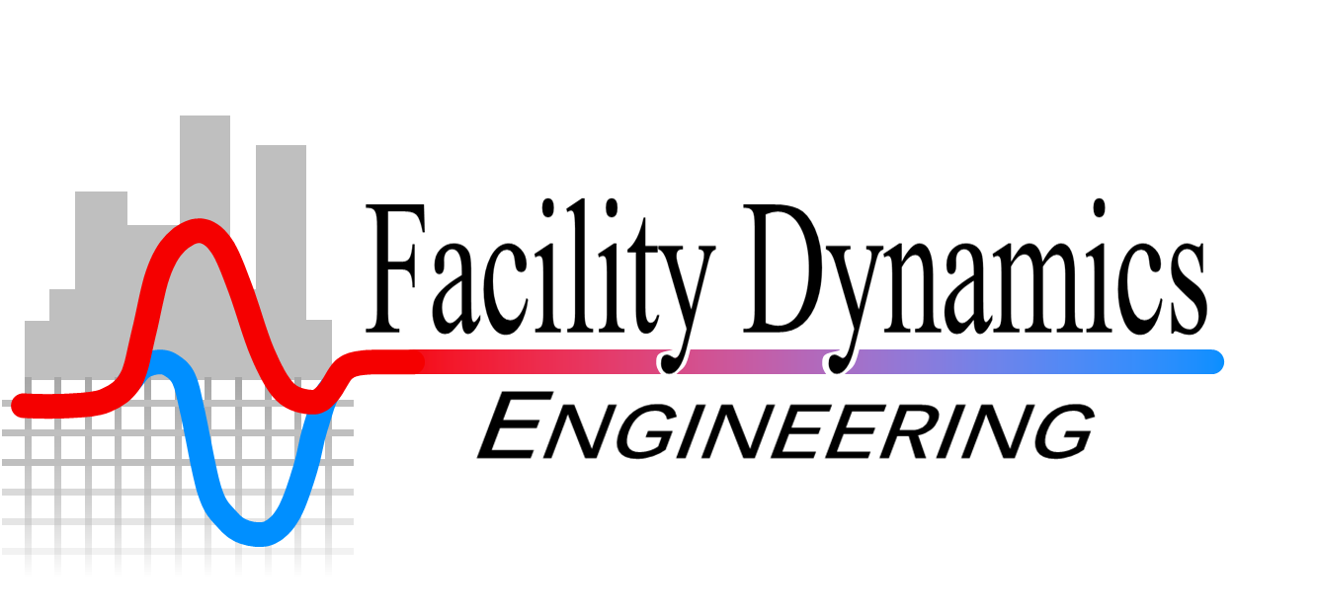
Chilled Water Plants; Basic Principles, Ongoing Commissioning/Operation, and Optimization
Refrigerants Supplement
Presented By:
David Sellers
Senior Engineer, Facility Dynamics Engineering

Slide 2
Ideal Refrigerant Properties
1928
Low condensing pressure
Evaporating pressure near atmospheric pressure
Condensing pressure not much higher than evaporating pressure
Low latent heat of vaporization for small machines to ensure controllability
Low vapor specific volume
Compatible with lubricating oil
Non-corrosive
Stable/does not decompose with age
Does not form non-condensable gasses upon contact with moisture
Does not form explosive compounds upon contact with lubricant
Non-explosive and non-inflammable
Low cost and easy to obtain
Non-poisonous and no discomfort if it leaks into air
Leaks easy to detect with simple methods
Compatible with gaskets and packing materials
Now
Nontoxic
Nonflammable
Zero ozone depletion potential (ODP)
Zero global warming potential (GWP)
Short atmospheric lifetime
High latent heat of vaporization
Low power consumption
Low vapor specific volume
Compressor discharge temperature below 260°F
Evaporating pressure above atmospheric pressure
Condensing pressure below the critical pressure

Slide 3
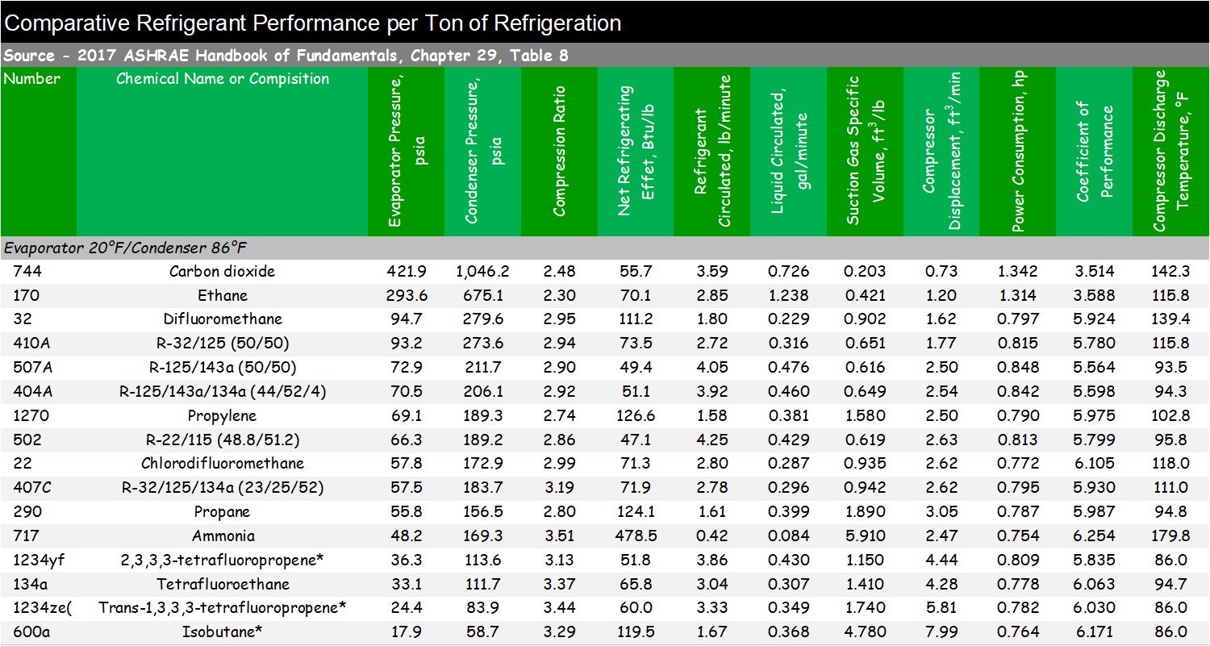
Refrigerant Properties Comparison for Typical HVAC Application Conditions

Slide 4
Refrigerant Properties Comparison for Typical Refrigeration Application Conditions

Slide 5
Refrigerant Properties Comparison for Typical Freezer Application Conditions

Slide 6
Refrigerant Environmental Properties

Slide 7
Refrigerant Environmental Properties

Slide 8
Refrigerant Environmental Properties

Slide 9
Refrigerant Environmental Properties

Slide 10
Refrigerant Environmental Properties

Slide 11
Refrigerant Environmental Properties

Slide 12
Refrigerant Environmental Properties

Slide 13
Refrigerant Environmental Properties

Slide 14
Refrigerant Environmental Properties

Slide 15
A Few Words about Refrigerant Blends

Slide 16
Azeotrope
A mixture made up of two or more refrigerants with similar boiling points that act as a single fluid. The components of azeotropic mixtures will not separate under normal operating conditions and can be charged as a vapor or liquid
Definitions from the National Refrigerants web site; http://www.refrigerants.com/frame.htm
Notes:
http://www.refrigerants.com/frame.htm

Slide 17
Near Azeotrope
A mixture made up of two or more refrigerants with different boiling points that, when in a totally liquid or vapor state, act as one component. However, when changing from vapor to liquid or liquid to vapor, the individual refrigerants evaporate or condense at different temperatures. Near-azeotropic mixtures have a temperature glide of less than 10° F and should be charged in the liquid state to assure proper mixture (non-azeotropic) composition
Definitions from the National Refrigerants web site; http://www.refrigerants.com/frame.htm
Notes:
http://www.refrigerants.com/frame.htm

Slide 18
Zeotrope
A mixture made up of two or more refrigerants with different boiling points. Zeotropic mixtures are similar to near-azeotropic mixtures with the exception of having a temperature glide greater than 10° F. Zeotropic mixtures should be charged in the liquid state
Definitions from the National Refrigerants web site; http://www.refrigerants.com/frame.htm
Notes:
http://www.refrigerants.com/frame.htm

