Slide 1
Your Personal Presentation Should Include:

Slide 2
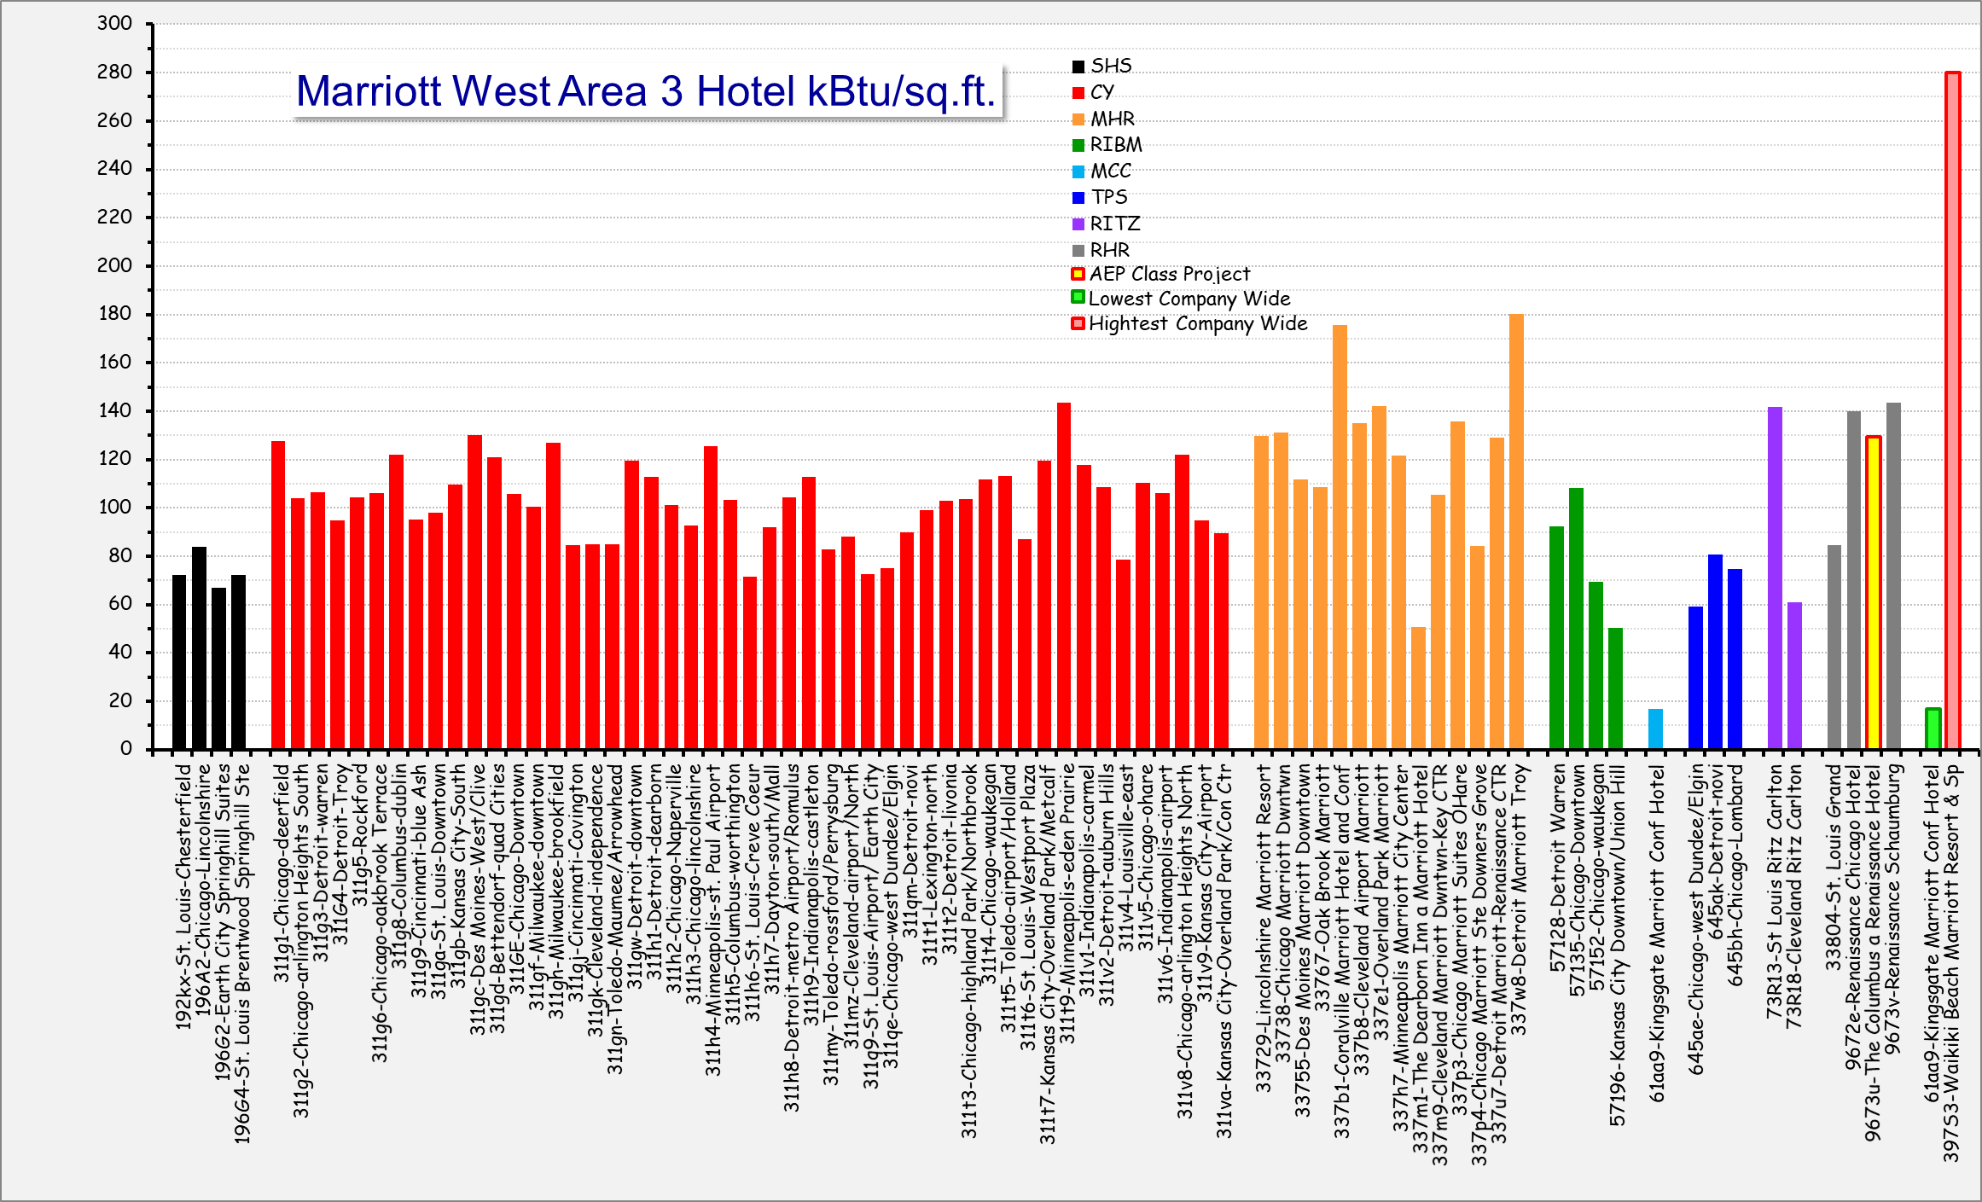
Your Personal Presentation Should Include:
Your Facilities EUI

Slide 3
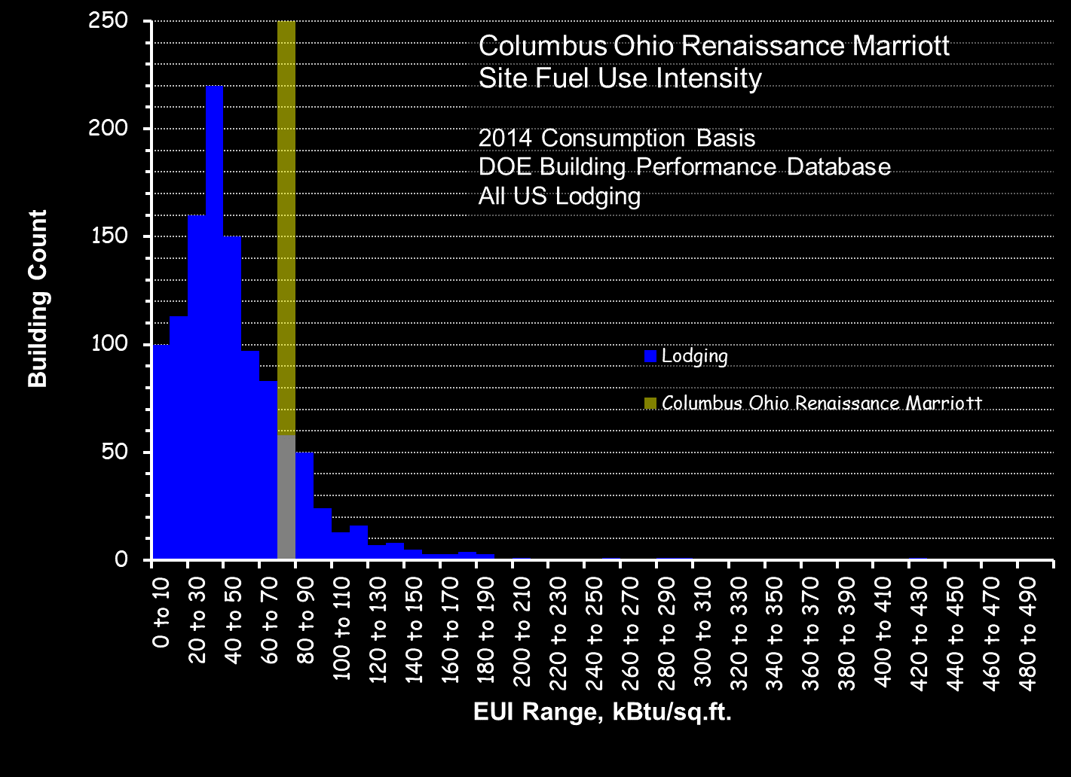
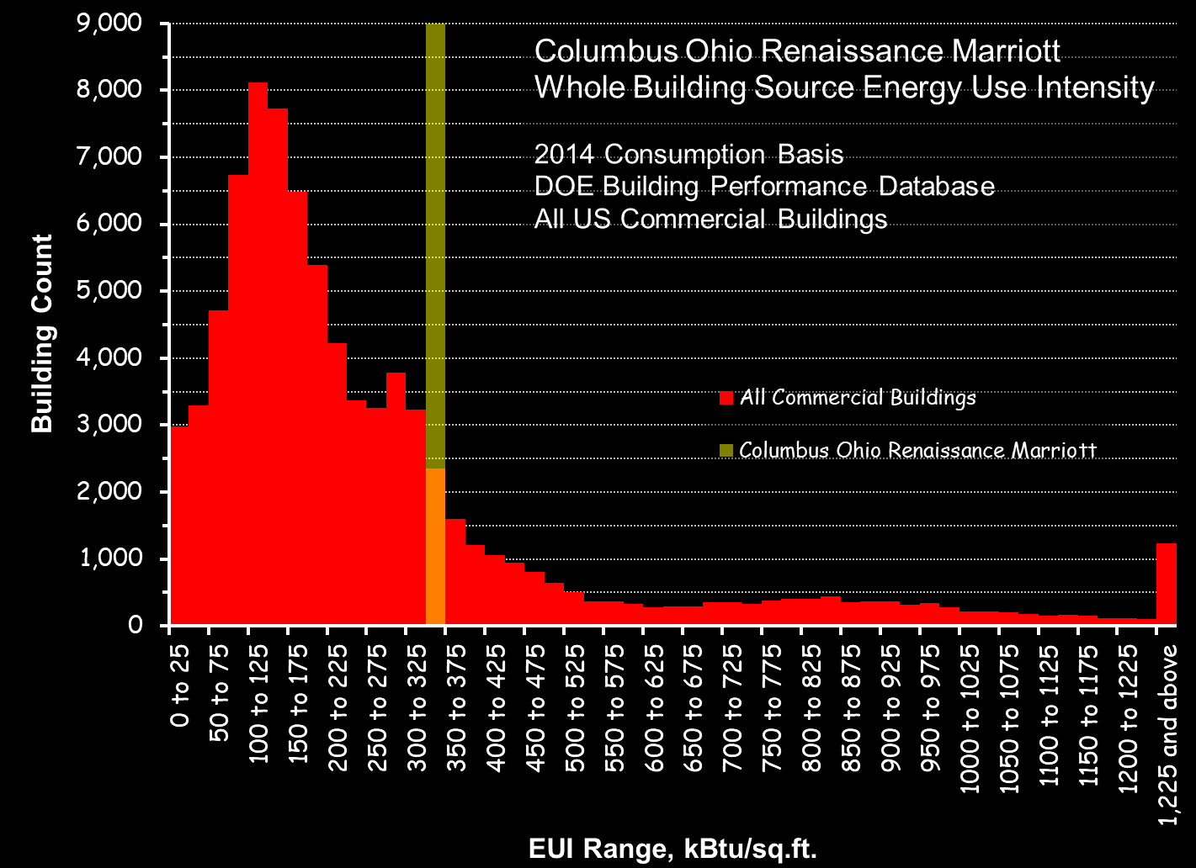
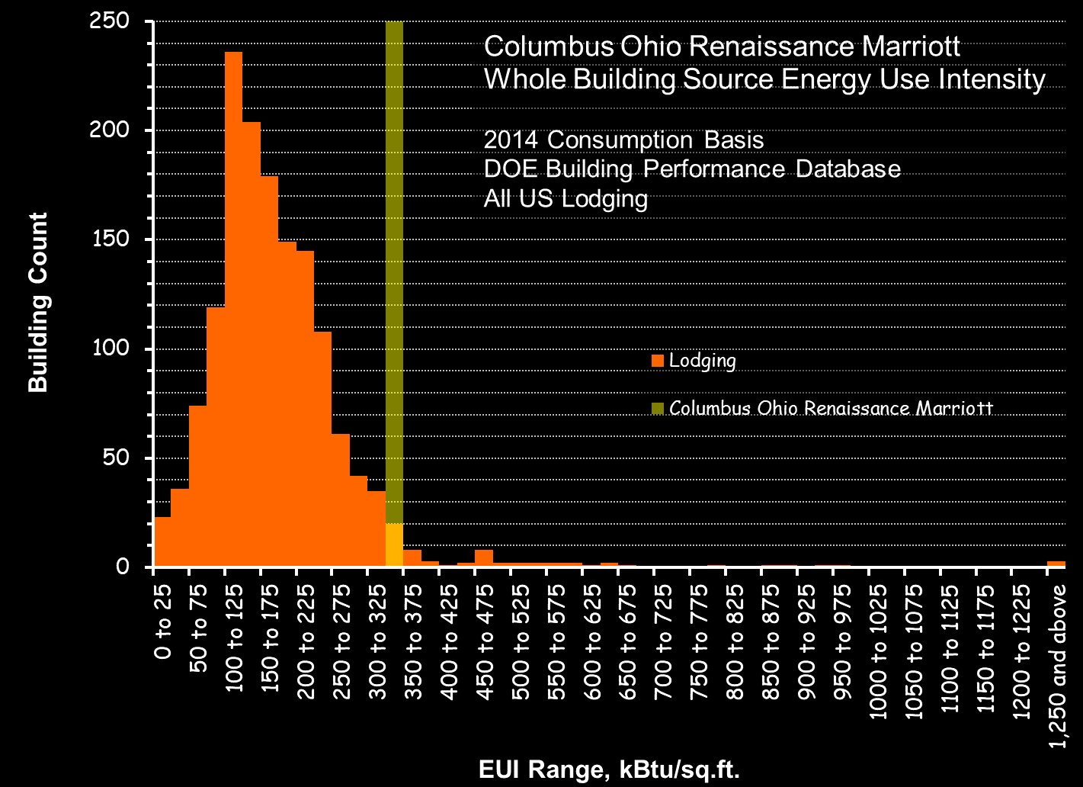
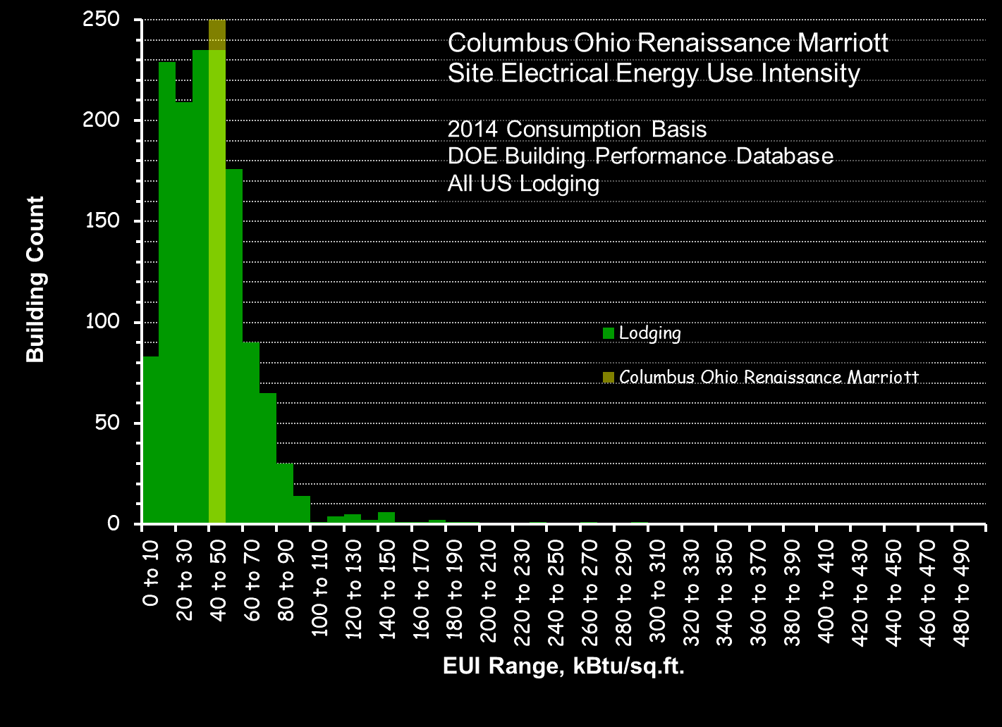
Your Personal Presentation Should Include:
Your Facilities EUI

Slide 4
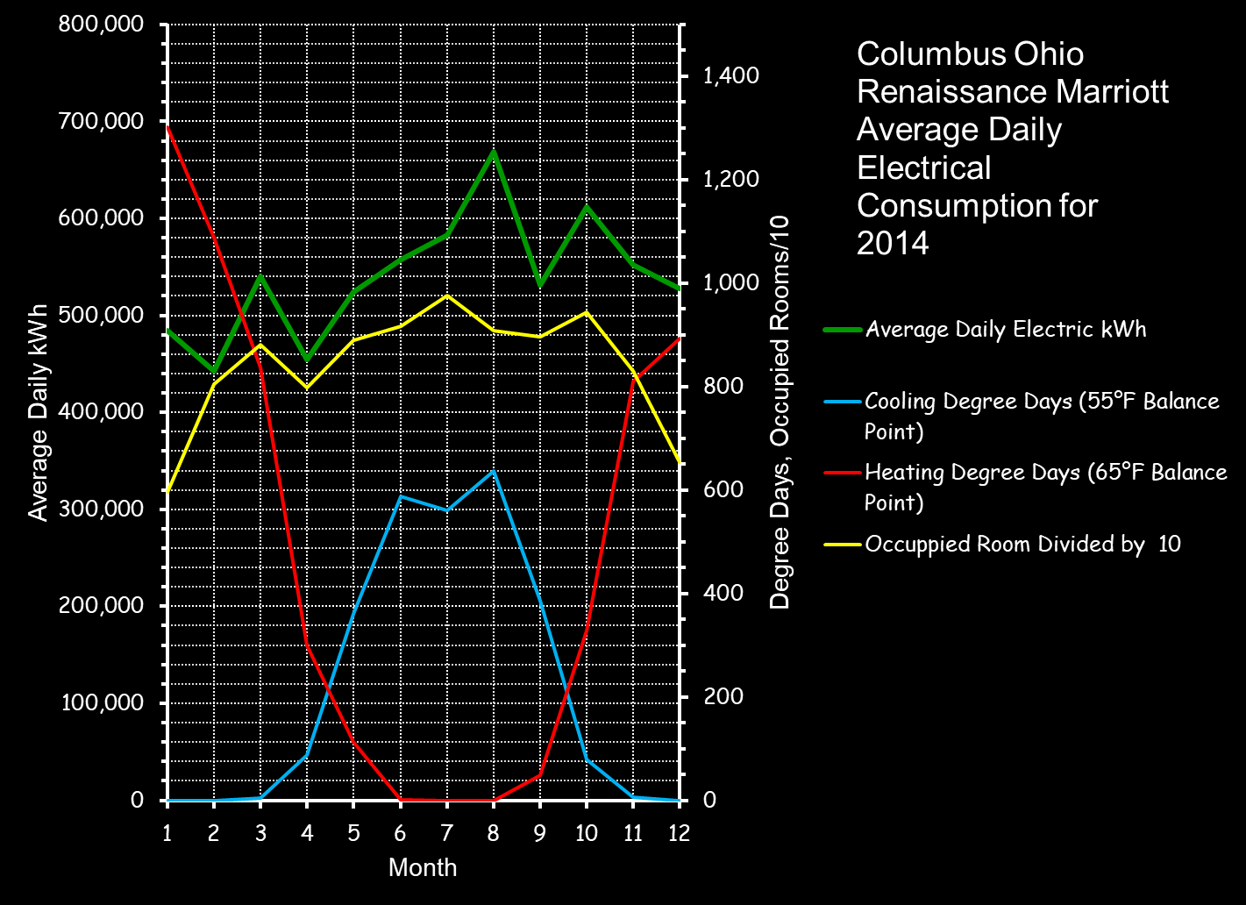
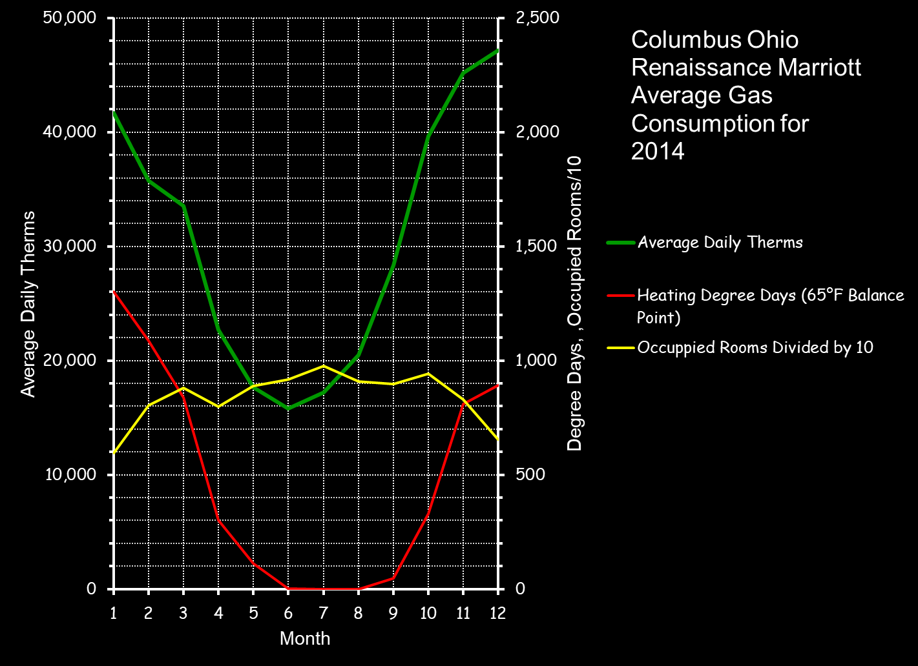
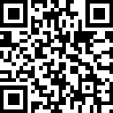
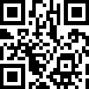
Your Personal Presentation Should Include:
Your Facilities EUI
Resources:
The Energy Analysis spreadsheet - http://tinyurl.com/BenchMarkSpreadsheet
Marriott’s EBR – kBTU Spreadsheet
LBNL Building Performance Database - http://tinyurl.com/LBNLCxCostBen

Slide 5
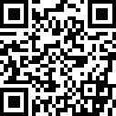
Your Personal Presentation Should Include:
Your Facilities Average Daily Consumption Patterns
Resources:
The ICEBO paper and UCAT - http://tinyurl.com/UCATToolAndPaper

Slide 6
Your Personal Presentation Should Include:
Your Findings List and Preliminary Cost/Benefit Assessment
This information should be presented to your GM in early February
Resources:
http://tinyurl.com/BenchMarkSpreadsheet

Slide 7
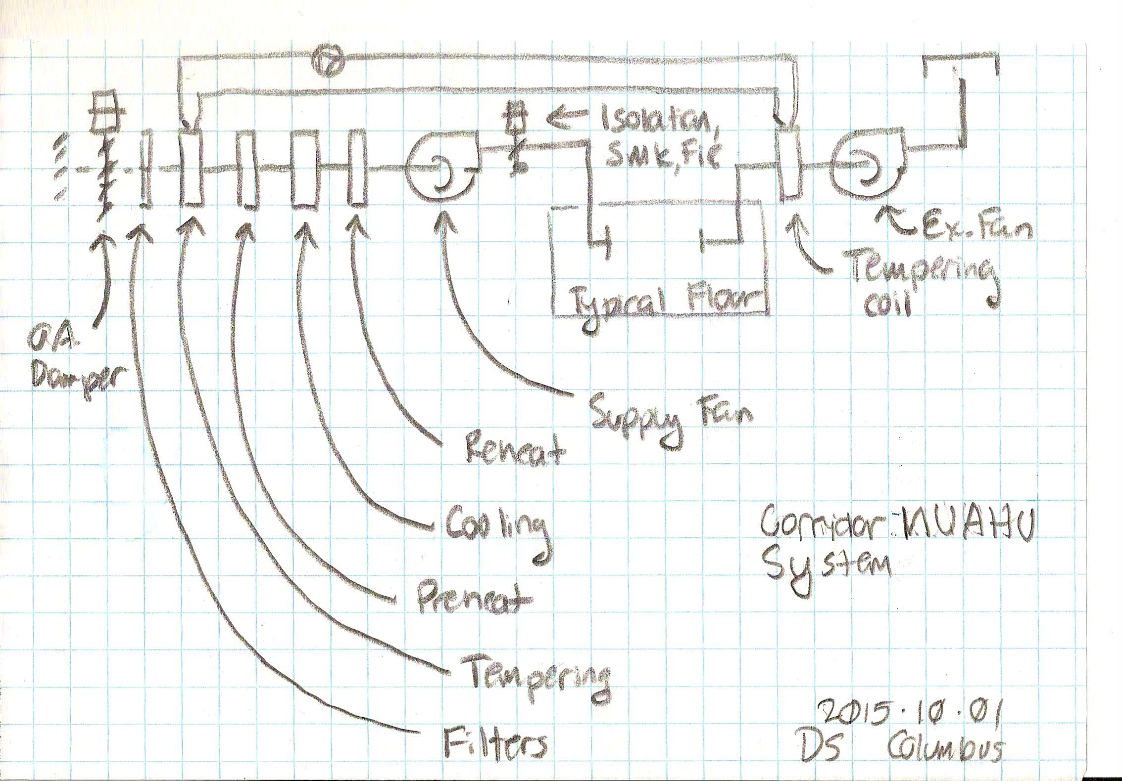
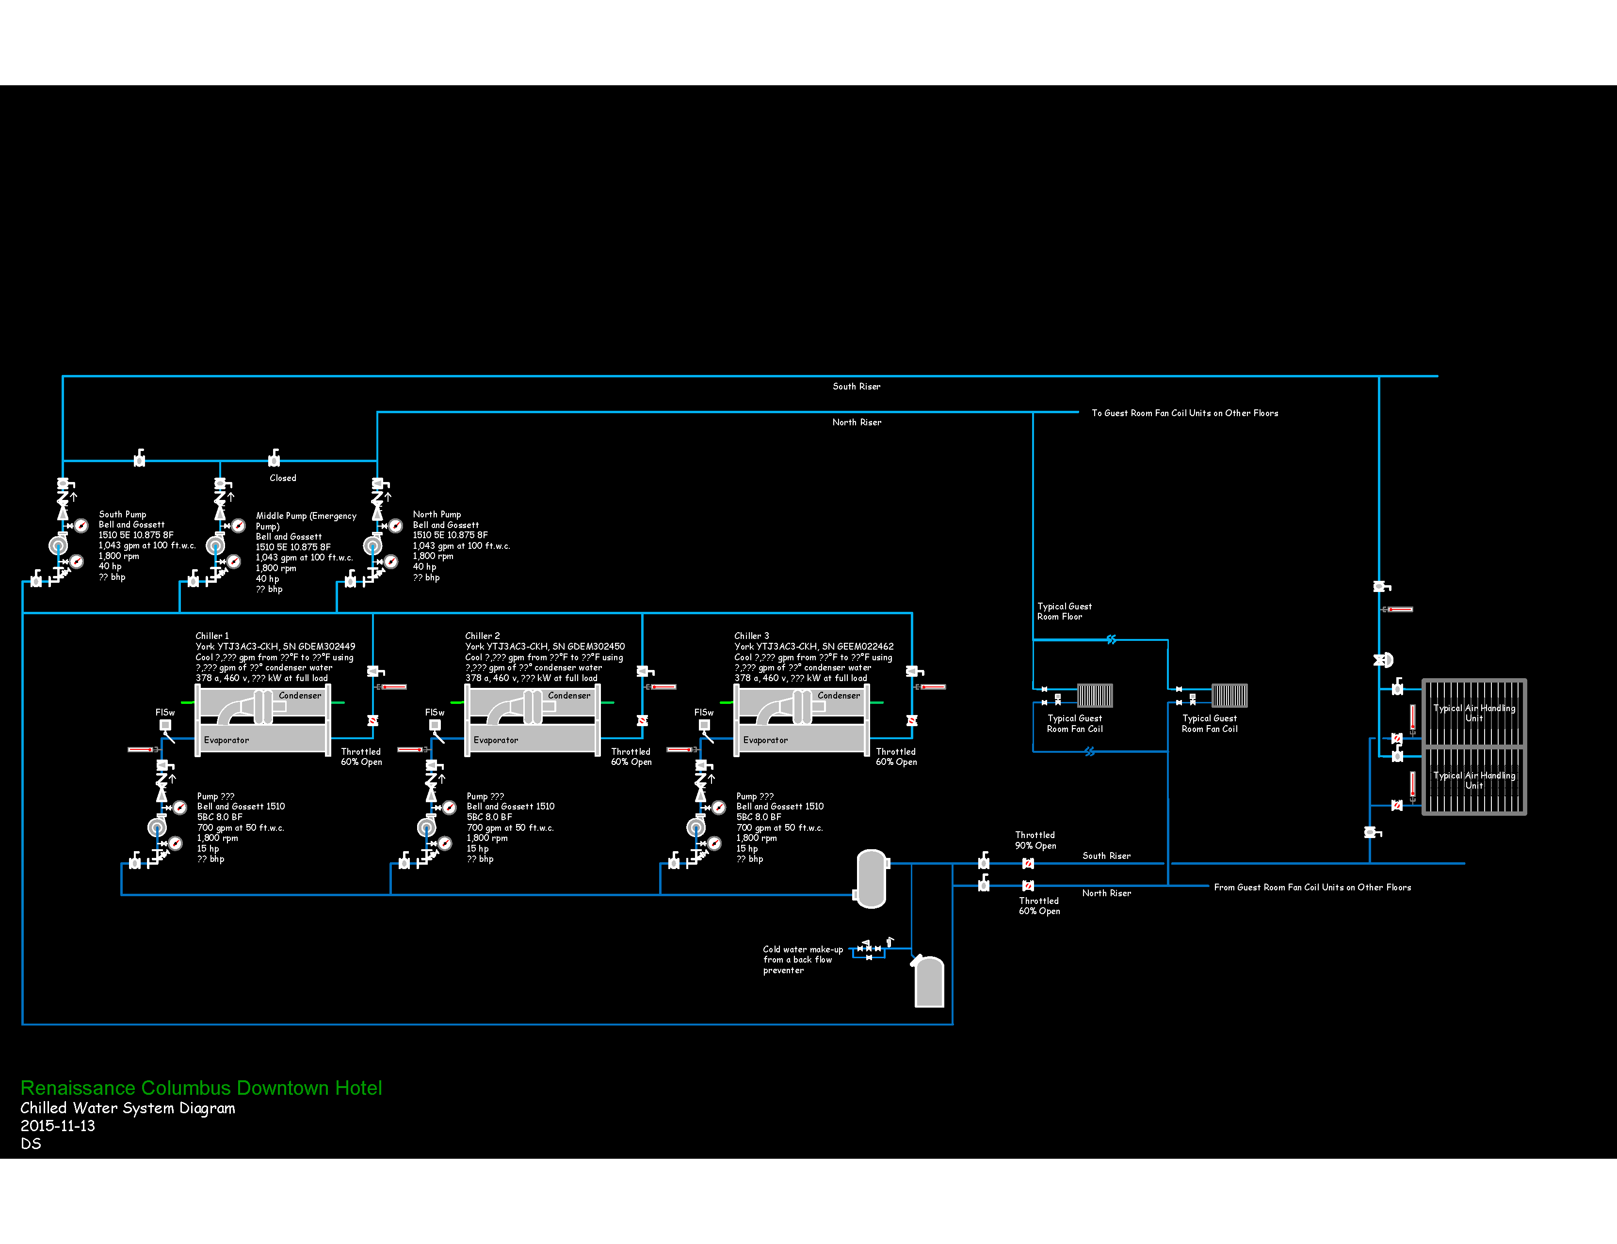
Your Personal Presentation Should Include:
Your Findings List and Preliminary Cost/Benefit Assessment
Your personal project is selected from one of your findings
The personal project selection:
  Should have a bit of complexity
  Should be approved by Agila if not already approved
  Guides your self study effort
Your findings list become a living document
Resources:
The person you see in the mirror every morning
Your operating team
This class and related materials

Slide 8
Your Personal Presentation Should Include:
A System Diagram for the System You Have Targeted

Slide 9
Your Personal Presentation Should Include:
A System Diagram for the System You Have Targeted
Hand drawn is fine!

Slide 10
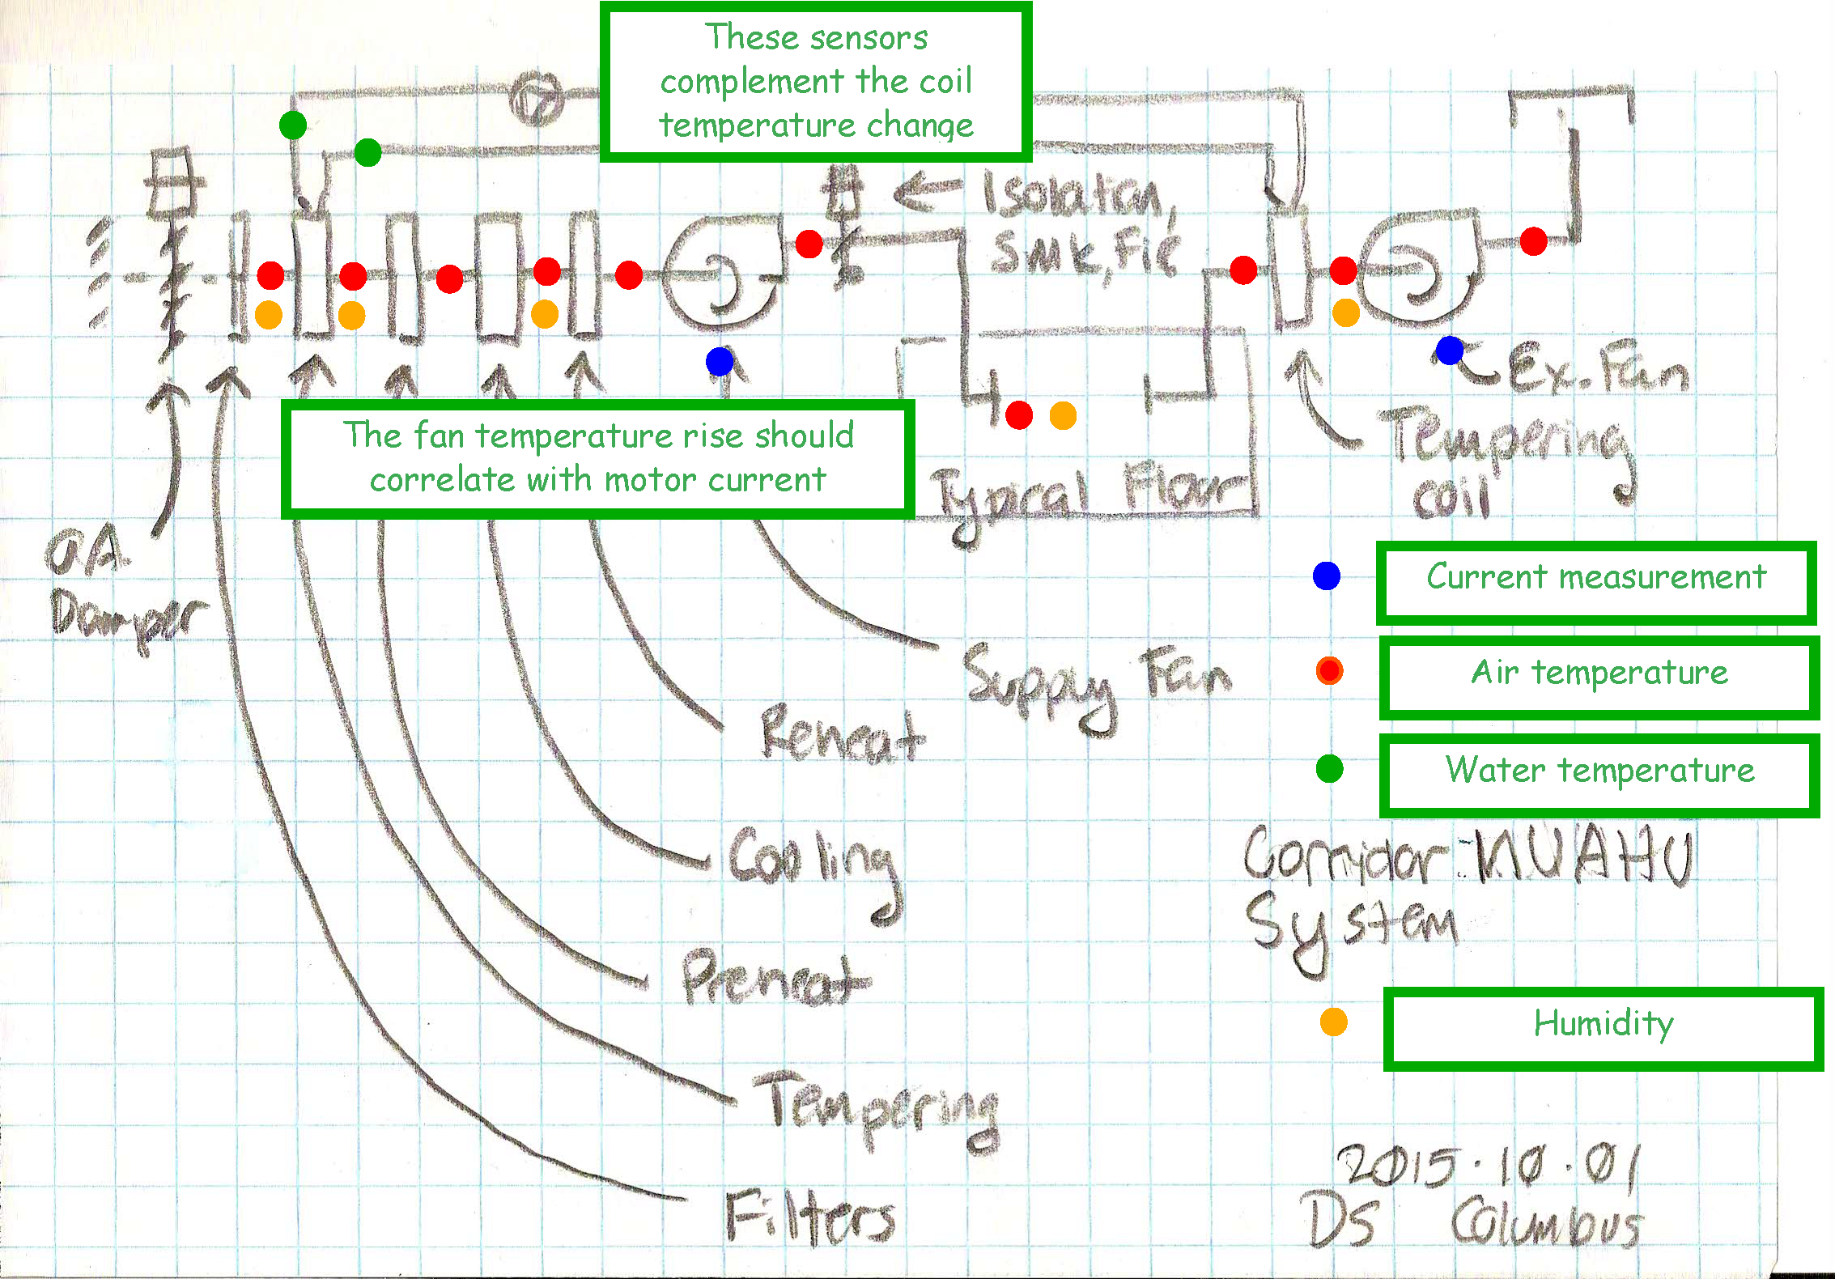
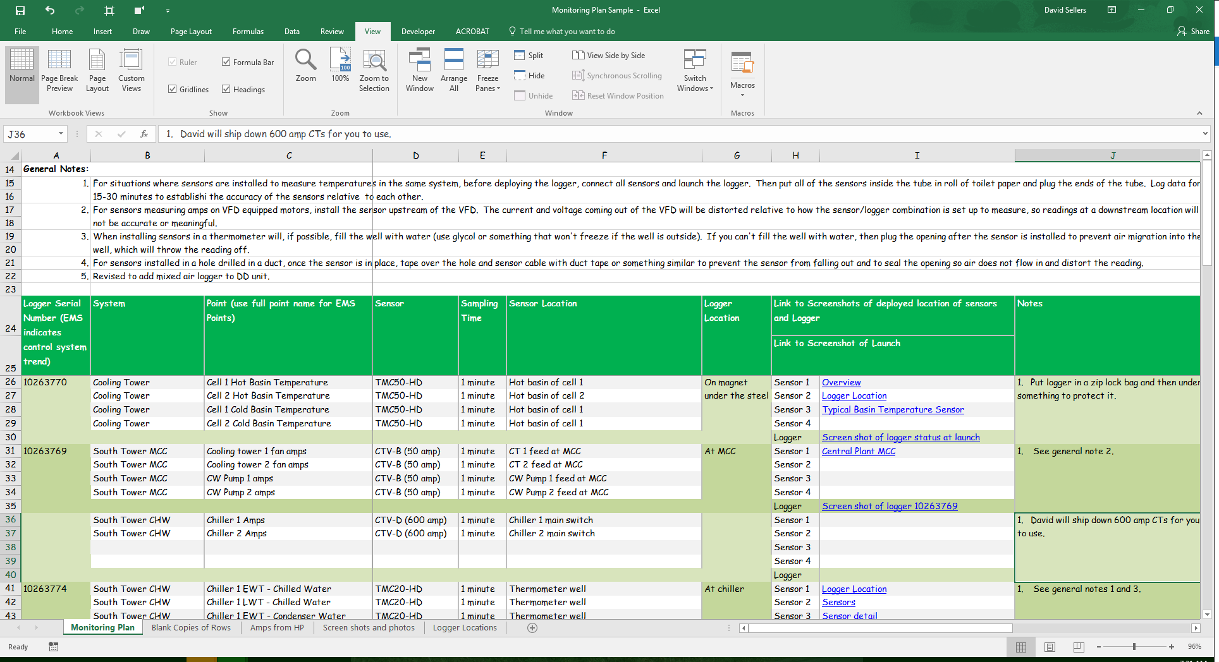
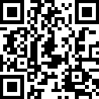
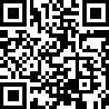
Your Personal Presentation Should Include:
A System Diagram for the System You Have Targeted
Hand drawn is fine!
Resources:
System Diagram Self Study Videos - http://tinyurl.com/SSSystemDgmIntro
RCxU - http://tinyurl.com/RCxUSystemDiagrams

Slide 11
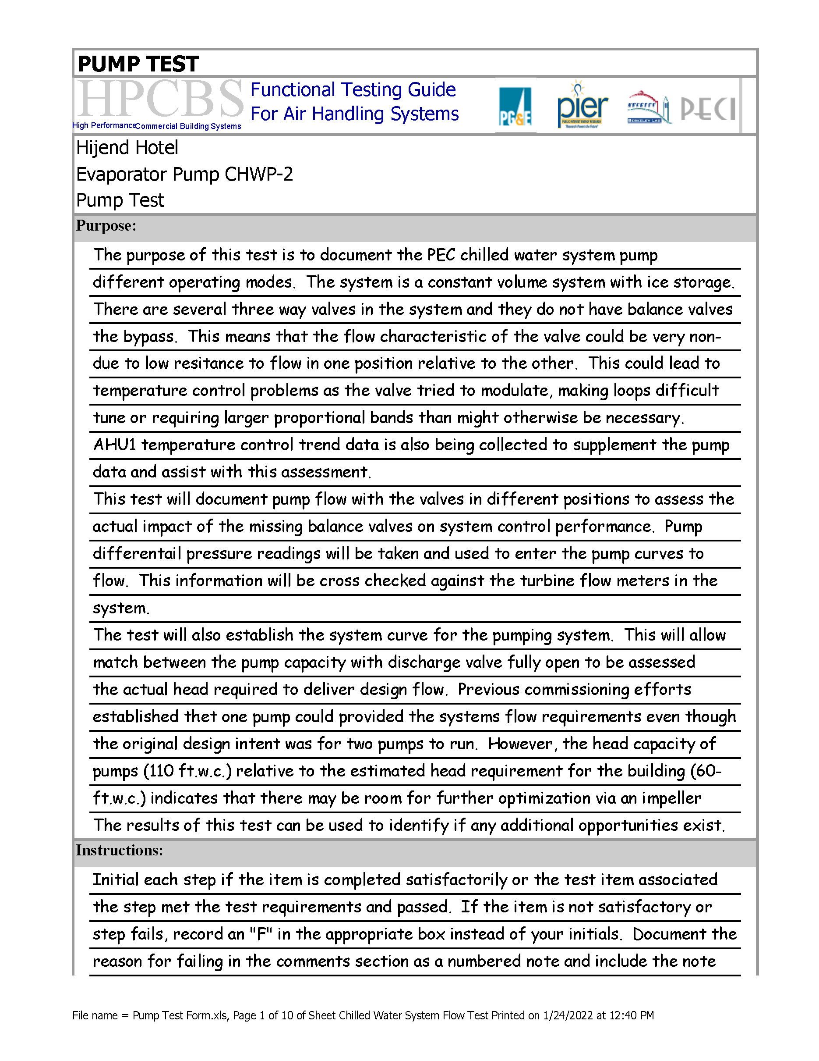
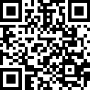
Your Personal Presentation Should Include:
Your Monitoring Plan
It can be as simple as a
marked-up version of your
system diagram
Resources:
Monitoring plan information - http://tinyurl.com/MonitoringPlanResources

Slide 12
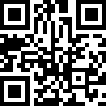
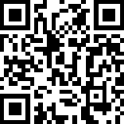
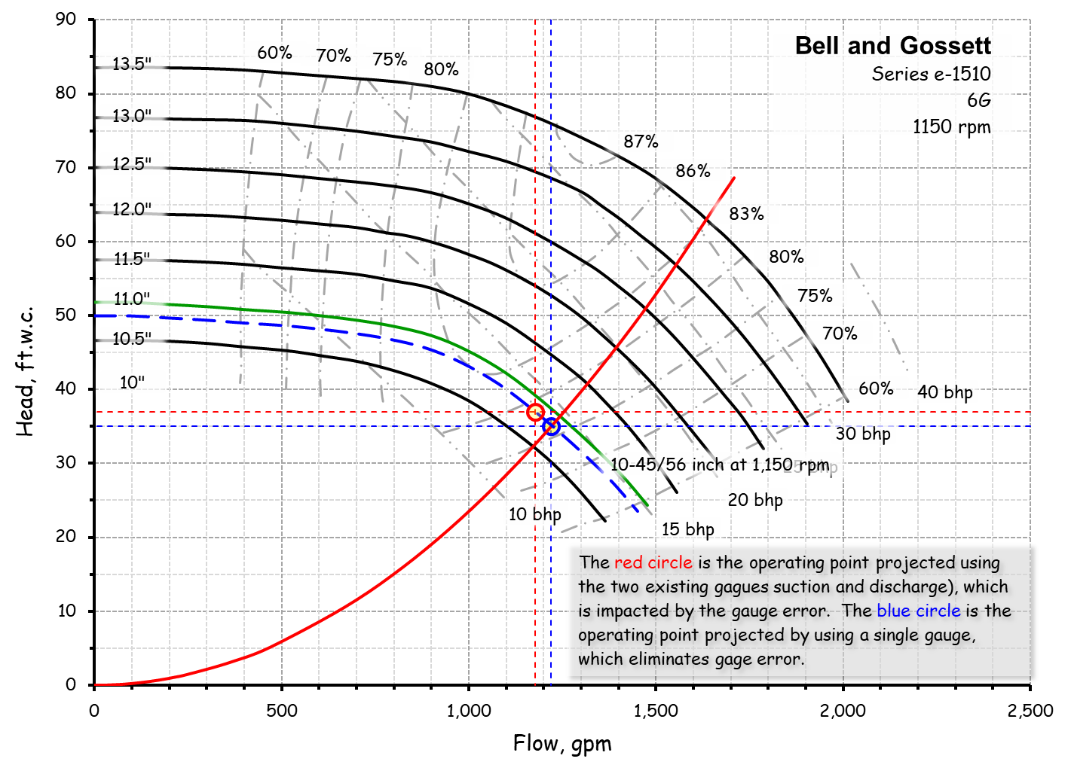
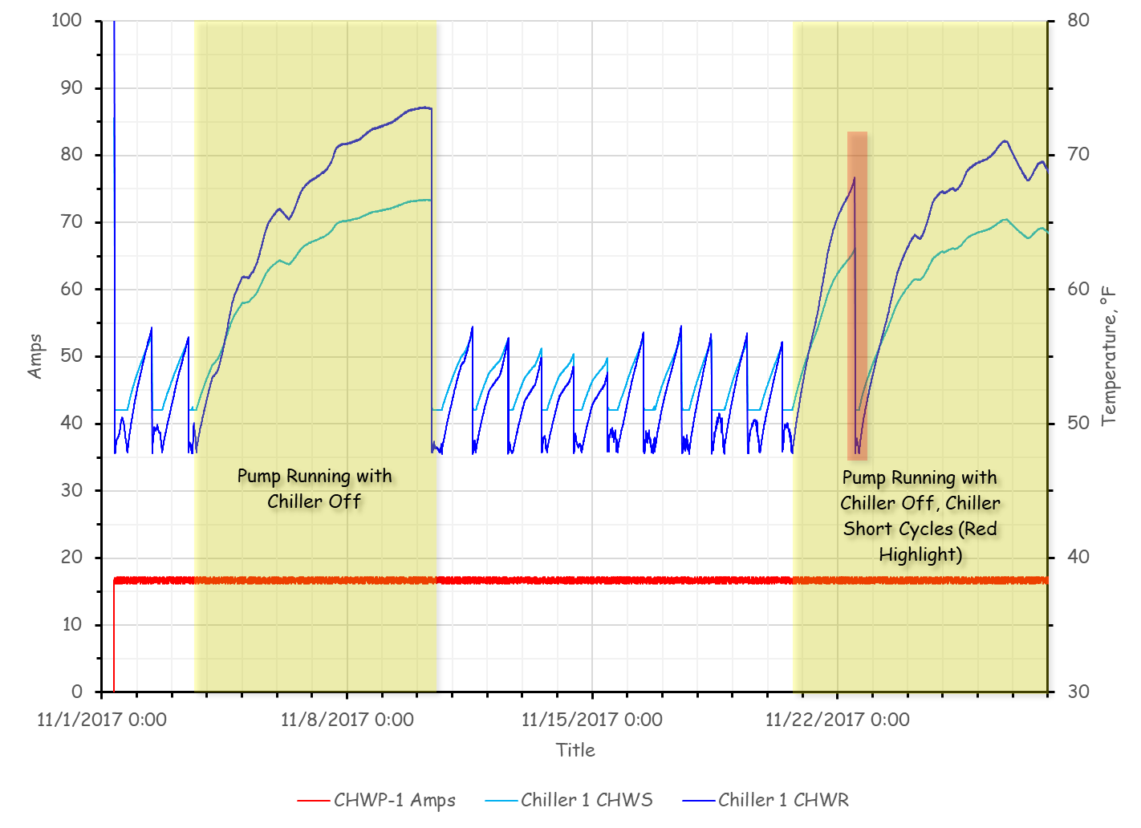
Your Personal Presentation Should Include:
Your Test Plan/Functional Test
It can be forced response, natural response (trend analysis based) or both
Designed to provide the data you need to evaluate your targeted improvement and develop savings projections
Resources:
Functional testing guide - http://tinyurl.com/FTGDownload
Functional testing video series - http://tinyurl.com/SSFunctionalTest

Slide 13
Your Personal Presentation Should Include:
Your Test Results and Some Related Trend Analysis
Test and trend data should support your savings projections and related recommendations

Slide 14
Your Personal Presentation Should Include:
Your Savings Projections
Based on the results of your test data
Based on engineering assumptions and fundamental relationships
Not based on what a sales representative told you!

Slide 15
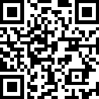
Your Personal Presentation Should Include:
Your Cost Benefit Projections (Optional)
Based on the results of your test data and implementation budgets
Based on your Owner’s financial perspective
https://tinyurl.com/EBCxBudgetFindings

Slide 16
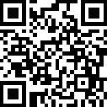
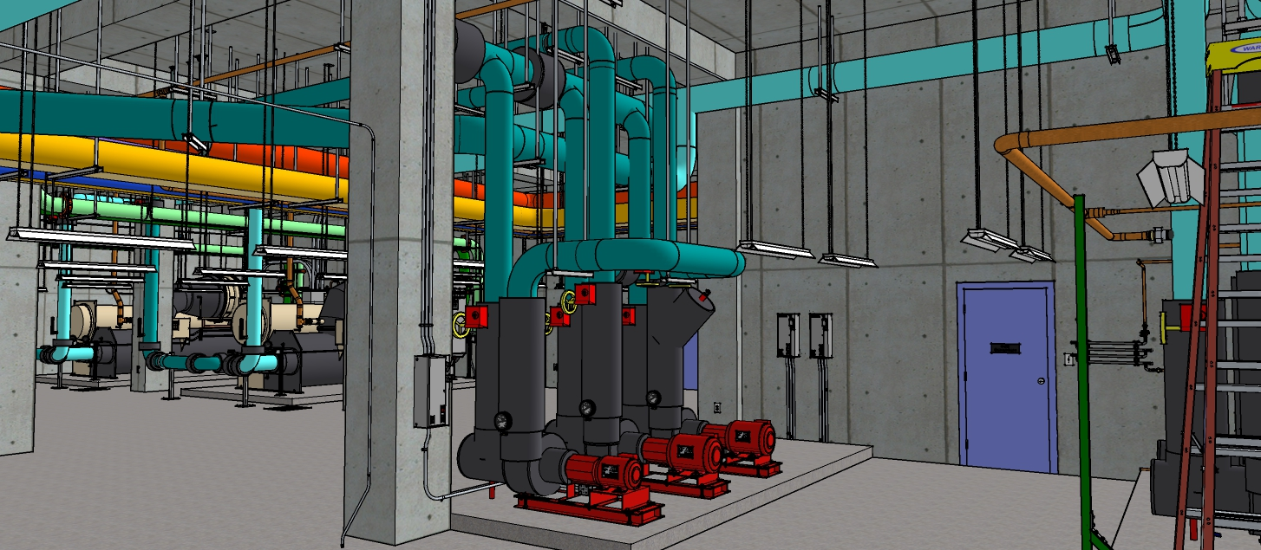
Your Personal Presentation Should Include:
Your Implementation Strategy and Documents
How will you procure bids that are “apples to apples”?
How will you verify your intended results have been delivered?
https://tinyurl.com/ScopeOfWorkDocs

