Slide 1


Life, Mentoring, and Commissioning
Presented by:
David Sellers
Senior Engineer, Facility Dynamics Engineering

Slide 2
Are Doing What You Set Out to Do When You Went to School?

Slide 3
What Commissioning Has Taught Us About Mentoring and Design
Notes:
When Michael asked me to do this, I was not sure I was a plenary speaker type of guy
But then he told me the title and I figured I might be O.K. at this one since I have been blessed with great mentors for my entire career.

Slide 4
What Mentors Have Taught Us About Commissioning and Design
Notes:
When Michael asked me to do this, I was not sure I was a plenary speaker type of guy
But then he told me the title and I figured I might be O.K. at this one since I have been blessed with great mentors for my entire career.

Slide 5
What Mentors Have Taught Me About Commissioning and Design
Notes:
When Michael asked me to do this, I was not sure I was a plenary speaker type of guy
But then he told me the title and I figured I might be O.K. at this one since I have been blessed with great mentors for my entire career.

Slide 6
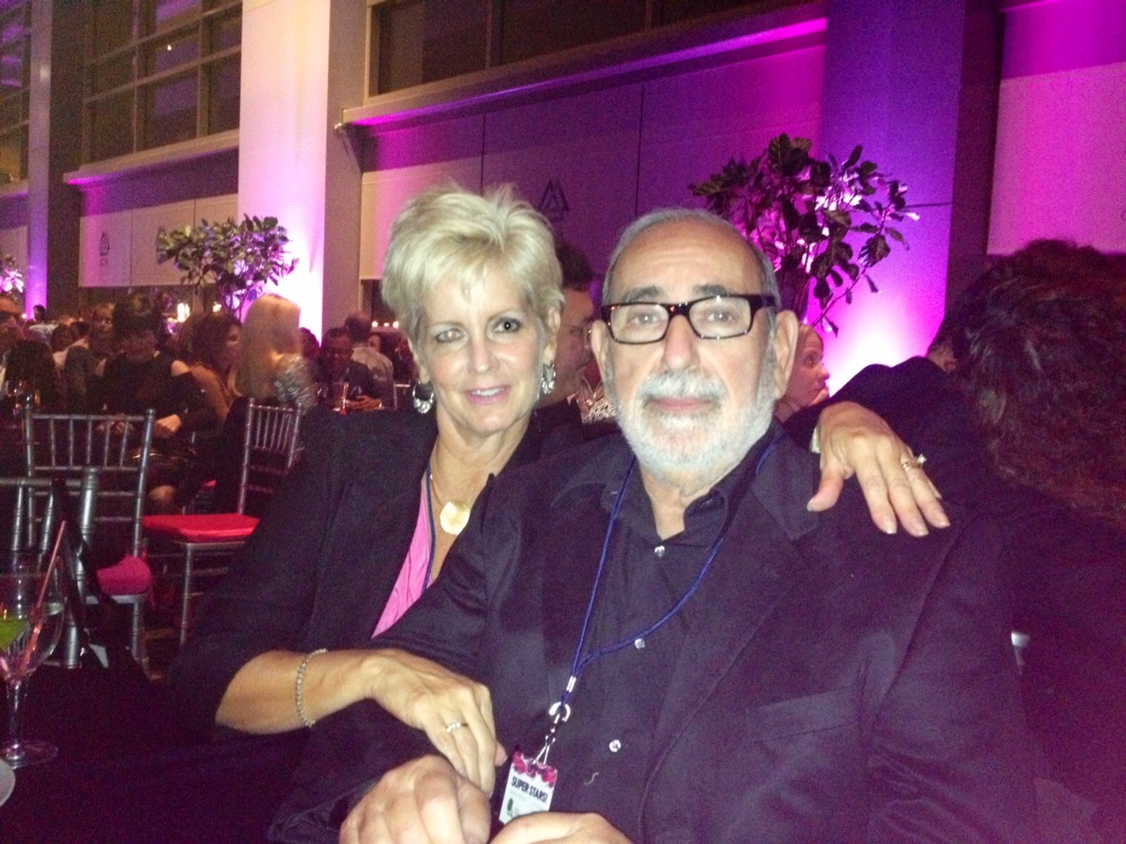
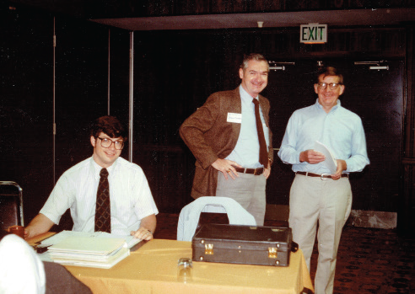
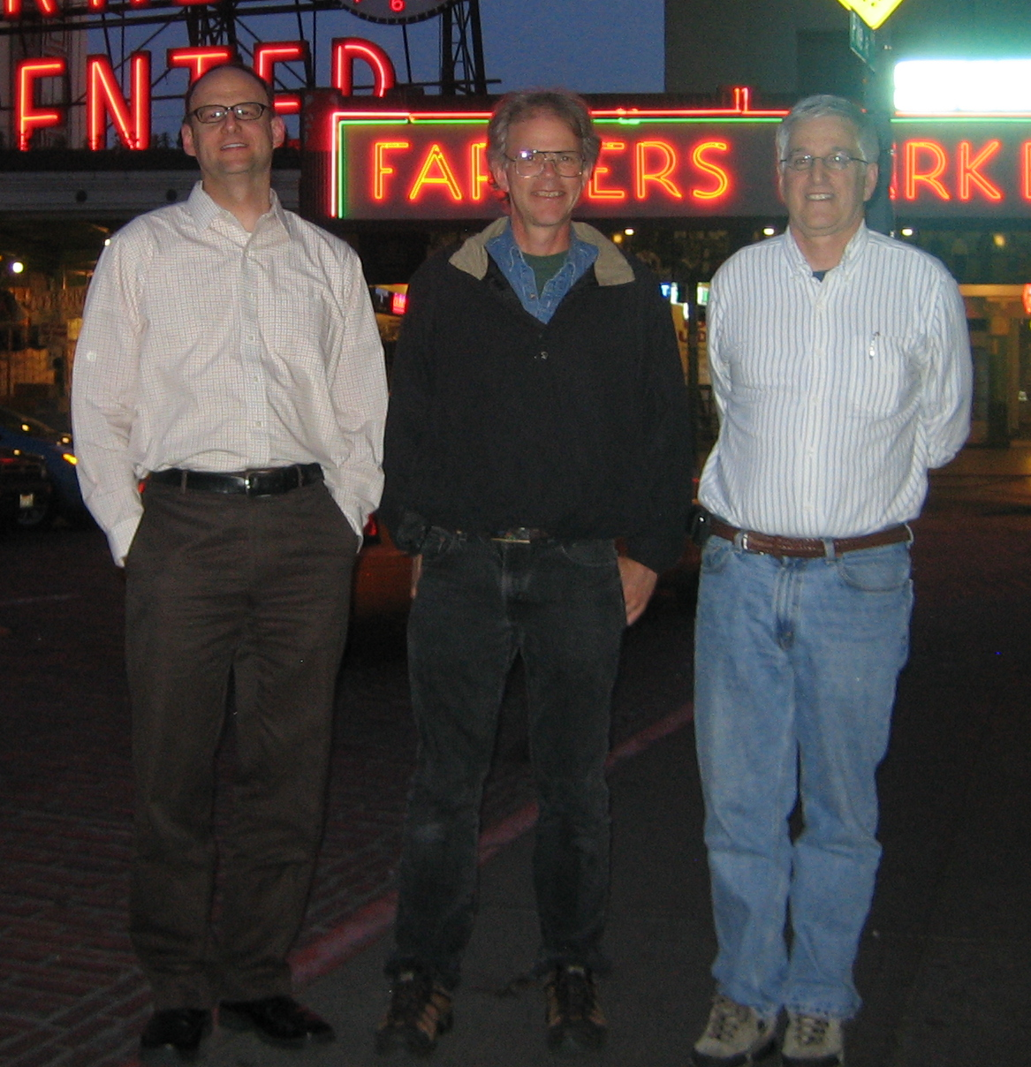
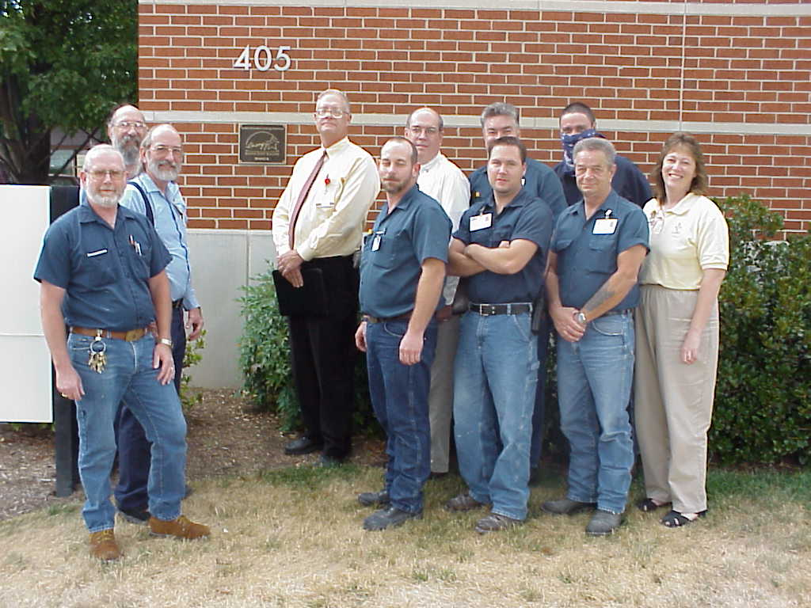
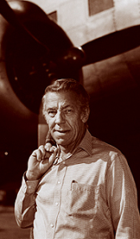

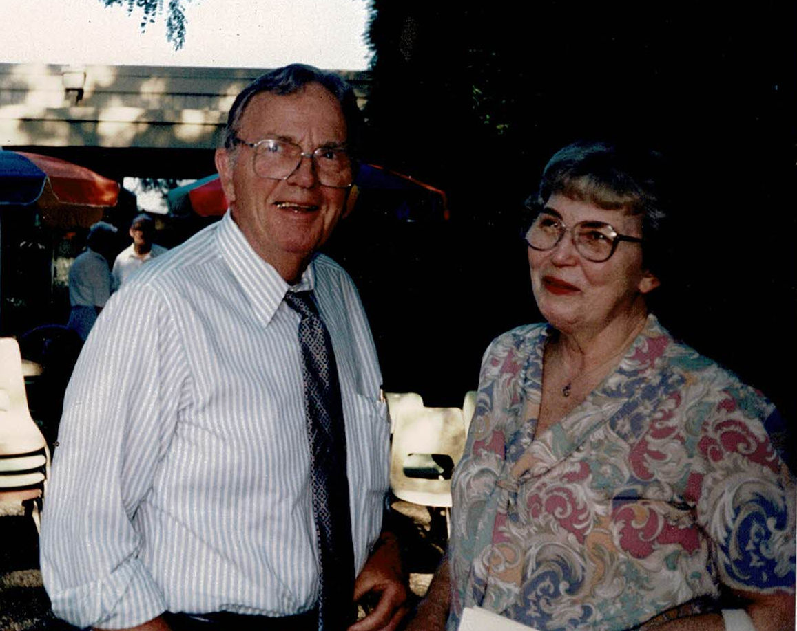
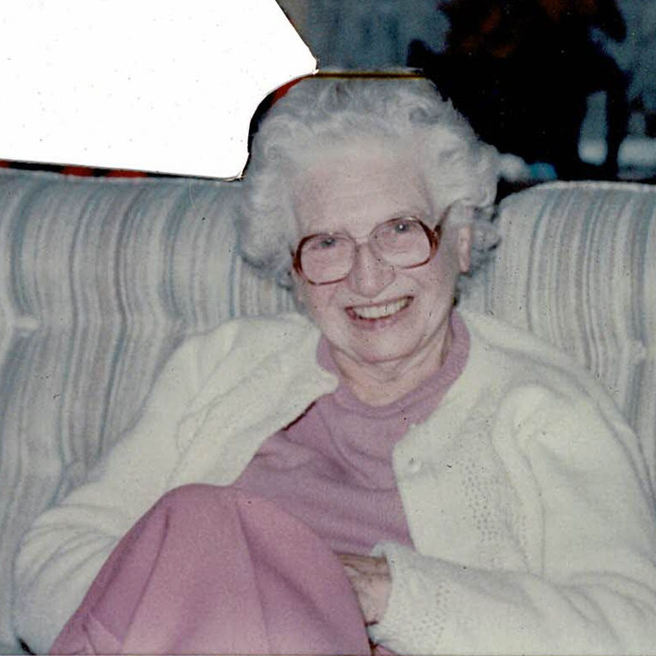
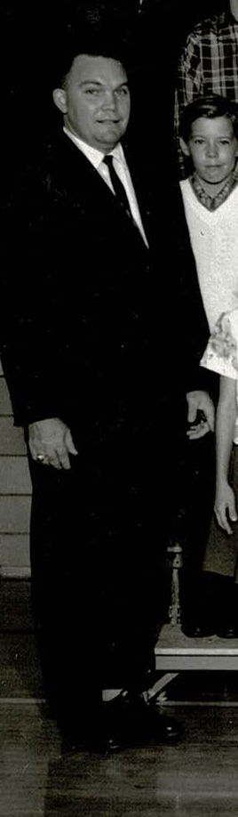
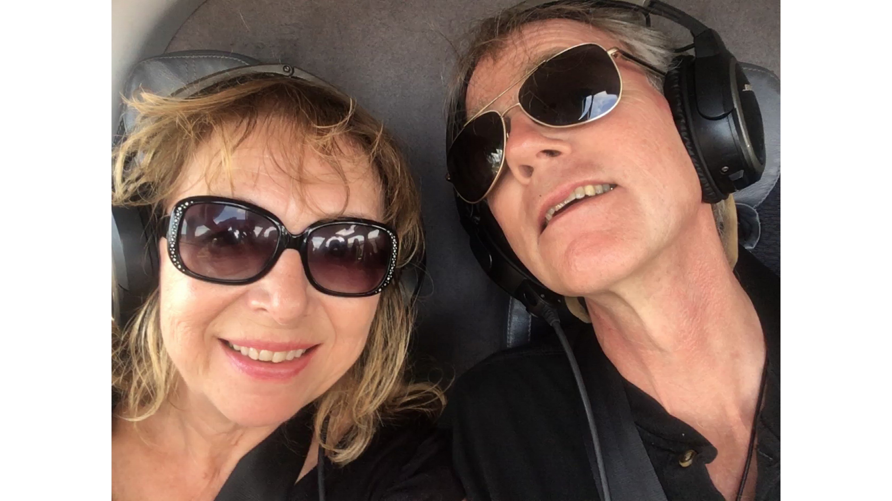
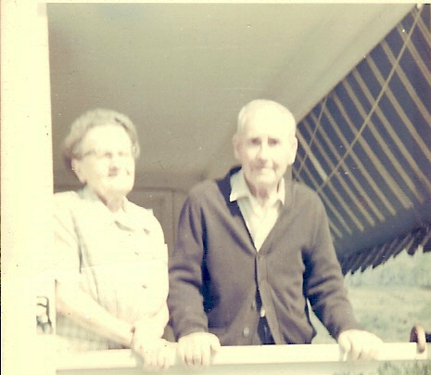
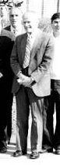
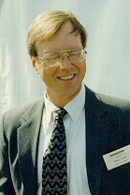
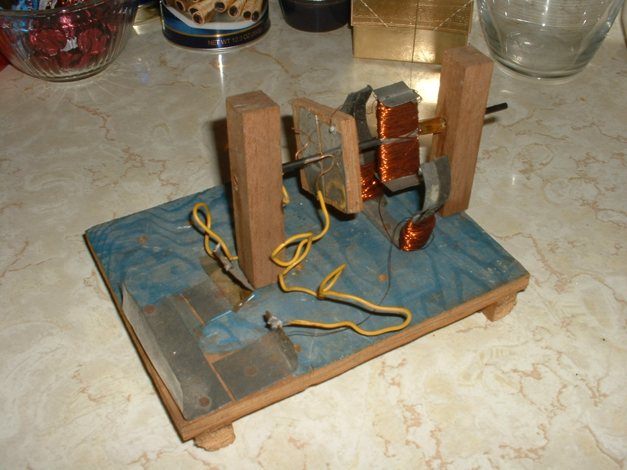
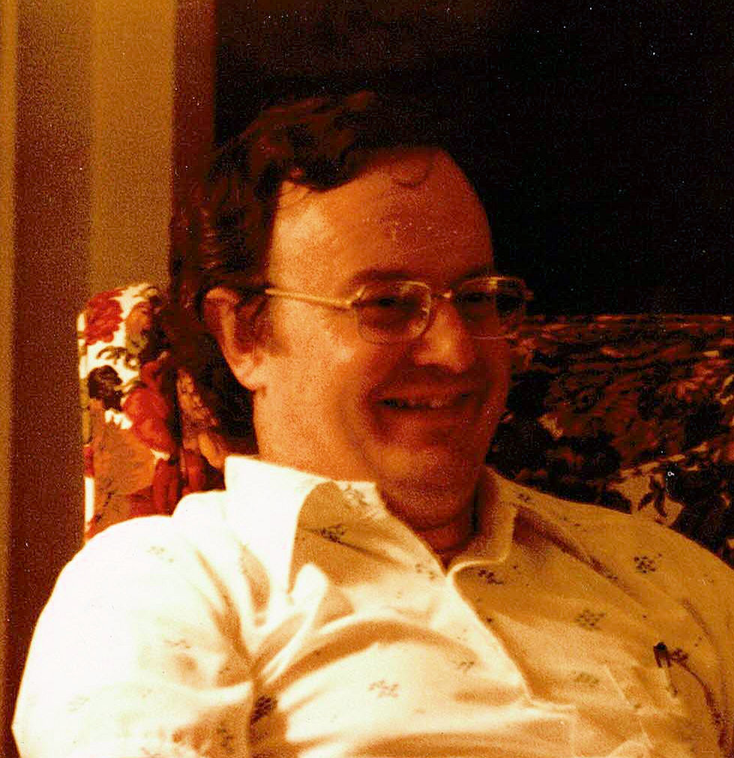
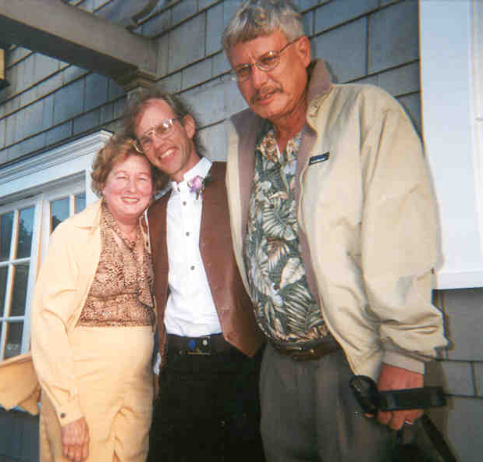


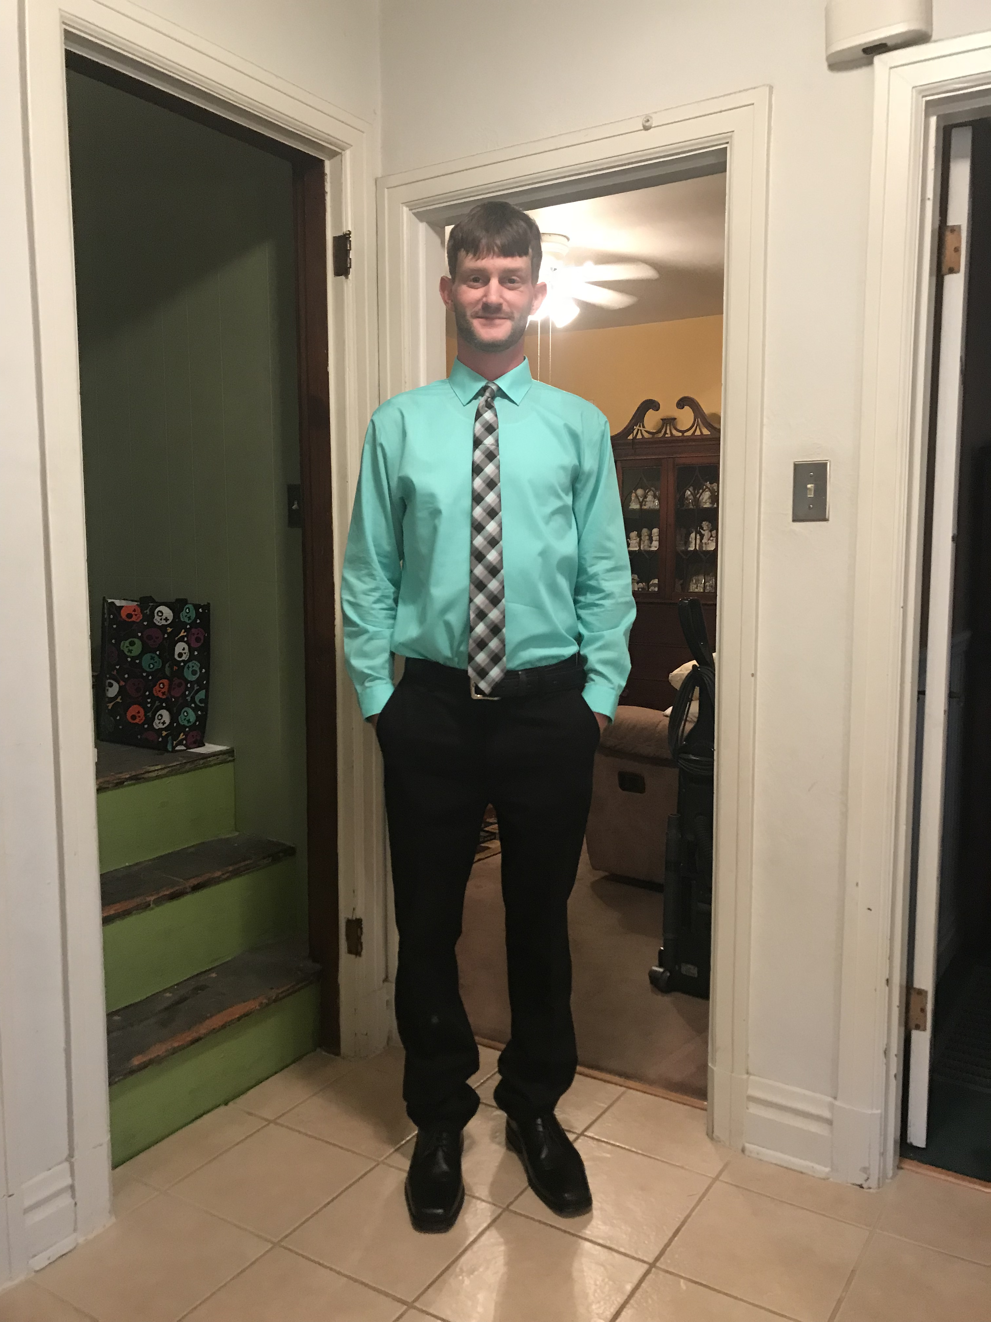
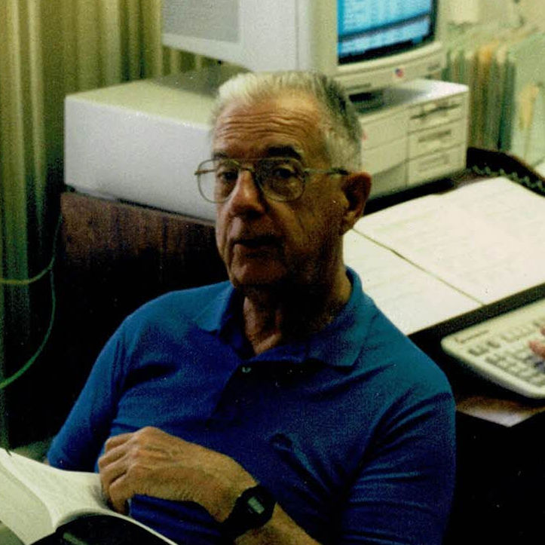
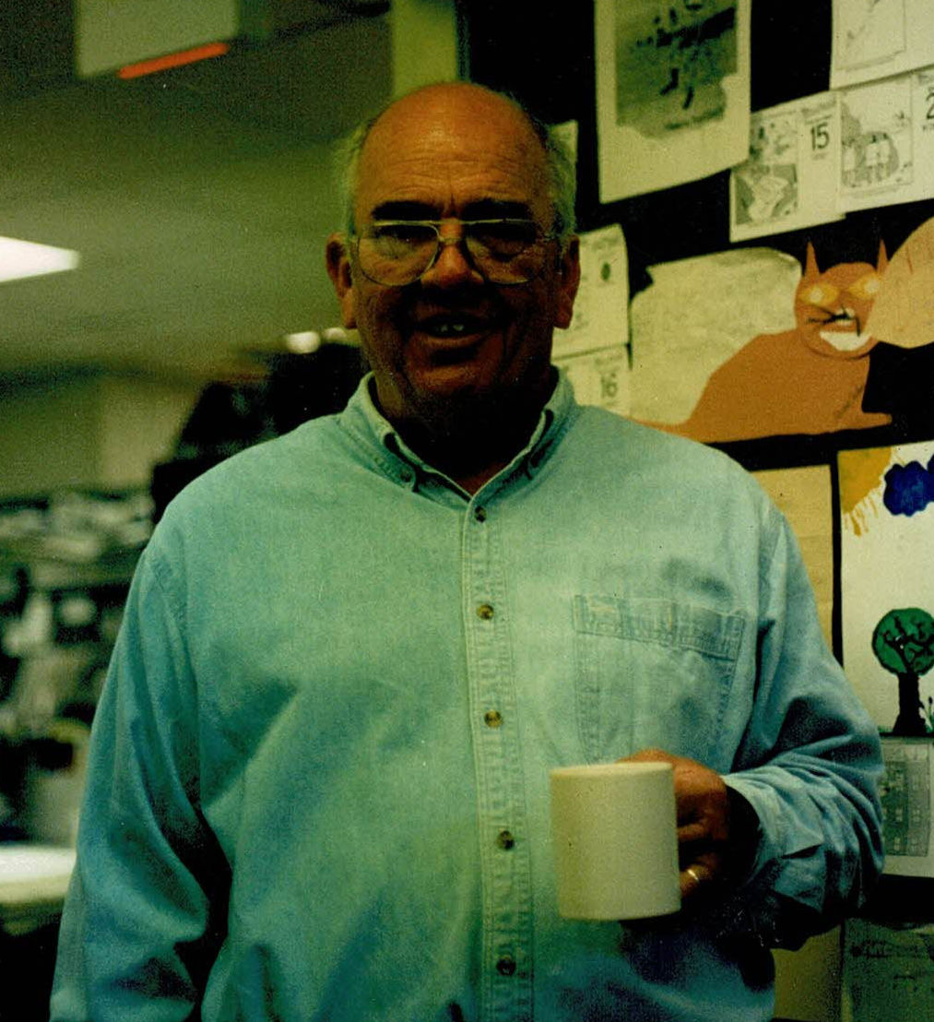
What Mentors Have Taught Me About Commissioning and Design
Notes:
When Michael asked me to do this, I was not sure I was a plenary speaker type of guy
But then he told me the title and I figured I might be O.K. at this one since I have been blessed with great mentors for my entire career.
Fill slide with mentor pictures and fade text

Slide 7
Maybe your heart is telling you something and you should listen
Notes:
When Michael asked me to do this, I was not sure I was a plenary speaker type of guy
But then he told me the title and I figured I might be O.K. at this one since I have been blessed with great mentors for my entire career.
Fill slide with mentor pictures and fade text

Slide 8
Davey, no matter how much you love what you do, it should never be more than 49% of your life
Notes:
When Michael asked me to do this, I was not sure I was a plenary speaker type of guy
But then he told me the title and I figured I might be O.K. at this one since I have been blessed with great mentors for my entire career.
Fill slide with mentor pictures and fade text

Slide 9
Try to be the type of person your dog believes you are
Notes:
When Michael asked me to do this, I was not sure I was a plenary speaker type of guy
But then he told me the title and I figured I might be O.K. at this one since I have been blessed with great mentors for my entire career.
Fill slide with mentor pictures and fade text

Slide 10
Think Outside the Box
Notes:
When Michael asked me to do this, I was not sure I was a plenary speaker type of guy
But then he told me the title and I figured I might be O.K. at this one since I have been blessed with great mentors for my entire career.
Fill slide with mentor pictures and fade text

Slide 11
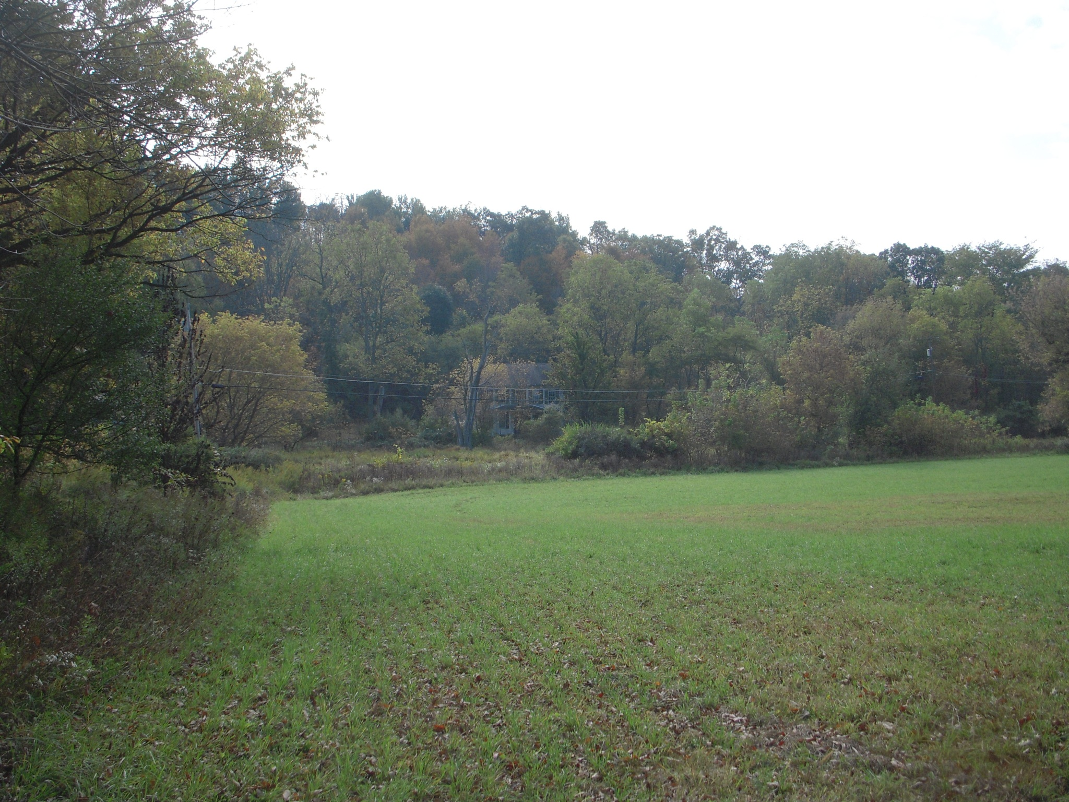
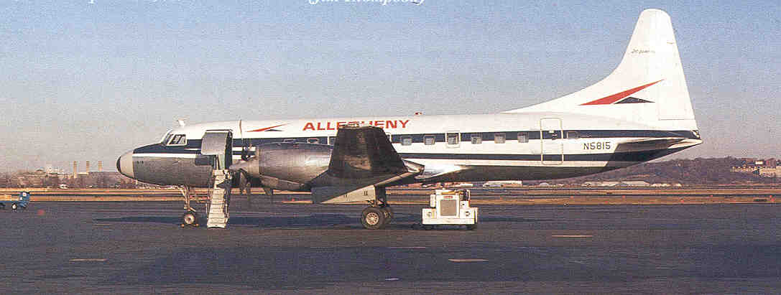
Two Things that have Always Been

Slide 12
Two Things that have Always Been

Slide 13
Two Things that have Always Been

Slide 14

The Common Thread

Slide 15
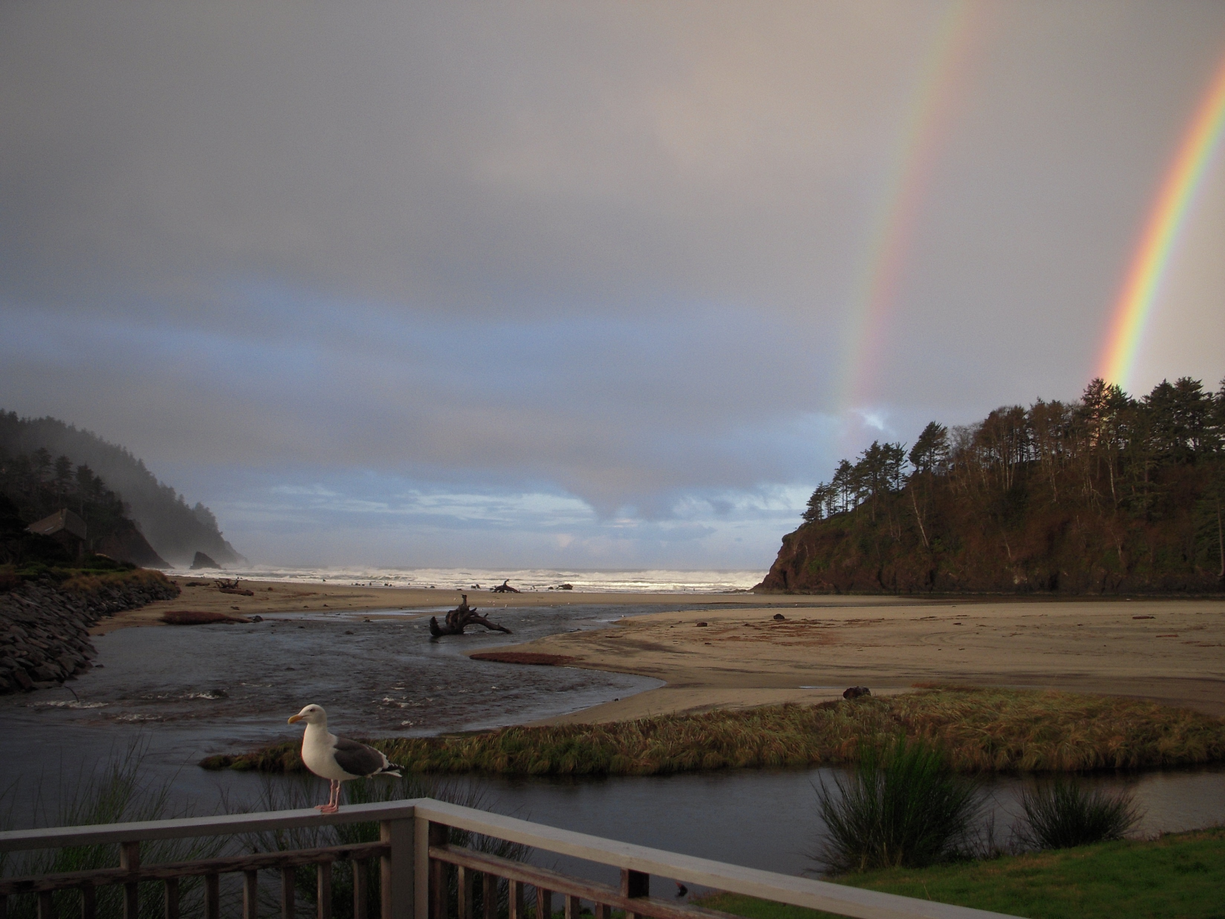
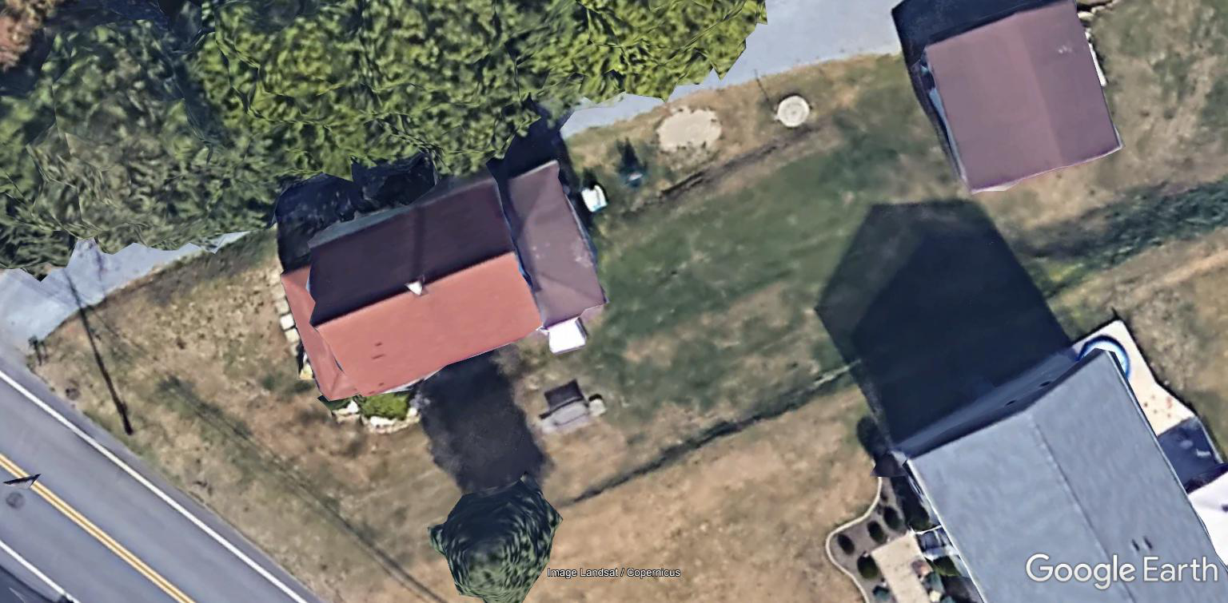
An Underlying Connection with the Earth
Mentor Characteristics
Mentor share their passion
Mentors provides guidance by leading you, not telling you
Mentors follow up

Slide 16
I Also Liked to Build Things

Slide 17
I Also Liked to Build Things
Mentor Characteristics
Mentor share their passion
Mentors provides guidance by leading you, not telling you
Mentors follow up

Slide 18
Dad Takes Me to Oregon
Mentor Characteristics
Mentor share their passion
Mentors provides guidance by leading you, not telling you
Mentors follow up

Slide 19
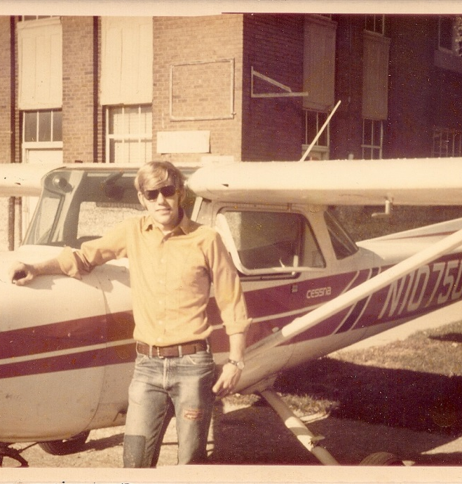

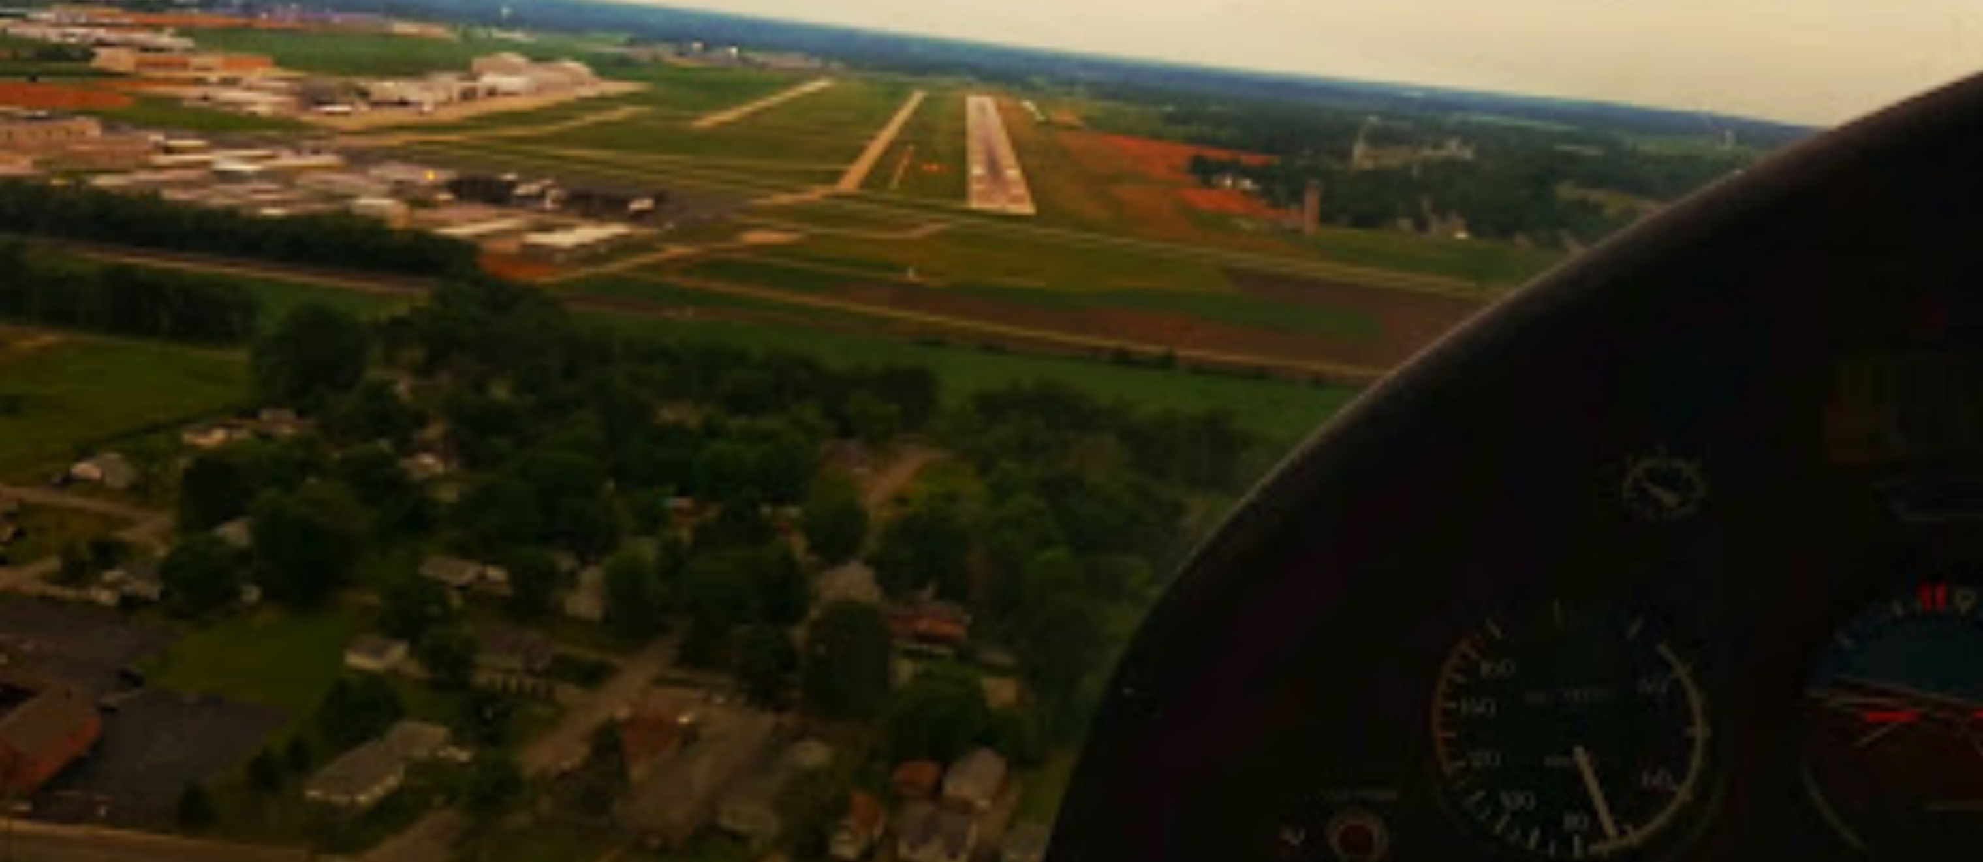
Dad Takes Me to Oregon
Mentor Characteristics
Mentor share their passion
Mentors provides guidance by leading you, not telling you
Mentors follow up
Mentors share dreams

Slide 20

I Set Out for a Career in Aviation
Mentor Characteristics
Mentor share their passion
Mentors provides guidance by leading you, not telling you
Mentors follow up
Mentors share dreams

Slide 21
I Set Out for a Career in Aviation
Mentor Characteristics
Mentor share their passion
Mentors provides guidance by leading you, not telling you
Mentors follow up
Mentors share dreams

Slide 22
I Set Out for a Career in Aviation
Mentor Characteristics
Mentor share their passion
Mentors provides guidance by leading you, not telling you
Mentors follow up
Mentors share dreams
Mentors are a bit selfless

Slide 23
I Work as an A&P and Lab Instructor
Mentor Characteristics
Mentor share their passion
Mentors provides guidance by leading you, not telling you
Mentors follow up
Mentors share dreams
Mentors are a bit selfless

Slide 24
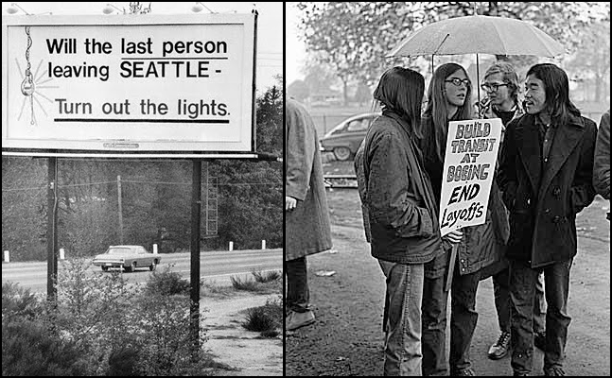
I Work as an A&P and Lab Instructor
Mentor Characteristics
Mentor share their passion
Mentors provides guidance by leading you, not telling you
Mentors follow up
Mentors share dreams
Mentors are a bit selfless
Mentors encourages self esteem
Mentors set professional goals
Mentors are proud of you

Slide 25
Reality Intervenes
Mentor Characteristics
Mentor share their passion
Mentors provides guidance by leading you, not telling you
Mentors follow up
Mentors share dreams
Mentors are a bit selfless
Mentors encourages self esteem
Mentors set professional goals
Mentors are proud of you

Slide 26
Reality Intervenes
Mentor Characteristics
Mentor share their passion
Mentors provides guidance by leading you, not telling you
Mentors follow up
Mentors share dreams
Mentors are a bit selfless
Mentors encourages self esteem
Mentors set professional goals
Mentors are proud of you

Slide 27
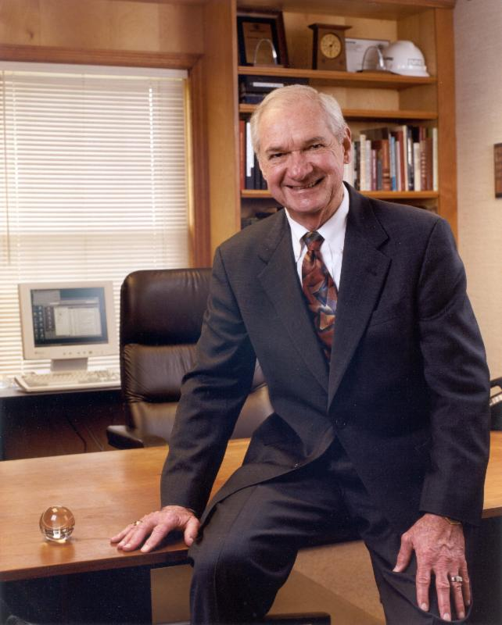
Reality Intervenes
    … that is to practice our profession with an emphasis upon our responsibility to protect the long-range interests of the society we serve and, specifically, to incorporate the ethics of energy conservation and environmental preservation in everything we do.
  ASHRAE Journal, vol. 42, no. 7, p. 16-21
  www.ASHRAE.org
Mentor Characteristics
Mentor share their passion
Mentors provides guidance by leading you, not telling you
Mentors follow up
Mentors share dreams
Mentors are a bit selfless
Mentors encourages self esteem
Mentors set professional goals
Mentors are proud of you
Mentor’s answer dumb questions with out judgement
Mentors help you see things differently
Mentors say thing’s like The goes intas gotta equal the goes outas

Slide 28
Inspiration Follows
Mentor Characteristics
Mentor share their passion
Mentors provides guidance by leading you, not telling you
Mentors follow up
Mentors share dreams
Mentors are a bit selfless
Mentors encourages self esteem
Mentors set professional goals
Mentors are proud of you
Mentor’s answer dumb questions with out judgement
Mentors help you see things differently
Mentors say thing’s like The goes intas gotta equal the goes outas
  Energy Conservation is an Ethic
    … that is to practice our profession with an emphasis upon our responsibility to protect the long-range interests of the society we serve and, specifically, to incorporate the ethics of energy conservation and environmental preservation in everything we do.
  ASHRAE Journal, vol. 42, no. 7, p. 16-21
  www.ASHRAE.org

Slide 29
Inspiration Follows
Mentor Characteristics
Mentor share their passion
Mentors provides guidance by leading you, not telling you
Mentors follow up
Mentors share dreams
Mentors are a bit selfless
Mentors encourages self esteem
Mentors sets professional goals
Mentors are proud of you
Mentor’s answer dumb questions with out judgement
Mentors help you see things differently
Mentors say thing’s like The goes intas gotta equal the goes outas
Mentor’s inspire you
  Energy Conservation is an Ethic
    … that is to practice our profession with an emphasis upon our responsibility to protect the long-range interests of the society we serve and, specifically, to incorporate the ethics of energy conservation and environmental preservation in everything we do.
  ASHRAE Journal, vol. 42, no. 7, p. 16-21
  www.ASHRAE.org

Slide 30
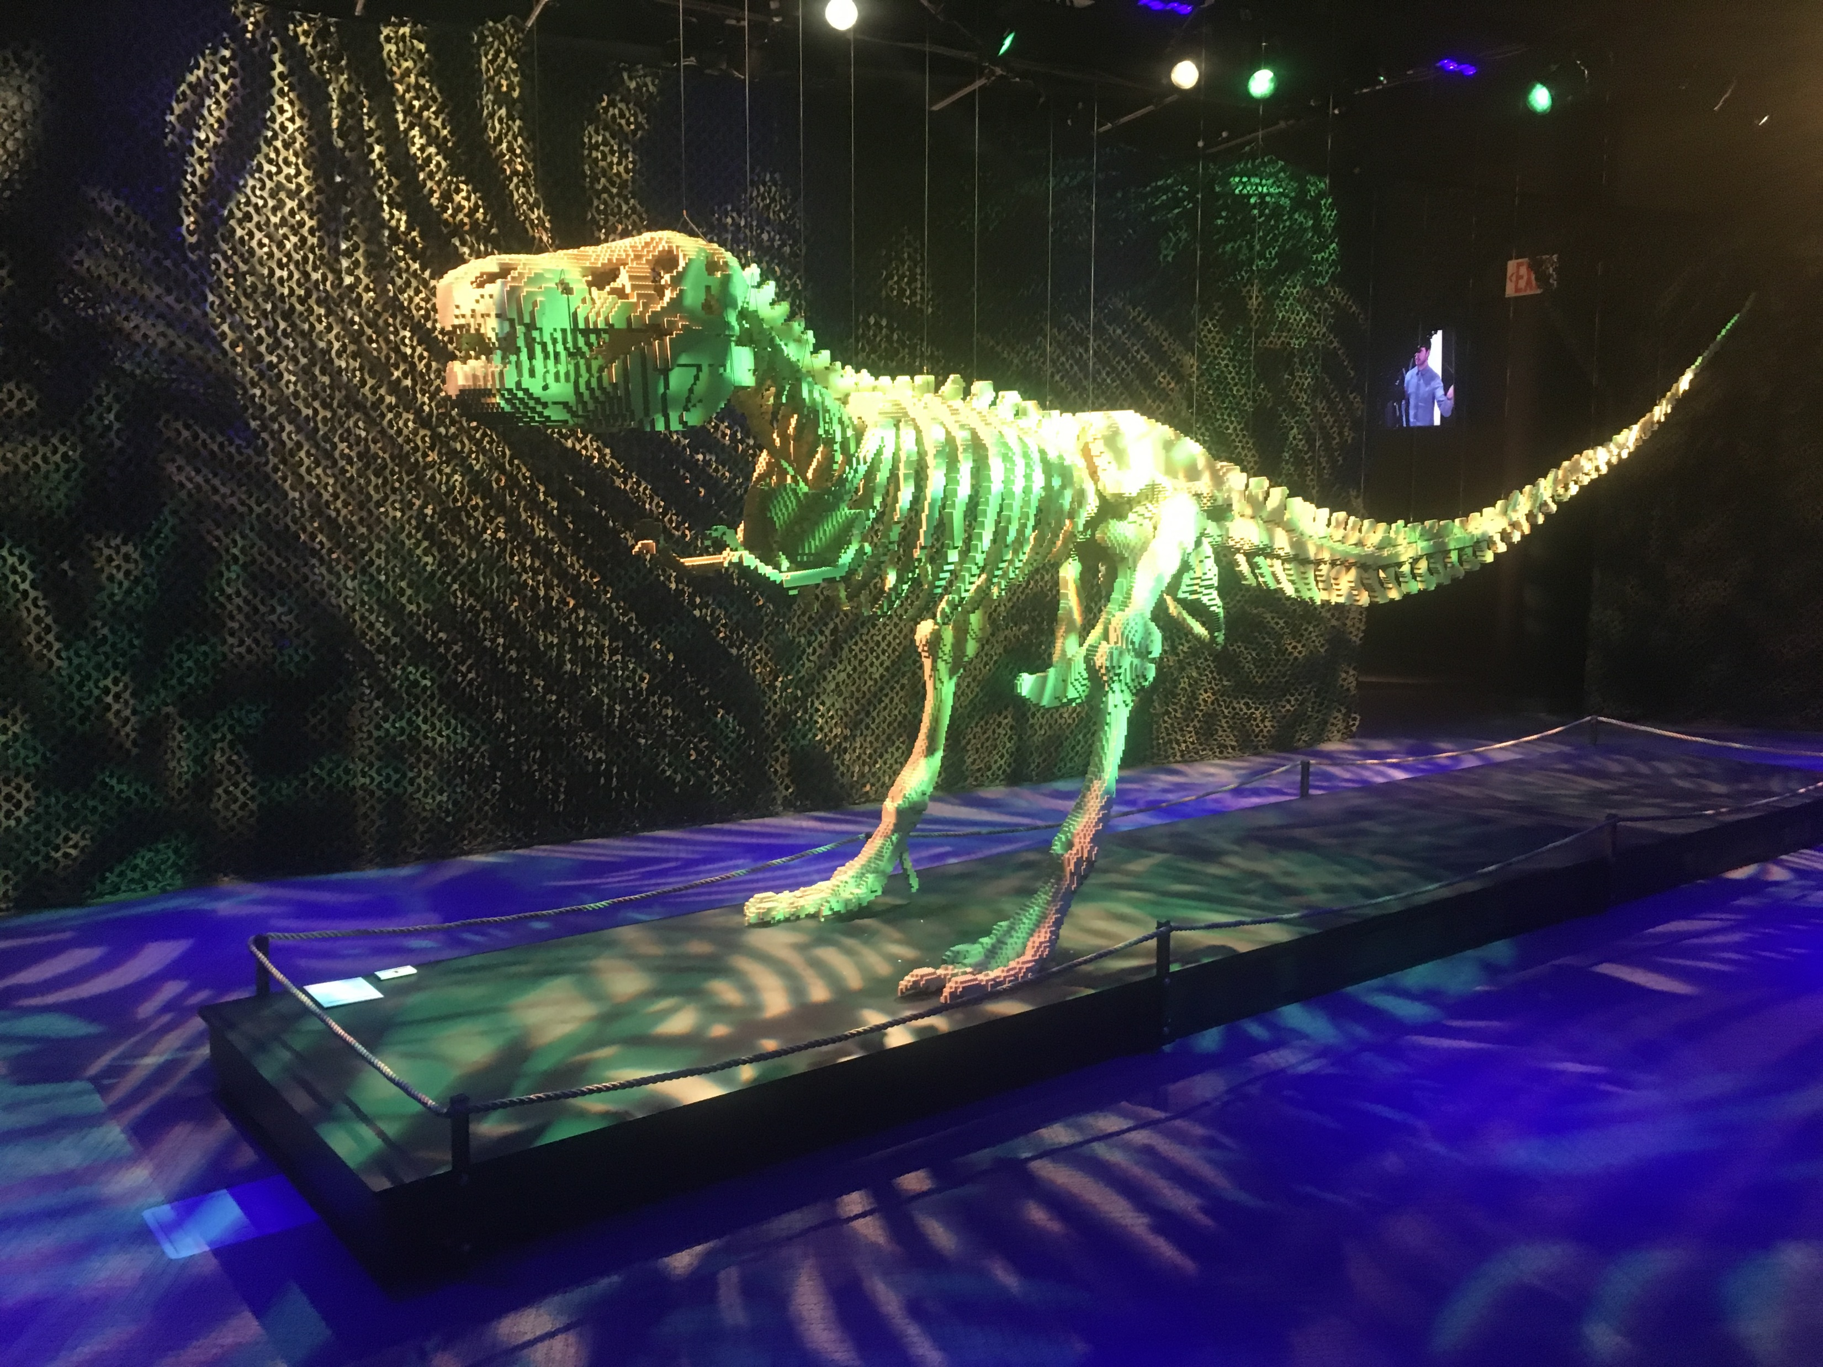
Mentor Characteristics
Mentor share their passion
Mentors provides guidance by leading you, not telling you
Mentors follow up
Mentors share dreams
Mentors are a bit selfless
Mentors encourages self esteem
Mentors sets professional goals
Mentors are proud of you
Mentor’s answer dumb questions with out judgement
Mentors help you see things differently
Mentors say thing’s like The goes intas gotta equal the goes outas
Mentor’s inspire you
Mentors know your history and advocate for good decisions
The possibility that there could be an energy crisis can be intuitively derived from a logical assessment of the information
Sometimes where you end up is foreshadowed by early life experience

Slide 31
Mentor Characteristics
Mentor share their passion
Mentors provides guidance by leading you, not telling you
Mentors follow up
Mentors share dreams
Mentors are a bit selfless
Mentors encourages self esteem
Mentors sets professional goals
Mentors are proud of you
Mentor’s answer dumb questions with out judgement
Mentors help you see things differently
Mentors say thing’s like The goes intas gotta equal the goes outas
Mentor’s inspire you
Mentors know your history and advocate for good decisions
The possibility that there could be an energy crisis can be intuitively derived from a logical assessment of the information
Sometimes where you end up is foreshadowed by early life experience

Slide 32
Mentor Characteristics
Mentor share their passion
Mentors provides guidance by leading you, not telling you
Mentors follow up
Mentors share dreams
Mentors are a bit selfless
Mentors encourages self esteem
Mentors sets professional goals
Mentors are proud of you
Mentor’s answer dumb questions with out judgement
Mentors help you see things differently
Mentors say thing’s like The goes intas gotta equal the goes outas
Mentor’s inspire you
Mentors know your history and advocate for good decisions
The possibility that there could be an energy crisis can be intuitively derived from a logical assessment of the information
Sometimes where you end up is foreshadowed by early life experience

Slide 33
Do you think you have been blessed with one or more great mentors?

Slide 34
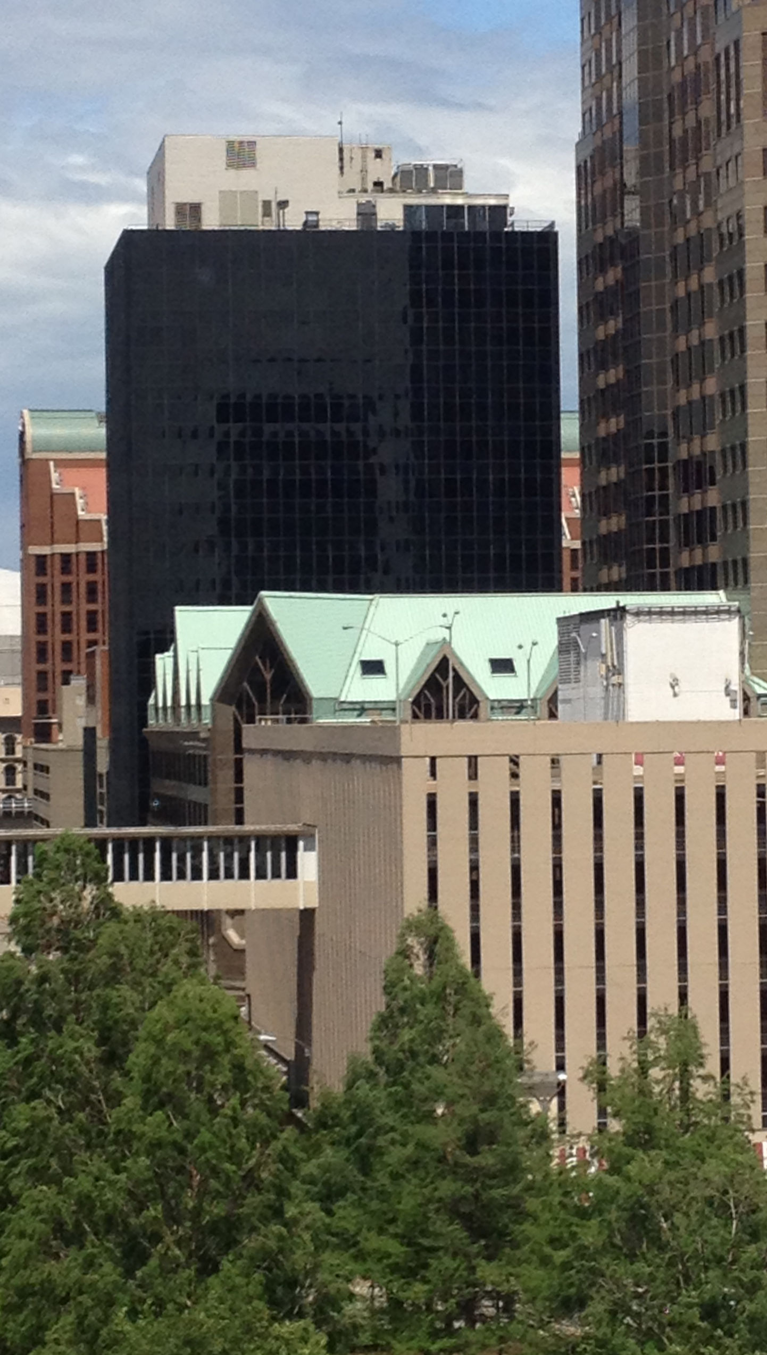
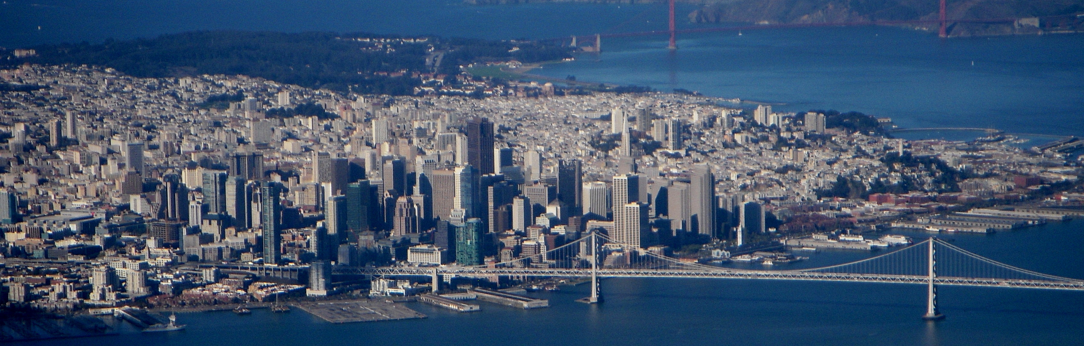
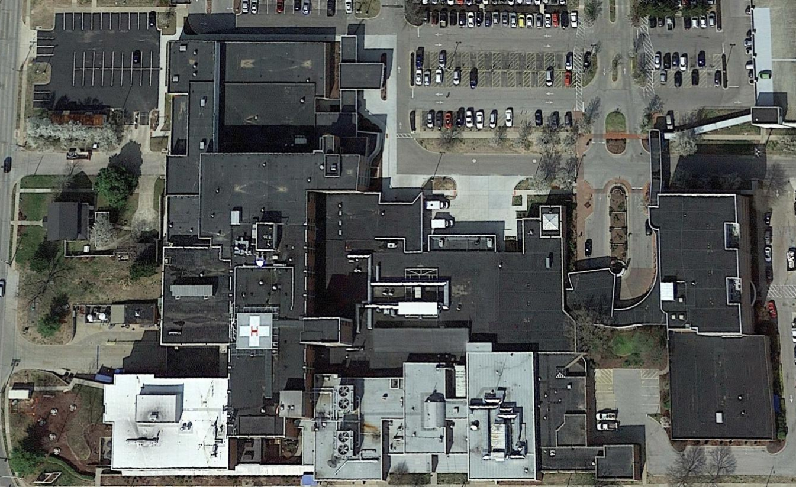
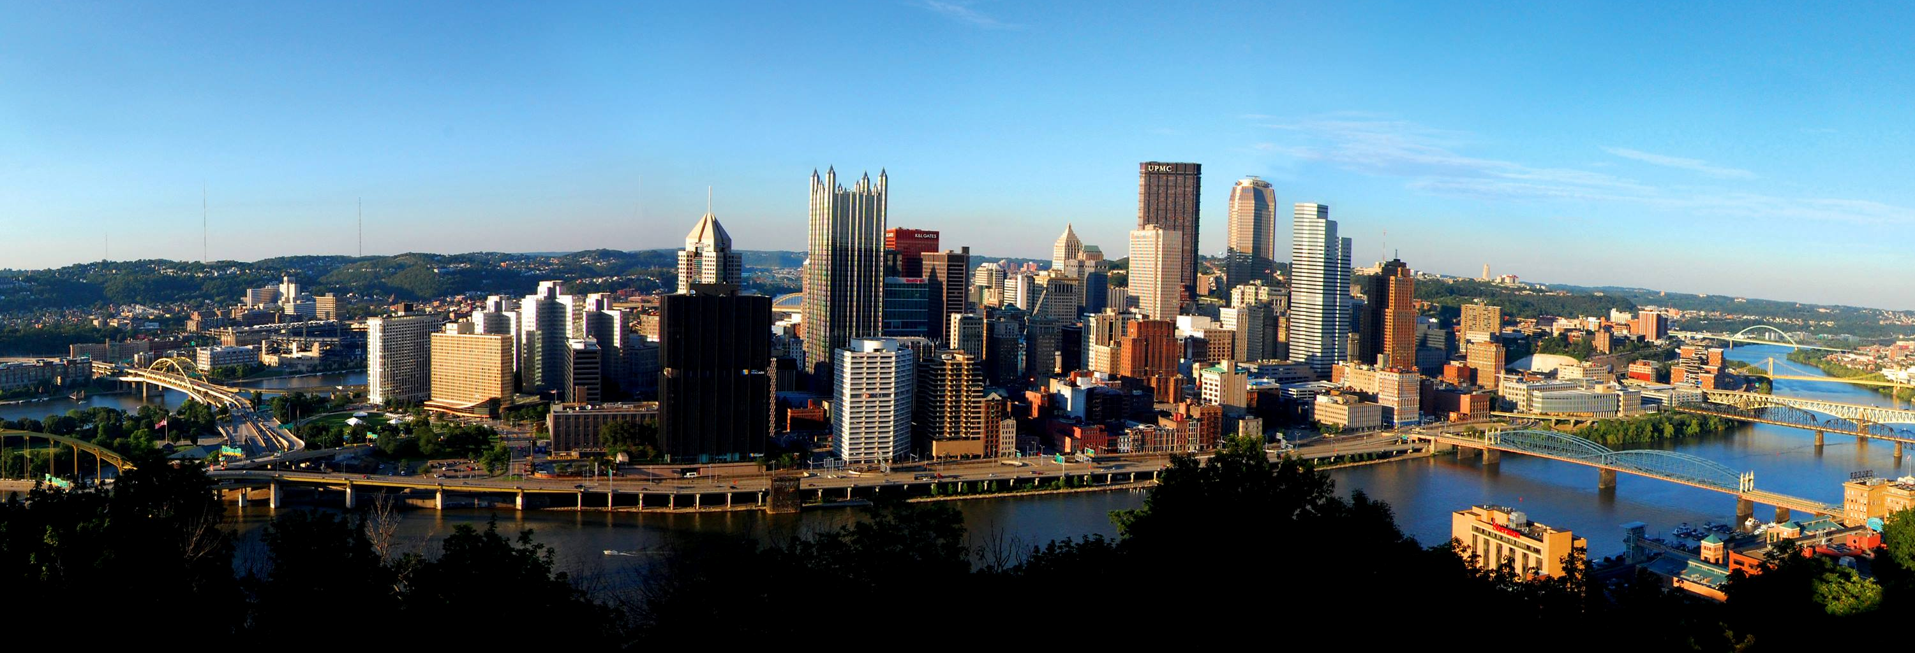
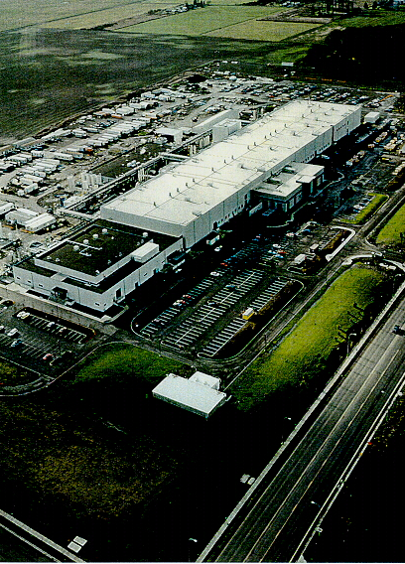
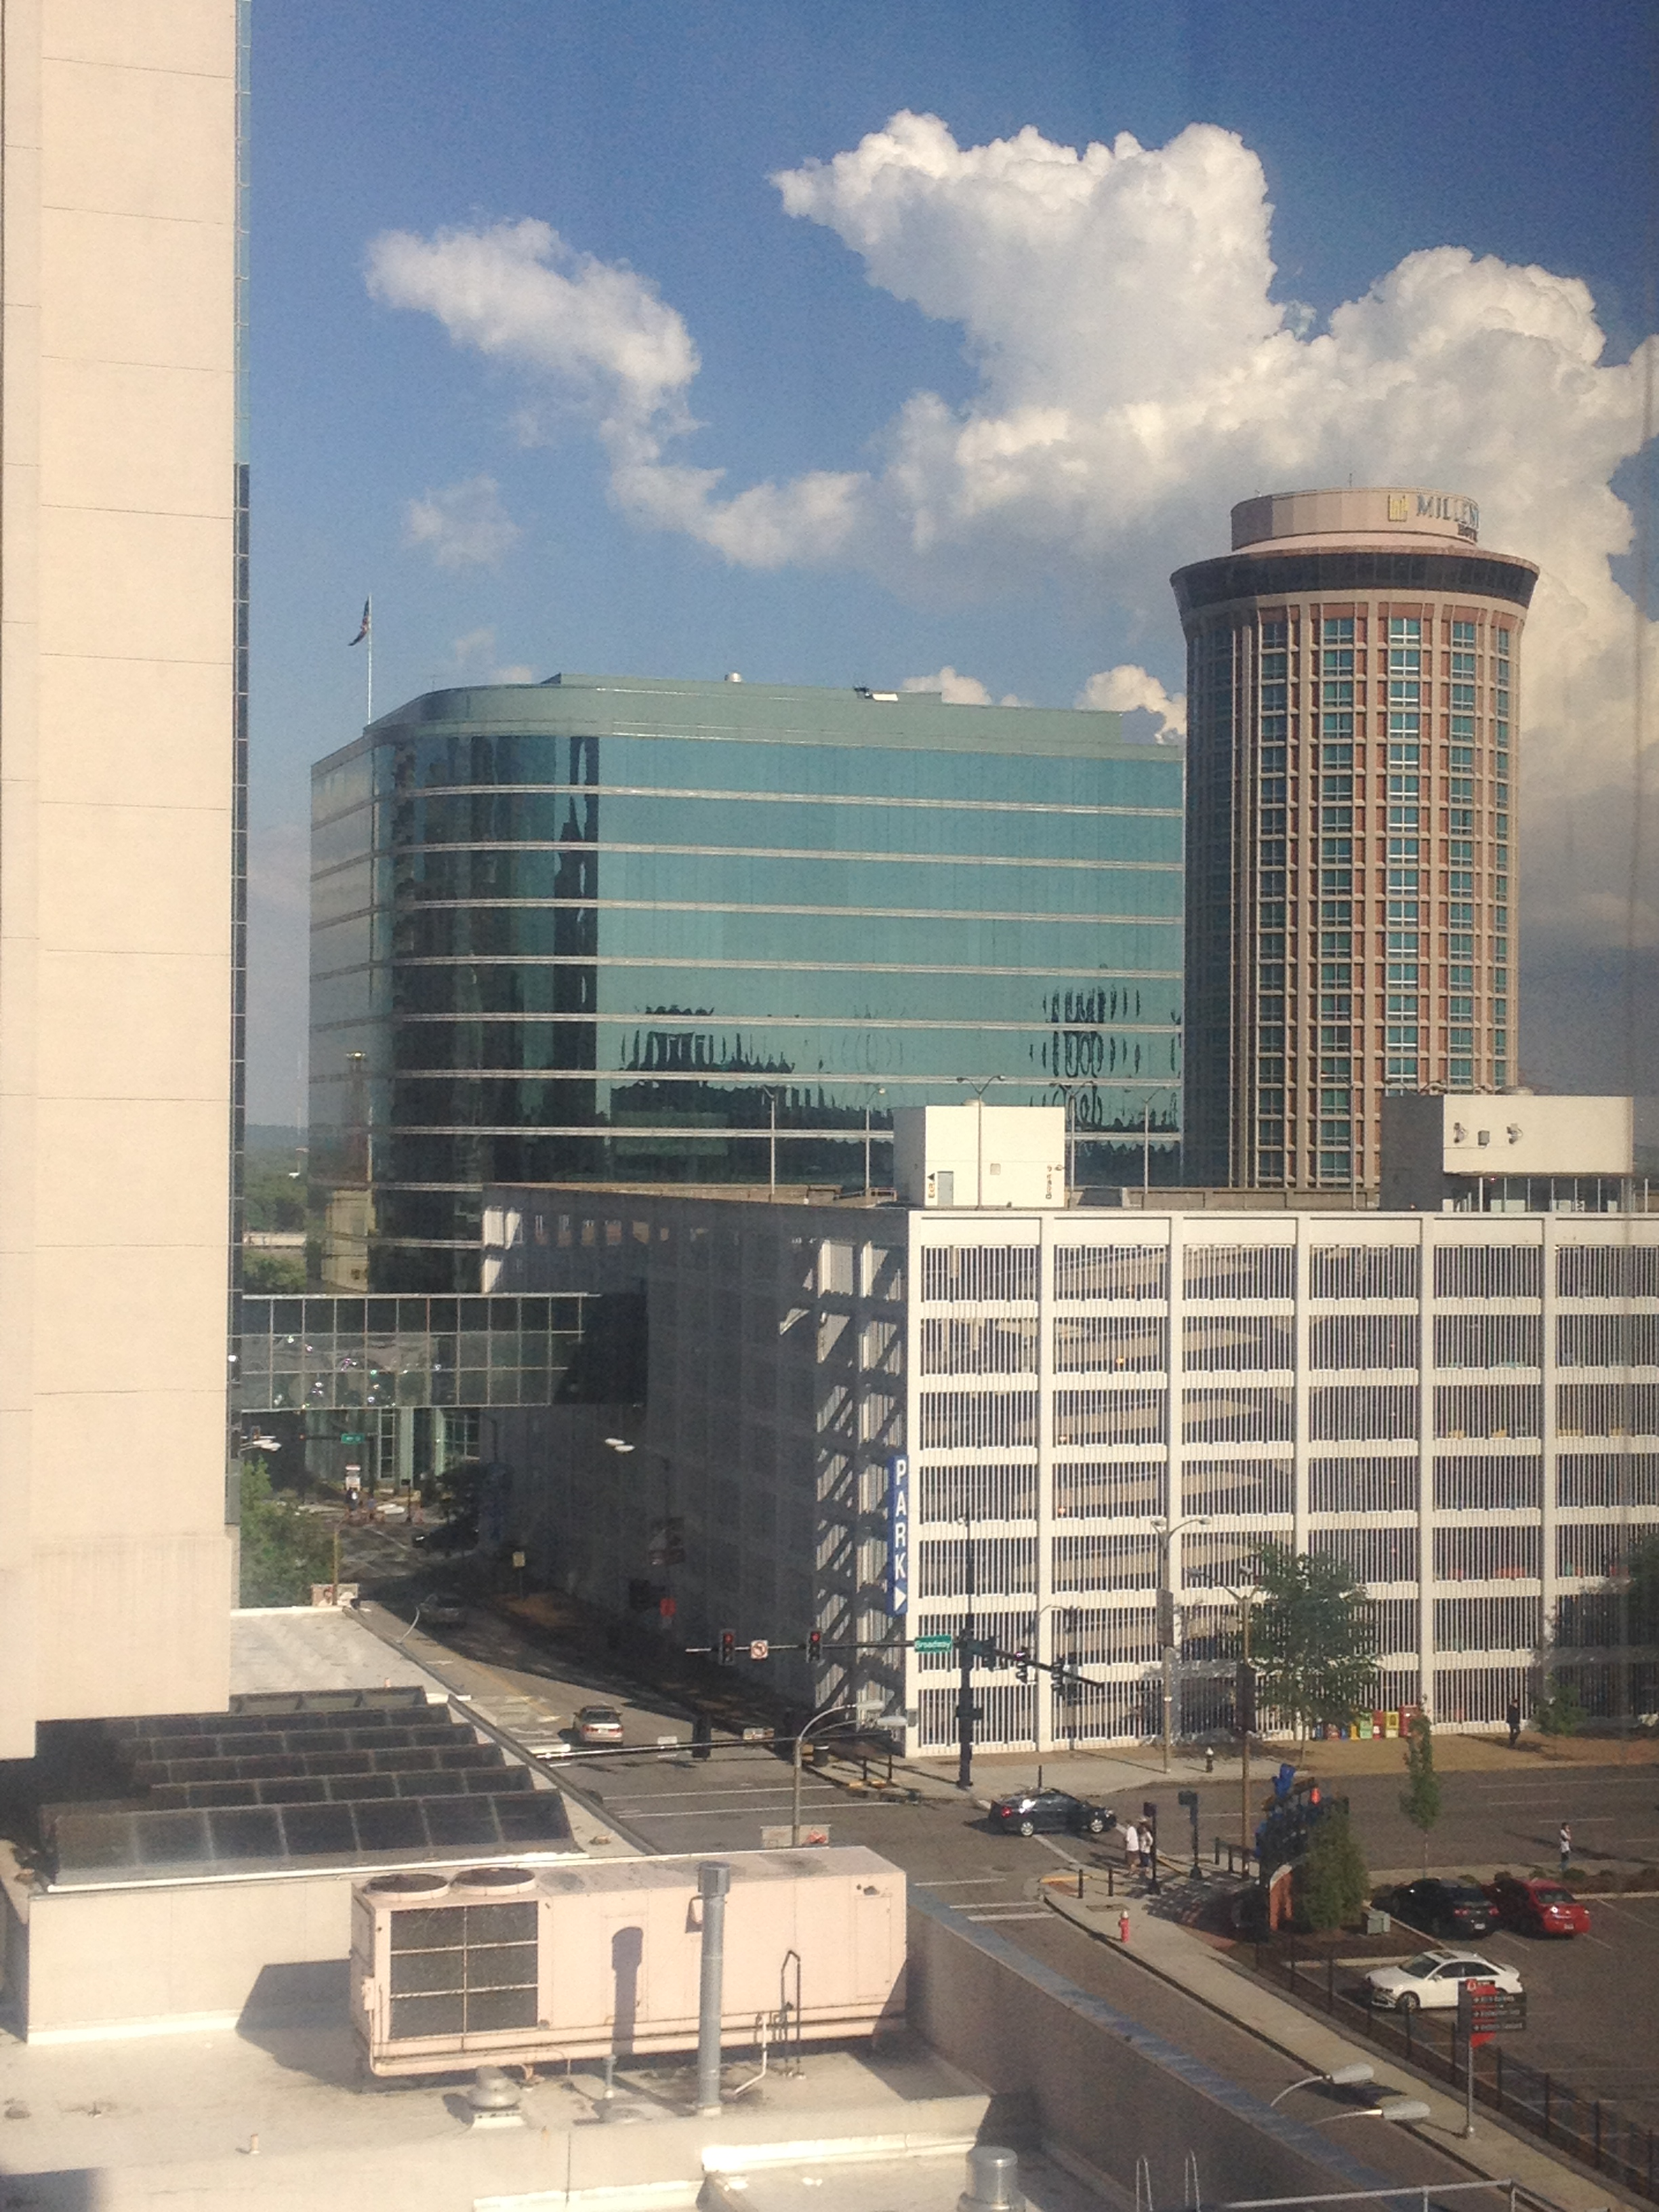
What Mentors Have Taught Me About Commissioning and Design
Notes:
When Michael asked me to do this, I was not sure I was a plenary speaker type of guy
But then he told me the title and I figured I might be O.K. at this one since I have been blessed with great mentors for my entire career.
Fill slide with mentor pictures and fade text

Slide 35
What Buildings Have Taught Me About Commissioning and Design
Notes:
When Michael asked me to do this, I was not sure I was a plenary speaker type of guy
But then he told me the title and I figured I might be O.K. at this one since I have been blessed with great mentors for my entire career.
Fill slide with mentor pictures and fade text

Slide 36
What Commissioning Has Taught Us About Mentoring and Design
Commissioning is a Process During Which Buildings Are Mentoring Us About Design
What Commissioning Has Taught Us About Mentoring and Design
What Commissioning Has Taught Us About Mentoring and Design Mentoring Us About Design
What Commissioning Has Taught Us About Mentoring and Design

Slide 37
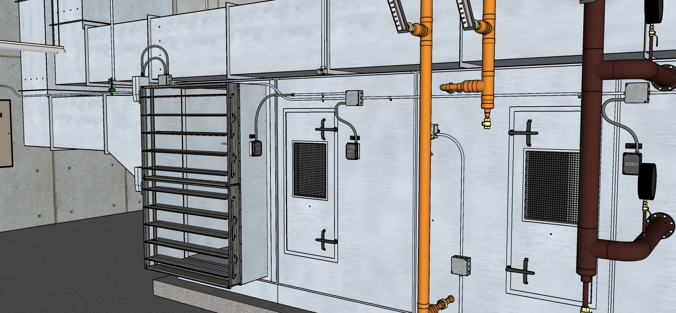
Airside Economizers
A Very Common HVAC Process
Significant energy savings potential
Simple in concept
Challenging to make/keep working

Slide 38
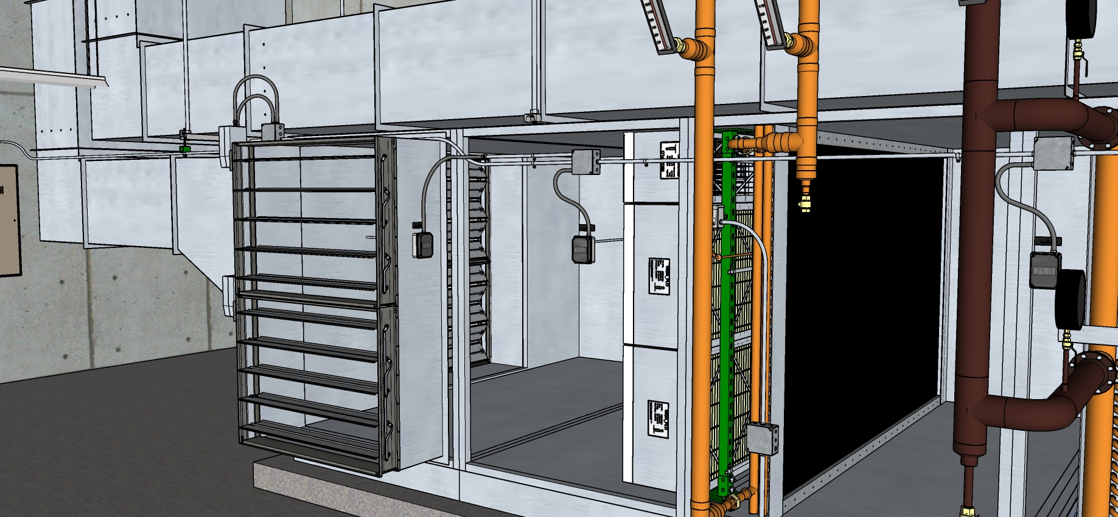
Airside Economizers
A Very Common HVAC Process
Significant energy savings potential
Simple in concept
Challenging to make/keep working

Slide 39
A Typical One Pipe Pneumatic Control System
Gauge
Air Supply (“Main” Air)
Piston
Filter
Spring
M
Diaphragm
Restrictor
Restrictor T
Actuator
Controller
Nozzle
“Flapper”

Slide 40
A Typical One Pipe Pneumatic Control System
M
A wide open flapper causes more of a pressure drop due to flow at the orifice in the restrictor tee than a flapper that has moved closer to the nozzle. As a result, the pressure down stream of the orifice is relatively low and the actuator retracts

Slide 41
A Typical One Pipe Pneumatic Control System
M
As the flapper closes, the flow and pressure drop due to flow through the restrictor tee orifice is reduced. As a result, the pressure down stream of the orifice builds and the actuator extends

Slide 42
A Typical One Pipe Pneumatic Control System
M
As the flapper closes, the flow and pressure drop due to flow through the restrictor tee orifice is reduced. As a result, the pressure down stream of the orifice builds and the actuator extends

Slide 43
A Typical One Pipe Pneumatic Control System
M
As the flapper closes, the flow and pressure drop due to flow through the restrictor tee orifice is reduced. As a result, the pressure down stream of the orifice builds and the actuator extends

Slide 44
A Typical One Pipe Pneumatic Control System
M
Flapper motion in the opposite direction increases the airflow through the restrictor tee orifice, the pressure downstream of the orifice drops again, and the actuator retracts

Slide 45
A Typical One Pipe Pneumatic Control System
M
Flapper motion in the opposite direction increases the airflow through the restrictor tee orifice, the pressure downstream of the orifice drops again, and the actuator retracts

Slide 46
A Typical One Pipe Pneumatic Control System
M
Flapper motion in the opposite direction increases the airflow through the restrictor tee orifice, the pressure downstream of the orifice drops again, and the actuator retracts

Slide 47
A Typical One Pipe Pneumatic Control System
M
Flapper motion in the opposite direction increases the airflow through the restrictor tee orifice, the pressure downstream of the orifice drops again, and the actuator retracts

Slide 48
A Typical One Pipe Pneumatic Control System
M
Flapper motion in the opposite direction increases the airflow through the restrictor tee orifice, the pressure downstream of the orifice drops again, and the actuator retracts

Slide 49
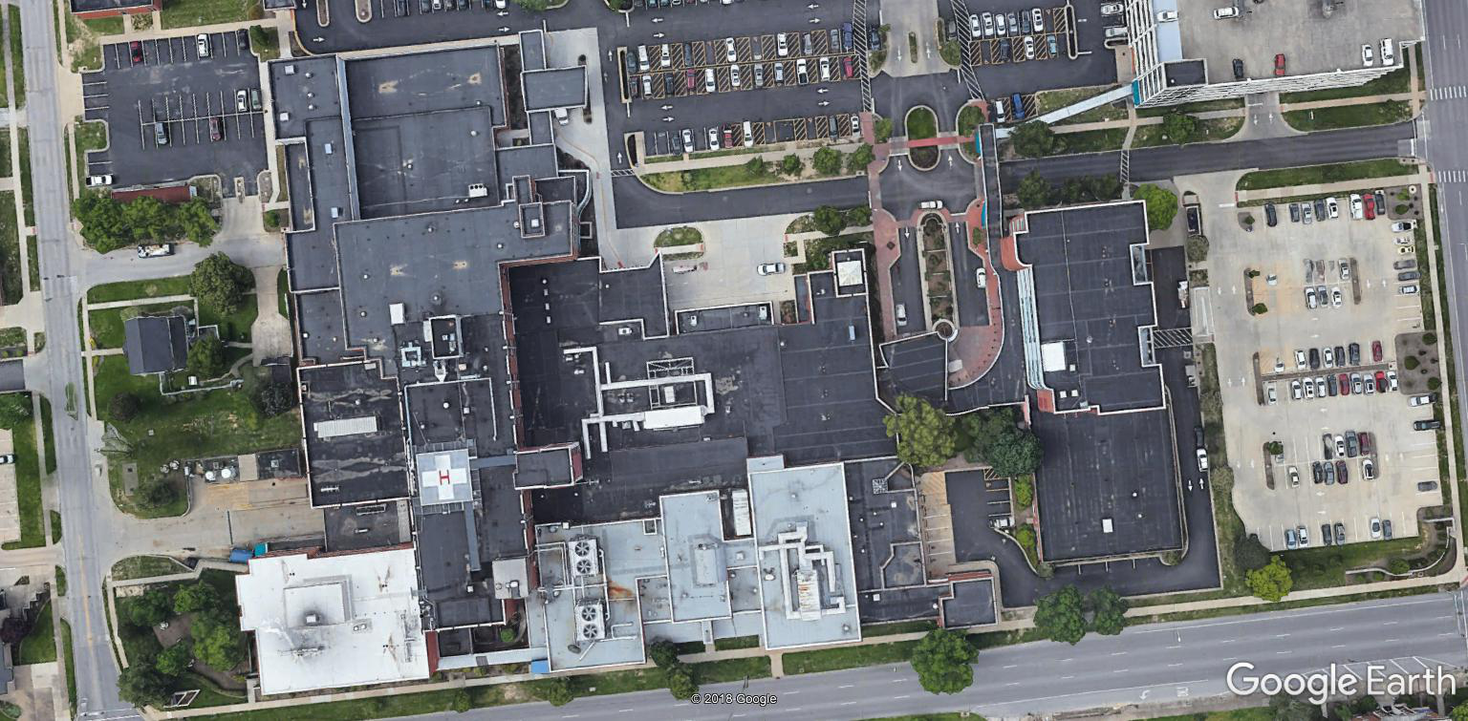
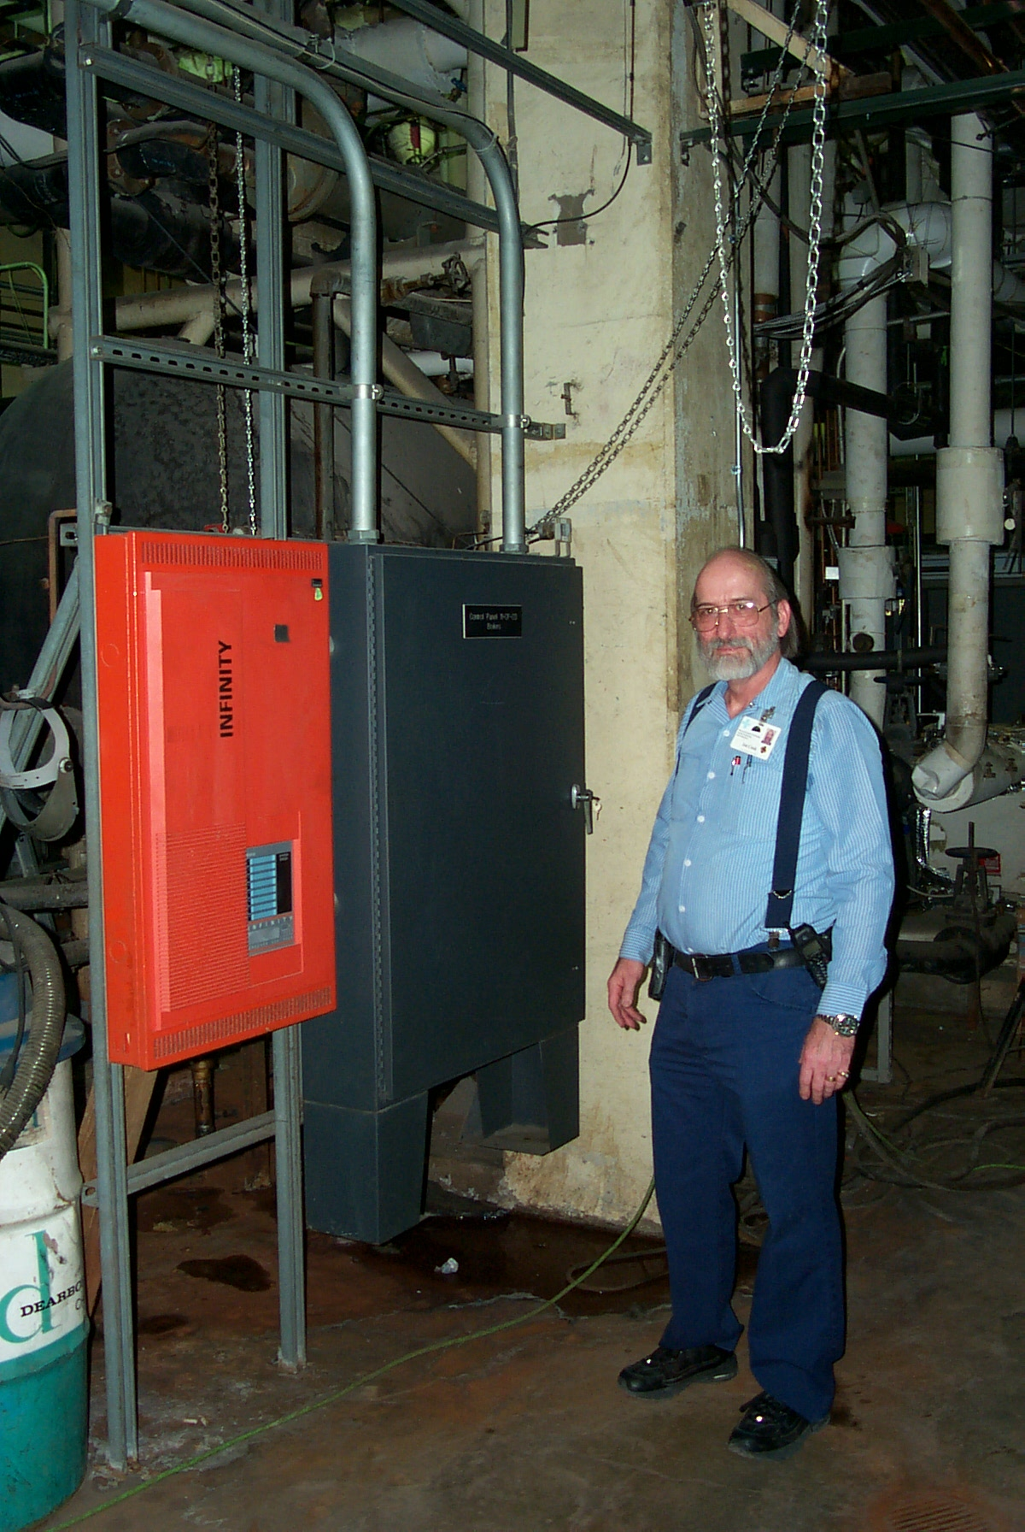
Memorial Hospital of Carbondale
Joe Cook
Didn’t kill me
Demonstrated that the building knows the answer, you just have to figure out how to ask the question

Slide 50
Memorial Hospital of Carbondale
Joe Cook
Didn’t kill me
Demonstrated that the building knows the answer, you just need to figure out how to ask the question

Slide 51
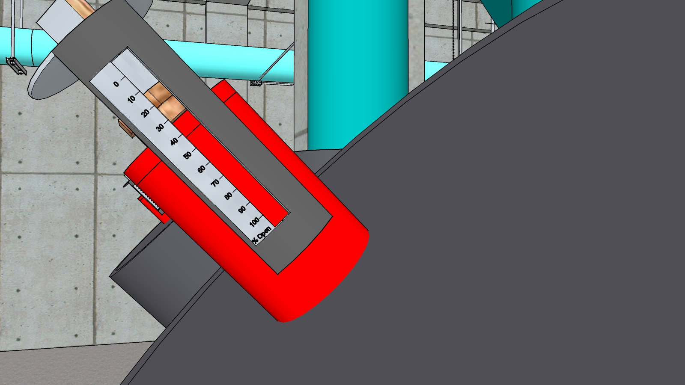
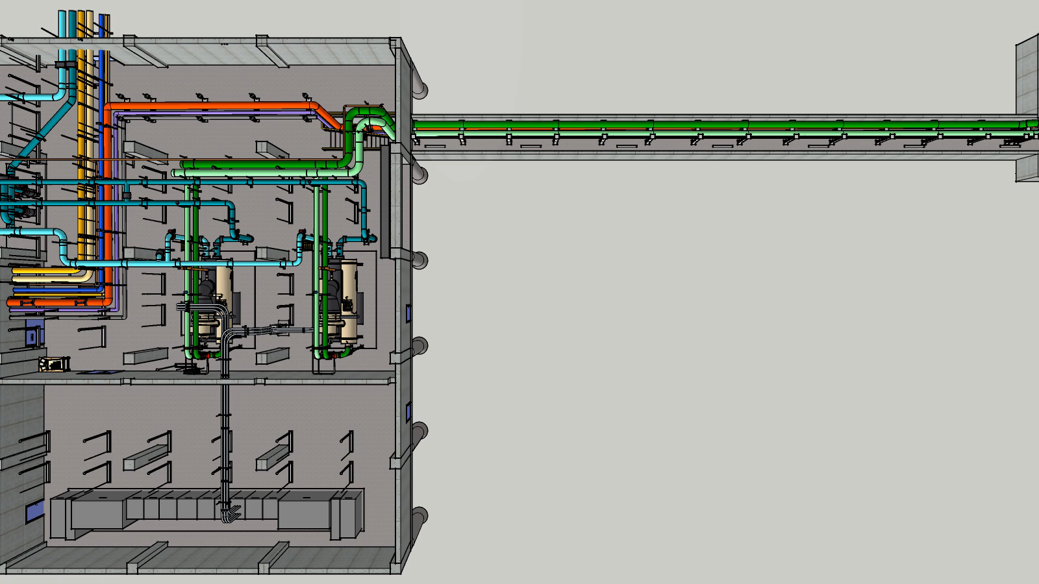
Pump Optimization
Another Common Opportunity

Slide 52
Pump Optimization
My first pump selection
Dead on at start-up (but I had a safety factor in there)
Learned about the affinity laws
  Tested impeller lines will be different from projected lines
Used my first VFD to run a pump at 68 hz to adapt it to a new operating condition

Slide 53
Some Bottom Lines
Mentors have a lot they can share with us from their experience with life and careers
Buildings and building systems have a lot to teach us if we get out there and “get dirty”

Slide 54
How Many of You Aspire to be Mentors?

Slide 55

Why This Matters
We went to explore the Moon, and in fact discovered the Earth
Gene Cernan
Apollo 17 Commander
Image courtesy NASA Image Archives; https://www.nasa.gov/multimedia/imagegallery/index.html

Slide 56
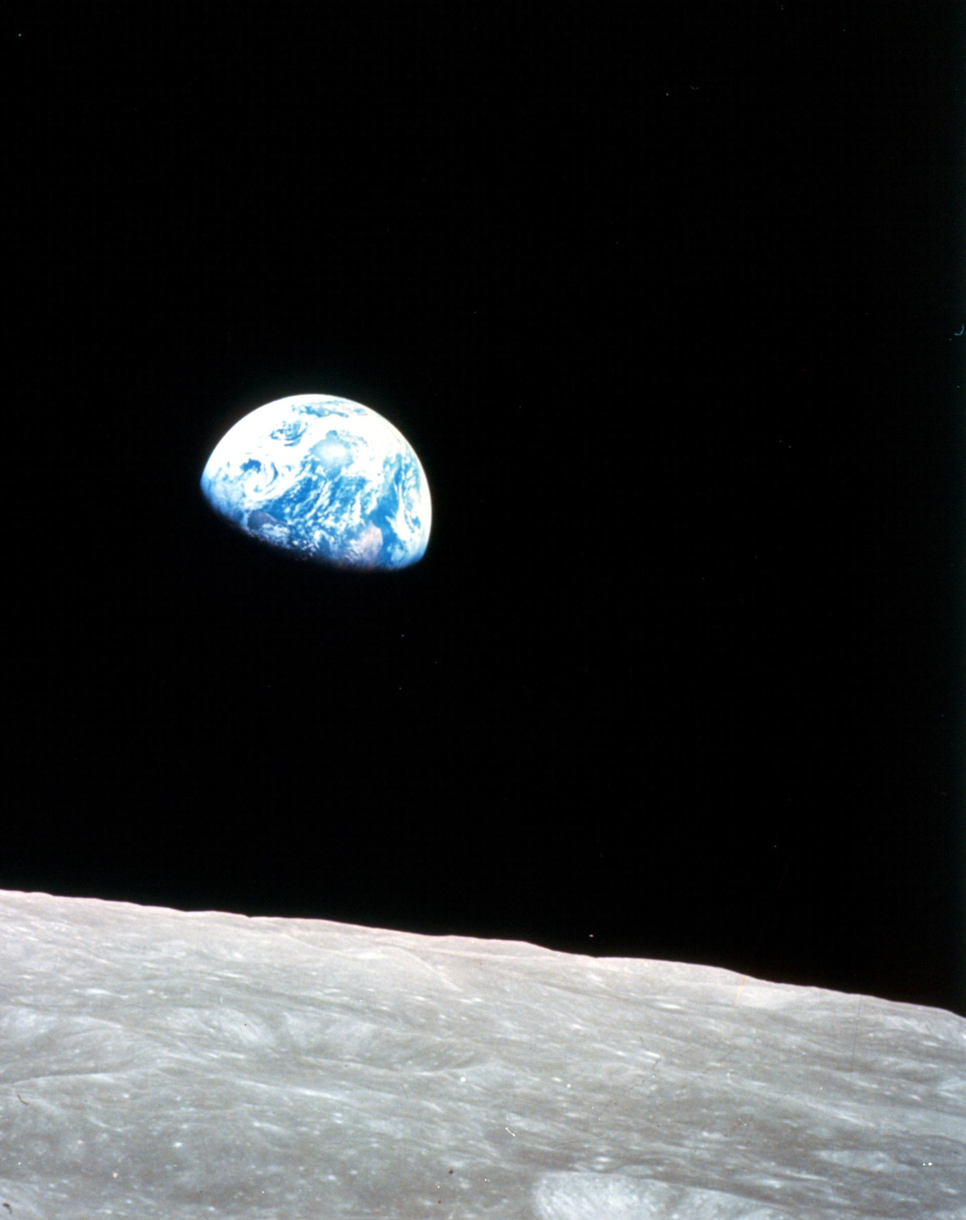
Why This Matters
In a highway service station
Over the month of June
Was a photograph of the earth
Taken coming back from the moon
And you couldn't see a city
On that marbled bowling ball
Or a forest or a highway
Or me here least of all
Joni Mitchell
Refuge of the Roads
Image courtesy NASA image archives https://www.nasa.gov/multimedia/imagegallery/image_feature_1249.html

Slide 57
Why This Matters
Holy Earth
How can we heal you?
We cover you like a blight...
Strange birds of appetite...
If I had a heart I'd cry.
Joni Mitchell
If I Had a Heart
Image courtesy NASA image archives https://www.nasa.gov/multimedia/imagegallery/image_feature_1249.html

Slide 58
Why This Matters
How can the spirit of the earth like the white man?...
Everywhere the white man has touched it, it is sore.
Wintu Holy Woman
Image courtesy NASA image archives https://www.nasa.gov/multimedia/imagegallery/image_feature_1249.html

Slide 59
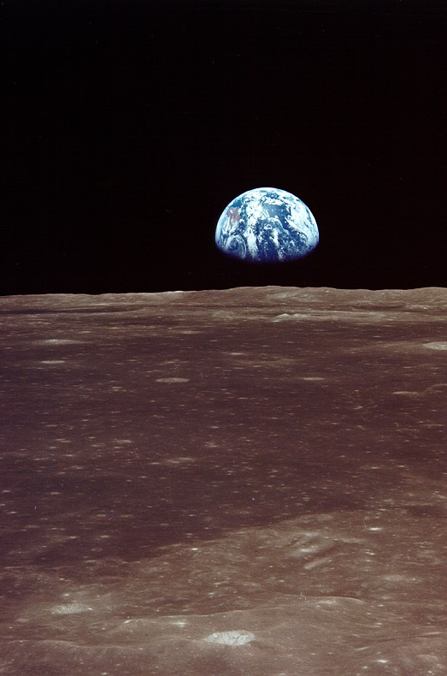
Why This Matters
Interviewer:
What is your strongest memory of Apollo 11?
Michael Collins; Command Module Pilot, Apollo 11
Looking back at Earth from a great distance.
I really believe that if the political leaders of the world could see their planet from a distance of 100,000 miles their outlook could be fundamentally changed.
The earth must become as it appears: blue and white, not capitalist or Communist; blue and white, not rich or poor; blue and white, not envious or envied.
Small, shiny, serene, blue and white, FRAGILE.
Image courtesy NASA Image Archives; https://www.hq.nasa.gov/office/pao/History/ap11ann/kippsphotos/6550.jpg

Slide 60

Why This Matters
Interviewer:
That was 40 years ago. Would it look the same today?
Michael Collins; Command Module Pilot, Apollo 11
… It's certainly not serene, but definitely fragile, and growing more so. When we flew to the moon, our population was 3 billion; today it has more than doubled and is headed for 8 billion…
… The loss of habitat, the trashing of oceans, the accumulation of waste products - this is no way to treat a planet.
Image courtesy NASA Image Archiveshttps://www.nasa.gov/image-feature/earth-as-viewed-from-10000-miles

Slide 61
Why This Matters
Interviewer:
That was 40 years ago. Would it look the same today?
Michael Collins; Command Module Pilot, Apollo 11
… It's certainly not serene, but definitely fragile, and growing more so. When we flew to the moon, our population was 3 billion; today it has more than doubled and is headed for 8 billion…
… The loss of habitat, the trashing of oceans, the accumulation of waste products - this is no way to treat a planet.
Image courtesy NASA/OSIRIS-REx team and the University of Arizona

Slide 62
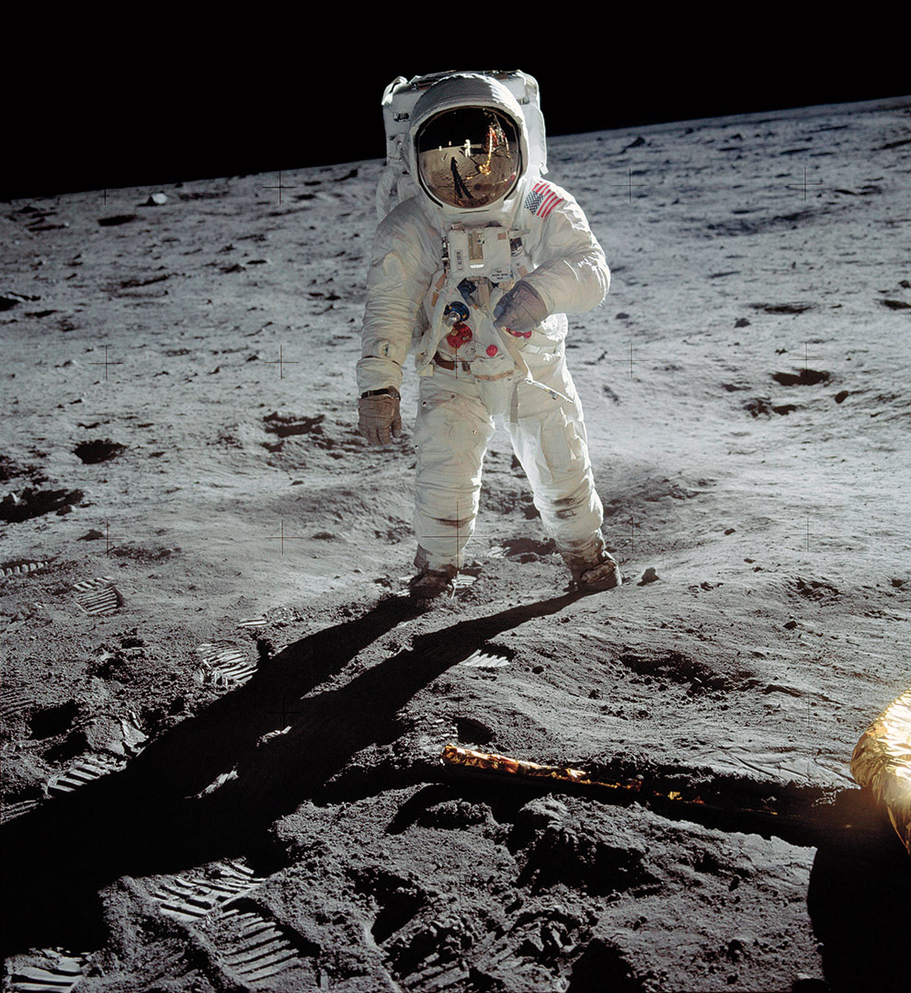
The very success of the human species over eons of time now threatens our extinction. It is the drive that made for success that must now be curbed, redirected, or released by expansion into a new world ecology. If we can find people skillful enough to reach the Moon, certainly we can find people to solve our environmental problems
Neil Armstrong

Slide 63
You Are Those People
We are running out of silver bullets
Jay Santos

Slide 64
You Are the Silver Bullets
We are running out of silver bullets
Jay Santos

Slide 65
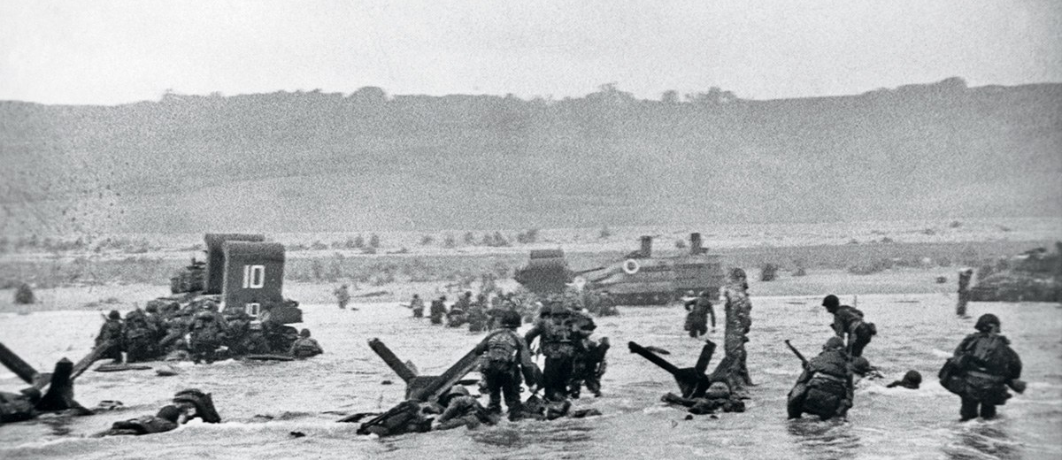
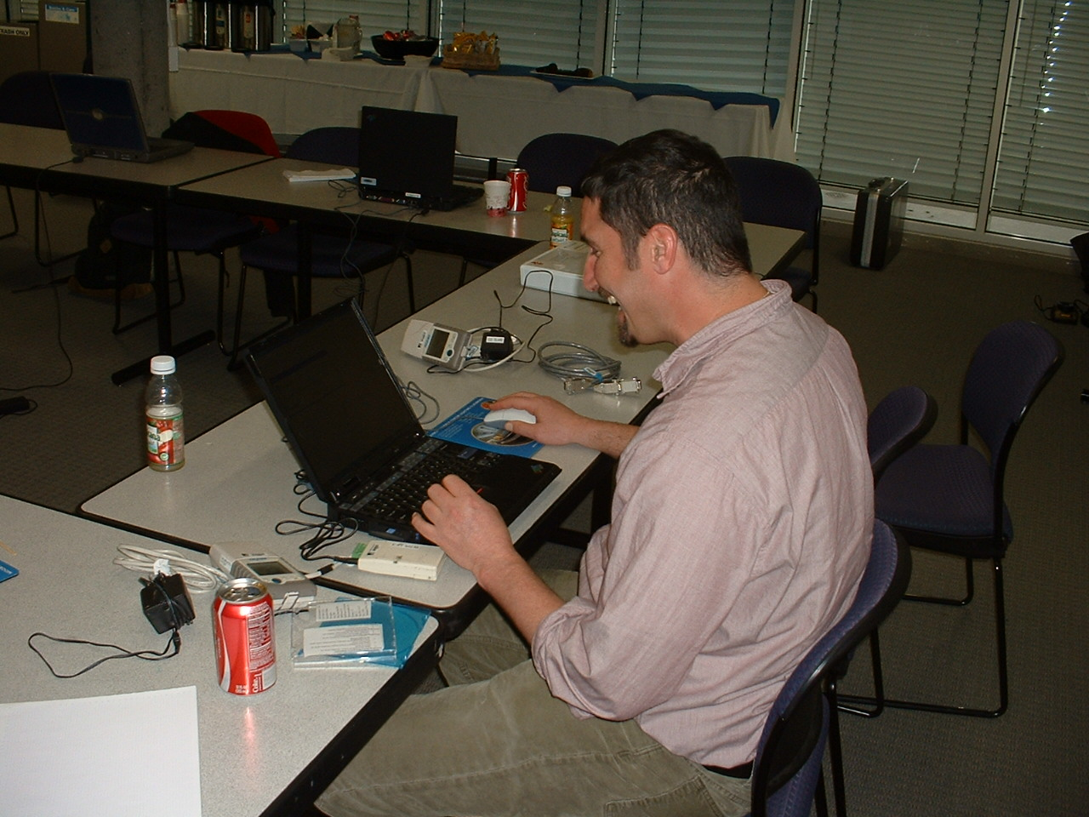
You Are the Next “Greatest Generation”
Continue working to solve the problem
Continue to take advantage of the opportunities places like the Pacific Energy Center offer
Share what you learn
Have fun doing it

Slide 66
You Are the Next “Greatest Generation”
Continue working to solve the problem
Continue to take advantage of the opportunities to learn like those the BCxA provides
Share what you learn
Have fun doing it

Slide 67
Thanks for Listening!
David Sellers
Senior Engineer
Facility Dynamics Engineering
Dsellers@FacilityDynamics.com https://av8rdas.wordpress.com/ (Blog) https://www.av8rdas.com/ (Cx Resources Website)

