Slide 1

Existing Building Commissioning Workshop:
Series 17, Session 2
Introduction to System Diagrams and the System Concept
Presented By:
David Sellers
Senior Engineer, Facility Dynamics Engineering

Slide 2
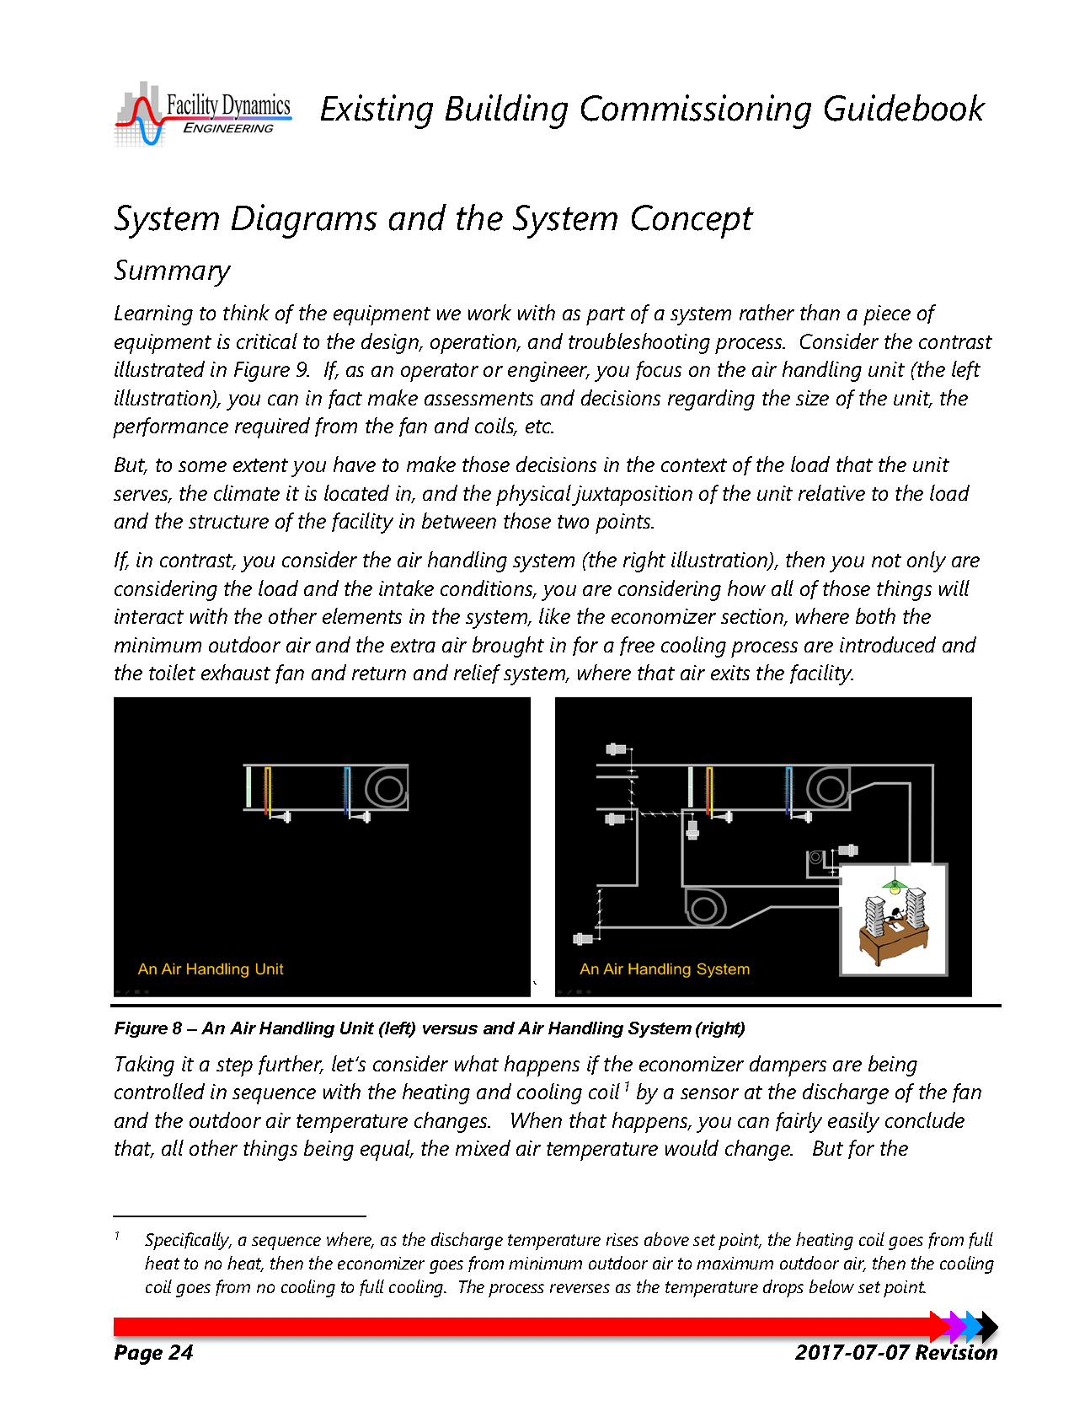
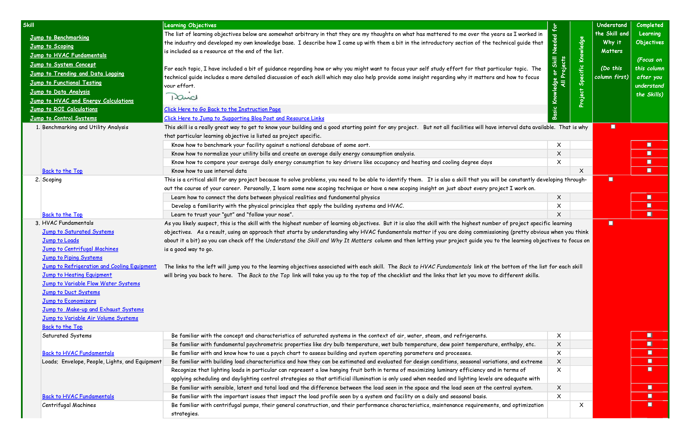
Self Study; Where You Should Be
Skills Guidebook
Checklist

Slide 3
System Diagraming Resources
Essential Blog Posts:
https://av8rdas.wordpress.com/2010/08/21/system-diagrams-essential-design-and-commissioning-tools/
https://av8rdas.wordpress.com/2010/08/27/system-diagrams-physically-complex-schematically-simple/
https://av8rdas.wordpress.com/2010/08/30/system-diagrams-untangled-it-it-should-look-like-a-ladder-on-its-side/
https://av8rdas.wordpress.com/2010/09/02/system-diagrams-order-of-connection-matters/

Slide 4
System Diagraming Resources
Supplementary Blog Posts; start with:
https://av8rdas.wordpress.com/2010/09/03/system-diagrams-untangling-the-pacific-energy-center-ice-storage-system/
For a complete list, use the drop-down “Category” menu and select “System Diagrams”

Slide 5
System Diagraming Resources
Visit the System Diagram Symbols Cx Resources Website Page
https://www.av8rdas.com/system-diagram-symbols.html
Download the files that will be helpful to you
Study the Symbols and Learn What They Represent

Slide 6
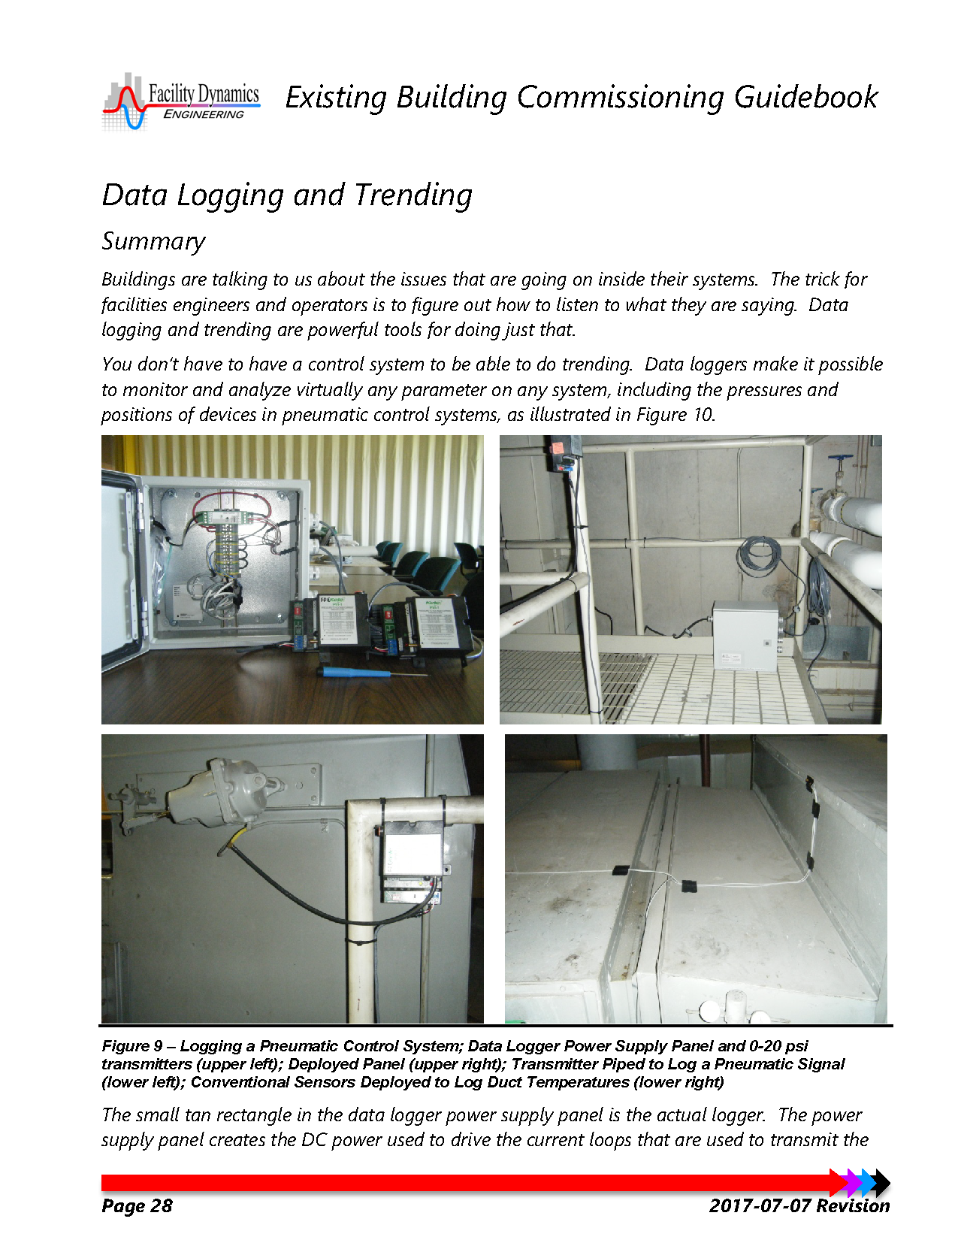
Self Study; Where You Should Be Headed
Skills Guidebook
Checklist

Slide 7
Monitoring Plan Resources
Resources linked from the technical guide
Resources on the Commissioning Resources Website
  https://www.av8rdas.com/monitoring-plan-spreadsheet.html

Slide 8
Datalogging and Control Systems are Intimately Related
To prepare for the next class, visit the Logic Diagram Tool page of the Commissioning Resources website
https://www.av8rdas.com/logic-diagram-tool.html
Download the Logic Diagram Tool file
Download the Logic Diagram Symbols file
Review the Logic Diagram Symbols file as time permits and be prepared to ask questions
Download and explore the other resources as time and interest permits

Slide 9
System Diagrams and the System Concept

Slide 10
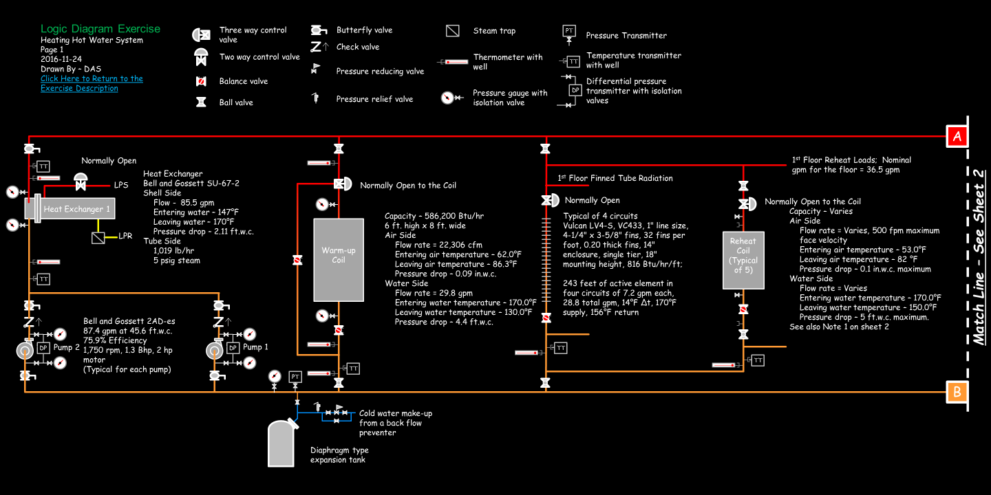
Its Not Just a Heat Exchanger … …It’s a Hot Water System

Slide 11
Its Not Just a Heat Exchanger … …It’s a Hot Water System

Slide 12
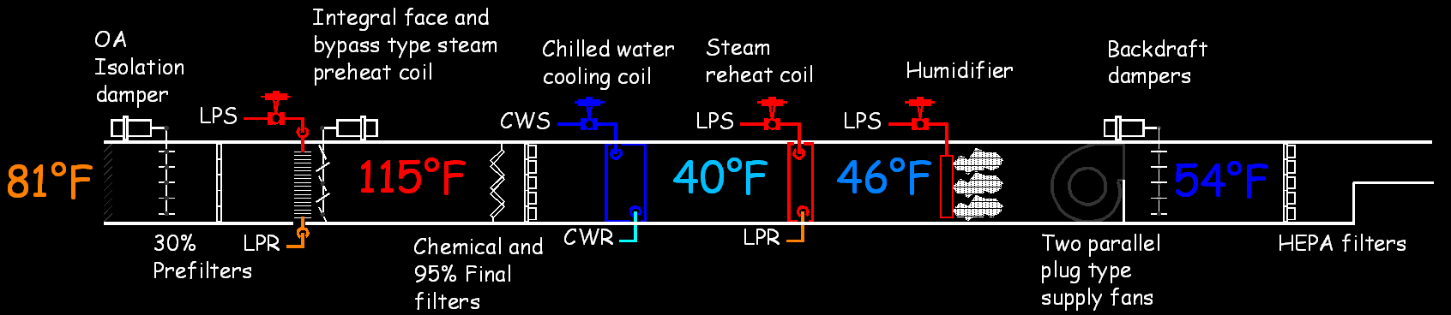
Its Not Just an Air Handling Unit … …It’s an Air Handling System

Slide 13
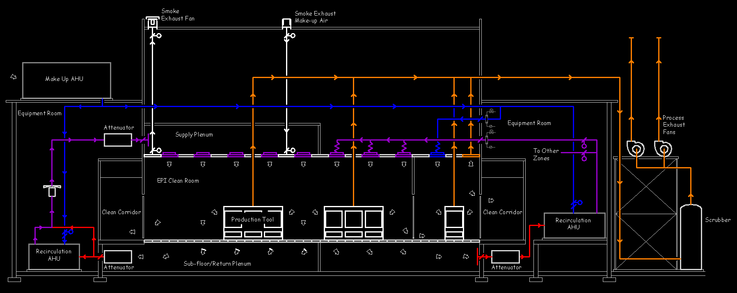
Its Not Just an Air Handling Unit … …It’s an Air Handling System

Slide 14
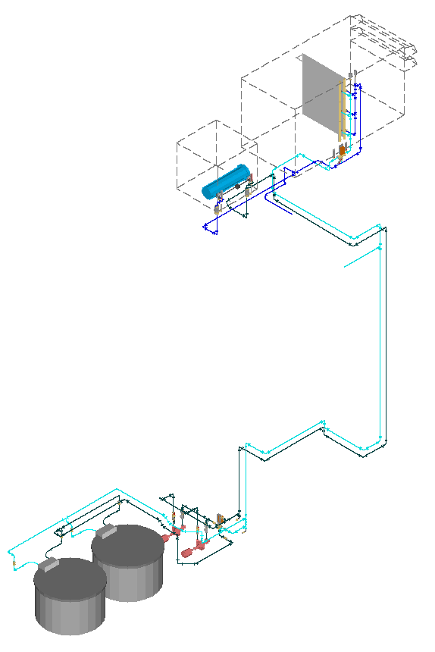
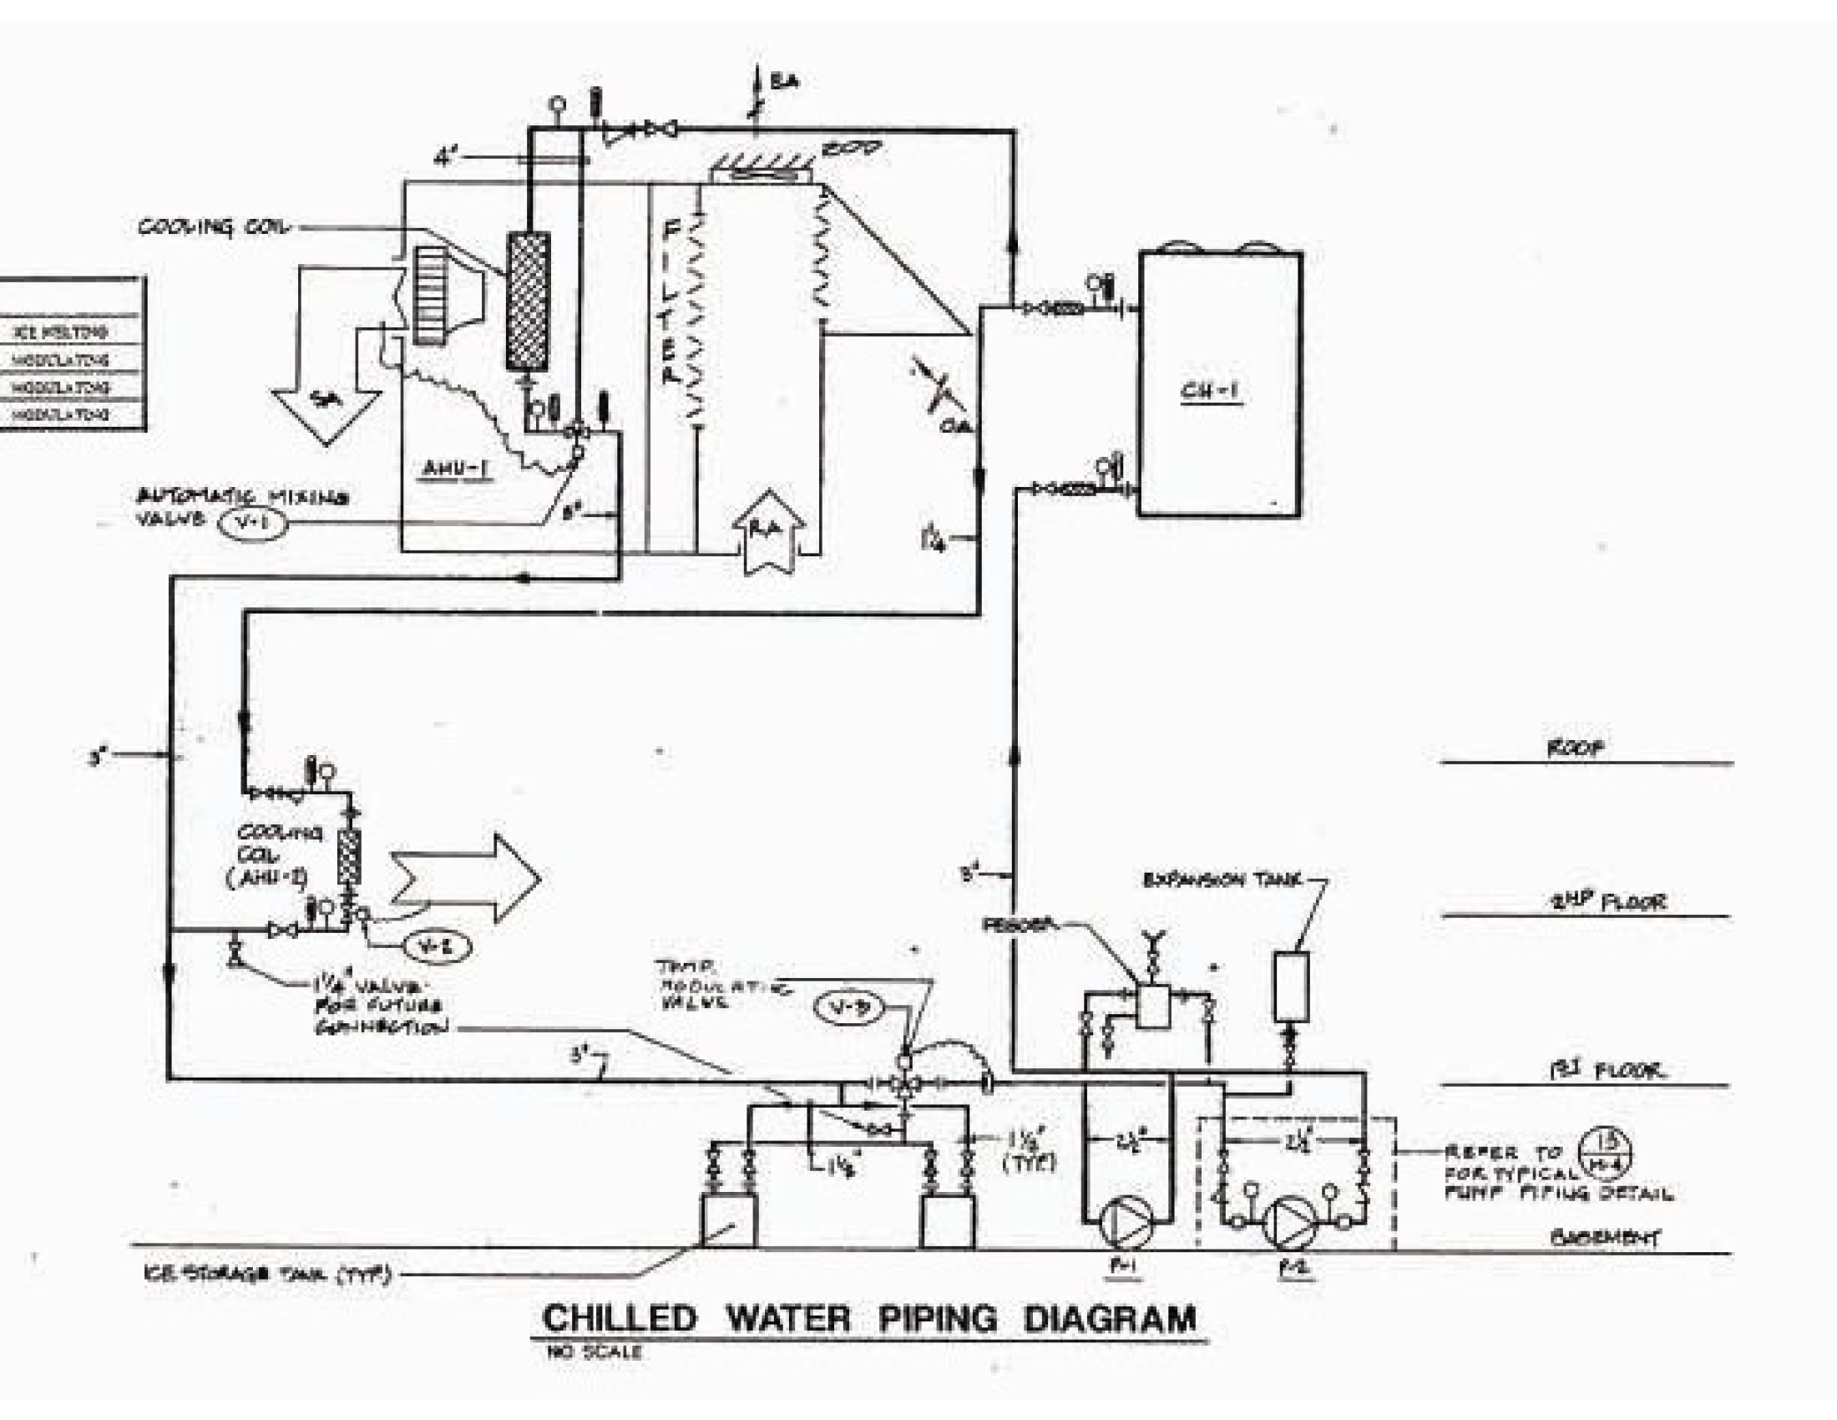
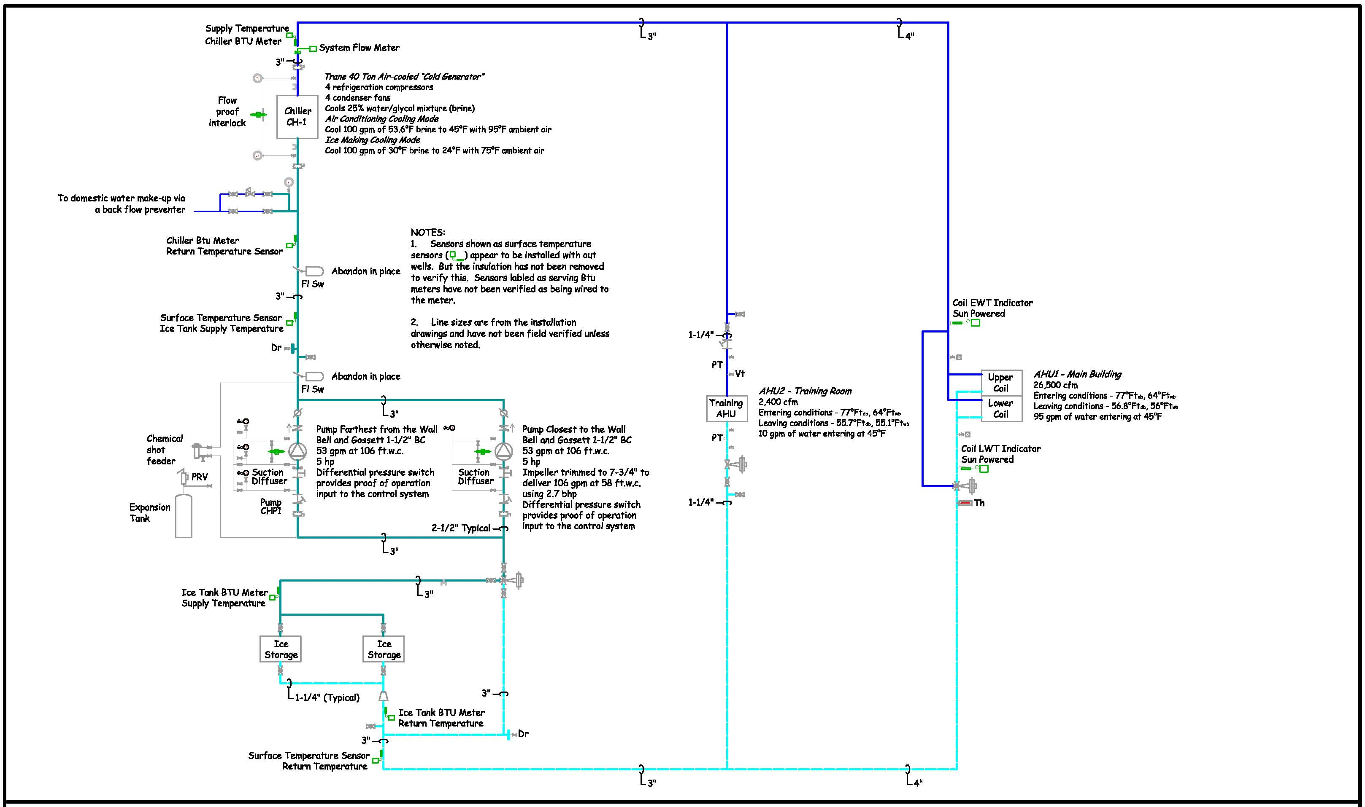
Physically Complex, Schematically Simple

Slide 15
Basic Concepts

Slide 16
“Like a Ladder on its Side”
Chuck McClure

Slide 17
Chuck’s Concept vs. the Designer’s Concept

Slide 18
A Ladder On Its Side in Japanese
横にはしごのように
Yoko ni hashigo no yō ni
We're doing that Japan training this week …. Just thought you'd want to know that the phrase "Ladder on its side" has officially been translated into another language!!
Brian Clark
Mechanical Engineer, Energy Branch
Construction Engineering Research Laboratory
US Corps of Engineers
Former EBCx Workshop Student

Slide 19
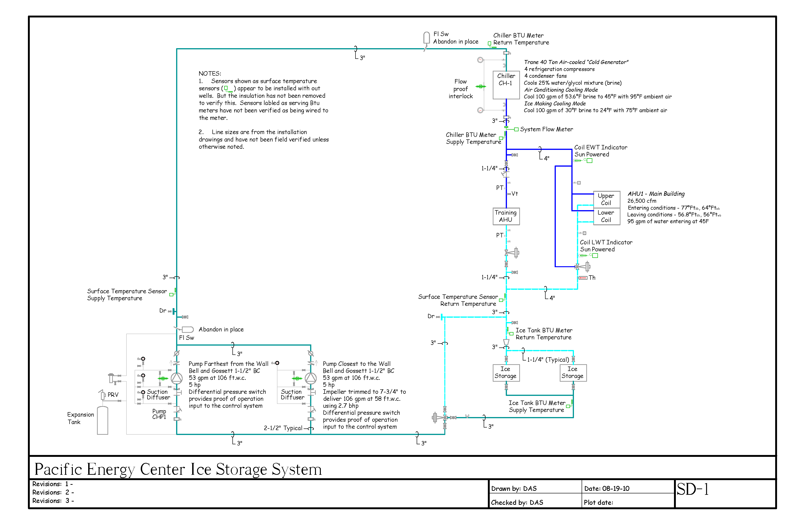
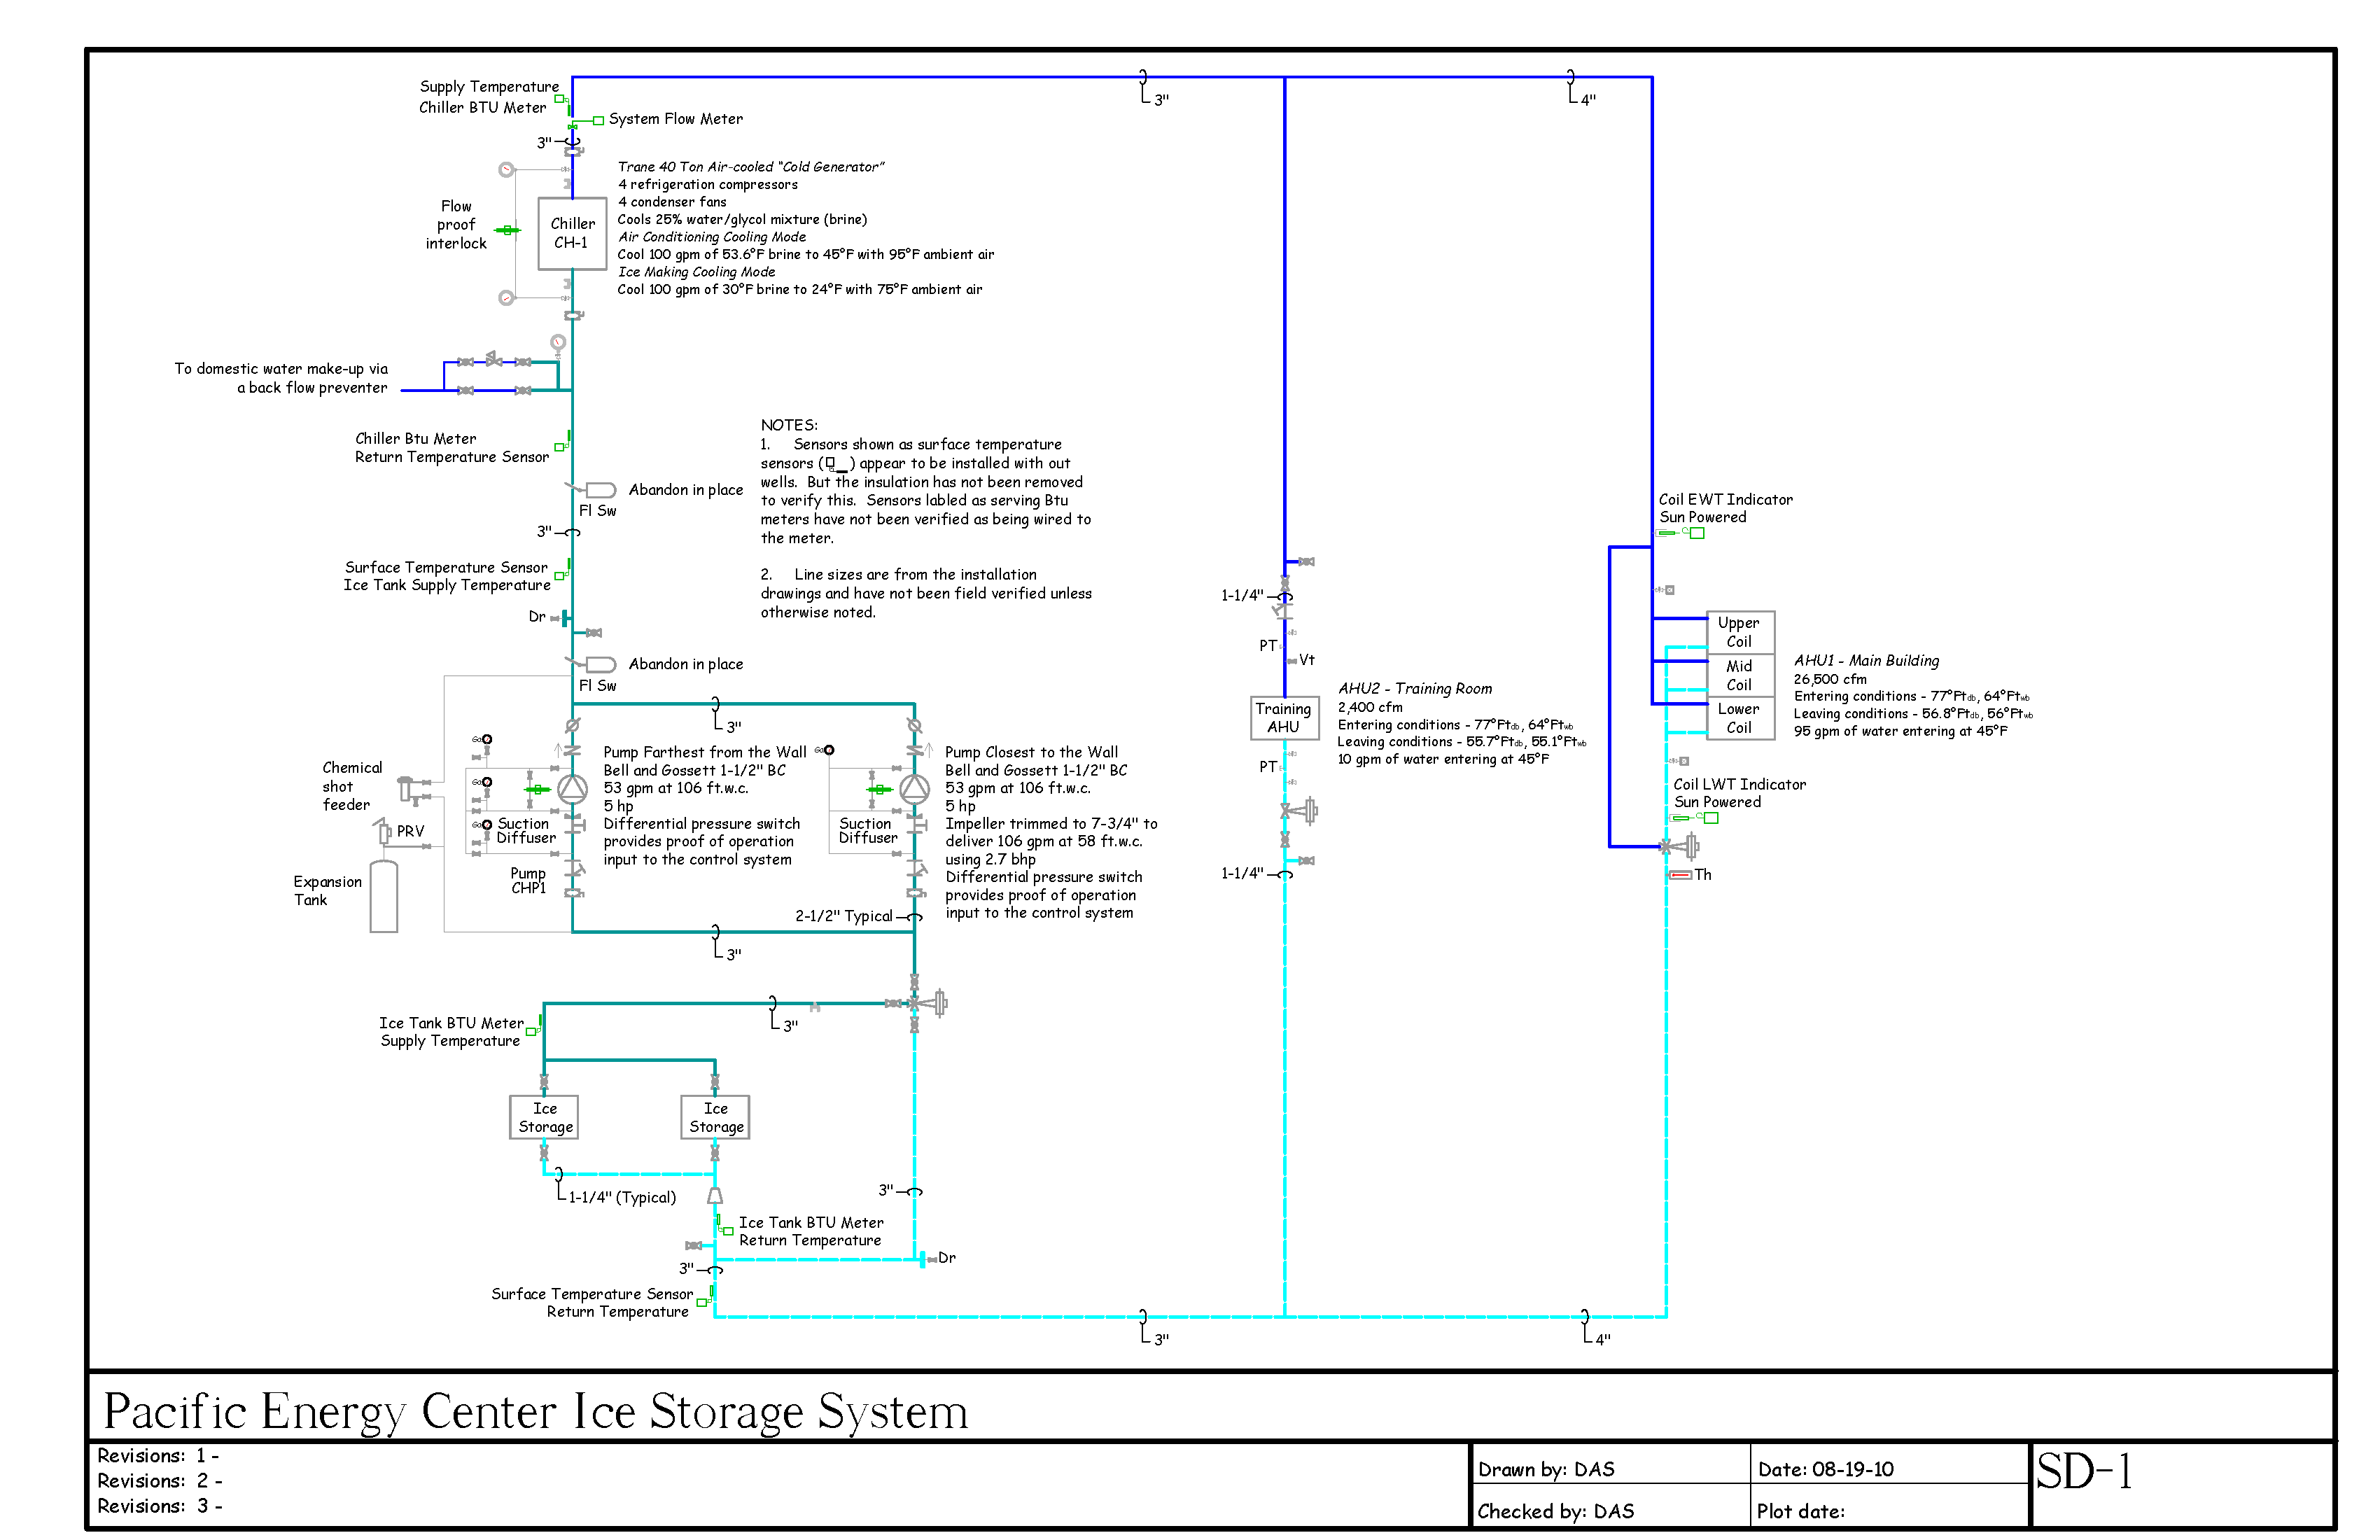
No Rules about Rungs and Rails

Slide 20
No Rules about Rungs and Rails

Slide 21
No Rules about Rungs and Rails

Slide 22
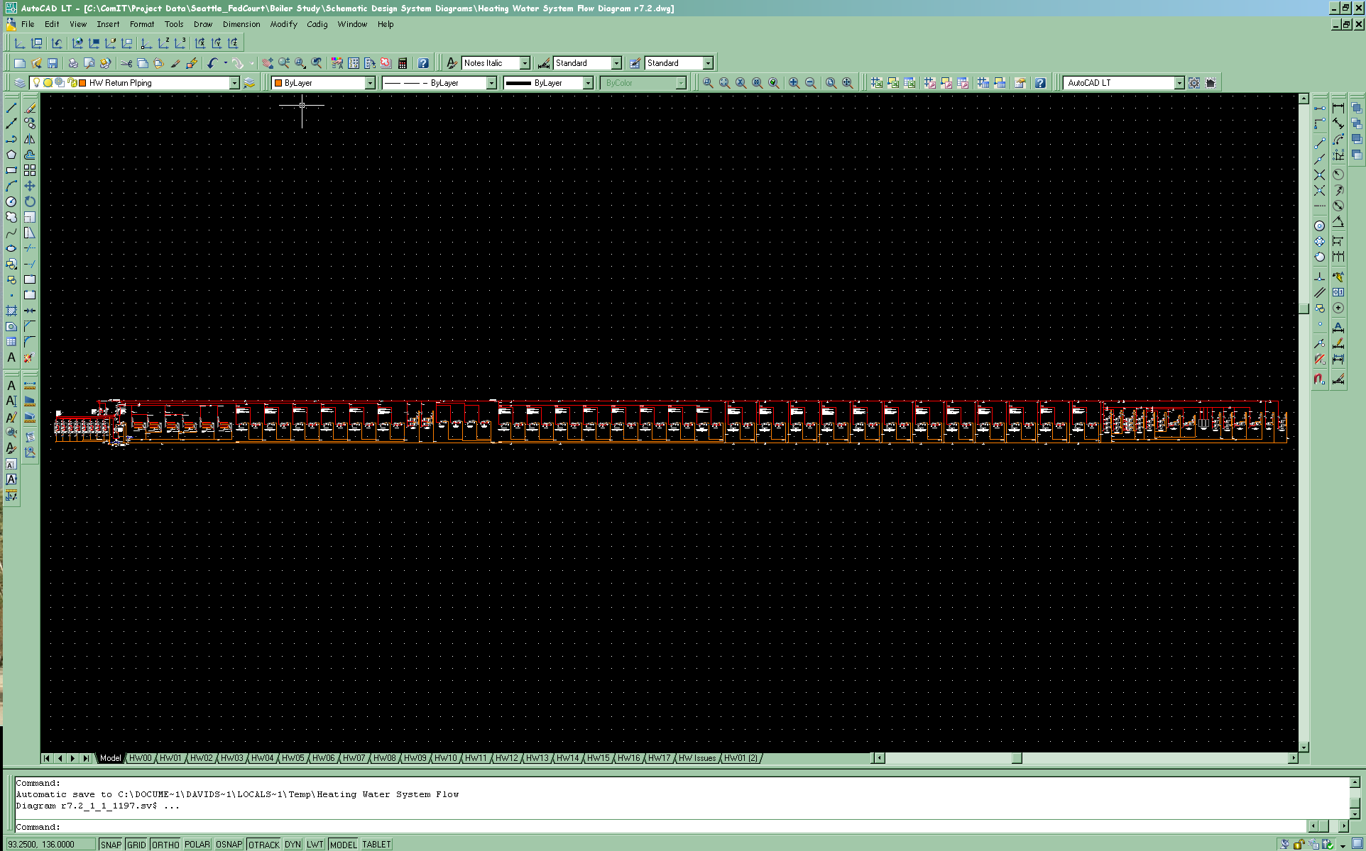
What If it’s a Big Ladder?

Slide 23
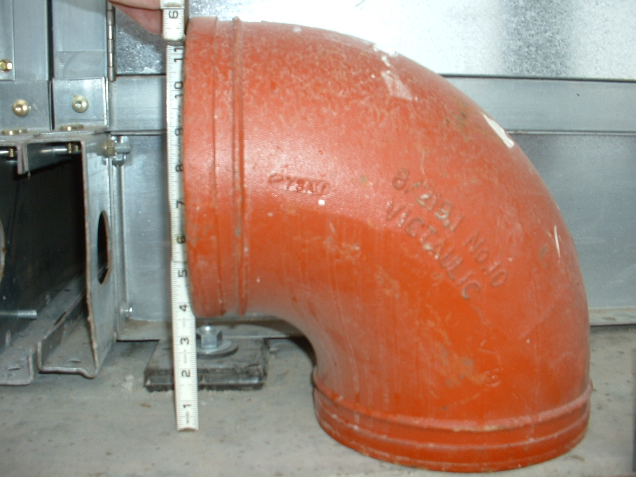
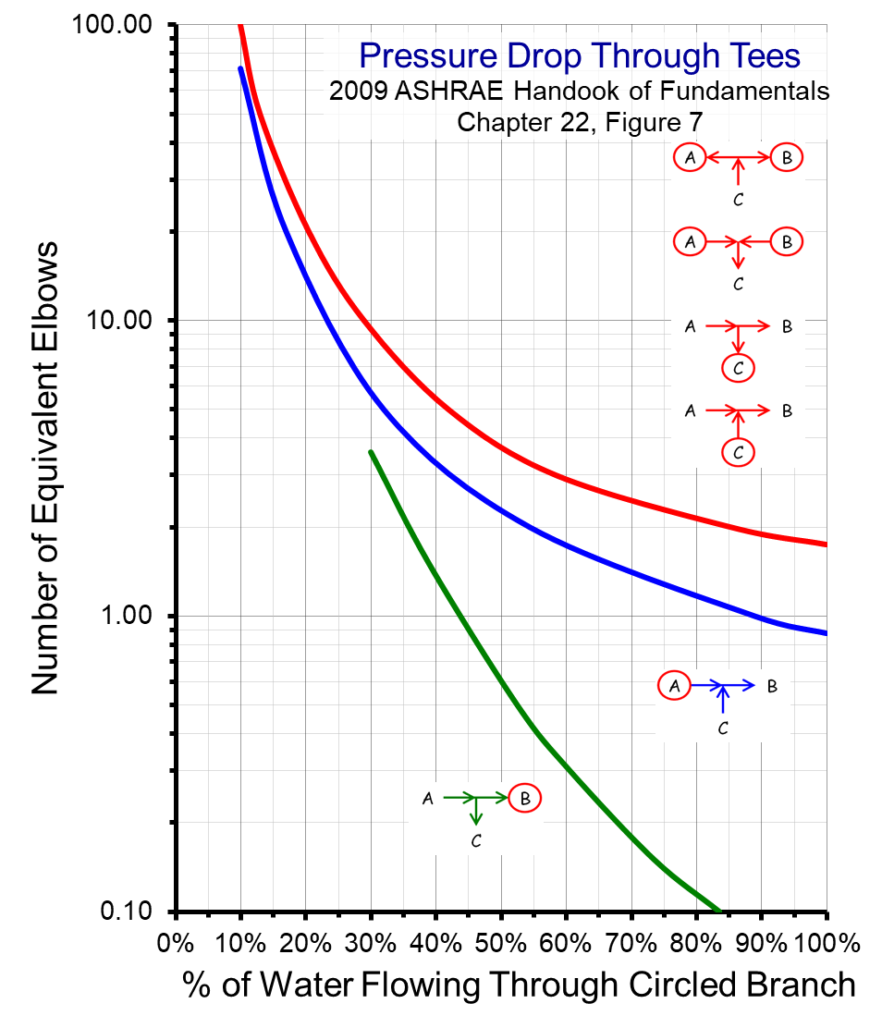
Elbows Don’t Matter

Slide 24
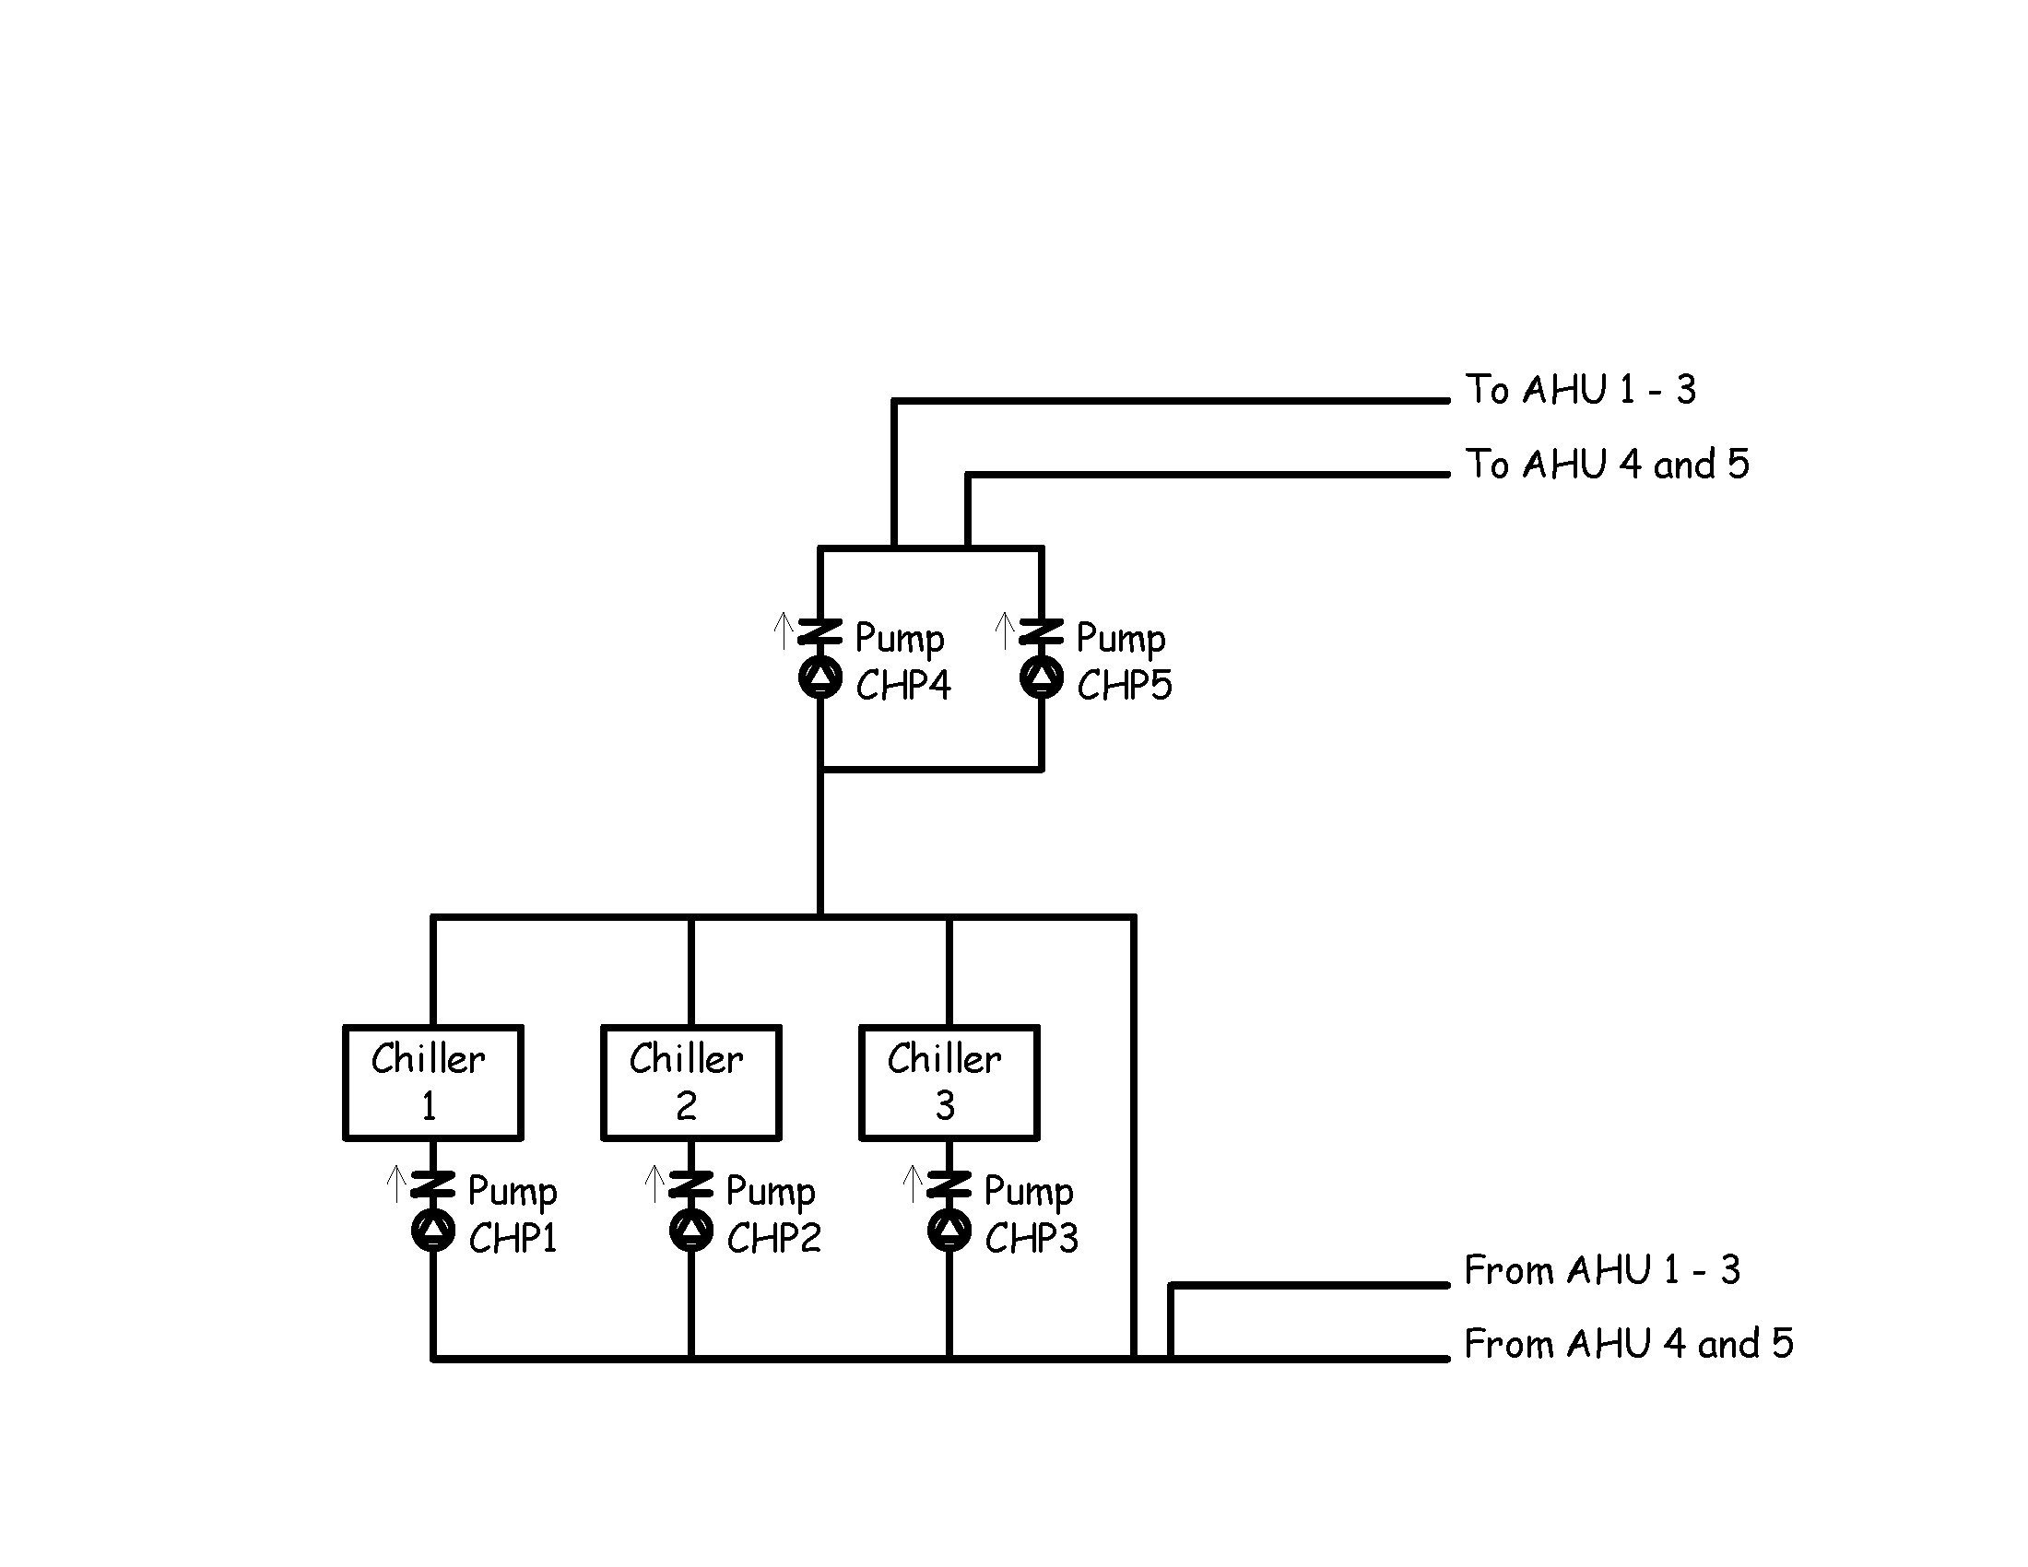
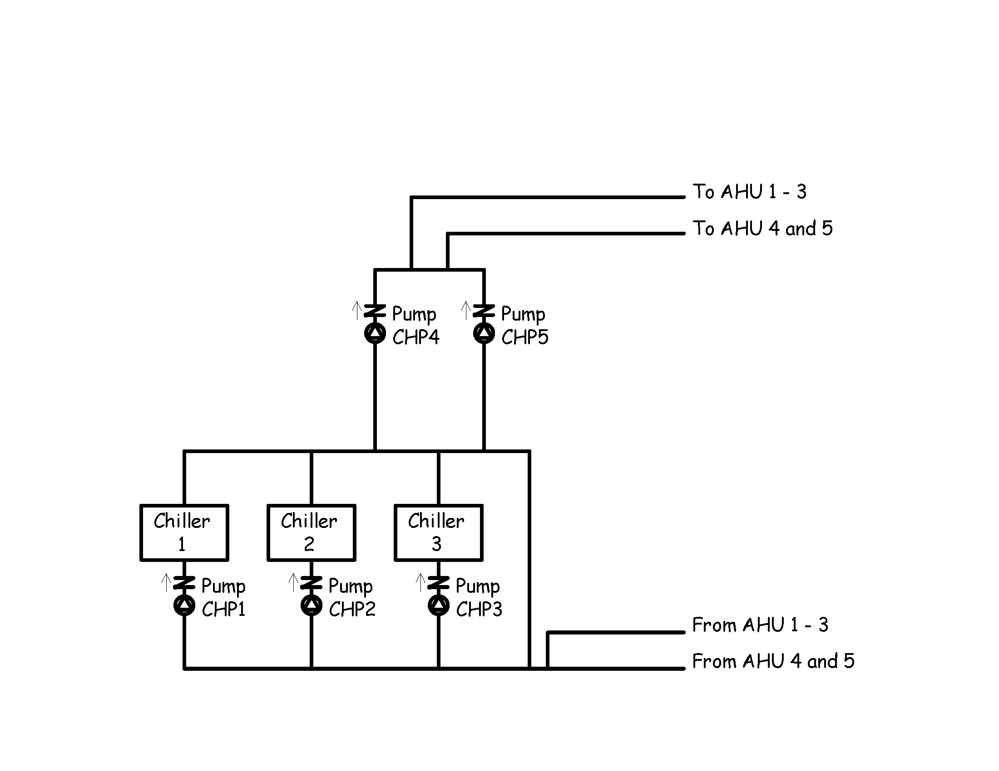
Tees Matter

Slide 25
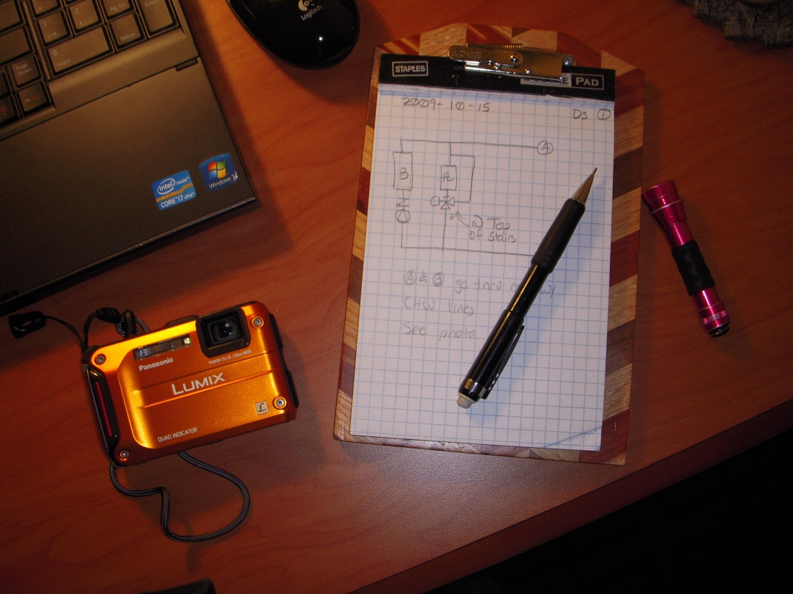
Order of Connection is Critical
How It Was Drawn
How It Was Piped

Slide 26
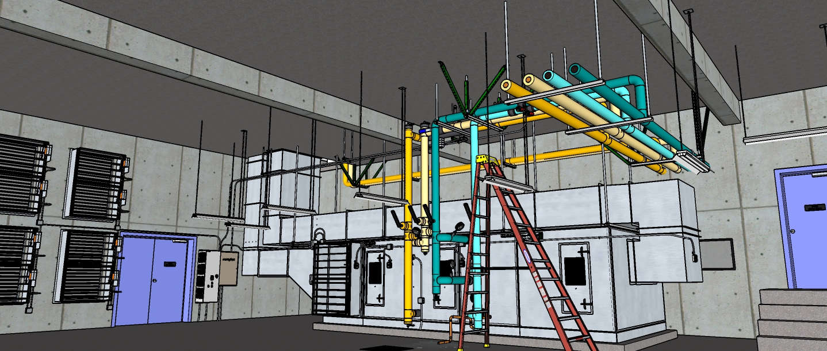
Getting Started

Slide 27
Hand Drawn is Fine

Slide 28
Hand Drawn is Fine

Slide 29
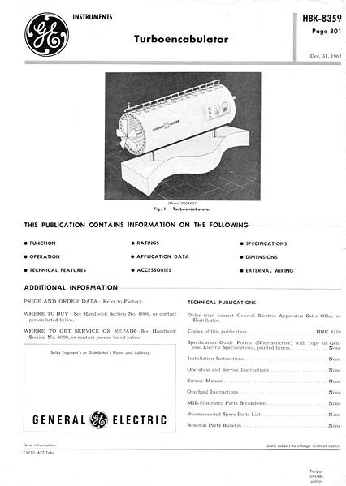
What’s That Thing?
You May Run Into “Things” You Don’t Recognize
Take a picture
Take a picture of the nameplate
  Look it up online
  Turbo Encabulator YouTube Video
  Send the picture to Ryan and I
Draw a box with a question mark
Keep on keeping on

Slide 30
Rules are Made to be Broken

Slide 31

Courtesy Michael Long, EBCx 16
Blowdown
i
i
7 psi
12 psi
88F
74F
Marley NC Steel Cooling Tower
Model: NC8402PAN2
Induced draft, crossflow
2 cells, 2 fan motor@ 15HP each
Total Capacity – 872 tons
Total water flow – 2100 gpm
Chiller
1
Chiller
2
CT 2
CT 1
Make-up
Water
PEP Filters
Centrifugal Sand Separator
82F
68F
SV
SV
10 psi
12 psi
Bell & Gossett 1510 6BC
1050 gpm @ 70 ft w.c.
65% efficiency
1,770 rpm, 25 hp motor
CDWP 2
CDWP 1
8 psi
16 psi

Slide 32
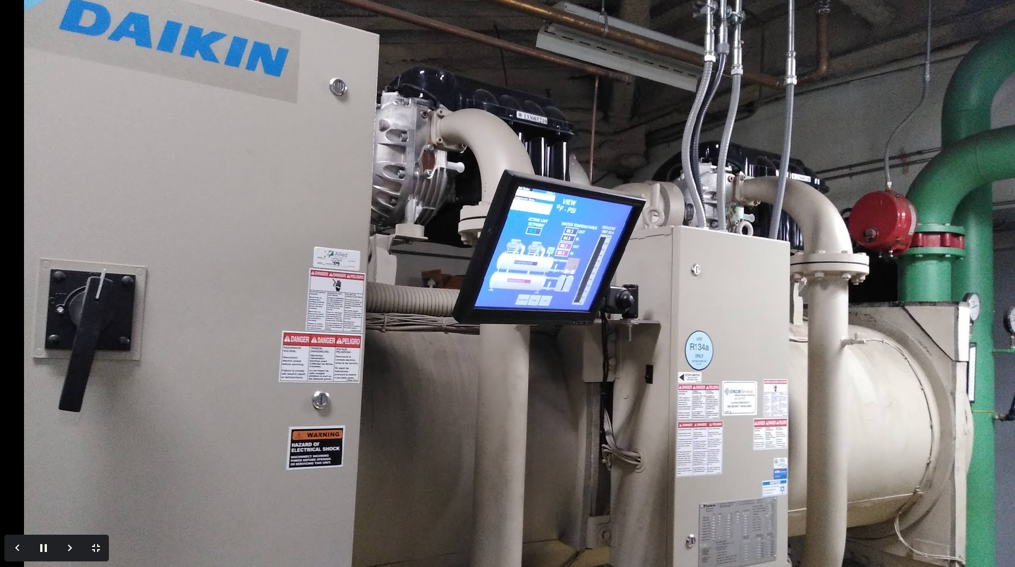
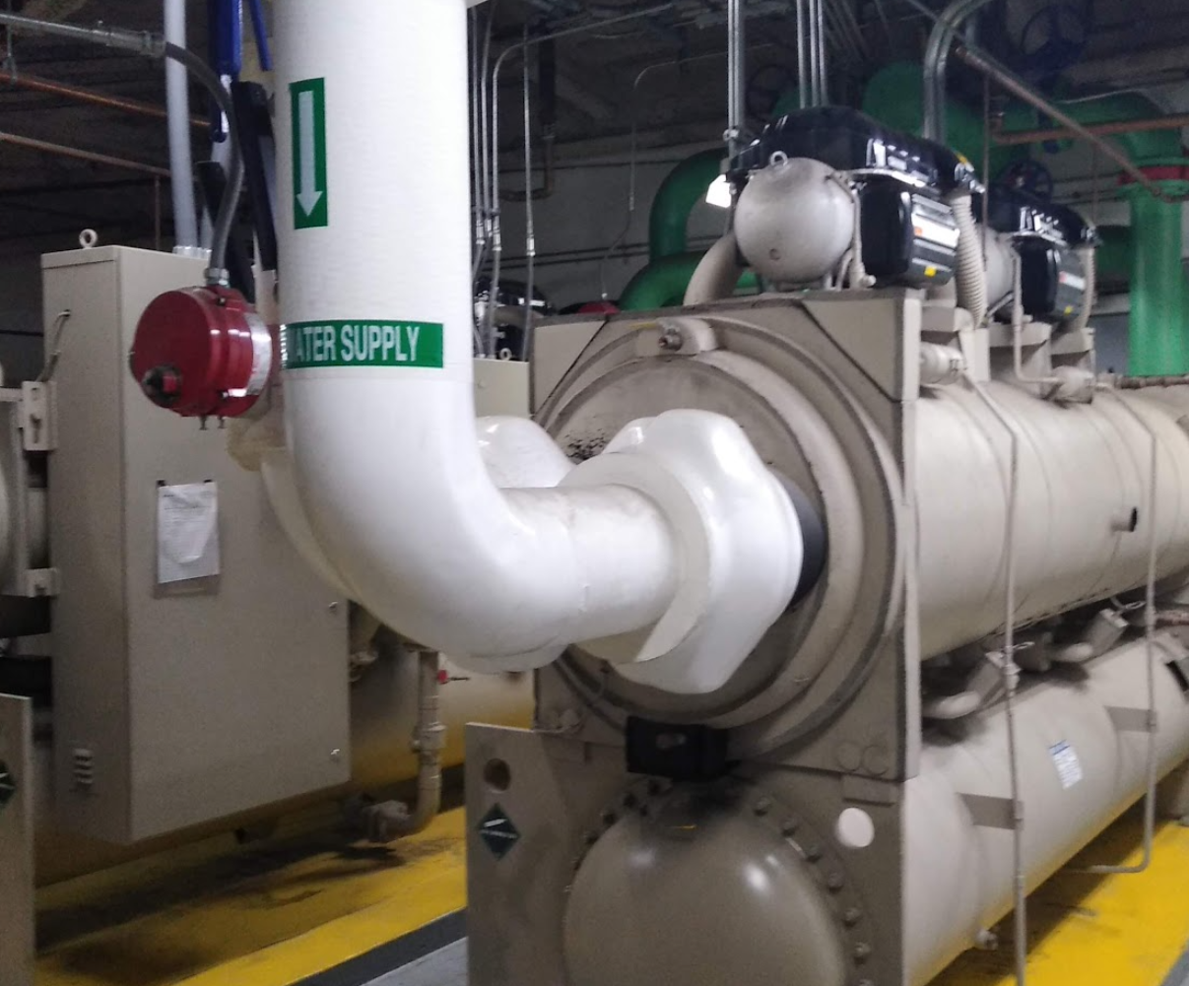
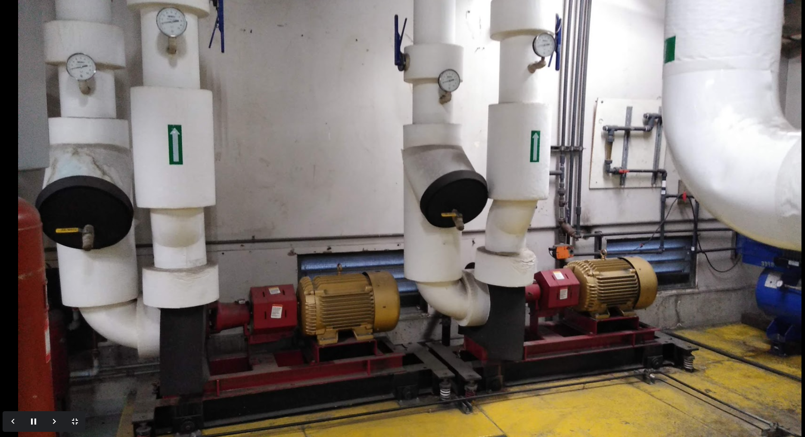

Slide 33
