Slide 1
Existing Building Commissioning Workshop: Series 17, November 4, 2021
Functional Testing
Presented By:
David Sellers
Senior Engineer, Facility Dynamics Engineering

Slide 2
Self Study; Where You Should Be
Skills Guidebook
Checklist

Slide 3
Self Study; Where You Should Be Headed
Skills Guidebook
Checklist

Slide 4
HVAC Fundamentals Resources
Resources linked from the technical guide
the Functional Testing Basics chapter
Resources on the blog
https://av8rdas.wordpress.com/?s=functional+testing

Slide 5
HVAC Fundamentals Resources
Resources linked from the technical guide
Resources on the Commissioning Resources Website
https://www.av8rdas.comReview the Functional Testing Basics chapter
Resources on the blog
https://av8rdas.wordpress.com/?s=functional+testing

Slide 6
HVAC Fundamentals Resources
Resources linked from the technical guide
Resources on the Commissioning Resources Website
https://www.av8rdas.com
Resources on the blog
https://av8rdas.wordpress.com

Slide 7
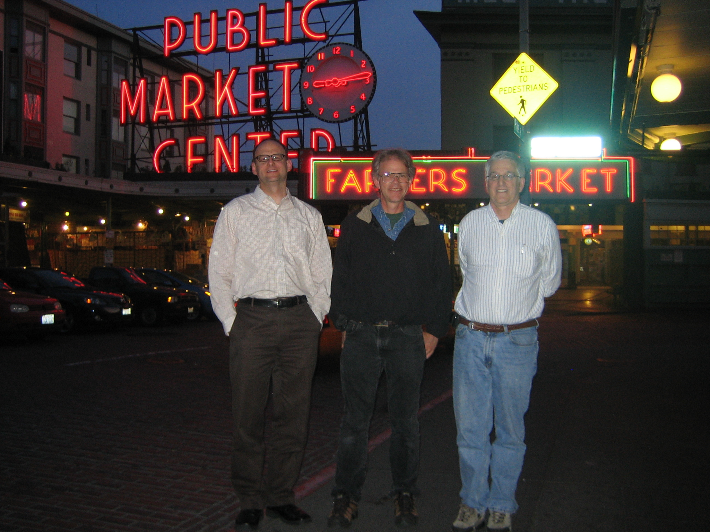
HVAC Fundamentals Resources
Resources linked from the technical guide
Resources on the Commissioning Resources Website
https://www.av8rdas.com
Resources on the blog
https://av8rdas.wordpress.com
Ryan and David (Jay if you are really lucky and we like you)

Slide 8
Continue to Review the Logic Diagram Resources
To prepare for the next class, visit the Logic Diagram Tool page of the Commissioning Resources website
https://www.av8rdas.com/logic-diagram-tool.html
Download the Logic Diagram Tool file
Download the Logic Diagram Symbols file
Review the Logic Diagram Symbols file as time permits and be prepared to ask questions
Download and explore the other resources as time and interest permits

Slide 9
Functional Testing Resources Informal
Resources linked from the technical guide
the Functional Testing Basics chapter
Resources on the blog
https://av8rdas.wordpress.com/?s=functional+testing

Slide 10
Functional Testing Resources Informal
Resources linked from the technical guide
Resources on the Commissioning Resources Website
https://www.av8rdas.comReview the Functional Testing Basics chapter
Resources on the blog
https://av8rdas.wordpress.com/?s=functional+testing

Slide 11
Functional Testing Resources Informal
Resources linked from the technical guide
Resources on the Commissioning Resources Website
https://www.av8rdas.com
Resources on the blog
https://av8rdas.wordpress.com

Slide 12
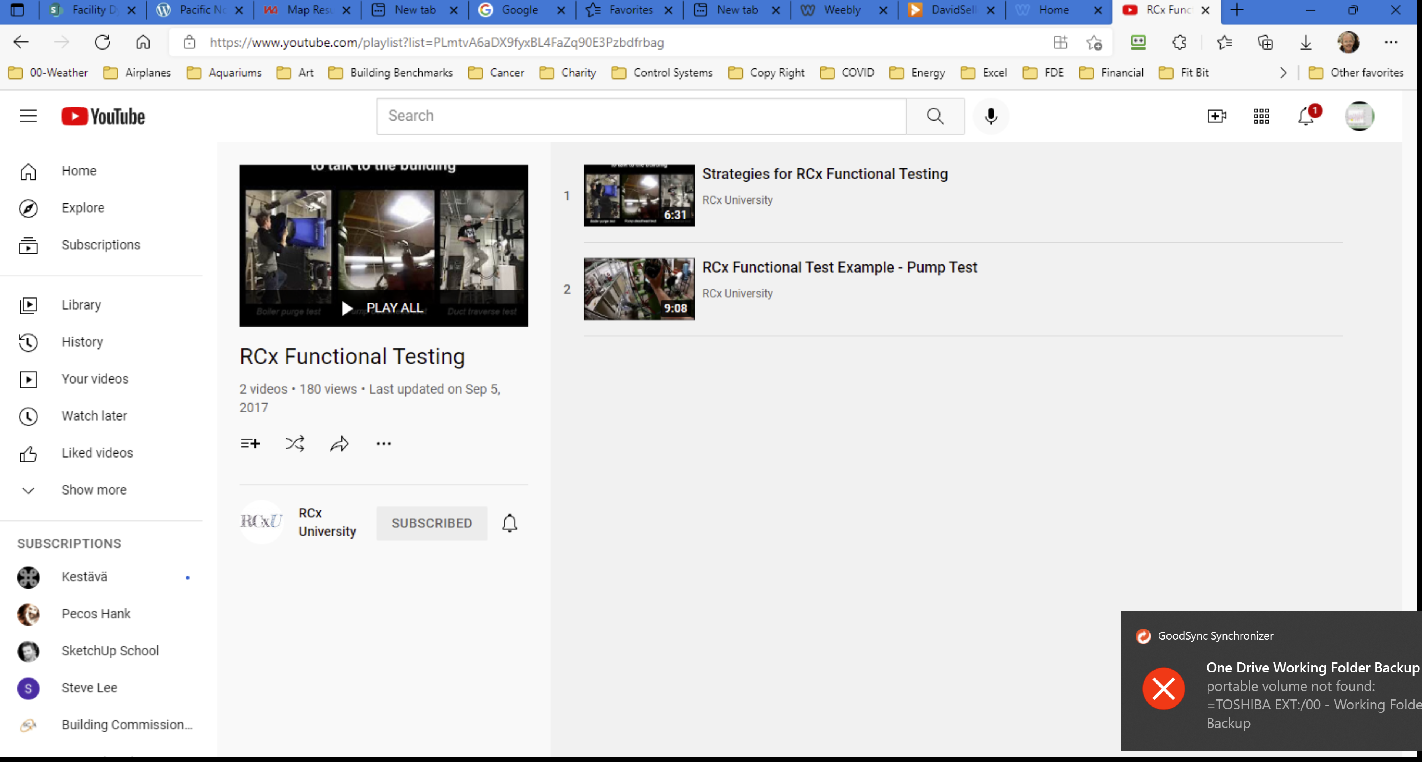
Functional Testing Resources Informal
Resources linked from the technical guide
Resources on the Commissioning Resources Website
https://www.av8rdas.com
Resources on the blog
https://av8rdas.wordpress.com
RCxU
https://www.youtube.com/channel/UCs2EJyl0uQE7gKsQspZbbvA/playlists

Slide 13
Functional Testing Resources Informal Introduction to Functional Testing Video Series
Module 1 (32 minutes)
This covers the basics up through the cominalities and differences between FT in EBx and NCx
https://www.screencast.com/t/QiUrsE2TLO4j

Slide 14
Functional Testing Resources Informal Introduction to Functional Testing Video Series
Module 2 (28 minutes)
This covers
Testing hierarchy
Introduces FT as a way to have a dialog with the building
Illustrates how tests can be targeted
https://www.screencast.com/t/ZcJMpL9bw

Slide 15
Functional Testing Resources Informal Introduction to Functional Testing Video Series
Module 3A (31 minutes)
This introduces a case study used to tie the concepts together in a practical application
Overview of the facility
Overview of the problem
https://www.screencast.com/t/ZcJMpL9bw

Slide 16
Functional Testing Resources Informal Introduction to Functional Testing Video Series
Module 3B (35 minutes)
Illustrates how a functional test is built based on the question we are trying to have the building answer
Includes the most dramatic introduction ever seen in the history of the Introduction to Functional Testing video series.
https://www.screencast.com/t/ZcJMpL9bw

Slide 17
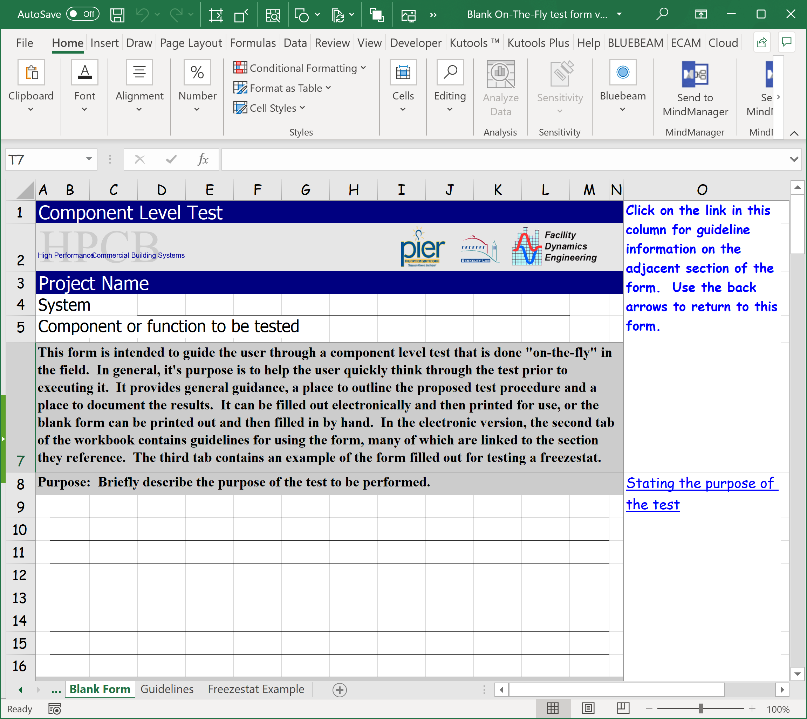
Let’s Give it a Try Informal Introduction to Functional Testing Video Series

