Slide 1

Existing Building Commissioning Workshop: Series 16, Session 5
Introduction to Functional Testing
Presented By:
David Sellers
Senior Engineer, Facility Dynamics Engineering

Slide 2
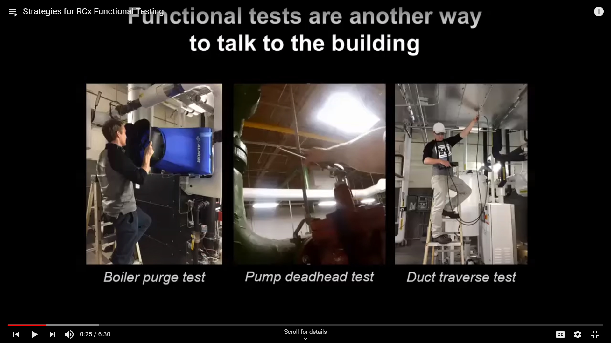
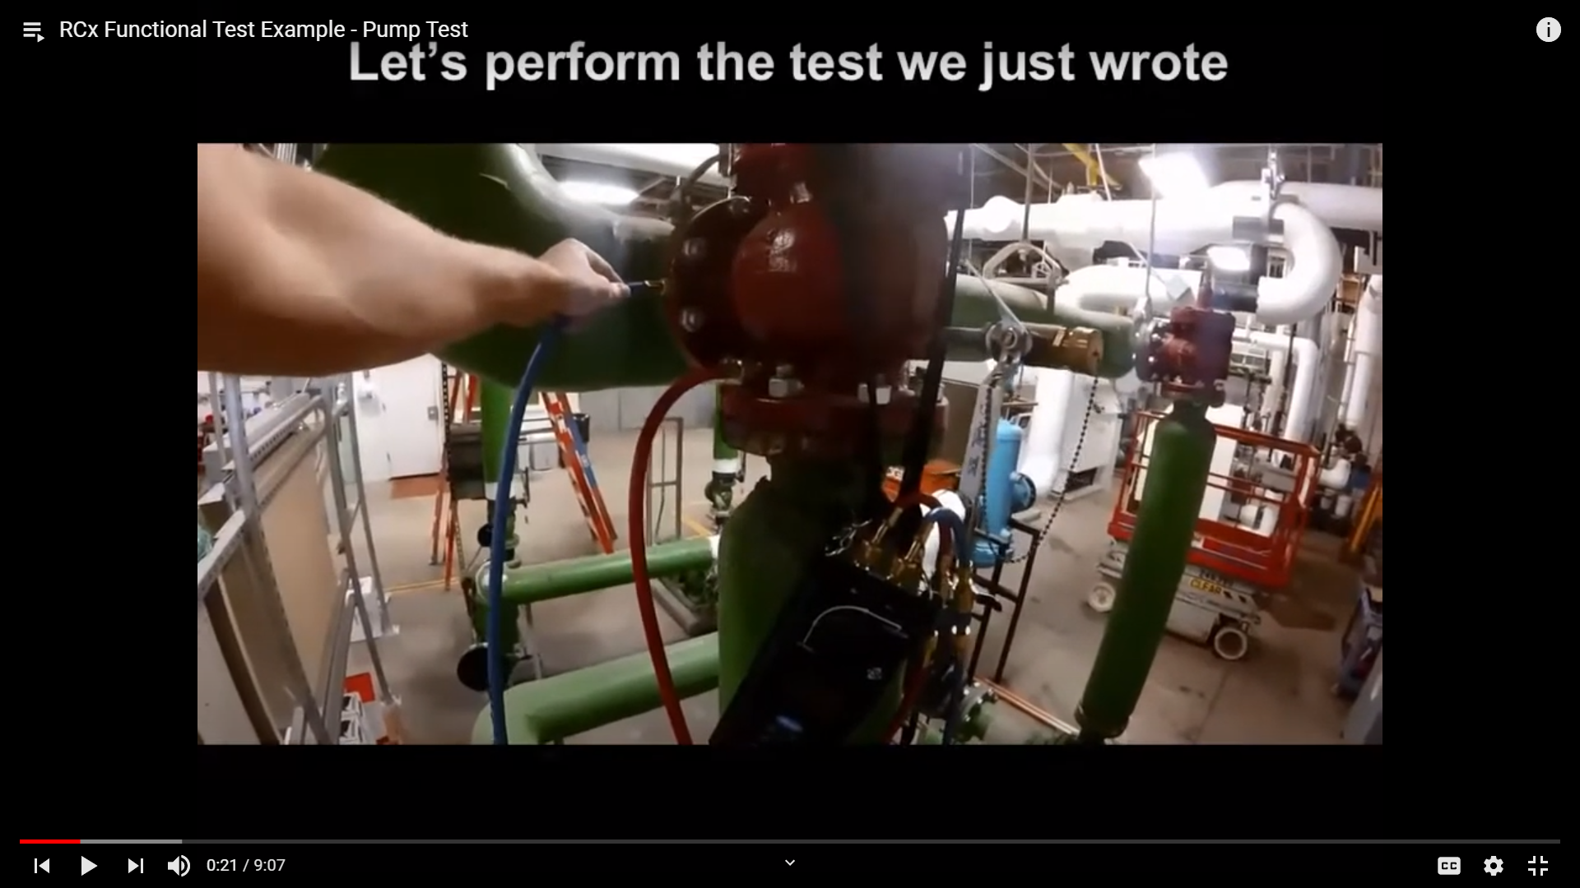
Supplementing RCxU
https://youtu.be/BjSMW46Utlg
https://youtu.be/Vu25LZ2ZLTA

Slide 3
Functional Testing
Core element of any commissioning process
Validates machinery and systems
  Do they deliver?
  Why don’t they deliver?
  Do the work well together?
  Why aren’t they working well together
  Was it big enough?
  How big should it be?

Slide 4
Functional Testing
Core element of any commissioning process
Validates machinery and systems for an NCx Process
  Do they deliver?
  Why don’t they deliver?
  Do the work well together?
  Why aren’t they working well together
  Was it big enough?
  How big should it be?

Slide 5
Functional Testing
Core element of any commissioning process
Validates machinery and systems for an EBCx Process
  Do they deliver?
  Why don’t they deliver?
  Do the work well together?
  Why aren’t they working well together
  Was it big enough?
  How big should it be?

Slide 6
Functional Testing
Core element of any commissioning process
Validates machinery and systems
  Do they deliver?
  Why don’t they deliver?
  Do the work well together?
  Why aren’t they working well together
  Was it big enough?
  How big should it be?

Slide 7
Functional Testing as it Relates to the Metrics of the Systems We Test
Physical Configuration
Distribution Equipment Selections
Installation Documents
Construction Project
Assembled Building
Owner’s Project Requirements
Loads
Operating Requirements
Process Parameters
System Configuration
Heat Transfer Equipment Selections

Slide 8
Functional Testing as it Relates to the Metrics of the Systems We Test
Work
Physical Configuration
Distribution Equipment Selections
Installation Documents
Construction Project
Assembled Building
Make Them
Here are the
Owner’s Project Requirements
Parts,
Loads
Operating Requirements
Process Parameters
System Configuration
Heat Transfer Equipment Selections

Slide 9
Functional Testing as it Relates to the Metrics of the Systems We Test
Work?
Physical Configuration
Distribution Equipment Selections
Installation Documents
Construction Project
Assembled Building
These Parts
Owner’s Project Requirements
of
Loads
How Do all
Operating Requirements
Process Parameters
System Configuration
Heat Transfer Equipment Selections

Slide 10
Functional Testing as it Relates to the Metrics of the Systems We Test
Physical Configuration
Distribution Equipment Selections
Installation Documents
Construction Project
Assembled Building
Work Better?
These Parts
Owner’s Project Requirements
Loads
of
How Can all
Operating Requirements
Process Parameters
System Configuration
Heat Transfer Equipment Selections

Slide 11
Functional Testing as it Relates to the Project Timeline

Slide 12
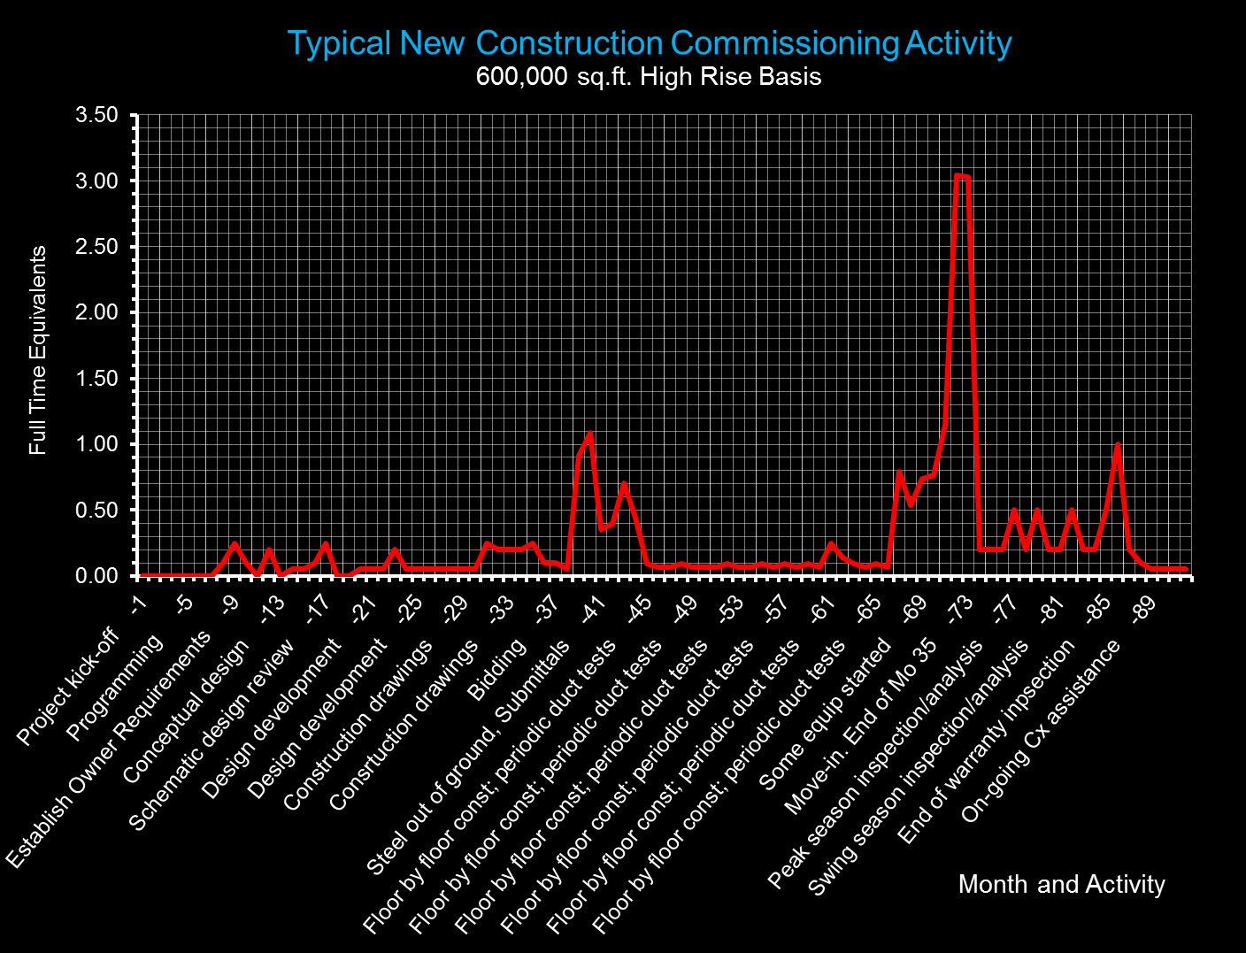
12

Slide 13
Schematic Design Phase
Design Development Phase
Construction Document Phase
Bidding and Award
Early Construction Phase
Middle Construction Phase
Warranty Phase
Ongoing Commissioning
Programming Phase
Conceptual Design Phase
Late Construction Phase
Acceptance Phase
Observation Phase
Ongoing Commissioning
13

Slide 14
Programming Phase
Conceptual Design Phase
Schematic Design Phase
Design Development Phase
Construction Document Phase
Bidding and Award
Early Construction Phase
Middle Construction Phase
Late Construction Phase
Acceptance Phase
Observation Phase
Warranty Phase
Ongoing Commissioning
Testing by Cx Authority
and Contractor
Testing by
“Mother Nature”
14

Slide 15
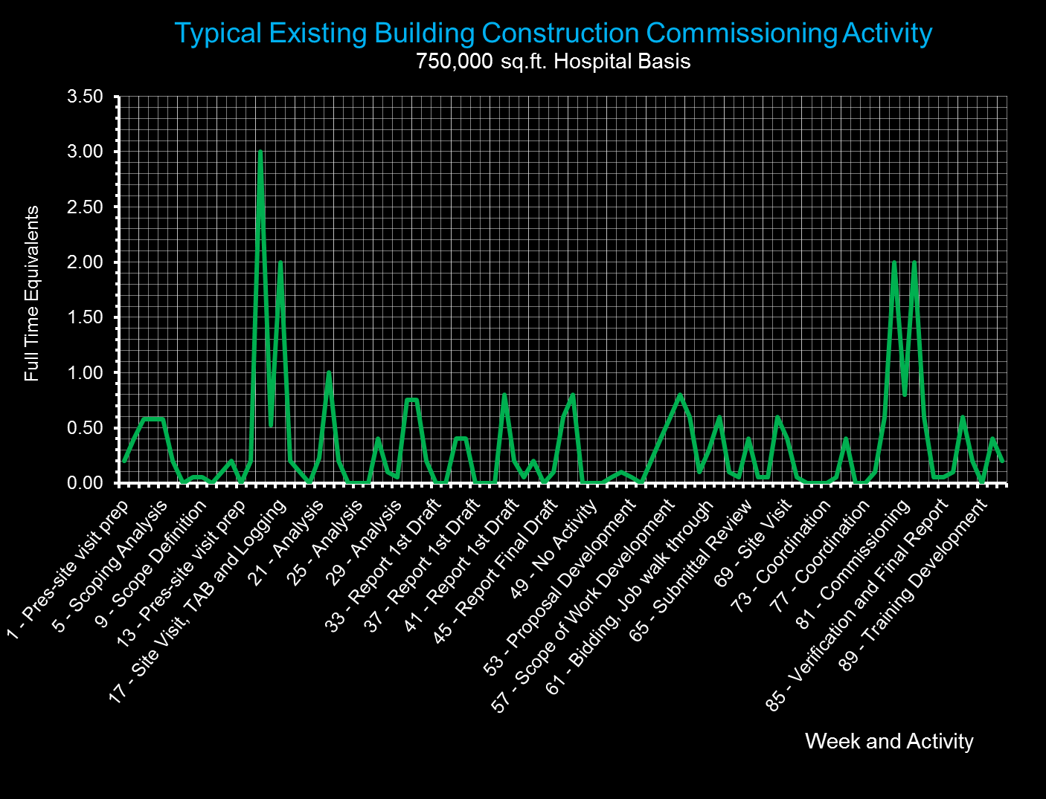
15
15

Slide 16
Scoping
Implementation
Verification
Testing by Cx Authority
and Building Operating Team
Investigation
16
16

Slide 17
Testing Quantifies the Problem
Testing by Cx Authority
and Building Operating Team
Testing Answers Questions Raised During Investigation
Testing Verifies Improvements
17
17

Slide 18
New Construction versus EBCx Testing
New Construction
EBCx
Trying to prove design intent
Demonstrate all elements of the system meet requirements
Verification and quality assurance process
Trying to understand design intent
Focused on certain elements of the system
Diagnostic and troubleshooting process

Slide 19
Forced vs. Natural Response Testing
Forced Response Testing
    I force a change and watch how the system responds
Natural Response Testing
    Mother Nature makes a change and I discover how the system responds

Slide 20

Forced vs. Natural Response Testing
Forced Response Testing
    I force a change and watch how the system responds
    View the video on Youtube at http://tinyurl.com/MR-1-Launch
Natural Response Testing
    I observe how a system responds to the normal course of events
Notes:
http://tinyurl.com/MR-1-Launch
Investigation revealed that the Redstone's engine shutdown was caused by two of its electrical cables separating in the wrong order.[6] These cables were a control cable, which provided various control signals, and a power cable, which provided electrical power and grounding. Both cables were plugged into the rocket at the bottom edge of one of its tail fins and would separate at liftoff.[11] The control cable was supposed to separate first, followed by the power cable. However, for this launch, the control cable was longer than expected—it was one designed for the military Redstone missile rather than the shorter cable designed for Mercury-Redstone. This control cable had been clamped to compensate for its greater length, but when the vehicle lifted off, the clamping did not work as planned and the control cable separation was delayed, eventually occurring about 29 milliseconds after the power cable had separated.[4][12]
During this brief interval, the lack of electrical grounding caused a substantial current to flow through an electrical relay which was supposed to trigger normal engine cut-off at the end of powered flight. This relay tripped, causing the Redstone to shut off its engine and send a "normal cut-off" signal to the capsule. Under normal circumstances, when the capsule received this signal during a flight, it would do two things: it would jettison its escape rocket, which was no longer of any use, and after the escape rocket had flown clear, fire the explosive bolts holding it to the booster for separation. In the case of MR-1, the capsule did jettison the escape rocket as it was designed to, but the separation sequence did not occur. The capsule was designed to suspend this separation until the vehicle's acceleration had almost ceased, so that the capsule would not be hit by a still-accelerating launch vehicle. This would happen when the capsule's acceleration sensors detected an acceleration approaching 0 g, which it would normally experience after the Redstone had shut down and was entering free fall. However, in MR-1, the Redstone was not in free fall but rather sitting supported on the ground. Thus the capsule sensors detected the effect of their own supported weight, which they read as a constant "acceleration" of 1 g. Because of this apparent acceleration, capsule separation was disabled.[4][13]
The jettison of the escape rocket activated the capsule's parachute recovery system. Since the altitude was below 10,000 feet (3,000 m), this system was triggered by its atmospheric pressure sensors and followed its usual sequence, with the drogue parachute deploying first, followed by the main parachute. But because the main parachute was not supporting the capsule's weight, the parachute system did not detect any load on this chute, so it acted as if the chute had failed and deployed the reserve parachute.[4][13]
https://en.wikipedia.org/wiki/Mercury-Redstone_1#Test_background_and_launch_failure
Since the Redstone's automatic inflight abort sensing system was running in open-loop mode, the engine shutdown did not trigger an abort. However, the system did report an abort condition, so it did function properly.[8][14]

Slide 21
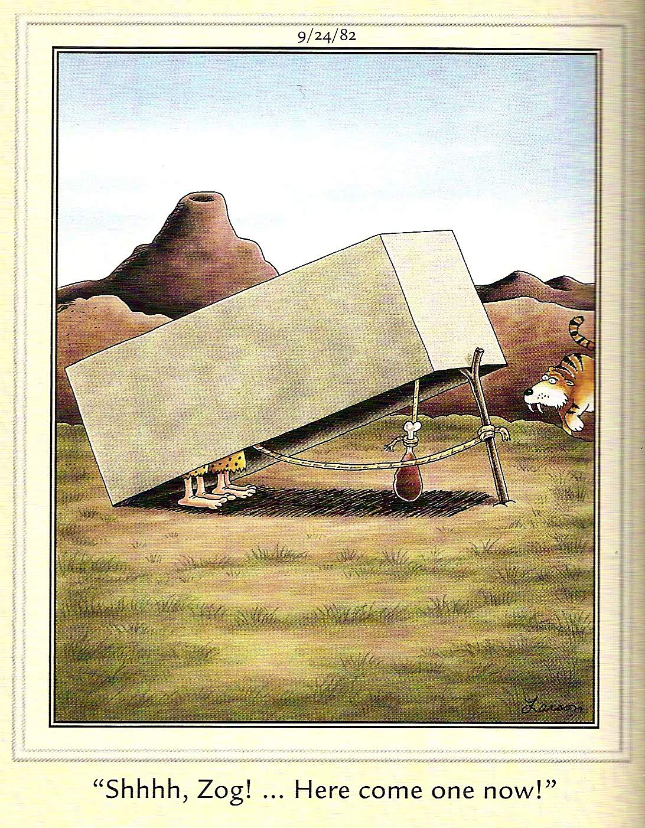
Sometimes, Things Don’t Work as Anticipated
Think of it as an opportunity to figure out how to make something work

Slide 22
Forced vs. Natural Response Testing
Forced Response Testing
  Example
  With it 50°F outside and the AHU near 100% OA, I over ride the outdoor air sensor and manually enter 100°F as the outdoor temperature
  I observe that :
    Outdoor air dampers commanded to MOA
    Leaving air set point commanded to low end of reset range
    Chilled water valve opens
Natural Response Testing
  Example
  I pull trend data from the system for a day when the outdoor air temperature swung from 53 – 82°F.
  I observe
    Chilled water temperature instability during low outdoor air temperature periods
    Transition to and from economizer at appropriate temperatures
    Return fan tracking fails on minimum outdoor air

Slide 23
Mother Nature Writes Great Functional Tests

Slide 24
Mother Nature Writes Great Functional Tests
Use Trends to Explore How Things Work at Design Conditions

Slide 25
Mother Nature Writes Great Functional Tests
Then Analyze How Things Work at Extreme Conditions

Slide 26
Mother Nature Writes Great Functional Tests
Then Take a Look at What Happens Under Common Conditions

Slide 27
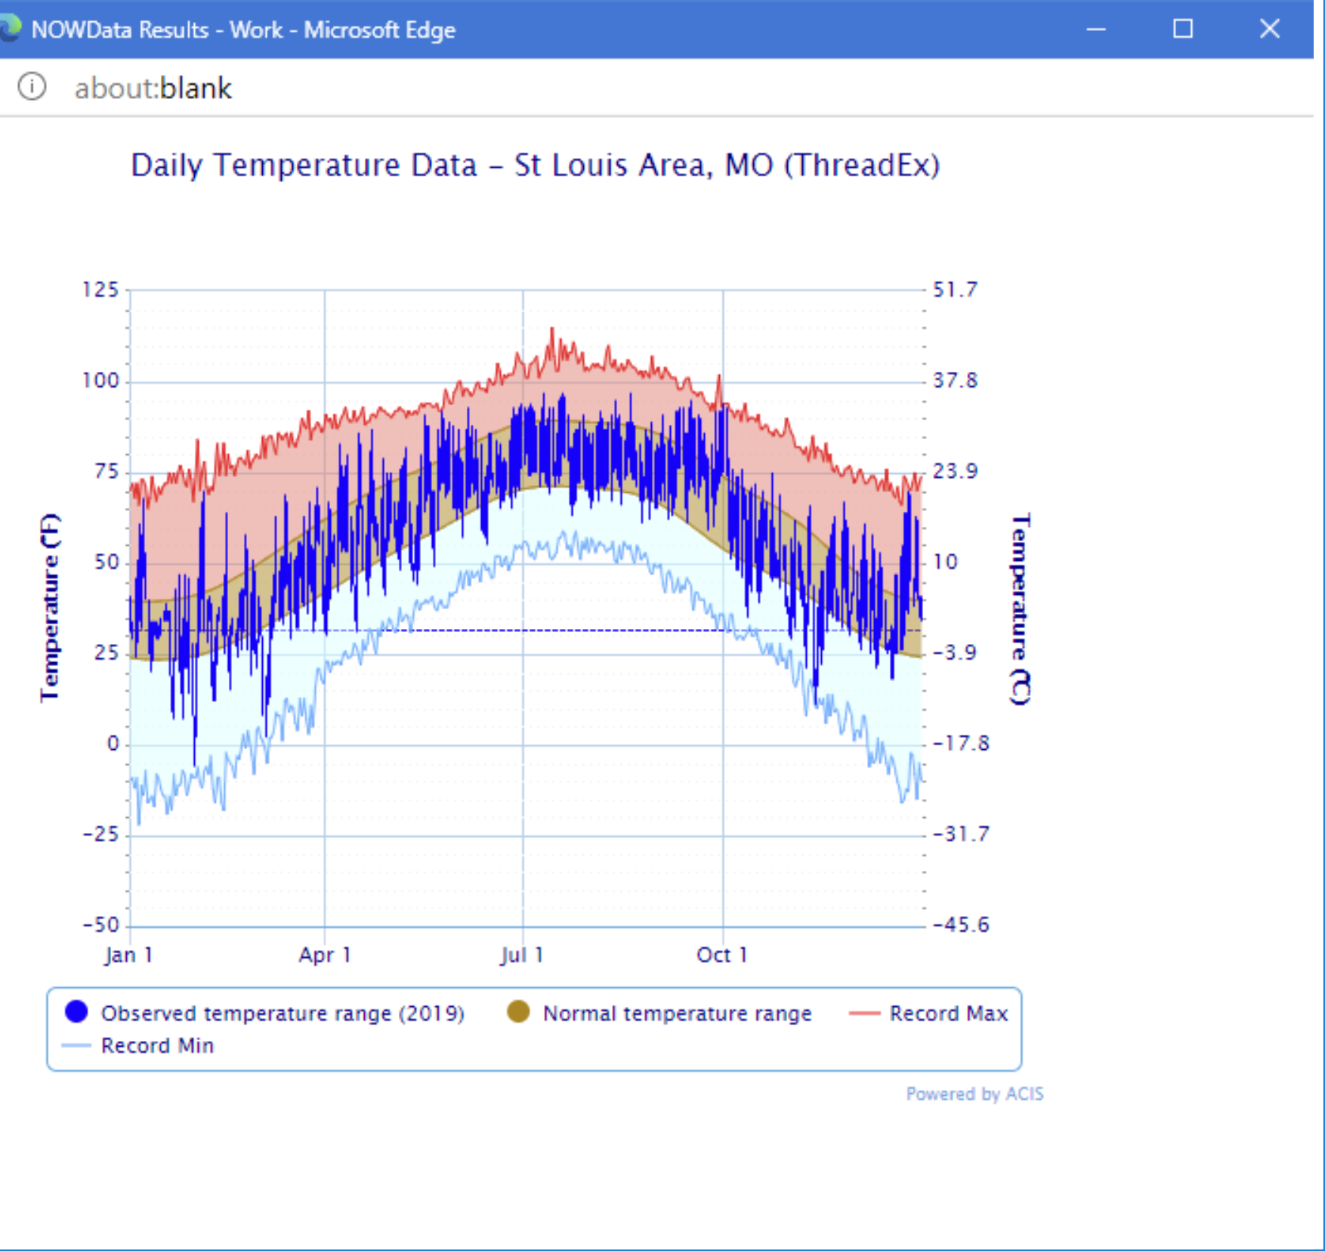
Finding Those Days https://av8rdas.wordpress.com/2019/02/17/a-new-resource-for-looking-at-climate-data/

Slide 28
Finding Those Days https://av8rdas.wordpress.com/2019/02/17/a-new-resource-for-looking-at-climate-data/

Slide 29
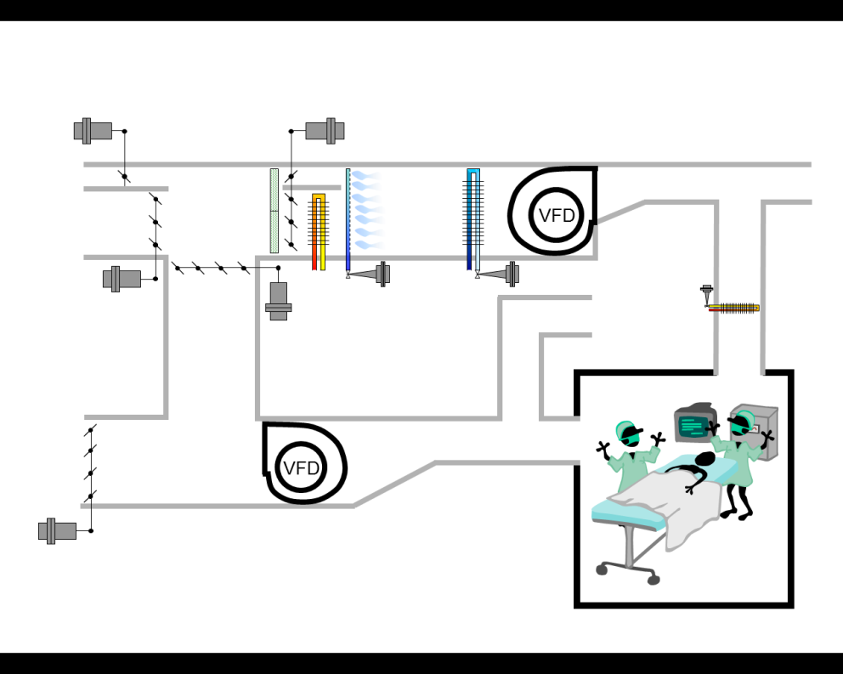
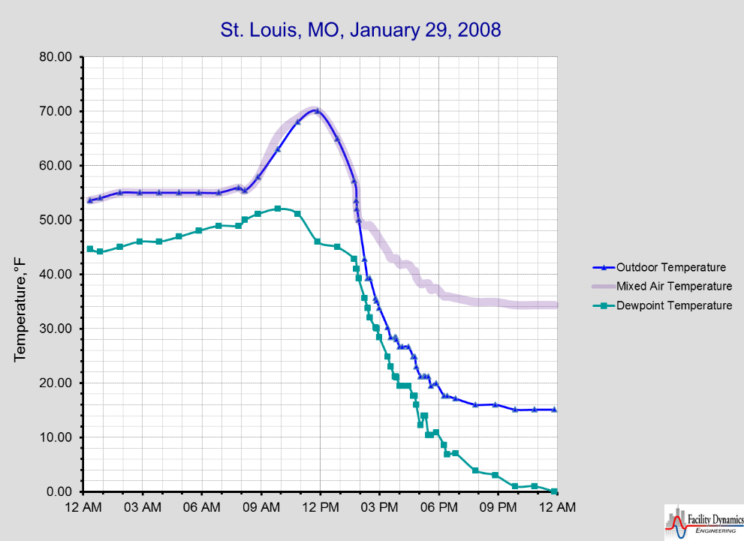
Mother Nature Writes Great Functional Tests
Don’t Forget to Consider a Day with an Extreme Diurnal Swing and its Impact on the Performance of Sensitive HVAC Processes

Slide 30
Mother Nature Writes Great Functional Tests
Don’t Forget to Consider a Day with an Extreme Diurnal Swing and its Impact on the Performance of Sensitive HVAC Processes
100% Outdoor Air with Humidification

Slide 31
Mother Nature Writes Great Functional Tests
Don’t Forget to Consider a Day with an Extreme Diurnal Swing and its Impact on the Performance of Sensitive HVAC Processes
100% Outdoor Air

Slide 32
Mother Nature Writes Great Functional Tests
Don’t Forget to Consider a Day with an Extreme Diurnal Swing and its Impact on the Performance of Sensitive HVAC Processes
Enthalpy Driven Change-over to Minimum Outdoor Air

Slide 33
Mother Nature Writes Great Functional Tests
Don’t Forget to Consider a Day with an Extreme Diurnal Swing and its Impact on the Performance of Sensitive HVAC Processes
Minimum Outdoor Air with Humidification

Slide 34
Mother Nature Writes Great Functional Tests
Don’t Forget to Consider a Day with an Extreme Diurnal Swing and its Impact on the Performance of Sensitive HVAC Processes
Enthalpy Driven Change-over to 100% Outdoor Air, Humidification

Slide 35
Mother Nature Writes Great Functional Tests
Don’t Forget to Consider a Day with an Extreme Diurnal Swing and its Impact on the Performance of Sensitive HVAC Processes
Economizer Modulates with Humidification

Slide 36
Mother Nature Writes Great Functional Tests
Don’t Forget to Consider a Day with an Extreme Diurnal Swing and its Impact on the Performance of Sensitive HVAC Processes
Minimum Outdoor Air with Preheat and Humidification

Slide 37
Mother Nature Writes Great Functional Tests
Don’t Forget to Consider a Day with an Extreme Diurnal Swing and its Impact on the Performance of Sensitive HVAC Processes
Minimum Outdoor Air with Preheat and Humidification; Freezestat trips if the Preheat Process Fails

Slide 38
Testing Hierarchy;
More than Balancing Man Power
Complete Equipment Safety Testing
Test Component Controls
Component Level Testing
Commission Supporting Utility Systems
Verify Prestart Checks & Startups
Verify Control Wiring and Calibration
Verify Control Programming
Test System Level Control Functionality
System Level Testing
Each utility system can have a testing hierarchy that is similar to this, much of which must be complete before the supporting system can be tested
Component Factory Startups
Component Startups
Test Building Level Control Functionality
Sub-assembly Factory Startups
Sub-assembly Startups
Begin Normal Operations
Run Trend Analysis; Fine Tune Systems
Verify Safeties with Prime Mover Off-line
Seasonal and Warranty Testing
Generally speaking, successful completion of everything inside the red dotted line is required for system acceptance
Start-up Prime Mover (Pump, Fan, etc.)
Begin Ongoing Cx

Slide 39
Testing Hierarchy;
More than Balancing Man Power
Complete Equipment Safety Testing
Test Component Controls
Component Level Testing
Commission Supporting Utility Systems
Verify Prestart Checks & Startups
Verify Control Wiring and Calibration
Verify Control Programming
Test System Level Control Functionality
System Level Testing
Each utility system can have a testing hierarchy that is similar to this, much of which must be complete before the supporting system can be tested
Component Factory Startups
Component Startups
Test Building Level Control Functionality
Mostly Forced
Response Testing
Sub-assembly Factory Startups
Sub-assembly Startups
Begin Normal Operations
Run Trend Analysis; Fine Tune Systems
Verify Safeties with Prime Mover Off-line
Seasonal and Warranty Testing
Generally speaking, successful completion of everything inside the red dotted line is required for system acceptance
Start-up Prime Mover (Pump, Fan, etc.)
Begin Ongoing Cx

Slide 40
Testing Hierarchy;
More than Balancing Man Power
Complete Equipment Safety Testing
Test Component Controls
Component Level Testing
Commission Supporting Utility Systems
Verify Prestart Checks & Startups
Verify Control Wiring and Calibration
Verify Control Programming
Test System Level Control Functionality
System Level Testing
Transition to Natural Response Testing
Each utility system can have a testing hierarchy that is similar to this, much of which must be complete before the supporting system can be tested
Component Factory Startups
Component Startups
Test Building Level Control Functionality
Mostly Forced
Response Testing
Sub-assembly Factory Startups
Sub-assembly Startups
Begin Normal Operations
Run Trend Analysis; Fine Tune Systems
Verify Safeties with Prime Mover Off-line
Seasonal and Warranty Testing
Generally speaking, successful completion of everything inside the red dotted line is required for system acceptance
Start-up Prime Mover (Pump, Fan, etc.)
Begin Ongoing Cx

Slide 41
Testing Hierarchy;
More than Balancing Man Power
Complete Equipment Safety Testing
Test Component Controls
Component Level Testing
Commission Supporting Utility Systems
Verify Prestart Checks & Startups
Verify Control Wiring and Calibration
Verify Control Programming
Test System Level Control Functionality
System Level Testing
Transition to Natural Response Testing
Each utility system can have a testing hierarchy that is similar to this, much of which must be complete before the supporting system can be tested
Component Factory Startups
Component Startups
Test Building Level Control Functionality
Mostly Forced
Response Testing
Sub-assembly Factory Startups
Sub-assembly Startups
Begin Normal Operations
Run Trend Analysis; Fine Tune Systems
Mostly Natural Response Testing
Verify Safeties with Prime Mover Off-line
Seasonal and Warranty Testing
Generally speaking, successful completion of everything inside the red dotted line is required for system acceptance
Start-up Prime Mover (Pump, Fan, etc.)
Begin Ongoing Cx

Slide 42
Functional Testing
One of the ways we have a dialog with the building

Slide 43
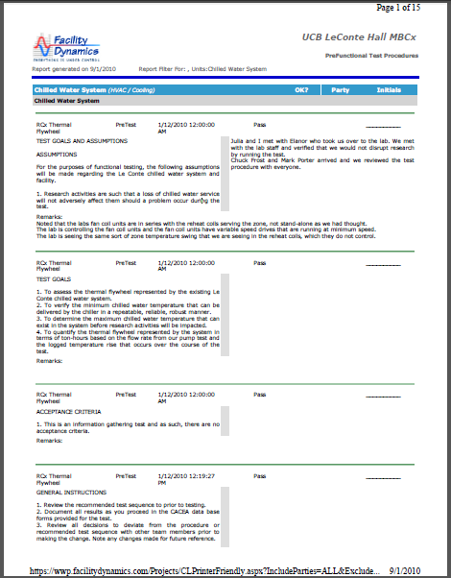
How Do We Dialog with a Building?
We perform a functional test
Functional test components
    Statement of purpose
    Instructions for using the test form
    Equipment requirements
    Acceptance criteria
    Precautions
    Documentation
    Procedure
    Return to Normal and Follow-up

Slide 44
The Real Trick
Figuring out what to ask

Slide 45
Figuring Out What to Ask
Scope the building to identify opportunities
Vet the opportunities
  Savings potential
  Owner priorities
  Capabilities
Collect the data you need
  Understand the system
  Understand what you need to know
  Deploy loggers
  Perform focused functional tests

Slide 46
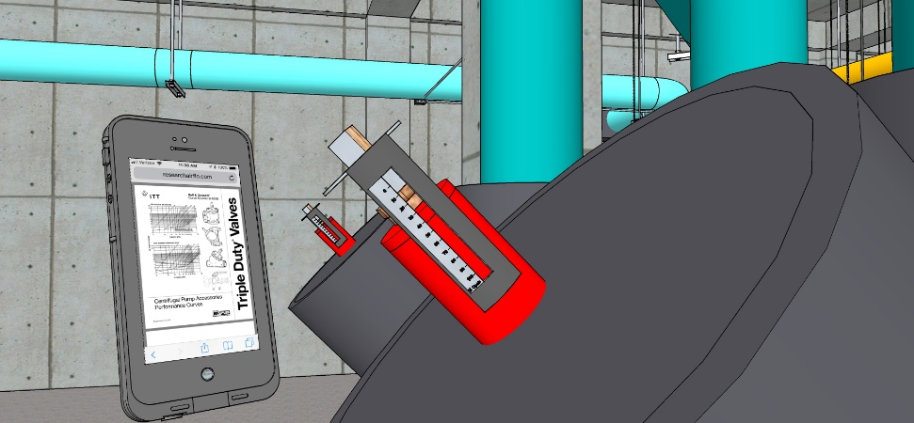
Understanding What you Need to Know
We will do savings estimates, not savings exactamates.
  Related to the clue that led you to the finding
  How accurate does it need to be

Slide 47
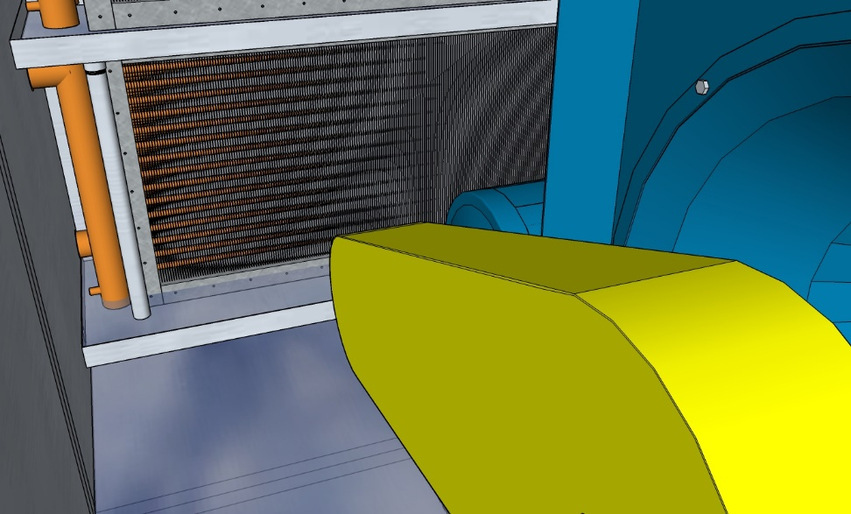
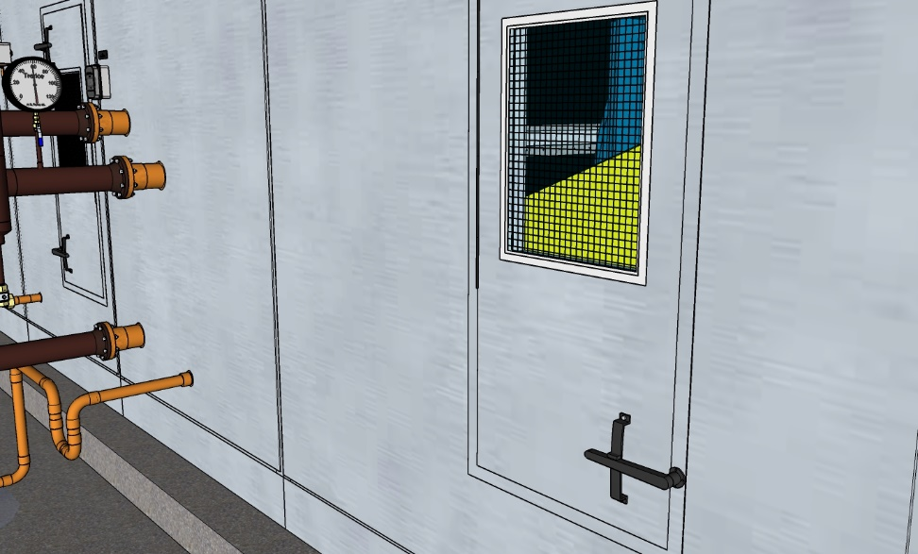
Understanding What you Need to Know
We will do savings estimates, not savings exactamates.
  Related to the clue that led you to the finding
  How accurate does it need to be
  May include a non-energy component

Slide 48
Understanding What you Need to Know
This will likely come down to one or more of the fundamental energy equations
This is probably the time to start understanding how your target system uses energy and other resources

Slide 49
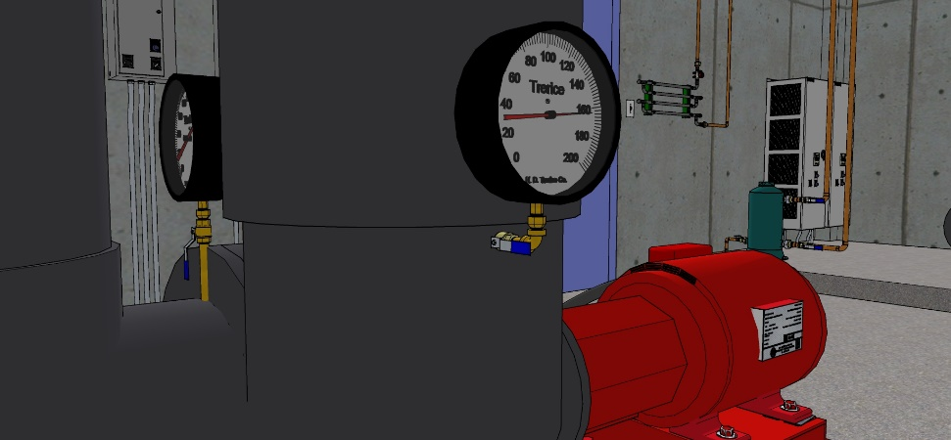
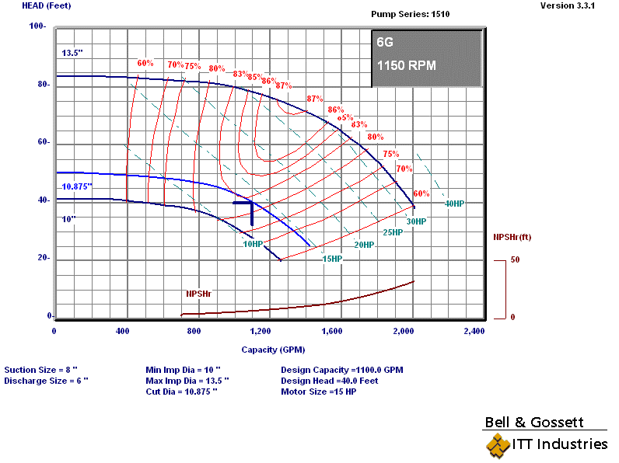
Understanding What you Need to Know
The way your target system uses resources and energy will be related to the basic principles behind it
  Understand the equipment
  Collect or develop performance curves
    Manufacturers data

Slide 50
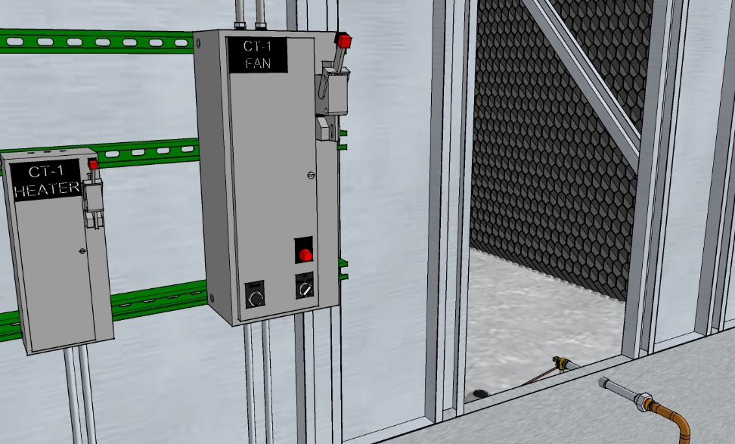
Understanding What you Need to Know
The way your target system uses resources and energy will be related to the basic principles behind it
  Understand the equipment
  Collect or develop performance curves
    Manufacturers data
    Manufacturer’s modeling software
    Field testing

Slide 51
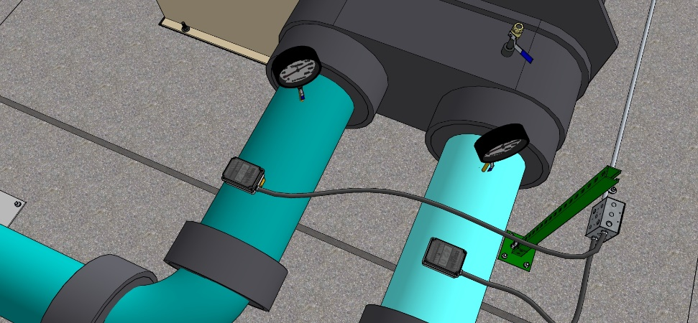
Understanding What you Need to Know
The load profile may be an important thing to understand

Slide 52
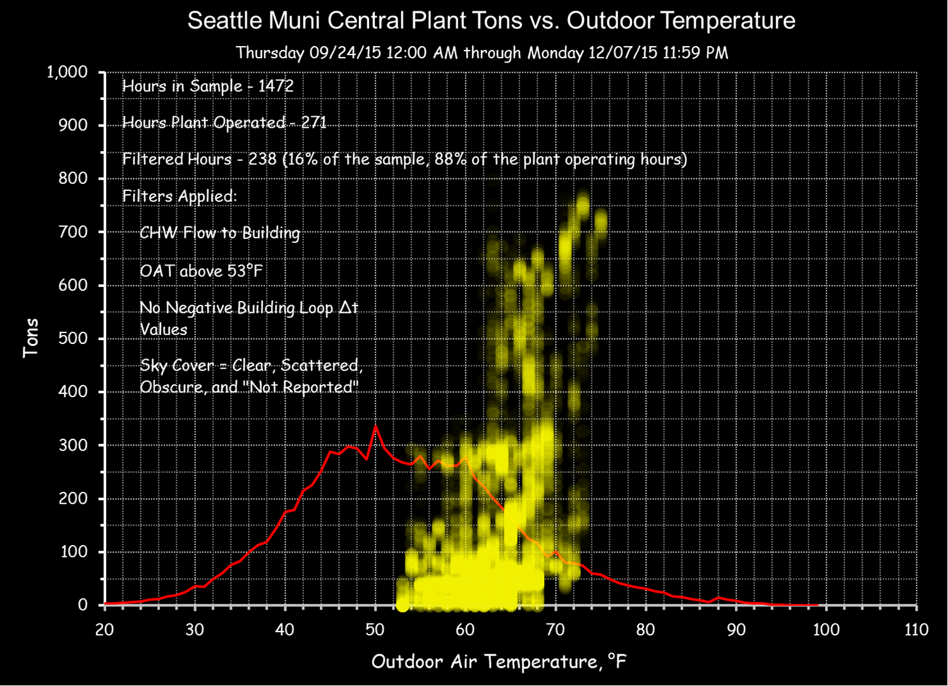
Understanding What you Need to Know
The load profile may be an important thing to understand
Begin to collect data ASAP

Slide 53
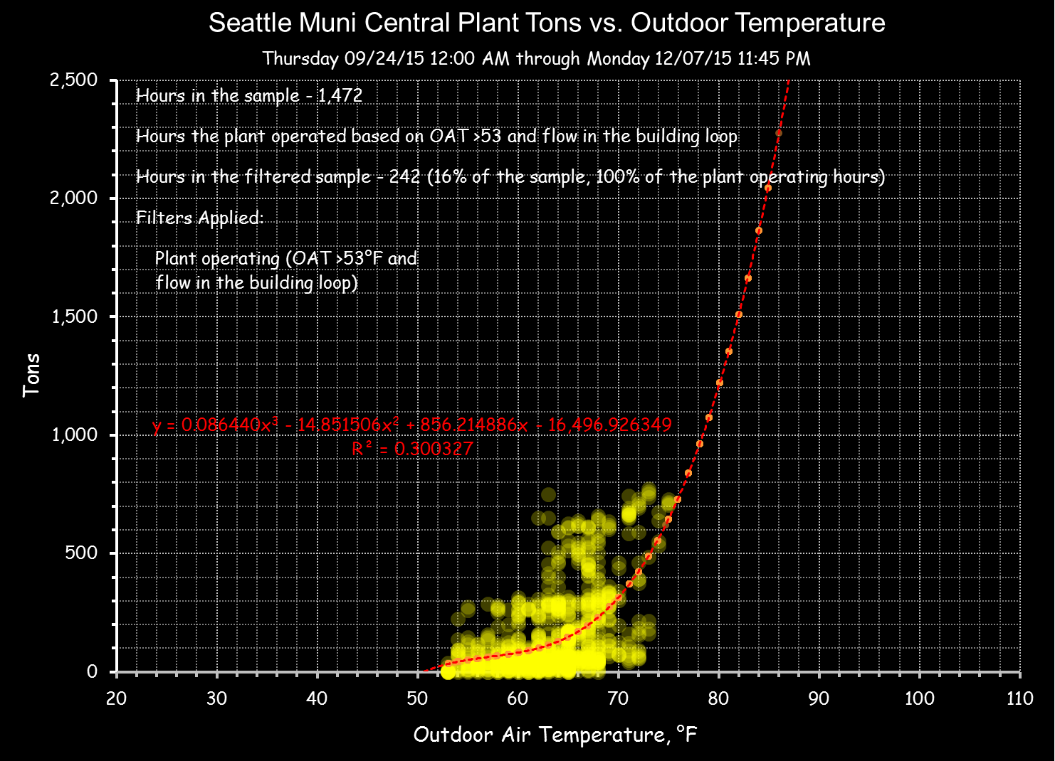
Understanding What you Need to Know
The load profile may be an important thing to understand
Begin to collect data ASAP
  The load on the end use systems becomes the load on the utility systems
  The load is usually driven by something we can measure
    Identify it
    Measure it
    Leverage regressions

Slide 54
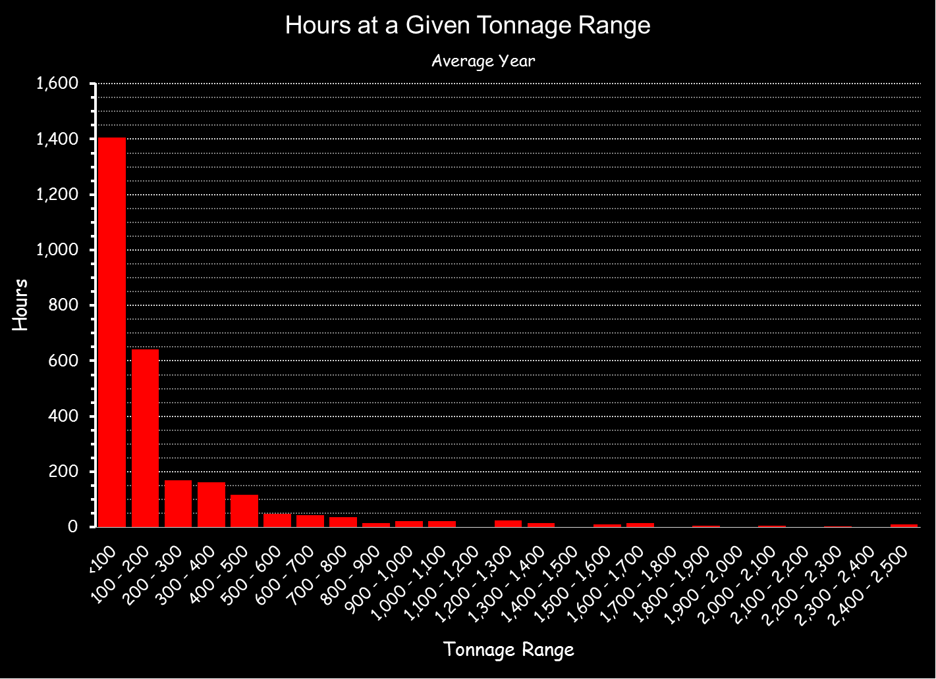
Understanding What you Need to Know
The load profile may be an important thing to understand
Begin to collect data ASAP
  The load on the end use systems becomes the load on the utility systems
  The load is usually driven by something we can measure
    Identify it
    Measure it
    Leverage regressions
Blog posts demonstrating regression techniques:
https://av8rdas.wordpress.com/?s=scatter+plots+building+performance

Slide 55
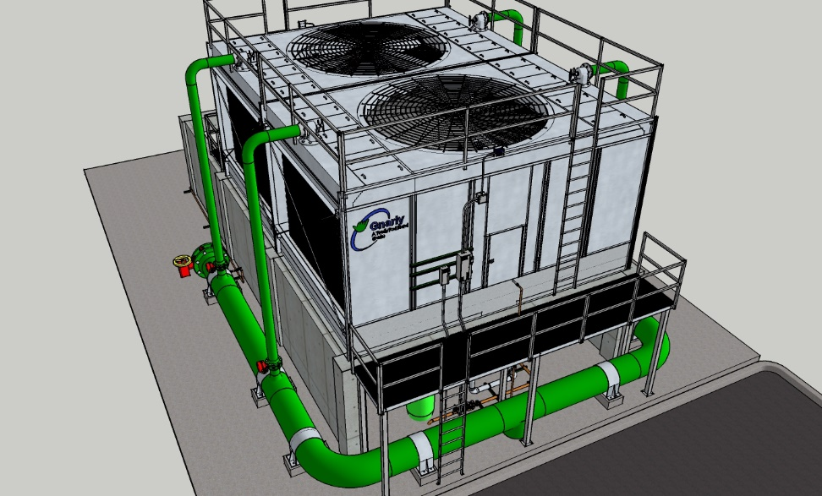
Understanding What you Need to Know
Sometimes, performance is a function of a number of variables
  Tower capacity is a function of wet bulb temperature
  Wet bulb temperature is a function of climate
  At a given wet bulb temperature fan power is nearly linear with load
  The load comes from the system the tower serves

Slide 56
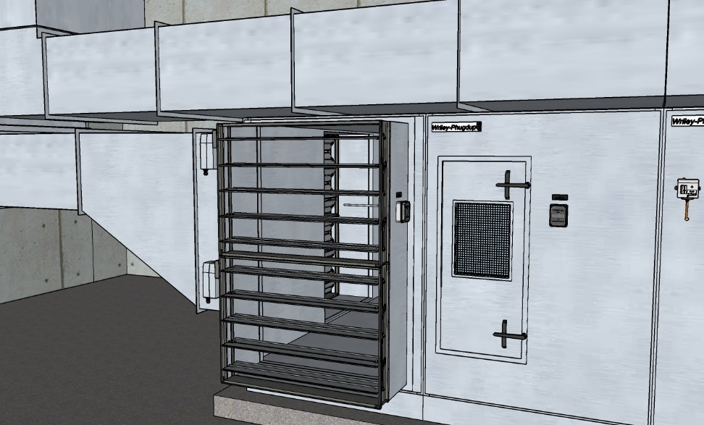
Understanding What you Need to Know
Sometimes, performance is a function of a number of variables
  Chilled water load in an economizer equipped system varies with the state of the economizer, the flow rate and the leaving temperature
  The state of the economizer varies with climate
  The flow rate may vary with load
  The leaving temperature may be reset

Slide 57
Understanding What you Need to Know
Identify the variables
Know what you don’t know
Plan your monitoring and test strategy accordingly

Slide 58
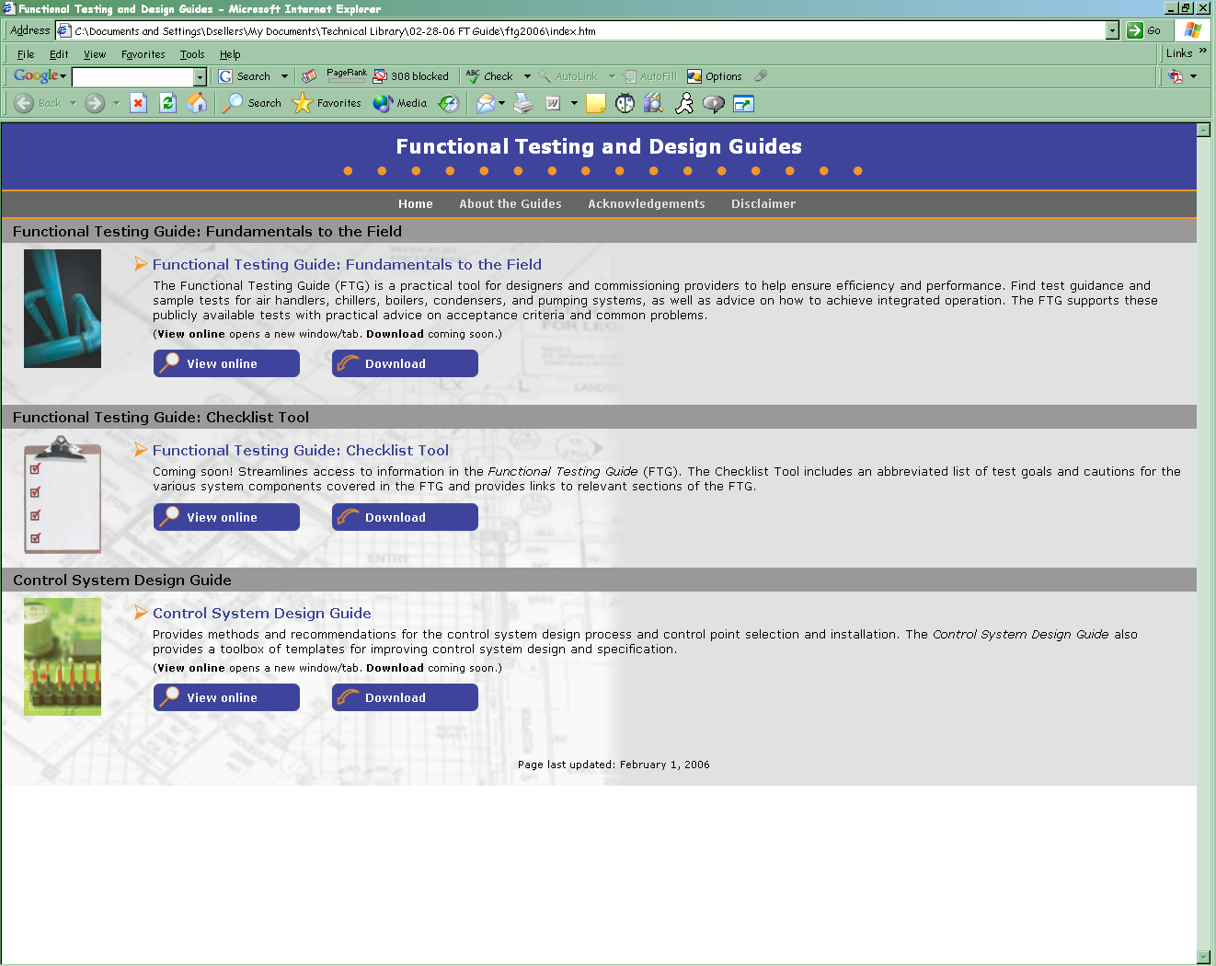
The Functional Testing Guide
Download at http://www.av8rdas.com/functional-testing-guide.html

Slide 59
Le Conte Annex Case Study
For a case study about how a functional test was developed to ask a building a question about the thermal inertial of its chilled water system and the results visit …
https://www.av8rdas.com/introduction-to-functional-testing.html
… and watch the 3rd and 4th video modules

Slide 60

Le Conte Annex Case Study
If you thought this presentation was exciting, then these videos will knock your socks off
Unsolicited Endorsement
Impartial Observer
(if you did not think this presentation was exiting then, thank goodness, you are probably normal)

