Slide 1
Existing Building Commissioning Workshop
Series 13, Session 5
Introduction to Functional Testing
David Sellers
Senior Engineer
Facility Dynamics Engineering
October 13, 2016

Slide 2
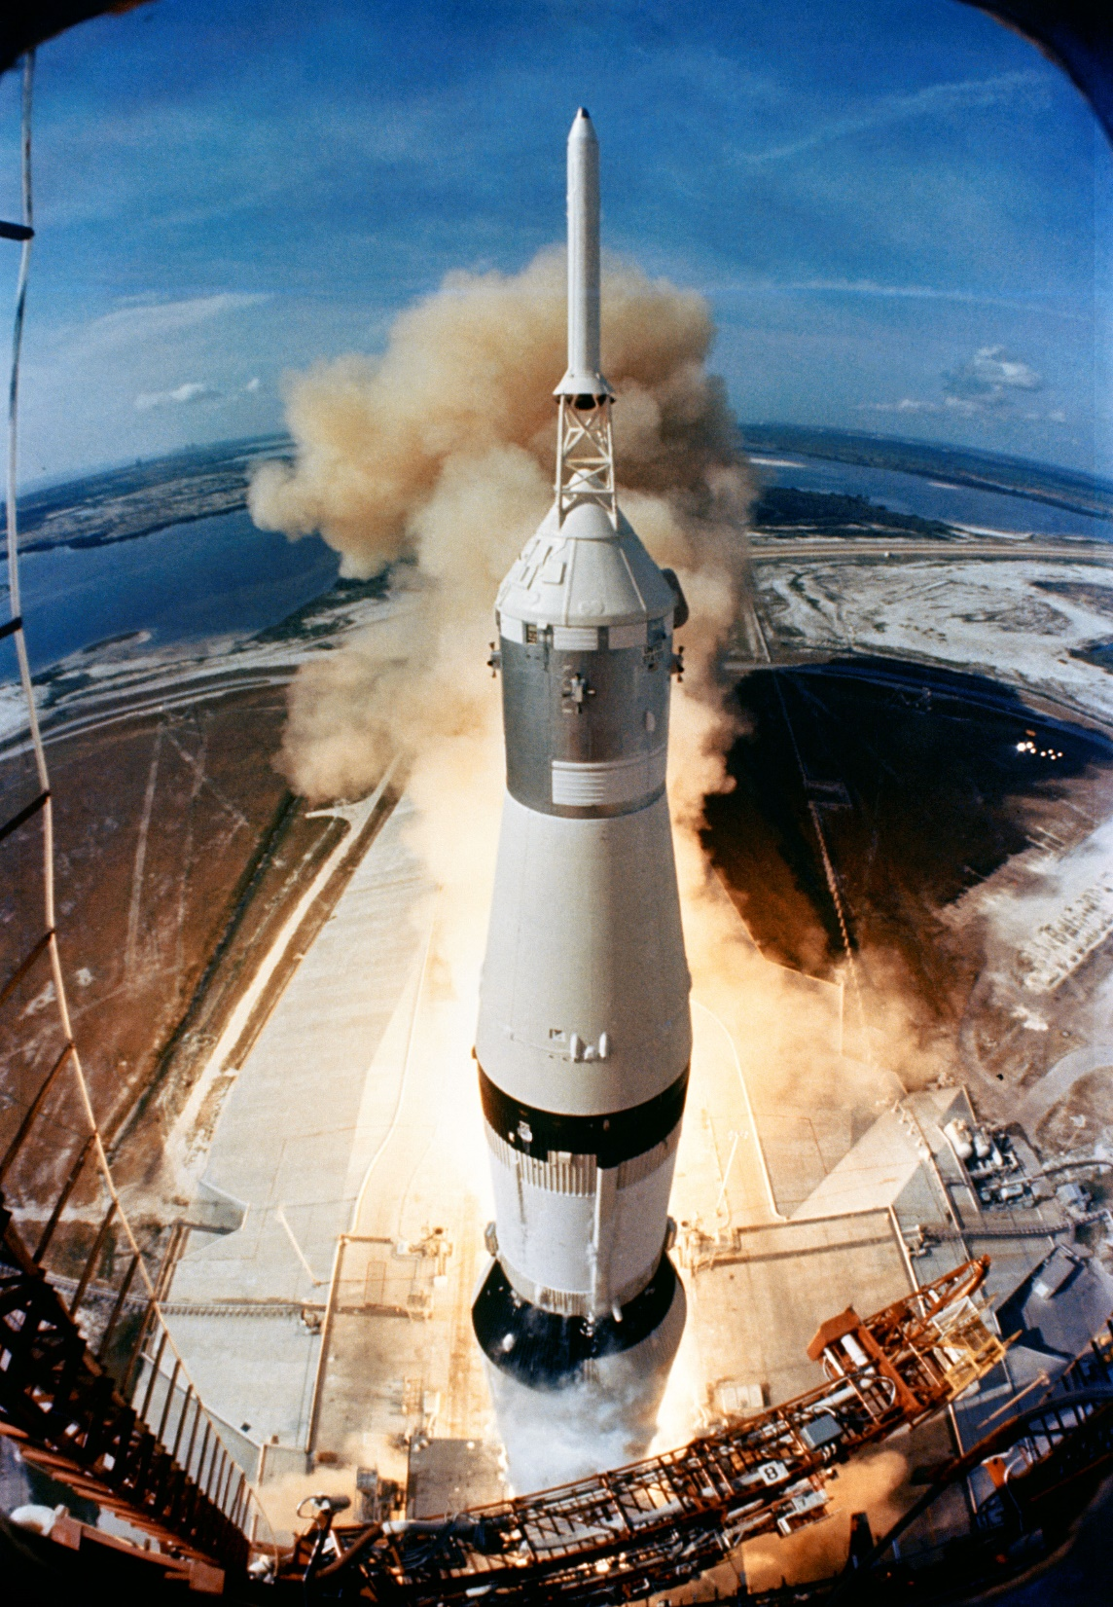
July 20, 1969, A Historic Day
Image courtesy NASA Image Archives; https://www.nasa.gov/multimedia/imagegallery/index.html

Slide 3
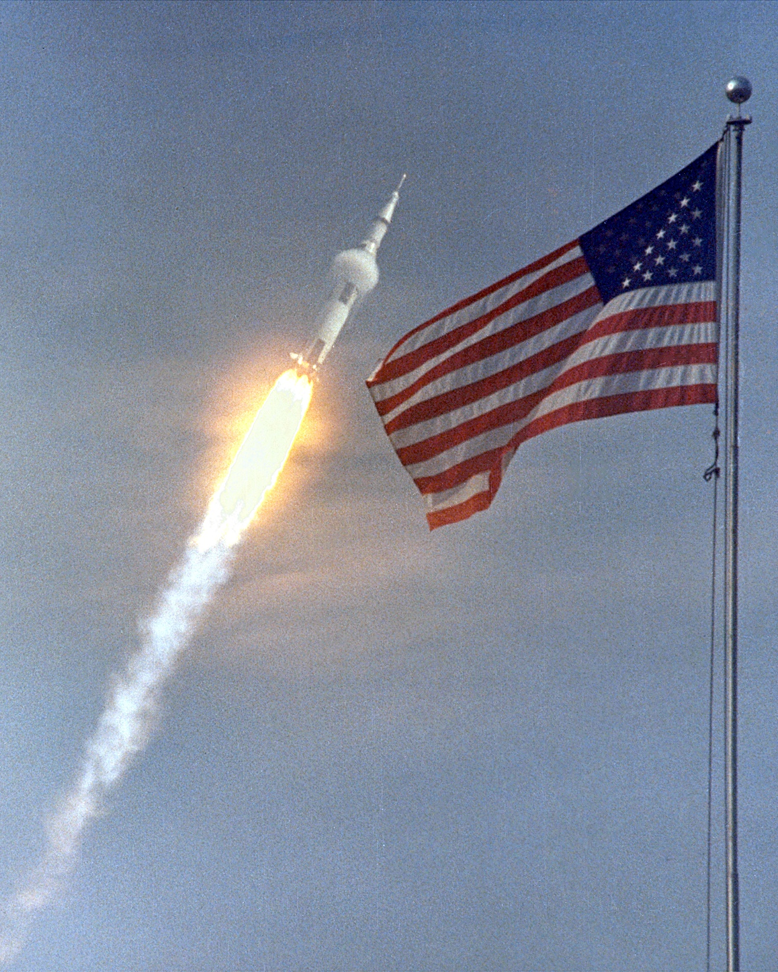
July 20, 1969, A Historic Day
Image courtesy NASA Image Archives; https://www.nasa.gov/multimedia/imagegallery/index.html

Slide 4

July 20, 1969, A Historic Day
Image courtesy NASA Image Archives; https://www.nasa.gov/multimedia/imagegallery/index.html

Slide 5
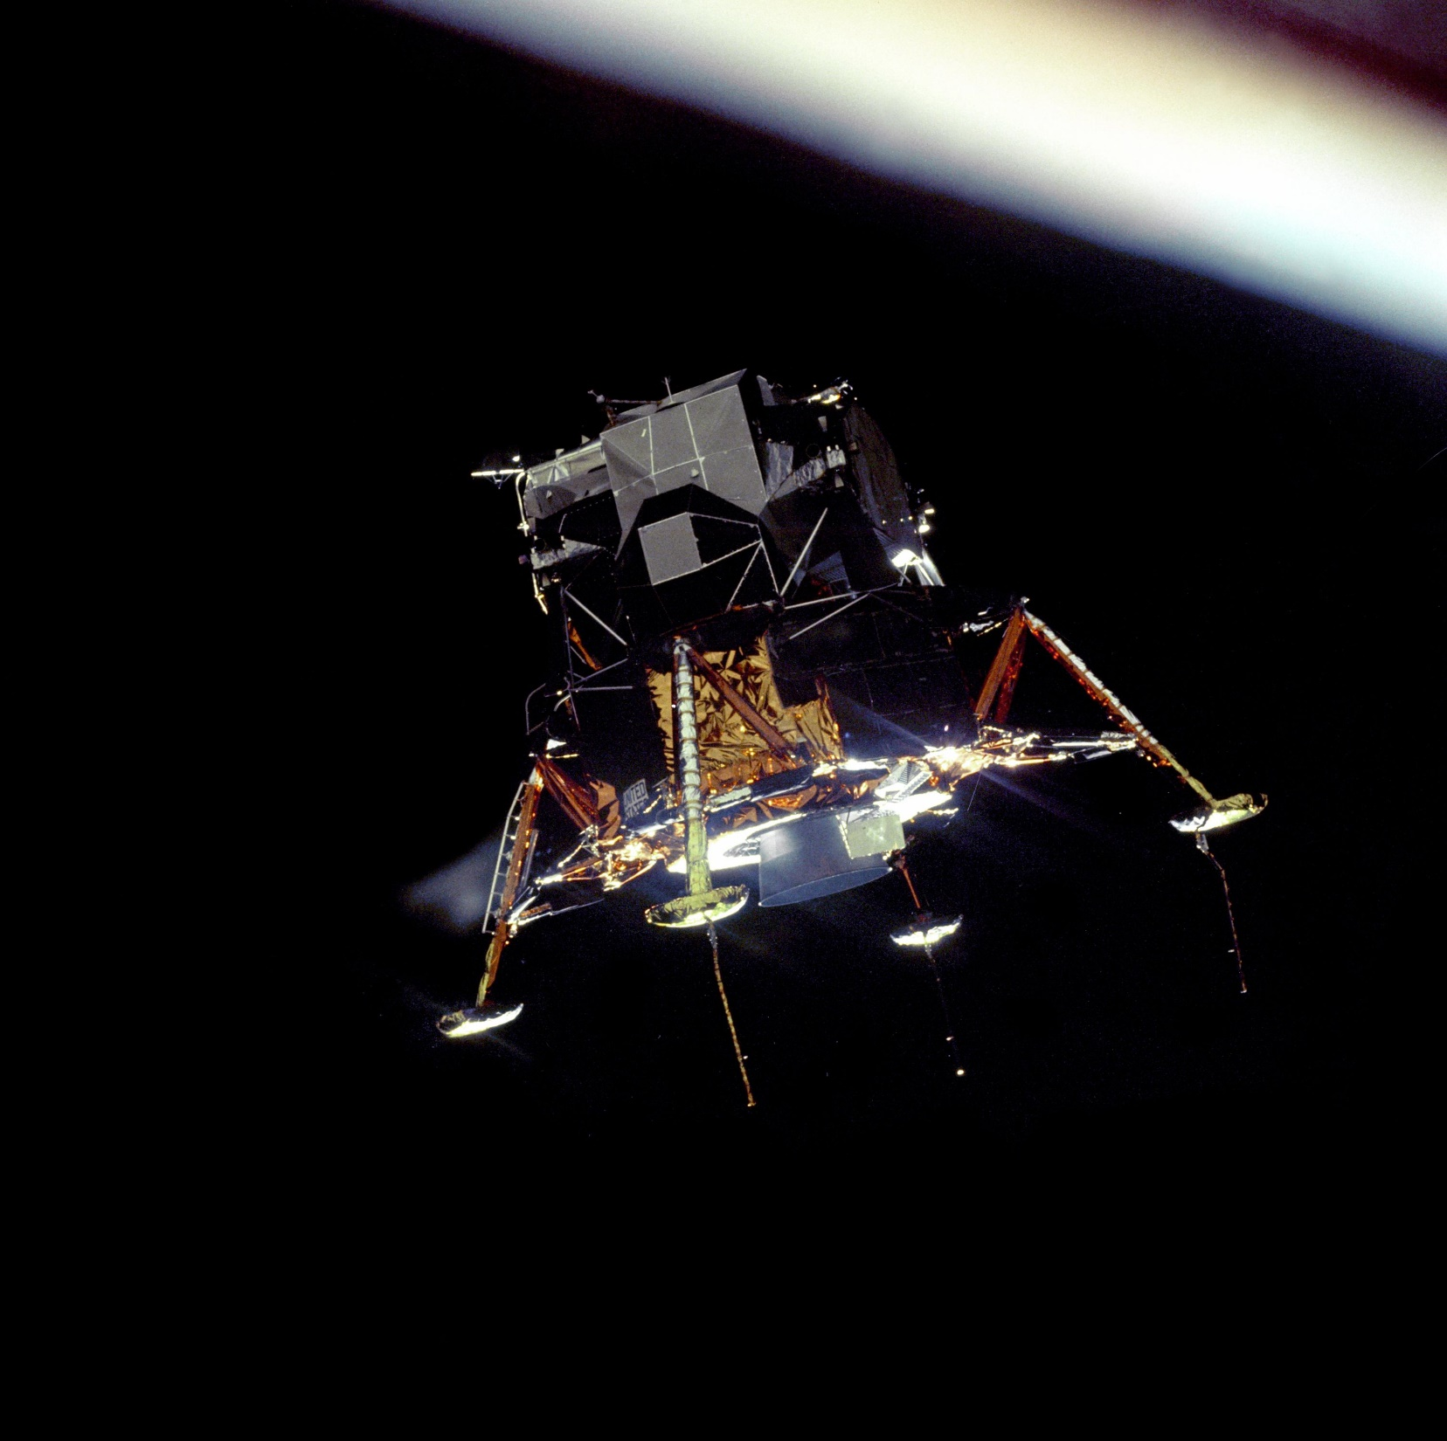
July 20, 1969, A Historic Day
Image courtesy NASA Image Archives; https://www.nasa.gov/multimedia/imagegallery/index.html

Slide 6
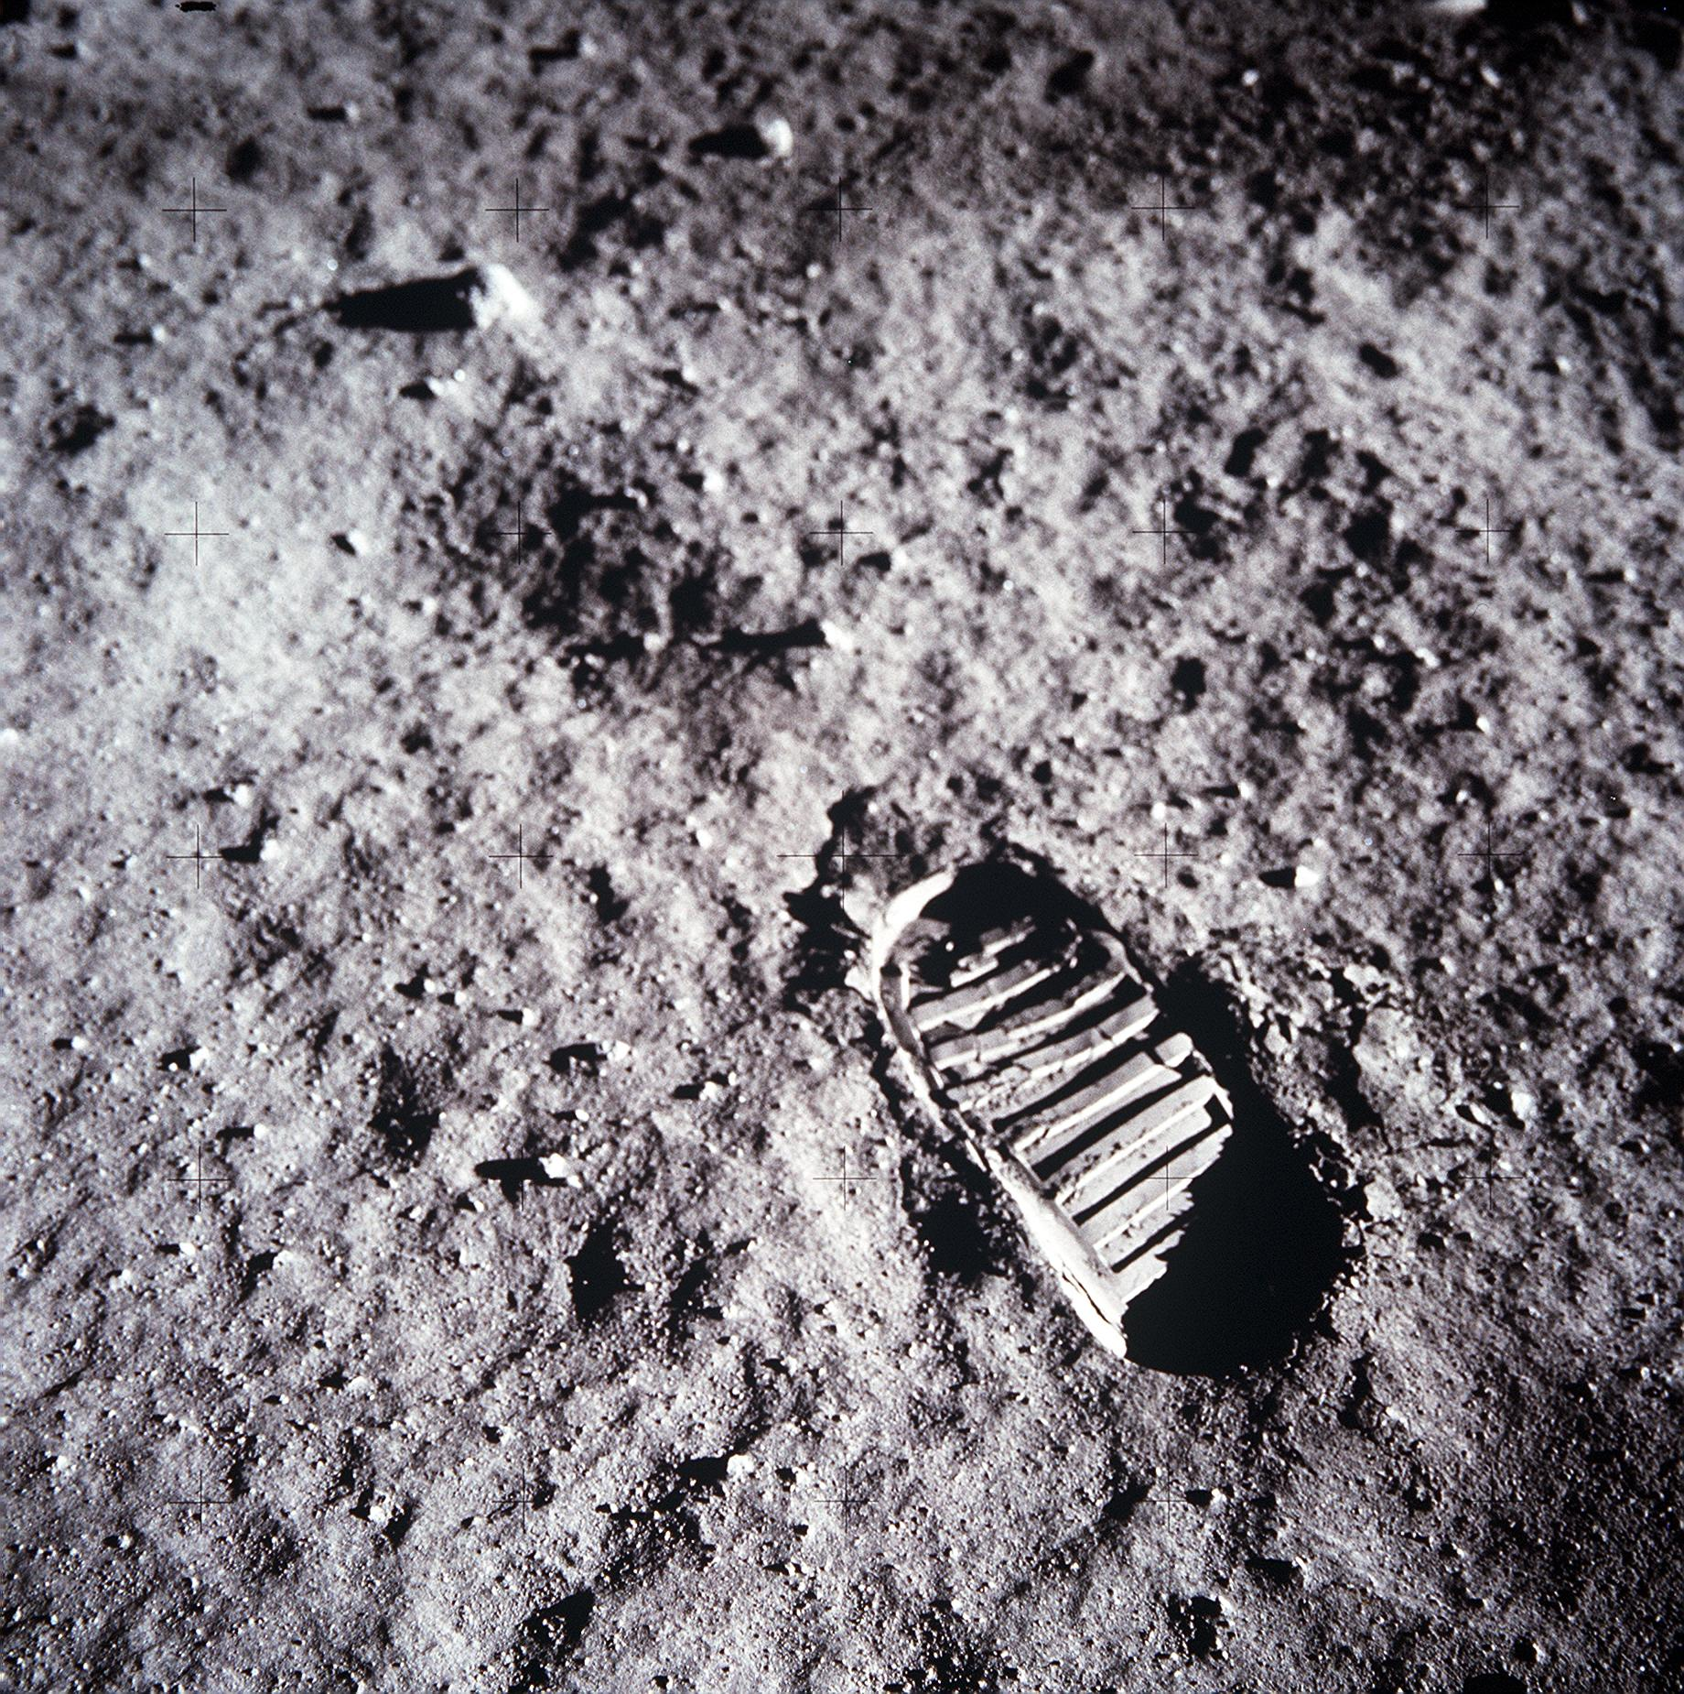
July 20, 1969, A Historic Day
Image courtesy NASA Image Archives; https://www.nasa.gov/multimedia/imagegallery/index.html

Slide 7
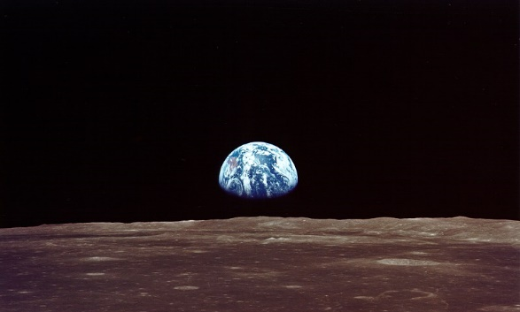
July 20, 1969, A Historic Day
We went to explore the Moon, and in fact discovered the Earth
Gene Cernan
Apollo 17 Commander
Image courtesy NASA Image Archives; https://www.nasa.gov/multimedia/imagegallery/index.html

Slide 8

July 20, 1969, A Historic Day
We went to explore the Moon, and in fact discovered the Earth
Gene Cernan
Apollo 17 Commander
Image courtesy NASA Image Archives; https://www.nasa.gov/multimedia/imagegallery/index.html

Slide 9

A Historic Day

Slide 10
A Lot of Amazing Technical Advances

Slide 11
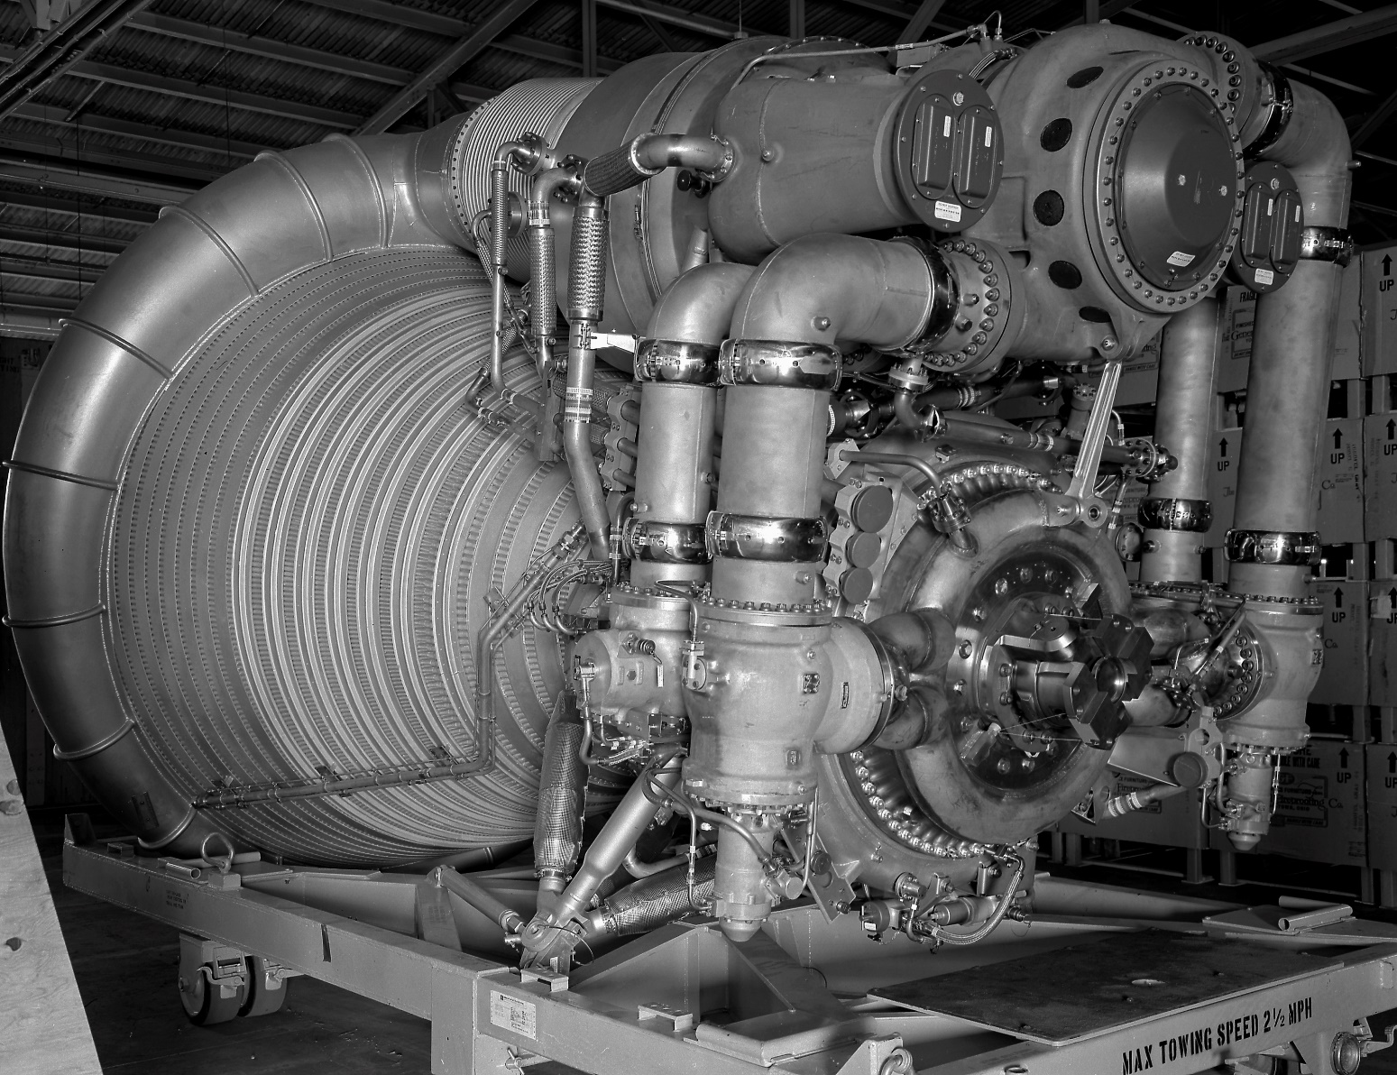
A Lot of Amazing Technical Advances
Saturn First Stage F-1 Engine
1,500,000 pounds of thrust
150 second burn time
5,683 lb/sec of LOX and RP1
  413.5 gps LOX
  257.9 gps RP-1
Image courtesy NASA Image Archives; https://www.nasa.gov/multimedia/imagegallery/index.html

Slide 12
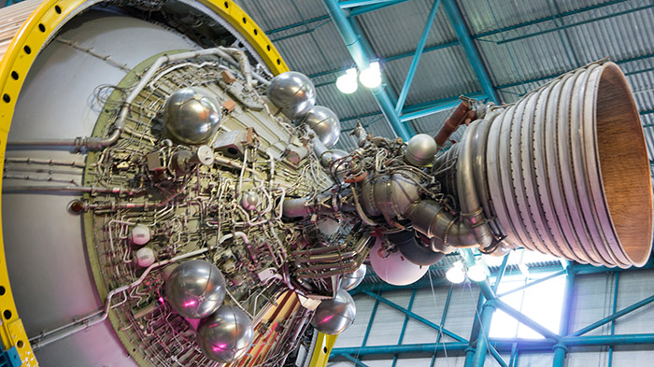
A Lot of Amazing Technical Advances
Saturn J-2 Upper Stage Engine
232,250 pounds of thrust
Restartable
Hydrogen fueled (cryogenic)
LOX for oxidizer
Image courtesy NASA Image Archives; https://www.nasa.gov/multimedia/imagegallery/index.html

Slide 13
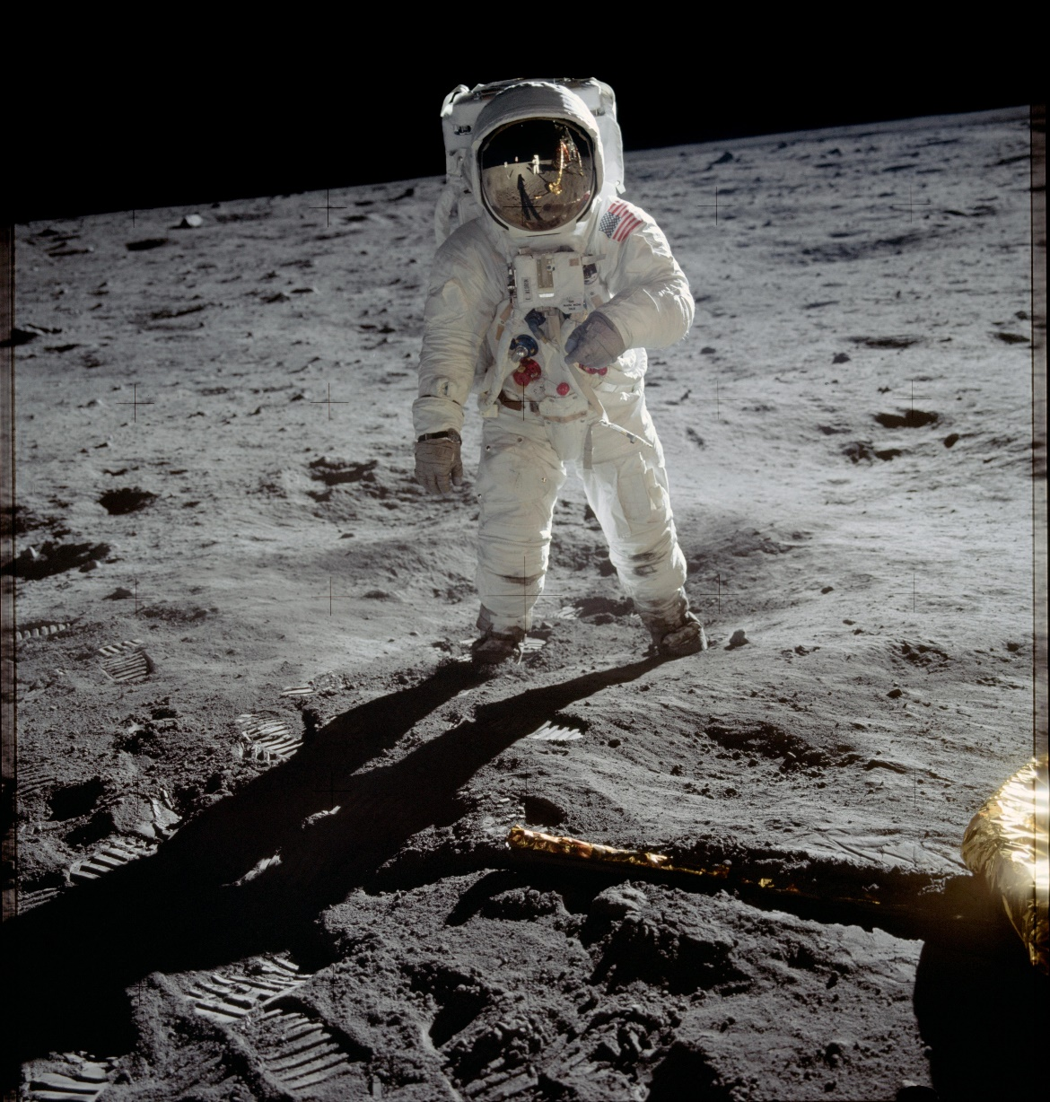
A Lot of Amazing Technical Advances
Space Suits
Allow meaningful movement
Support life
    In a vacuum
    At -290 to +310°F
    Immune to micro-metiorites
Image courtesy NASA Image Archives; https://www.nasa.gov/multimedia/imagegallery/index.html

Slide 14
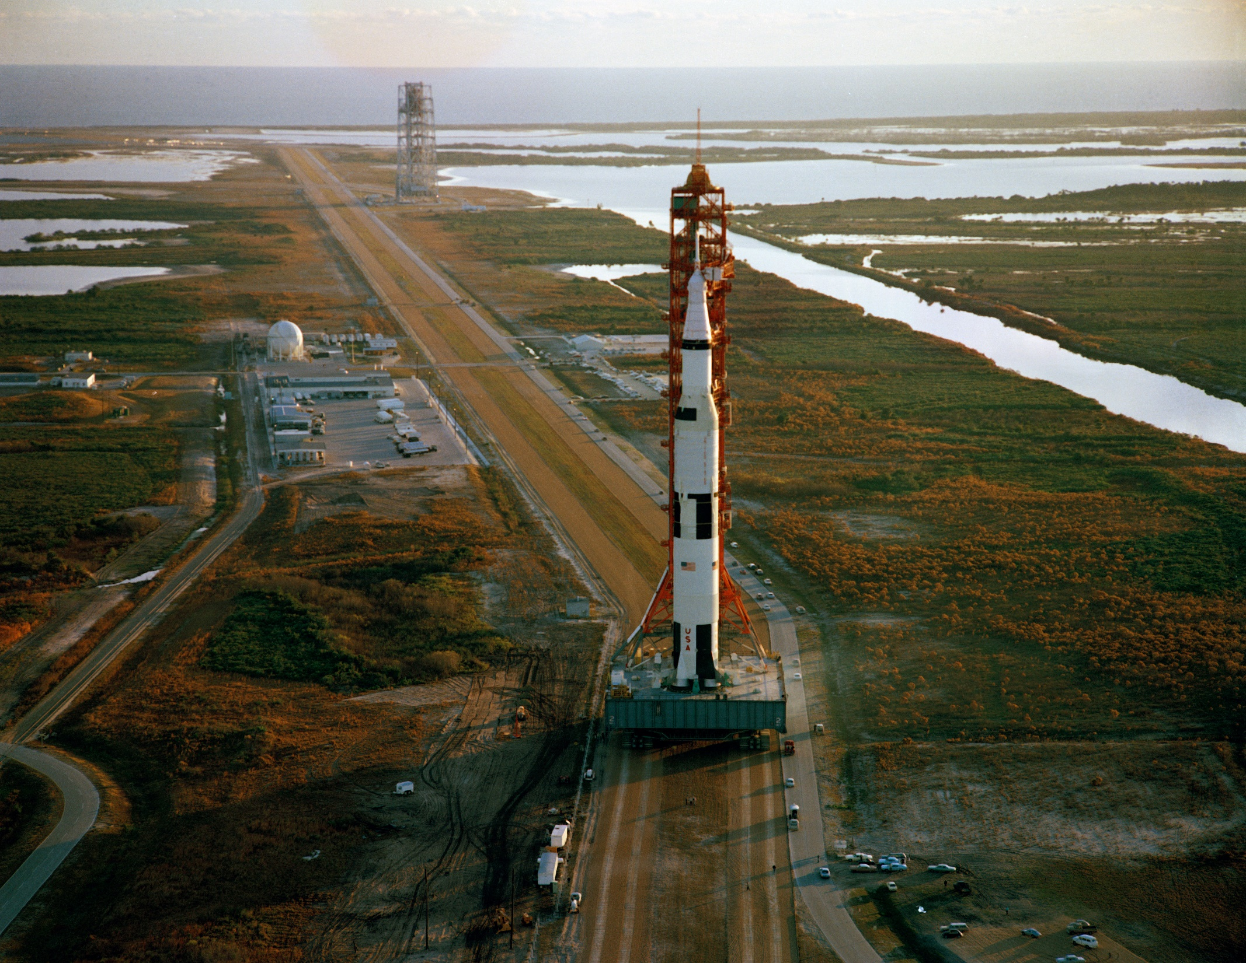
A Lot of Amazing Technical Advances
Crawler/transporter
4,100 hp
Moved 9,870,000 pounds at 1 mph 3.4 – 4.2 miles
Kept the load level with-in 10° of arc going up a 5% grade
Image courtesy NASA Image Archives; https://www.nasa.gov/multimedia/imagegallery/index.html

Slide 15
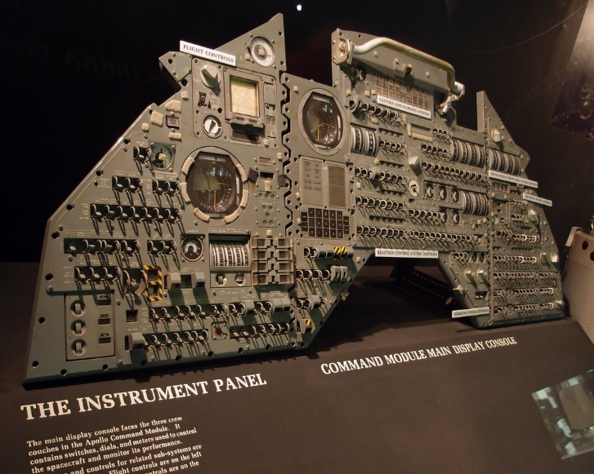
A Lot of Amazing Technical Advances
Apollo Guidance Computer
1 Mhz processor speed
70 pounds
Image courtesy NASA Image Archives; https://www.nasa.gov/multimedia/imagegallery/index.html

Slide 16
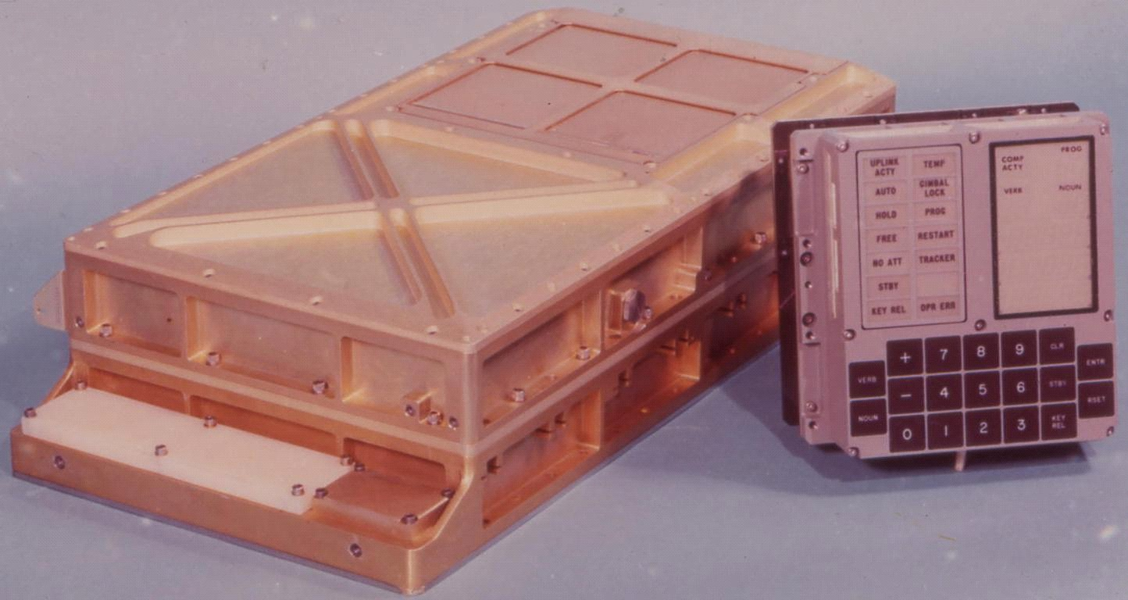
A Lot of Amazing Technical Advances
Apollo Guidance Computer
1 Mhz processor speed
70 pounds
Image courtesy NASA Image Archives; https://www.nasa.gov/multimedia/imagegallery/index.html

Slide 17
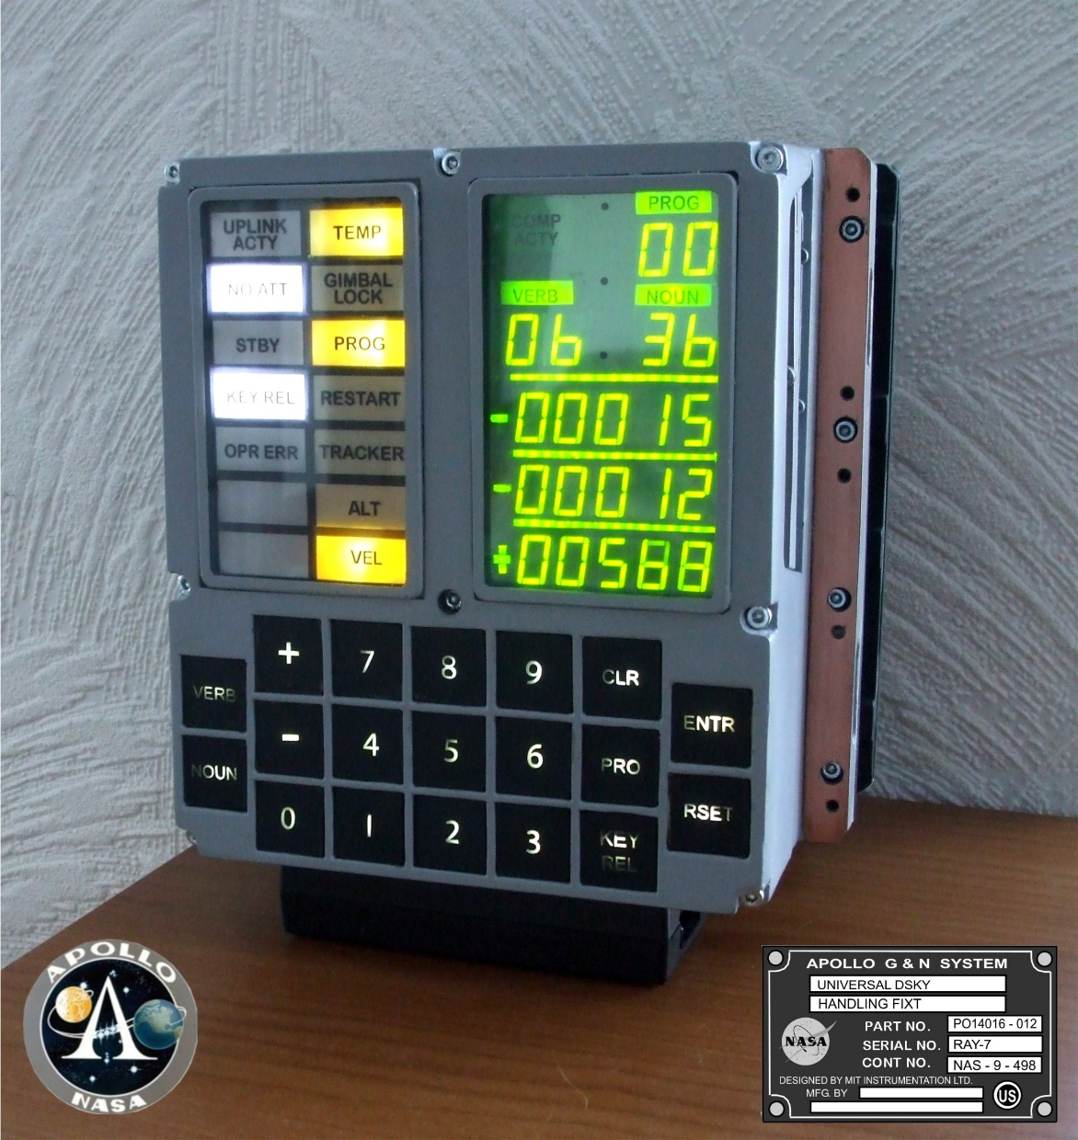
A Lot of Amazing Technical Advances
Apollo Guidance Computer
1 Mhz processor speed
70 pounds
Image courtesy NASA Image Archives; https://www.nasa.gov/multimedia/imagegallery/index.html

Slide 18
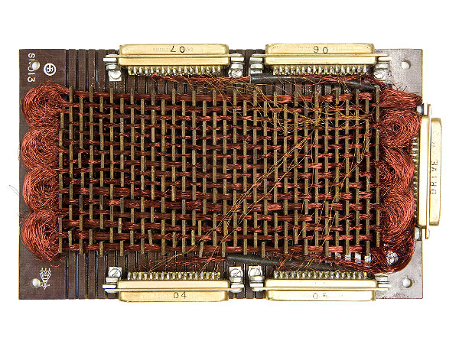
A Lot of Amazing Technical Advances
Apollo Guidance Computer
1 Mhz processor speed
70 pounds
4k Memory
Image courtesy NASA Image Archives; Charles Stark Draper Laboratory, Copyright Owner © Mark Richards

Slide 19
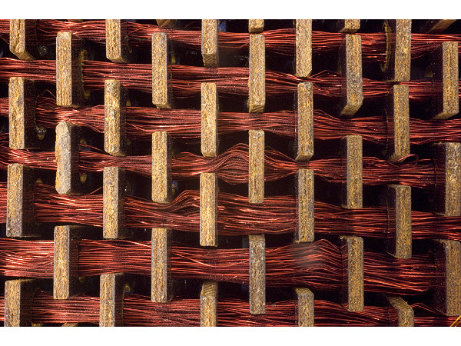
A Lot of Amazing Technical Advances
Apollo Guidance Computer
1 Mhz processor speed
70 pounds
4k Memory
Image courtesy NASA Image Archives; Charles Stark Draper Laboratory, Copyright Owner © Mark Richards

Slide 20
They Were Doing Rocket Science
As a result, we sent people to the moon
and returned them safely to earth

Slide 21
We Are Not Doing Rocket Science
But we seem to have a hard time getting the AHU to
run on a schedule and use energy efficiently

Slide 22
Functional Testing
How we find out if we are doing the job

Slide 23
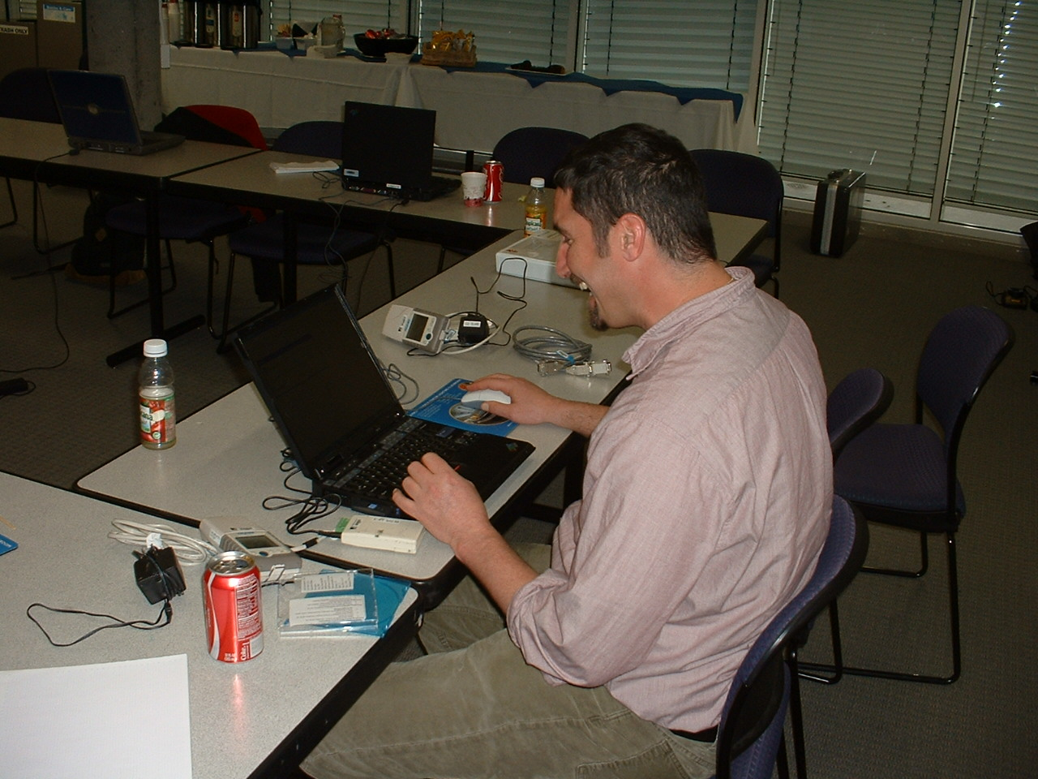
Functional Testing is FUN!

Slide 24
Functional Testing
Core element of any commissioning process
Validates machinery and systems
  Do they deliver?
  Why don’t they deliver?
  Do the work well together?
  Why aren’t they working well together
  Was it big enough?
  How big should it be?

Slide 25
Functional Testing
Core element of any commissioning process
Validates machinery and systems
  Do they deliver?
  Why don’t they deliver?
  Do the work well together?
  Why aren’t they working well together
  Was it big enough?
  How big should it be?

Slide 26
Functional Testing as it Relates to the Metrics of the Systems We Test
Physical Configuration
Distribution Equipment Selections
Installation Documents
Construction Project
Assembled Building
Owner’s Project Requirements
Loads
Operating Requirements
Process Parameters
System Configuration
Heat Transfer Equipment Selections

Slide 27
Functional Testing as it Relates to the Metrics of the Systems We Test
Work
Physical Configuration
Distribution Equipment Selections
Installation Documents
Construction Project
Assembled Building
Make Them
Here are the
Owner’s Project Requirements
Parts,
Loads
Operating Requirements
Process Parameters
System Configuration
Heat Transfer Equipment Selections

Slide 28
Functional Testing as it Relates to the Metrics of the Systems We Test
Work?
Physical Configuration
Distribution Equipment Selections
Installation Documents
Construction Project
Assembled Building
These Parts
Owner’s Project Requirements
of
Loads
How Do all
Operating Requirements
Process Parameters
System Configuration
Heat Transfer Equipment Selections

Slide 29
Functional Testing as it Relates to the Metrics of the Systems We Test
Physical Configuration
Distribution Equipment Selections
Installation Documents
Construction Project
Assembled Building
Work Better?
These Parts
Owner’s Project Requirements
Loads
of
How Can all
Operating Requirements
Process Parameters
System Configuration
Heat Transfer Equipment Selections

Slide 30
Functional Testing as it Relates to the Project Timeline

Slide 31
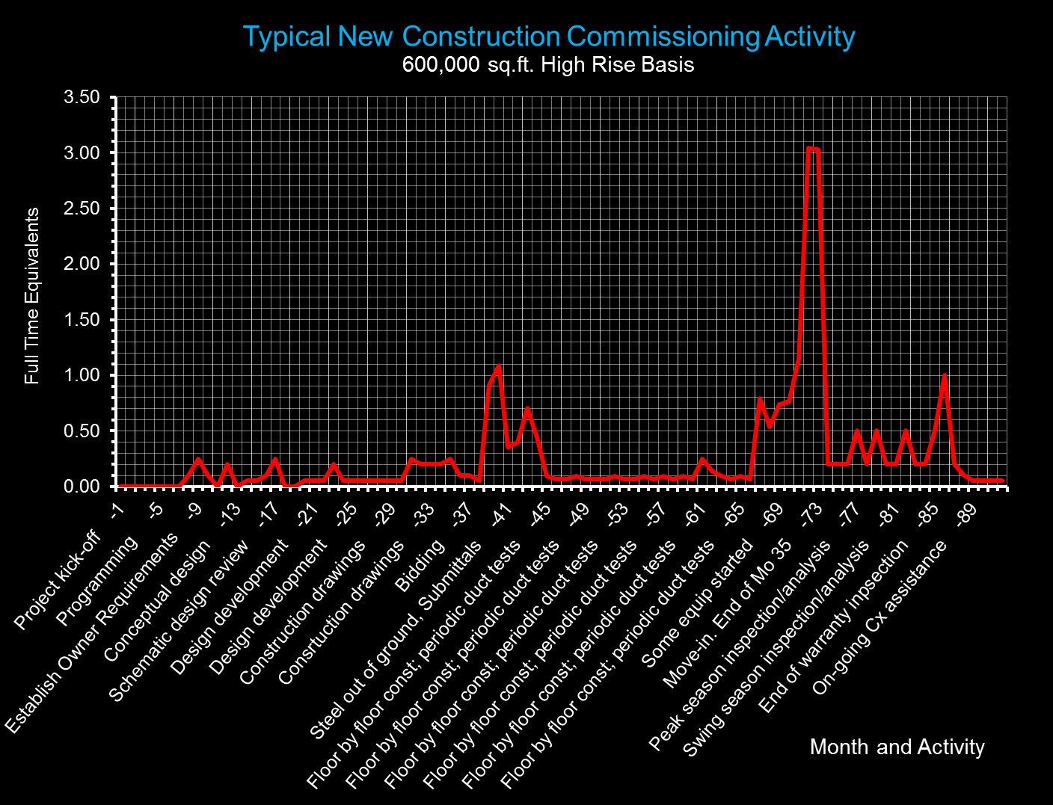
31

Slide 32
Schematic Design Phase
Design Development Phase
Construction Document Phase
Bidding and Award
Early Construction Phase
Middle Construction Phase
Warranty Phase
Ongoing Commissioning
Programming Phase
Conceptual Design Phase
Late Construction Phase
Acceptance Phase
Observation Phase
Ongoing Commissioning
32

Slide 33
Programming Phase
Conceptual Design Phase
Schematic Design Phase
Design Development Phase
Construction Document Phase
Bidding and Award
Early Construction Phase
Middle Construction Phase
Late Construction Phase
Acceptance Phase
Observation Phase
Warranty Phase
Ongoing Commissioning
Testing by Cx Authority
and Contractor
Testing by
“Mother Nature”
33

Slide 34
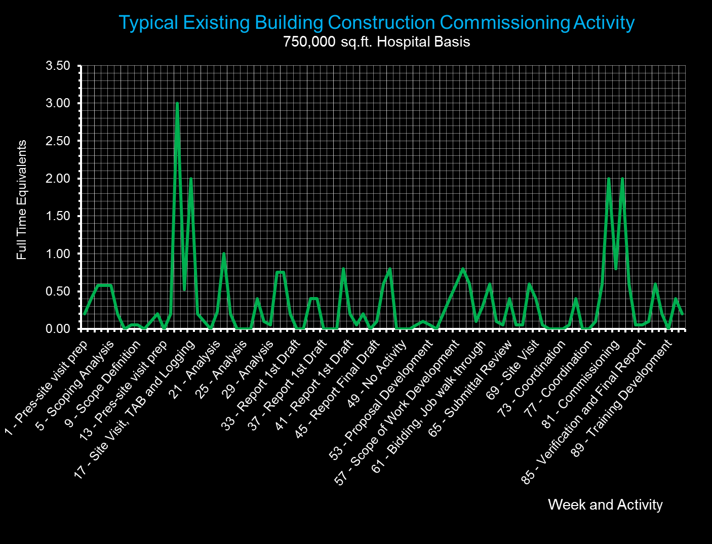
34
34

Slide 35
Scoping
Implementation
Verification
Testing by Cx Authority
and Building Operating Team
Investigation
35
35

Slide 36
Testing Quantifies the Problem
Testing by Cx Authority
and Building Operating Team
Testing Answers Questions Raised During Investigation
Testing Verifies Improvements
36
36

Slide 37
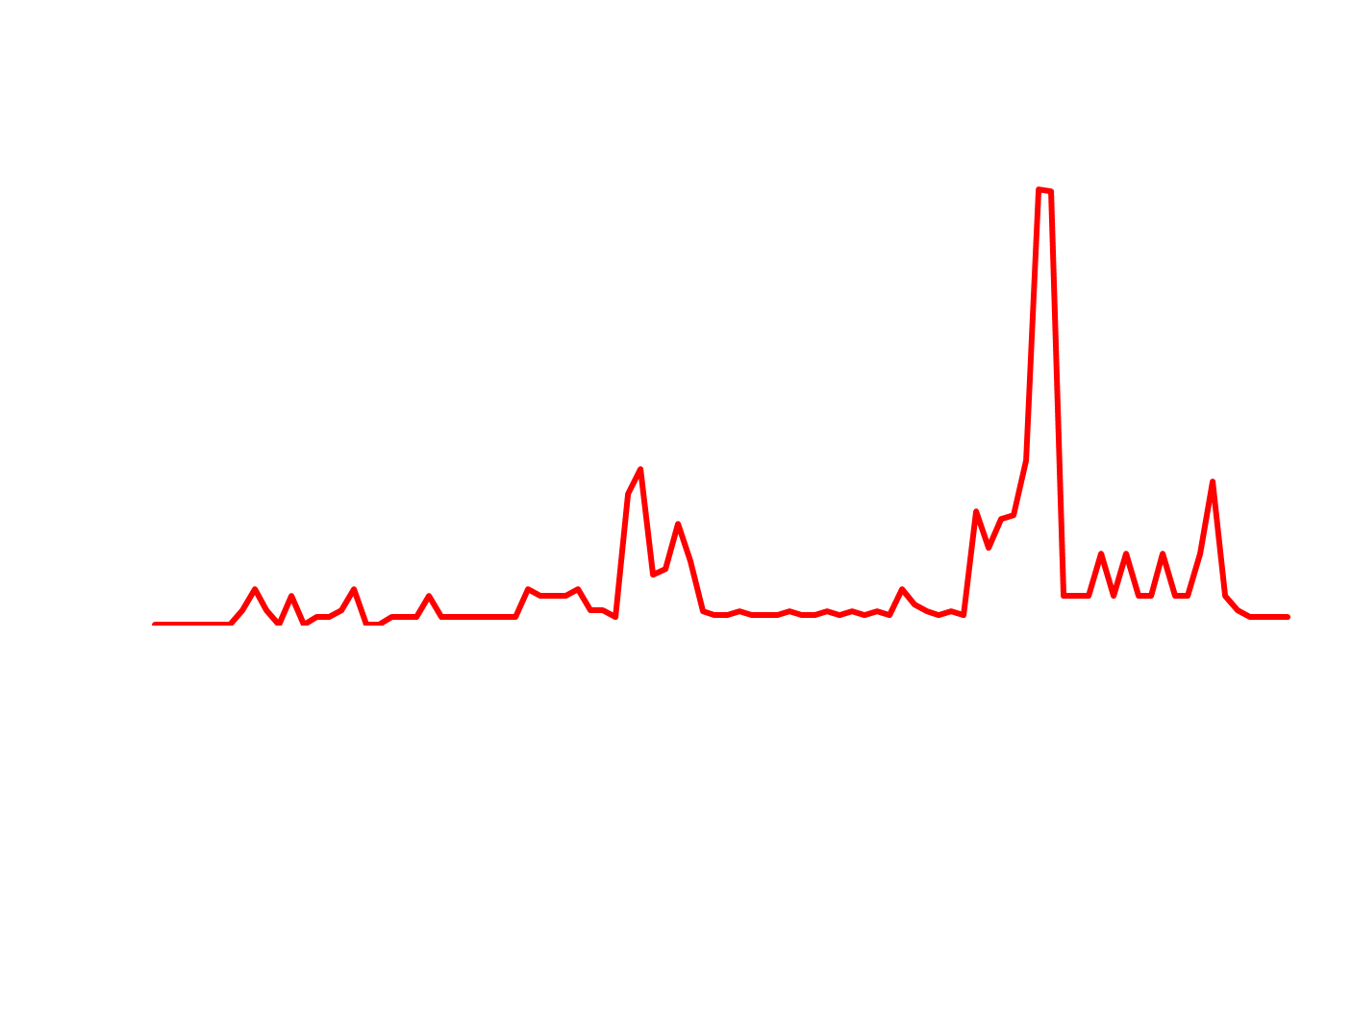
37
37

Slide 38
New Construction versus EBCx Testing
New Construction
EBCx
Trying to prove design intent
Demonstrate all elements of the system meet requirements
Verification and quality assurance process
Trying to understand design intent
Focused on certain elements of the system
Diagnostic and troubleshooting process

Slide 39
Forced vs. Natural Response Testing
Forced Response Testing
    I force a change and watch how the system responds
Natural Response Testing
    Mother Nature makes a change and I discover how the system responds

Slide 40
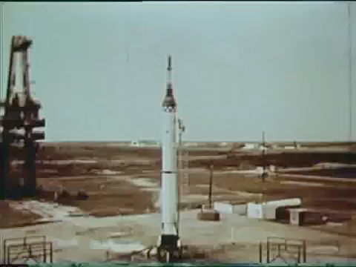
Forced vs. Natural Response Testing
Forced Response Testing
    I force a change and watch how the system responds
    View the video on Youtube at http://tinyurl.com/MR-1-Launch
Natural Response Testing
    I observe how a system responds to the normal course of events
Notes:
http://tinyurl.com/MR-1-Launch
Investigation revealed that the Redstone's engine shutdown was caused by two of its electrical cables separating in the wrong order.[6] These cables were a control cable, which provided various control signals, and a power cable, which provided electrical power and grounding. Both cables were plugged into the rocket at the bottom edge of one of its tail fins and would separate at liftoff.[11] The control cable was supposed to separate first, followed by the power cable. However, for this launch, the control cable was longer than expected—it was one designed for the military Redstone missile rather than the shorter cable designed for Mercury-Redstone. This control cable had been clamped to compensate for its greater length, but when the vehicle lifted off, the clamping did not work as planned and the control cable separation was delayed, eventually occurring about 29 milliseconds after the power cable had separated.[4][12]
During this brief interval, the lack of electrical grounding caused a substantial current to flow through an electrical relay which was supposed to trigger normal engine cut-off at the end of powered flight. This relay tripped, causing the Redstone to shut off its engine and send a "normal cut-off" signal to the capsule. Under normal circumstances, when the capsule received this signal during a flight, it would do two things: it would jettison its escape rocket, which was no longer of any use, and after the escape rocket had flown clear, fire the explosive bolts holding it to the booster for separation. In the case of MR-1, the capsule did jettison the escape rocket as it was designed to, but the separation sequence did not occur. The capsule was designed to suspend this separation until the vehicle's acceleration had almost ceased, so that the capsule would not be hit by a still-accelerating launch vehicle. This would happen when the capsule's acceleration sensors detected an acceleration approaching 0 g, which it would normally experience after the Redstone had shut down and was entering free fall. However, in MR-1, the Redstone was not in free fall but rather sitting supported on the ground. Thus the capsule sensors detected the effect of their own supported weight, which they read as a constant "acceleration" of 1 g. Because of this apparent acceleration, capsule separation was disabled.[4][13]
The jettison of the escape rocket activated the capsule's parachute recovery system. Since the altitude was below 10,000 feet (3,000 m), this system was triggered by its atmospheric pressure sensors and followed its usual sequence, with the drogue parachute deploying first, followed by the main parachute. But because the main parachute was not supporting the capsule's weight, the parachute system did not detect any load on this chute, so it acted as if the chute had failed and deployed the reserve parachute.[4][13]
https://en.wikipedia.org/wiki/Mercury-Redstone_1#Test_background_and_launch_failure
Since the Redstone's automatic inflight abort sensing system was running in open-loop mode, the engine shutdown did not trigger an abort. However, the system did report an abort condition, so it did function properly.[8][14]

Slide 41
Forced vs. Natural Response Testing
Forced Response Testing
  Example
  With it 50°F outside and the AHU near 100% OA, I over ride the outdoor air sensor and manually enter 100°F as the outdoor temperature
  I observe that :
    Outdoor air dampers commanded to MOA
    Leaving air set point commanded to low end of reset range
    Chilled water valve opens
Natural Response Testing
  Example
  I pull trend data from the system for a day when the outdoor air temperature swung from 53 – 82°F.
  I observe
    Chilled water temperature instability during low outdoor air temperature periods
    Transition to and from economizer at appropriate temperatures
    Return fan tracking fails on minimum outdoor air

Slide 42
Mother Nature Writes Great Functional Tests

Slide 43
Mother Nature Writes Great Functional Tests
Use Trends to Explore How Things Work at Design Conditions

Slide 44
Mother Nature Writes Great Functional Tests
Then Analyze How Things Work at Extreme Conditions

Slide 45
Mother Nature Writes Great Functional Tests
Then Take a Look at What Happens Under Common Conditions

Slide 46
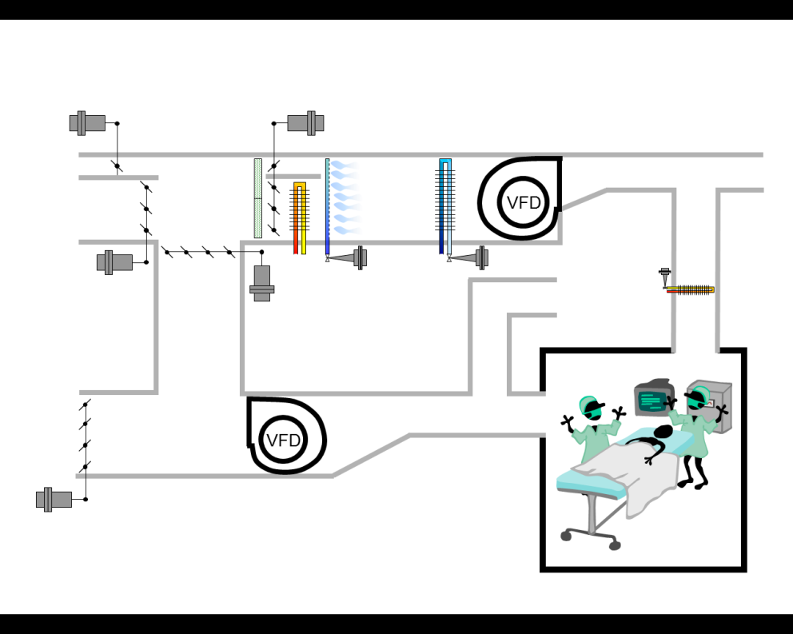
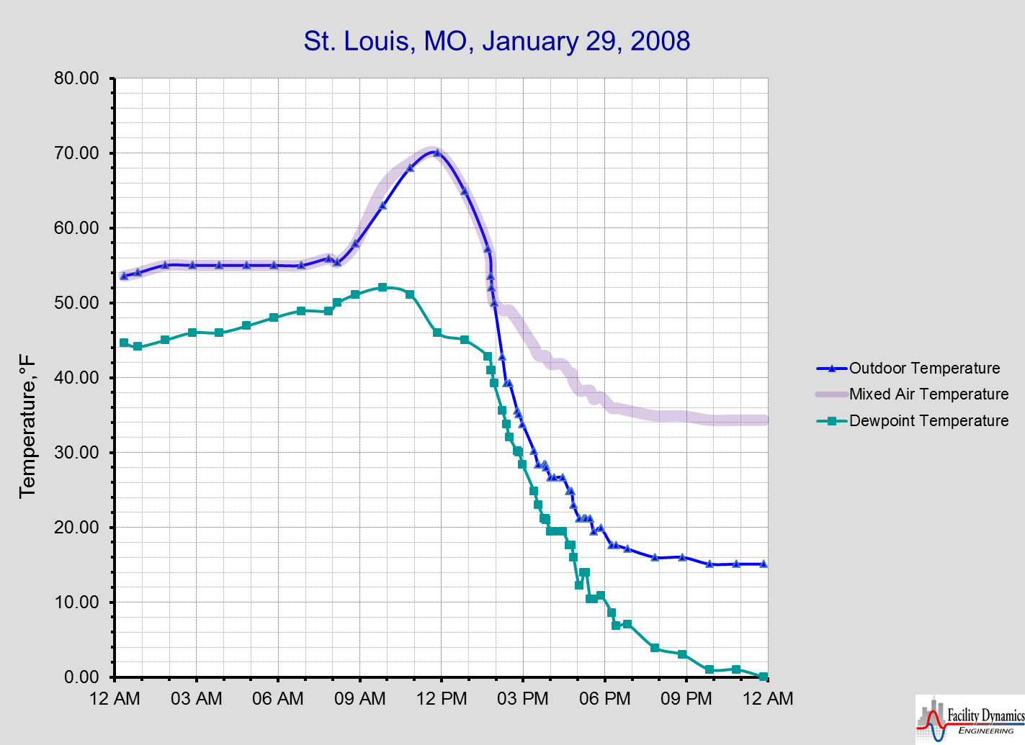
Mother Nature Writes Great Functional Tests
Don’t Forget to Consider a Day with an Extreme Diurnal Swing and its Impact on the Performance of Sensitive HVAC Processes

Slide 47
Mother Nature Writes Great Functional Tests
Don’t Forget to Consider a Day with an Extreme Diurnal Swing and its Impact on the Performance of Sensitive HVAC Processes
100% Outdoor Air with Humidification

Slide 48
Mother Nature Writes Great Functional Tests
Don’t Forget to Consider a Day with an Extreme Diurnal Swing and its Impact on the Performance of Sensitive HVAC Processes
100% Outdoor Air

Slide 49
Mother Nature Writes Great Functional Tests
Don’t Forget to Consider a Day with an Extreme Diurnal Swing and its Impact on the Performance of Sensitive HVAC Processes
Enthalpy Driven Change-over to Minimum Outdoor Air

Slide 50
Mother Nature Writes Great Functional Tests
Don’t Forget to Consider a Day with an Extreme Diurnal Swing and its Impact on the Performance of Sensitive HVAC Processes
Minimum Outdoor Air with Humidification

Slide 51
Mother Nature Writes Great Functional Tests
Don’t Forget to Consider a Day with an Extreme Diurnal Swing and its Impact on the Performance of Sensitive HVAC Processes
Enthalpy Driven Change-over to 100% Outdoor Air, Humidification

Slide 52
Mother Nature Writes Great Functional Tests
Don’t Forget to Consider a Day with an Extreme Diurnal Swing and its Impact on the Performance of Sensitive HVAC Processes
Economizer Modulates with Humidification

Slide 53
Mother Nature Writes Great Functional Tests
Don’t Forget to Consider a Day with an Extreme Diurnal Swing and its Impact on the Performance of Sensitive HVAC Processes
Minimum Outdoor Air with Preheat and Humidification

Slide 54
Mother Nature Writes Great Functional Tests
Don’t Forget to Consider a Day with an Extreme Diurnal Swing and its Impact on the Performance of Sensitive HVAC Processes
Minimum Outdoor Air with Preheat and Humidification; Freezestat trips if the Preheat Process Fails

Slide 55
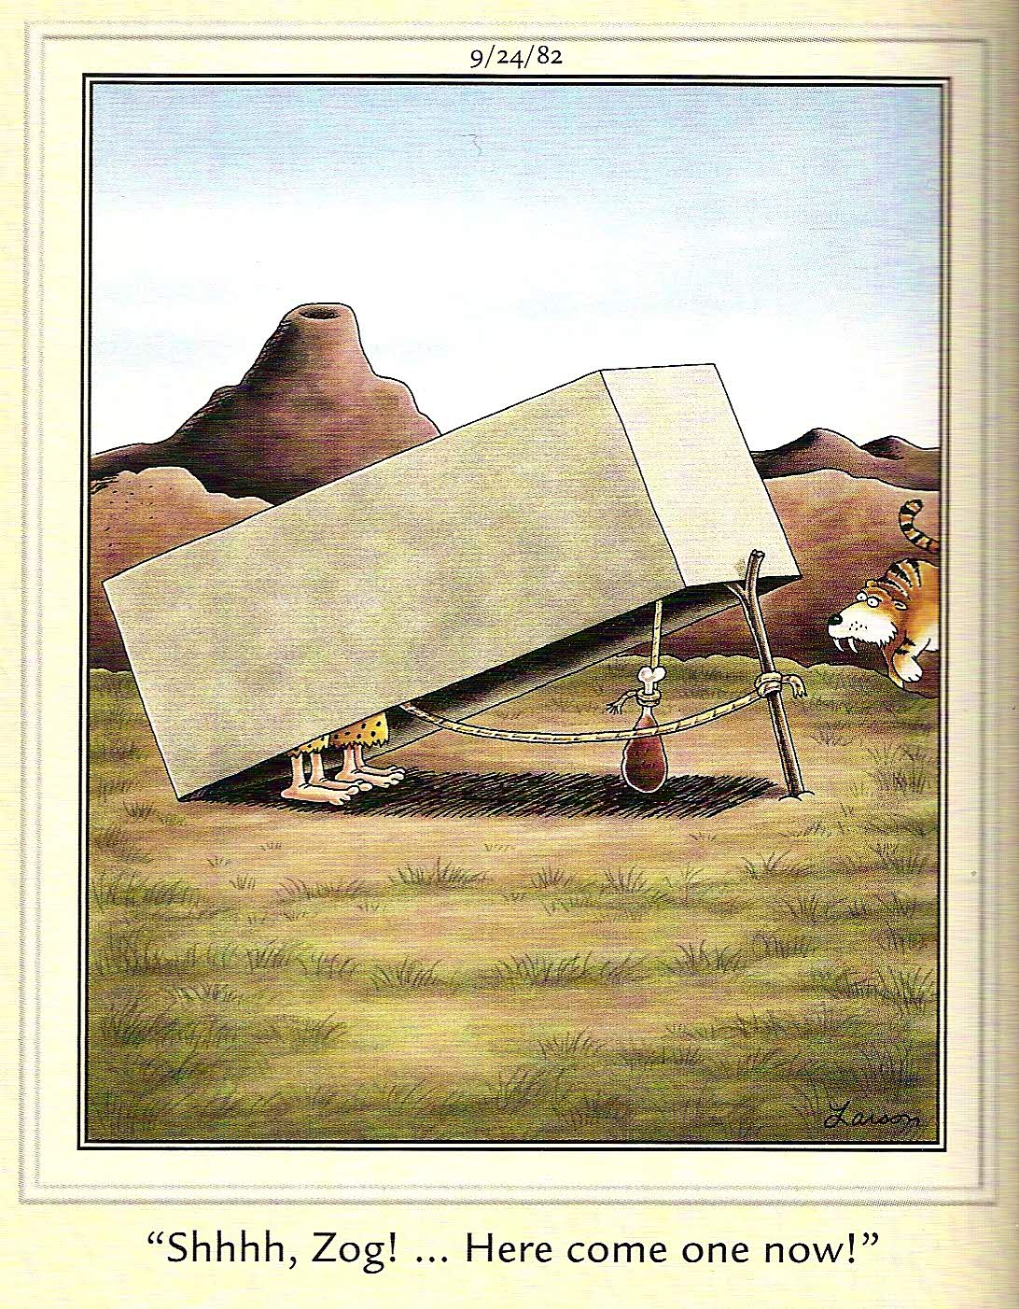
Sometimes, Things Don’t Work as Anticipated
Think of it as an opportunity to figure out how to make something work

Slide 56
Testing Hierarchy;
More than Balancing Man Power
Complete Equipment Safety Testing
Test Component Controls
Component Level Testing
Commission Supporting Utility Systems
Verify Prestart Checks & Startups
Verify Control Wiring and Calibration
Verify Control Programming
Test System Level Control Functionality
System Level Testing
Each utility system can have a testing hierarchy that is similar to this, much of which must be complete before the supporting system can be tested
Component Factory Startups
Component Startups
Test Building Level Control Functionality
Sub-assembly Factory Startups
Sub-assembly Startups
Begin Normal Operations
Run Trend Analysis; Fine Tune Systems
Verify Safeties with Prime Mover Off-line
Seasonal and Warranty Testing
Generally speaking, successful completion of everything inside the red dotted line is required for system acceptance
Start-up Prime Mover (Pump, Fan, etc.)
Begin Ongoing Cx

Slide 57
The Control System
A Critical Supporting Utility System
  A poorly functioning control system can take the best mechanical system incorporating the most efficient equipment and turn it into an inefficient, inoperable mess and occasionally, debris.
Notes:
GreenPrints 2002 – Atalanta, GA
57
11/10/2017

Slide 58
Functional Testing
One of the ways we have a dialog with the building

Slide 59
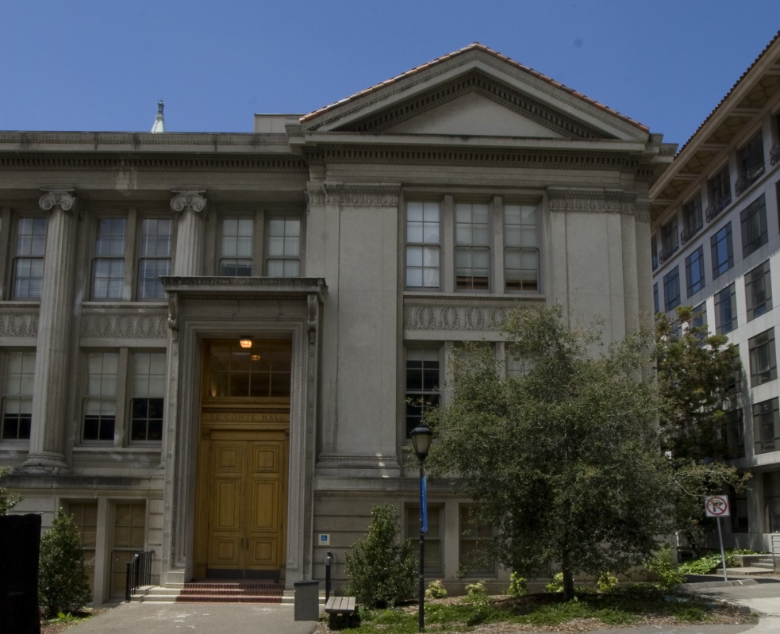
Le Conte Hall
  UC Berkeley Physics Department Home
  148,000 square feet
  Four floors plus basement
    Floors 1 and 2 - Classrooms and research
    Floors 3 and 4 - Offices, class rooms, informal meeting space
  Interconnected with other physics department buildings
  MBCx program participant since 2009
  MBCx Best Practices Award winner for the 2009 program cycle
Notes:
Julia

Slide 60
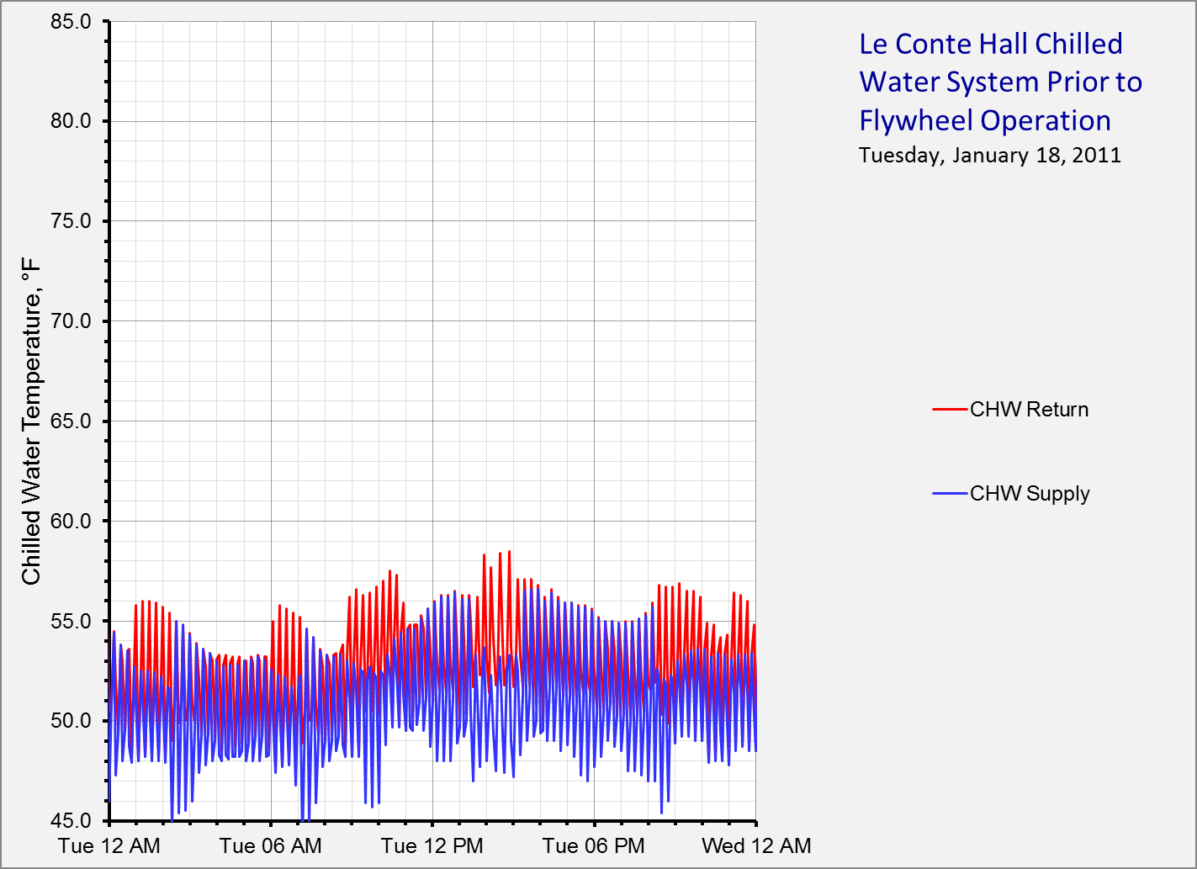
Large temperature supply temperature swings potentially a problem in terms of maintaining the desired conditions at the load

Slide 61
Five to six compressor cycles per hour or more; a.k.a “short cycling”

Slide 62
The Problem with Short Cycling
Unresolved short cycling cost impacts
    Less than optimal temperature control
      IEQ issues in hot and humid climates
      Product quality issues
      Ripple effects (other control processes become unstable
    Premature compressor failure
      Unscheduled outage
      Unscheduled cost - $20,000 - $40,000 each for the 50 ton compressors on this project

Slide 63
Dealing with Short Cycling
Infinite Capacity Modulation
False load
Lengthen the compressor run cycles and off cycles

Slide 64
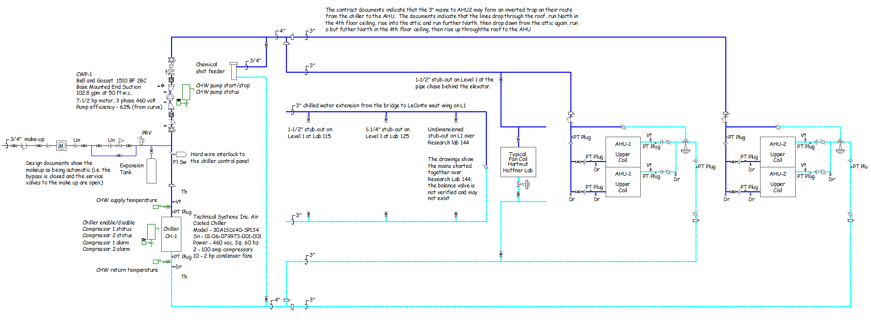
The Research Load is Not the Only Small Load
73 Ton Future 100% Outdoor Air Load
Very Small Research Load
100 Ton, dual compressor chiller, 12.5 tons minimum capacity before hot gas comes on
58 Ton Economizer Equipped Load

Slide 65
Dealing with Short Cycling
Dreamland
Infinite Capacity Modulation
False load
Lengthen the compressor run cycles and off cycles
Energy Intensive
Solves the Problem
Saves $3,830 per Year

Slide 66
Here’s a Question
How much of a thermal flywheel does the existing piping system represent?

Slide 67
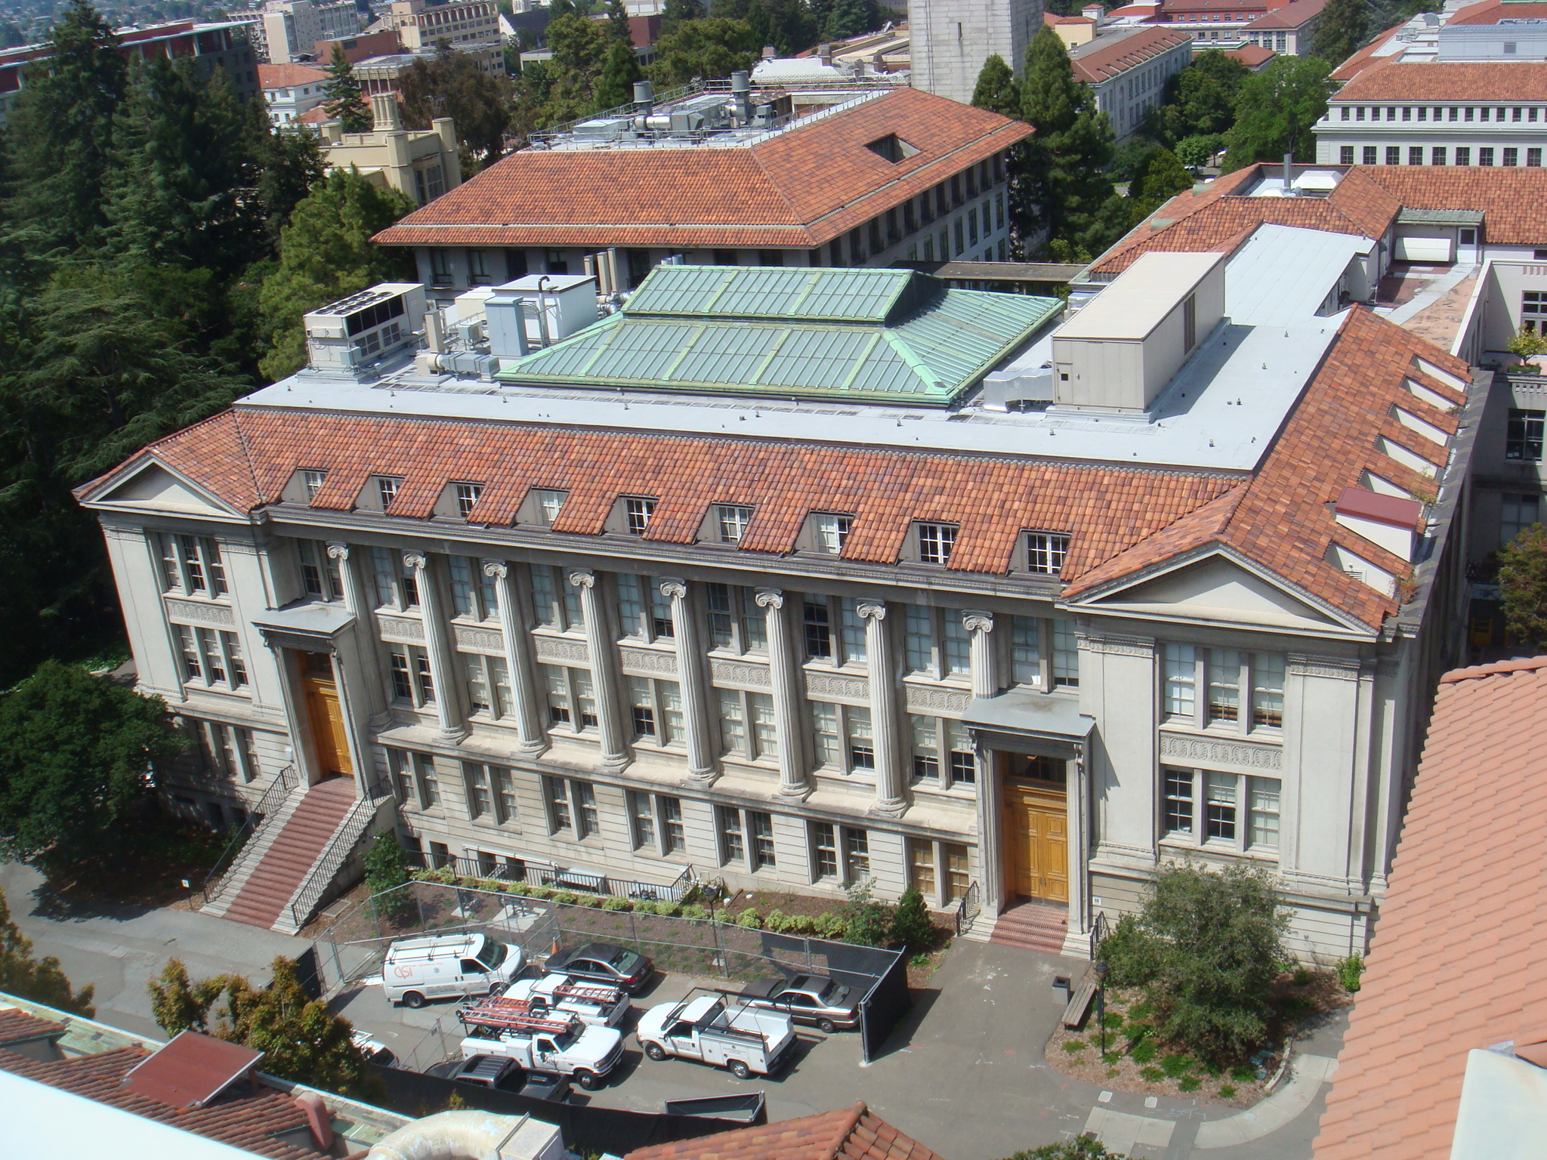
Who Knows the Answer?
… the Building Knows

Slide 68
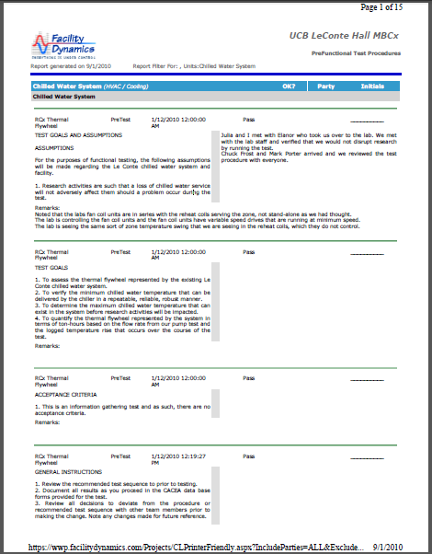
How Do We Ask The Building About It?
We perform a functional test
Functional test components
    Statement of purpose
    Instructions for using the test form
    Equipment requirements
    Acceptance criteria
    Precautions
    Documentation
    Procedure
    Return to Normal and Follow-up
Visit www.Av8rdas.wordpress.com for a copy of the test; Link located on the right side of the home page under 03 – Materials from Classes and Presentations

Slide 69
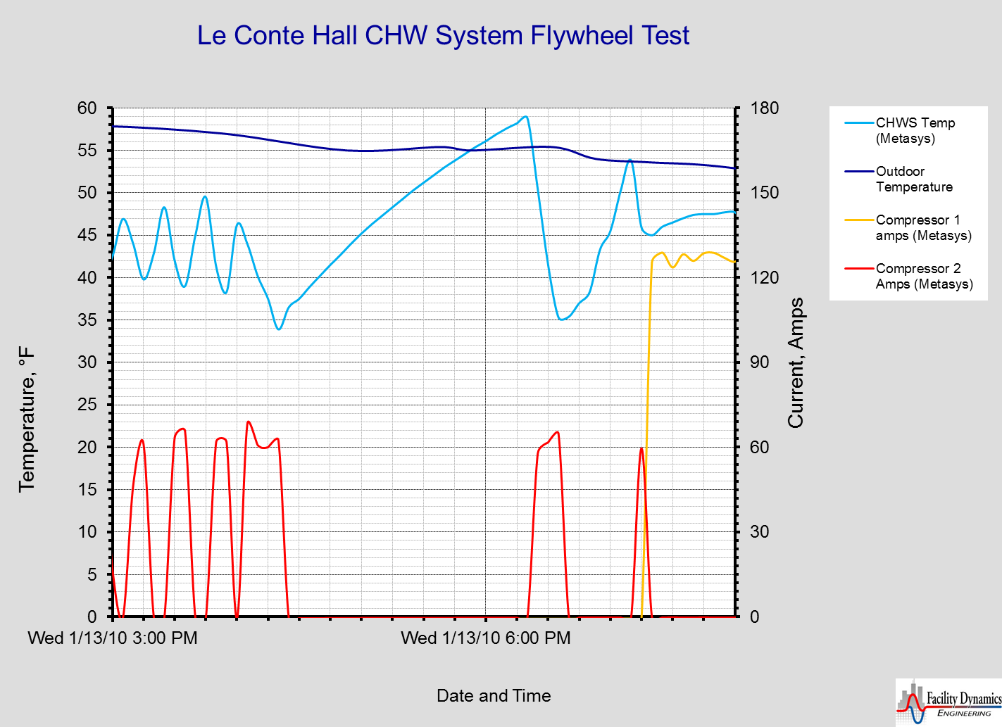
Our Results
Lab and building functions can handle an upper limit of 59°F for the flywheel
A 2 hour flywheel representing about 13 ton-hours is possible
Trend data shows colder temperature than local indication during the “charge” cycle
It will take one compressor about 10 minutes to recharge the flywheel

Slide 70
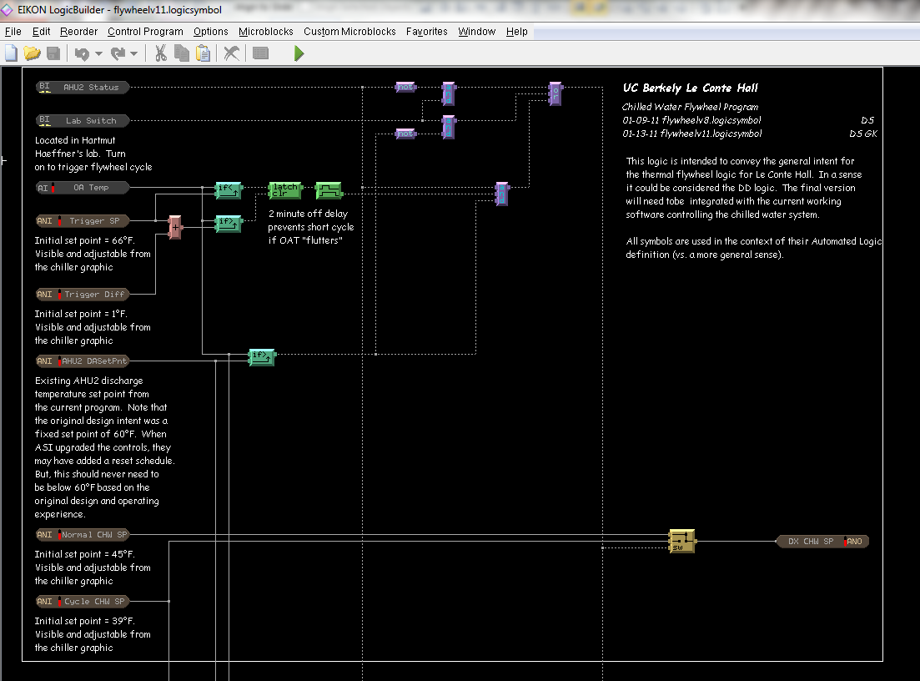
Automating Our Results

Slide 71
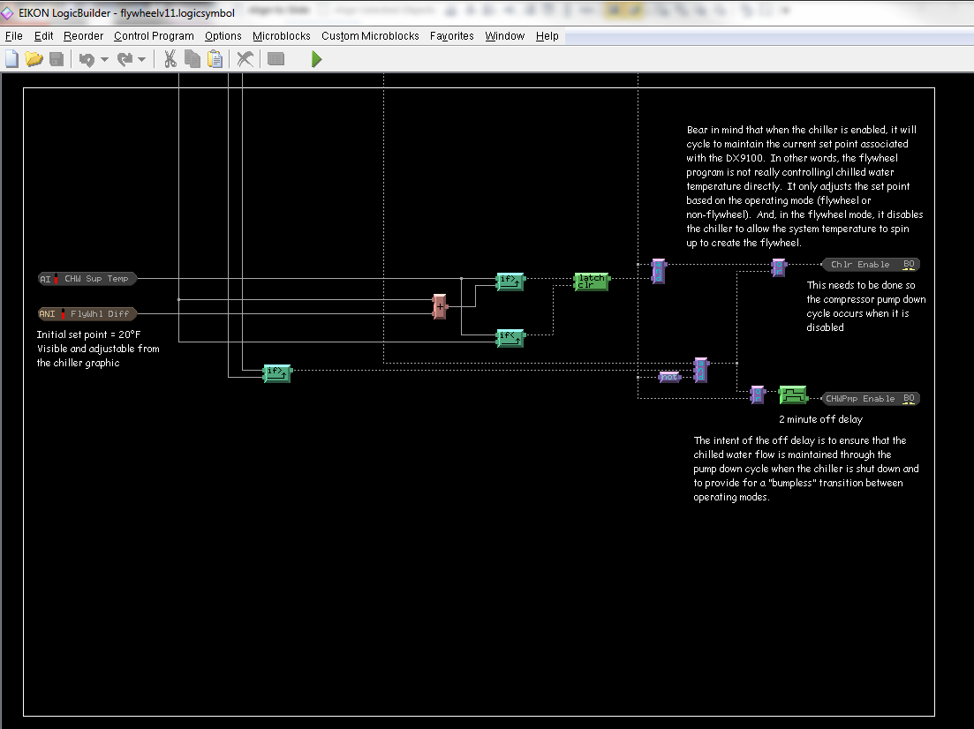
Opportunity 1 - Captured

Slide 72
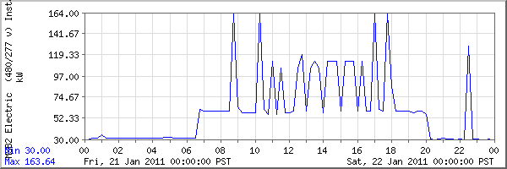
Opportunity 2 - Identified
Whole building meter data indicates that the compressors tend to run at full load any time they run

Slide 73
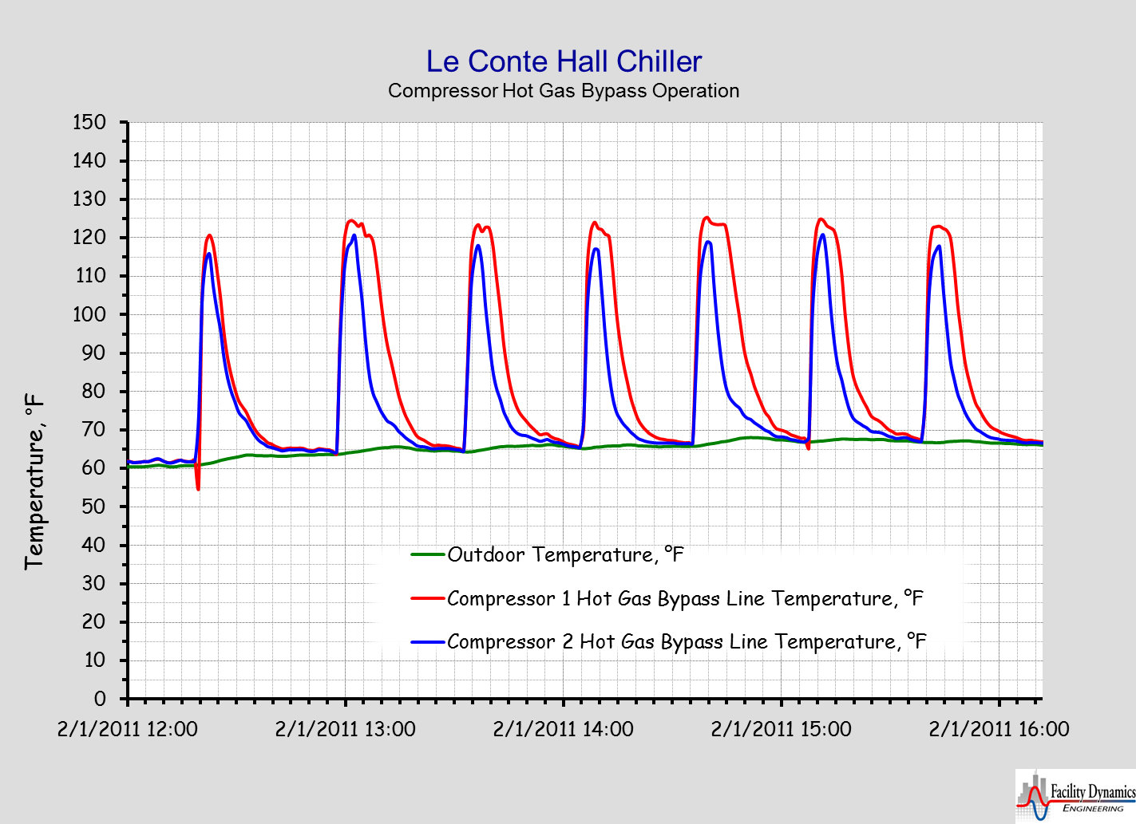
Logger Data Confirms Suspicions

Slide 74
Unnecessary Hot Gas = Unrealized Savings
Good News
Bad News
Flywheel cycle captures 26,900 kWh/$2,690 of savings via the MBCx project
    Testing performed as part of the general MBCx effort
    Programming modified “on the fly”
Additional savings potential justifies a factory service call
    Perform routine checks and maintenance
    Optimize set points
    Optimize controls
11,404 kWh/$1,140 of savings “left on the table
Visit www.Av8rdas.wordpress.com for the complete story
Notes:
11,404 $1,140
26,900 $2,690

Slide 75
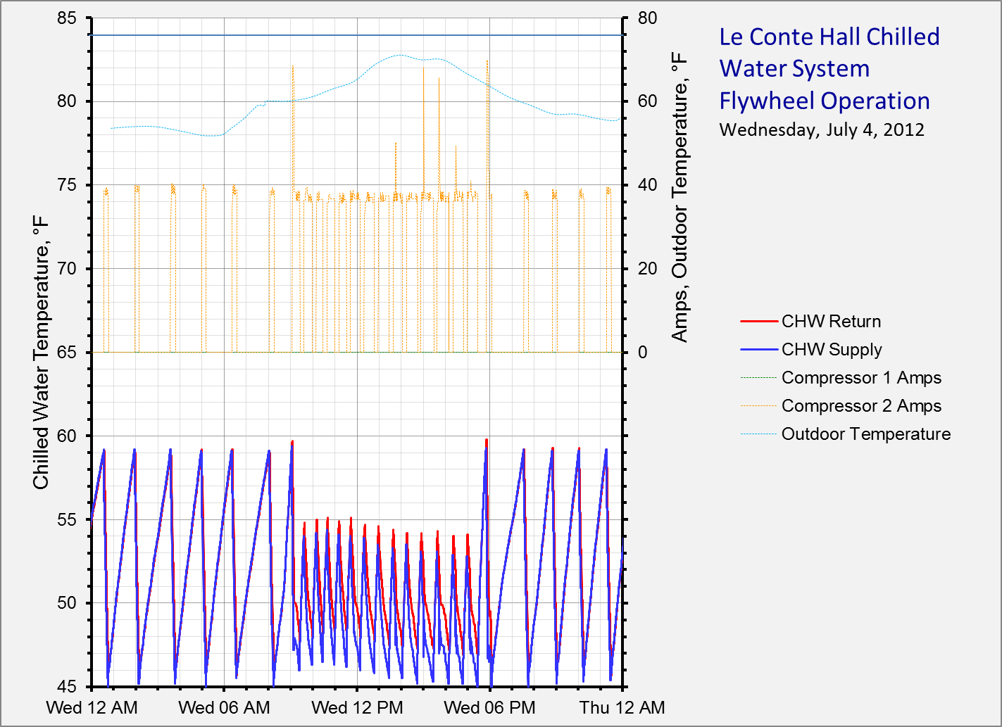
The Bottom Line
A Warm, Low
Occupancy Day
Compressor capacity limited during the charge cycle
1-1/2 to 2 cycles per hour with the lab and lightly loaded AHU
About 10 minutes on and 90 minutes off with only the lab load

Slide 76
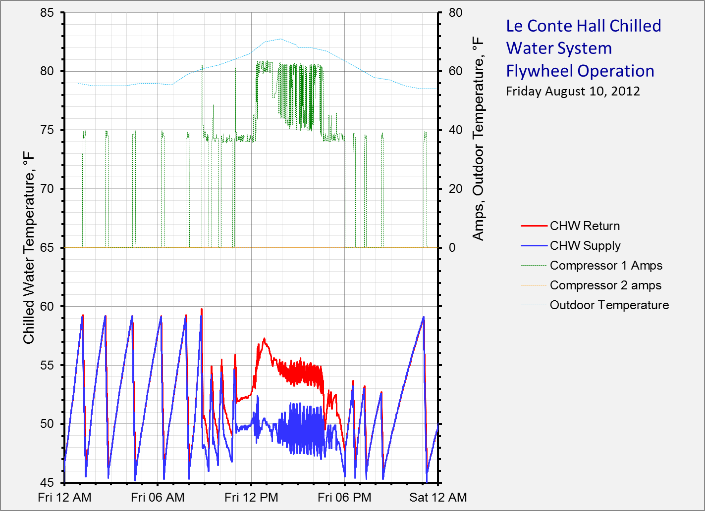
Unloading system “captures” the load and runs the compressor steady-state against it
System exits the flywheel cycle when conditions warrant normal operation
The Bottom Line
A Warm, Normal
Occupancy Day

Slide 77
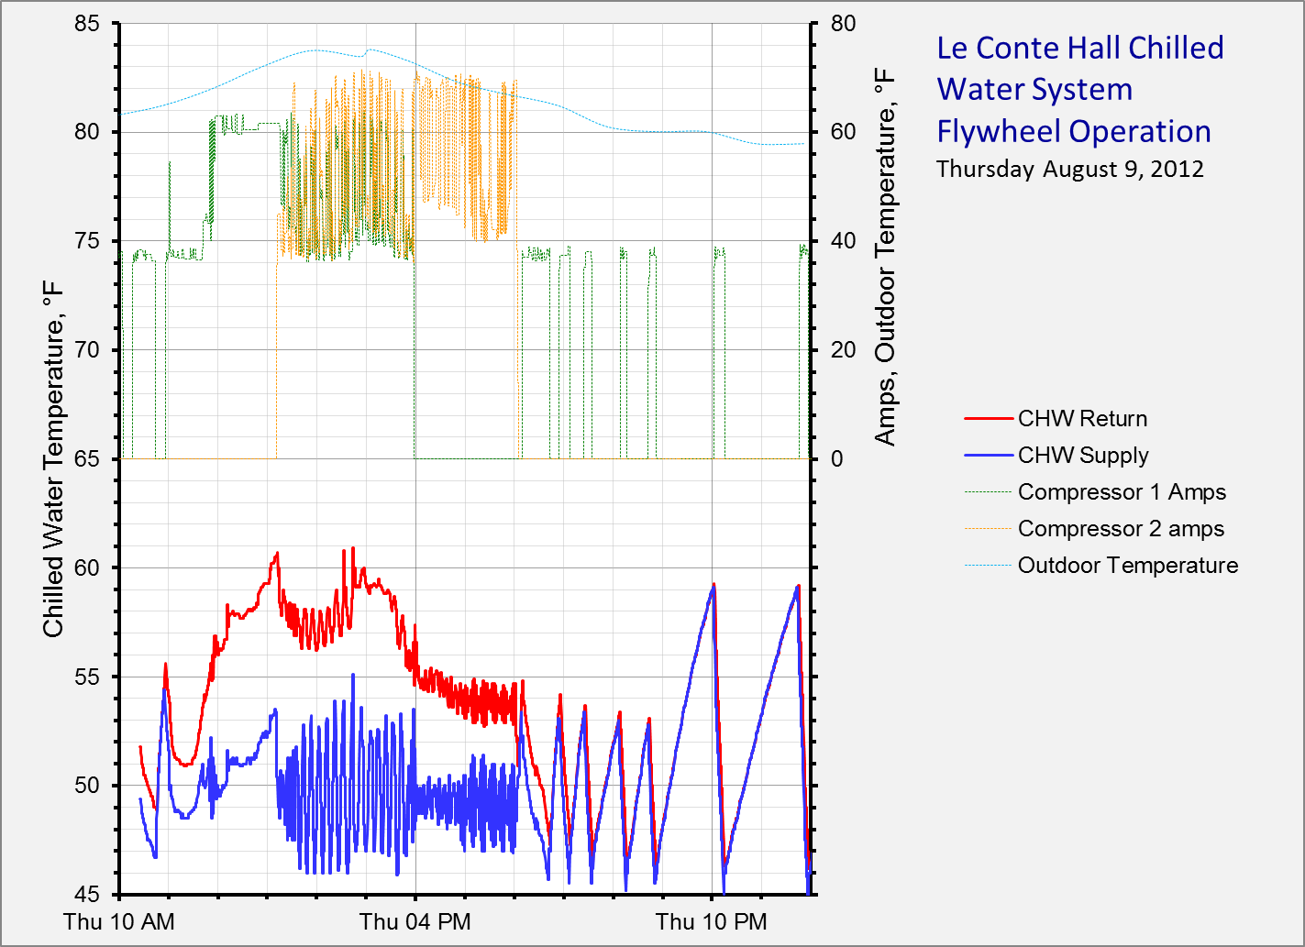
Second compressor comes on line to supplement the lead compressor and also matches capacity to requirements
Lag compressor takes over as lead and continues to match the load with out short cycling
The Bottom Line
A Warm, Normal
Occupancy Day

Slide 78
Temperature swings are moderated compared to the pattern prior to the service call
The Bottom Line
A Warm, Normal
Occupancy Day

Slide 79
The Real Trick
… Figuring out what to ask

Slide 80
Figuring Out What to Ask
Scope the building to identify opportunities
Vet the opportunities
  Savings potential
  Owner priorities
  Capabilities
Collect the data you need
  Understand the system
  Understand what you need to know
  Deploy loggers
  Perform focused functional tests

Slide 81
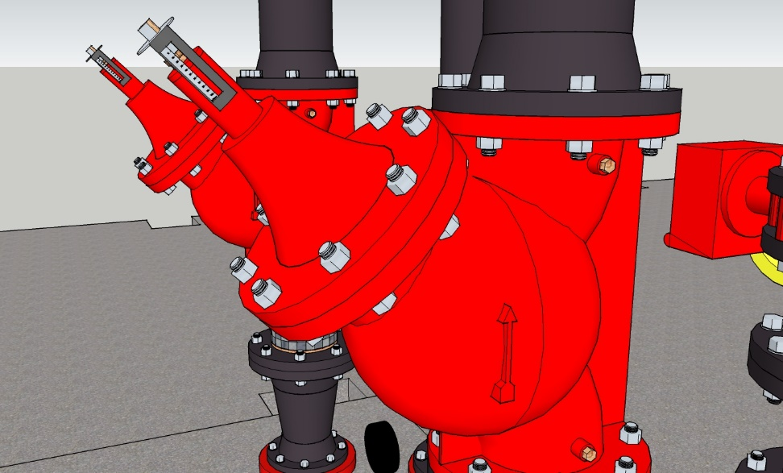
Understanding What you Need to Know
We will do savings estimates, not savings exactamates.
  Related to the clue that led you to the finding
  How accurate does it need to be

Slide 82
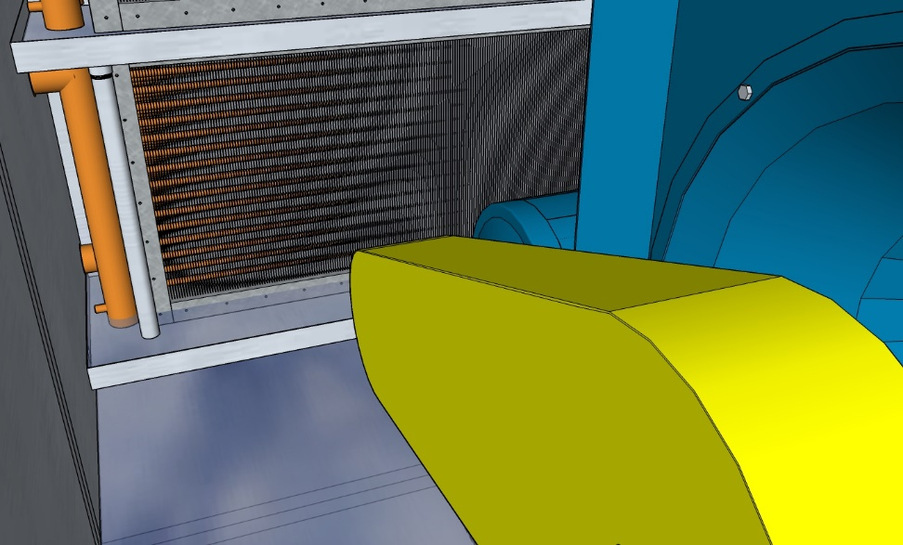
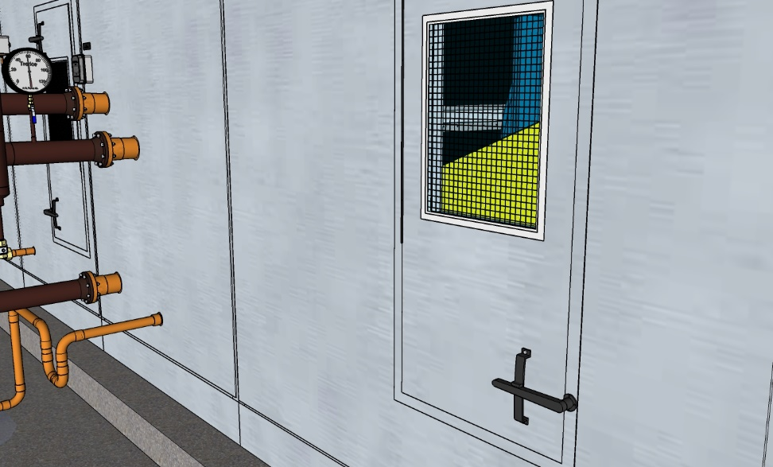
Understanding What you Need to Know
We will do savings estimates, not savings exactamates.
  Related to the clue that led you to the finding
  How accurate does it need to be
  May include a non-energy component

Slide 83
Understanding What you Need to Know
This will likely come down to one or more of the fundamental energy equations
This is probably the time to start understanding how your target system uses energy and other resources

Slide 84
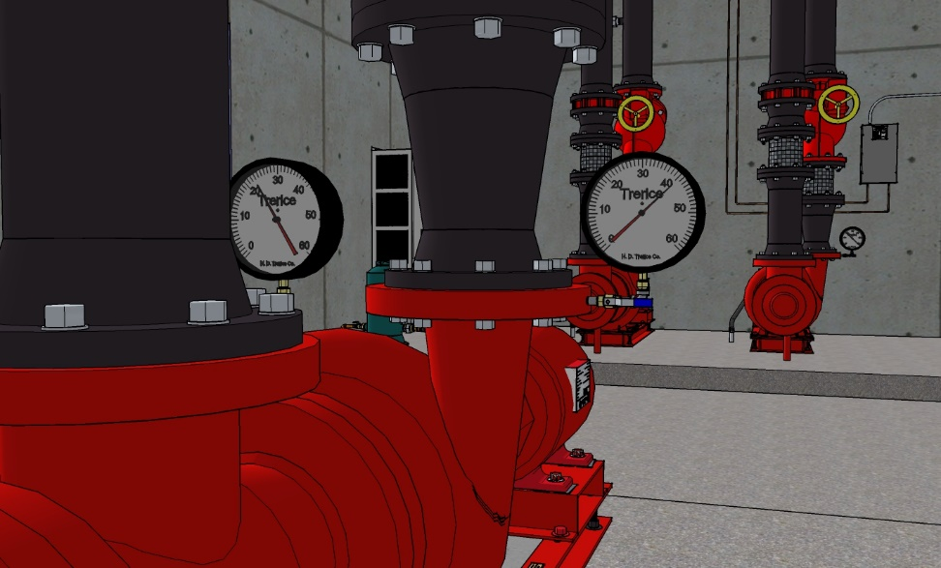
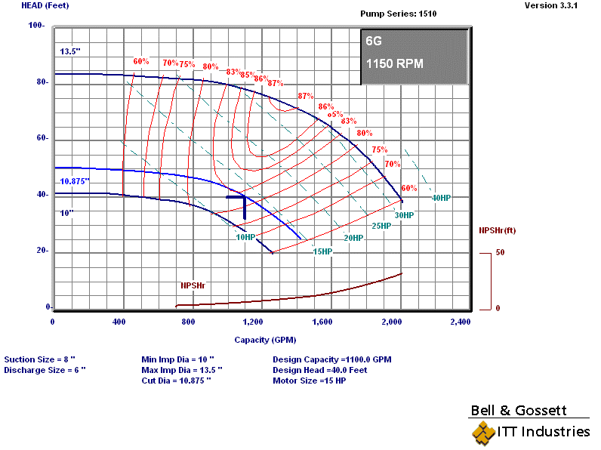
Understanding What you Need to Know
The way your target system uses resources and energy will be related to the basic principles behind it
  Understand the equipment
  Collect or develop performance curves
    Manufacturers data

Slide 85
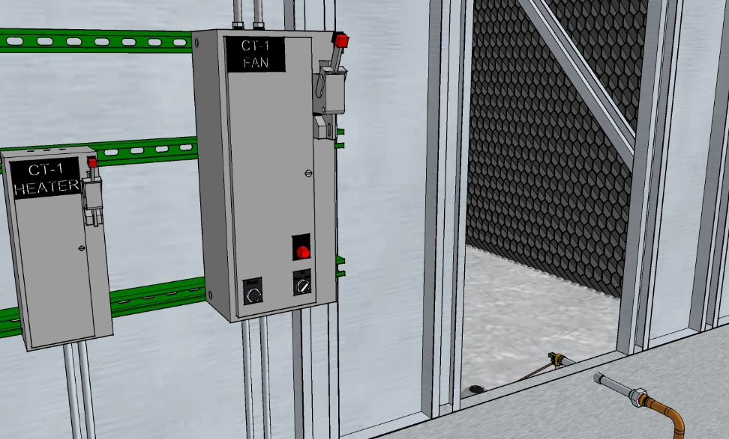
Understanding What you Need to Know
The way your target system uses resources and energy will be related to the basic principles behind it
  Understand the equipment
  Collect or develop performance curves
    Manufacturers data
    Manufacturer’s modeling software
    Field testing

Slide 86
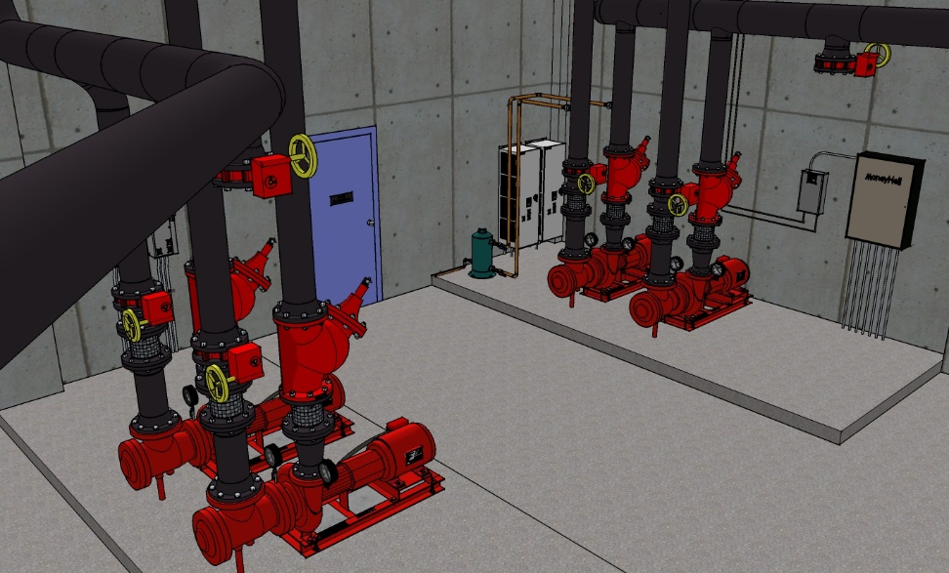
Understanding What you Need to Know
The load profile may or may not matter

Slide 87
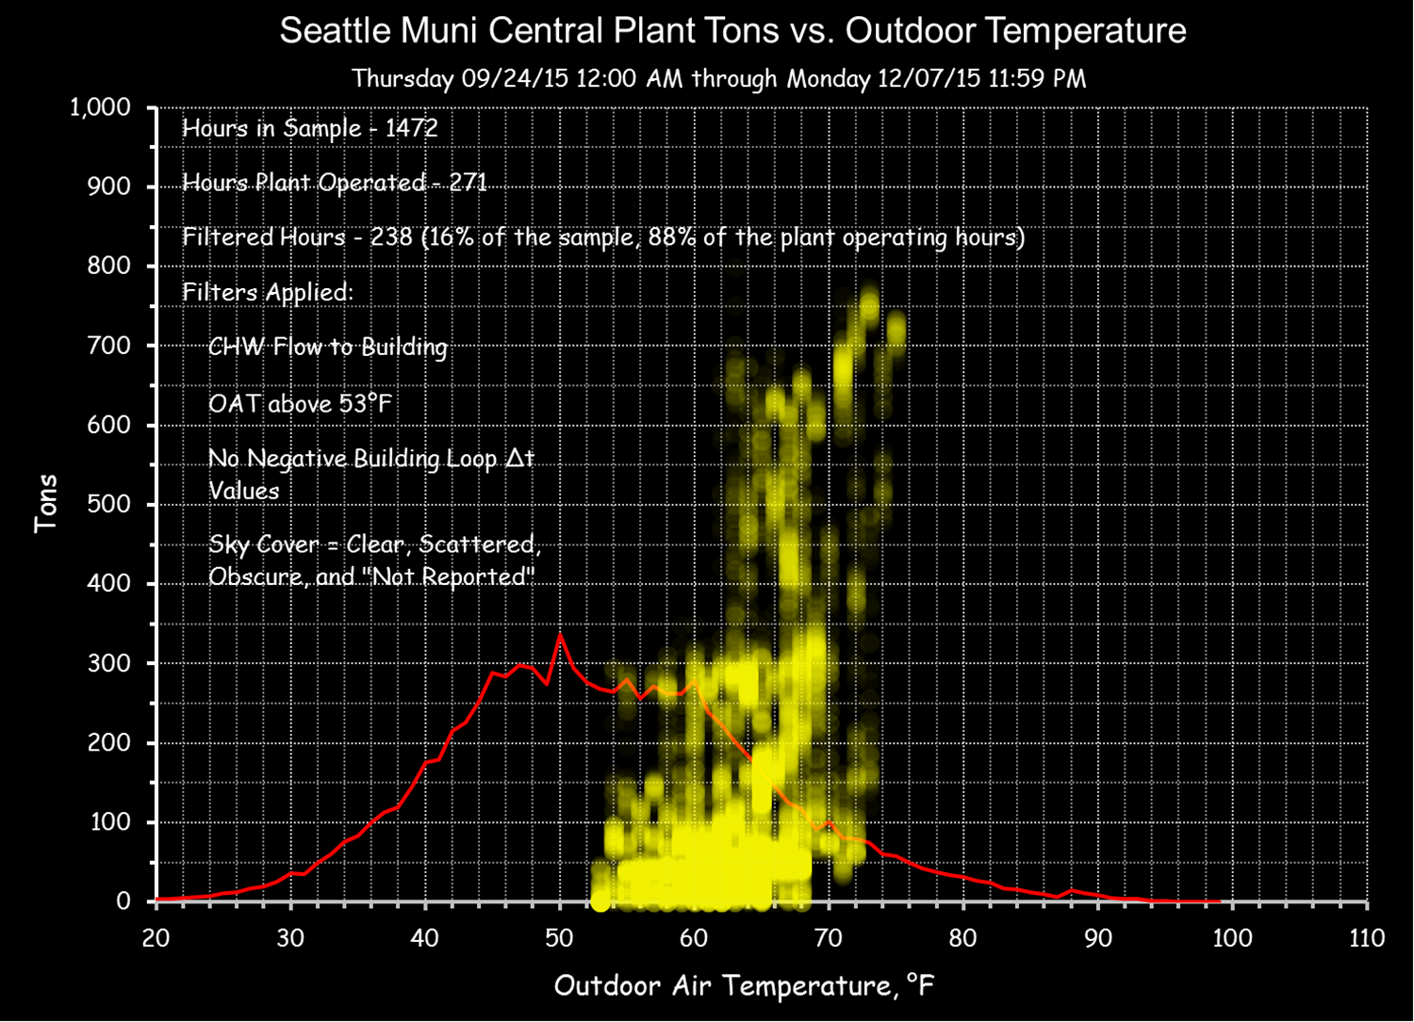
Understanding What you Need to Know
The load profile may or may not matter
If it does matter, begin to collect data ASAP

Slide 88
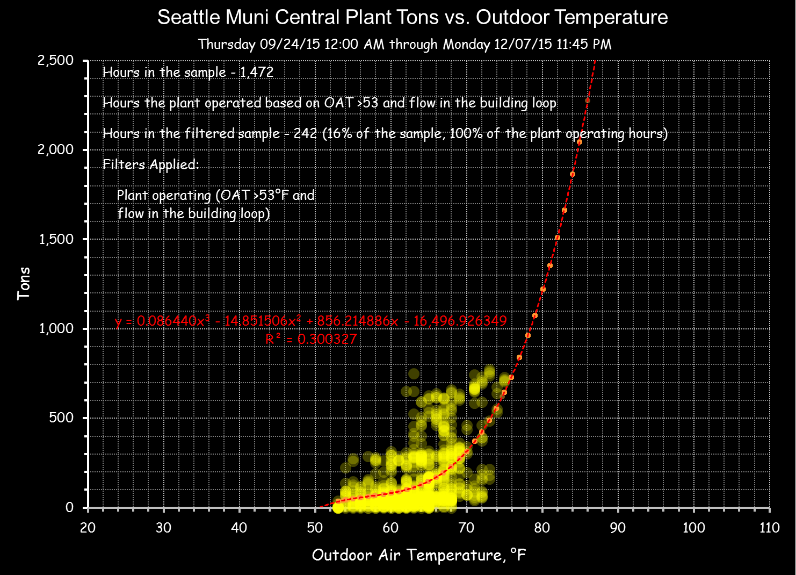
Understanding What you Need to Know
The load profile may or may not matter
If it does matter, begin to collect data ASAP
  The load on the end use systems becomes the load on the utility systems
  The load is usually driven by something we can measure
    Identify it
    Measure it
    Leverage regressions

Slide 89
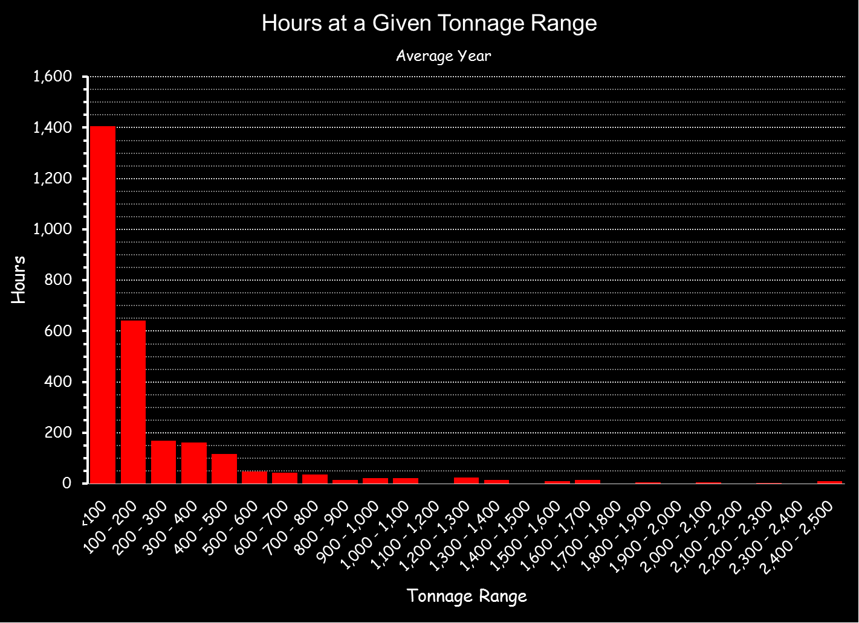
Understanding What you Need to Know
The load profile may or may not matter
If it does matter, begin to collect data ASAP
  The load on the end use systems becomes the load on the utility systems
  The load is usually driven by something we can measure
    Identify it
    Measure it
    Leverage regressions

Slide 90
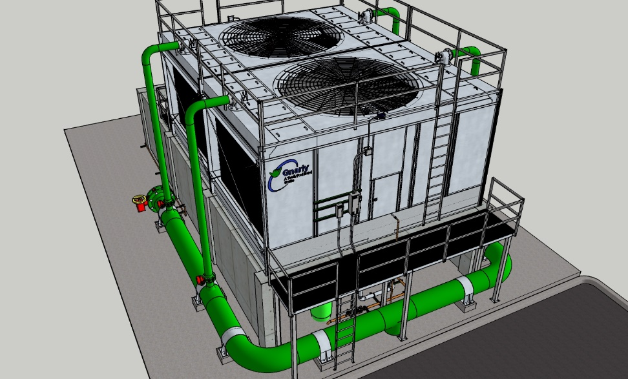
Understanding What you Need to Know
Sometimes, performance is a function of a number of variables
  Tower capacity is a function of wet bulb temperature
  Wet bulb temperature is a function of climate
  At a given wet bulb temperature fan power is nearly linear with load
  The load comes from the system the tower serves

Slide 91
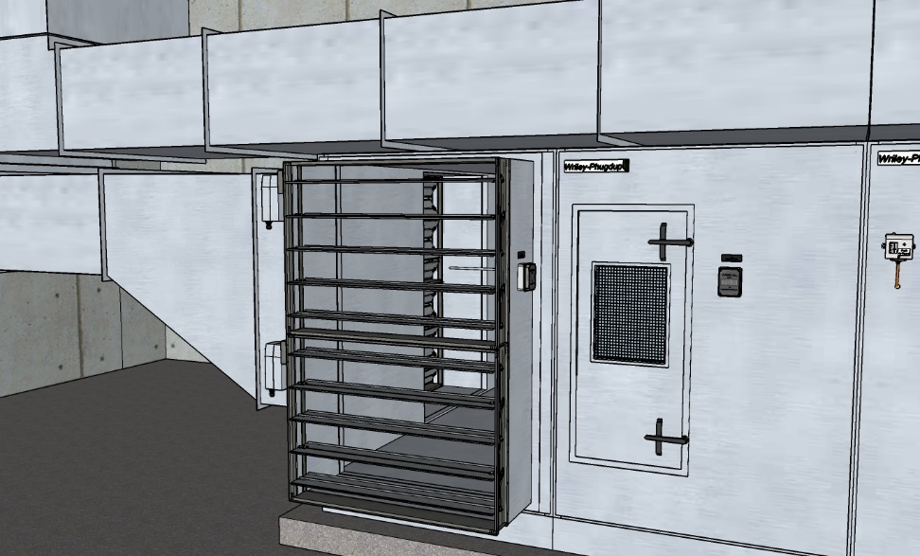
Understanding What you Need to Know
Sometimes, performance is a function of a number of variables
  Chilled water load in an economizer equipped system varies with the state of the economizer, the flow rate and the leaving temperature
  The state of the economizer varies with climate
  The flow rate may vary with load
  The leaving temperature may be reset

Slide 92
Understanding What you Need to Know
Identify the variables
Know what you don’t know
Plan your monitoring and test strategy accordingly

Slide 93
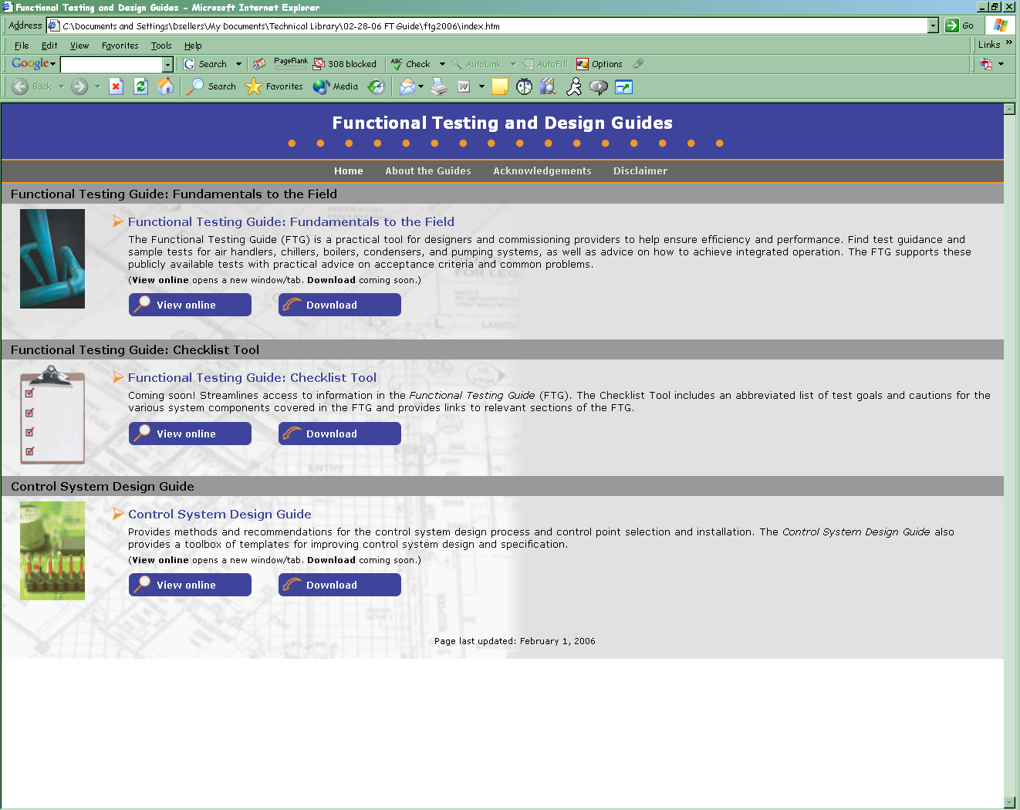
How Can the Functional Testing Guide Help?

