Slide 1
Existing Building Commissioning Workshop: Series 16, Session 4
A Field Introduction to Hot Gas Bypass and the Vapor Compression Cycle
Presented By:
David Sellers
Senior Engineer, Facility Dynamics Engineering

Slide 2
Get Connected with My Poll Everywhere
Via text messaging
Step 1
Text DAVIDSELLERS022 to 22333 (the hyphen gets inserted automatically on some phones)

Slide 3
Get Connected with My Poll Everywhere
Via text messaging
Step 2
Receive confirmation that you have joined the session

Slide 4
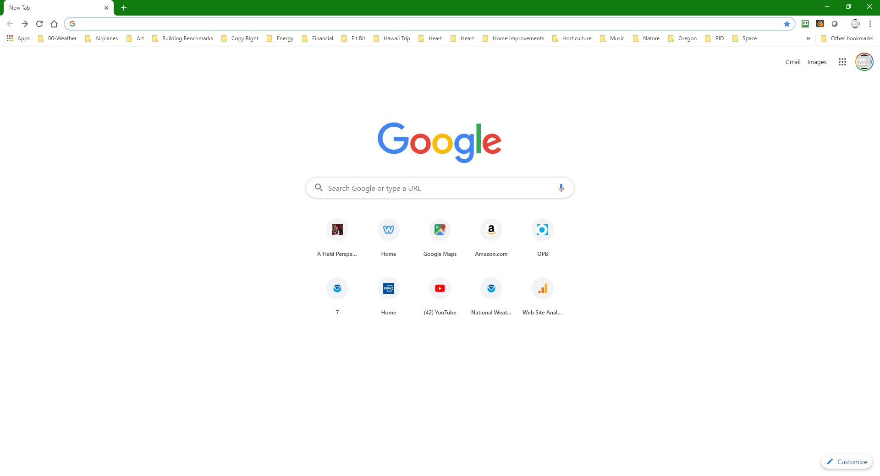
Get Connected with My Poll Everywhere
Via web browser
Step 1
Go to pollev.com/davidsellers022

Slide 5
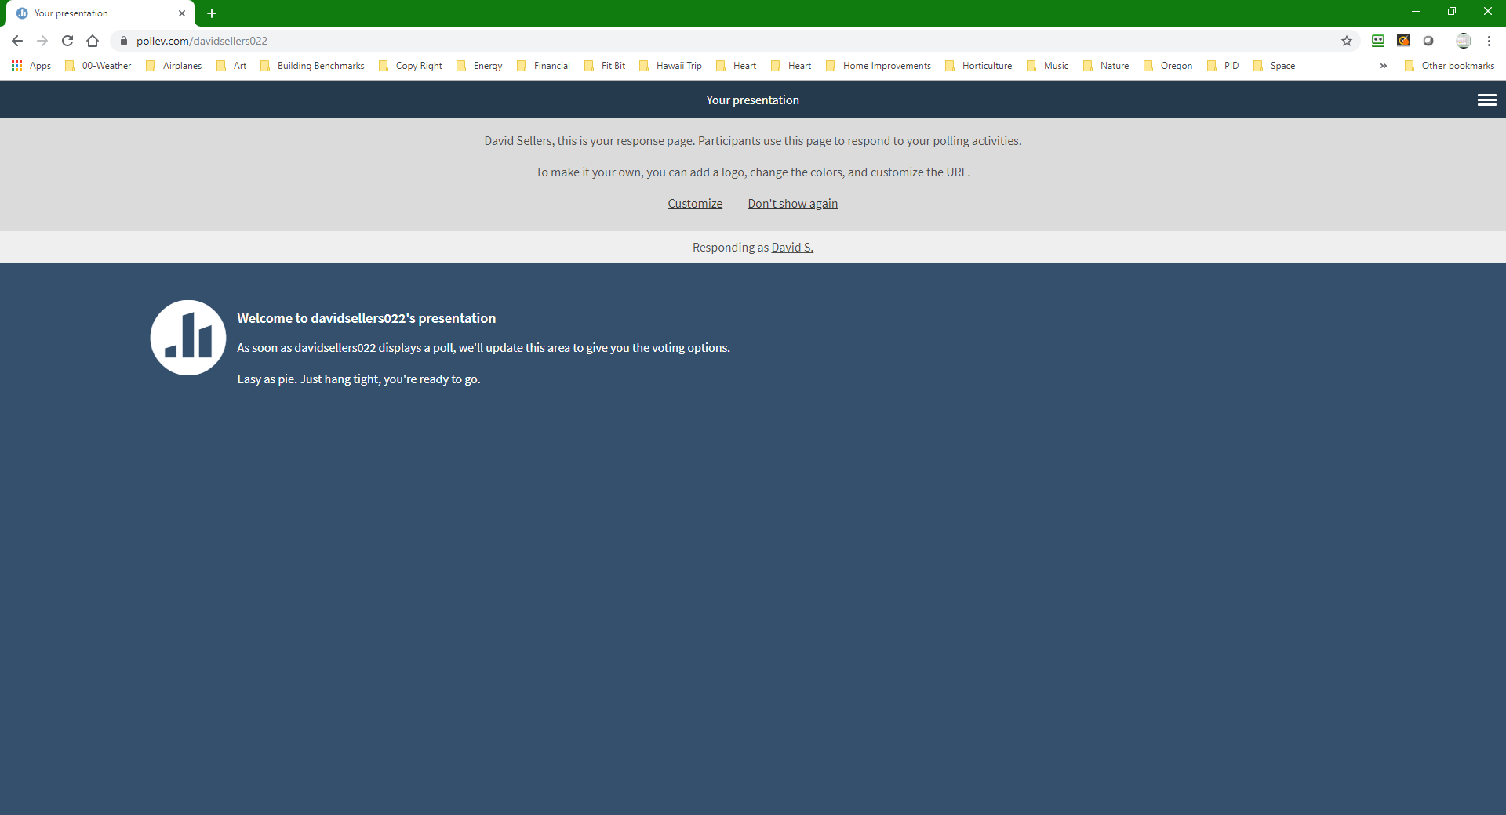
Get Connected with My Poll Everywhere
Via web browser
Step 1
Go to pollev.com/davidsellers022

Slide 6
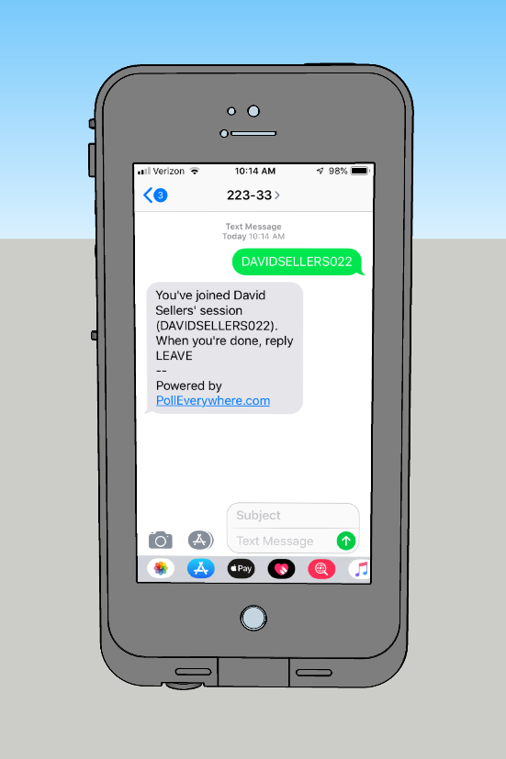
Get Connected with My Poll Everywhere
Via web browser or text messaging
Step 3
Wait for a poll question to come up

Slide 7
Notes:
Poll Title: What's the weather like where you are at? https://www.polleverywhere.com/free_text_polls/2dxl0d5Yb3aqmsBKVPYWy

Slide 8
Vapor Compression Refrigeration Machines
An application of saturated system and phase change principles and concepts
https://av8rdas.wordpress.com/2013/07/15/saturated-multi-phase-systems-and-proof-that-a-watched-pot-does-actually-boil/

Slide 9
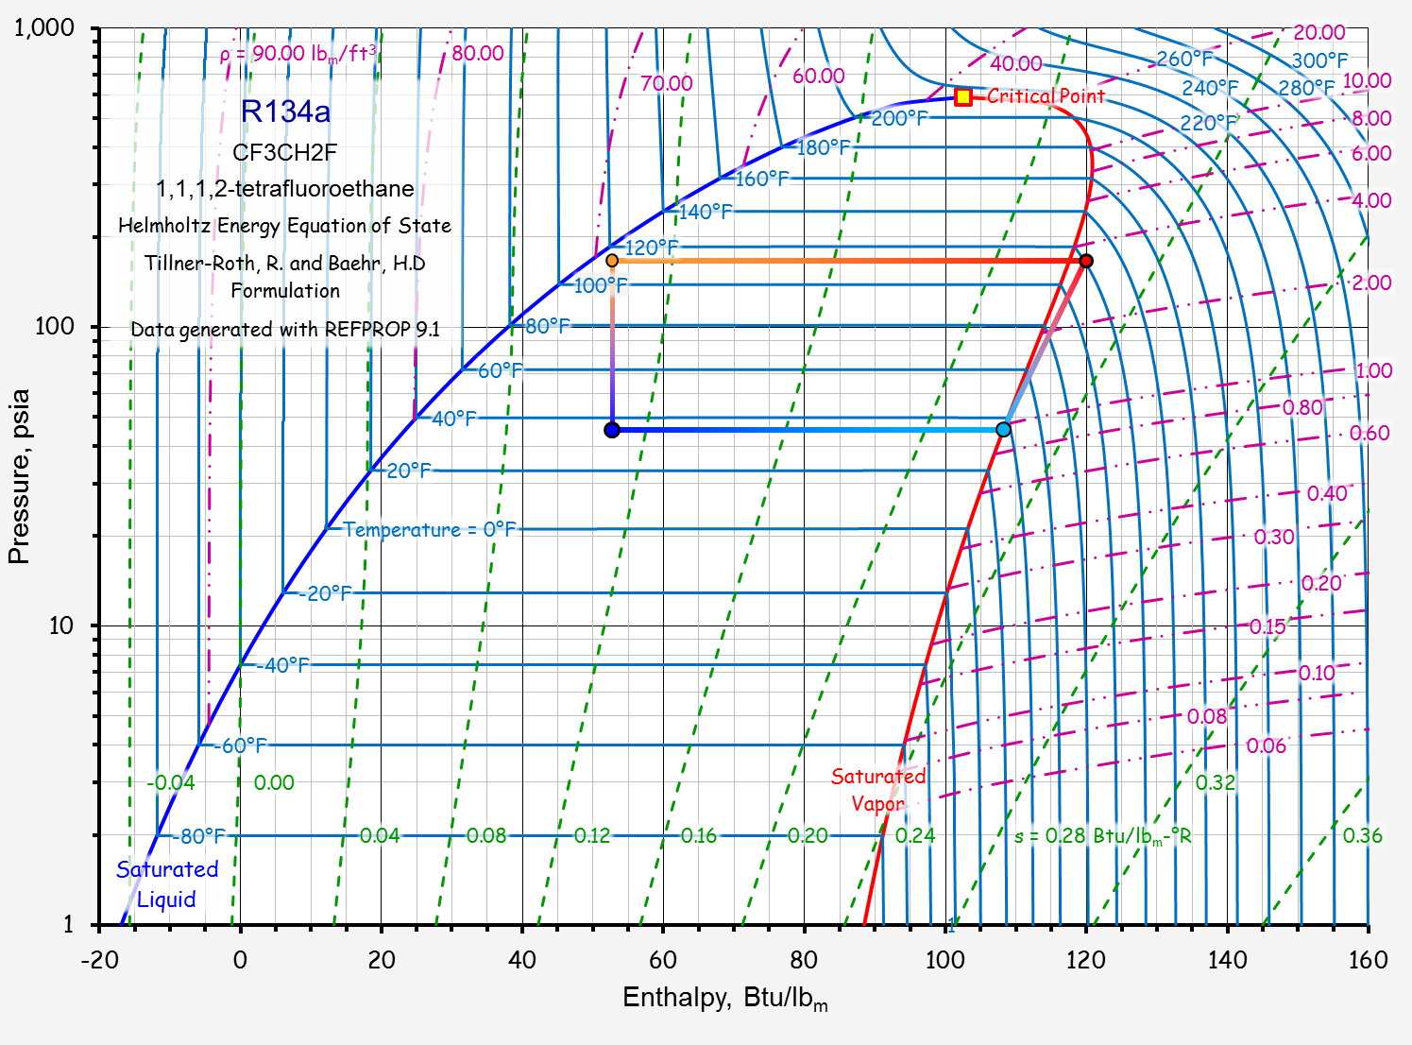
Condensation
Expansion
Compression
Evaporation

Slide 10
An Air-Cooled Vapor Compression Cycle Chiller

Slide 12
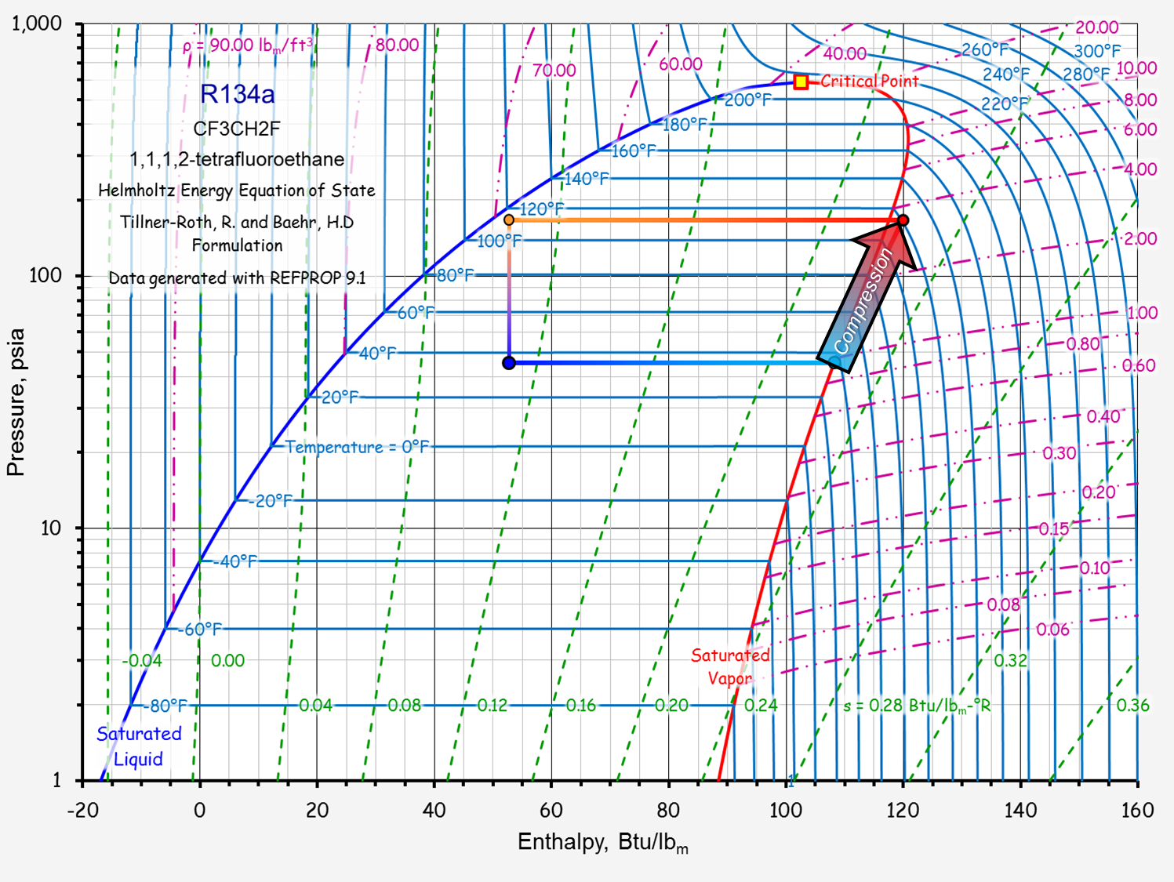
Hot Gas Line
Compressor

Slide 13
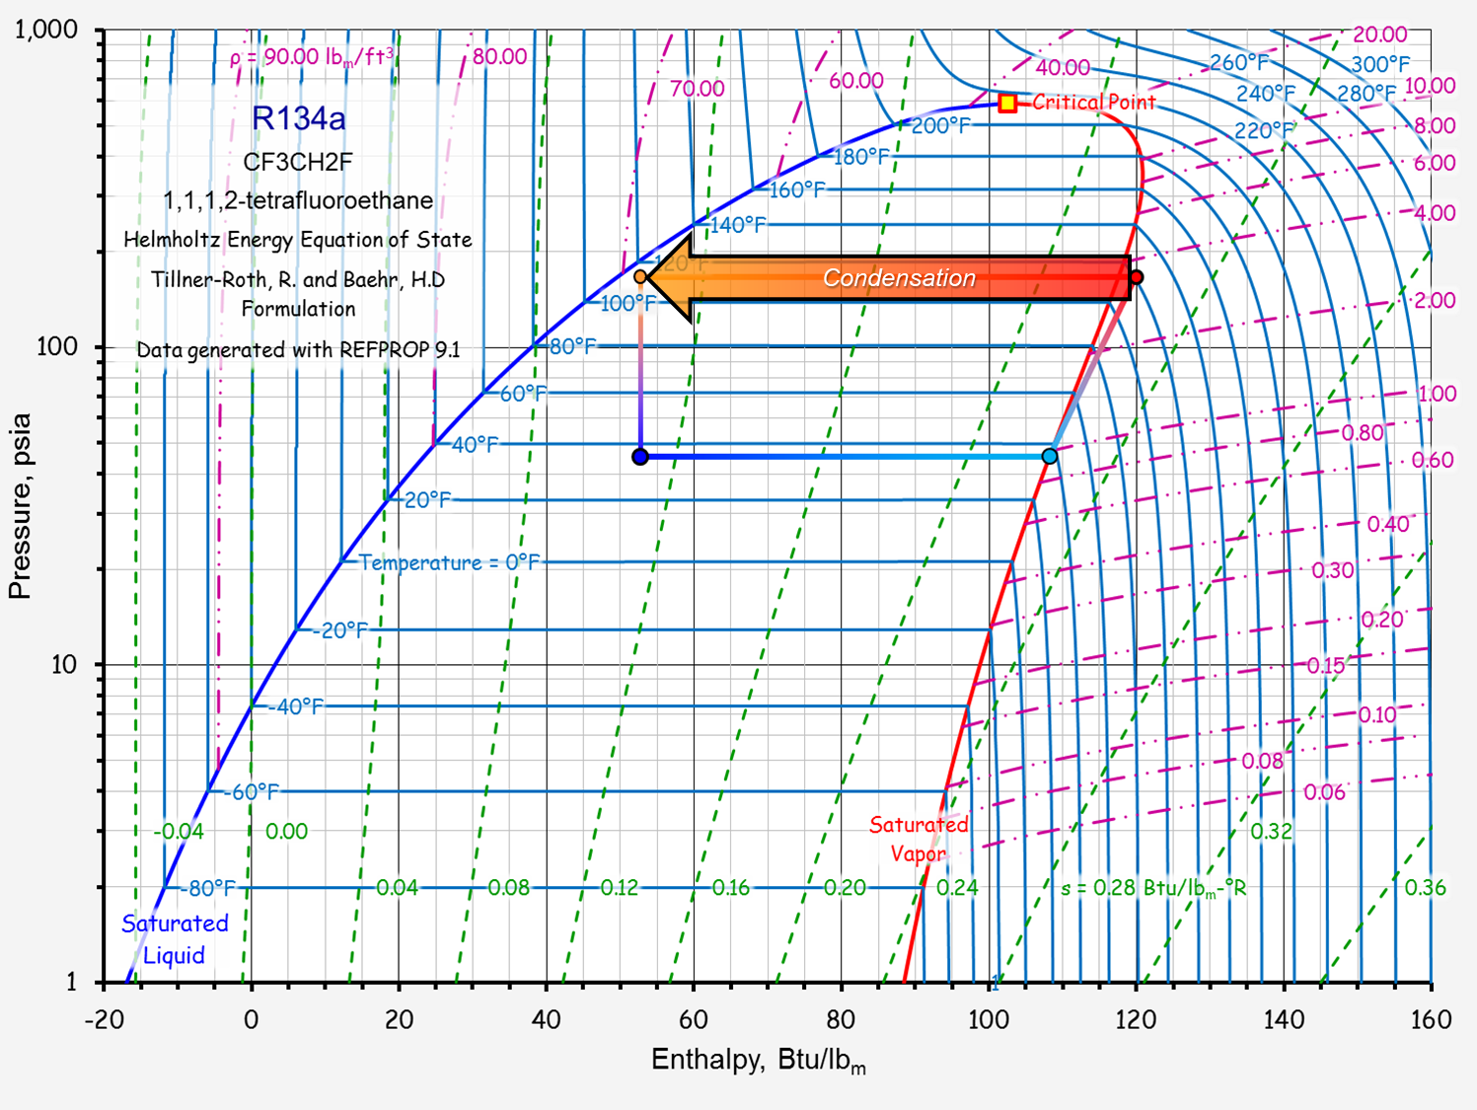
Condenser
Liquid Line Solenoid Valve
Receiver
Liquid Line

Slide 14
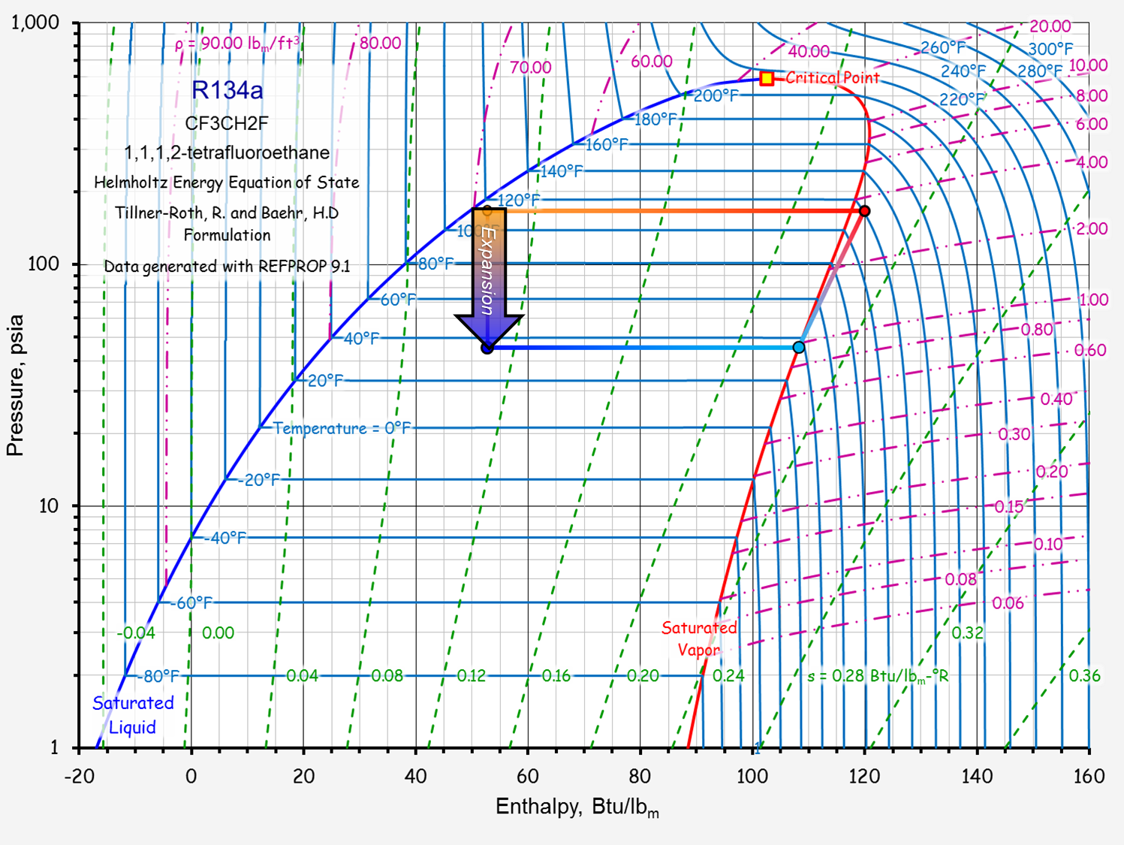
Expansion Valve

Slide 15
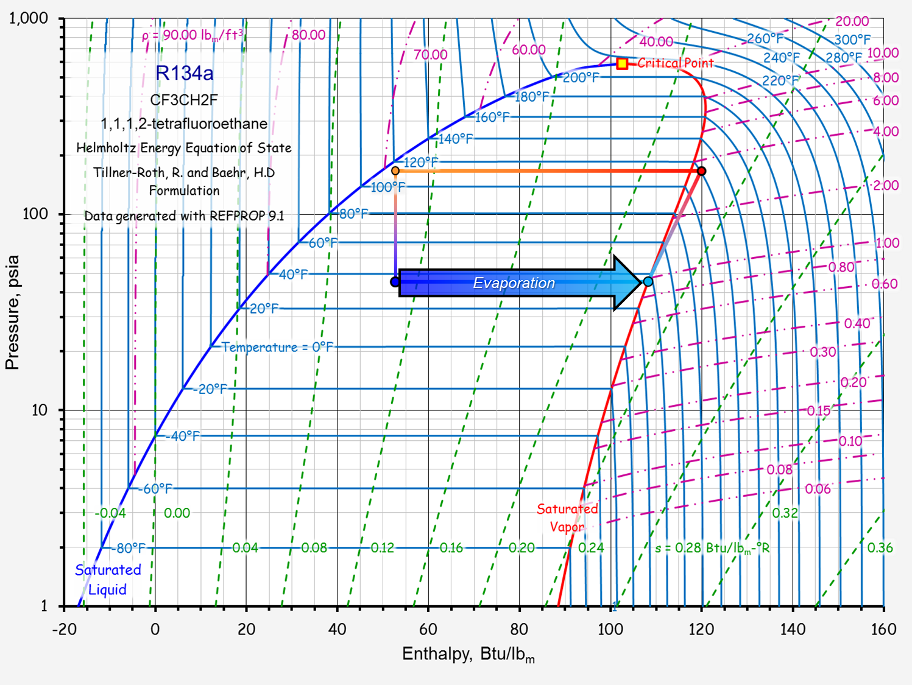
Suction Line
Evaporator

Slide 16
An Air-Cooled Vapor Compression Cycle Chiller
Condenser
Hot Gas Line
Liquid Line Solenoid Valve
Receiver
Expansion Valve
Liquid Line
Suction Line
Evaporator
Compressor

Slide 17
Notes:
Poll Title: Click on the characteristic(s) of the suction line (more than one might apply) https://www.polleverywhere.com/clickable_images/tkixDbA1h12unfLsdlIxK

Slide 18
Notes:
Poll Title: Click on the characteristic(s) of the liquid line (more than one might apply) https://www.polleverywhere.com/clickable_images/1GTfhK08hKMt6frkU3SrU

Slide 19
Notes:
Poll Title: Click on the characteristic(s) of the hot gas line (more than one might apply) https://www.polleverywhere.com/clickable_images/TtyTkijOHsNyOn61tRi2u

Slide 20
Which Pipe is Which
Suction Line
Liquid Line
Hot gas line
Largest, coldest and insulated
Smallest, warm, usually not insulated
Size between suction and liquid line size, hot, typically not insulated

Slide 21
Notes:
Poll Title: Click on the item of equipment that you think is the air cooled chiller. https://www.polleverywhere.com/clickable_images/Ef4D78wBZ4FsmJqPCBWMM

Slide 22
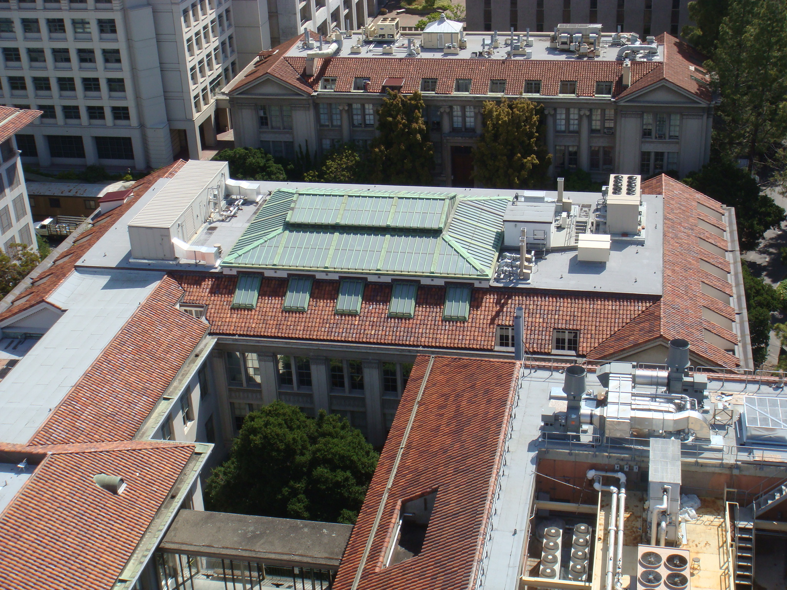
An Air Cooled Vapor Compression Cycle Chiller

Slide 23
Notes:
Poll Title: Click on the area on the chiller where you think the condensing coils are located. https://www.polleverywhere.com/clickable_images/p7iPdry9rFof1WTJ2pM1t

Slide 24
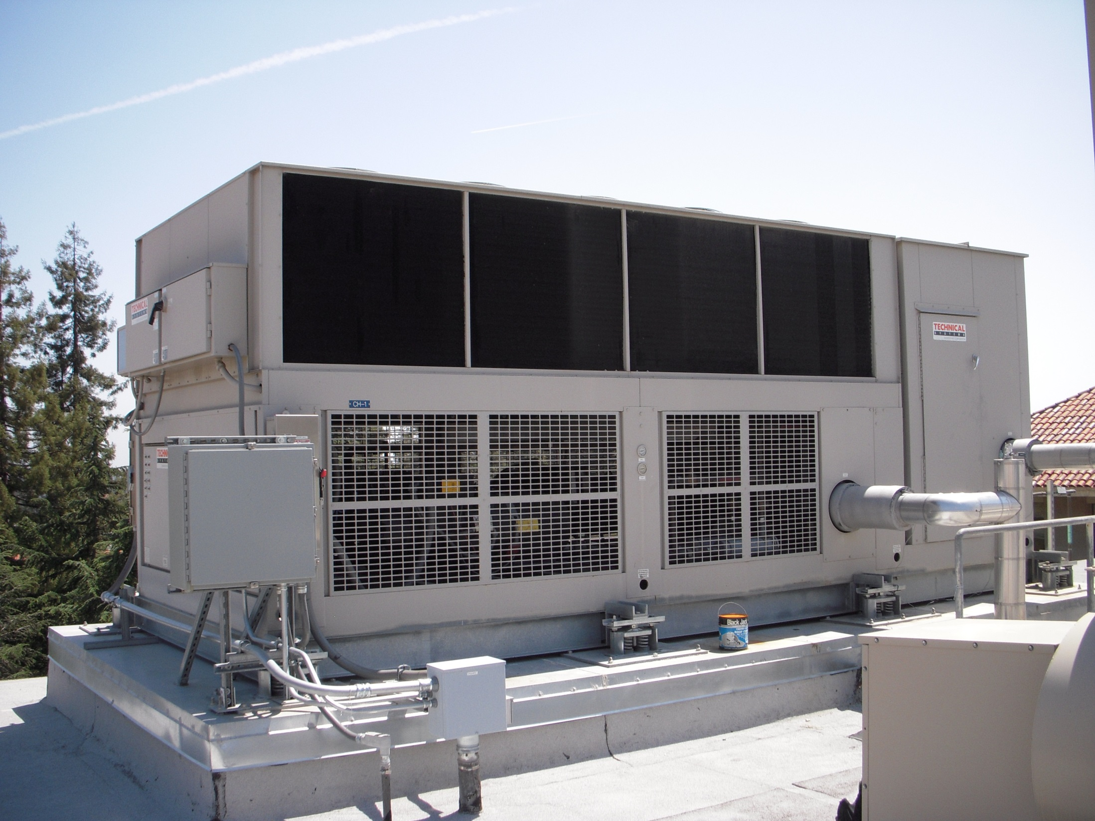
Condenser

Slide 25
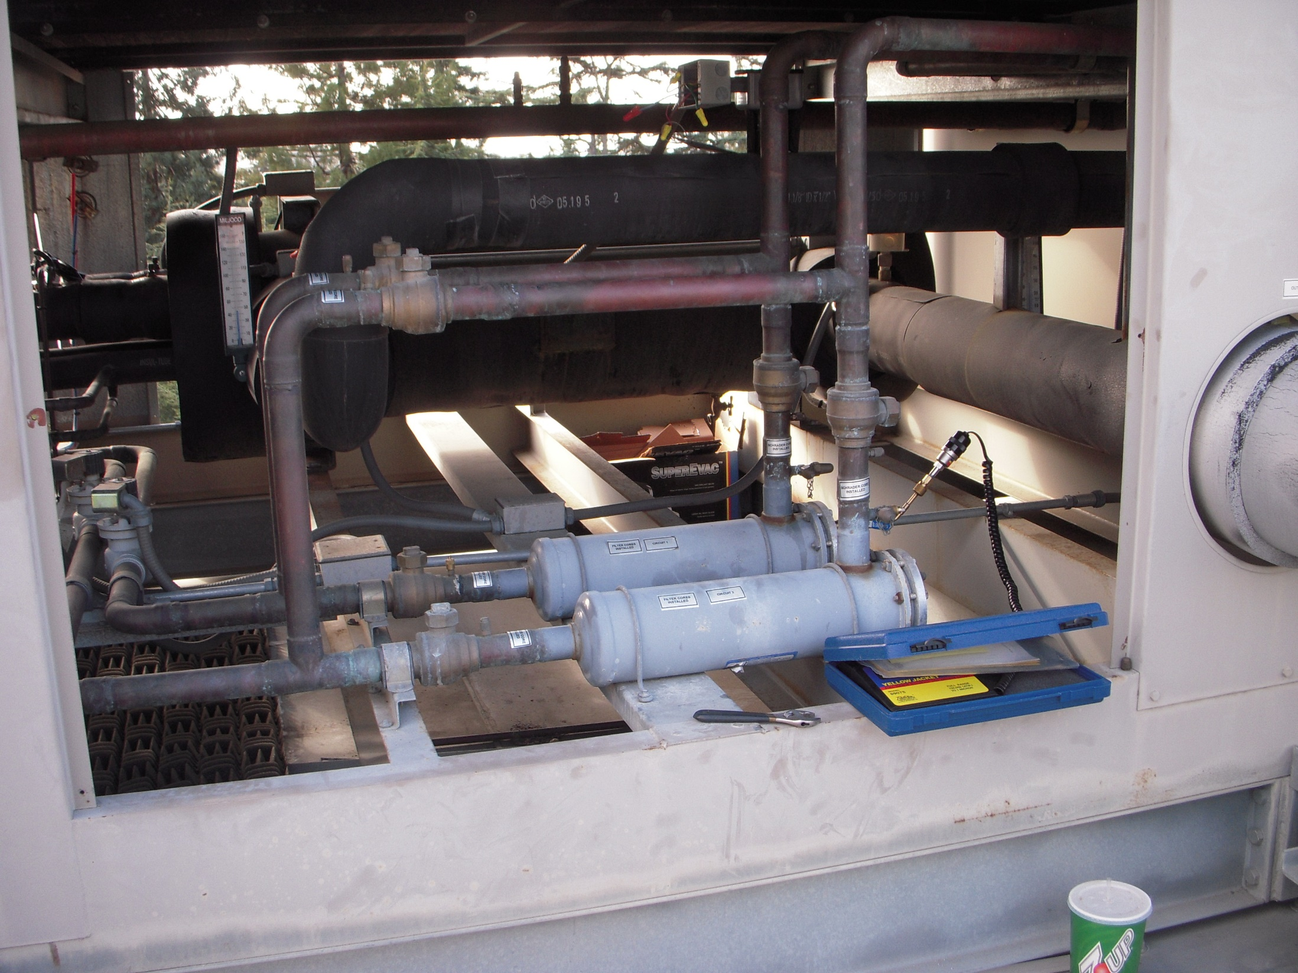
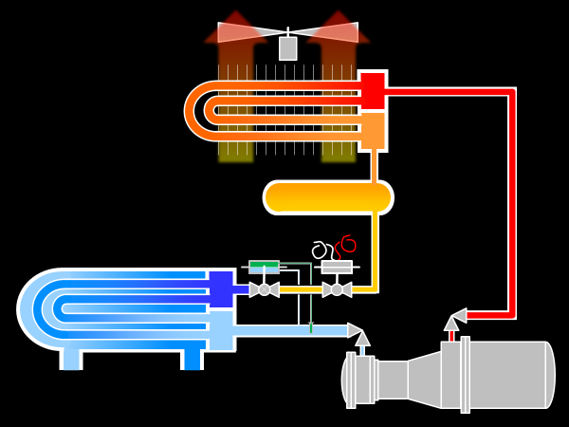
Service Bypass to Allow Filter Dryer to be Serviced (Not shown on diagram
Evaporator
Filter Dryer (Not shown on diagram)
Service Valves (Not shown on diagram

Slide 26
Liquid Lines
Chilled Water Pipes
Suction Line
Liquid Line Solenoid Valve

Slide 27
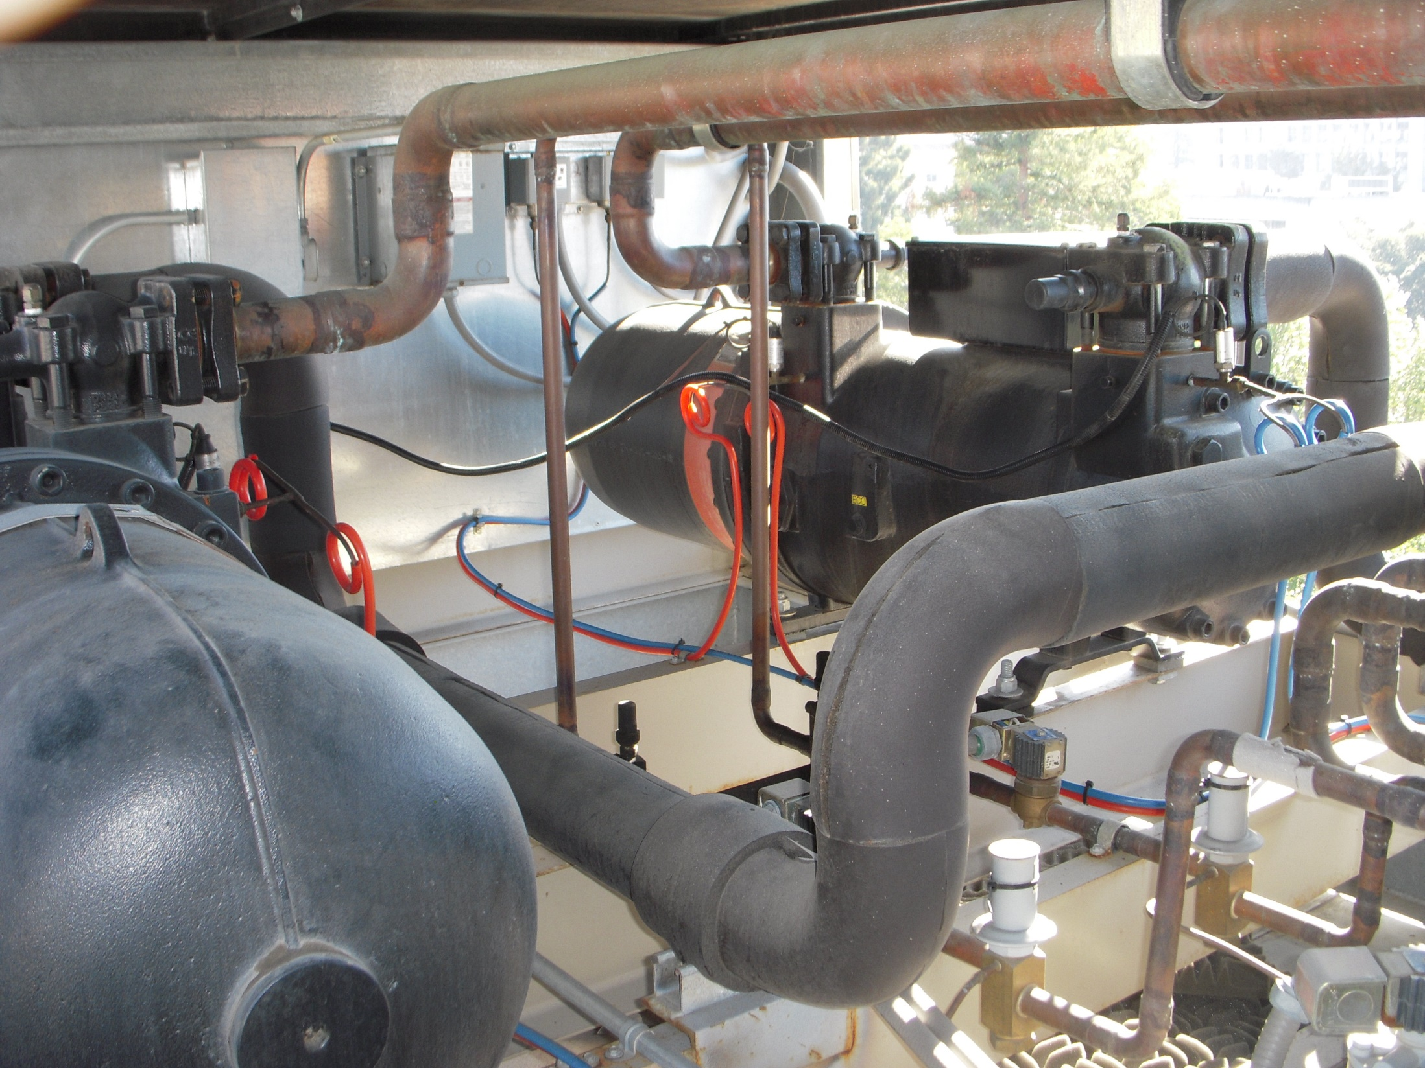
Hot Gas Lines
Compressor
Compressor
Suction Line

Slide 28
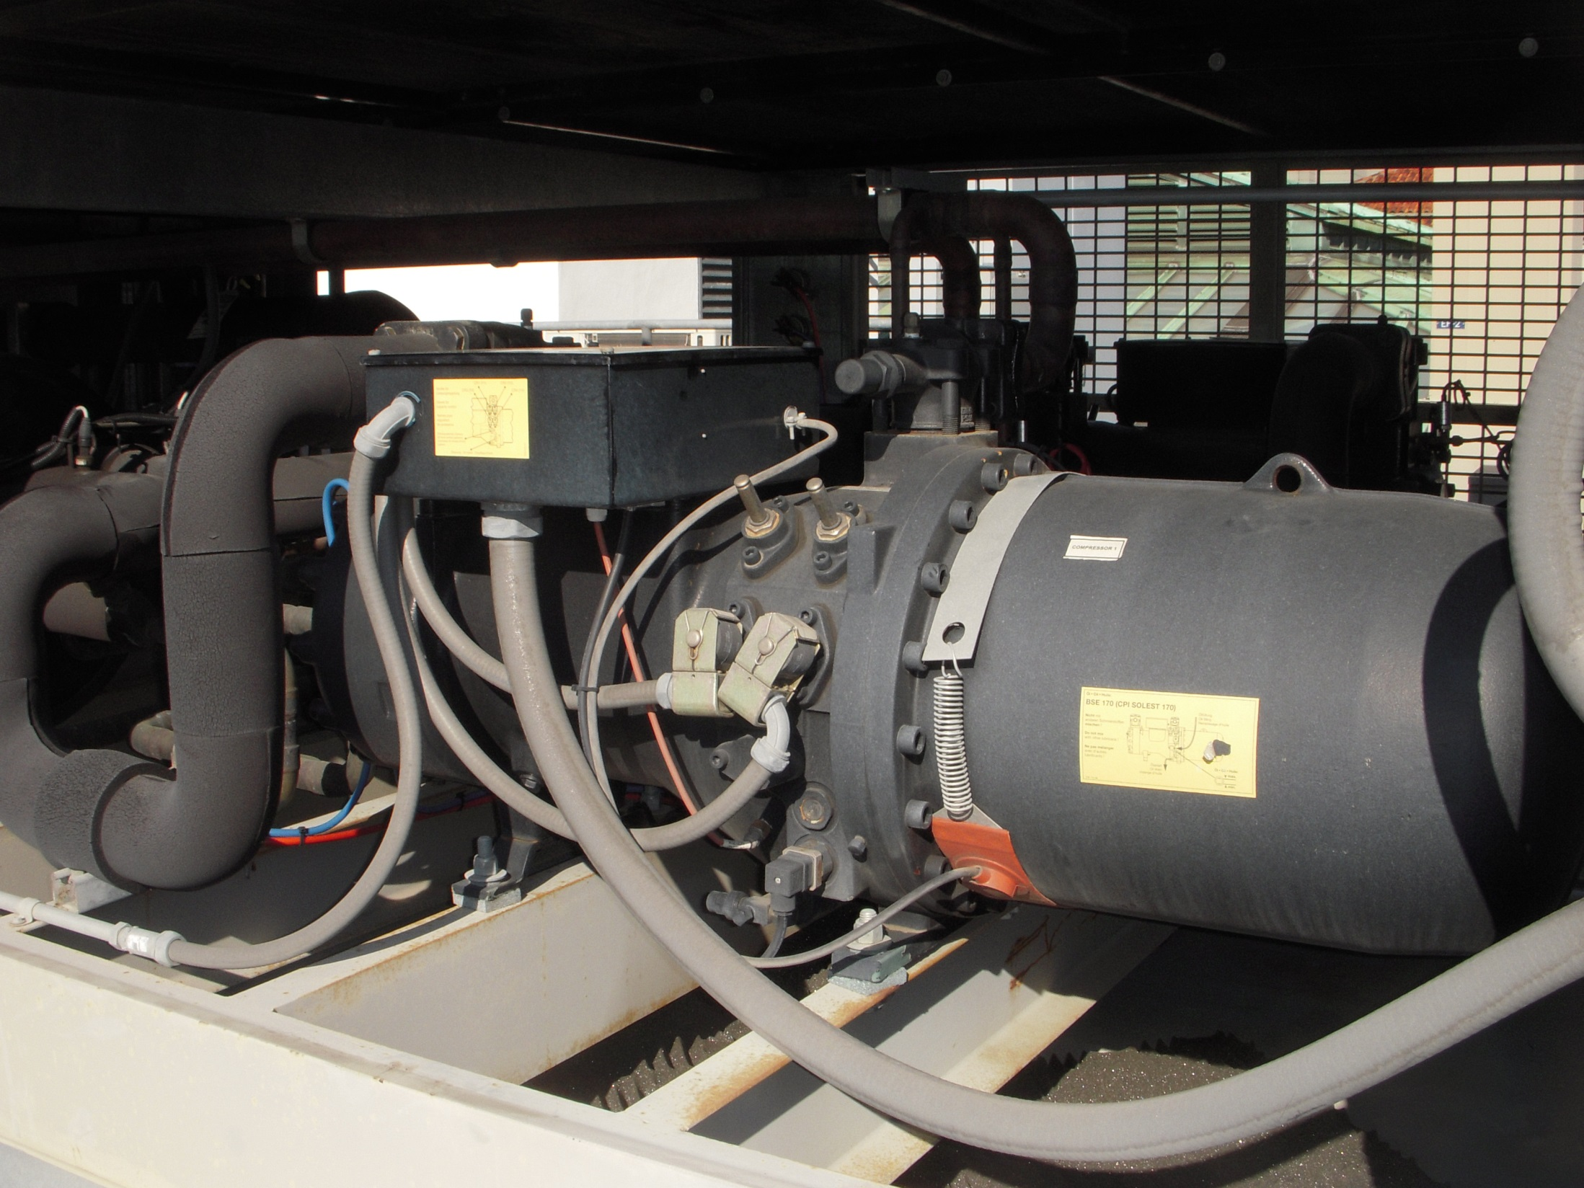
Compressor
Suction Line

Slide 29
Unloaders

Slide 30
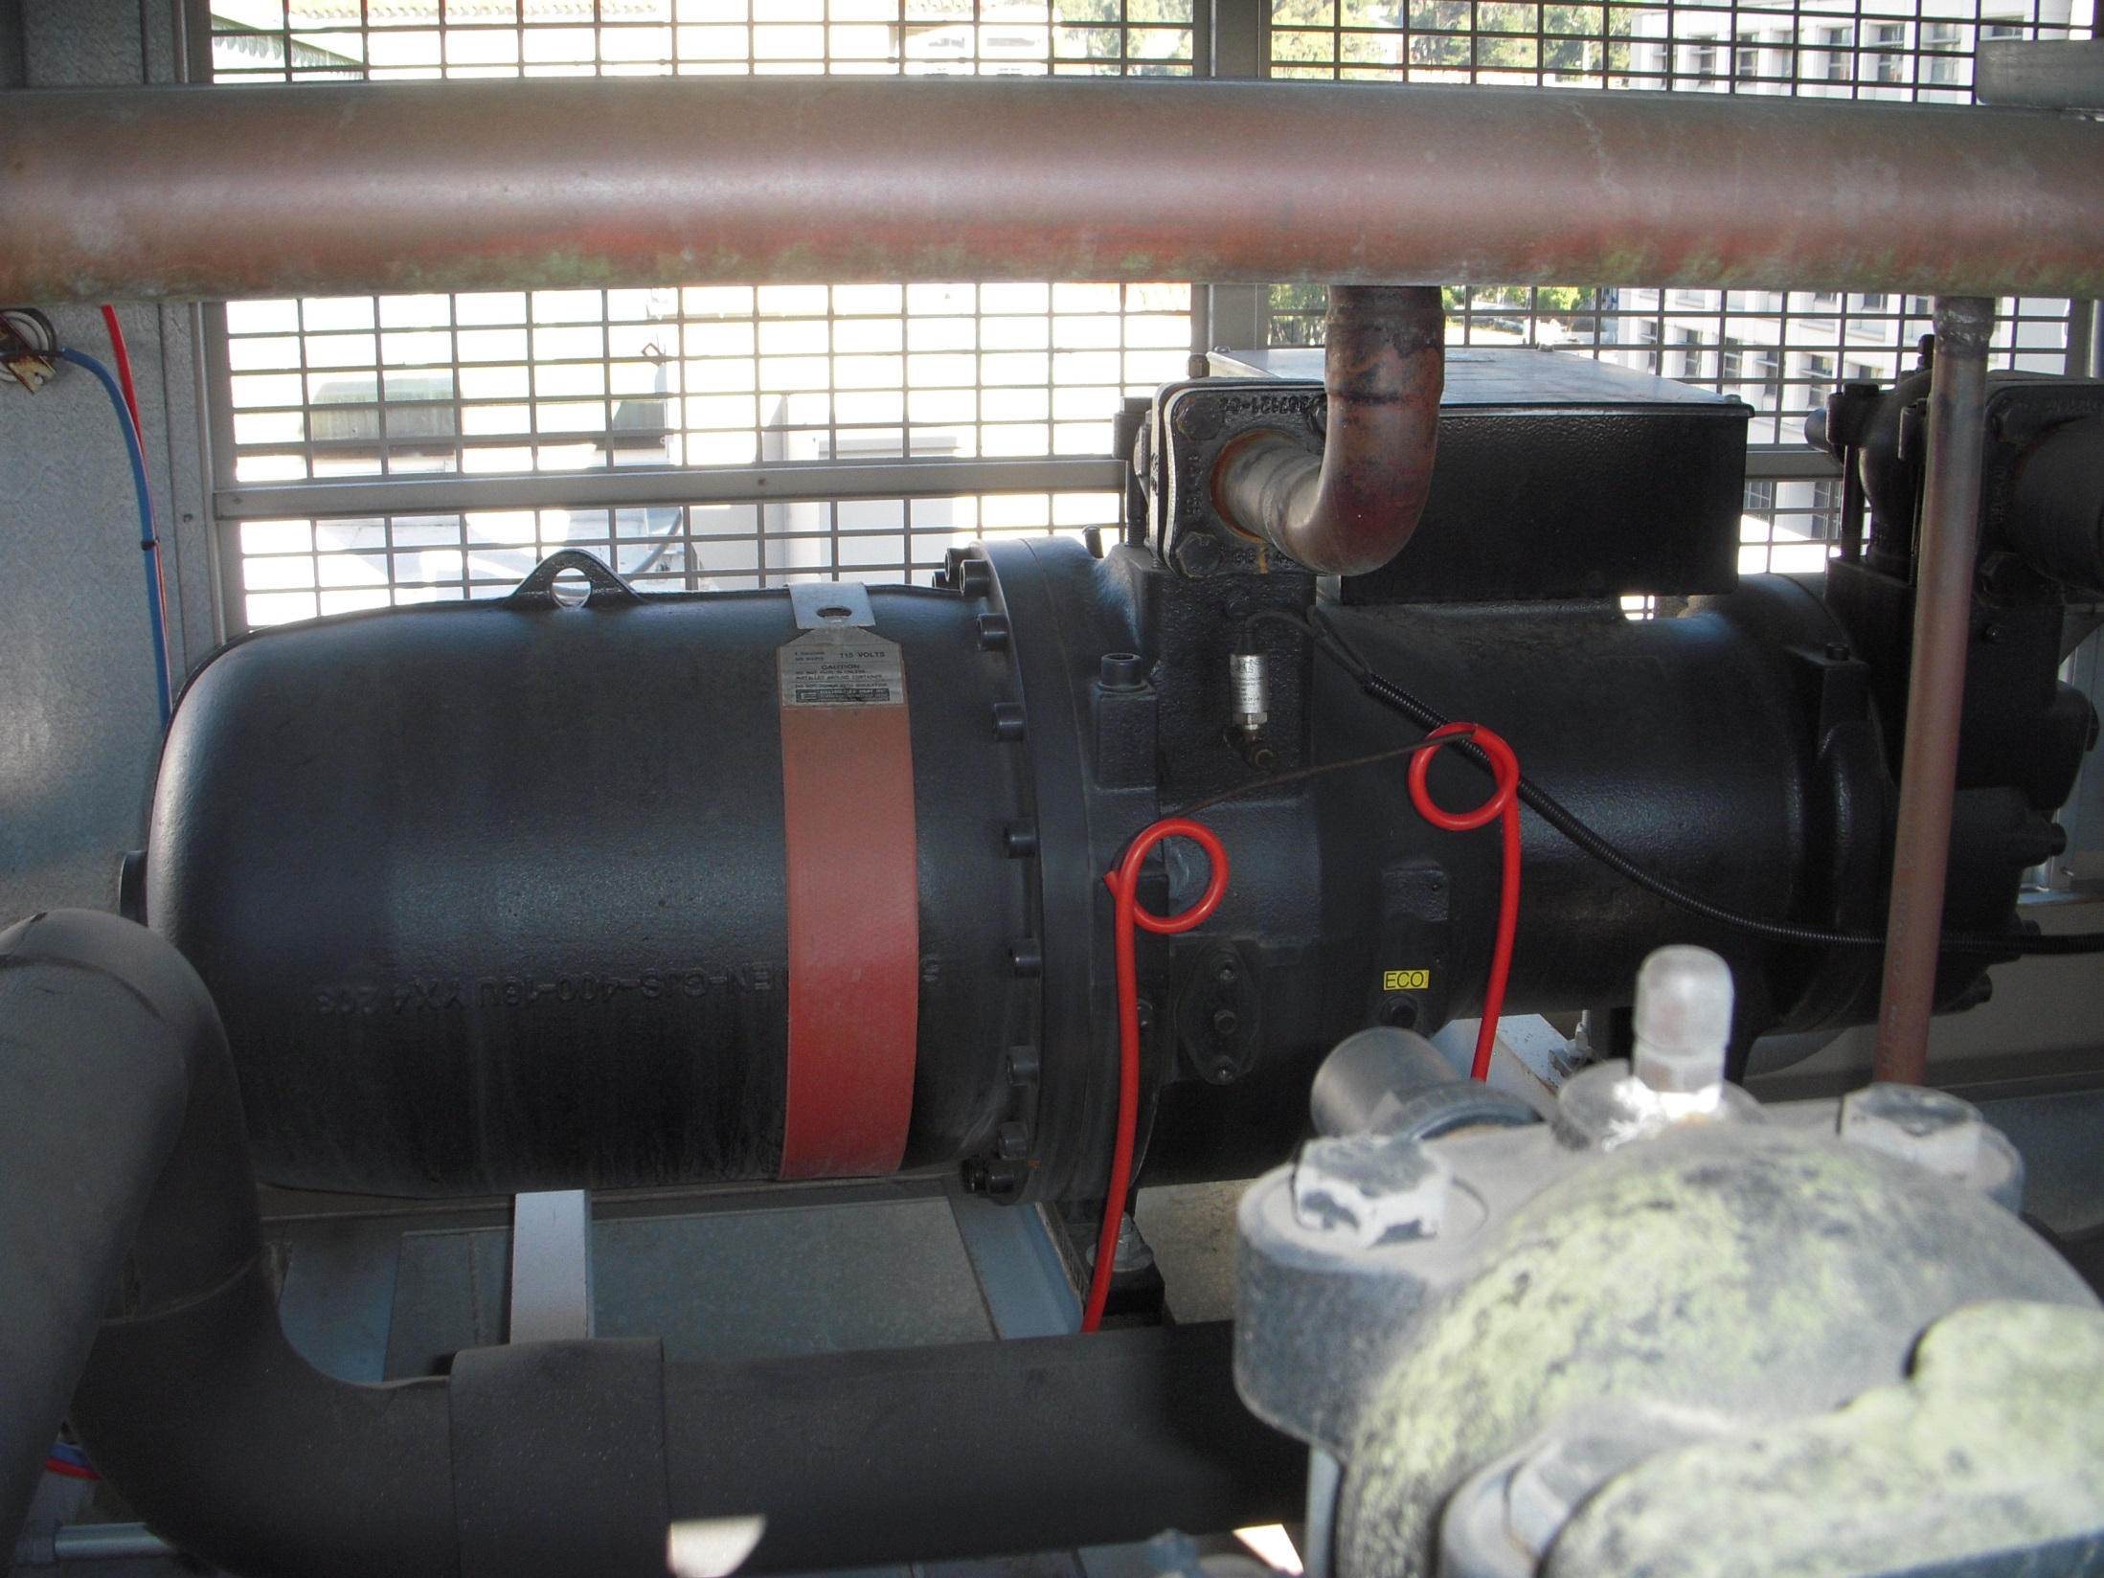
Crank Case Heater

Slide 31
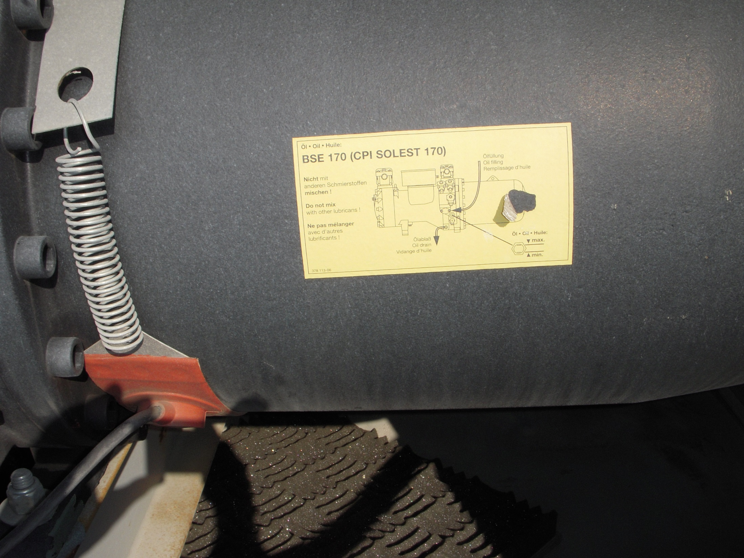
Crank Case Heater

Slide 32
Notes:
Poll Title: When should the crankcase heaters be energized? https://www.polleverywhere.com/multiple_choice_polls/ZJNJcLfHkZjFrfVSNMMq6

Slide 33
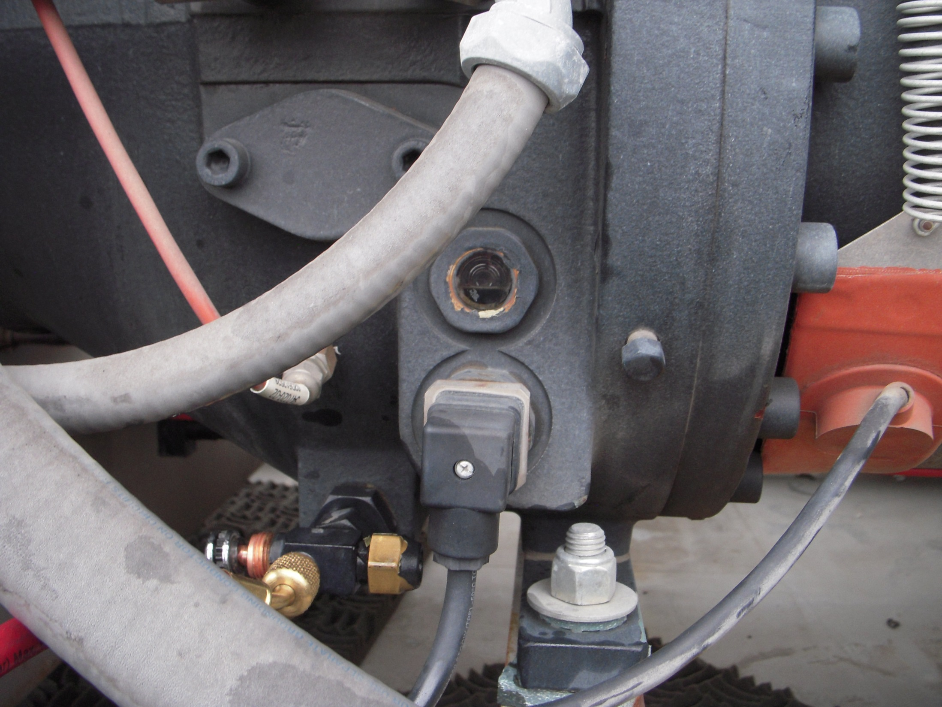
Oil Sight Glass

Slide 34
Notes:
Poll Title: The oil level in the sight glass will not change much over the course of an operating cycle. https://www.polleverywhere.com/multiple_choice_polls/RY8qZuXtDMBLeed6XVXA9

Slide 35
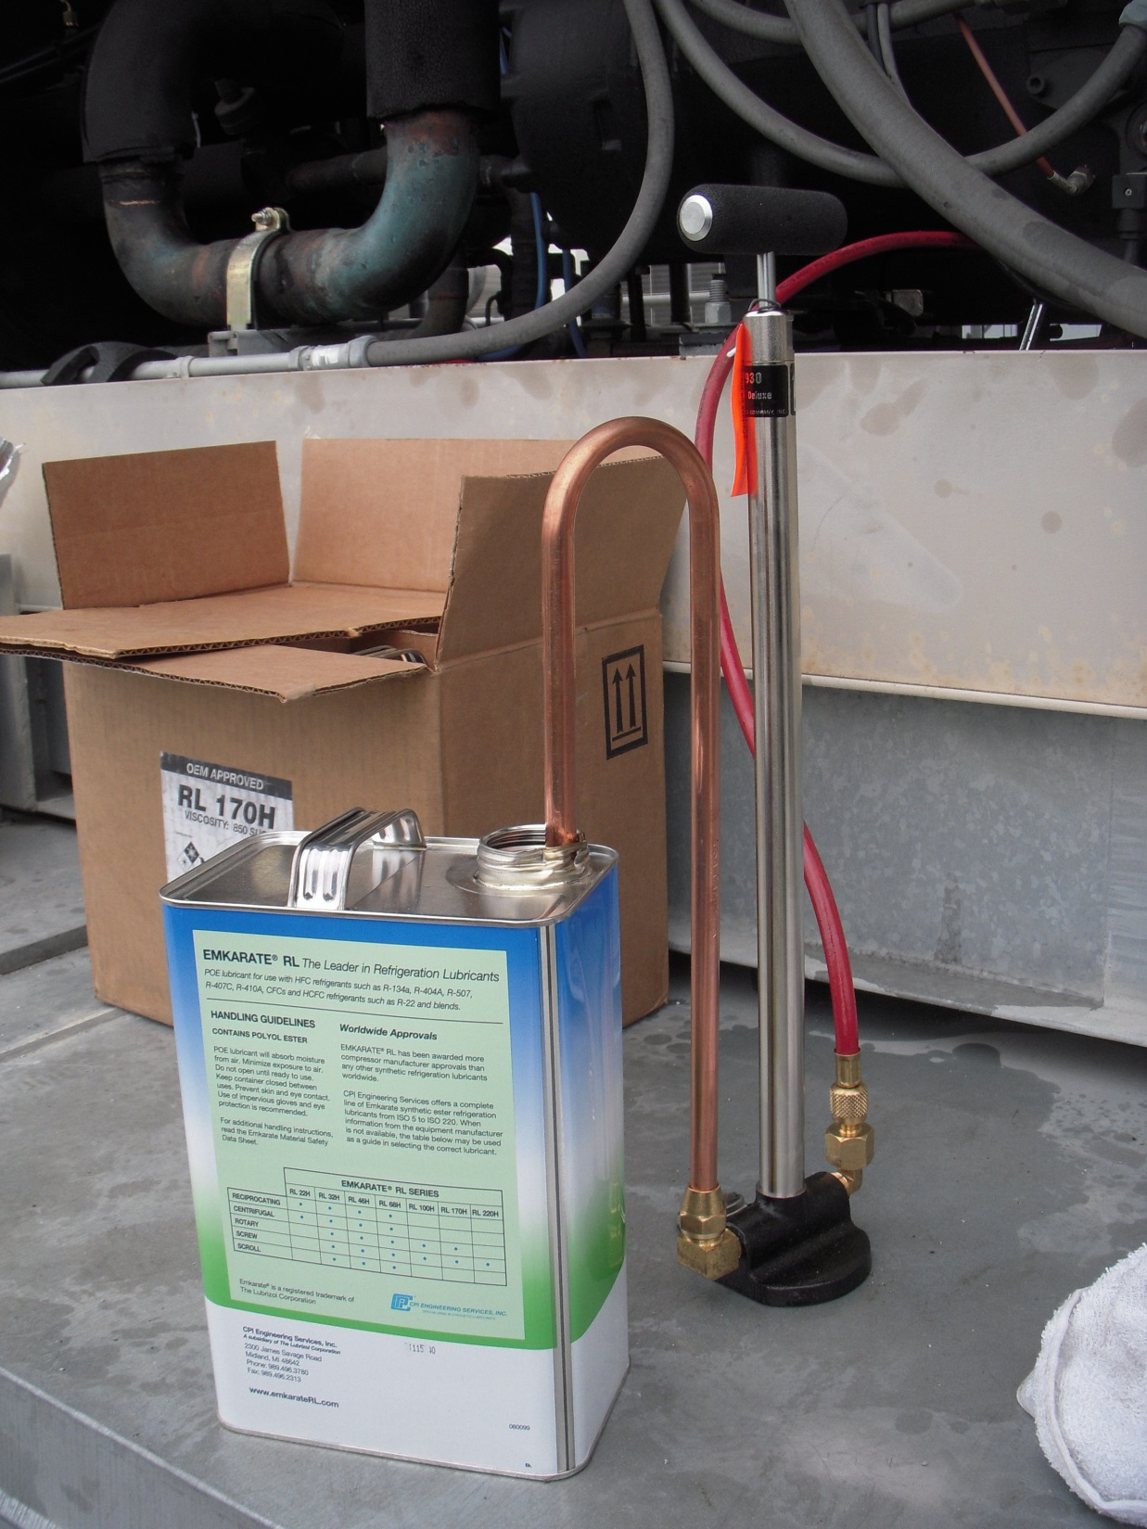
Hand Pump for Adding Oil

Slide 36
Notes:
Poll Title: Refrigerant oil is specific to the refrigerant that is used in a refrigeration system. https://www.polleverywhere.com/multiple_choice_polls/EPll2Xm0gTo8JuqIAri3U

Slide 37
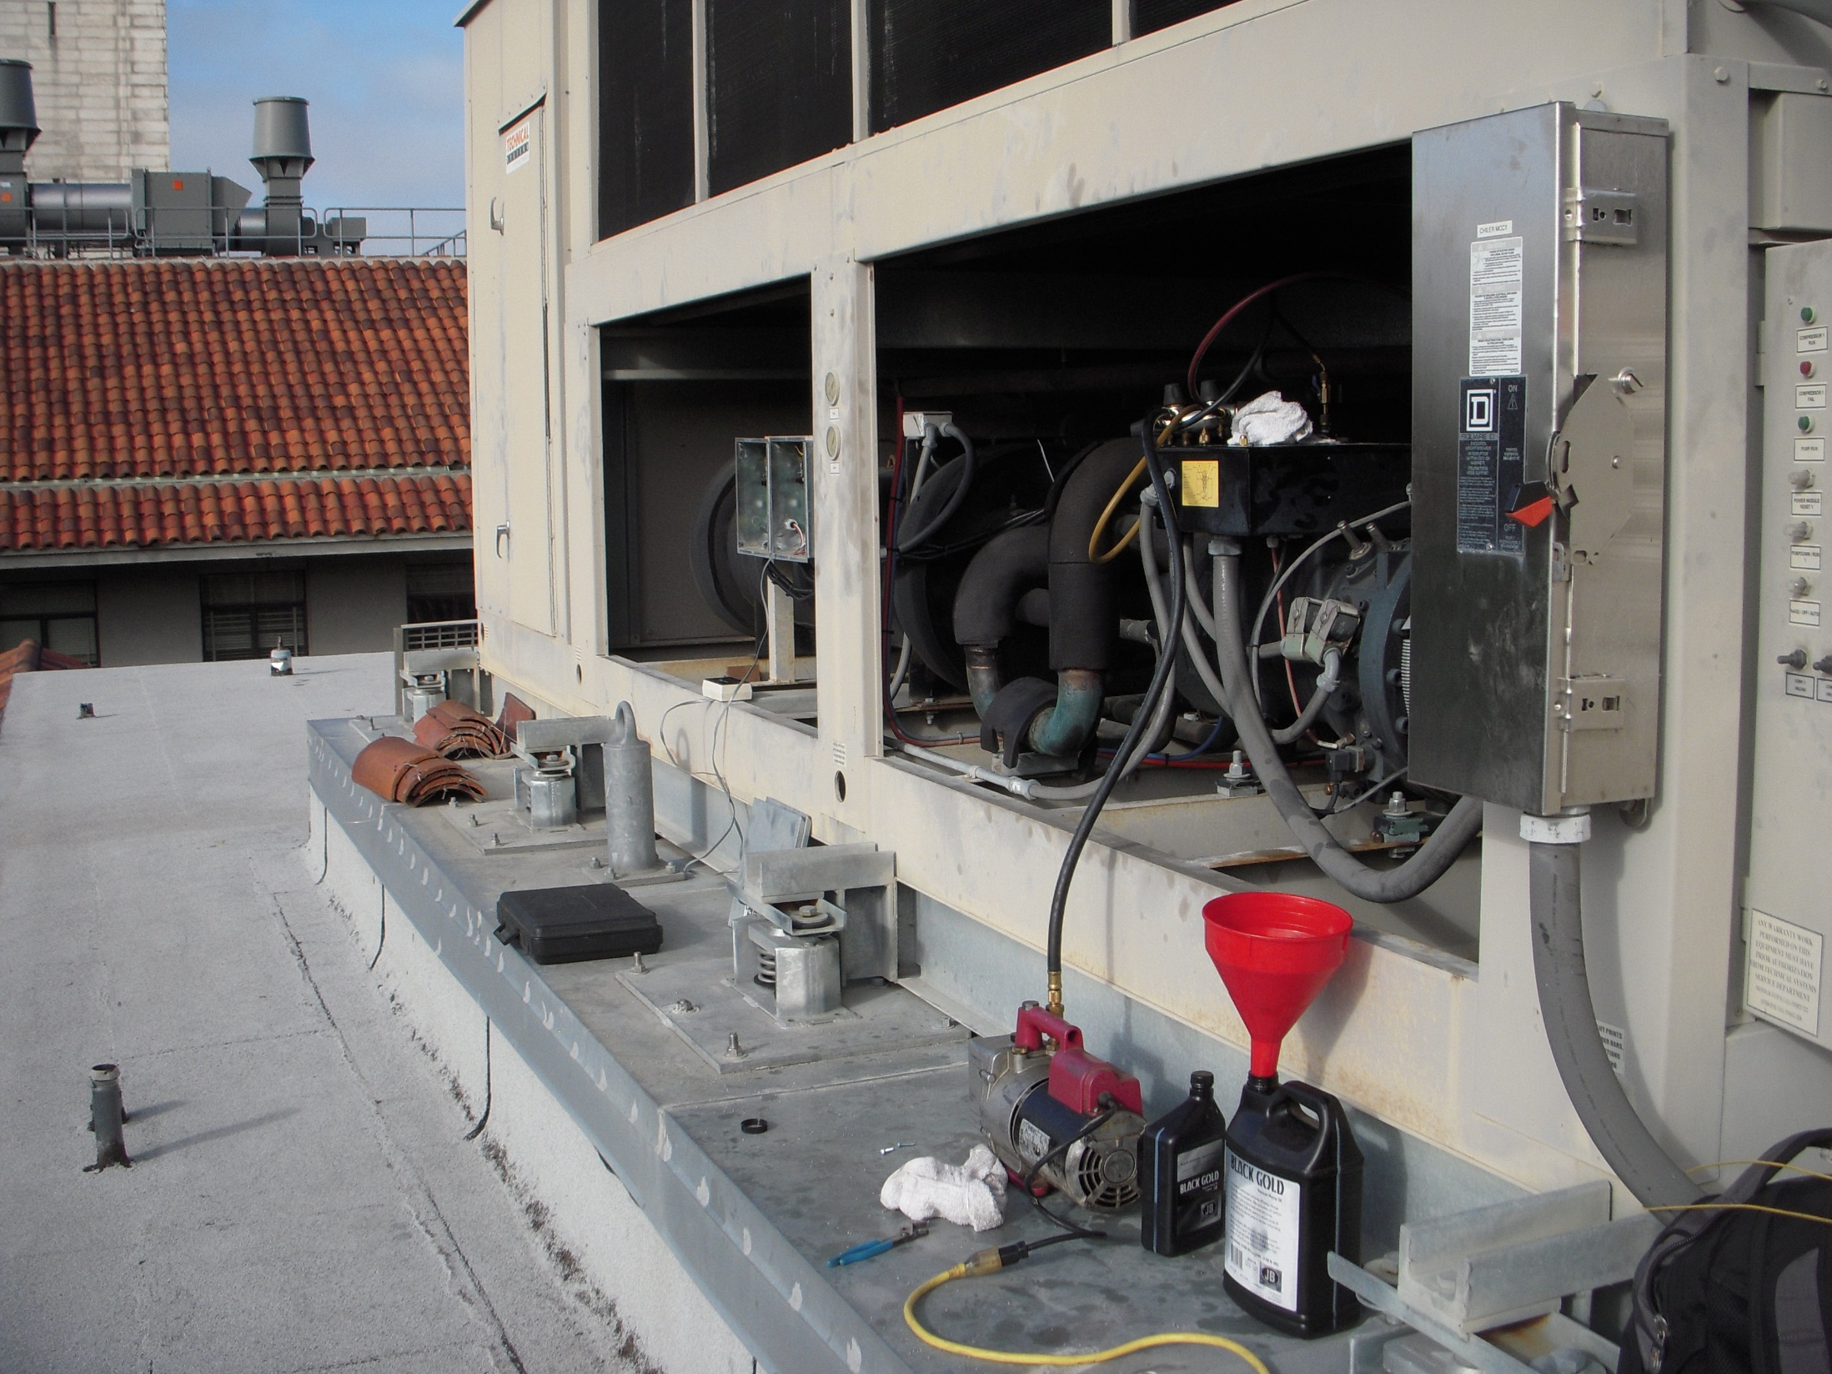
Vacuum Pump Evacuating the System in Preparation for Charging
Vacuum Pump

Slide 38
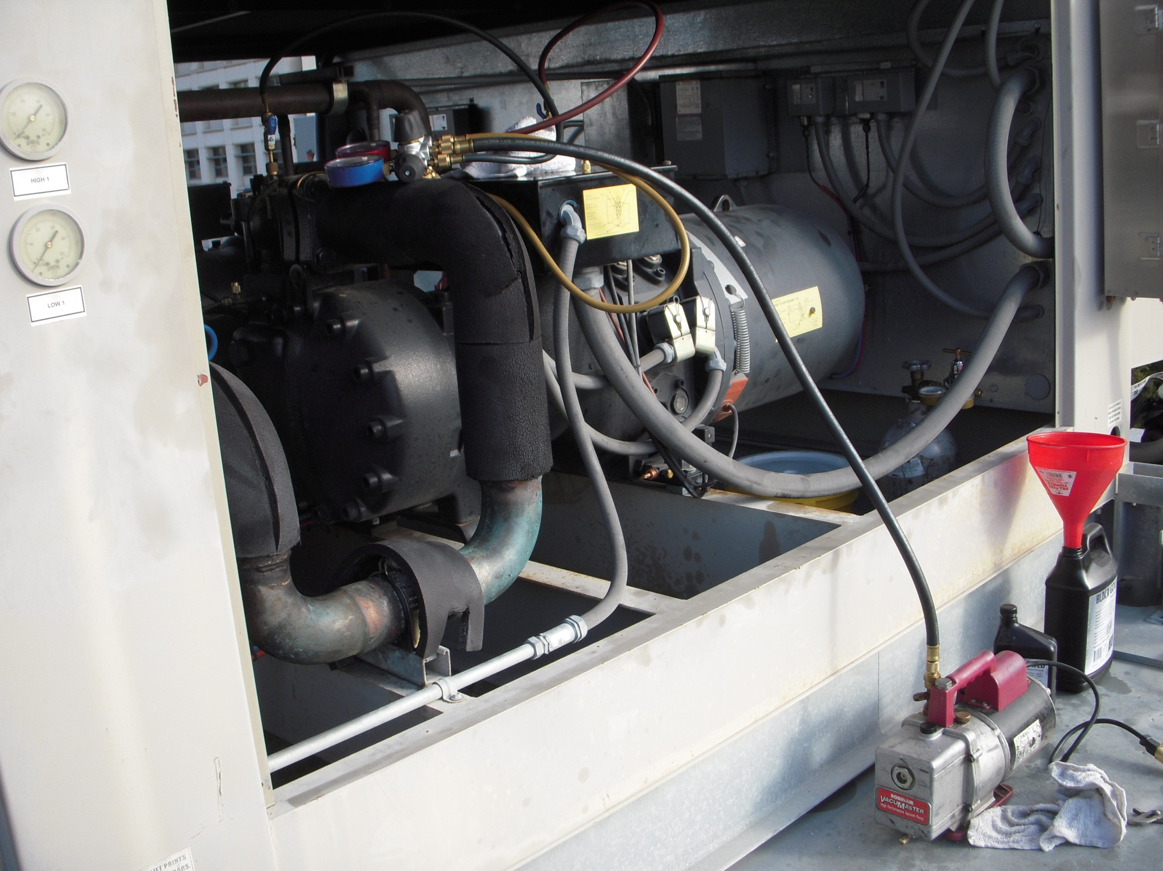

Slide 39
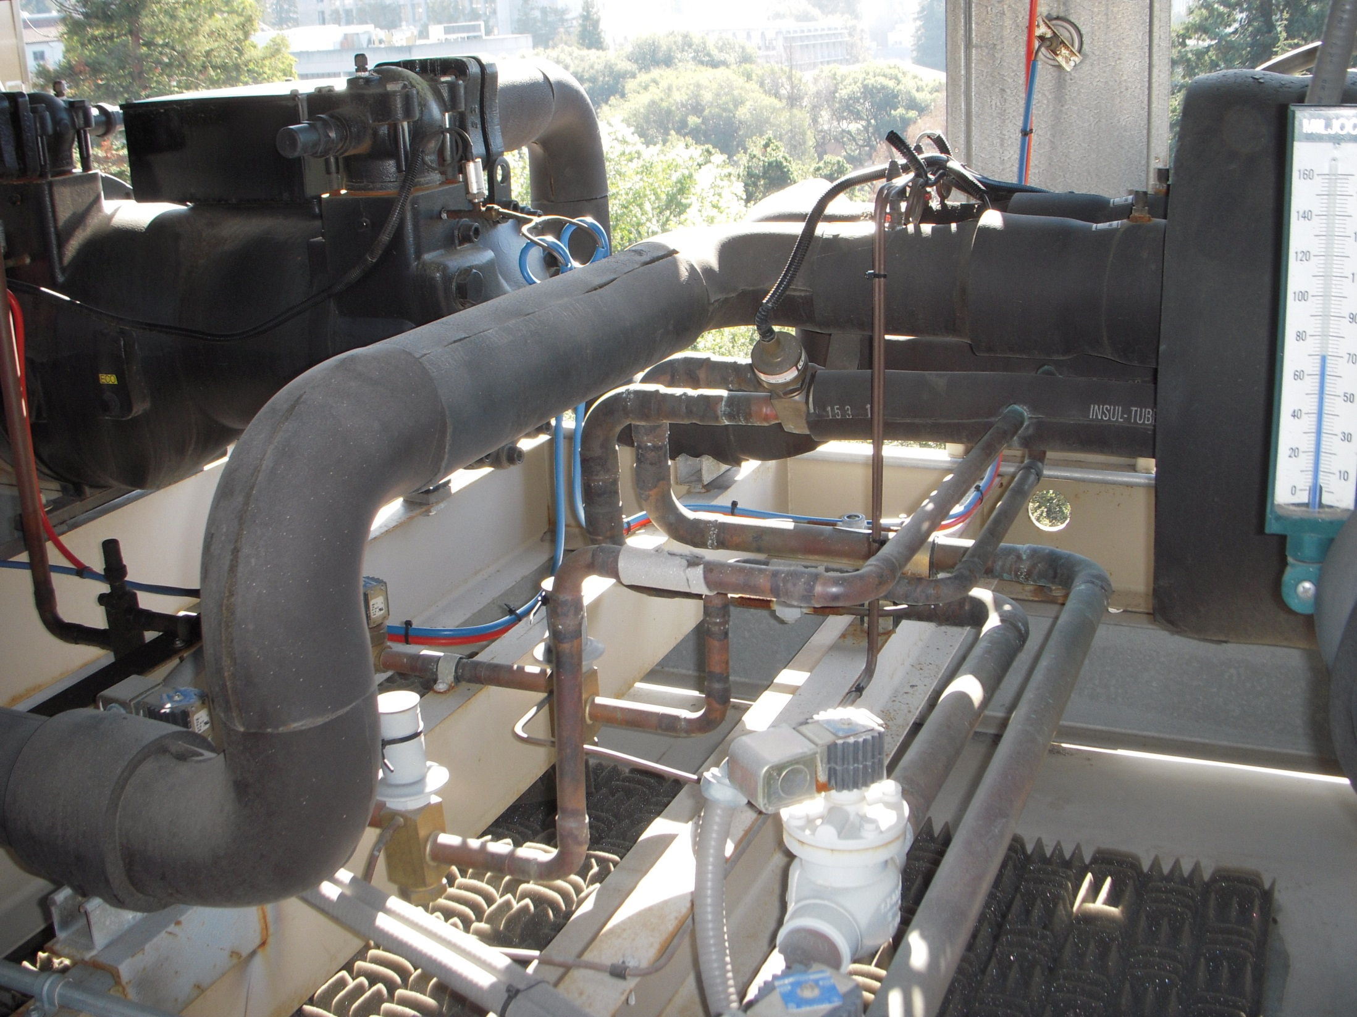
Expansion Valve
Suction Line
Liquid Line Solenoid Valve
Liquid Lines

Slide 40
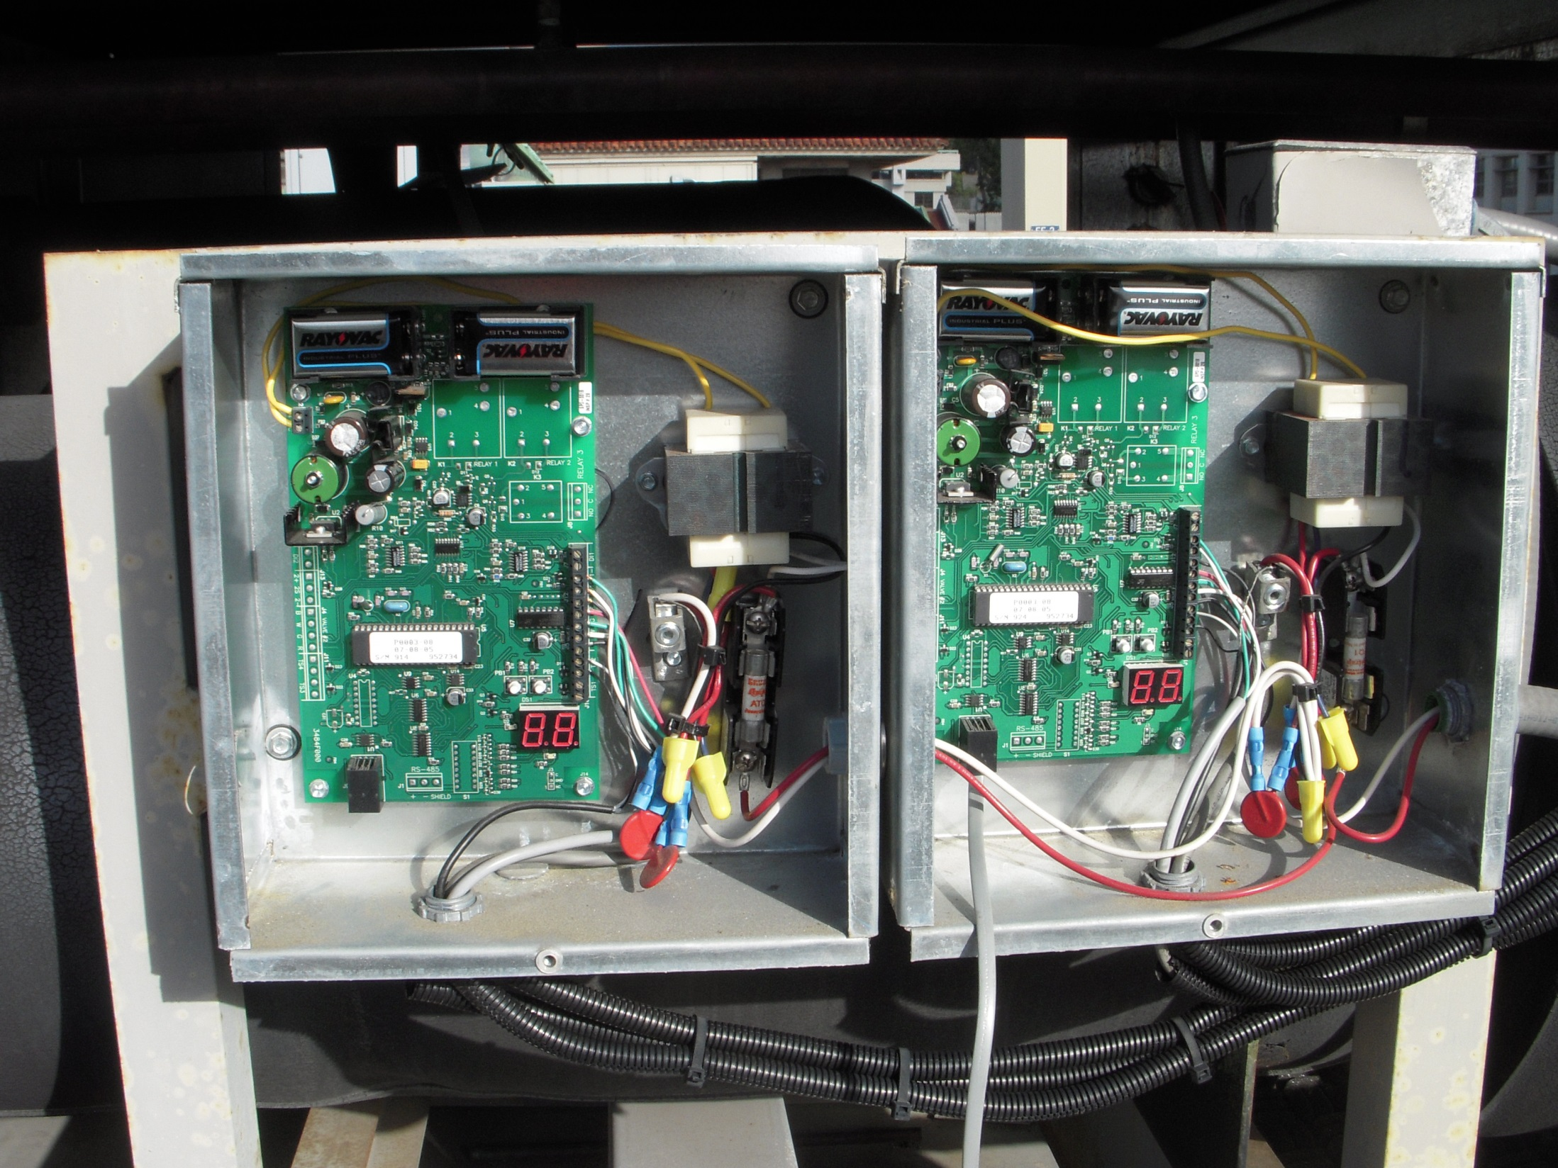
Electronic Expansion Valve Controllers

Slide 41
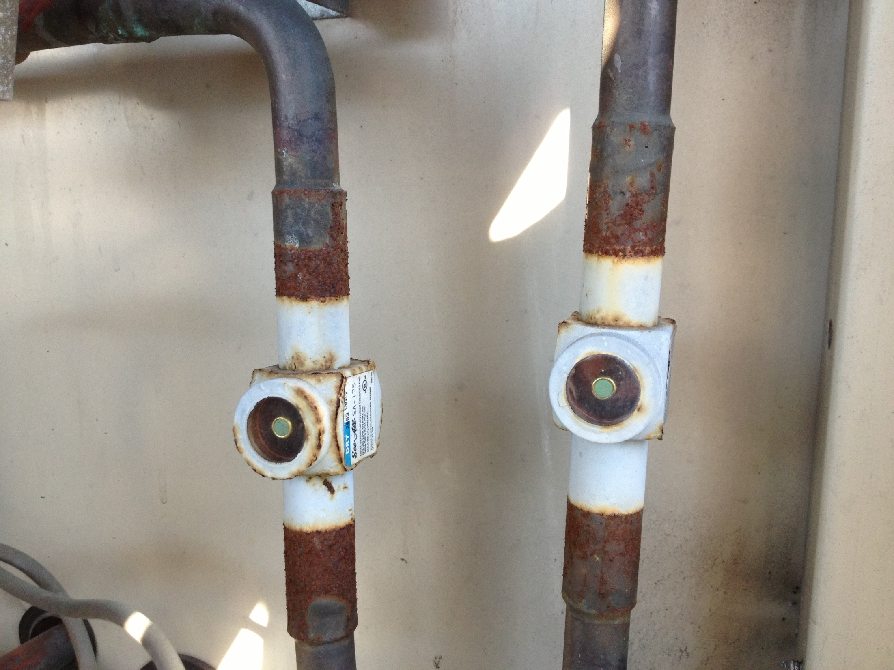
A Refrigerant Sight Glass

Slide 42
Notes:
Poll Title: The green dots in the refrigerant sight glass will alternate between green and red during the Christmas holidays. https://www.polleverywhere.com/multiple_choice_polls/MVnMOf6dKOkRA9F5CgD13

Slide 43
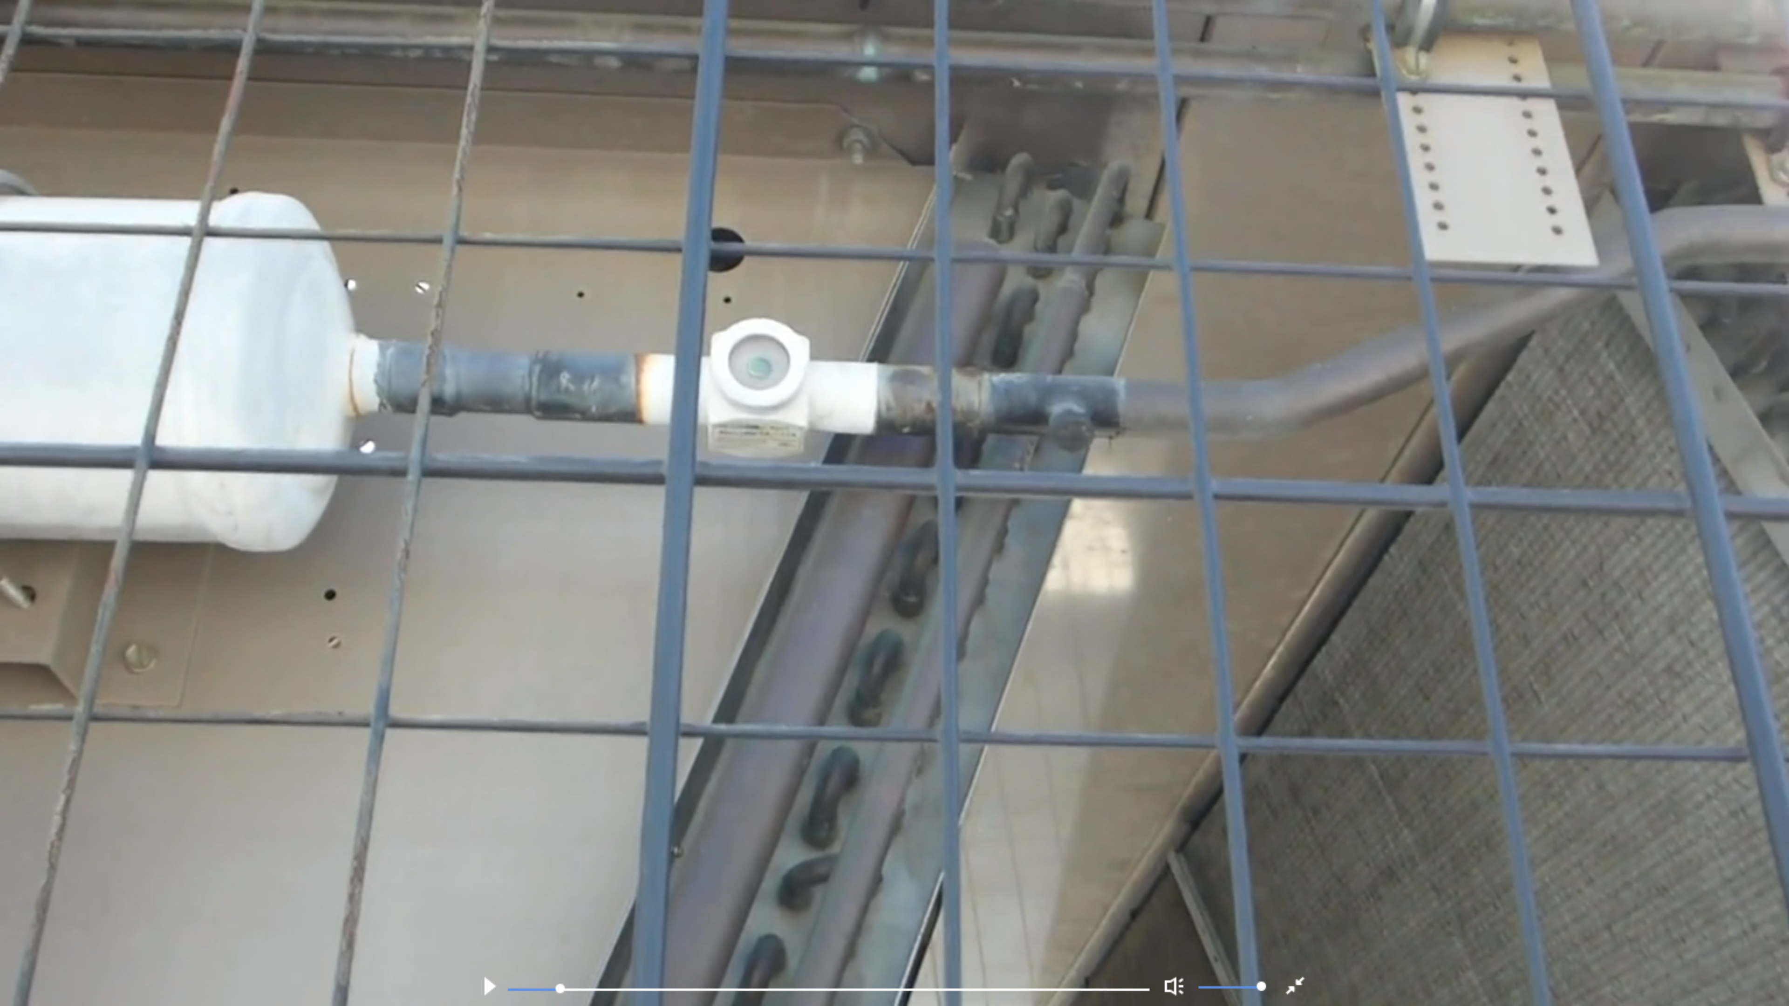
https://www.av8rdas.com/ebcx-workshop-series-16.html#EBCx16-4

Slide 44
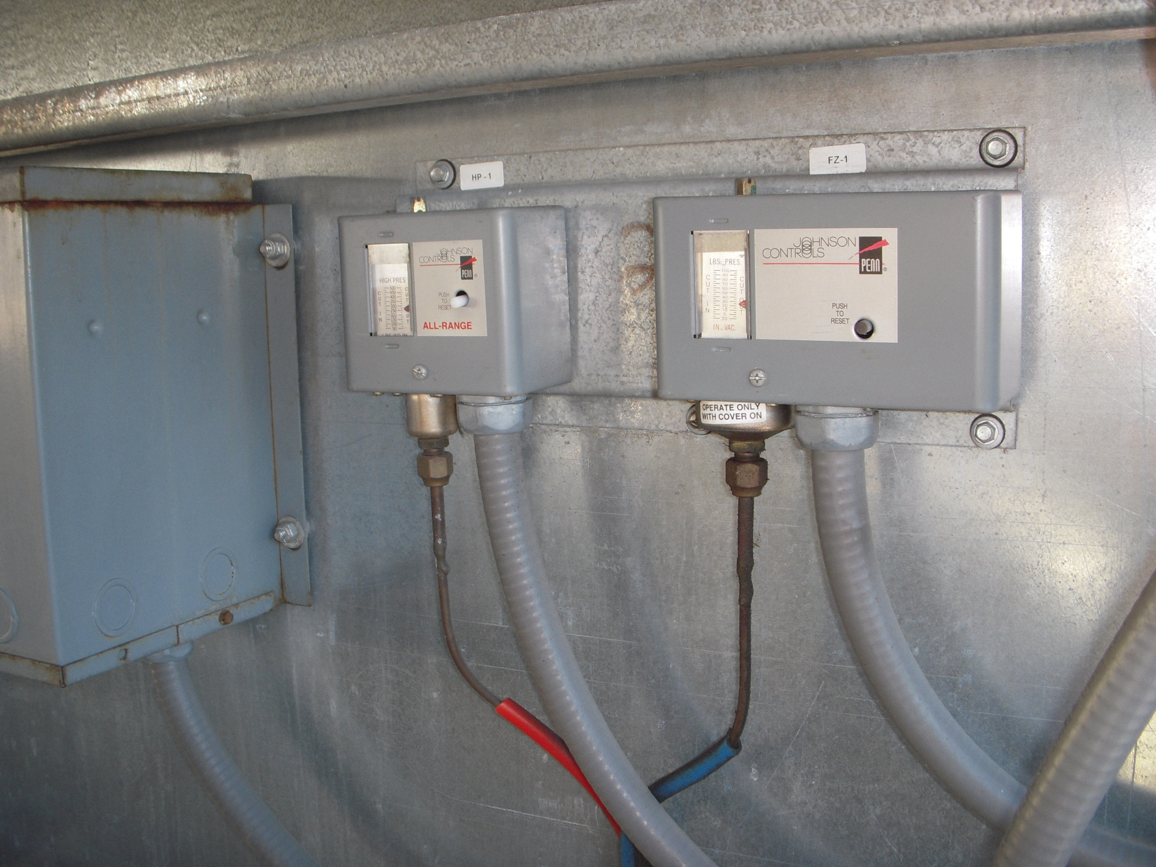
Typical Control Switches

Slide 45
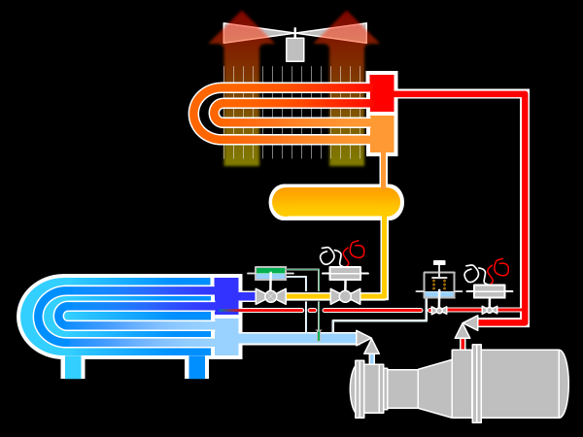
Adding Hot Gas Bypass
Hot Gas Solenoid
Hot Gas Regulator

Slide 46
Hot Gas Bypass Lines
Hot Gas Solenoid Valve
Service Valve
Hot Gas Regulator

Slide 47
Hot Gas Connections to the Evaporator

