Slide 1
Existing Building Commissioning Workshop: Series 16, Session 4
A Field Introduction to Hot Gas Bypass and the Vapor Compression Cycle
Presented By:
David Sellers
Senior Engineer, Facility Dynamics Engineering

Slide 2
Vapor Compression Refrigeration Machines
An application of saturated system and phase change principles and concepts

Slide 3
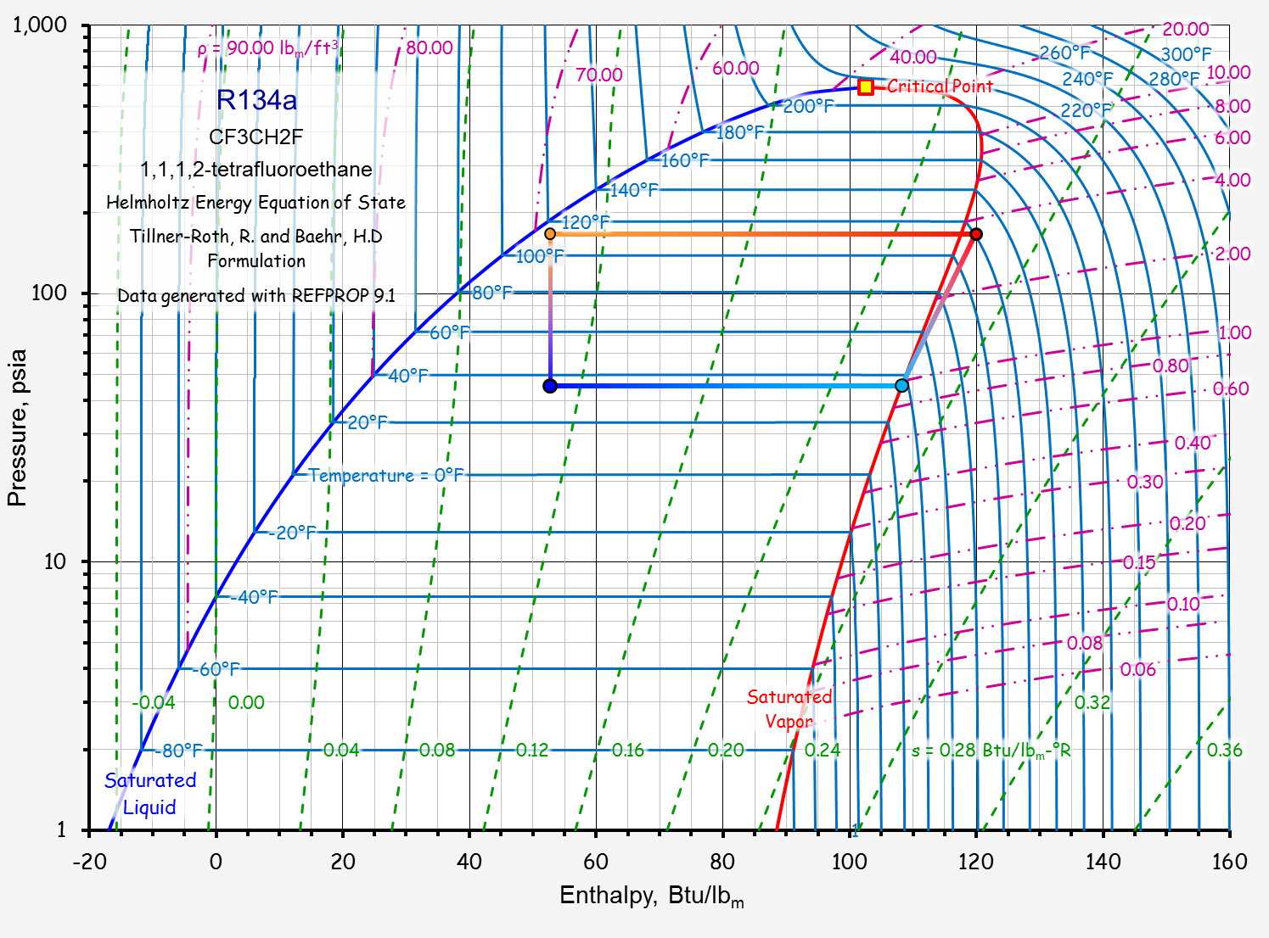
Condensation
Expansion
Compression
Evaporation

Slide 4
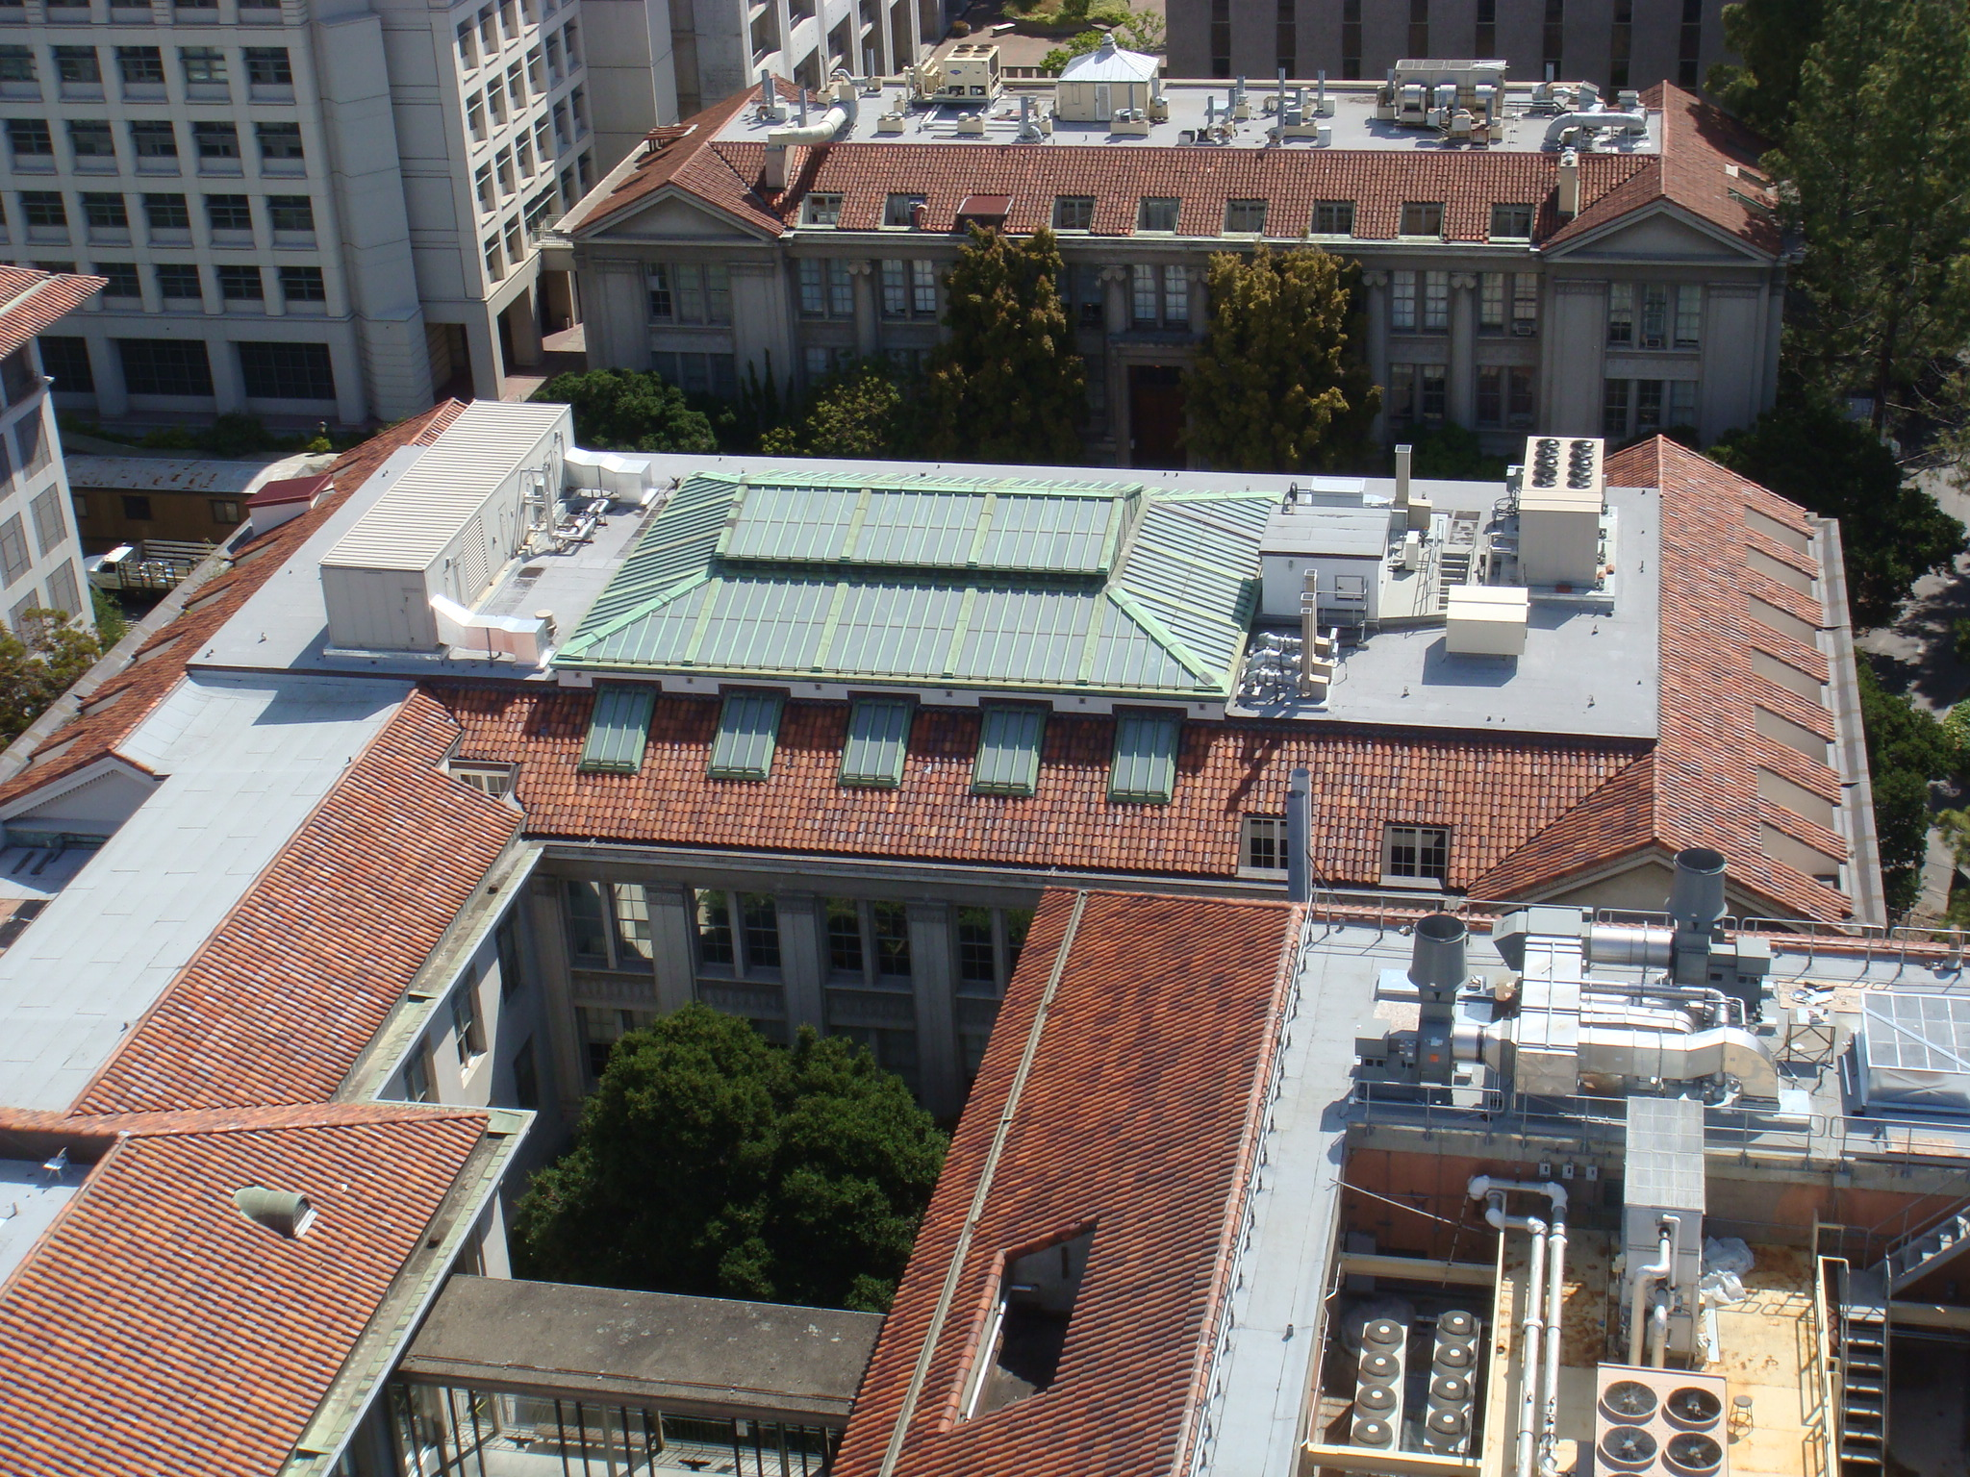
An Air Cooled Vapor Compression Cycle Chiller

Slide 5
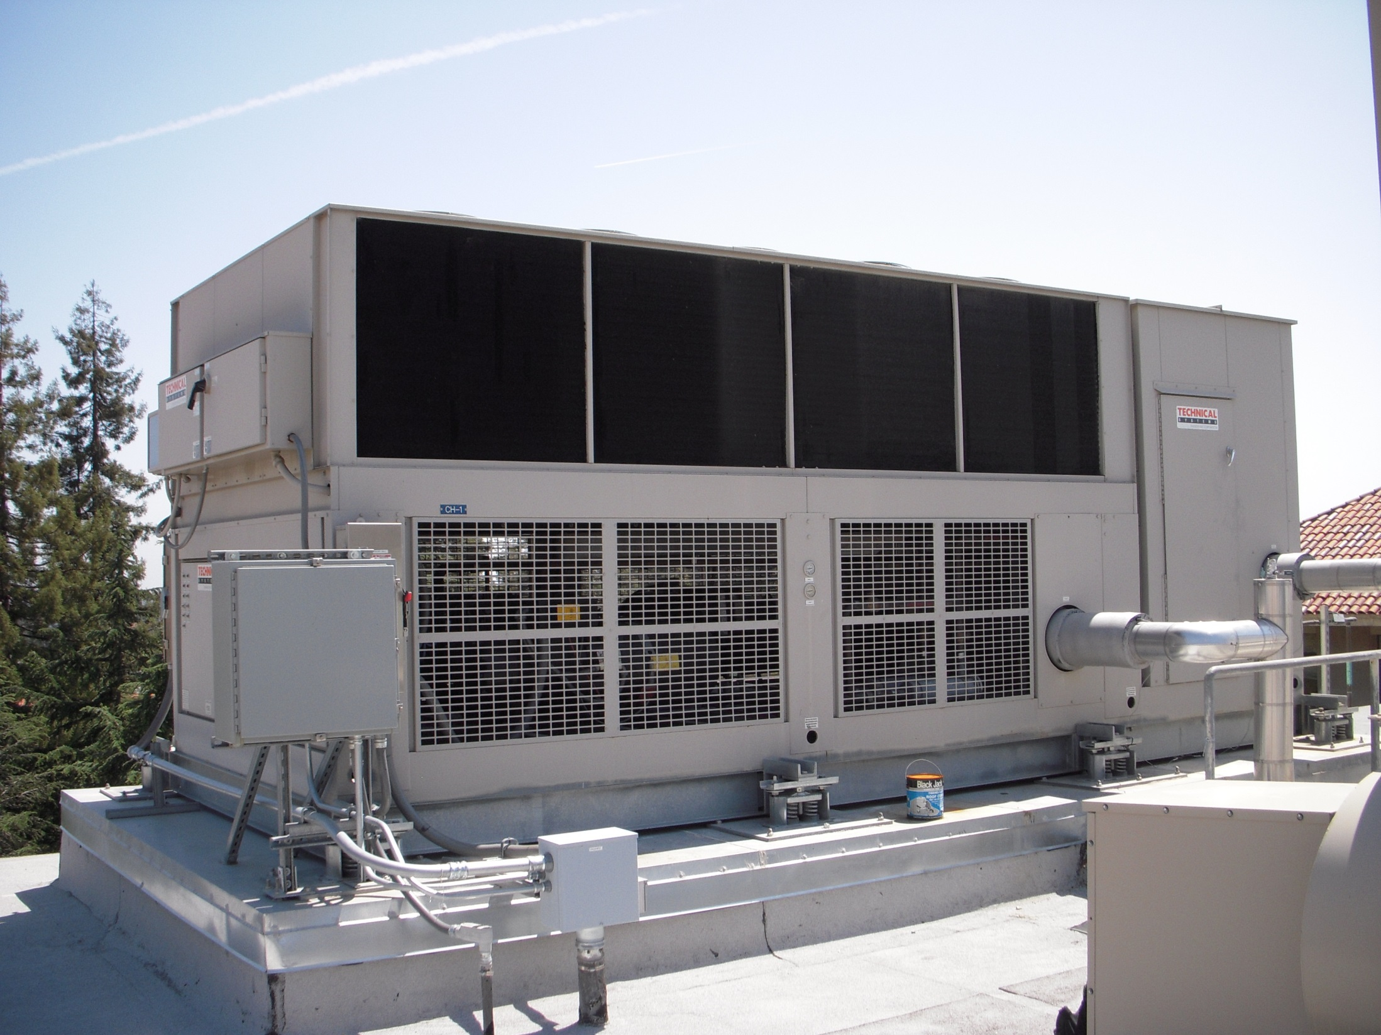

Slide 6
An Air Cooled Vapor Compression Cycle Chiller

Slide 7
Hot Gas Line
Liquid Line Solenoid Valve
Liquid Line
Suction Line
Evaporator

Slide 8
Which Pipe is Which
Suction Line
Liquid Line
Hot gas line
Largest, coldest and insulated
Smallest, warm, usually not insulated
Size between suction and liquid line size, hot, typically not insulated

Slide 9
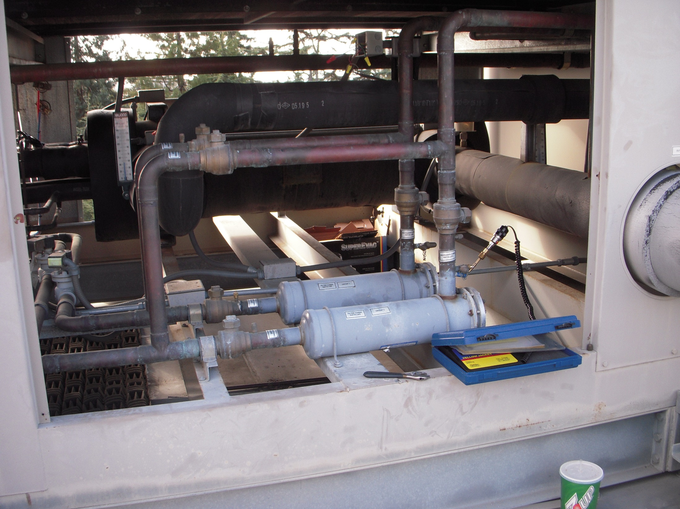
Service Bypass to Allow Filter Dryer to be Serviced (Not shown on diagram
Evaporator
Filter Dryer (Not shown on diagram)
Service Valves (Not shown on diagram

Slide 10
Liquid Lines
Chilled Water Pipes
Suction Line
Liquid Line Solenoid Valve

Slide 11
Hot Gas Line
Liquid Line
Suction Line
Evaporator
Compressor

Slide 12
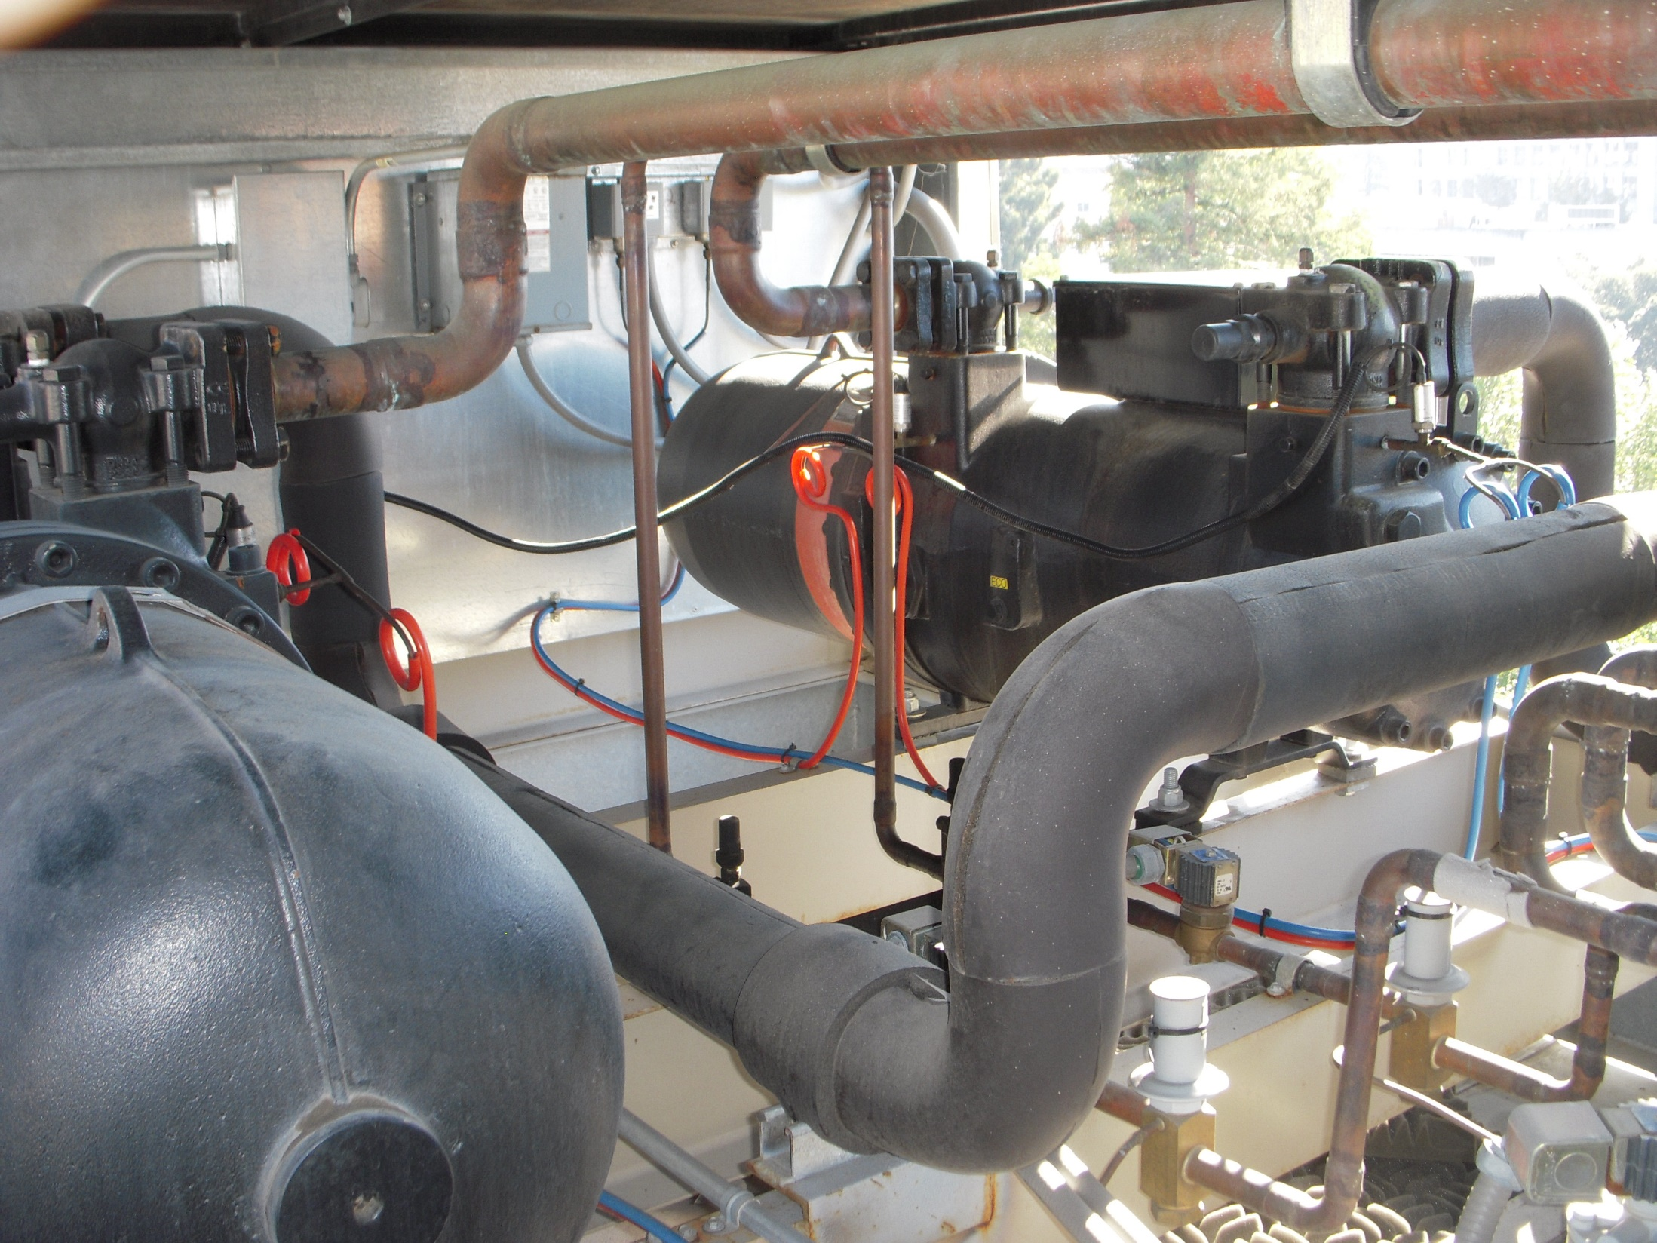
Hot Gas Lines
Compressor
Compressor
Suction Line

Slide 13
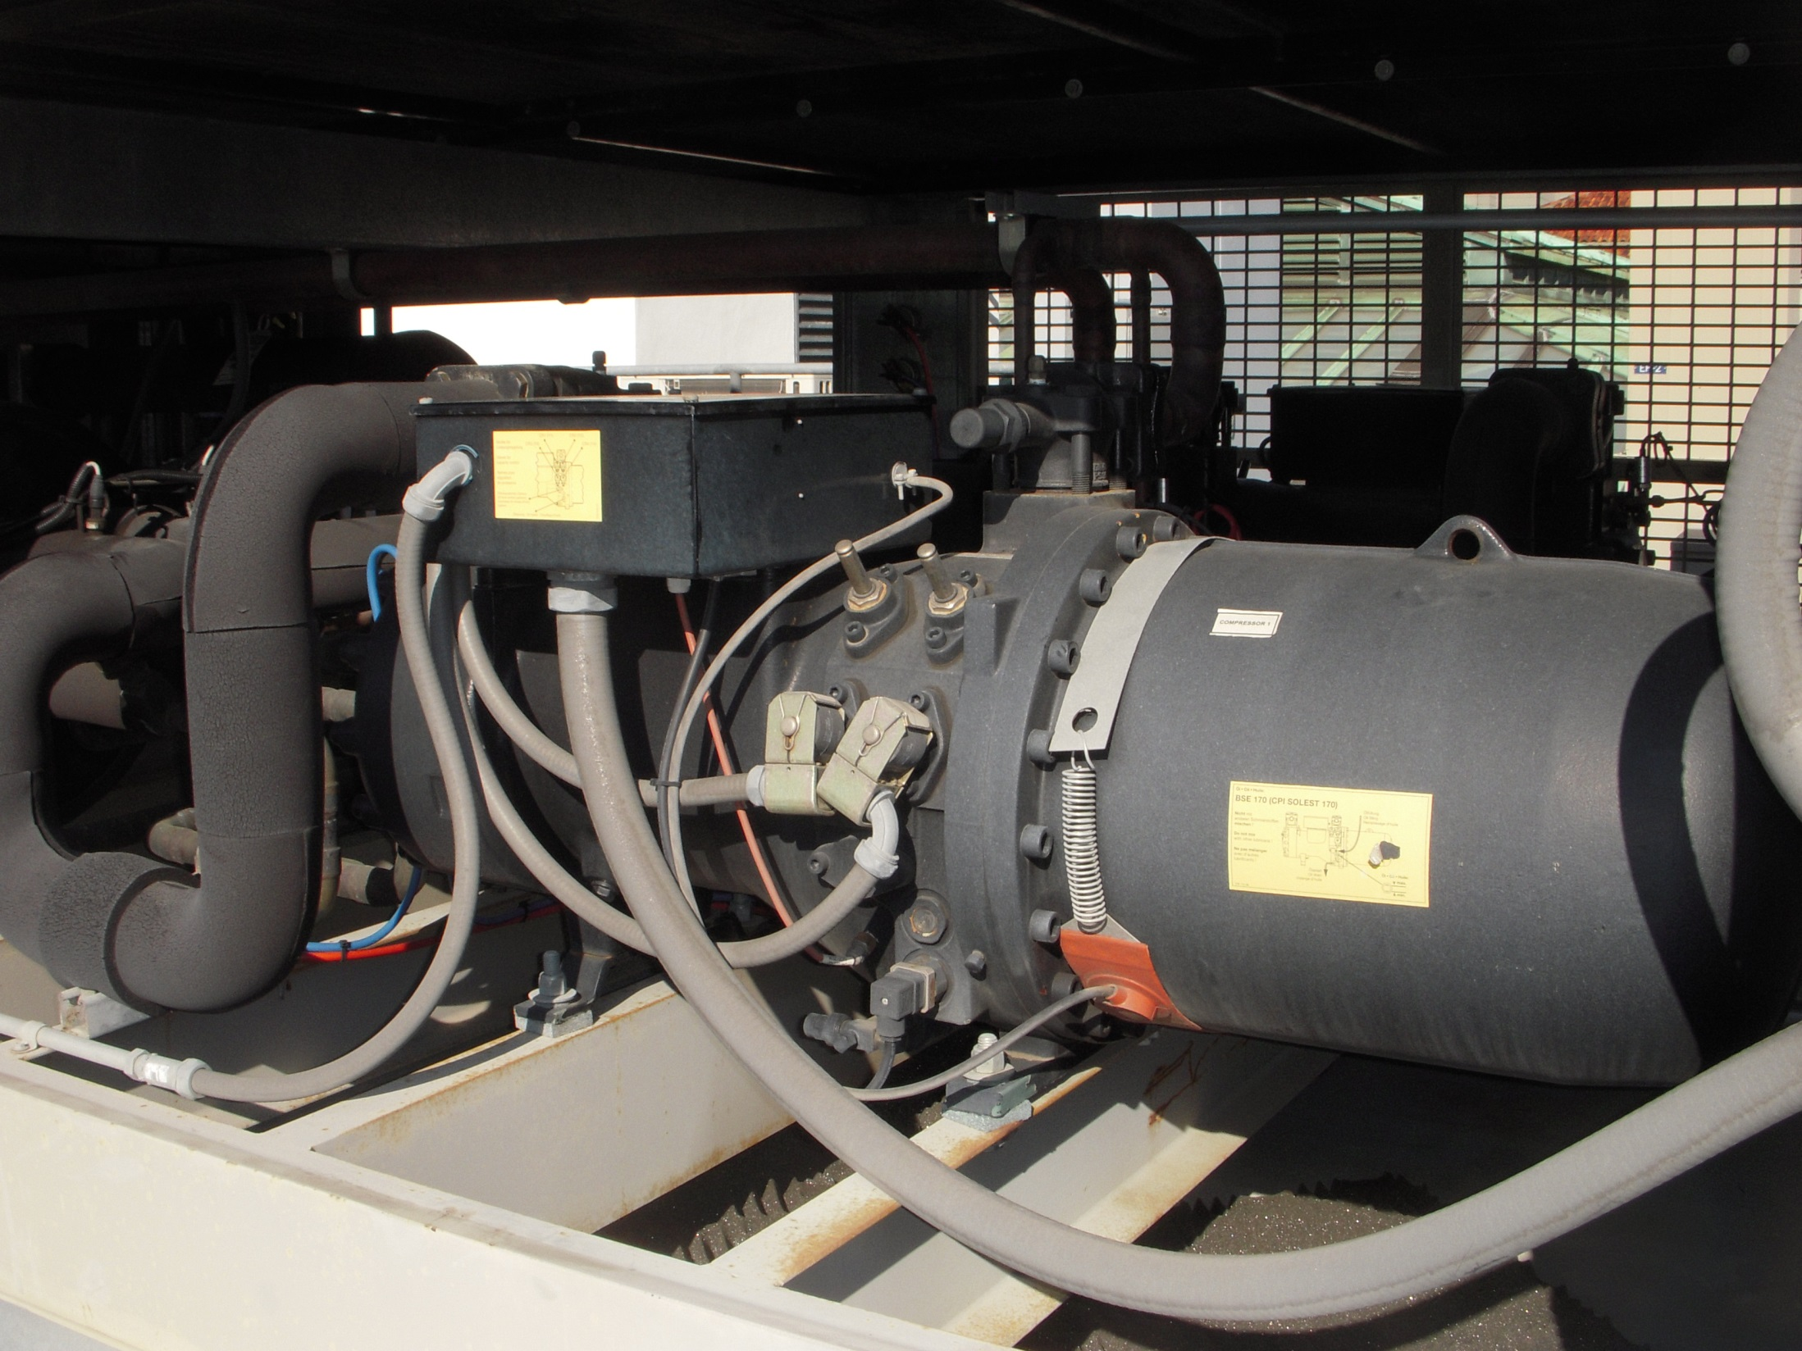
Compressor
Suction Line

Slide 14
Unloaders

Slide 15
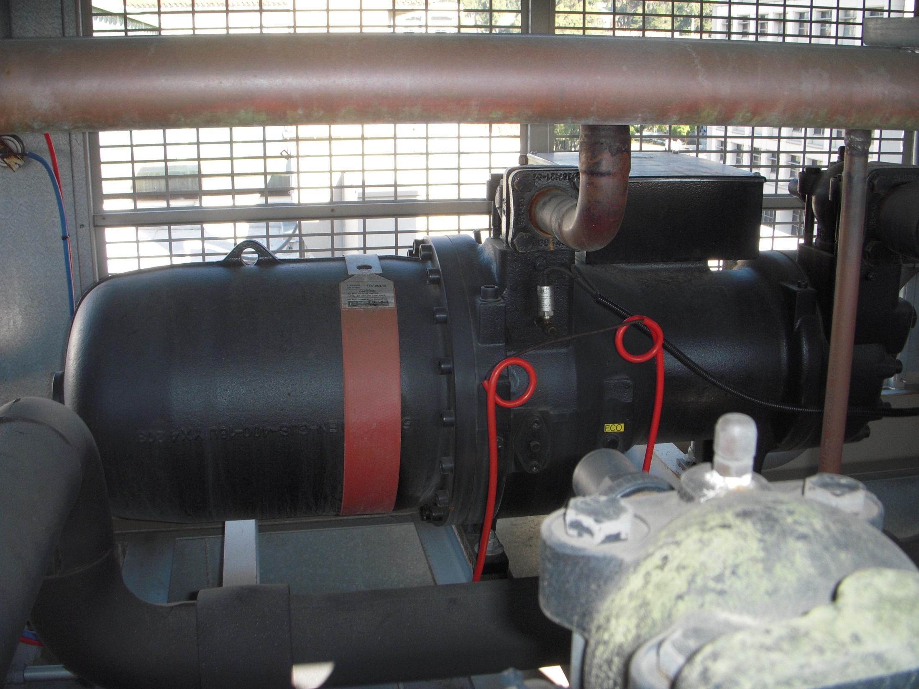
Crank Case Heater

Slide 16
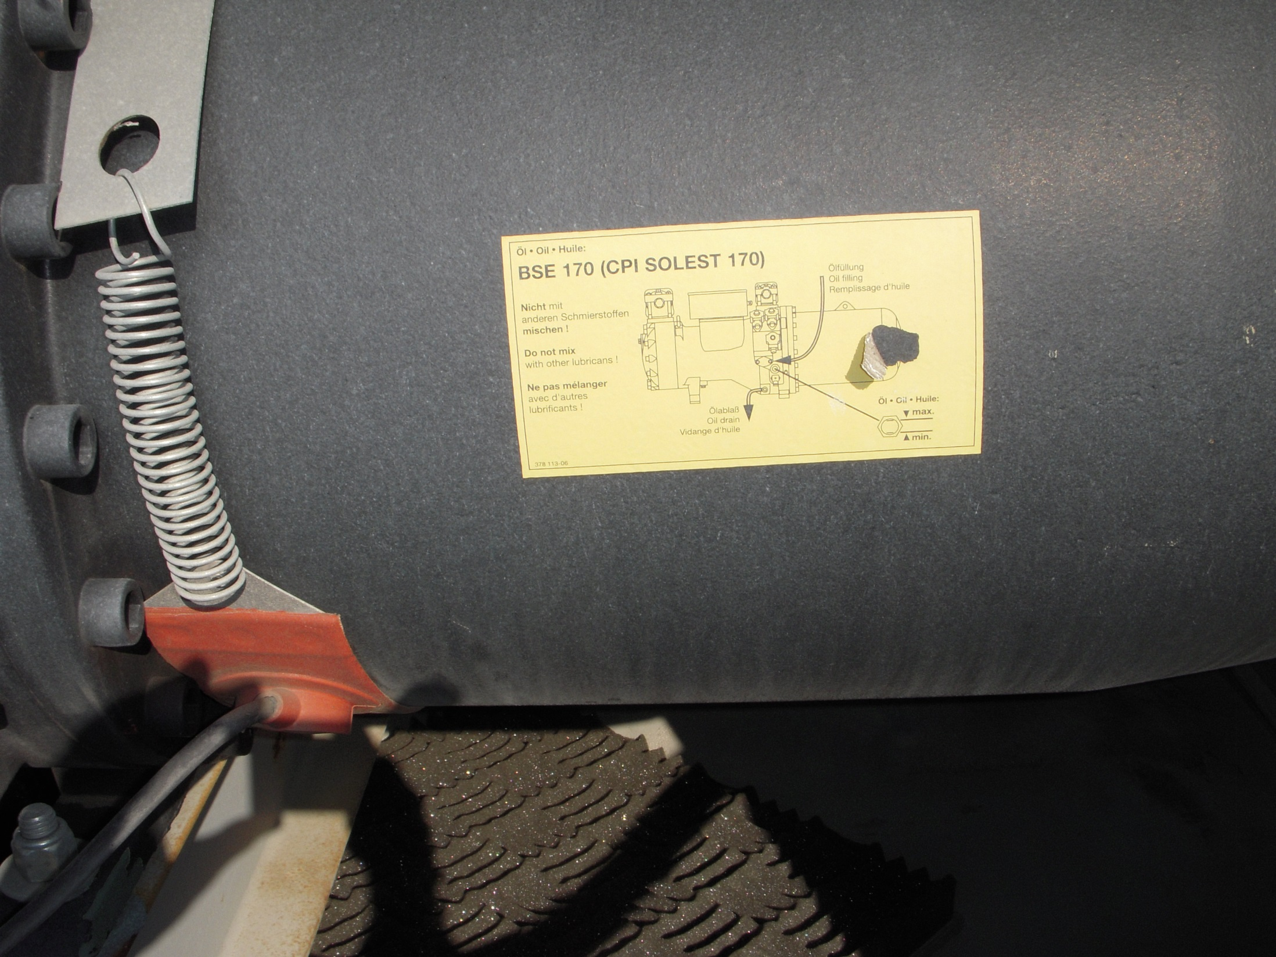
Crank Case Heater

Slide 17
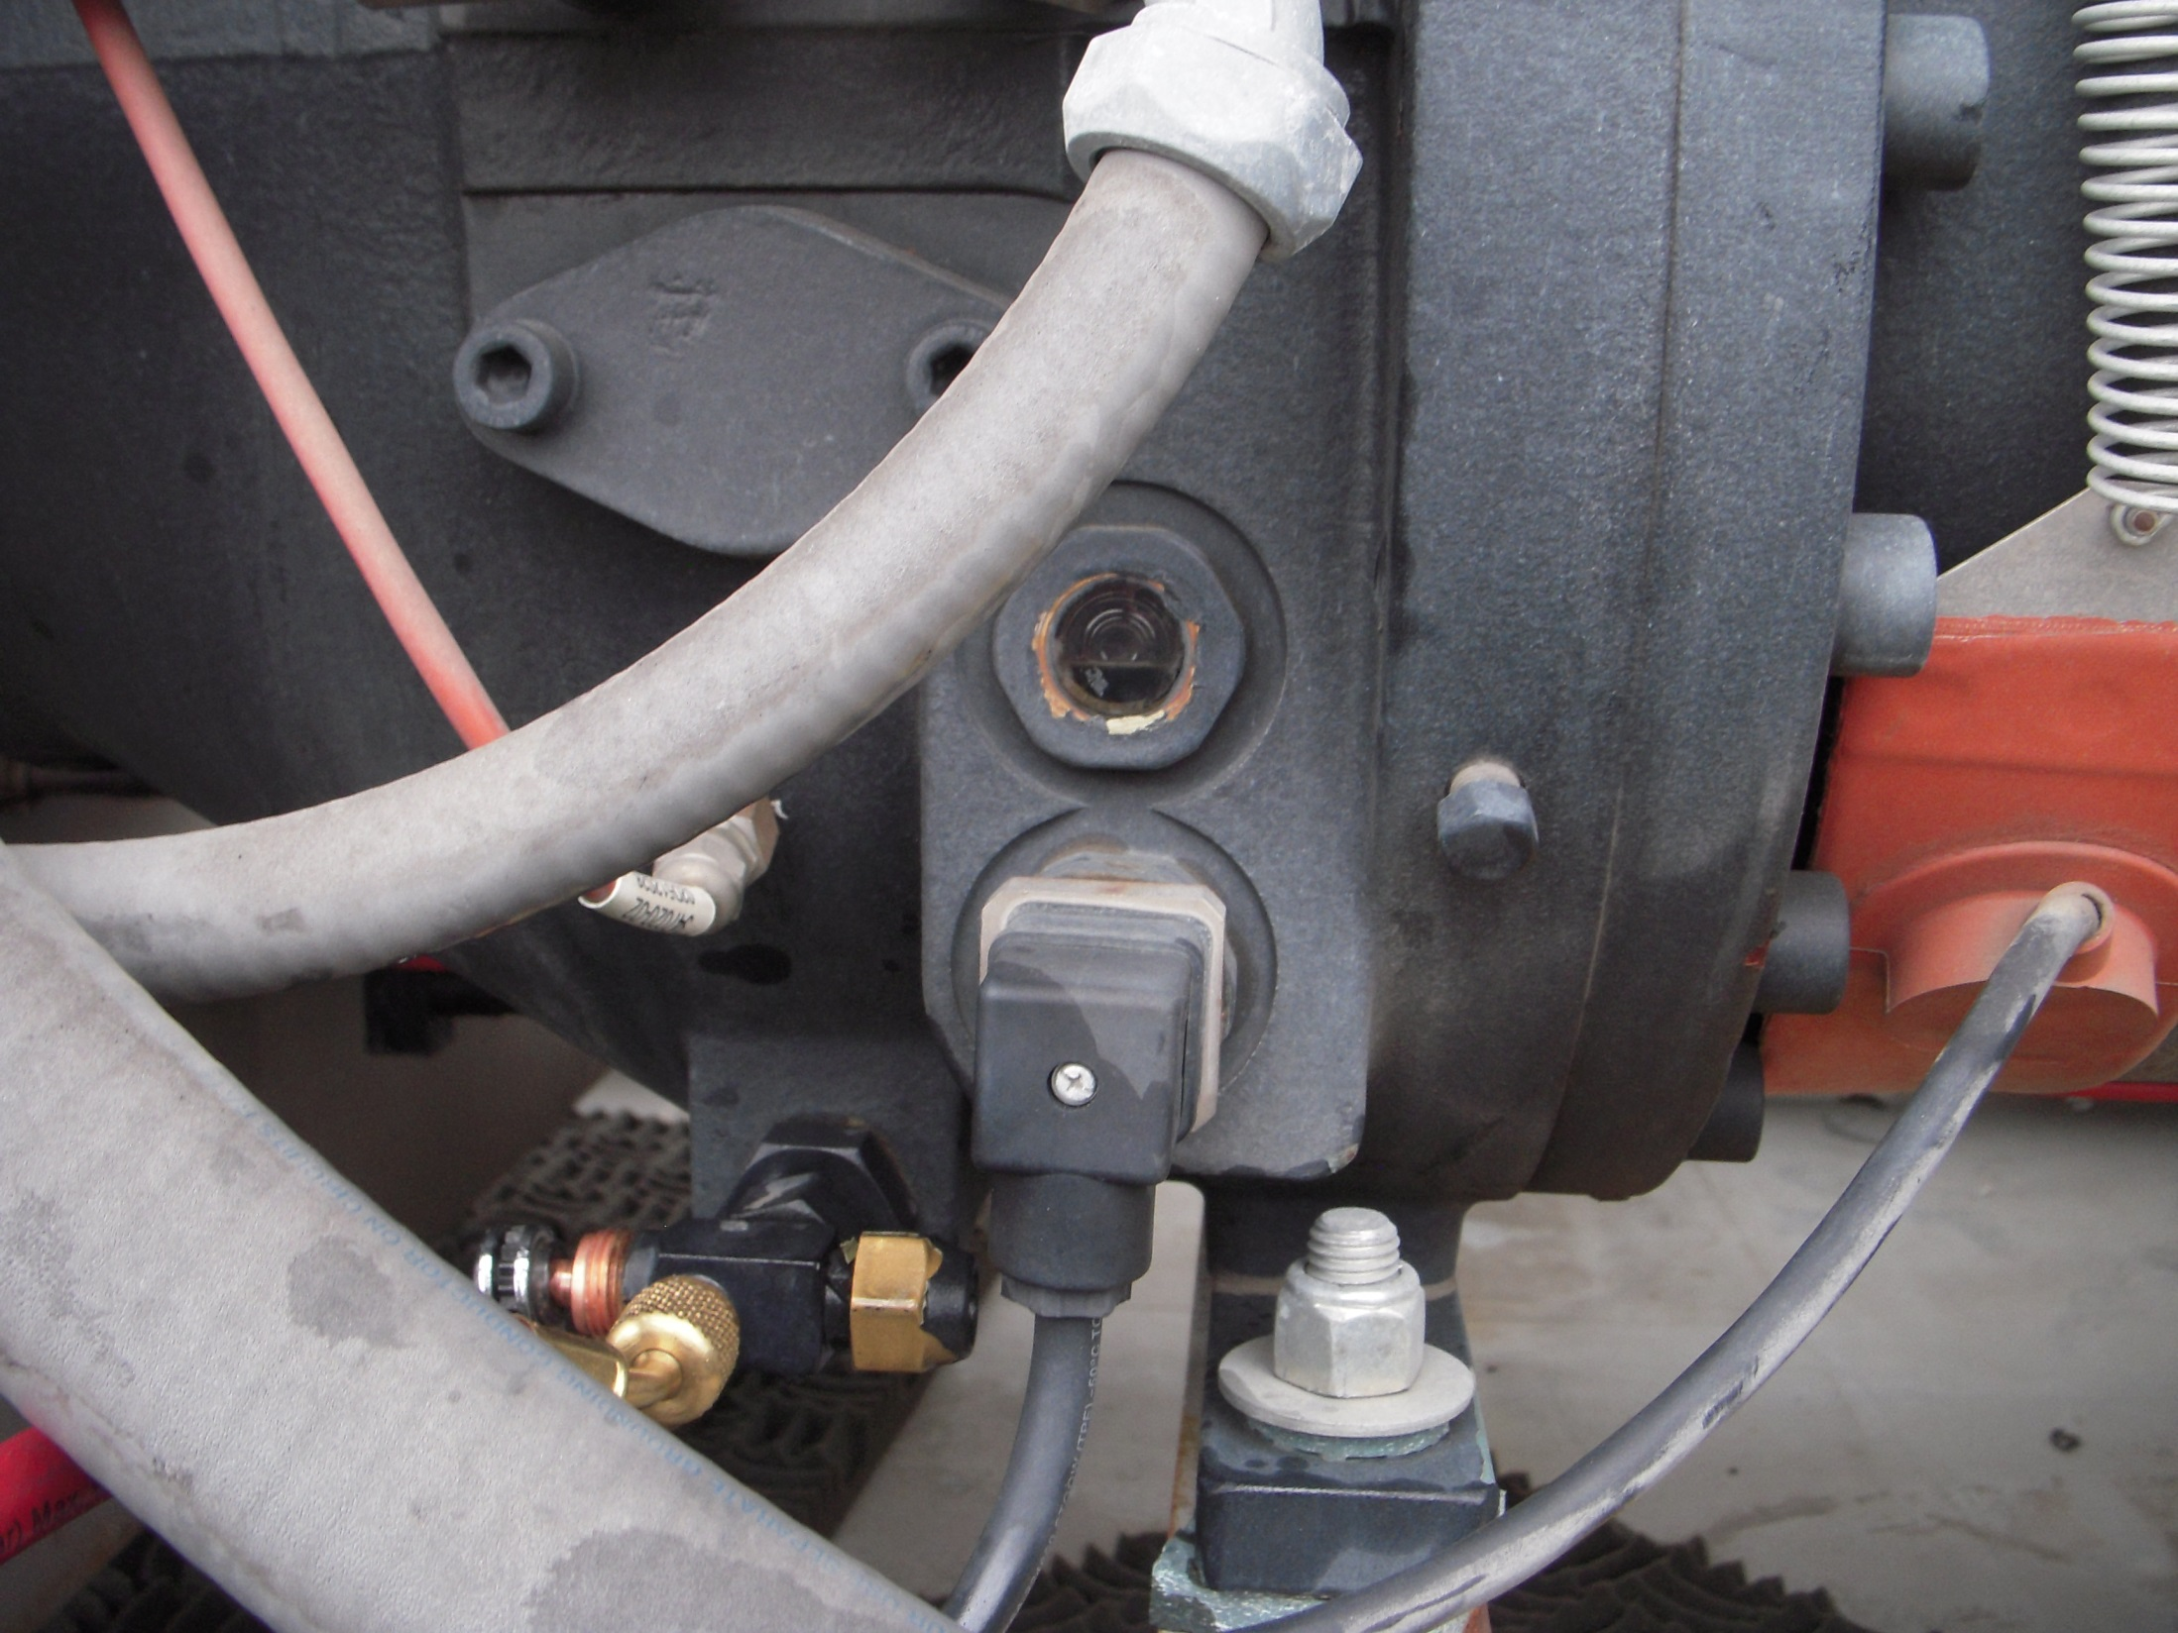
Oil Sight Glass

Slide 18
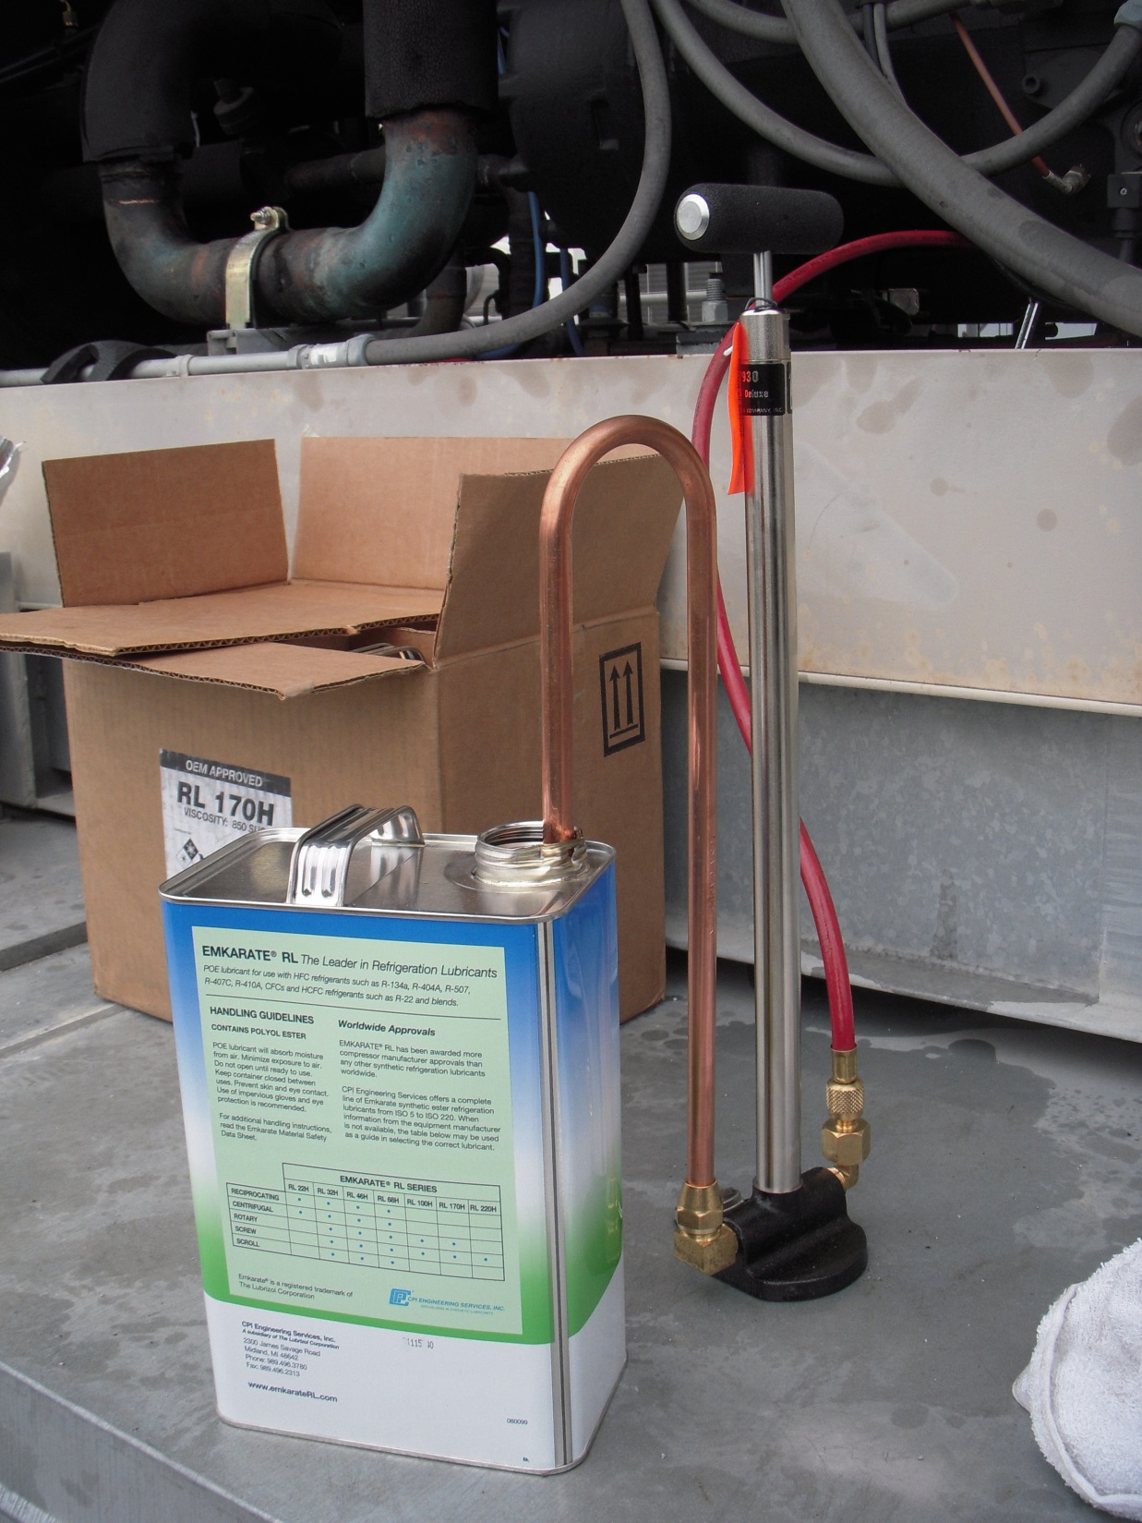
Hand Pump for Adding Oil

Slide 19
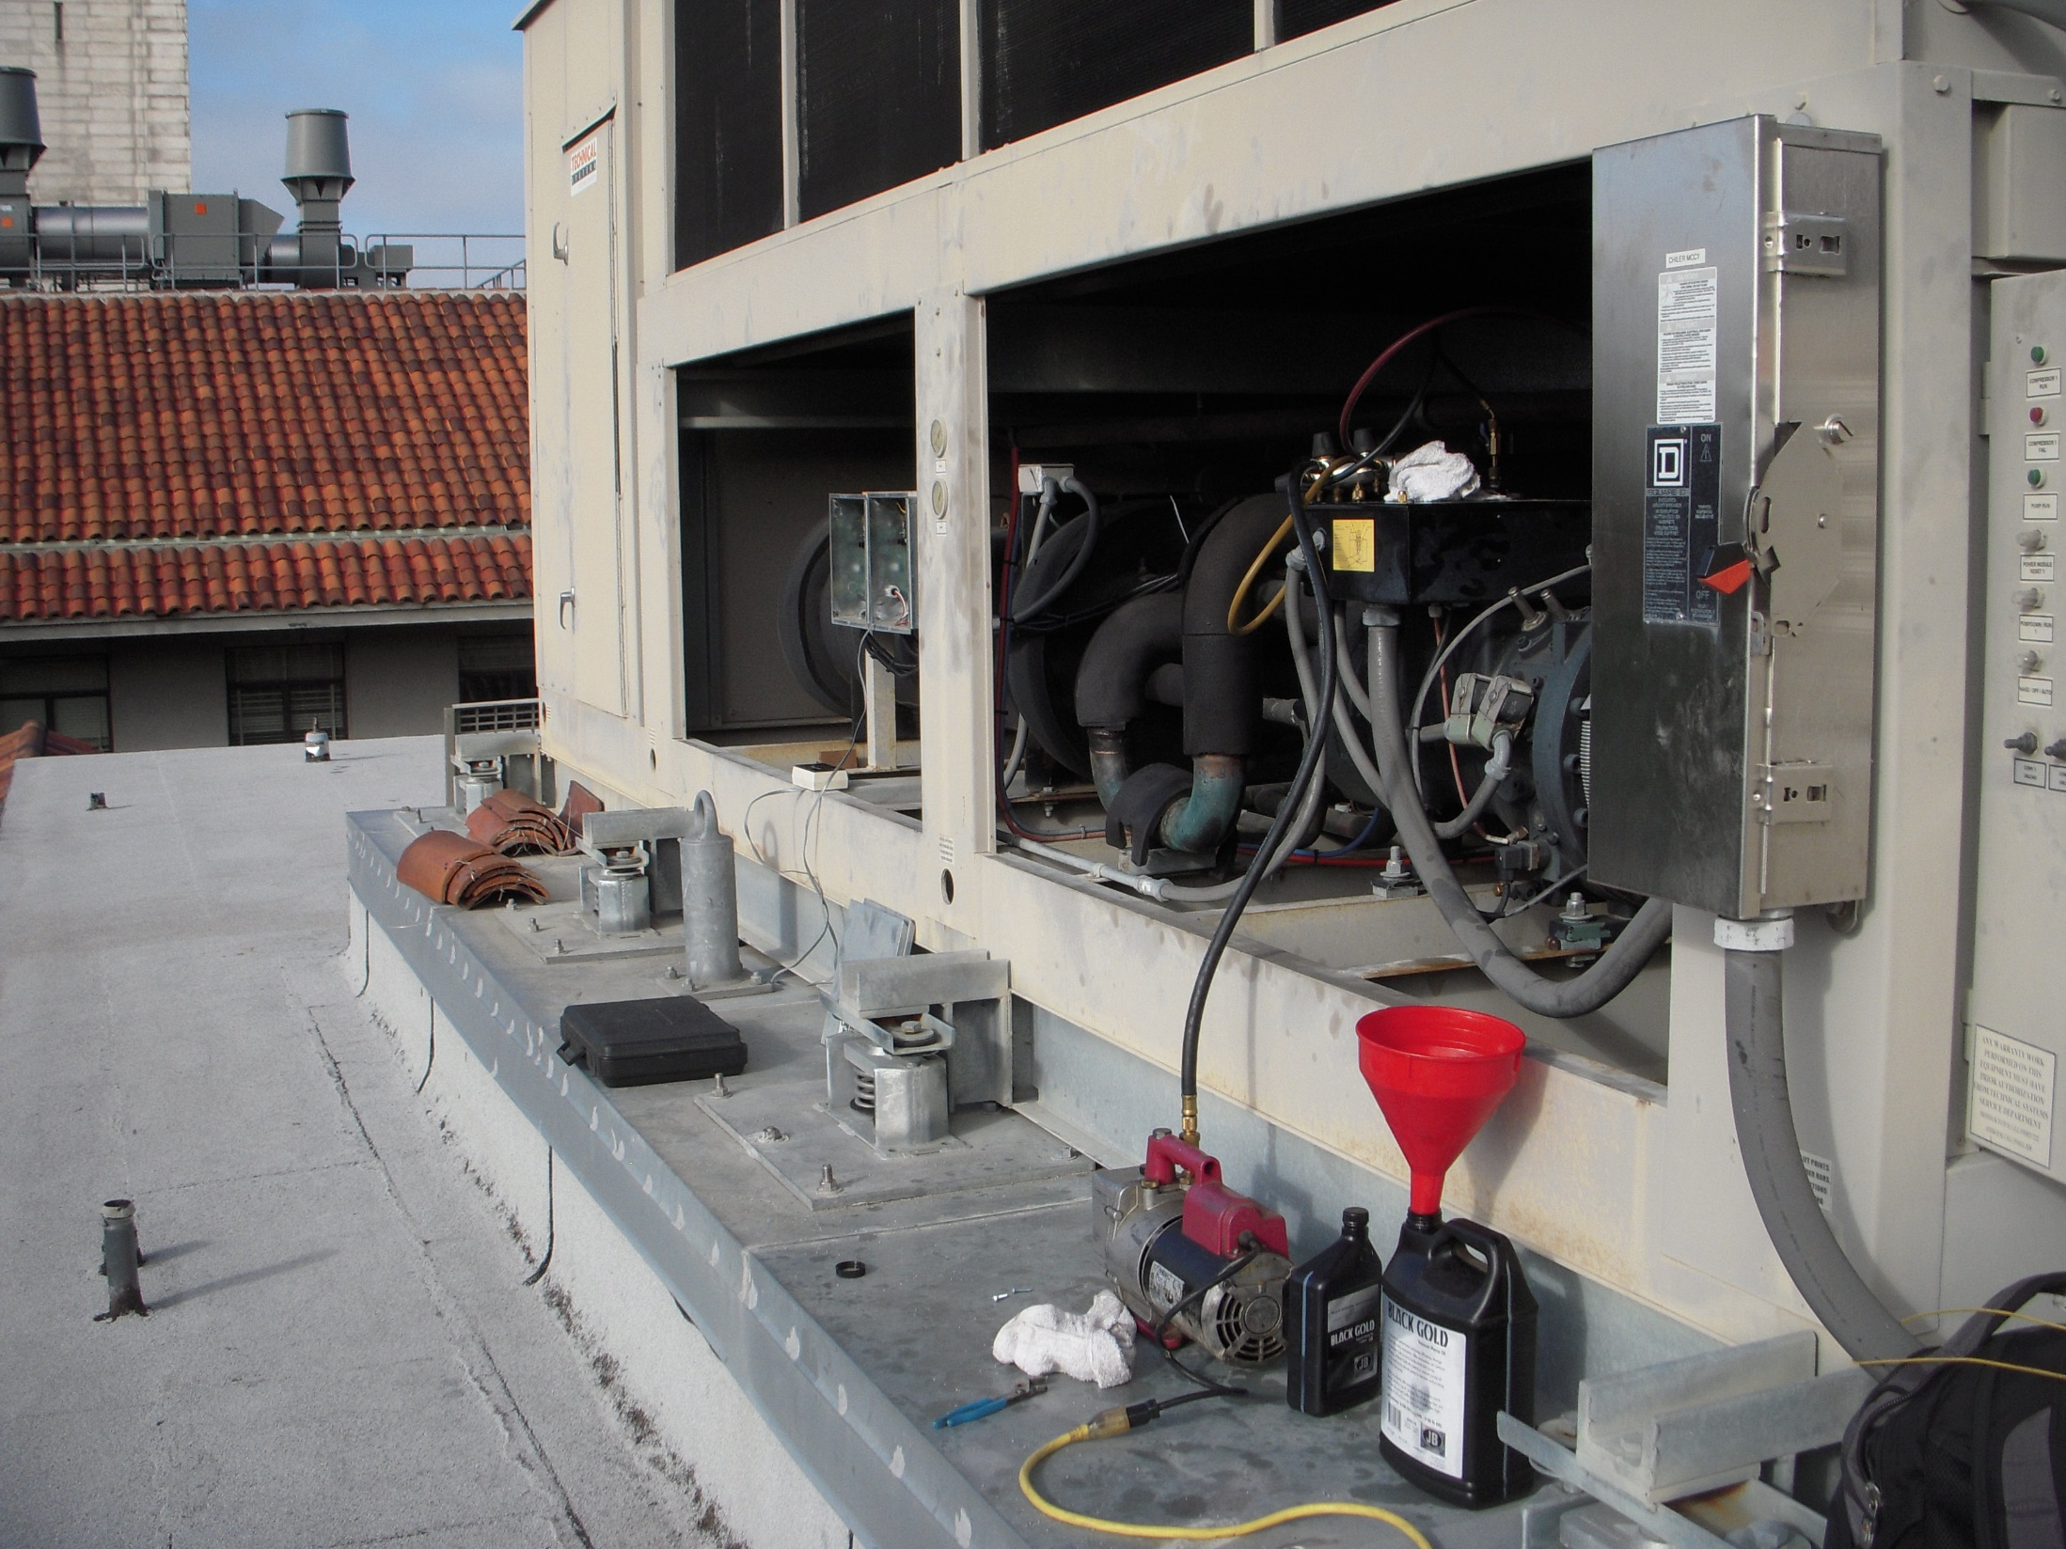
Vacuum Pump Evacuating the System in Preparation for Charging
Vacuum Pump

Slide 20
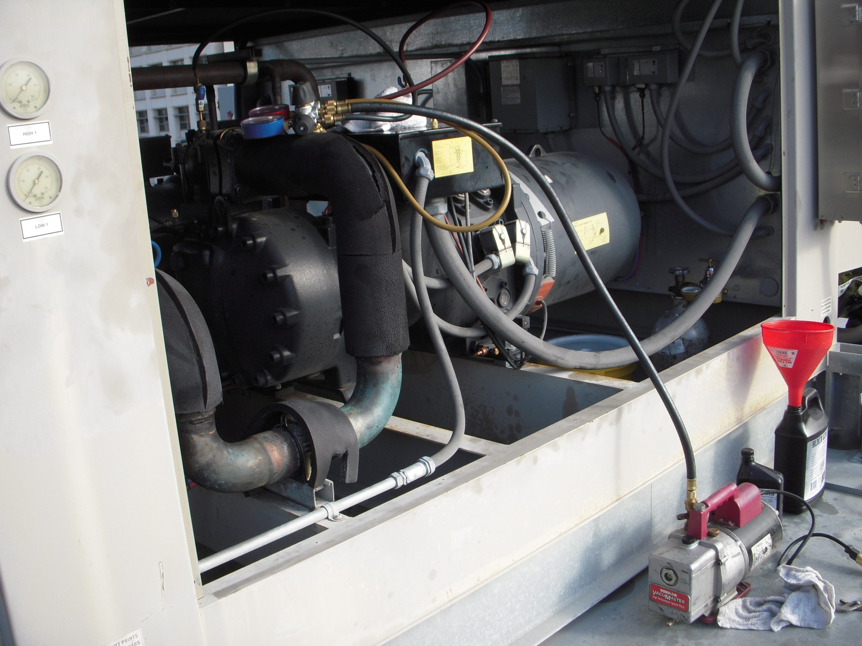

Slide 21
Condenser
Receiver
Compressor

Slide 22
Condenser

Slide 23
Condenser
Receiver
Liquid Line Solenoid Valve
Expansion Valve
Evaporator
Compressor

Slide 24
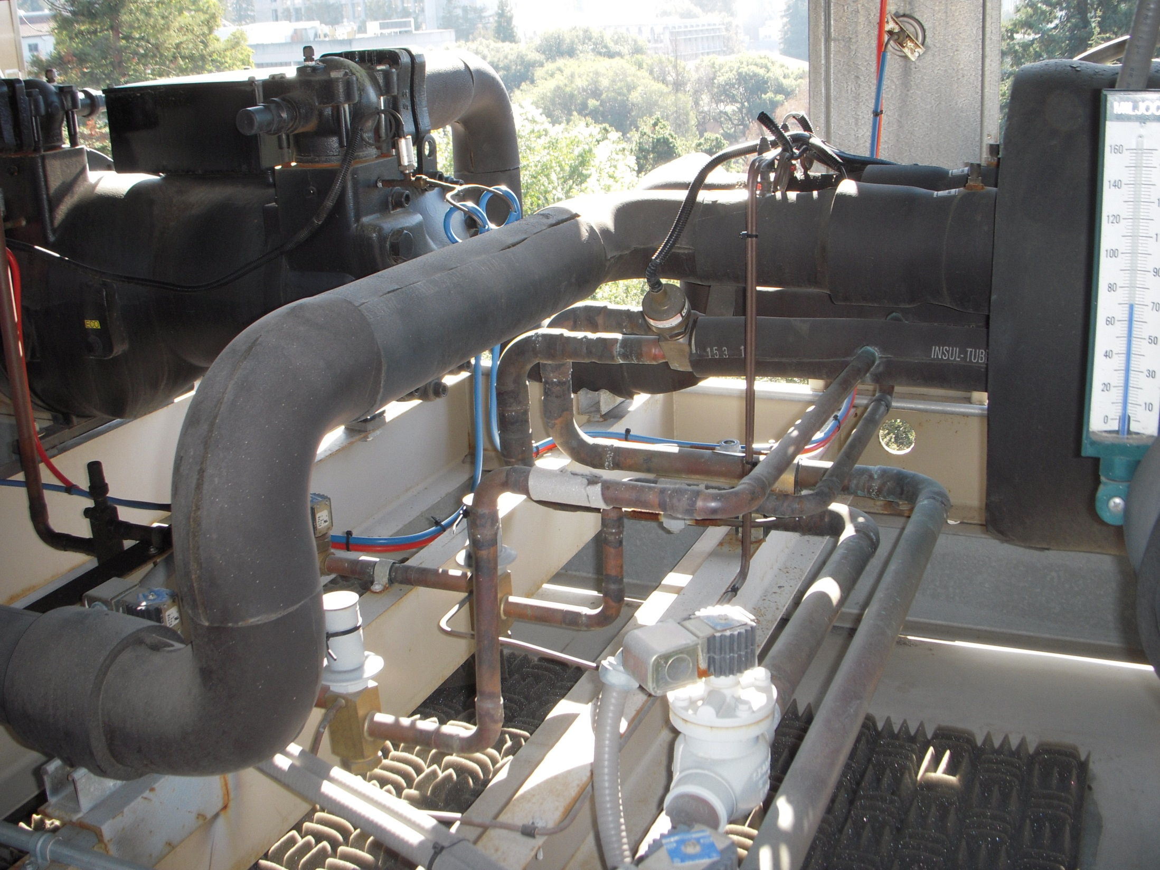
Expansion Valve
Suction Line
Liquid Line Solenoid Valve
Liquid Lines

Slide 25
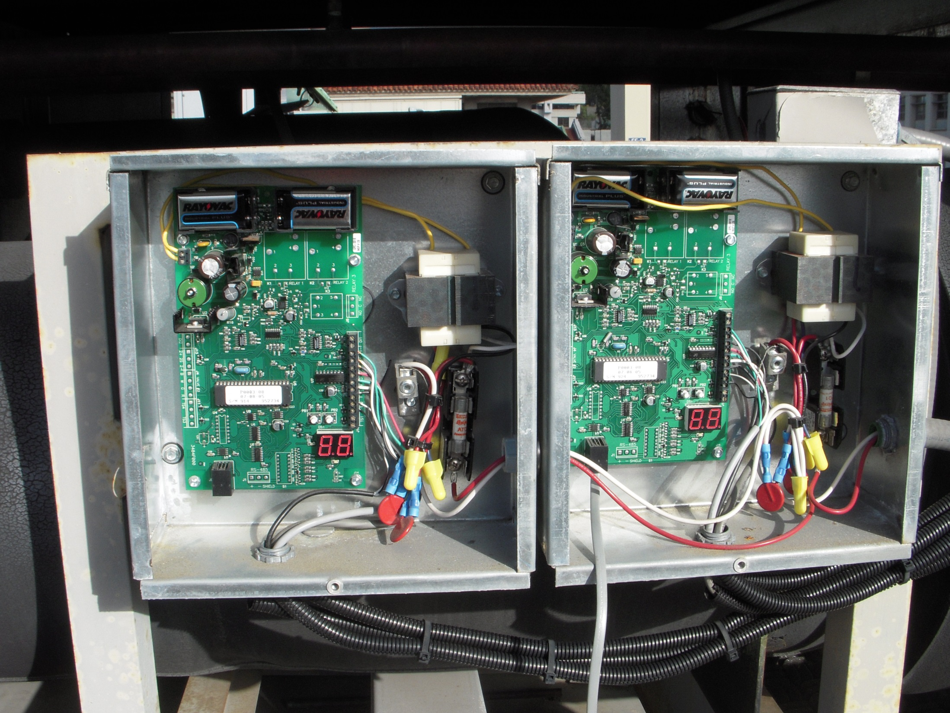
Electronic Expansion Valve Controllers

Slide 26
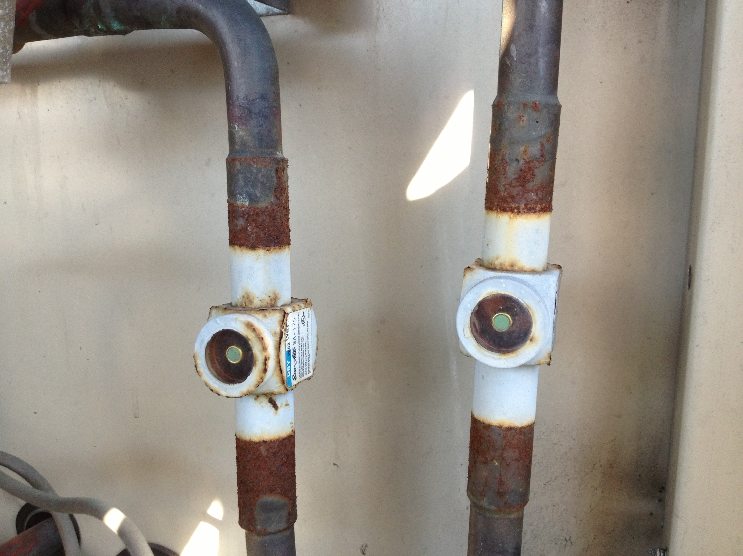
A Refrigerant Sight Glass

Slide 27
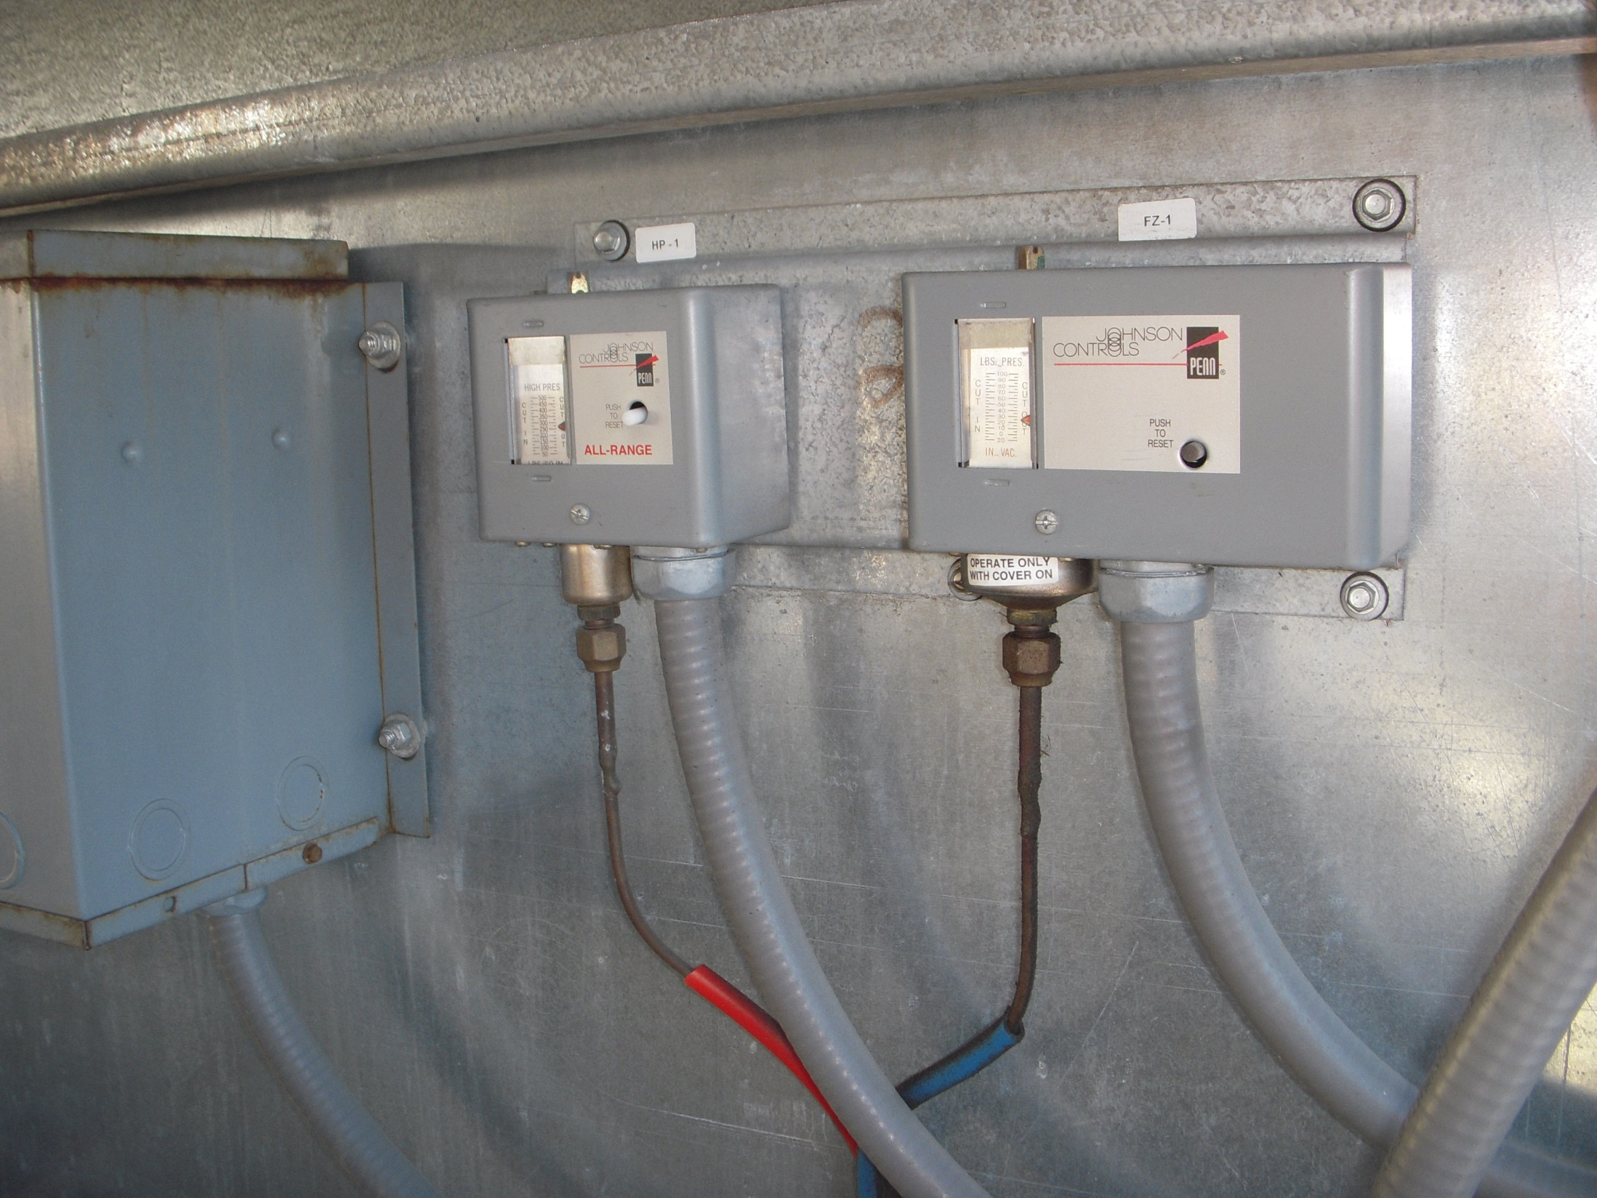
Typical Control Switches

Slide 28
Adding Hot Gas Bypass
Hot Gas Solenoid
Hot Gas Regulator

Slide 29
Hot Gas Bypass Lines
Hot Gas Solenoid Valve
Service Valve
Hot Gas Regulator

Slide 30
Hot Gas Connections to the Evaporator

