Slide 1
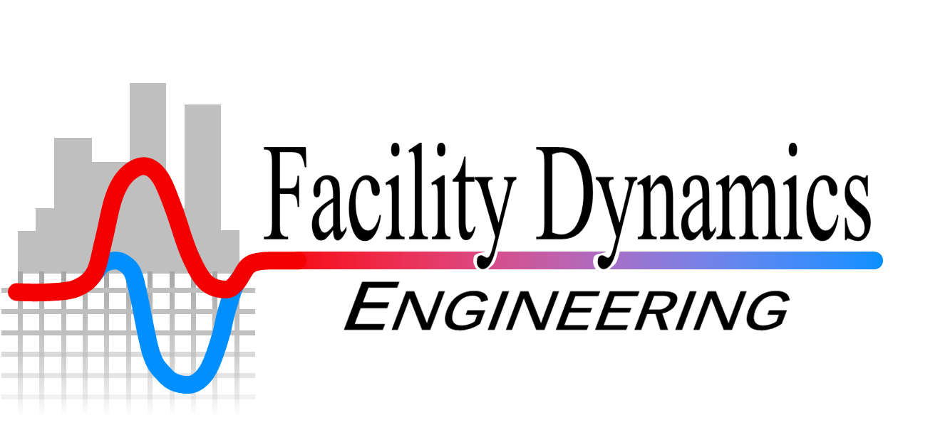
Existing Building Commissioning Workshop:
Series 17, 2022-08-11
Energy Calculations Support
Presented By:
David Sellers
Senior Engineer, Facility Dynamics Engineering

Slide 2
Evaporator Pump Optimization Options

Slide 4
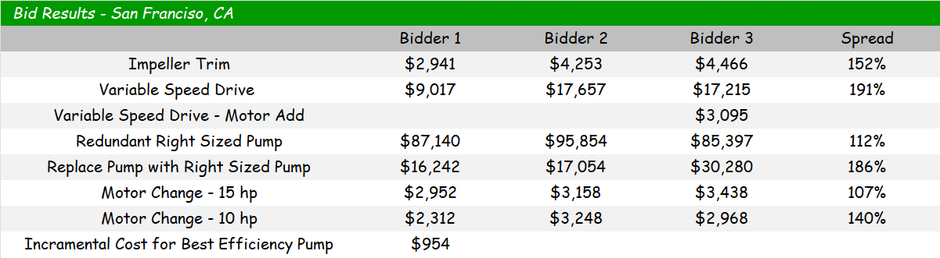
Bid Results Summary

Slide 6
Bid Results Summary for Different Locations

Slide 7
Owner Type 1 Financial Perspective
Investment fund for a teachers union retirement fund - 5 year simple payback window, in-house control work capabilities

Slide 8
Owner Type 2 Financial Perspective
Real Estate investment portfolio - 2 year simple payback window, all modification work is out of house

Slide 9
Owner Type 3 Financial Perspective
Personal investment, 8 year simple payback window for central plant equipment, all modification work is out of house

Slide 10
Owner Type 4 Financial Perspective
Personal investment, 10 year simple payback window for central plant equipment. Capital Budget has upcoming projects to add redundant evaporator, condenser and distribution chilled water pumps - same make and model as existing - this year and redundant chiller and cooling tower next year

Slide 11
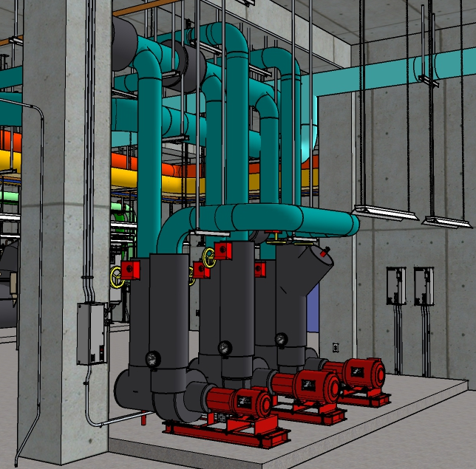
Other Opportunities/Issues in the Plant
Chillers are staged for equal run time rather than optimizing the sequence to leverage the different chiller characteristics
  Potential to improve over-all efficiency
  Potential to reduce chiller wear and tear
The second evaporator pump runs a significant number of hours
  Potential to save additional energy by optimizing the second pump
  Wide open triple duty valve still has a significant pressure drop
Triple duty valves require a plant outage to repair the seat
From the Owner’s perspective, the plant is mission critical
  The additional pump provides redundancy but how should it be achieved?
  How can the impact of the installation on day-to-day operations be minimized?

Slide 12
These Things Won’t Just Happen
What should the project look like?
How should the pump piping be configured?
How should the pump be sequenced with the other equipment in the plant?
What other improvements should be included?
How should the work be sequenced?

Slide 13
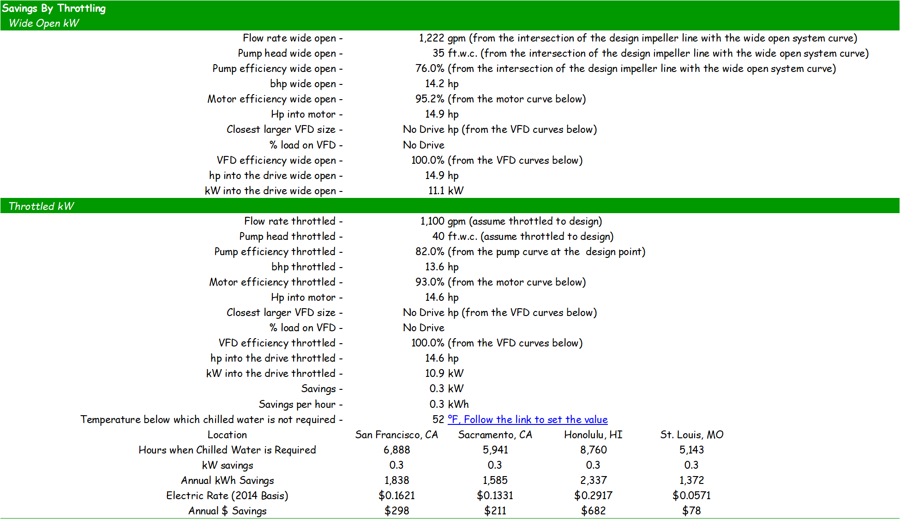
Developing a Scope of Work
What are the performance characteristics I am looking for?
How should the piping be configured?
How should it be controlled?
Are there details of the installation that are important to me?
How will I verify that I got what I paid for?
Are there and corporate contracting requirements that the bidders need to be aware of?
Specifications
System Diagram
Point List and Narrative Sequence
Specifications and Diagrams
Commissioning
Owner Contracting Requirements

