Slide 1

Existing Building Commissioning Workshop:
Series 17, 2022-03-10
Economizer Logic Exercise
Presented By:
David Sellers
Senior Engineer, Facility Dynamics Engineering

Slide 2
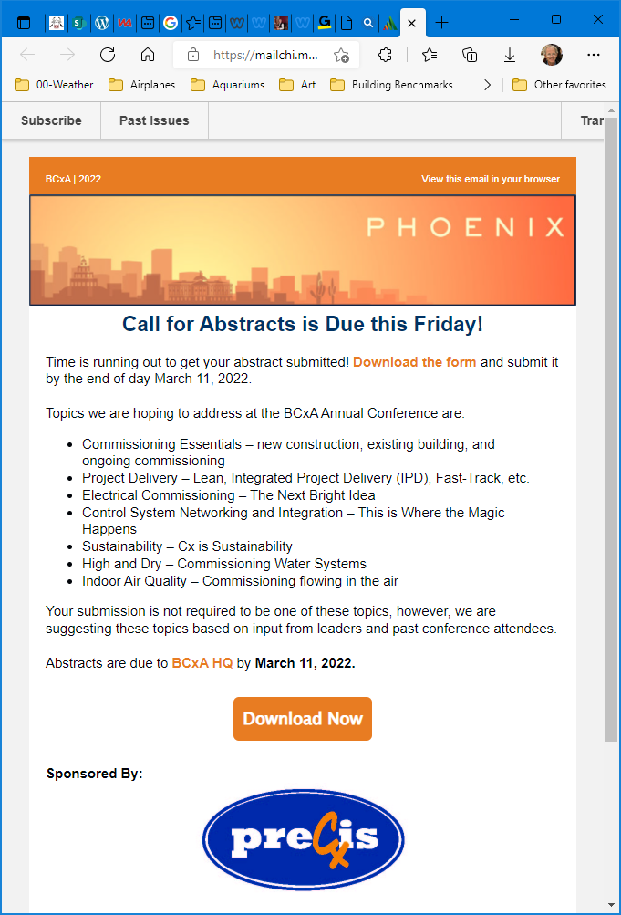
Commissioning Conference
Call for papers is still open
  https://www.bcxa.org/conference/

Slide 3
Logic and Field Conditions are Related
Good hardware and system configurations must be supported by sound logic
Sound logic must be supported by good hardware and appropriate system configurations
In other words
GIGO
and for a feedback control process GOGI

Slide 4
Perfect Economizer Attributes
Primarily Hardware/ Configuration Based
Primarily Logic Based
Accurate Temperature Sensing
Accurate Outdoor Air Flow Sensing
Relative Calibration
Good Mixing
Integration with Other HVAC Processes
  Minimum Outdoor Air Regulation
  Preheat
  Heating/Humidification
  mechanical cooling/dehumidification
  Schedules
  Warm-up/Cool-down
Integration with the Loads and Climate

Slide 5
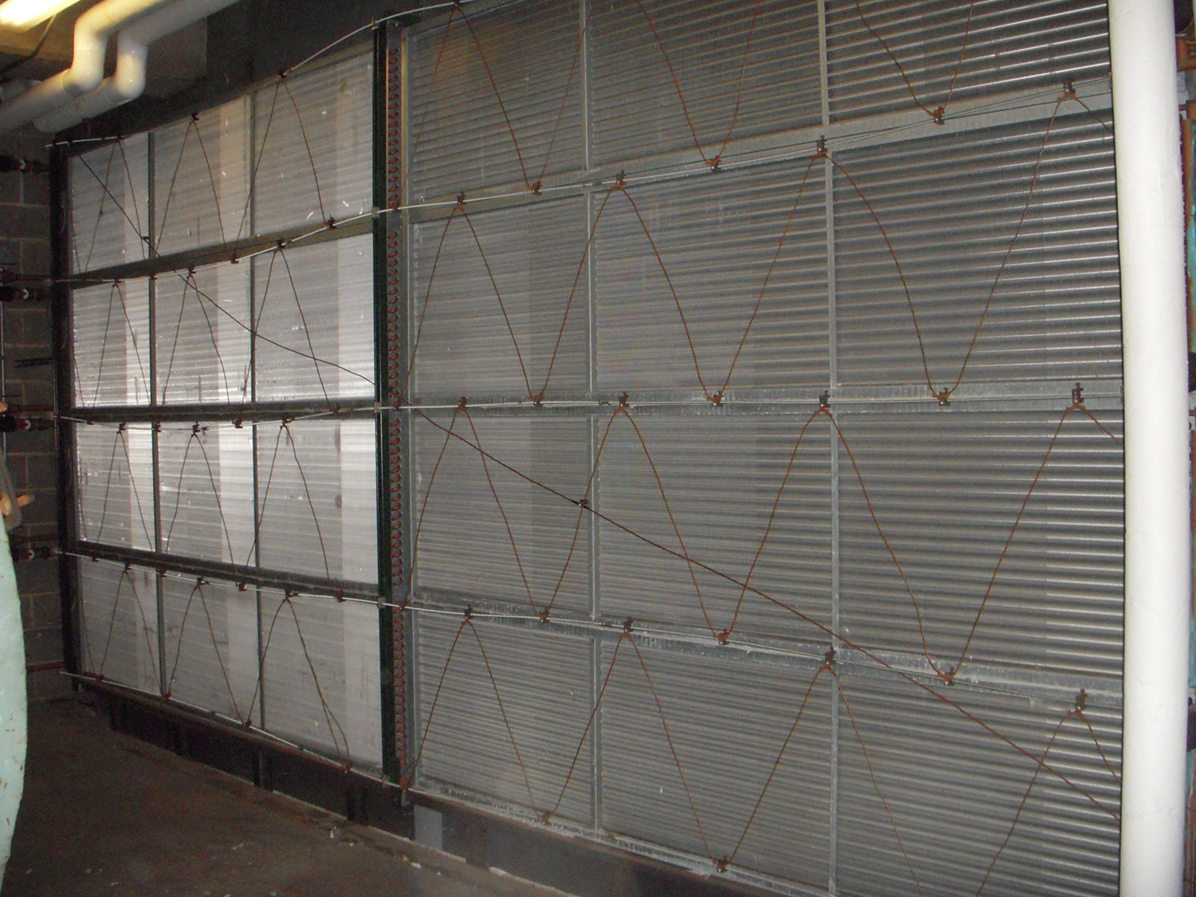
Focusing on Accurate Temperature Sensing

Slide 6
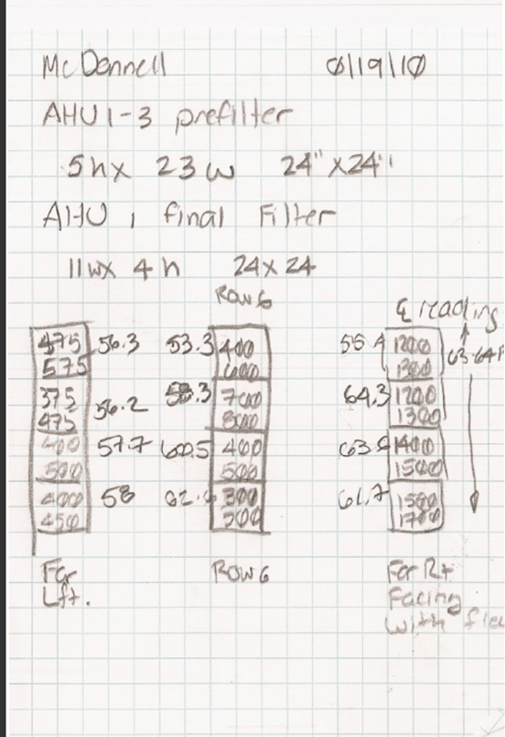
Freezestat Sensing Element (Typical of 8)
Return Air
Averaging Temperature Sensor Sensing Element
Leaving Side of Preheat Coil
Temperature and Velocity Measurements at the Filter Bank on the Entering Side of the Coil

Slide 7
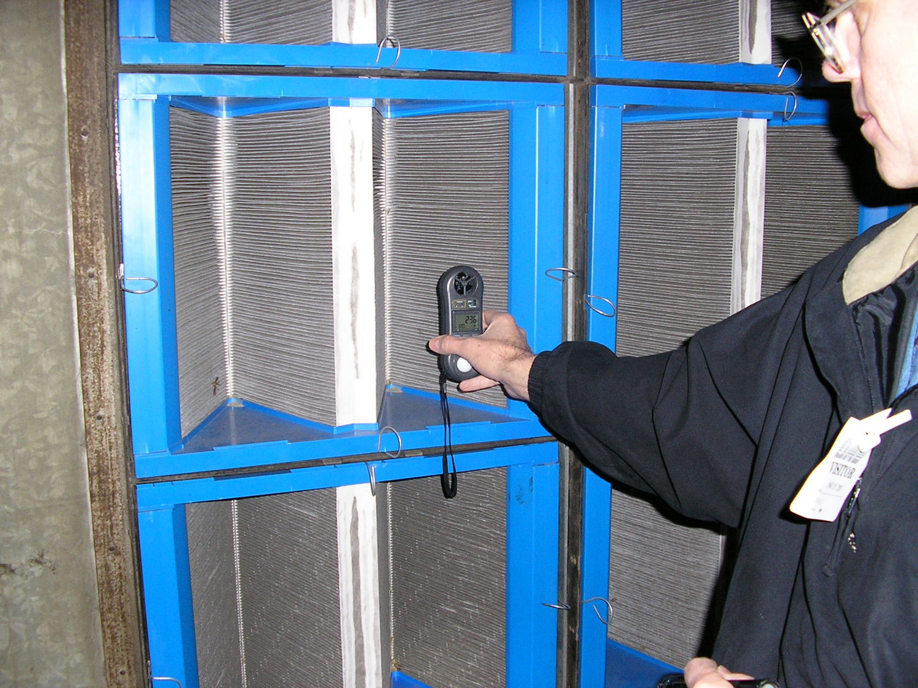

Slide 9
55-57°F, 475 – 575 fpm
Freezestat Sensing Element (Typical of 8)
Return Air
60-62°F, 1,400 – 1,500 fpm
Averaging Temperature Sensor Sensing Element
Leaving Side of Preheat Coil
Temperature and Velocity Measurements at the Filter Bank on the Entering Side of the Coil

Slide 10
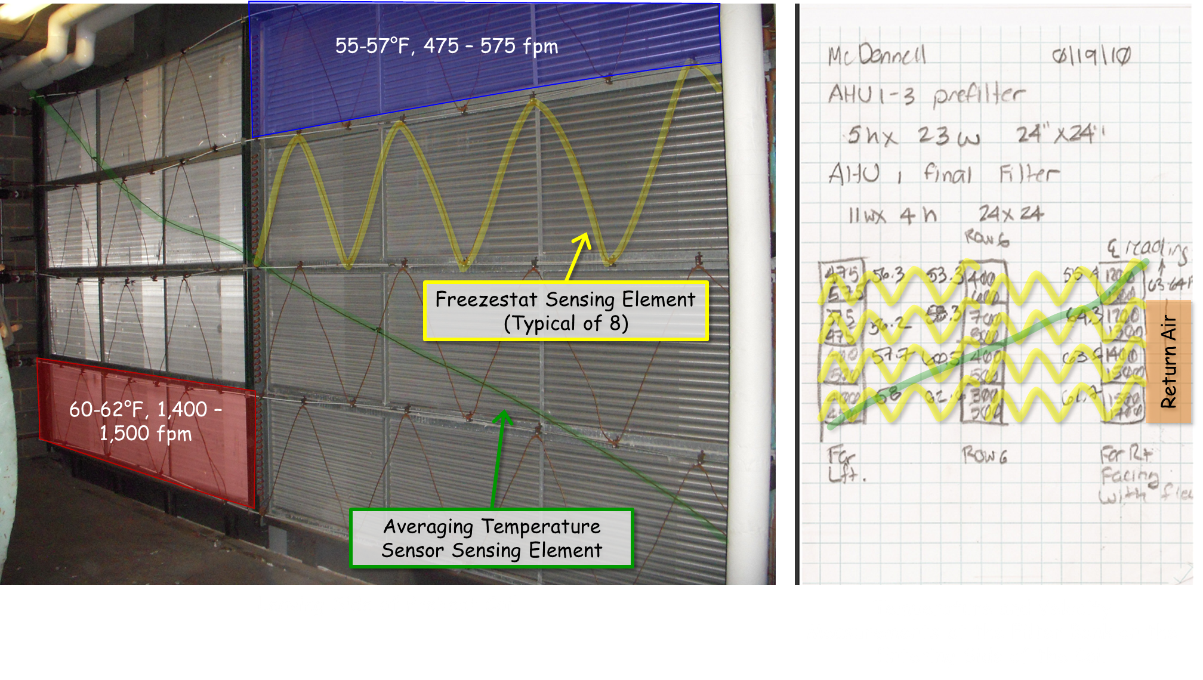
Focusing on Accurate Temperature Sensing

Slide 11
Focusing on Accurate Temperature Sensing
The average of the MAT measurements was 57.4F
The mass-weighted MAT (i.e. the true average) was 58.3°F
The control system “thought” the temperature was 54.6
The average temperature “seen” by the averaging was 56.5°F
The weighted average temperature “seen” by the averaging sensor was 56.2°F

Slide 12
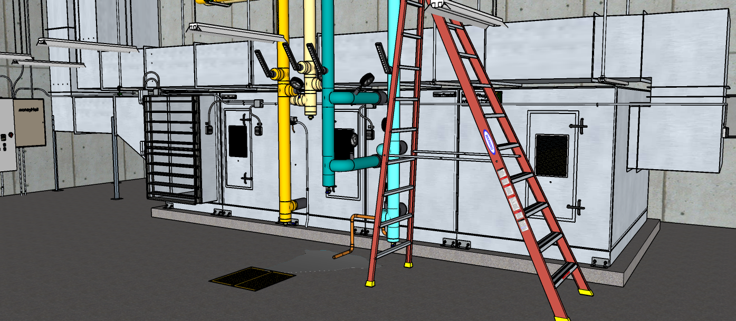
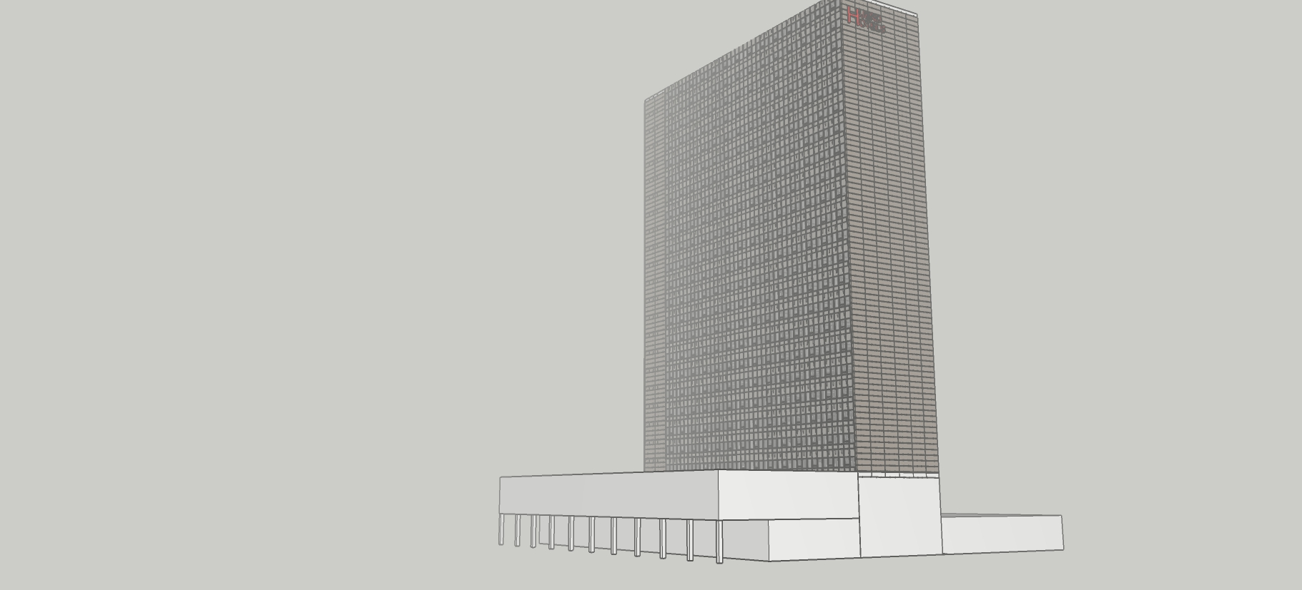
Let’s Look at How the Ball Room AHU Does in this Department

Slide 13
Current Conditions

Slide 14
Current Conditions
Foggy
Furnace running at home when you left
Low 50’s °F through early afternoon, then clearing and sunny with a high of 68-70°F anticipated
Hotel at 84% occupancy
Major conference happening
  Main ball room in use
  Meeting rooms and Junior Ball Room in use
  Spaces under control at design target of 72°F/50% RH
  Ballroom MOA settings recently verified at 25%

Slide 16
Now, Lets Focus on Logic (and its Integration with Hardware and Configuration)

Slide 17
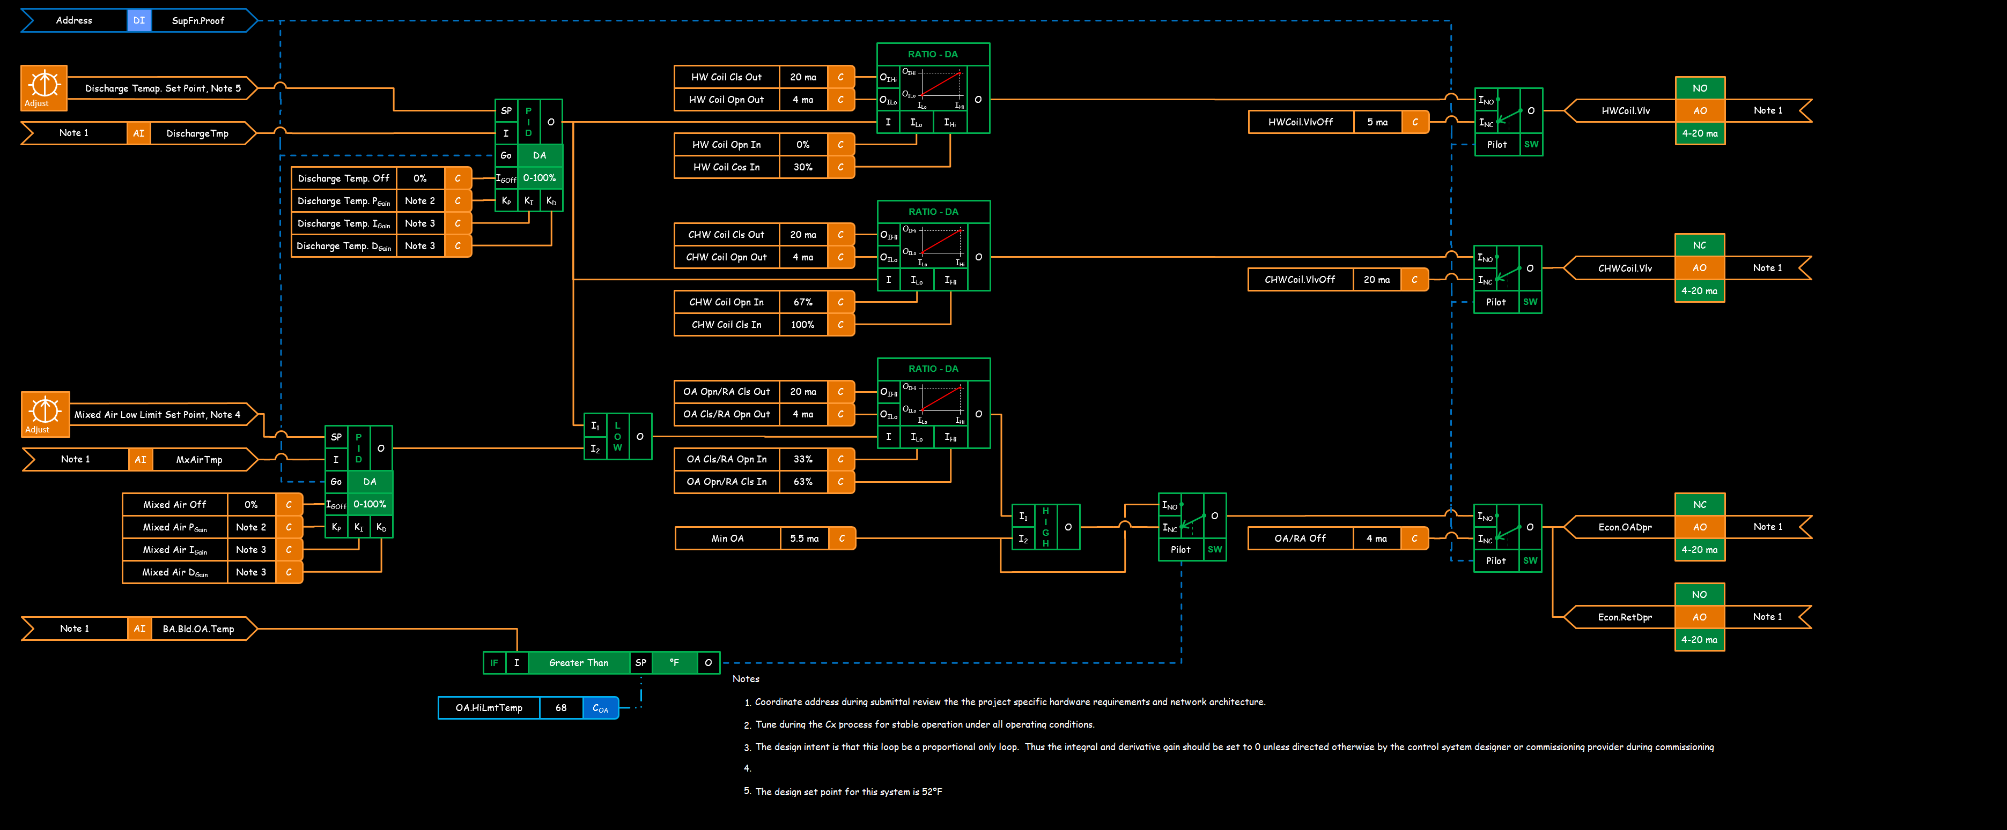
Break-out 01

Slide 18
Break-out 01
Focus on this portion of the logic

Slide 19
Break-out 01
Focus on this portion of the logic
How does it work?
Why is it needed?
For the Ball Room AHU, is the input information valid?

Slide 20
Break-out 01 - Discussion
Focus on this portion of the logic
How does it work?
Why is it needed?
For the Ball Room AHU, is the input information valid?
If there are issues:
  What are the operational implications?
  What are the energy efficiency implications

Slide 21
Break-out 02
Focus on this portion of the logic

Slide 22
Break-out 02
Focus on this portion of the logic
How does it work?
Do you think the set point is correct?
  Why or why not?
  What functional tests could you do to verify it?

Slide 23
Break-out 02 Discussion
Focus on this portion of the logic
How does it work?
Do you think the set point is correct?
  Why or why not?
  What functional tests could you do to verify it?

Slide 24
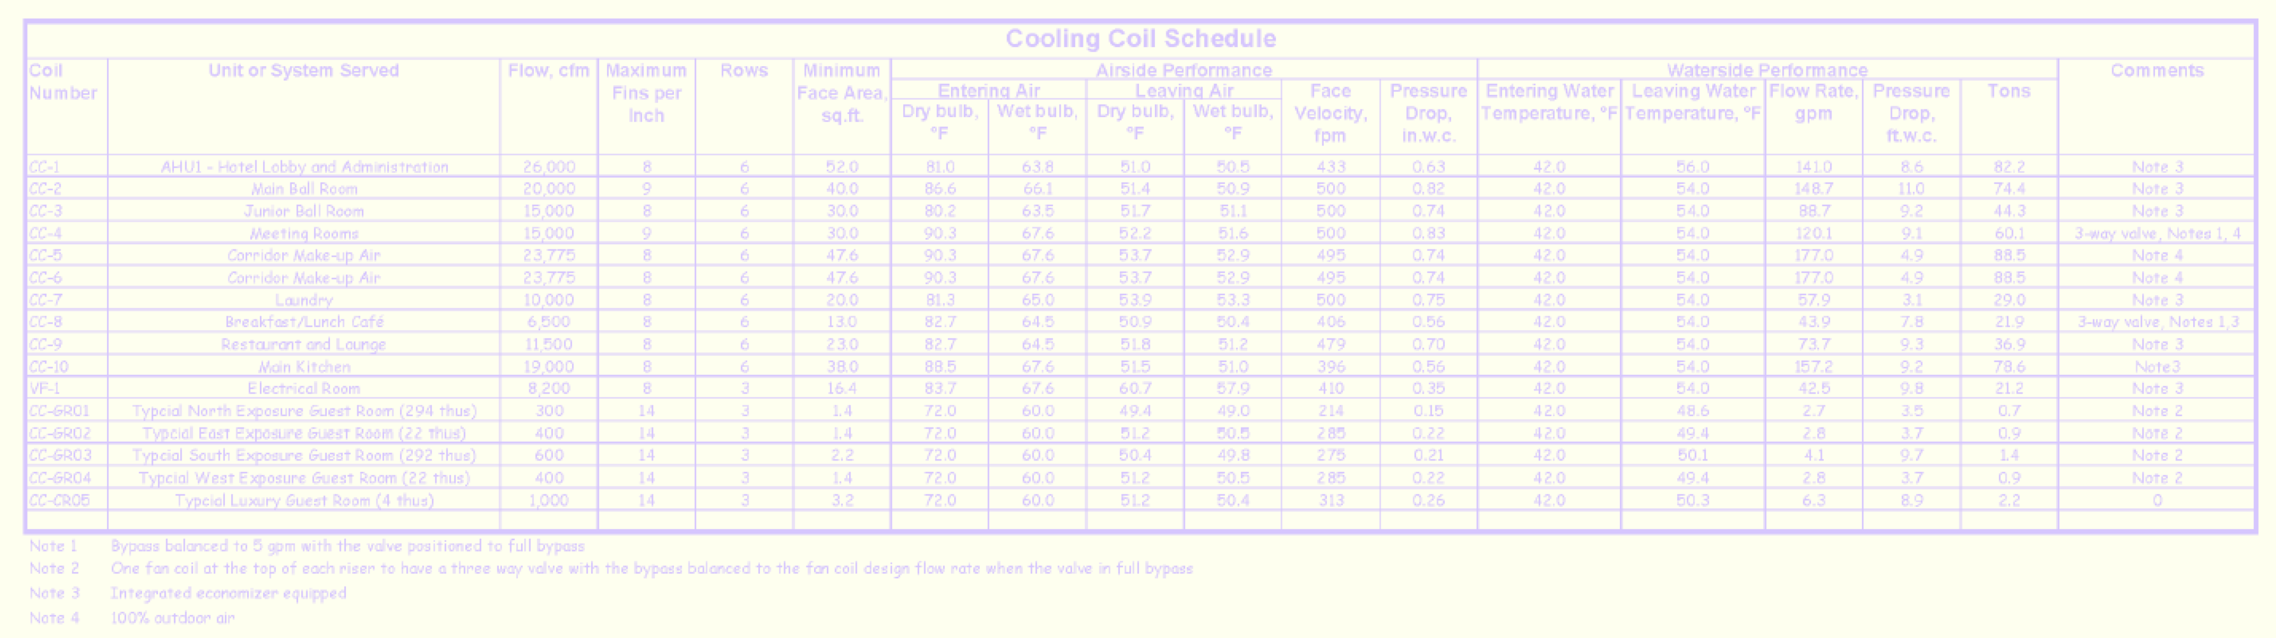
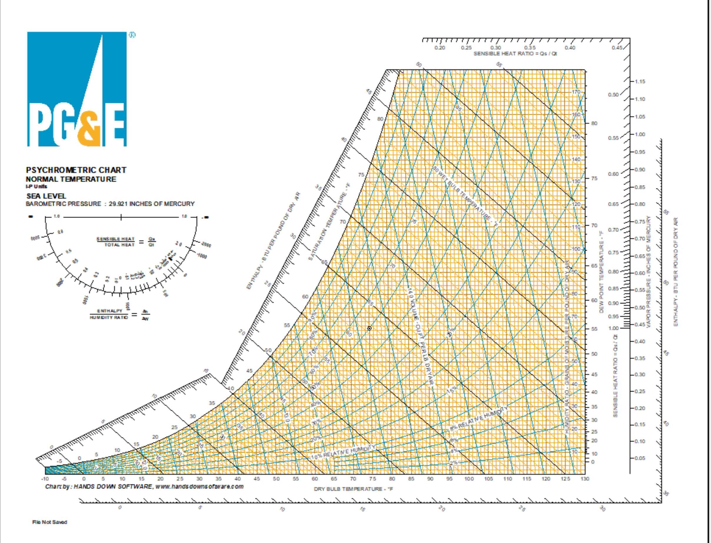
Break-out 03
Focus on this portion of the logic
Given:
  The cooling coil schedule
  The Ball Room design target
  Sensible heat gain of 1°F in the return air path
  Your psych chart
What outdoor air design condition did the designer use?
What was the minimum outdoor air percentage the designer intended to provide?

Slide 25
Break-out 03 Discussion
Focus on this portion of the logic
Given:
  The cooling coil schedule
  The Ball Room design target
  Sensible heat gain of 1°F in the return air path
  Your psych chart
What outdoor air design condition did the designer use?
What was the minimum outdoor air percentage the designer intended to provide?
How do you address what you discovered?

