Slide 1
2020 RCx Academy Week 6 Assessing an Economizer
10 June 2020

Slide 2
A Few References That May be Helpful
Economizer Evaluation Checklist
https://www.av8rdas.com/economizer-evaluation-checklist.html
Economizer Stratification Video
https://www.av8rdas.com/economizer-stratification.html
Economizer Stratification Blog Post
https://av8rdas.wordpress.com/2013/01/17/retrocommissioning-findings-economizer-mixed-air-plenum-stratificationoverview/
Pacific Energy Center Economizers; Design, Performance and Commissioning Issues Class Materials
https://www.av8rdas.com/pacific-energy-center-design-performance-and-commissioning-issues-classes.html#Economizers

Slide 3
For the Purposes of This Exercise:
The Hijend Hotel has been relocated to Sacramento California
That’s why Sacremento climate data has been provided
This makes the freezestat more important

Slide 4
Our Goals
Given:
The economizer evaluation checklist
Sacramento climate data
Field notes taken on the day in question
Current conditions
Foggy
Outdoor temperatures in the low 50’s°F
A full Ball Room that appears to be holding the 72°F/50% RH target
An AHU discharge temperature of 51°F
A wet cooling coil
The images that follow
Do the following
Evaluate the economizer in the context of an RCx/Ongoing Cx process
What would your next steps be?
Note that there may be some items you can not evaluate with the information you have been given
Identify what additional information you would like to see for the evaluation

Slide 5
Supporting Data
Economizer Evaluation Checklist
Bin plot for Sacramento on a psych chart
Bin data for Sacramento
Sacramento TMY3 file
Field notes from a temperature and velocity traverse that was taken
The control system logic for the discharge temperature control process
The images that follow

Slide 6
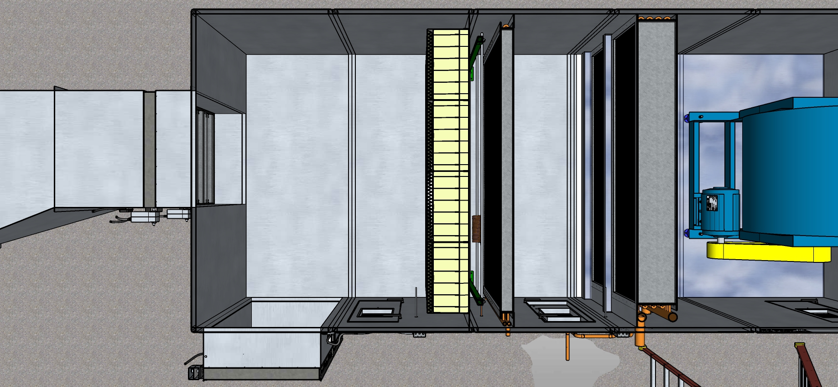
Economizer/Mixed Air Section Plan View

Slide 7
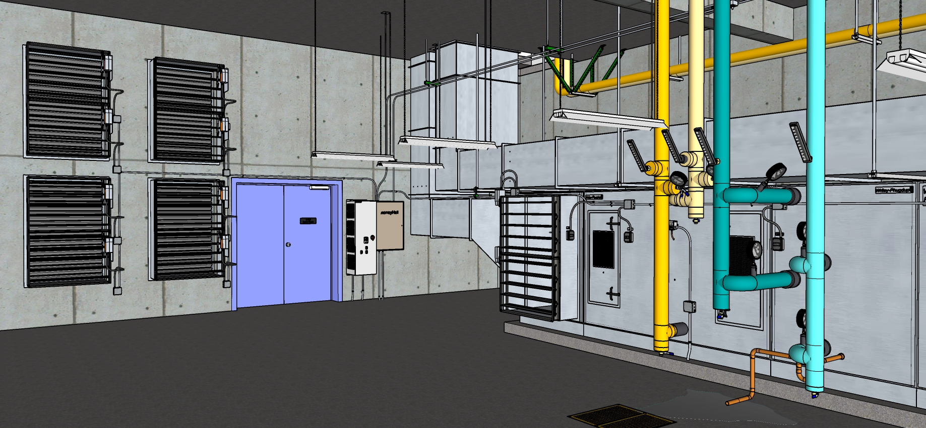
Equipment Overview

Slide 8
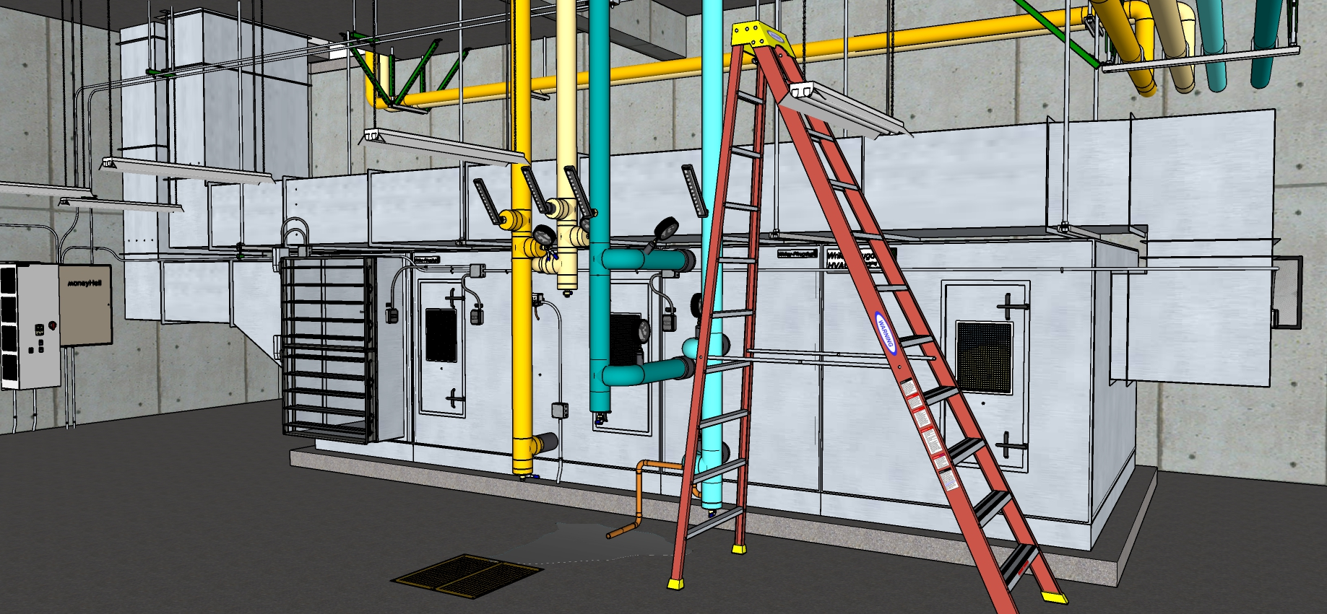
Equipment Overview

Slide 9
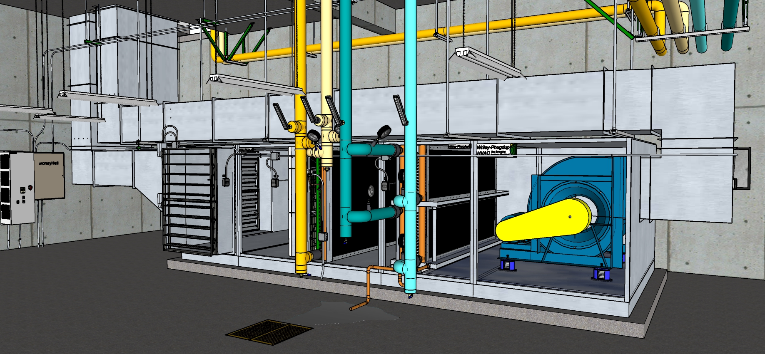
Equipment Overview

Slide 10
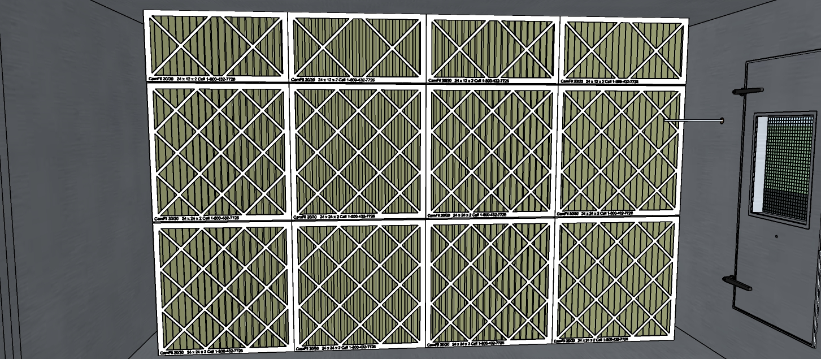
Filter Bank

Slide 11
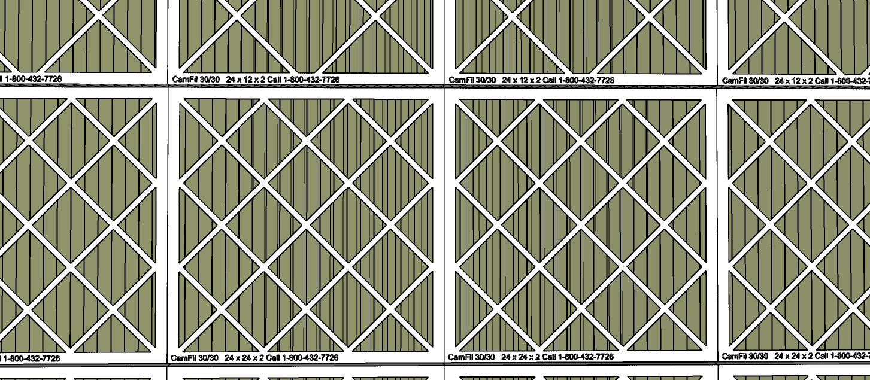
Filter Detail

Slide 12
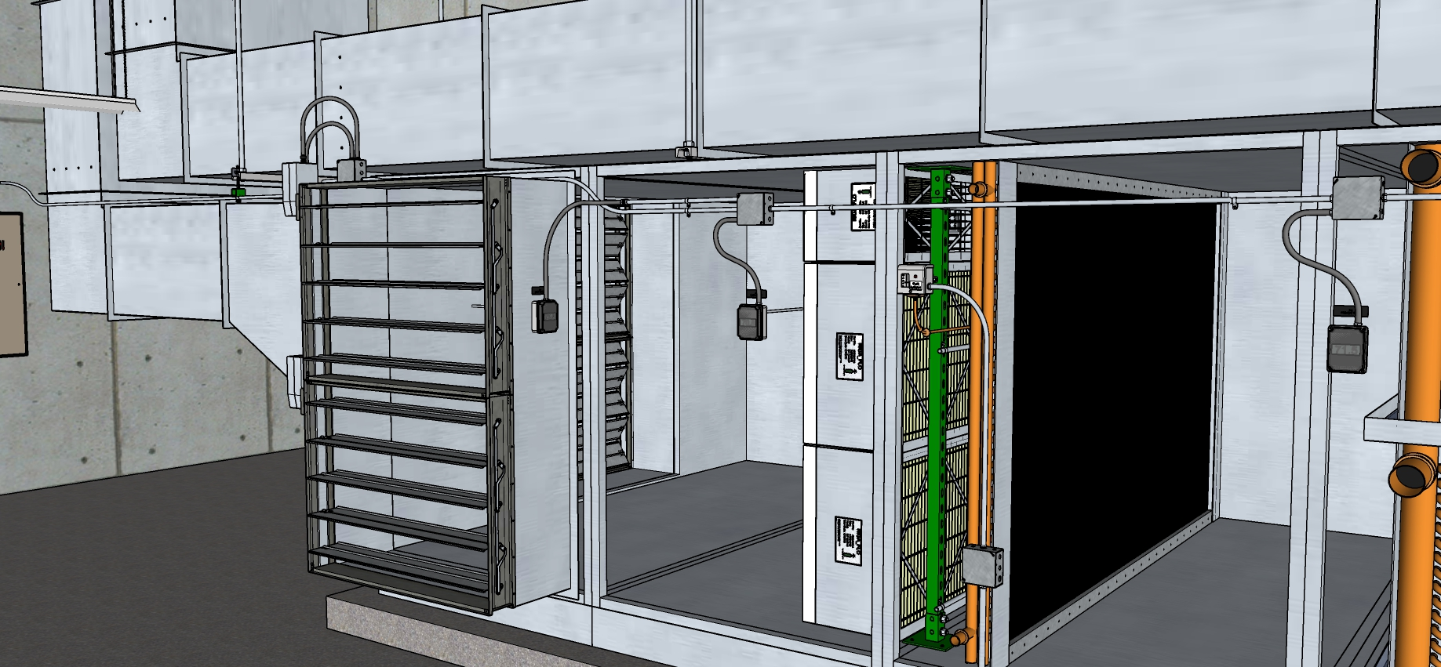
Mixed Air Plenum Overview

Slide 13
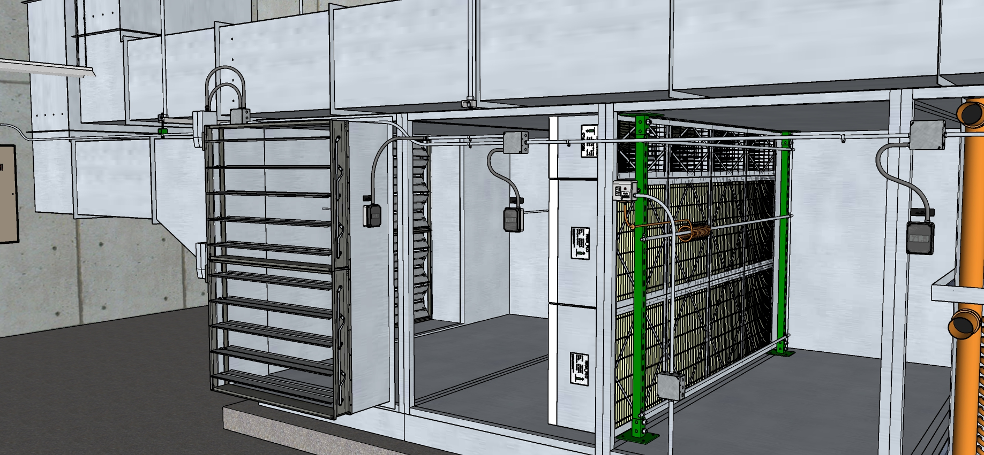
Mixed Air Plenum Overview – Heating Coil Hidden

Slide 14
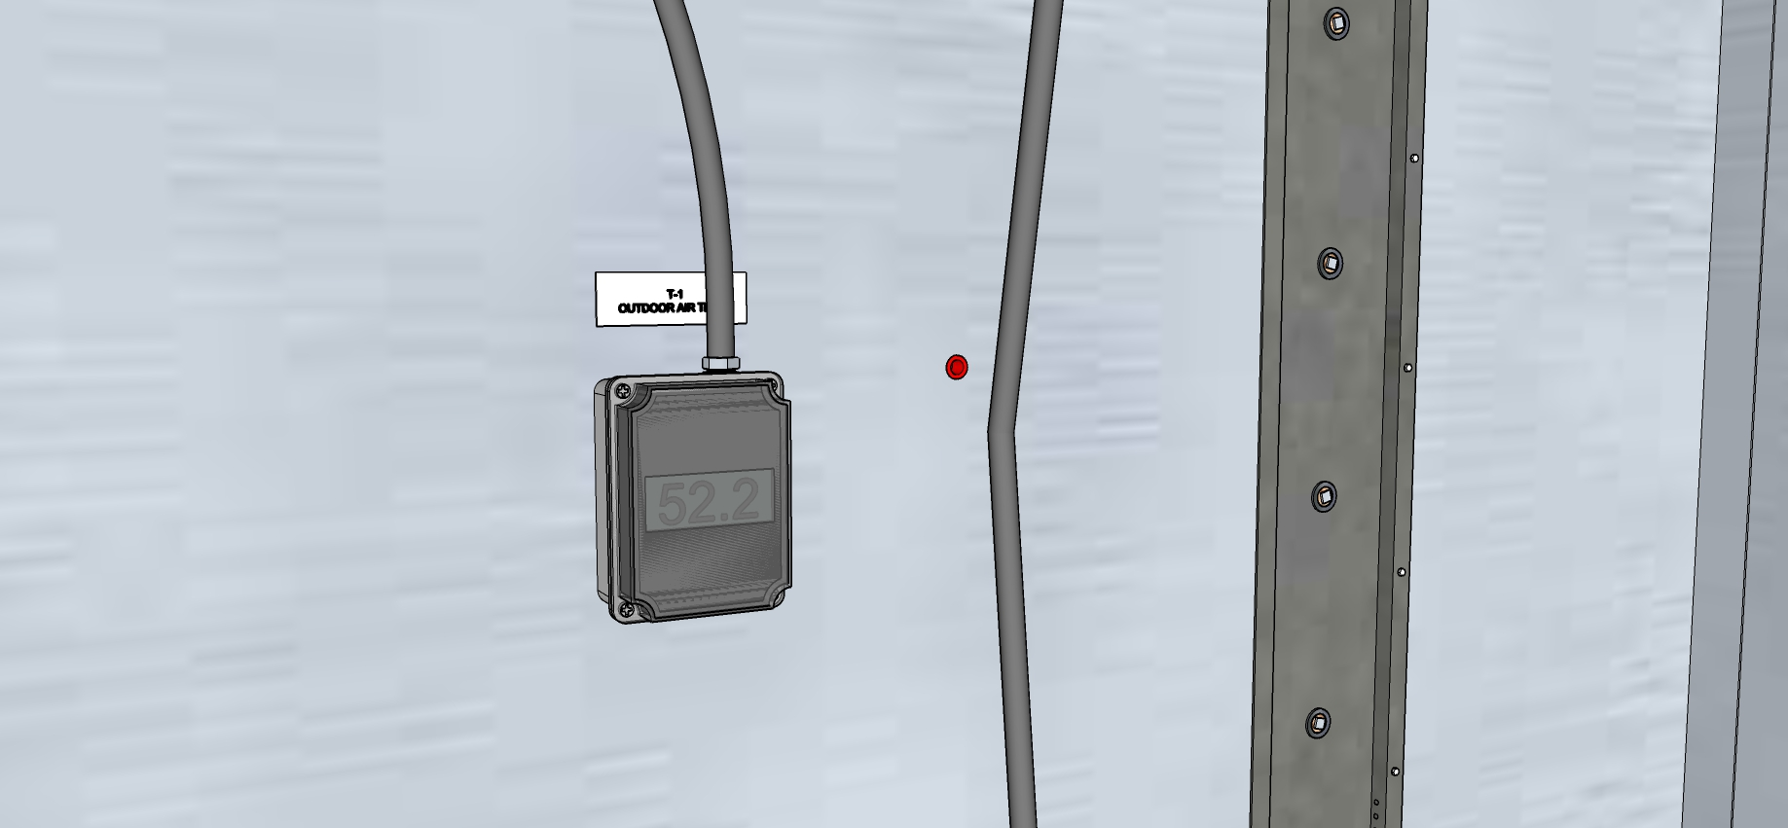
Outdoor Air Temperature Sensor

Slide 15
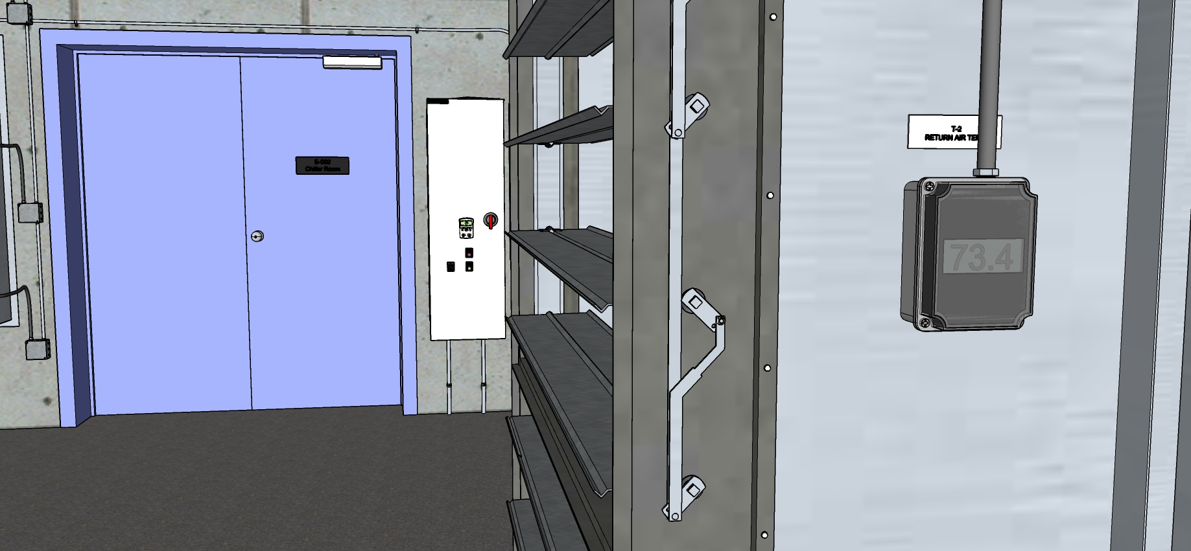
Return Air Temperature Sensor

Slide 16
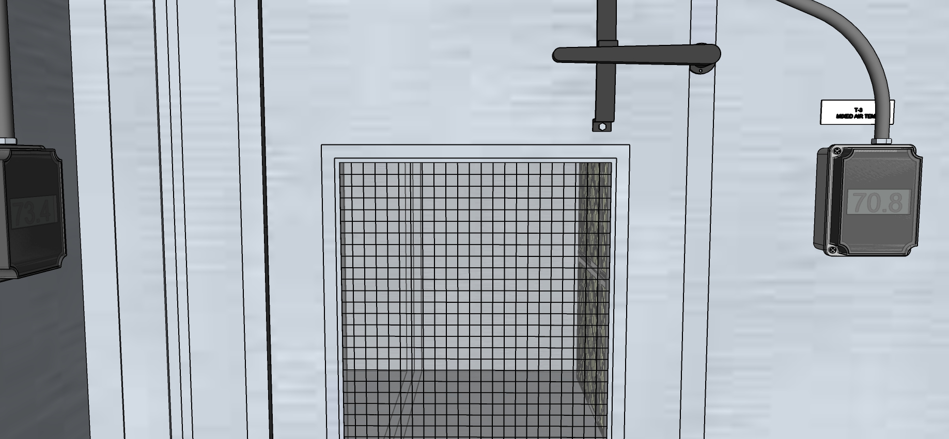
Return Air Temperature Sensor

Slide 17
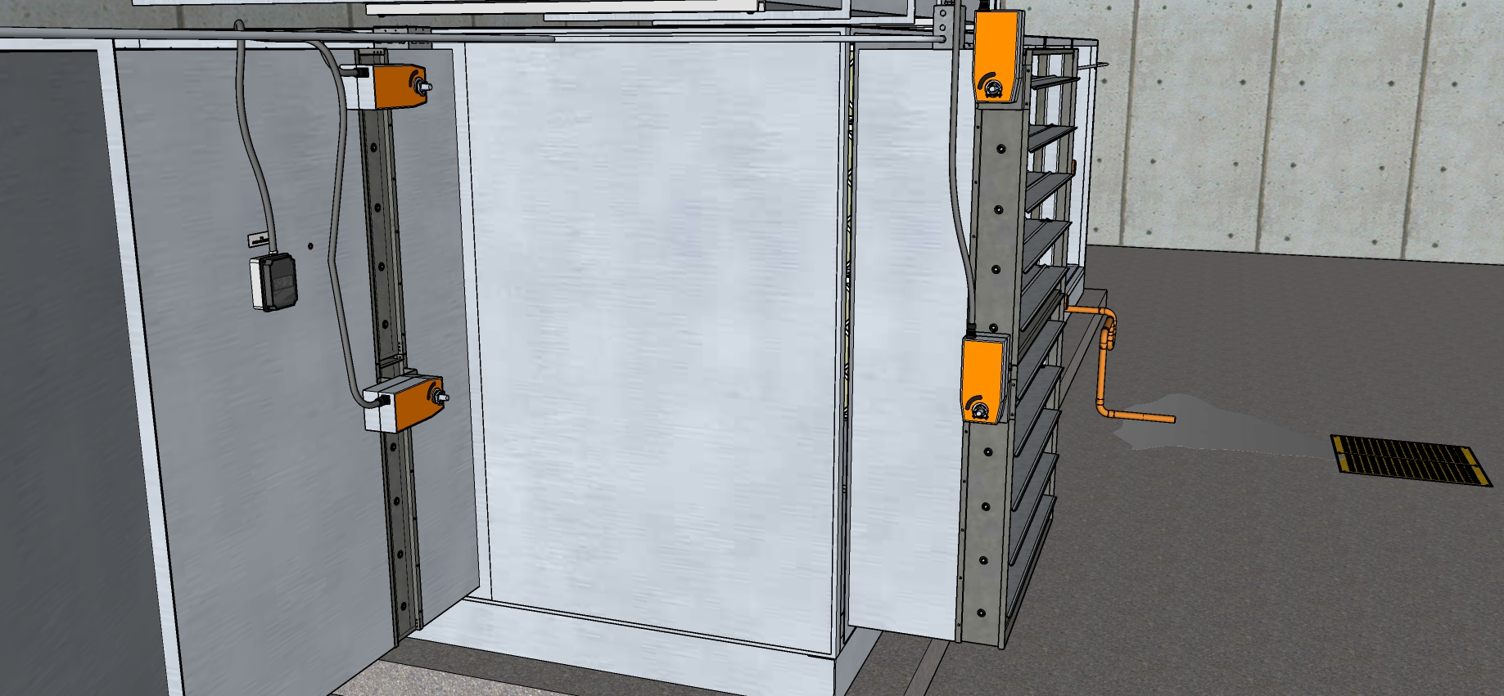
Dampers Viewed from Actuator Side

Slide 18
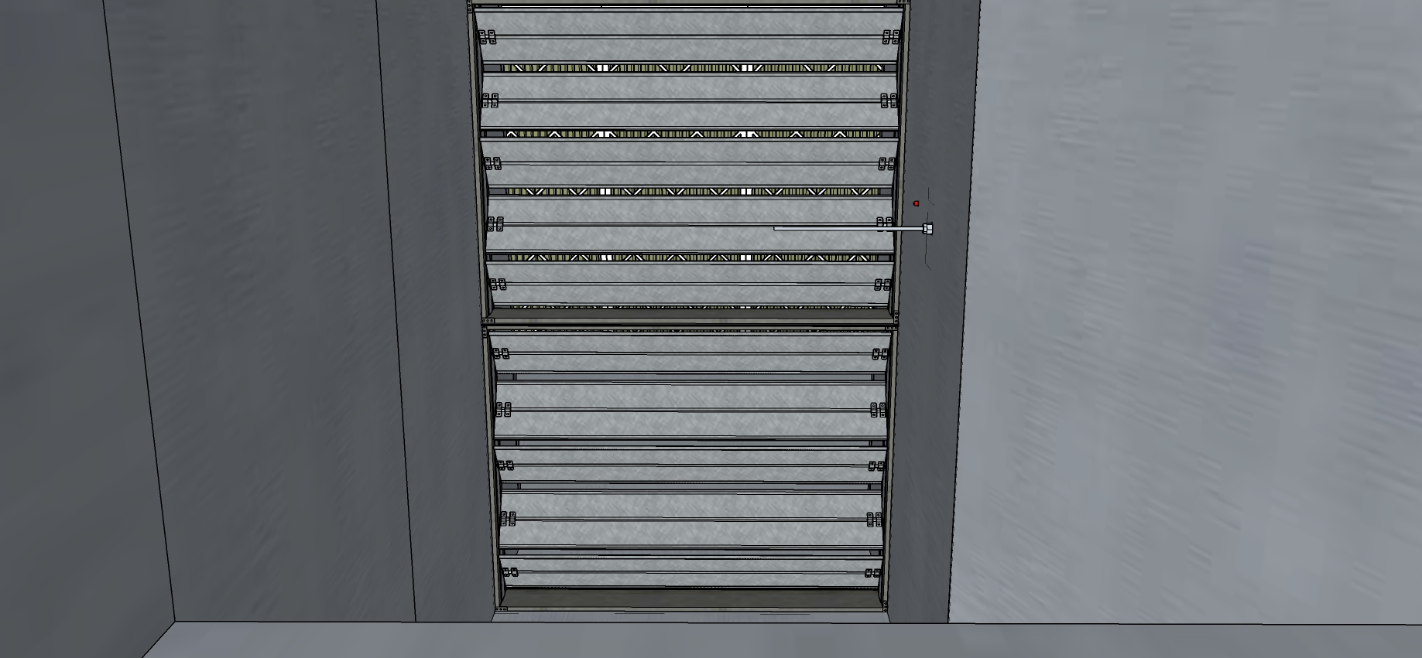
Outdoor Air Damper from Inside the OA Duct

Slide 19
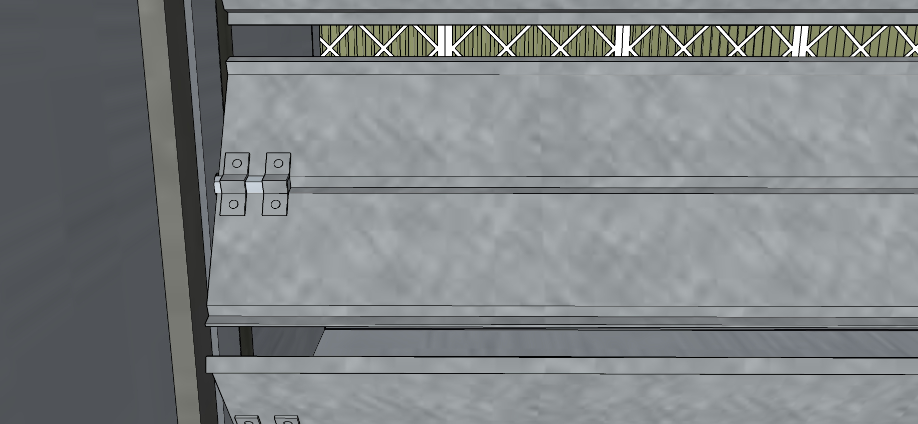
Outdoor Air Damper Blade Close-up

Slide 20
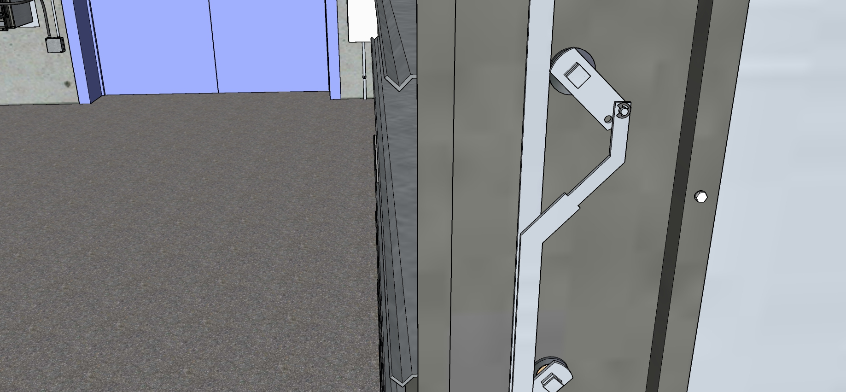
Return Air Damper Blade Close-up

Slide 21
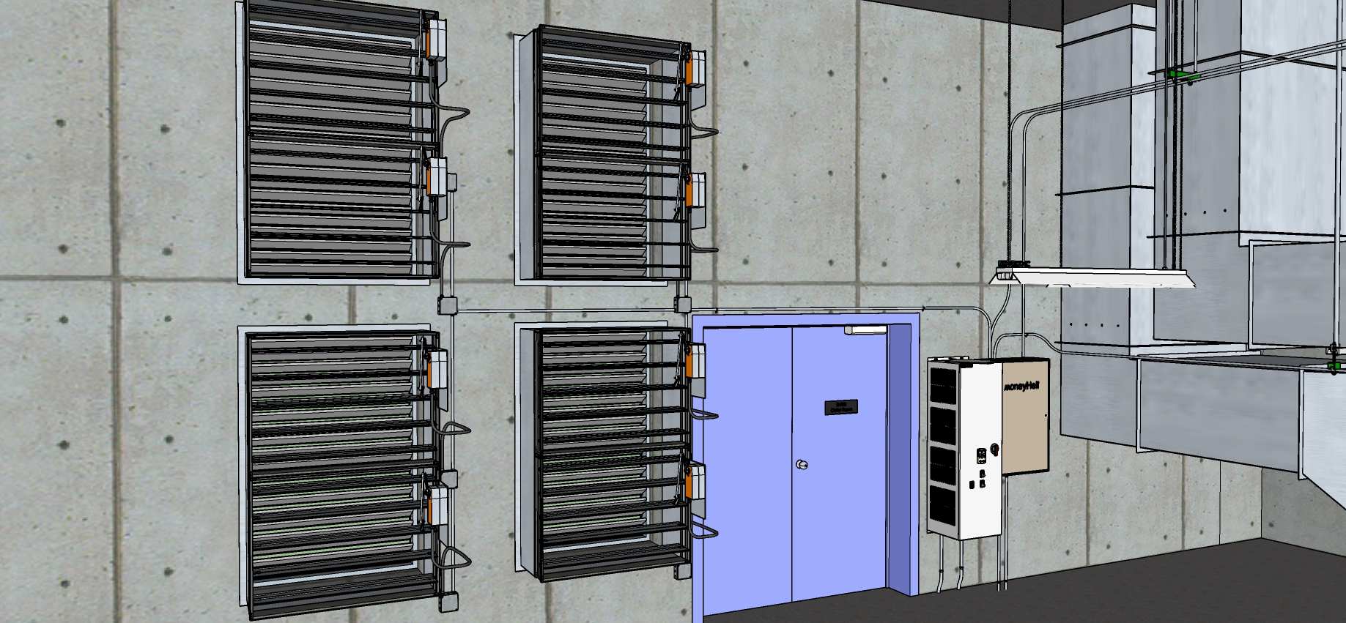
Relief Dampers - Overview

Slide 22
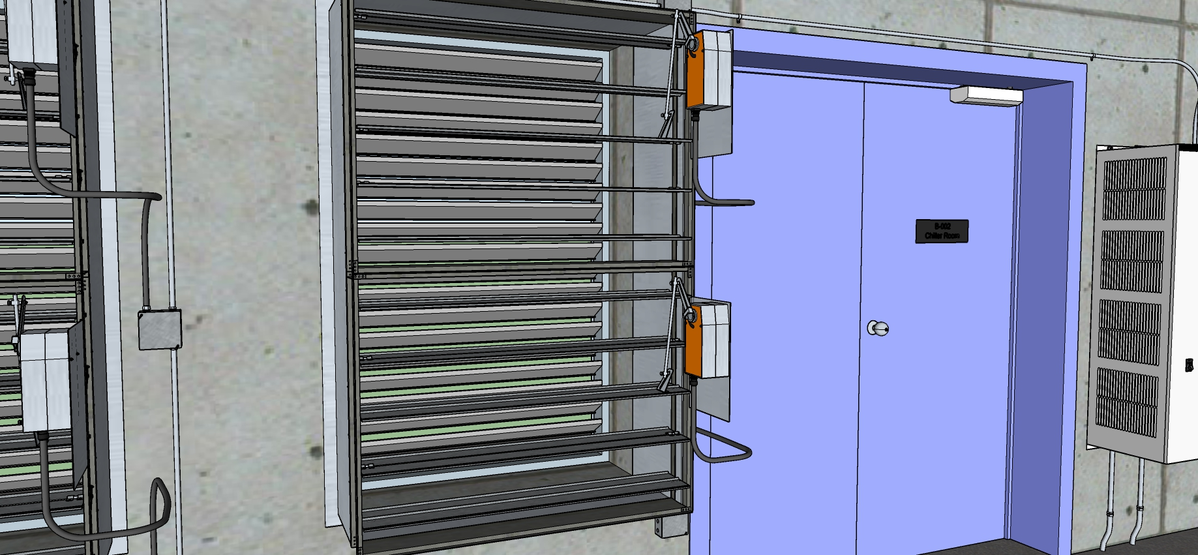
Relief Dampers – Close-up

Slide 23
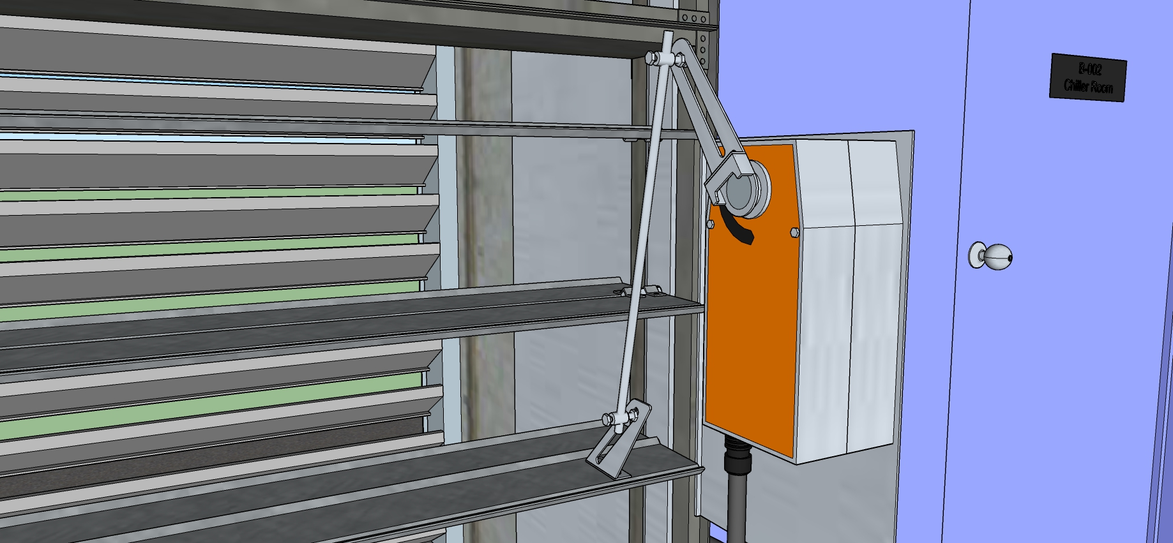
Relief Dampers – Actuator and Blade Close-up

Slide 24
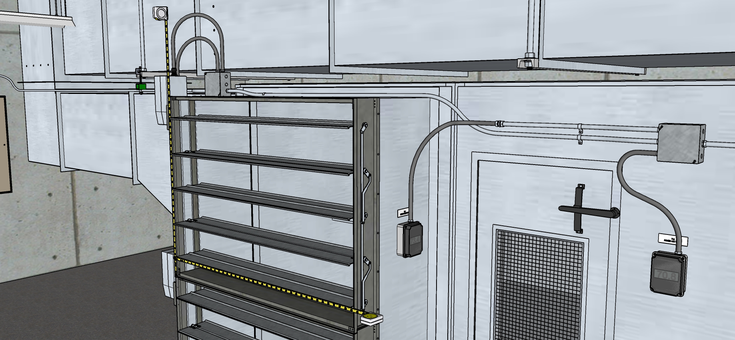
Return Air Damper Measurements - Overview

Slide 25
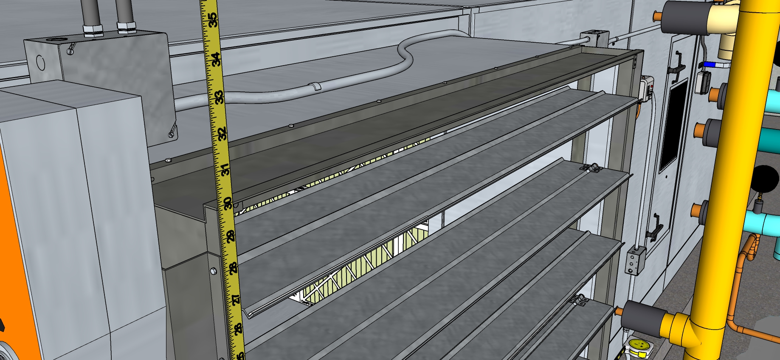
Return Air Damper Measurements - Height

Slide 26
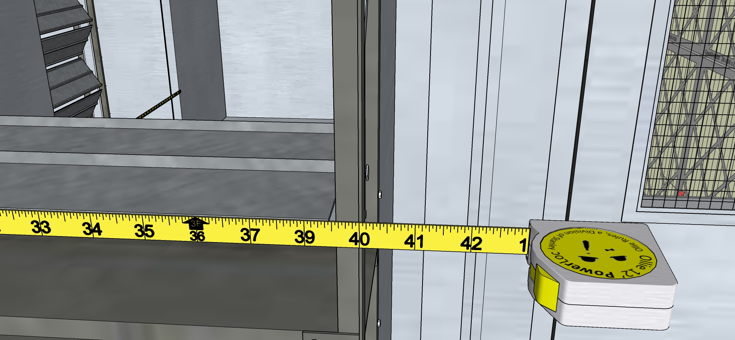
Return Air Damper Measurements - Width

Slide 27
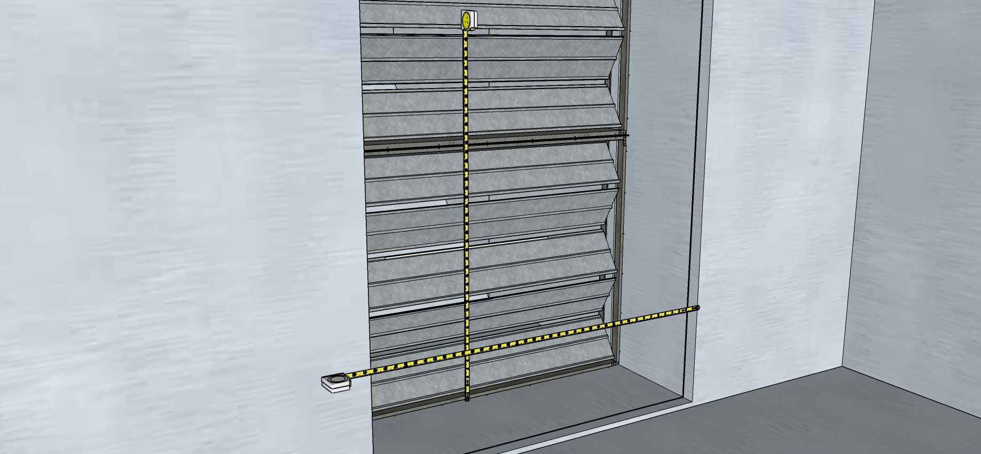
Outdoor Air Damper Measurements - Overview

Slide 28
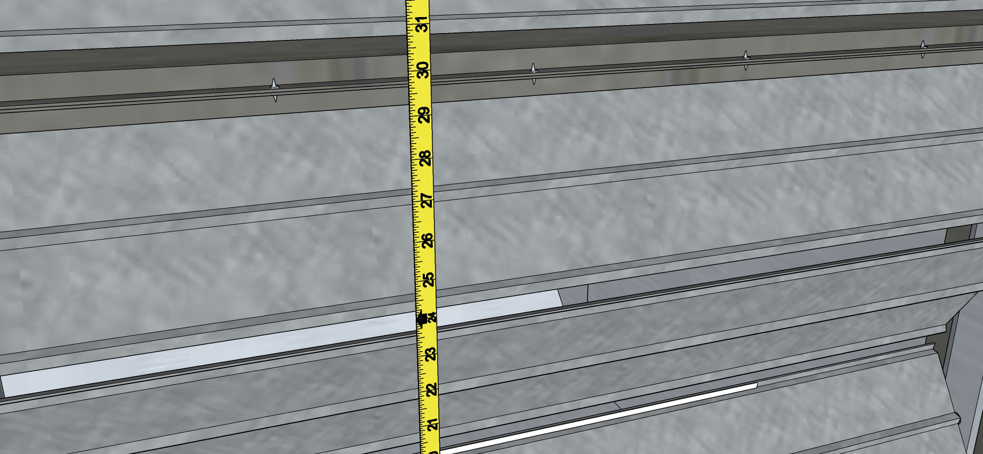
Outdoor Air Damper Measurements - Height

Slide 29
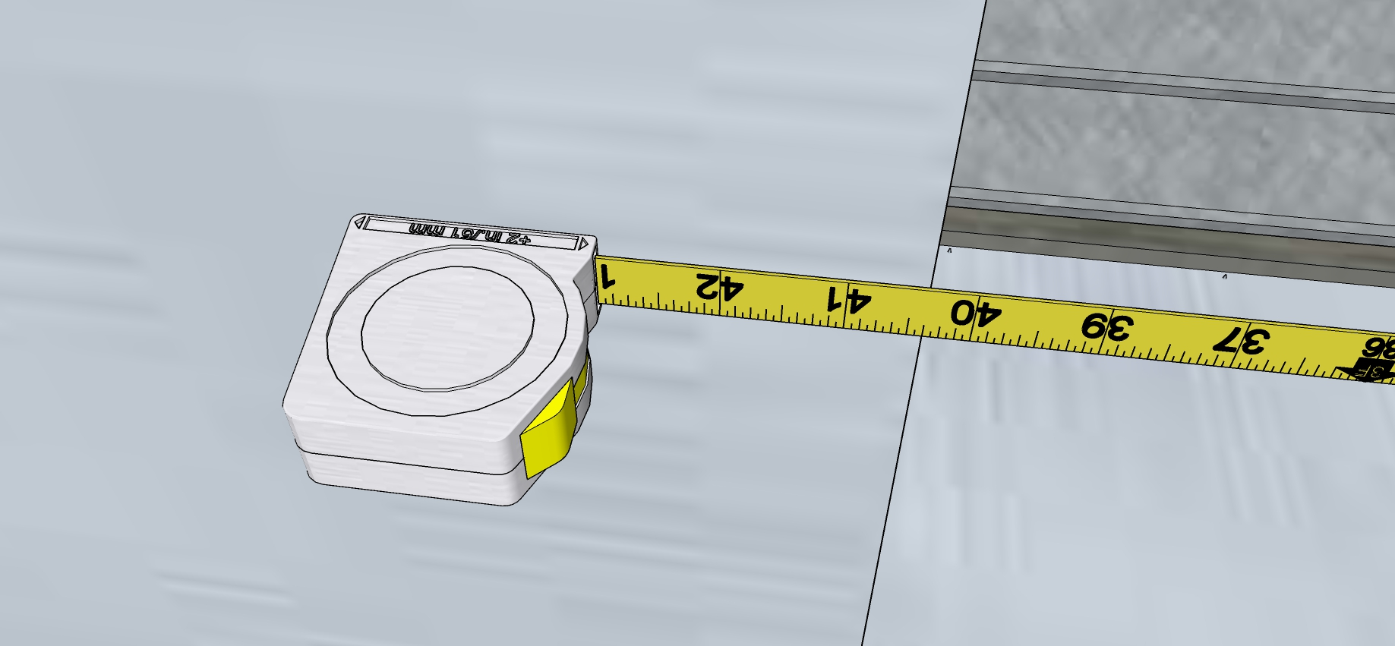
Outdoor Air Damper Measurements - Width

Slide 30
Relief Dampers – Measurements Overview

Slide 31
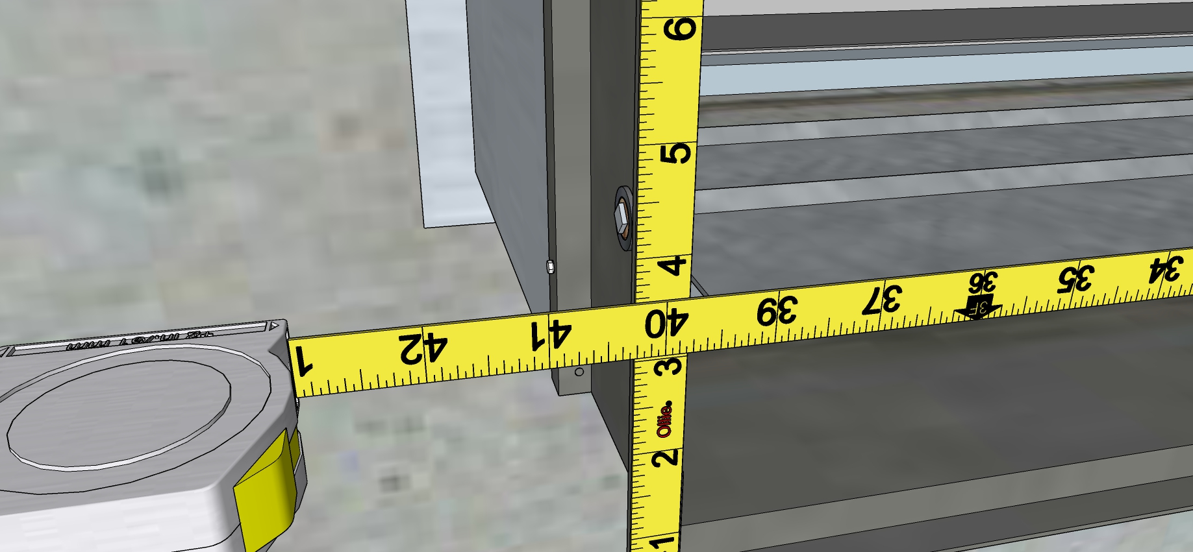
Relief Dampers – Measurements - Width

Slide 32
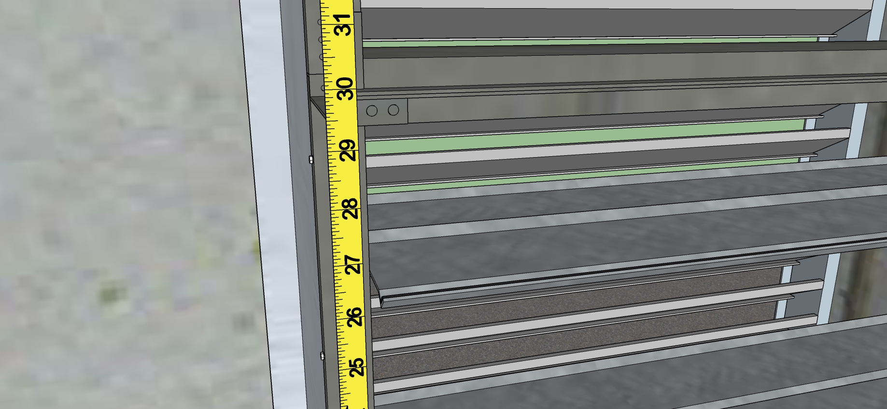
Relief Dampers – Measurements - Height

Slide 33
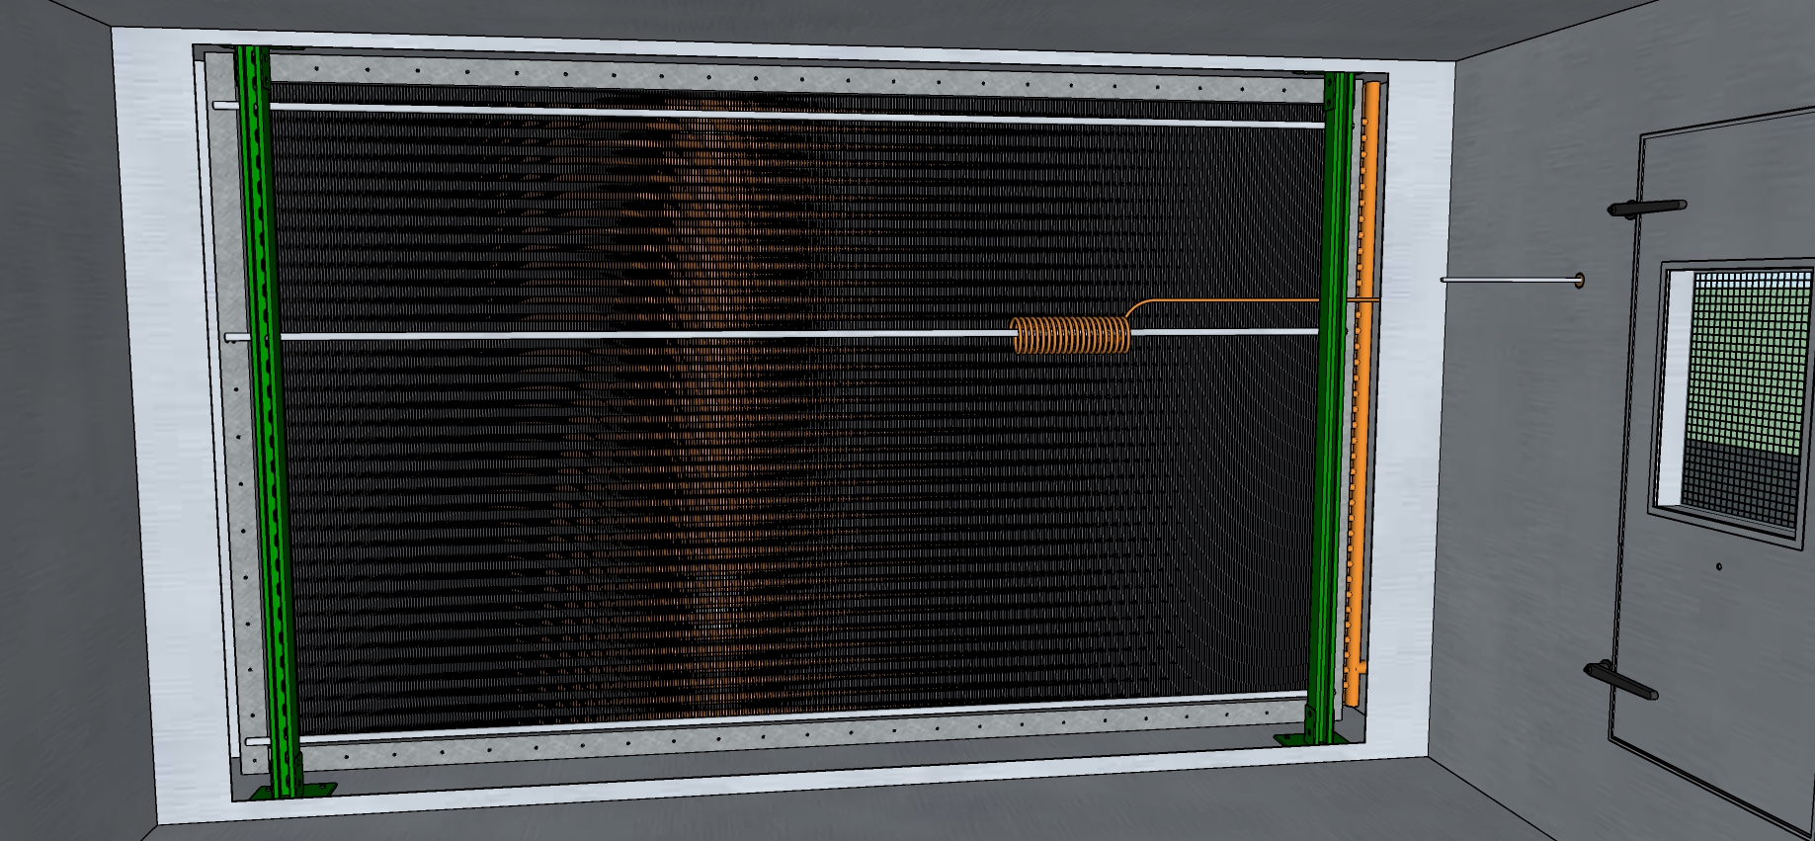
Mixed Air Plenum Looking in the Direction of Airflow, Filters Hidden

Slide 34
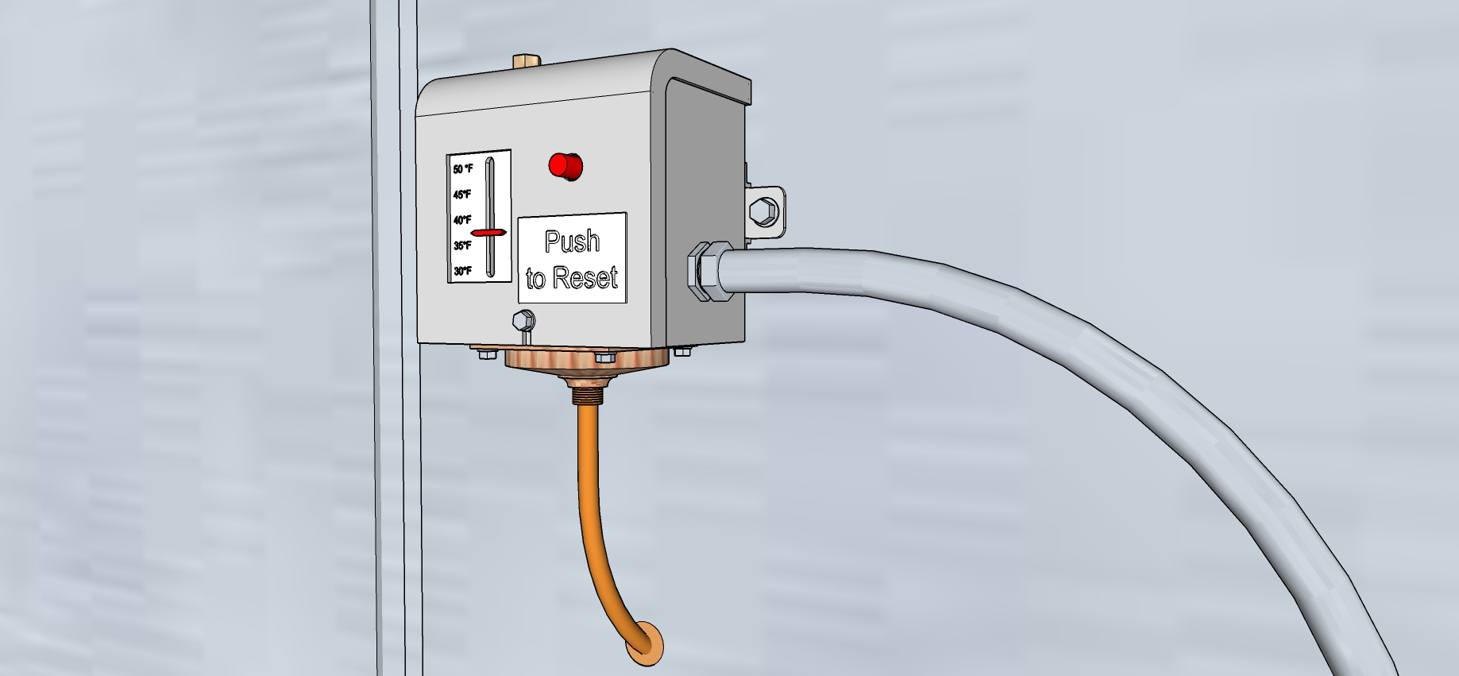
Control Device

Slide 35
Minimum Outdoor Air Regulation
How is minimum outdoor air regulated for this system?
How well do you think the strategy will work?
What are some of the assumptions behind the strategy?
Do you think the system is in the correct operating mode?
If Doreen had not told you that they targeted 25% minimum outdoor air, is there a way you could have estimated the design value from the construction documents?

Slide 36
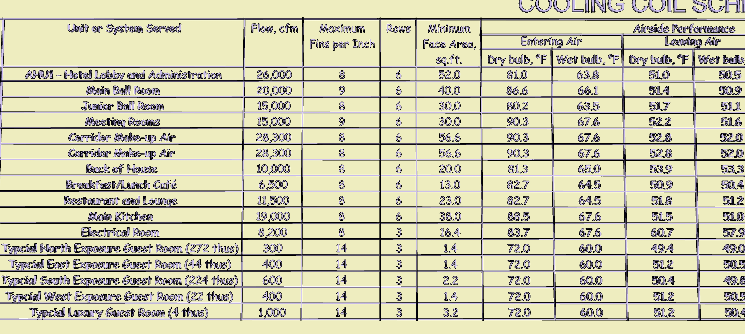

Slide 37
Minimum Outdoor Air Regulation
How is minimum outdoor air regulated for this system?
How well do you think the strategy will work?
What are some of the assumptions behind the strategy?
Do you think the system is in the correct operating mode?
If Doreen had not told you that they targeted 25% minimum outdoor air, is there a way you could have estimated the design value from the construction documents?

Slide 38
Damper Sizing
Given the rules of thumb you have learned for estimating air handling unit flow rates and damper sizing, how well do you think the dampers are sized?

Slide 39
Damper Configuration, Condition, Orientation and Mixing
Are there any issues with the arrangement and condition of the dampers?
How well is the mixed air plenum set up to mix?
How well is it performing based on the test data you have?

Slide 40
Sensors and Controls – Part 1 – Field Conditions
Given a new rule of thumb:
There should be approximately 2 feet of averaging element and freezestat element for every 4 square feet of air handling unit cross sectional area
Do you think the existing sensor arrangement is adequate?
Is a freezestat an averaging sensor?
Is the hot water coil a preheat coil?
Do the various heat transfer processes appear to be properly coordinated?

Slide 41
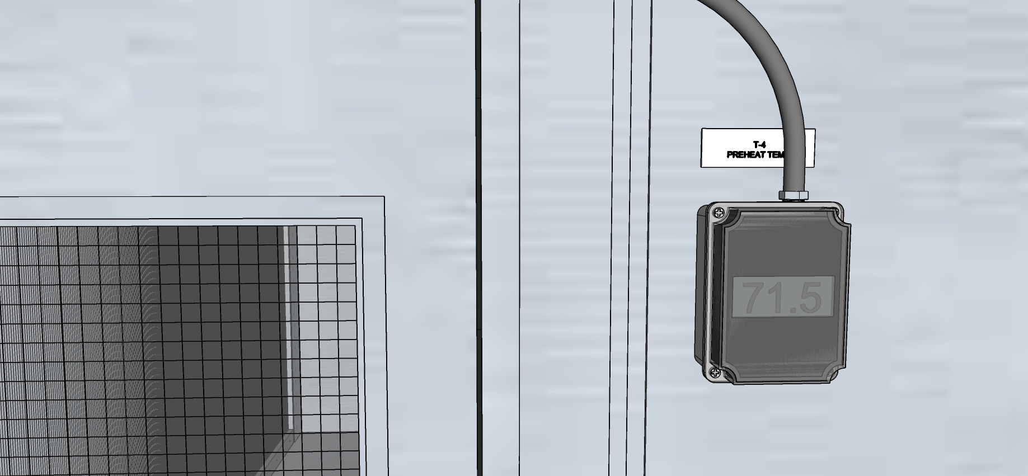
Hot Water Coil Leaving Air Temperature

Slide 42
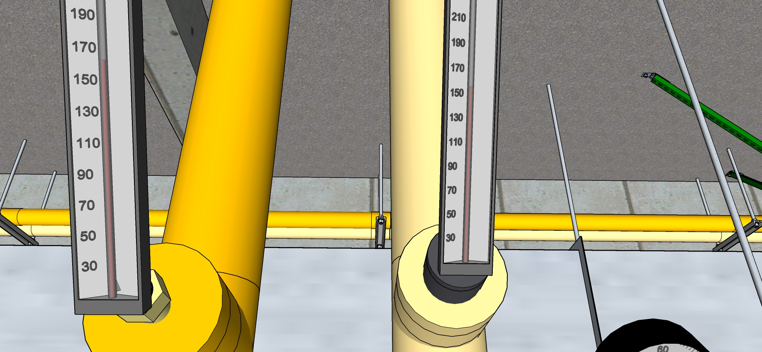
Hot Water Coil Pipe Temperatures

Slide 43
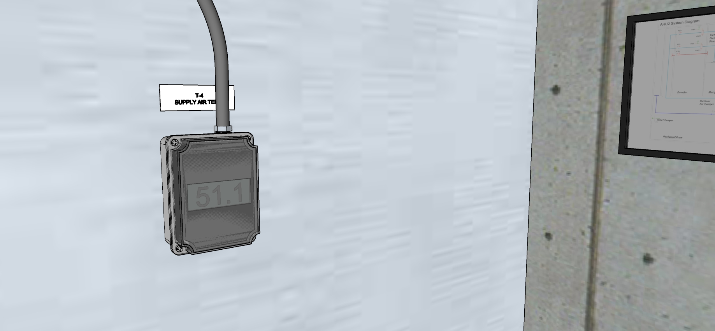
Supply Air Temperature

Slide 44
Sensors and Controls – Part 2 – Control Logic
What type of economizer high limit control is provided?
Is the limit control appropriately set?
Is there a mixed air low limit cycle?
If Doreen tells you that they have a hard time getting the unit to start during cold weather due to nuisance freezestat trips, what do you think might be wrong?
Is the relief air system working properly?
Is the economizer properly integrated with the other heat transfer elements?

