Slide 1
EBCx Workshop Series 18
Session 2
David Sellers, Facility Dynamics Engineering
Senior Engineer

Slide 2
Self Study Goals

Slide 3

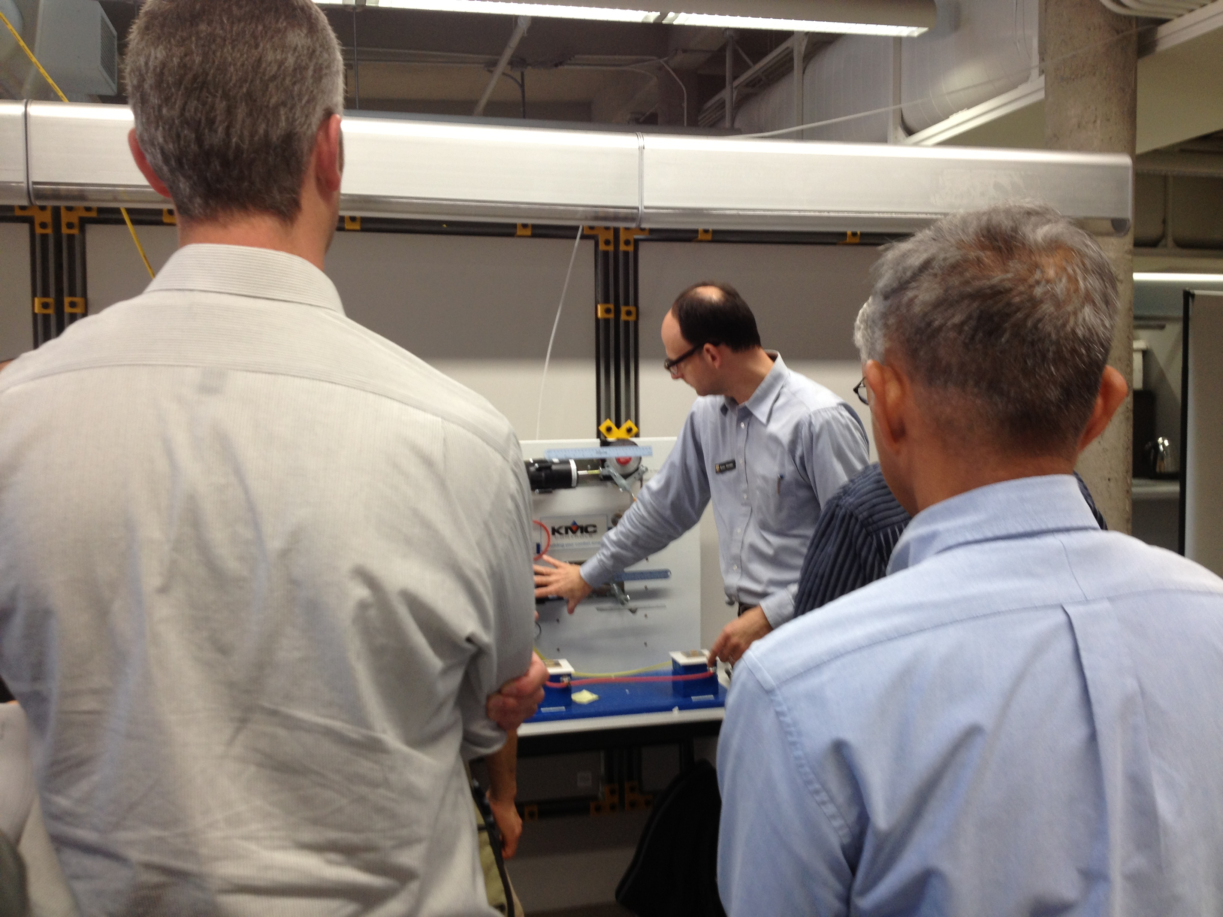


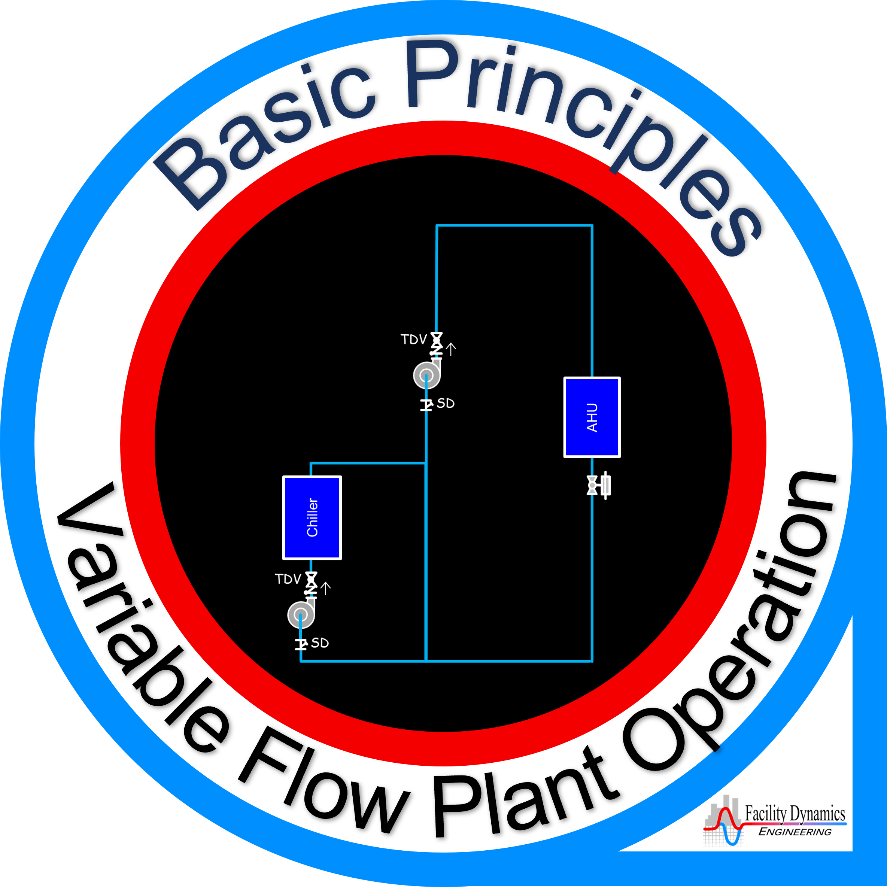
What You Should be Doing
Identify a Project Building
Begin to fill out the building information form Ryan will provide
Benchmark the building
  EnergyStar
  DOE Building Performance Database
Start a Utility Consumption Analysis
Make a site visit to scope it and start a findings list

Slide 4



Steps for Your Self-Study Effort
Collect your merit badges
https://tinyurl.com/SSBenchmarkUCAScoping
https://tinyurl.com/SSLoadsAndPsych
https://tinyurl.com/SSSystemDgmIntro

Slide 5



Steps for Your Self-Study Effort
Continue to Develop your System Diagram Skills
Developing the Hijend Hotel CHW Distribution Loop Diagram
https://tinyurl.com/HijendDistLoop
Add the Evaporator Loop to the Diagram
https://tinyurl.com/HijendEvapLoopFlyThru
Field Verify Joe DeNugy’s Central Plant Diagram
https://tinyurl.com/HijendCHWFieldVerify

Slide 6
Next Steps for Your Self-Study Effort
Reach Out to Ryan if You Have Questions or Need Some Help
r2s2@pge.com

Slide 7
Situational Awareness
A Psych Chart Refresher

Slide 8
A Psych Chart Refresher
Constant Humidity Ratio
Constant Dry Bulb
Constant RH
Constant SHR
Identify the different lines on a psych chart
Constant dry bulb
Constant wet bulb
Constant dew point
Constant humidity ratio
Constant relative humidity
Specific heat ratio
Constant Dew Point
Constant Wet Bulb
Constant Enthalpy

Slide 9
Constant Humidity Ratio
Constant Dry Bulb
Constant RH
Constant SHR
Constant Dew Point
Constant Wet Bulb
Constant Enthalpy

Slide 10
Let’s Go to the Breakout Rooms

Slide 11
Constant SHR
Constant RH
Constant Dry Bulb
Constant Humidity Ratio
Constant Dew Point
Constant Wet Bulb
Constant Enthalpy

Slide 12
Situational Awareness
The Ball Room Design Conditions

Slide 13
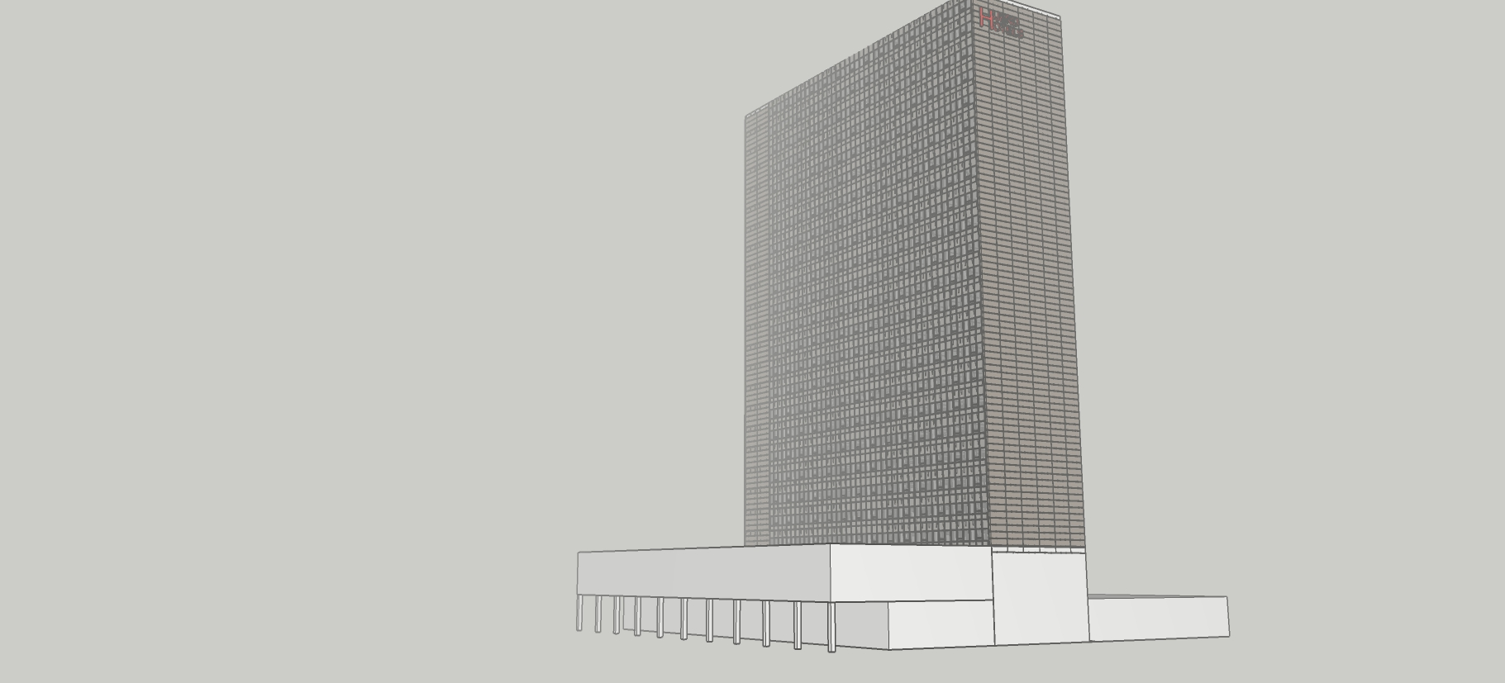
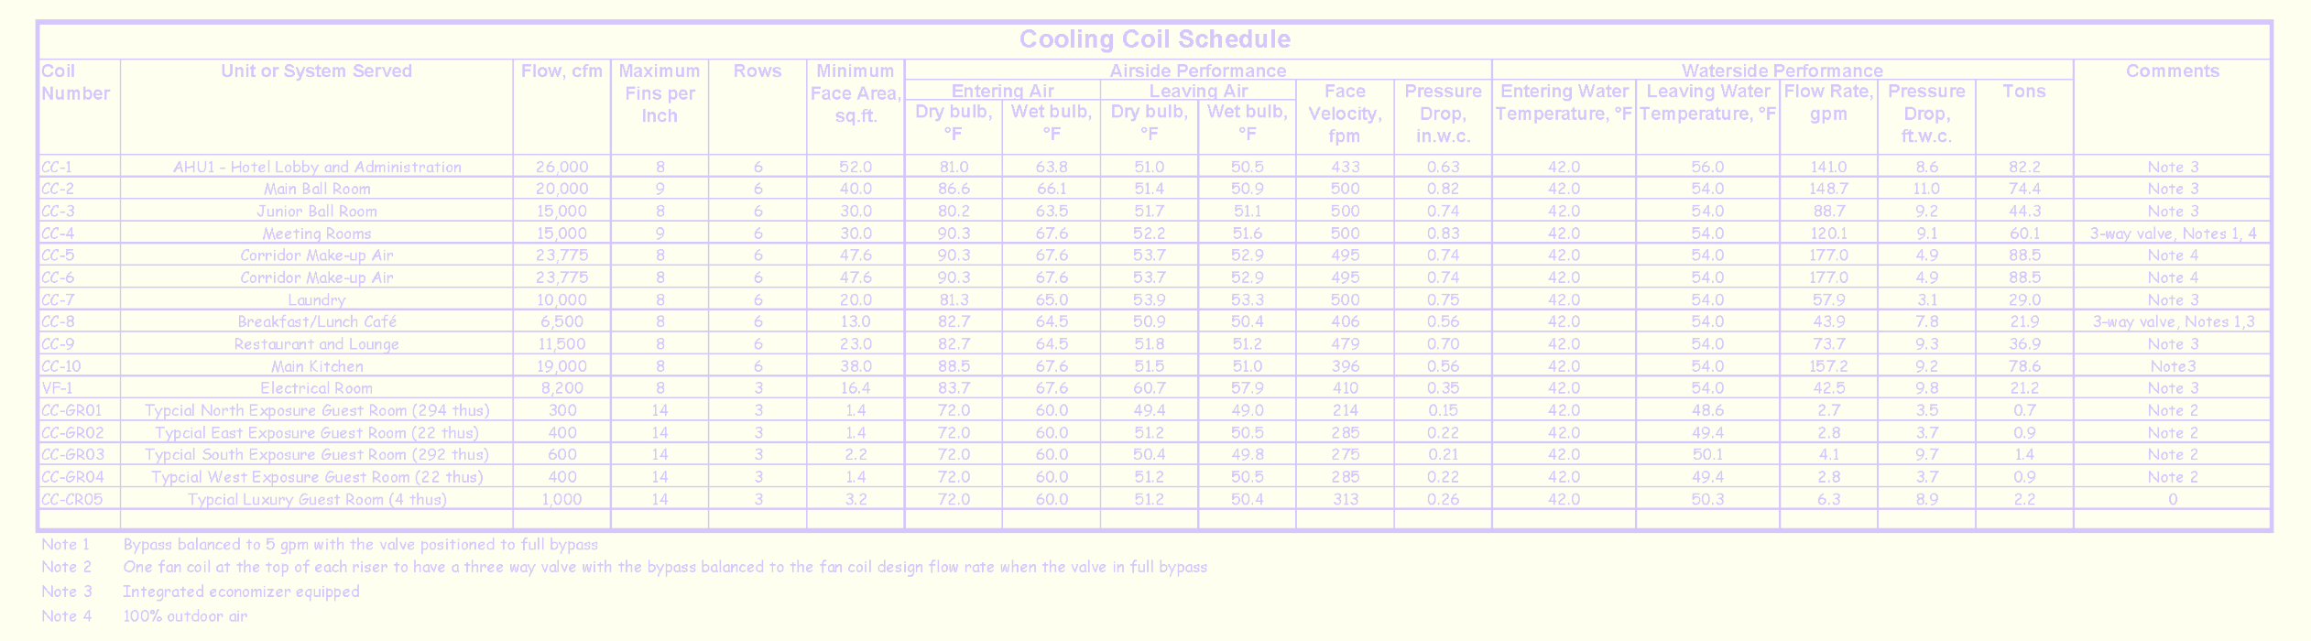
Current Conditions

Slide 14

Current Conditions
Foggy
Furnace running at home when you left
Low 50’s °F through early afternoon, then clearing and sunny with a high of 68-70°F anticipated
Let’s see what you have learned
https://tinyurl.com/EBCxWS0201SitAware
Hotel at 84% occupancy
Major conference happening
  Main ball room in use
  Meeting rooms and Junior Ball Room in use
  Spaces under control at design target of 72°F/50% RH
  Ballroom MOA settings recently verified

Slide 16
Getting Ready for the Field

Slide 17
We Already Have Some Clues
Utility data insights based on the EUI and average daily consumption patterns
Building documents
  Provide insights regarding the building and equipment
  Allow preliminary system diagrams to be developed
Operating conditions on the day of our visit frame up expectations

Slide 18
The EUI Relationship
The EUI relationship

Slide 19
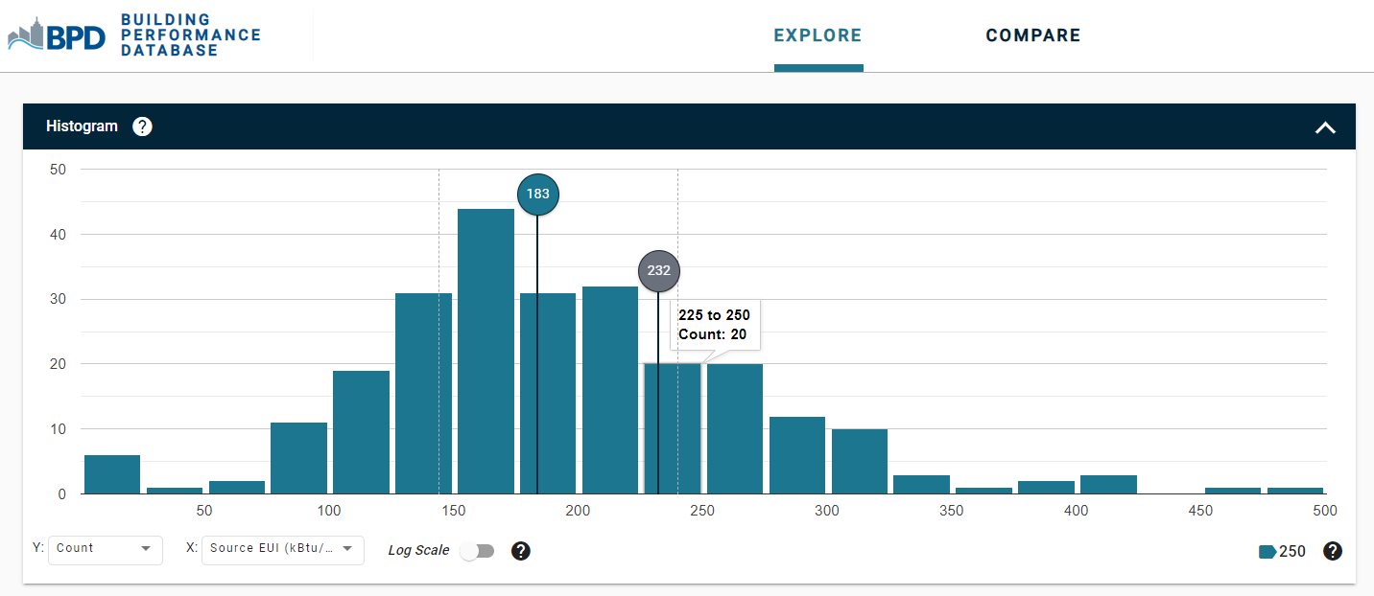
Adding Things Up

Slide 20
Adding Things Up

Slide 21
Projecting Savings

Slide 22
Projecting Savings

Slide 23
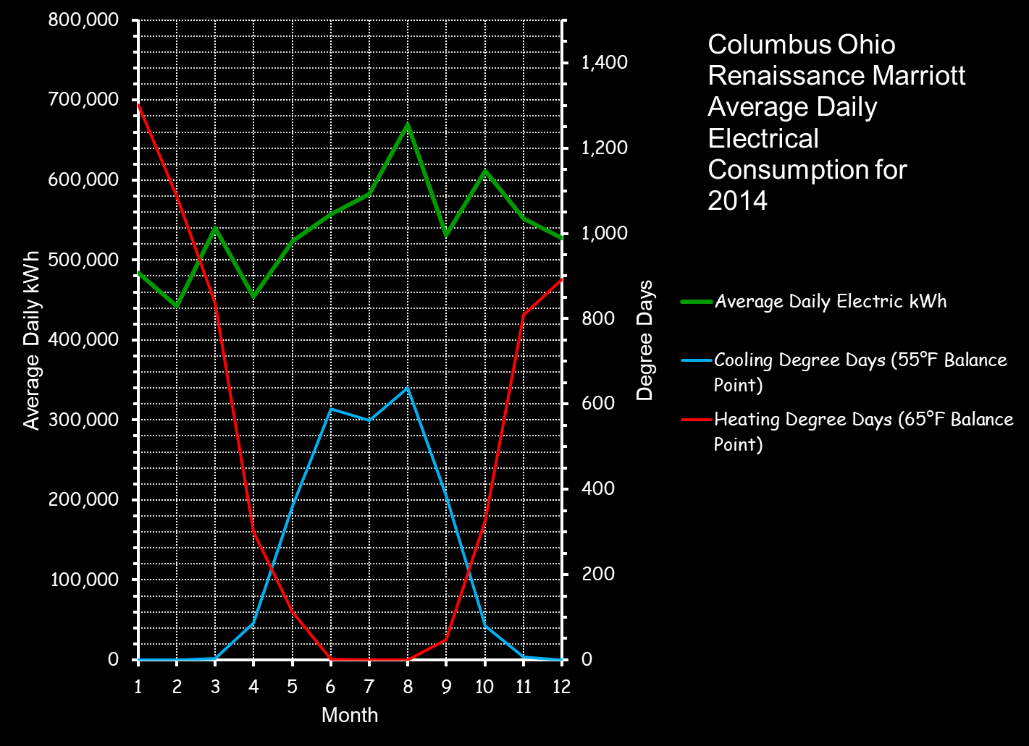
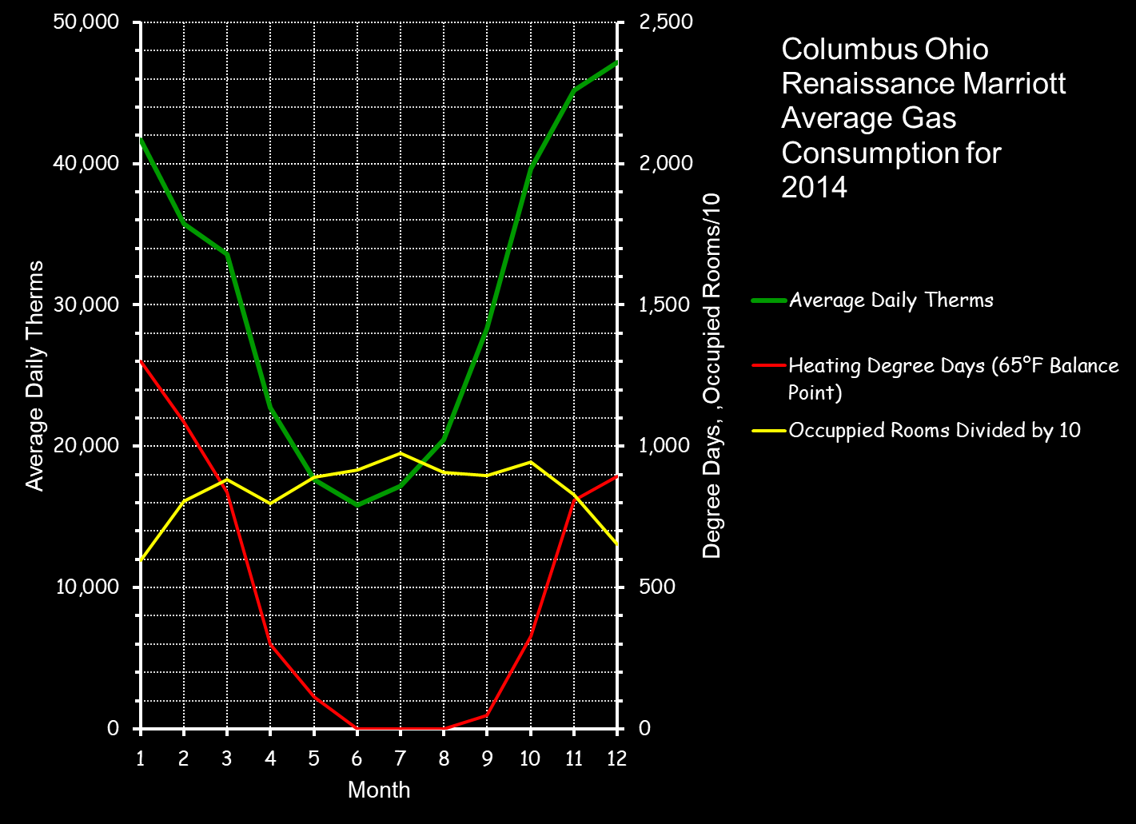

Slide 25
Think About It
It Will Come Up as We Work With the Hijend Hotel

Slide 26
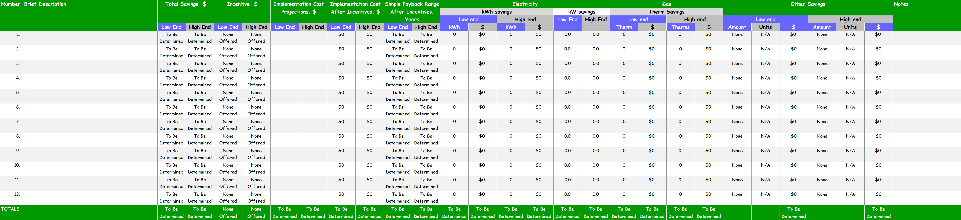

Start Your Findings List the Day You Start Your Project
https://tinyurl.com/EBCxCostBenefitSpreadsheet

Slide 27
A (Potentially) Informative Relationship
This relationship tells us that the power used by a pump is directly related to the flow and head it produces and inversely related to the pump, motor and drive system efficiency

Slide 28
Power vs. Energy
Power
Energy
Instantaneous rate of energy use
Power used over a period of time

Slide 29
Power vs. Energy
Power
Energy
Instantaneous rate of energy use
Thermal energy is similar
Power used over a period of time

Slide 30
Power vs. Energy
Power
Energy
Instantaneous rate of energy use
Power used over a period of time
Can be established by a test
Variations in flow and head will shift the operating point and cause variations in power
Shifting the operating point can cause pump efficiency to vary, also affecting power
Variations in power will cause variations in motor and drive efficiency

Slide 31
Power vs. Energy
Power
Energy
Instantaneous rate of energy use
Power used over a period of time
For a constant flow system:
Nothing varies
Only one test point is required

Slide 32
Power vs. Energy
Power
Energy
Instantaneous rate of energy use
Power used over a period of time
For a variable flow system:
Everything can vary
Multiple test points are required

Slide 33
Power vs. Energy
Power
Energy
Instantaneous rate of energy use
Power used over a period of time
For a variable flow system:
Establishing the load or flow profile for your energy calculations is critical

Slide 34
Establishing Load and Flow Profiles
Calculated
Measured
Potentially time consuming
May require complex mathematics or software
Only as good as the assumptions
No assumptions!
  Reflects the current state of affairs
May require complex mathematics or software
  But typically, you can handle it with Excel
Requires some time to establish
  Using regressions can compress the timeline
  Need to start gathering data early
Start thinking about it while you are scoping and look for ways you could do it

Slide 35

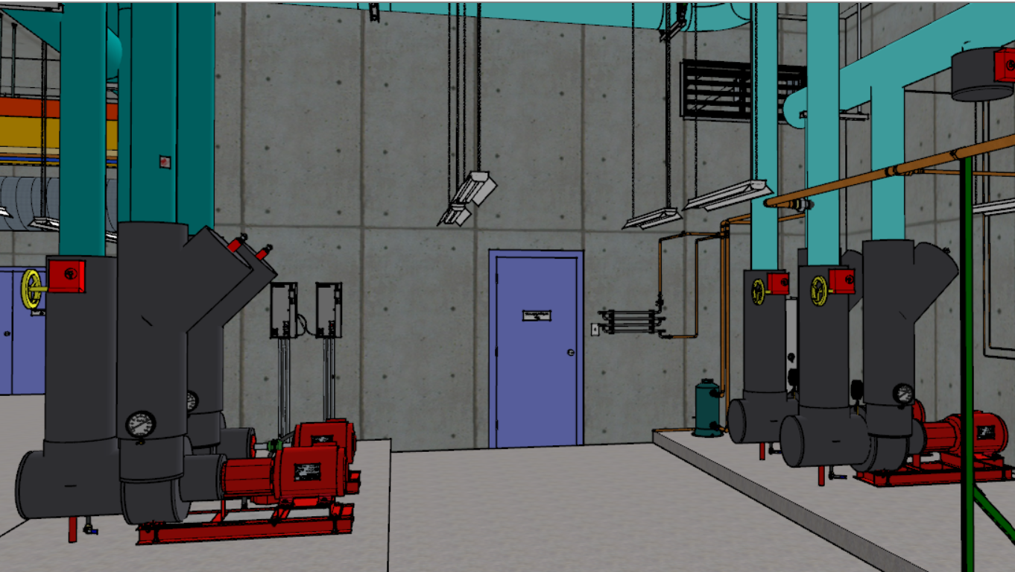
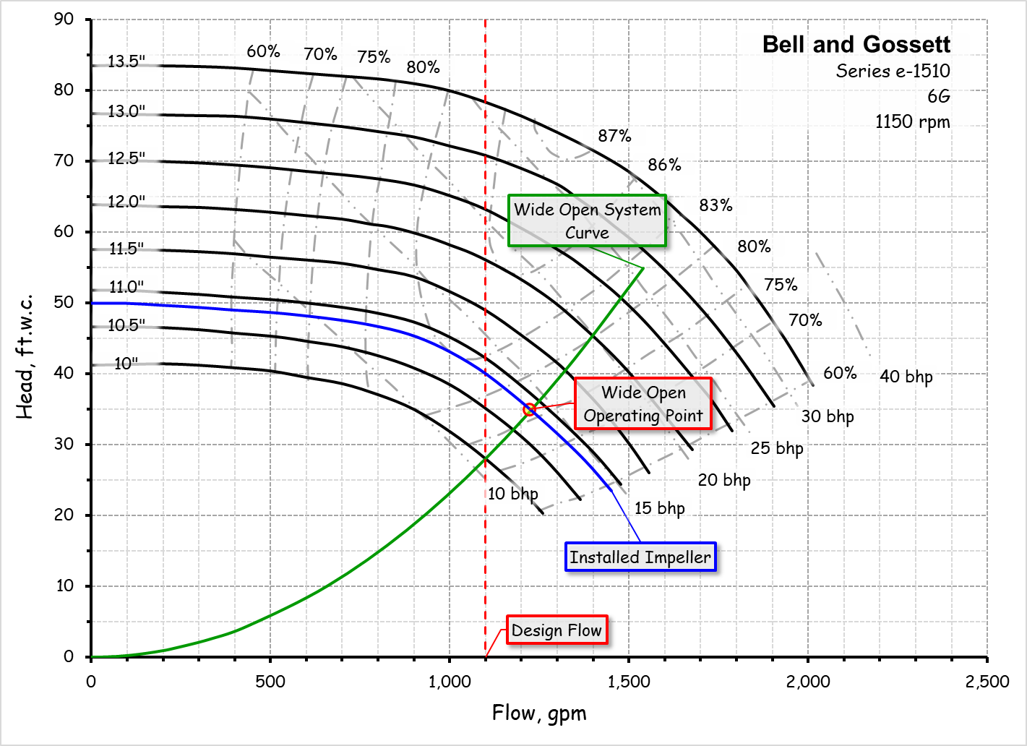
Pumps are Common EBCx Targets
The Hijend Hotel chilled water plant seems to have a number of them
Here ‘s a question for you https://tinyurl.com/EBCxWS0102PumpOpt

Slide 36
Pumps are Common EBCx Targets
The Hijend Hotel chilled water plant seems to have a number of them
Here ‘s a question for you https://tinyurl.com/EBCxWS0102PumpOpt

Slide 37
Assessing the Plant Load Condition
Break Out Session

Slide 38
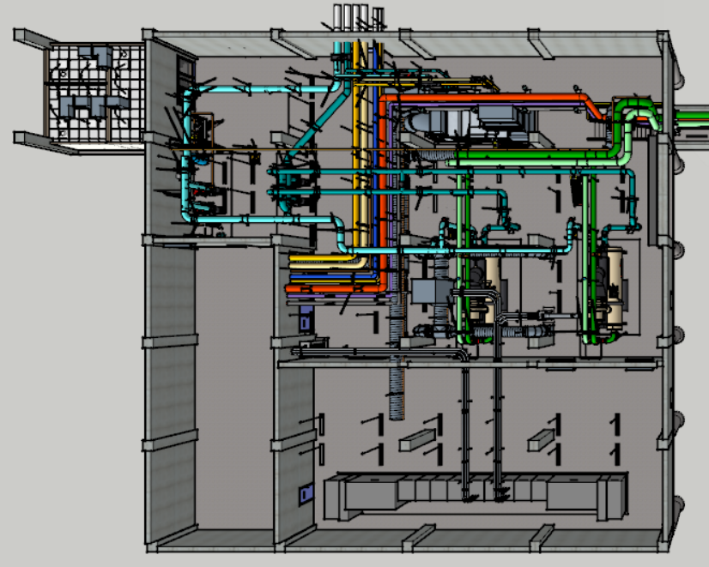
Assessing the Plant Load Condition
Let’s get oriented

Slide 39
Given:
The central plant model
The drawings you have for the plant
The work we have done up to this point

Slide 40
Assignment:
Estimate the current load condition on the central plant
Look for ways that you could develop a load profile
  There could be more than one
  Some will be better than others
  What are the pro’s and con’s for your list?

Slide 41
Let’s Go to the Breakout Rooms

Slide 42
Scoping the Ball Room AHU
Break Out Session

Slide 43
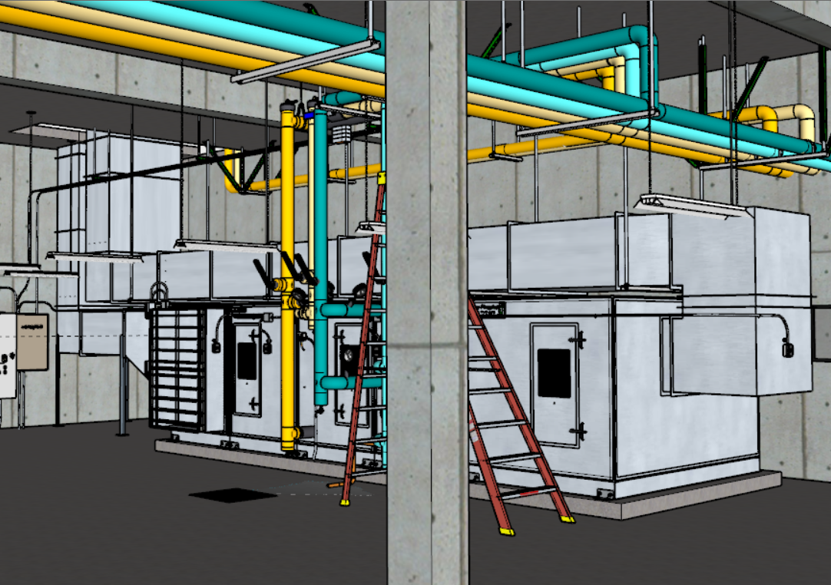
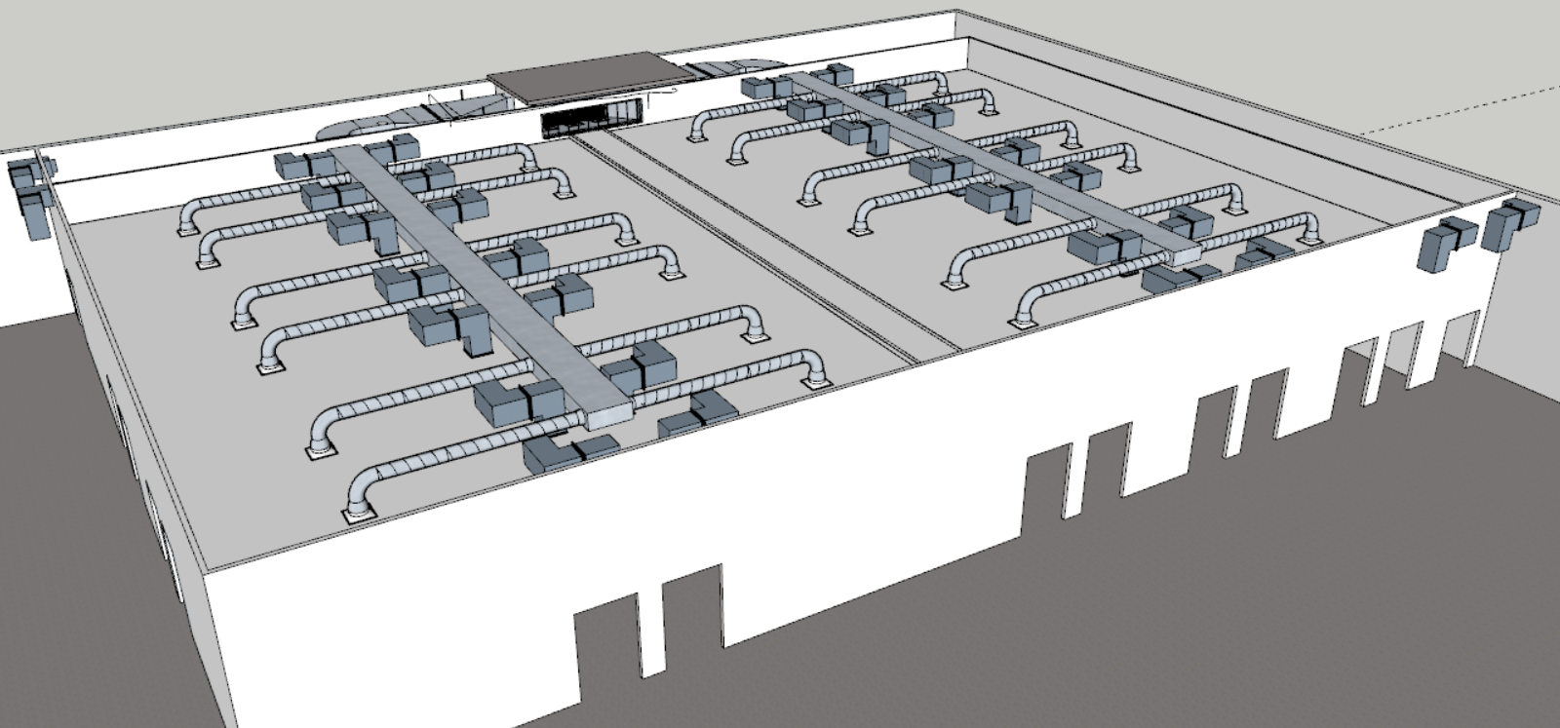
Scoping the Ball Room AHU
The Ball Room AHU is one of the components of the current load on the central plant

Slide 44
Scoping the Ball Room AHU
Let’s Get Oriented

Slide 45
Given:
The Ball Room AHU model
The documents you have for the equipment room and ball room
Previous observations

Slide 46
Assignment:
Scope the Ball Room AHU and expand the findings list
Are you finding things that may be contributors to the load condition you observed at the central plant?
If so, why?

Slide 47
Let’s Go to the Breakout Rooms

Slide 48
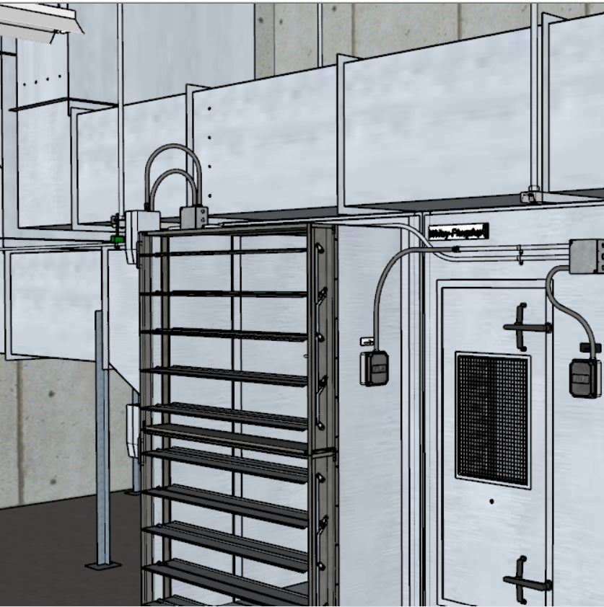
An HVAC Relationship and Few Handy Rules of Thumb for Assessing an Economizer in the Field

Slide 49
An HVAC Relationship and Few Handy Rules of Thumb for Assessing an Economizer in the Field

Slide 50
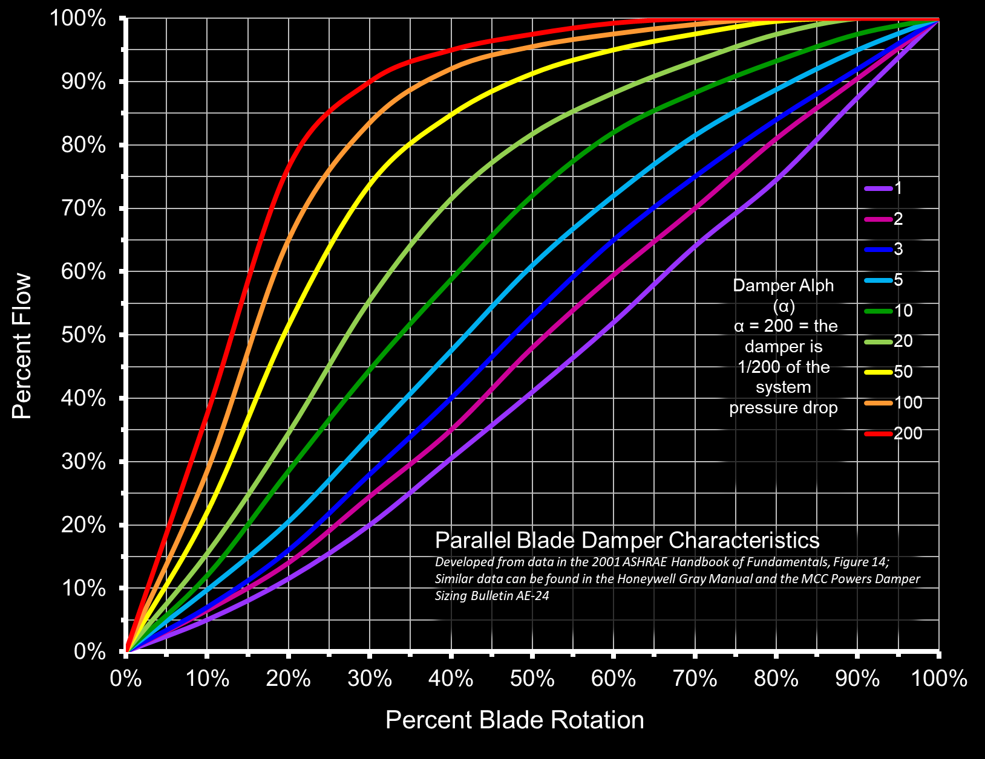
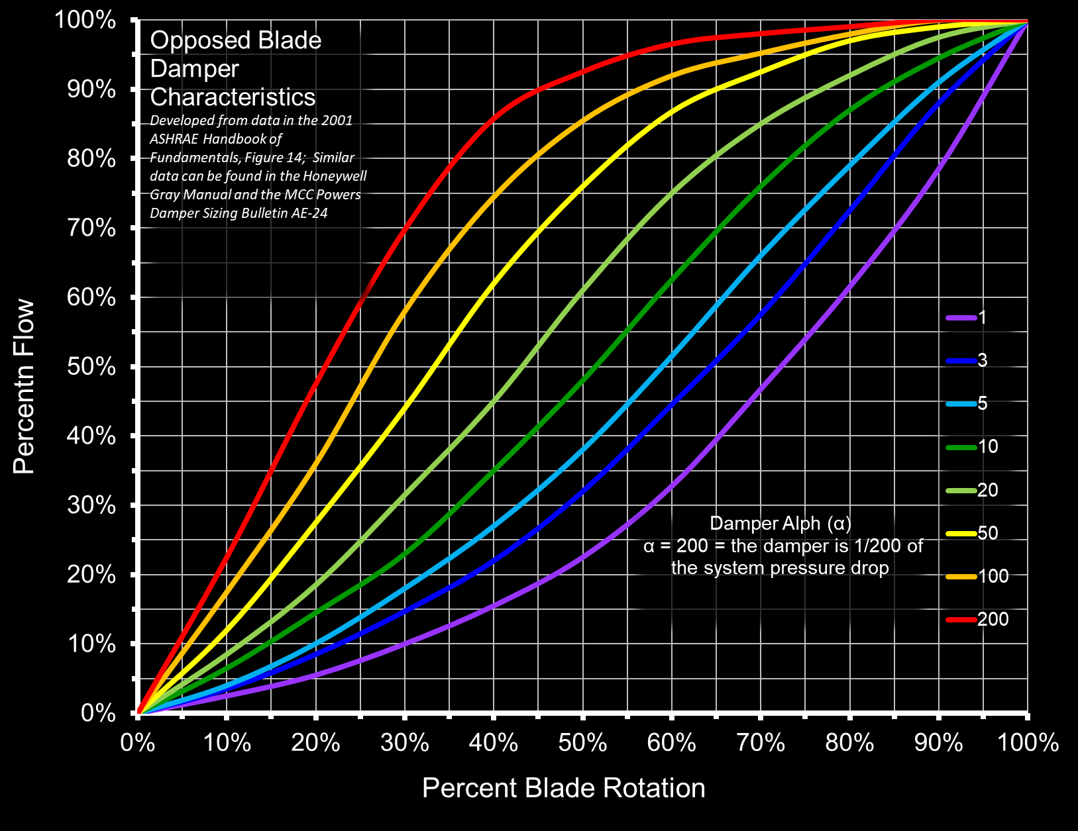
An HVAC Relationship and Few Handy Rules of Thumb for Assessing an Economizer in the Field

Slide 51
An HVAC Relationship and Few Handy Rules of Thumb for Assessing an Economizer in the Field

Slide 52
An HVAC Relationship and Few Handy Rules of Thumb for Assessing an Economizer in the Field

Slide 53
Given:
The Ball Room AHU Economizer (Scenes 10 and 11 will be handy)
The documents you have for the equipment room and ball room
The relationships we just discussed

Slide 54
Assignment
Evaluate the Ball Room AHU Economizer dampers
Do you think the dampers will have a linear characteristic
Do you think mixing will be thorough?
What are some of the implications of your observations?

Slide 55
Let’s Go to the Breakout Rooms

Slide 56
Developing a System Diagram in the Field

Slide 57
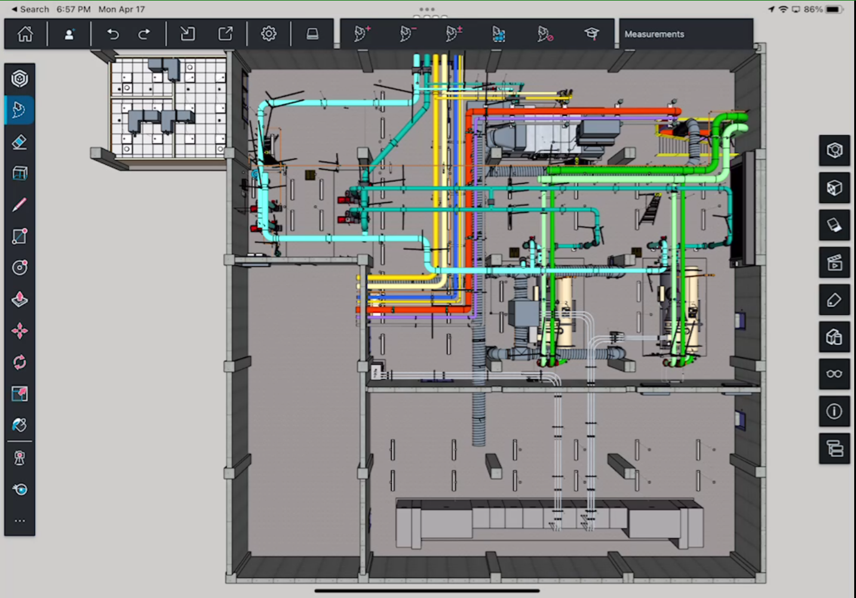

Slide 58
The Distribution Loop

Slide 59
Given:
The distribution loop sketch
The Hijend Hotel chilled water plant model

Slide 60
Assignment:
Add the evaporator loops to the sketch (hint: they will plug in between points C and D)

Slide 61
Let’s Go to the Breakout Rooms

Slide 62
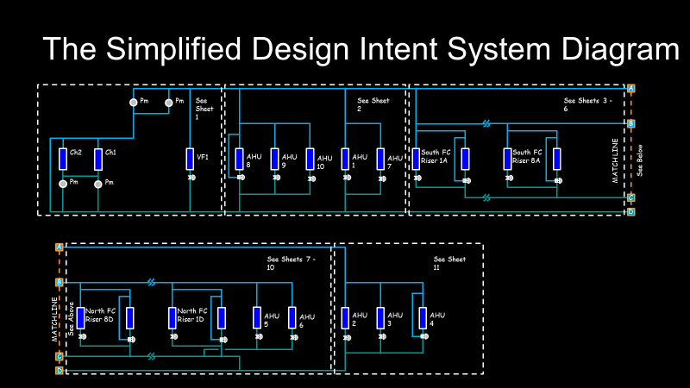
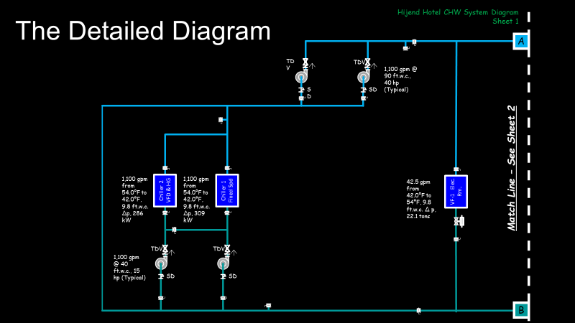
A System Diagram Development “Plan B”
Develop a first draft diagram from the project documents
Field verify it

Slide 63
The Simplified Design Intent System Diagram
A
Pm
Pm
See Sheet 1
See Sheet 2
See Sheets 3 - 6
B
MATCH LINE
See Below
Ch2
Ch1
VF1
AHU8
AHU9
AHU10
AHU1
AHU7
South FC Riser 1A
South FC Riser 8A
Pm
Pm
C
D
A
See Sheets 7 - 10
See Sheet 11
B
MATCH LINE
See Above
North FC Riser 8D
North FC Riser 1D
AHU5
AHU6
AHU2
AHU3
AHU4
C
D

Slide 64
The Detailed Diagram
Hijend Hotel CHW System Diagram
Sheet 1
A
Developed from the mechanical drawings and submittals
Needs to be field verified
TDV
TDV
1,100 gpm @ 90 ft.w.c., 40 hp (Typical)
SD
SD
Match Line – See Sheet 2
1,100 gpm from 54.0°F to 42.0°F, 9.8 ft.w.c. Δp, 286 kW
Chiller 2
VFD & HG
1,100 gpm from 54.0°F to 42.0°F, 9.8 ft.w.c. Δp, 309 kW
Chiller 1
Fixed Spd
42.5 gpm from 42.0°F to 54°F, 9.8 ft.w.c. Δ p, 22.1 tons
VF-1 Elec. Rm.
TDV
TDV
1,100 gpm @ 40 ft.w.c., 15 hp (Typical)
SD
SD
B

Slide 65
The Detailed Diagram
Hijend Hotel CHW System Diagram
Sheet 1
A
TDV
TDV
1,100 gpm @ 90 ft.w.c., 40 hp (Typical)
SD
SD
Match Line – See Sheet 2
1,100 gpm from 54.0°F to 42.0°F, 9.8 ft.w.c. Δp, 286 kW
Chiller 2
VFD & HG
1,100 gpm from 54.0°F to 42.0°F, 9.8 ft.w.c. Δp, 309 kW
Chiller 1
Fixed Spd
42.5 gpm from 42.0°F to 54°F, 9.8 ft.w.c. Δ p, 22.1 tons
VF-1 Elec. Rm.
TDV
TDV
1,100 gpm @ 40 ft.w.c., 15 hp (Typical)
SD
SD
B

Slide 66

Hijend Hotel CHW System Diagram
Sheet 2
A
C
Match Line – See Sheet 1
Match Line – See Sheet 3
43.9 gpm from 42.0°F to 54°F, 7.8 ft.w.c. Δ p, 21.9 tons; bypass balanced for 5 gpm in full bypass.
AHU8 Cafe
73.7 gpm from 42.0°F to 54°F, 9.3 ft.w.c. Δ p, 36.9 tons
AHU9 Rest/Lng
157.2 gpm from 42.0°F to 54°F, 9.6 ft.w.c. Δ p, 78.6 tons
AHU10 Kitchen
141 gpm from 42.0°F to 54°F, 8.6 ft.w.c. Δ p, 42.2 tons
AHU1 Admin/Lby
57.9 gpm from 42.0°F to 54°F, 3.1 ft.w.c. Δ p, 29 tons
AHU7 Laundry
B
D

Slide 67
Hijend Hotel CHW System Diagram
Sheet 3
C
E
F
Fan Coil Riser 1.5 A, North Face
62 gpm at 42°EWT, LWT varies, 19.1 tons
See coil schedule and fan coil riser schedule for details; three way valve bypass balanced for design flow in full bypass.
Fan Coil Riser 2.5 A, North Face
125.4 gpm at 42°EWT, LWT varies, 34.9 tons
See coil schedule and fan coil riser schedule for details; three way valve bypass balanced for design flow in full bypass.
Match Line – See Sheet 2
1st Floor (Typical through Floor 23)
24th Floor
1st Floor (Typical through Floor 24)
25th Floor
Match Line – See Sheet 4
West FCU
West FCU
West FCU
East FCU
West FCU
East FCU
G
D
H

Slide 68
Hijend Hotel CHW System Diagram
Sheet 4
E
I
F
J
Fan Coil Riser 3.5 A, North Face
124.5 gpm at 42°EWT, LWT varies, 34.2 tons
See coil schedule and fan coil riser schedule for details; three way valve bypass balanced for design flow in full bypass.
Fan Coil Riser 4.5 A, North Face
124.5 gpm at 42°EWT, LWT varies, 34.2 tons
See coil schedule and fan coil riser schedule for details; three way valve bypass balanced for design flow in full bypass.
Match Line – See Sheet 3
1st Floor (Typical through Floor 24)
25th Floor
1st Floor (Typical through Floor 24)
25th Floor
Match Line – See Sheet 5
West FCU
East FCU
West FCU
East FCU
West FCU
East FCU
West FCU
East FCU
G
K
H
L

Slide 69
Hijend Hotel CHW System Diagram
Sheet 5
I
M
J
N
Fan Coil Riser 5.5 A, North Face
124.5 gpm at 42°EWT, LWT varies, 34.2 tons
See coil schedule and fan coil riser schedule for details; ; three way valve bypass balanced for design flow in full bypass.
Fan Coil Riser 6.5 A, North Face
124.5 gpm at 42°EWT, LWT varies, 34.2 tons
See coil schedule and fan coil riser schedule for details; three way valve bypass balanced for design flow in full bypass.
Match Line – See Sheet 4
1st Floor (Typical through Floor 24)
25th Floor
1st Floor (Typical through Floor 24)
25th Floor
Match Line – See Sheet 6
West FCU
East FCU
West FCU
East FCU
West FCU
East FCU
West FCU
East FCU
K
O
L
P

Slide 70
Hijend Hotel CHW System Diagram
Sheet 6
M
Q
N
R
Fan Coil Riser 7.5 A, North Face
125.4 gpm at 42°EWT, LWT varies, 34.9 tons
See coil schedule and fan coil riser schedule for details; three way valve bypass balanced for design flow in full bypass.
Fan Coil Riser 8.5 A, North Face
121.5 gpm at 42°EWT, LWT varies, 35.5 tons
See coil schedule and fan coil riser schedule for details; three way valve bypass balanced for design flow in full bypass.
Match Line – See Sheet 5
1st Floor (Typical through Floor 24)
25th Floor
1st Floor (Typical through Floor 23)
24th Floor
Match Line – See Sheet 7
West FCU
East FCU
West FCU
West FCU
East FCU
West FCU
East FCU
O
S
P
T

Slide 71
Hijend Hotel CHW System Diagram
Sheet 7
Q
U
R
V
Fan Coil Riser 8.5 D, South Face
90.6 gpm at 42°EWT, LWT varies, 30.6 tons
See coil schedule and fan coil riser schedule for details; three way valve bypass balanced for design flow in full bypass.
Fan Coil Riser 7.5 D, South Face
187.6 gpm at 42°EWT, LWT varies, 63.4 tons
See coil schedule and fan coil riser schedule for details; three way valve bypass balanced for design flow in full bypass.
Match Line – See Sheet 6
1st Floor (Typical through Floor 23)
24th Floor
1st Floor (Typical through Floor 24)
25th Floor
Match Line – See Sheet 8
West FCU
East FCU
West FCU
West FCU
East FCU
West FCU
East FCU
S
W
T
X

Slide 72
Hijend Hotel CHW System Diagram
Sheet 8
U
Y
V
Z
Fan Coil Riser 6.5 D, South Face
189.5 gpm at 42°EWT, LWT varies, 64.0 tons
See coil schedule and fan coil riser schedule for details; three way valve bypass balanced for design flow in full bypass.
Fan Coil Riser 5.5 D, South Face
94.7 gpm at 42°EWT, LWT varies, 32 tons
See coil schedule and fan coil riser schedule for details; three way valve bypass balanced for design flow in full bypass.
Match Line – See Sheet 7
1st Floor (Typical through Floor 24)
25th Floor
1st Floor (Typical through Floor 24)
25th Floor
Match Line – See Sheet 9
West FCU
East FCU
West FCU
East FCU
East FCU
East FCU
W
A
X
B

Slide 73
Hijend Hotel CHW System Diagram
Sheet 9
U
Y
V
Z
Fan Coil Riser 4.5 D, South Face
189.5 gpm at 42°EWT, LWT varies, 64.0 tons
See coil schedule and fan coil riser schedule for details; three way valve bypass balanced for design flow in full bypass.
Fan Coil Riser 3.5 D, South Face
185.4 gpm at 42°EWT, LWT varies, 62.6 tons
See coil schedule and fan coil riser schedule for details; three way valve bypass balanced for design flow in full bypass.
Match Line – See Sheet 8
1st Floor (Typical through Floor 24)
25th Floor
1st Floor (Typical through Floor 24)
25th Floor
Match Line – See Sheet 10
West FCU
East FCU
West FCU
East FCU
West FCU
East FCU
East FCU
W
A
X
B

Slide 74
Hijend Hotel CHW System Diagram
Sheet 10
U
Y
V
Fan Coil Riser 2.5 D, South Face
181.2 gpm at 42°EWT, LWT varies, 61.2 tons
See coil schedule and fan coil riser schedule for details; three way valve bypass balanced for design flow in full bypass.
Fan Coil Riser 1.5 D, South Face
467.4 gpm at 42°EWT, LWT varies, 218.3 tons
See coil schedule and fan coil riser schedule for details; three way valve bypass balanced for design flow in full bypass.
Match Line – See Sheet 9
1st Floor (Typical through Floor 23)
24th Floor
1st Floor
25th Floor
AHU5 Corr. MAU
Roof Level
Match Line – See Sheet 11
186.3 gpm from 42.0°F to 54°F, 6.9 ft.w.c. Δ p, 91.2 tons (Typical of each MAU)
AHU6 Corr.MAU
West FCU
East FCU
West FCU
East FCU
West FCU (Typical through 24th floor)
West FCU
W
X
Z

Slide 75
Hijend Hotel CHW System Diagram
Sheet 11
Y
Match Line – See Sheet 10
148.7 gpm from 42.0°F to 54°F, 11 ft.w.c. Δ p, 74.4 tons
AHU2 Ball Room
88.7 gpm from 42.0°F to 54°F, 9.2 ft.w.c. Δ p, 44.3 tons
AHU3 Jr. Ball Room
120.1 gpm from 42.0°F to 54°F, 9.1 ft.w.c. Δ p, 60.1 tons; bypass balanced for 5 gpm in full bypass.
AHU4 Mtg. Rooms
Z

Slide 76
Fan Coil Unit Riser Schedule

Slide 77
Cooling Coil Schedule

Slide 78
System Volume Projection

Slide 79
Given:
The “Plan B” concept
The Hijend Hotel chilled water plant model
Joe DeNuguy’s system diagram developed from the project documents before going on site

Slide 80
Assignment:
Field verify the central plant portion of Joe DeNuguy’s system diagram
Was the system installed as intended based on the project documents?

Slide 81
Let’s Go to the Breakout Rooms

Slide 83


