Slide 1
EBCx Workshop Series 18
Session 1
David Sellers, Facility Dynamics Engineering
Senior Engineer

Slide 2

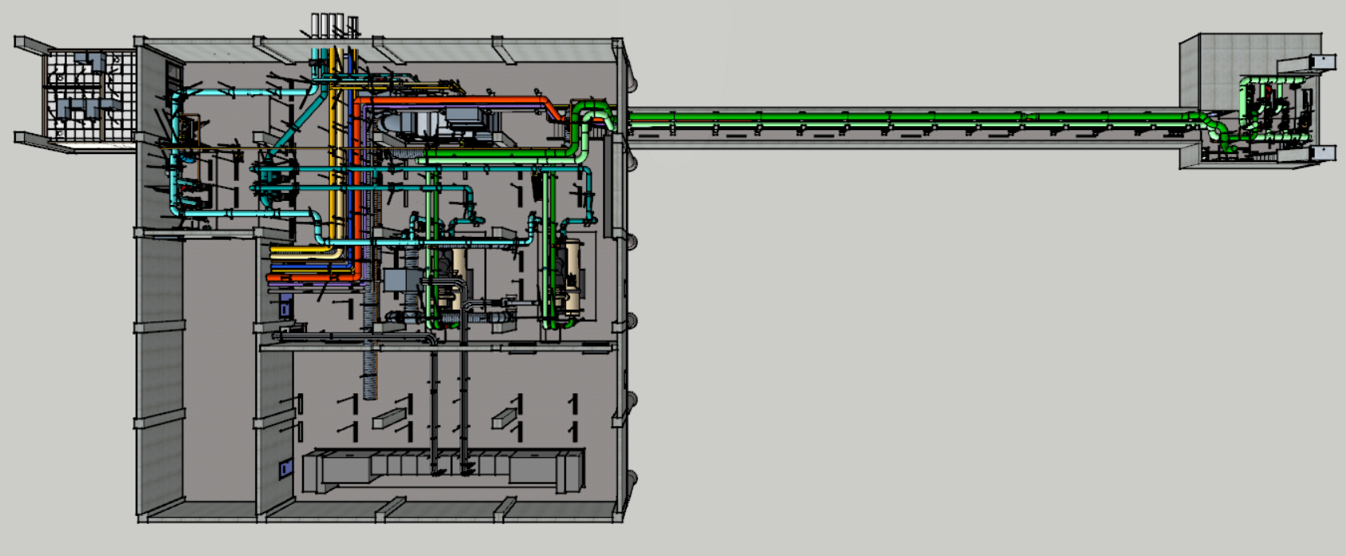
Are Your Ready to Use SketchUp
https://tinyurl.com/EBCxWS0101SketchUpReady

Slide 3
Self Study Goals

Slide 4
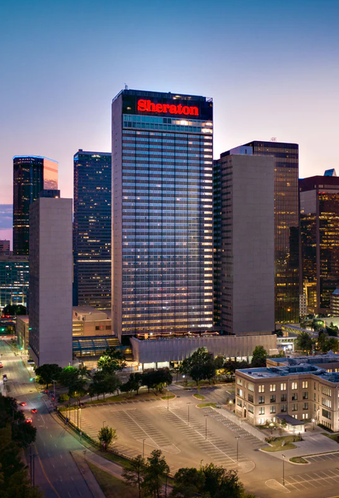
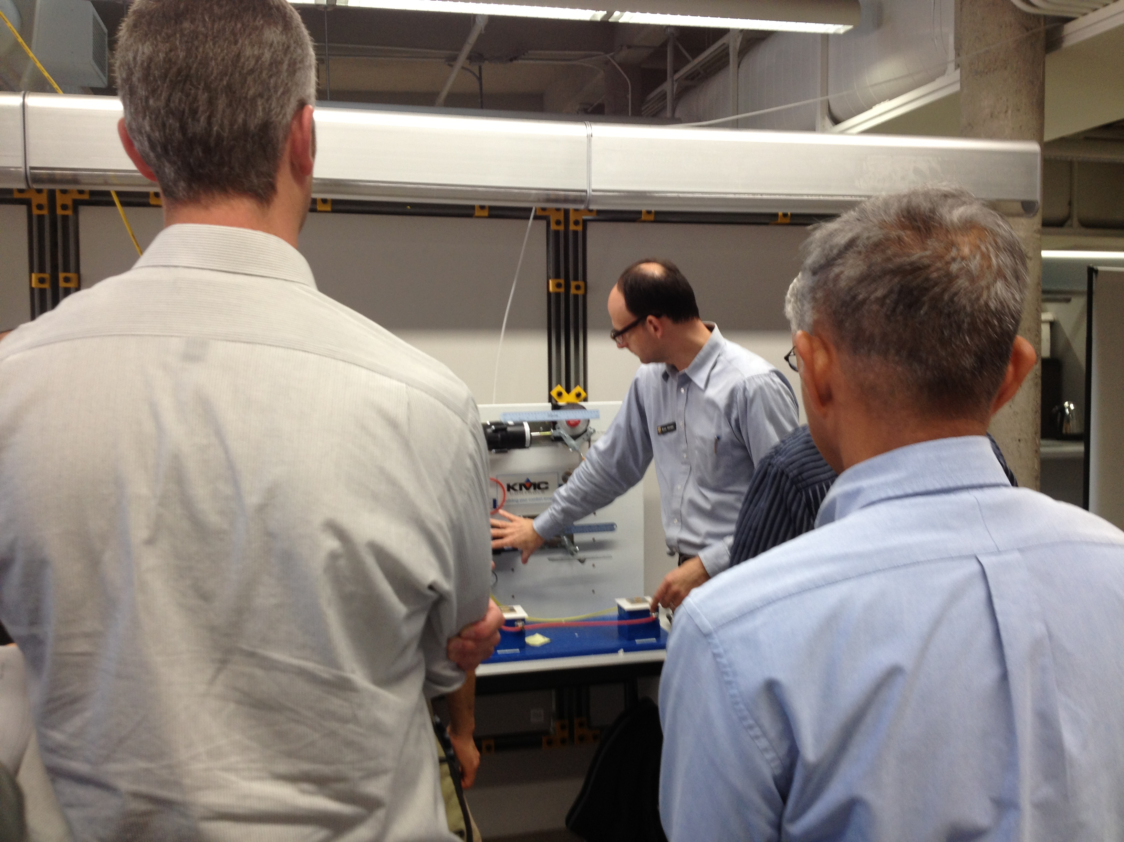
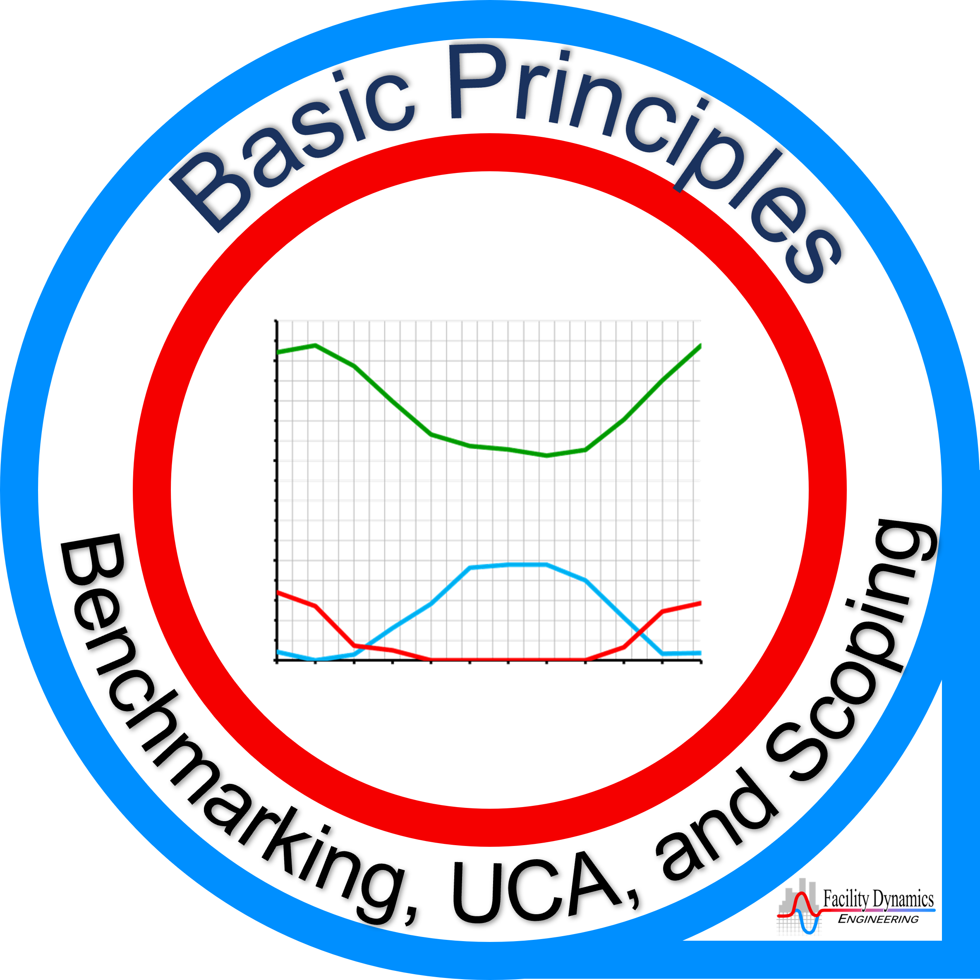

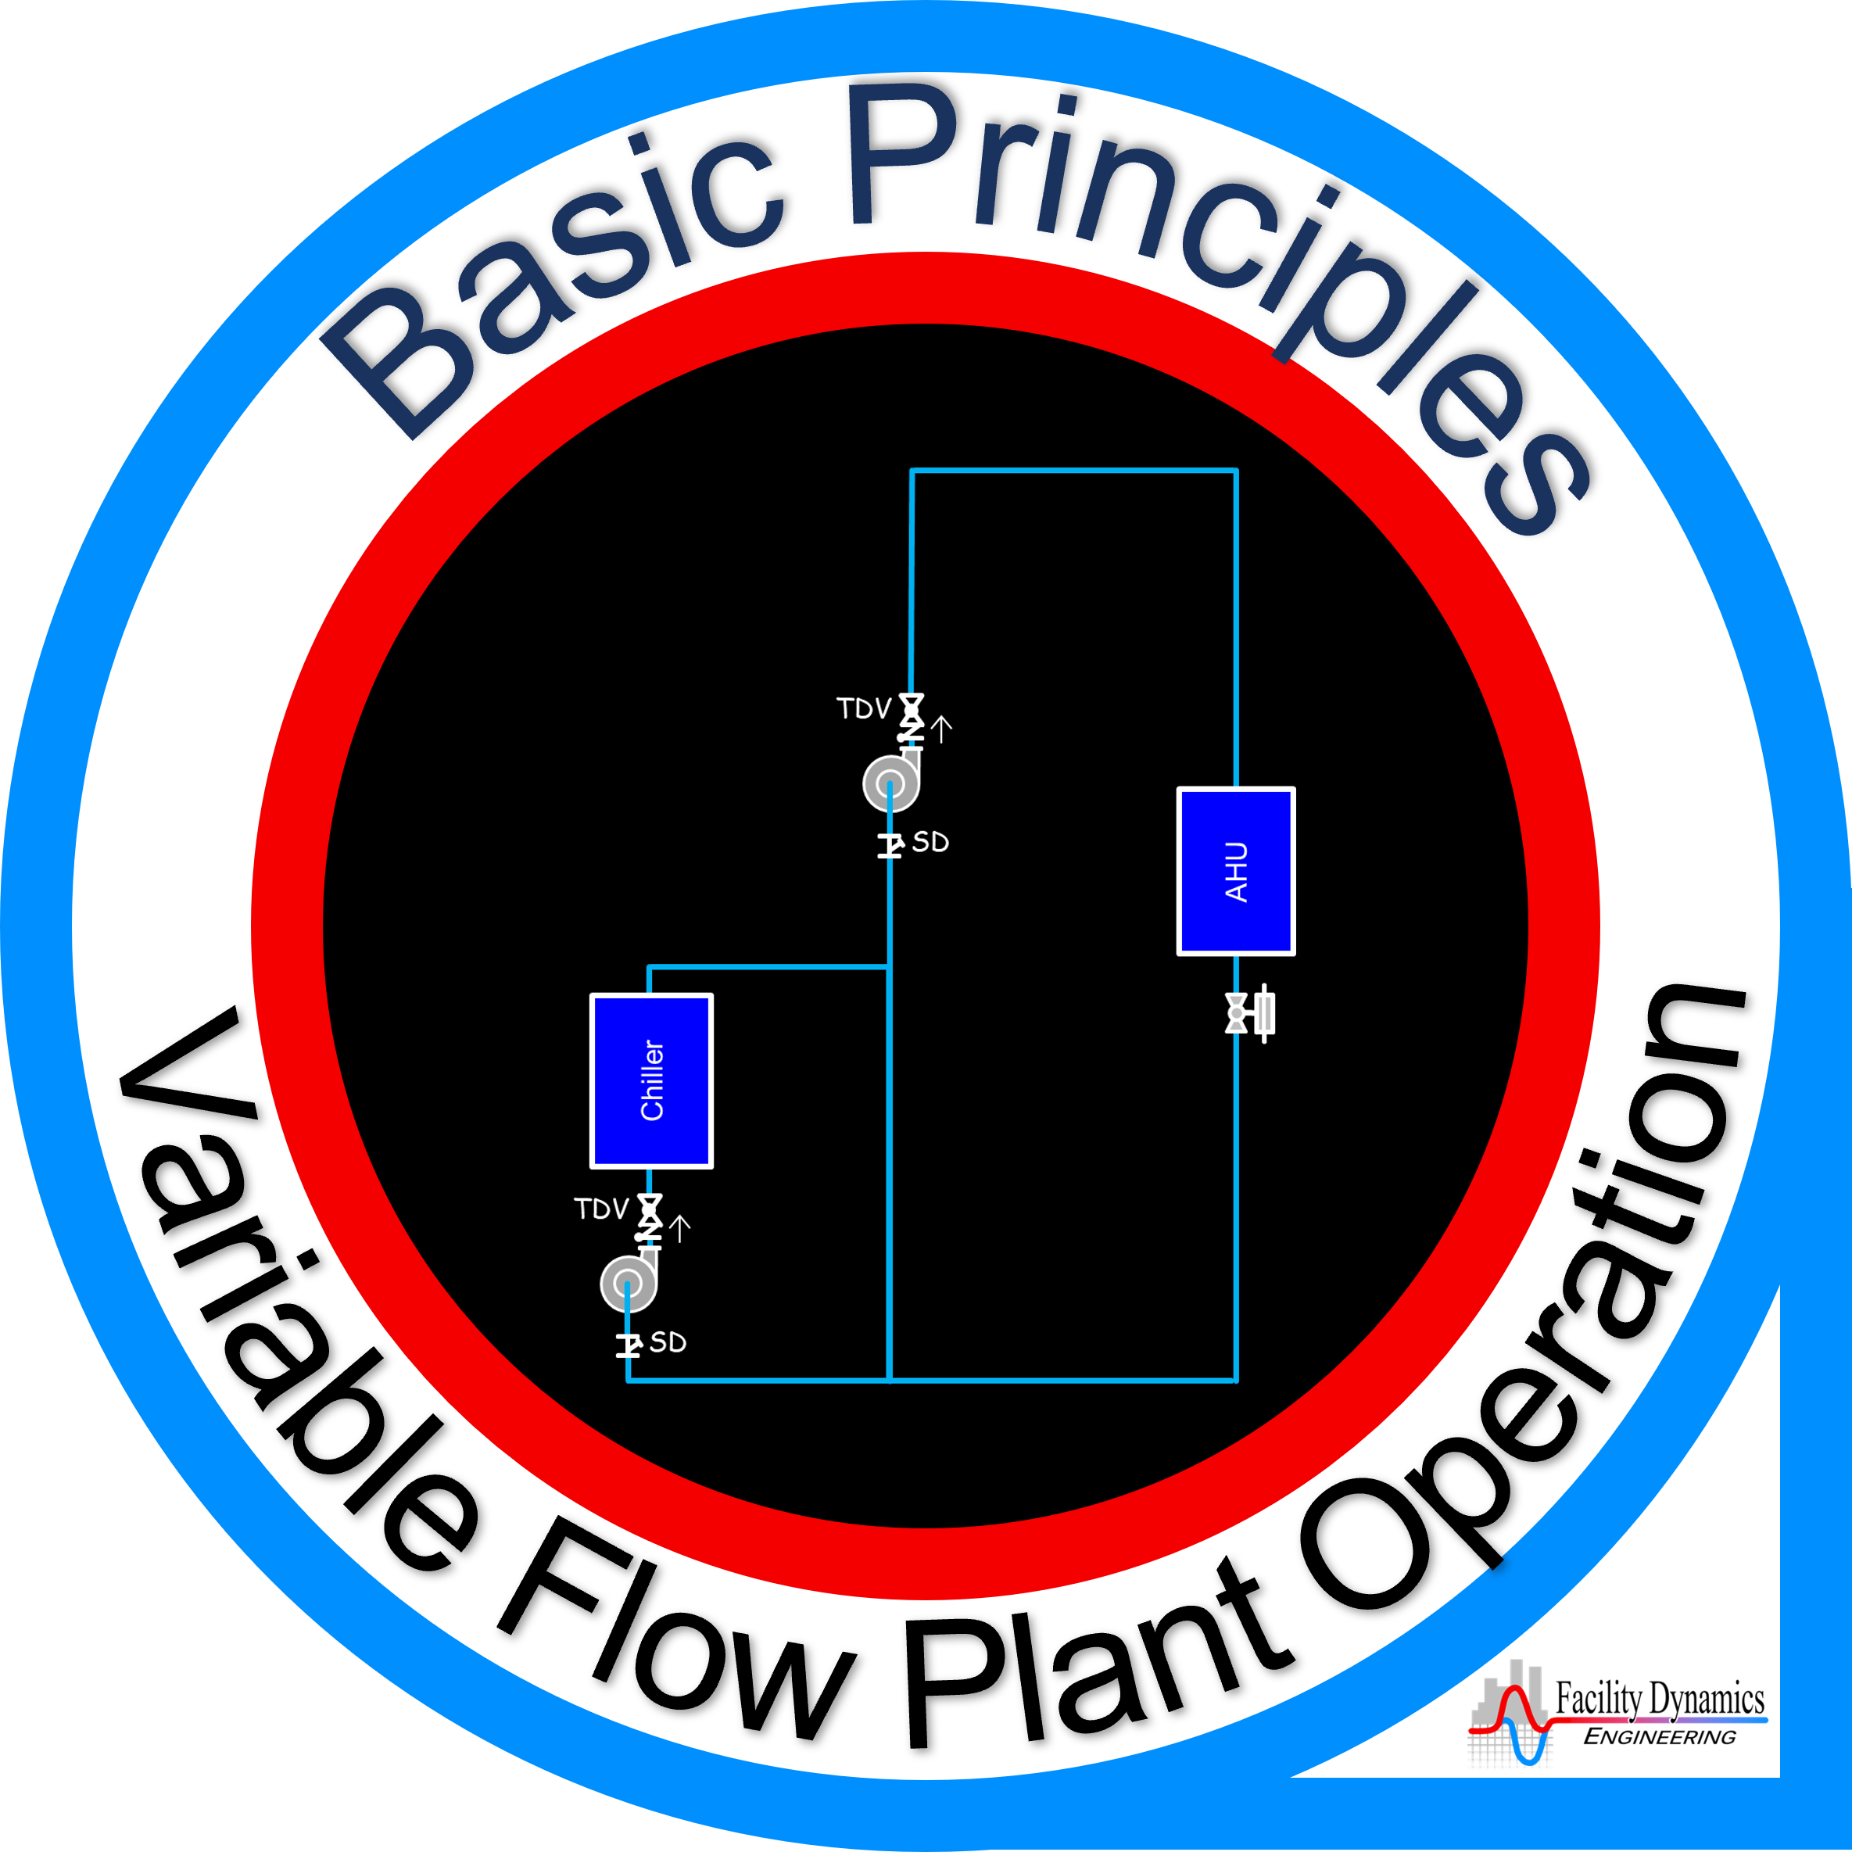
What You Should be Doing
Identify a Project Building
Begin to fill out the building information form Ryan will provide
Benchmark the building
  EnergyStar
  DOE Building Performance Database
Start a Utility Consumption Analysis
Make a site visit to scope it and start a findings list

Slide 5



Steps for Your Self-Study Effort
Collect your merit badges
https://tinyurl.com/SSBenchmarkUCAScoping
https://tinyurl.com/SSLoadsAndPsych
https://tinyurl.com/SSSystemDgmIntro

Slide 6
Next Steps for Your Self-Study Effort
Reach Out to Ryan if You Have Questions or Need Some Help
r2s2@pge.com

Slide 7
Navigating In SketchUp

Slide 8
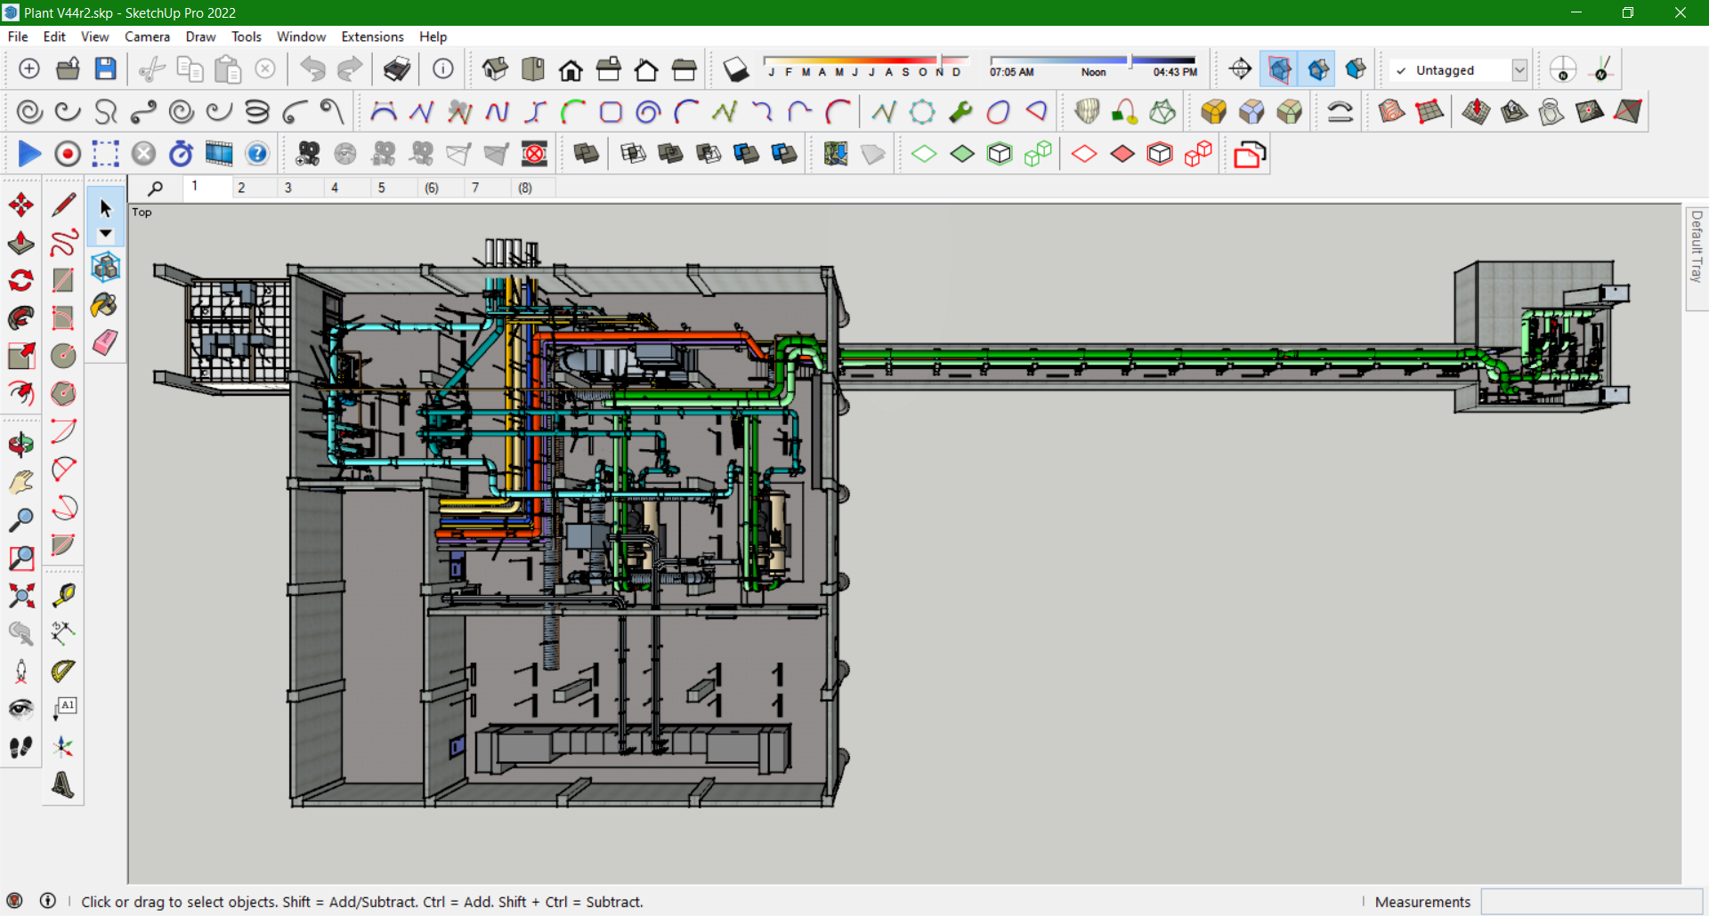

Slide 9
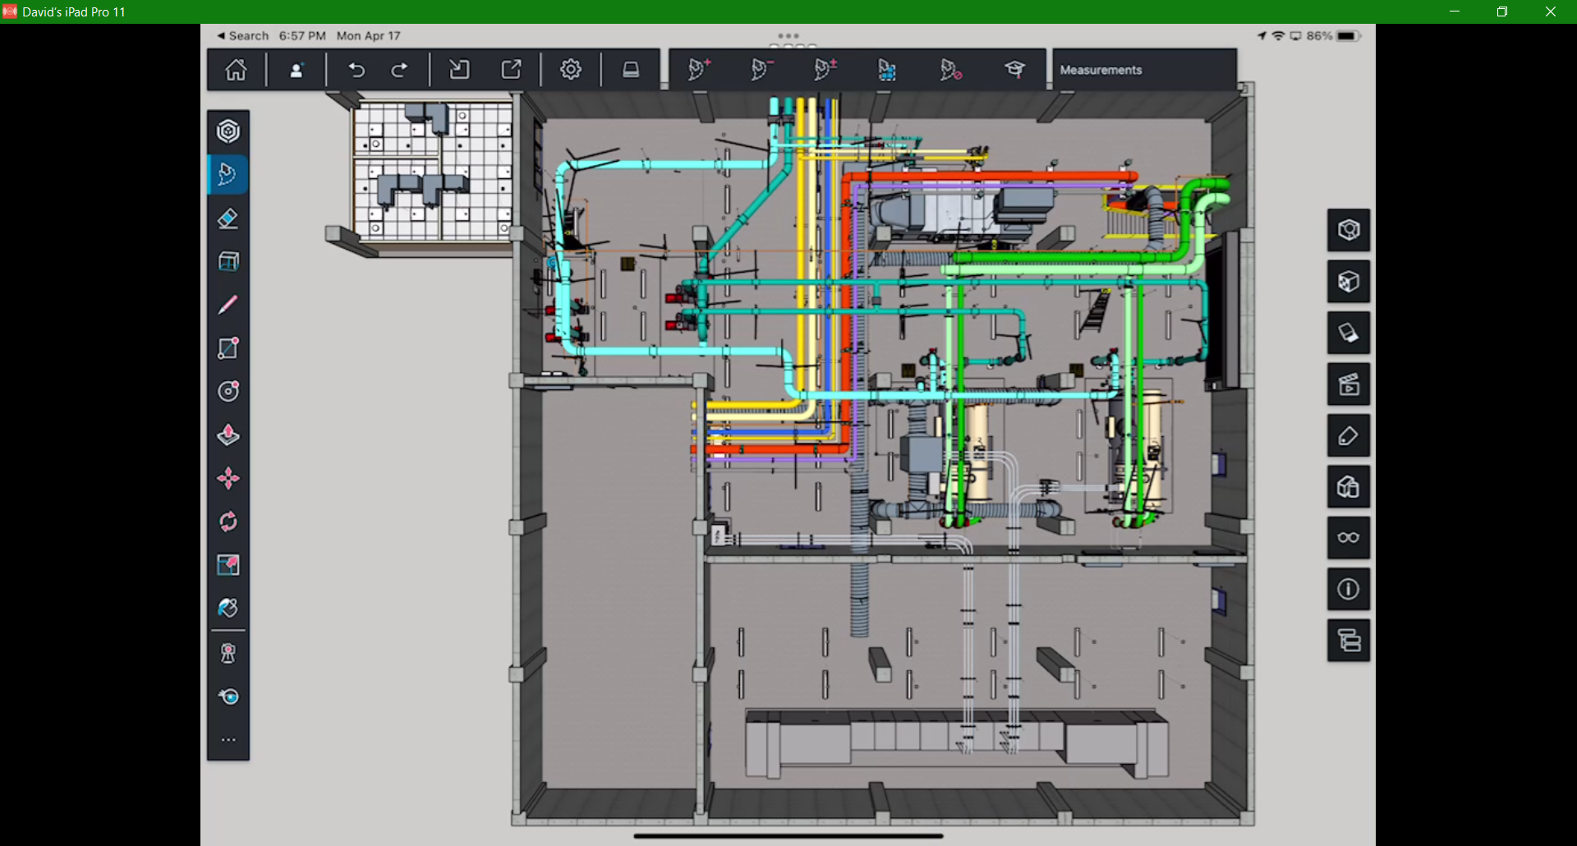

Slide 10
The Technical Guide

Slide 11
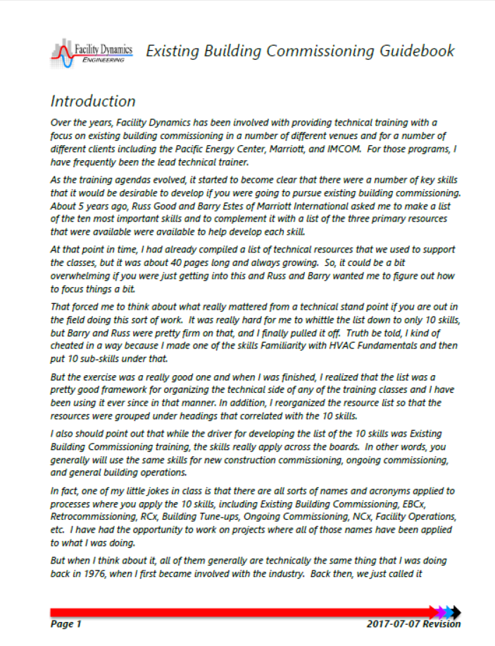

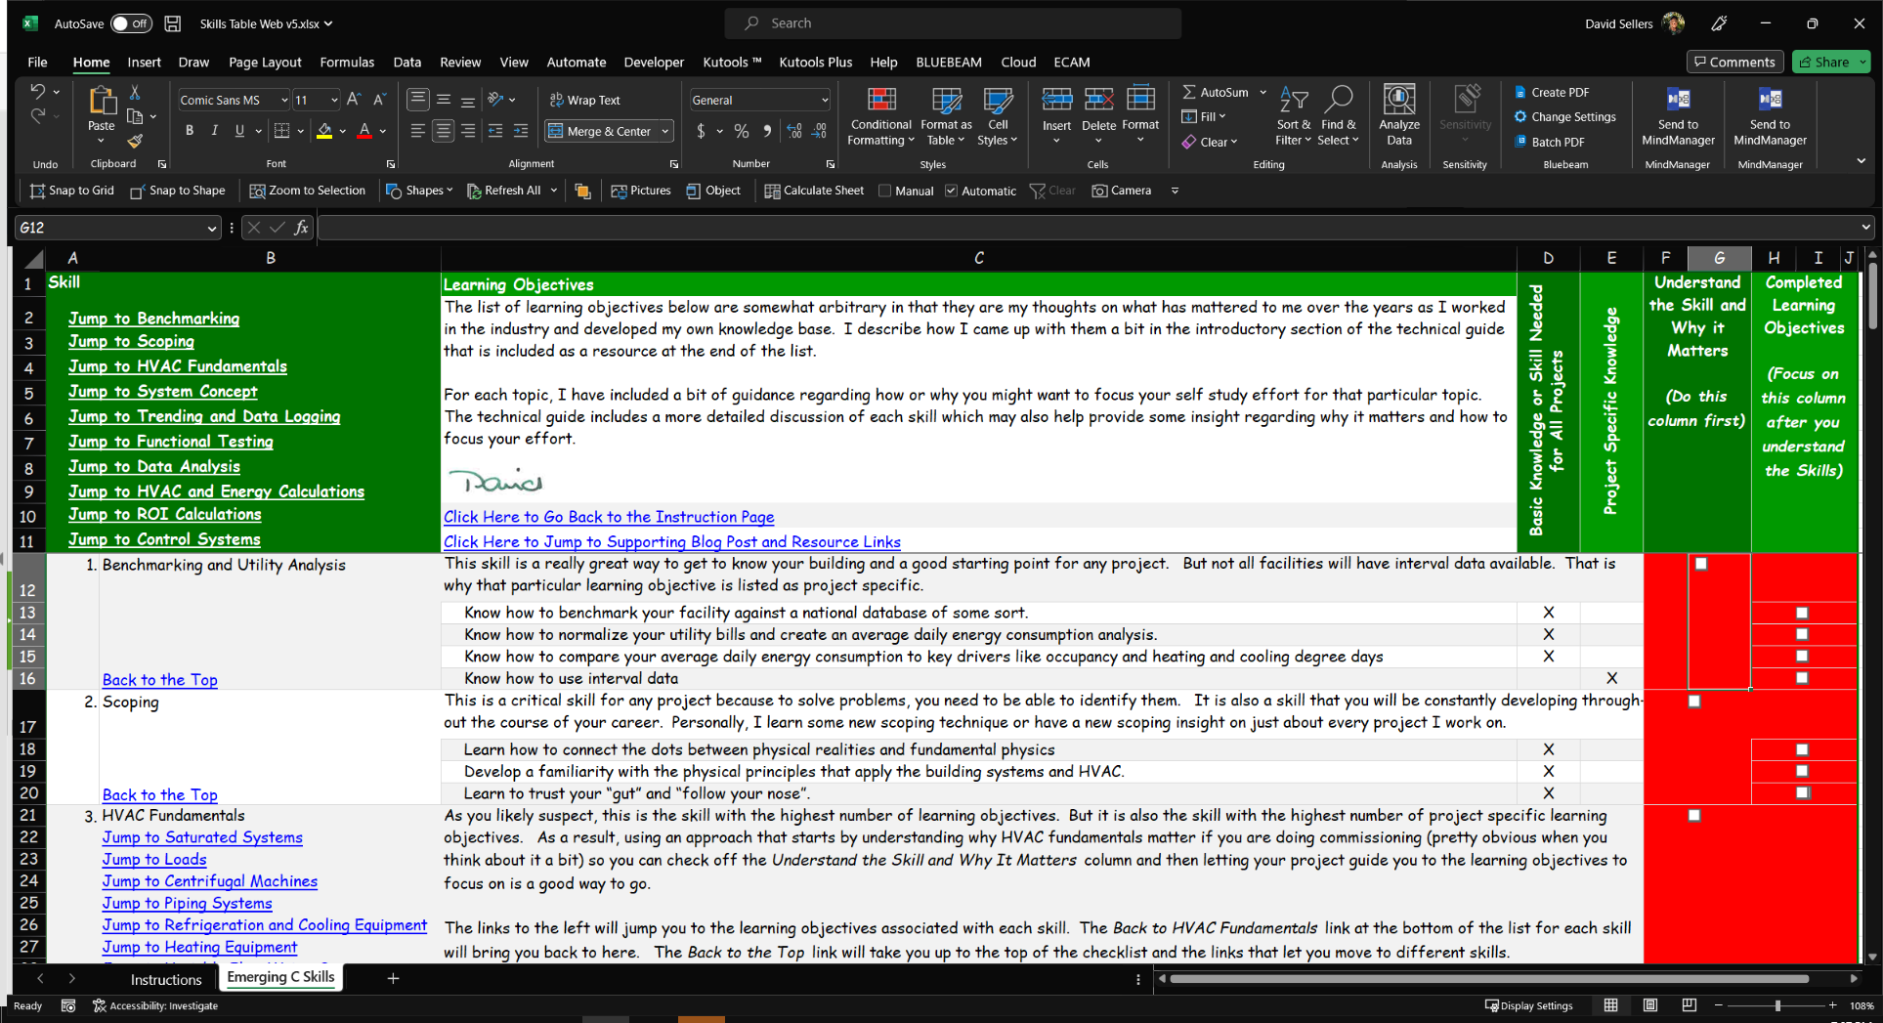
An EBCx Resource
https://tinyurl.com/EBCxGuideAndChecklist

Slide 12
Situational Awareness
A Psych Chart Refresher

Slide 13
A Psych Chart Refresher
Constant Humidity Ratio
Constant Dry Bulb
Constant RH
Constant SHR
Identify the different lines on a psych chart
Constant dry bulb
Constant wet bulb
Constant dew point
Constant humidity ratio
Constant relative humidity
Specific heat ratio
Constant Dew Point
Constant Wet Bulb
Constant Enthalpy

Slide 14
Constant Humidity Ratio
Constant Dry Bulb
Constant RH
Constant SHR
Constant Dew Point
Constant Wet Bulb
Constant Enthalpy

Slide 16
Constant SHR
Constant RH
Constant Dry Bulb
Constant Humidity Ratio
Constant Dew Point
Constant Wet Bulb
Constant Enthalpy

Slide 17
Situational Awareness
The Ball Room Design Conditions

Slide 18
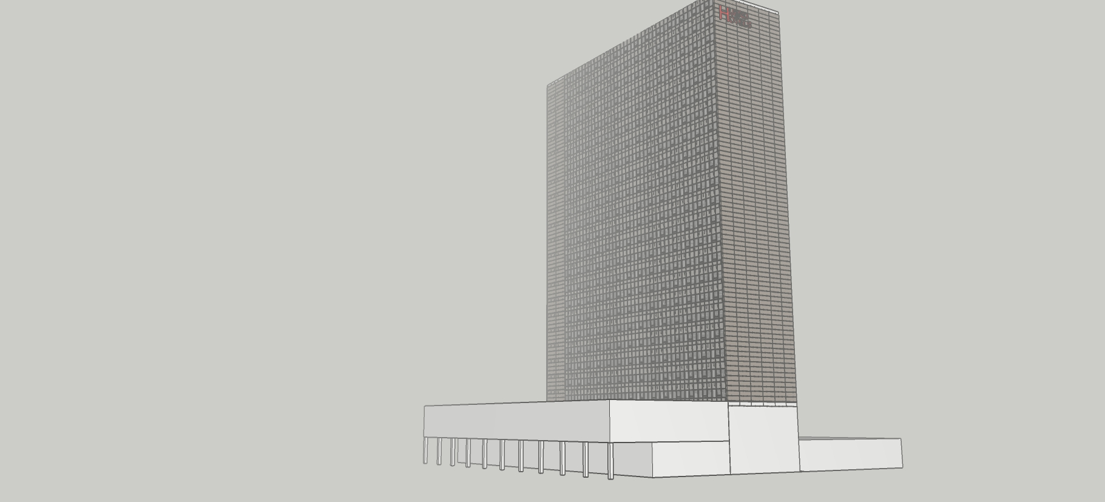
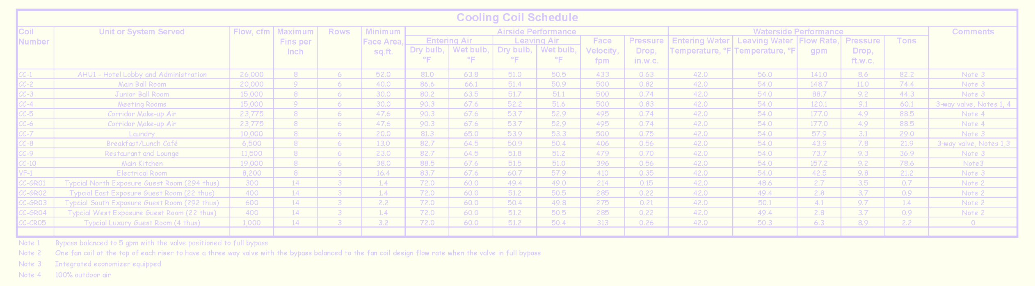
Current Conditions

Slide 19
Current Conditions
Foggy
Furnace running at home when you left
Low 50’s °F through early afternoon, then clearing and sunny with a high of 68-70°F anticipated
Hotel at 84% occupancy
Major conference happening
  Main ball room in use
  Meeting rooms and Junior Ball Room in use
  Spaces under control at design target of 72°F/50% RH
  Ballroom MOA settings recently verified

Slide 20
Ball Room Design Conditions
75°F
50% RH
Plot the design point on the chart
Constant Dew Point

Slide 21
Ball Room Design Conditions
75°F
50% RH
Plot the design point on the chart
75°F
Constant Dew Point

Slide 22
Ball Room Design Conditions
75°F
50% RH
Plot the design point on the chart
75°F
50% RH
Constant Dew Point
Ball Room Design Condition

Slide 23
Ball Room Design Conditions
75°F
50% RH
Plot the design point on the chart
75°F
50% RH
Read other parameters
Dew Point = 55.1°F
Ball Room Design Condition

Slide 24
Situational Awareness
Break Out Session

Slide 25
How to Draw a Straight Line in PowerPoint

Slide 26
How to Draw a Curved Line in PowerPoint

Slide 27
Given
Outdoor temperature = 52.2°F
Foggy
The Ball Room design condition target
AHUs with integrated economizer cycles
Should the economizer equipped AHUs be on minimum outdoor air?
Ball Room Design Condition

Slide 29
Given
52.2°F
Fog (100% RH)
Outdoor temperature = 52.2°F
Foggy
The Ball Room design condition target
AHUs with integrated economizer cycles
Should the economizer equipped AHUs be on minimum outdoor air?
No because the OA enthalpy is lower than the Ball Room Enthalpy
Ball Room h = 28.1 Btu/lb
OA h = 21.6 Btu/lb
Ball Room Design Condition

Slide 30
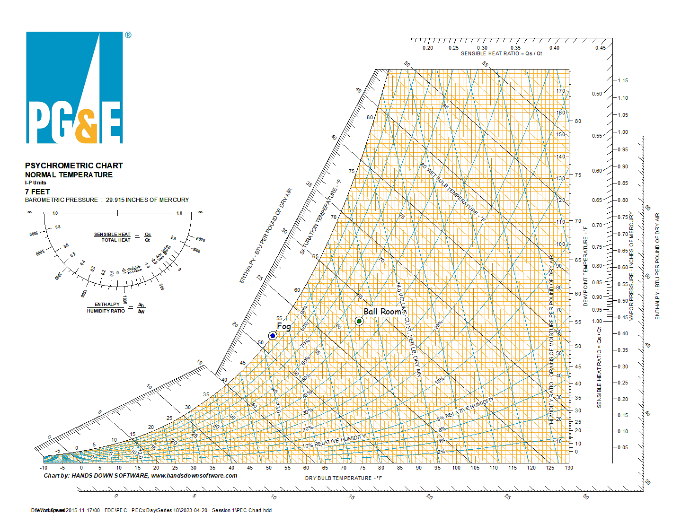

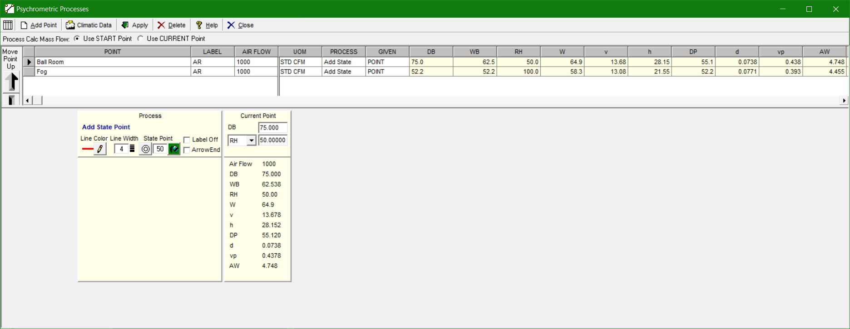
Facilitating Your Analysis
A free electronic psych chart
https://tinyurl.com/FreePsychChart

Slide 31
Facilitating Your Analysis
A free electronic psych chart
https://tinyurl.com/FreePsychChart

Slide 32
Facilitating Your Analysis
A free electronic psych chart
https://tinyurl.com/FreePsychChart

Slide 33
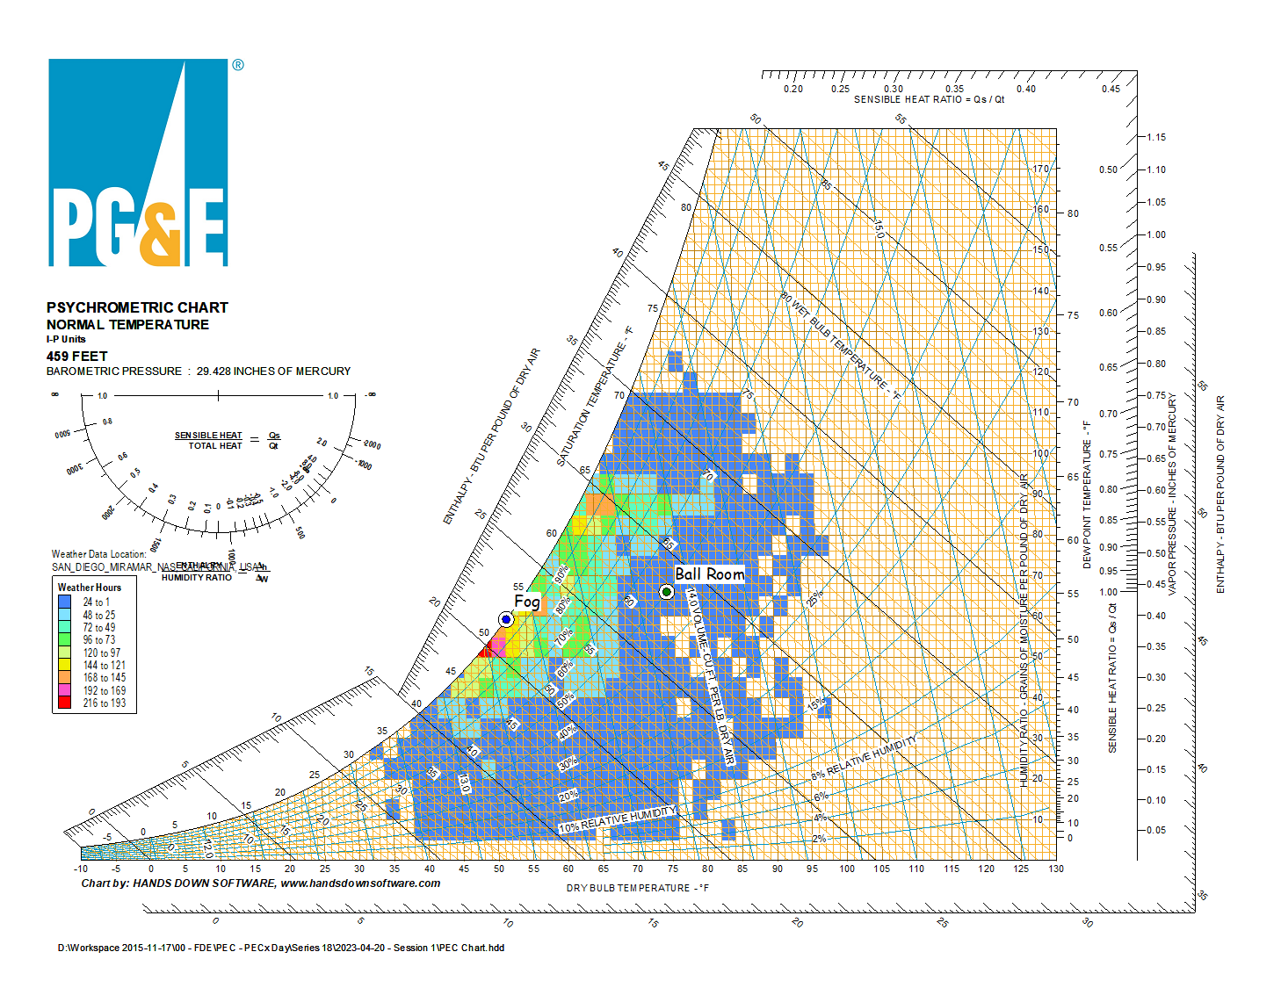
Facilitating Your Analysis
A free electronic psych chart
https://tinyurl.com/FreePsychChart

Slide 34

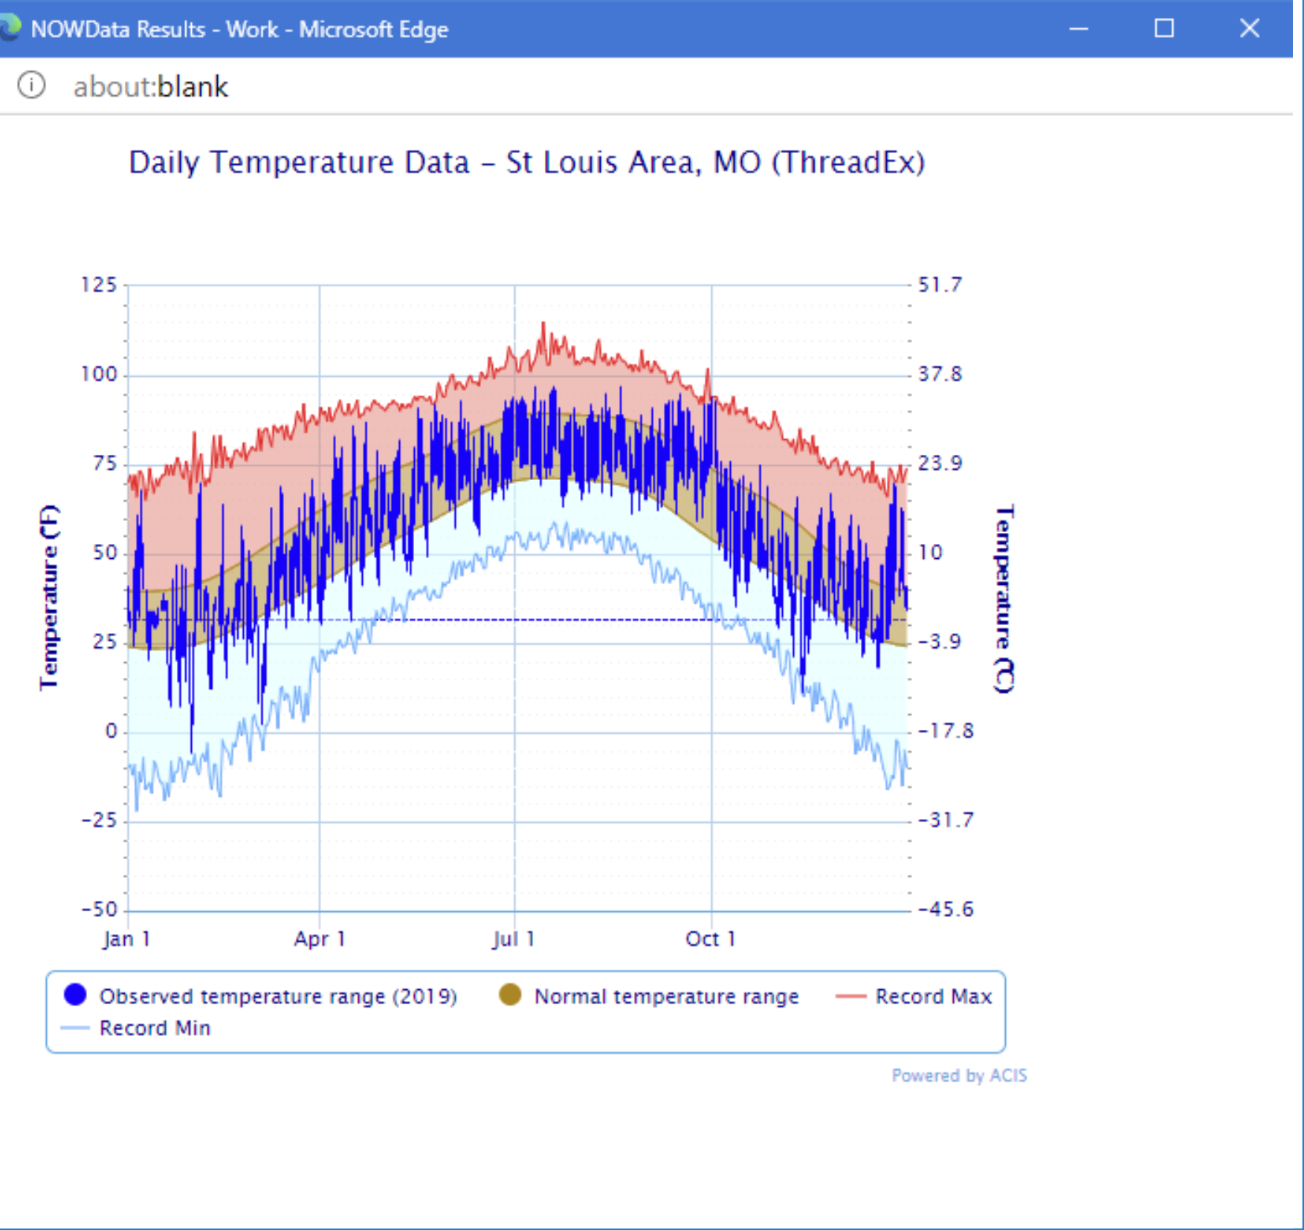
No Pro Version? No Problem! https://tinyurl.com/NOWData

Slide 35
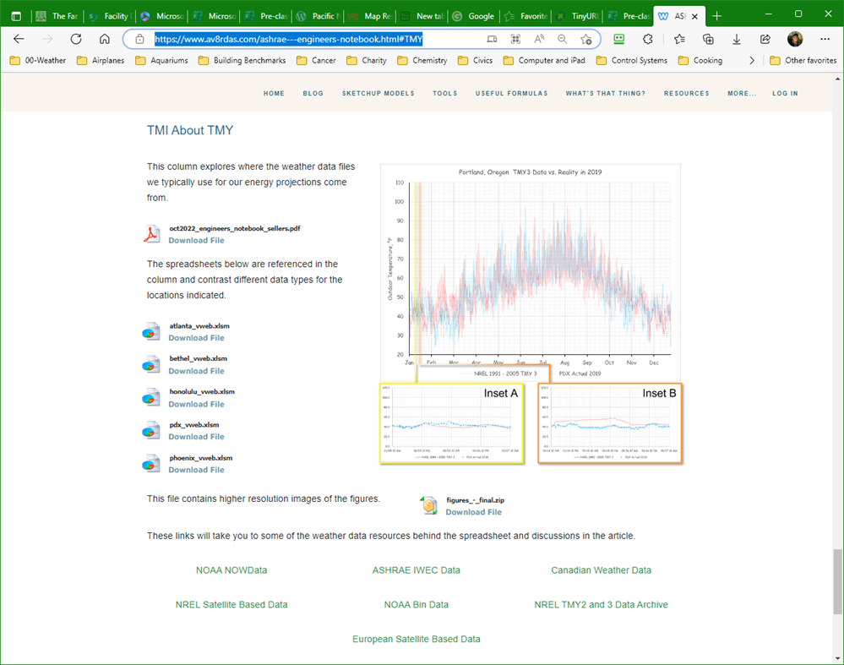
Finding Those Days https://tinyurl.com/NOWData

Slide 36

Another Climate Data Resource https://tinyurl.com/TMIAboutTMY

Slide 37
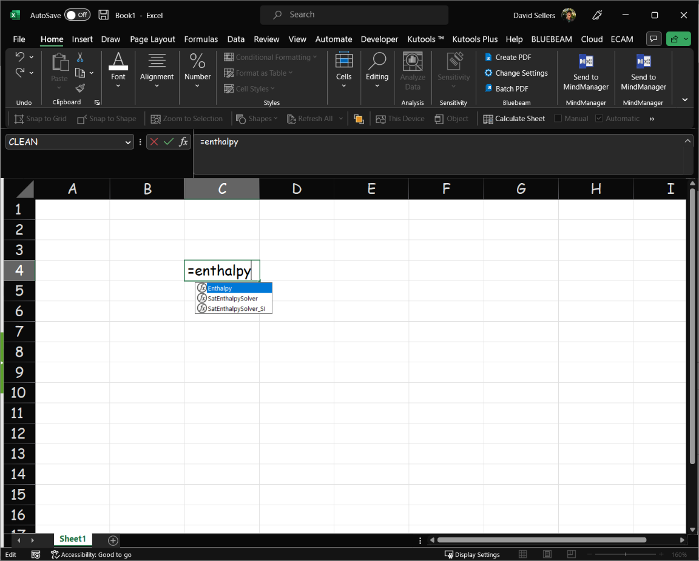

Doing Math with Psychrometrics
KW Engineering’s Get Psyched Excel Plug-in
https://tinyurl.com/kWEngineeringGetPsyched

Slide 38
Situational Awareness
Break Out Session

Slide 39
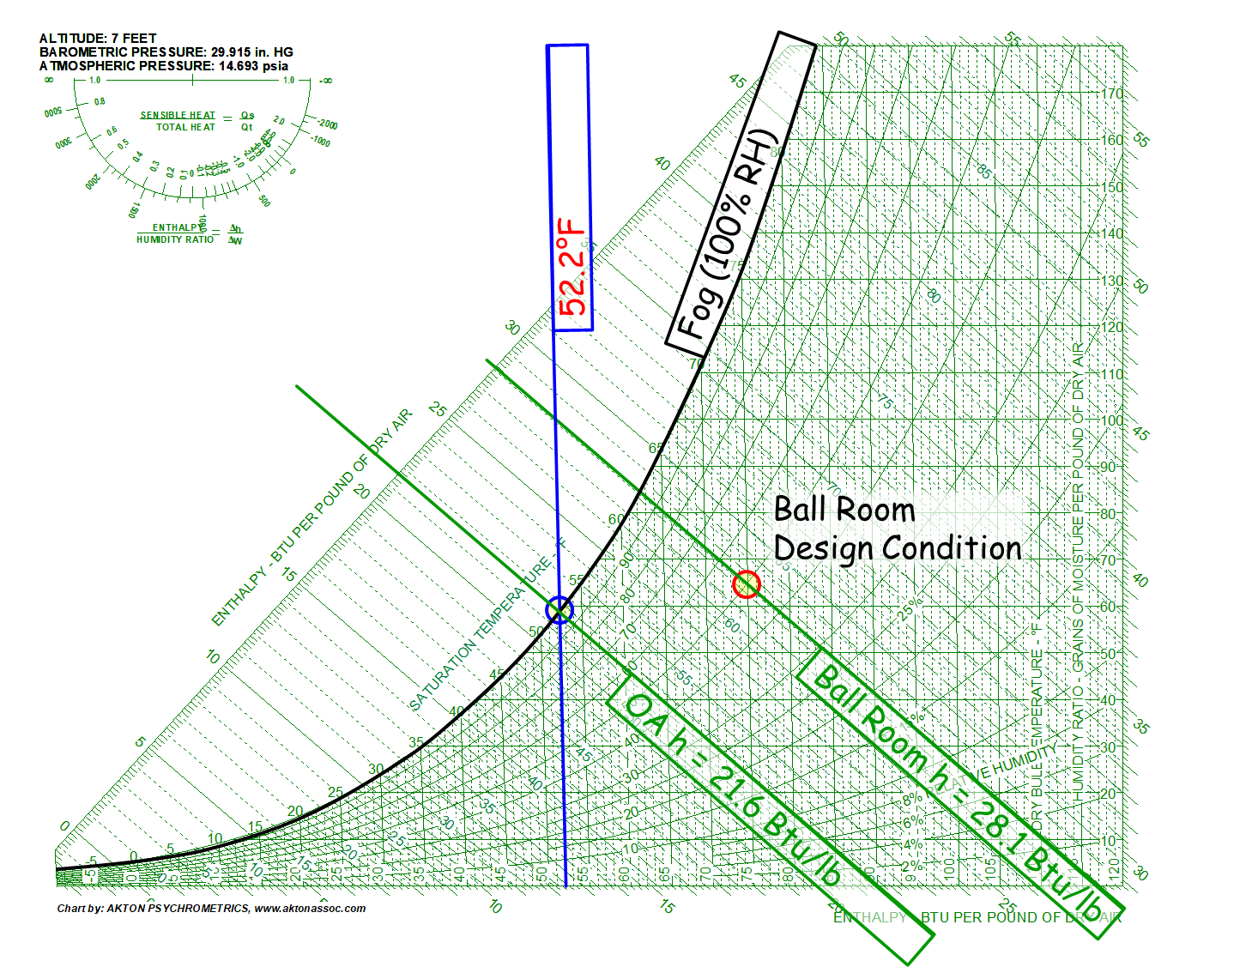

Given:
Information so far
Chilled water plant equipment schedule
A bit more information about the Hijend Hotel:
  Occupancy runs 80-95%
  Conference facility
What outdoor design cooling conditions were used by the design team?
On the day in question, would you anticipate a large load on the CWH plant and why or why not?

Slide 41
Given:
Information so far
Chilled water plant equipment schedule
A bit more information about the Hijend Hotel:
  Occupancy runs 80-95%
  Conference facility
What outdoor design cooling conditions were used by the design team?
On the day in question, would you anticipate a large load on the CWH plant and why or why not?

Slide 42
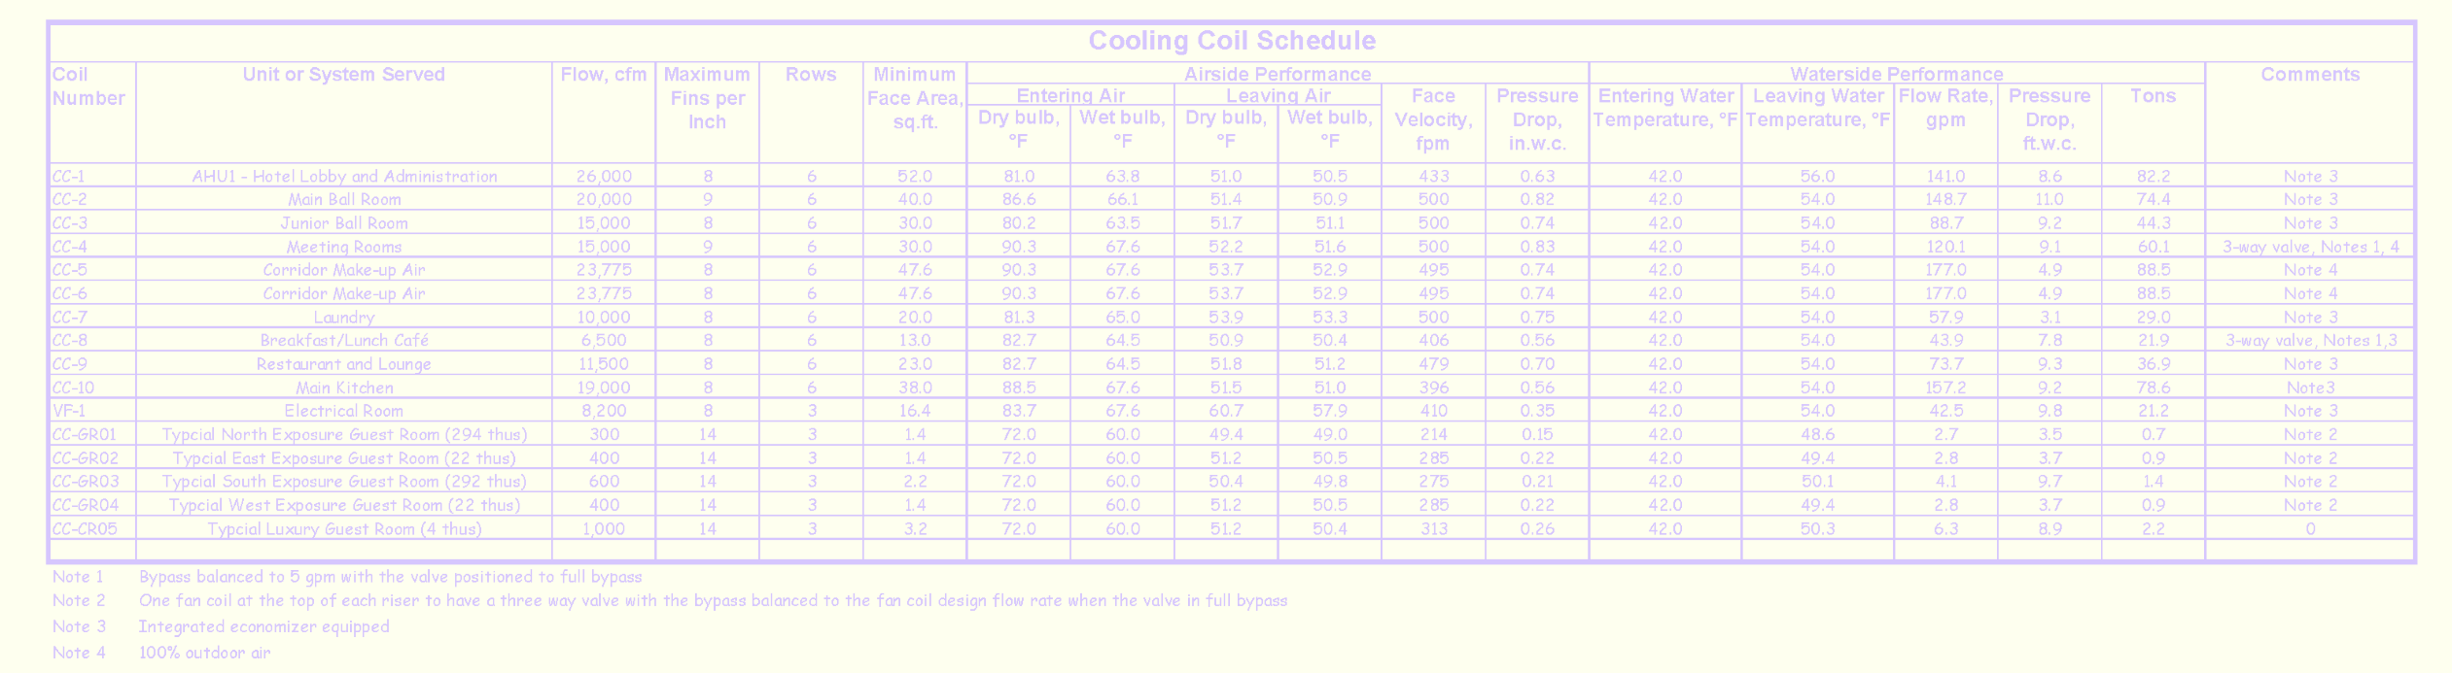
Given:
What outdoor design cooling conditions were used by the design team?
Cooling design conditions = 90.3t_{db}/67.6t_{wb} Based on 100% OA AHU entering air condition
On the day in question, would you anticipate a large load on the CWH plant and why or why not?

Slide 43
Given:
What outdoor design cooling conditions were used by the design team?
Cooling design conditions = 90.3t_{db}/67.6t_{wb} Based on 100% OA AHU entering air condition
On the day in question, would you anticipate a large load on the CWH plant and why or why not?
Very little load because the OAT is at or below the design AHU Leaving Air Temperatures (LATs). And the OAT is also below the balance point for a perimeter space

Slide 44
Getting Ready for the Field

Slide 45
We Already Have Some Clues
Utility data insights based on the EUI and average daily consumption patterns
Building documents
  Provide insights regarding the building and equipment
  Allow preliminary system diagrams to be developed
Operating conditions on the day of our visit frame up expectations

Slide 46
The EUI Relationship
The EUI relationship

Slide 47
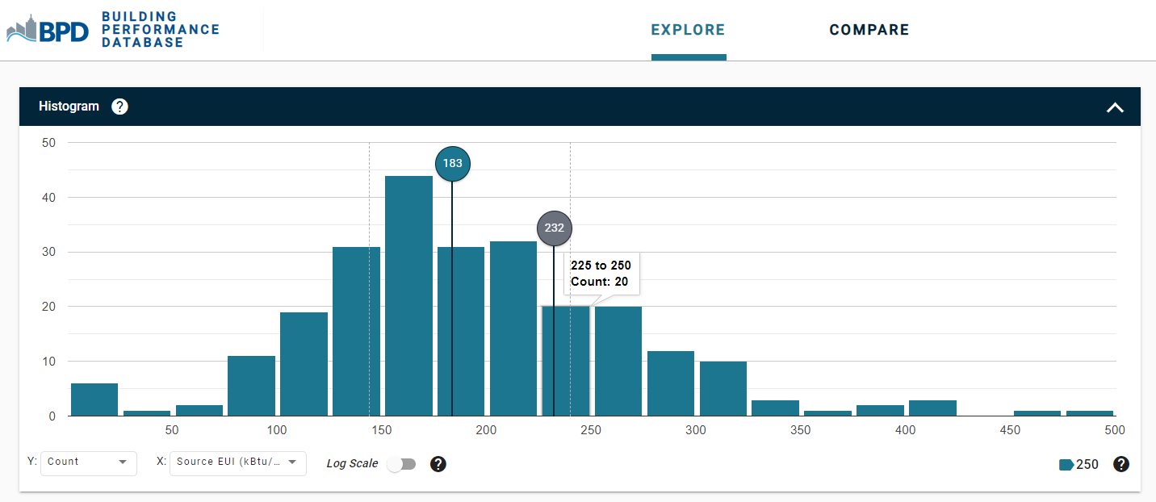
Adding Things Up

Slide 48
Adding Things Up

Slide 49
Projecting Savings

Slide 50
Projecting Savings

Slide 51
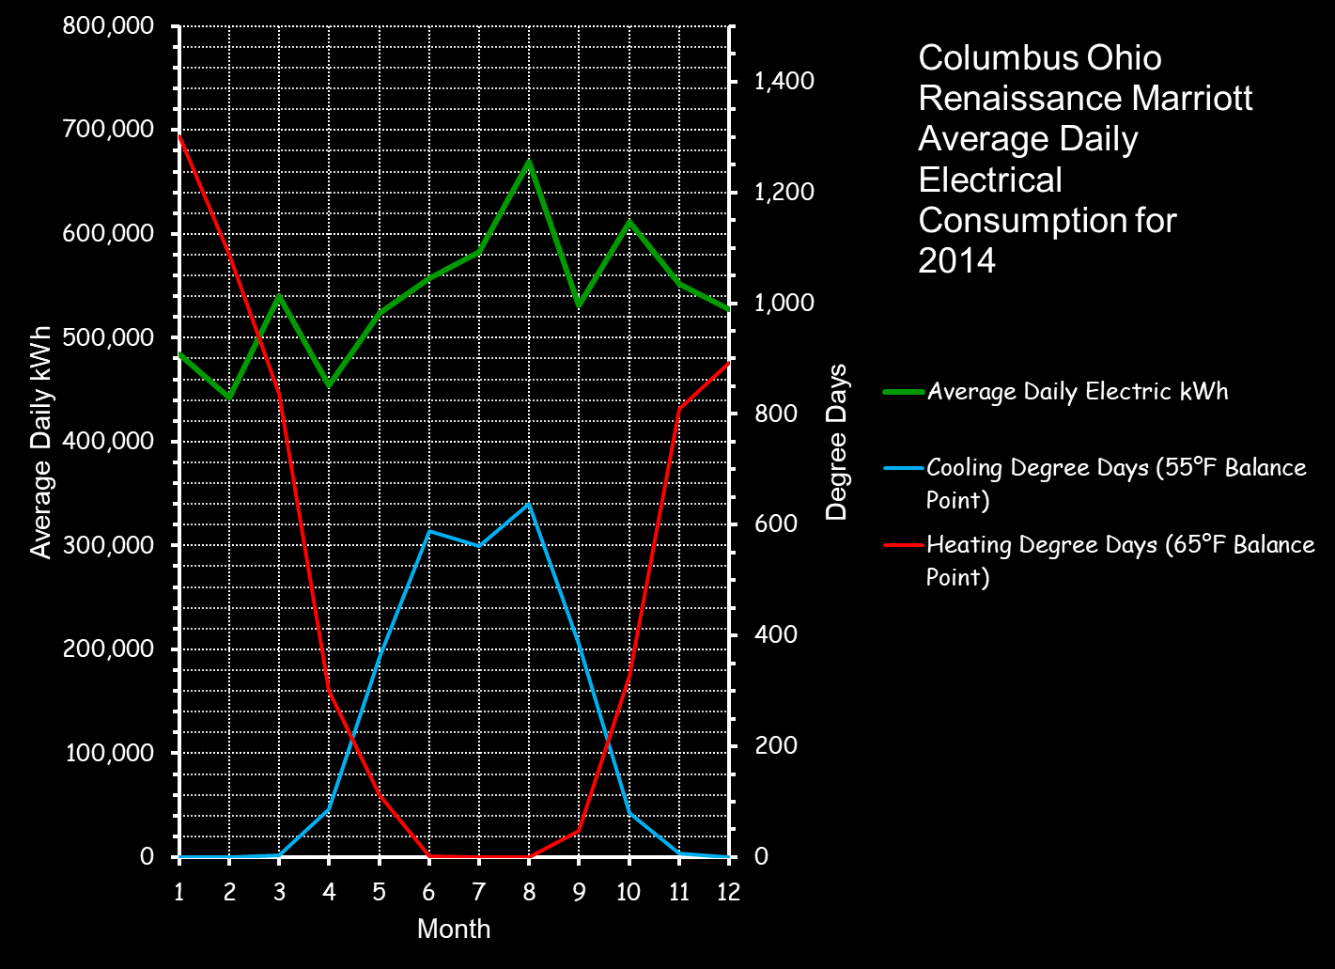
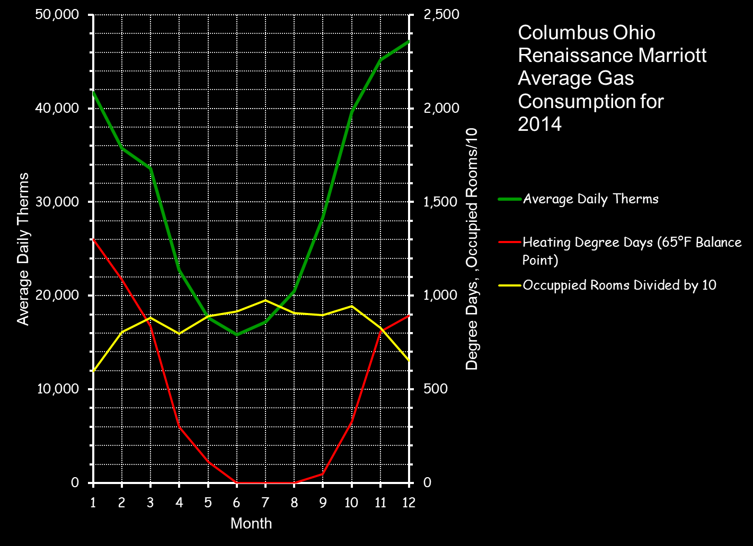

Slide 53
Think About It
It Will Come Up as We Work With the Hijend Hotel

Slide 54
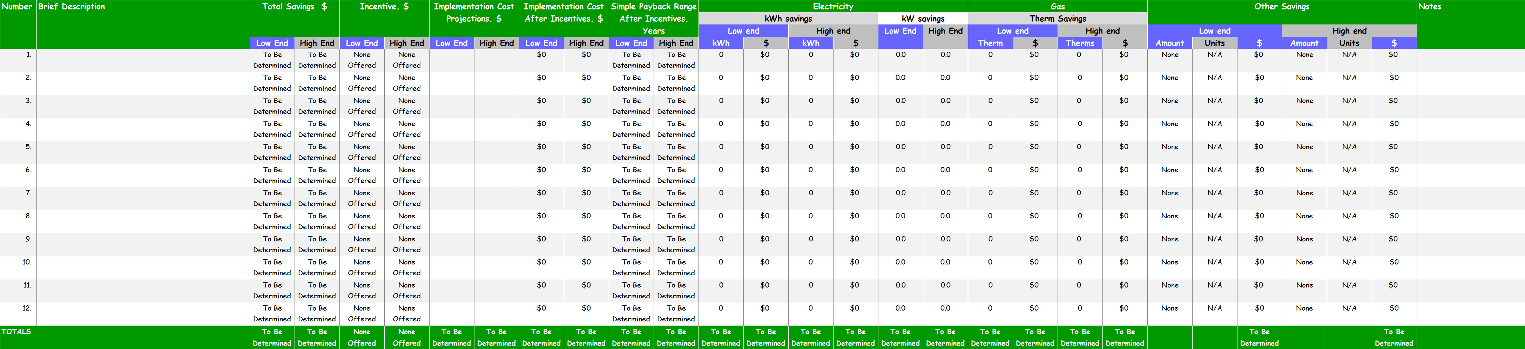

Start Your Findings List the Day You Start Your Project
https://tinyurl.com/EBCxCostBenefitSpreadsheet

Slide 55
A (Potentially) Informative Relationship
This relationship tells us that the power used by a pump is directly related to the flow and head it produces and inversely related to the pump, motor and drive system efficiency

Slide 56
Power vs. Energy
Power
Energy
Instantaneous rate of energy use
Power used over a period of time

Slide 57
Power vs. Energy
Power
Energy
Instantaneous rate of energy use
Thermal energy is similar
Power used over a period of time

Slide 58
Power vs. Energy
Power
Energy
Instantaneous rate of energy use
Power used over a period of time
Can be established by a test
Variations in flow and head will shift the operating point and cause variations in power
Shifting the operating point can cause pump efficiency to vary, also affecting power
Variations in power will cause variations in motor and drive efficiency

Slide 59
Power vs. Energy
Power
Energy
Instantaneous rate of energy use
Power used over a period of time
For a constant flow system:
Nothing varies
Only one test point is required

Slide 60
Power vs. Energy
Power
Energy
Instantaneous rate of energy use
Power used over a period of time
For a variable flow system:
Everything can vary
Multiple test points are required

Slide 61
Power vs. Energy
Power
Energy
Instantaneous rate of energy use
Power used over a period of time
For a variable flow system:
Establishing the load or flow profile for your energy calculations is critical

Slide 62
Establishing Load and Flow Profiles
Calculated
Measured
Potentially time consuming
May require complex mathematics or software
Only as good as the assumptions
No assumptions!
  Reflects the current state of affairs
May require complex mathematics or software
  But typically, you can handle it with Excel
Requires some time to establish
  Using regressions can compress the timeline
  Need to start gathering data early
Start thinking about it while you are scoping and look for ways you could do it

Slide 63

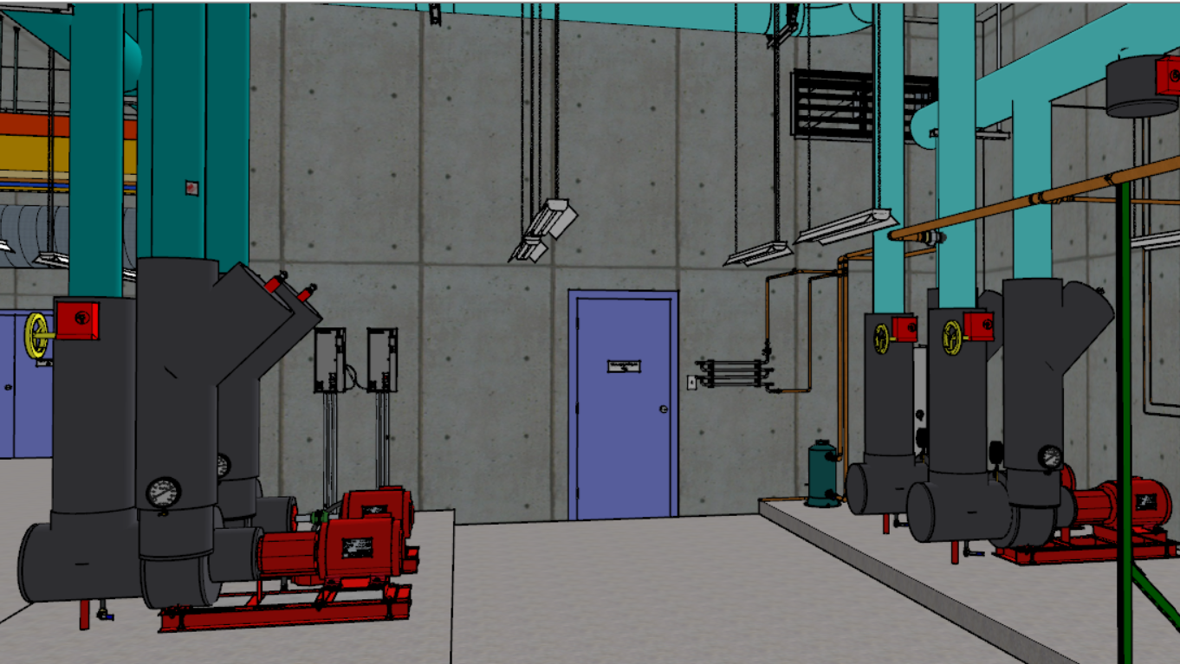
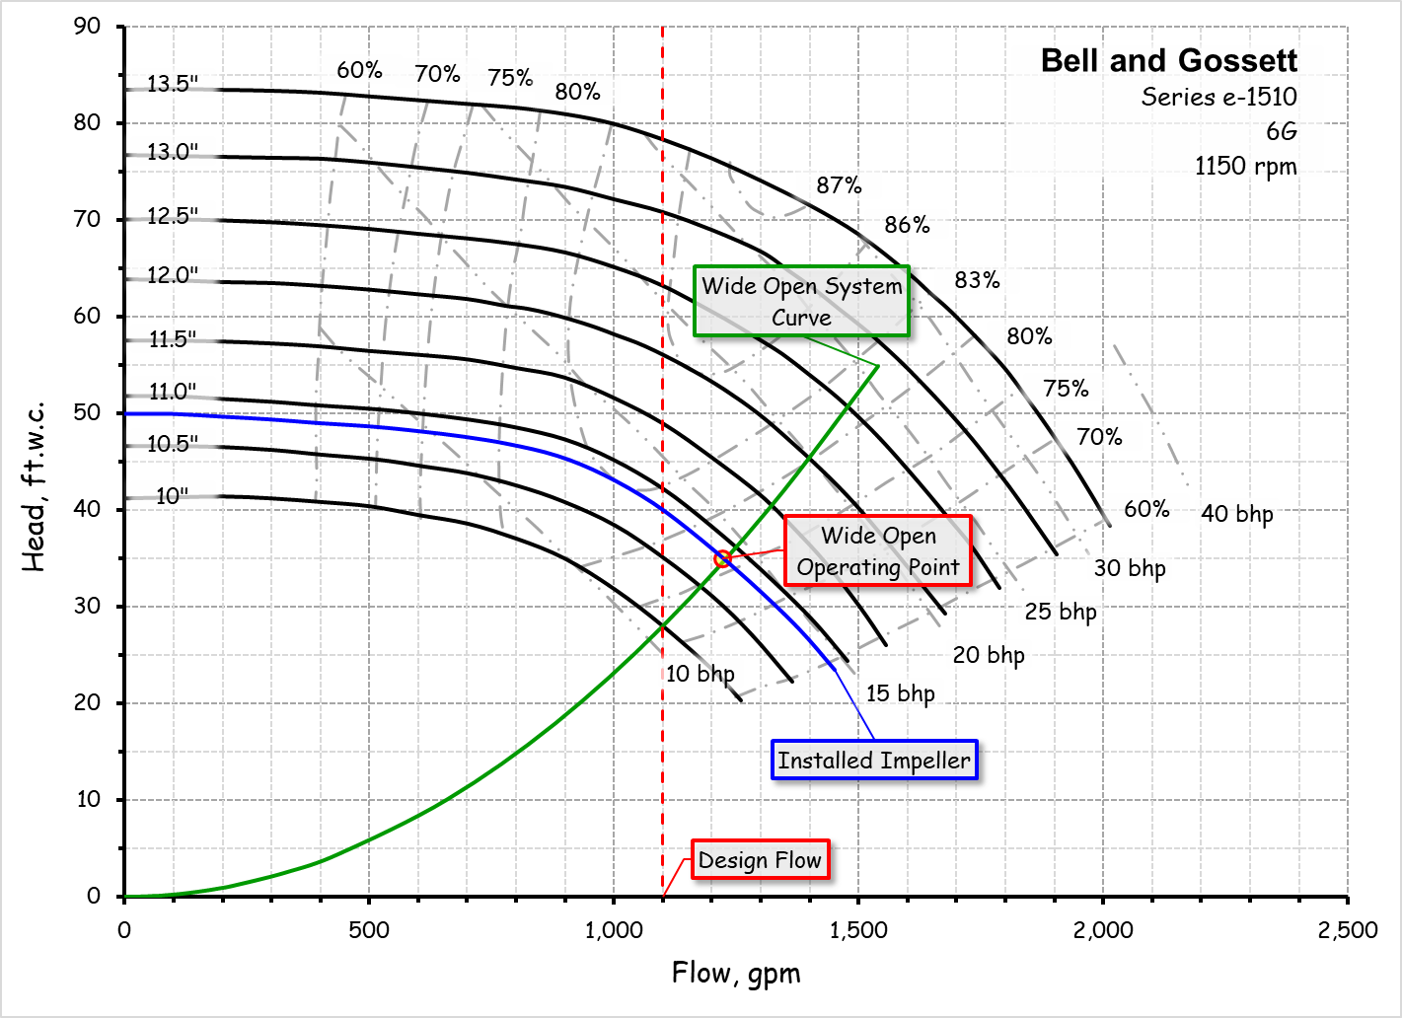
Pumps are Common EBCx Targets
The Hijend Hotel chilled water plant seems to have a number of them
Here ‘s a question for you https://tinyurl.com/EBCxWS0102PumpOpt

Slide 64
Pumps are Common EBCx Targets
The Hijend Hotel chilled water plant seems to have a number of them
Here ‘s a question for you https://tinyurl.com/EBCxWS0102PumpOpt

Slide 65
Assessing the Plant Load Condition
Break Out Session

Slide 66
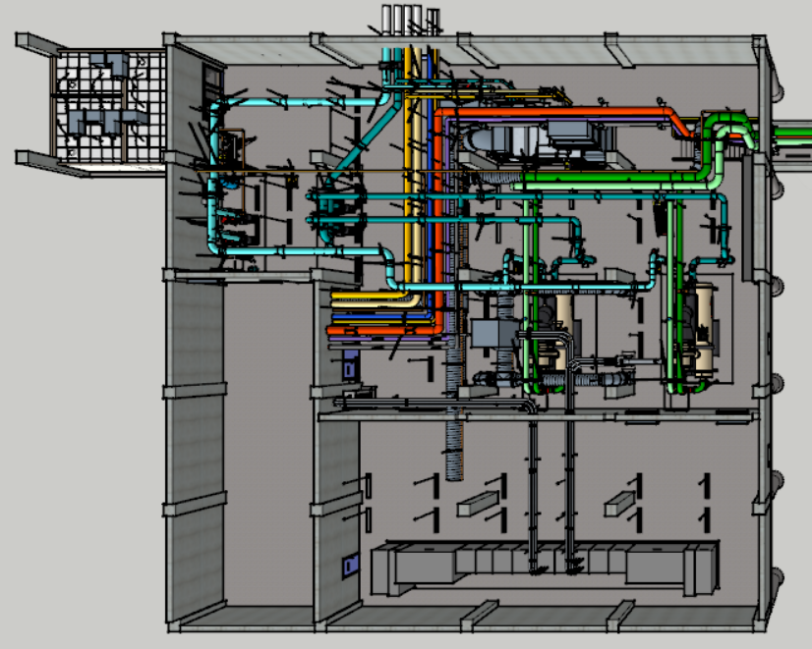
Assessing the Plant Load Condition
Let’s get oriented

Slide 67
Given:
The central plant model
The drawings you have for the plant
The work we have done up to this point

Slide 68
Assignment:
Estimate the current load condition on the central plant
Look for ways that you could develop a load profile
  There could be more than one
  Some will be better than others
  What are the pro’s and con’s for your list?

Slide 69
Scoping the Ball Room AHU
Break Out Session

Slide 70
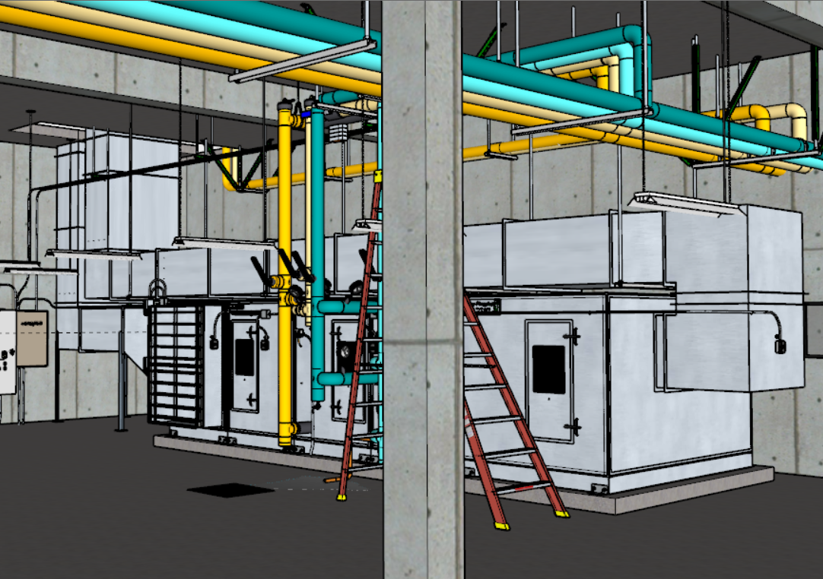
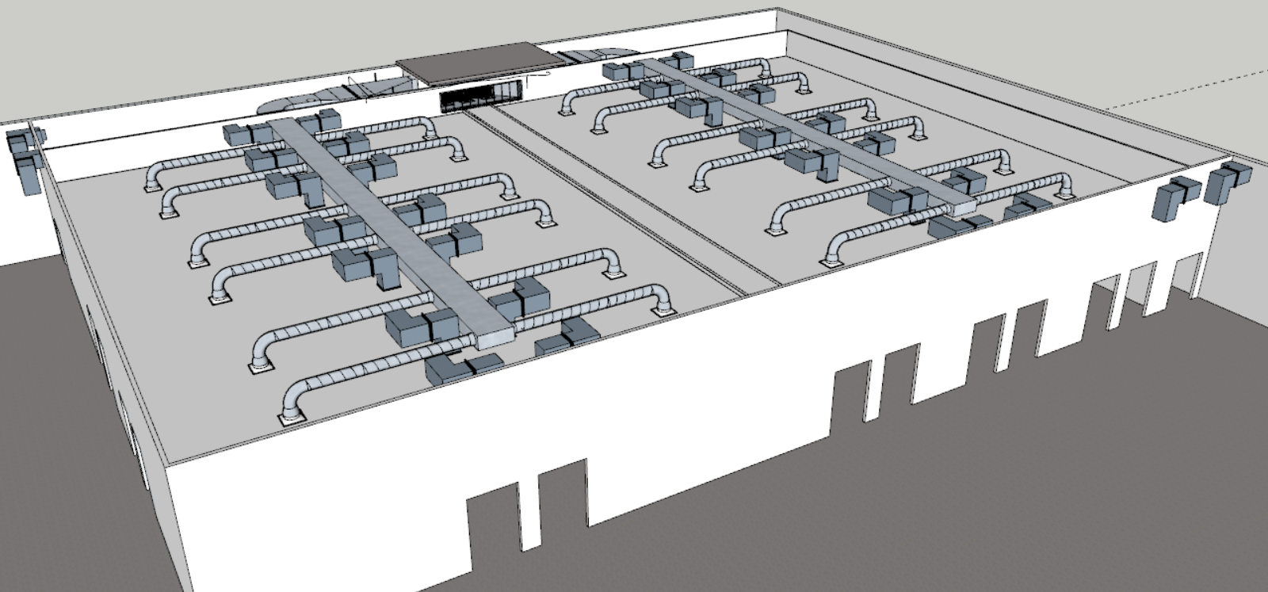
Scoping the Ball Room AHU
The Ball Room AHU is one of the components of the current load on the central plant

Slide 71
Given:
The Ball Room AHU model
Previous observations

Slide 72
Assignment:
Scope the Ball Room AHU and expand the findings list
Are you finding things that may be contributors to the load condition you observed at the central plant?
If so, why?

Slide 74


