Slide 1

Existing Building Commissioning Workshop:
Series 17, 2022-02-10
Cooling Tower Optimization Mystery
Presented By:
David Sellers
Senior Engineer, Facility Dynamics Engineering

Slide 2
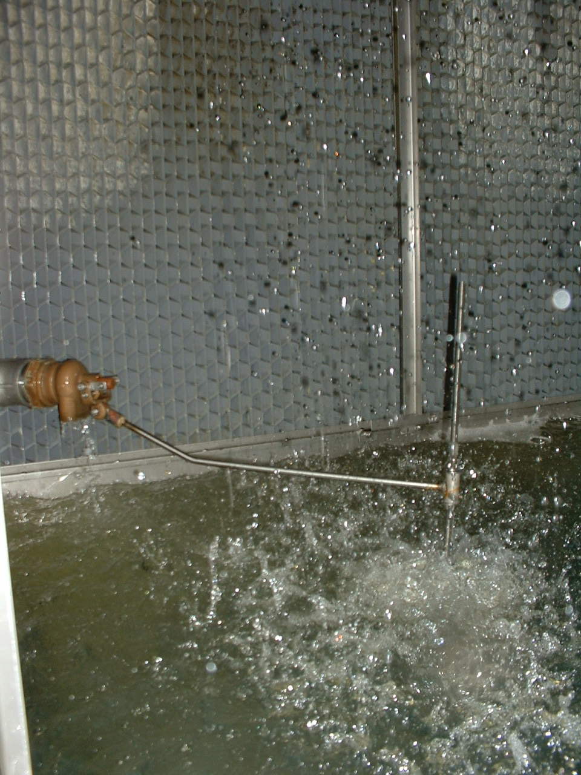
Given Previous Discussions

Slide 3
Given Previous Discussions

Slide 4
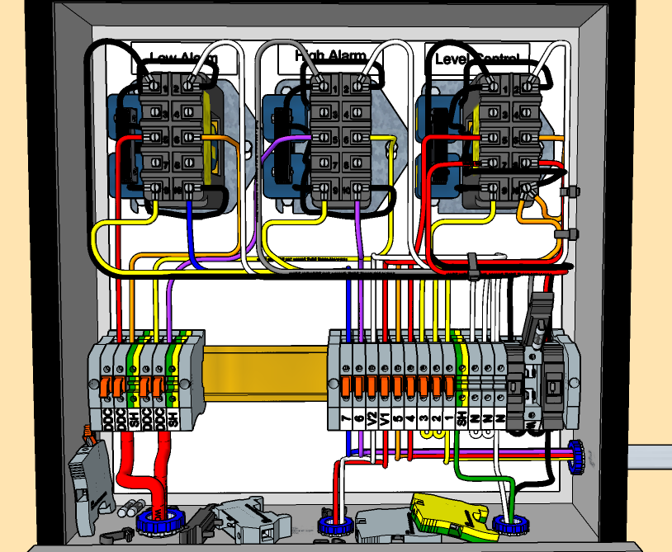
Given Previous Discussions

Slide 5
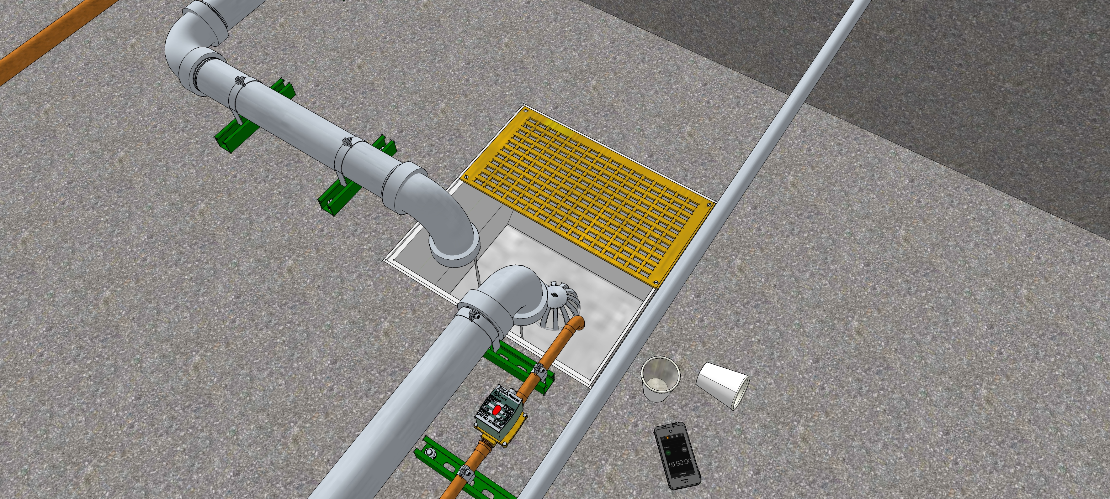
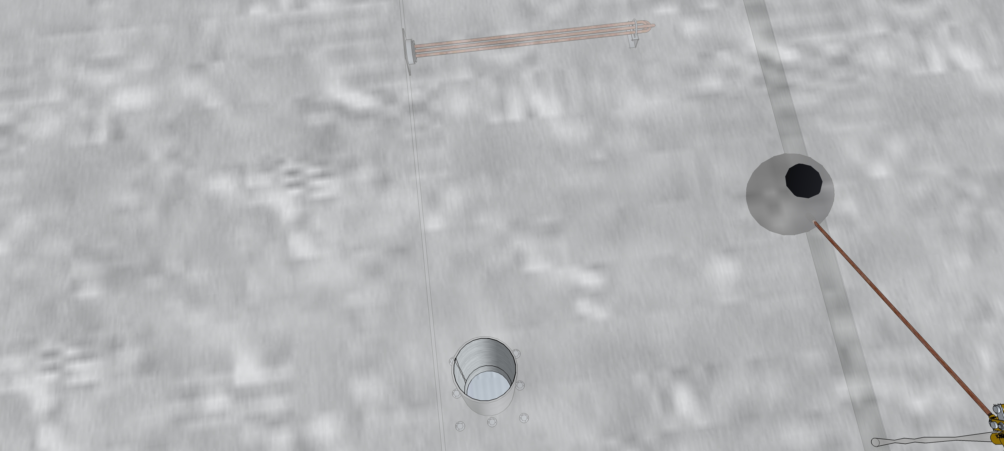
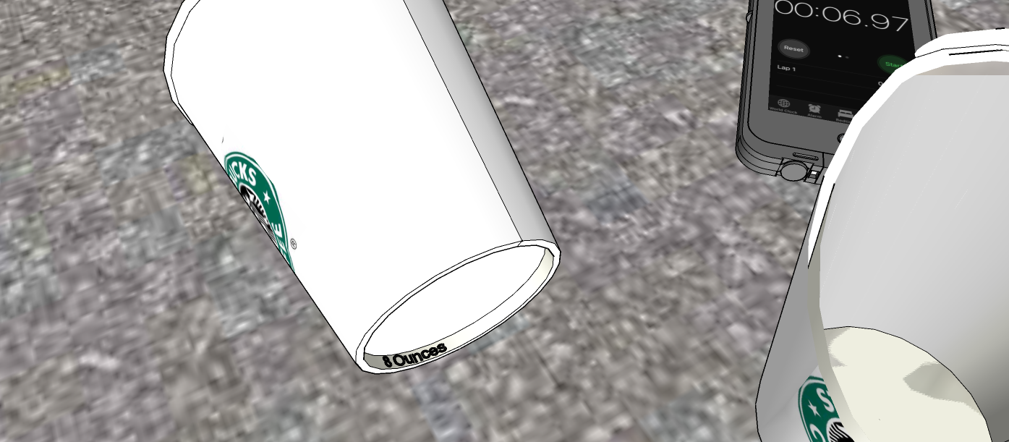
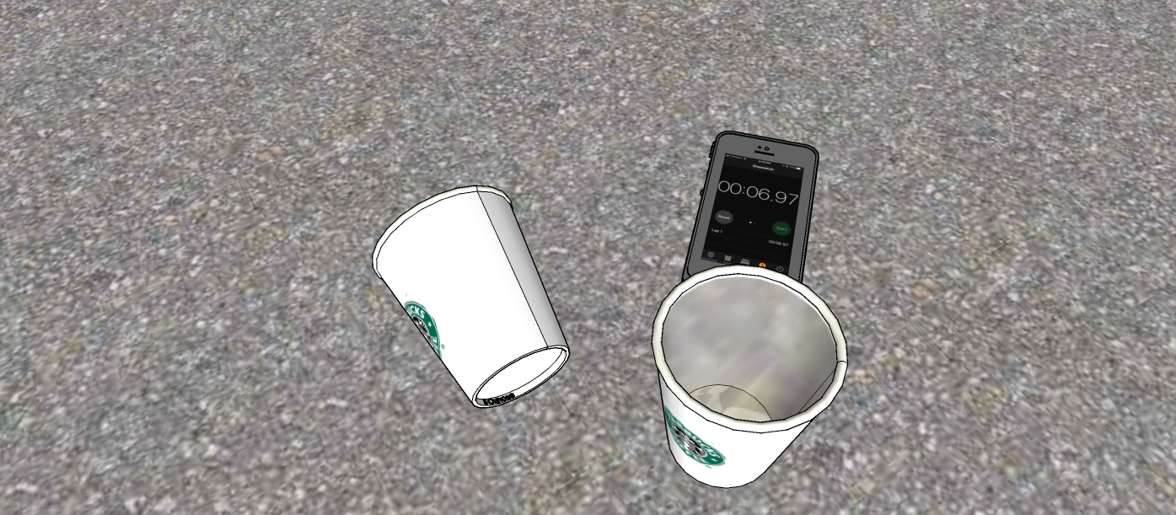
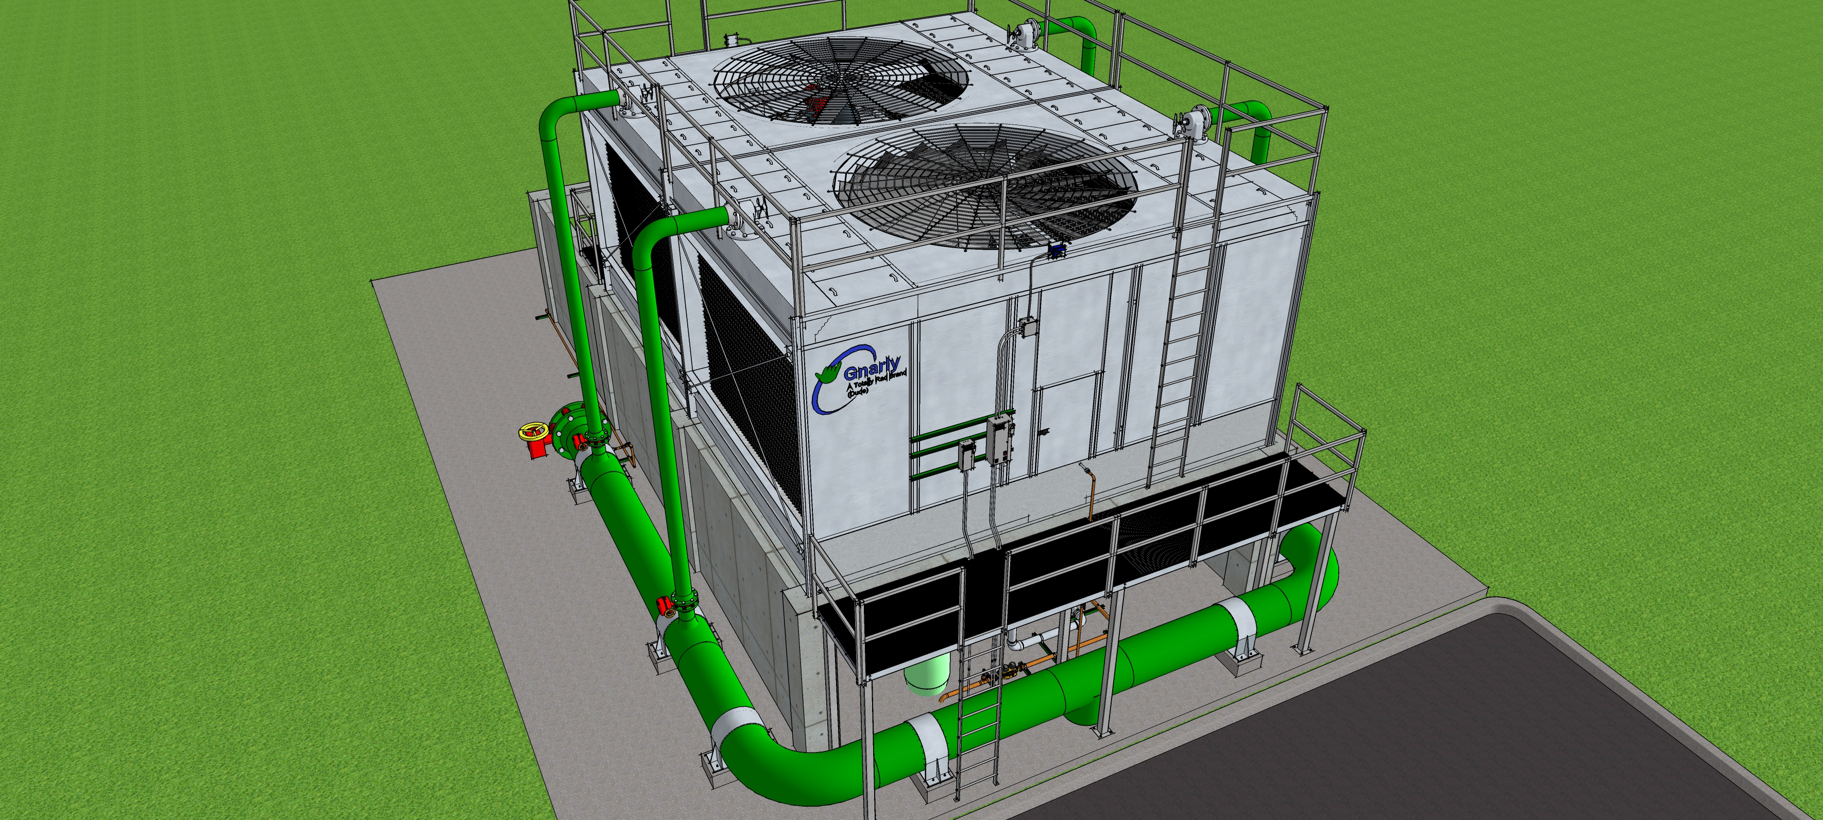
And Related Costs/Benefit Potential

Slide 6
And a Similar Opportunity at the Hijend Hotel

Slide 7
And a Similar Opportunity at the Hijend Hotel

Slide 8
And a Similar Opportunity at the Hijend Hotel

Slide 9
And a Similar Opportunity at the Hijend Hotel

Slide 10
And a Similar Opportunity at the Hijend Hotel

Slide 11
Along with the Following Information
Hijend Hotel Models or Images
CW System Diagram
Cooling Tower Dimensions
  Hot Basin
    Operating Depth – 7-1/2”
    Length – 13’ 6-1/2”
    Width – 4’ 4-3/8”
  Cold Basin
    Length – 21’ 9”
    Width – 13’ 6-3/4”
    Sump Width – 2’ 9-5/8”
    Sump Depth – 3-7/8”
    Overflow Depth at Sump – 1’ 2-3/8”
12’ of 8” hot basin CWR connection pipe above the hot basin water level
4” Minimum recommended water level (at sump)

Slide 12
Answer the Following Questions
What needs to be considered to set the following water levels for your control system
  Overflow alarm?
  Low level alarm?
  Open the make-up valve?
  Close the make-up valve?
What would your recommendations be for the appropriate operating levels for:
  Overflow alarm?
  Low level alarm?
  Open the make-up valve?
  Close the make-up valve?
Are their any issues that would need to be addressed to ensure success in terms of not wasting water after your new level control system is in place?

