Slide 1
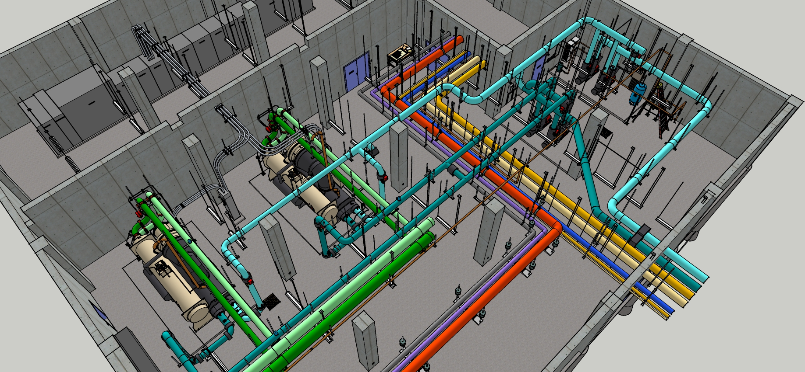
Your Assignment
Develop a load and flow profile for the plant given:
  Logged chiller Δt
  Logged chiller amps
  Logged system Δt
  Weather data
  Pump test data
  Conservation of mass and energy

Slide 2
Your Assignment
Load Profile Development Steps
Develop the profile for the logged interval
Extrapolate the profile to reflect a year
  Load or flow vs. outdoor air temperature
  Fit a trend line to it
  Use a TMY file for San Diego to project the annual flow profile
  Consider what the limits of your projection might be relative to the conditions during which the data was collected

