Slide 1
Existing Building Commissioning Series Workshop
Sessions 3 and 4
David Sellers
Senior Engineer, Facility Dynamics Engineering

Slide 2
A Bit About Parallel Pumps

Slide 3
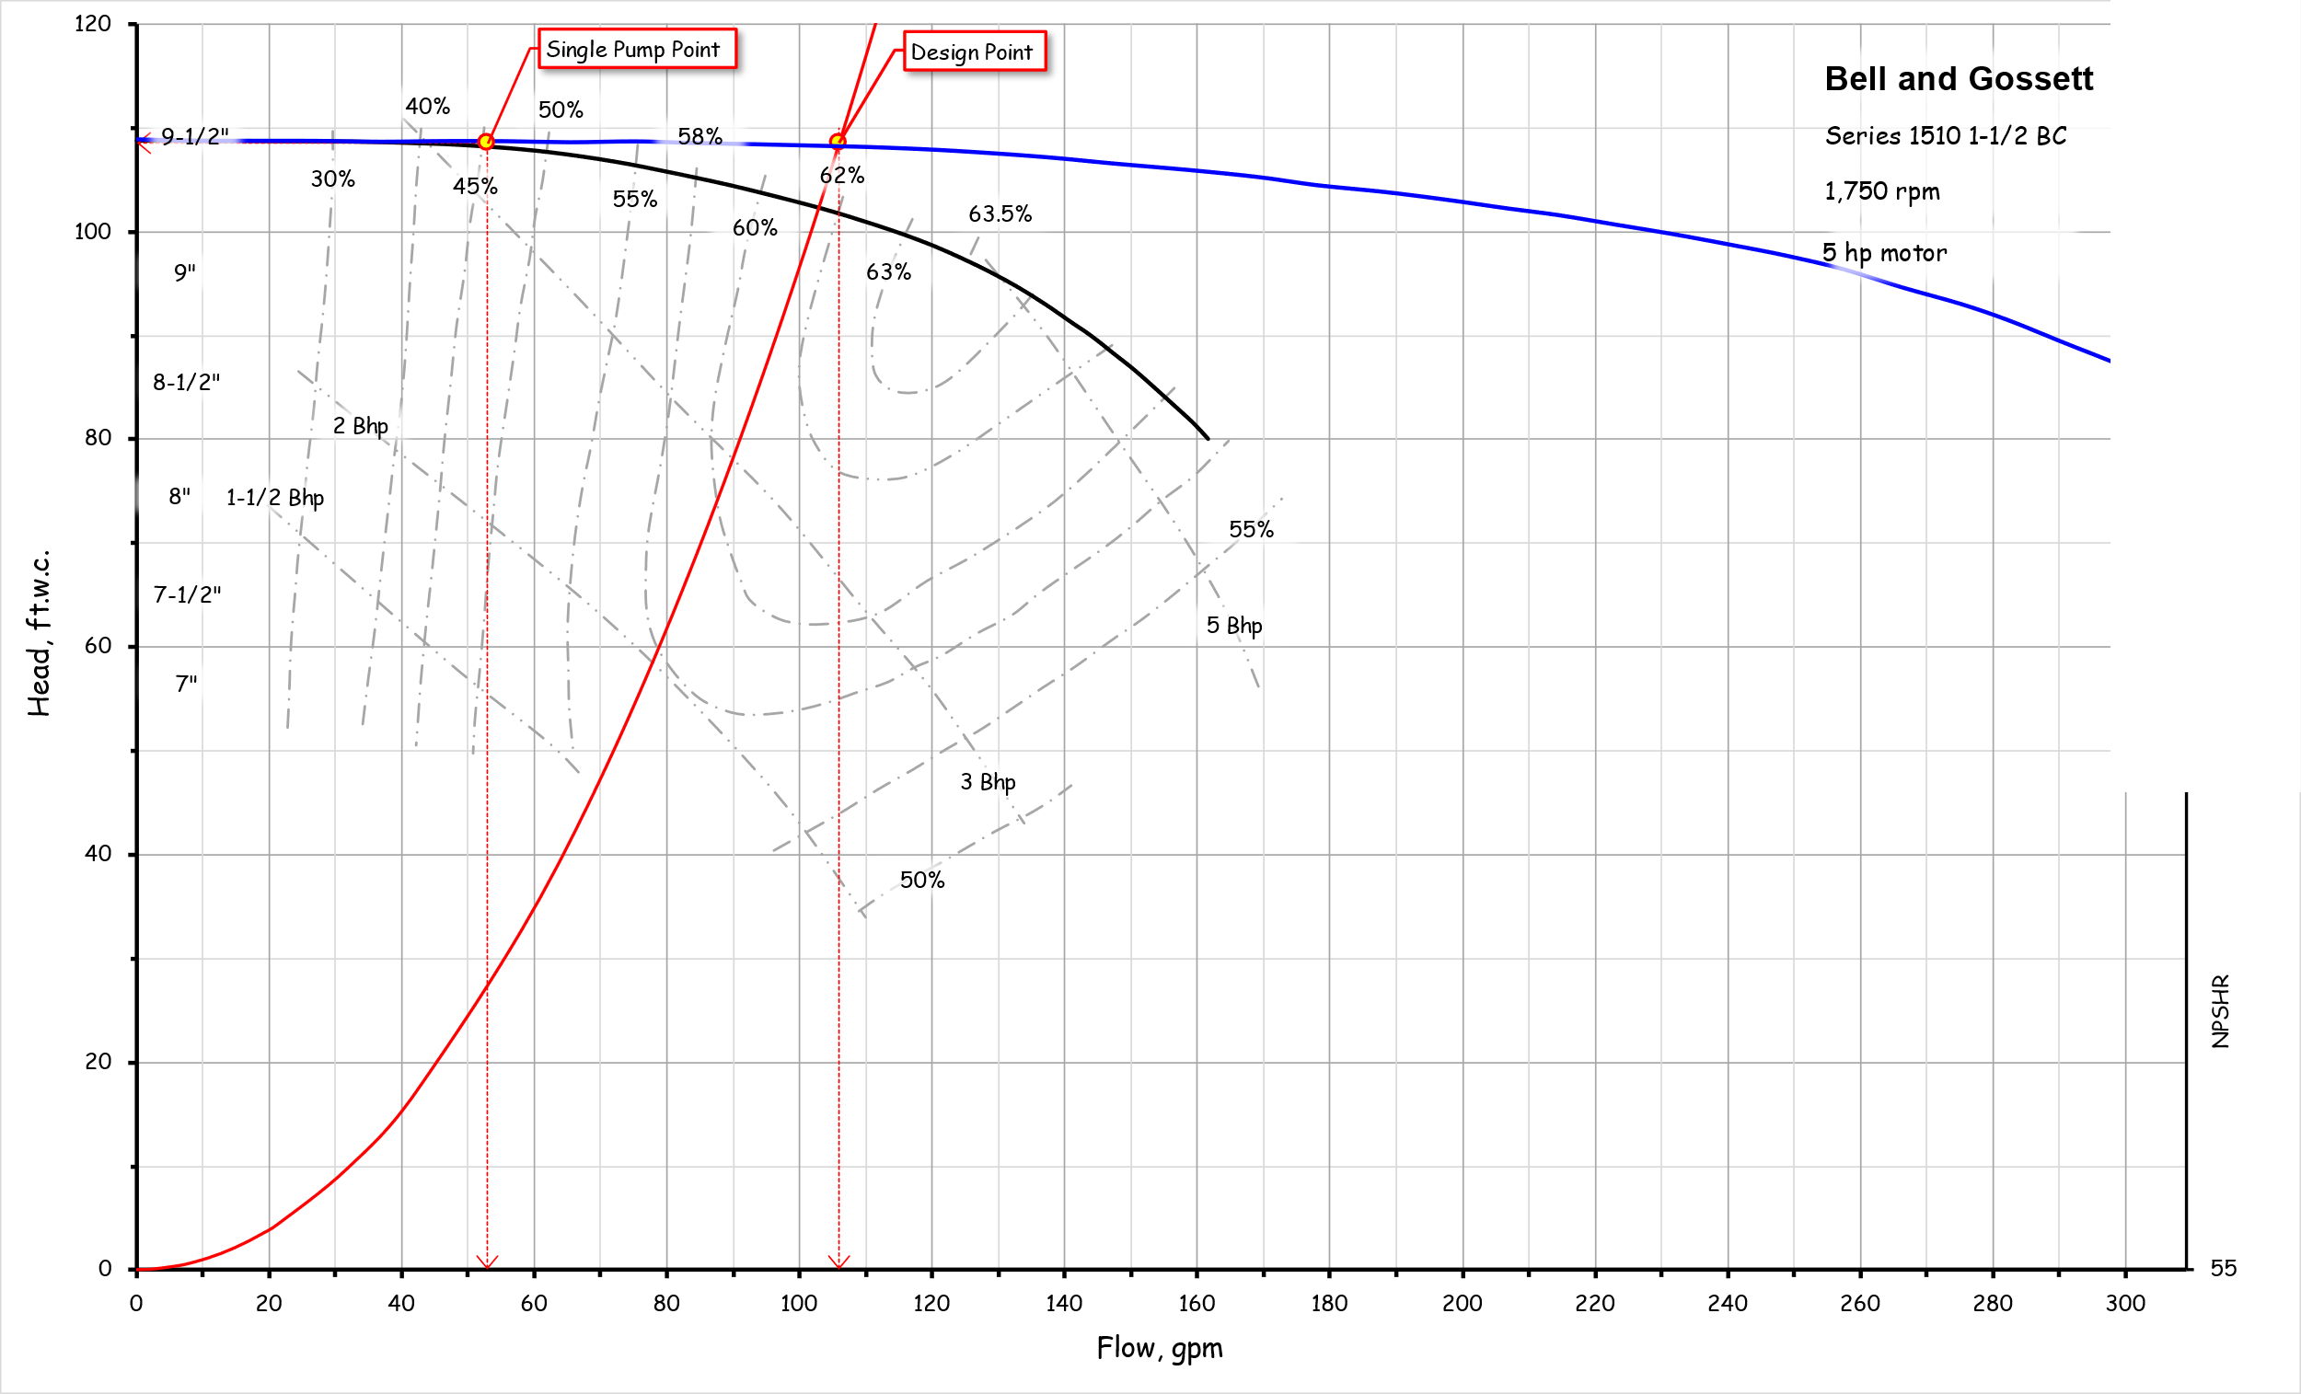
Parallel Pumps with a Steep System Curve

Slide 4
Parallel Pumps with a Steep System Curve
Turning off one pump does not change the flow much

Slide 5
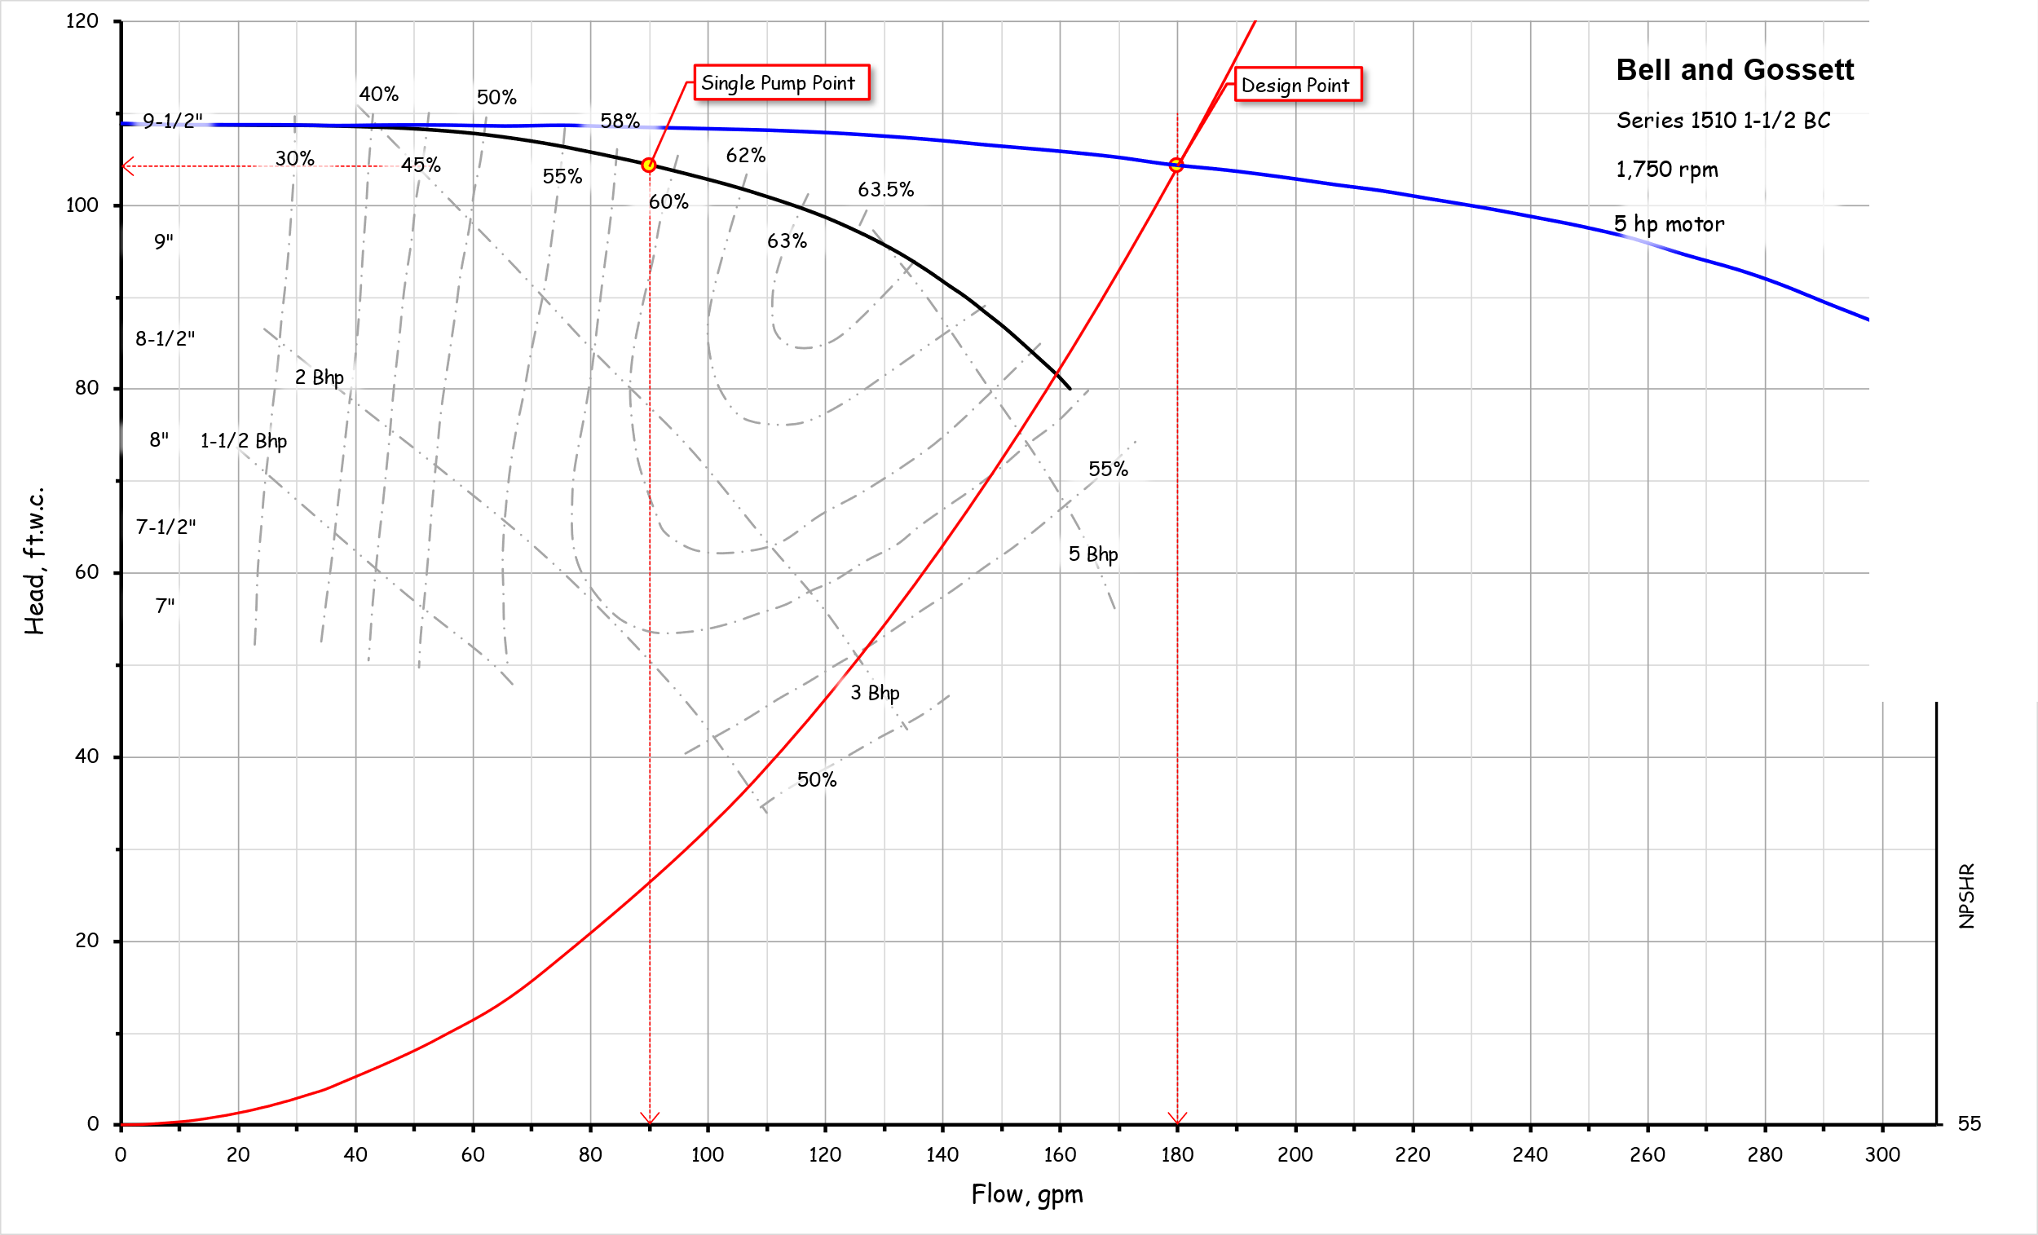
Parallel Pumps with a Shallower System Curve
Turning off one pump has a larger impact on the flow but will never cut it in half

Slide 6
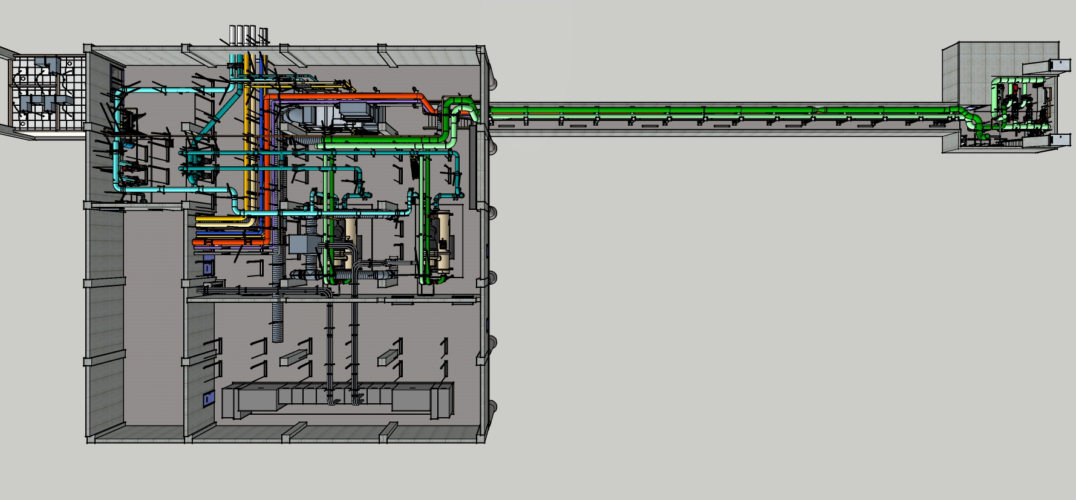
Long Common Parallel Pipe Runs can have Shallow System Curves

Slide 7
Long Common Parallel Pipe Runs can have Shallow System Curves

Slide 8
A Bit About How Cooling Towers Work

Slide 9
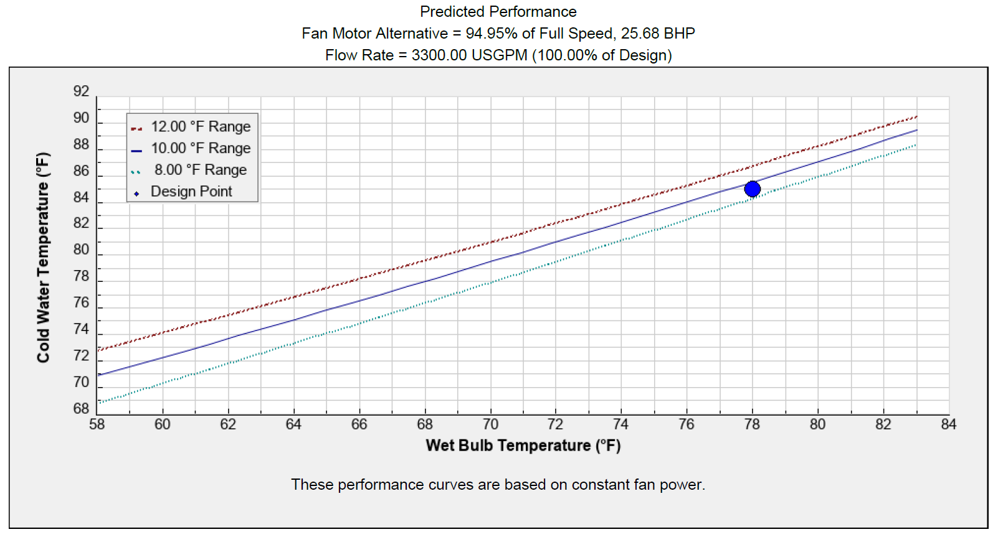
Key Concepts
Leaving water temperature is driven by wet bulb temperature
Approach increases as wet bulb temperature drops from design condition
The load sets the range (tower delta t)
Capacity is directly related to air flow rate
Air flow rate is directly related to fan speed and power to the cube of fan speed
Flow distribution over the fill is critical

Slide 10
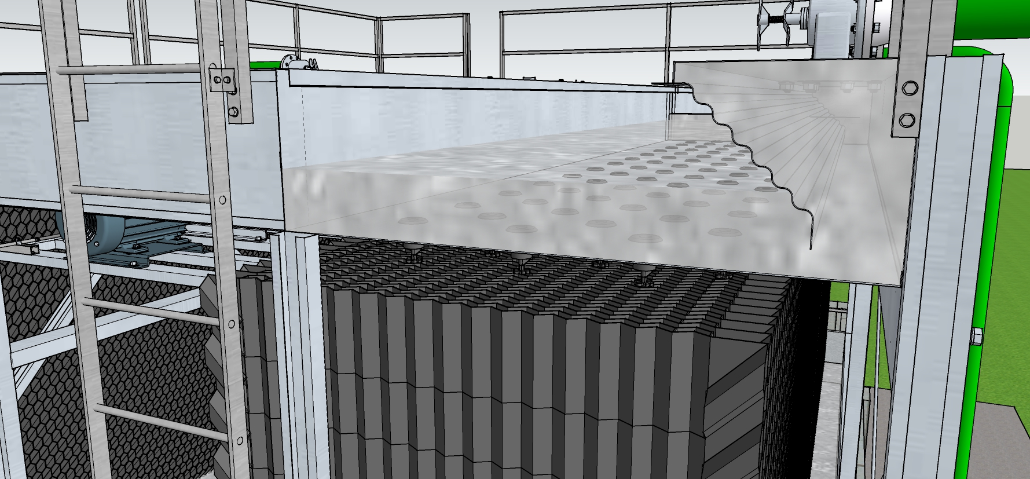
Key Concepts
Leaving water temperature is driven by wet bulb temperature
Approach increases as wet bulb temperature drops from design condition
The load sets the range (tower delta t)
Capacity is directly related to air flow rate
Air flow rate is directly related to fan speed and power to the cube of fan speed
Flow distribution over the fill is critical

Slide 11
Key Concepts
Leaving water temperature is driven by wet bulb temperature
Approach increases as wet bulb temperature drops from design condition
The load sets the range (tower delta t)
Capacity is directly related to air flow rate
Air flow rate is directly related to fan speed and power to the cube of fan speed
Flow distribution over the fill is critical

Slide 12
Break Out 01
Given
Our discussion
Your growing confidence
The drawings and equipment schedule
The system diagram
The Cooling Tower images file folder
Virtually wander around the tower and look for opportunities (don’t forget to right them down)
Do you think the flow is balanced between the different basins?
Do you think the staging of the cells is appropriate?
What is the data logger data telling you?
Has the staff implemented an improvement by leveraging a discarded resource?

Slide 14
Break Out 02
Given
Our discussion
Your growing confidence
The drawings and equipment schedule
The system diagram
The Tunnel and Pump Room images file folder
Virtually wander around the plant, pumps and tunnel to look for opportunities
Do you think the flow rate is appropriate for the current operating condition?
Does the elevation of the cooling towers relative to the plant have any implications?
What makes the ProMinent Ultra peristaltic pump special compared to the others?
Why is there a bypass valve?

