Slide 1
Existing Building Commissioning Series Workshop
Sessions 3 and 4
David Sellers
Senior Engineer, Facility Dynamics Engineering

Slide 2
Air Side Economizers are Often EBCx Opportunities
Industry metrics indicate 70% or more of them have an issue
Poor minimum outdoor air regulation
Poor damper sizing
Damper seal leakage
Poor mixing
Improper or non-functioning high limit control strategy
Nuisance freezestat trips
Coil freeze-ups

Slide 3
Resources for Further Study
Economizer Evaluation Checklist
https://www.av8rdas.com/economizer-evaluation-checklist.html
Economizer Stratification Video
https://www.av8rdas.com/economizer-stratification.html
Economizer Stratification Blog Post
https://av8rdas.wordpress.com/2013/01/17/retrocommissioning-findings-economizer-mixed-air-plenum-stratificationoverview/
Pacific Energy Center Economizers; Design, Performance and Commissioning Issues Class Materials
https://www.av8rdas.com/pacific-energy-center-design-performance-and-commissioning-issues-classes.html#Economizers

Slide 4
Our Initial Focus
Poor minimum outdoor air regulation
Poor damper sizing
Damper seal leakage
Poor mixing

Slide 5
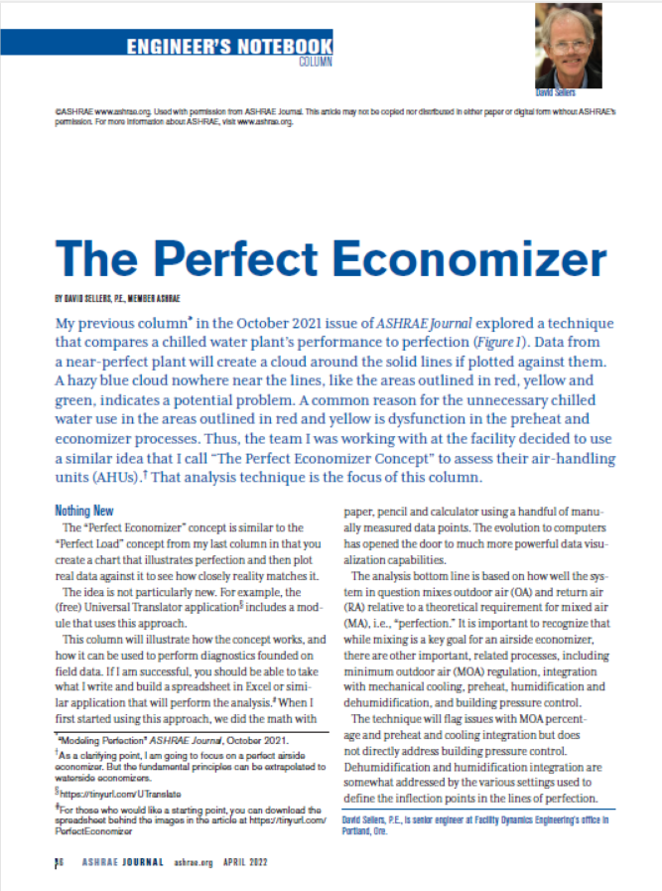
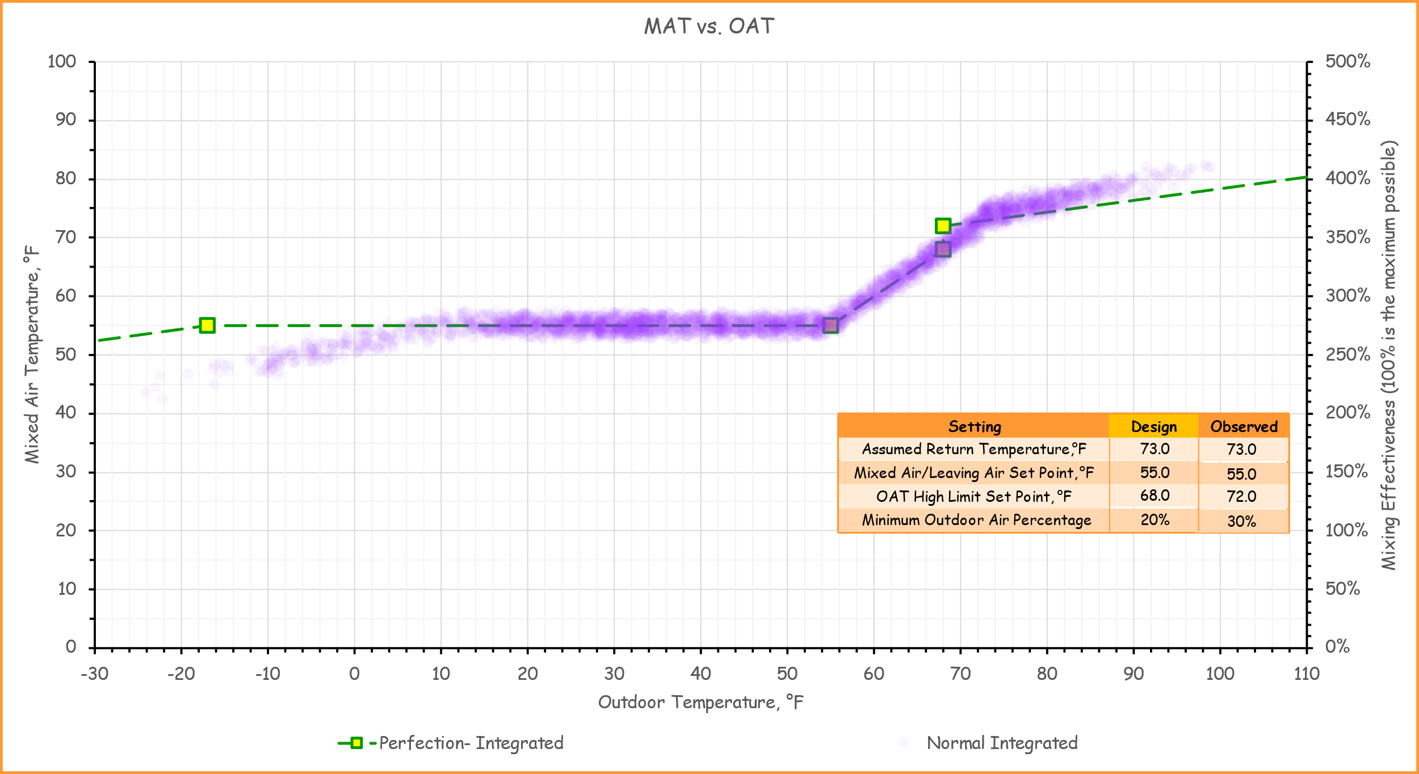
An Important Monitoring Plan Target
Improper or non-functioning high limit control strategy
https://tinyurl.com/PerfectEconomizer

Slide 6
The Economizer Evaluation Checklist

Slide 7
The Economizer Evaluation Checklist
Economize evaluation guidance for all phases of a project
Included with the functional testing guide
https://tinyurl.com/BallRoomAHU2020

Slide 8
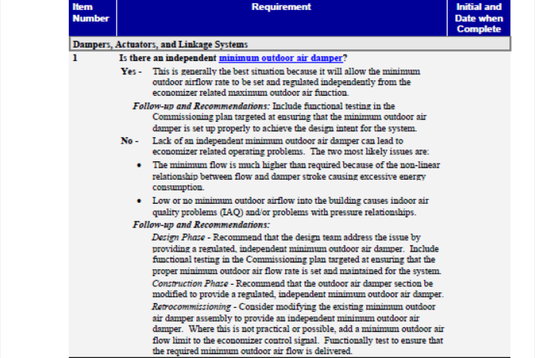
Break Out 01
Given
The first section of the checklist
The images of the Ball Room AHU that follow
The drawings provided
Assess the minimum outdoor air (MOA) flow regulation capability of the Ball Room AHU economizer
How well is it regulated?
What are some of the assumptions behind the strategy?
Can you estimate the MOA% required from the documents?
Are their other things that you observe that would be items that should be added to your findings list?

Slide 9
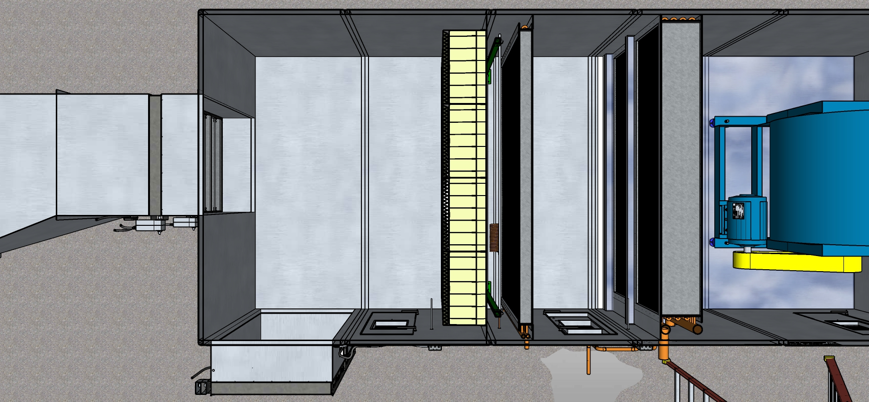
Economizer/Mixed Air Section Plan View

Slide 10
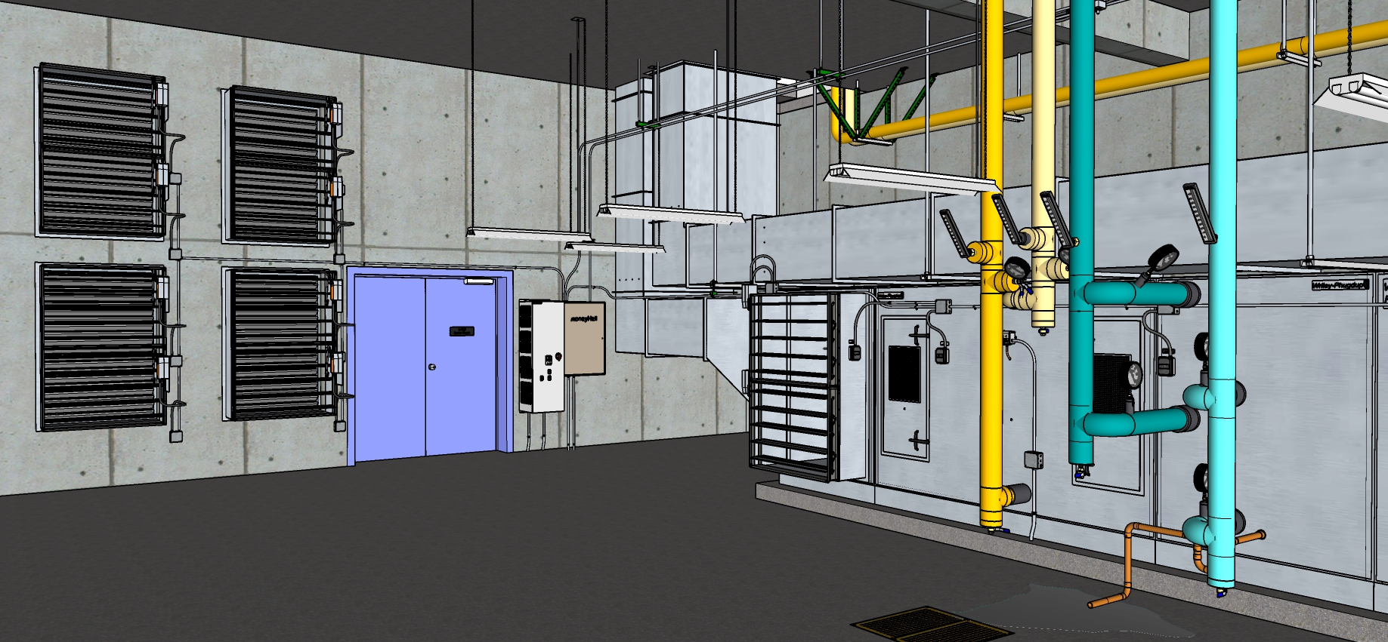
Equipment Overview

Slide 11
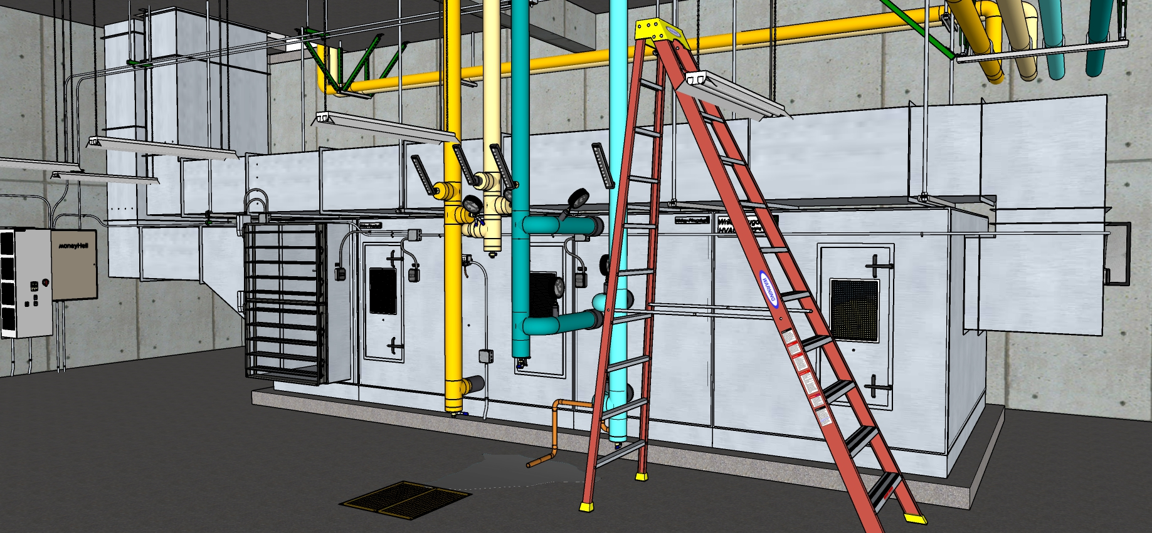
Equipment Overview

Slide 12
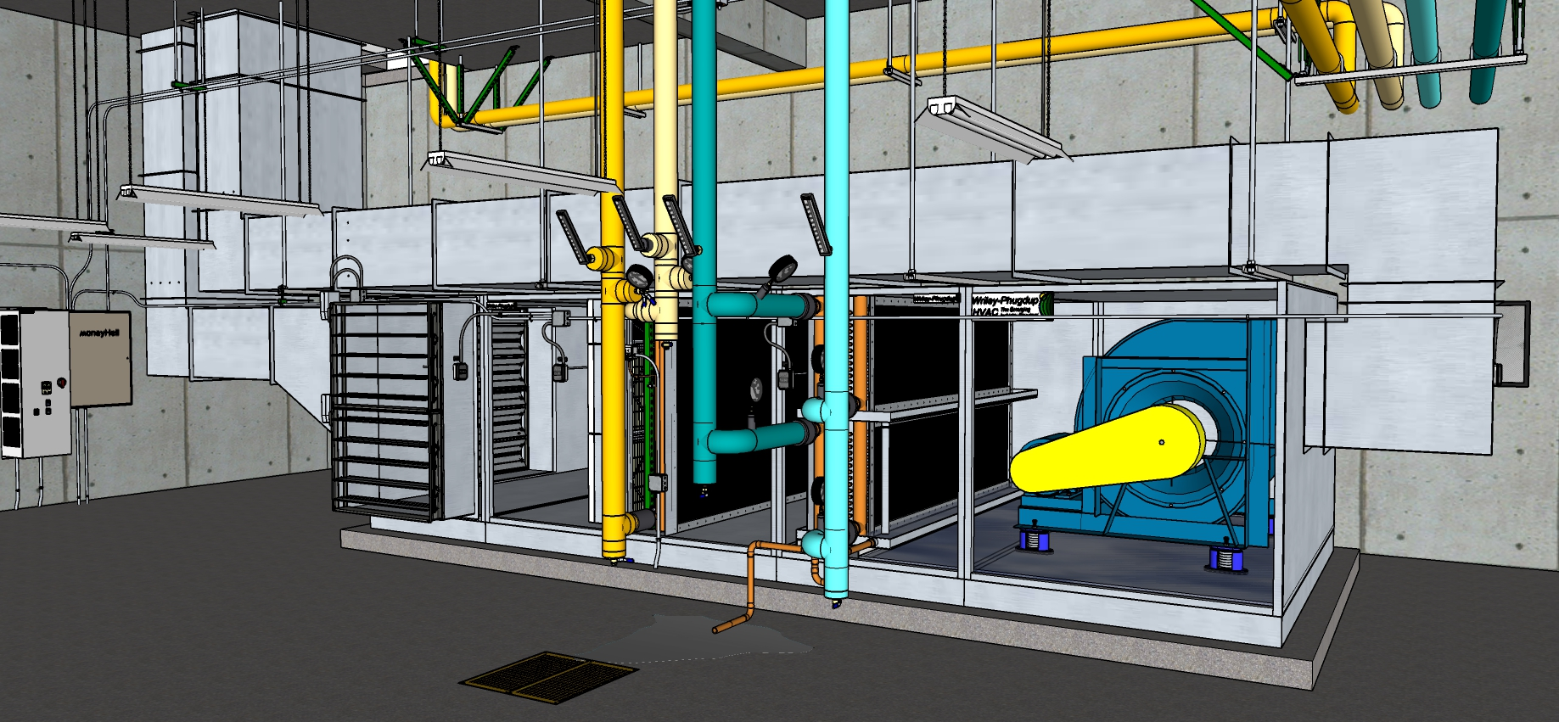
Equipment Overview

Slide 13
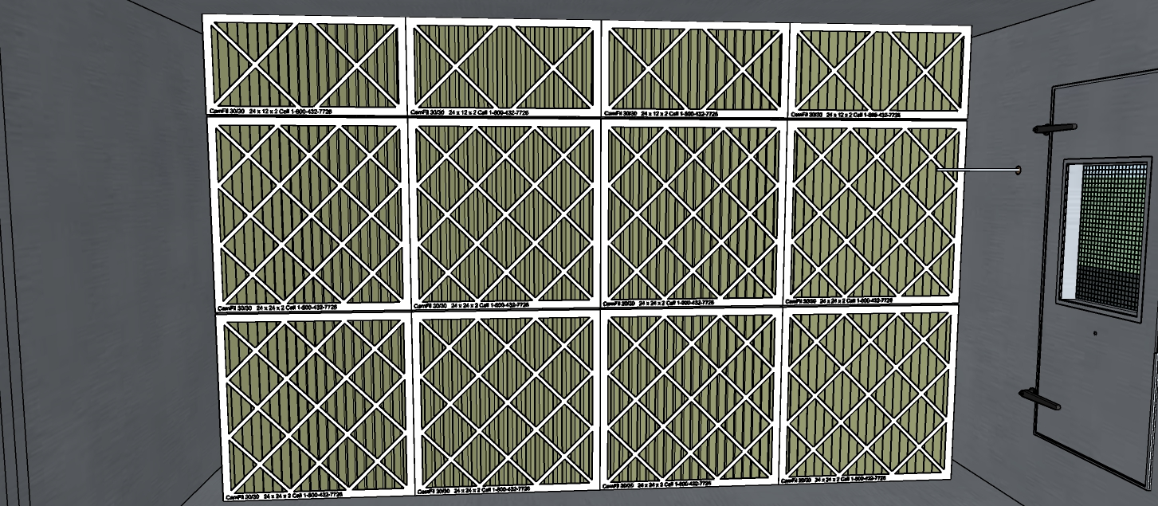
Filter Bank

Slide 14
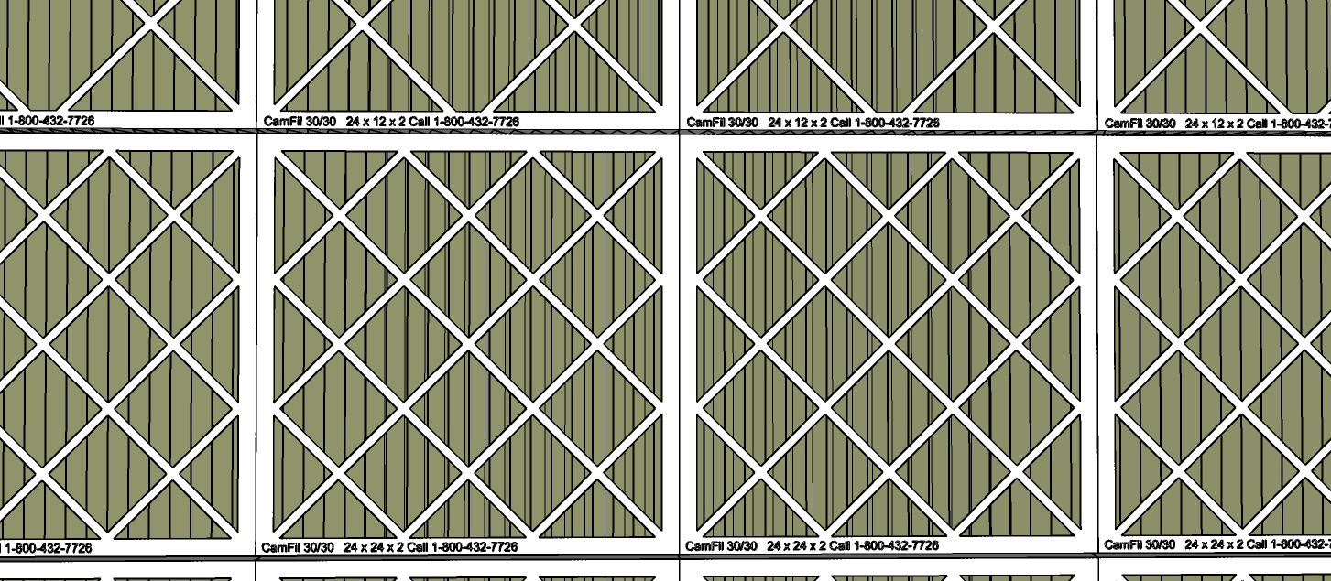
Filter Detail

Slide 15
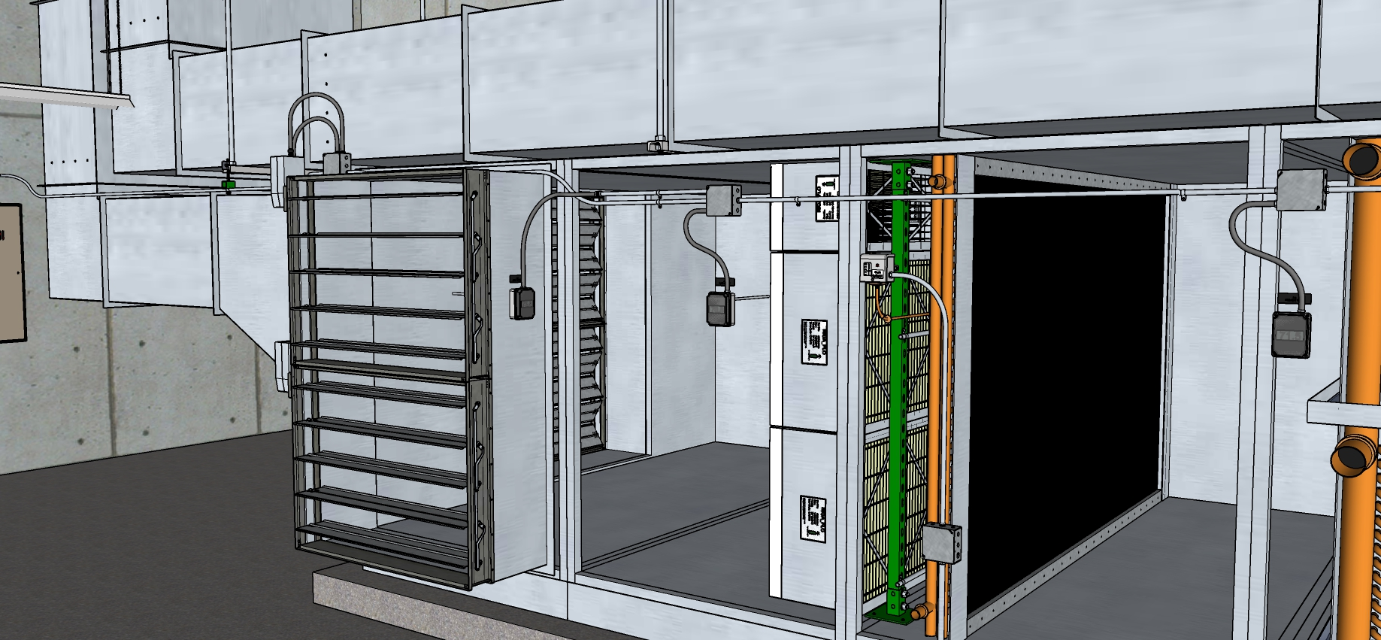
Mixed Air Plenum Overview

Slide 16
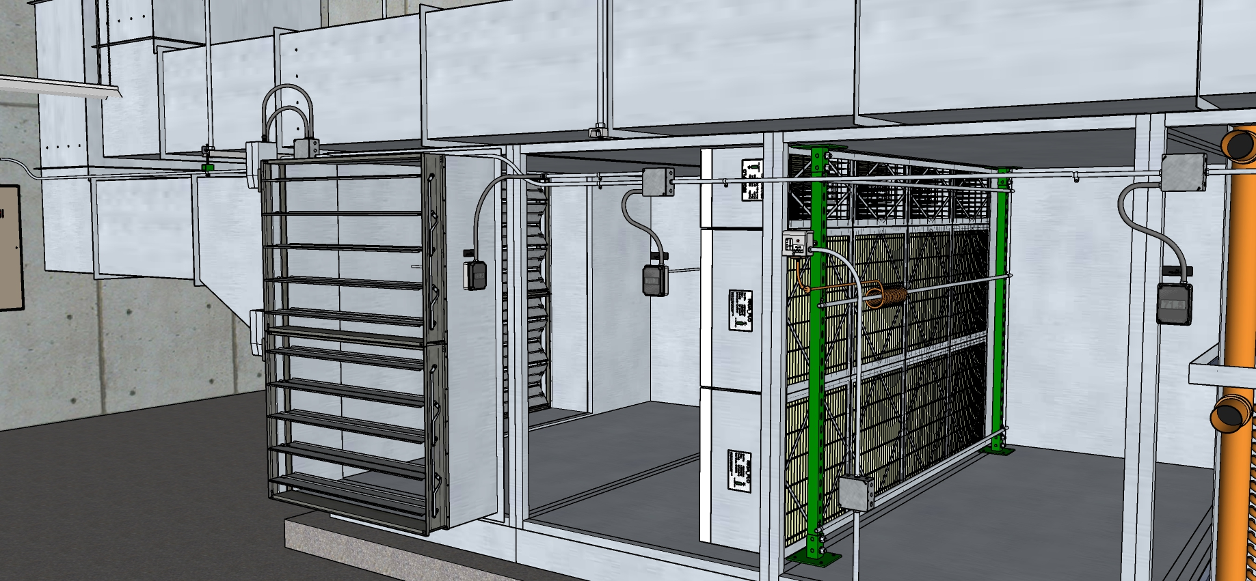
Mixed Air Plenum Overview – Heating Coil Hidden

Slide 17
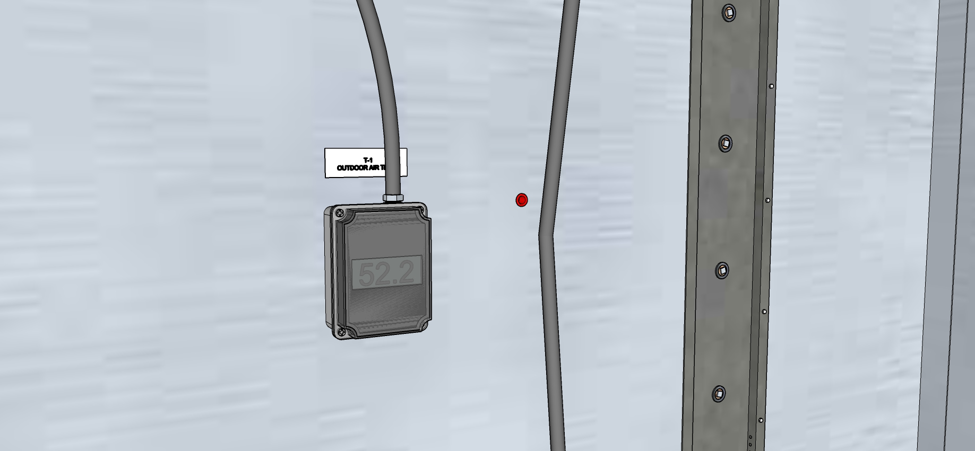
Outdoor Air Temperature Sensor

Slide 18
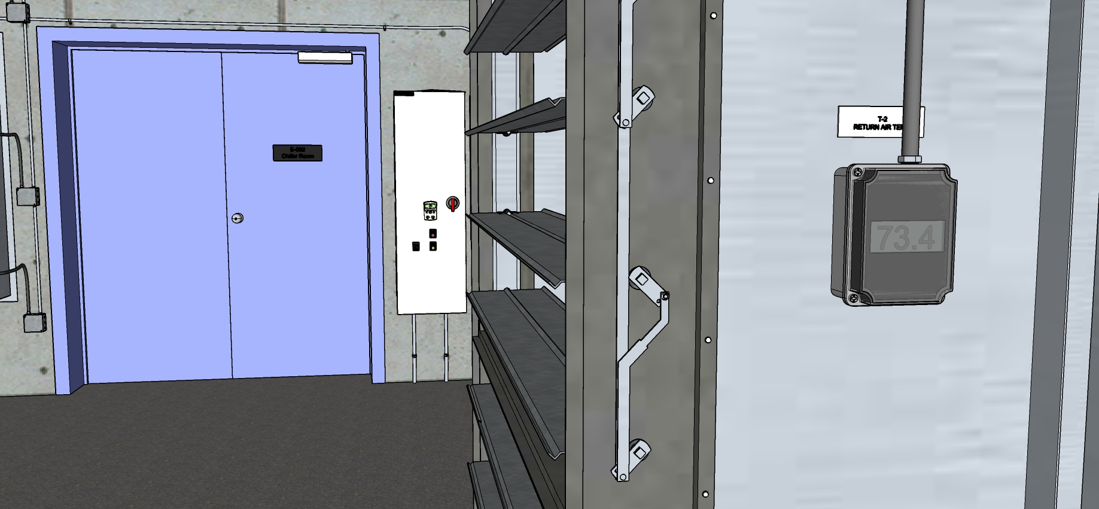
Return Air Temperature Sensor

Slide 19
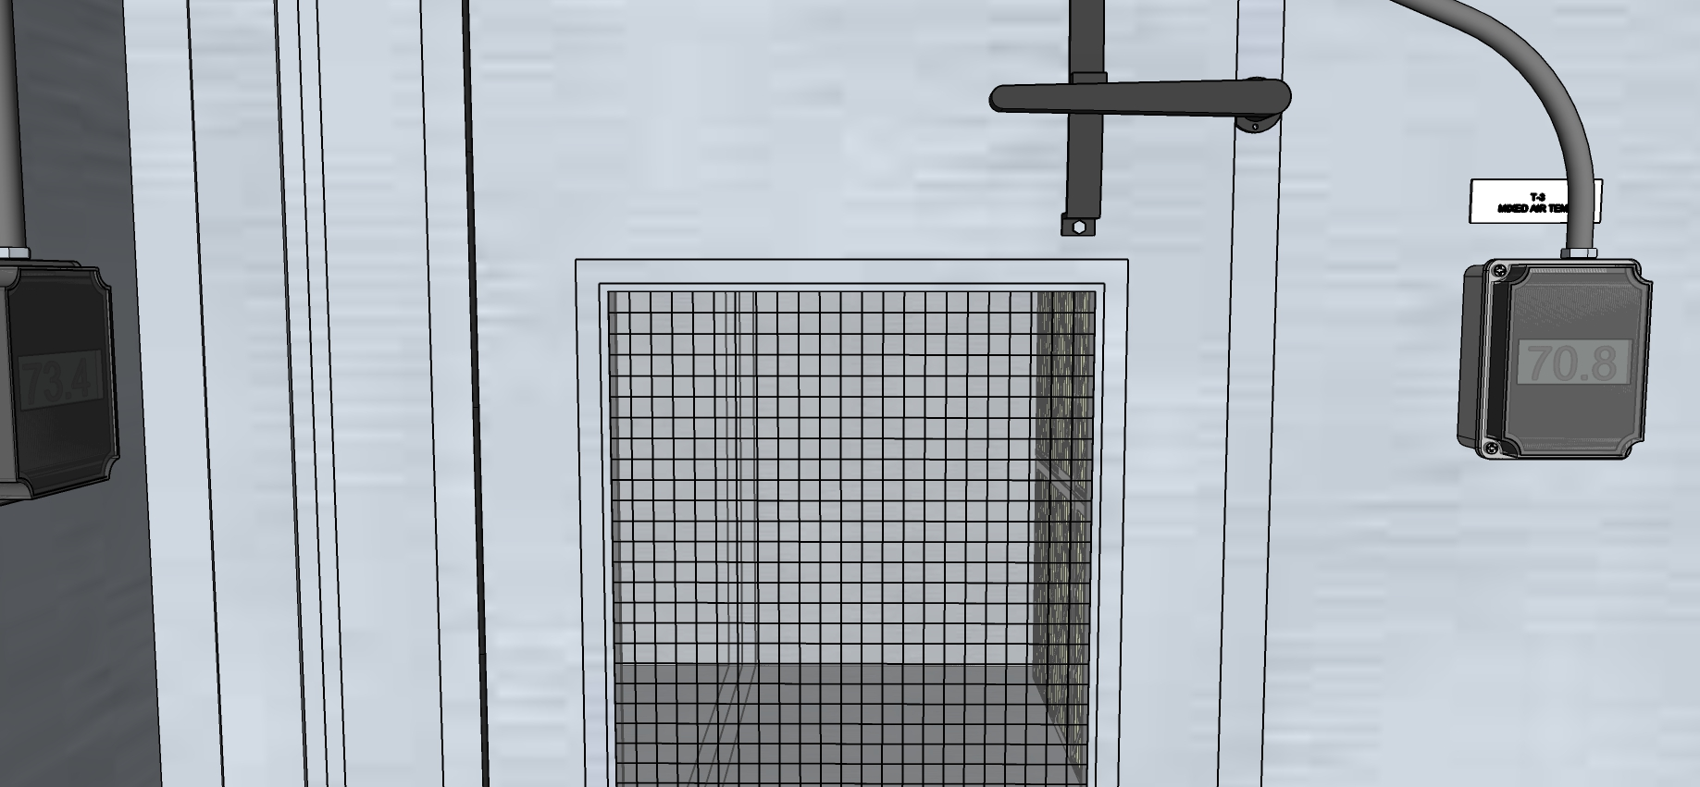
Return Air Temperature Sensor

Slide 20
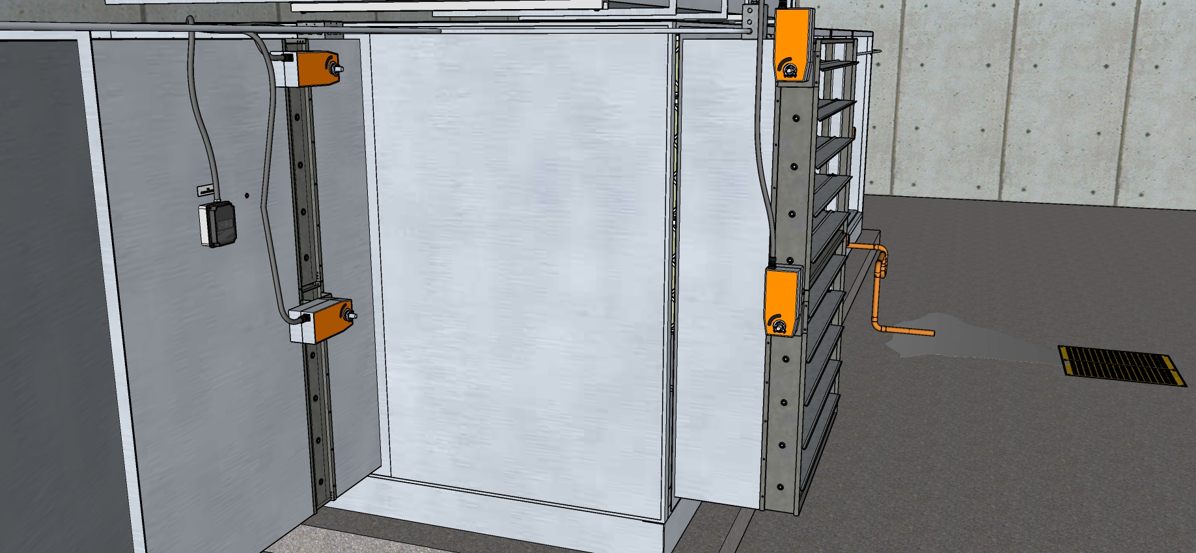
Dampers Viewed from Actuator Side

Slide 21
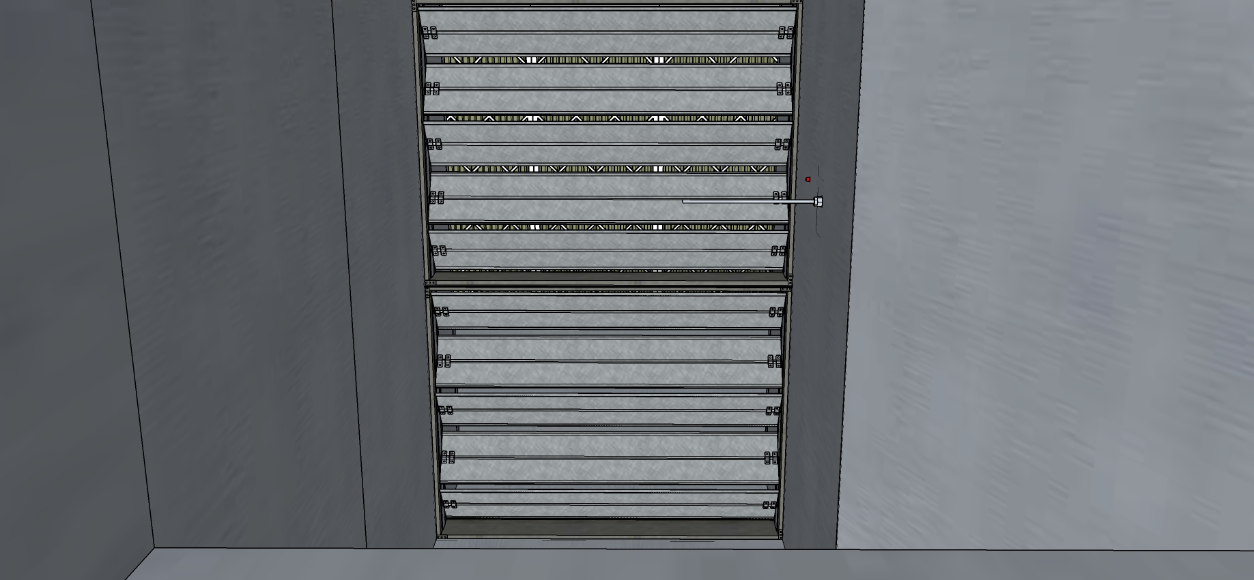
Outdoor Air Damper from Inside the OA Duct

Slide 22
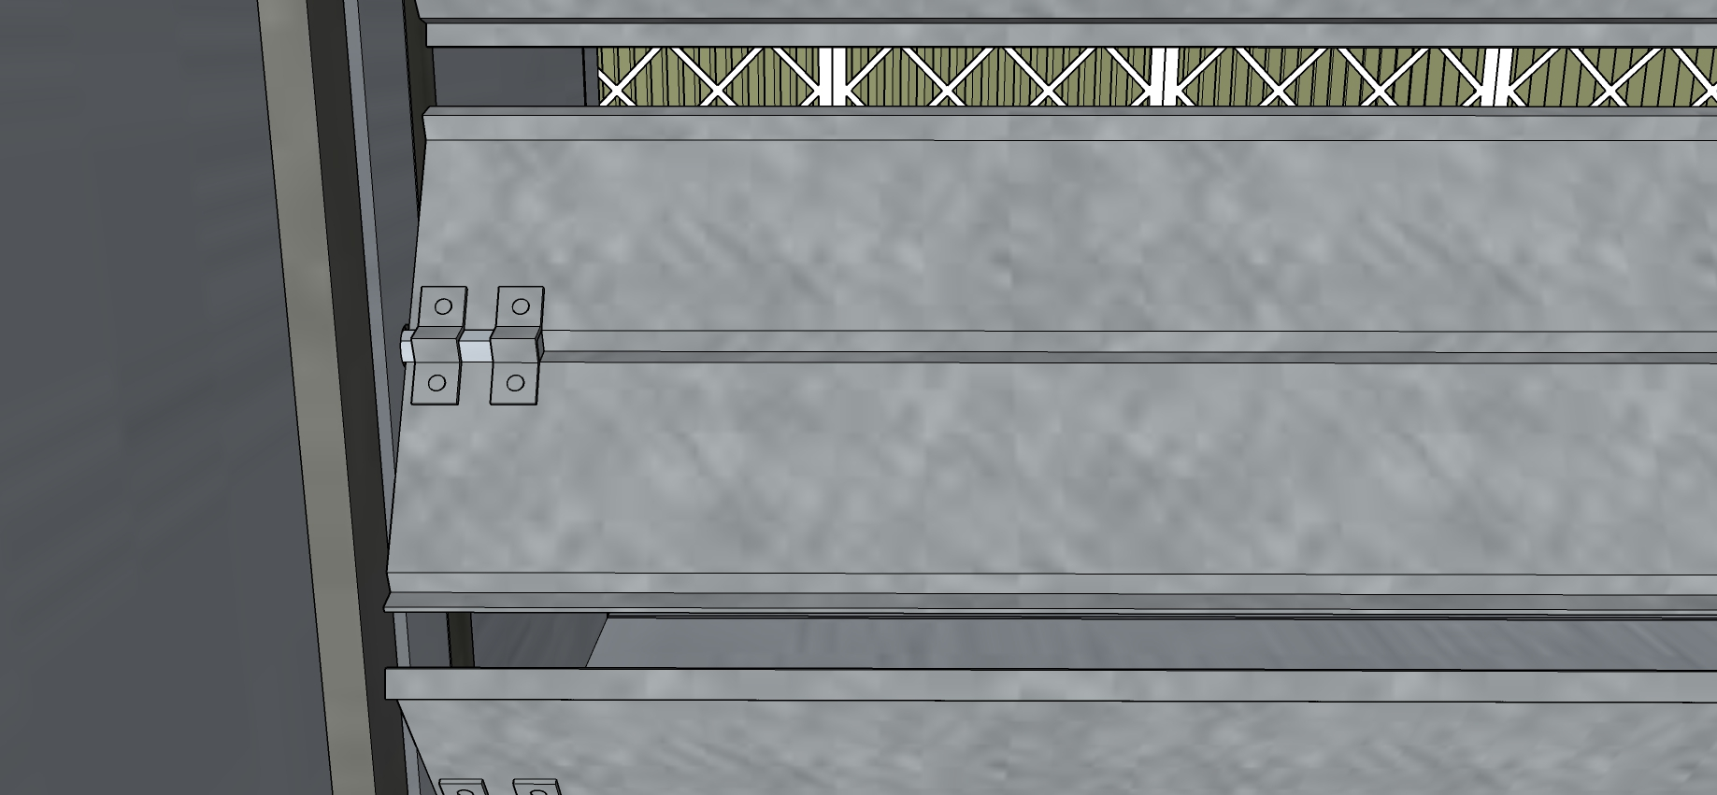
Outdoor Air Damper Blade Close-up

Slide 23
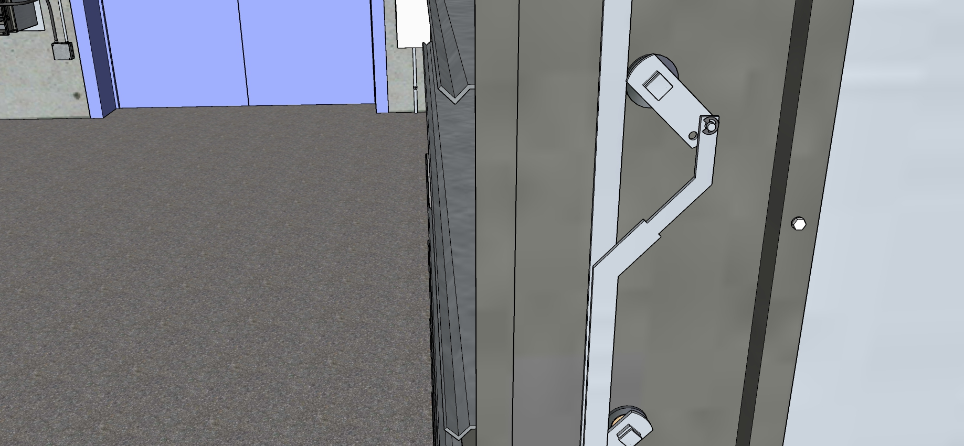
Return Air Damper Blade Close-up

Slide 24
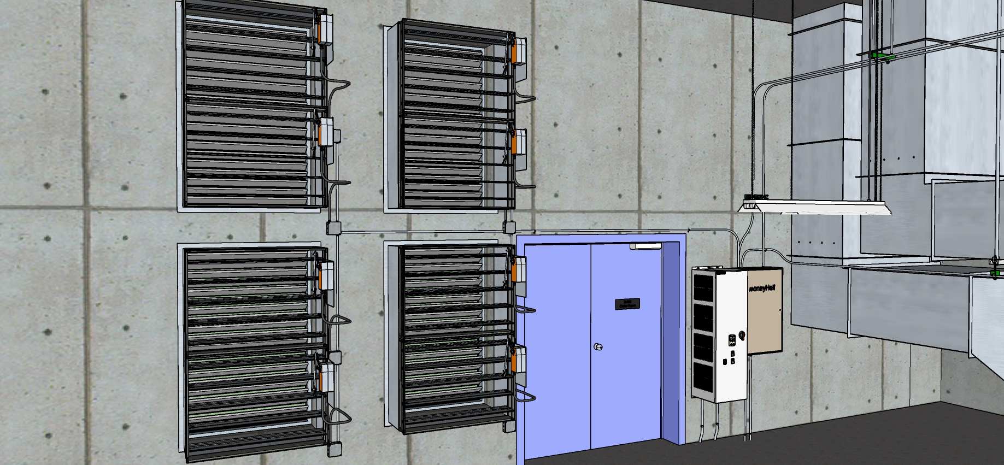
Relief Dampers - Overview

Slide 25
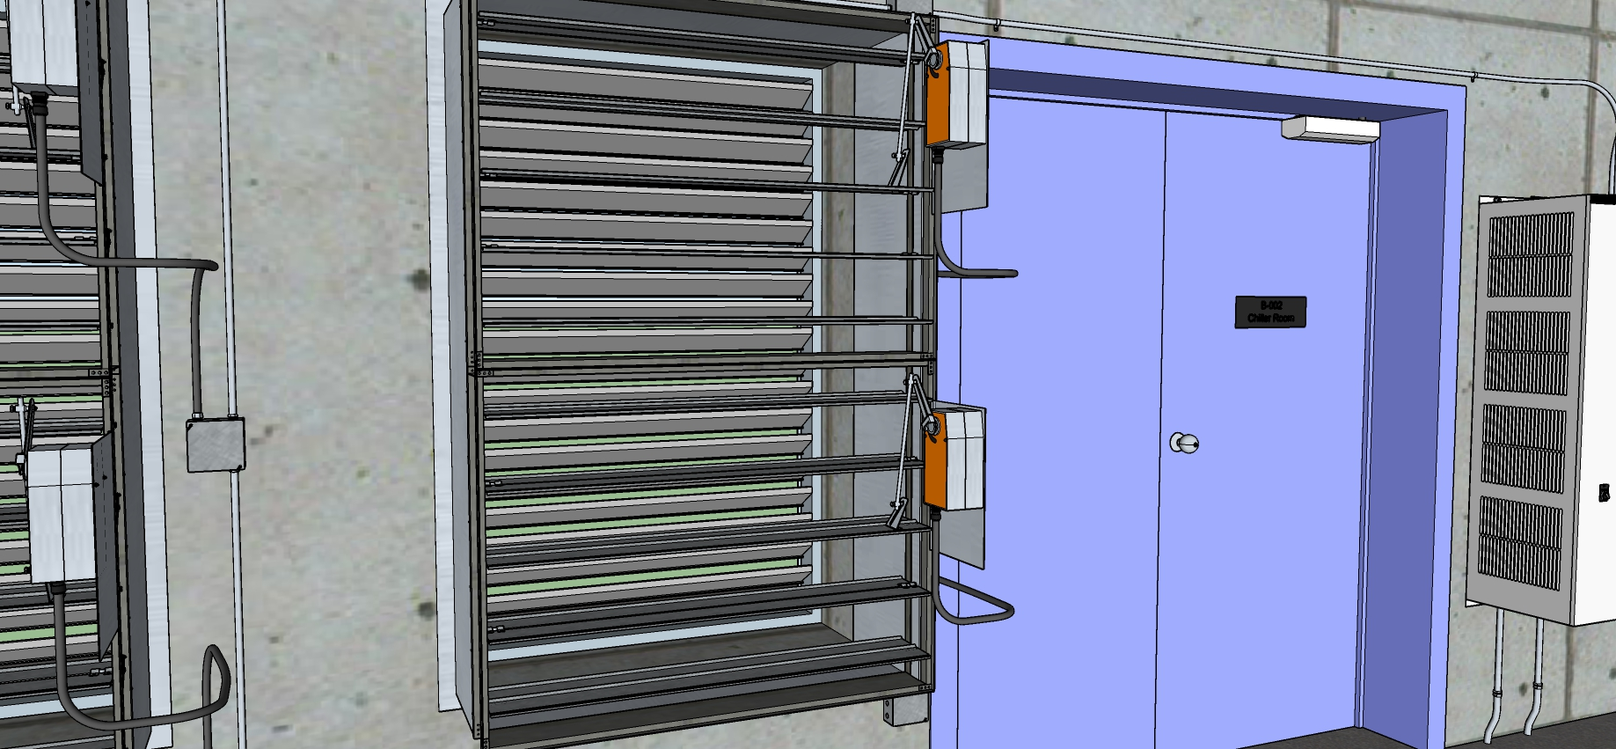
Relief Dampers – Close-up

Slide 26
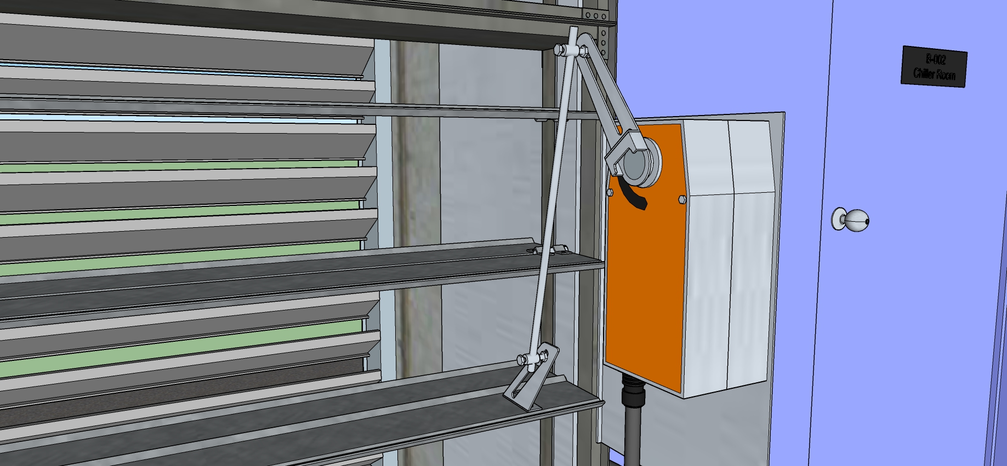
Relief Dampers – Actuator and Blade Close-up

Slide 27
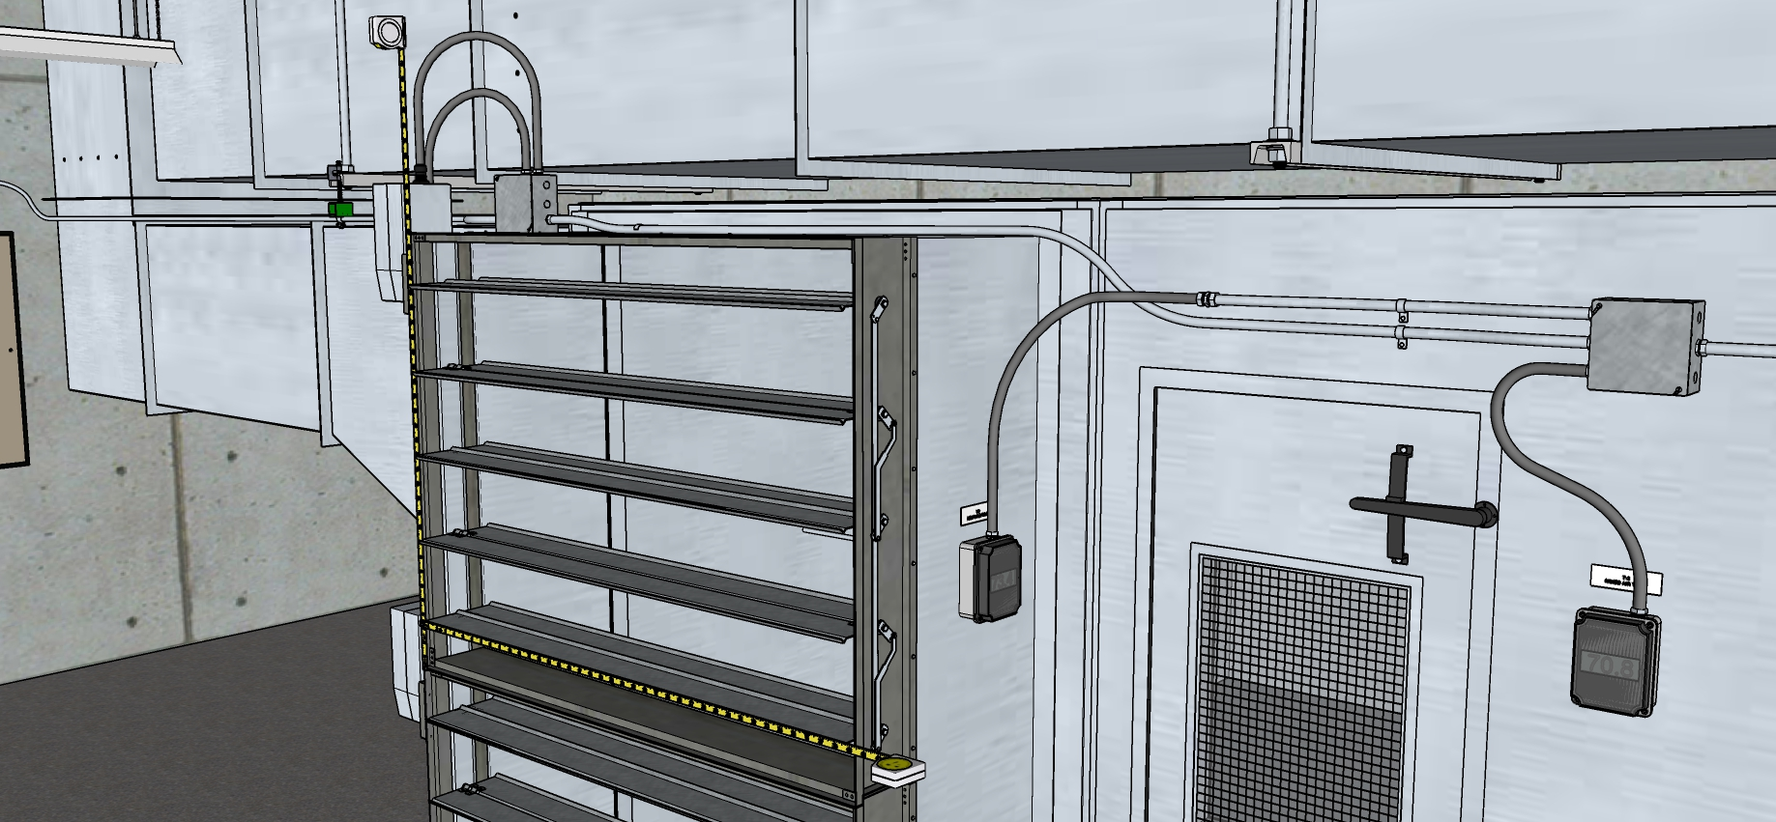
Return Air Damper Measurements - Overview

Slide 28
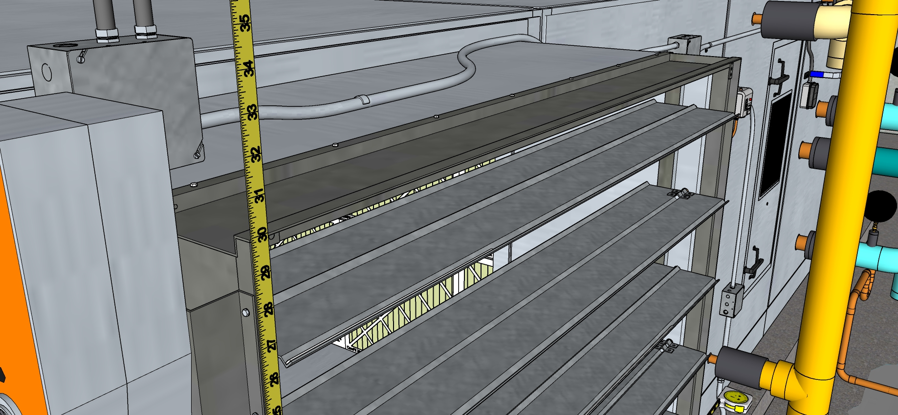
Return Air Damper Measurements - Height

Slide 29
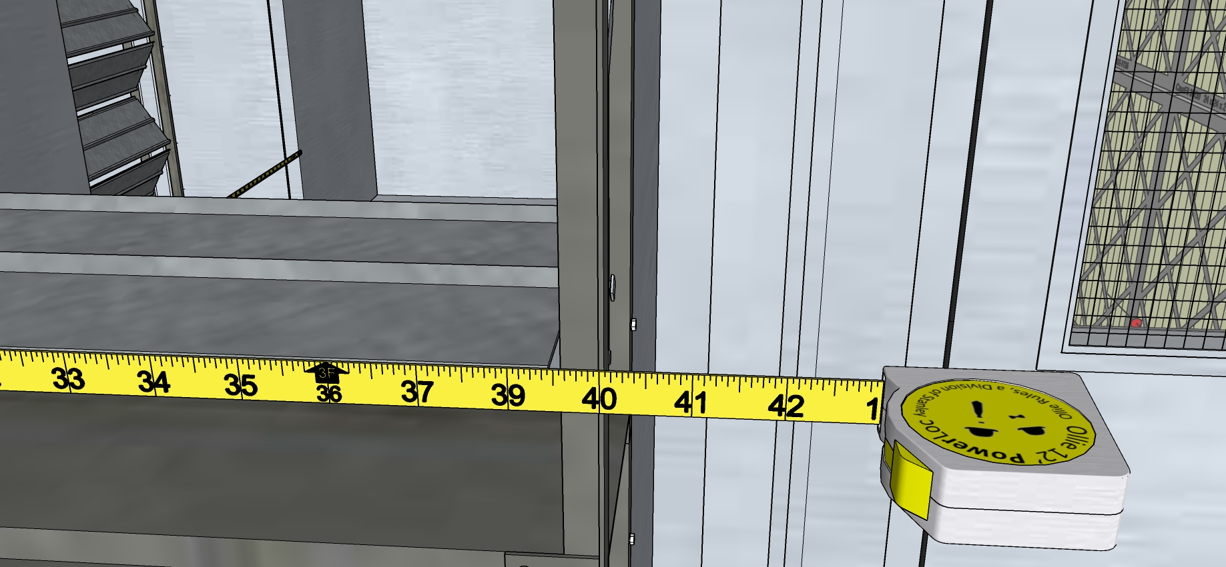
Return Air Damper Measurements - Width

Slide 30
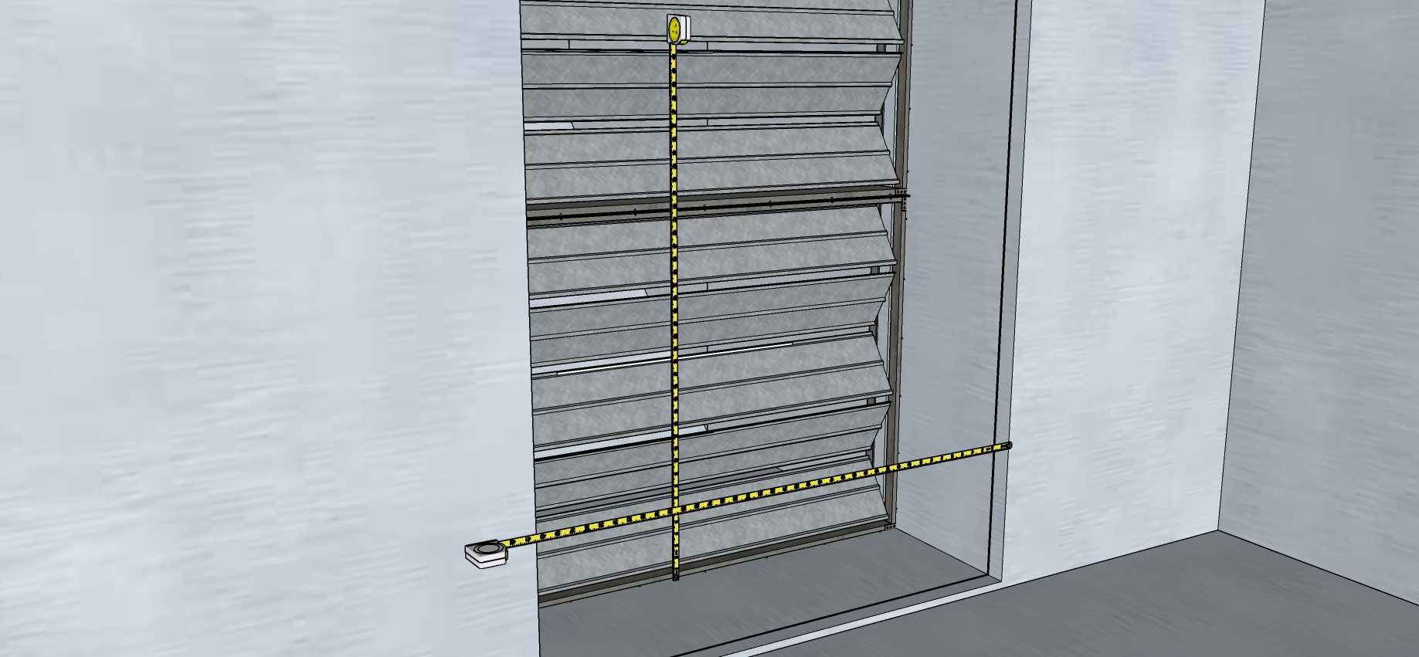
Outdoor Air Damper Measurements - Overview

Slide 31
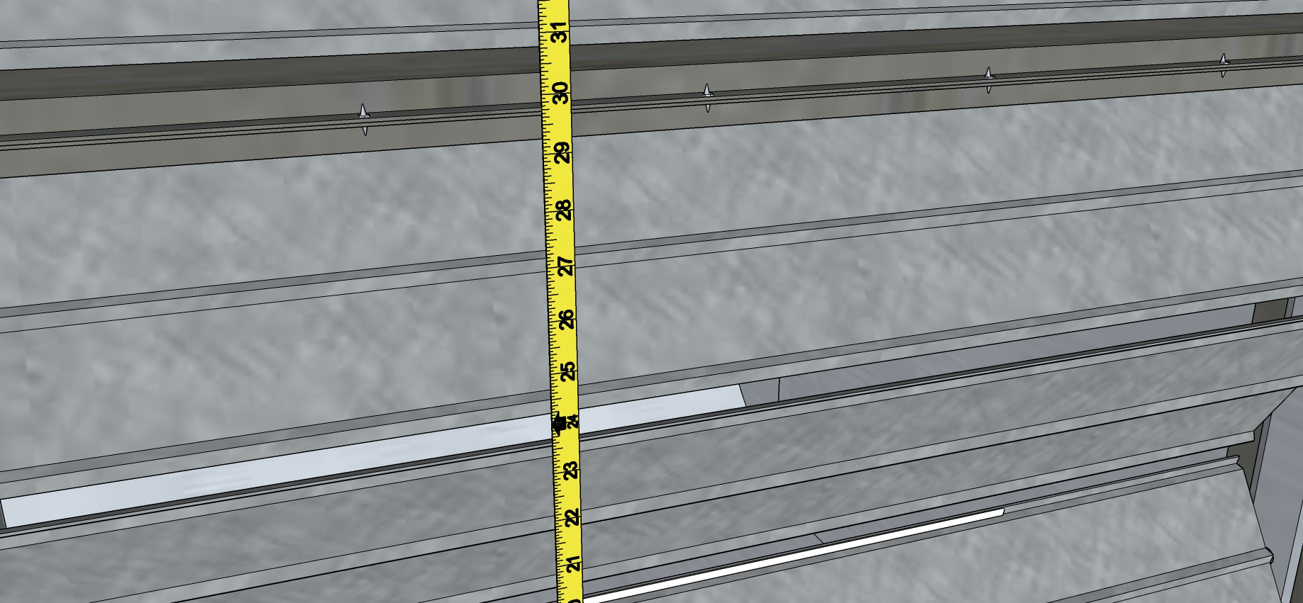
Outdoor Air Damper Measurements - Height

Slide 32
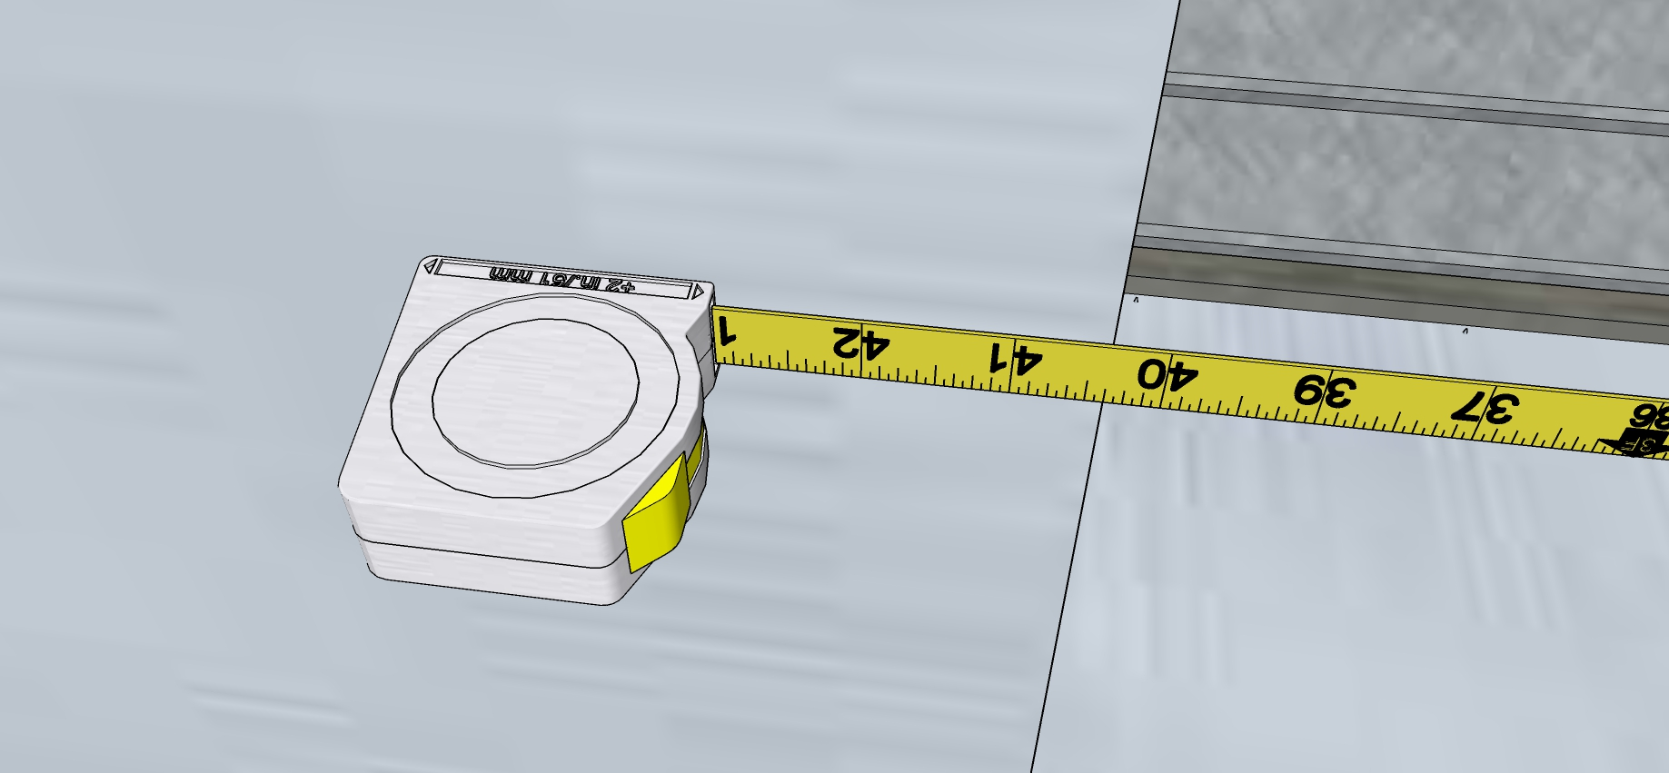
Outdoor Air Damper Measurements - Width

Slide 33
Relief Dampers – Measurements Overview

Slide 34
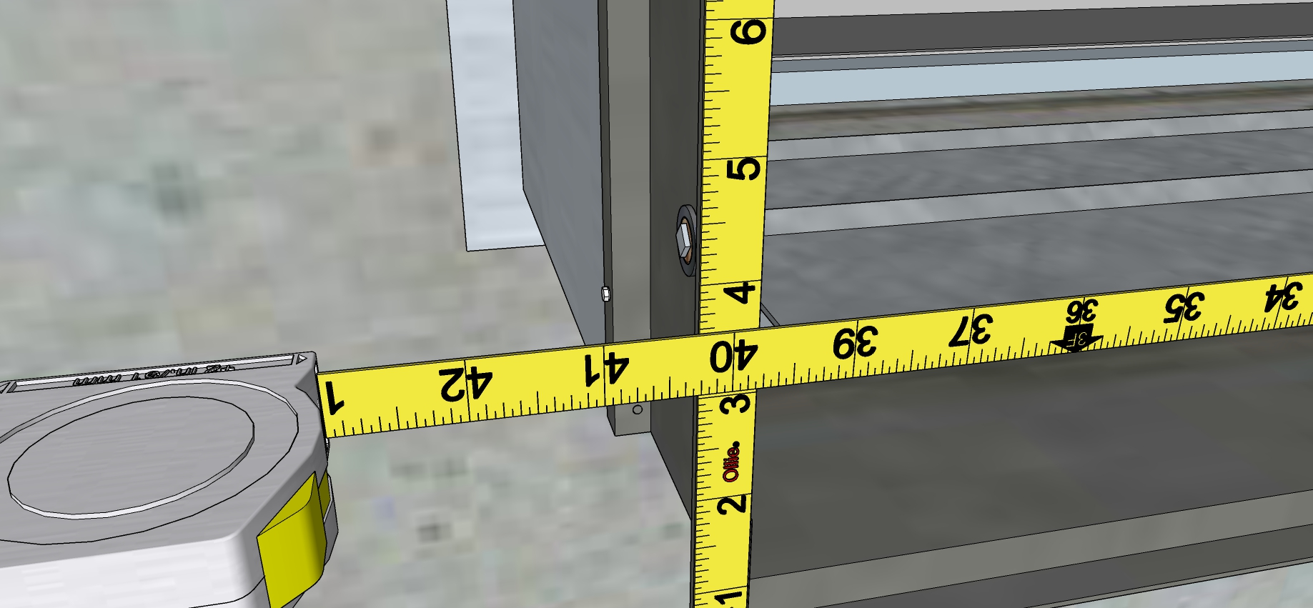
Relief Dampers – Measurements - Width

Slide 35
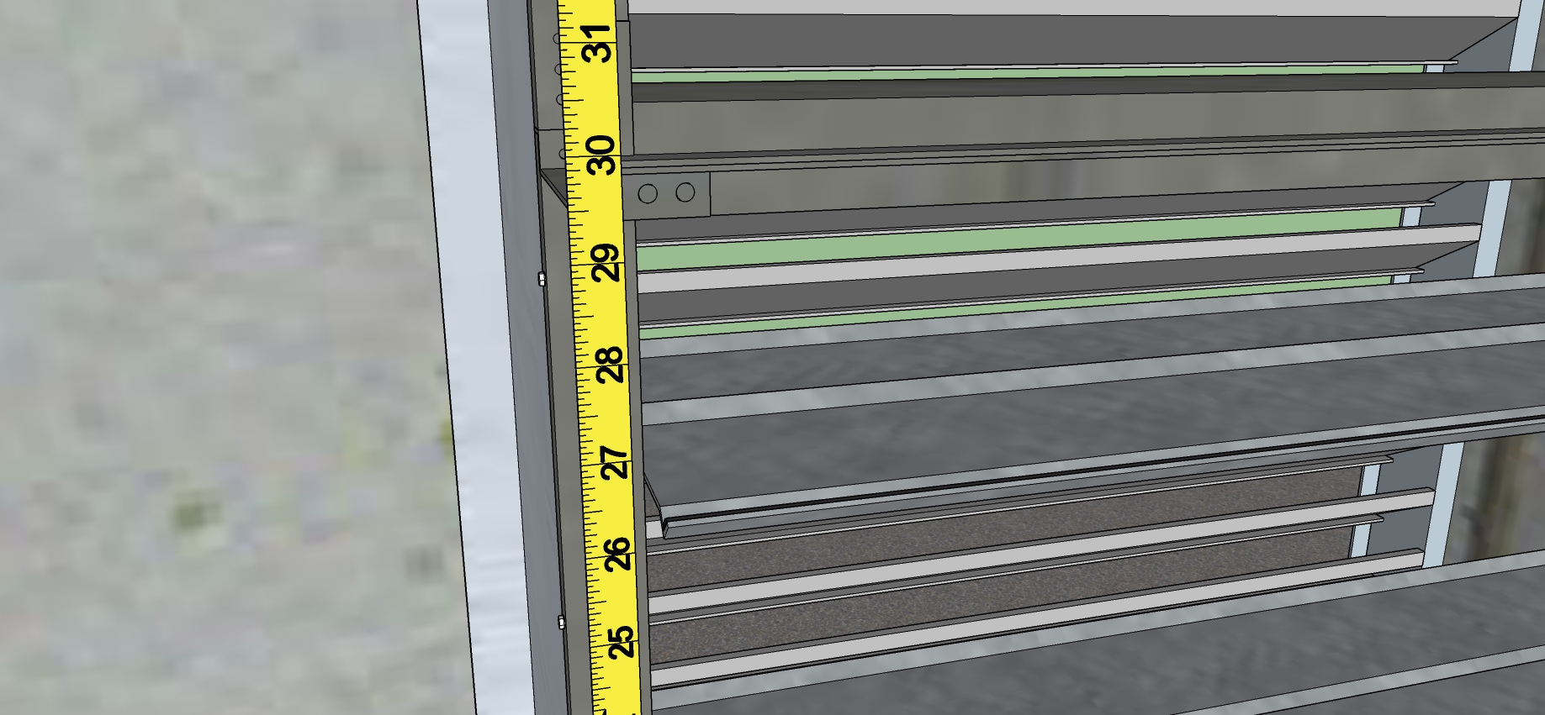
Relief Dampers – Measurements - Height

Slide 36
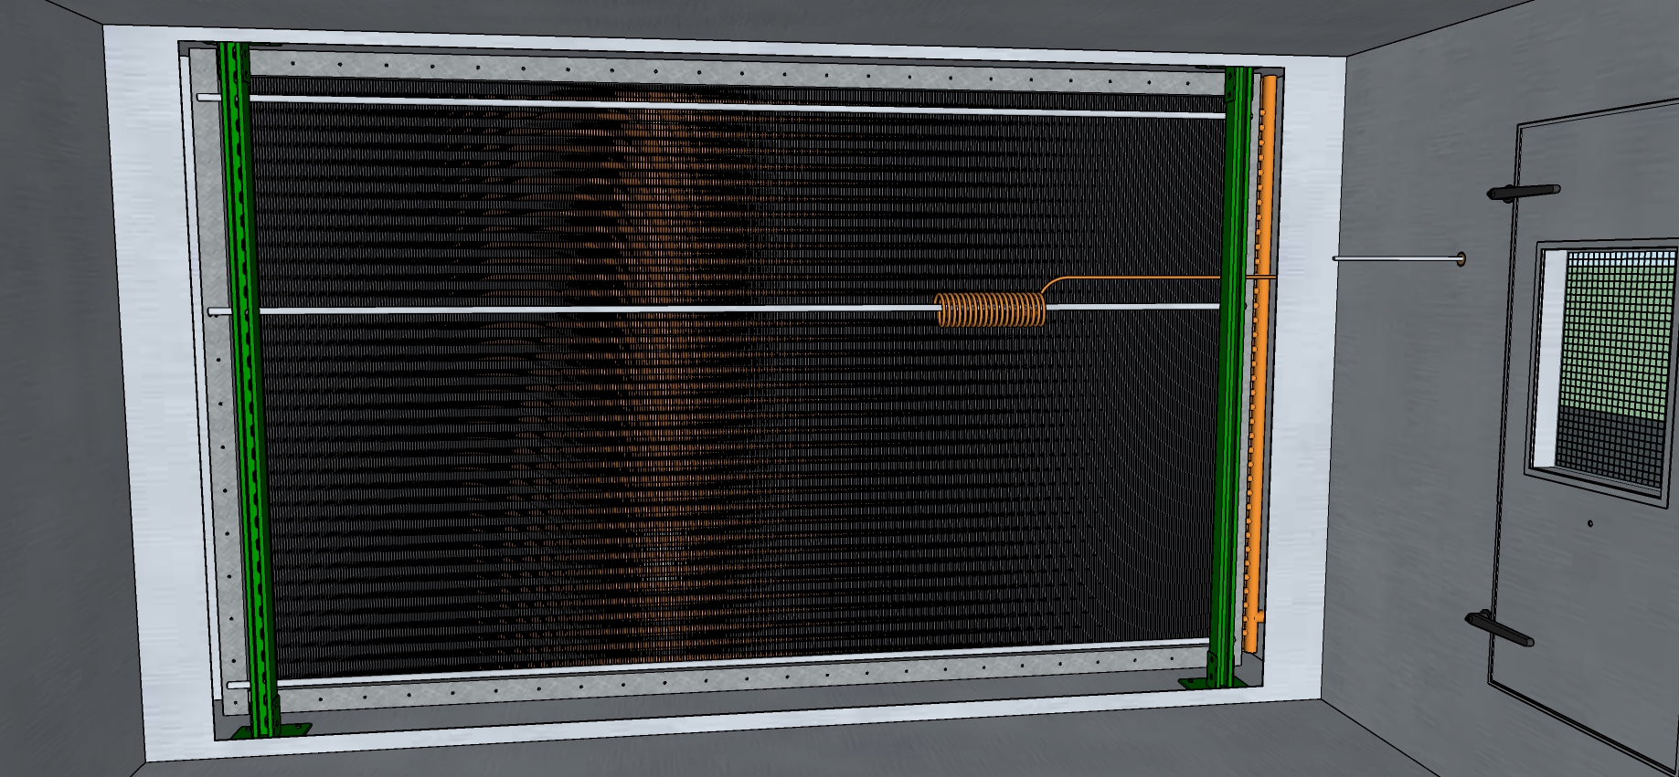
Mixed Air Plenum Looking in the Direction of Airflow, Filters Hidden

Slide 37
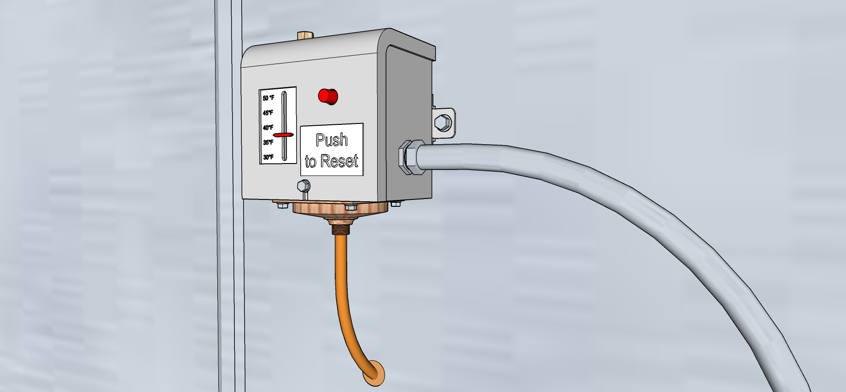
Control Device

Slide 38
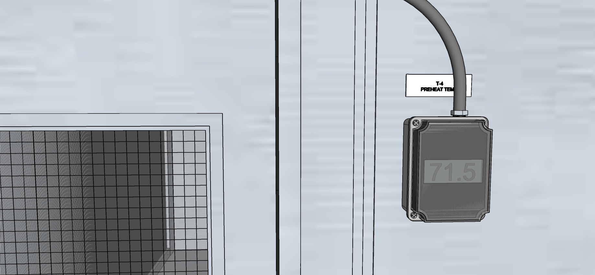
Hot Water Coil Leaving Air Temperature

Slide 39
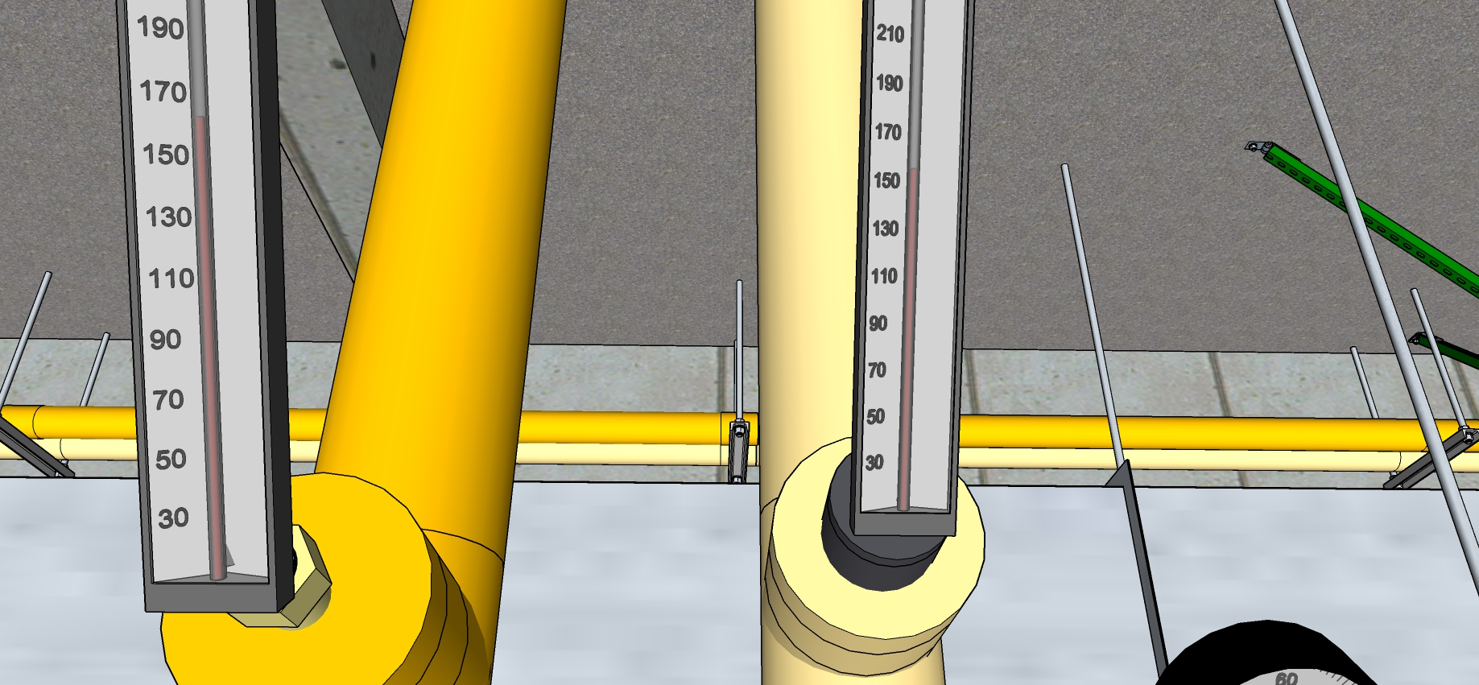
Hot Water Coil Pipe Temperatures

Slide 40
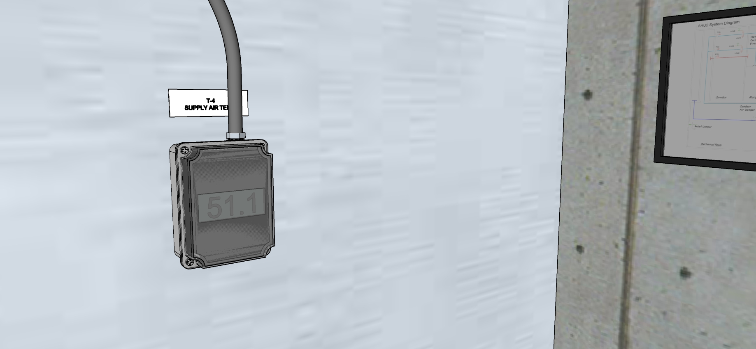
Supply Air Temperature

Slide 41
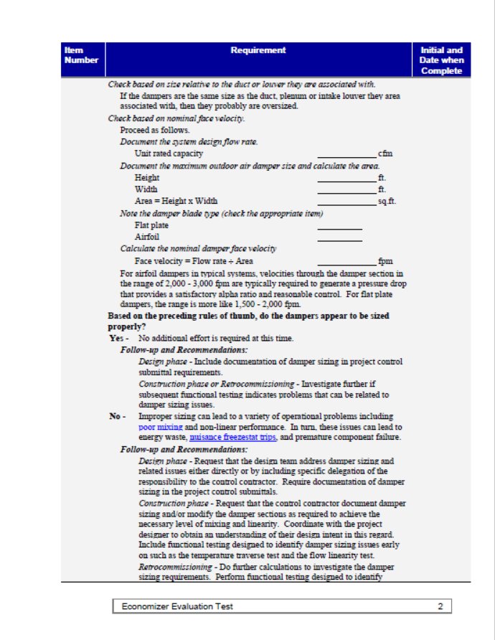
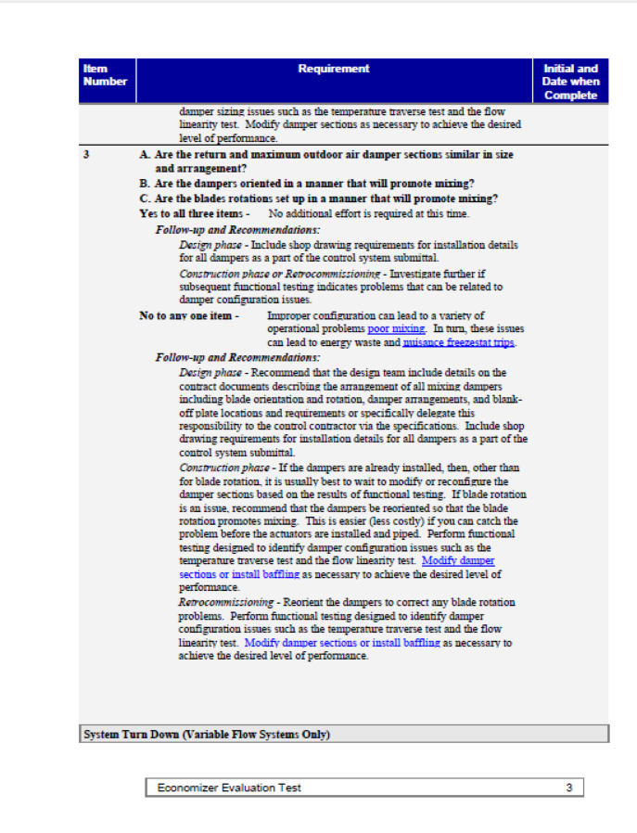

Slide 42
Break Out 02
Given
The second section of the checklist
Previous information
Damper curves that follow
Assess the economizer damper sizing and arrangement
How well sized are they?
How well are they arranged to promote mixing?
Are their improvements you would recommend?
Would your recommendations vary with the climate the system was in?
What monitoring and testing would you want to do based on what you observe?

Slide 43
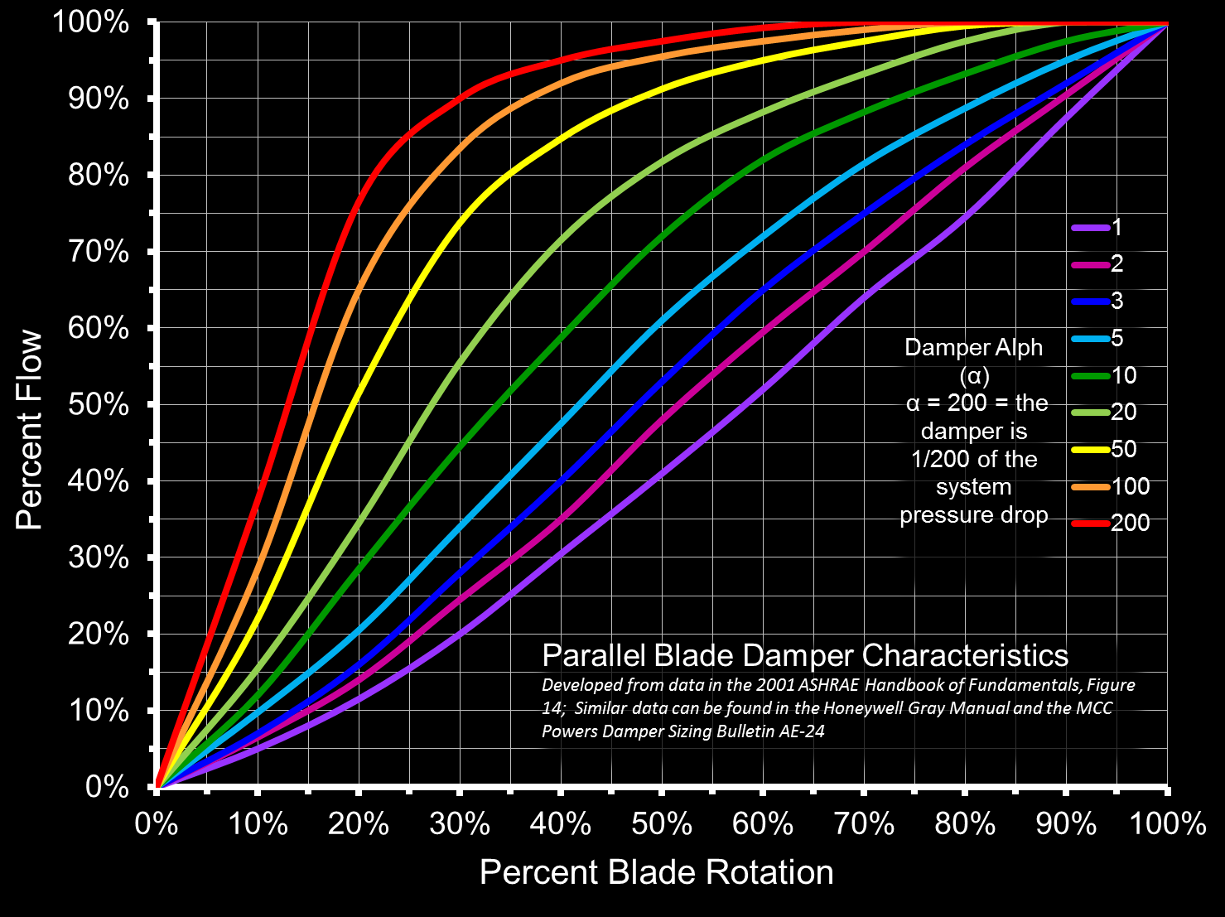
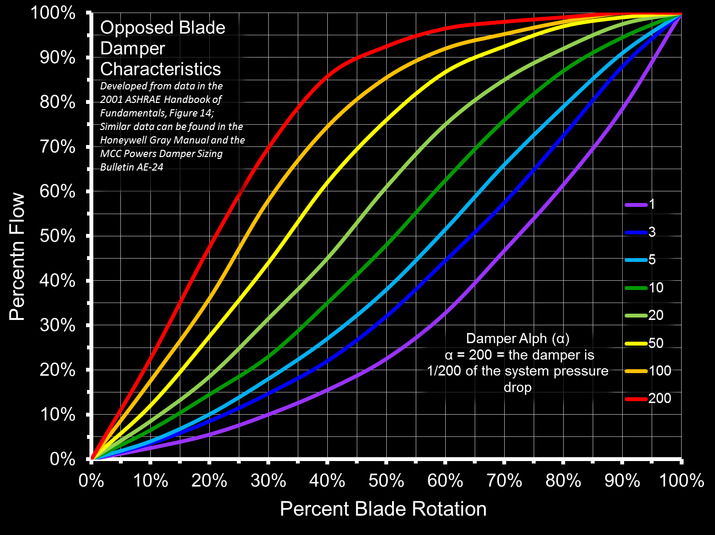
Damper Characteristic Curves

