Slide 1
Best Life Cycle Cost Filter Operation
David Sellers, Senior Engineer
Facility Dynamics Engineering
www.FacilityDynamics.com

Slide 2
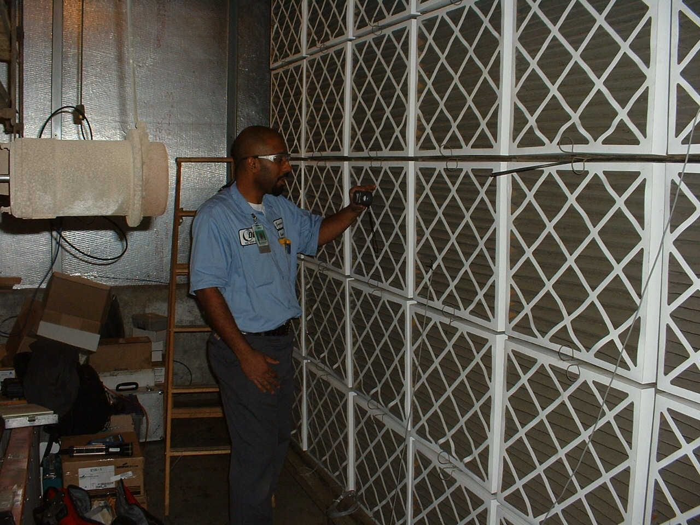
Conventional Thinking = HVAC is Filtration

Slide 3
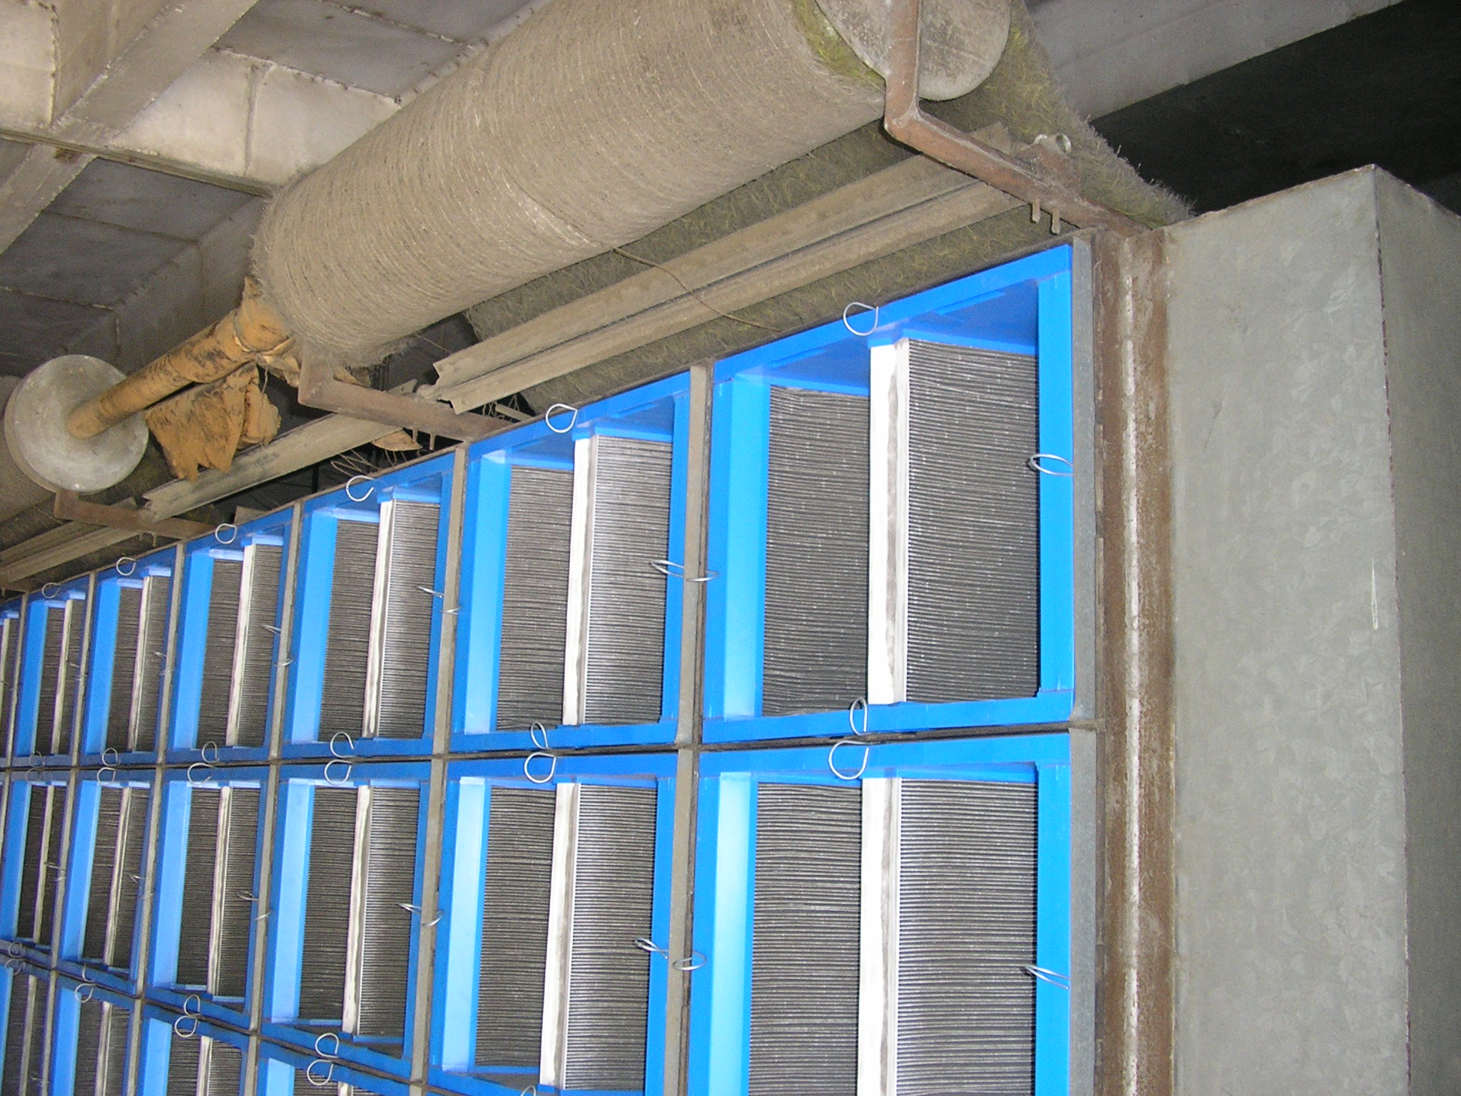
Filtration and HVAC Go Hand in Hand
Air conditioning is the control of the humidity of the air by either increasing or decreasing its moisture content. Added to the control of the humidity are the control of temperature either by heating or cooling the air, the purification of the air by washing or filtering the air, and the control of air motion and ventilation
Dr. Willis Carrier

Slide 4
Filtration and HVAC Go Hand in Hand
Air conditioning is the control of the humidity of the air by either increasing or decreasing its moisture content. Added to the control of the humidity are the control of temperature either by heating or cooling the air, the purification of the air by washing or filtering the air, and the control of air motion and ventilation
Dr. Willis Carrier

Slide 5
LEED® Requirements Push Towards Higher Filtration Levels
IE Q Credit 5: Indoor Chemical and Pollutant Source Control
  Particle filters or air cleaning devices shall be provided to clean the outdoor air at any location prior to its introduction to occupied spaces.
  These filters or devices shall be rated a minimum efficiency reporting value (MERV) of 13 or higher in accordance with ASHRAE Standard 52.2.

Slide 6
COVID Mitigation Pushes Towards Higher Filtration Levels
ASHRAE EPIDEMIC TASK FORCE
Core Recommendations for Reducing Airborne Infectious
Aerosol Exposure
  Use combinations of filters and air cleaners that achieve MERV 13 or better levels of performance for air recirculated by HVAC systems

Slide 7
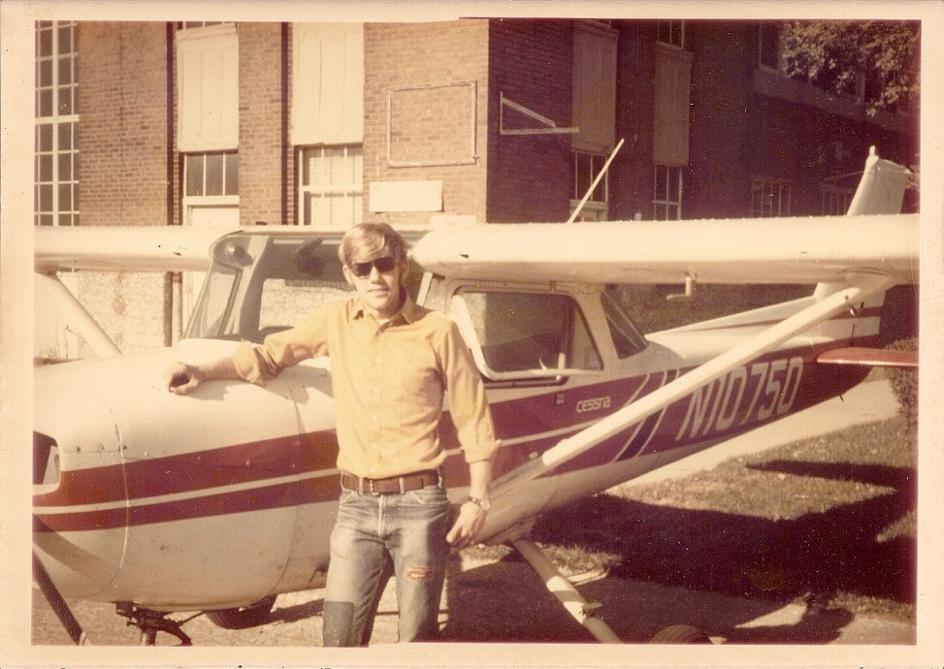
A Bit About Me and My Interest In this Topic
1972
  Set out to be an airplane mechanic and aircraft maintenance engineer

Slide 8
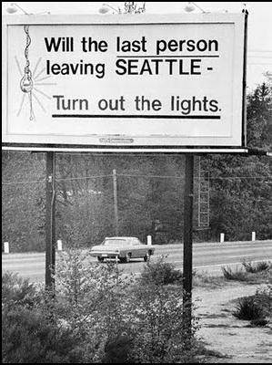
A Bit About Me and My Interest In this Topic
1976
  Reality intervenes
Image Courtesy www.kpluwonders.org/
Notes:
http://www.kpluwonders.org/

Slide 9
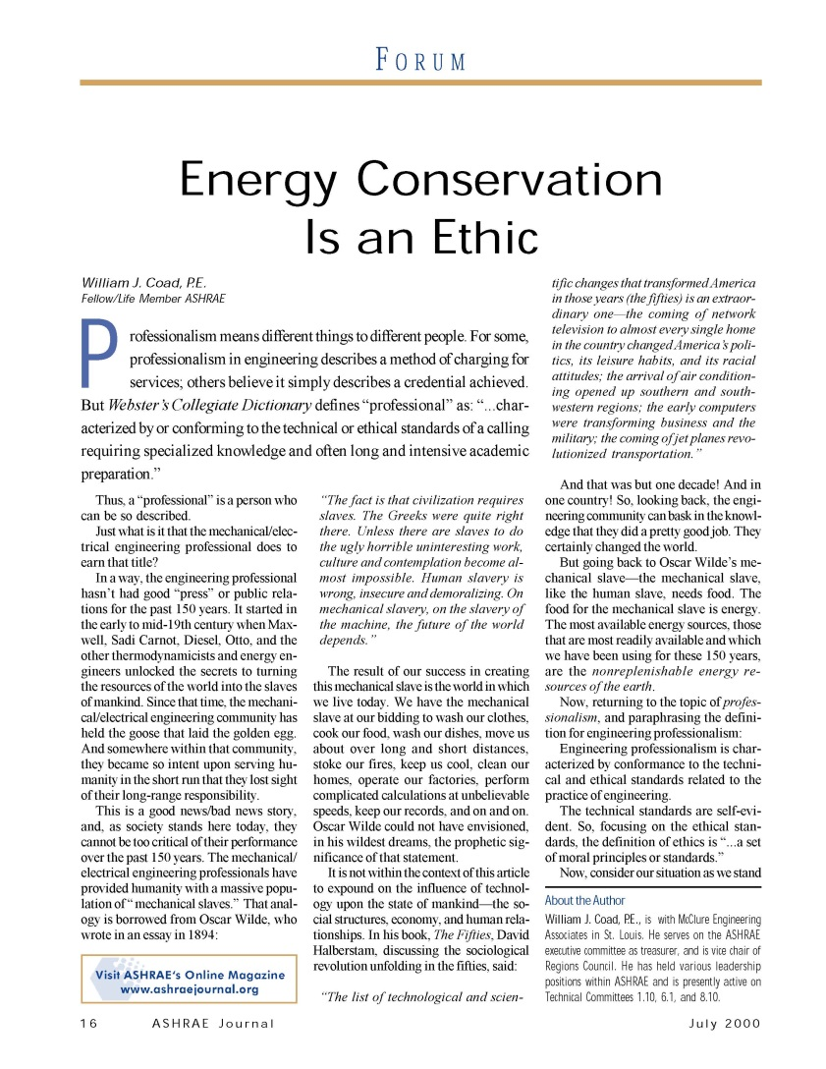
A Bit About Me and My Interest In this Topic
1976
  Bill Coad inspires me to think a different way…
    … that is to practice our profession with an emphasis upon our responsibility to protect the long-range interests of the society we serve and, specifically, to incorporate the ethics of energy conservation and environmental preservation in everything we do.
  ASHRAE Journal, vol. 42, no. 7, p. 16-21
  www.ASHRAE.org

Slide 10
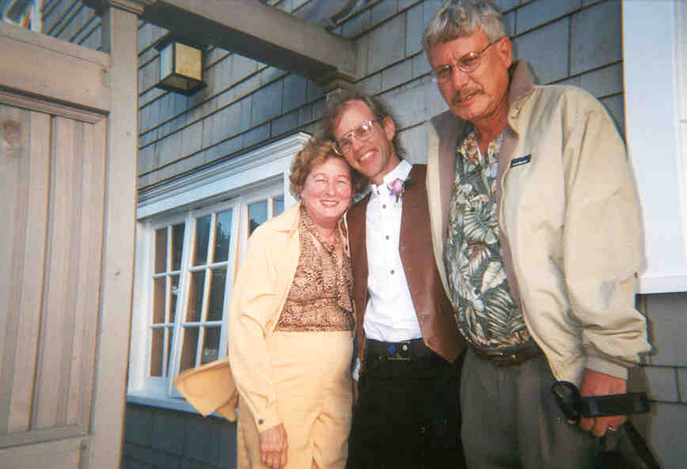
A Bit About Me and My Interest In this Topic
1976
  I change career paths and am blessed with great mentors

Slide 11
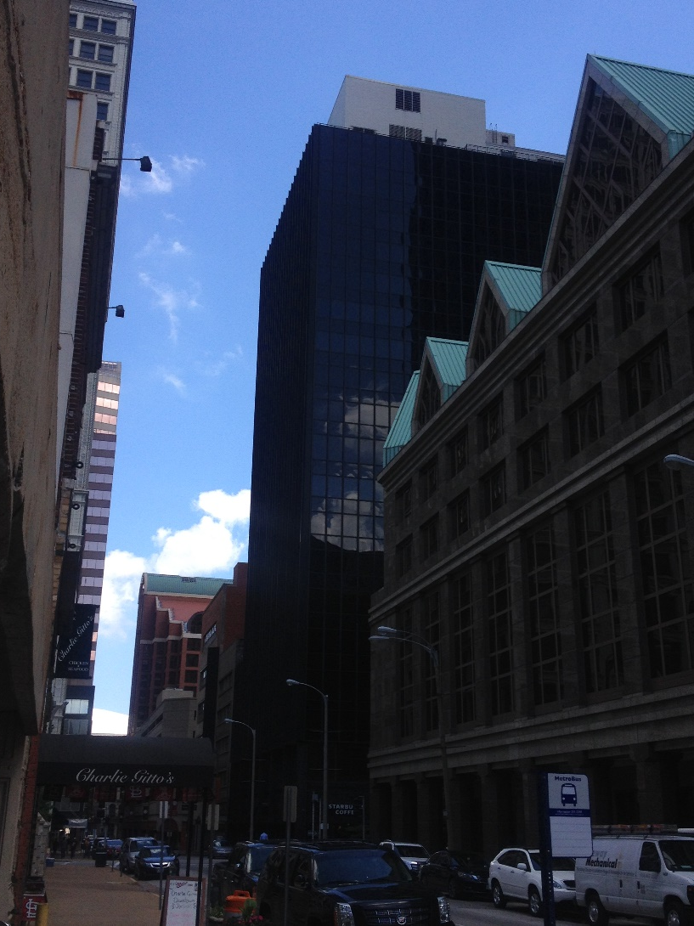
A Bit About Me and My Interest In this Topic
1976
  I encounter my first commercial HVAC system filter bank

Slide 12
A Bit About Me and My Interest In this Topic
1976
  I encounter my first commercial HVAC system filter bank
  It’s different from the one in Mom and Dad’s furnace

Slide 13
A Bit About Me and My Interest In this Topic
1976
  I encounter my first commercial HVAC system filter bank
  It’s different from the one in Mom and Dad’s furnace
  Cleaner air = Cleaner equipment in addition to better IEQ

Slide 14
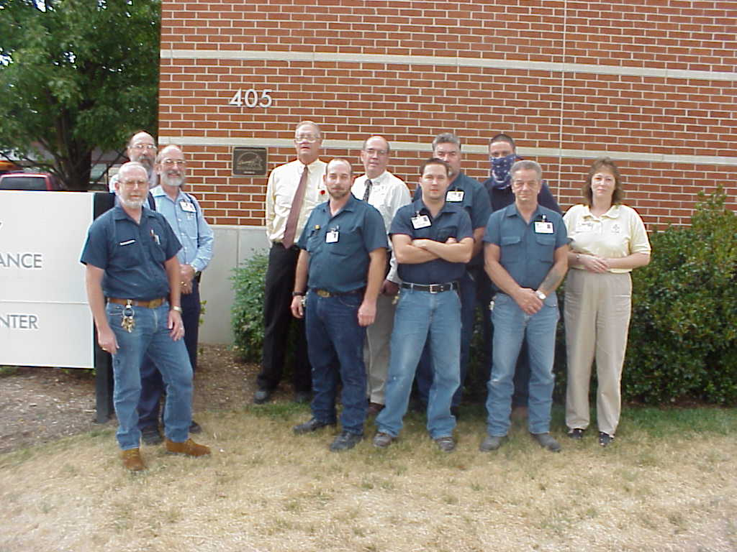
A Bit About Me and My Interest In this Topic
1979/1980
  I begin a long-term relationship with the team at Memorial Hospital of Carbondale

Slide 15
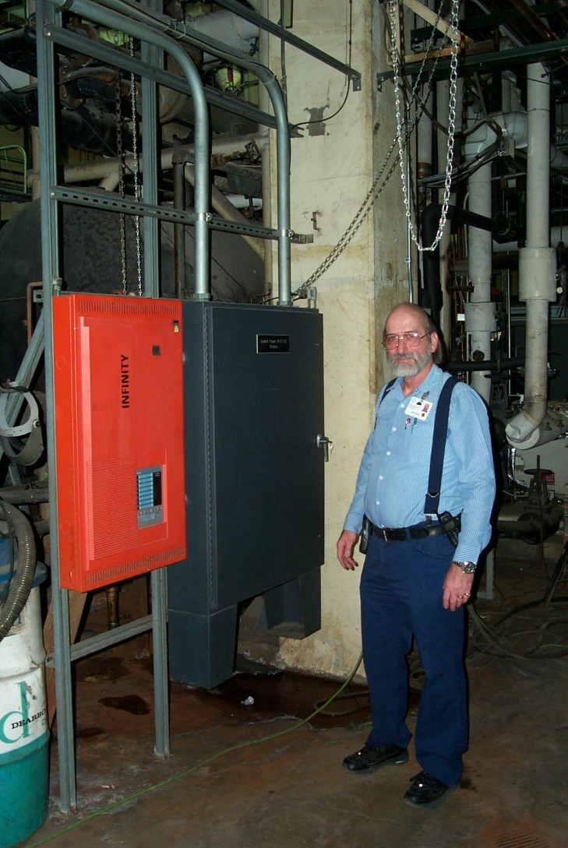
A Bit About Me and My Interest In this Topic
1979/1980
  Joe Cook, Bob Keller and I begin to “do battle” with the Surgery Air Handling System

Slide 16
A Bit About Me and My Interest In this Topic
1979/1980
  Joe Cook, Bob Keller and I begin to “do battle” with the Surgery Air Handling System
    First exposure to multiple filter beds
    First exposure to high filtration efficiencies
    Realize that filters are only as good as their frames
    Realize that filters = resource consumption on multiple fronts

Slide 17
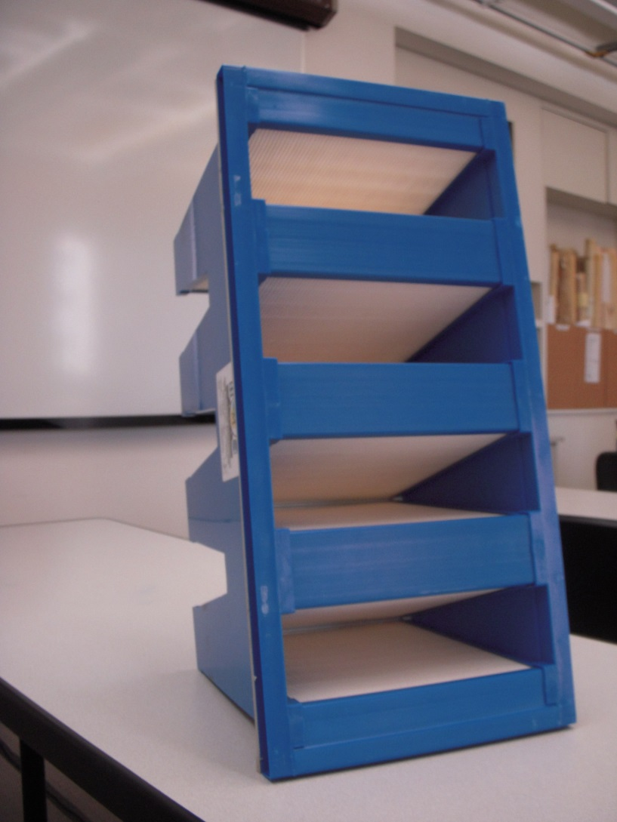
A Bit About Me and My Interest In this Topic
1990
  We need a few more year’s from the aging surgery system
    OR loads going up
    OR replacement moving out the timeline
    Looking for ways to mitigate filter pressure drop and preserve efficiency
    Discover extended surface area filters

Slide 18
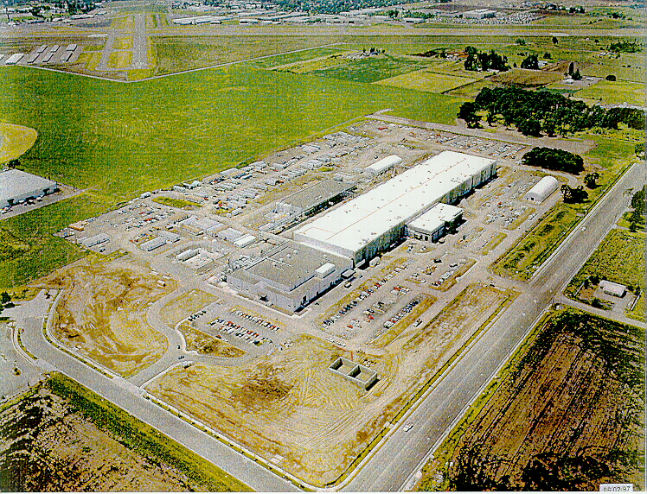
A Bit About Me and My Interest In this Topic
1997
  Move to Oregon to become a facilities engineer at Komatsu Silicon’s Hillsboro facility
    HVAC system owner
    Process exhaust system owner
    Central chilled water plant system co-owner
    DDC system co-owner
    Fire protection system owner

Slide 19
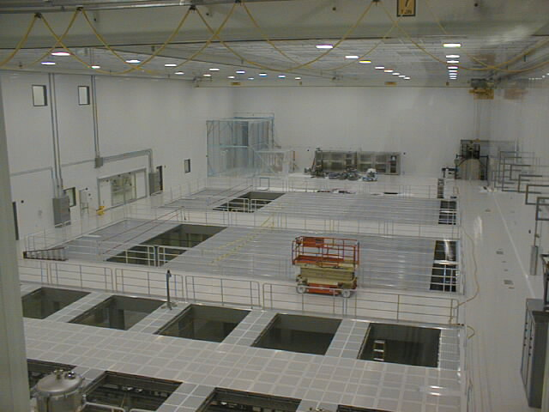
A Bit About Me and My Interest In this Topic
1997
  Move to Oregon to become a facilities engineer at Komatsu Silicon’s Hillsboro facility
    HVAC system owner means I own many, many, many filters
      Learn a lot about HEPA and ULPA filters
      Begin to observe filter loading rates
      Confronted with what a filter change represents in terms of resources

Slide 20
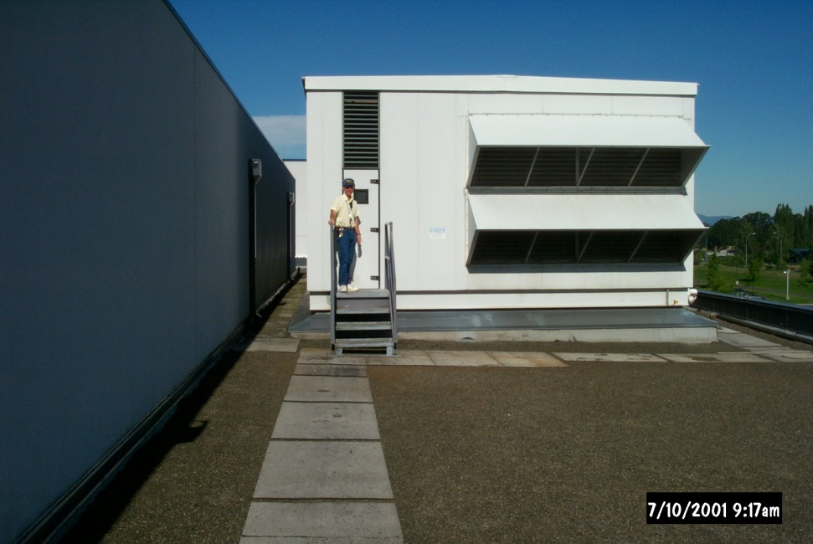
A Bit About Me and My Interest In this Topic
1998
  Semiconductor industry downturn opens the door to alternative approaches to operations
    Clean room envelope issues cause significant ripple effects with the make up AHU

Slide 21
A Bit About Me and My Interest In this Topic
1998
  Semiconductor industry downturn opens the door to alternative approaches to operations
    Clean room envelope issues cause significant ripple effects with the make up AHU
Leakage results in the need to run the back-up fan
  14,000 more outdoor air cfm than design (30%)
    Significant HVAC process and fan energy load
  Square law means the duct system is running a or above the pressure class
    Significant risk

Slide 22
A Bit About Me and My Interest In this Topic
1998
  Semiconductor industry downturn opens the door to alternative approaches to operations
    Clean room envelope issues cause significant ripple effects with the make up AHU
Applying extended surface area HEPA filters:
  Eliminates about 0.50 in.w.c. of static
  Provides a “flatter” loading curve
  Particle count test meets requirements

Slide 23
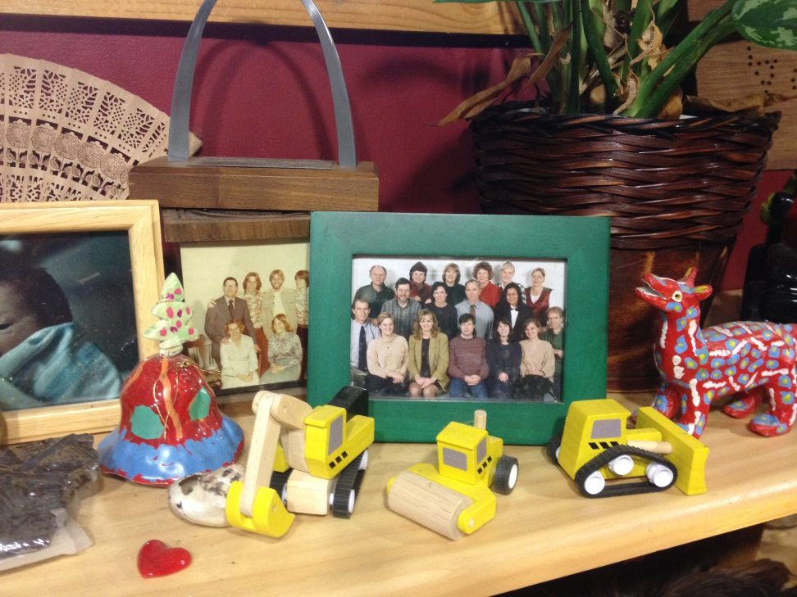
A Bit About Me and My Interest In this Topic
1999
  Semiconductor industry downturn continues
    Plant idled
    I move to PECI
      Begin to pursue life cycle cost filter based operation as a retrocommissioning measure

Slide 24
A Bit About Me and My Interest In this Topic
1999
  Semiconductor industry downturn continues
    Plant idled
    I move to PECI
      Begin to pursue life cycle cost filter based operation as a retrocommissioning measure
      I tag along on Mike Chimack’s ACEEE paper on the topic
Live cycle cost filter operation = resource savings on multiple fronts
  Fan energy
  Filter first cost
    Supply stream
    Embedded energy
  Installation labor
  Disposal
    Landfill volume
    Disposal costs
    More embedded energy

Slide 25
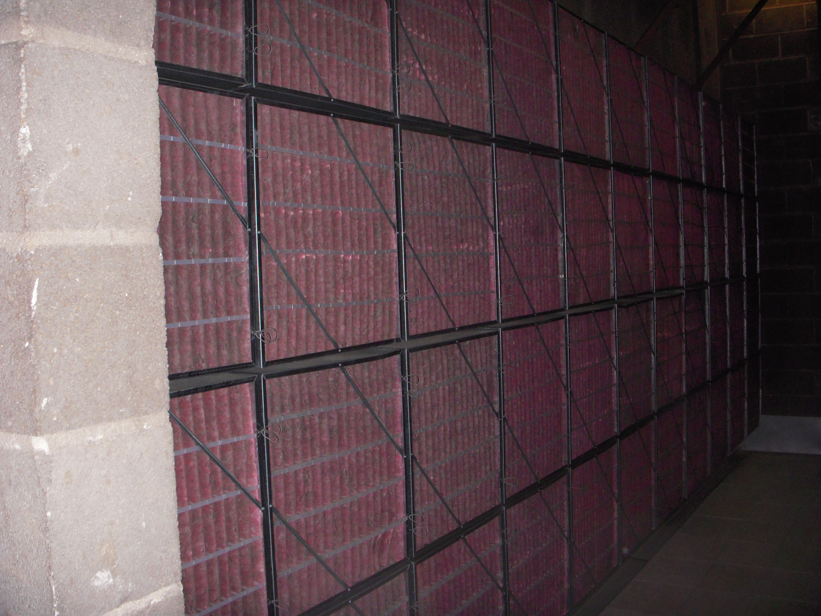
Energy is Not the Only Resource Consumed by Air Handling Equipment
There could easily be at least one 24” x 24” filter for every 2,000 – 4,000 square feet of building space
CBECS 2018 data says there is about 96,758,000,000 square feet of commercial building space

Slide 26
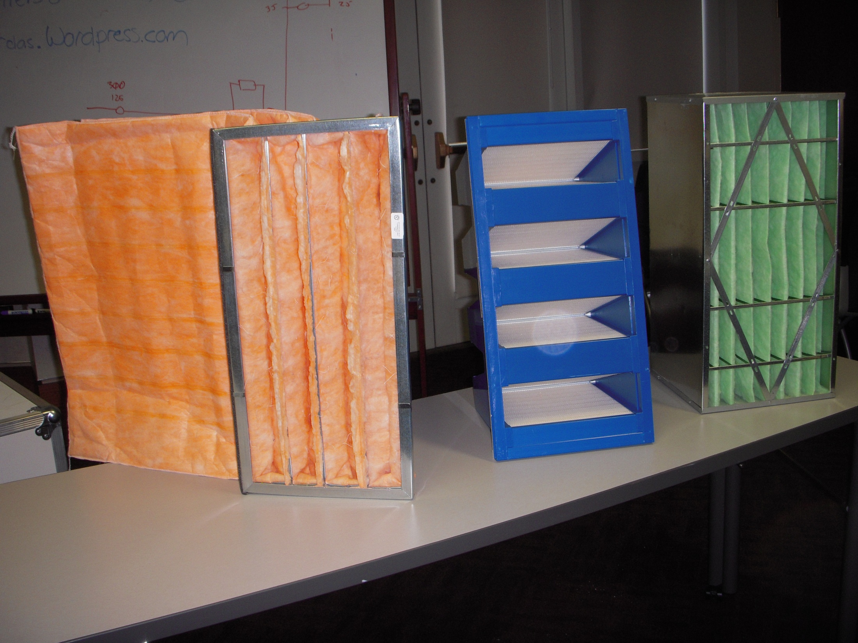
There is More to Filter Media than Being Fuzzy

Slide 27
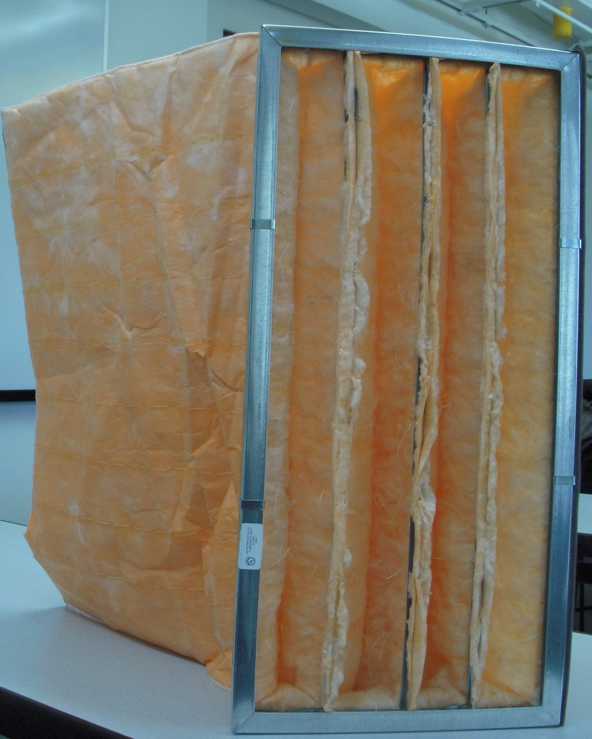
There is More to Filter Media than Being Fuzzy
Camfil Farr HI-FLO
  MERV11 (60-65% ASHRAE Dust-spot Efficiency)
  24” high, 12” wide, 22” deep
  4 flexible pockets
  29 sq.ft. of high lofted air laid micro fiber glass media
  ∆P_{Clean} at 493 fpm = 0.30 in.w.c.
  ∆P_{MaxDirty} = 1.50 in.w.c.
  Dust holding capacity – 175 grams
  $16.68

Slide 28
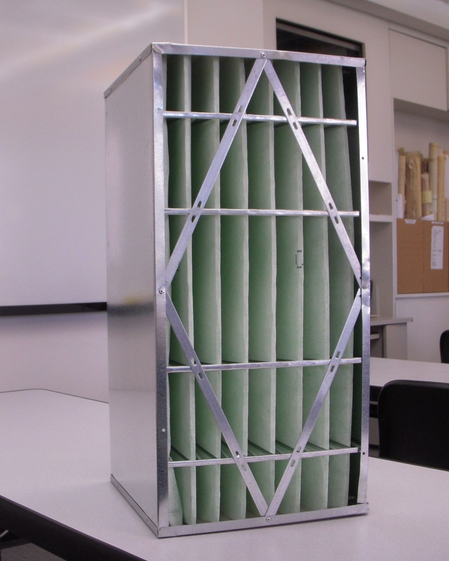
There is More to Filter Media than Being Fuzzy
Camfil Farr RIGA-FLO
  MERV11 (60-65% ASHRAE Dust-spot Efficiency)
  24” high, 12” wide, 11.5” deep
  8 semi-rigid pockets
  26.5 sq.ft. of high-lofted, depth-loading, microfine glass media
  ∆P_{Clean} at 493 fpm = 0.35 in.w.c.
  ∆P_{MaxDirty} = 1.50 in.w.c.
  Dust holding capacity = 225 grams
  $49.97

Slide 29
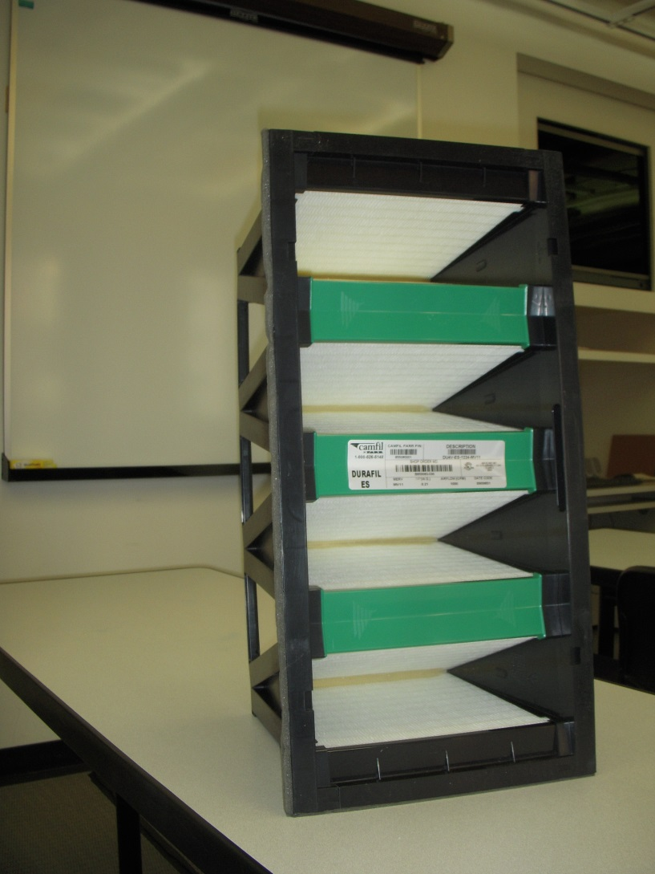
There is More to Filter Media than Being Fuzzy
Camfil Farr DuraFil ES
  MERV11 (60-65% ASHRAE Dust-spot Efficiency)
  24” high, 12” wide, 11.5” deep
  4 pockets
  100 sq.ft. of wet laid fiberglass media
  ∆PClean at 493 fpm = 0.21 in.w.c.
  ∆PMaxDirty = 1.50 in.w.c.
  Dust holding capacity = 200 grams
  $66.10

Slide 30
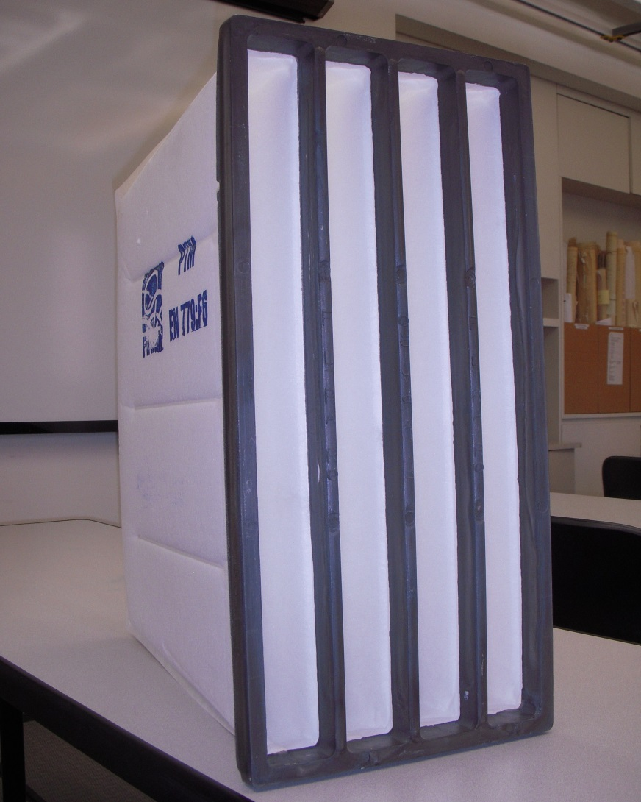
There is More to Filter Media than Being Fuzzy
FILTRAIR PTL (F6)
  MERV11 (60-65% ASHRAE Dust-spot Efficiency)
  24” high, 12” wide, 24” deep
  4 rigid pockets
  30.2 sq. ft. of synthetic, high performance depth loading fibers laid using a progressive density multi-layering technique
  ∆P_{Clean} at 492 fpm = 0.22 in.w.c.
  ∆P_{MaxDirty} = 1.80 in.w.c.
  Dust holding capacity = 1,150 grams
  $124

Slide 31
Same MERV but Otherwise, Very Different
Summary
Model First Cost MERV ∆P, in.w.c. Media Dust
at 500 fpm Area. Capacity,
sq.ft. Grams
HI-FLO $16.68 11 0.30 29.0 175
RIGA-FLO $49.97 11 0.35 26.5 225
DuraFil ES $66.10 11 0.21 100 200
PTL (F6) $124.00 11 0.22 30.2 1,150

Slide 32
Filtration Mechanisms
Highly Dependent on the Details of the “Fuzzyness”
Straining
Impingement
Interception
Diffusion
Electrostatic Effects
    Potential to drop off over time
    Appendix J of ASHRAE 52 attempts to address this

Slide 33
Face Loading Filters

Slide 34
Depth Loading Filters

Slide 35
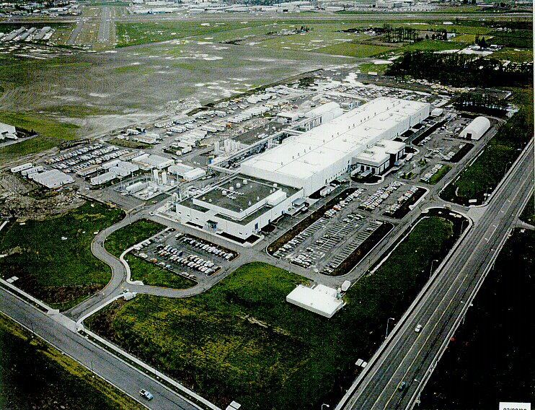
Conventional Thinking = Change Based on Time in Service

Slide 36
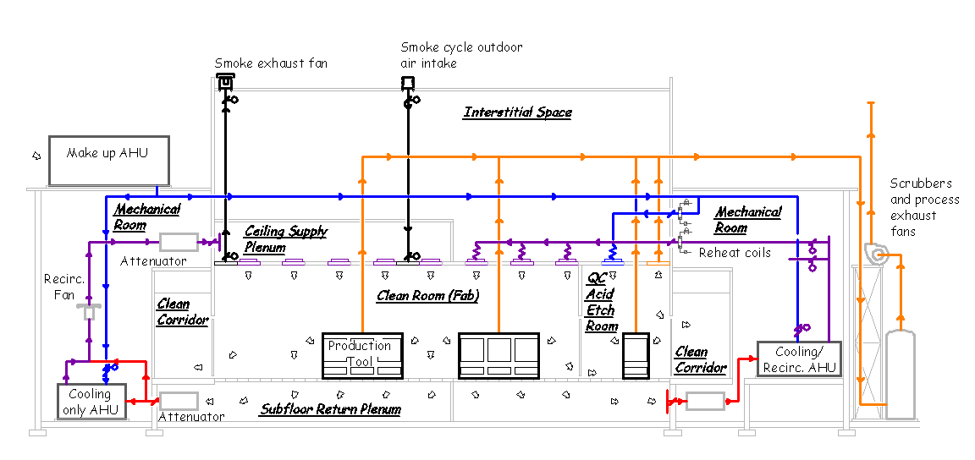
Filter Banks Load at Different Rates
Clean room make up systems loaded more quickly than other systems and loading rate varied with season

Slide 37
Filter Banks Load at Different Rates
Clean room recirculation systems handled extremely clean air and loaded very, very slowly

Slide 38
Filter Banks Load at Different Rates
Scheduled economizer equipped systems serving non-process areas were somewhere in-between in terms of loading rate

Slide 39
Filter Life Cycle Costs
Filter Operating Cost
The slope of this curve is very dependent on the filter loading characteristic
Cost per Day
First cost component
  Decreases over time
  Non-linear
    Day 1 – Cost per day = Cost of filter set
    Day X – Cost per day = (Cost of filter set)/X Days
Energy cost component
  Increases over time
  Non-linear
Total cost component
  Decreases then increases over time
  Change filters at inflection point for best life cycle cost
Increasing Time

Slide 40
Calculating Power Into the Fan Motor as kW

Slide 41
Filter Life Cycle Costs
Filter Operating Cost
Cost per Day
First cost component
  Decreases over time
  Non-linear
    Day 1 – Cost per day = Cost of filter set
    Day X – Cost per day = (Cost of filter set)/X Days
Energy cost component
  Increases over time
  Non-linear
Total cost component
  Decreases then increases over time
  Change filters at inflection point for best life cycle cost
Increasing Time

Slide 42
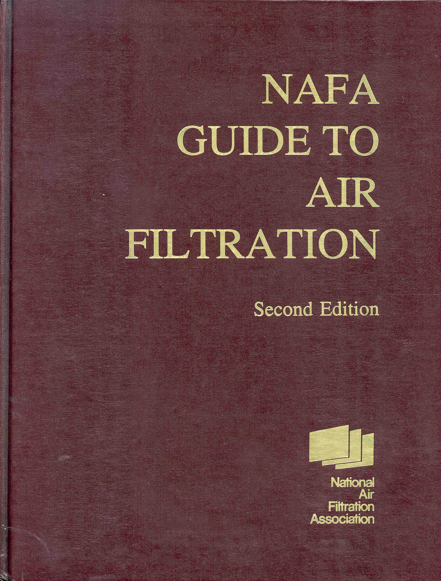
Key Points
Not a new concept
  NAFA Guide to Air Filtration
  1993
  Chapter 13 – Owning and Operating Cost

Slide 43
Key Points
Not a new concept
  NAFA Guide to Air Filtration
  1993
  Chapter 13 – Owning and Operating Cost
Life Estimating
A very important consideration is filter life …
… Because of the many variables in the environment, the development of a method for precisely estimating filter life has eluded filter experts over the years.
Most data is based on user experience or manufacturer’s life tests.

Slide 44
The Life Cycle Cost Game
Benefits of more expensive media
  More surface area
  Engineered loading characteristics
  Lower pressure drops (less fan energy)
  More dust holding capability
Leveraging the benefits
  Lower fan energy
  Longer life
  Eliminate prefilters
    Eliminates related fan energy
    Eliminates related labor
    Eliminates related disposal
    Allows final filters to run to a higher ∆P_{Dirty}

Slide 45
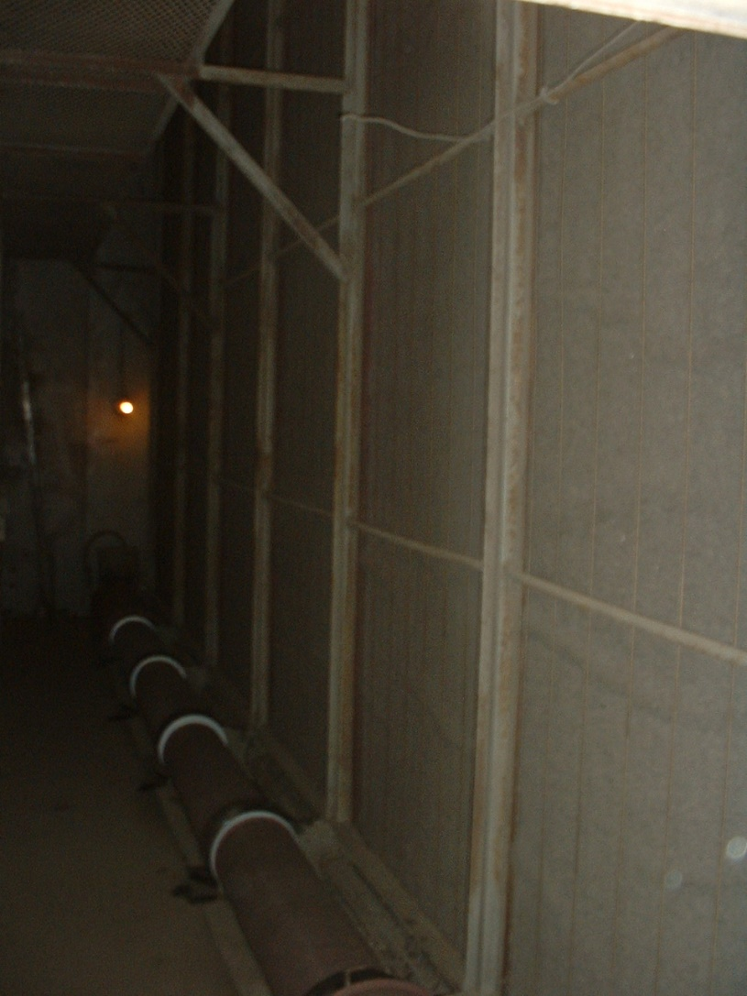
A Word about Eliminating Prefilters
Prefilters do not make the air leaving the system any cleaner
Prefilters do protect the final filter; maybe;
  To protect the final filter, the prefilter has to be able to intercept a significant amount of the entering contaminate
  If the entering contaminant particle size is smaller than what the prefilter can handle, then their benefit is minimized
Roll Media Style Prefilter

Slide 46
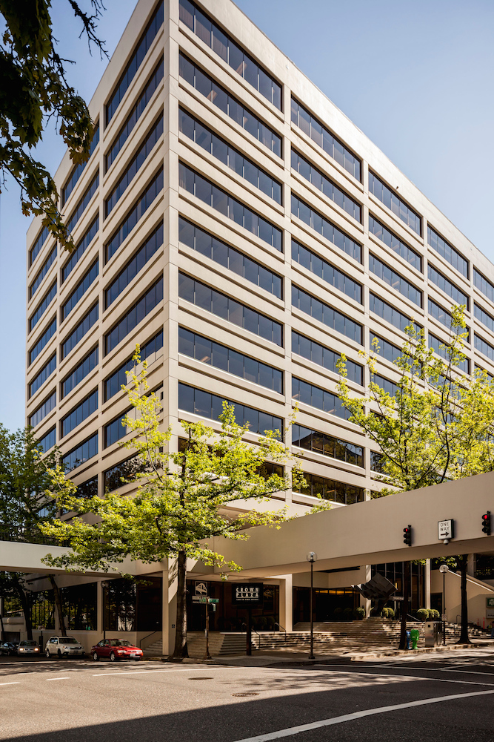
A Word about Eliminating Prefilters
An Example
  Crown Plaza, Portland, OR
  Two identical AHUs
  Operating team wanted to switch to life cycle based filter operation with high performance filters
  Not sure what to do about eliminating prefilters
  Decided to experiement by running one system with and one system with out prefilters
Image courtesy http://www.ddgportland.com/

Slide 47
A Word about Eliminating Prefilters
The Result
  Prefilters did not load that much
  Final filters in both systems tended to load at about the same rate
Image courtesy http://www.ddgportland.com/

Slide 48
A Word about Eliminating Prefilters
The Reason
  Intakes at street level next to the Naito Parkway
  Primary contaminant was rubber duct
    There is a reason we have to buy new tires occasionally
  Prefilters were not very effective against the rubber dust particles
Image courtesy http://www.ddgportland.com/

Slide 49
A Word about Eliminating Prefilters
The Caveat
  Had the building been near a grove of cotton wood trees, prefilters may have been desirable for at least part of the year to protect the final filters from cotton wood seeds
Image courtesy http://www.ddgportland.com/

Slide 51
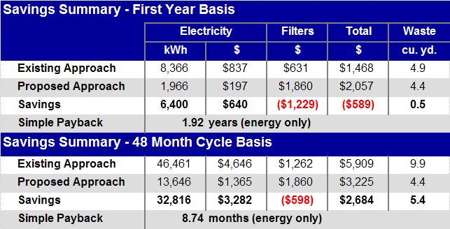
Taking a life cycle perspective is important
An important “ripple effect”

Slide 52
Cost and benefit may not occur in the same purchasing group

Slide 53
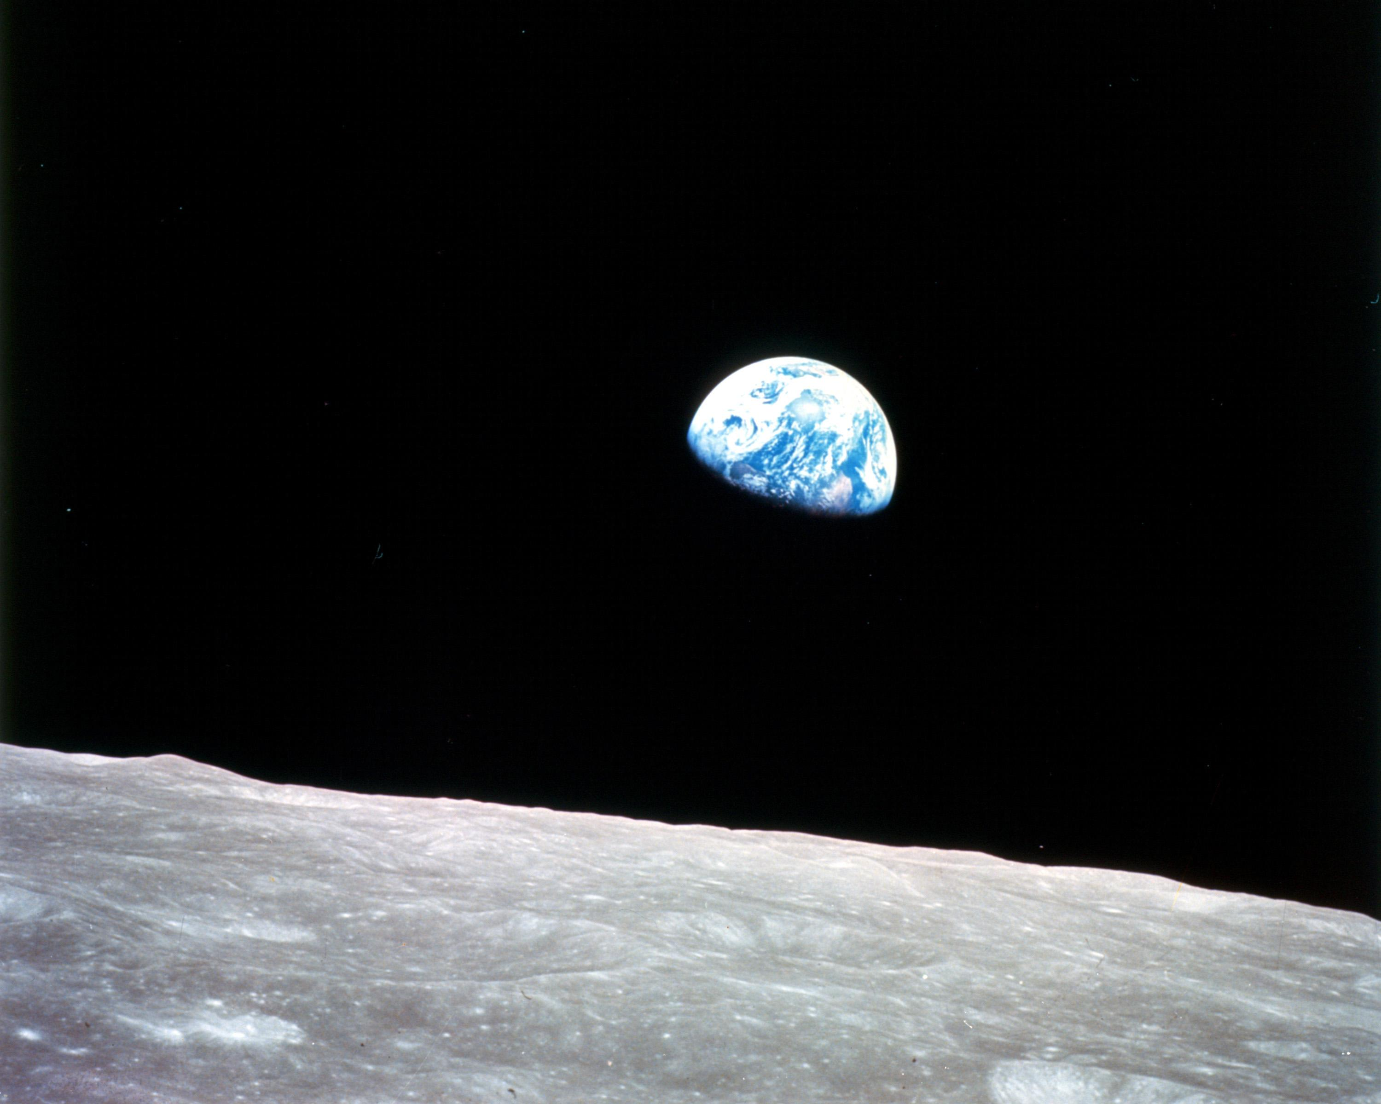
In a highway service station
Over the month of June
Was a photograph of the earth
Taken coming back from the moon
And you couldn't see a city
On that marbled bowling ball
Or a forest or a highway
Or me here least of all
Joni Mitchell
Refuge of the Roads
Image Courtesy William Anders, Apollo 8, 1968 NASA

Slide 54
My Observations:
Only one “marbled bowling ball” in the near vicinity
Unable to see the Division of Design and Construction
Unable to see the Division of Physical Plant and Campus Services
I suspect they are all in this together, and us with them
We need to start acting and thinking as if that is the case
Image Courtesy William Anders, Apollo 8, 1968 NASA

Slide 55
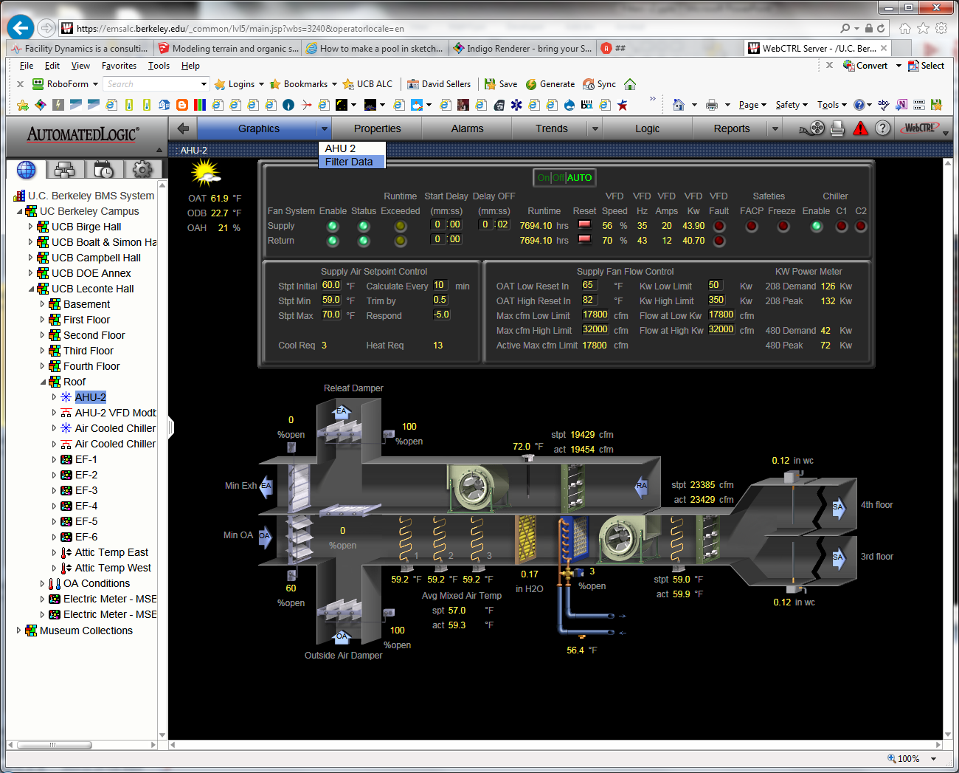
“State of the art” technology allows real time monitoring for the “inflection point” in the filter life cycle cost curve (a.k.a. the point in time when you should change the filters)

Slide 56
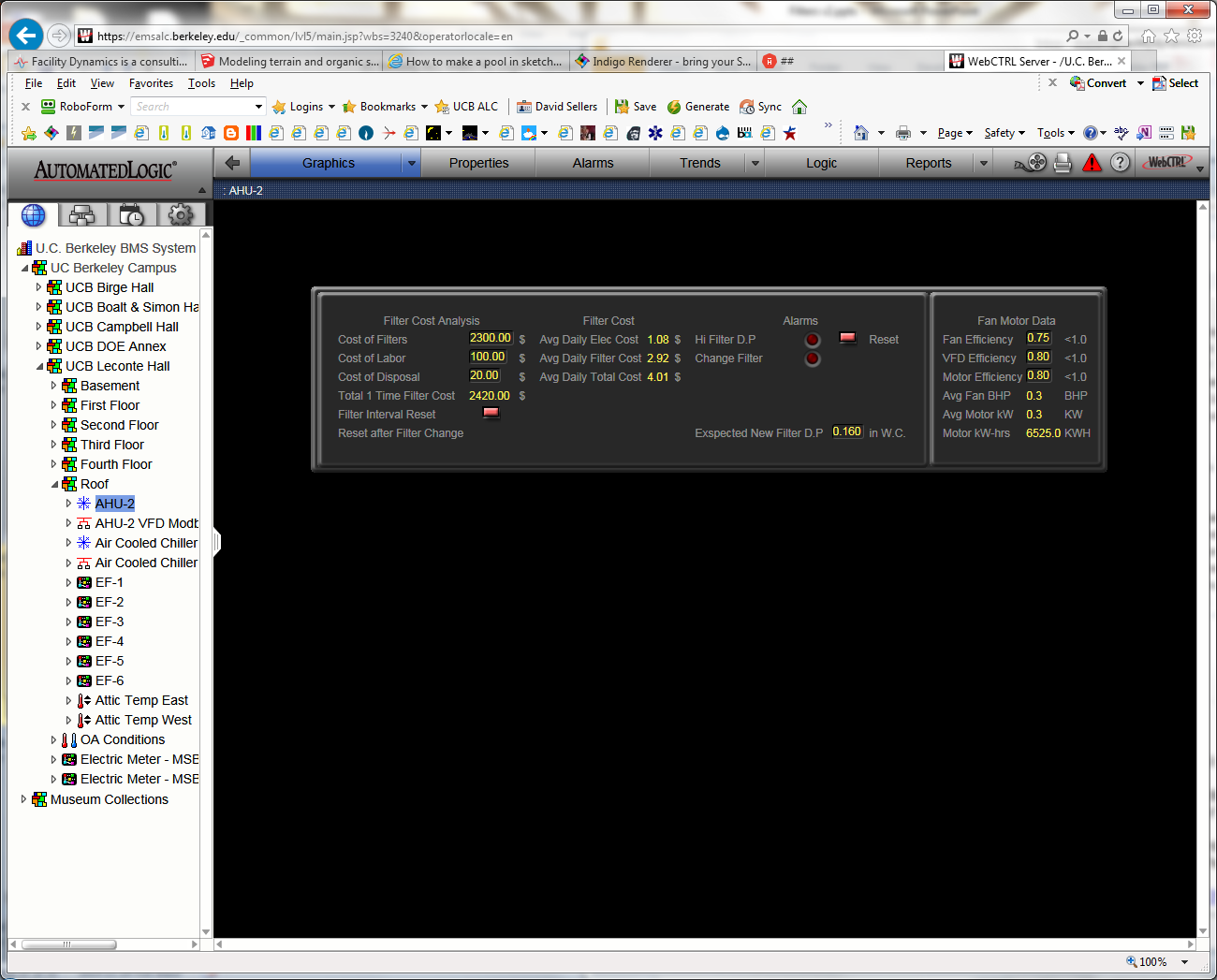

Slide 57
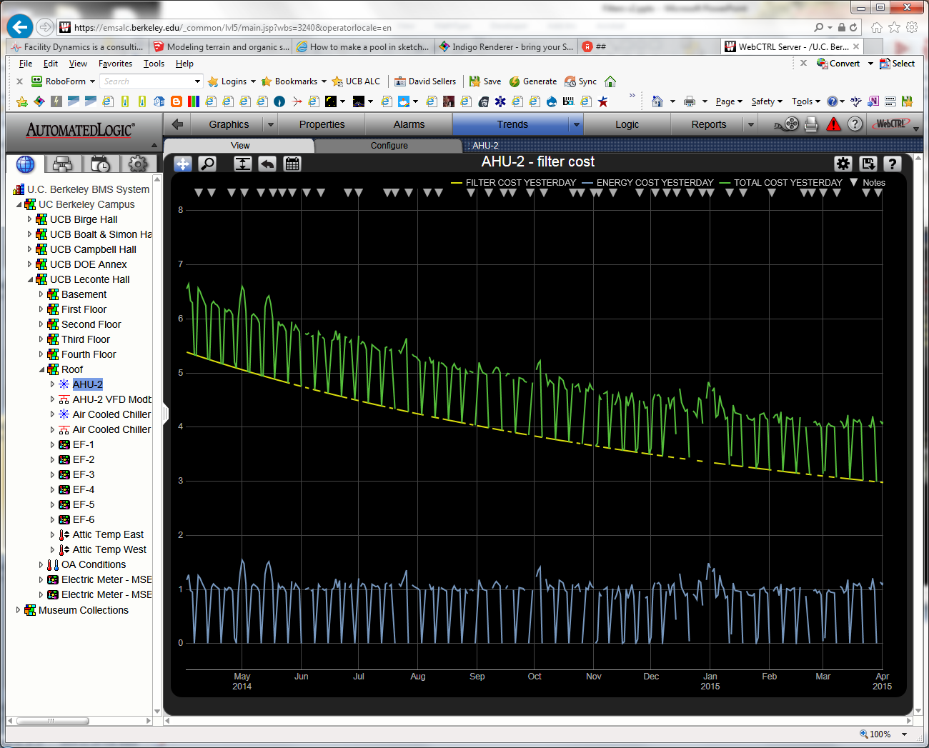

Slide 58
Note that the cost curve is still dropping
The model projected an inflection point at about 48 month's
We are currently at about 64 months
  Schedules tightened
  VAV operating mode initiated at about 36 months

Slide 59

Changing filter types or replacement approaches for process areas may involve changing a quality control standard

Slide 60
Non-VSD Equipped System Caution
  Lower pressure = fan moving out its fan curve
  Fan moving out its fan curve = more fan energy
  Fan moving out its fan curve = more reheat energy in a constant volume reheat system
Include a sheave change or VFD in the cost to upgrade to lower pressure drop filters
Leveraging the VSD if you add it

Slide 61
Filter Location Impacts Fan Energy
Shorter
Minimum loss potential
Longer
Negative pressure after filters
Higher loss potential
No negative pressure after filters
Different configurations
Different dimensions
Different fan static requirements
Longer

Slide 62
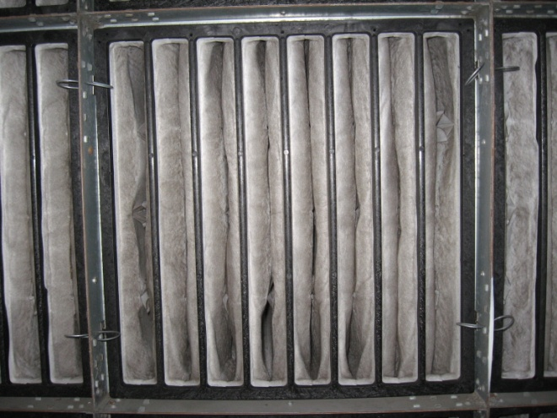
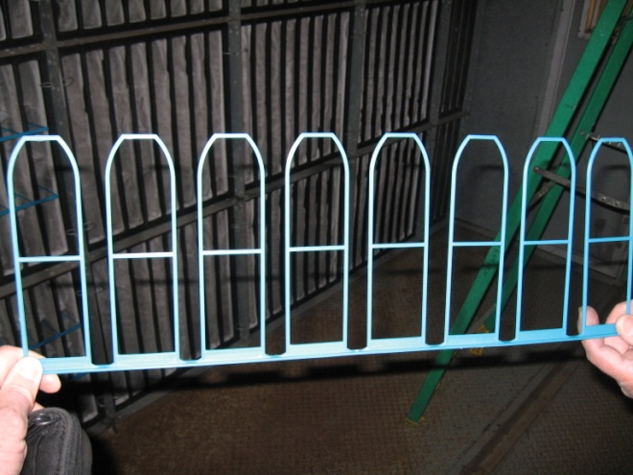
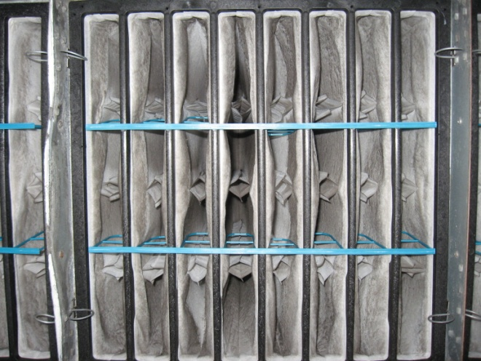
Details Matter, Even with Filters
∆P = 0.1987 in.w.c. at 68,259 cfm
∆$ < $5 per filter
First cost increase = $220
Pressure drop reduction improvement = 0.08 in.w.c.
Annual energy savings improvement = $841
  24/7 operation
  Nominal 67,000 cfm constant volume system
  $0.10 per kWh electricity
∆P = 0.1143 in.w.c. at 67,344 cfm
Notes:
What Ron did was take a measurement across the bank with no fingers inserted. Then they inserted fingers in the filters associated with zone 1 and took a measurement, then zone 2, etc. By the time they got the fingers in all of the filters, they went from a pressure drop of 0.1987 in.w.c. across the bank to a pressure drop of 0.1143 in.w.c across the filter bank at about the same flow rate. In other words, they took about .08 in.w.c. out of the system. Using the average flow rate and assuming a motor efficiency of 95%, drive losses of 3%, and a fan efficiency of 72%, that they took about 1.29 bhp or .96 kW out of the system. Since the system runs round the clock at a constant volume, that's worth about 8,405 kWh or, at UCB's electric rate, $841 per year; just the impact of the inserts, not the generally lower pressure drop of the filter itself.

Slide 63
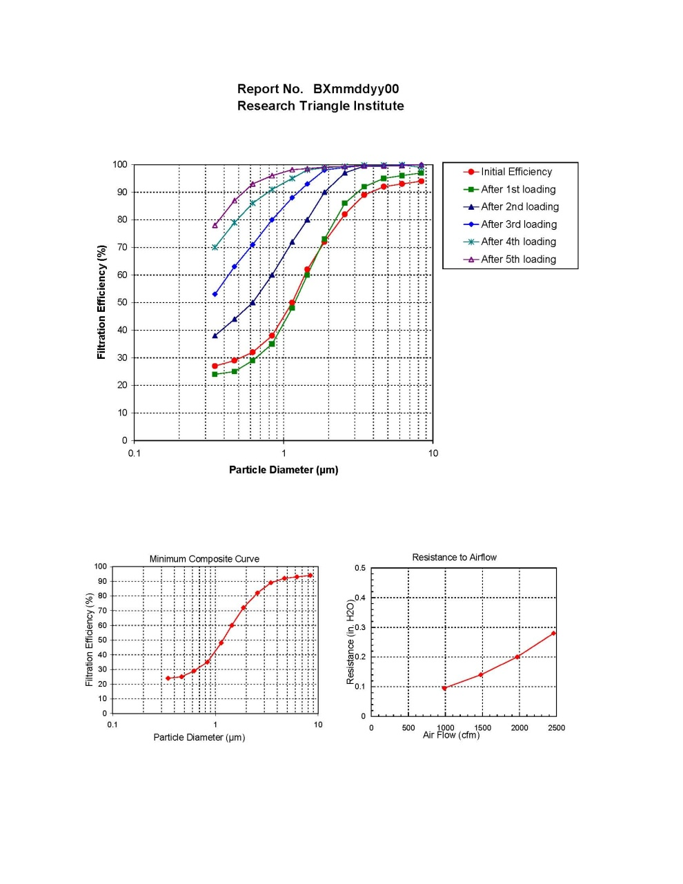
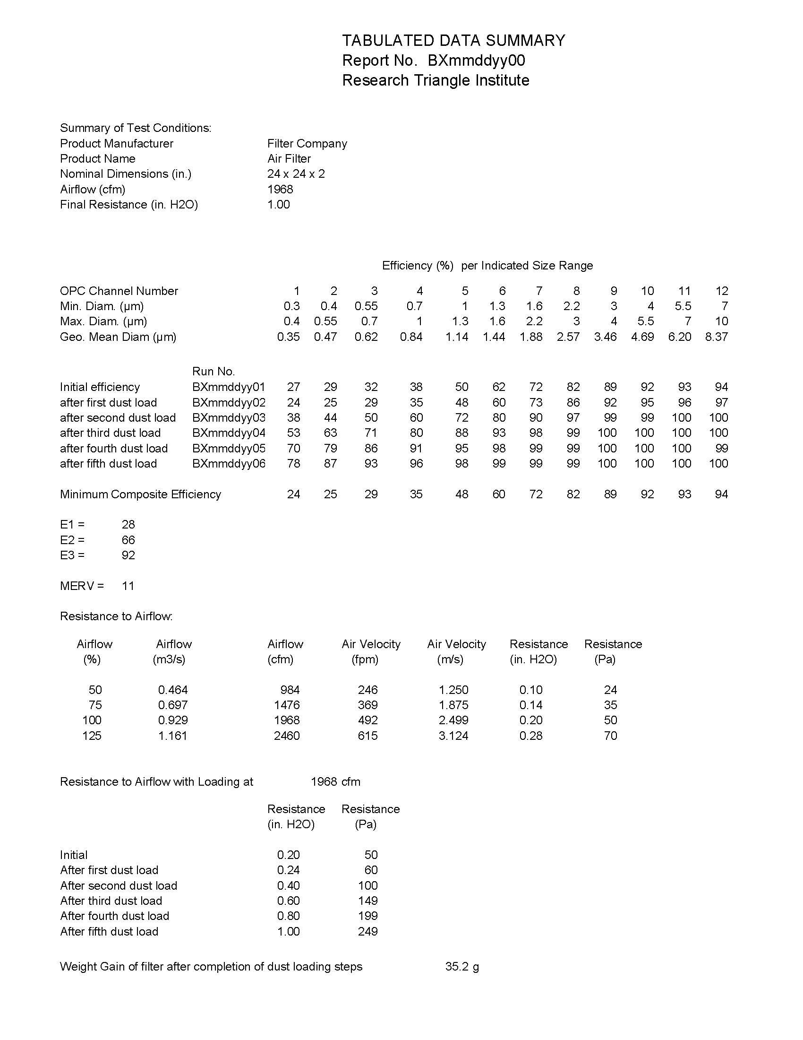
Independent Laboratory Testing
Verifying Manufacturer’s Claims

Slide 64
ASHRAE Standard 52
The Basis for the Manufacturer’s claims
Test dust ≠ Real dust
Tested efficiency ≠ Installed efficiency
Tested efficiency ≠ Persistent installed efficiency
  See Appendix J

Slide 65
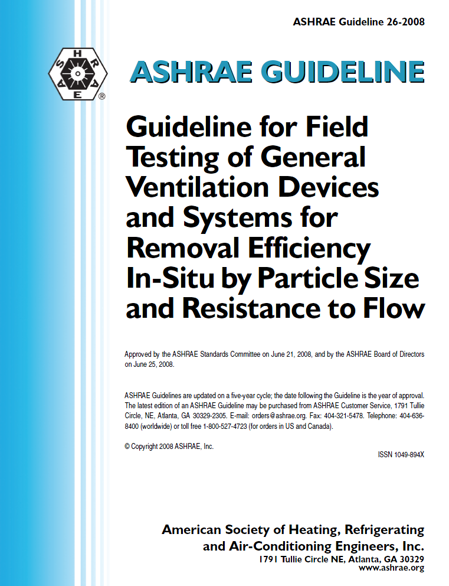
Assessing Reality
Tests for installed efficiency and pressure drop
Captures the impact of field realities
  Real world dust
  Frame impacts
  System impacts
Provides for correlation with lab test

Slide 66
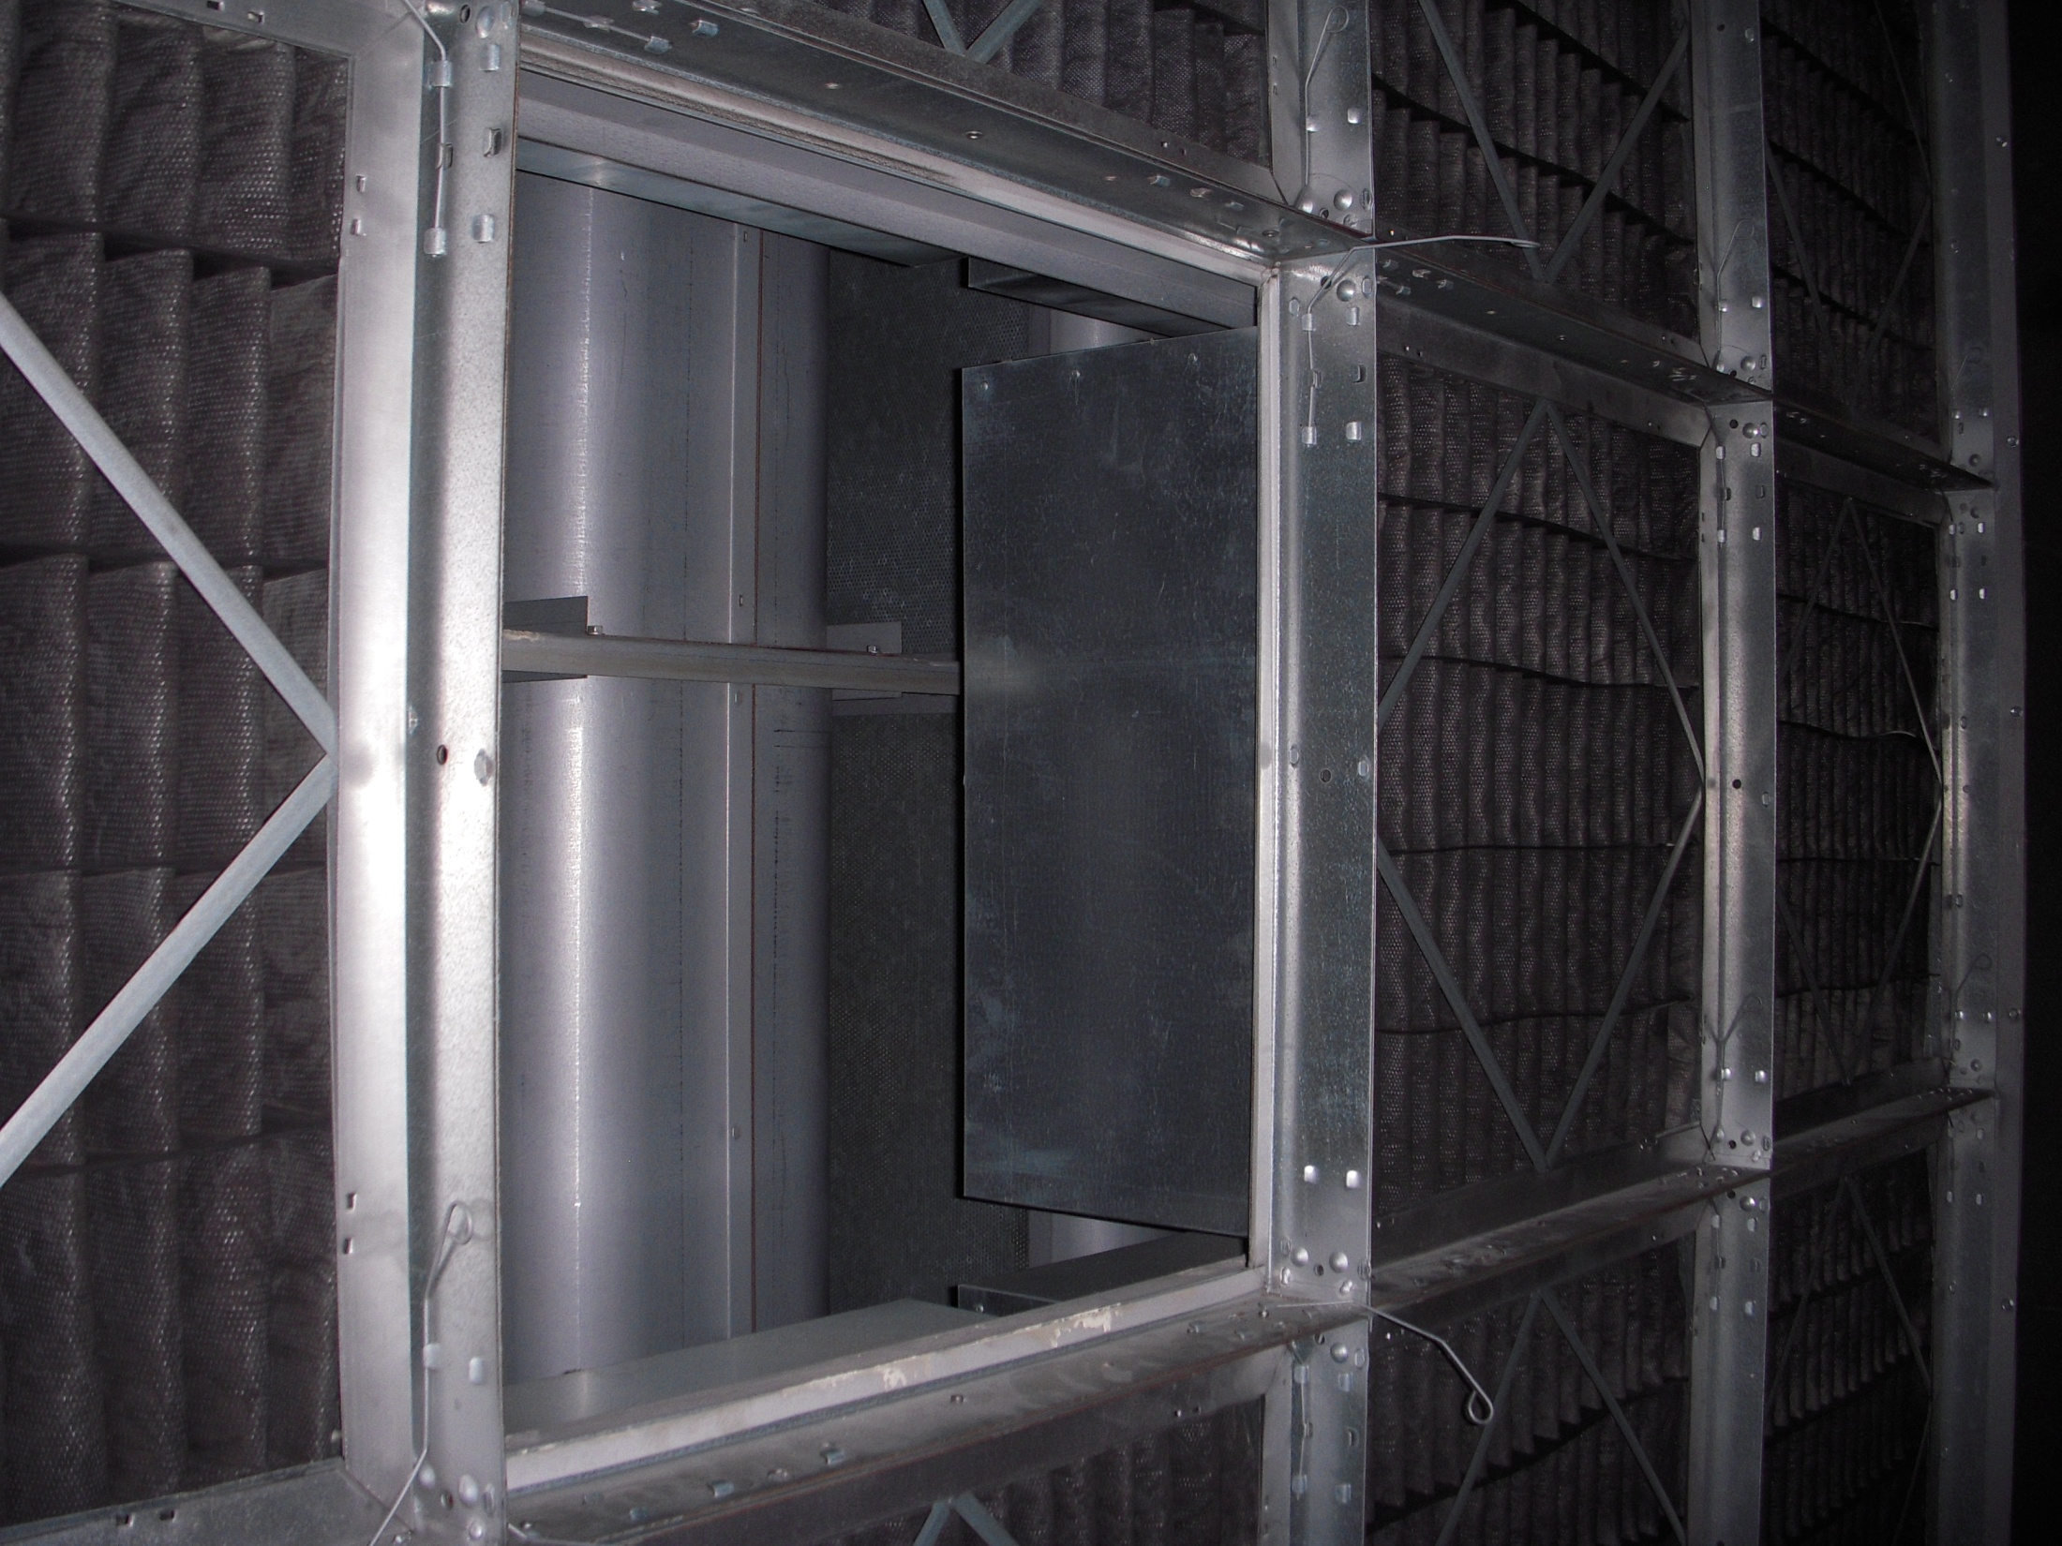
Good Filter + Mediocre Frame = Mediocre Filtration
95% (MERV14) filters
Frame Construction
    16 gauge riveted
    No stiffeners between sections
    No caulk
    Foam gaskets
    No knife edge seals
    Spring clip retainers
Net filtration efficiency likely less than MERV 14
Structural loads can become significant
    At the design dirty pressure drop, each filter has 30 pounds of force acting on it

Slide 67
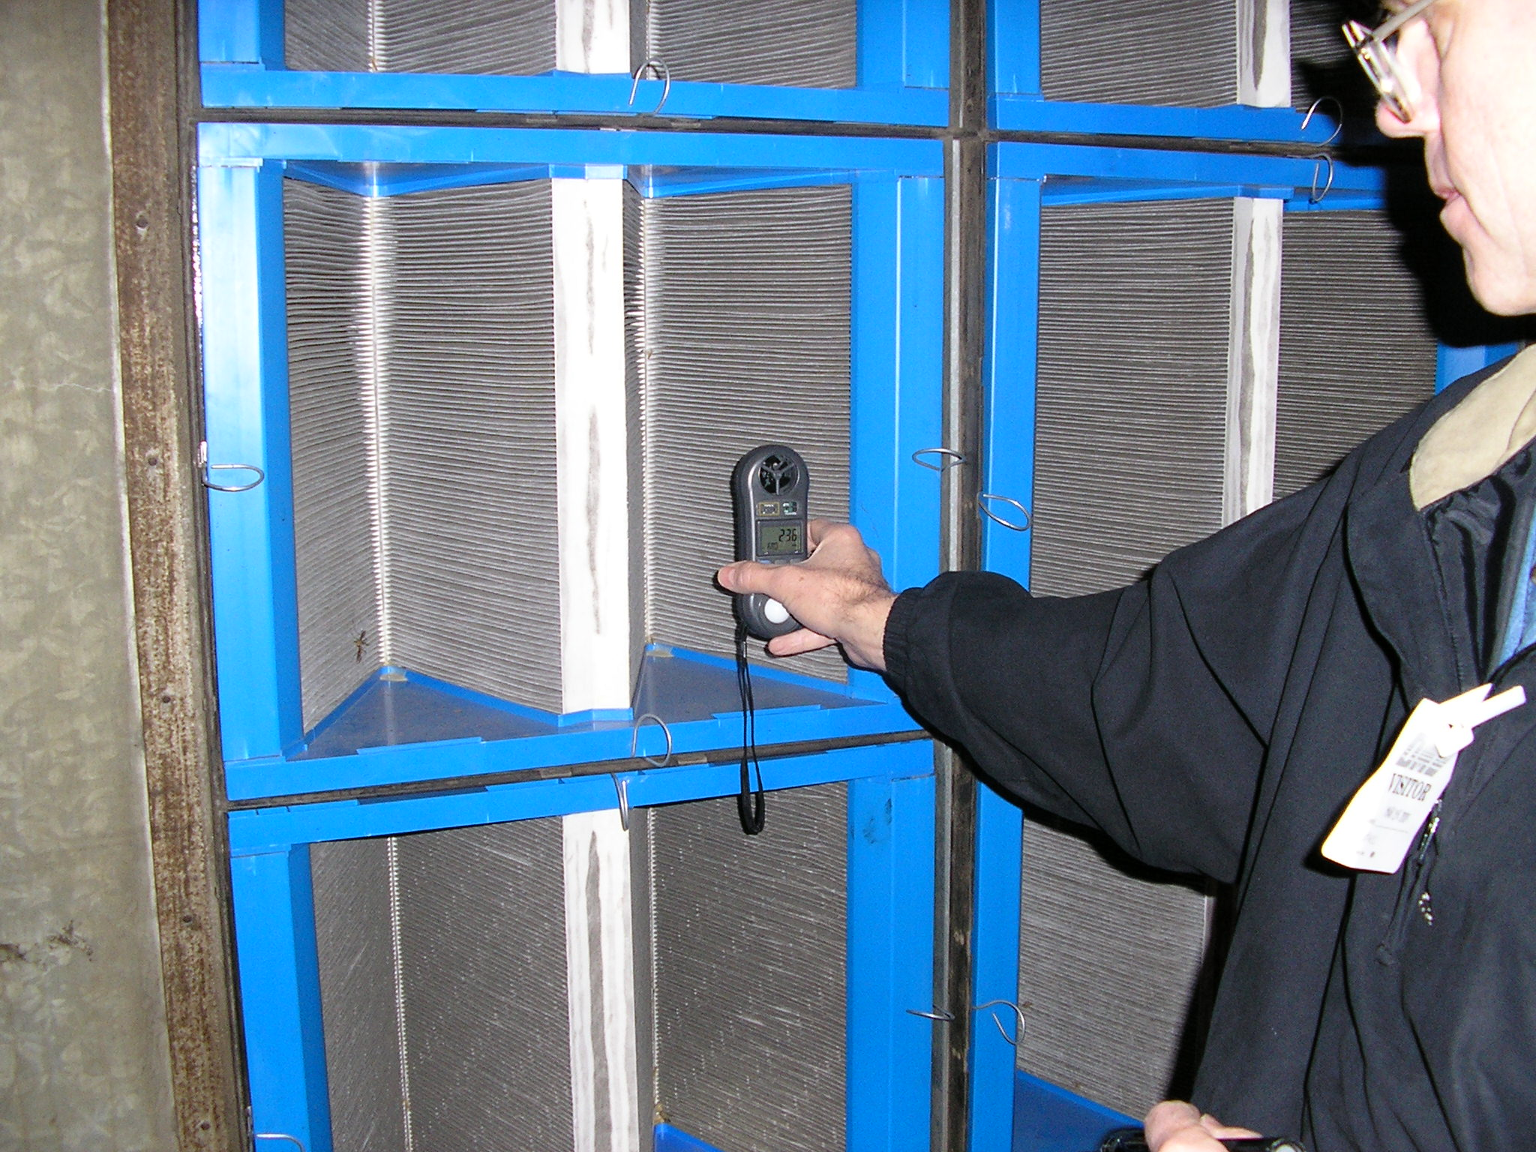
Intermittent turbulence associated with the position of the economizer dampers in this system cause the filter bank to vibrate under some air flow conditions, knocking particles loose on the downstream side

Slide 68
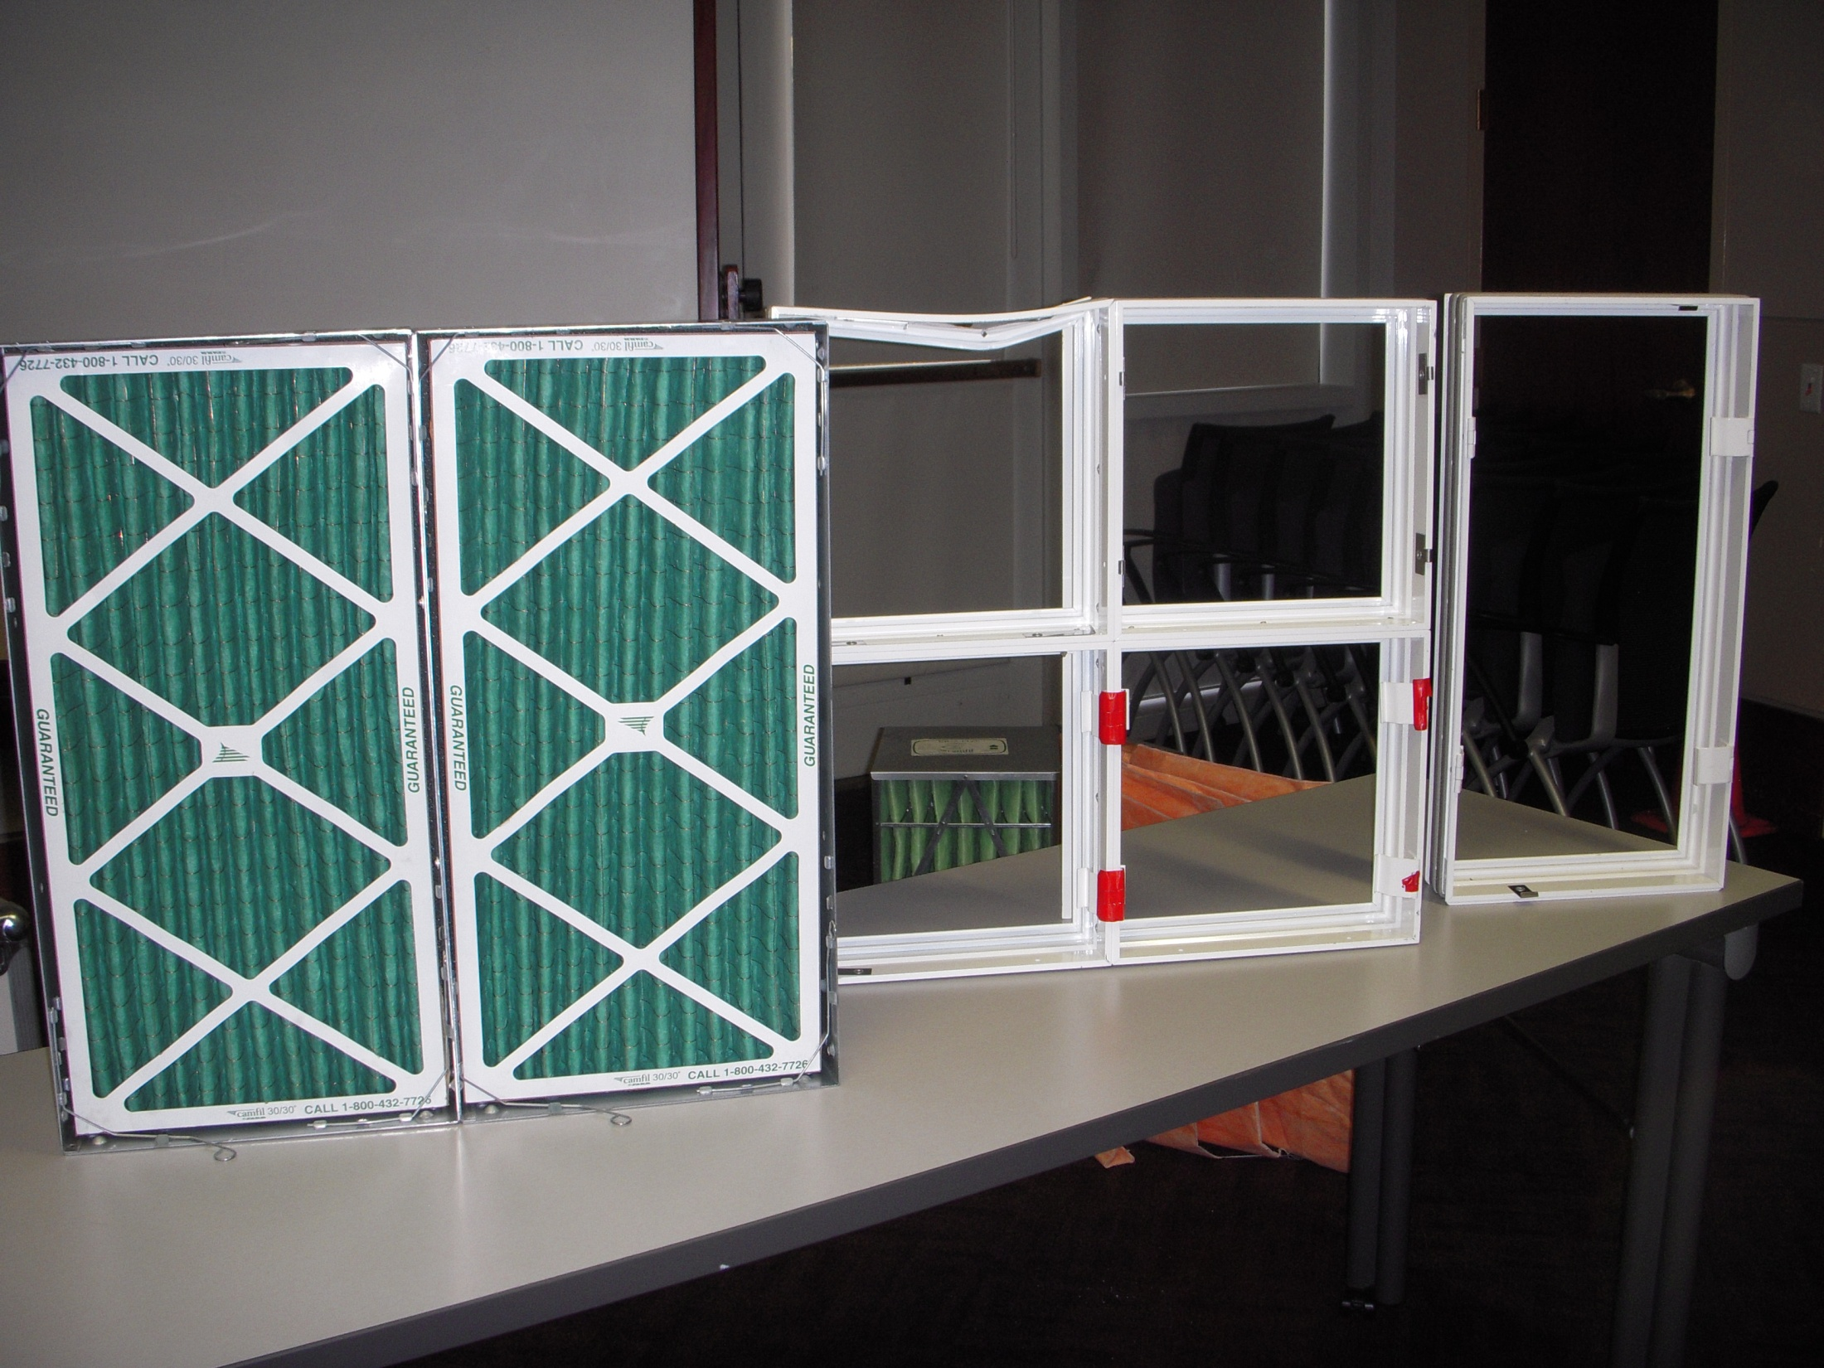
A Filter is Only as Good as its Frame
Camfil Farr Type 8
16 gauge galvanized steel
Foam gaskets (optional)
Spring clip retainers (not included)
Riveted or bolted up assembly (not included)
Structural steel supports required between every-other vertical row (not included and frequently omitted)
$66.97 per “hole” (materials only)

Slide 69
A Filter is Only as Good as its Frame
Total Filtration Manufacturing Optiframe/H
Extruded, epoxy powder coated framing material
Tongue and groove joints between modules
Quadruple closed cell foam gaskets between modules
Knife edge filter seals
1.5” I beam structural support between rows
Over-center and swing bolt retainers
$125 per “hole” (installed)
“Encounter” with forklift when sample shipped recently buckles the frame locally but leaves the rest of the sample solid and intact

Slide 70
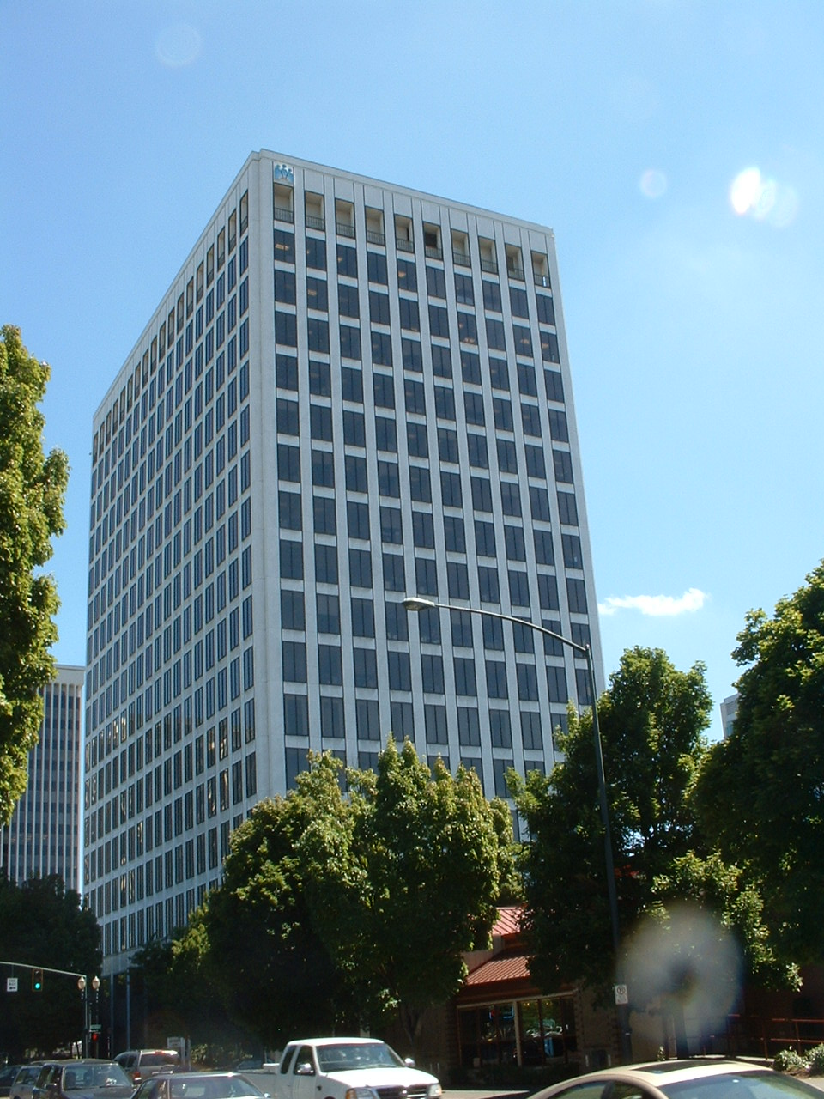
Kaiser Permanente Building
Portland, Oregon
Lead facilities engineer interested in life cycle cost based operation
Had concerns regarding flexible bag filters in VAV systems
Challenges
  Mandatory operating policy to change filters every 2 years
  Relatively low electric rates ($.037/kWh vs $.08/kWh)
Authorized to perform a side by side comparison
  FDE contributes engineering support

Slide 71
Proposed Comparison

Slide 72
Proposed Comparison – Prefilter
Current Practice
Proposed Practice

Slide 73
Proposed Comparison – Final Filter
Current Practice
Proposed Practice

Slide 74
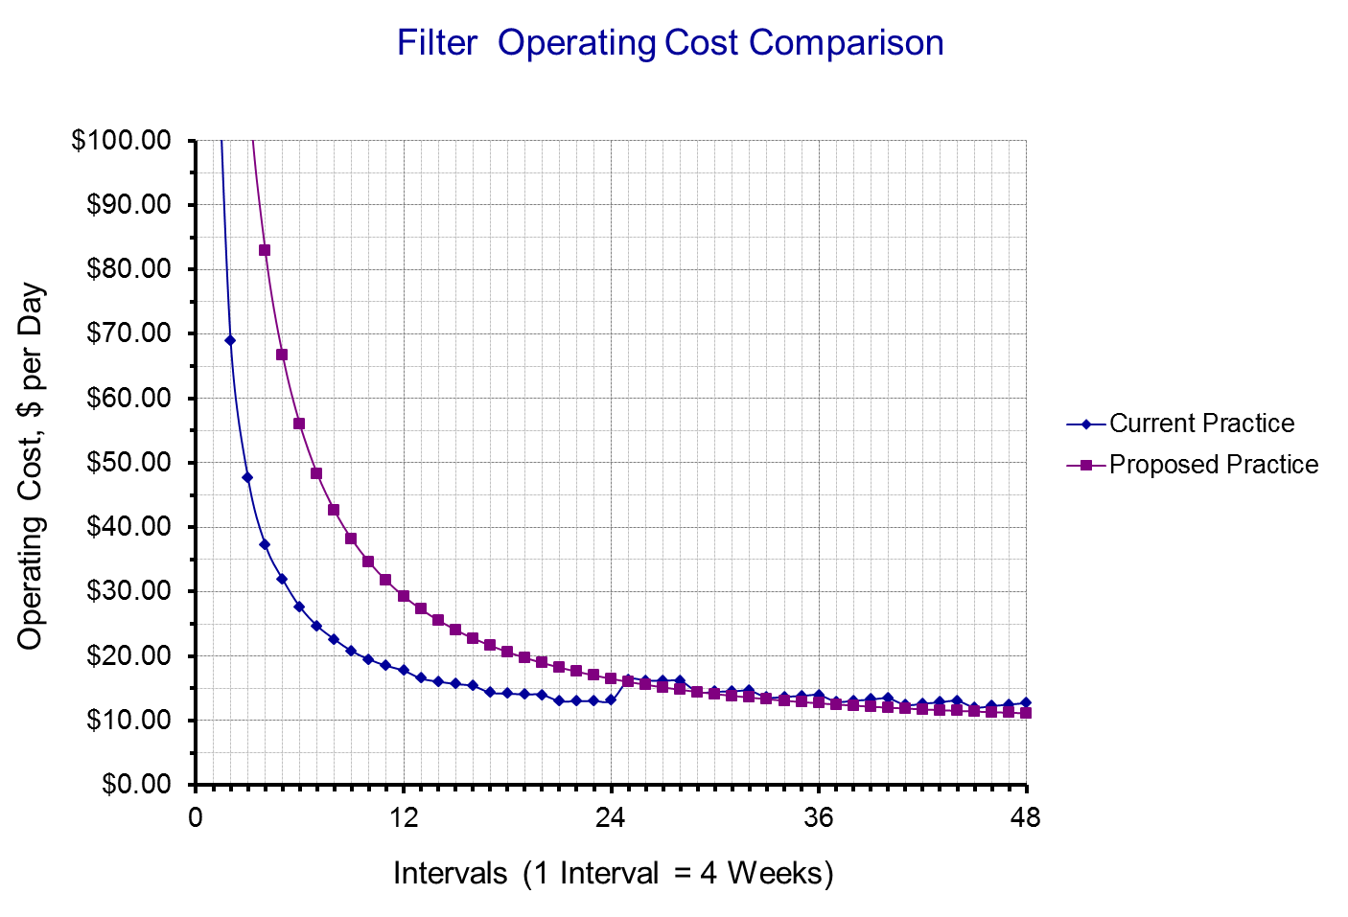

Slide 75
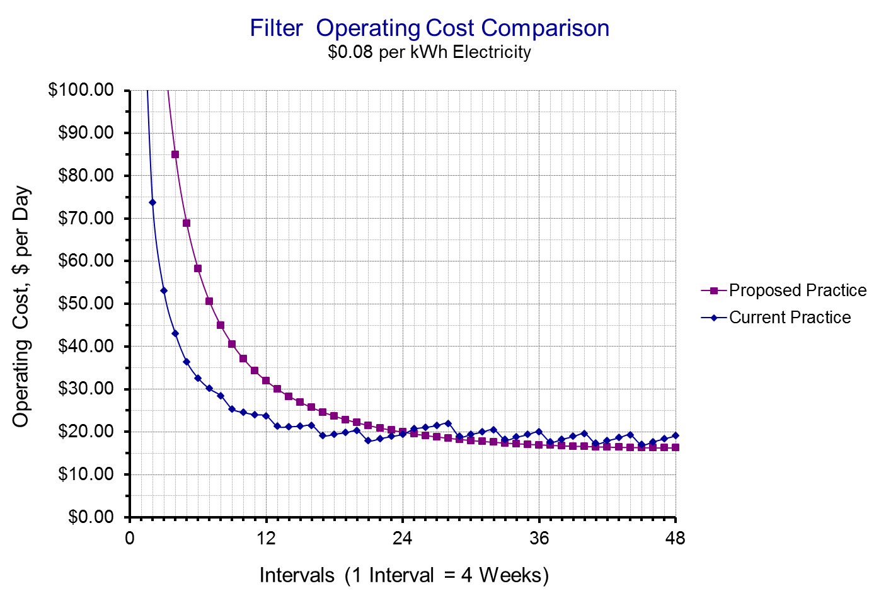

Slide 76
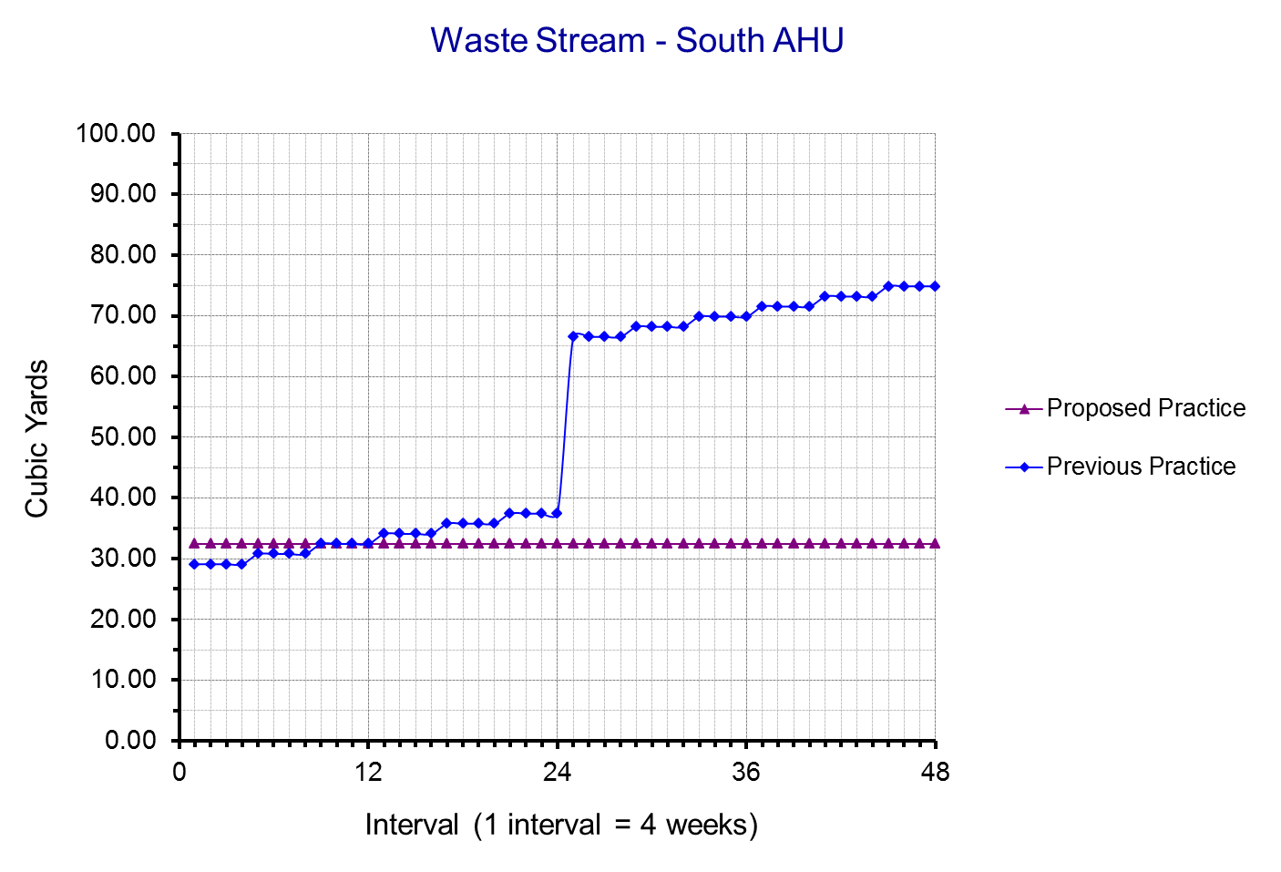

Slide 77
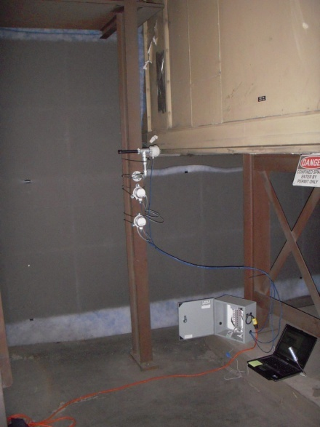
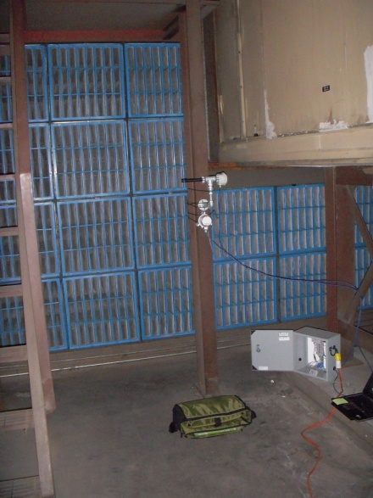
Kaiser Permanente Building
Portland, Oregon
Field Test of Conventional vs. Extended Surface Area Filters
  Near Identical Systems
  Near Identical Load Profiles
  5 Minute Logged Data
EFS MERV 11 soft pocket bag filter with MERV 7 roll type prefilter
EFS MERV 11 rigid pocket bag filter with no prefilter

Slide 78
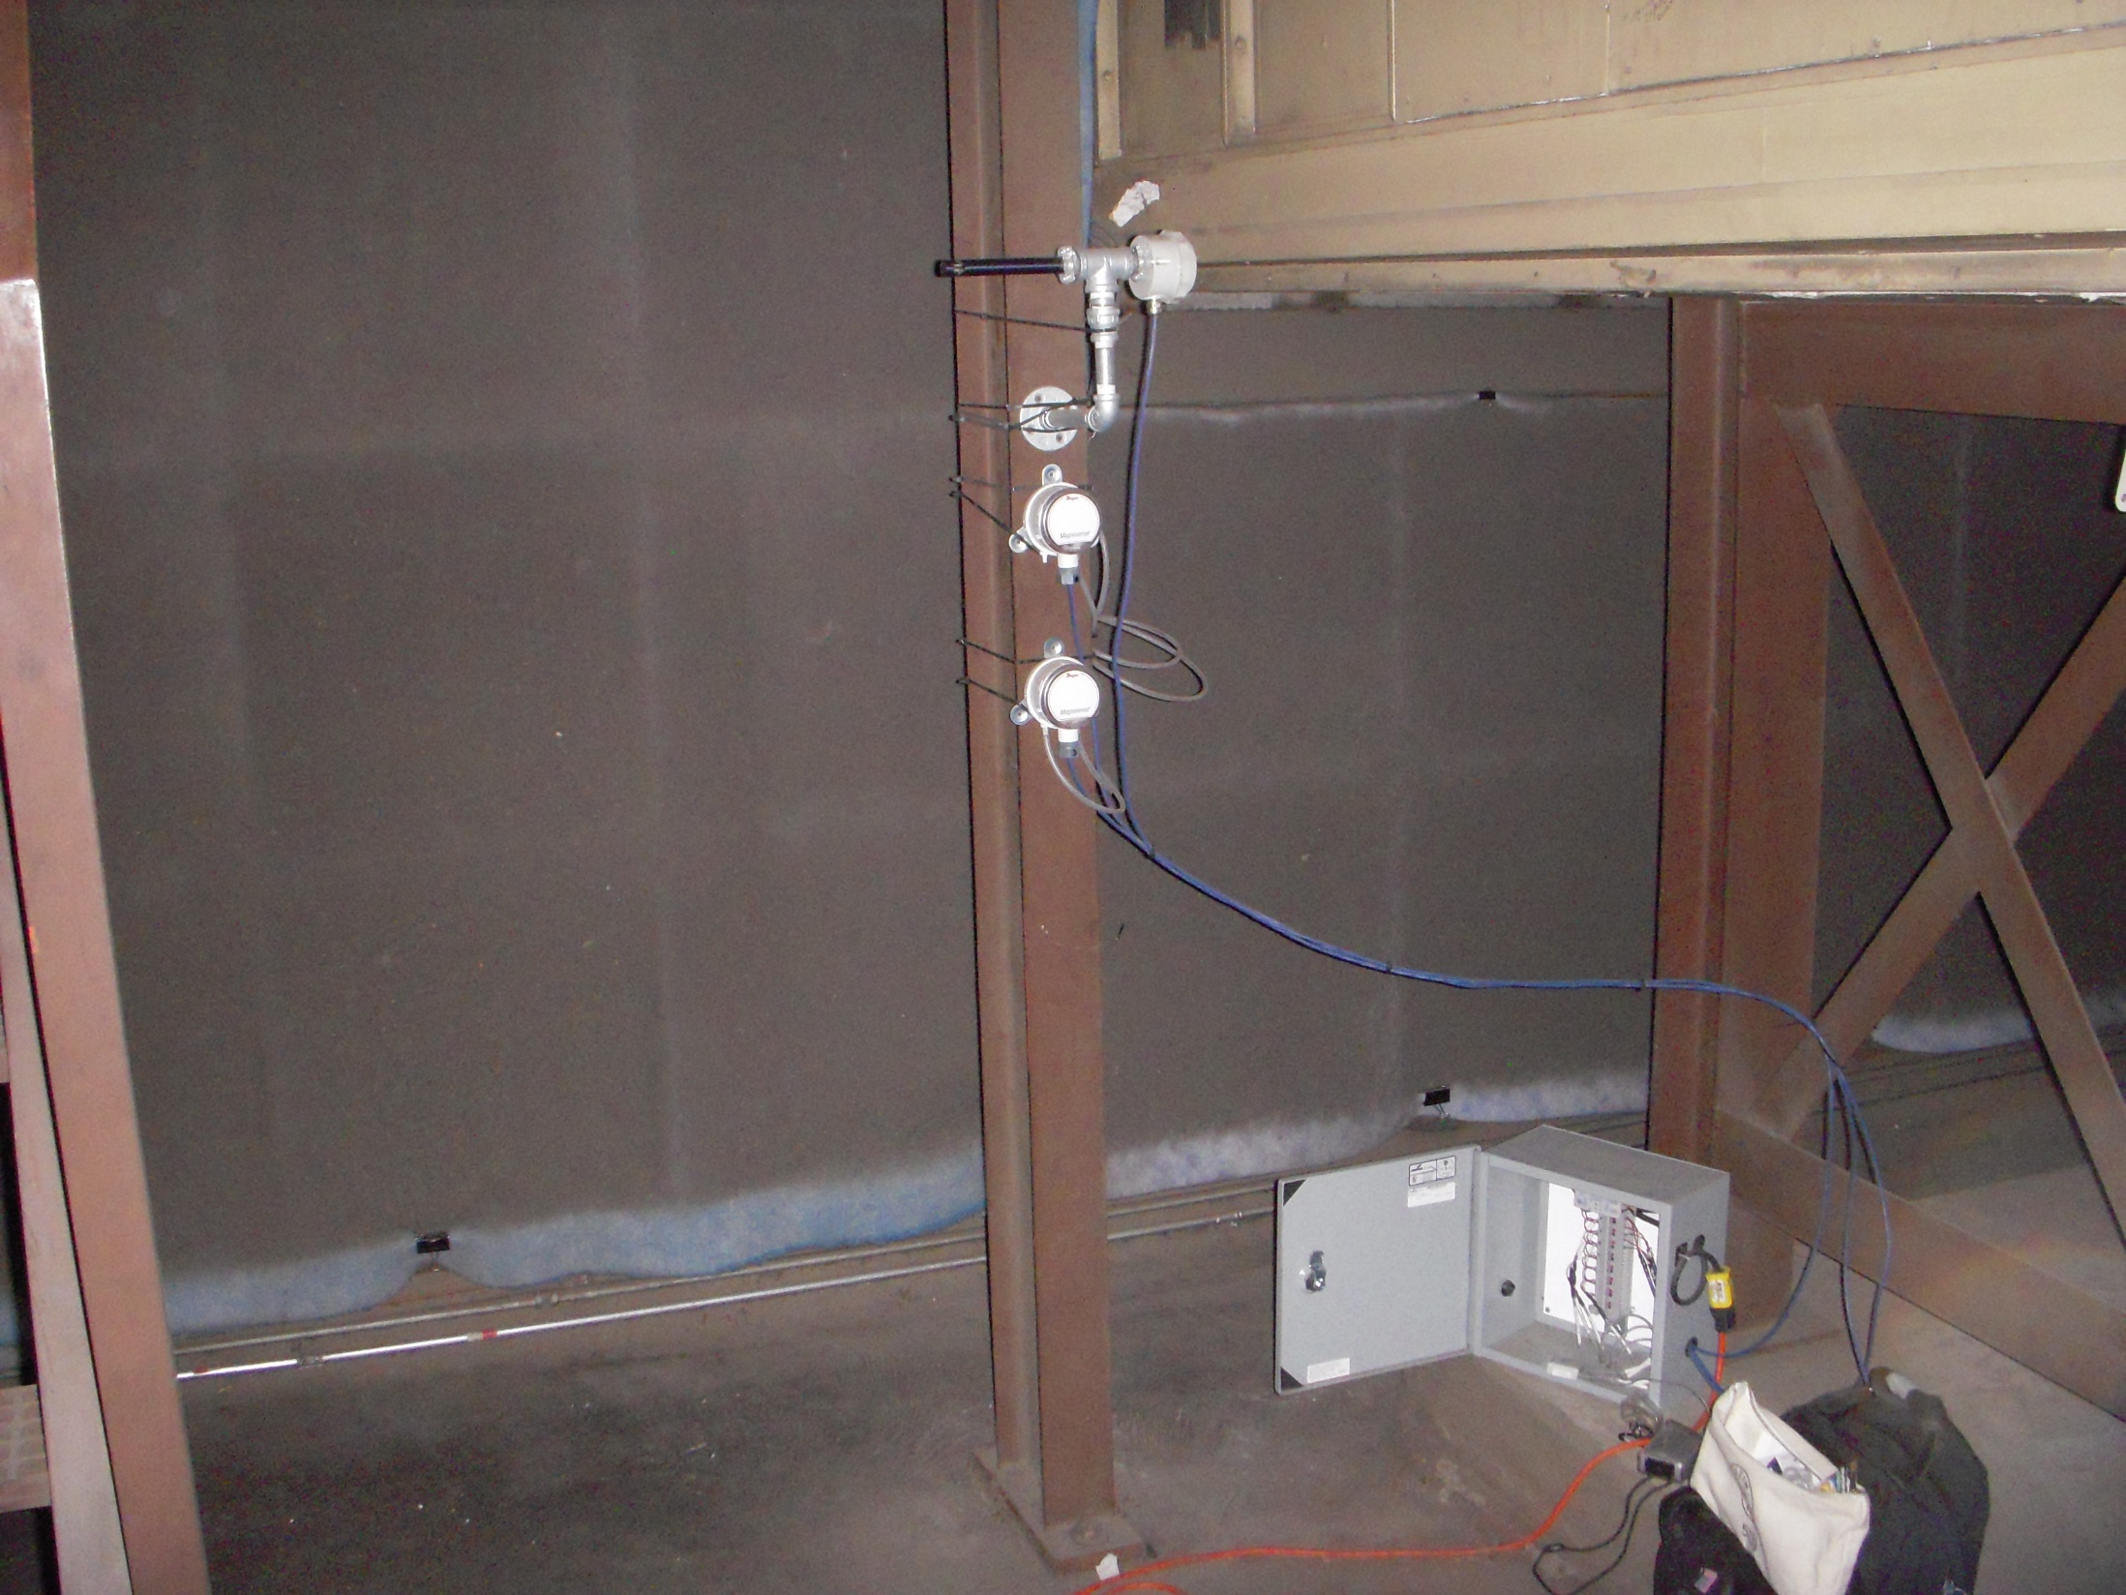
Prefilter pressure drop transmitter
Velocity pressure transmitter
Final filter pressure drop transmitter
DC power supply panel

Slide 79
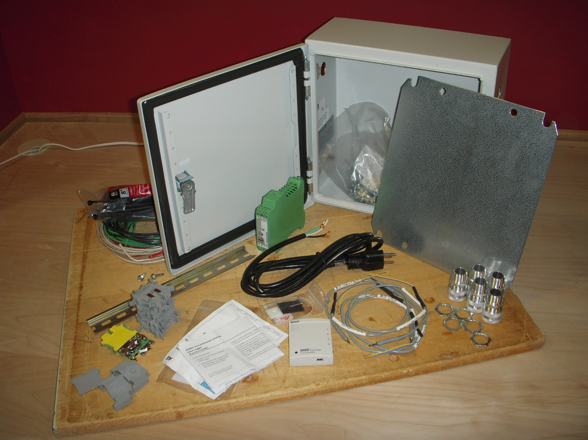
Visit My Blog for Details

Slide 80
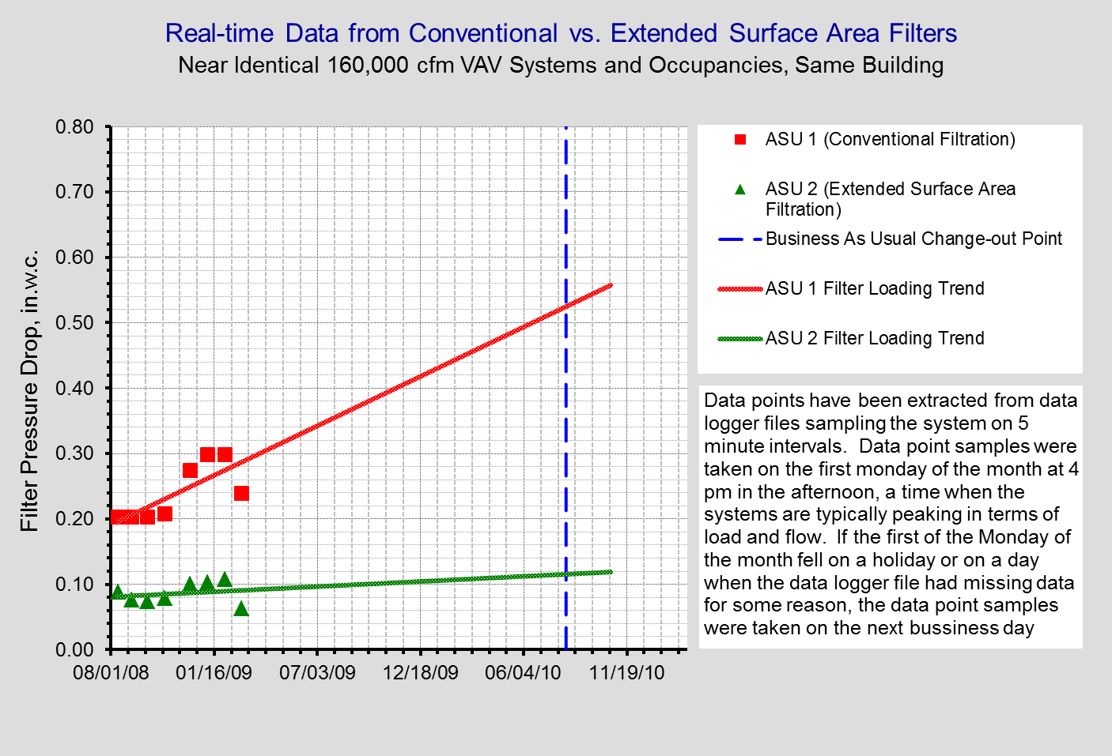

Slide 81
Extended surface area filters are projected to approach conventional filter clean pressure drop near the end of the current time based conventional filter life cycle based on logged data at the 25% of timeline point.

Slide 82
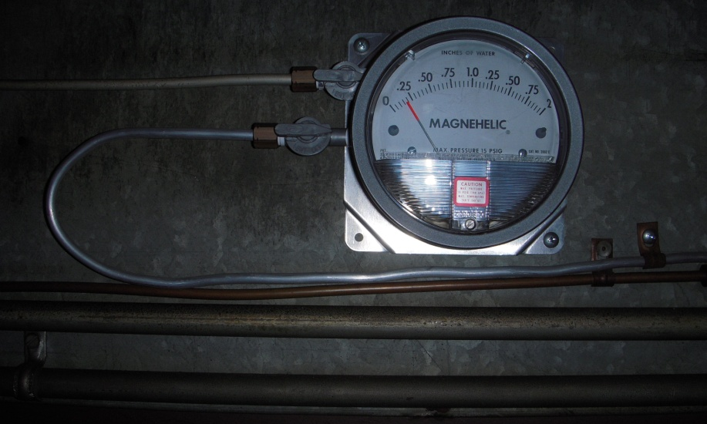
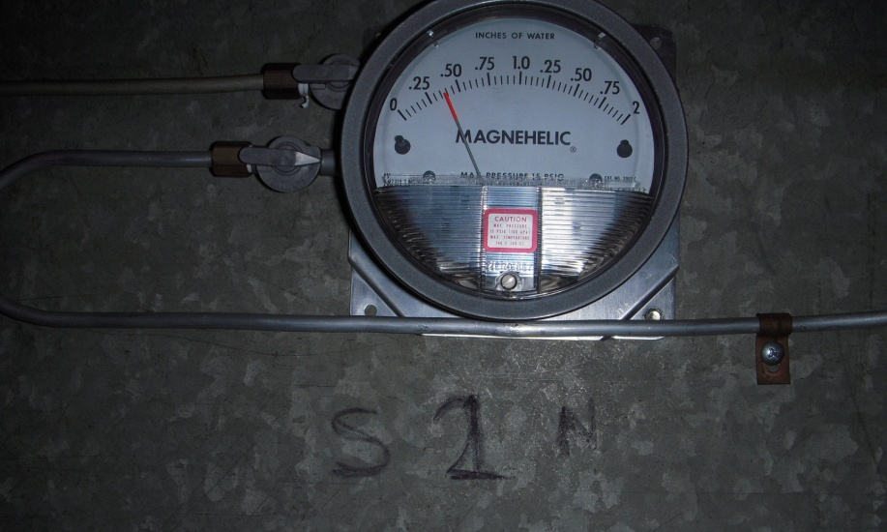
Bottom Line
New Approach
Original Approach
New approach matching projections
277 grams of dust accumulated
No signs of microbiological problems
Conventional approach below projection but about twice the new approach
Dust accumulated to be determined, but the dust accumulated by the new approach exceeds the rated capacity of this filter

Slide 83
FLOW
Conventional bag filter pressure drop increases at low flow?
∆P

Slide 84


Another Interesting Observation
FLOW
∆P
Conventional
Extended Surface Area

Slide 85
Electrostatic Filters
(Re)Emerging Technology
Good News
Bad News
Approaches MERV 13 efficiency
MERV 8 depth
MERV 8 pressure drop
  Allows LEED requirements to be achieved with out an excessive fan energy penalty
  Allows LEED requirements to be achieved in less space
Power supplies required to power up electrostatics
  Small number per filter
  Each filter requires the small number
  Eat’s away at the fan energy savings
  Adds some complexity

Slide 86

Practice Due Diligence
ASHRAE Journal article based on research in Denmark found a correlation between perceived air quality and filter life for flexible bag filters
Scheduled operation seemed to make things worse
Active carbon seemed to mitigate the problem
For our field trails to date this has not been an issue

Slide 87

The Savings Ripple Out Beyond the AHU
Flow = Mass in Motion = Energy
Distribution System Losses
Transformer
Losses
Fan Efficiency Losses
Switch Gear
MCC
VFD Efficiency Losses
kWh
Transformer
VFD
Belt Efficiency Losses
Motor Efficiency Losses
More Distribution System Losses

Slide 88
The Savings Ripple Out Beyond the AHU
All of That + Compressor/Compressor Motor Losses
Water and
Chemicals
Compressor
Internal Gains
Piping Network
Piping Network
Piping Network
All of That + More Pump Heat
Condenser
Evaporator
Internal Gains + Fan Heat
Cooling Tower
Load
End Use
Expansion Device
Internal Gains + Fan Heat + Pump Heat
Make-up, Blow-down, and Water Treatment
Water Chiller
Expansion tank and make up water
Pump
Pump

Slide 89

Fossil Fuel Base Generation Has Ripple Effects
Conservation of mass and energy says that the mass of all of this coal will eventually show up as gasses going up the stack
Most plants run on electricity
A lot of electricity comes from fossil fuel
    The current heat rate for fossil fuel plants is about 10,000 Btu/kWh
    A kWh is 3,413 Btu

Slide 90
Based on egrid 2010 data, about 71% of the electricity generated in the USA is generated by burning something

Slide 91

My Logic Based Conclusion;
We Have to be Having Some Sort of Impact
You
are Here

Slide 92
You Also
are Here

Slide 93

We Don’t Inherit the World from our Ancestors, We Borrow it From Our Children
Unknown

Slide 94
A Few Bottom Lines
Operate Filters Based on Life Cycle Cost
Purchase Clean Air, not Filters
Accumulate Multiple Benefits
  Save fan energy
    Fan Power
    Fan heat
    Related ripple Effects
  Reduce filter consumption
  Reduce filter maintenance labor
  Reduce waste stream
We Don’t Inherit the World from our Ancestors, We Borrow it From Our Children
Unknown

Slide 95
Resources on Filtration
Follow the field trial at www.Av8rdas.Wordpress.com (starts in a September 2009 post)
The Art and Science of Air Filtration in Health Care
    HPAC - October 1998
Filtration: An Investment in IAQ
    HPAC - August 1997
Specifying Filters
    HPAC - November 2003
    All by H.E. Barney Burroughs
National Air Filtration Association (NAFA)
    http://www.nafahq.org/
  Using Extended Surface Air Filters in Heating Ventilation and Air Conditioning Systems: Reducing Utility and Maintenance Costs while Benefiting the Environment, by Michael J. Chimack et.al., ACEEE 2000 Proceedings

