Slide 1

Existing Building Commissioning Project Review Workshop Lab
Cost/Benefit Assessment – Part 1
Presented By:
David Sellers
Senior Engineer, Facility Dynamics Engineering

Slide 2
The Questions Behind the Lab Sessions
How do you develop the cost/benefit for an EBCx or resource conservation finding starting with a broad assessment at the initial time of observation and moving forward to a more detailed bin data or hour by hour analysis?
How do you decide how far to go in your development?
What are the tools and techniques used to accomplish the cost/benefit development?

Slide 3
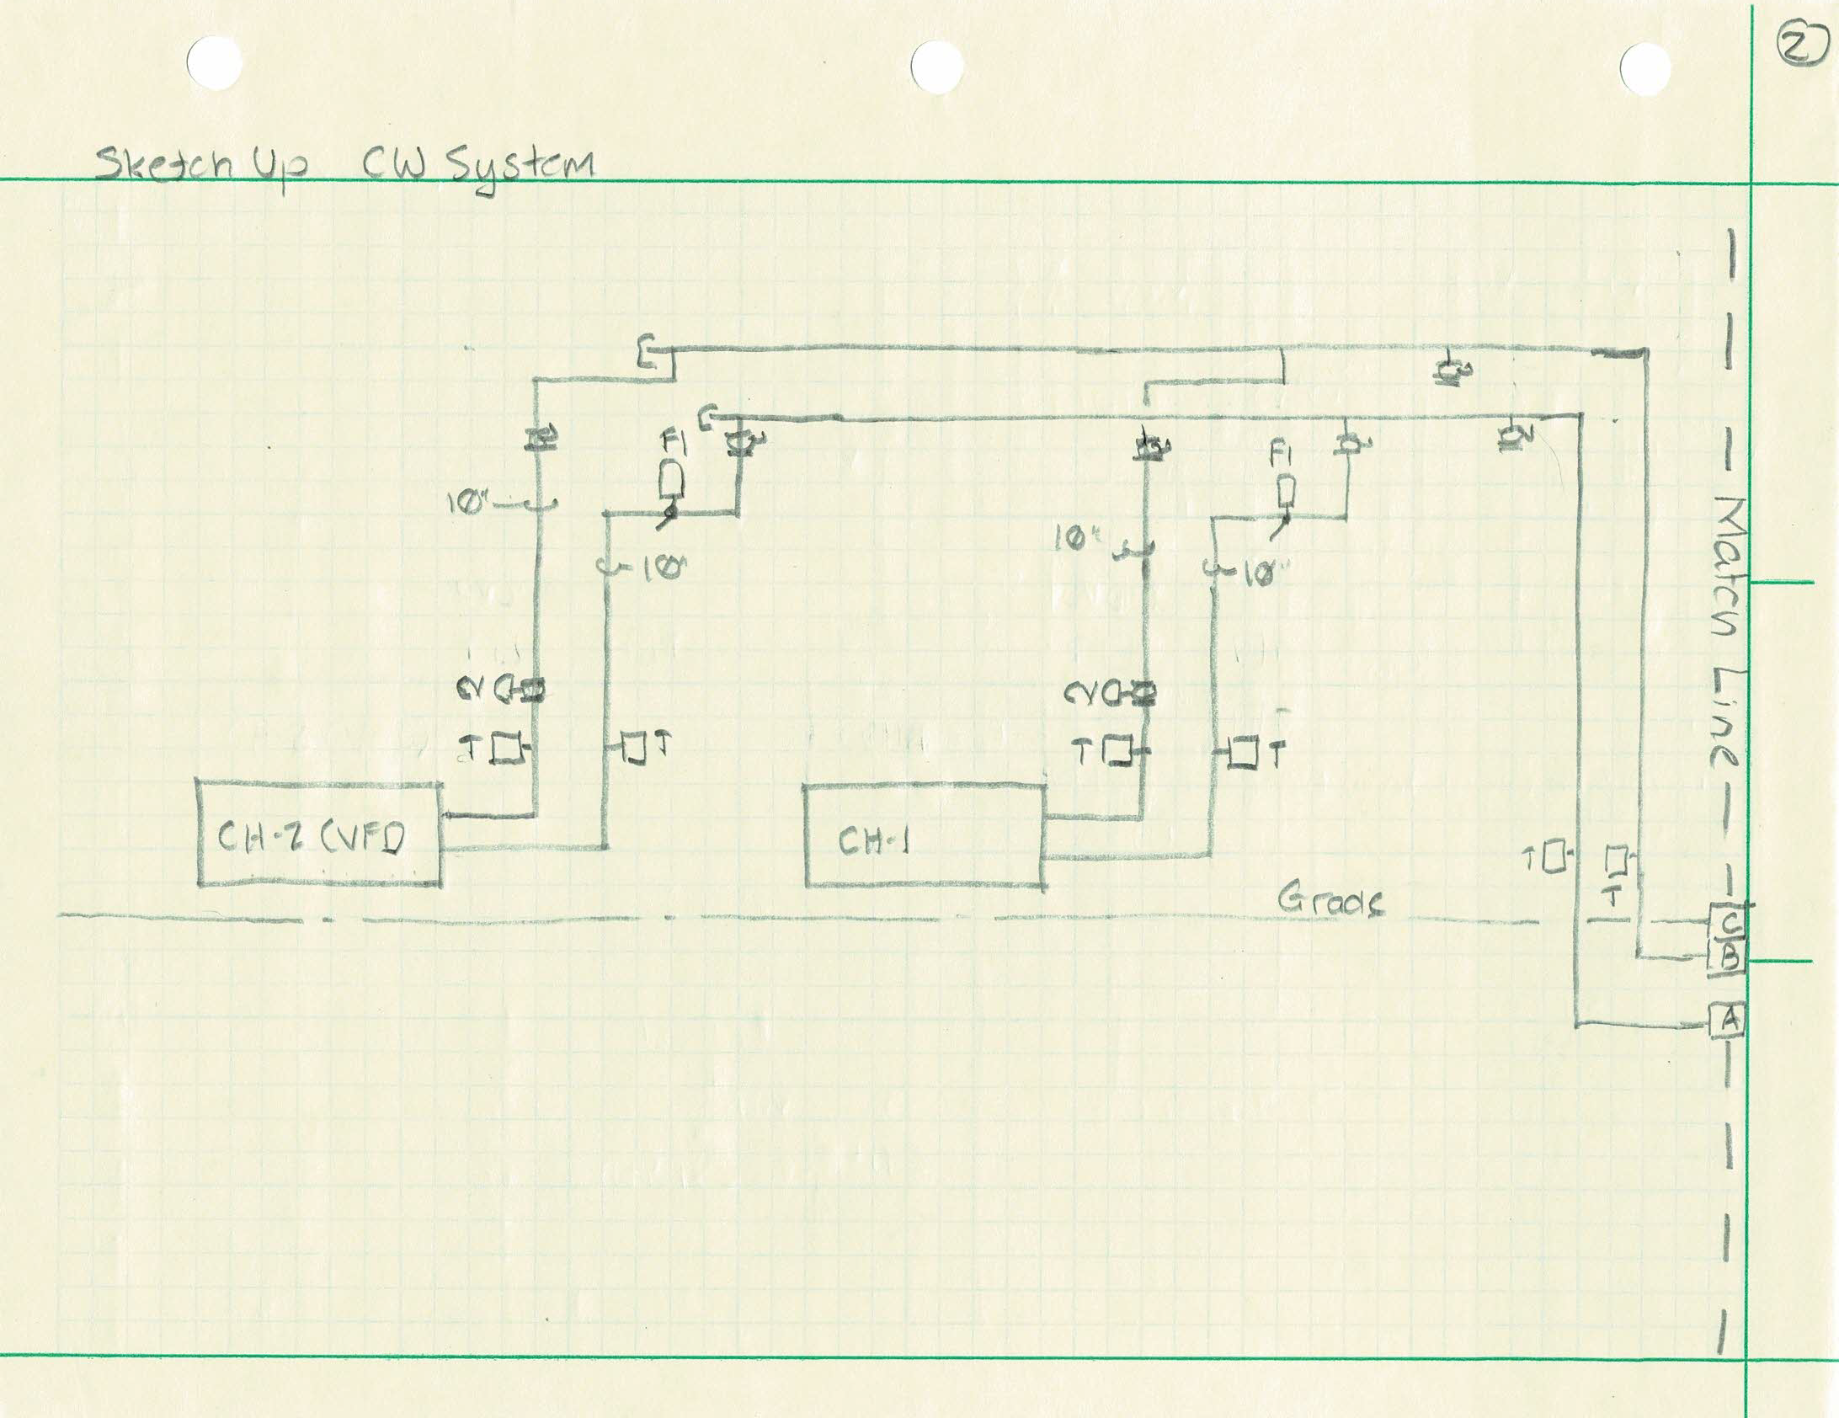
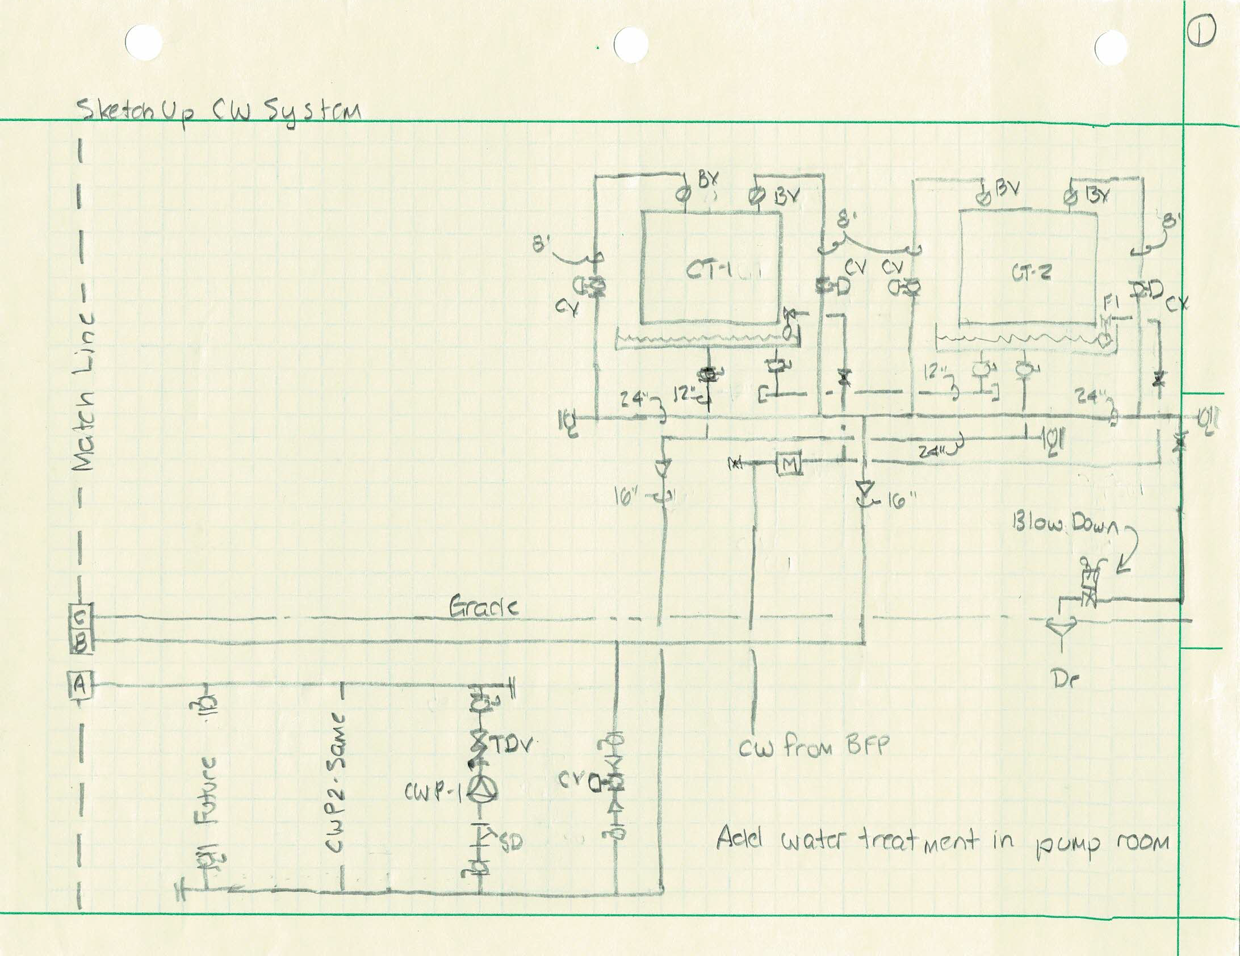
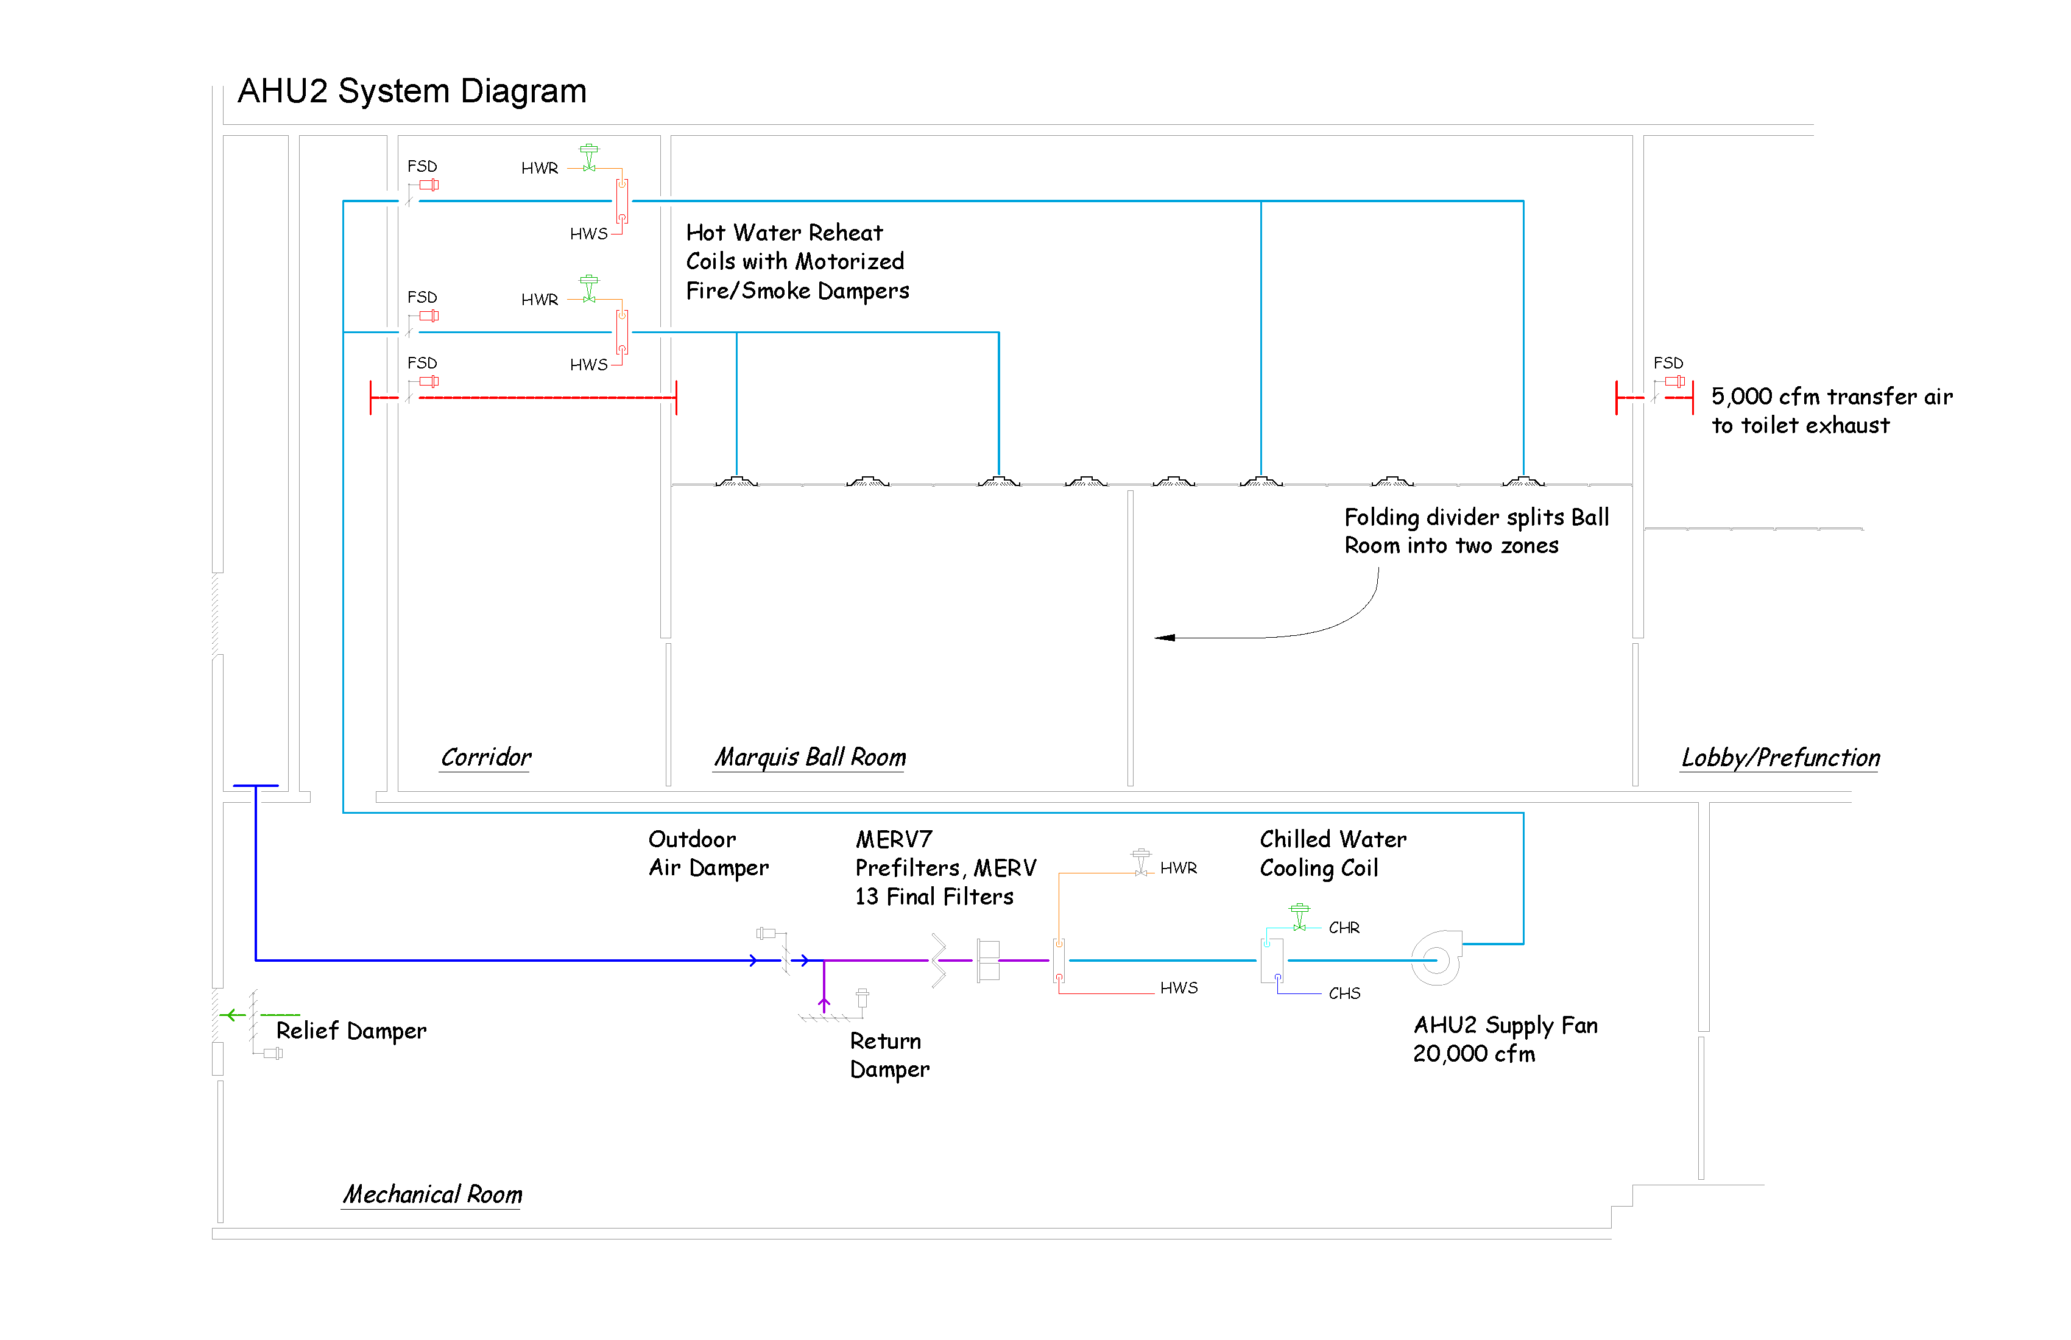
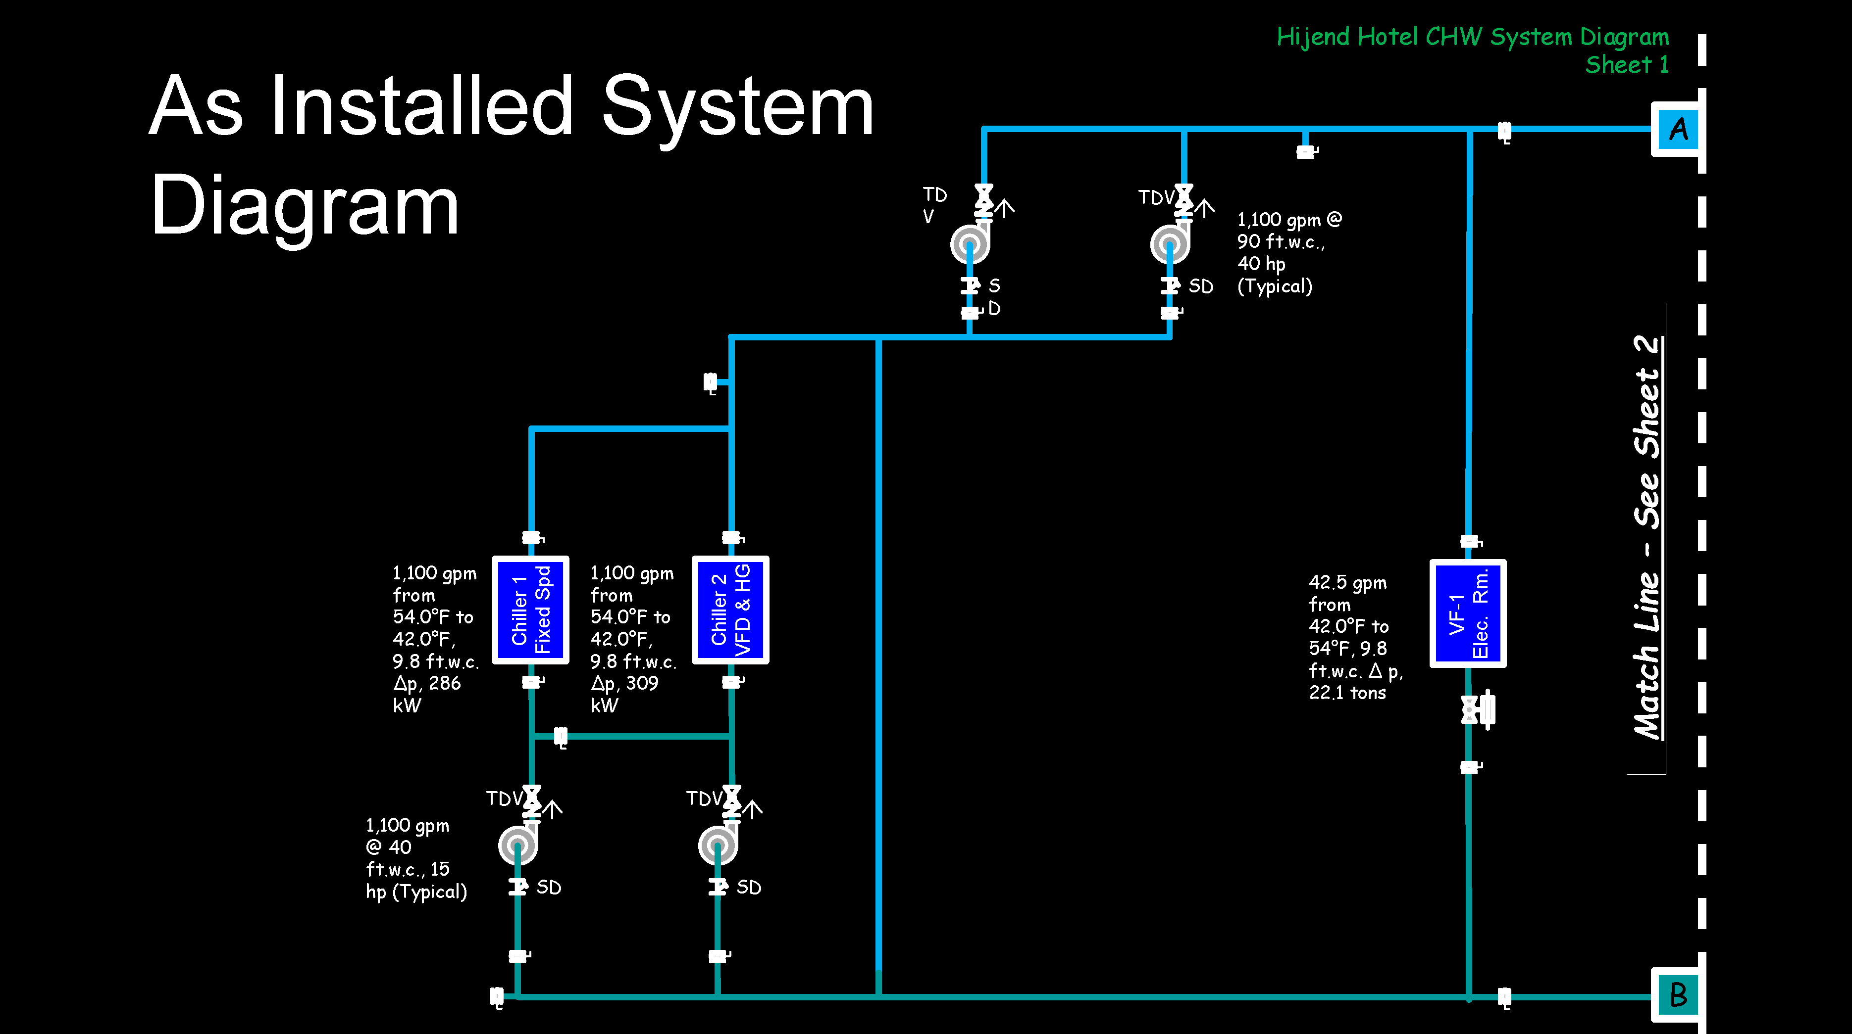
Today’s Focus
In the general case, what are typical targets for optimization?
In the general case, what will optimization indicators look like?
Practice identifying optimization targets in an air handling system.
Make a first pass at developing the savings potential for one of the common opportunities.
Start firming up the savings projection.
I will use a pumping system to illustrate concepts that you will then apply to an air handling system

Slide 4
Optimization Targets

Slide 5
Optimization Targets
The Load Being Served
The Energy Conversion Equipment and Process
The Distribution Equipment and System

Slide 6
Optimization Targets
The Energy Conversion Equipment and Process
The Load Being Served
The Distribution Equipment and System

Slide 7
Optimization Targets
The Energy Conversion Equipment and Process
The Load Being Served
The Distribution Equipment and System

Slide 8
Optimization Targets
The Energy Conversion Equipment and Process
The Distribution Equipment and System
The Load Being Served

Slide 9
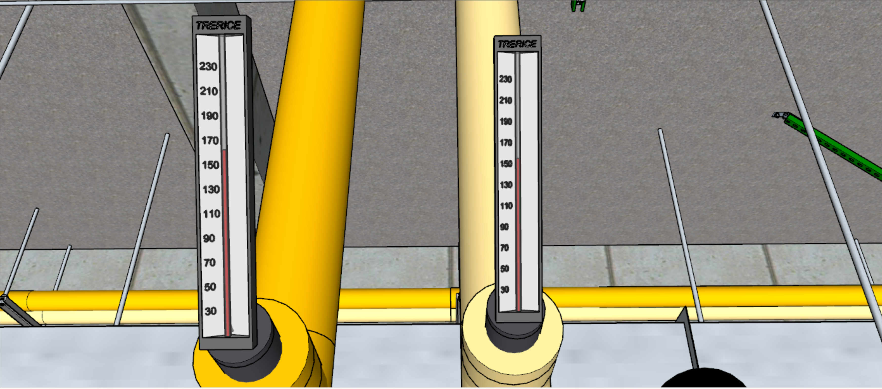
Optimization Targets
The Load Being Served
The Distribution Equipment and System
The Energy Conversion Equipment and Process

Slide 10
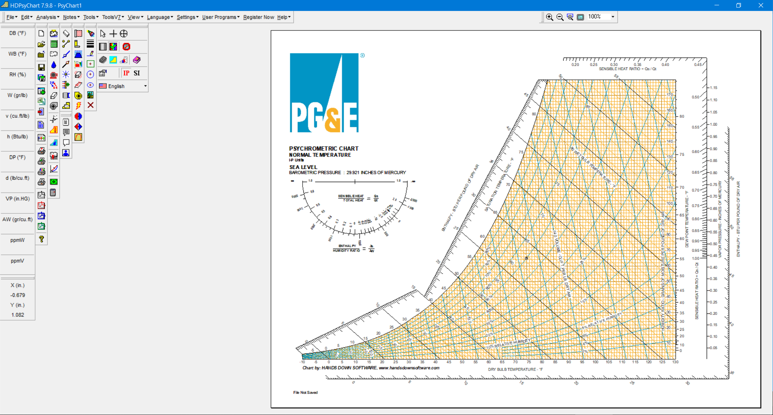
Evaluation
The Simple Application of A Few Basic Relationships
The Energy Conversion Equipment and Process
Apply the steady flow energy equation …
The Distribution Equipment and System
… using the equations of state for air to evaluate the variables …
… and the appropriate ASHRAE psychrometric equations like this …
… to solve for the variable of interest

Slide 11
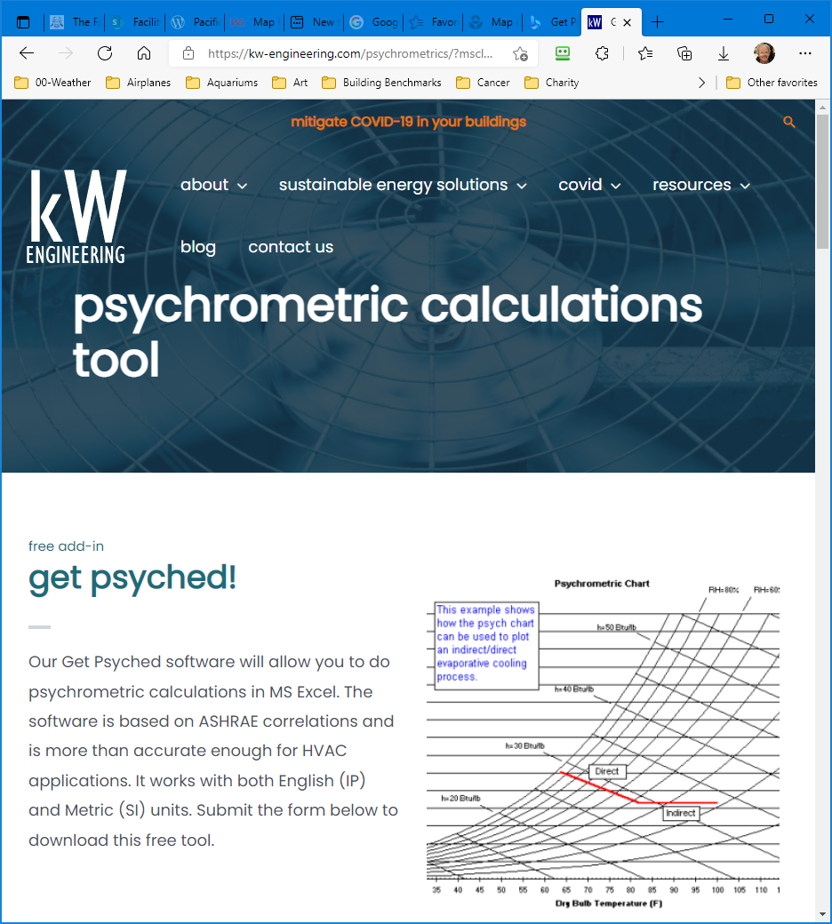
Evaluation
The Simple Application of A Few Basic Relationships
The Energy Conversion Equipment and Process
Apply the steady flow energy equation …
The Distribution Equipment and System
… using the equations of state for air to evaluate the variables …
… and the appropriate ASHRAE psychrometric equations like this …
… to solve for the variable of interest

Slide 12
Evaluation
The Simple Application of A Few Basic Relationships
The Energy Conversion Equipment and Process
Or use a psych chart and the Get Pysched Excel plug-in
The Distribution Equipment and System
https://tinyurl.com/FreePsychChart
https://tinyurl.com/kWEngineeringGetPsyched

Slide 13
Evaluation
The Load Being Served
The Energy Conversion Equipment and Process
The Distribution Equipment and System

Slide 14
Evaluation
The Load Being Served
The Energy Conversion Equipment and Process
The Distribution Equipment and System

Slide 15
Evaluation
The Load Being Served
The Energy Conversion Equipment and Process
The Distribution Equipment and System

Slide 16
Evaluation
The Load Being Served
The Energy Conversion Equipment and Process
The Distribution Equipment and System

Slide 17
Evaluation
The Energy Conversion Equipment and Process
The Load Being Served
The Distribution Equipment and System

Slide 18
Evaluation
The Energy Conversion Equipment and Process
The Load Being Served
The Distribution Equipment and System

Slide 19
Evaluation
The Load Being Served
The Energy Conversion Equipment and Process
The Distribution Equipment and System

Slide 20
Evaluation
The Load Being Served
The Energy Conversion Equipment and Process
The Distribution Equipment and System

Slide 21
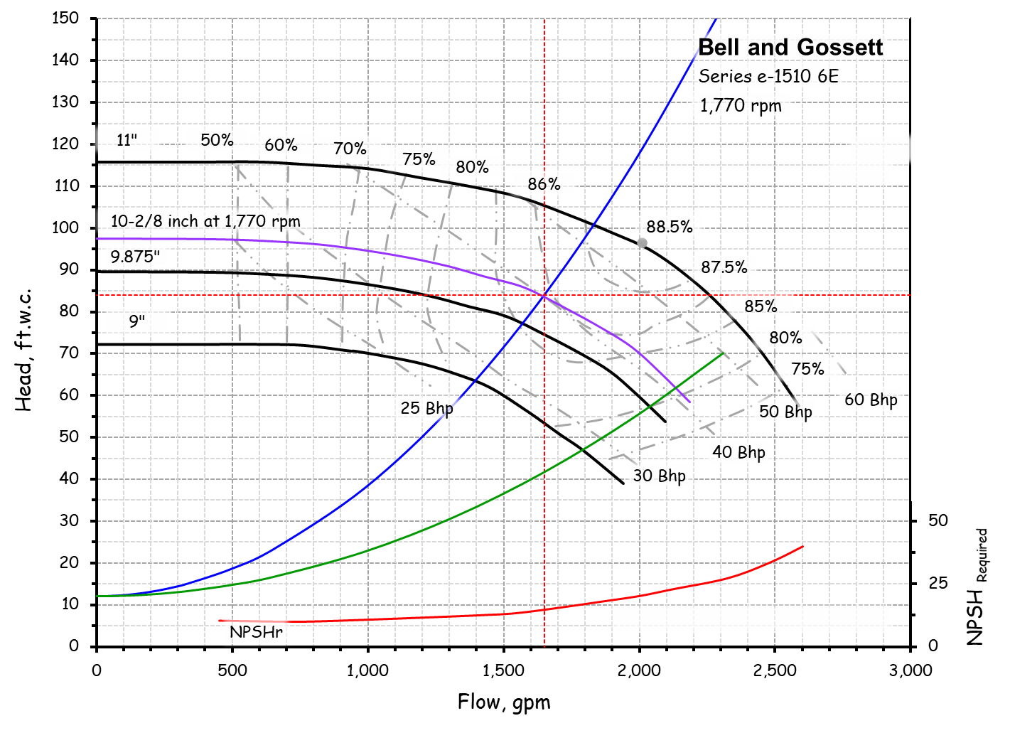
Evaluation
The Load Being Served
The Energy Conversion Equipment and Process
The Distribution Equipment and System
Fan and pump kW relationships are very similar, so similar concepts apply

Slide 22
Evaluation
The Load Being Served
The Energy Conversion Equipment and Process
The Distribution Equipment and System
Fan and pump kW relationships are very similar, so similar concepts apply

Slide 23
Evaluation
The Load Being Served
The Energy Conversion Equipment and Process
The Distribution Equipment and System
Efficiency can vary with operating point
Impeller trims and throttling cross efficiency lines
Variable speed drives preserve efficiency

Slide 24
Evaluation
The Load Being Served
The Energy Conversion Equipment and Process
The Distribution Equipment and System
Efficiency can vary with operating point
Impeller trims and throttling cross efficiency lines
Variable speed drives preserve efficiency

Slide 25
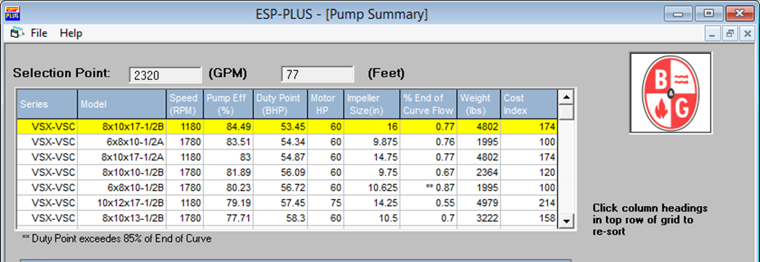

Evaluation
The Load Being Served
The Energy Conversion Equipment and Process
The Distribution Equipment and System
Efficiency can vary with operating point
Impeller trims and throttling cross efficiency lines
Variable speed drives preserve efficiency
Many pumps can satisfy a given head and flow requirement
Many existing pumps were picked for best first cost
A right sized pump can be an EBCx alternative

Slide 26
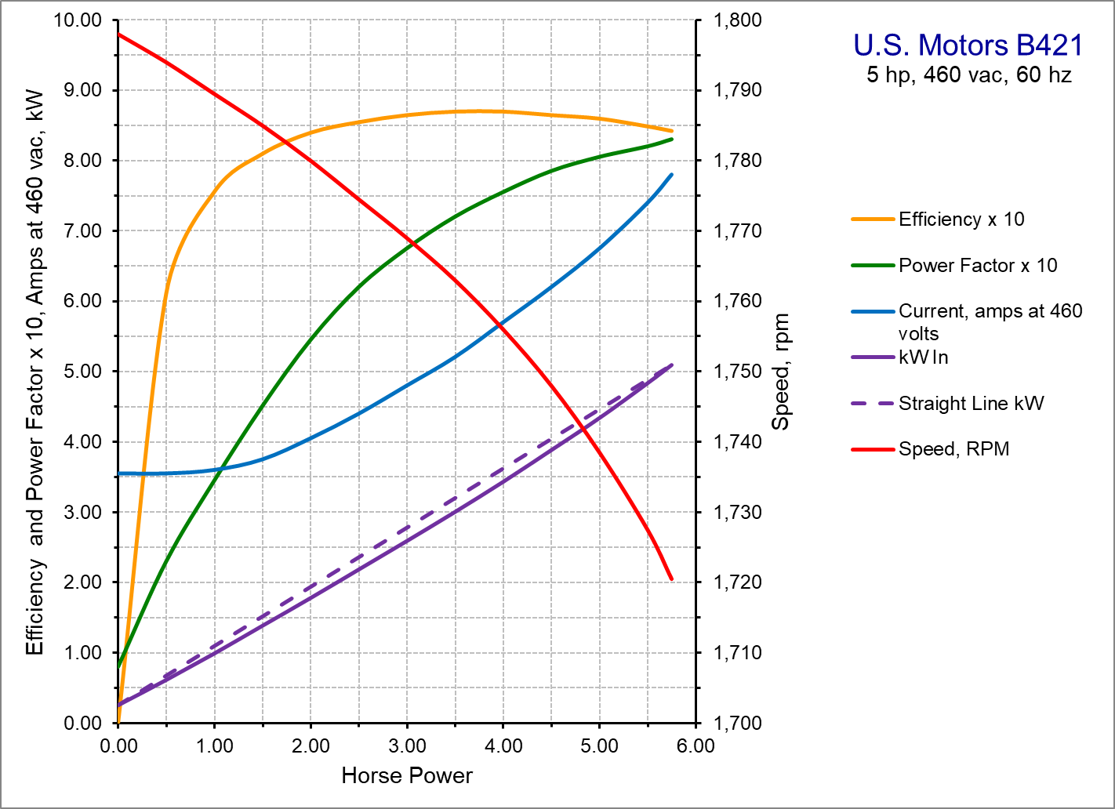
Evaluation
The Load Being Served
The Energy Conversion Equipment and Process
The Distribution Equipment and System
Belt efficiency can vary with maintenance
Well adjusted belts are 97-98% efficient
Poorly adjusted belts can be less than 90%
Poorly adjusted belts = heat
  Hot pulleys (thermographic detection possible)
  Heat in air stream = parasitic load
Proper belt tensioning can be an quick EBCx win

Slide 27
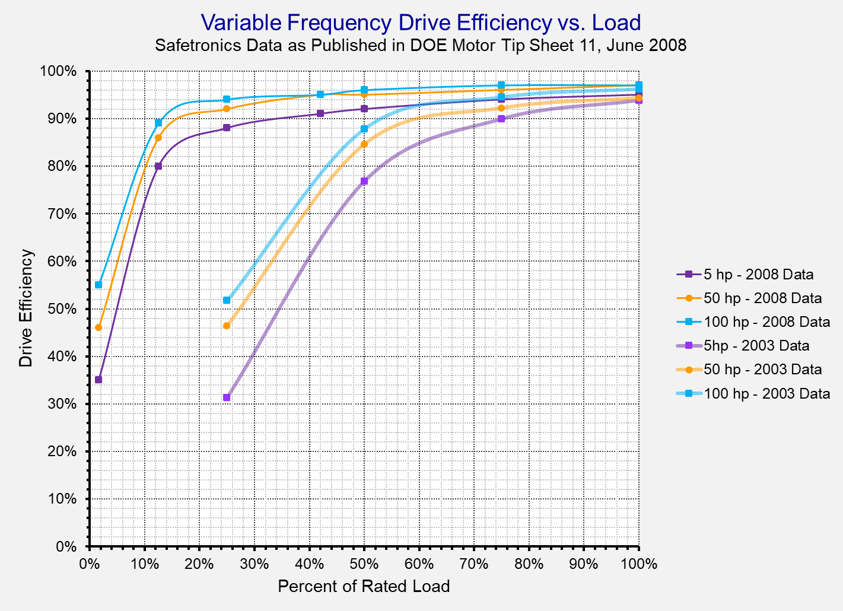
Evaluation
The Load Being Served
The Energy Conversion Equipment and Process
The Distribution Equipment and System
Motor efficiency varies with load and motor size
Larger motors are generally more efficient
Motor efficiency rises then falls as load drops
For a given size, motor efficiency can vary with product line
A 10 hp motor loaded to 75% may be more efficient than a 7-1/2 hp motor at full load
EBCx activities shift operating points and thus shift motor efficiency

Slide 28
Evaluation
The Load Being Served
The Energy Conversion Equipment and Process
The Distribution Equipment and System
Variable Speed Drive efficiency varies with load and frame size
All drives have losses that vary with
  Size
  Age
  Load
Frame sizes are not the same as motor sizes
EBCx activities shift operating points and thus shift VSD efficiency

Slide 29
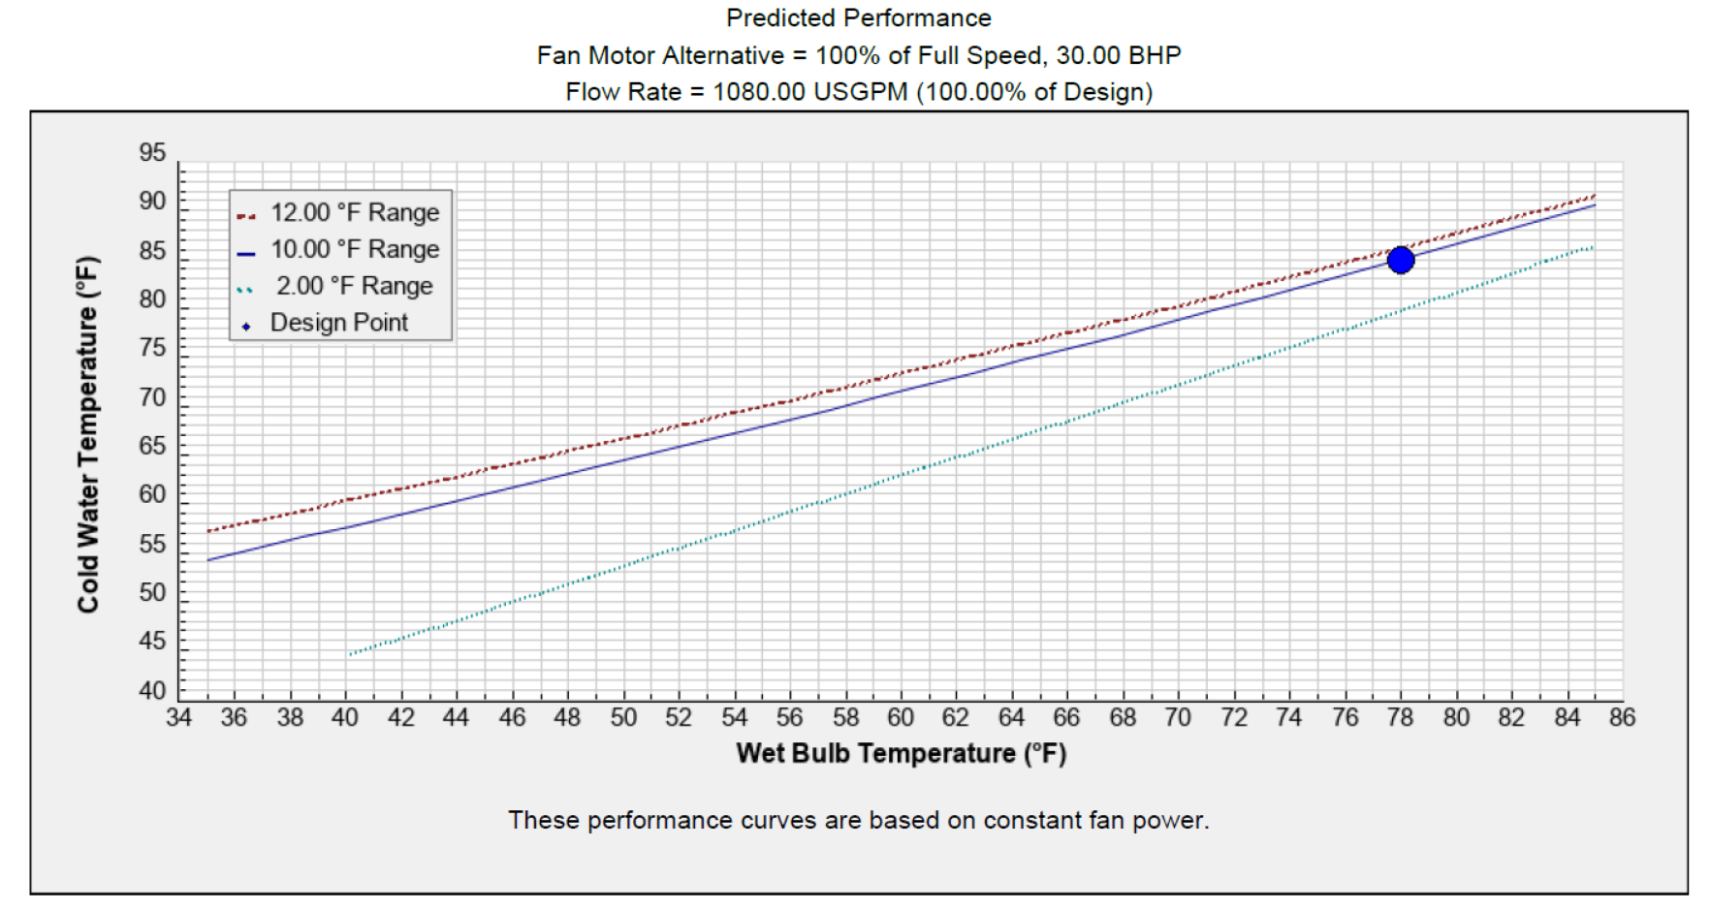
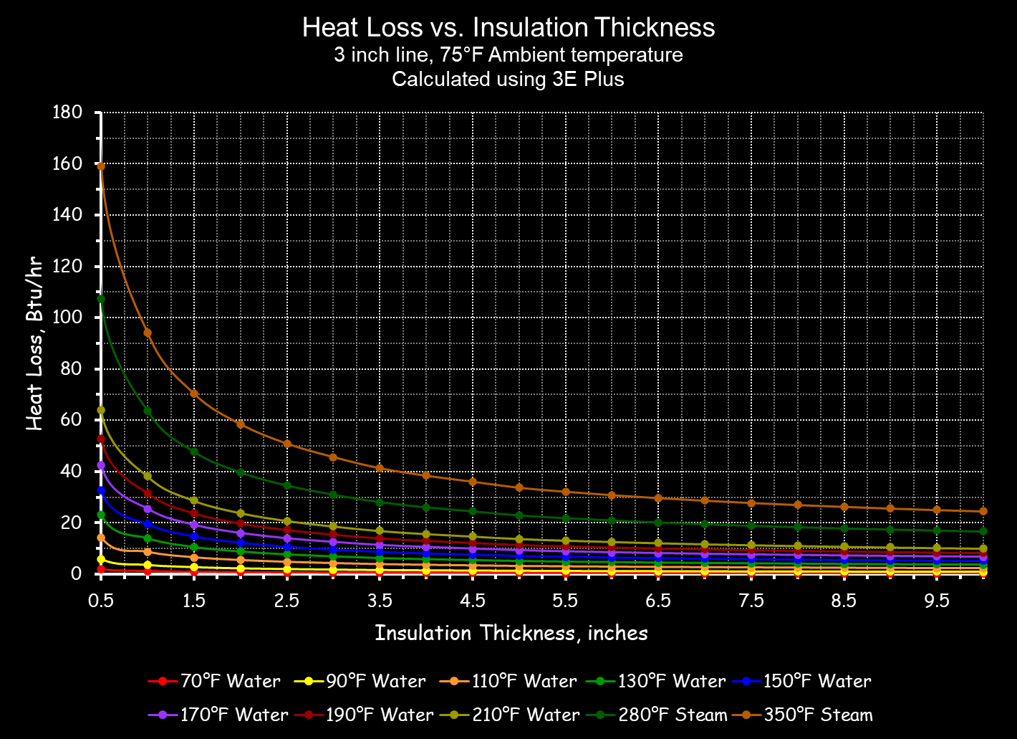
Evaluation
The Load Being Served
The Energy Conversion Equipment and Process
The Distribution Equipment and System
Even will insulated ducts and pipes loose energy
A little bit over a long run adds up
Small ducts with low flows can pick up a surprising amount of heat
Insulation repairs on hot systems are a quick EBCx win
NAIMA’s 3EPlus makes assessing insulation losses easy; https://tinyurl.com/NAIMA3EPlus

Slide 30
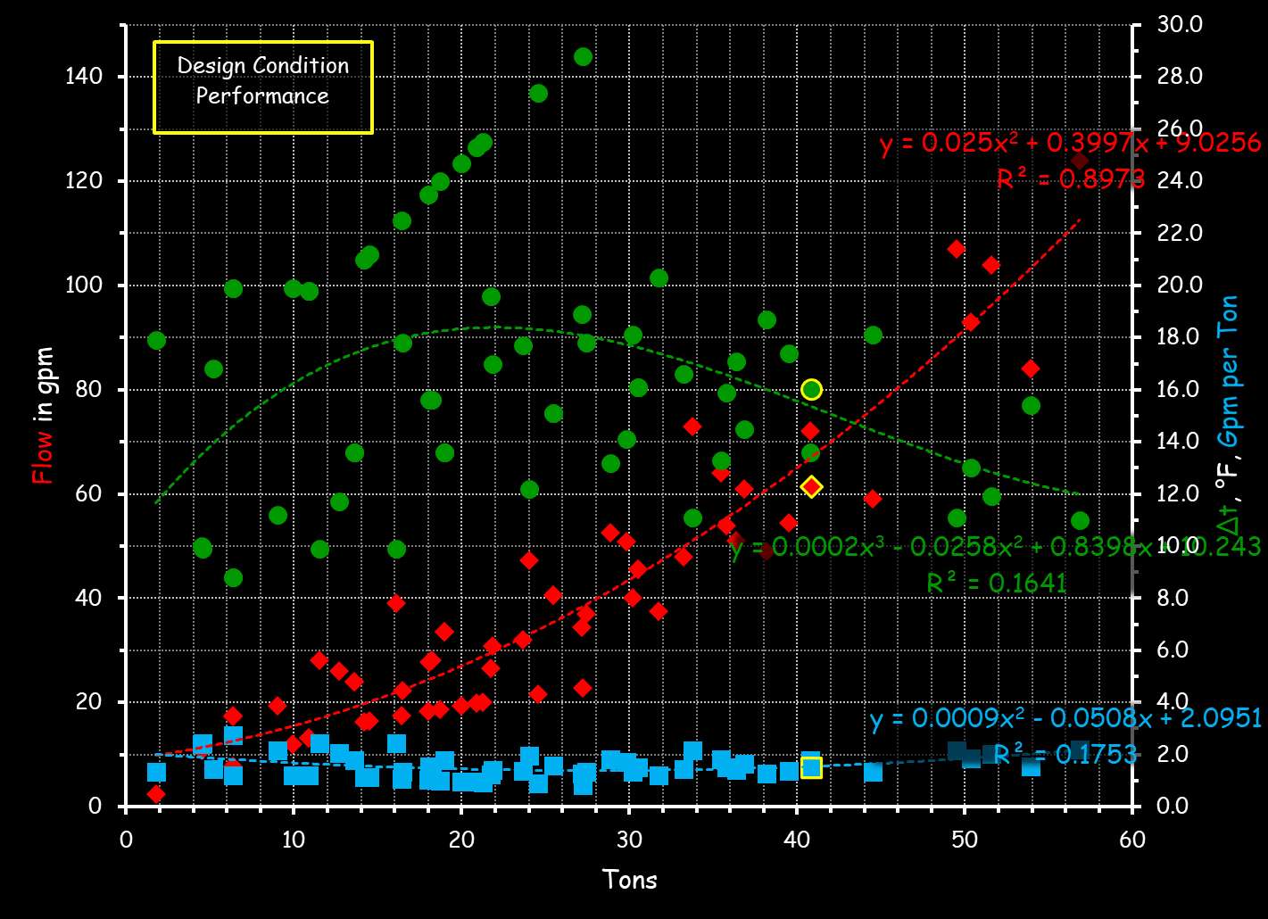
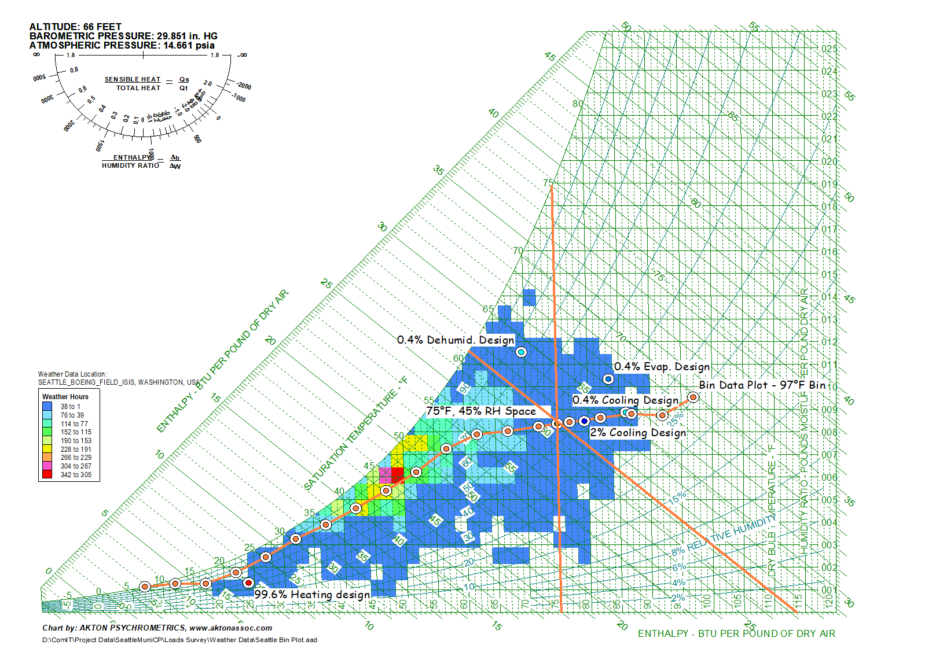
Evaluation
Energy Goes Down
The Load Being Served
The Energy Conversion Equipment and Process
Performance often varies with temperature
The Distribution Equipment and System
Energy Goes Up

Slide 31
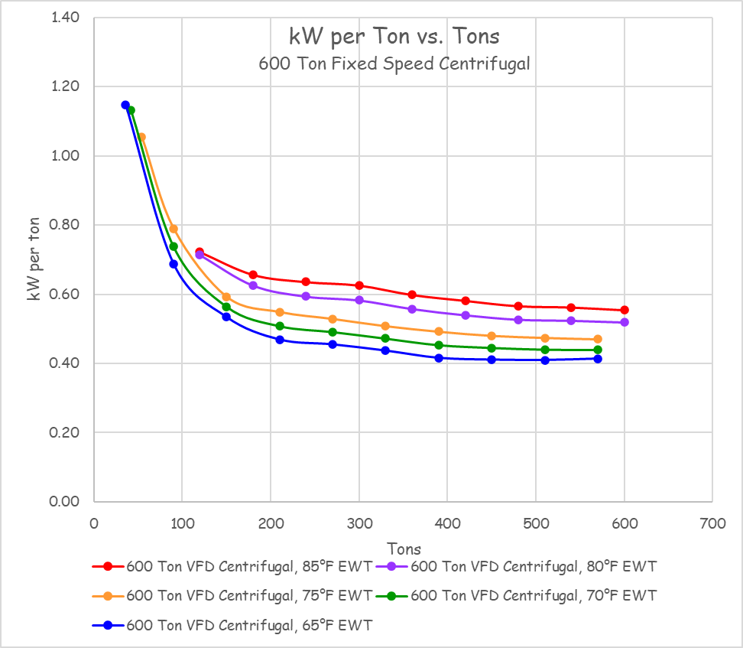
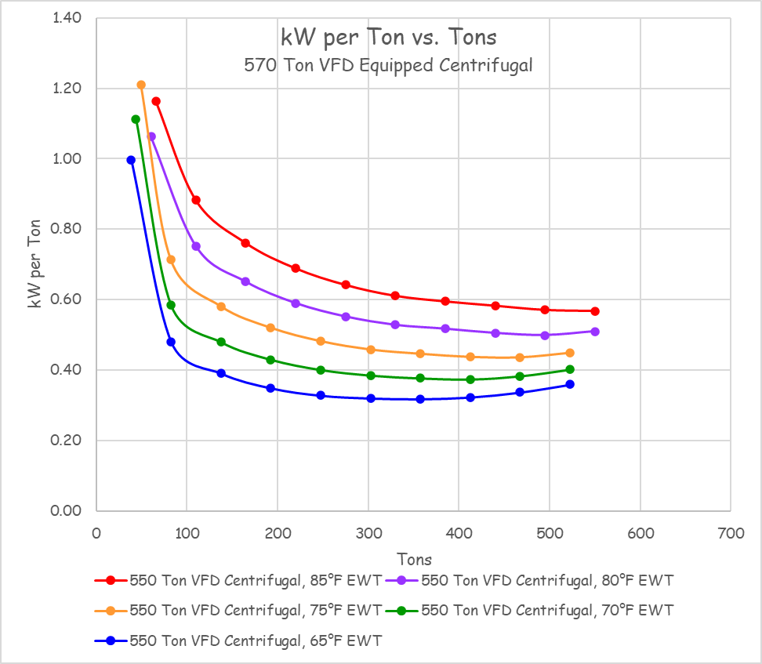
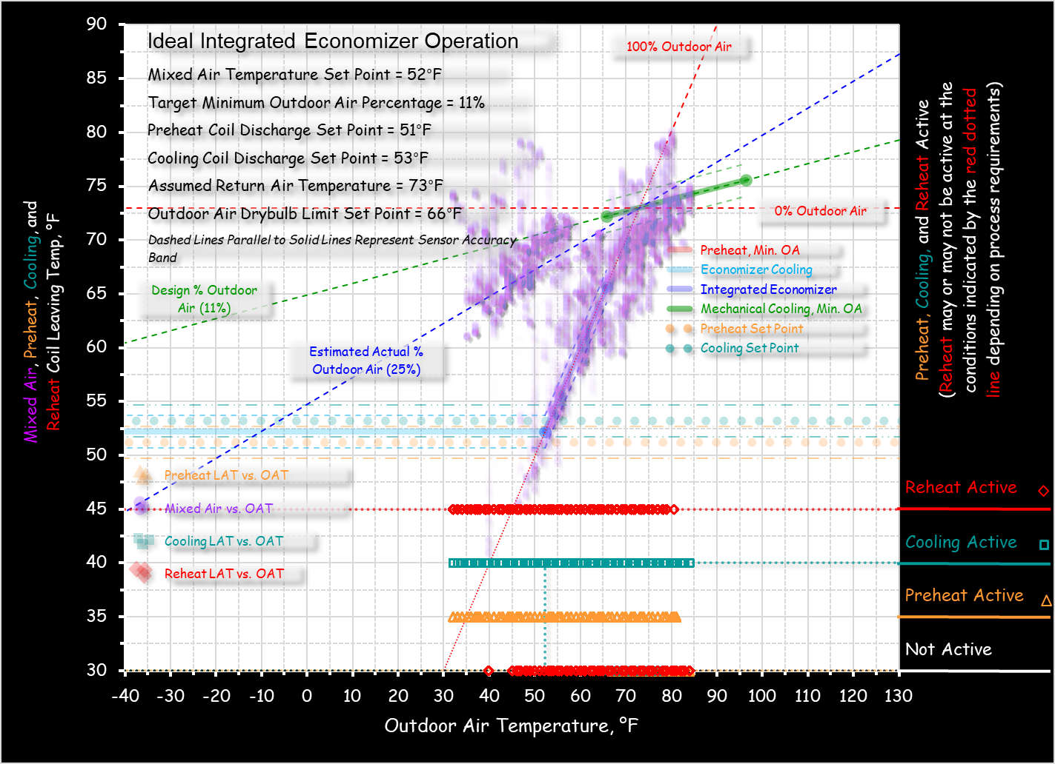
Evaluation
Energy Goes Down
The Load Being Served
The Energy Conversion Equipment and Process
Performance often varies with temperature
The Distribution Equipment and System
Energy Goes Up

Slide 32
Evaluation
Energy Goes Down
The Load Being Served
The Energy Conversion Equipment and Process
Performance often varies with temperature
Different machines = Different performance curves
The Distribution Equipment and System
Energy Goes Up

Slide 33
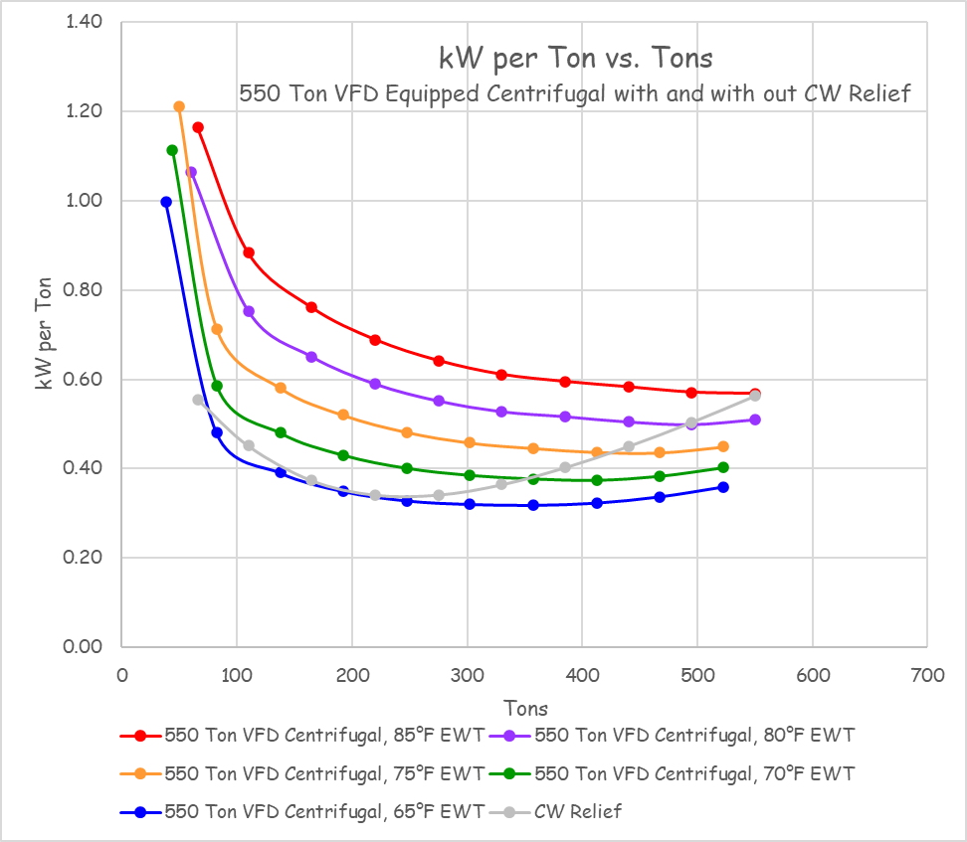
Evaluation
Energy Goes Down
The Load Being Served
The Energy Conversion Equipment and Process
Performance often varies with temperature
Different machines = Different performance curves
The Distribution Equipment and System
Energy Goes Up

Slide 34
Evaluation
Energy Goes Down
The Load Being Served
The Energy Conversion Equipment and Process
Performance often varies with temperature
Other resources may be involved
The Distribution Equipment and System
Energy Goes Up

Slide 35
Evaluation
The Load Being Served
The Energy Conversion Equipment and Process
Energy Goes Down
Energy Goes Up
Frequently there are trade-offs that need to be considered
The Distribution Equipment and System

Slide 36
Evaluation
The Energy Conversion Equipment and Process
Energy Goes Down
Energy Goes Up
The Load Being Served
The Distribution Equipment and System
Generally, in all cases:
Climate plays a role

Slide 37
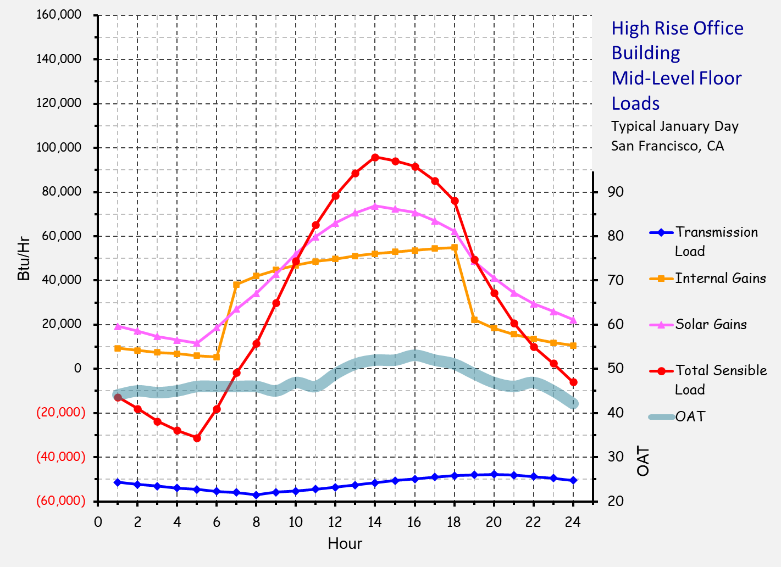
Evaluation
The Energy Conversion Equipment and Process
Energy Goes Down
Energy Goes Up
The Load Being Served
The Distribution Equipment and System
Generally, in all cases:
Climate plays a role
Schedules play a role

Slide 38
Evaluation
The Energy Conversion Equipment and Process
Energy Goes Down
Energy Goes Up
The Load Being Served
The Distribution Equipment and System
Generally, in all cases:
Climate plays a role
Schedules play a role

Slide 39
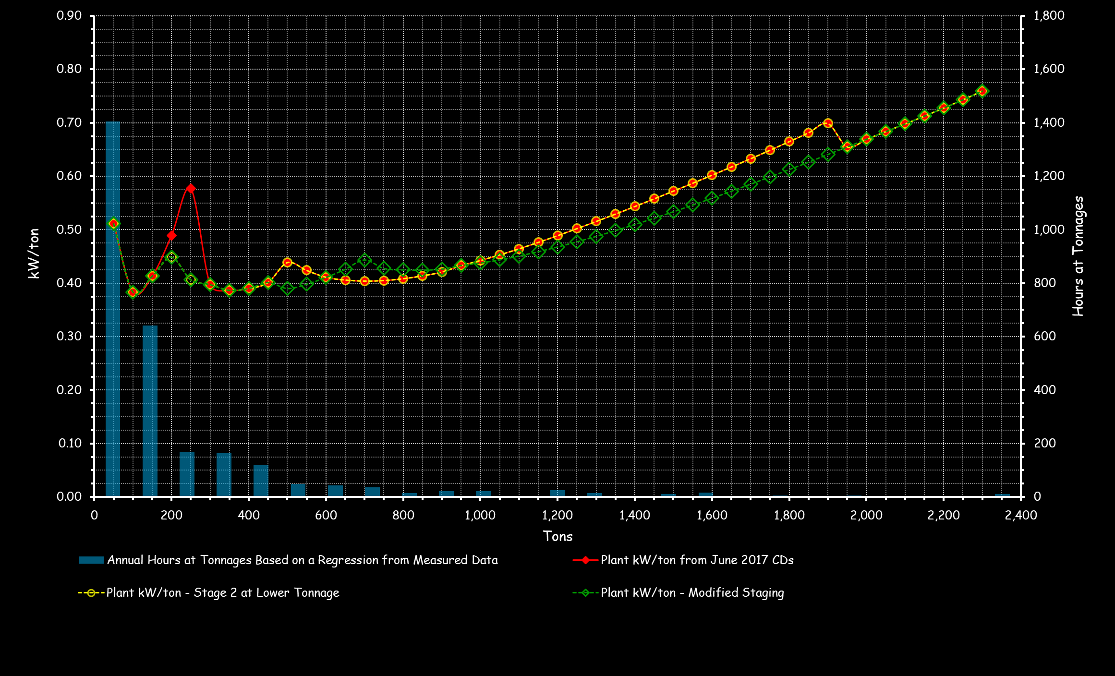
Evaluation
The Energy Conversion Equipment and Process
Energy Goes Down
Energy Goes Up
The Load Being Served
The Distribution Equipment and System
Generally, in all cases:
Climate plays a role
Schedules play a role
Load profile plays a role

Slide 40
Evaluation
The Energy Conversion Equipment and Process
Energy Goes Down
Energy Goes Up
The Load Being Served
The Distribution Equipment and System
Generally, in all cases:
Climate plays a role
Schedules play a role
Load profile plays a role

Slide 41
Evaluation
The Energy Conversion Equipment and Process
Energy Goes Down
Energy Goes Up
Other than that, there’s not much to doing energy savings projections
The Load Being Served
The Distribution Equipment and System
Generally, in all cases:
Climate plays a role
Schedules play a role
Load profile plays a role

Slide 42
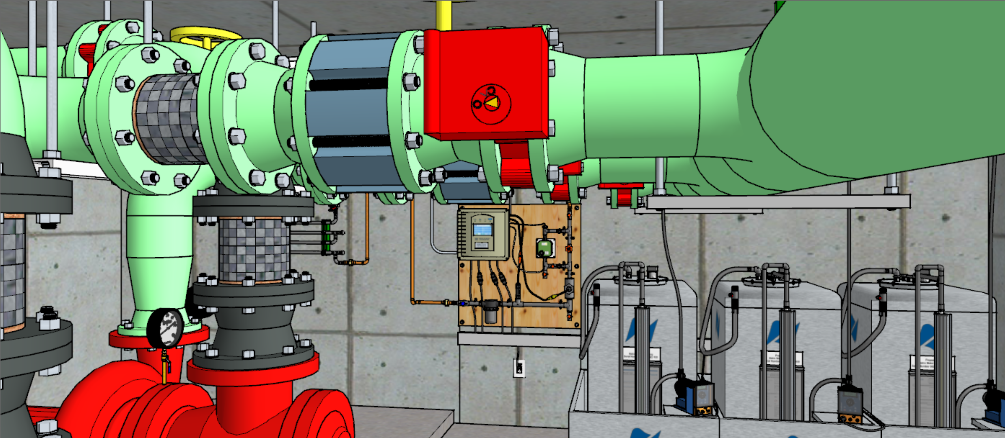
Trying it Out on a Condenser Water System

Slide 43
What Are Some of the Indicators?

Slide 44
What Are Some of the Indicators?

Slide 45
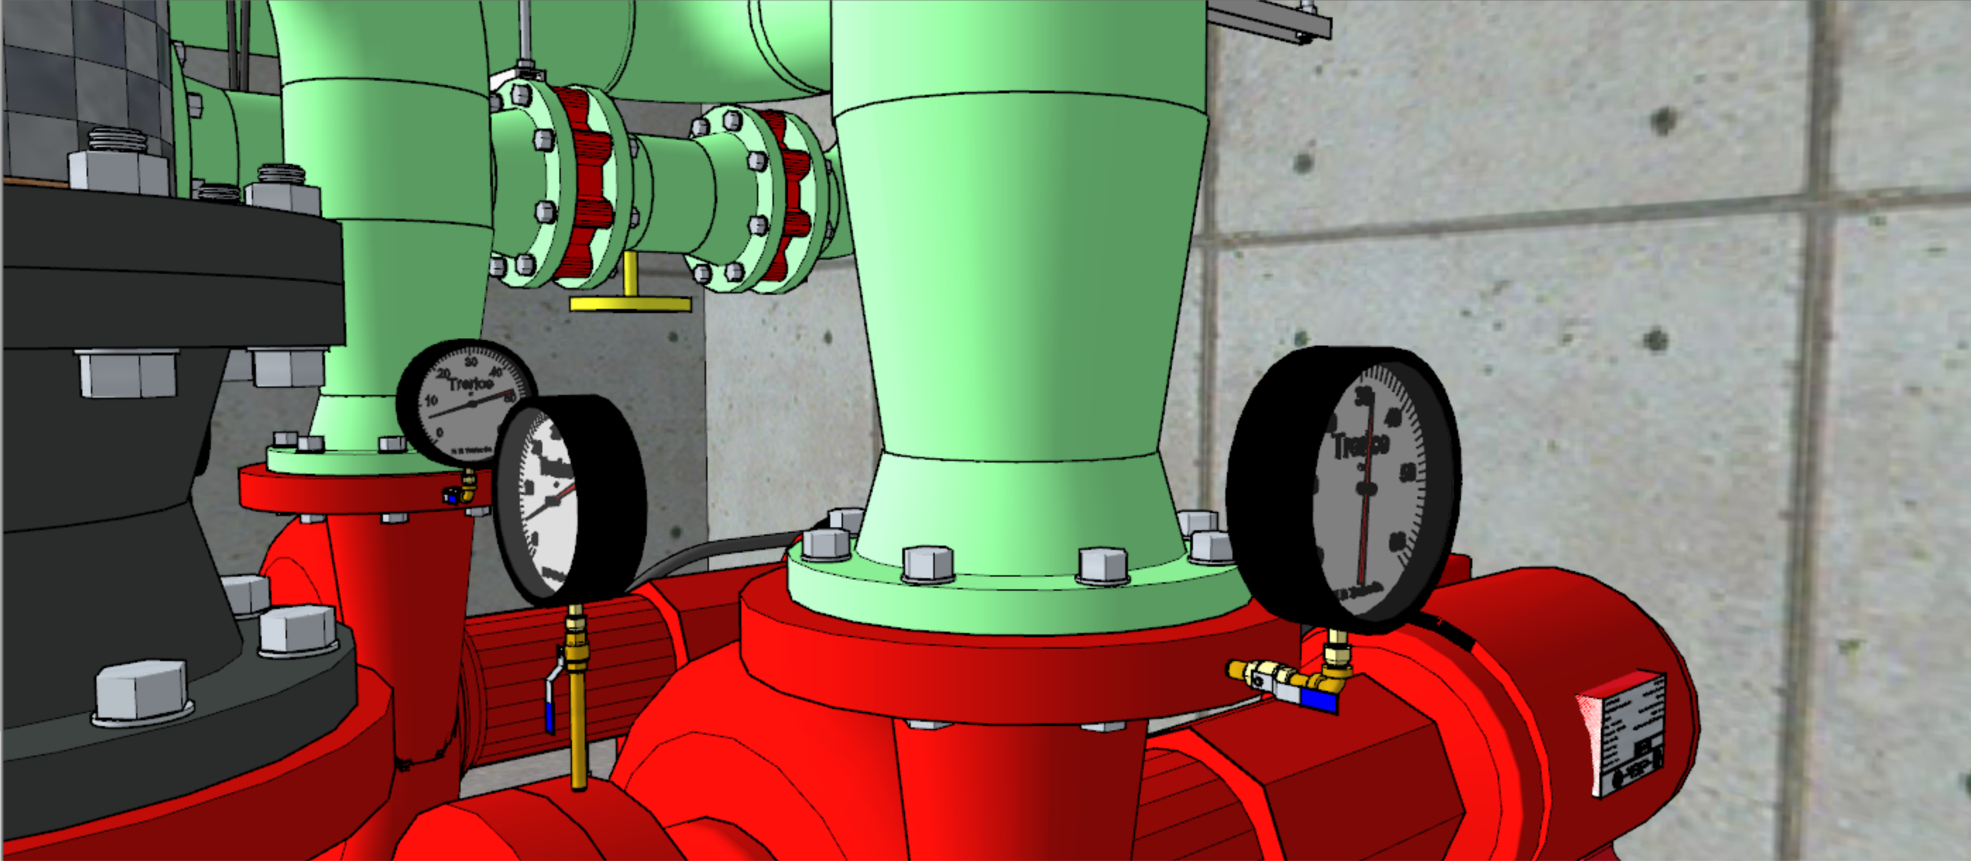
What Are Some of the Indicators?
Valve position vs. mark
Observed condenser pressure drop vs. design value
System sized for a chiller that is not there
Long pipe run common to pumps with several different operating states
Pump head seems high given the arrangement
System temperature rise vs. heat being rejected

Slide 46
How Can We Estimate Flow Rate?

Slide 47
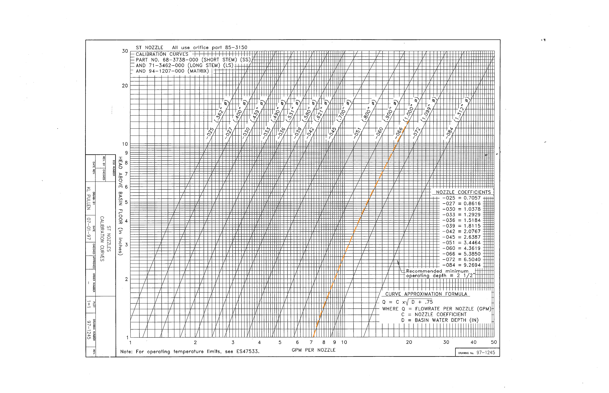
How Can We Estimate Flow Rate?
Pump Test (gauge readings and pump curve)
Condenser pressure drop (gauge readings, design value, and square law)
Cold basin water level drop on start-up (level change over time)
Hot basin depth (level and nozzle curves)

Slide 48
How Can We Estimate Flow Rate?
Pump Test (gauge readings and pump curve)
Condenser pressure drop (gauge readings, design value, and square law)
Cold basin water level drop on start-up (level change over time)
Hot basin depth (level and nozzle curves)

Slide 49
How Can We Estimate Savings?
Throttle up the impeller curve
Move down the system curve
  Impeller trim
  Change the speed
  Change the pump

Slide 50
How Can We Estimate Savings?
Throttle up the impeller curve
Move down the system curve
  Impeller trim
  Change the speed
  Change the pump

Slide 51
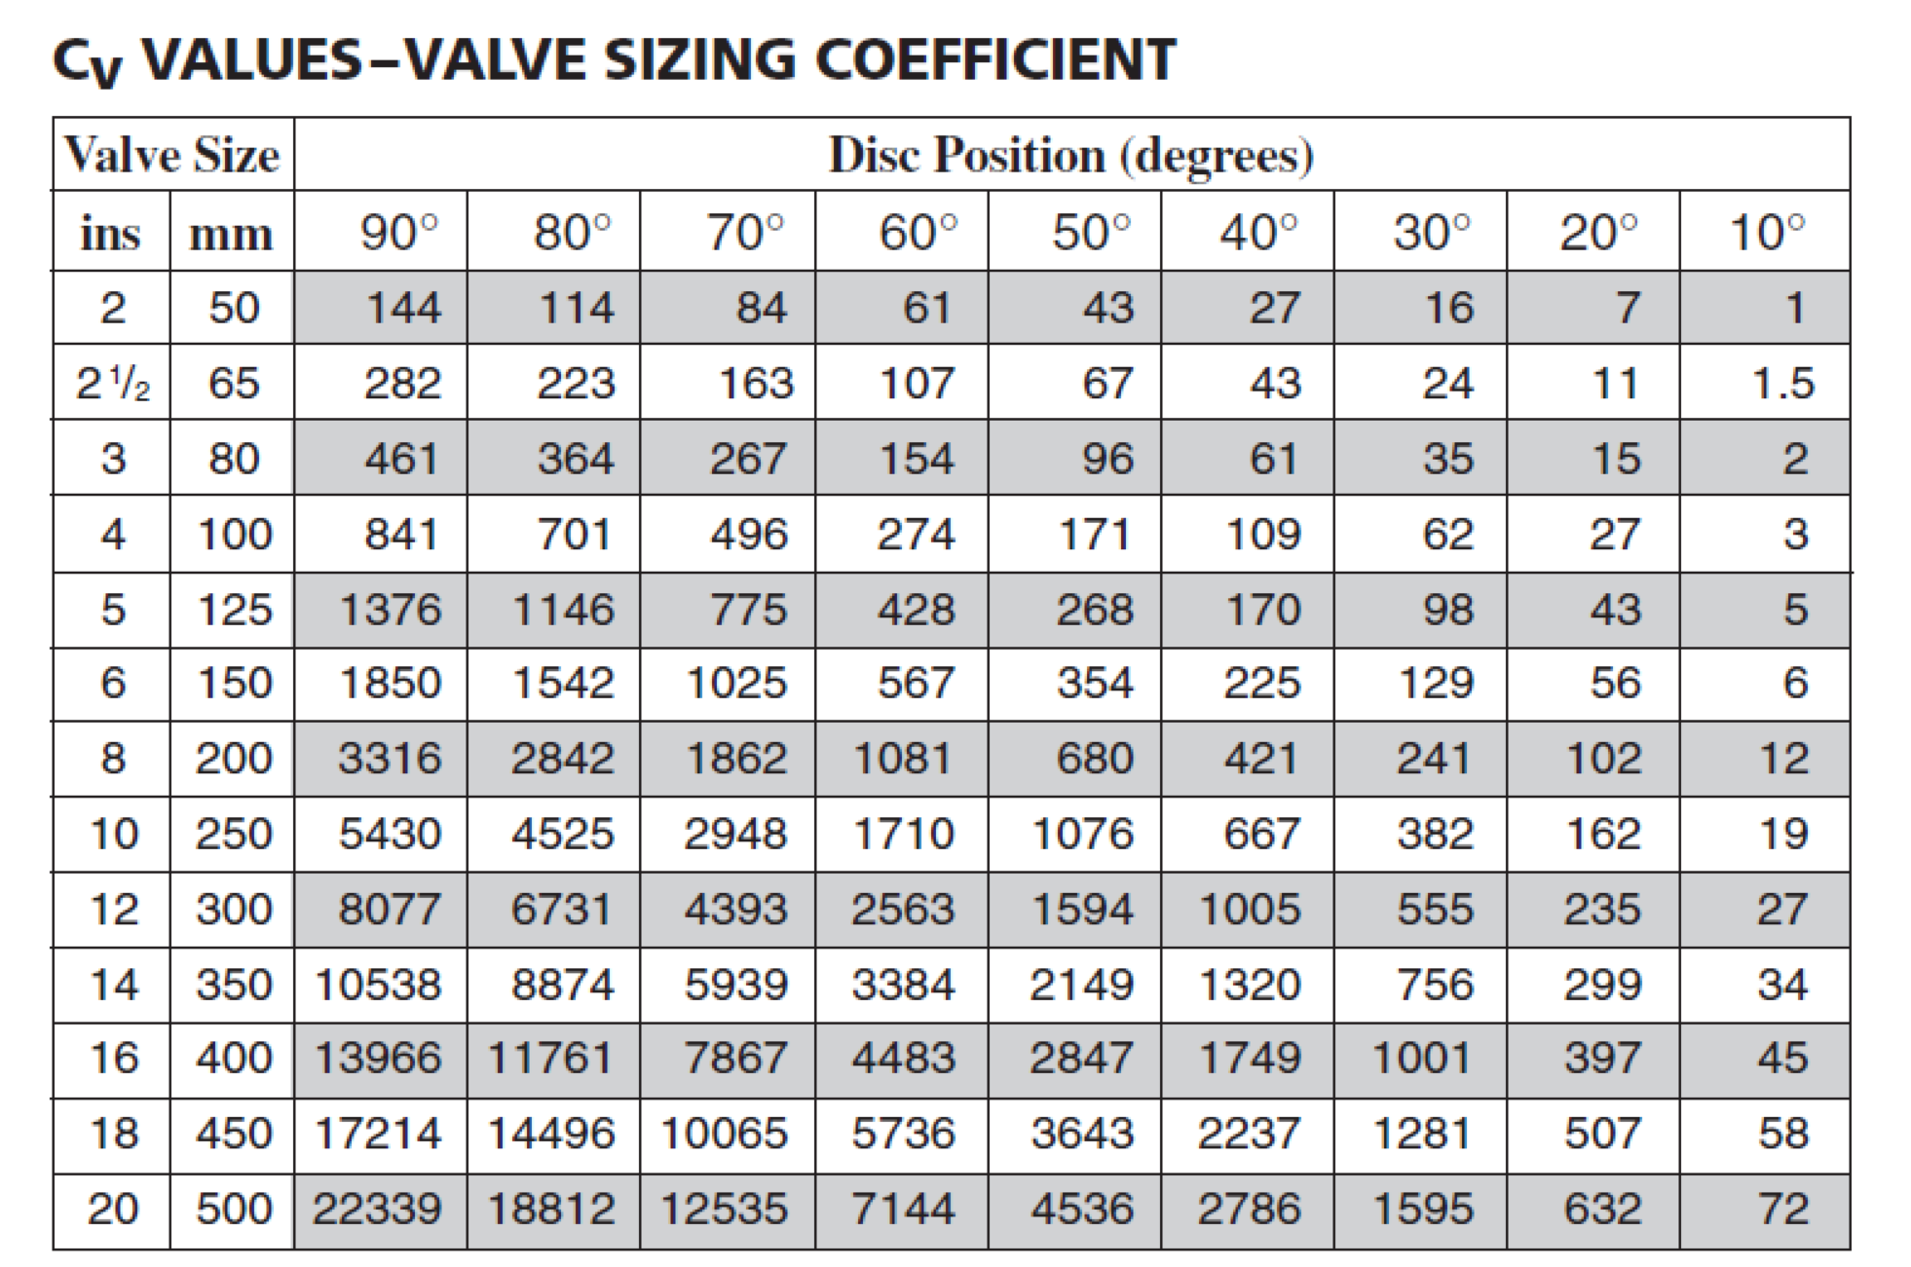
How Can We Estimate Savings?
Throttle up the impeller curve
Move down the system curve
  Impeller trim
  Change the speed
  Change the pump
Throttled valve pressure drop

Slide 52
How Can We Estimate Savings?
Throttle up the impeller curve
Move down the system curve
  Impeller trim
  Change the speed
  Change the pump
Throttled valve pressure drop

Slide 53
How Can We Estimate Savings?
Throttle up the impeller curve
Move down the system curve
  Impeller trim
  Change the speed
  Change the pump
Throttled valve pressure drop

Slide 54
Focusing on the Ball Room AHU Hot Water Valve Leak
The Load Being Served
The Distribution Equipment and System
The Energy Conversion Equipment and Process

Slide 55
Breakout 01
Given
Assignment
Ball Room AHU Model
Drawings
  System Diagram
  Equipment Schedule
  Point List/Narrative Sequence
Operator Discussions
Scope out the Ball Room AHU to identify potential opportunities to improve performance and save resources

Slide 57
Breakout 02
Given
Assignment
The minimum outdoor air setting
The economizer high limit setting
An assumption that warm-up is accomplished by the reheat coils
A typical operating schedule (next slide)
The weather data resources we discussed
Field observations of the system operating parameters
Determine the number of hours the heating coil may need to function
Determine the number of hours a year the observed HW coil temperature rise is a false load
Determine the number of hours a year the false load becomes a chilled water false load

Slide 58
Ball Room AHU Typical Schedule
Monday – Friday 6:00 AM – 10:00 PM
Saturday – 3:00 PM – Midnight
Sunday – 9:00 AM – 3:00 PM

Slide 59
https://www.screencast.com/t/N75JtXeNNpuIhttps://www.screencast.com/t/N75JtXeNNpuI

Slide 60
Breakout 03
Given
Assignment
Field observations
The District Steam Tariff
EnergyStar Conversion Factors
Identify the thermal energy waste for the current hour of operation
How many tons of false load is this putting on the chilled water plant?
What are the possible causes of the undesired HW coil temperature rise?
Consider the questions in the next slide

Slide 61
Break Out 03 Questions
Does boiler system thermal efficiency come into play with the district steam thermal source?
How would your conclusions regarding energy waste be impacted if the HW system was served by a conventional boiler like the Lochinvar CopperFin product?
How would your conclusions regarding energy waste be impacted if the HW system was served by a condensing boiler like the Aerco Benchmark product?

Slide 63
Breakout 04
Given
Assignment
Mixed air plenum test results
Determine the true mixed air temperature?
What is the actual system flow rate?
Adjust your thermal savings projection for the hour based on this information
How many tons of load on the chilled water plant are due to the current economizer dysfunction?

