Slide 1
2020 RCx Academy
Scope of Work Exercise
27 January 2021

Slide 2

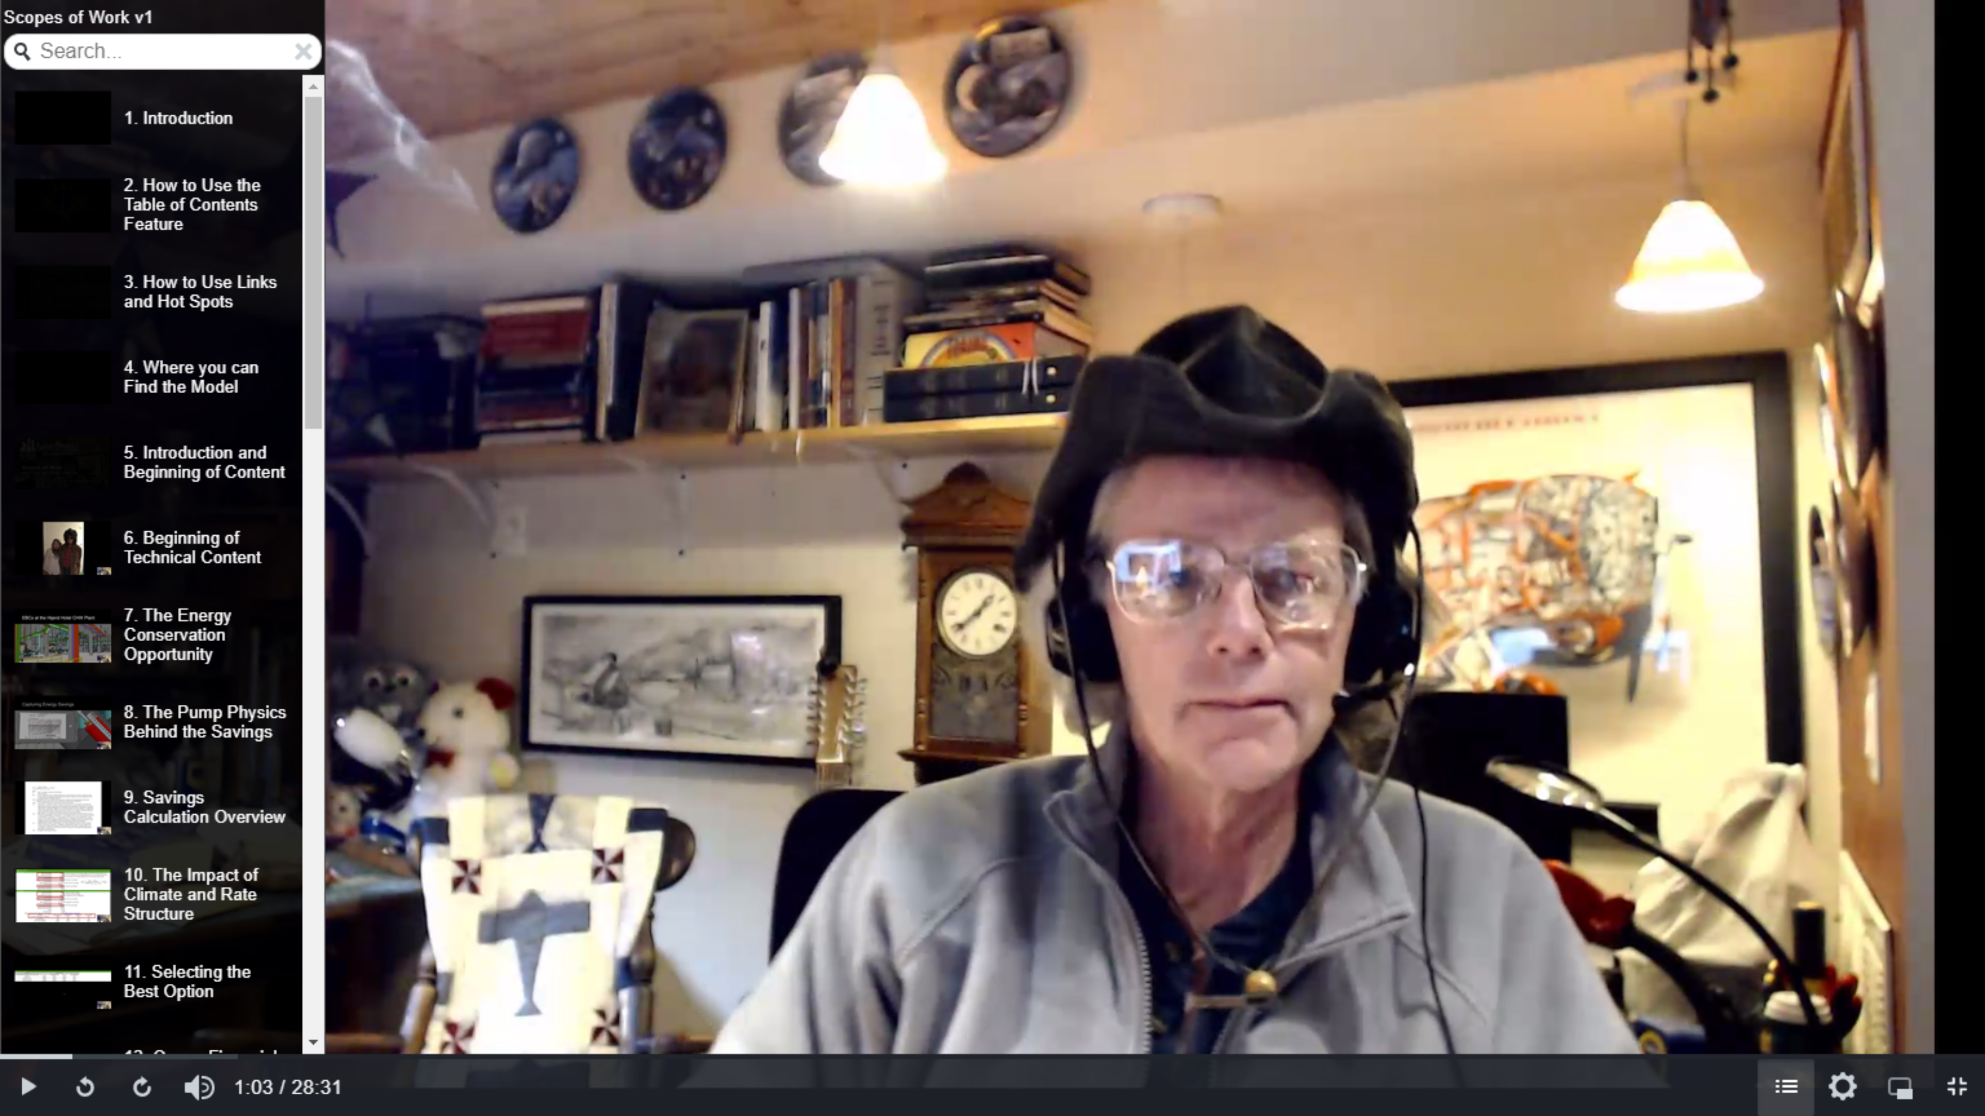
A Resource https://www.screencast.com/t/VIaNTeGfkCH

Slide 3
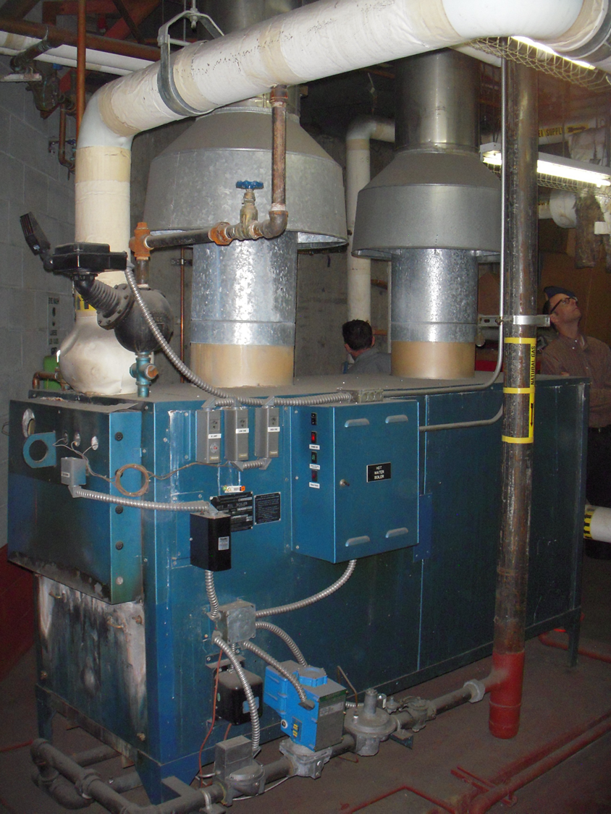
Let’s Replace a Boiler
Background
Existing boilers are at the end of useful life
Existing boilers are conventional non-condensing boilers, nominal 84% efficiency
Existing system serves warm-up coils, finned tube radiation and reheat coils with the LWT reset from 160°F – 180°F
Capacity has not been an issue
The building tends to overheat in mild weather
The building operating team likes the existing boiler vendor

Slide 4
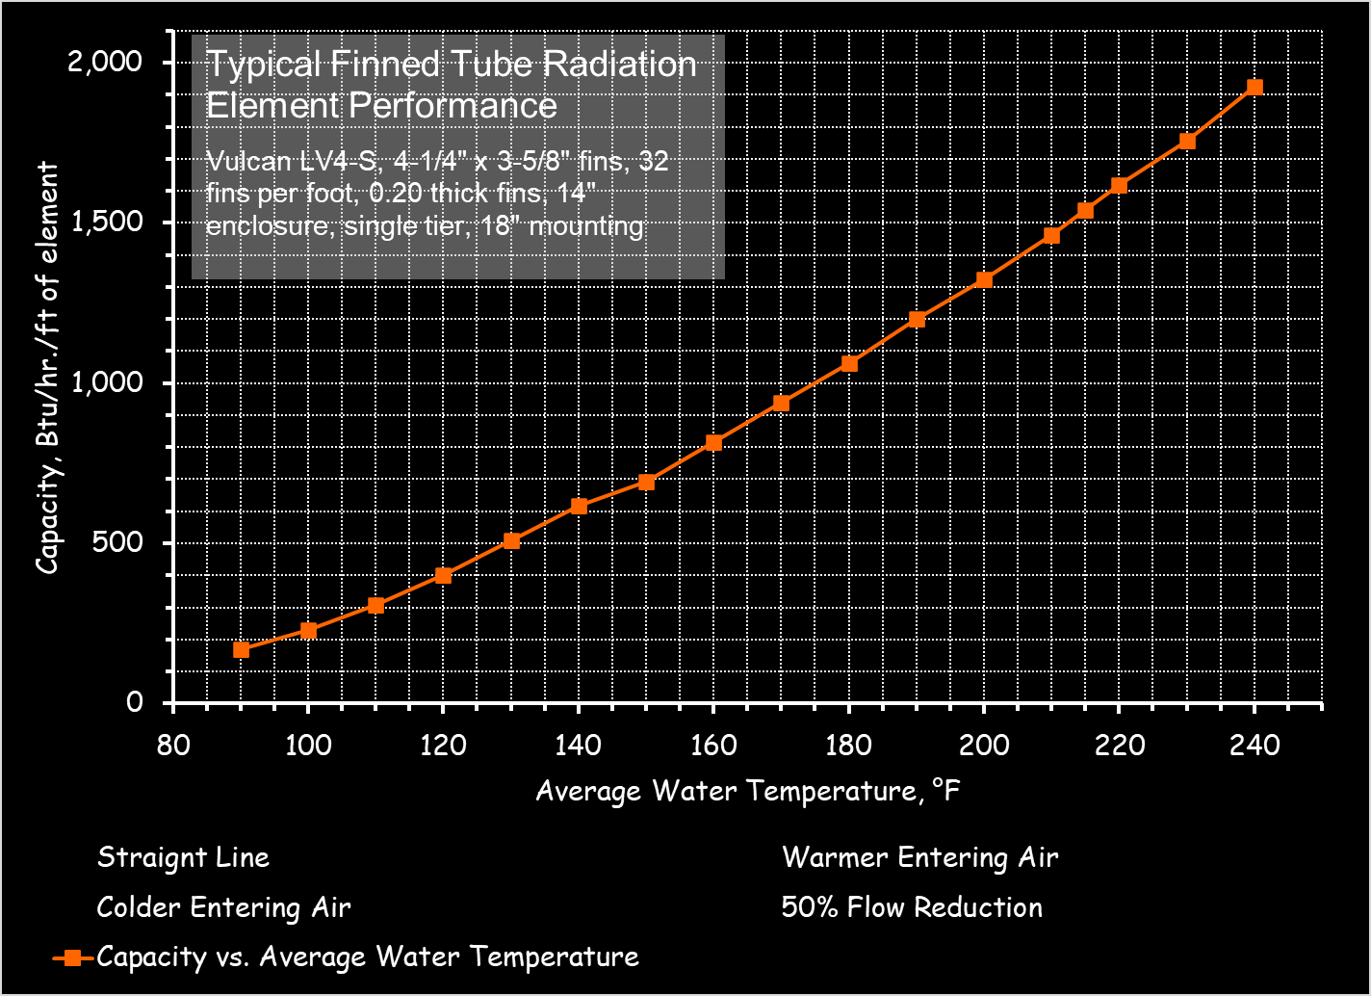
EBCx Project Results
An expanded reset schedule has the potential to improve comfort by better managing FTR capacity
Reheat loads could be served with 110°F water
Reset savings = $2,000 per year in parasitic losses

Slide 5
A Few Acronyms and Definitions (AFA²D)
Definitions
  Heating
    A process that adds energy. For a space, this is often accomplished by circulating air through it at a temperature above the required set point. For an airstream, this is often accomplished by passing it over a surface that is above the required supply temperature.

Slide 6
AFA²D
Definitions
  Freezing
    A condition that occurs when water is cooled to the point where it changes phase from a solid to a liquid.

Slide 7
AFA²D
Definitions
  Water Damage
    A condition that occurs after frozen water contained in a HVAC coil changes back to the liquid phase.

Slide 8
AFA²D
Definitions
  Expletive
    A generic reference to the field terminology used to describe and discuss water damage when it occurs.

Slide 9
AFA²D
Definitions
  Preheat
    A process that heats a fluid stream to prepare it for a subsequent HVAC process. In air handling systems, this process is used to raise subfreezing air above freezing to protect water filled elements down stream from damage due to freezing.
    See the Functional Testing Guide (www.peci.org/ftguide) Air Handling System Reference Guide Chapter 5 – Preheat, Table 5.1 to contrast preheat, reheat and heating applications

Slide 10
AFA²D
Definitions
  Reheat
    A process that uses heat to warm air being delivered to a zone to prevent over cooling. The temperature of the air was set by the need to hit a dehumidification target or by the requirements of another zone, so it can not be raised at the central system. The volume can not be reduced because it has been set to assure proper ventilation (contaminant control). In the limit, reheat will raise the supply temperature to the zone temperature but not above it.

Slide 11
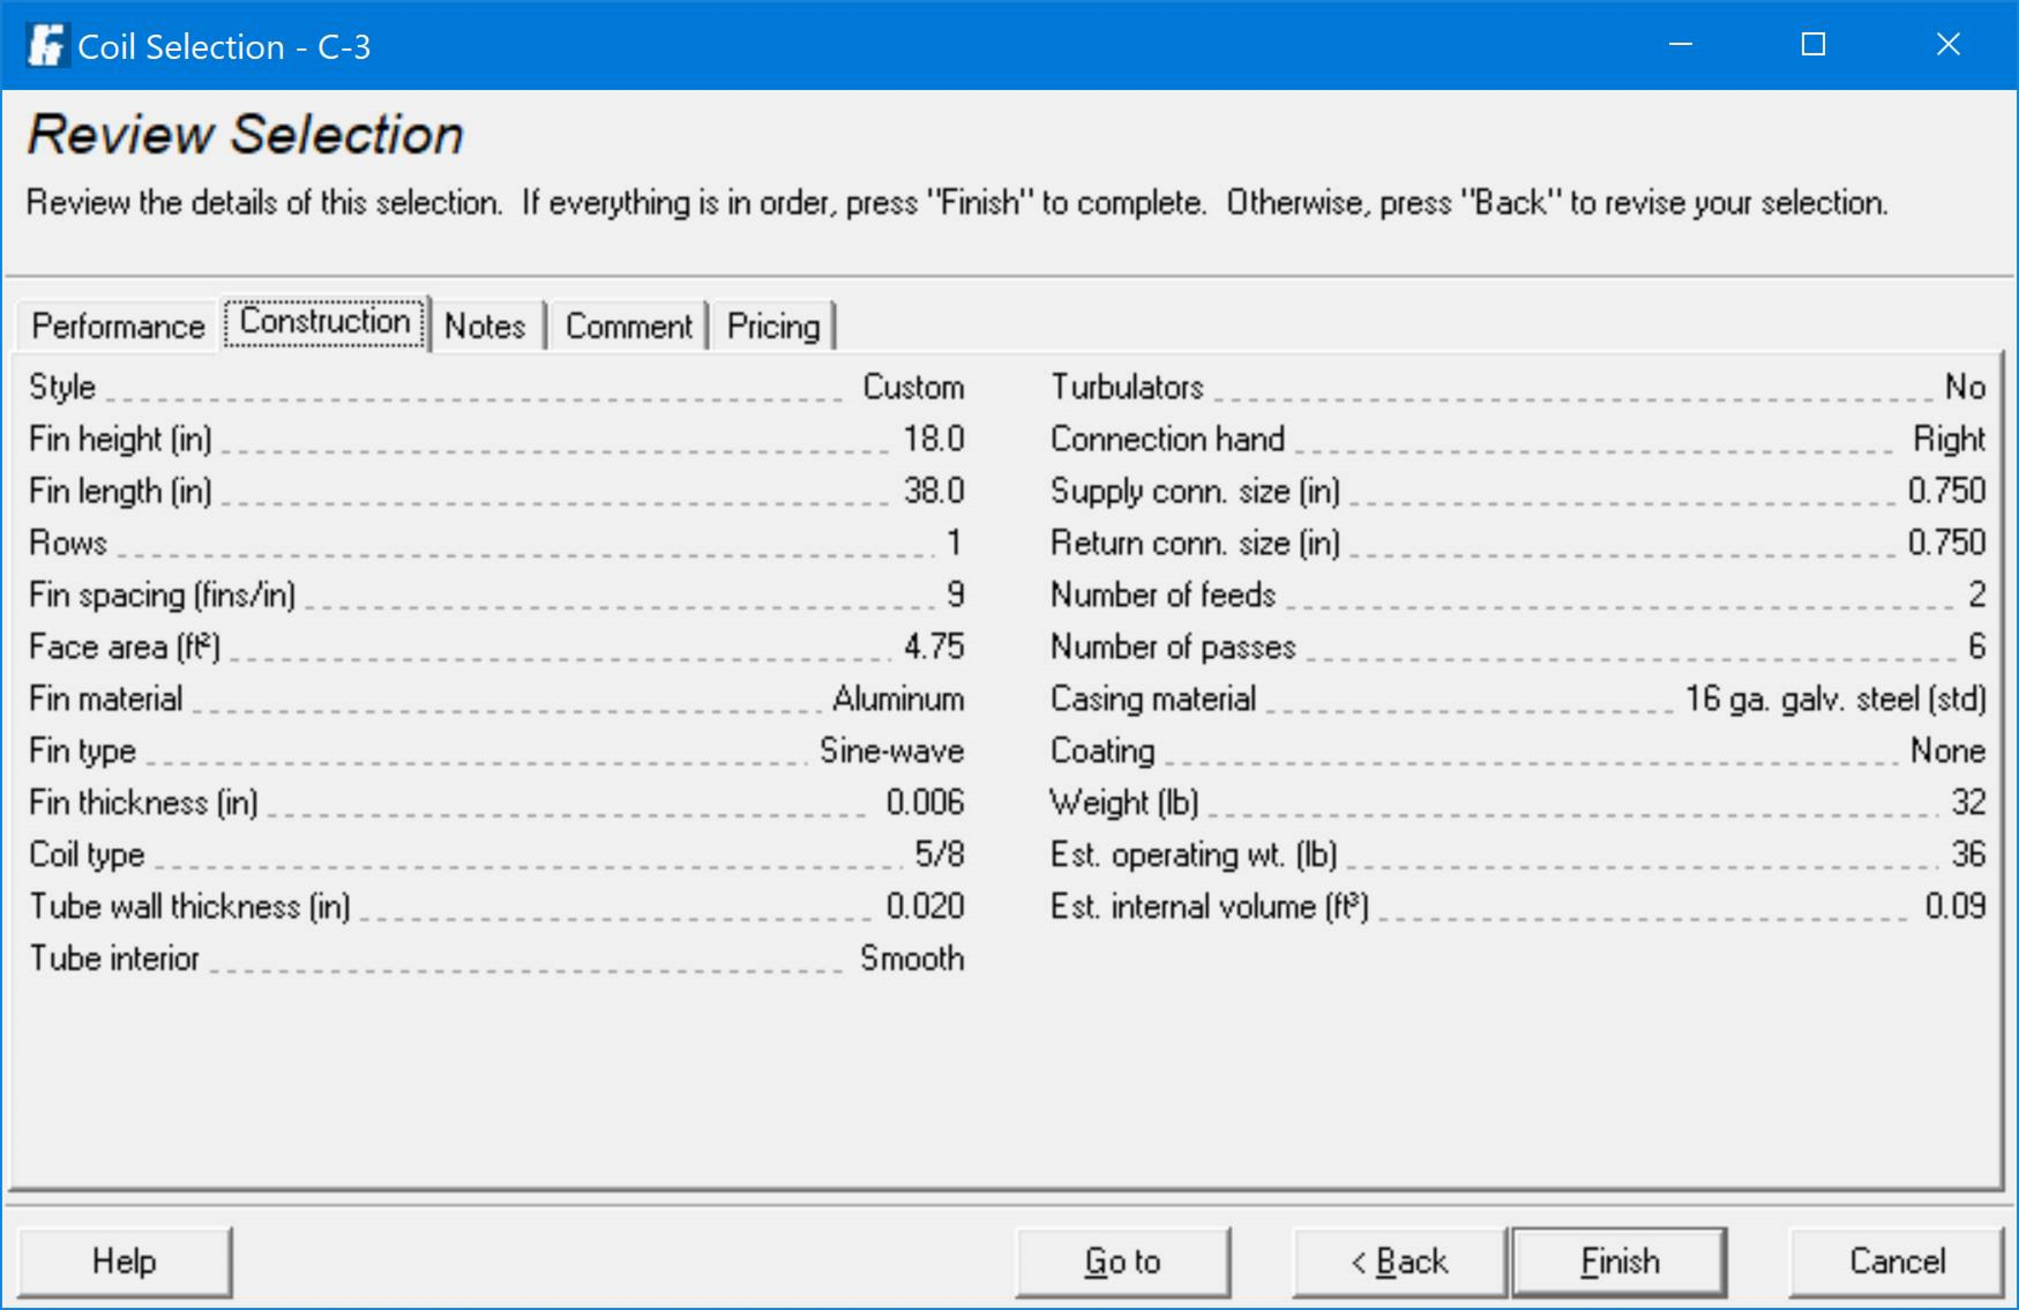
EBCx Project Results
An expanded reset schedule has the potential to improve comfort by better managing FTR capacity
Reheat loads could be served with 110°F water
Reset savings = $2,000 per year in parasitic losses

Slide 12
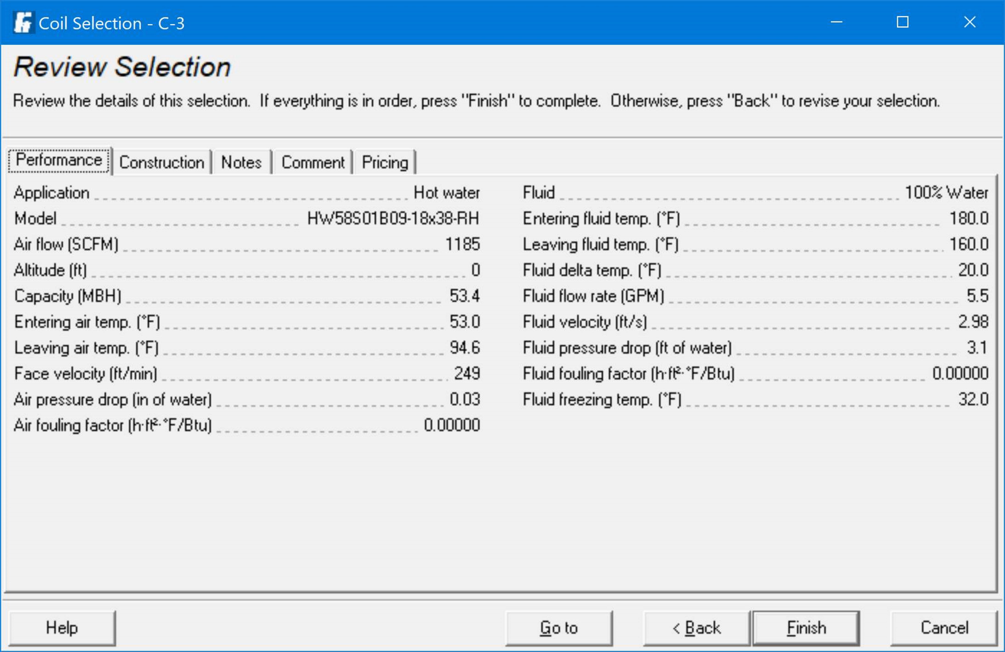
EBCx Project Results
An expanded reset schedule has the potential to improve comfort by better managing FTR capacity
Reheat loads could be served with 110°F water
Reset savings = $2,000 per year in parasitic losses

Slide 13

EBCx Project Results
An expanded reset schedule has the potential to improve comfort by better managing FTR capacity
Reheat loads could be served with 110°F water
Reset savings = $2,000 per year in parasitic losses

Slide 14
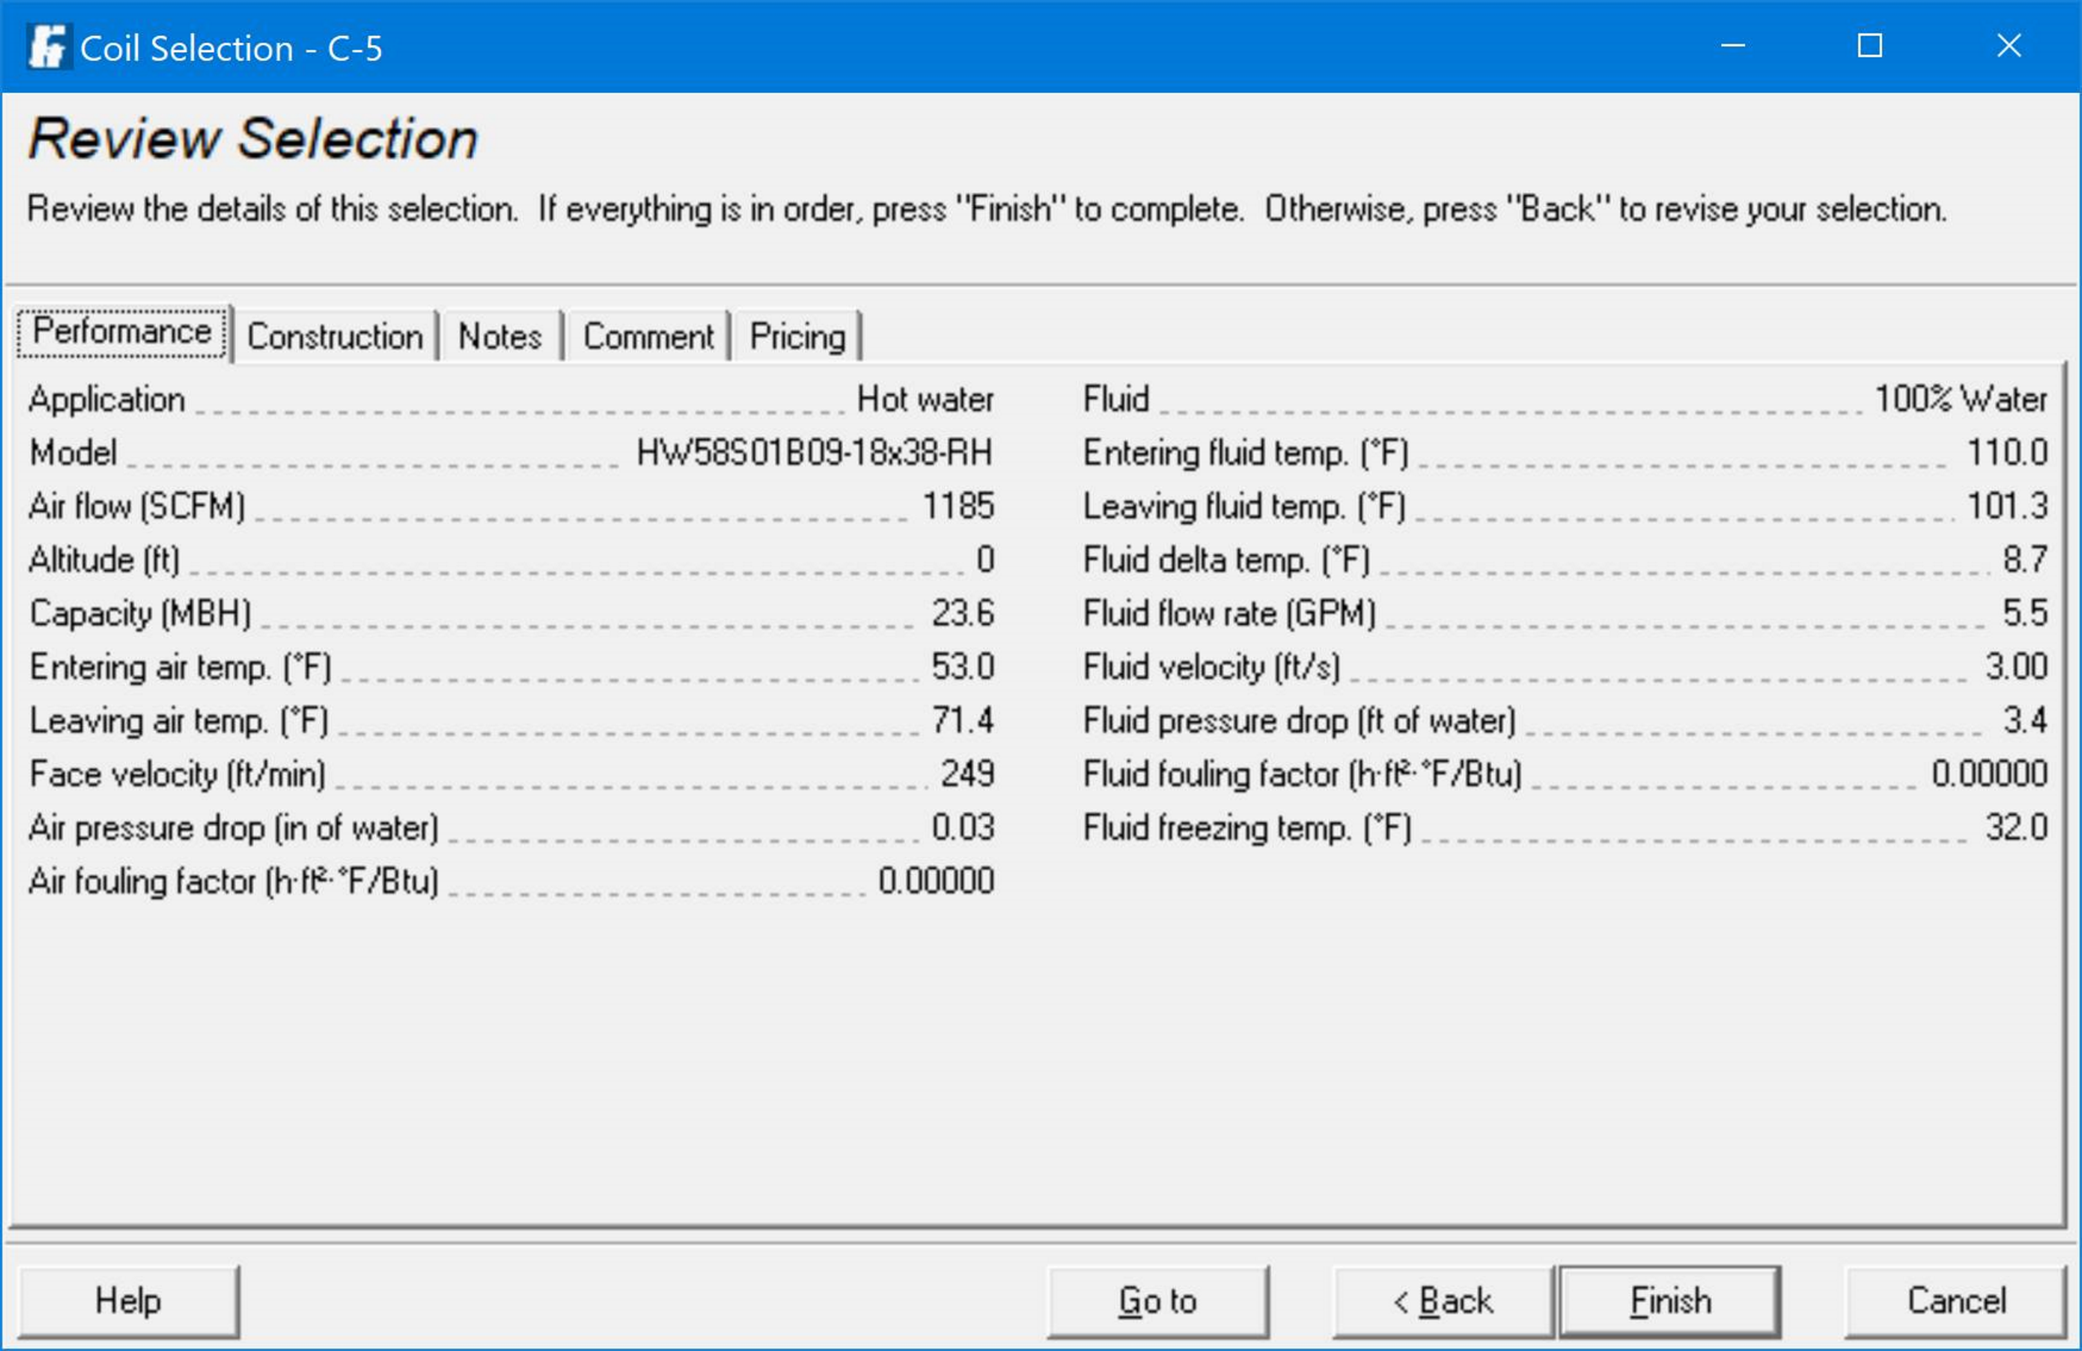
EBCx Project Results
An expanded reset schedule has the potential to improve comfort by better managing FTR capacity
Reheat loads could be served with 110°F water
Reset savings = $2,000 per year in parasitic losses

Slide 15
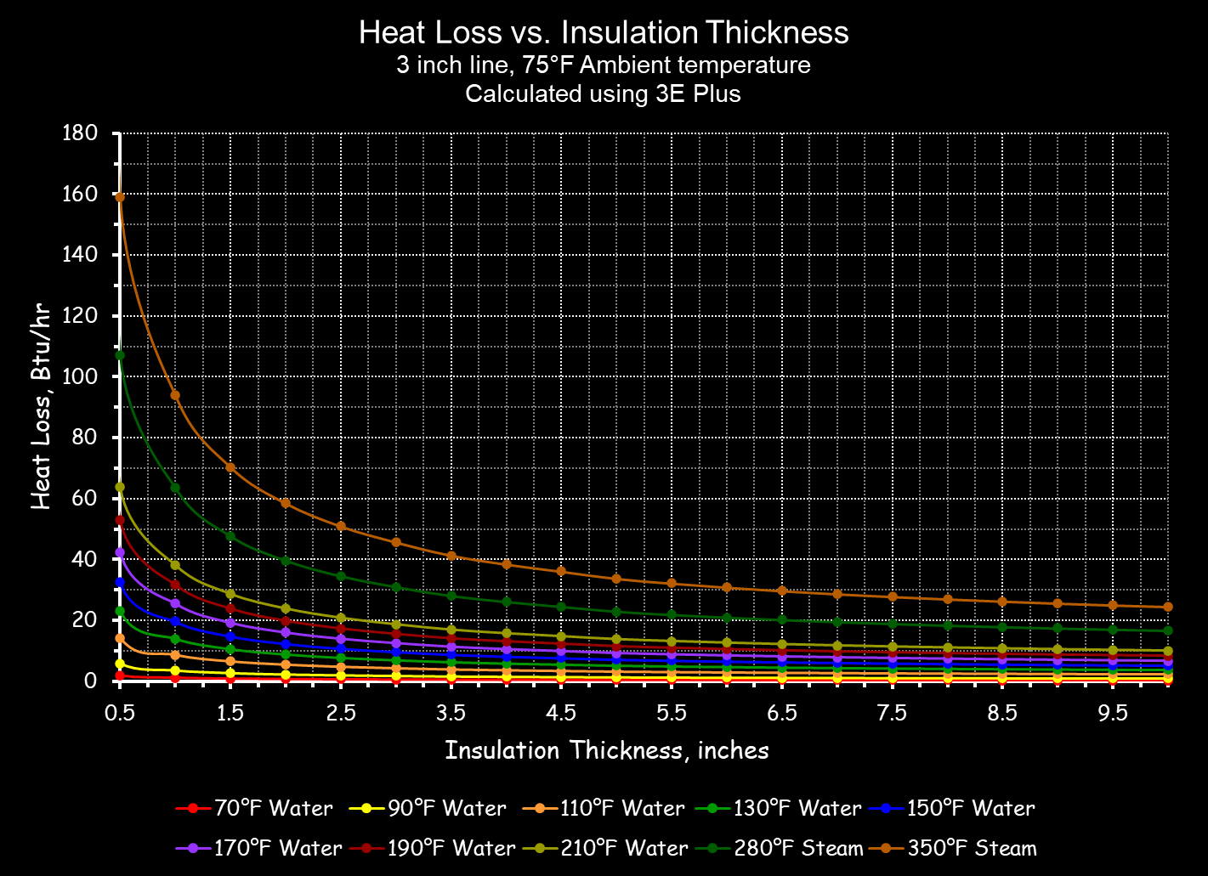
EBCx Project Results
An expanded reset schedule has the potential to improve comfort by better managing FTR capacity
Reheat loads could be served with 110°F water
Expanding the reset schedule yields savings of $2,000 per year in parasitic losses

Slide 16
EBCx Project Results
An expanded reset schedule has the potential to improve comfort by better managing FTR capacity
Reheat loads could be served with 110°F water
Reset savings = $2,000 per year in parasitic losses

Slide 17
Three way control valve
Butterfly valve
Steam trap
PT
Pressure Transmitter
BIMCOM
Supreme Command Facility
Alternative Shape Analysis Command
Ames Research Facility
Heating Hot Water System
Two way control valve
Check valve
Temperature transmitter with well
Pressure reducing valve
Thermometer with well
TT
Balance valve
Pressure gauge with isolation valve
DP
Differential pressure transmitter with isolation valves
Ball valve
Pressure relief valve
TT
1st Floor Reheat Loads; Nominal gpm for the floor = 36.5 gpm
Boiler/Pump (Typical)
Laars Mighty Therm
Input – 1,670,000 Btu/hr
Output – 1,396,000 Btu/hr
Flow – 120 gpm
Pressure drop – 1.5 ft.w.c.
EWT – 157°F
LWT – 180°F
15 amp 1 ph 120 vac
Bell and Gossett
656S ECM
120 gpm at 3.3 ft.w.c.
1.12 bhp
1725 rpm
Normally Open to the Coil
1st Floor Finned Tube Radiation
TT
TT
Normally Open
Normally Open to the Coil
Boiler 1
Boiler 2
Capacity – 586,200 Btu/hr
6 ft. high x 8 ft. wide
Air Side
Flow rate = 22,306 cfm
Entering air temperature – 62.0°F
Leaving air temperature – 86.3°F
Pressure drop – 0.09 in.w.c.
Water Side
Flow rate = 29.8 gpm
Entering water temperature – 180.0°F
Leaving water temperature – 140.0°F
Pressure drop – 4.4 ft.w.c.
Typical for 2 AHUs (East and West)
Typical of 4 circuits
Vulcan LV4-S, VC433, 1" line size, 4-1/4" x 3-5/8" fins, 32 fins per foot, 0.20 thick fins, 14" enclosure, single tier, 18" mounting height, 816 Btu/hr/ft;
243 feet of active element in four circuits of 7.2 gpm each, 28.8 total gpm, 14°F ∆t, 170°F average water temperature, 156°F return
Capacity – Varies
Air Side
Flow rate = Varies, 500 fpm maximum face velocity
Entering air temperature – 53.0°F
Leaving air temperature – 82 °F
Pressure drop – 0.1 in.w.c. maximum
Water Side
Flow rate = Varies
Entering water temperature – 180.0°F
Leaving water temperature – 140.0°F
Pressure drop – 5 ft.w.c. maximum.
Warm-up Coil
Reheat Coil (Typical of 5)
DP
DP
FTR and Rheat Typical for 5 Floors
TT
TT
TT
TT
TT
TT
Bell and Gossett 2.5BB
240 gpm at 45.6 ft.w.c.
71.15% Efficiency
1,750 rpm, 3.9 Bhp, 5hp motor
(Typical for each pump)
Diaphragm type expansion tank
Cold water make-up from a back flow preventer
DP
Pump 2
DP
Pump 1
PT
Notes:
Bell and Gossett 2AD-es Flow - 87.4 Head - 45.6 Speed - 1,750 Bhp - 1.3 Efficiency - 75.9% Motor hp - 2

Slide 18
Facility Operations Request
Prepare and RFP to replace the existing boiler with the current model rated for the same capacity
If possible, capture the savings identified by the EBCx project

Slide 19
Boiler Break-out Session 1
Given
The preceding information
The local climate (next slide and TMY file)
Annual gas cost of $25,200
Field data suggests existing boiler efficiency has degraded to 70-75%
A requirement to secure a minimum of three bids
A requirement to go with the low bidder
A requirement for an open equipment specification (not flat specs; the “Or Equal” clause is mandated)
Do you think a like for like replacement is the best option?
  If no, what other options should be considered?
No matter what boiler is selected, what items should the RFP address and/or include to ensure:
  Efficiency optimization is maximized
  The Facility Operation team’s needs are met
  Key installation and performance issues are addressed
  All bidders “see” the project the same way

Slide 20
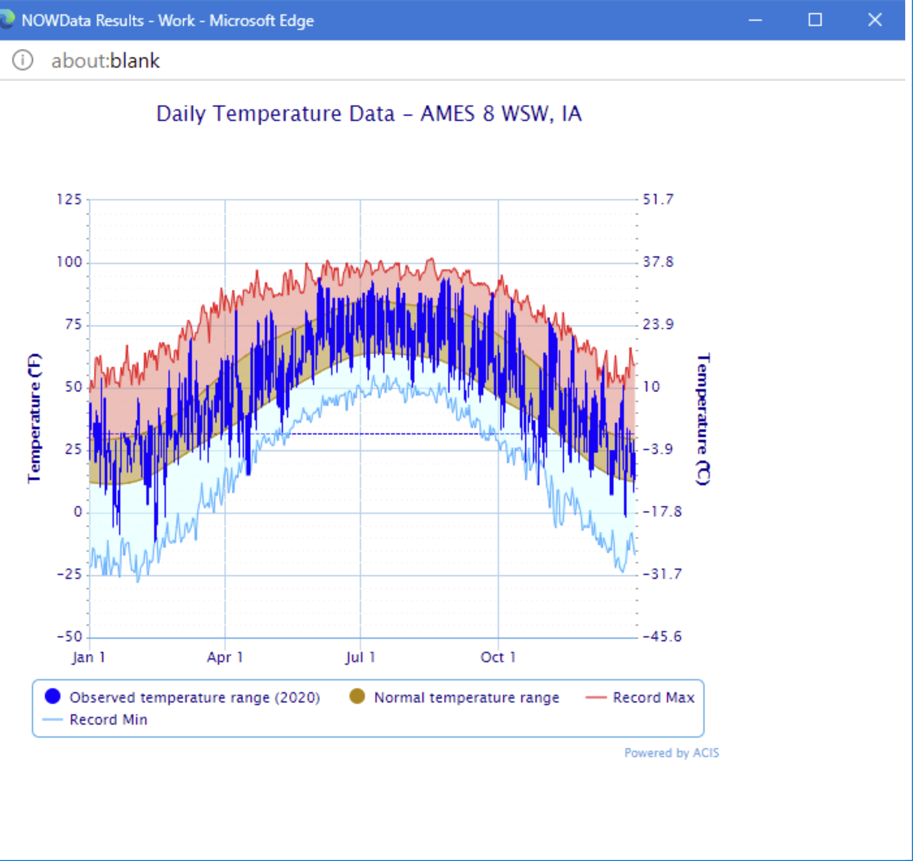
Climate Data
Probably not the actual location
For security reasons, we can not disclose where the facility is.
But if we were allowed, we would tell you it was near Ames, Iowa.
Unfortunately, we can not say that, so you are on your own.

Slide 21
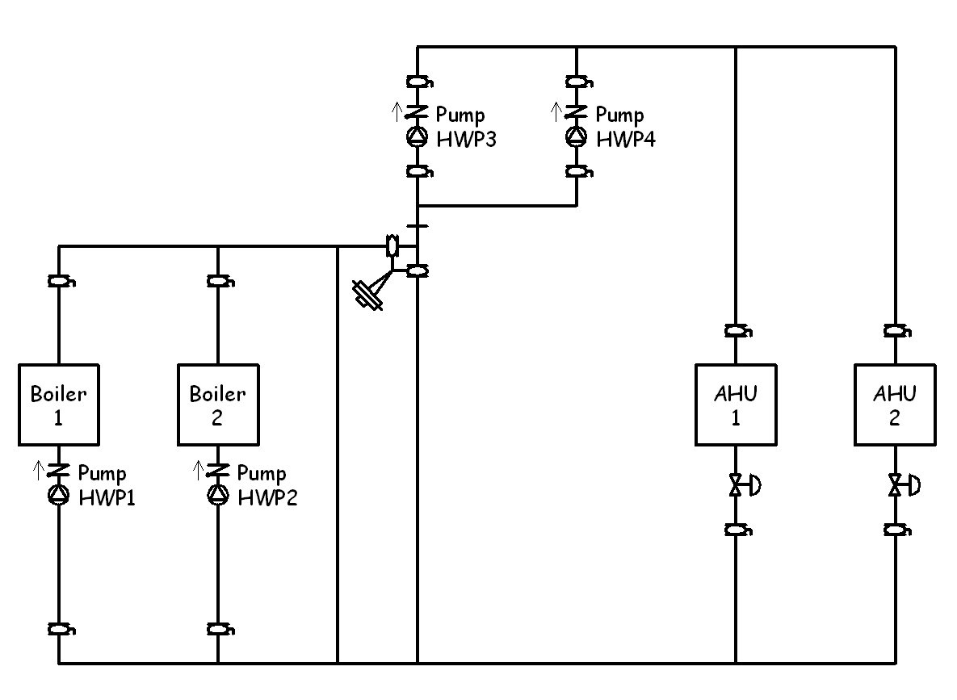
Variable Flow Connection that Keeps the Boilers Hot While the Loop Does “What-Ever”
Non-condensing boilers piped in a constant volume loop and operate at a constant flow at a safe (non-condensing) temperature (typically 140°F)
Variable flow distribution loop sees flow that varies with load
Three way valve mixes water from the boiler loop with water returning from the loads to provide supply temperatures at or below the boiler loop temperature

Slide 22
Boiler Piping

Slide 24
Boiler Break-out Session 2
Given
The basis of design boiler information
Basis of design requirements
  System diagram that follows
  Ability to reset supply LWT to 110°F is the design target/incentive basis
    EWT range of 90 - 101°F under that condition
  Cx process hopes to get to a 95°F LWT temperature under some conditions
    EWT range of 75 - 86°F under that condition
The proposed “equal” substitution by the contractor
Is the proposed substitution equivalent to the basis of design boiler?
If not, what could you do about it?

Slide 25
Three way control valve
Butterfly valve
Steam trap
PT
Pressure Transmitter
BIMCOM
Supreme Command Facility
Alternative Shape Analysis Command
Ames Research Facility
Heating Hot Water System
Two way control valve
Check valve
Temperature transmitter with well
Pressure reducing valve
Thermometer with well
TT
Balance valve
Pressure gauge with isolation valve
DP
Differential pressure transmitter with isolation valves
Ball valve
Pressure relief valve
TT
1st Floor Reheat Loads; Nominal gpm for the floor = 36.5 gpm
Boiler/Pump (Typical)
Aerco Benchmark 1.5
Input – 1,500,000 Btu/hr
Output – 1,395,000 Btu/hr
Flow – 43.7 gpm
Pressure drop – 6.5 ft.w.c.
EWT – 157°F
LWT – 180°F
Turn down ratio – 14:1
13 fla at 120 vac 1 phase
Bell and Gossett
611
120 gpm at 11 ft.w.c.
.84 bhp, 1hp motor
1750 rpm
Normally Open to the Coil
1st Floor Finned Tube Radiation
TT
TT
Normally Open
Normally Open to the Coil
Boiler 1
Boiler 2
Capacity – 586,200 Btu/hr
6 ft. high x 8 ft. wide
Air Side
Flow rate = 22,306 cfm
Entering air temperature – 62.0°F
Leaving air temperature – 86.3°F
Pressure drop – 0.09 in.w.c.
Water Side
Flow rate = 29.8 gpm
Entering water temperature – 180.0°F
Leaving water temperature – 140.0°F
Pressure drop – 4.4 ft.w.c.
Typical for 2 AHUs (East and West)
Typical of 4 circuits
Vulcan LV4-S, VC433, 1" line size, 4-1/4" x 3-5/8" fins, 32 fins per foot, 0.20 thick fins, 14" enclosure, single tier, 18" mounting height, 816 Btu/hr/ft;
243 feet of active element in four circuits of 7.2 gpm each, 28.8 total gpm, 14°F ∆t, 170°F supply, 156°F return
Capacity – Varies
Air Side
Flow rate = Varies, 500 fpm maximum face velocity
Entering air temperature – 53.0°F
Leaving air temperature – 82 °F
Pressure drop – 0.1 in.w.c. maximum
Water Side
Flow rate = Varies
Entering water temperature – 170.0°F
Leaving water temperature – 150.0°F
Pressure drop – 5 ft.w.c. maximum.
See also Note 1 on sheet 2
Warm-up Coil
Reheat Coil (Typical of 5)
DP
DP
FTR and Rheat Typical for 5 Floors
TT
TT
TT
TT
TT
TT
Bell and Gossett 2.5BB
240 gpm at 45.6 ft.w.c.
71.15% Efficiency
1,750 rpm, 3.9 Bhp, 5hp motor
(Typical for each pump)
Diaphragm type expansion tank
Cold water make-up from a back flow preventer
DP
Pump 2
DP
Pump 1
PT
Notes:
Bell and Gossett 2AD-es Flow - 87.4 Head - 45.6 Speed - 1,750 Bhp - 1.3 Efficiency - 75.9% Motor hp - 2

