Slide 1
2020 RCx Academy
Week 1
Kick-off
13 MAY 2020

Slide 2
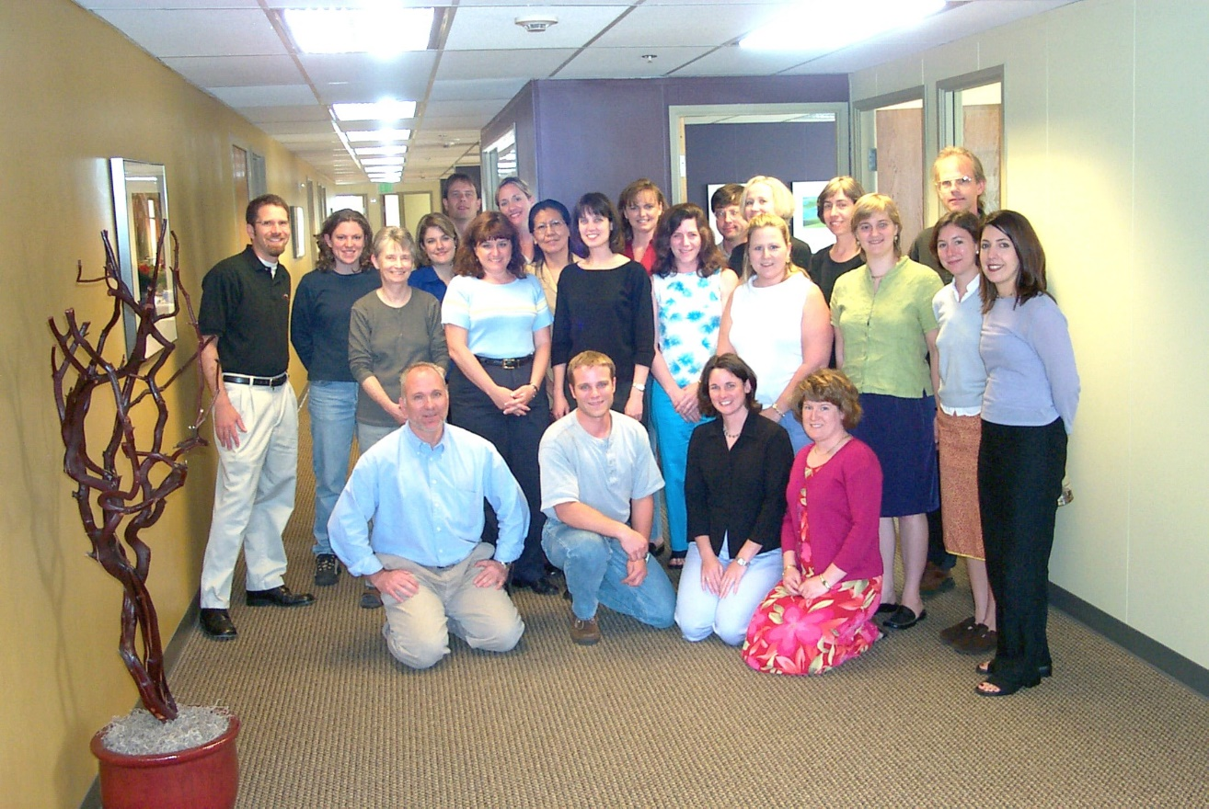
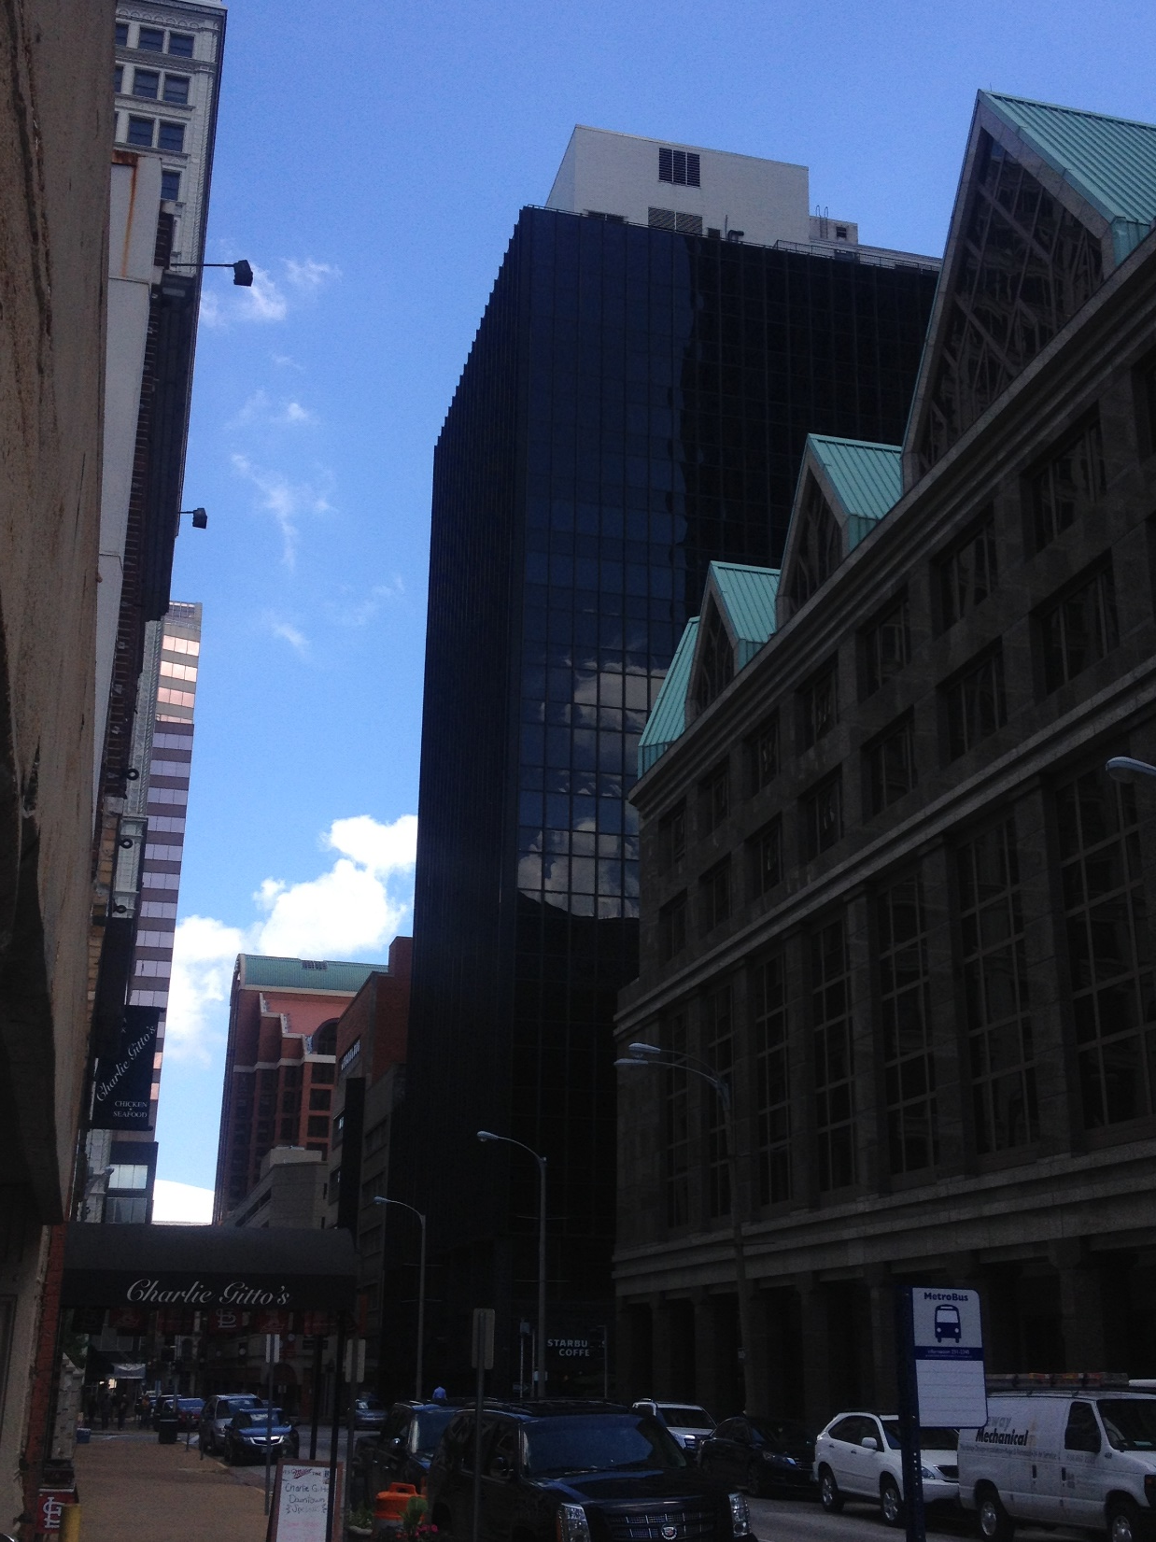
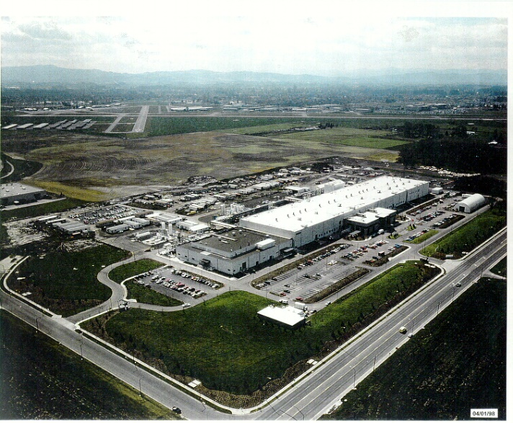
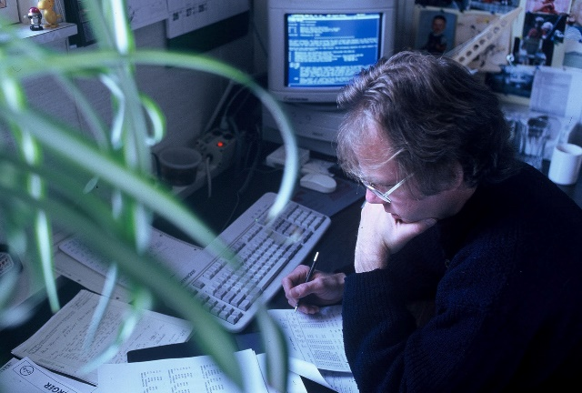
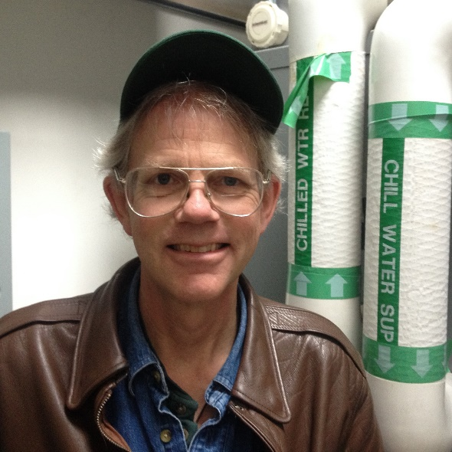
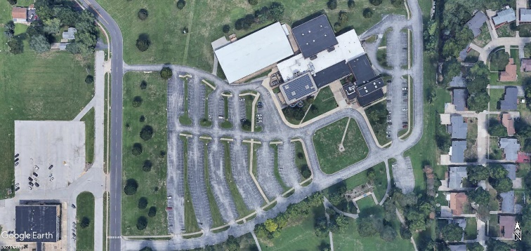
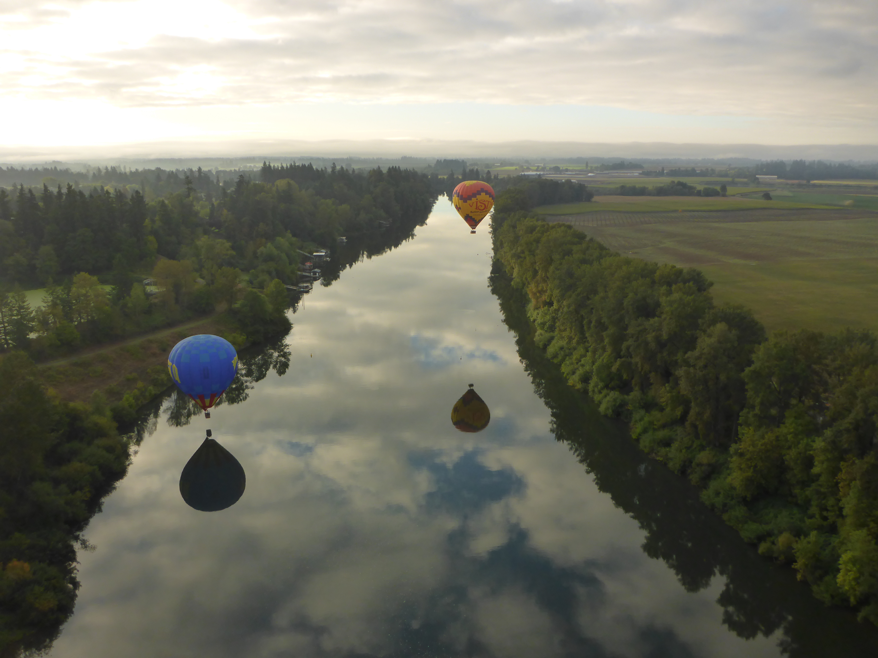
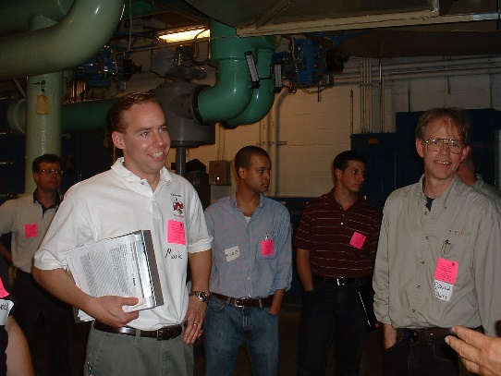
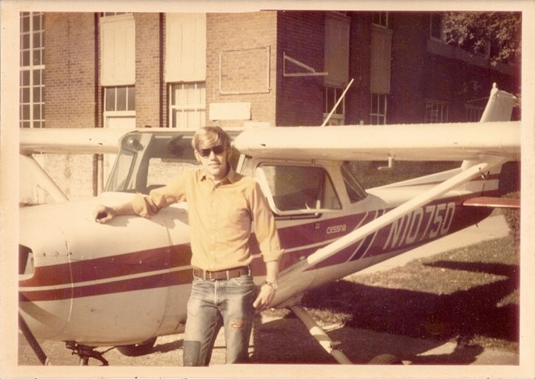
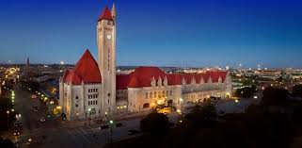
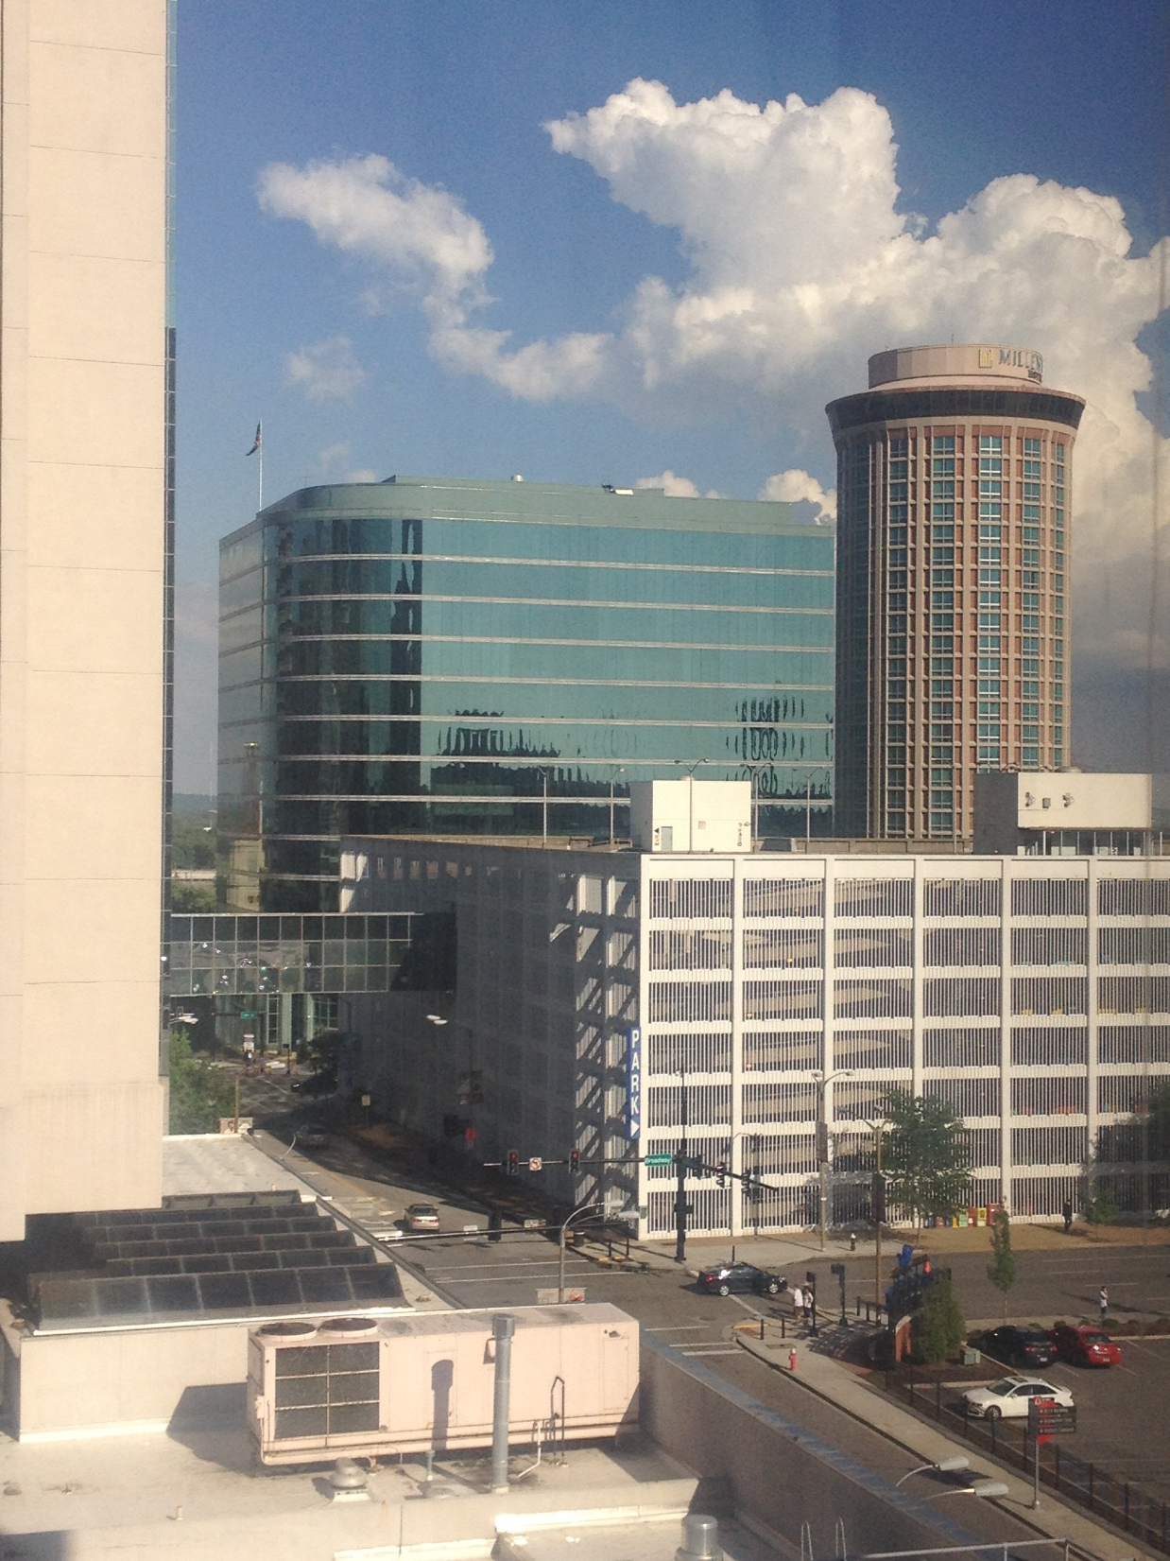
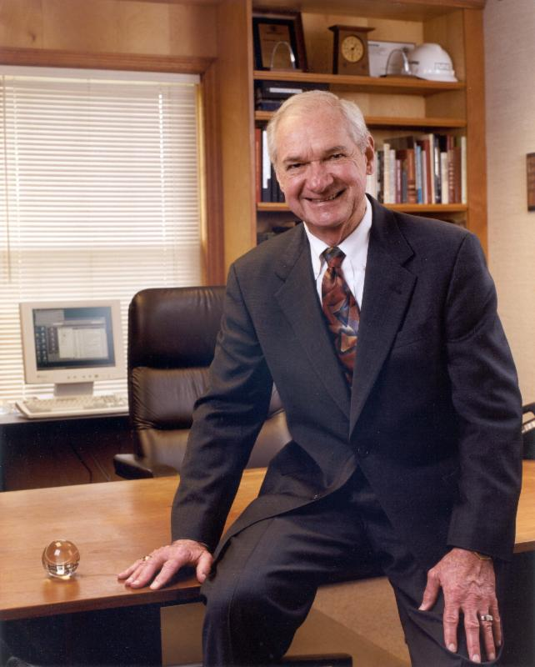
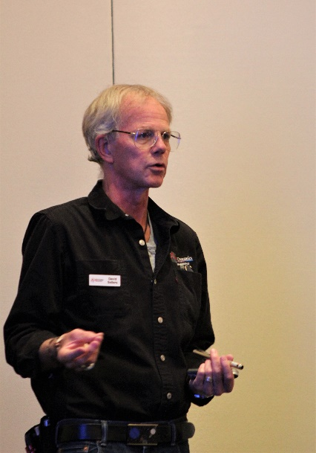
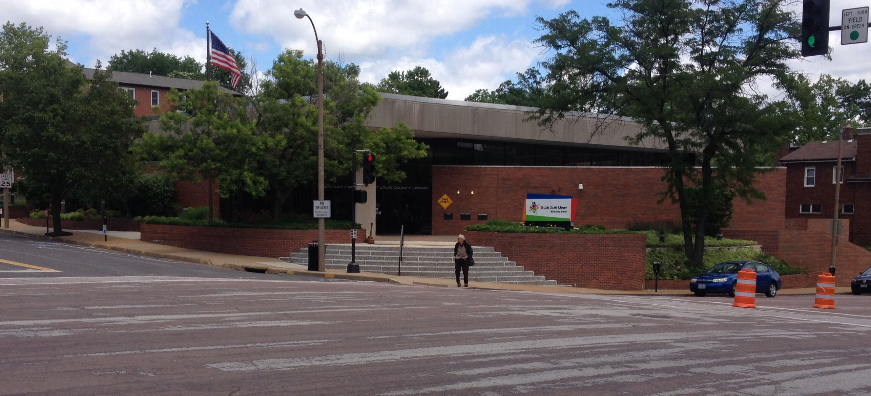
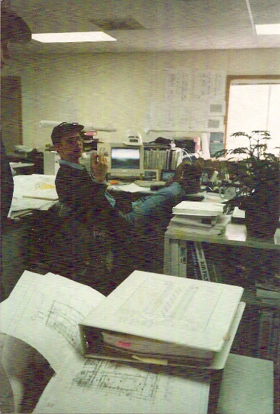
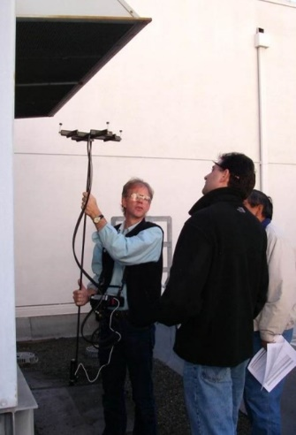
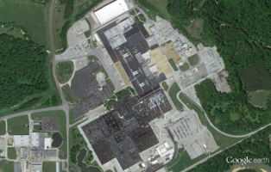
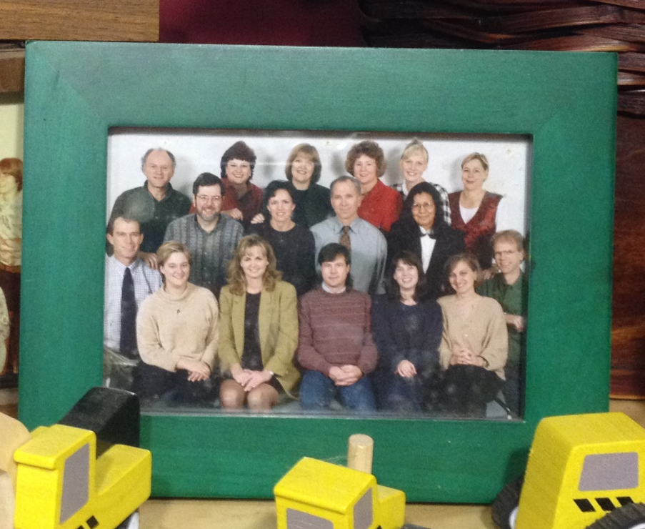
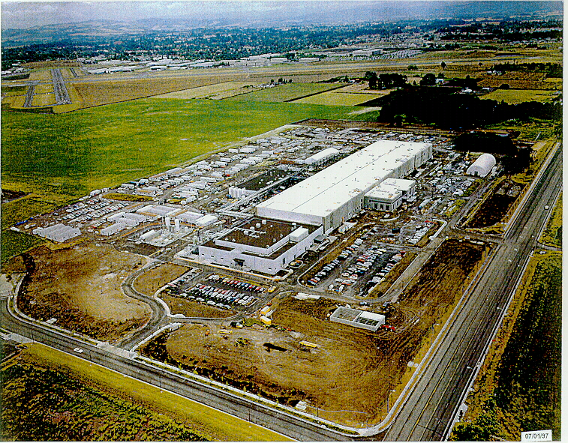
A Bit About Me
I intended to be an aircraft maintenance engineer ...

Slide 3
A Bit About Me
I intended to be an aircraft maintenance engineer …
… but became inspired about energy efficiency and building systems

Slide 4
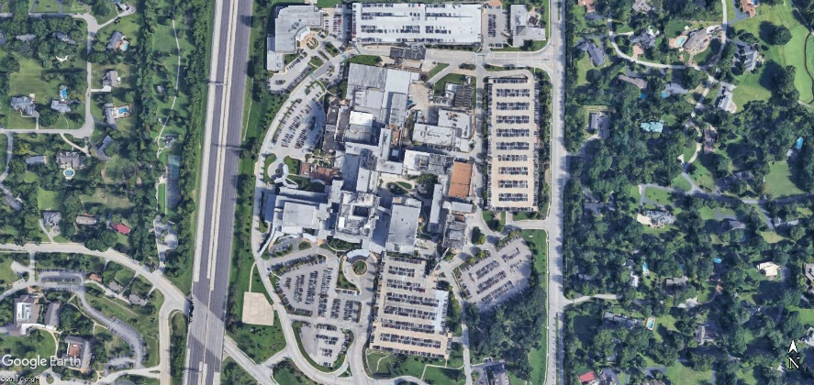

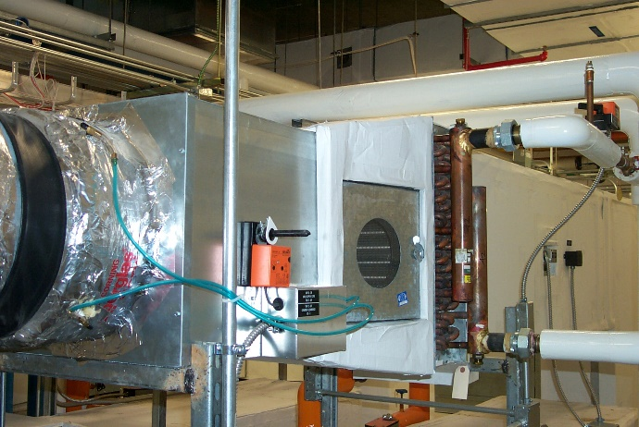
I’m Doing Something Totally Different
I intended to be an aircraft maintenance engineer
  How many of you are doing what you went to school to learn to do?
(Go to https://tinyurl.com/PVequalsmRT for more pictures and videos from the balloon flight)

Slide 5
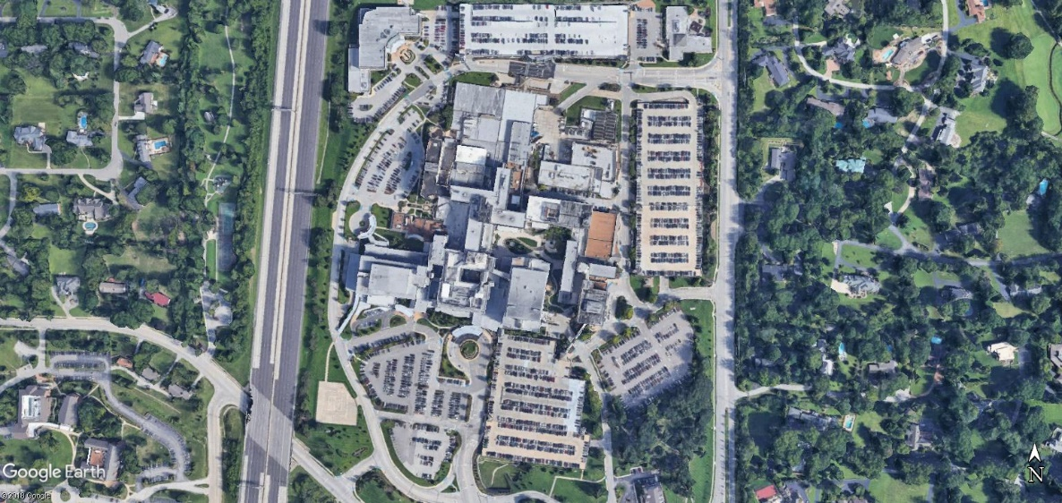



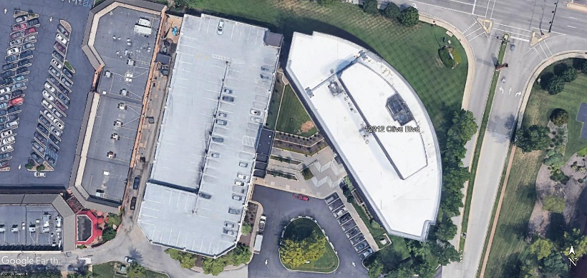
I’m Doing Something Totally Different
I intended to be an aircraft maintenance engineer
  How many of you are doing what you went to school to learn to do?
(Go to https://tinyurl.com/PVequalsmRT for more pictures and videos from the balloon flight)

Slide 6
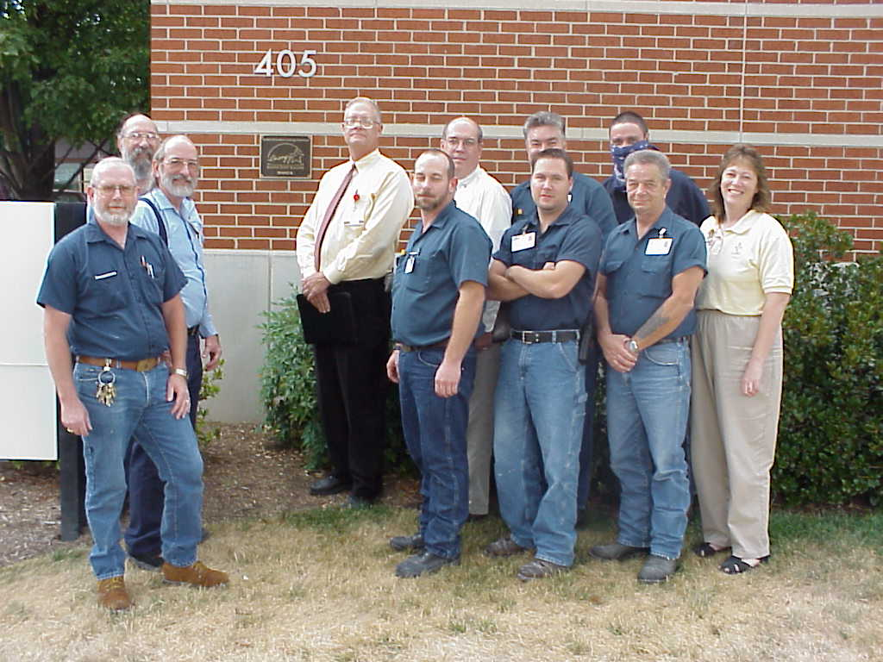
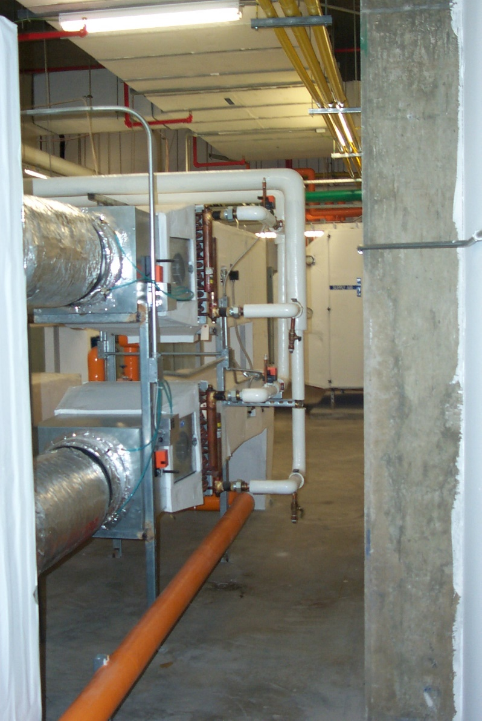
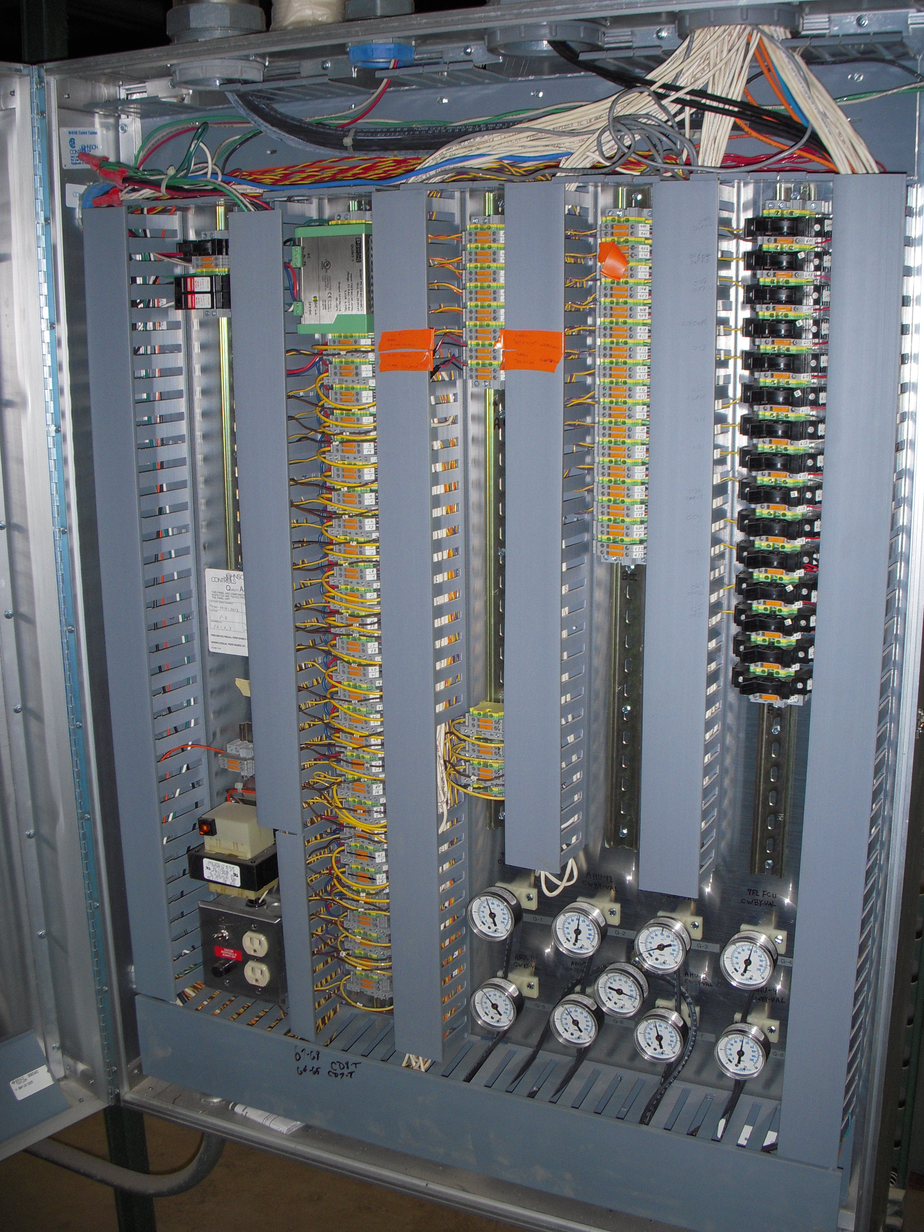


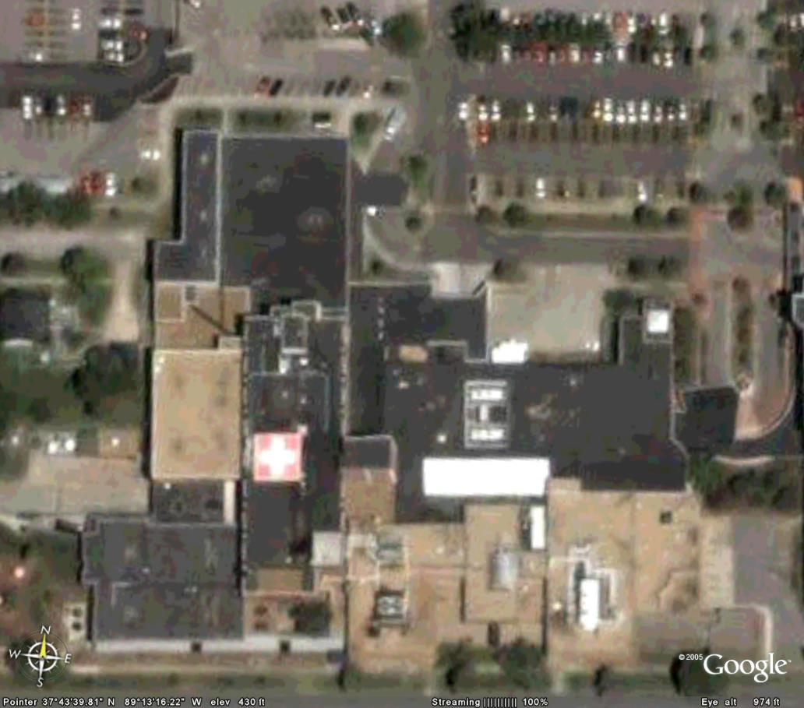
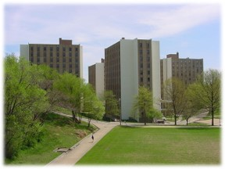
I’m Doing Something Totally Different
I intended to be an aircraft maintenance engineer
  How many of you are doing what you went to school to learn to do?
(Go to https://tinyurl.com/PVequalsmRT for more pictures and videos from the balloon flight)

Slide 7
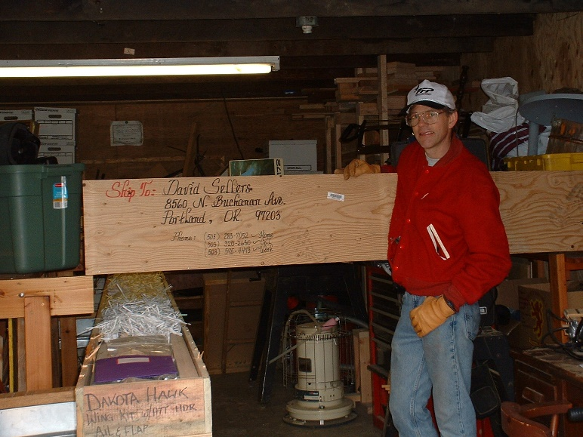

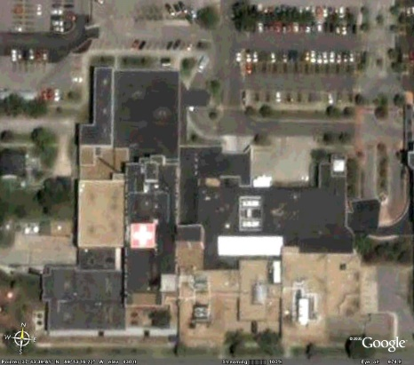


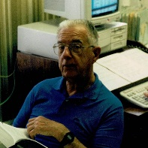
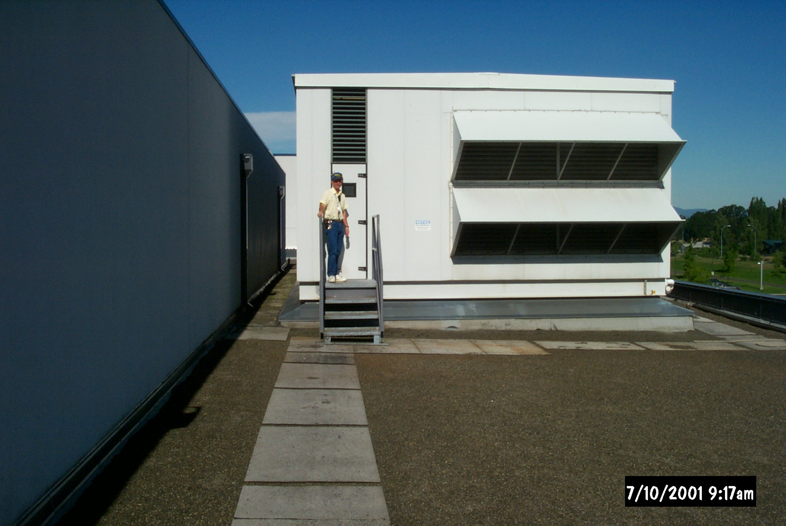
I’m Doing Something Totally Different
I intended to be an aircraft maintenance engineer
  How many of you are doing what you went to school to learn to do?
(Go to https://tinyurl.com/PVequalsmRT for more pictures and videos from the balloon flight)

Slide 8
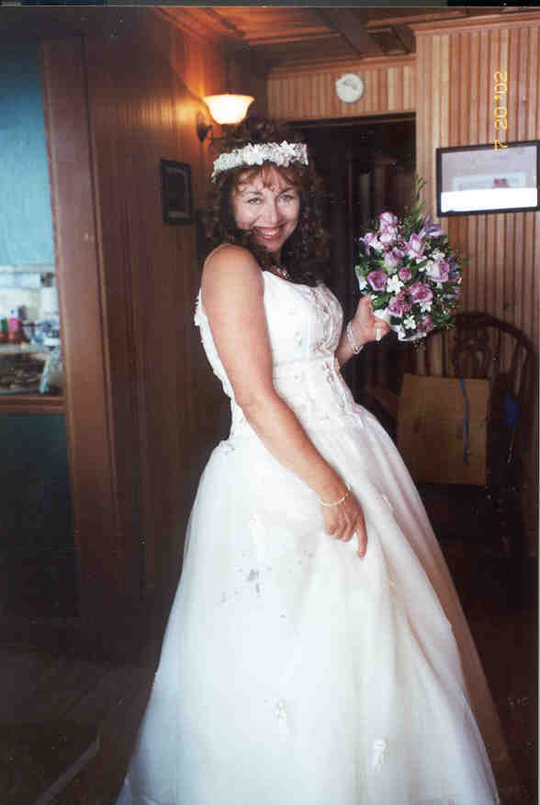


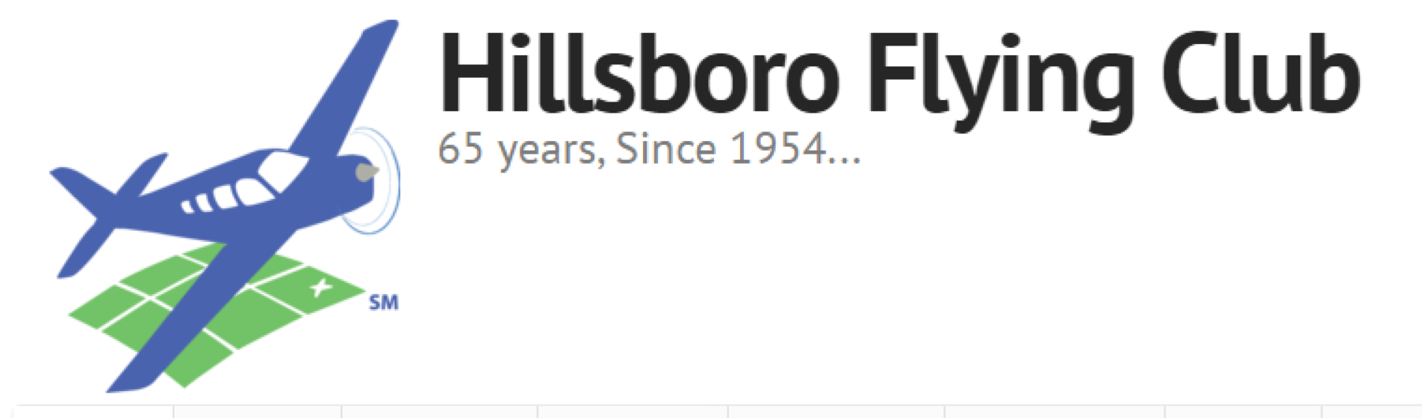
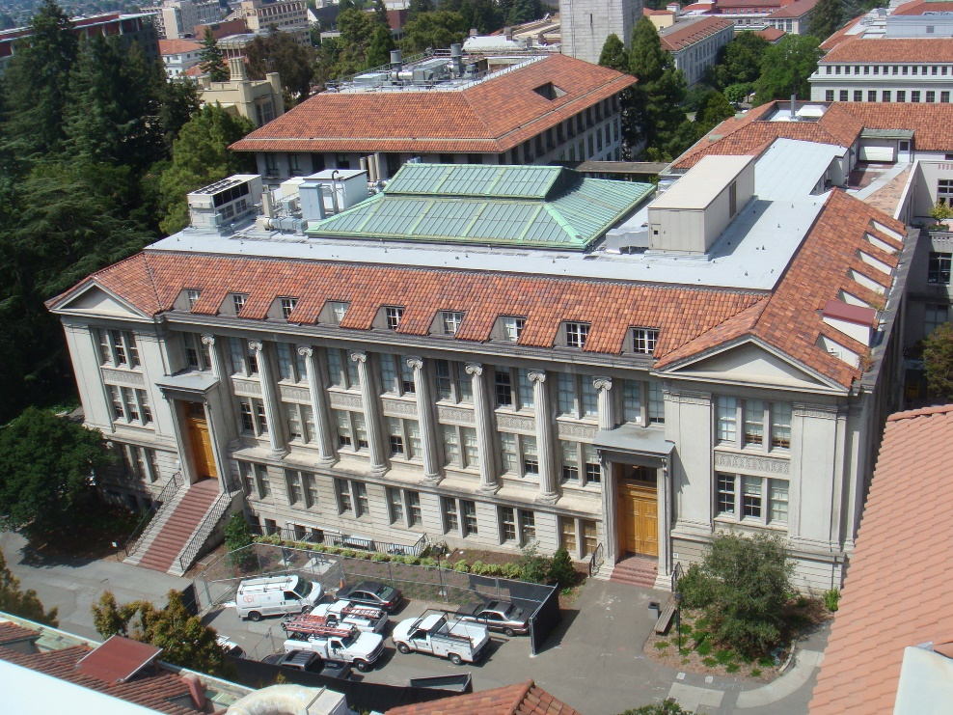

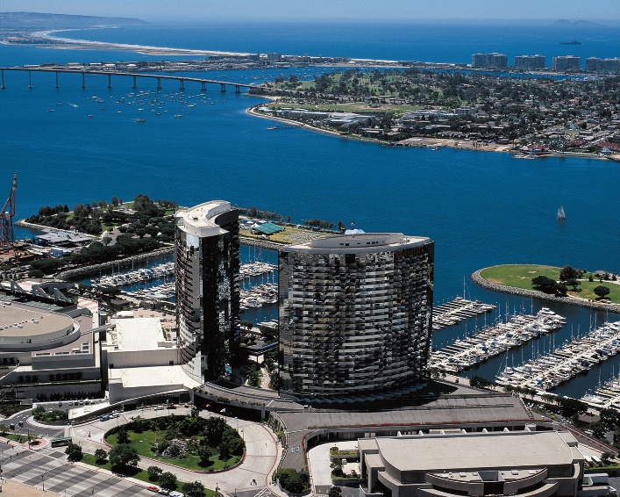

I’m Doing Something Totally Different
I intended to be an aircraft maintenance engineer
  How many of you are doing what you went to school to learn to do?
(Go to https://tinyurl.com/PVequalsmRT for more pictures and videos from the balloon flight)

Slide 9

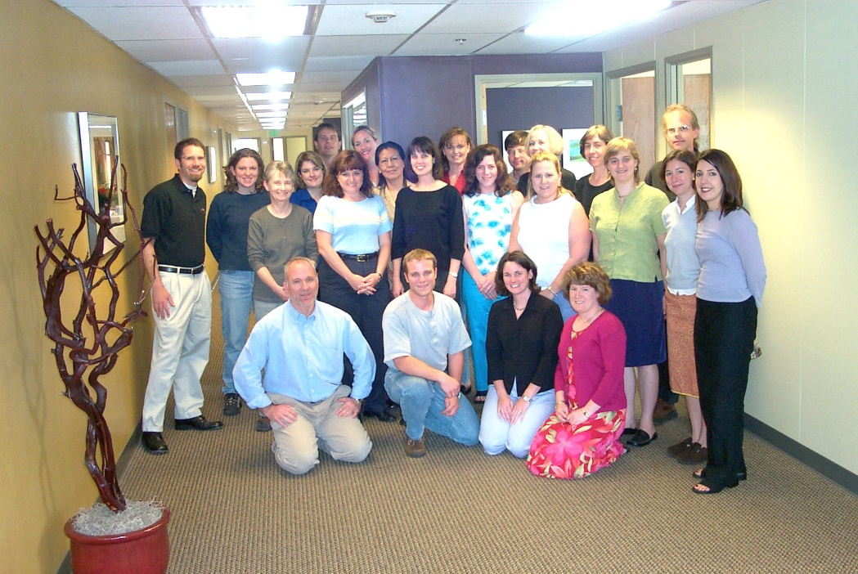

I’m Doing Something Totally Different
I intended to be an aircraft maintenance engineer
  How many of you are doing what you went to school to learn to do?
(Go to https://tinyurl.com/PVequalsmRT for more pictures and videos from the balloon flight)

Slide 10

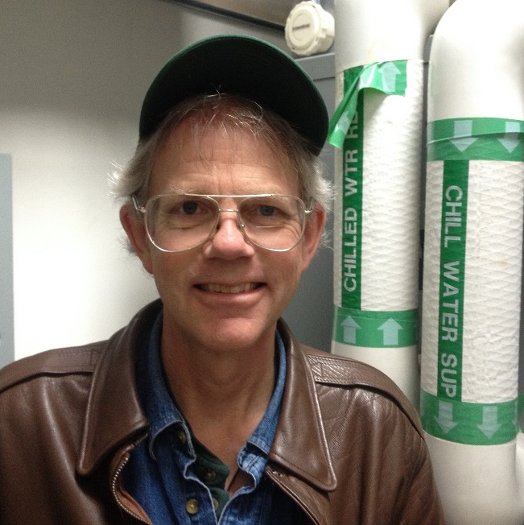



I’m Doing Something Totally Different
I intended to be an aircraft maintenance engineer
  How many of you are doing what you went to school to learn to do?
(Go to https://tinyurl.com/PVequalsmRT for more pictures and videos from the balloon flight)

Slide 11
I’m Doing Something Totally Different
I intended to be an aircraft maintenance engineer
  How many of you are doing what you went to school to learn to do?
(Go to https://tinyurl.com/PVequalsmRT for more pictures and videos from the balloon flight)

Slide 12

I’m Doing Something Totally Different
I intended to be an aircraft maintenance engineer
  How many of you are doing what you went to school to learn to do?
(Go to https://tinyurl.com/PVequalsmRT for more pictures and videos from the balloon flight)
(Go to https://tinyurl.com/PVequalsmRT for more pictures and videos from the balloon flight)

Slide 13
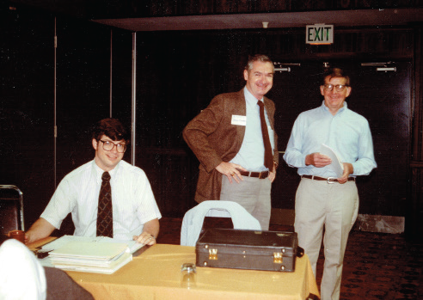
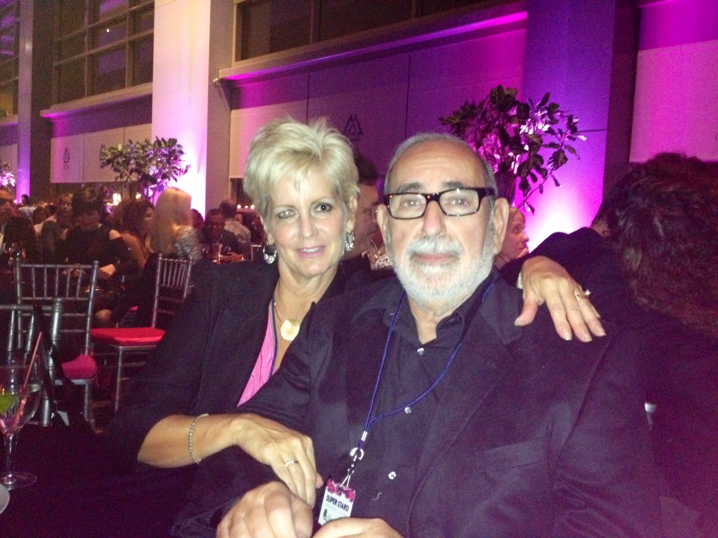
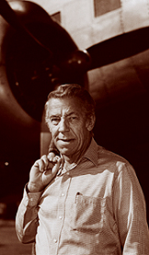

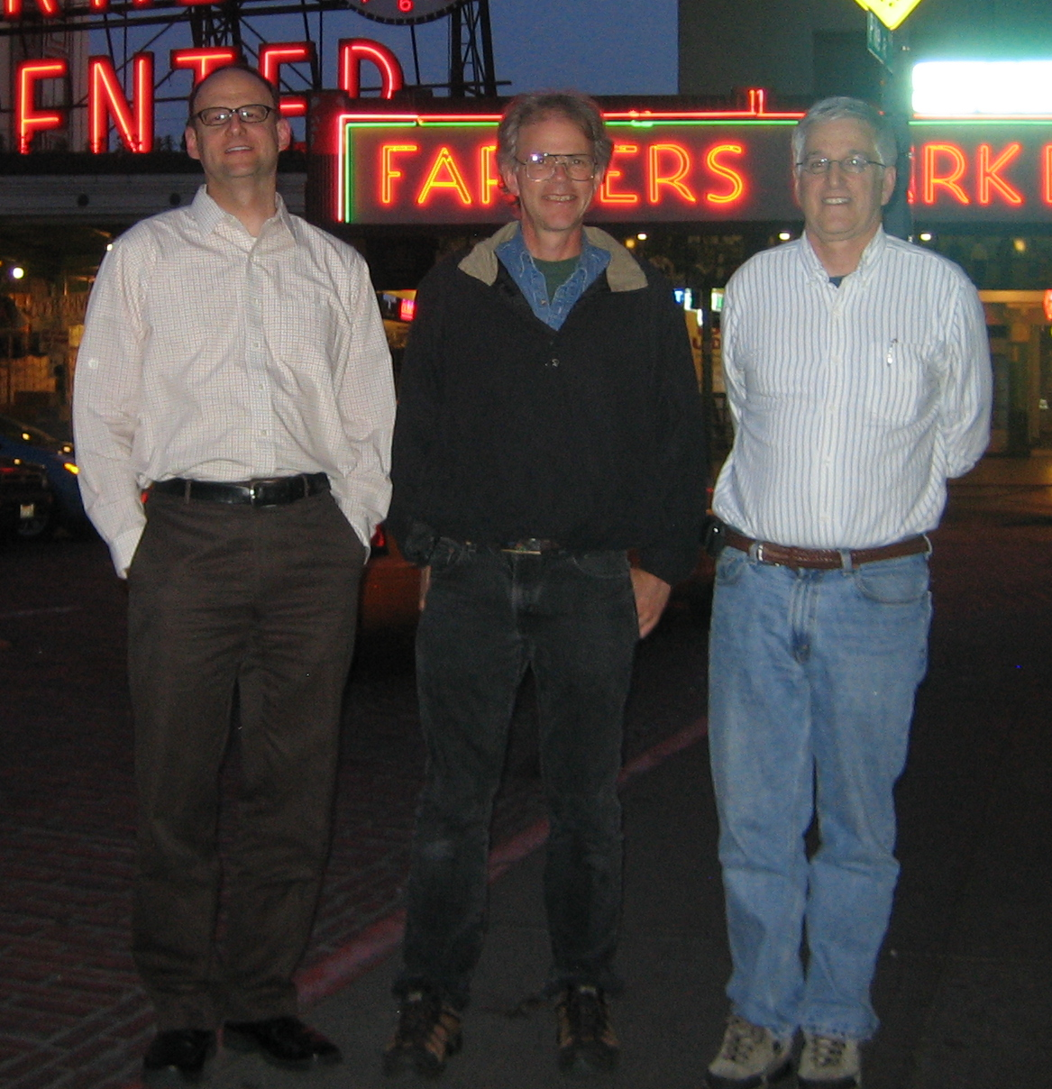
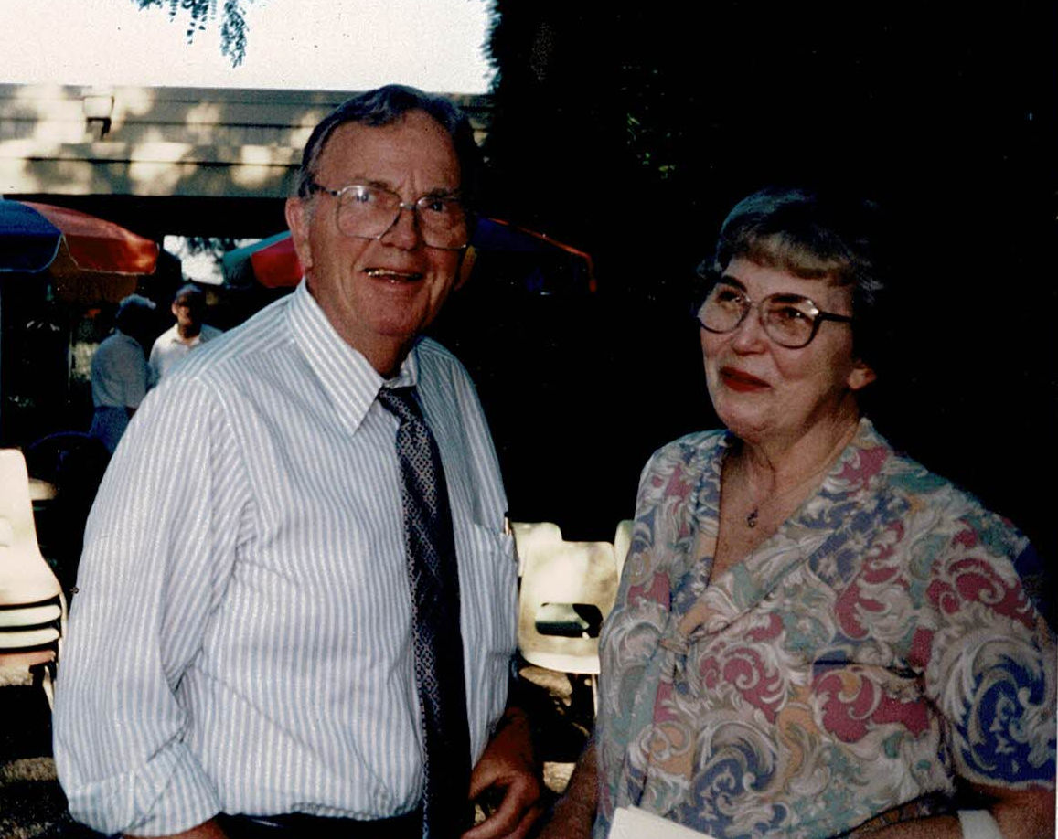
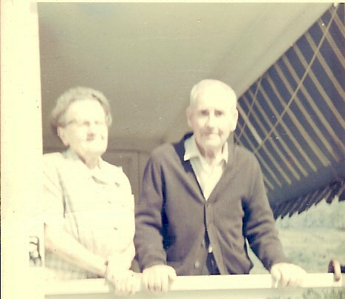
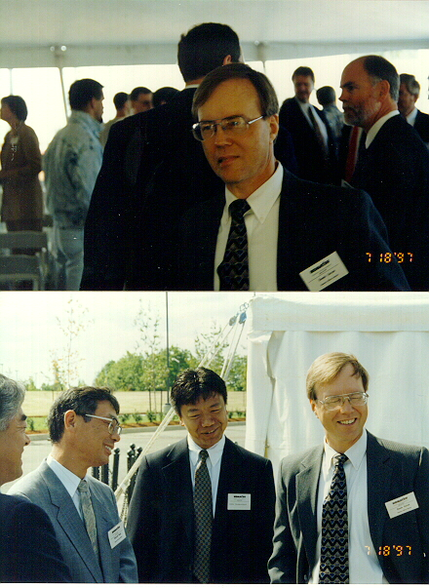
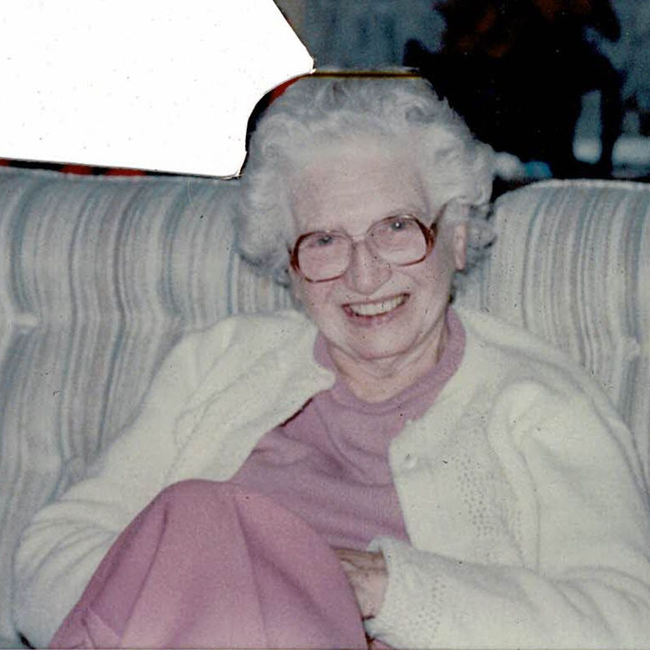
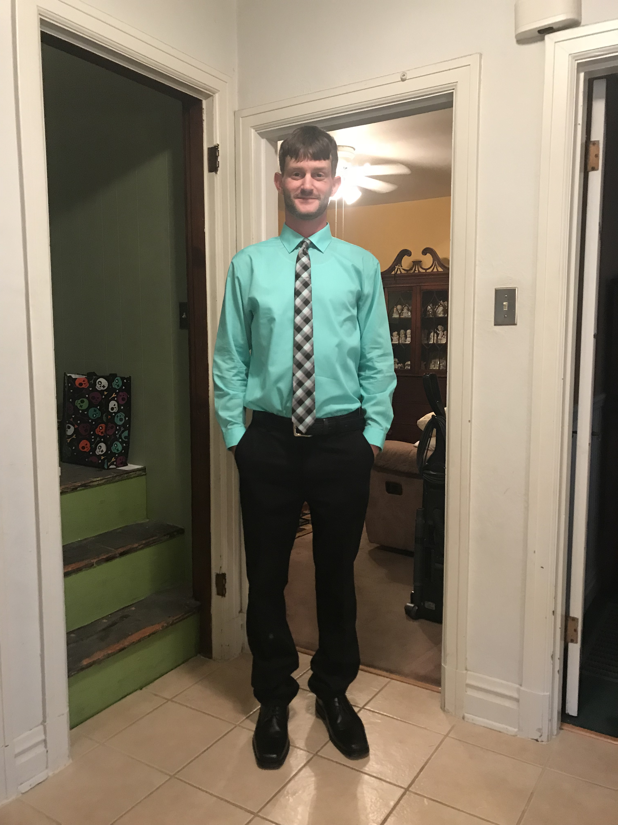

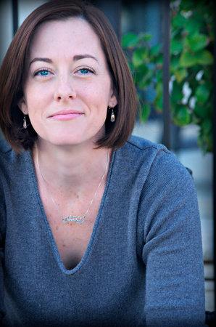
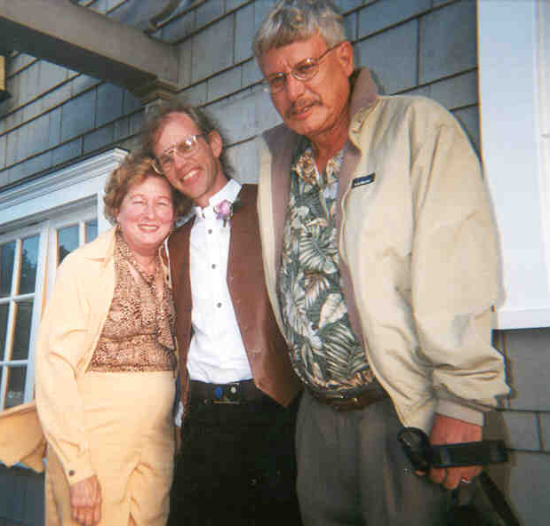

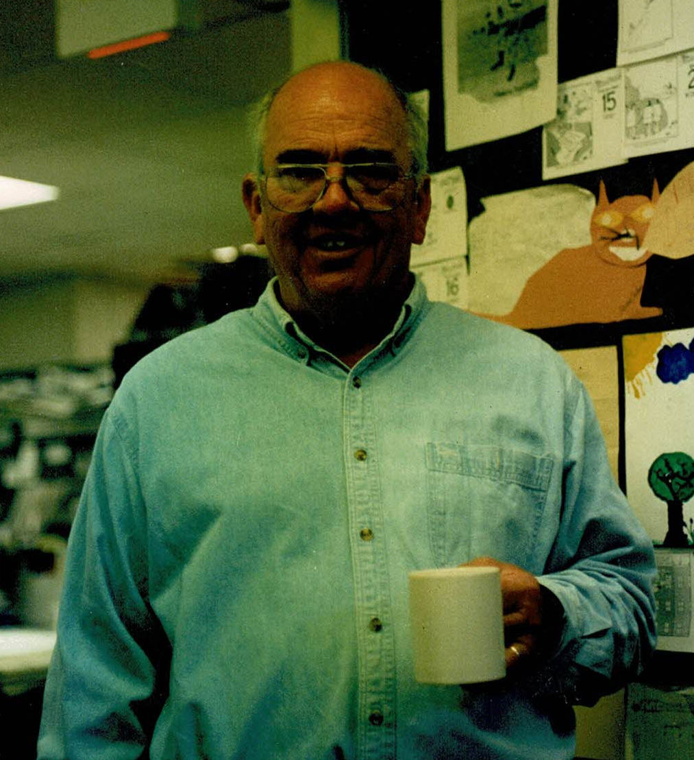

You Can Too

Slide 14

I’ve Had Great Mentors Along the Way

Slide 15
Let’s Take a Break (But)
See if you can tell me the title of my most recent blog post …
Clue – www.av8rdas.wordpress.com
See if you can tell me how many bridges you can see in the image of the Pittsburgh skyline on the home page of our commissioning resources website
Clue – www.av8rdas.com

Slide 16



How I Taught Things Previously

Slide 17

How I Taught Things Previously

Slide 18
Then, Kathy Needed an Art Studio

Slide 19

And I Realized This …

Slide 20
… Could be This

