Slide 1
Existing Building Commissioning Workshop Series 16, May 6, 2021
Energy Calculations – Part 2
Presented By:
David Sellers
Senior Engineer, Facility Dynamics Engineering

Slide 2
Review

Slide 3
How Pumps Use Energy

Slide 4
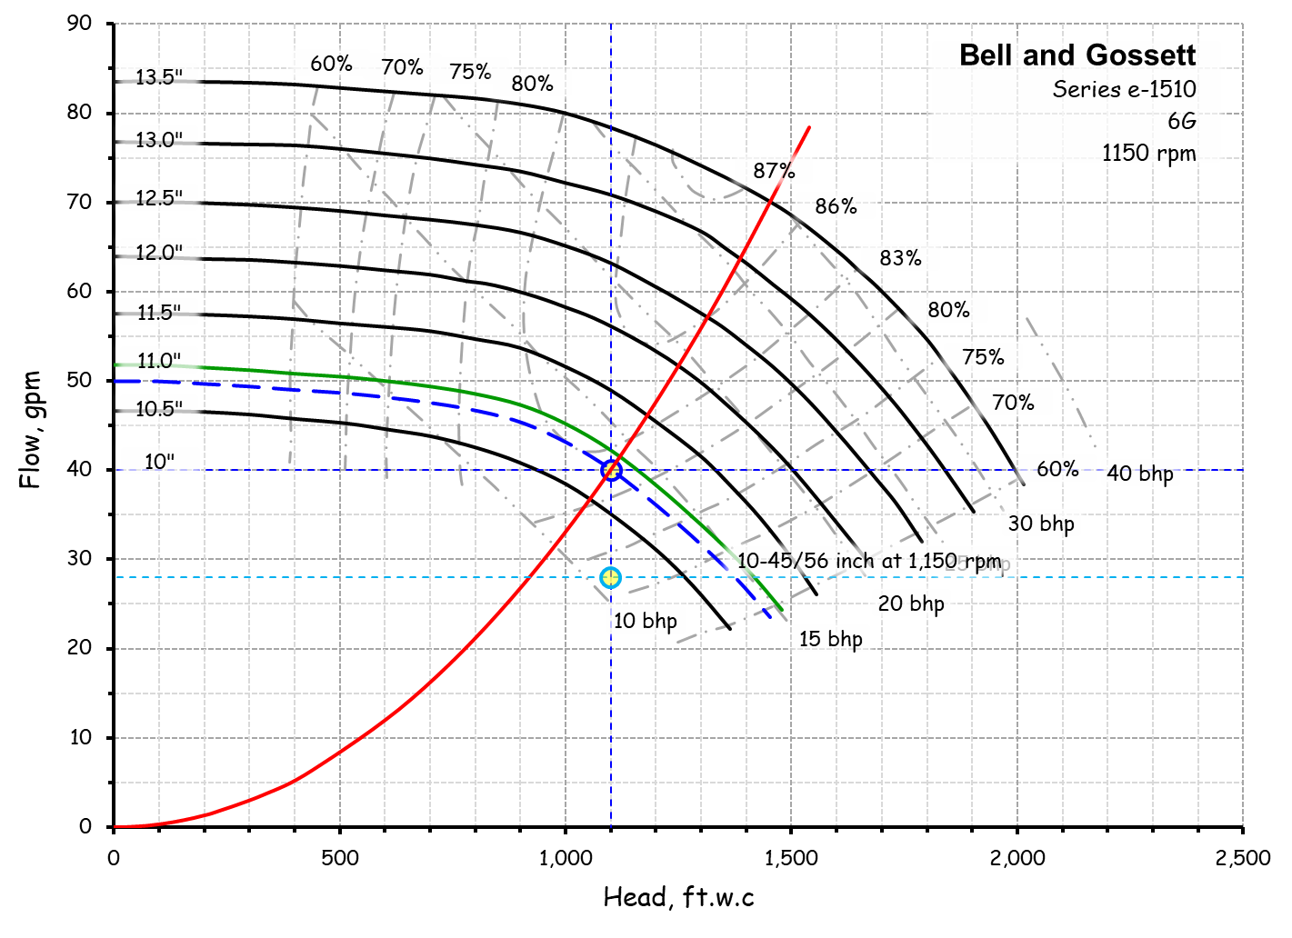
Observation 1
A field clue reveals the opportunity to save pump run hours by returning the selector switch to “Auto” for the lead pump

Slide 5
Let’s Explore That
A field clue reveals the opportunity to save pump run hours by returning the selector switch to “Auto” for the lead pump

Slide 6
Observation 2
A field clue reveals the opportunity to save 12 ft.w.c. in pump head if the pump can be optimized by some other means besides throttling
Throttling probably saved some energy

Slide 7
Lets Explore That
A field clue reveals the opportunity to save 12 ft.w.c. in pump head if the pump can be optimized by some other means besides throttling
Throttling probably saved some energy

Slide 8
Pump Optimization Options - Throttling
Increasing Head
Increasing Flow
Notes:
H F
7.84 8.00
6.00 7.00
3.06 5.00
1.10 3.00
0.49 2.00
0.12 1.00
0.00 0.00

Slide 9
Pump Optimization Options – Trim Impeller
Increasing Head
Increasing Flow
Notes:
H F
7.84 8.00
6.00 7.00
3.06 5.00
1.10 3.00
0.49 2.00
0.12 1.00
0.00 0.00

Slide 10
Pump Optimization Options – Reduce Speed
Increasing Head
Increasing Flow
Notes:
H F
7.84 8.00
6.00 7.00
3.06 5.00
1.10 3.00
0.49 2.00
0.12 1.00
0.00 0.00

Slide 11
Pump Optimization Options – Right Sizing
Increasing Head
Increasing Flow
Notes:
H F
7.84 8.00
6.00 7.00
3.06 5.00
1.10 3.00
0.49 2.00
0.12 1.00
0.00 0.00

Slide 12
The Assignment

Slide 13
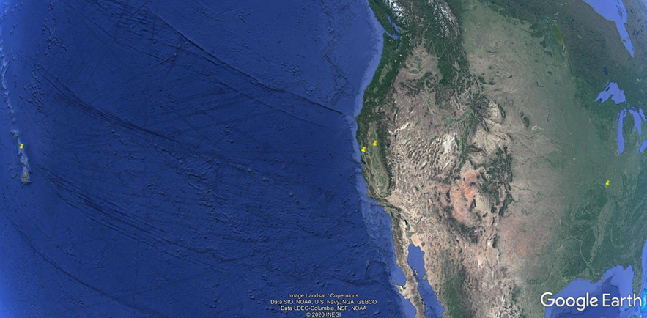
The Assignment
Assess the savings for all the options for the Chiller 2 evaporator pump
Not all of them may be viable
Once you have identified the viable options, e-mail me for bids for doing the work
Don’t wait until the last minute!
Develop the simple payback for each option
Select the option you would ultimately choose for each Owner type and explain why
Perform the assessment for the following locations
Honolulu, HI
$0.2917 per kWh electricity
San Francisco, CA
$0.1621 per kWh electricity
Sacramento, CA
$0.1331 per kWh electricity
St. Louis, MO
$0.0571 per kWh electricity

Slide 14
The Assignment
Assess the savings for all the options for the Chiller 2 evaporator pump
Not all of them may be viable
Once you have identified the viable options, e-mail me for bids for doing the work
Develop the simple payback for each option
Select the option you would ultimately choose and explain why
Perform the assessment for the following locations
Honolulu, HI
$0.2917 per kWh electricity
San Francisco, CA
$0.1621 per kWh electricity
Sacramento, CA
$0.1331 per kWh electricity
St. Louis, MO
$0.0571 per kWh electricity

Slide 15
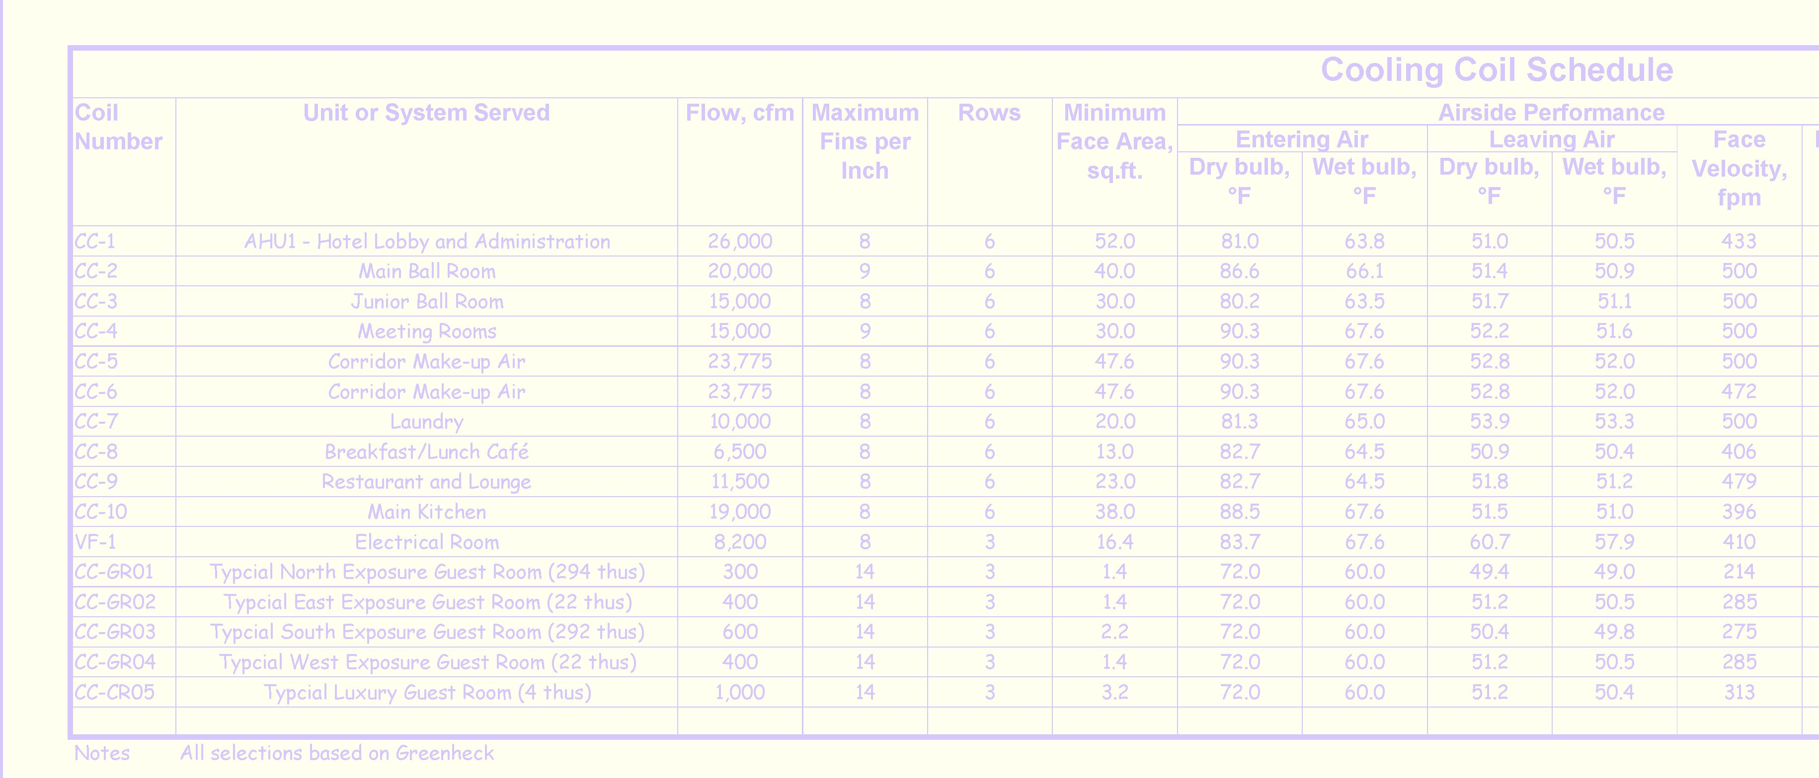
The Assignment
Perform the assessment for the following locations
Breakout A - Honolulu, HI
$0.2917 per kWh electricity
Breakout B - San Francisco, CA
$0.1621 per kWh electricity
Breakout C - Sacramento, CA
$0.1331 per kWh electricity
Breakout D - St. Louis, MO
$0.0571 per kWh electricity

Slide 16
Owner Types/Financial Metrics
Owner 1 - Investment fund for a teachers union retirement fund - 5 year simple payback window, in-house control work capabilities.
Owner 2 - Real Estate investment portfolio - 2 year simple payback window, all modification work is out of house.
Owner 3 - Personal investment, 8 year simple payback window for central plant equipment, all modification work is out of house.
Owner 4 - Personal investment, 10 year simple payback window for central plant equipment. Capital Budget has upcoming projects to add redundant evaporator, condenser and distribution chilled water pumps - same make and model as existing - this year and redundant chiller and cooling tower next year.

Slide 17
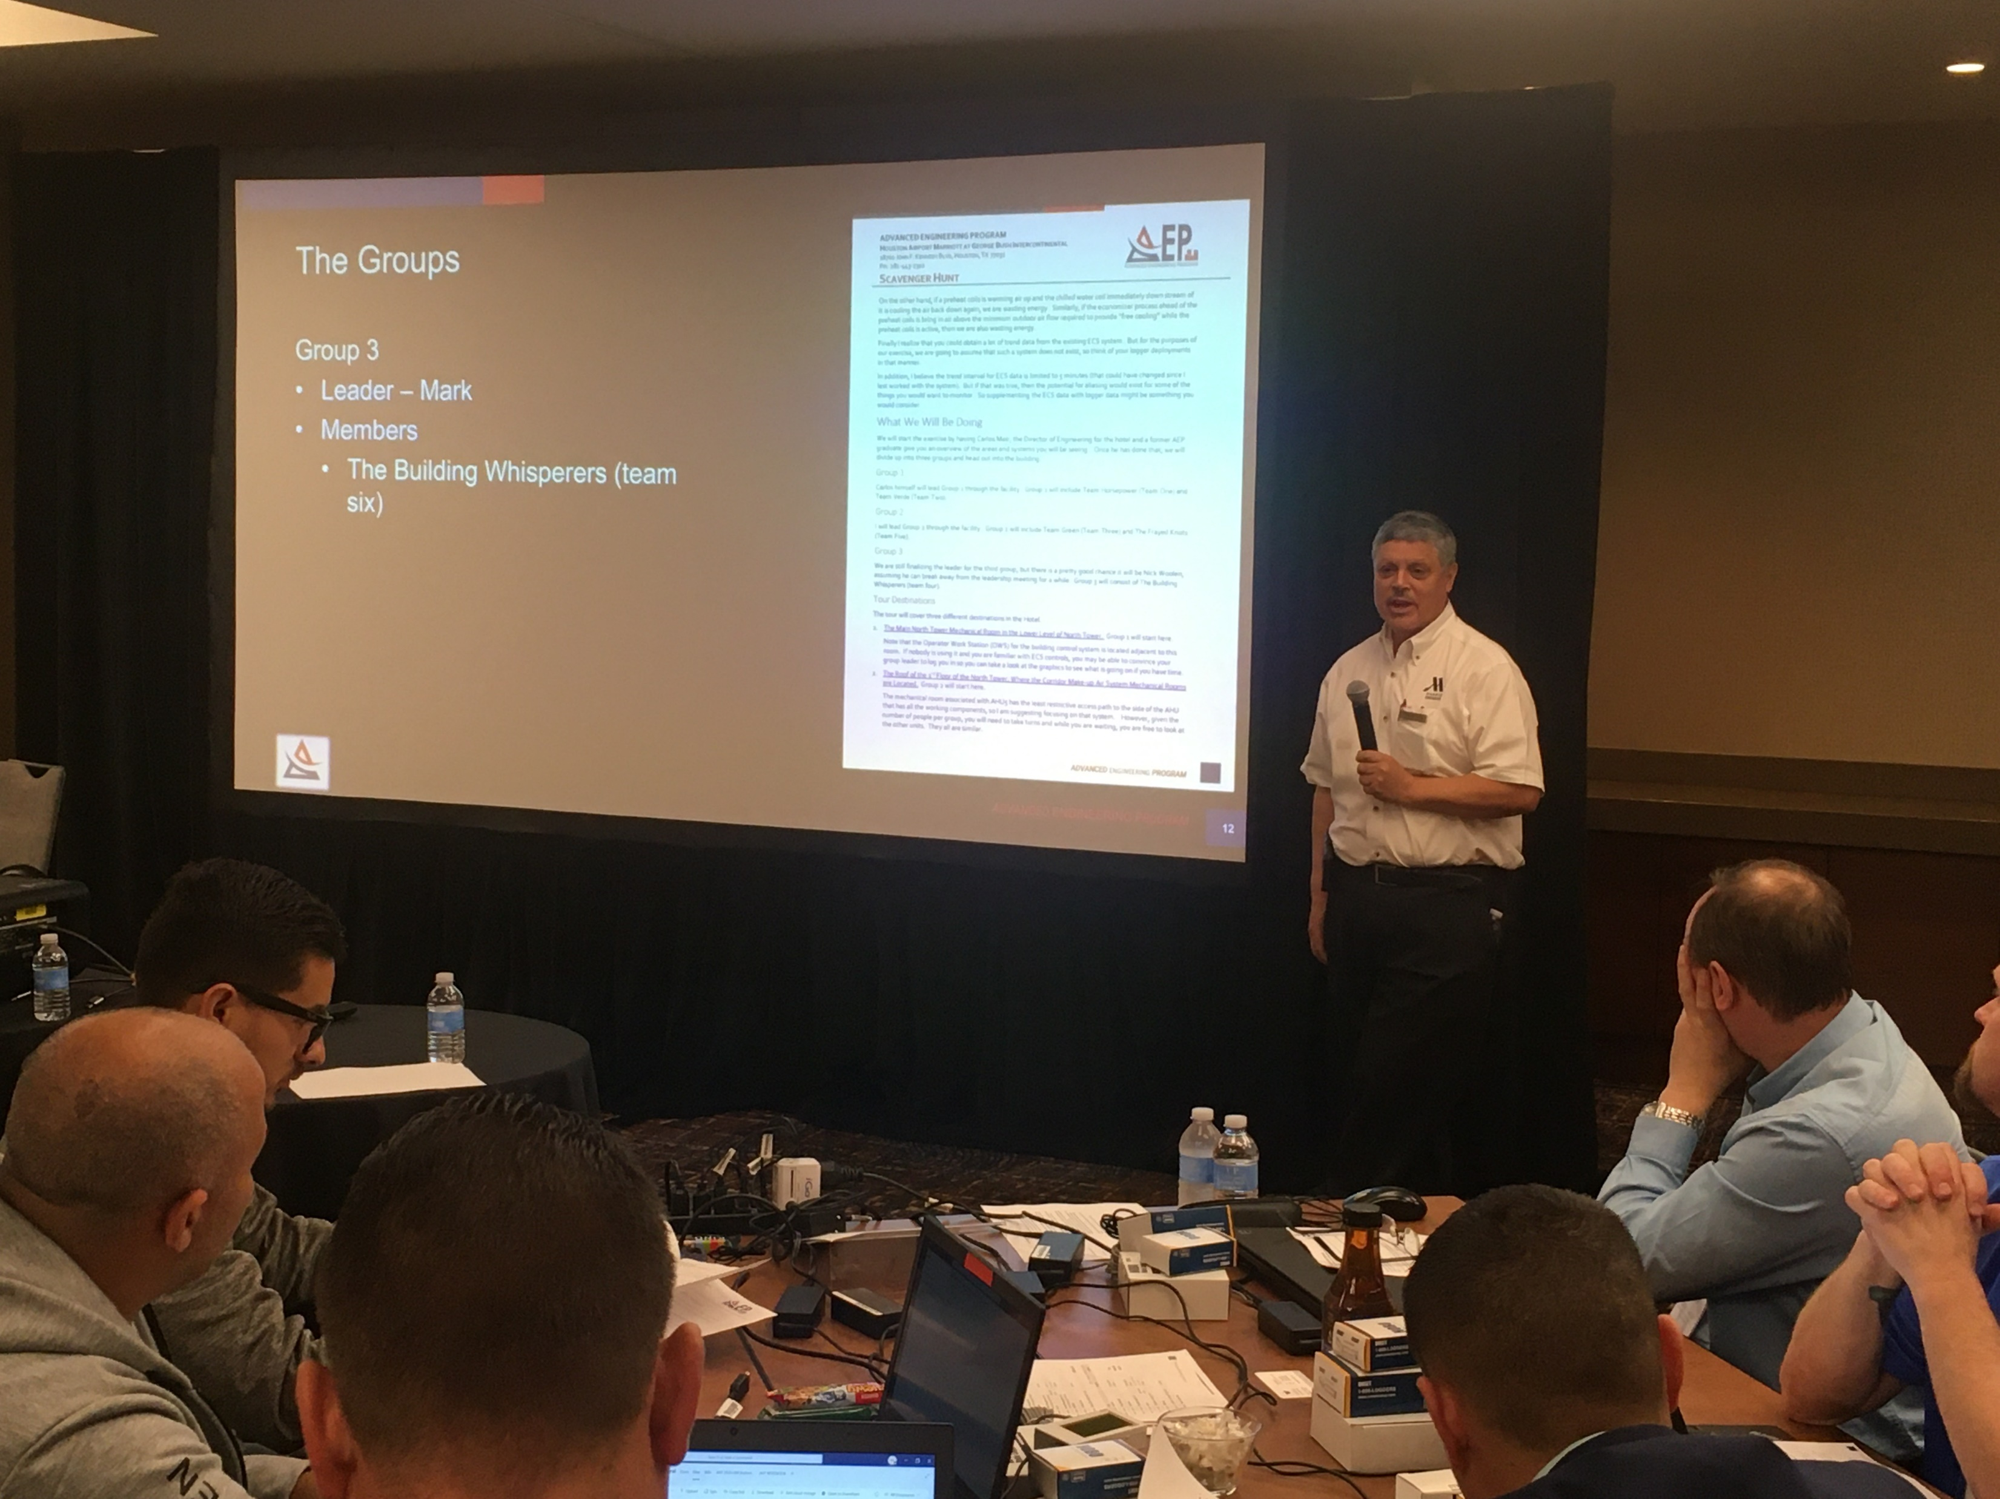
An Assumption
Assume the plant can be shut down when the outdoor temperature is below 51°F

Slide 18
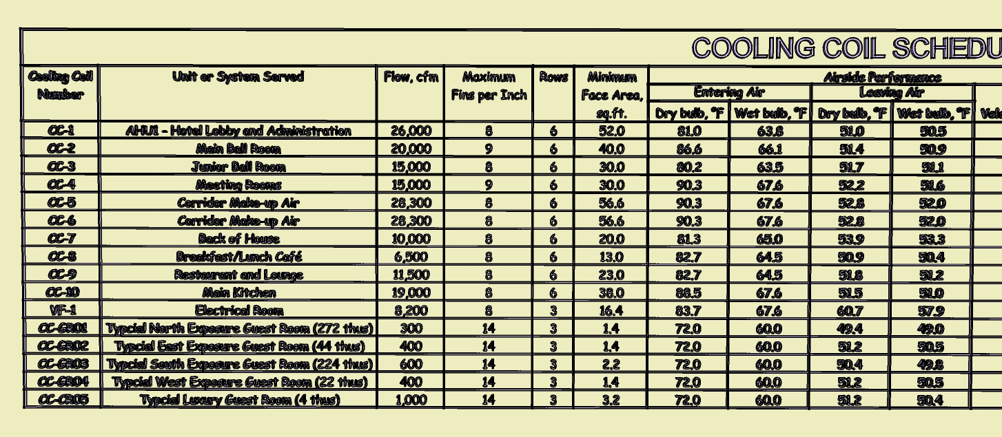
Presenting Your Results
One Team will present their results during the next webinar
Informal presentation
Ryan will ask for a volunteer ahead of time
No volunteers means Ryan picks someone at random at the next during the next webinar
If your team volunteers, everyone on the team gets a datalogger
You will not know if anyone has volunteered (so be ready to present)

Slide 19
Resources

Slide 20
Resources

Slide 21
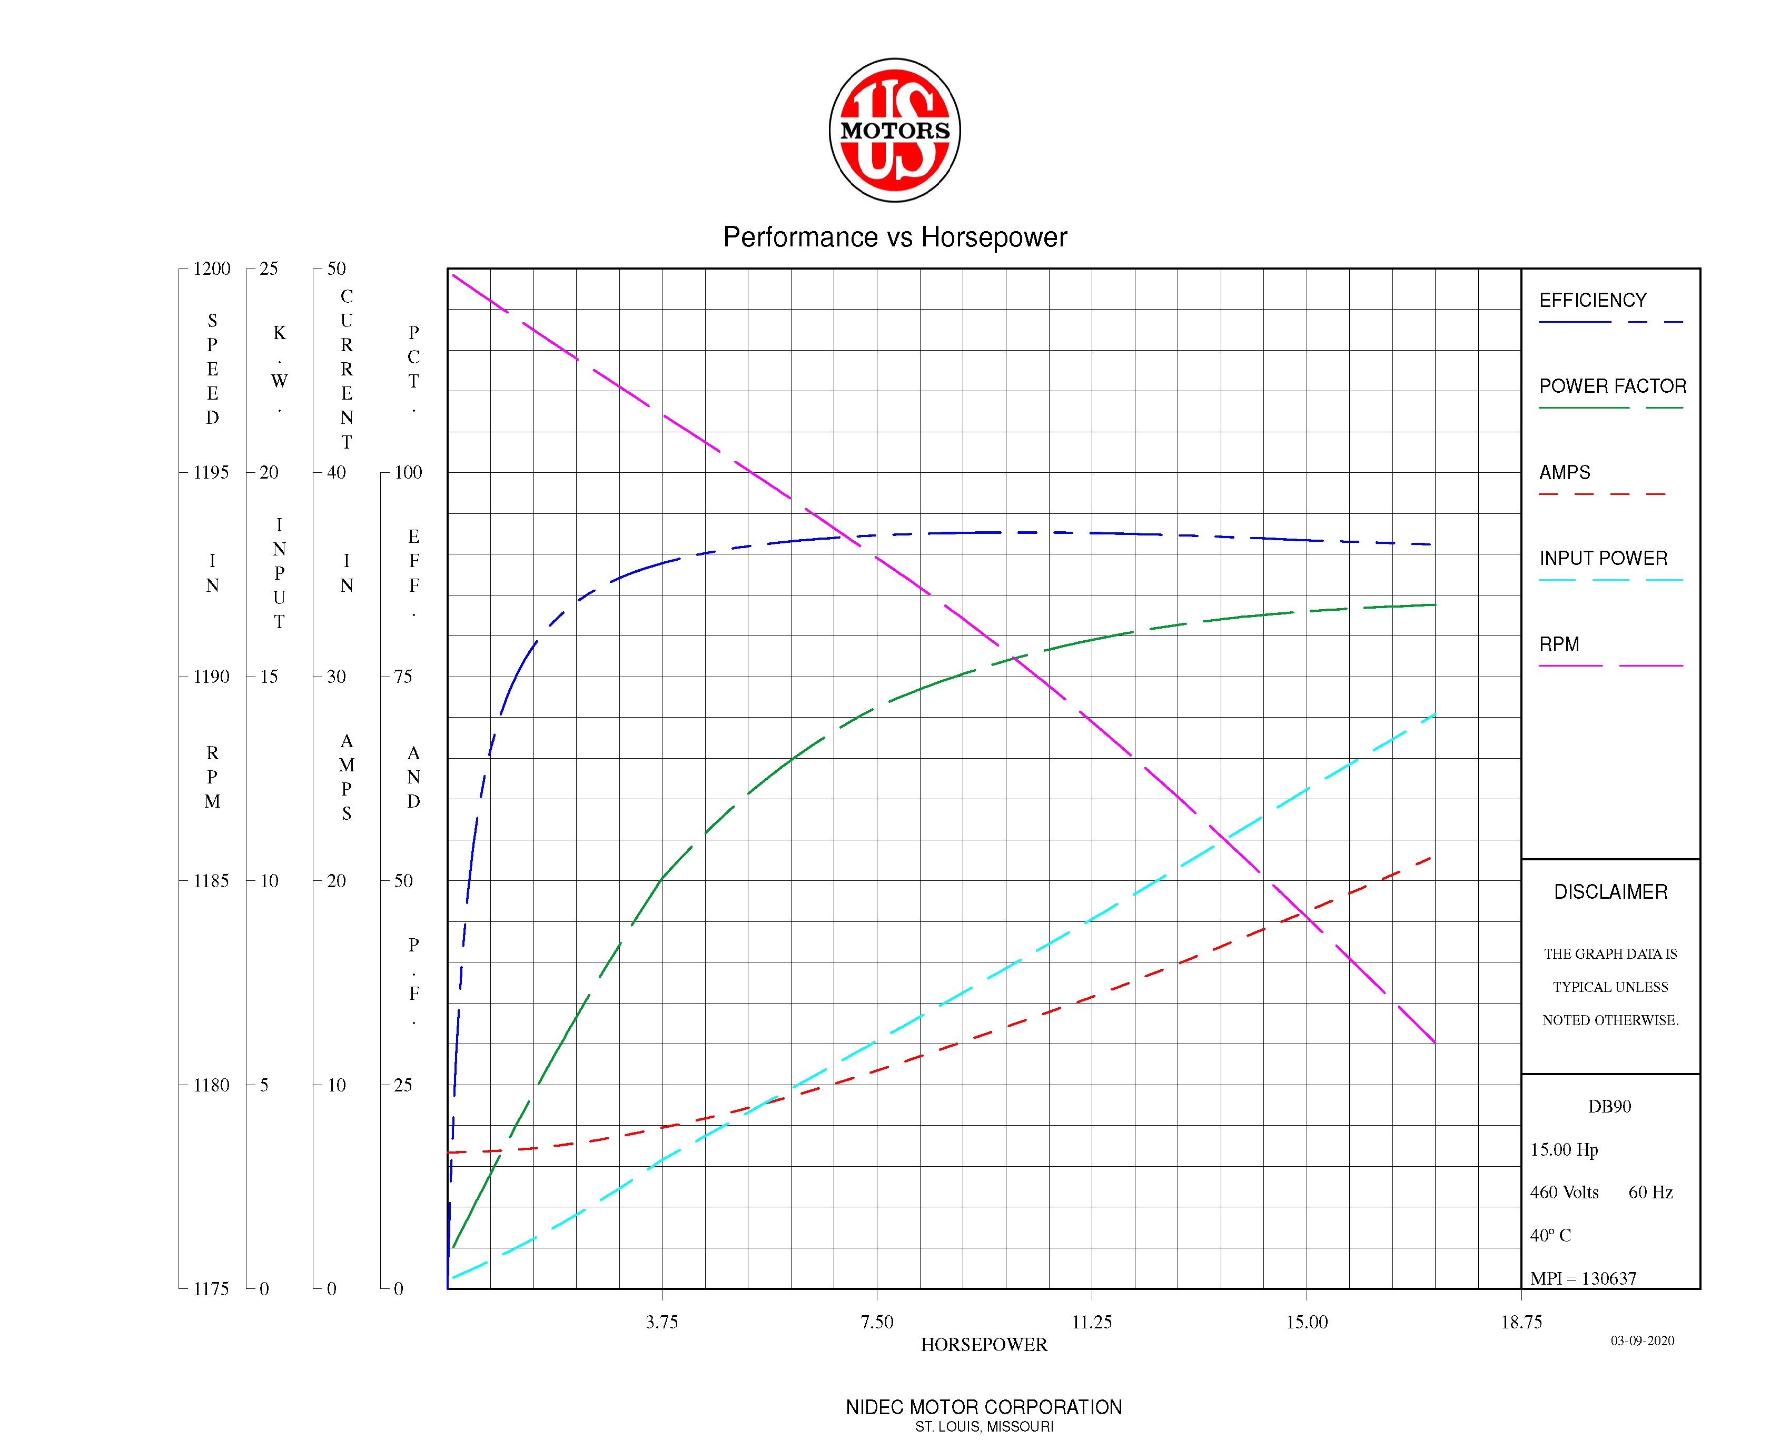

Slide 22
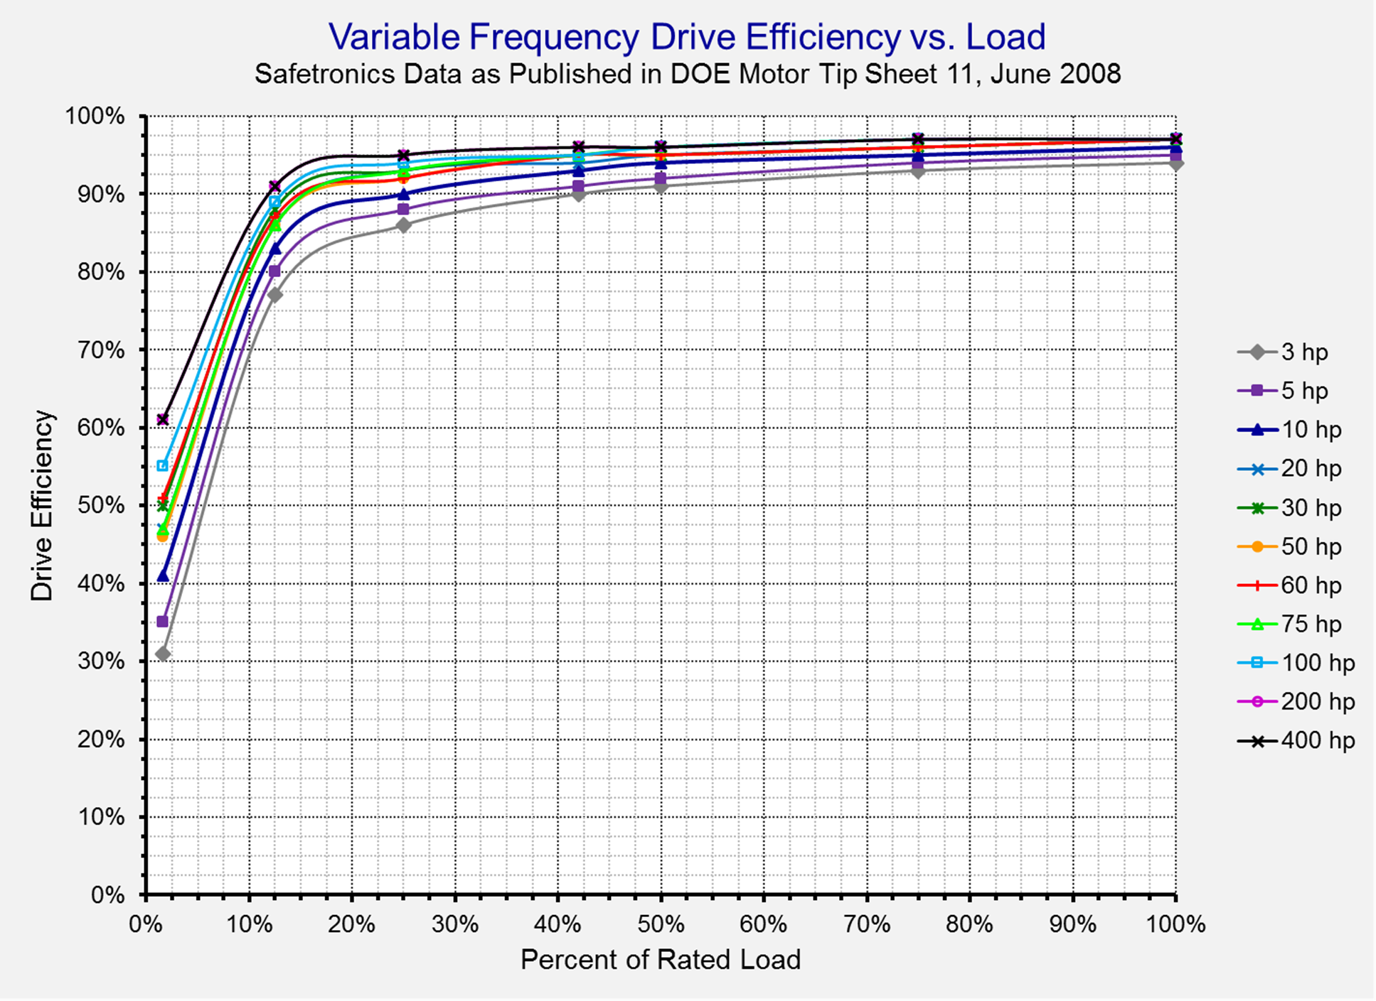

Slide 23
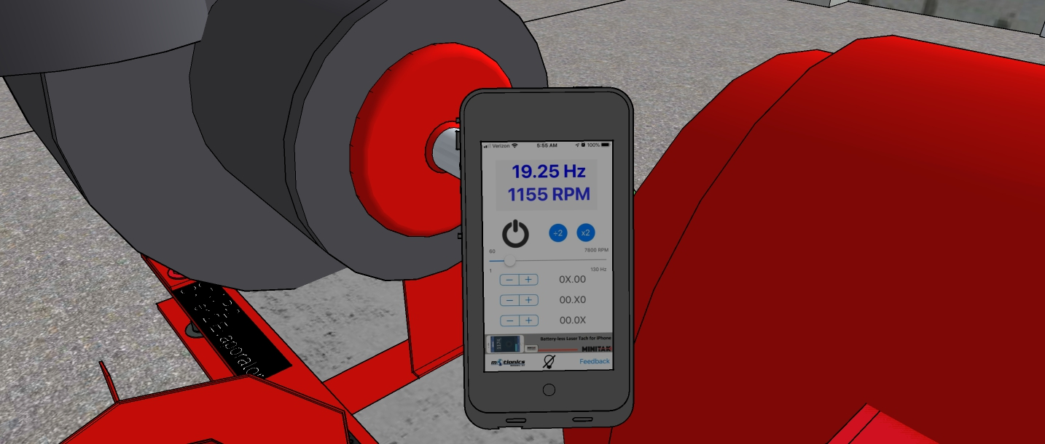
Pump Speed

Slide 24
Other Resources
Square Law Tool
http://www.av8rdas.com/affinity-laws.html
Affinity Law Information
http://www.av8rdas.com/affinity-laws.html
Affinity Law Tools
Flow and Impeller Diameter Relationship
http://www.av8rdas.com/affinity-laws.html#Diameter
Flow and Impeller Speed Relationship
http://www.av8rdas.com/affinity-laws.html#Speed
Power and Impeller Speed Relationship
http://www.av8rdas.com/affinity-laws.html#Power

Slide 25
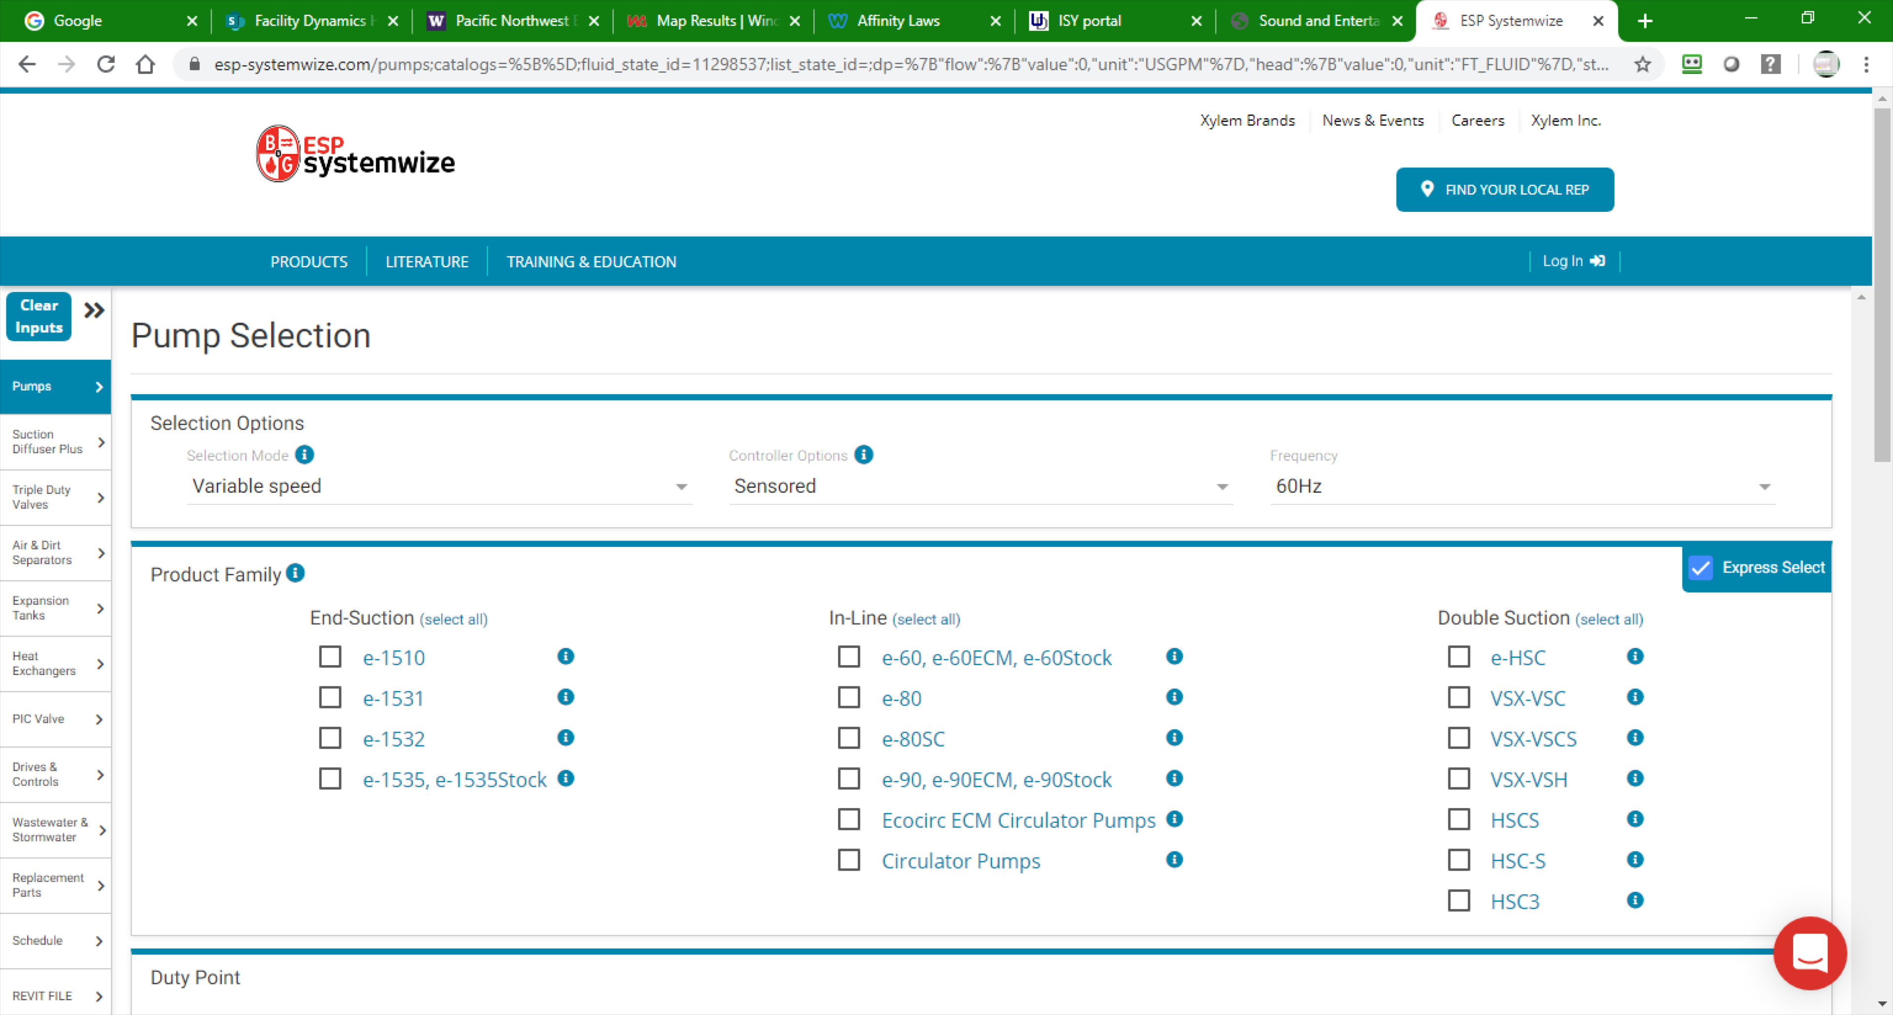
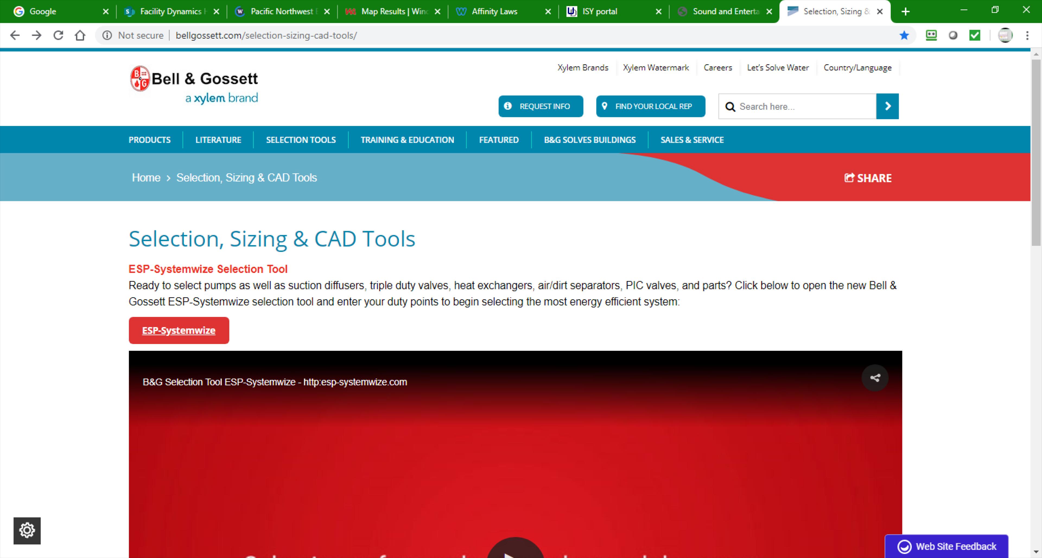
Other Resources
Pump Selection Tool
http://bellgossett.com/selection-sizing-cad-tools/

Slide 26
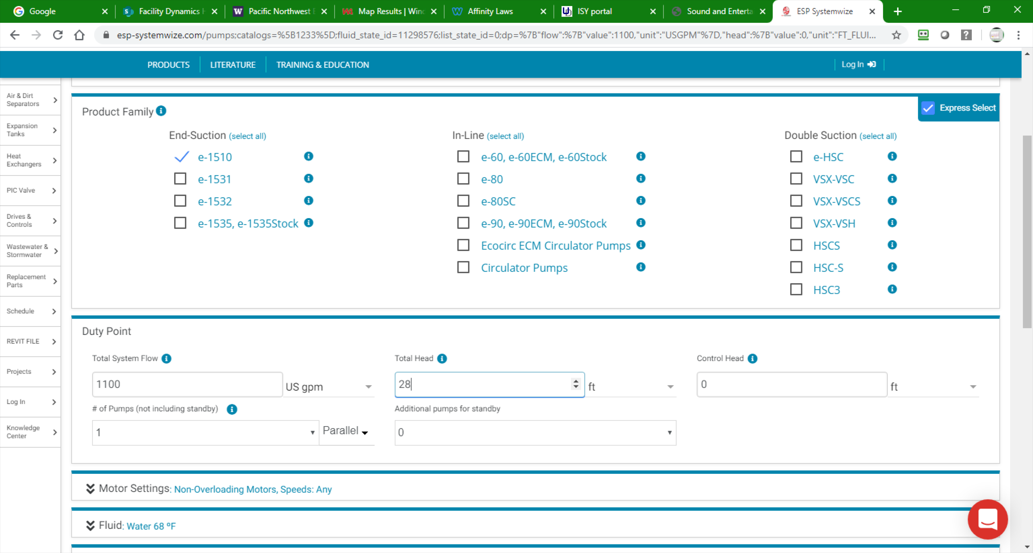
Other Resources
Pick the “ESP-Systemwize” link and you will be taken to a data entry screen for pumps

Slide 27
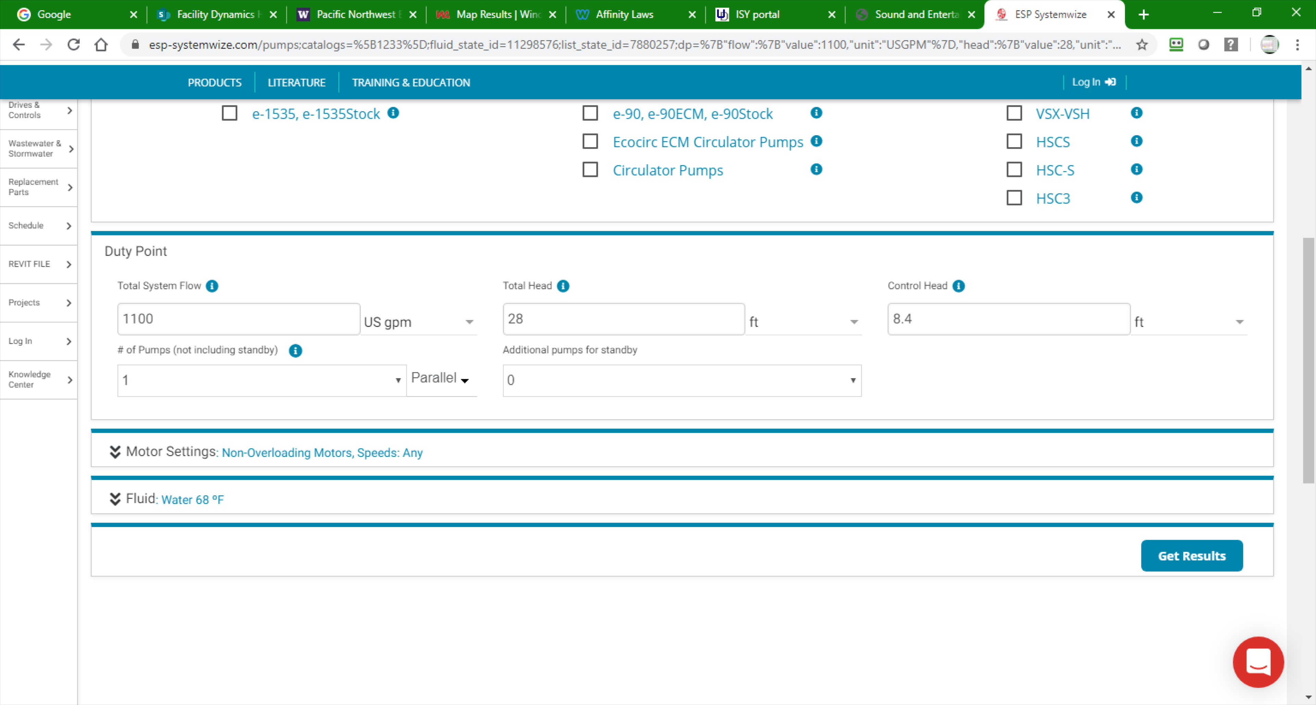
Other Resources
Enter your selection criteria

Slide 28
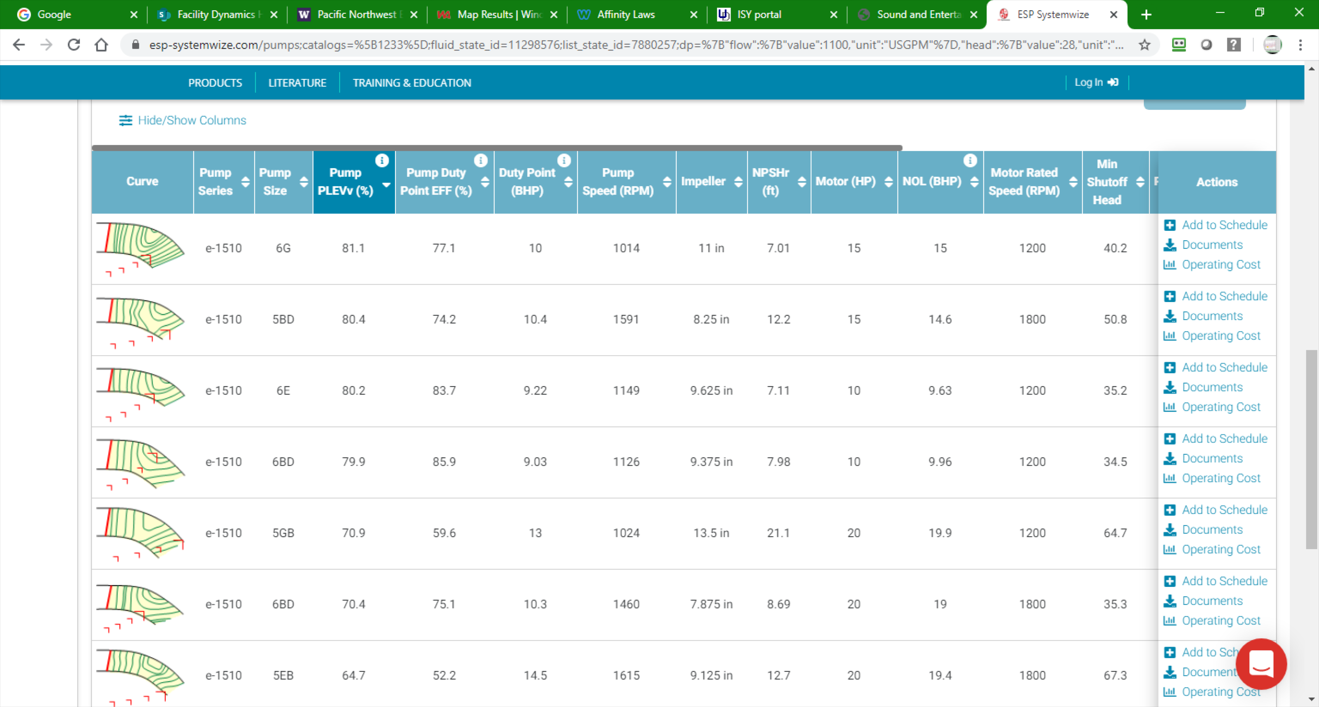
Other Resources
Select “Get Results”

Slide 29
Other Resources
Page down to see your options

