Slide 1
This is Cool
Free iPhone app from Motionics
https://apps.apple.com/us/app/strobe-light-tachometer/id978182913

Slide 2
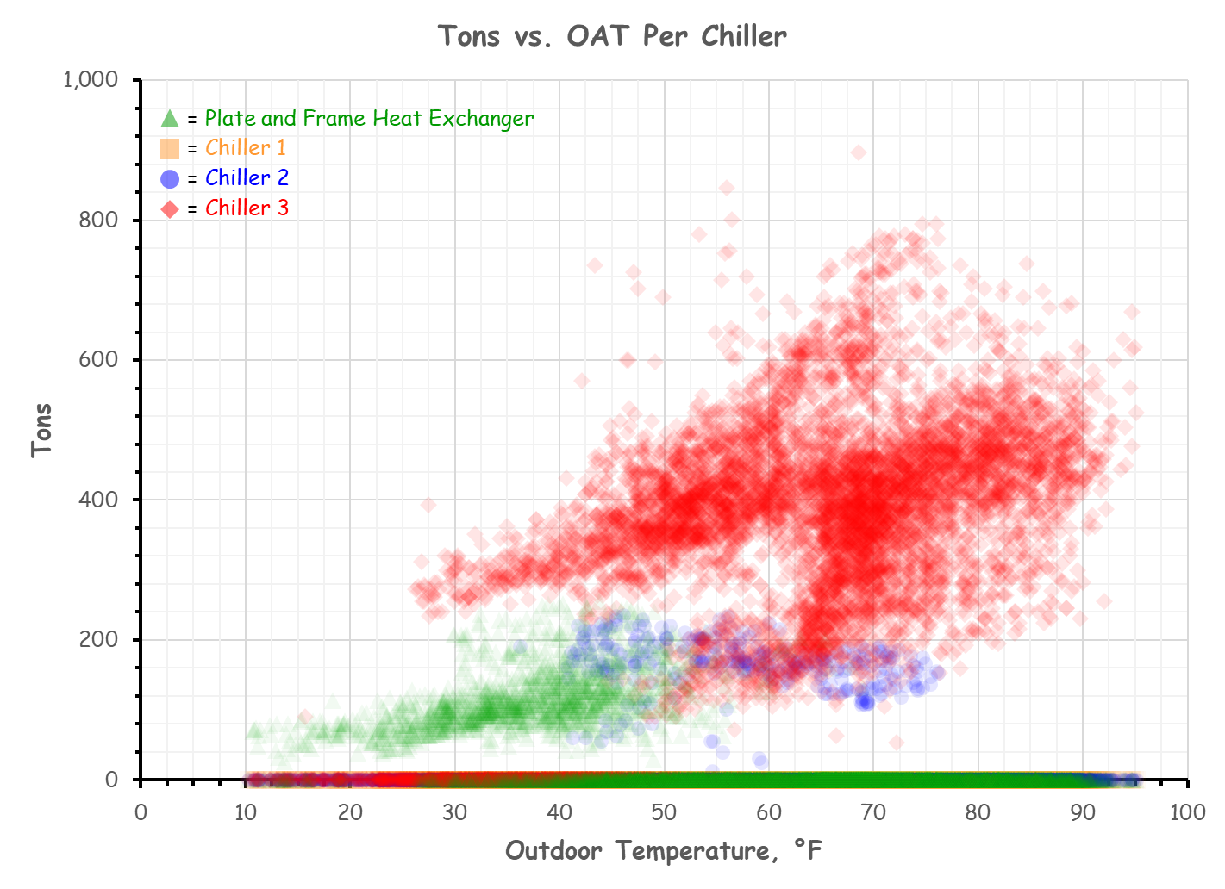
Given:

Slide 3
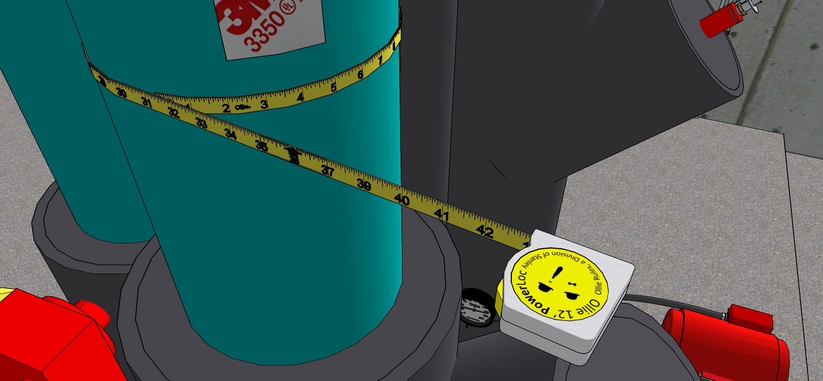
Pipe Diameter from Circumference

Slide 4
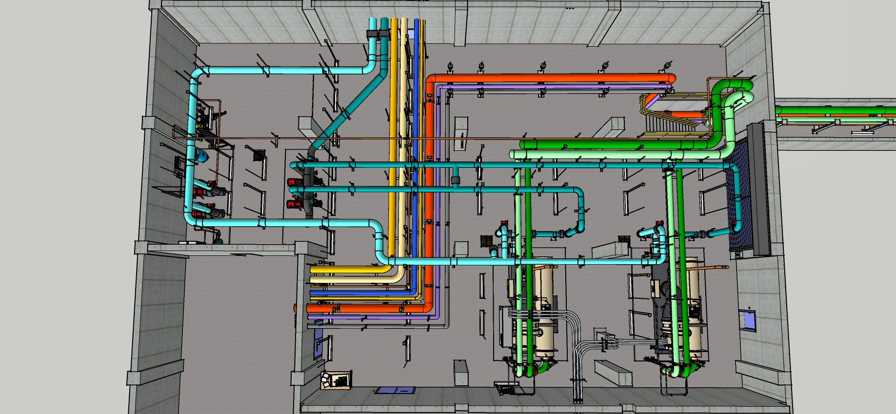
Some Dimensions
25’ Center Lines
20’ Center Lines

Slide 5
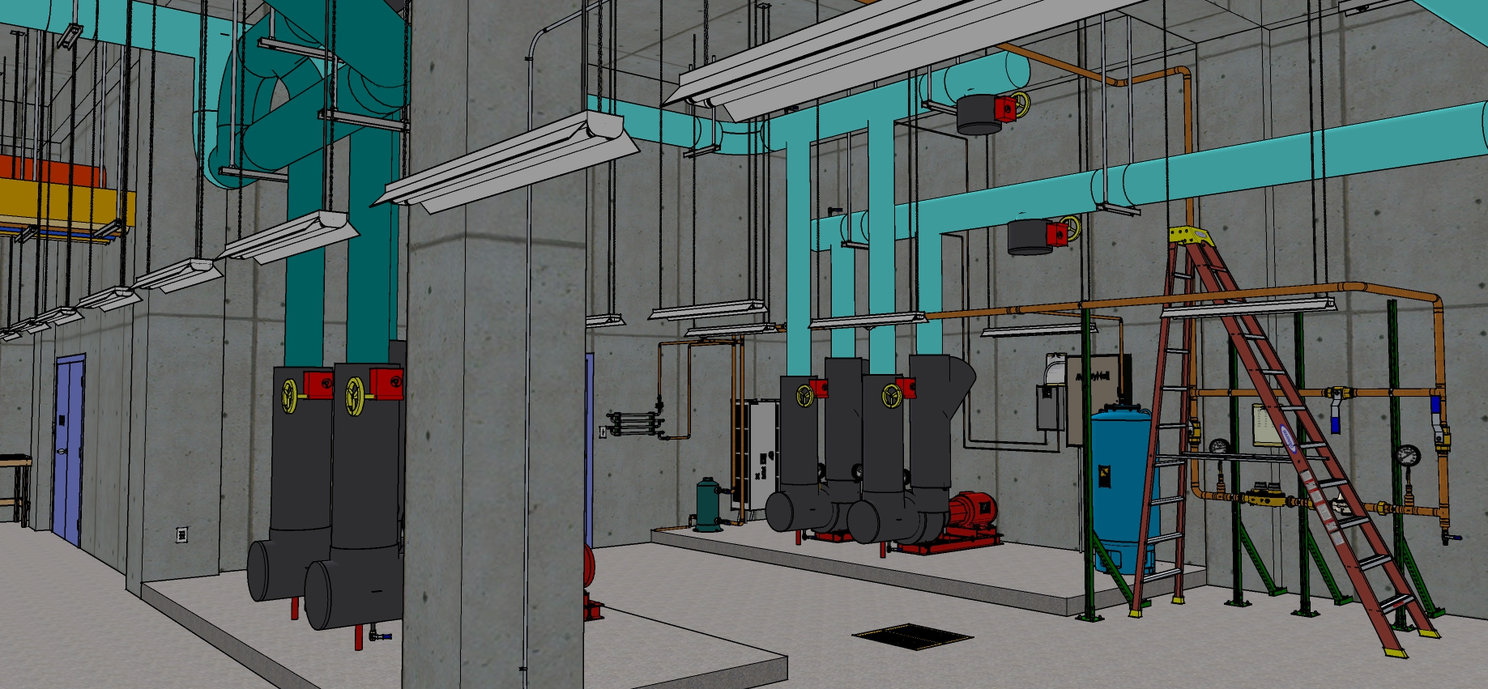
Some Dimensions
18’ Slab to bottom of slab above

Slide 6
A Few Friction Factors
8 inch pipe at the design flow rate

Slide 7
A Few Friction Factors
8 inch pipe at the maximum recommended velocity (10 ft/sec)

Slide 8
A Few Friction Factors
8 inch pipe at the maximum recommended friction rate (4 ftwc/100 ft)

Slide 9
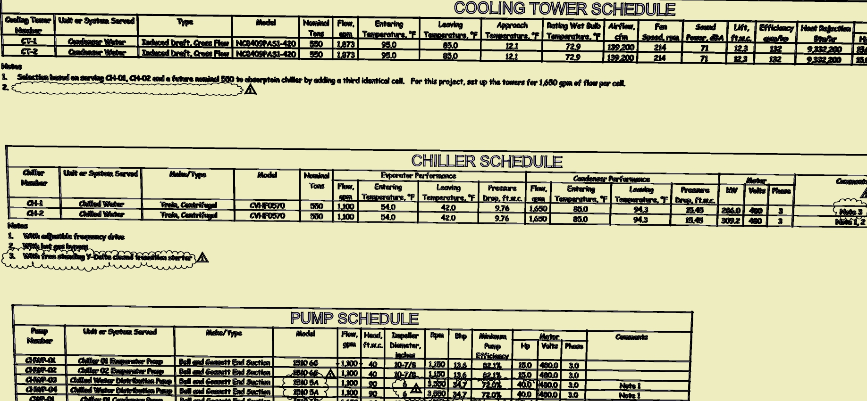
Some Chiller Data

Slide 10
A Few Rules of Thumb
If you know the linear feet of pipe, if you multiply that by a factor of 1.5 to 2.0, you will end up with a number representing the equivalent feet of pipe for HVAC systems that includes things like the valves, fittings, etc.
Use engineering judgement
Straight run with no fittings = multiplier of 1.0
A run with a few fittings = multiplier of 1.5
A run with a significant number of fittings = multiplier of 2.0
A run with a crazy number of fittings = multiplier in excess of 2.0
Remember, its an estimate, not an exactimate

Slide 11
What is the head requirement for the evaporator pumps in the plant?

