Slide 1
Pumps and Piping; Design, Performance and Commissioning Issues
Open and Closed Systems
Presented By:
David Sellers
Senior Engineer, Facility Dynamics Engineering

Slide 2
Central Plants Typically Have Open and Closed Systems Associated with Them
Compressor
Piping Network
Piping Network
Piping Network
Condenser
Evaporator
Load
Cooling Tower
Expansion Device
Make-up, Blow-down, and Water Treatment
Water Chiller
Expansion tank and make up water
Condenser Water Pump
Chilled Water Pump
Typically an open system
More than one interface with the atmosphere or a compressible gas
Typically a closed system
Only one interface with atmosphere or a compressible gas

Slide 3
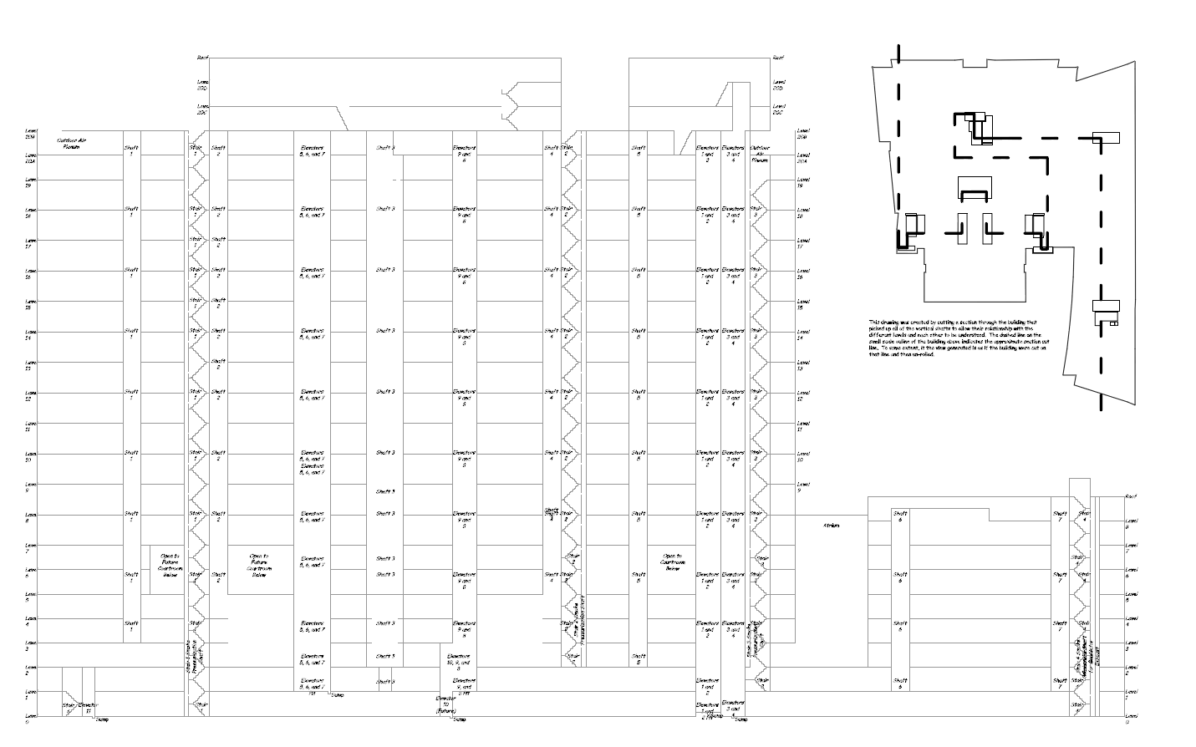
Air handling units are here
Cooling towers and make up connections are here
Piping mains run up and down this chase
Chillers, pumps, and chilled water make up connection here

Slide 4
Approximately 475 ft. from the lowest point in the CHW system to the highest point in the CHW system

Slide 5
Approximately 15 ft. from the cold basin to the hot basin of the cooling towers
Approximately 455 ft. from the lowest point in the CW system to the cold basins of the cooling towers

Slide 6
Closed Chilled Water System
Open Condenser Water System

Slide 7
The closed chilled water system could be completely filled from a connection at the high point in the system
The open condenser water system could only be filled to the rim of the open basin from a connection at the high point in the system
Closed Chilled Water System
Open Condenser Water System

Slide 8
A Couple of Questions
What pressure should be used as a fill pressure for the chilled water system and why?
Notes:
Electric rate = $0.0480 $ per kWh
Natural gas rate = $0.7700 $ per therm
Over-all boiler plant efficiency = 69% Basis - Energy Star Performance Ratings Methodology for Incorporating Source Energy Use
Net Cost for Steam = $11.16 per MMBtu
Boiler plant emmissions = 116.3 lbs CO₂/MMBtu
Electrical plant emmissions = 1.8440 lbs CO₂/kWh
Chiller plant over-all efficiency = 0.90 kW/ton

Slide 9
A Couple of Questions
What pressure should be used as a fill pressure for the chilled water system and why?
If the evaporator pumps serving the chillers are rated to produce 30 ft.w.c. of head at design conditions, what would an appropriate range be for the pressure gauges on the pump?
Notes:
Electric rate = $0.0480 $ per kWh
Natural gas rate = $0.7700 $ per therm
Over-all boiler plant efficiency = 69% Basis - Energy Star Performance Ratings Methodology for Incorporating Source Energy Use
Net Cost for Steam = $11.16 per MMBtu
Boiler plant emmissions = 116.3 lbs CO₂/MMBtu
Electrical plant emmissions = 1.8440 lbs CO₂/kWh
Chiller plant over-all efficiency = 0.90 kW/ton

Slide 10
Some More Questions
How much head needs to be included in the condenser water pump selection to lift water through an elevation change?
Assuming the condenser pump is at the lowest point in the system, what would the gauge on its suction connection read when the system was not operating?
Would this reading change when you started the pump?
Notes:
Electric rate = $0.0480 $ per kWh
Natural gas rate = $0.7700 $ per therm
Over-all boiler plant efficiency = 69% Basis - Energy Star Performance Ratings Methodology for Incorporating Source Energy Use
Net Cost for Steam = $11.16 per MMBtu
Boiler plant emmissions = 116.3 lbs CO₂/MMBtu
Electrical plant emmissions = 1.8440 lbs CO₂/kWh
Chiller plant over-all efficiency = 0.90 kW/ton

Slide 11
Closed Systems
Interface is at the expansion tank
Open or diaphragm type
Different sizing issues
Different piping issues
Pressure tends to hold constant at the expansion tank
Expansion tank typically at the distribution pump suction connection
Air separation may or may not be at the expansion tank
Fill pressure needs to be sufficient to vent air at high points
Compressor
Piping Network
Condenser
Evaporator
Load
Expansion Device
Water Chiller
Expansion tank and make up water
Pump
Make up typically connected at the expansion tank
Very little required once filled
Limited water treatment
Monitor volume and pressure

Slide 12
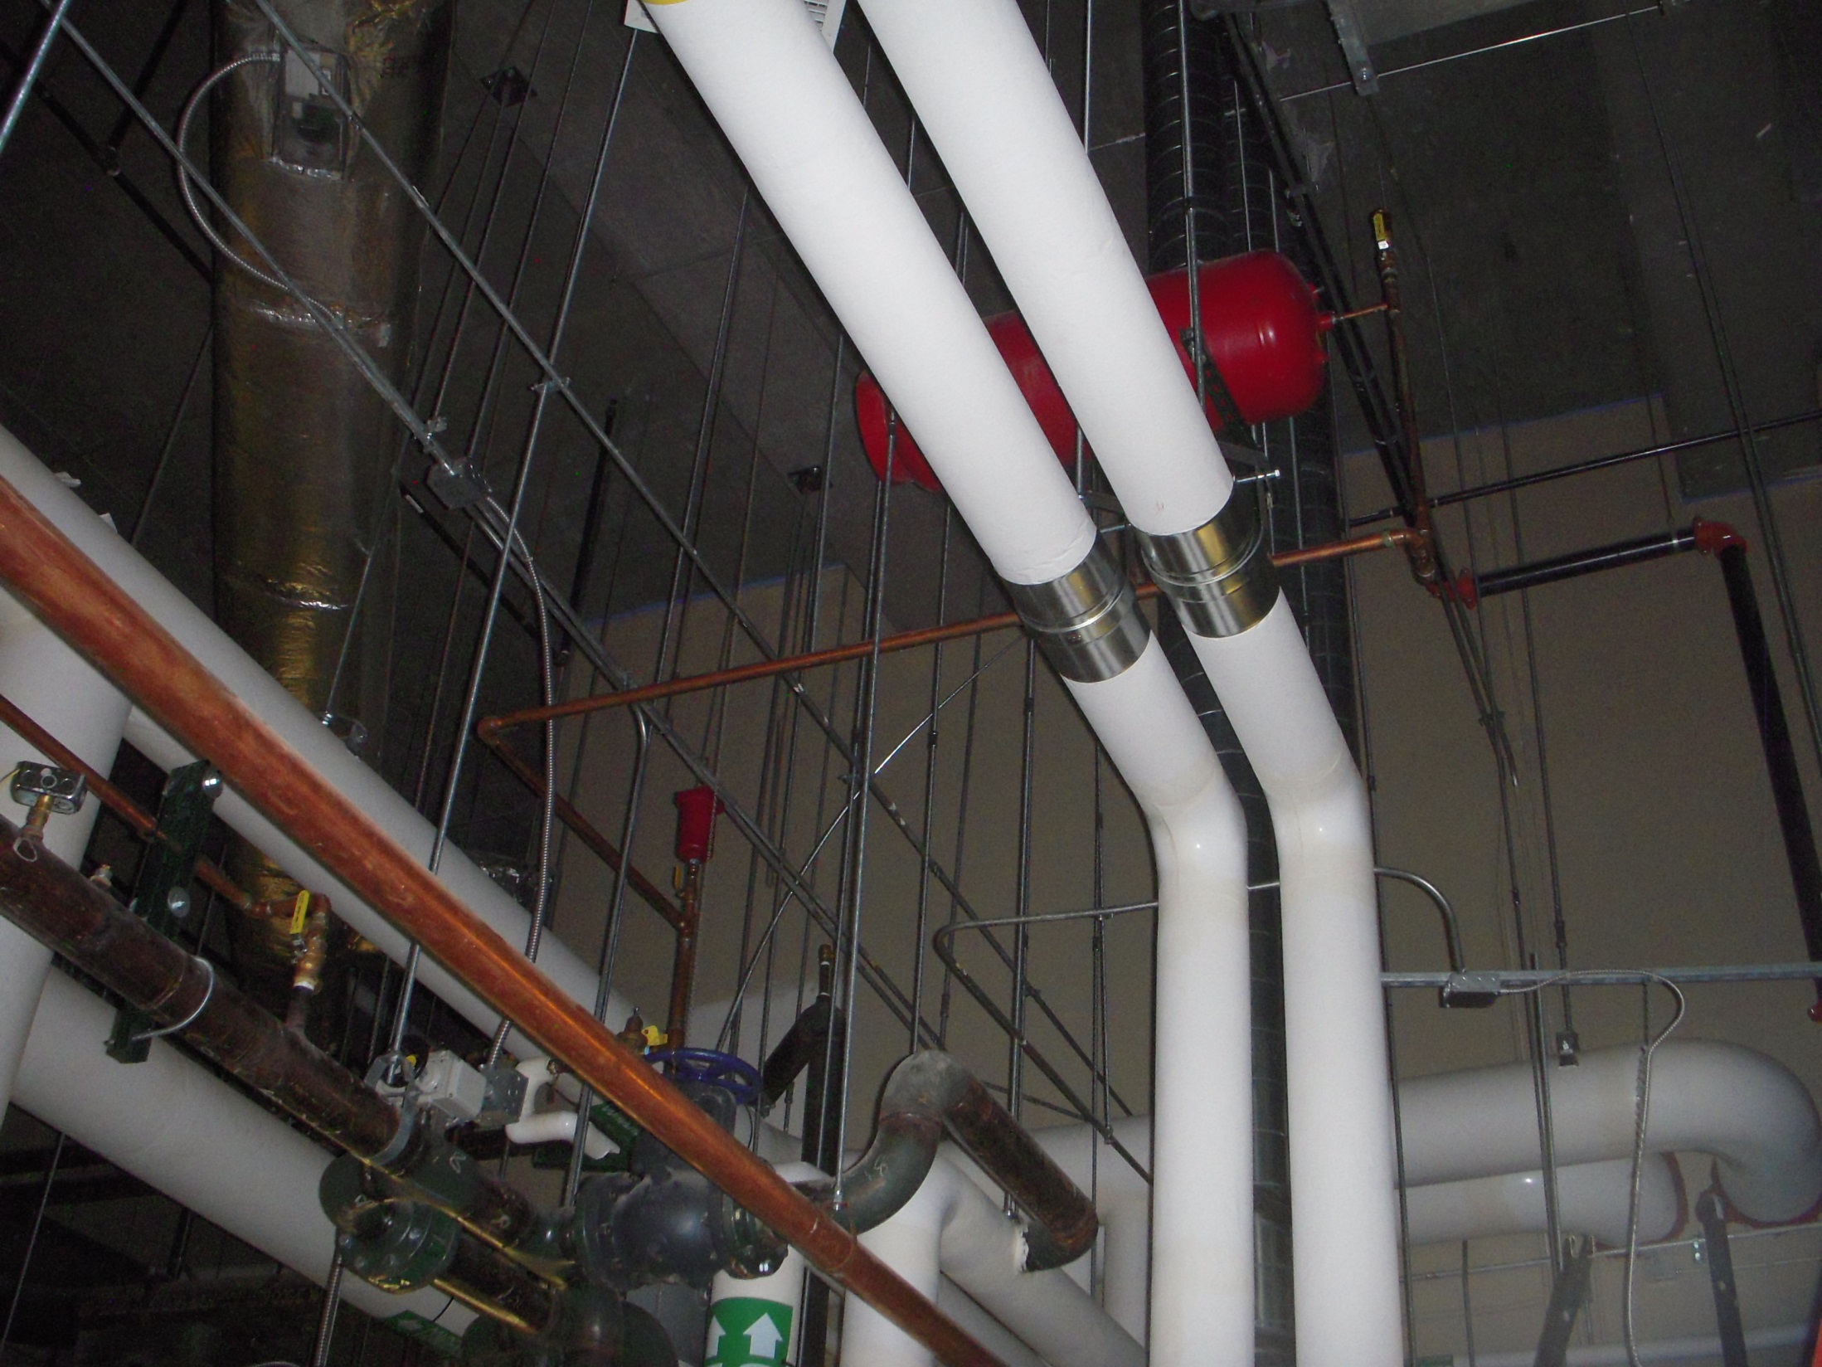
Non-Diaphragm Expansion Tank

Slide 13
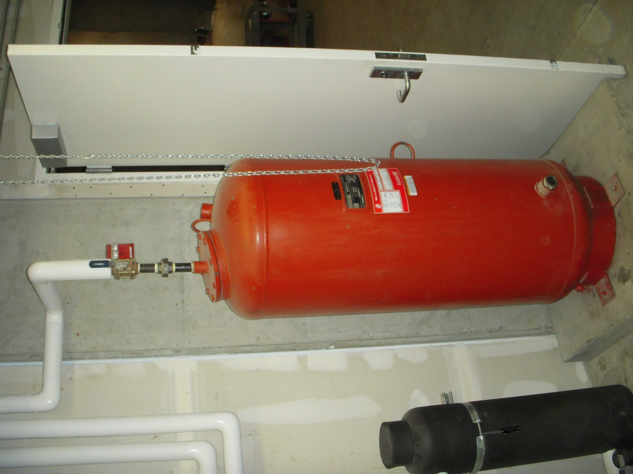
Diaphragm Expansion Tank

Slide 14
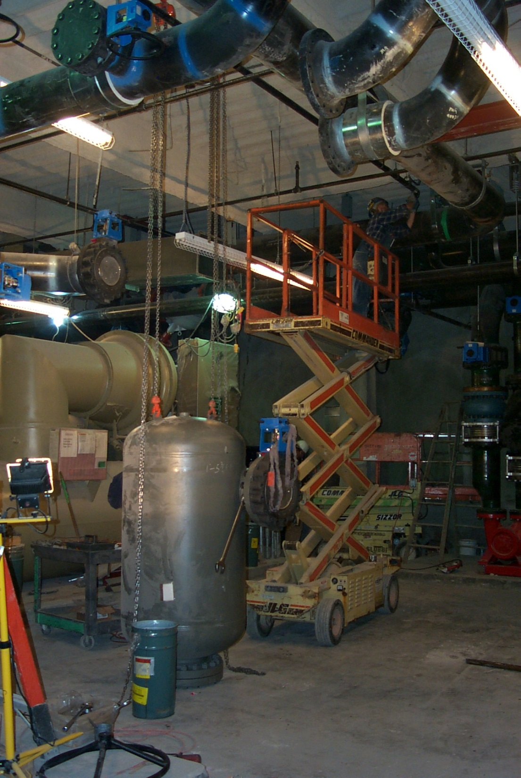
Air Separators

Slide 15
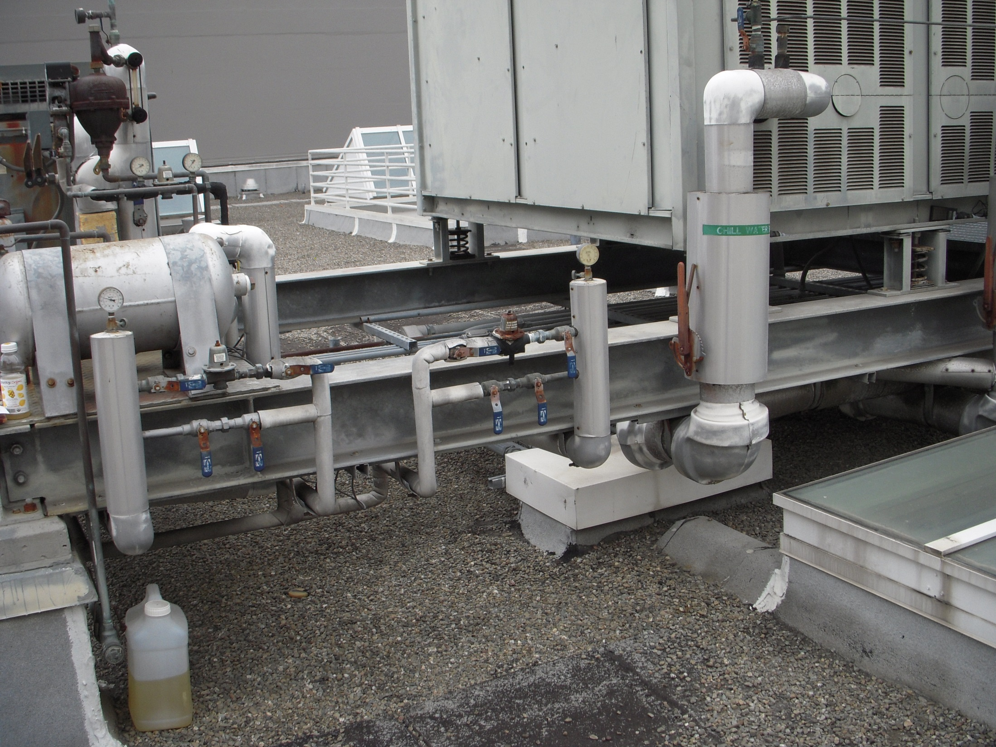
Makeup Connections

Slide 16
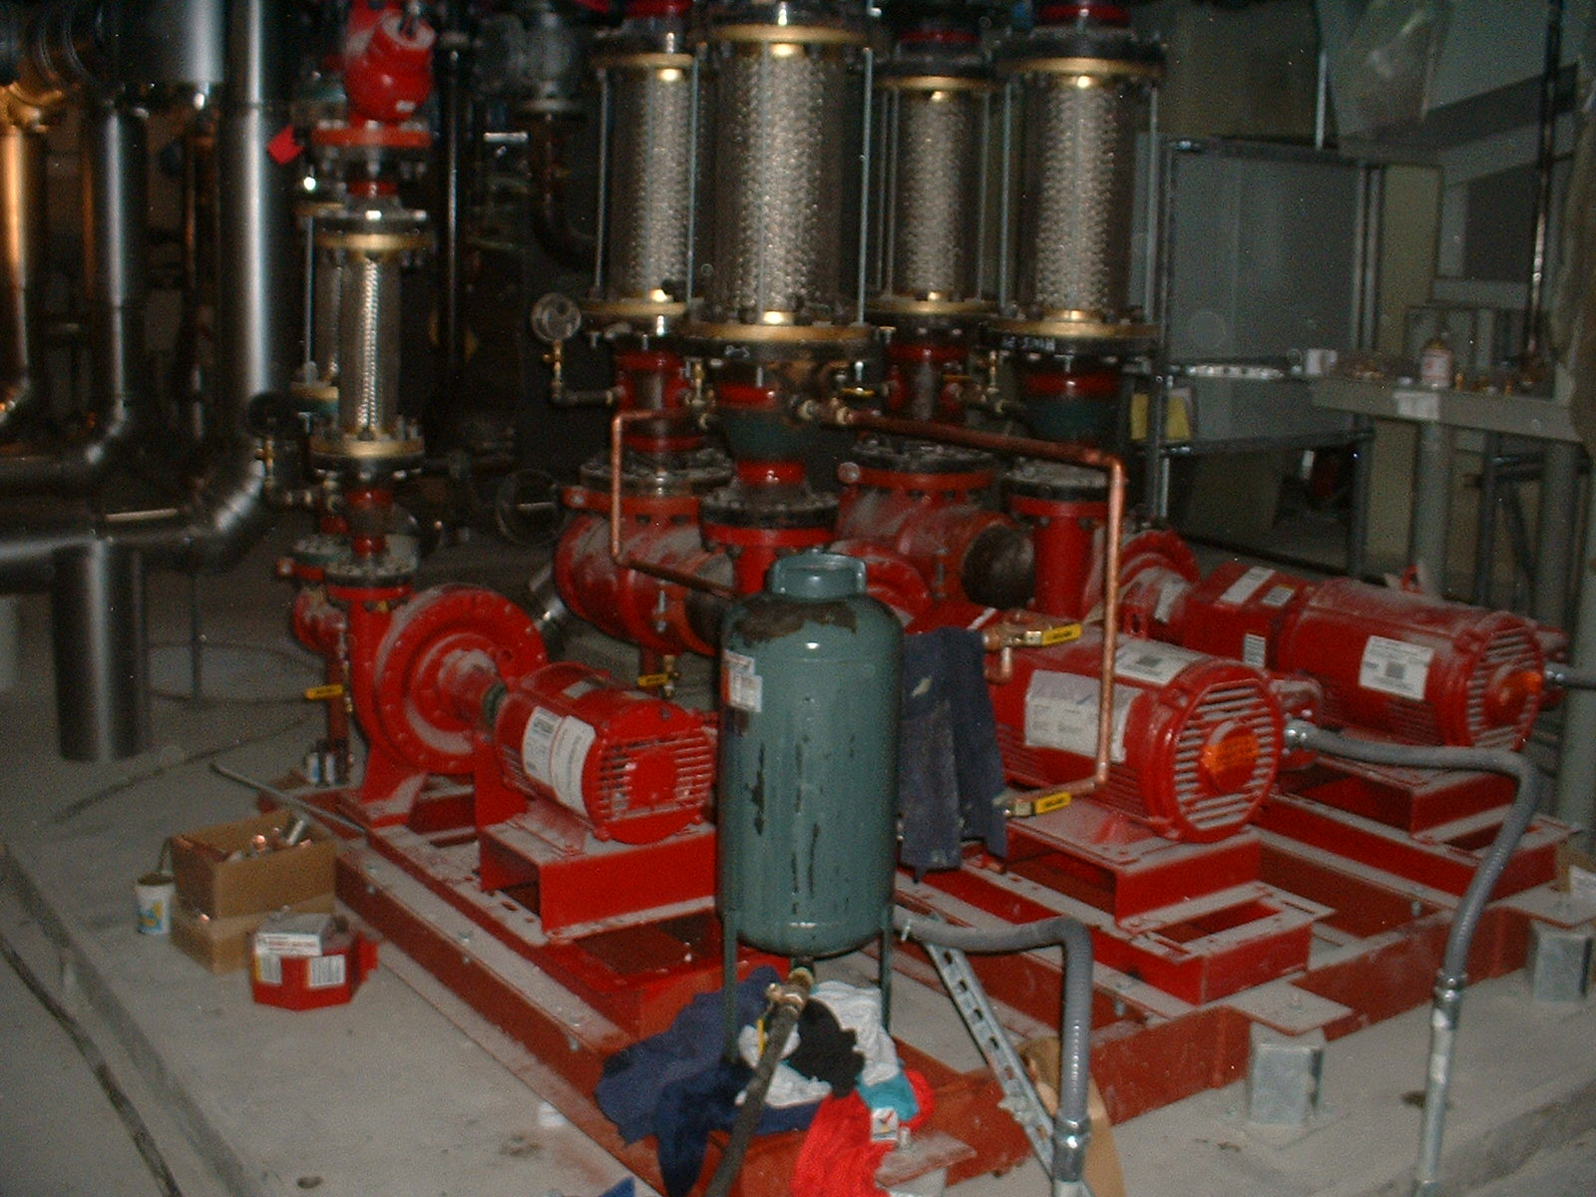
Water Treatment via Shot Feeder

Slide 17
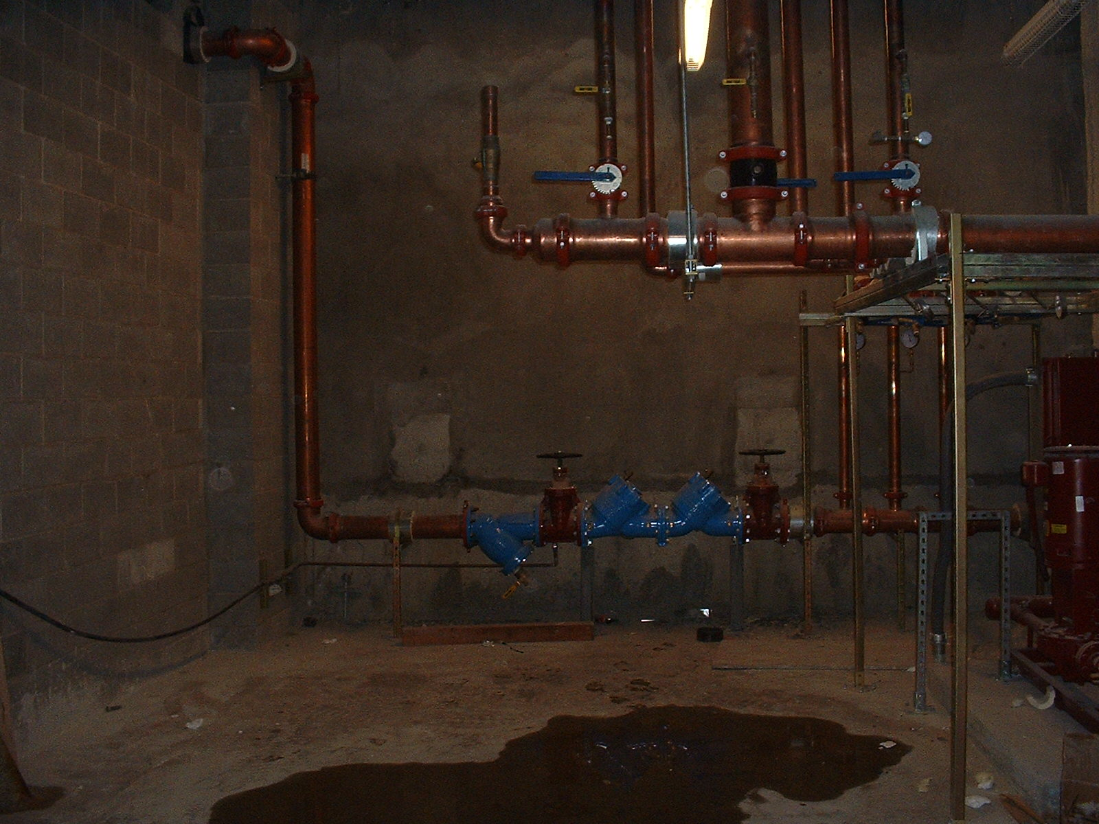
Back Flow Preventer Isolating Treated Water from Potable (Drinking) Water

Slide 18
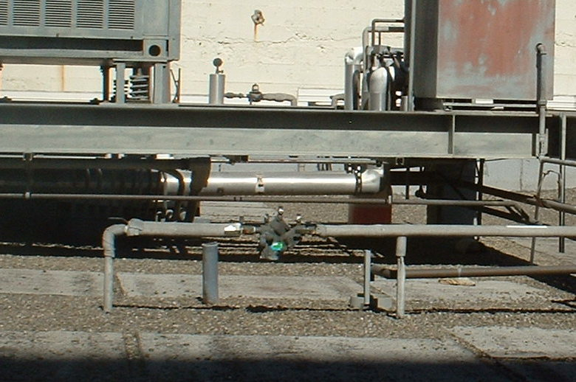
Back Flow Preventer Isolating Treated Water from Potable (Drinking) Water

Slide 19
Open Systems
Interfaces are at the cooling tower return and supply points
Cold water typically connected to a sump or cold basin
Hot water distributed by spray nozzles or orifices in a “hot basin”
Pump head must lift the water between the basins
Make-up requirements more significant
Evaporation
Blow-down
Compressor
Piping Network
Piping Network
Condenser
Evaporator
Cooling Tower
Expansion Device
Make-up, Blow-down, and Water Treatment
Water Chiller
Pump
Water treatment requirements more significant
Chilled and hot water systems can be open systems

Slide 20
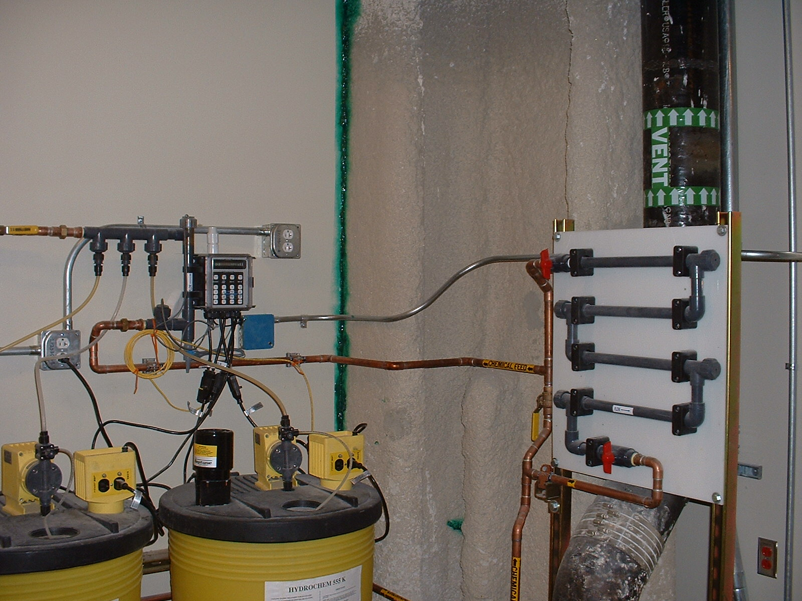
Water Treatment

Slide 21
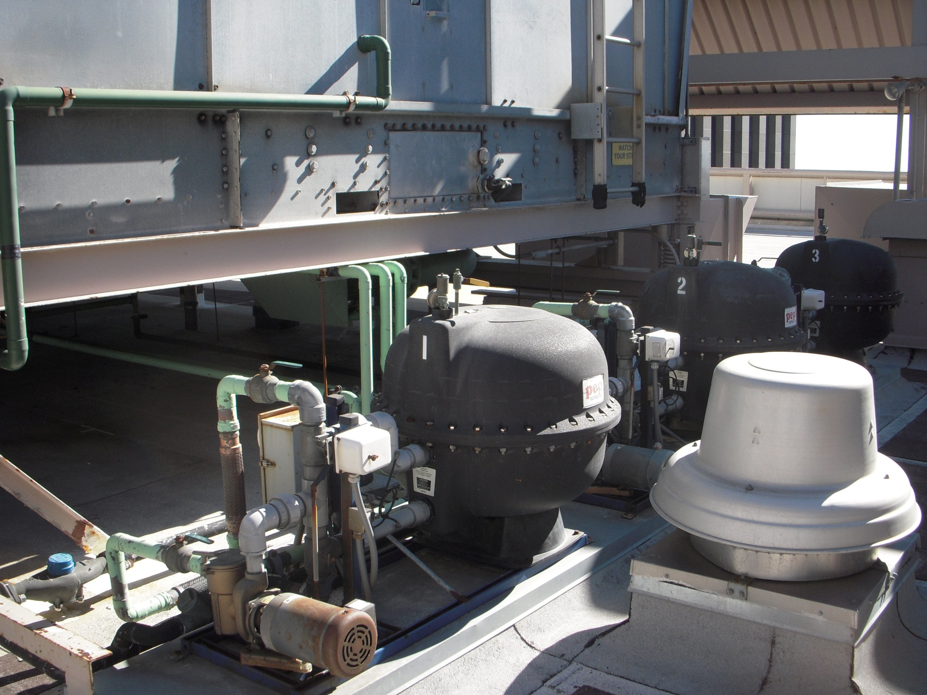
Side Stream Filtration

Slide 22
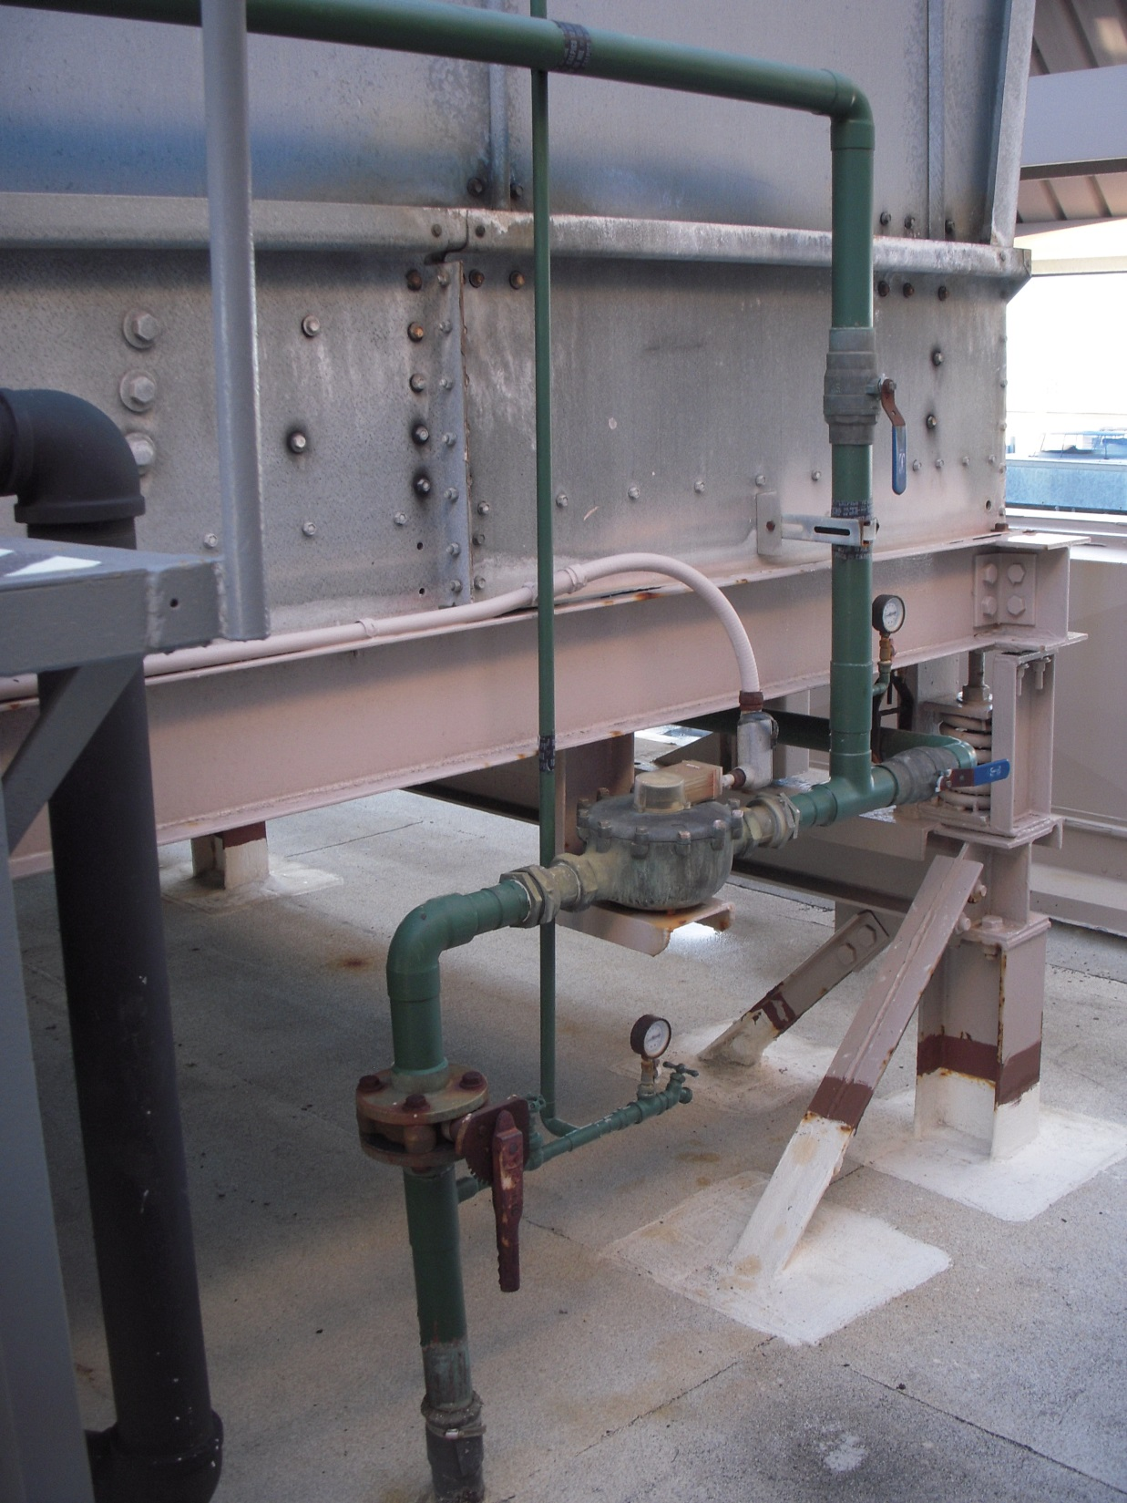
Cooling Tower Make-up Piping and Meter

Slide 23
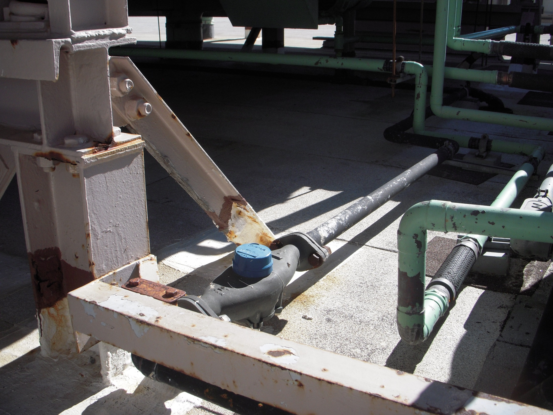
Cooling Tower Blow-down Piping and Meter

Slide 24
Cooling Tower Opportunity http://youtu.be/EVtO-y_NKN8
Notes:
http://youtu.be/EVtO-y_NKN8

Slide 25
Air handling units are here
Cooling towers and make up connections are here
Piping mains run up and down this chase
Chillers, pumps, and chilled water make up connection here

Slide 26
Approximately 475 ft. from the lowest point in the CHW system to the highest point in the CHW system

Slide 27
Approximately 15 ft. from the cold basin to the hot basin of the cooling towers
Approximately 455 ft. from the lowest point in the CW system to the cold basins of the cooling towers

