Slide 1
VAV Systems
Design, Performance and Commissioning Issues
Terminal Unit Basics
David Sellers
Senior Engineer
Facility Dynamics Engineering
March 7, 2018

Slide 2
What’s In This Module
Your basic box:
Pressure dependent
Pressure independent
Fan powered boxes
Double duct boxes

Slide 3
Your Basic Box
Enclosure
Damper
Duct to Zone
Duct from System
Crank Arm
Linkage and Swivel Joints
Actuator

Slide 4
Your Basic Box
Enclosure
Damper
Duct to Zone
Duct from System
Centerline Drive Actuator
with set screws

Slide 5
Your Basic Box
T

Slide 6
Your Basic Box
T

Slide 7
Your Basic Box
Flow through the box is a function of damper position and pressure difference …
…thus it is called pressure dependent
T

Slide 8
Your Basic Box
L
T
P
T
T
Time
Time
L
T
T
Time

Slide 9
Your Basic Box
L
T
P
T
Time
Time
L
T
T
Time

Slide 10
Your Basic Box
L
T
P
T
Time
Time
L
T
T
Time

Slide 11
Your Basic Box
L
T
P
T
Time
Time
L
T
T
Time

Slide 12
Becoming Pressure Independent
Volume regulation can also be accomplished mechanically (both fixed and variable)
F
C_{Flow}
T
Maximum
Flow
Minimum
Temperature

Slide 13
The Relationship Between Flow and Velocity

Slide 14
The Relationship Between Velocity and Velocity Pressure

Slide 15
Pneumatic vs. DDC Terminal Unit Controllers
DDC Terminal Units
Pneumatic Terminal Units
Newer technology
No moving parts
Maintenance on condition
Can provide important diagnostics
Leaving air temperature
Current flow rate
Can provide data useful for system optimization strategies
Set points can be adjusted and verified from the OWS
Performance can be verified from the OWS
Been around for a long time
A lot of moving parts
Don’t know the condition
They are low first cost
They are low first cost
They are low first cost
They are low first cost

Slide 16
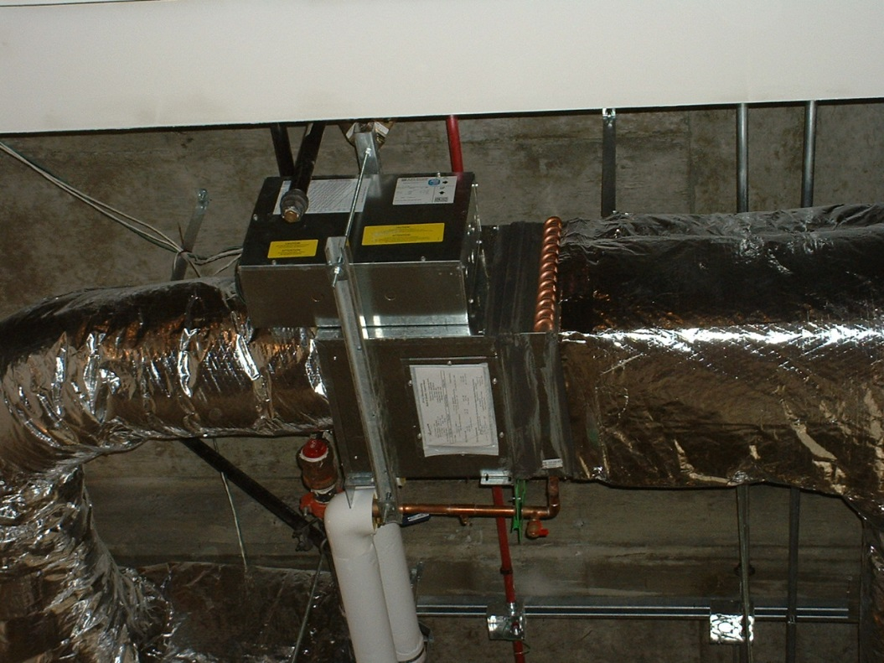
The Relationship Between Velocity and Velocity Pressure
12 inch VAV Box
Maximum flow
2,000 cfm
VP = .2494 in.w.c.
Minimum flow
325 cfm
VP = .0066 in.w.c.

Slide 17
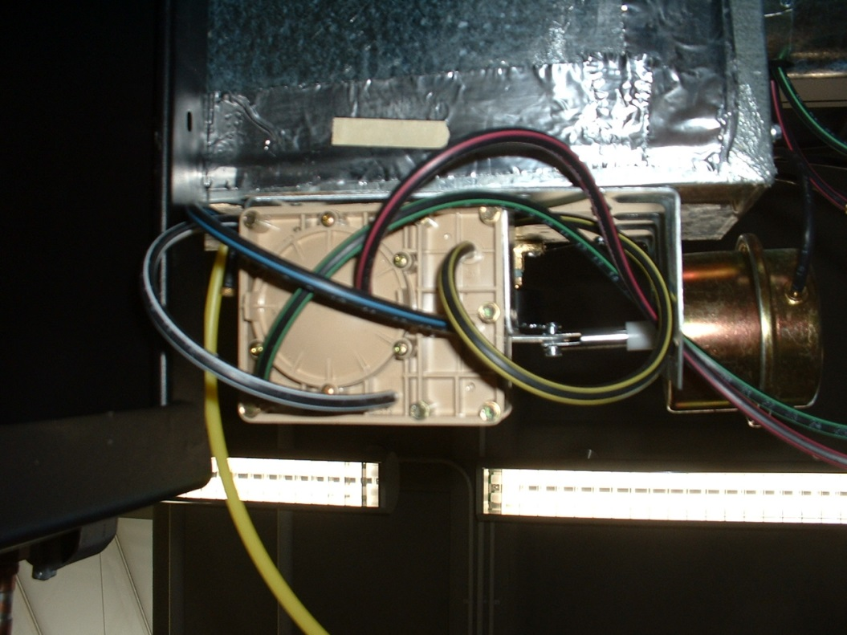
The Relationship Between Velocity and Velocity Pressure
12 inch VAV Box
Maximum flow
2,000 cfm
VP = 0.2494 in.w.c.
Force = 0.0465 lb
Force = 0.74 oz
Minimum flow
325 cfm
VP = 0.0066 in.w.c.
Force = 0.0017 lb
Force = 0.03 oz
Frame of reference; a letter in an envelop weighs about 1 oz.
Notes:
0.0465 lb 0.74 oz 0.0017 lb 0.03 oz

Slide 18
Pneumatic Terminal Failure Modes
Flow set points drift up
Recent experience
Sample 10 of 45 pneumatic zones
Three years since last service effort
Many of the controllers worked
Many thermostats were out of calibration
0 (zero) zones were regulating at the required flow
Many zones were wide open
Some reheat valves were leaking through

Slide 19
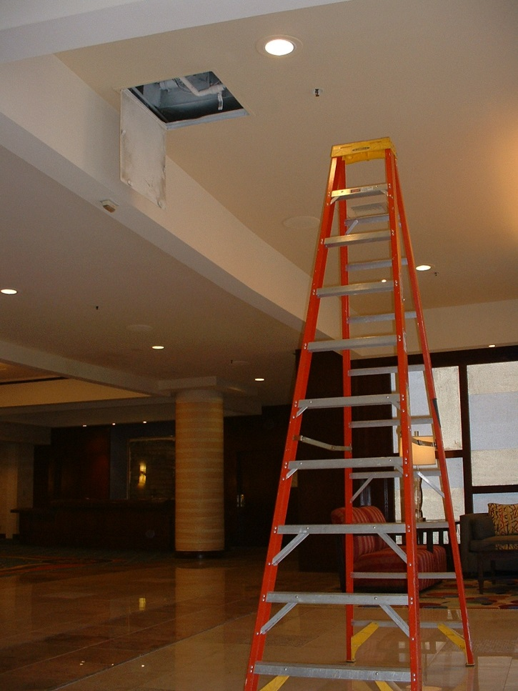
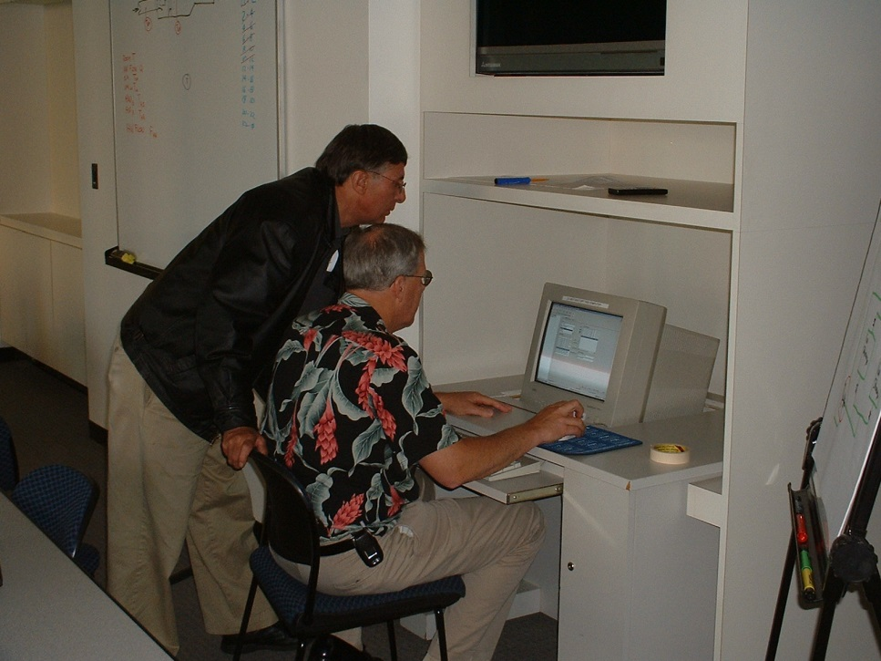
Pneumatic Zones = Opportunity
Troubleshooting a Pneumatic Terminal
Troubleshooting a DDC Terminal

Slide 20
The Regulator (PG13)
http://tinyurl.com/3kebw3s
Notes:
http://tinyurl.com/3kebw3s

Slide 21
VAV Reheat
Control valve
Reheat coil
F
C_{Flow}
T
Maximum
Flow
Minimum
Temperature

Slide 22
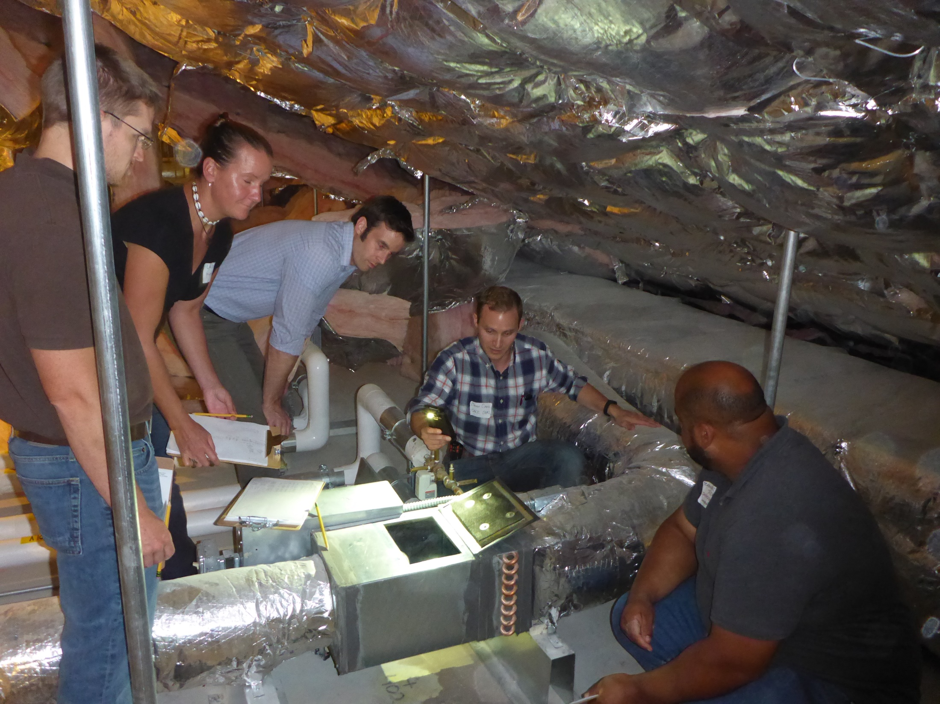
A Typical VAV Reheat Box

Slide 23
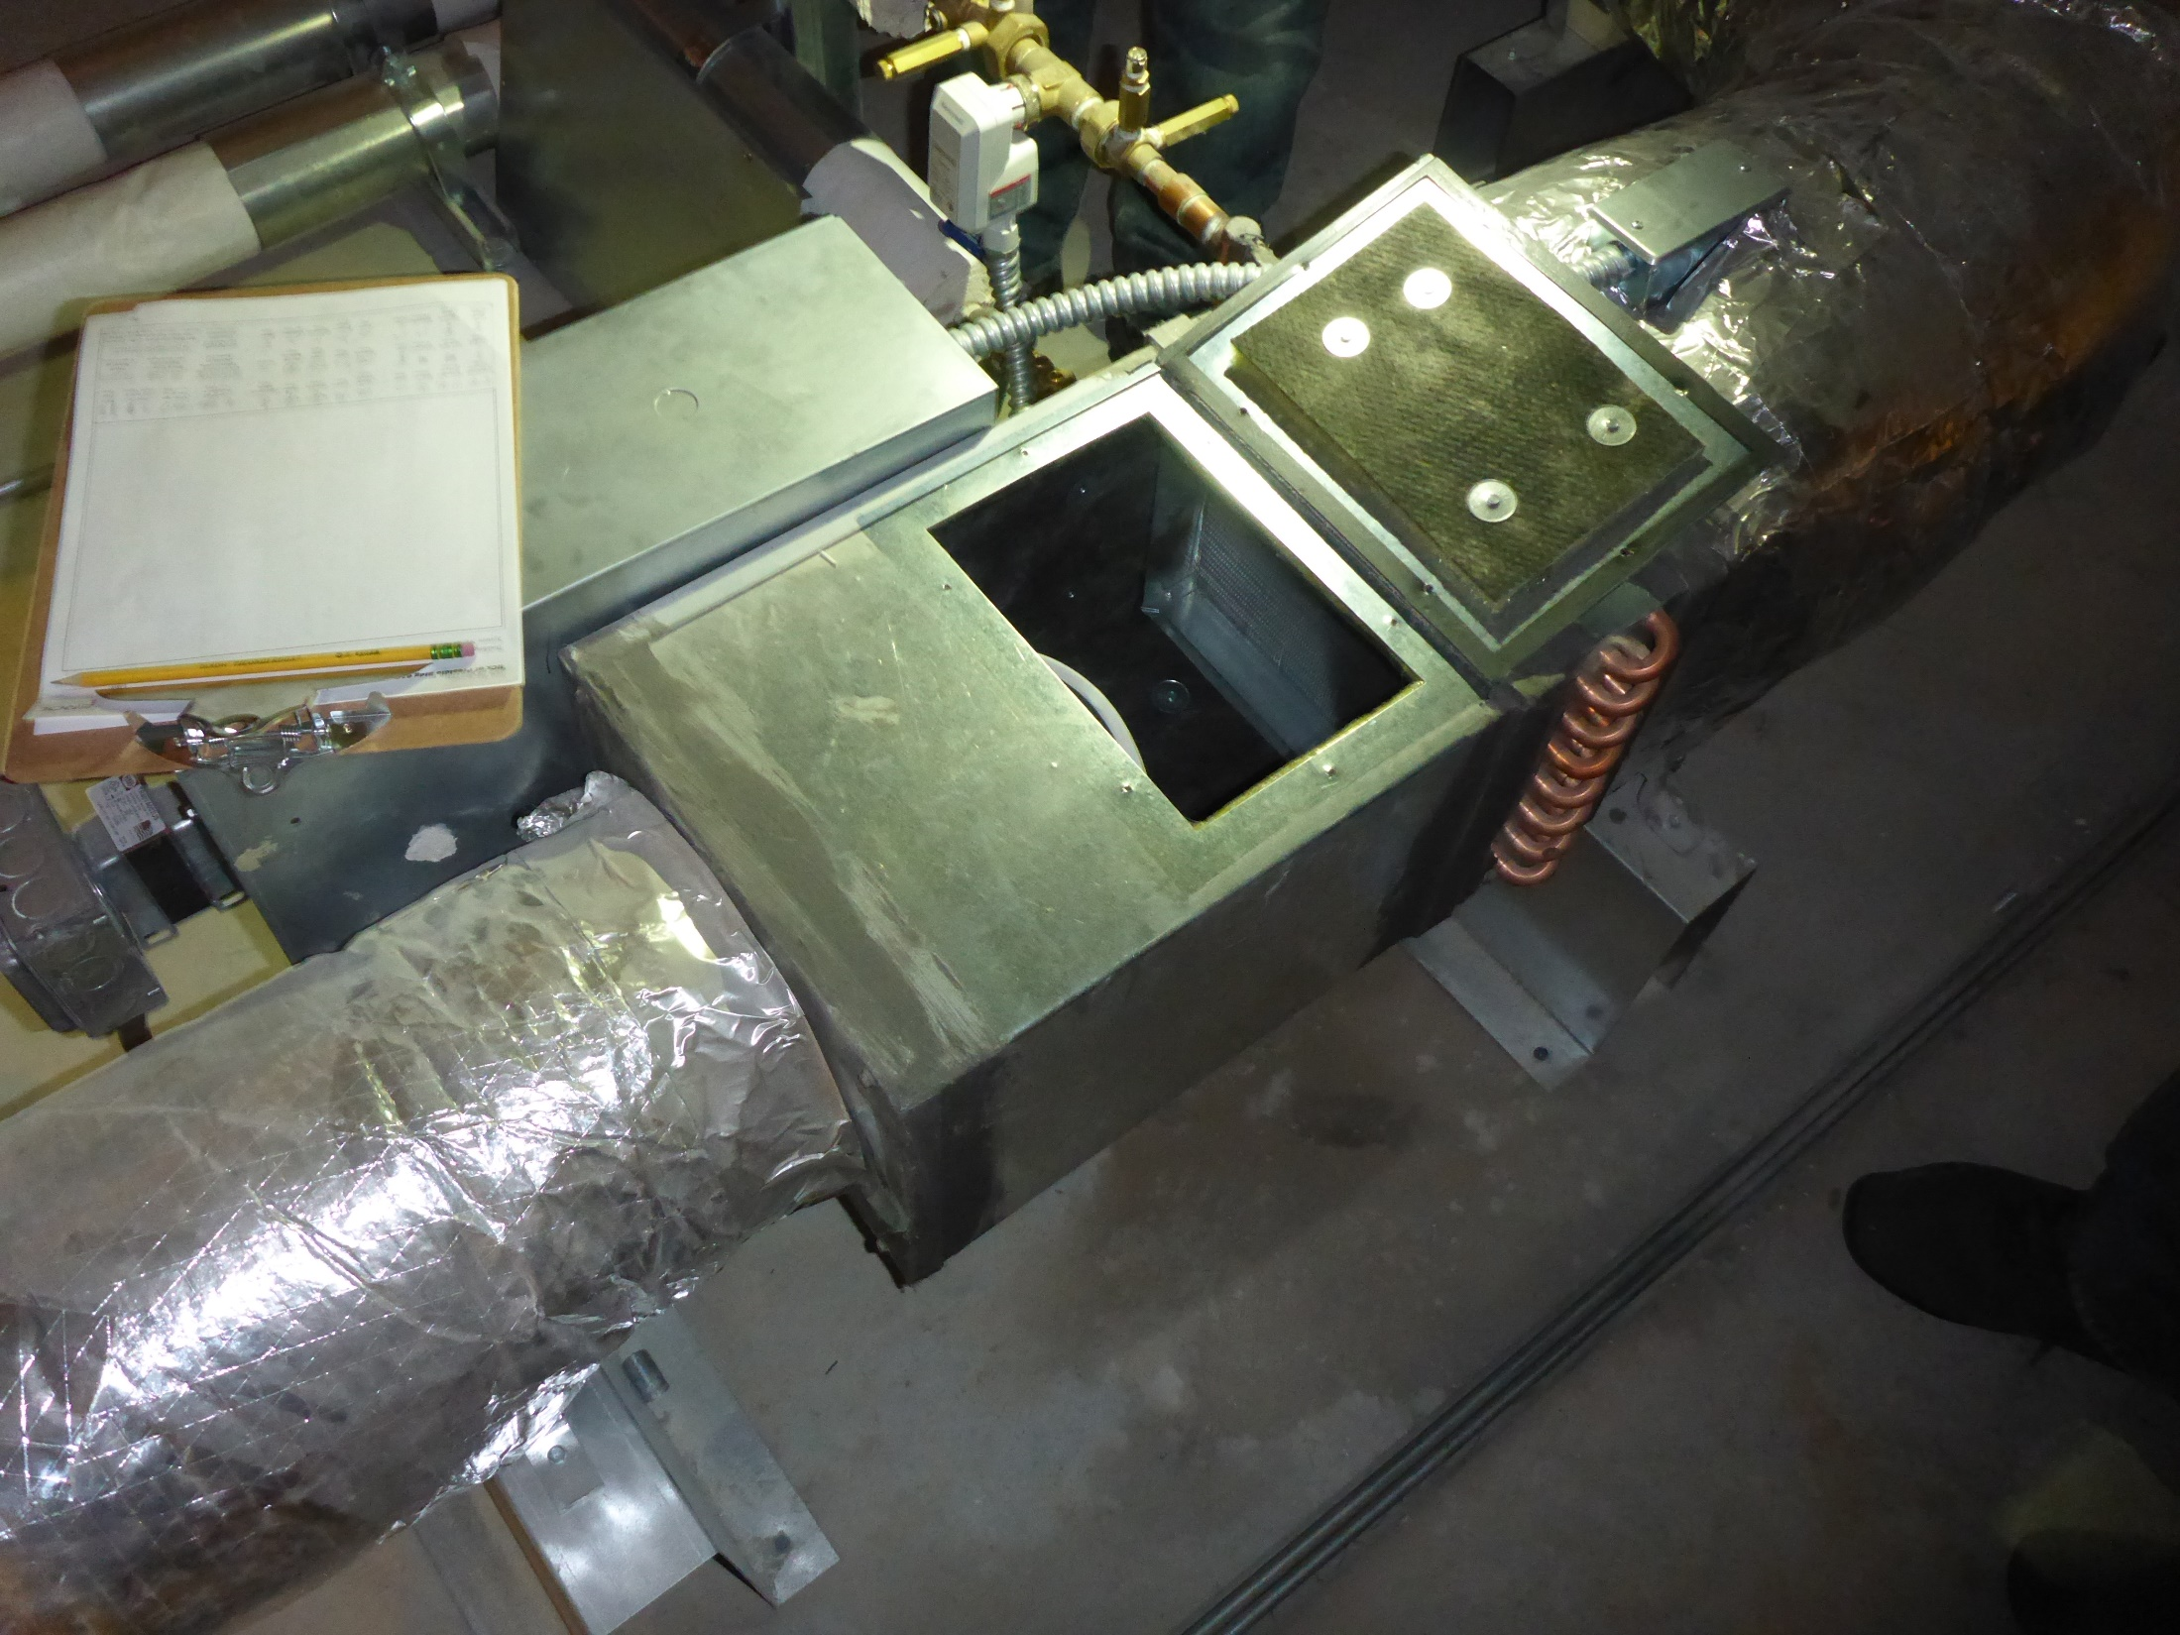
Overview

Slide 24
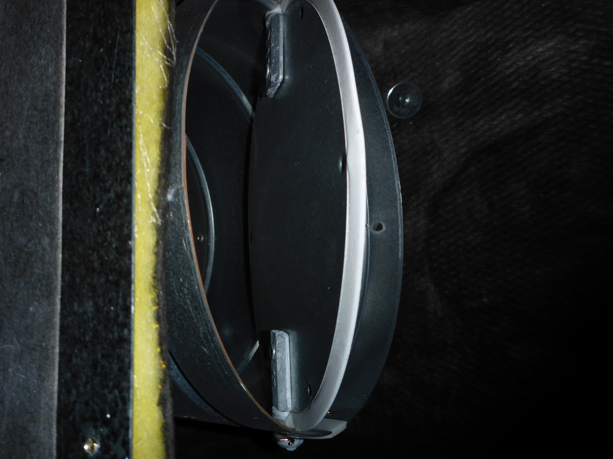
The Damper

Slide 25
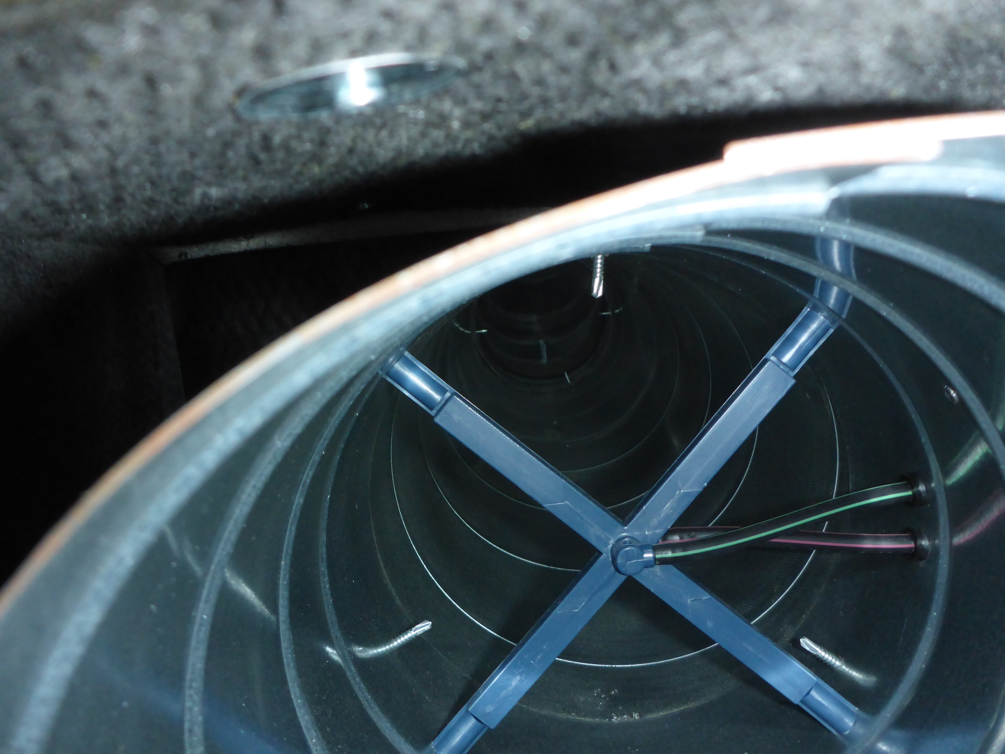
The Flow Sensor

Slide 26
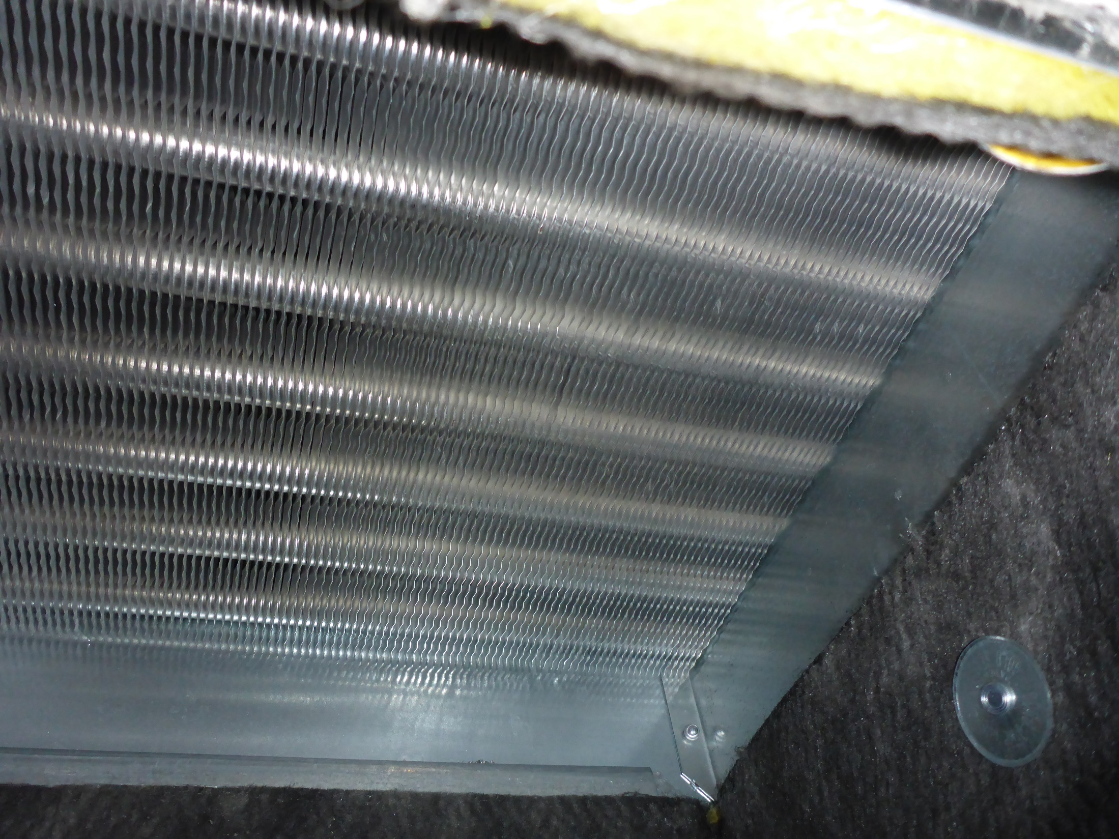
The Reheat Coil

Slide 27
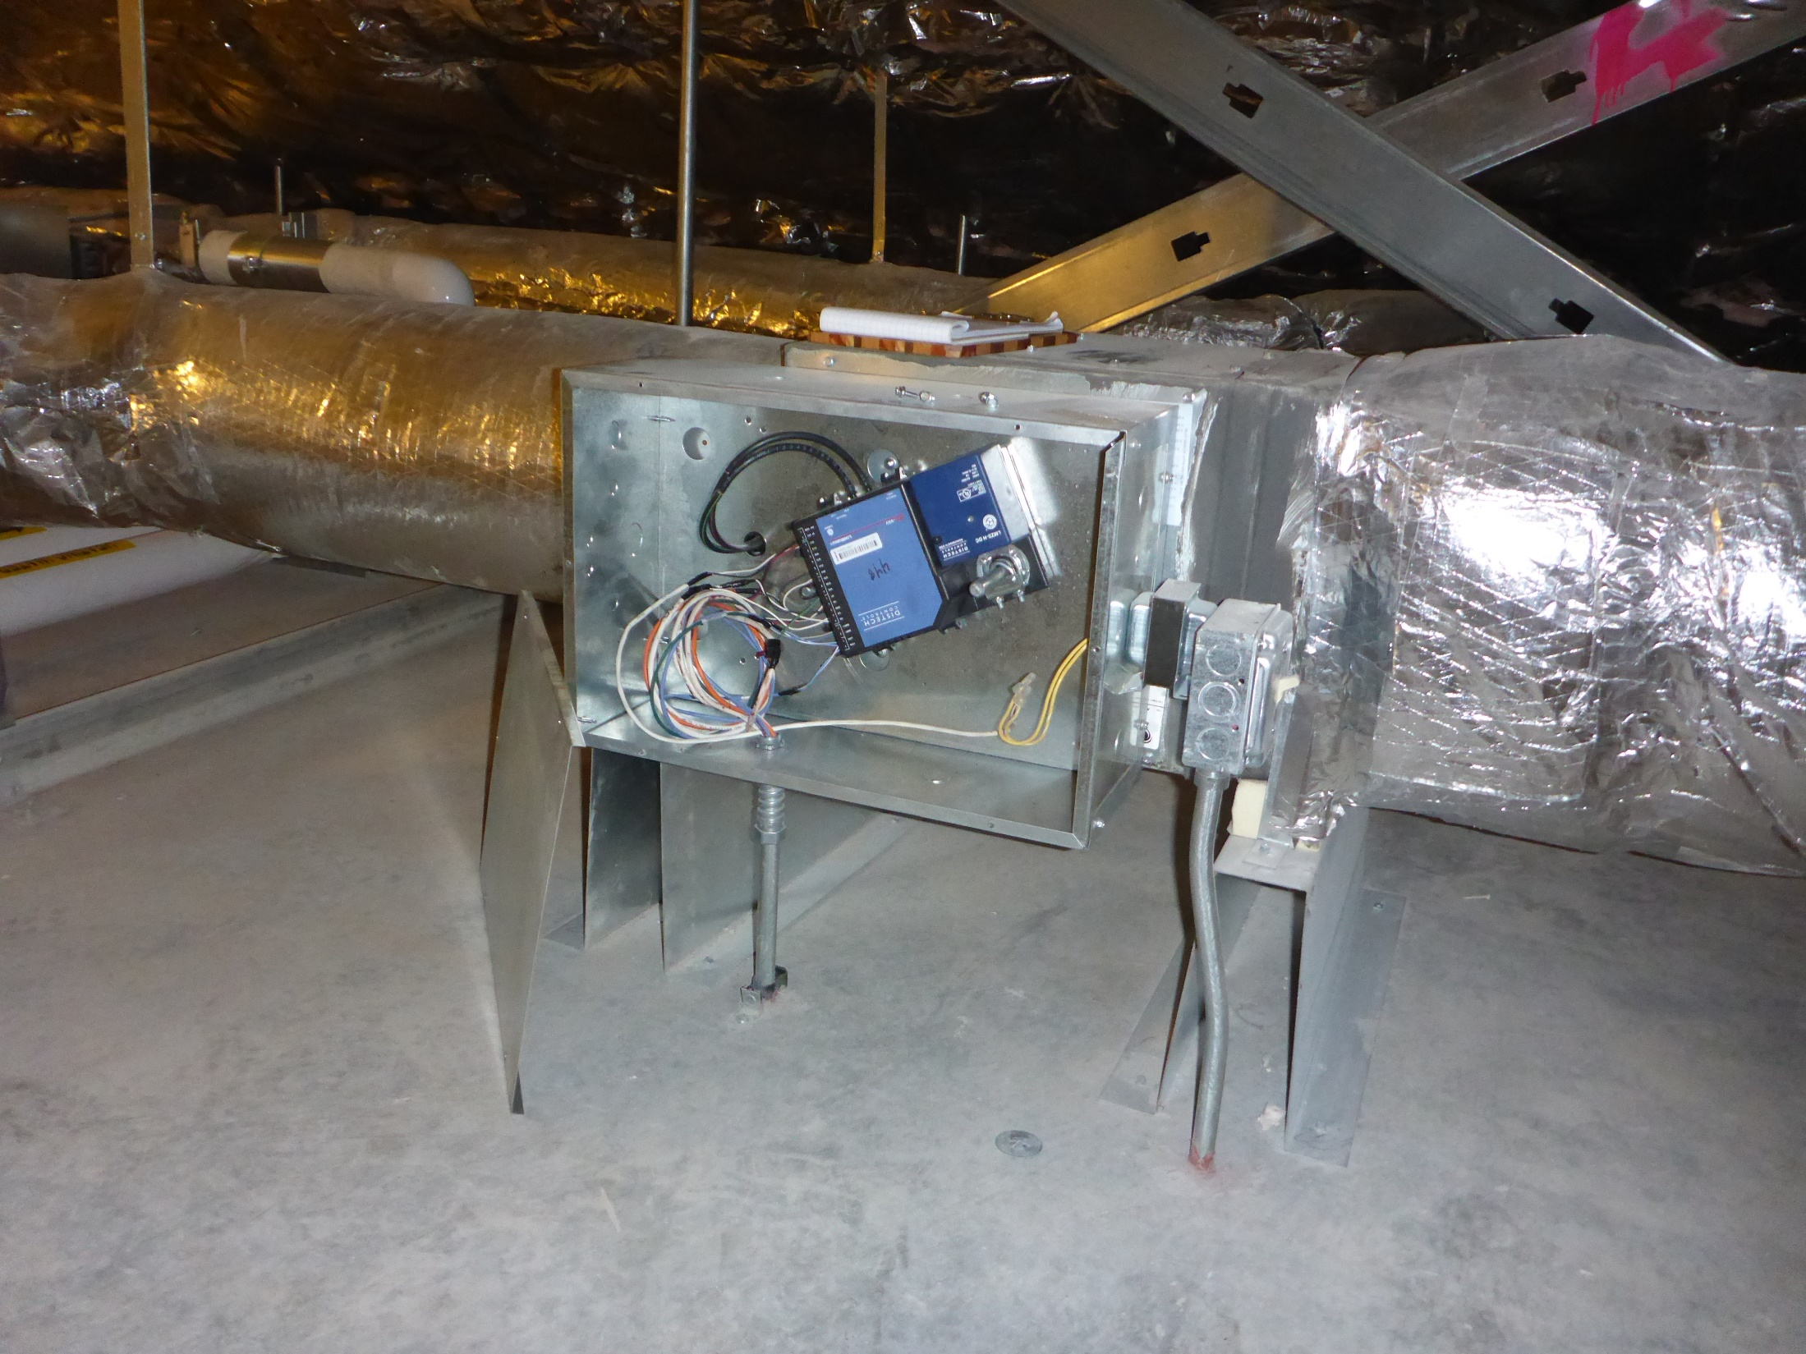
The DDC Controller with Built In Actuator

Slide 28
A Pneumatic DDC Controller and Actuator

Slide 29
Recovering Heat to Reheat Series Fan Powered Box
F
C_{Flow}
T

Slide 30
Recovering Heat to Reheat Series Fan Powered Box
Fan
F
C_{Flow}
Return Connection
T
Filter
Fan runs continuously when the zone is occupied
Tends to be constant volume
Reduction in primary flow (cooling air) is compensated for by increased return flow
First stage of reheat
Coil provides second stage

Slide 31
Recovering Heat to Reheat Series Fan Powered Box
Fan
F
C_{Flow}
Return Connection
T
Filter

Slide 32
Recovering Heat to Reheat Parallel Fan Powered Box
Fan
F
C_{Flow}
Return Connection
T
Filter
Fan runs intermittently when the zone is occupied
Tends to be constant volume when the fan runs
Zone sees some reduction in flow until the fan starts
First stage of reheat
Coil provides second stage

Slide 33
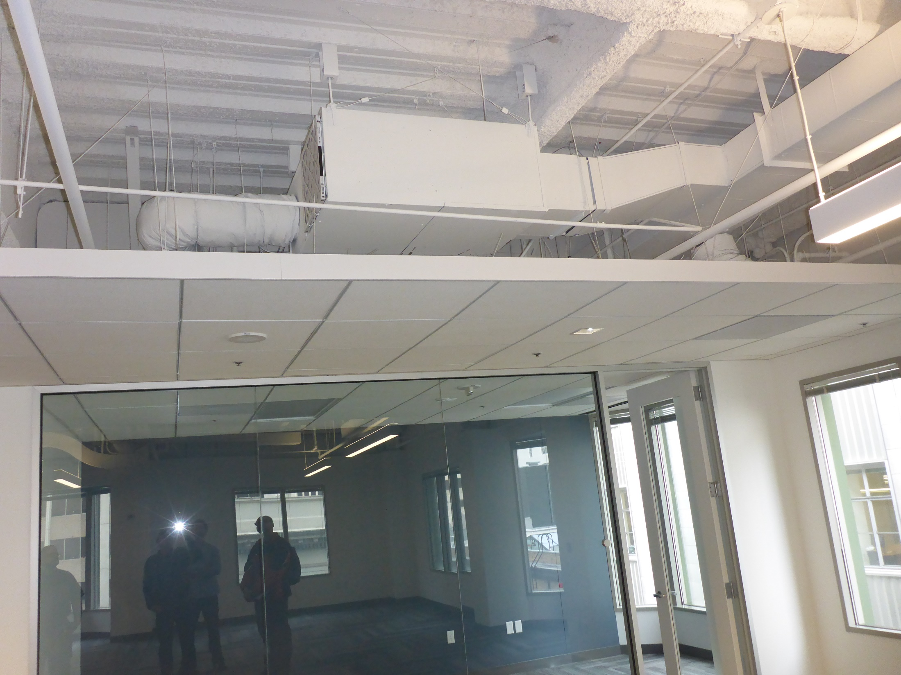
A Typical Fan Powered Box

Slide 34
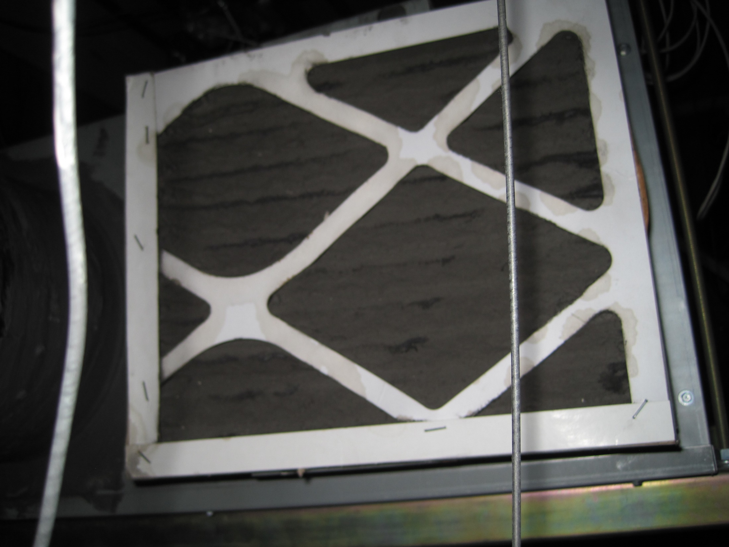
A Typical Fan Powered Box Filter

Slide 35
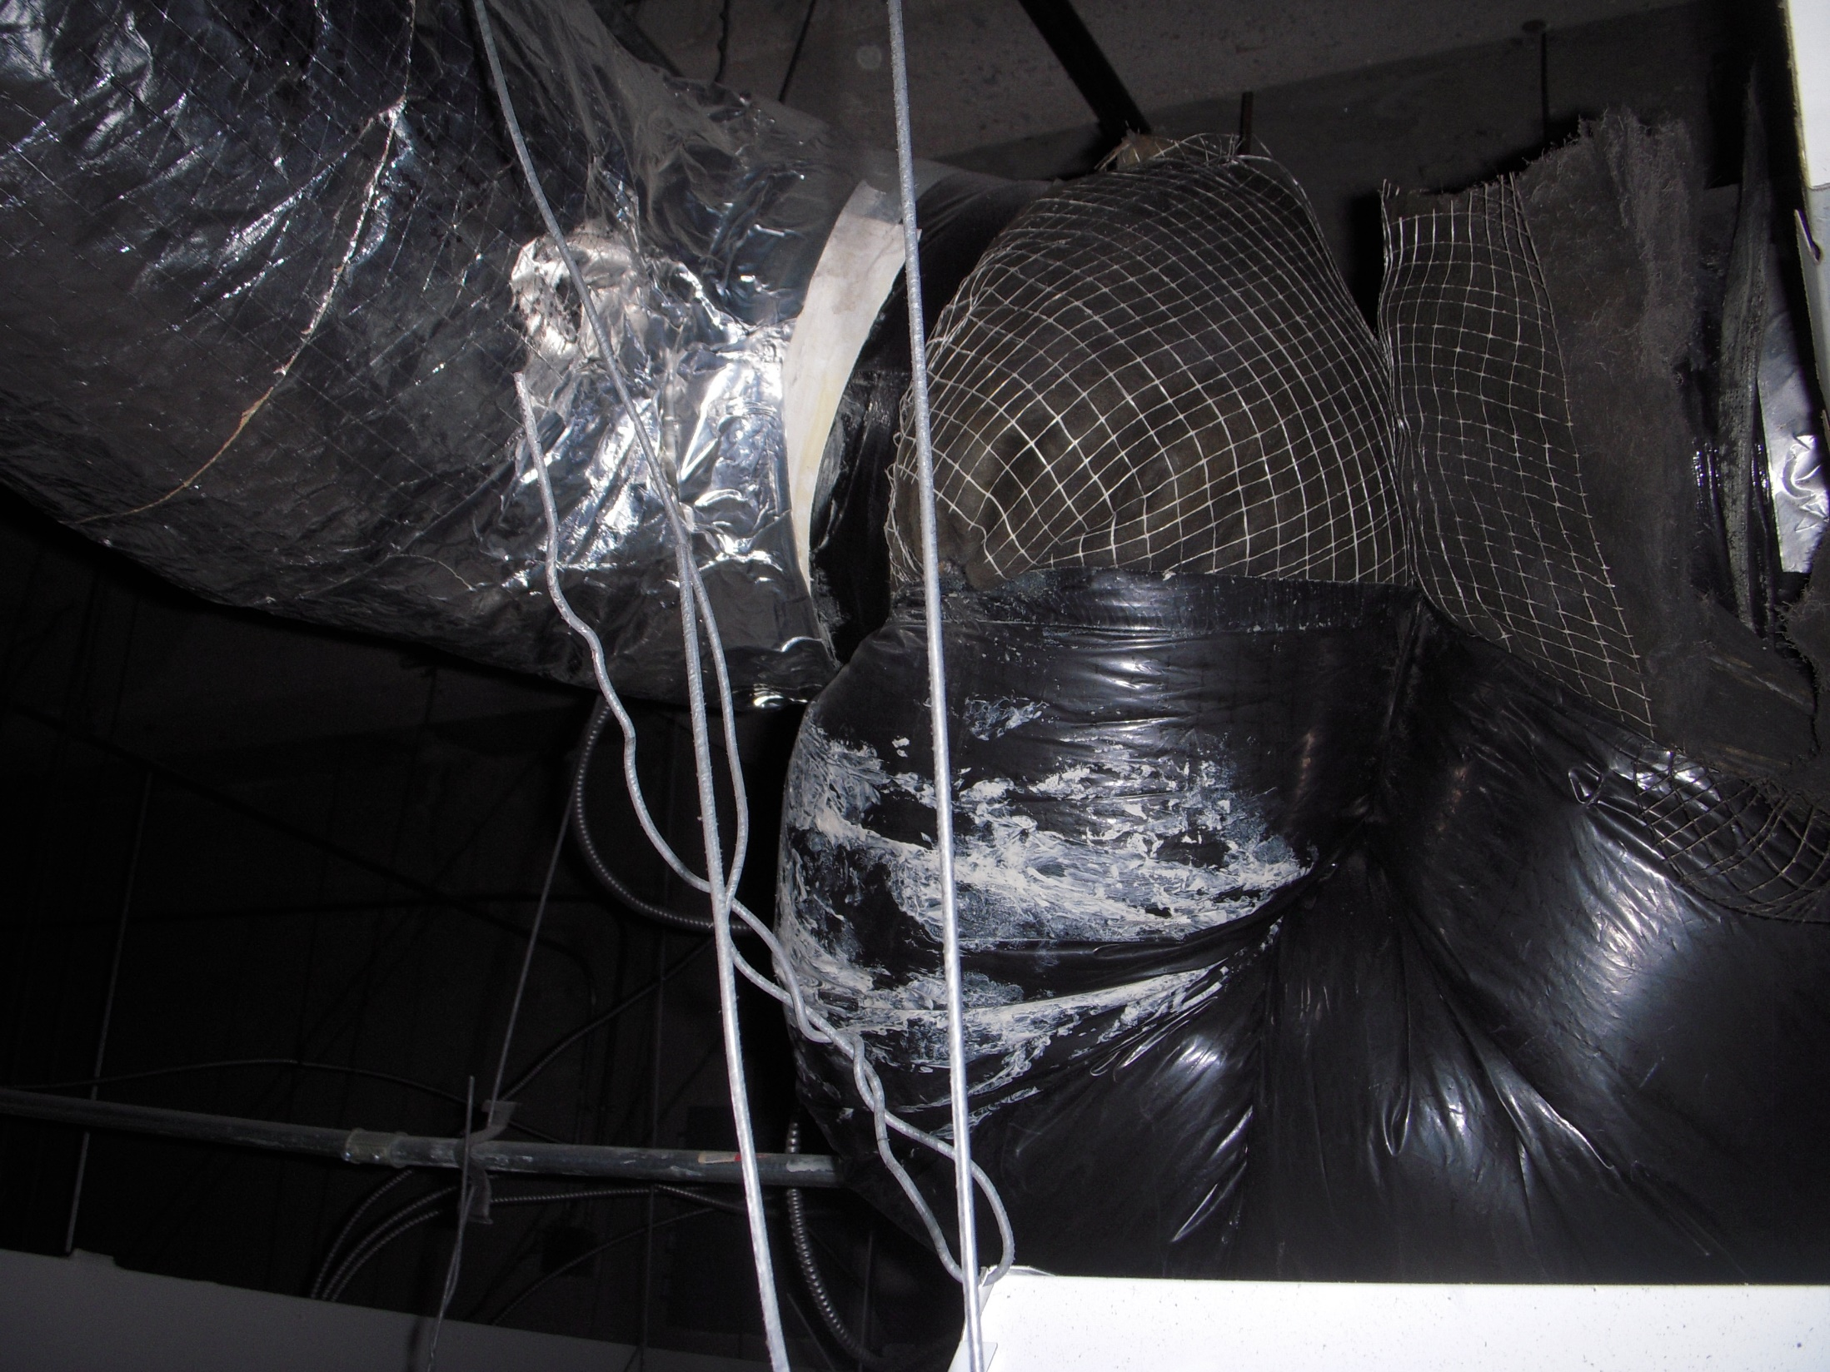
A Typical Optimized Inlet Condition

Slide 36
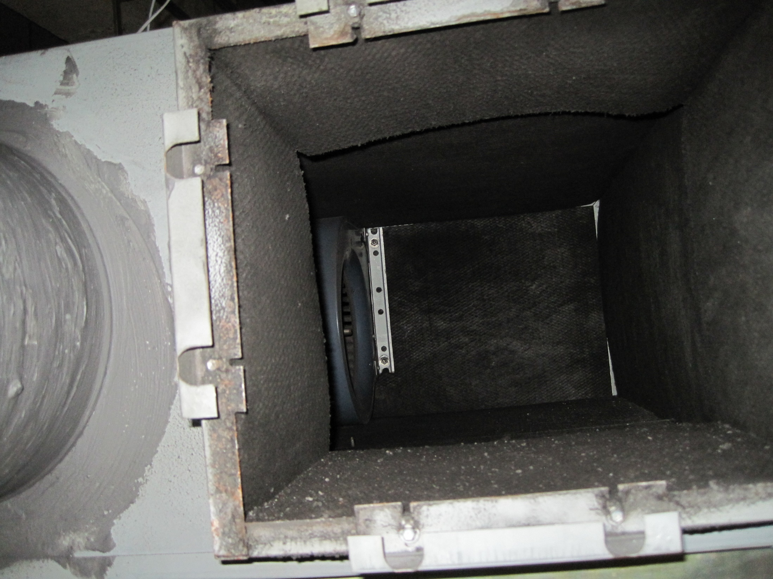
The In Series Fan

Slide 37
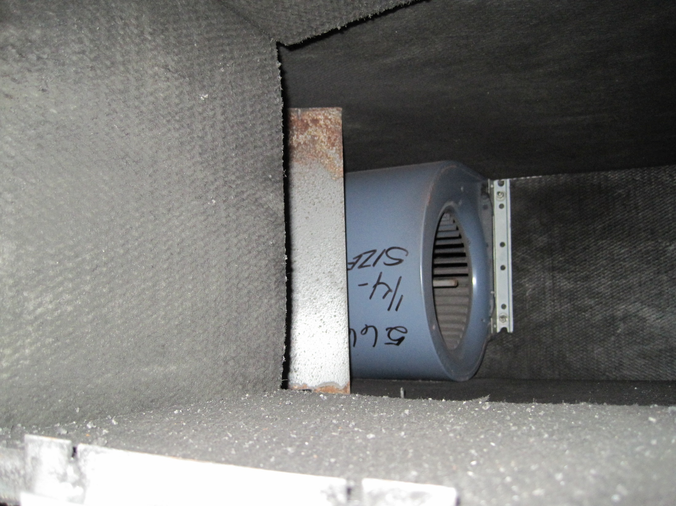
The In Series Fan

Slide 38
Double Duct Boxes = Reheat with Hot Air
Twice the components = twice the “fun”
Often separate fan systems for each deck
Ventilation air typically provided by the cold deck
Always minimum cold deck flow
Hot deck goes to 0 cfm
Cold duct or “deck”
F
Mixed air to the zone
Hot duct or “deck”
F
C_{Flow}
T

Slide 39
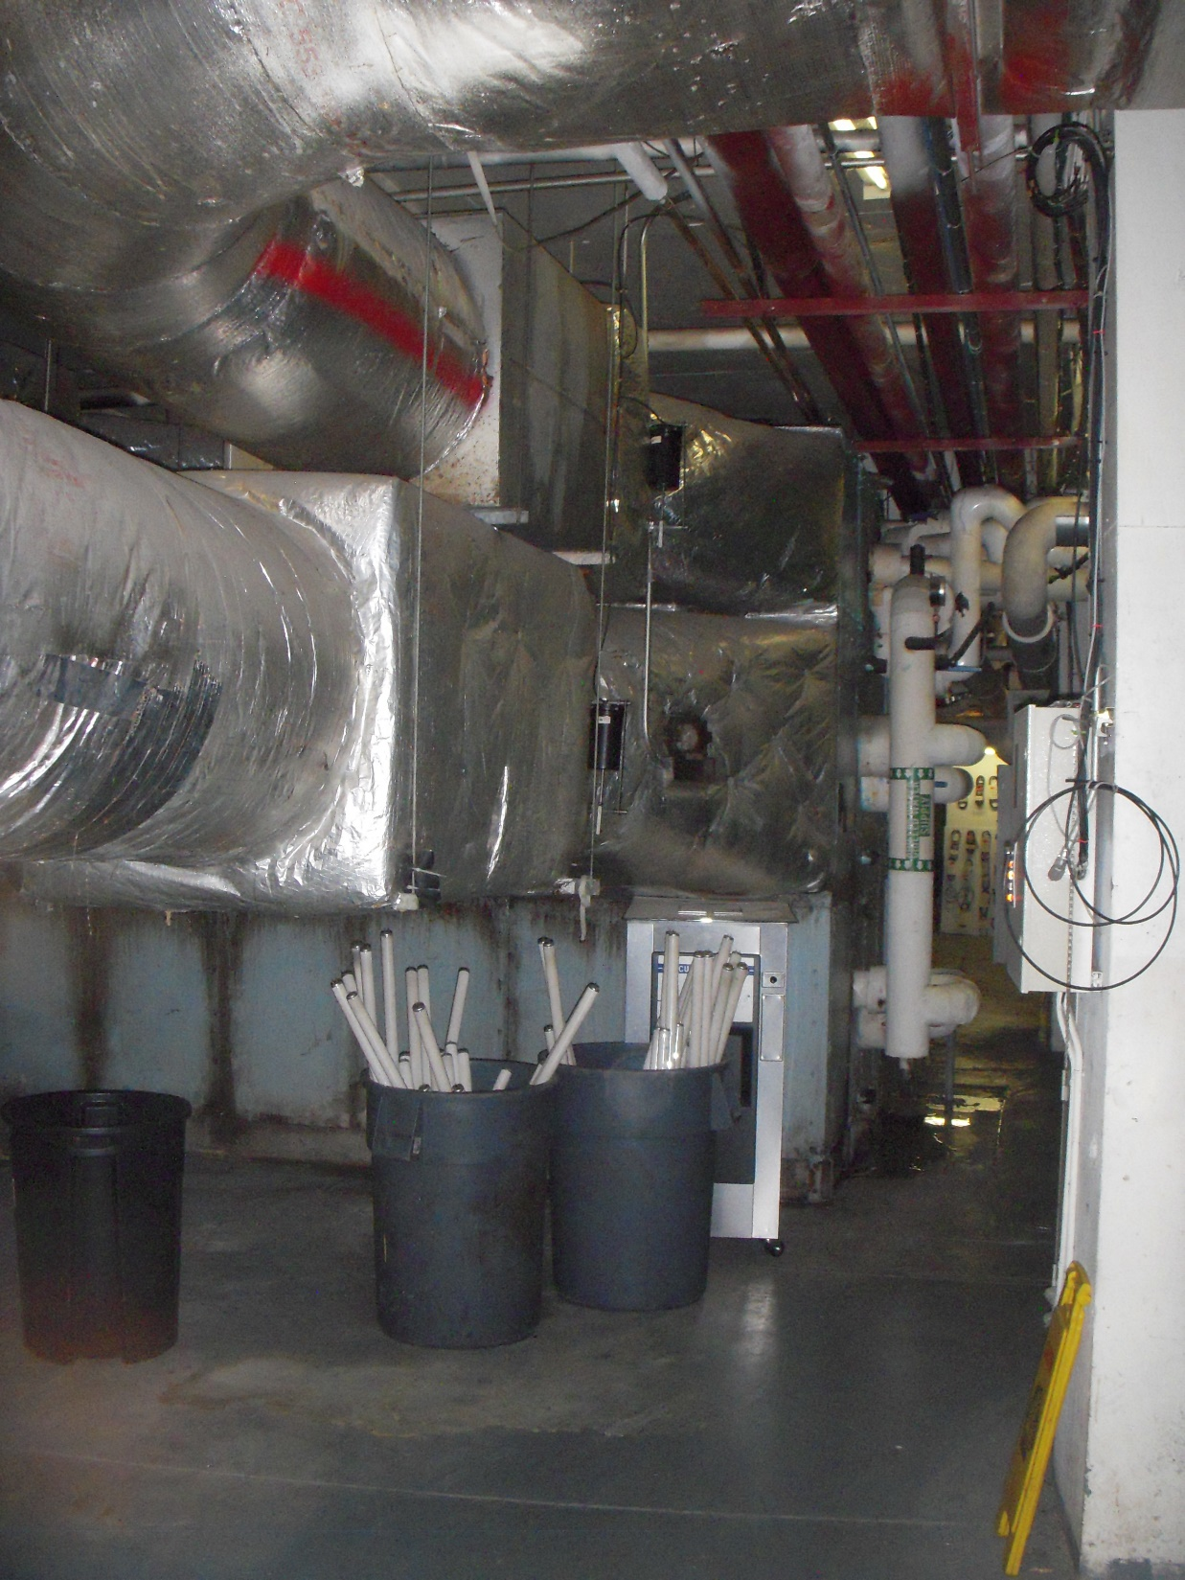
A Single Path Double Duct Unit

Slide 40
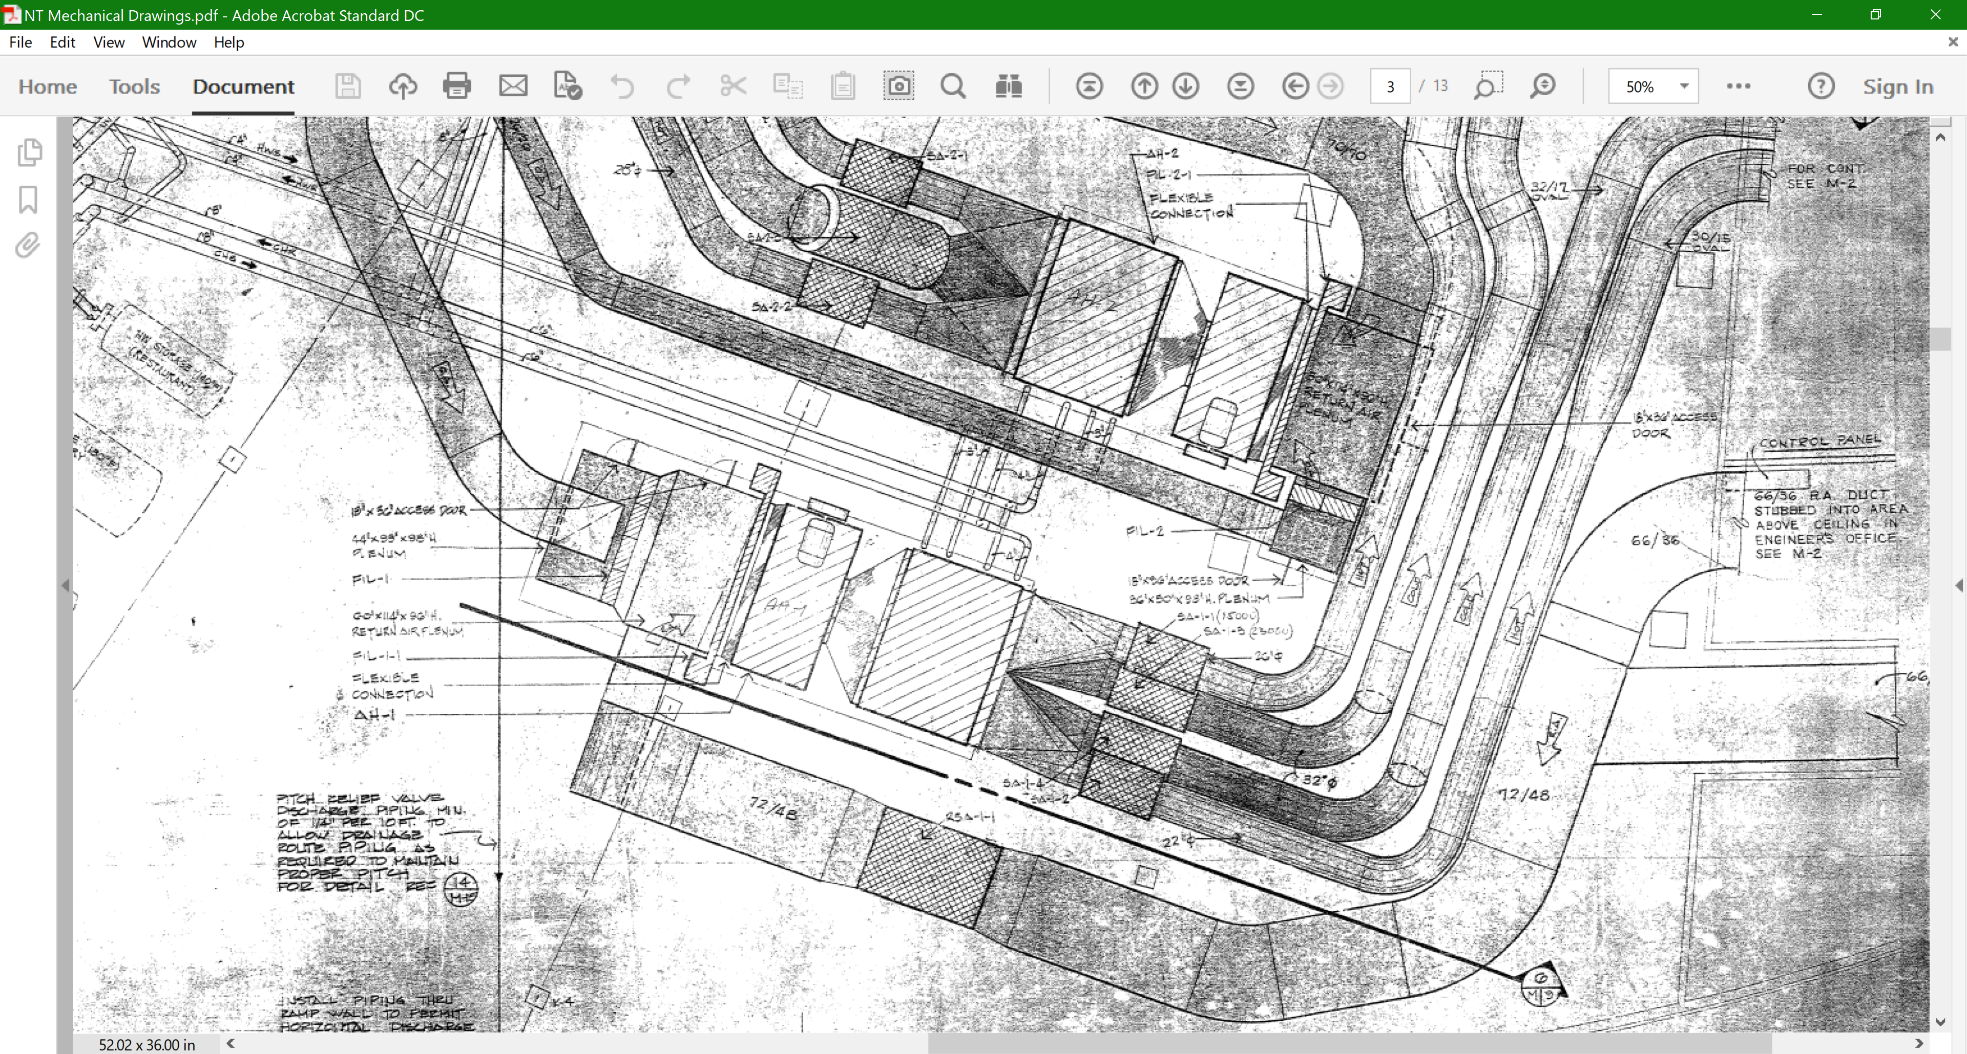
A Single Path Double Duct Unit

Slide 41
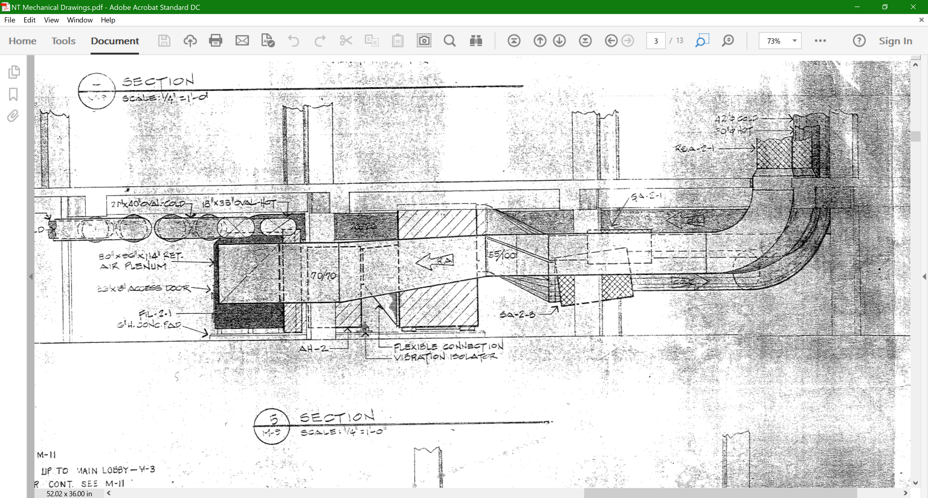
A Single Path Double Duct Unit

Slide 43
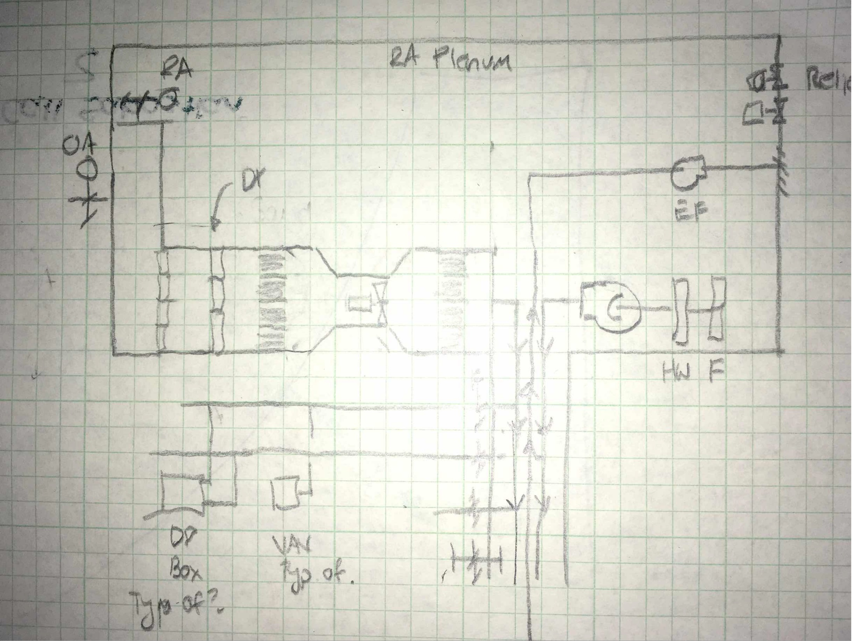
A Dual Path Double Duct Unit

Slide 44
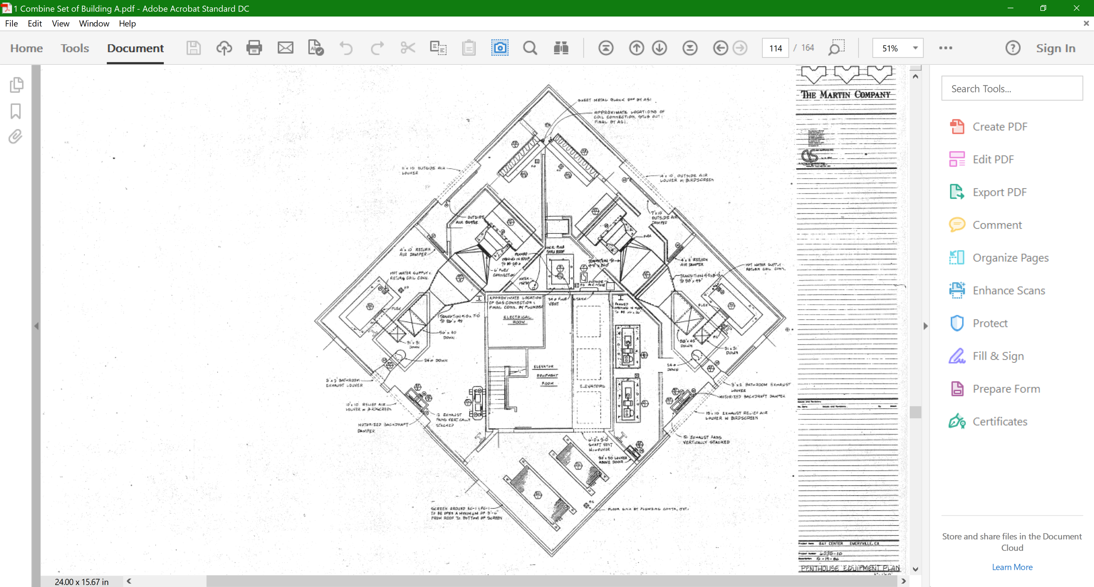
A Dual Path Double Duct Unit

Slide 45
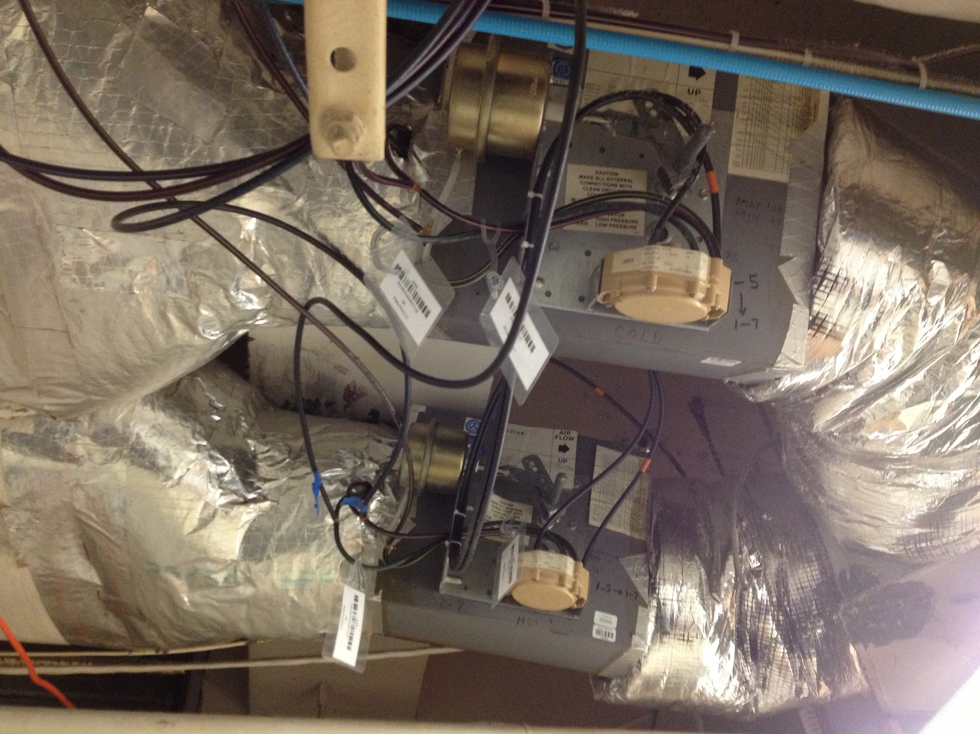
A Constant Volume to VAV Conversion

Slide 46
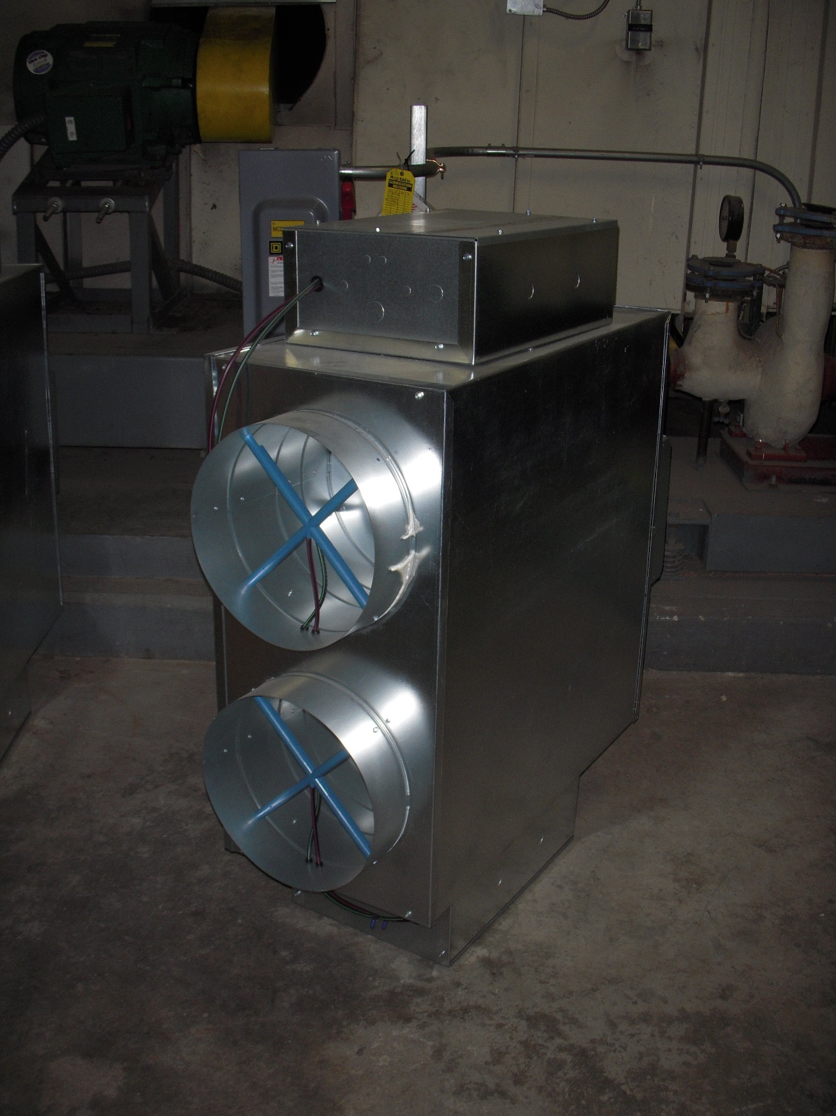
A Double Duct Box

Slide 47
Bottom Lines
The basic box is pretty simple
Making it bullet proof makes it a bit more complex
Making it energy efficient makes it more complex
Making it cost effective makes persistent complexity challenging

